Slide 1





Changing accretion in
AGN
Sruthi Suresh
3rd year PhD
University of Melbourne
Supervisor : Prof. Rachel Webster

Slide 2

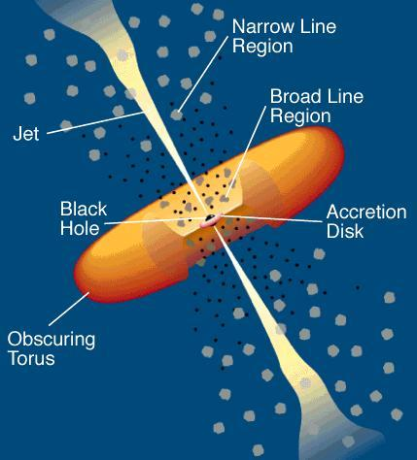
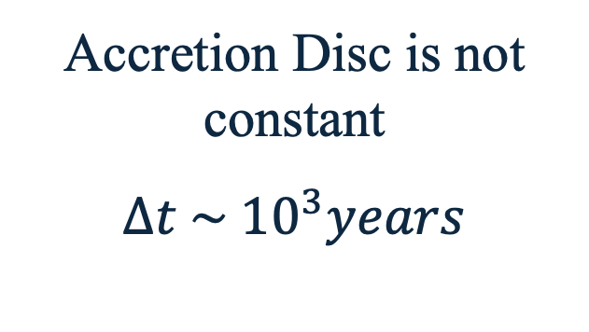
Standard AGN Geometry
Low Eddington rates in Type 2 AGN
Changing look AGN
Accretion Disc is not constant
$$∆t \sim {10}^{3}years$$
Variable accretion
Missing obscured AGN
True type 2 AGN
..and many more
AGN classification based on orientation
Notes:
Standard AGN model – classifies AGN based on AGN. But we have evidence that shows that Accretion is variable and that AD is not constant. It appears and disappears at timescales of about 1000 years. We believe that this modification to the model could explain existence of True type AGN, Changing look AGN, why some obscured AGN is missing in one wavelength but observed in other.

Slide 3


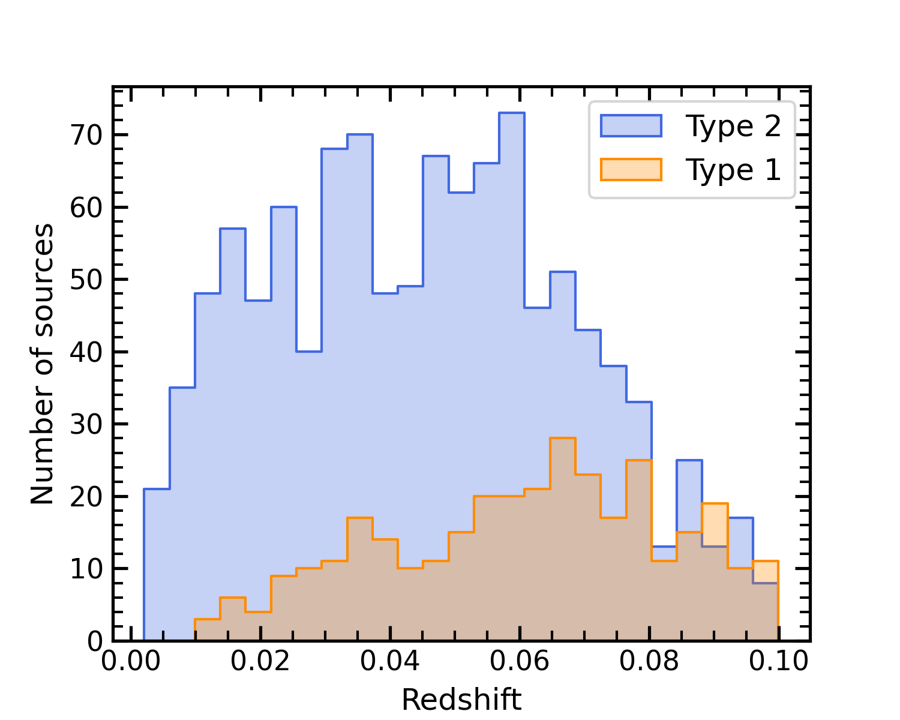
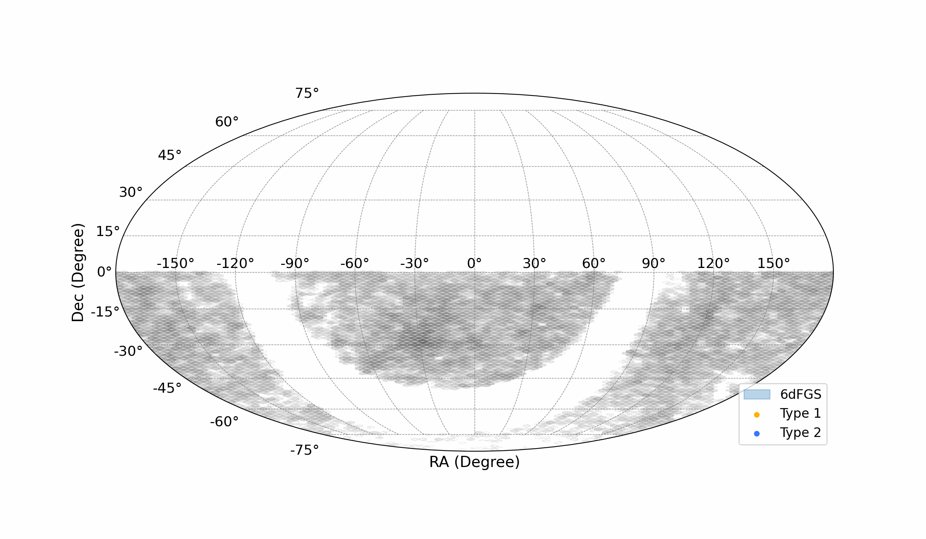
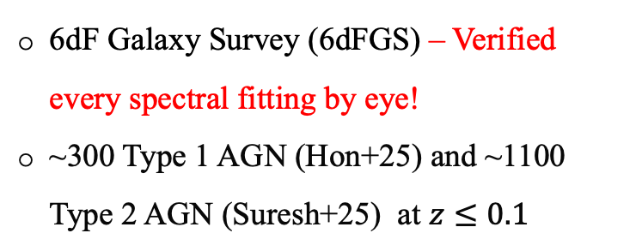
Data sample - Multiwavelength Analysis
Optical
6dF Galaxy Survey (6dFGS) – Verified every spectral fitting by eye!
~300 Type 1 AGN (Hon+25) and ~1100 Type 2 AGN (Suresh+25) at $z≤0.1$
Type 1
Type 2
X-ray
eROSITA survey
eRASS:4 (and eRASS:5 when available)
IR
ALLWISE catalogue
Notes:
We claim this by doing a multi wavelength analysis. Talk about the data. Recovered all in IR, but we see some of our sources are missing in X-ray

Slide 4
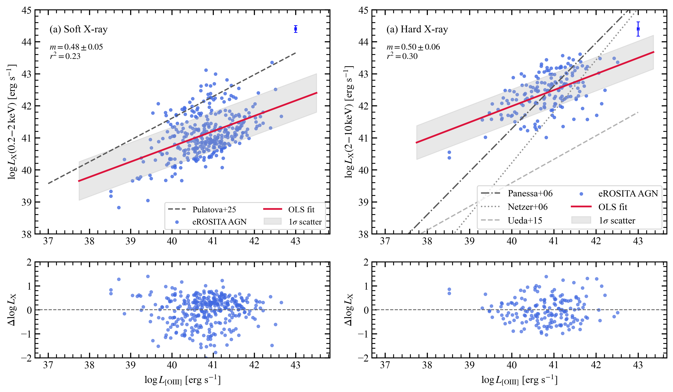
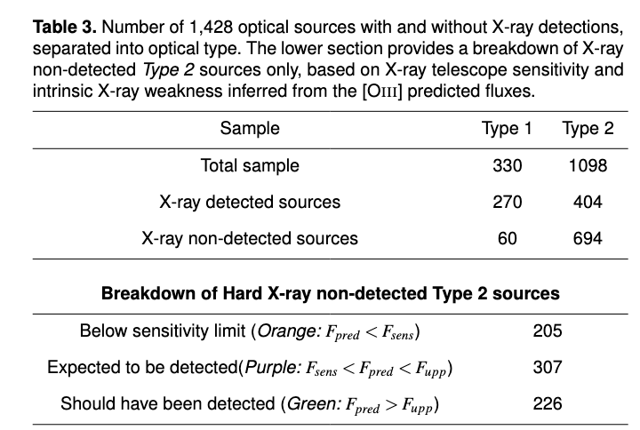
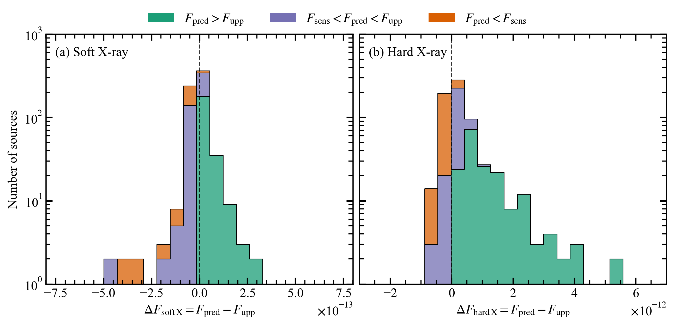

X-ray Sample
X-ray detections for 674 sources
Around 60% of Type 2 are not detected in X-ray
Three possible reasons –
  X-ray emission falls below detection limits
  X-ray absorbed by intervening material
  Little or no X-ray emission
~500 Type 2 AGN have intrinsically low X-ray emission
Notes:
Detected sources relation – apply it on non-detections – overplot relations in literature, below plot shows the residuals. We have three quantity now, predicted flux, upper limit flux and flux sensitivity at each source. Green and purple should have been detected. This shows that the first reason is ruled out. Second ruled out when we compared with BASS and found the non-detections are consistent.

Slide 5
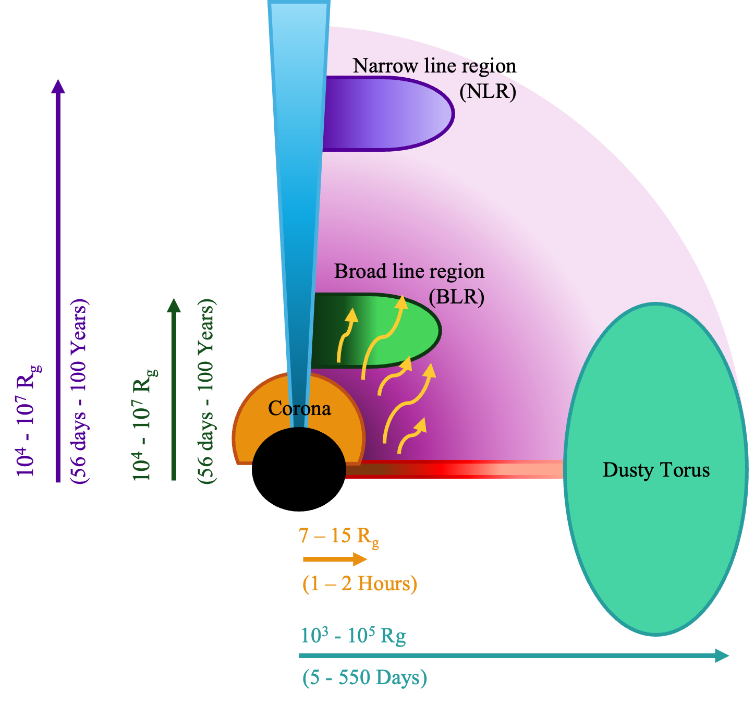
Emission timescales in AGN
Observed response of AGN emission regions is primarily set by light-travel time, with more distant regions responding later.
Two evidences suggest that the accretion disc appears and disappears on a characteristic timescale.
Notes:
So now we have two sets of sample – Detected and non-detected. We use this knowledge of X-ray non-detections to the multi-lambda analysis. But, why do a multi-lambda analysis? Timescales of emission in AGN helps us understand what happens in AD. Schematic model shows the different emissions. Light travel time plays an imp role.

Slide 6
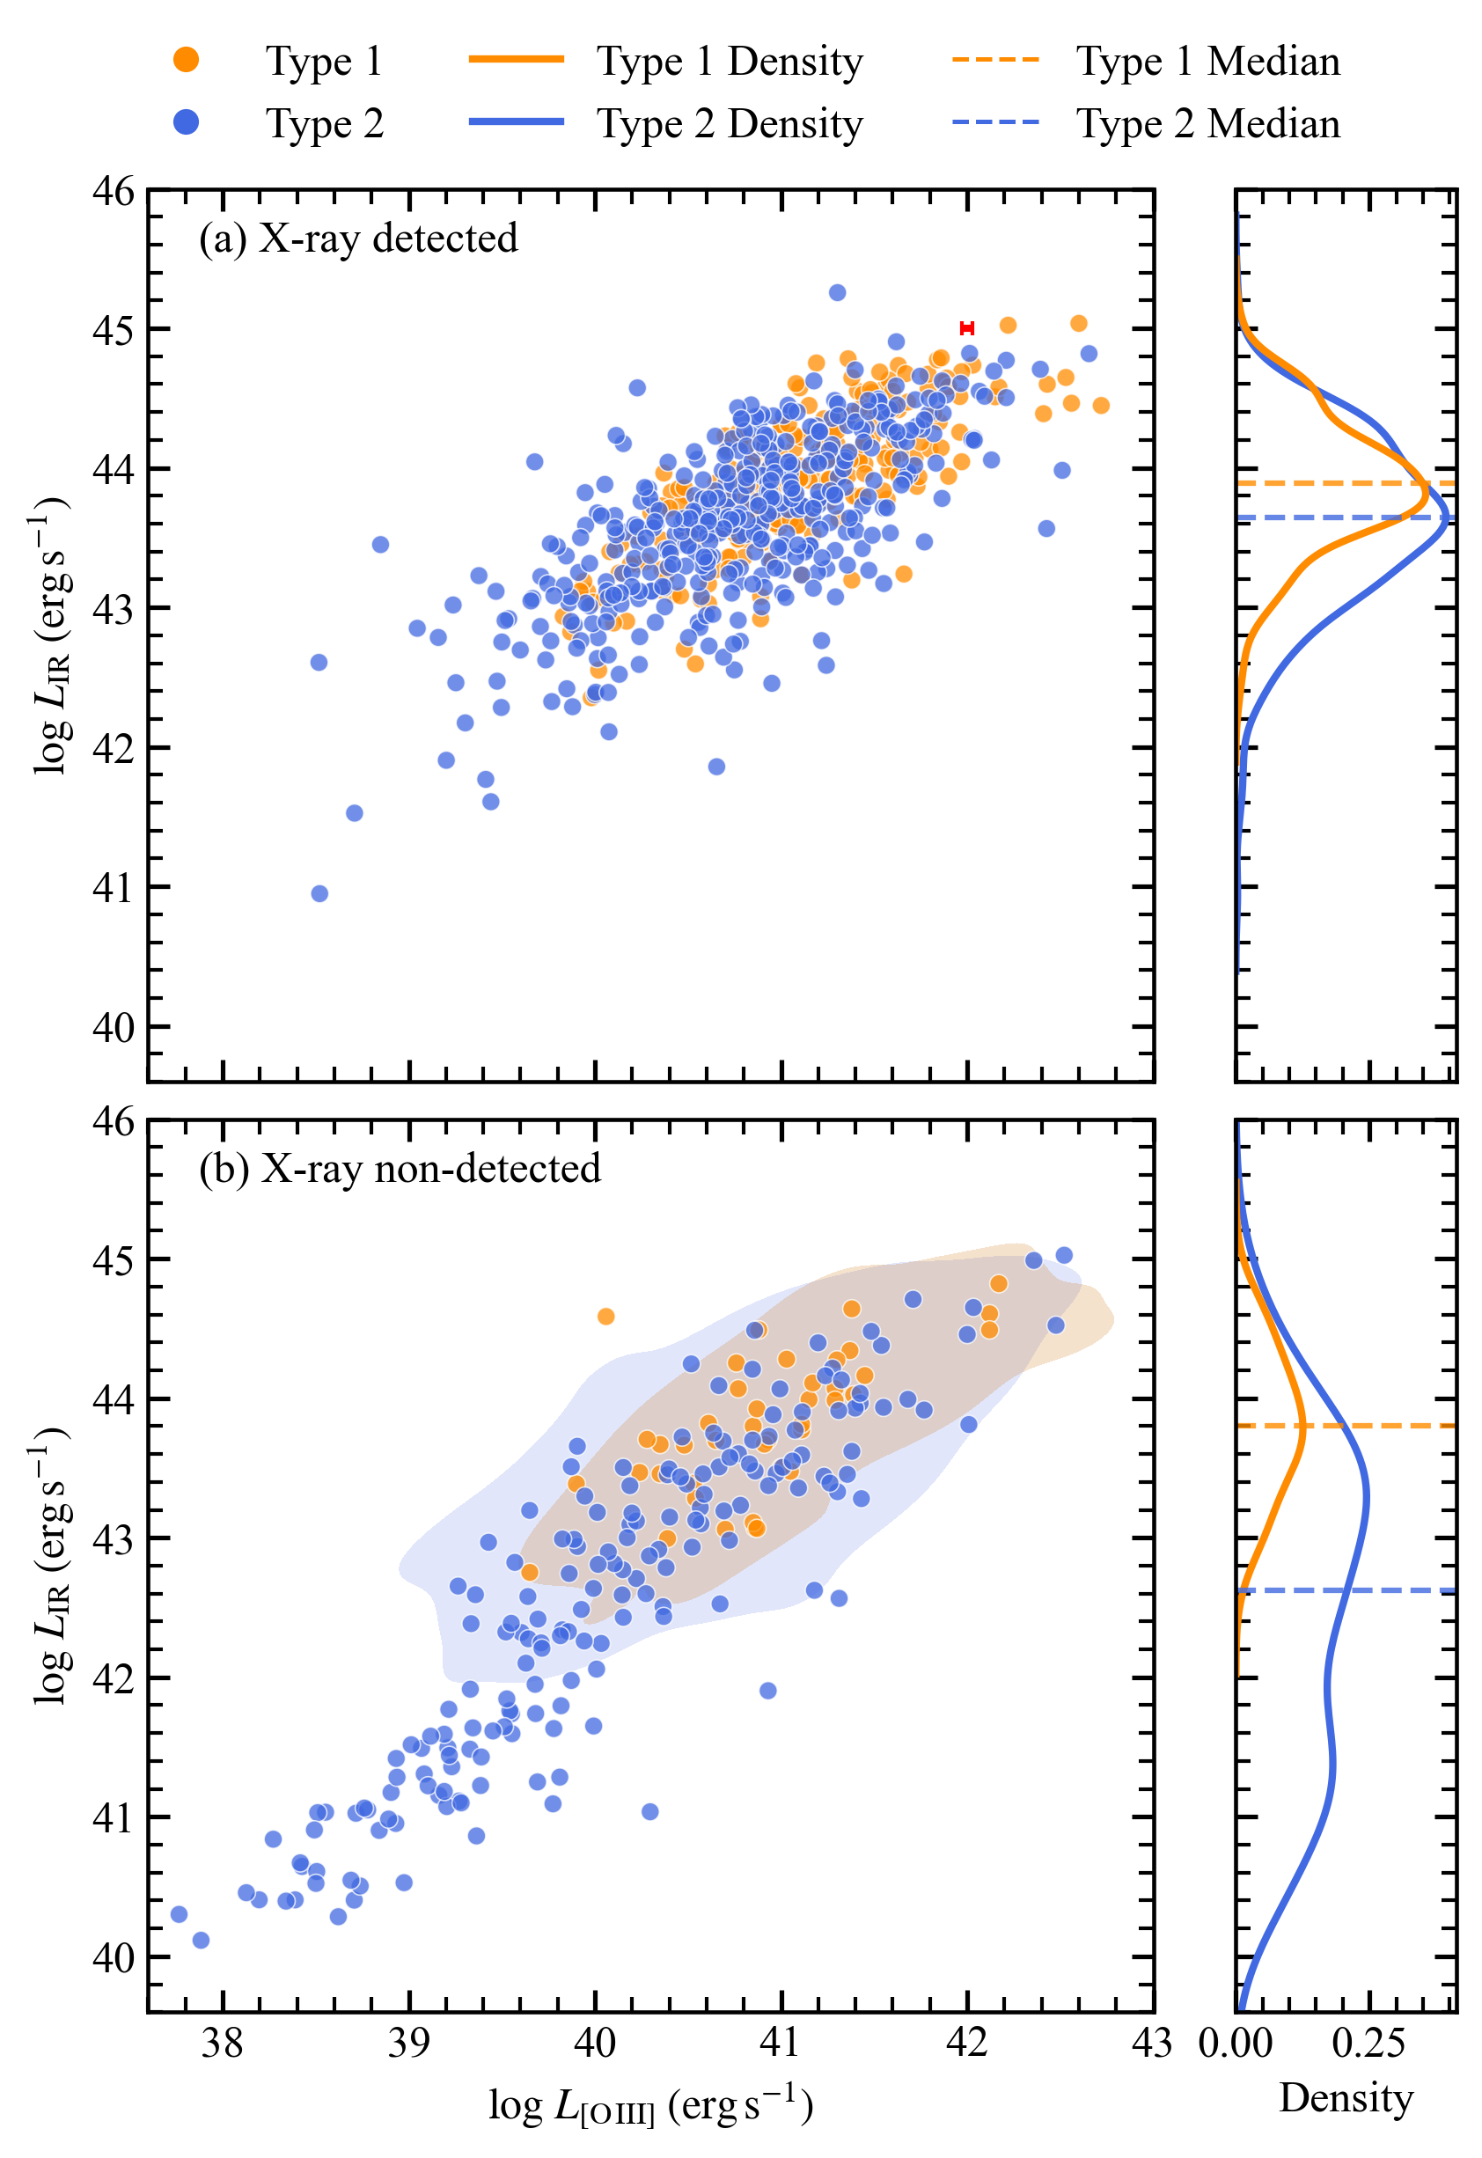
Timescale-dependent accretion
Optical vs Mid-IR
Type 1 and Type 2 AGN are similar
Type 2 tend to have lower IR and optical signatures, suggesting a luminosity-dependent classification (partial)
Missing Type 2 AGNs are less luminous
As AGN accretion weakens, X-rays may fade first, while optical and IR emission can persist for longer
Notes:
We see that both Ty1 and Ty2 occupy same region spatially. Suggesting a luminosity dependent classification along with orientation model.
X-ray non-detection shows an order-of-magnitude faster decline in mid-IR. AGN turns off, Xray shows information first, while optical takes longer to show the same.

Slide 7
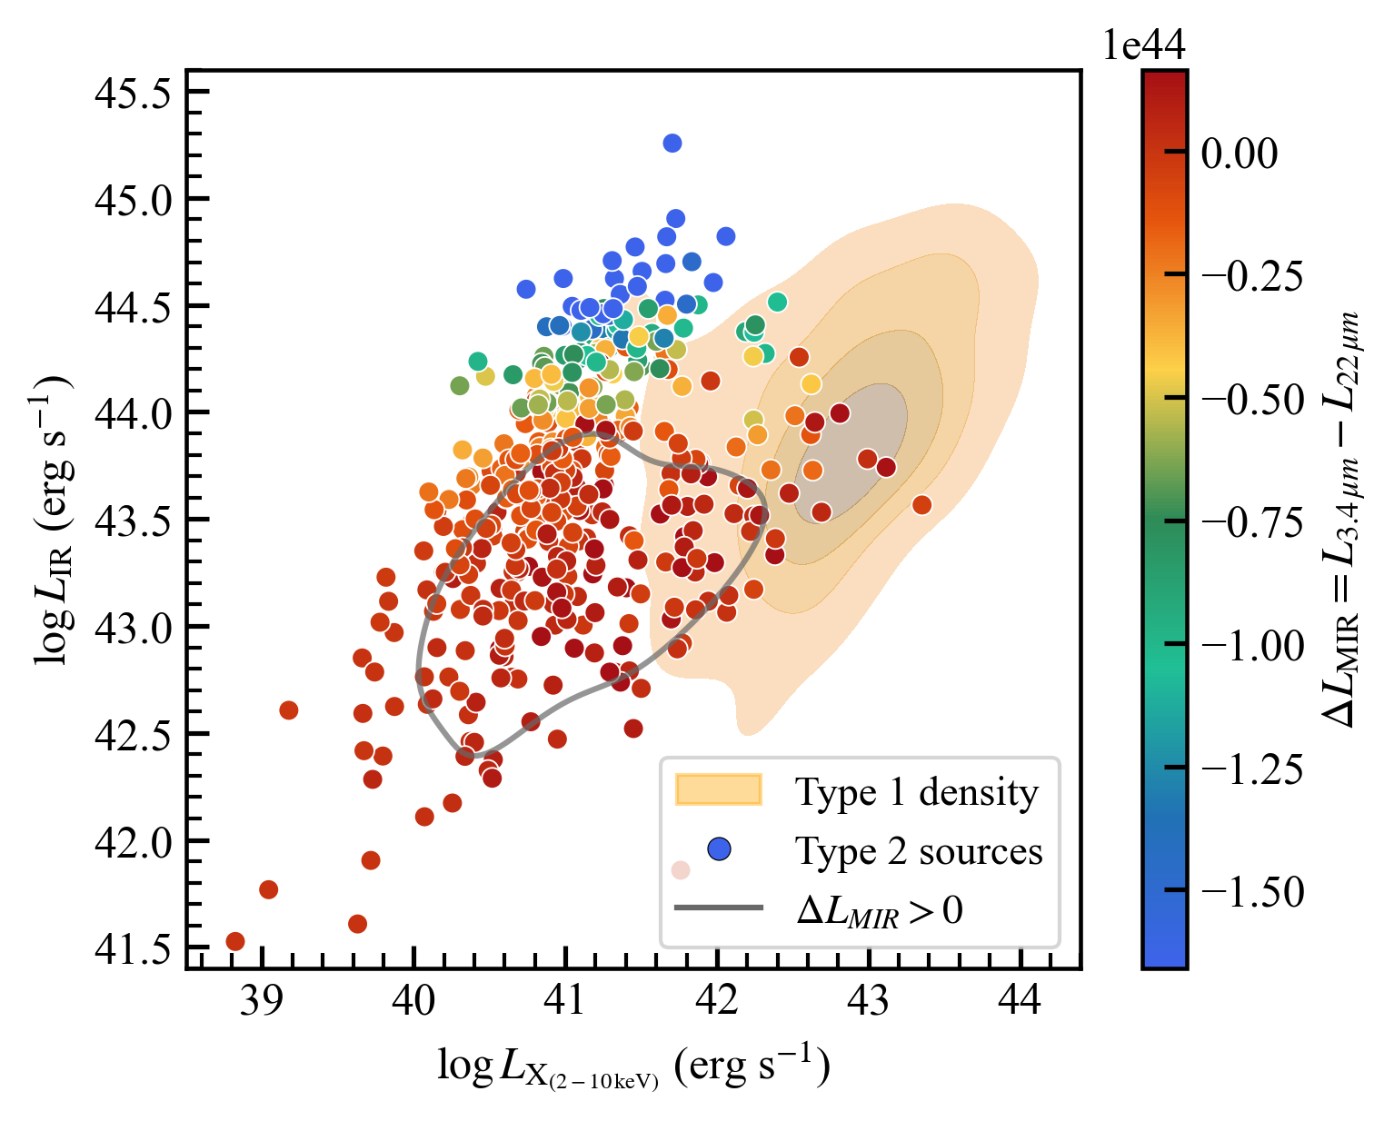
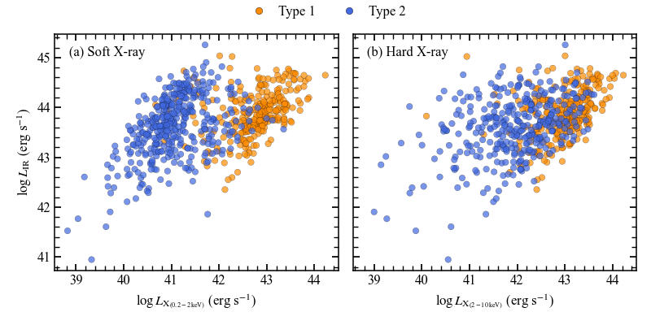
Delay in Optical when a ccretion increases
X-ray vs Mid-IR
Sudden increase in accretion observed in X-ray, while optical withhold this information
Both types look fairly similar in Hard X-rays
Torus absorbs soft X-ray emission in Type 2 AGN
But! Some Type 2 behave like Type 1!
IR shows less W4 excess over W1
True Type 2 sources exist!
Notes:
Clear distinction in the types in the soft X-ray agrees well with the orientation model. However, a subset of 50 sources occupy Ty 1 parameter space, indicating an increase in X-ray emission, while the IR shows less W4 excess over W1
There might be a sudden increase in accretion – X-ray shows this change immediately (soft X-ray lum increases); however, it takes longer to see changes in optical
Both these results shows that the AD is not constant and variable accretion needs to be considered to understand AGN

Slide 8
In Summary
Analysed ~300 Type 1 and ~1100 Type 2 AGN
Nearly 500 (~ 54%) low luminosity (low z) Type 2 AGN are not detected in X-ray
→ Accretion disc appears and disappears
As AGN accretion fades, X-rays disappear much sooner than optical/IR

Slide 9
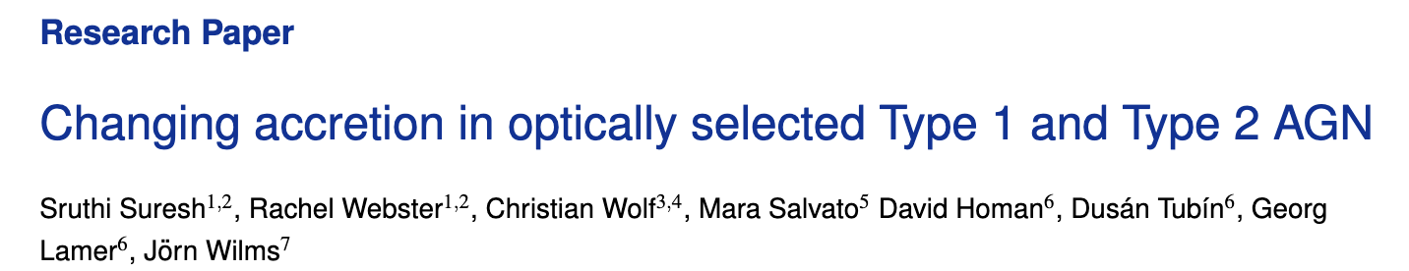

Standard AGN Geometry
To be submitted soon…….
Accretion Disc is not constant
$$∆t \sim {10}^{3}years$$
Variable accretion
(Where to look)
(When to look)
(Could answer many PhD students’ questions!)
Notes:
In conclusion, adding variable accretion to the existing AGN model could help us better understand the anomalies in AGN types. Basically,

Slide 10
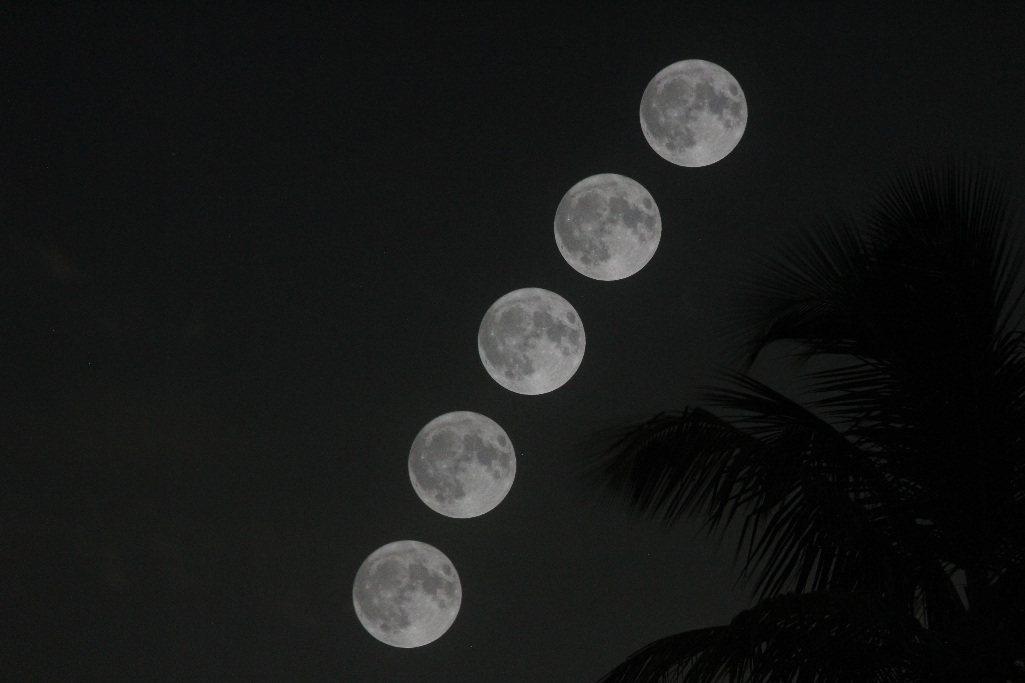

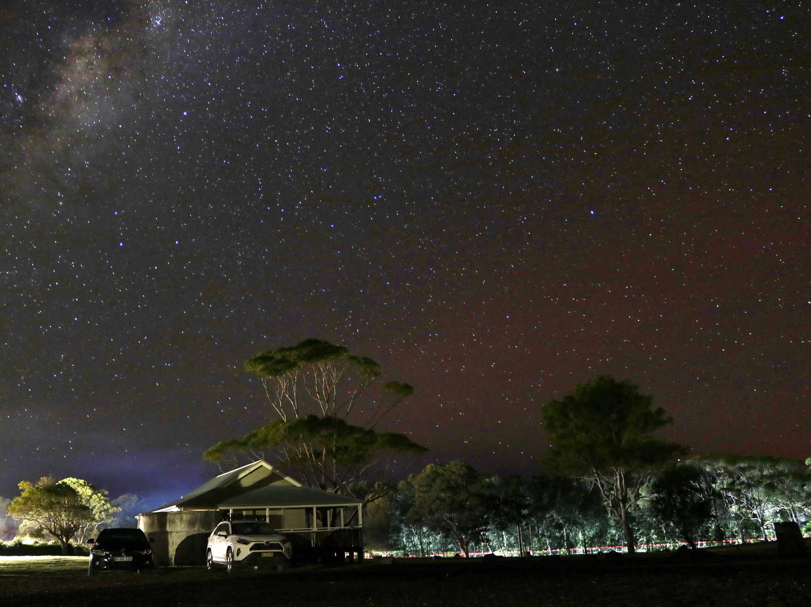
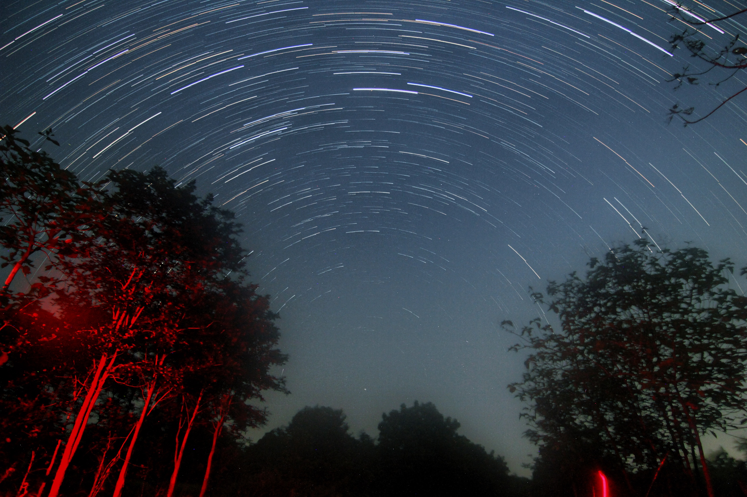
Future goals
Thank you!

Slide 11
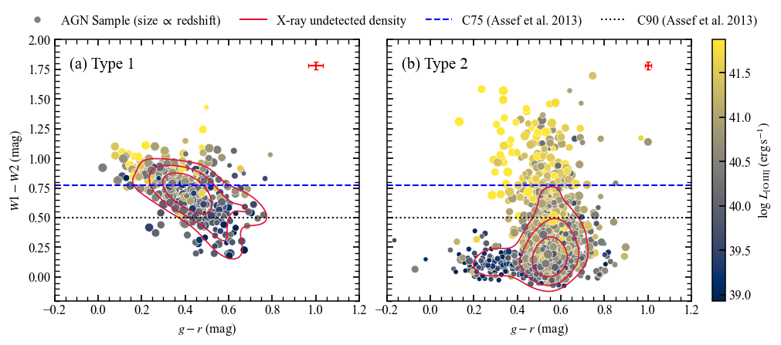
Optical vs near-IR
IR – Optical colour-colour diagram
Low-luminosity Type 2s are often missed in IR-based AGN selection
Type 2 X-ray non-detections occupy lower W1-W2 colours, while optical g-r matches spatially with Type 1

Slide 12
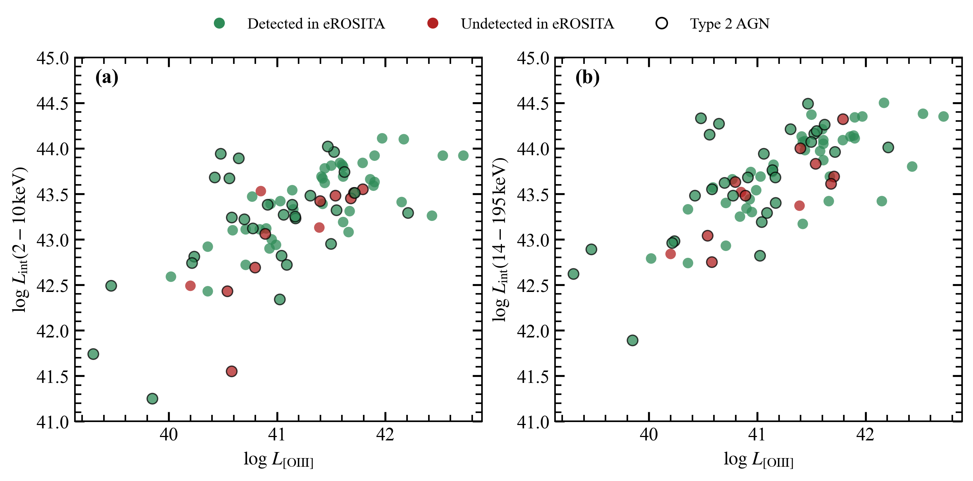
BASS comparison
Notes:
A subset of 50 sources occupy Ty 1 parameter space, indicating an increase in X-ray emission, while the IR shows less W4 excess over W1
Bottom line – There might be a sudden increase in accretion – X-ray shows this change immediately; however, it takes longer to see changes in optical

Slide 13
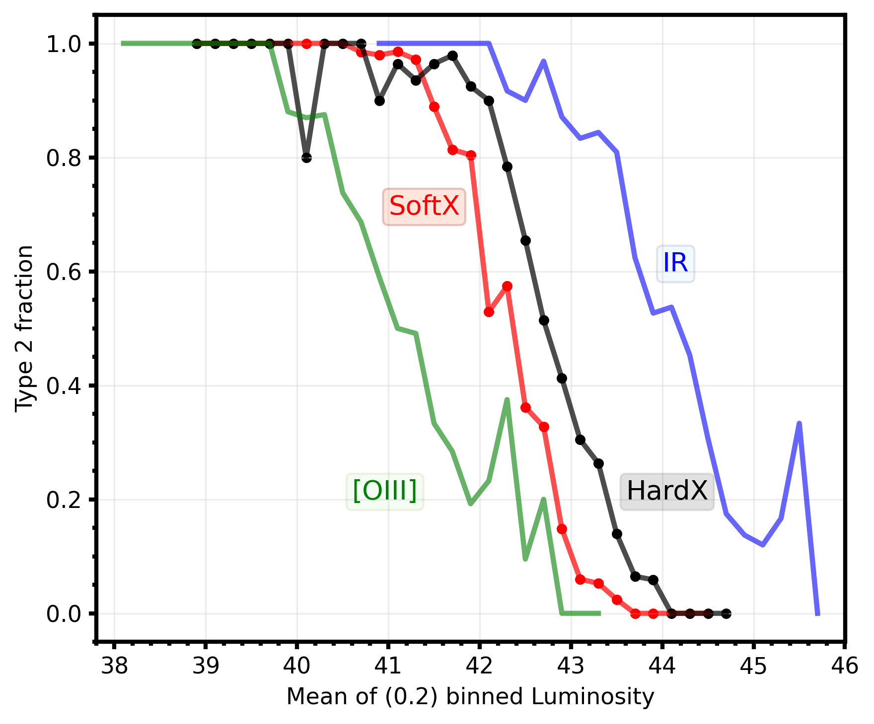
Luminosity dependent classification

Slide 14
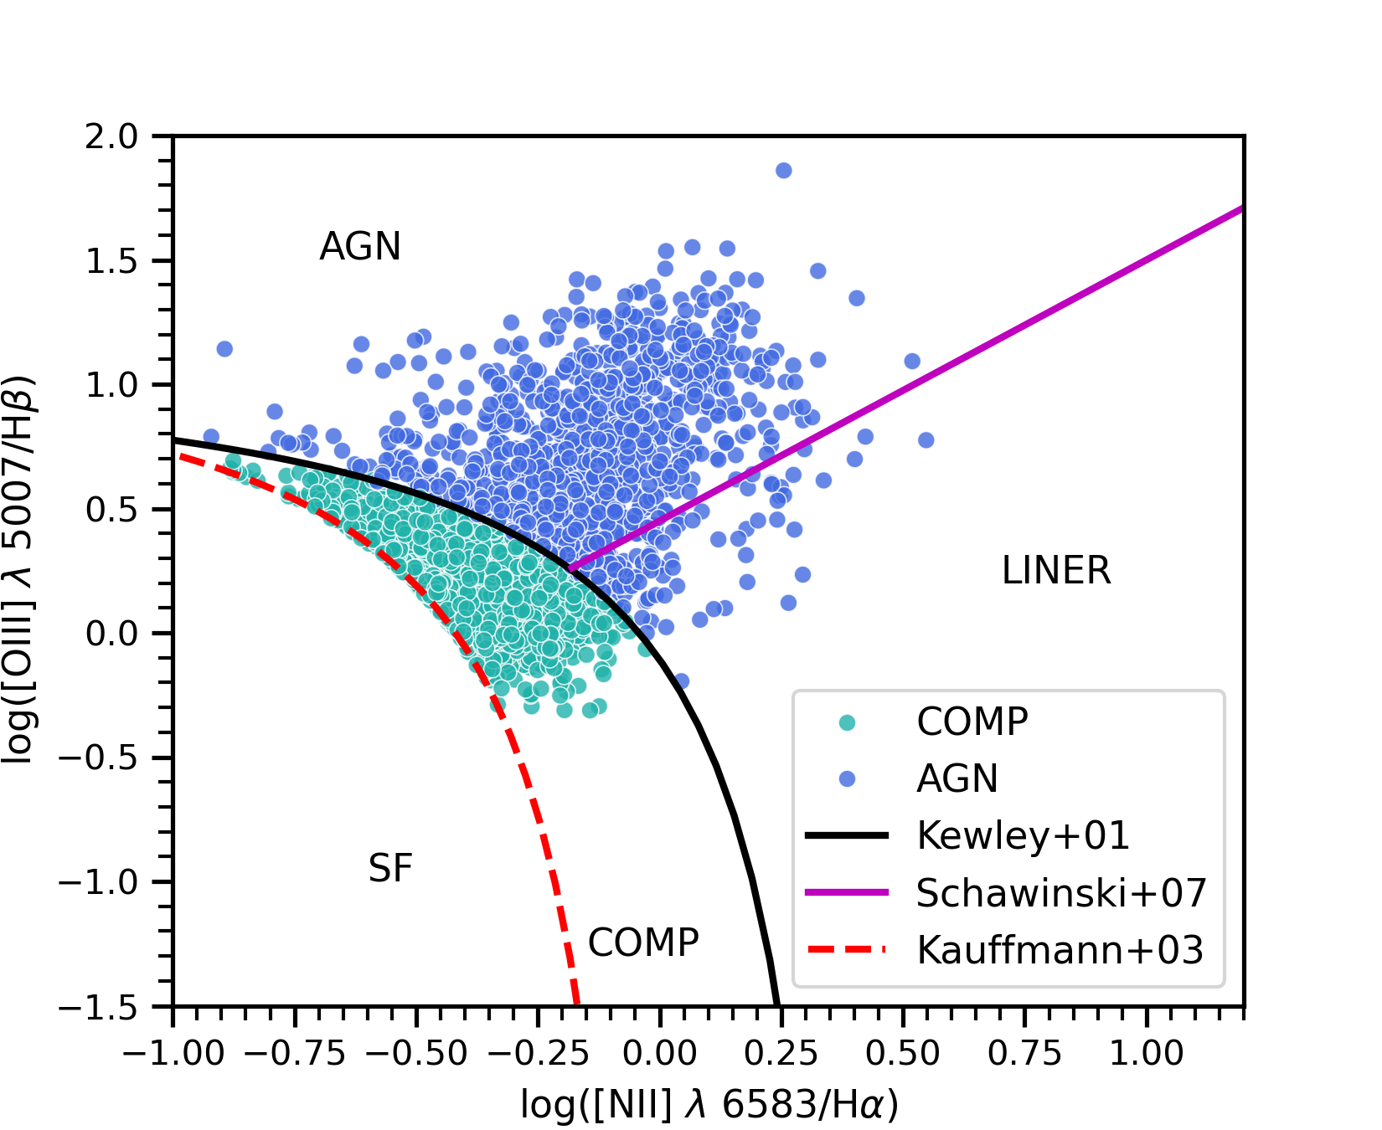
BPT

Slide 15
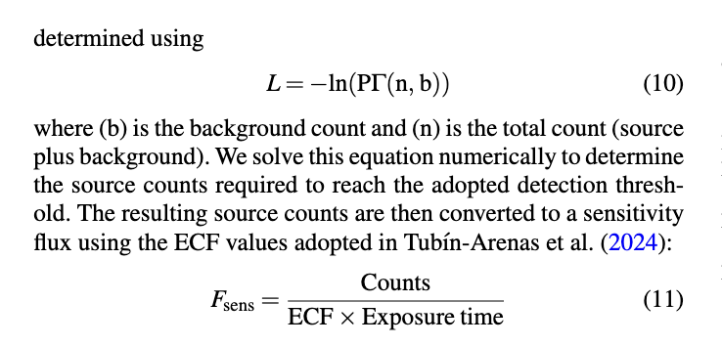
Sensitivity limit calculation

