Slide 1
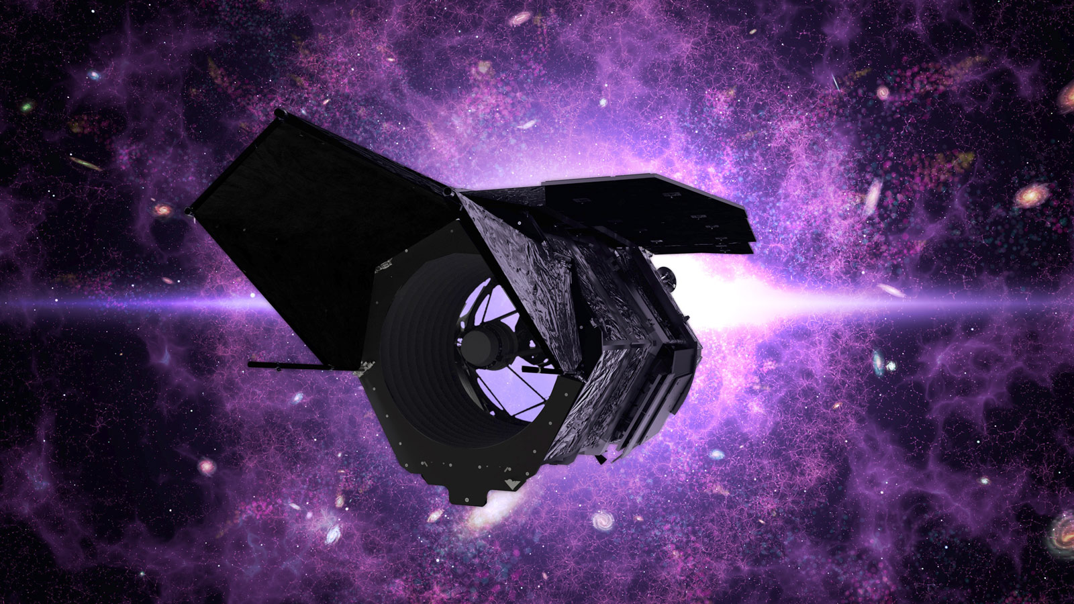

When Jets Don’t Quench:
Fueling/Feedback? in Blue LERGs
Swetha Sankar | Johns Hopkins University
Illuminating the Active Universe • 2026
with A. Petric, T. Heckman, R. Janssen, M. Lacy, N. Nesvadba, K. Rowlands, P. Patil, A. Giman, and collaborators
Notes:
[Sources]
Visual layout and galaxy artwork: user-provided HotSci presentation, slide 1.

Slide 2
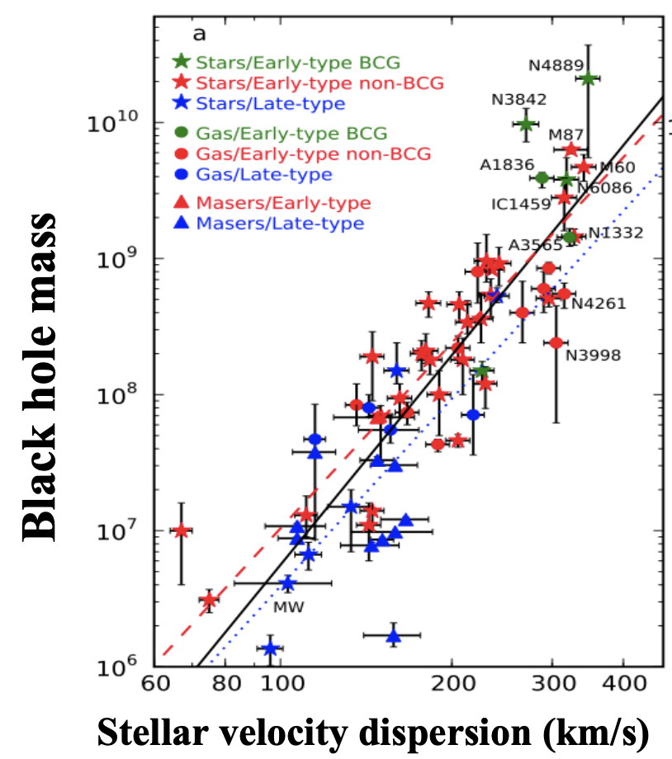
Black-hole growth is linked to galaxy evolution
Black-hole mass tracks
the stellar bulge
The scaling relation implies that black-hole growth and galaxy evolution are coupled.
AGN feedback provides mechanism for this coupling
McConnell & Ma+2013

Slide 3
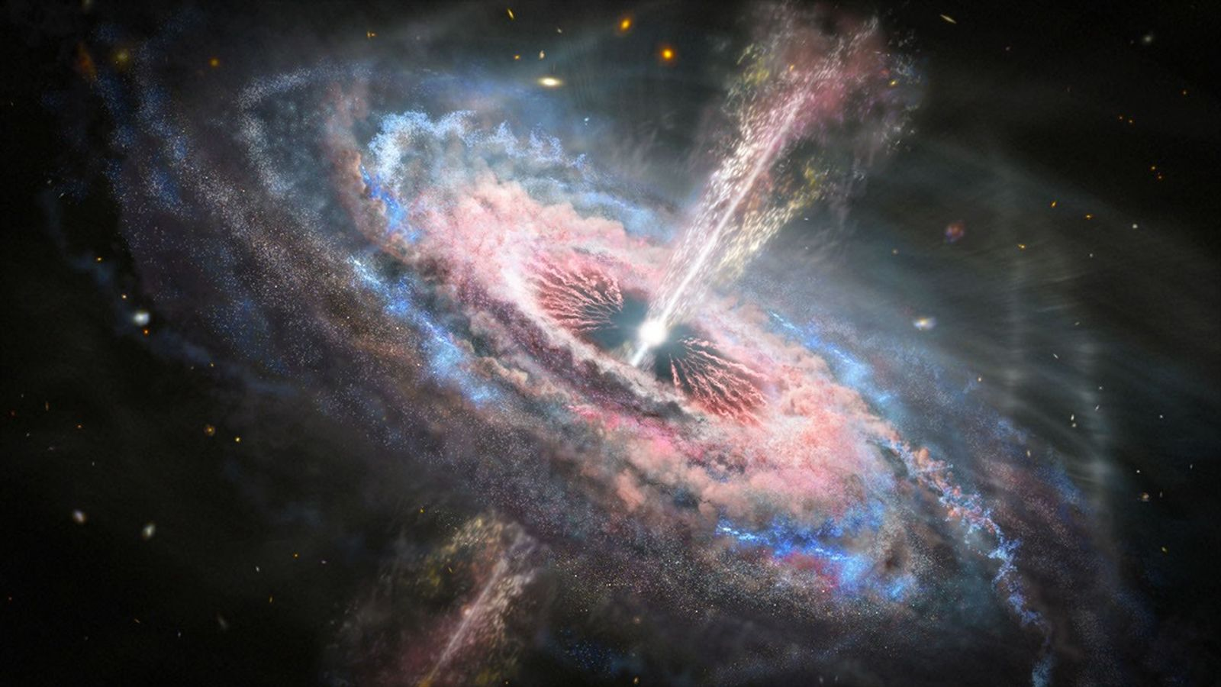
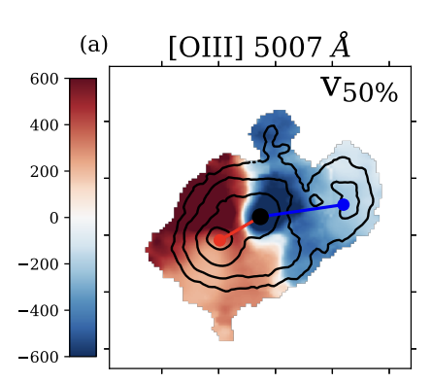
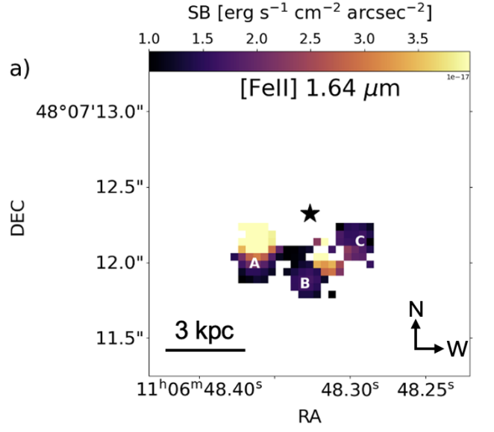
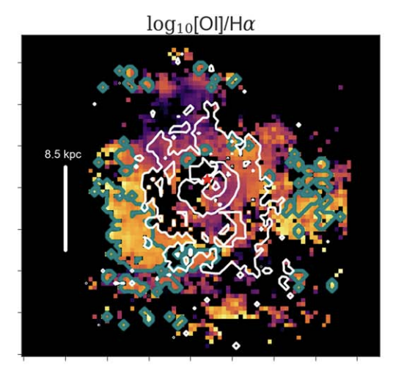
AGN couple to galaxies through winds and jets
RADIATIVE
NASA / ESA / N. Arav (illustration)
Rupke+2023 · coauthor
Sankar+2026
Vayner+2026 · coauthor
fast ionized winds
resolved shocks
host ISM coupling
Notes:
[Sources]
NASA Hubble, Quasar Tsunamis Rip Across Galaxies (2020) — quasar outflow illustration: https://science.nasa.gov/missions/hubble/quasar-tsunamis-rip-across-galaxies/
NASA Hubble/Chandra/VLA, MS 0735.6+7421 — radio plasma filling X-ray cavities: https://science.nasa.gov/asset/hubble/galaxy-cluster-ms-0735/
Heckman & Best 2014 — radiative/wind-dominated and jet/mechanical feedback framework.
[/Sources]

Slide 4
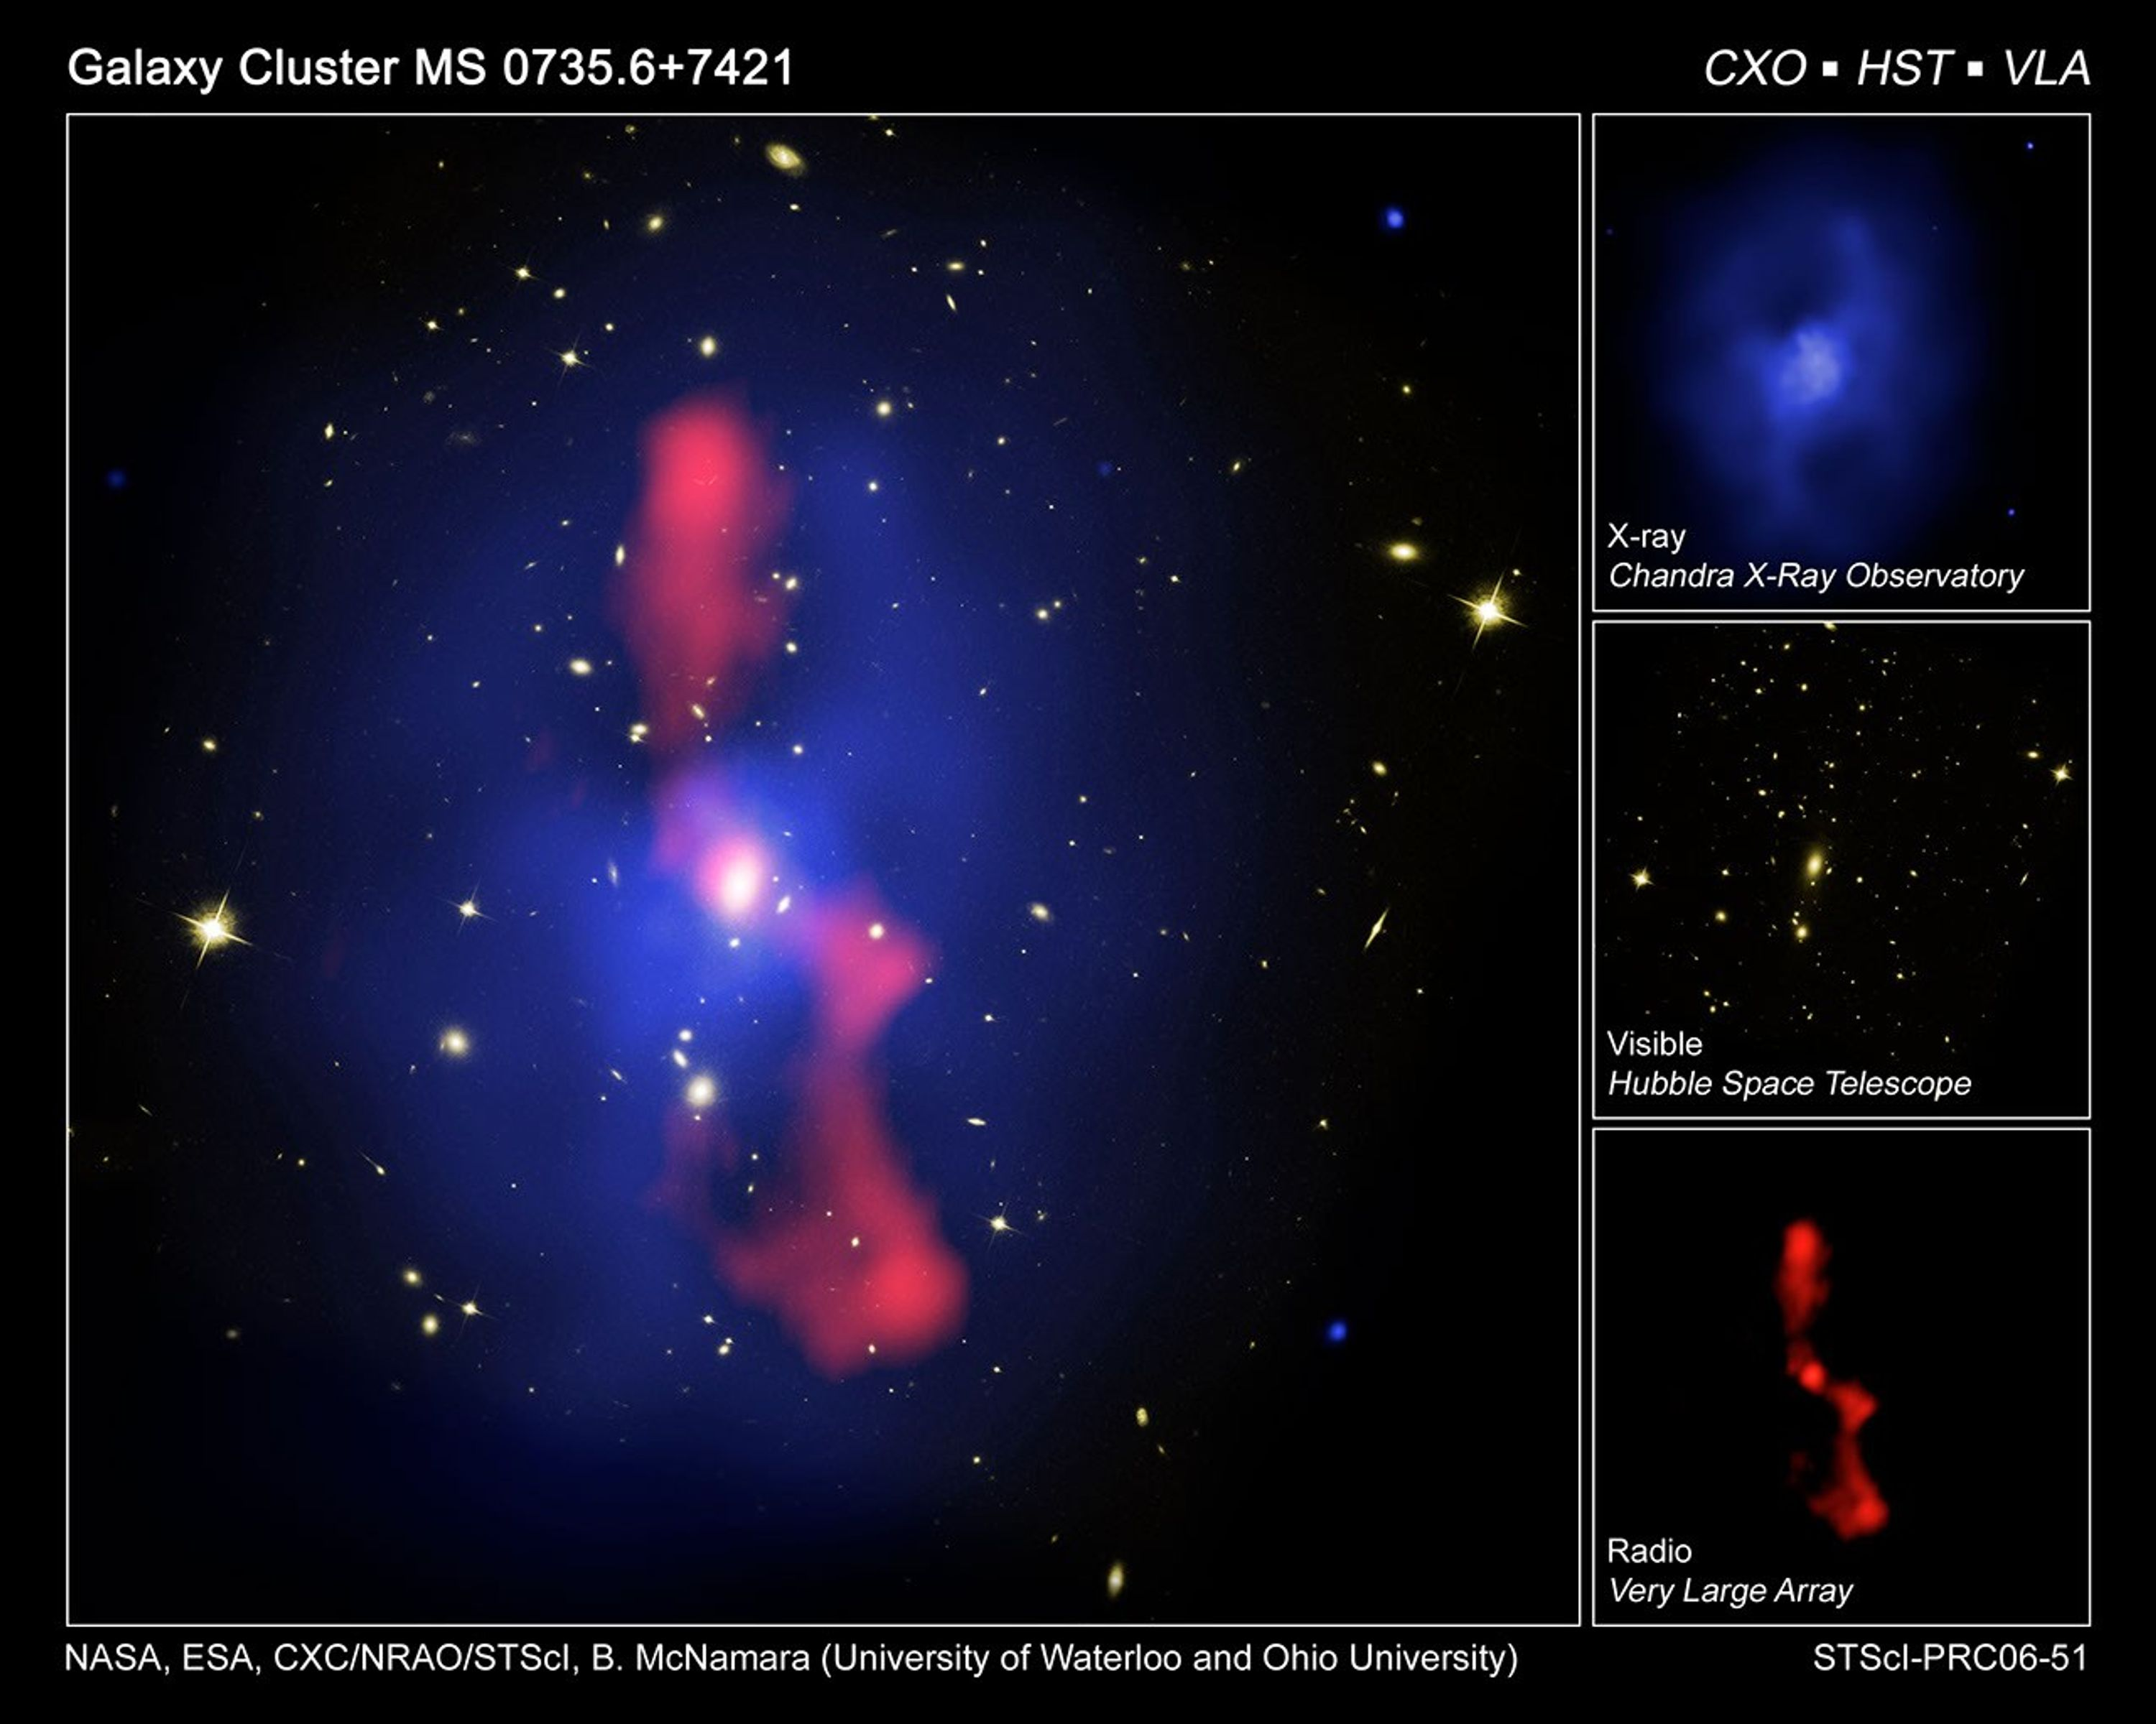
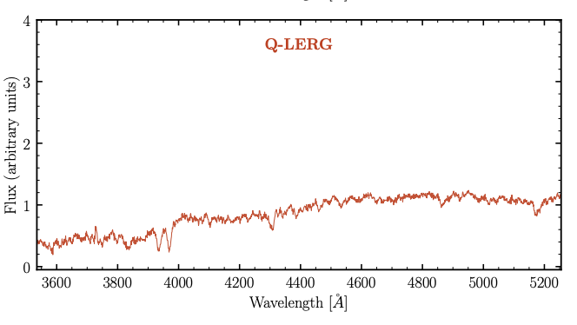
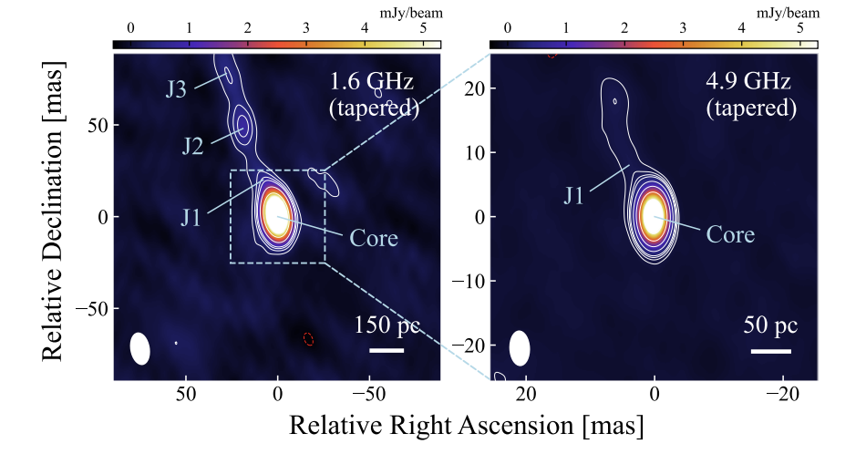
AGN couple to galaxies through winds and jets
RADIATIVE
KINETIC
NASA / ESA / N. Arav (illustration)
Kondapally+2025
Weak, low-excitation line spectrum
Radiatively inefficient nucleus
Obuchi,Zaw+2026
Strong high-excitation lines
Radiatively efficient nucleus
Notes:
[Sources]
NASA Hubble, Quasar Tsunamis Rip Across Galaxies (2020) — quasar outflow illustration: https://science.nasa.gov/missions/hubble/quasar-tsunamis-rip-across-galaxies/
NASA Hubble/Chandra/VLA, MS 0735.6+7421 — radio plasma filling X-ray cavities: https://science.nasa.gov/asset/hubble/galaxy-cluster-ms-0735/
Heckman & Best 2014 — radiative/wind-dominated and jet/mechanical feedback framework.
[/Sources]

Slide 5
AGN couple to galaxies through winds and jets
RADIATIVE
KINETIC
NASA / ESA / N. Arav (illustration)
Kondapally+2025
Weak, low-excitation line spectrum
Radiatively inefficient nucleus
Obuchi,Zaw+2026
FOCUS OF THIS WORK → LERGs
Strong high-excitation lines
Radiatively efficient nucleus
Notes:
[Sources]
NASA Hubble, Quasar Tsunamis Rip Across Galaxies (2020) — quasar outflow illustration: https://science.nasa.gov/missions/hubble/quasar-tsunamis-rip-across-galaxies/
NASA Hubble/Chandra/VLA, MS 0735.6+7421 — radio plasma filling X-ray cavities: https://science.nasa.gov/asset/hubble/galaxy-cluster-ms-0735/
Heckman & Best 2014 — radiative/wind-dominated and jet/mechanical feedback framework.
[/Sources]

Slide 6
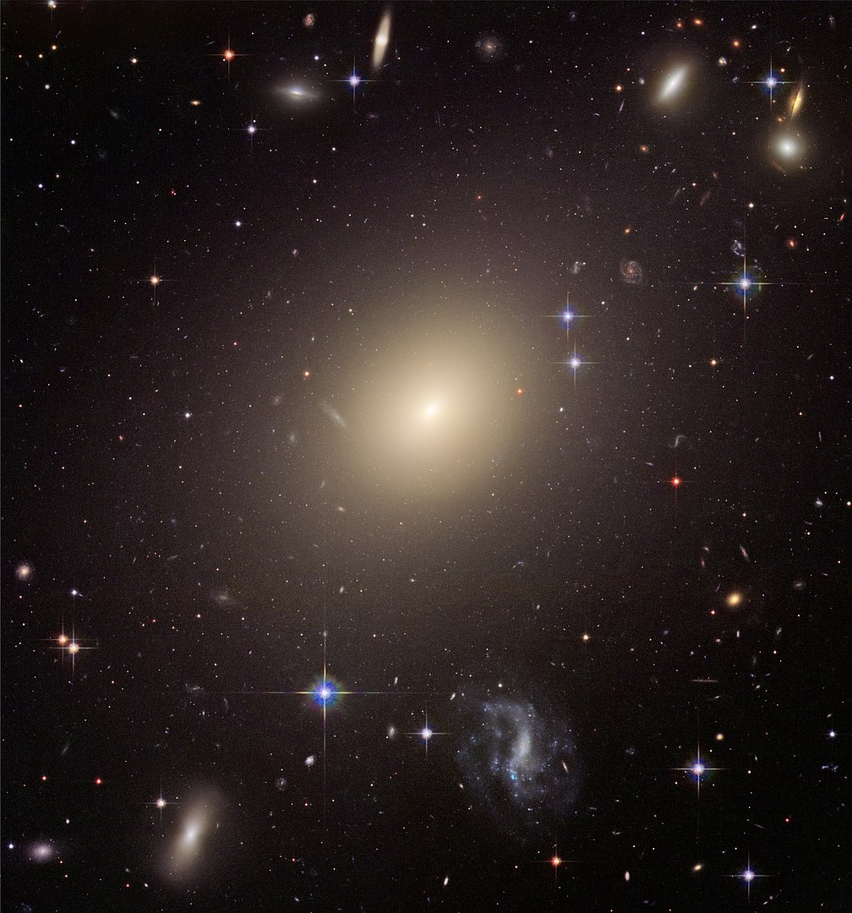
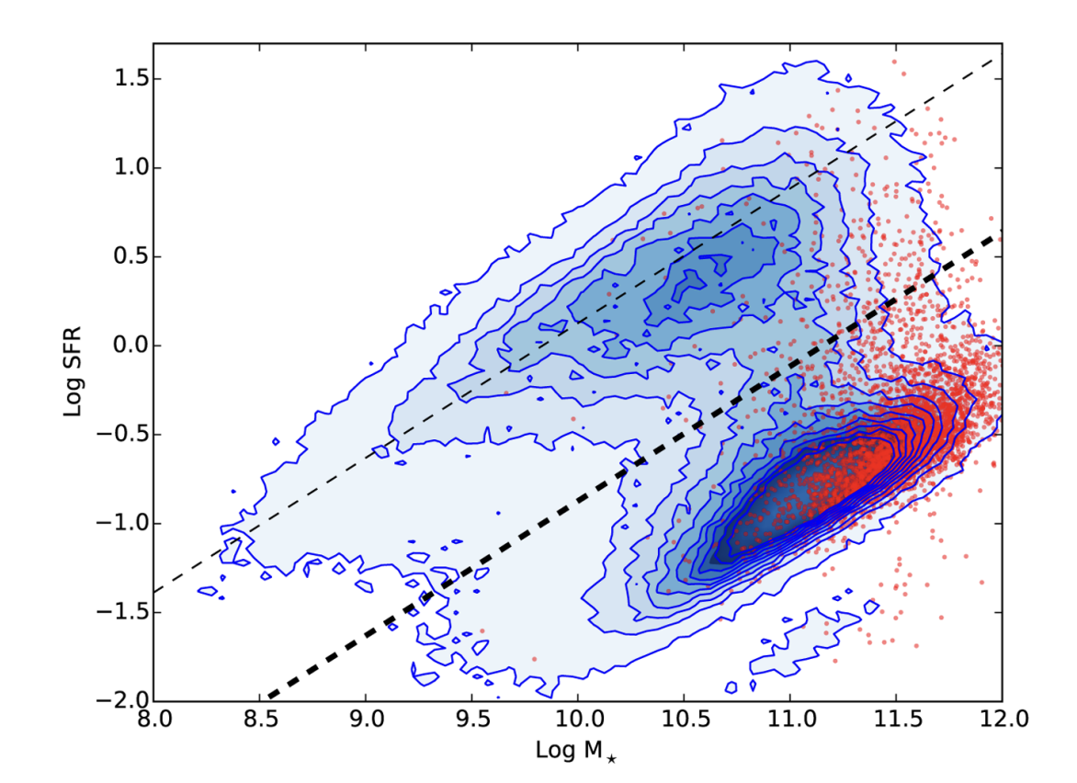
Typical LERGs:
92% of LERG hosts lie below the star-forming main sequence
Ellison+2015
Notes:
EXPECTATION: red and dead elliptical galaxies
Plot of Radio luminosities of these sources (compared to luminosities of radio loud Quasars)

Slide 7
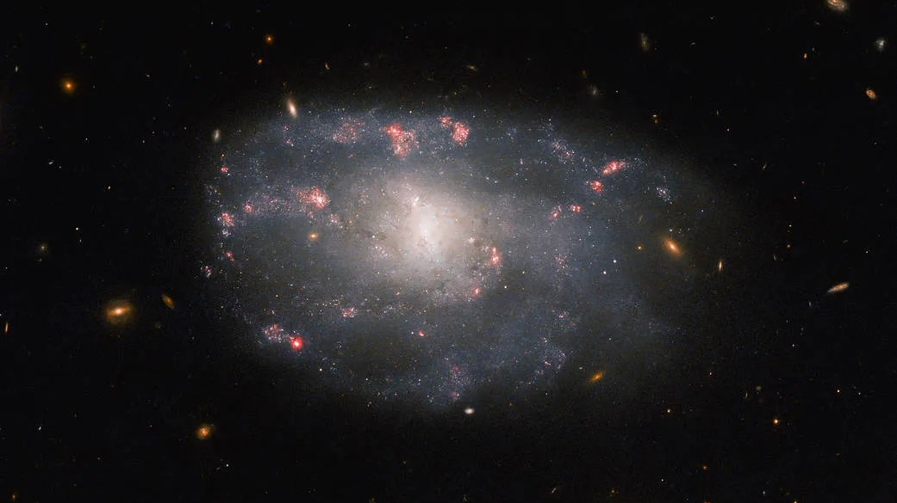
But some LERGs live in gas-rich, star-forming galaxies
Notes:
EXPECTATION: red and dead elliptical galaxies
Plot of Radio luminosities of these sources (compared to luminosities of radio loud Quasars)

Slide 8
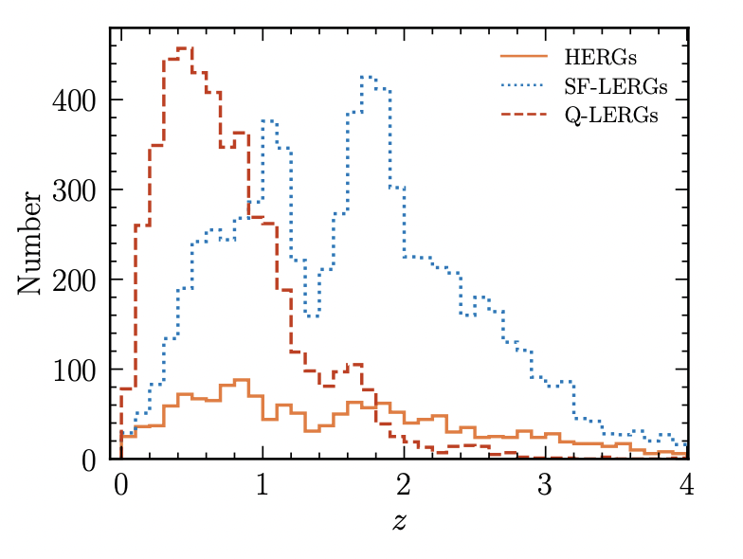
Star-forming LERGs become increasingly common toward high redshift
But some LERGs live in gas-rich, star-forming galaxies
poor photometric filter coverage
survey is flux limited
8 nearby (z<0.1) systems let us resolve the physics.
Kondapally+2022; LOFAR Deep Fields (LoTTS)
Notes:
Talk about why finding SF LERGs is unusual and what it means at higer redshifts
Why are lower redshift LERGs particularly important to study?

Slide 9
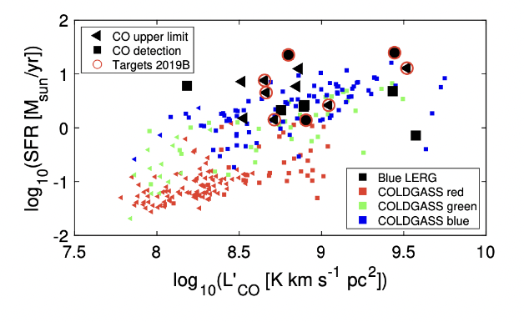
CO observations reveal substantial cold-gas reservoirs in several targets
PRELIMINARY
Janssen et al. in prep
9

Slide 10
CO observations reveal substantial cold-gas reservoirs in several targets
Is this a transient stage in kinetic-mode AGN evolution?
1. Where is the gas coming from?
2. Is it being processed?
3. What is the jet’s role in all of this???
Janssen et al. in prep
10

Slide 11
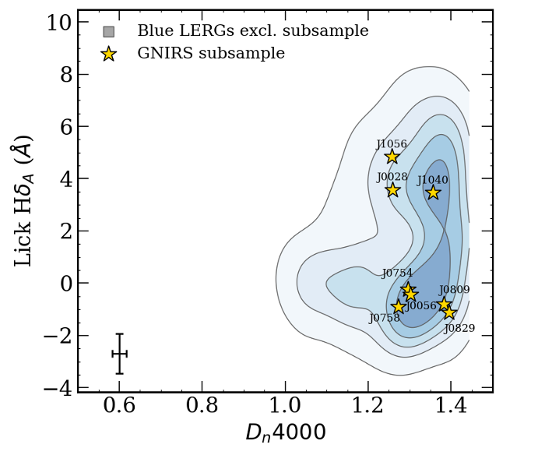
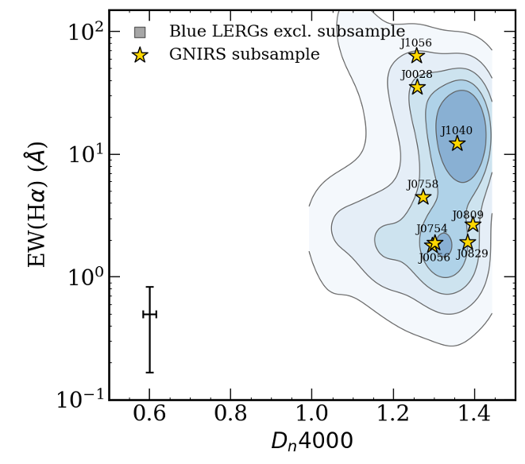
A classification caveat
Blue-LERG selection can also admit objects with diluted Dₙ4000
Secure young /
star-forming hosts
J0028, J1040, J1056
recent star-formation history / burstiness
recent ionizing activity
Host SF uncertain
possible non-thermal contribution
J0056, J0754, J0758,
J0809, J0829

Slide 12
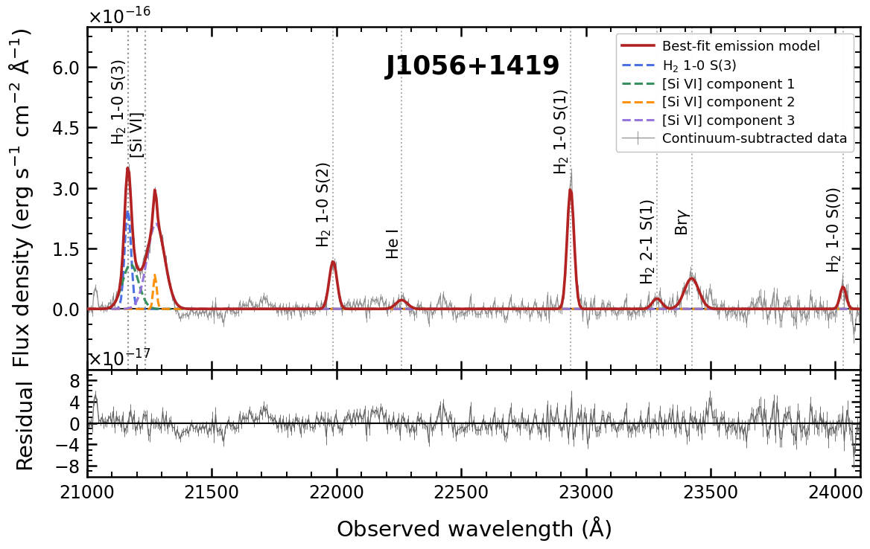
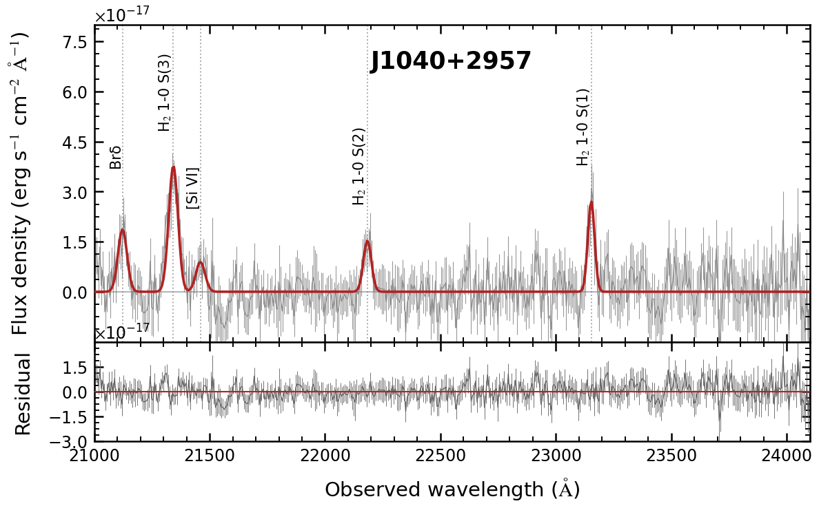

The two strongest detections reveal multiple H₂ transitions
$H_{2}$(1-0 S(1))
Notes:
Prepare!!! Add SDSS spectra

Slide 13
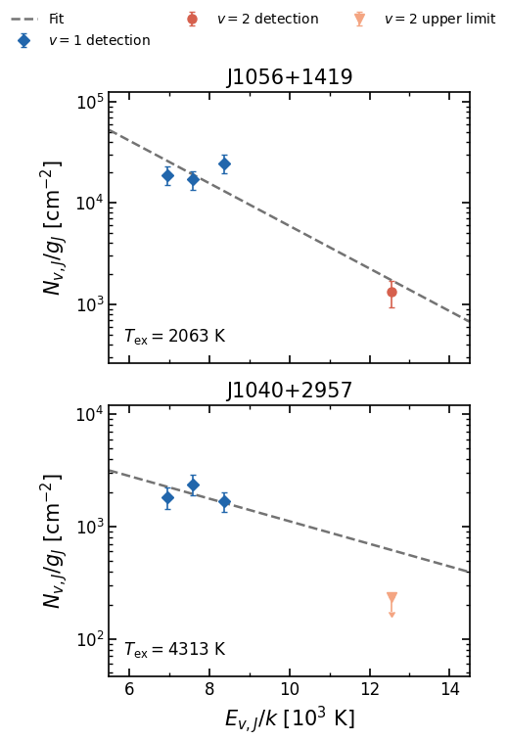
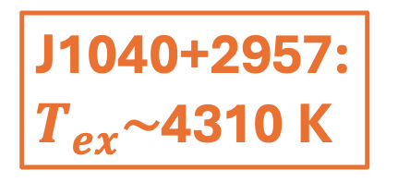
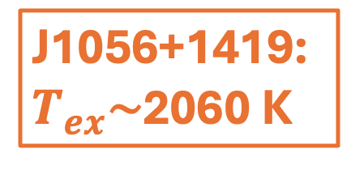
What are their excitation conditions?
J1056+1419: $T_{ex}$​∼2060 K
J1040+2957: $T_{ex}$​∼4310 K
J1040+2957
Warm H₂ is clearly present, but the integrated ratios do not uniquely identify its heating mechanism.
Notes:
Prepare!!! Add SDSS spectra

Slide 14
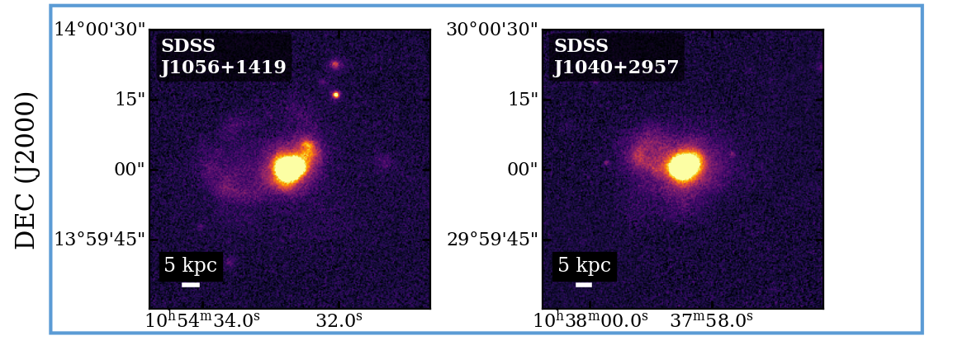

These are also disturbed/ in late stage mergers…
featureless
$H_{2}$(1-0 S(1))
Tidal features
$H_{2}$(1-0 S(1))
Notes:
Prepare!!! Add SDSS spectra

Slide 15
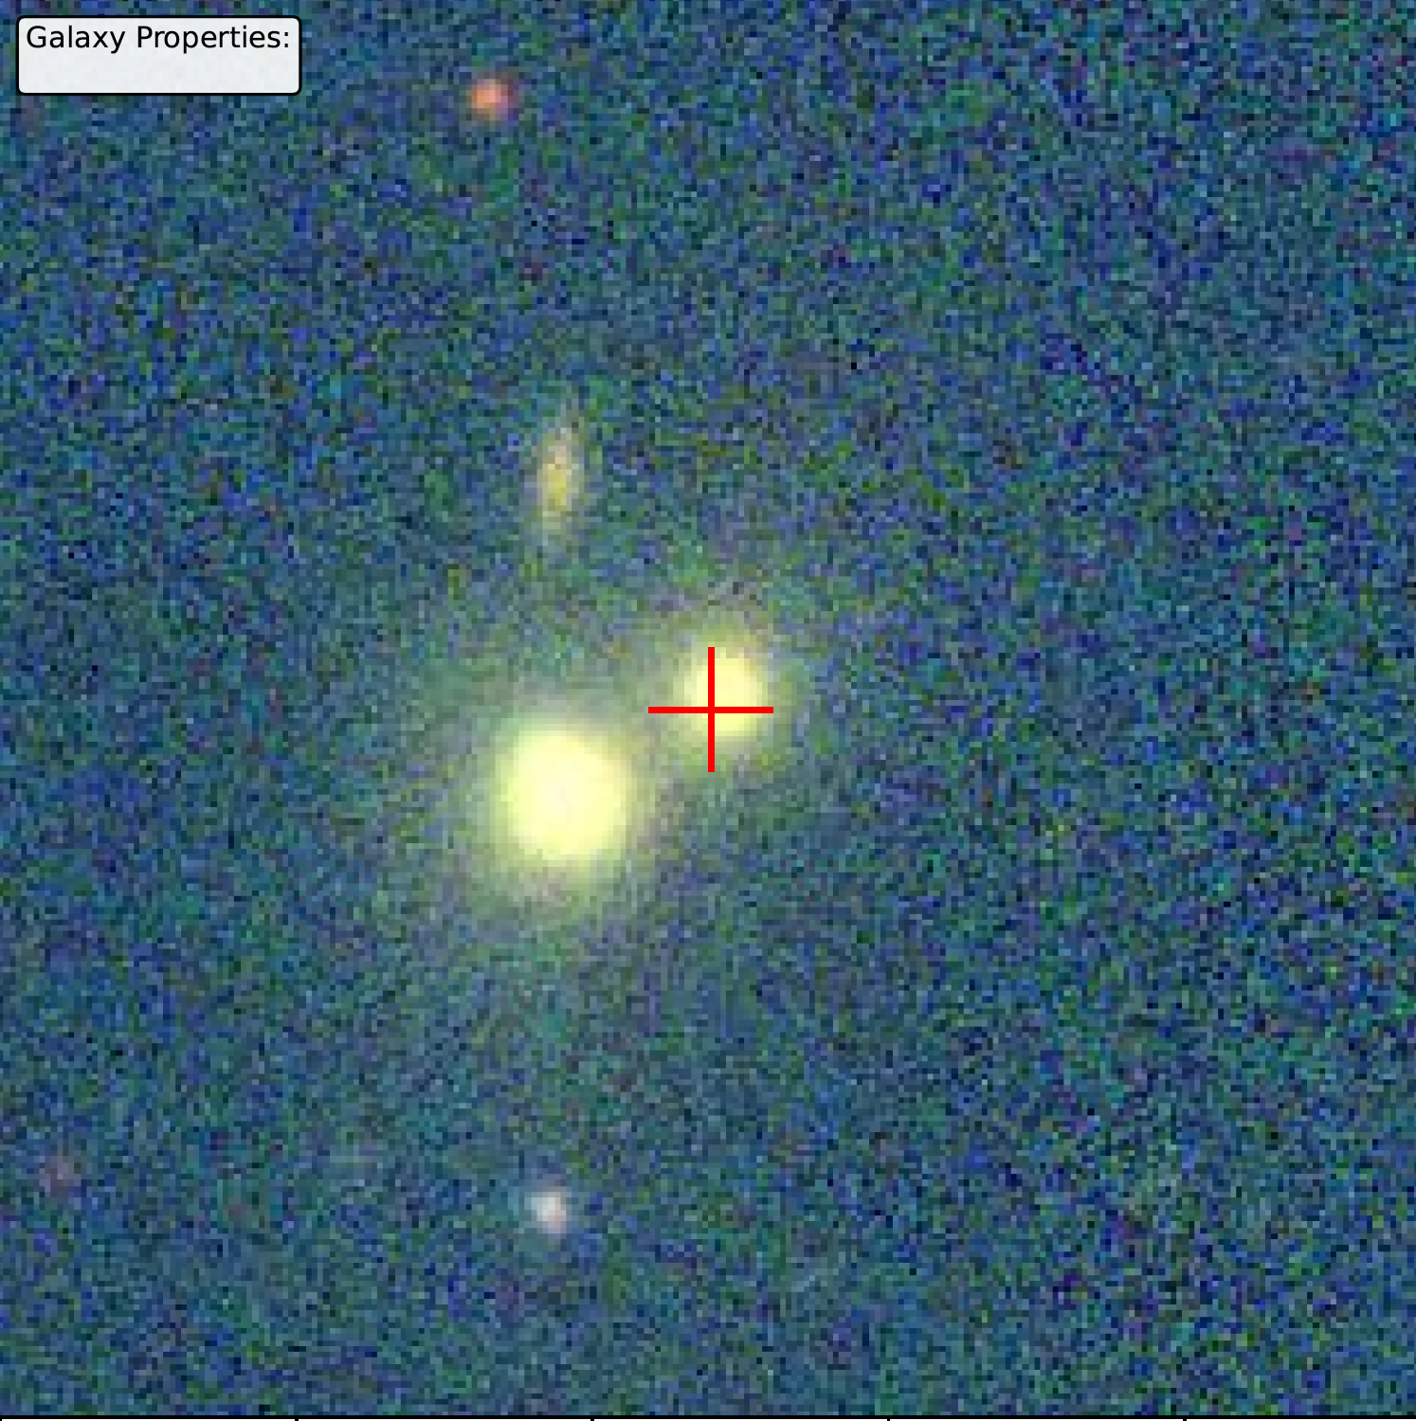
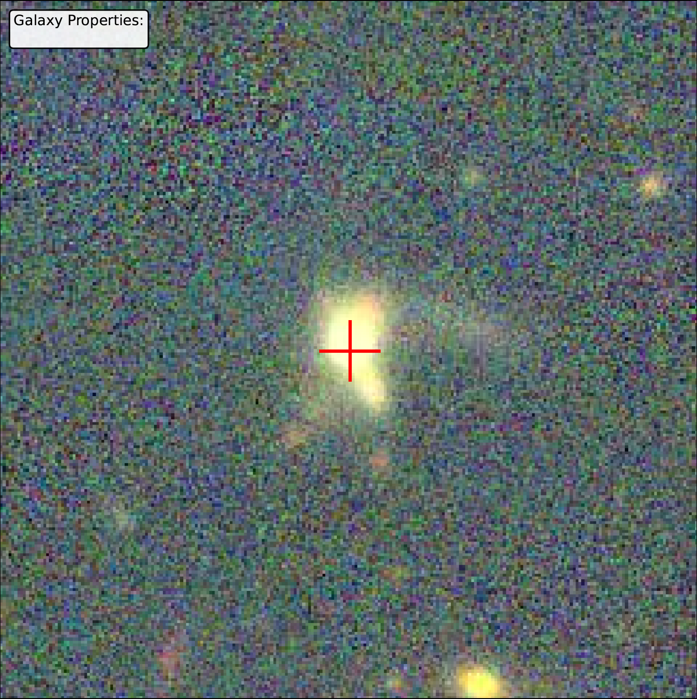
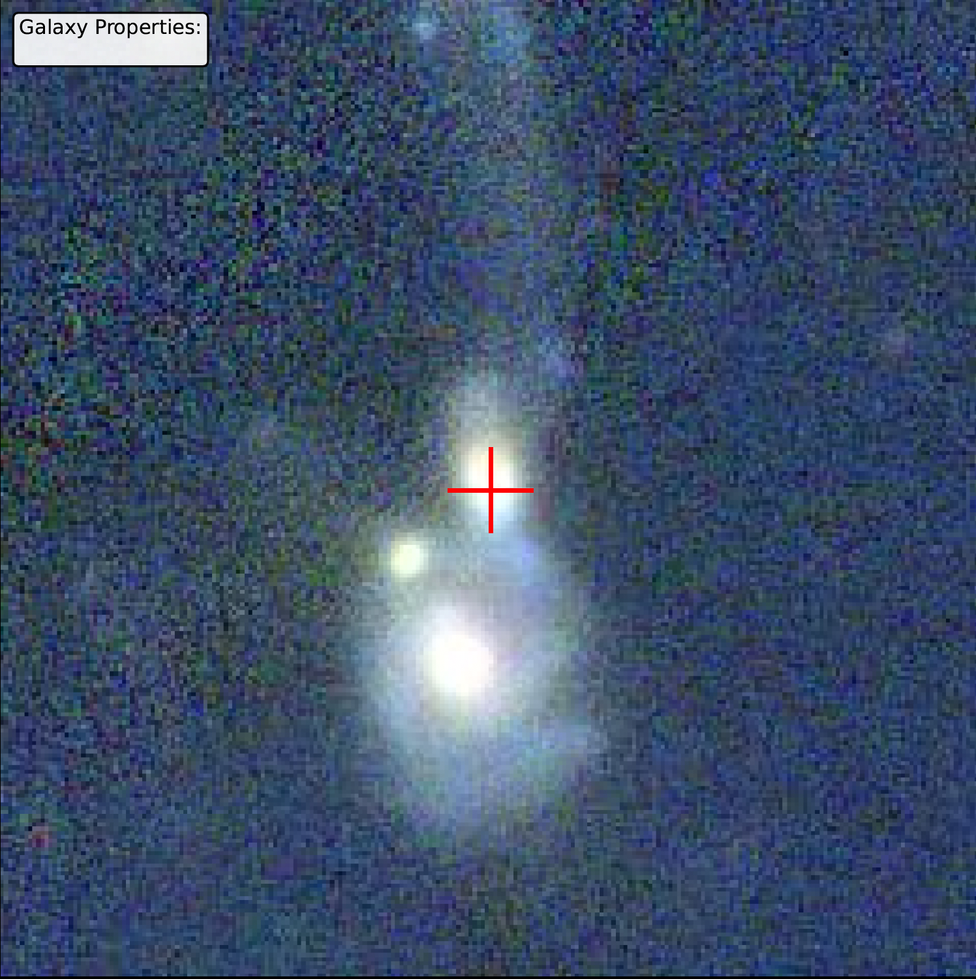
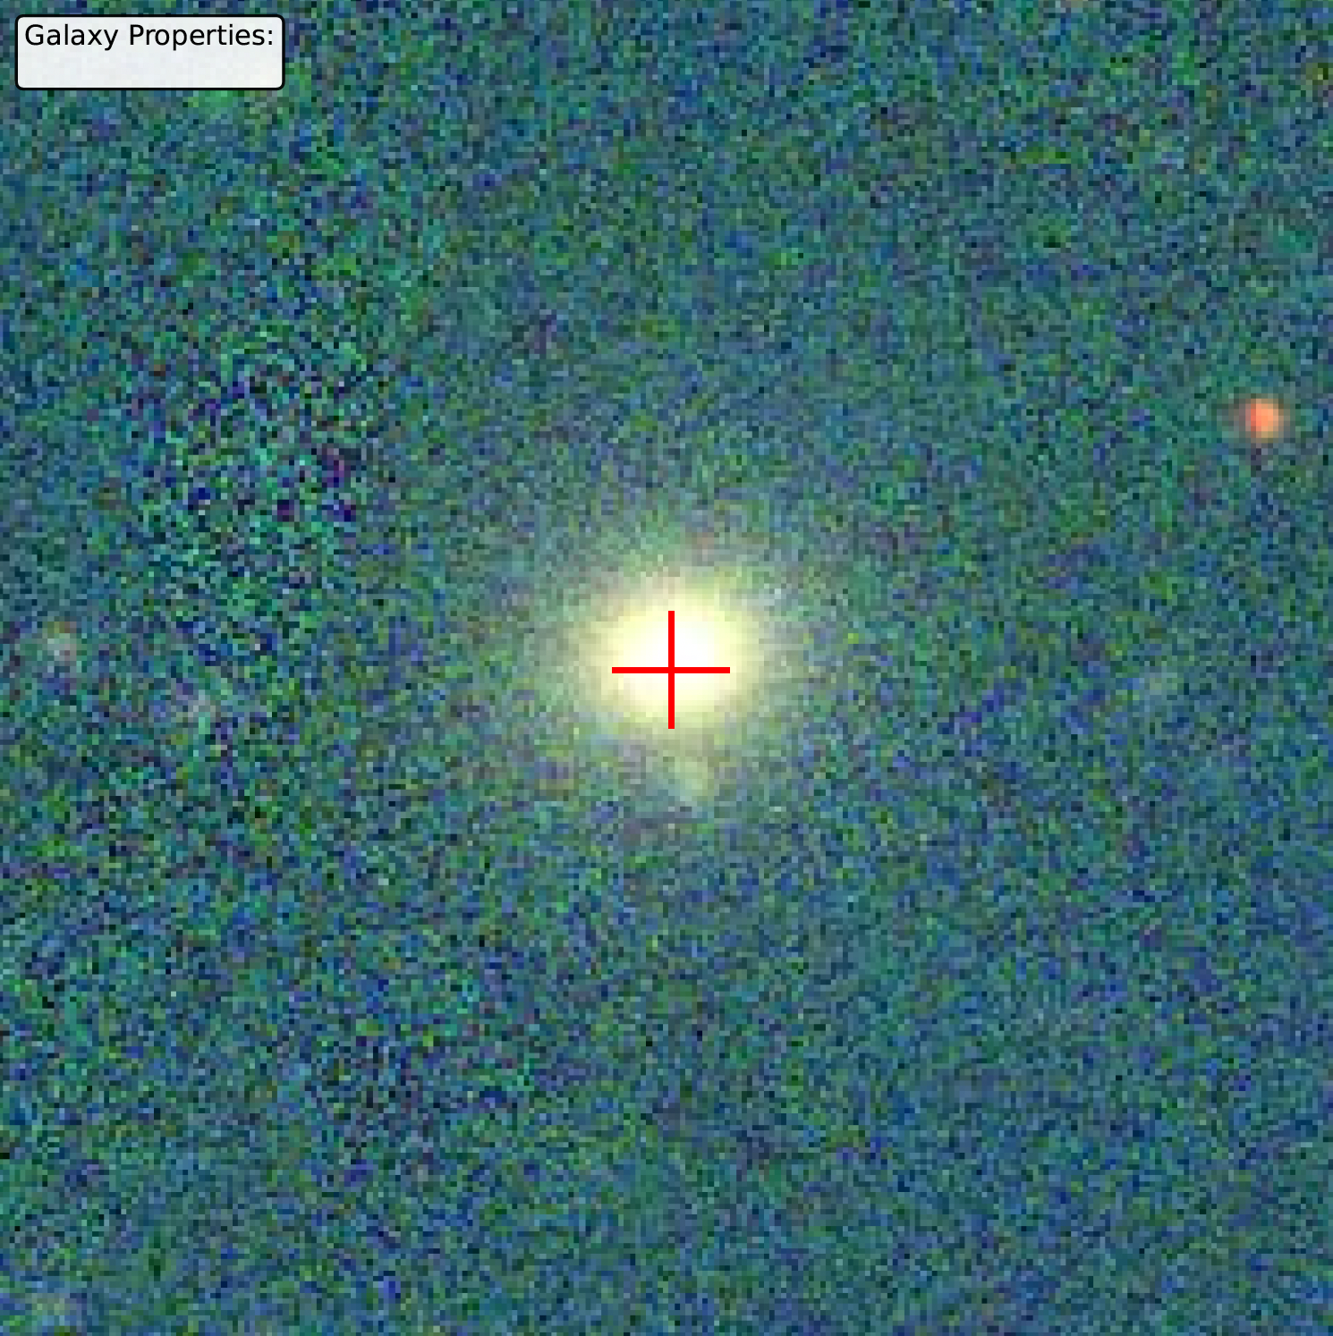
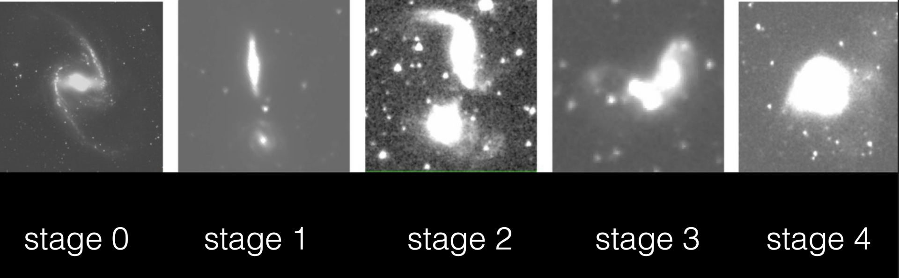

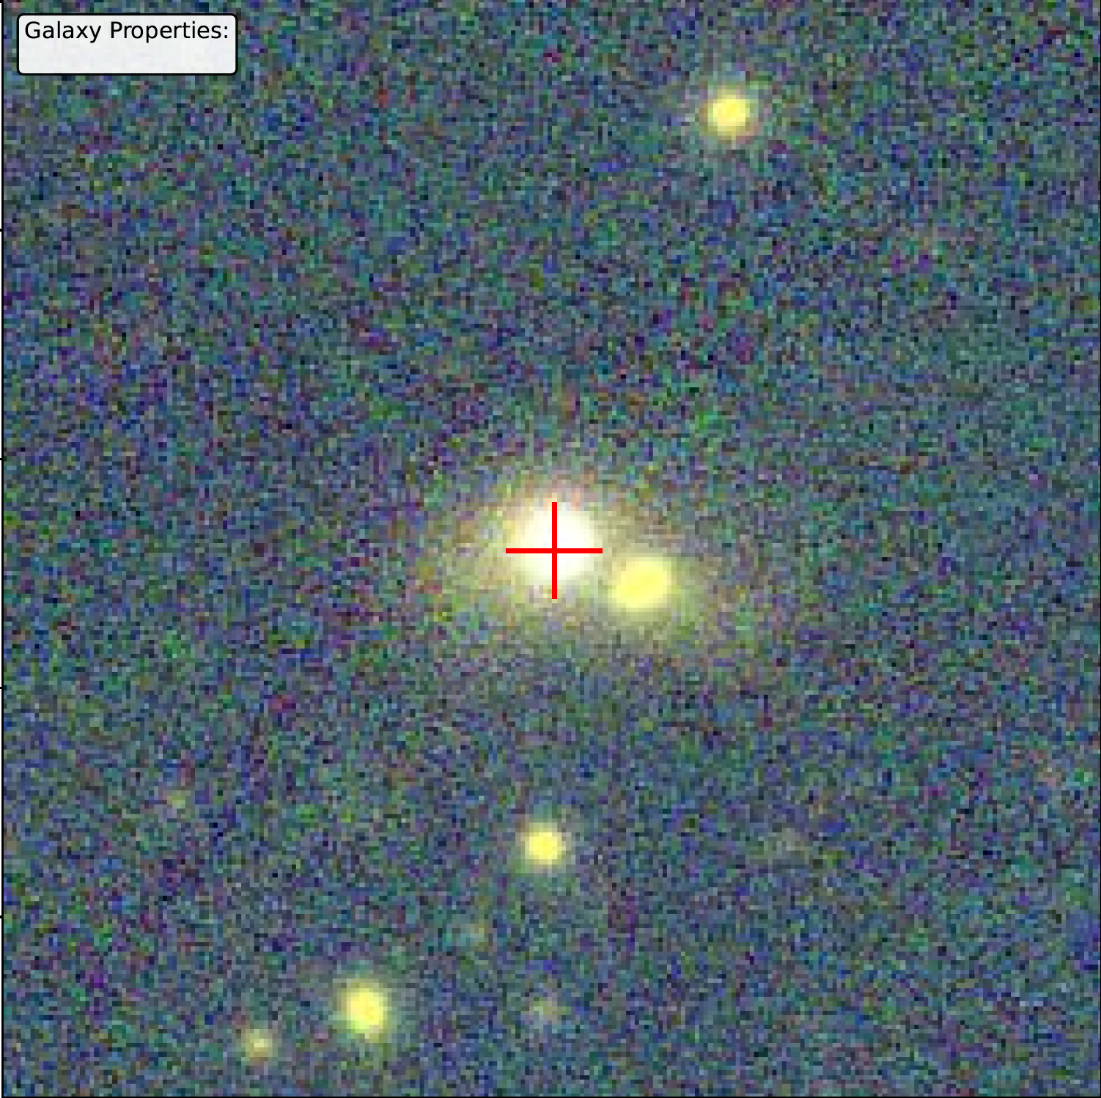
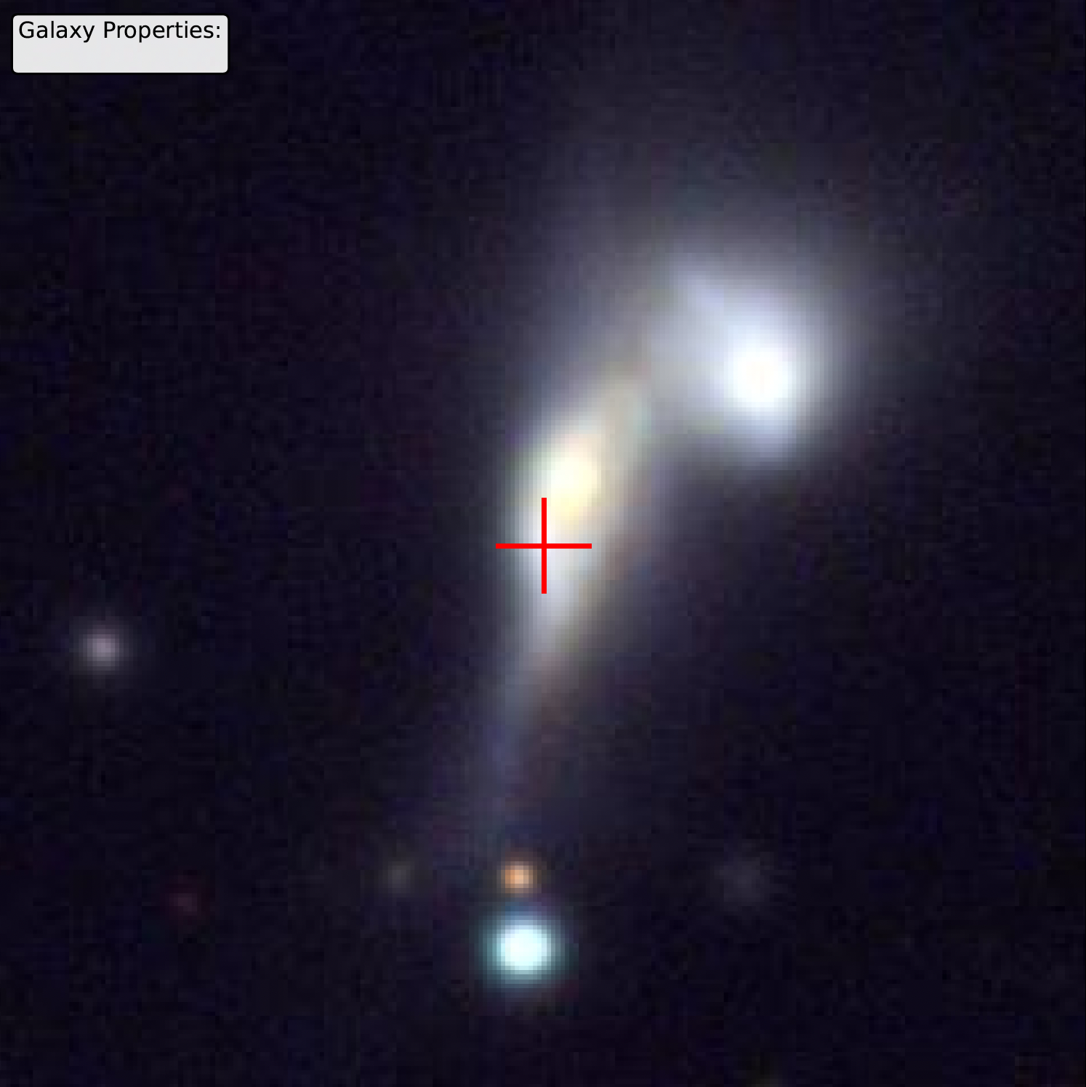
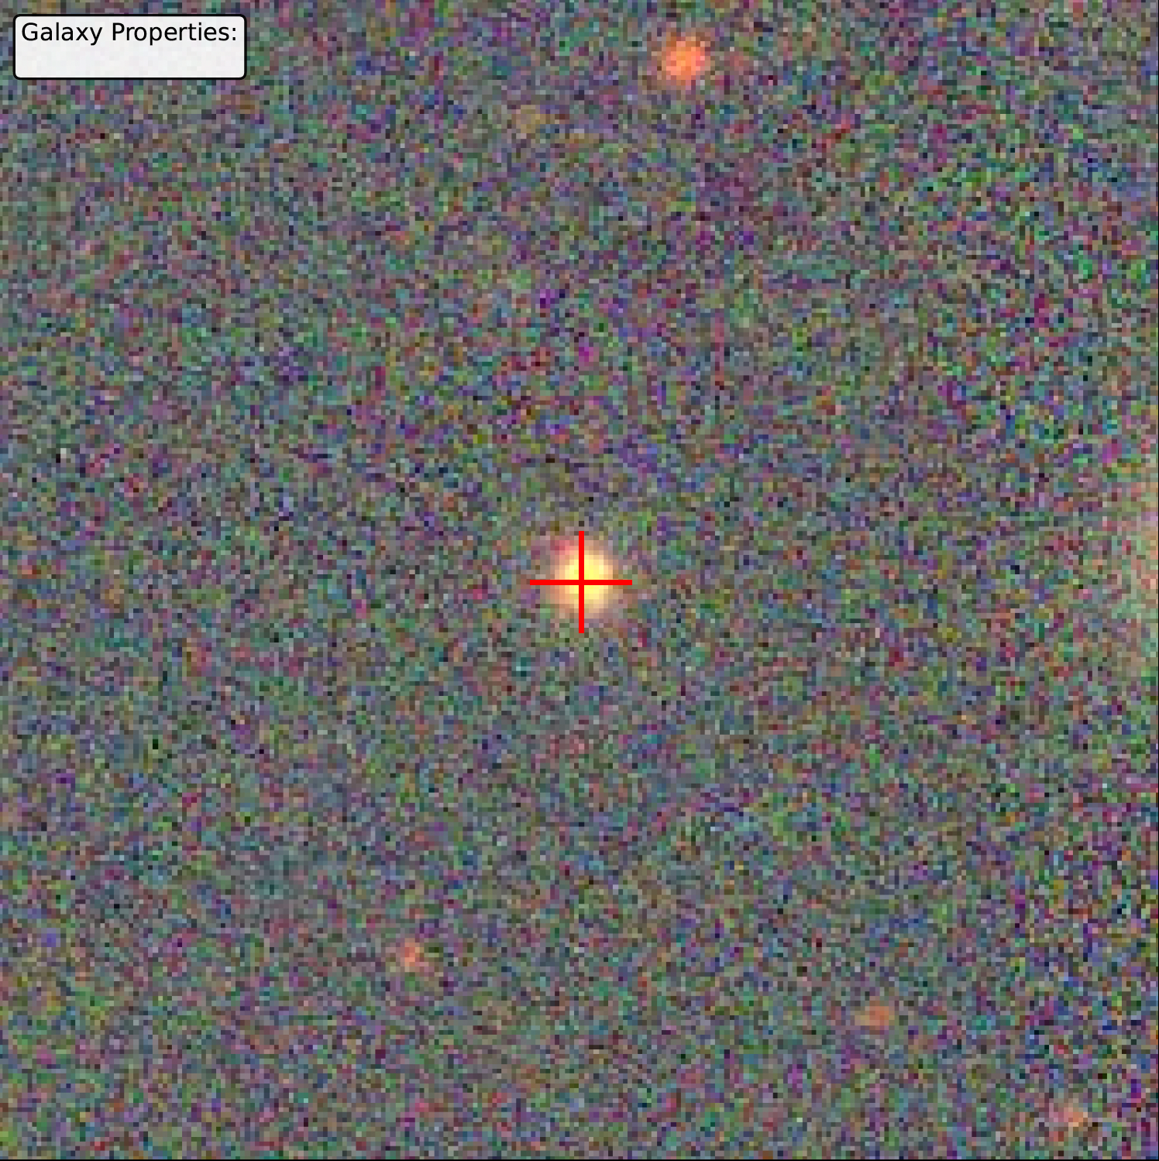

Comparison to the Parent Sample
We classify galaxies by merger stage to test whether the quiescent or star-forming nature of radio galaxies is linked to interaction stage
Close Companions
Disturbed/ Mergers
Single/ Isolated
Petric+2011
$H_{2}$(1-0 S(1))
20 kpc
$H_{2}$(1-0 S(1))
Notes:
Prepare!!! Add SDSS spectra

Slide 16
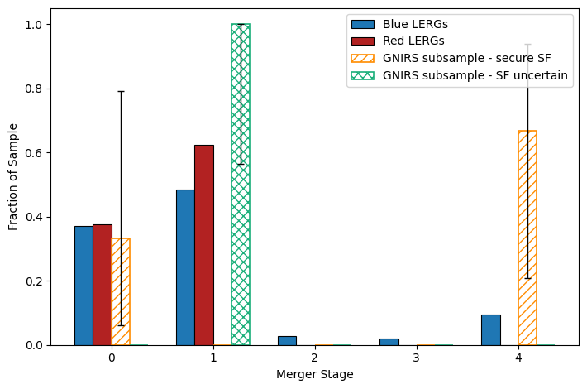
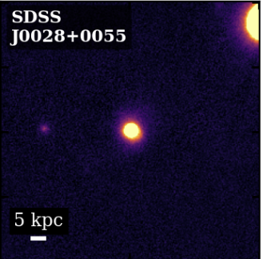
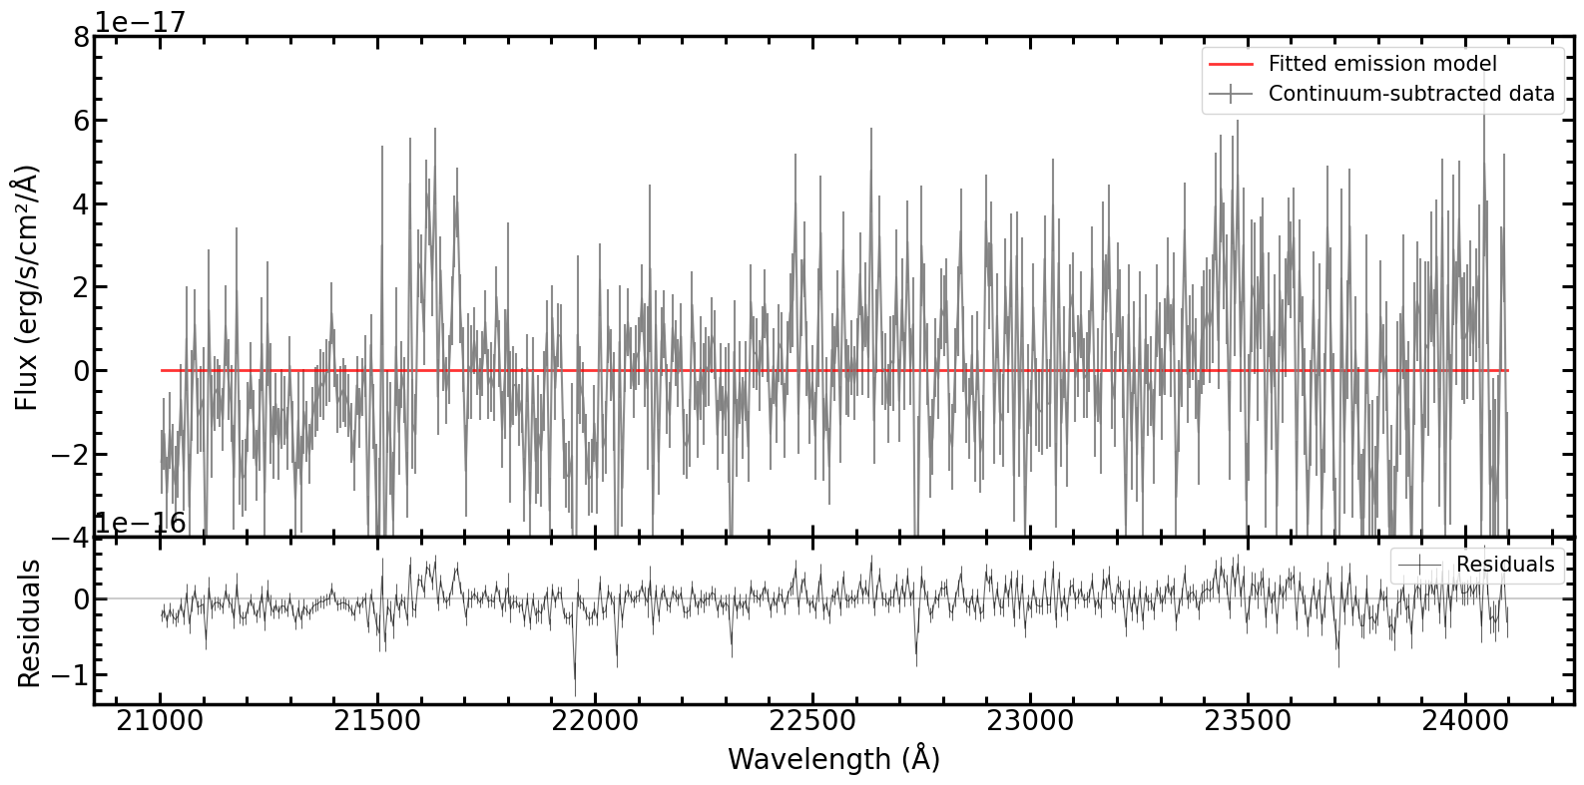
That, however, is not the case for the entire sample…
Isolated Example
Population Context
???
Only occupied by BLERGs
Is the isolated population an earlier/later stage of the process or something different?
$H_{2}$(1-0 S(1))
Notes:
Prepare!!! Add SDSS spectraSome SF-LERGs have obvious interaction signatures; others do not — and for the isolated systems, our current spectroscopy cannot yet determine whether the jet is affecting the molecular gas.

Slide 17
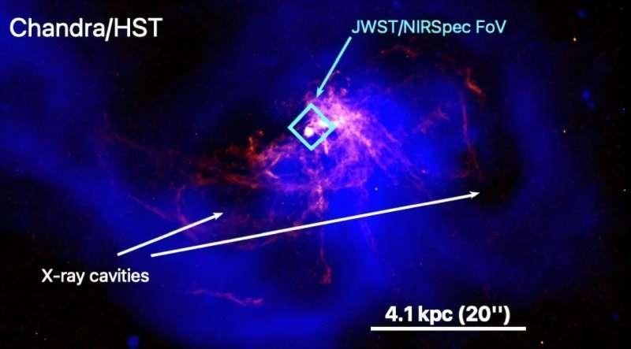
That, however, is not the case for the entire sample…
Population Context
Isolated Example
???
NGC 4696
Hlavacek-Larrondo+2026
Potential hypothesis for future work: cooling/ condensation replenishes cold gas, feeds nucleus, produces patchy star formation.
$H_{2}$(1-0 S(1))
Notes:
Prepare!!! Add SDSS spectraSome SF-LERGs have obvious interaction signatures; others do not — and for the isolated systems, our current spectroscopy cannot yet determine whether the jet is affecting the molecular gas.

Slide 18
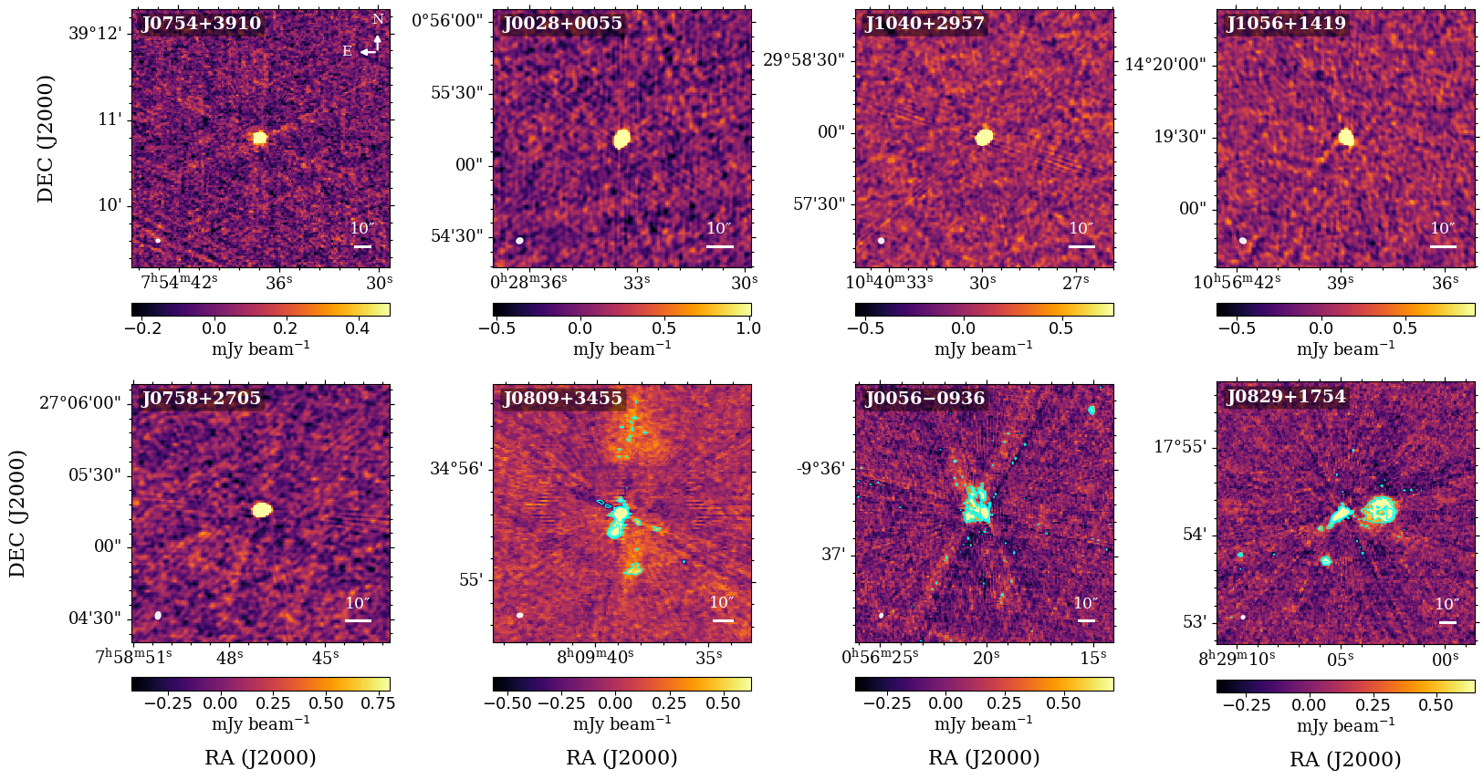
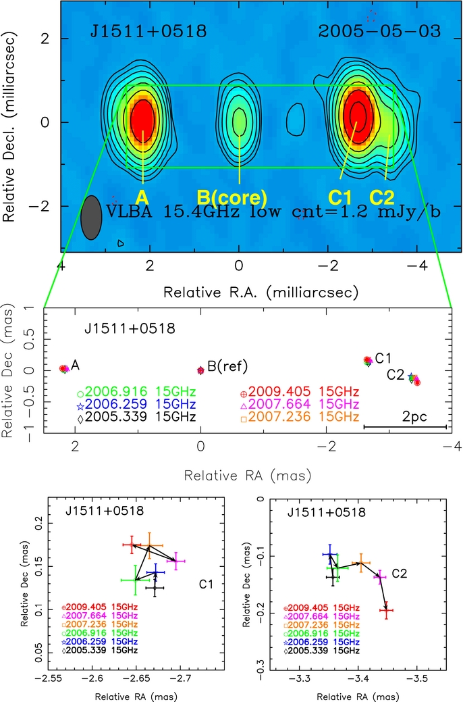
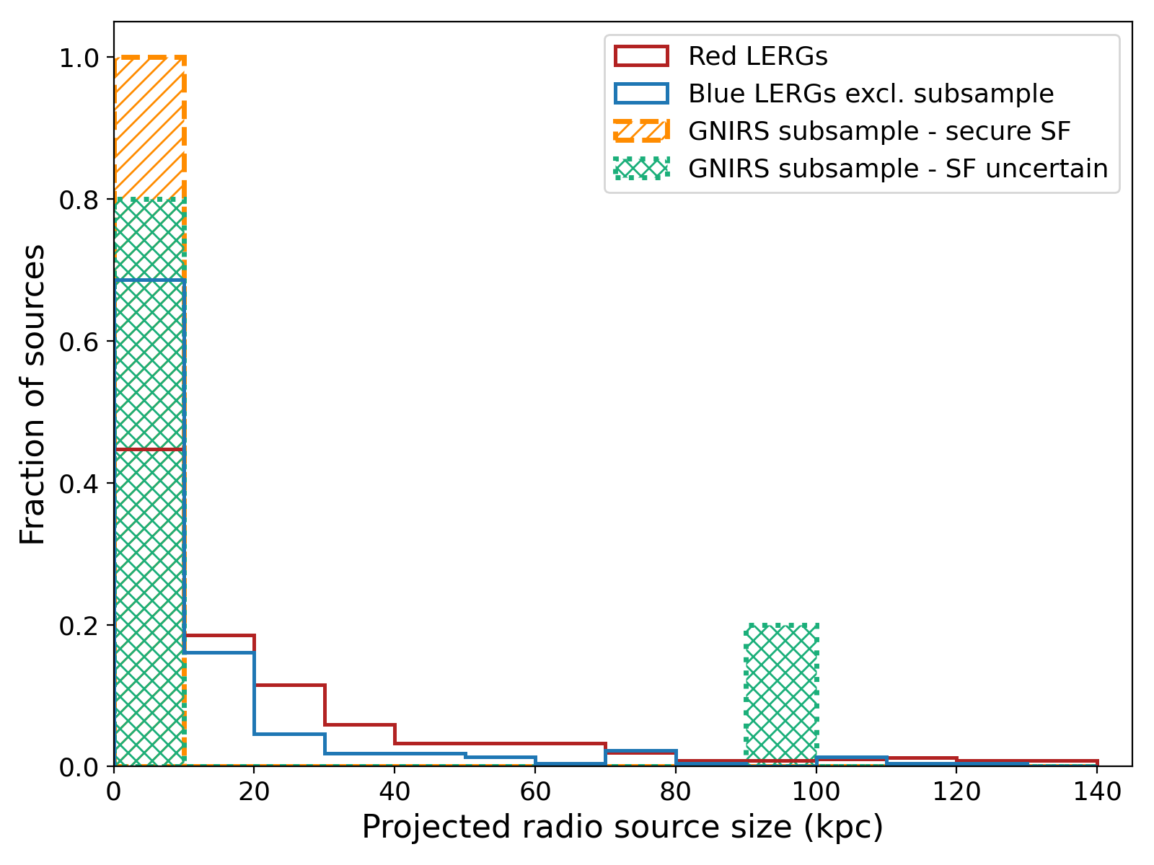
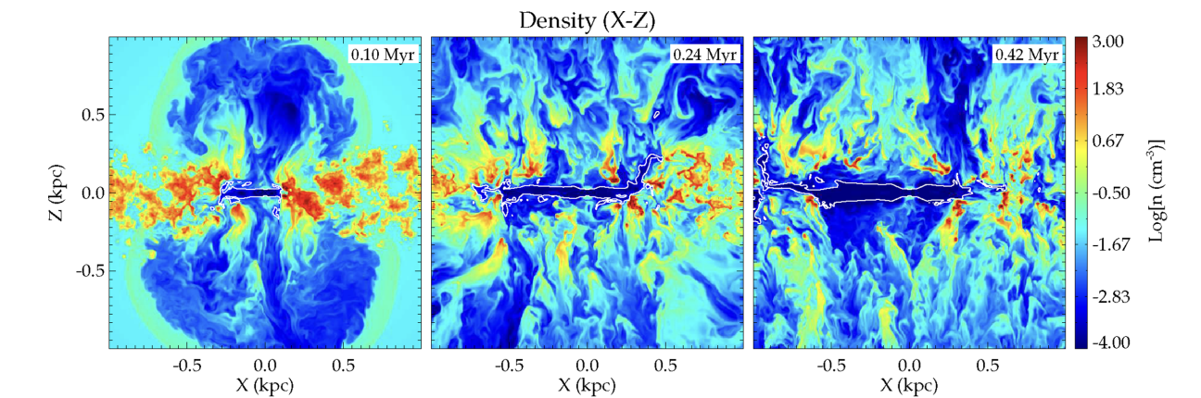
1)
Younger/ More Recently Triggered Jets
Timing could match a recent gas rich episode
An+2012
2)
Frustrated/Confined
Dense ISM shaping the radio source
Mukherjee+2018

Slide 19
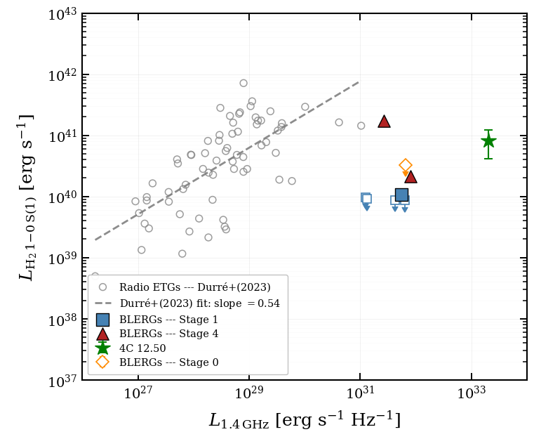
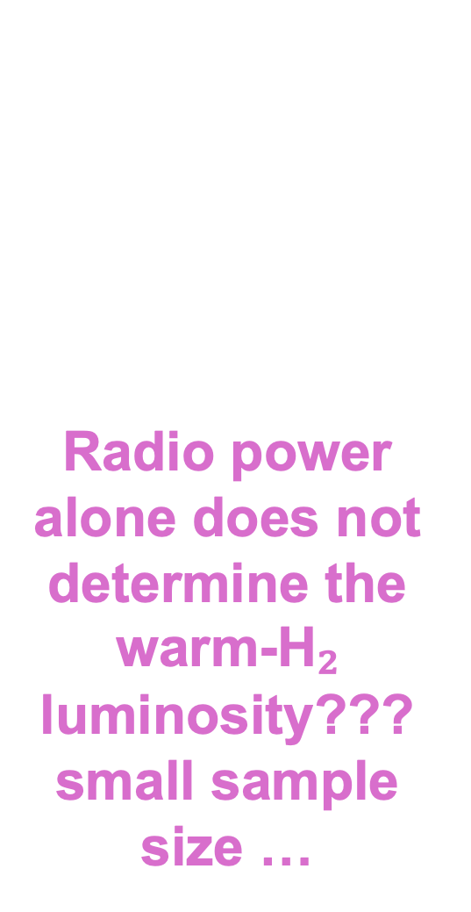
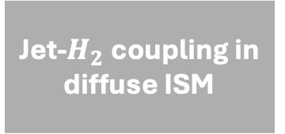
If jets solely drive H₂ excitation, $L_{H_{2}}$ should scale with $L_{1.4GHz}$
Radio power alone does not determine the warm-H₂ luminosity??? small sample size …
Jet-$H_{2}$coupling in diffuse ISM
???
less efficient coupling to molecular gas despite high radio power

Slide 20

A Few Lingering Questions…
What is fueling/ sustaining star formation in isolated BLERGs?
Is there a stronger correlation with stellar mass? Environment?
Does merger stage matter more than radio power?
Is there evidence for the gas “filaments” feeding the SMBH?
Are disturbed and isolated Blue LERGs the same phenomenon?
Does the jet suppress, redistribute, or compress star-forming gas?
How does the Blue LERG phenomenon change toward cosmic noon when there was more gas supply?
How long does the gas-rich LERG phase last?
Are compact sources genuinely newly triggered, or recurrent/restarted?
And so on…
$H_{2}$(1-0 S(1))
NEVER FEAR WFSS IS HERE!!
$H_{2}$(1-0 S(1))
Notes:
Prepare!!! Add SDSS spectra

Slide 21
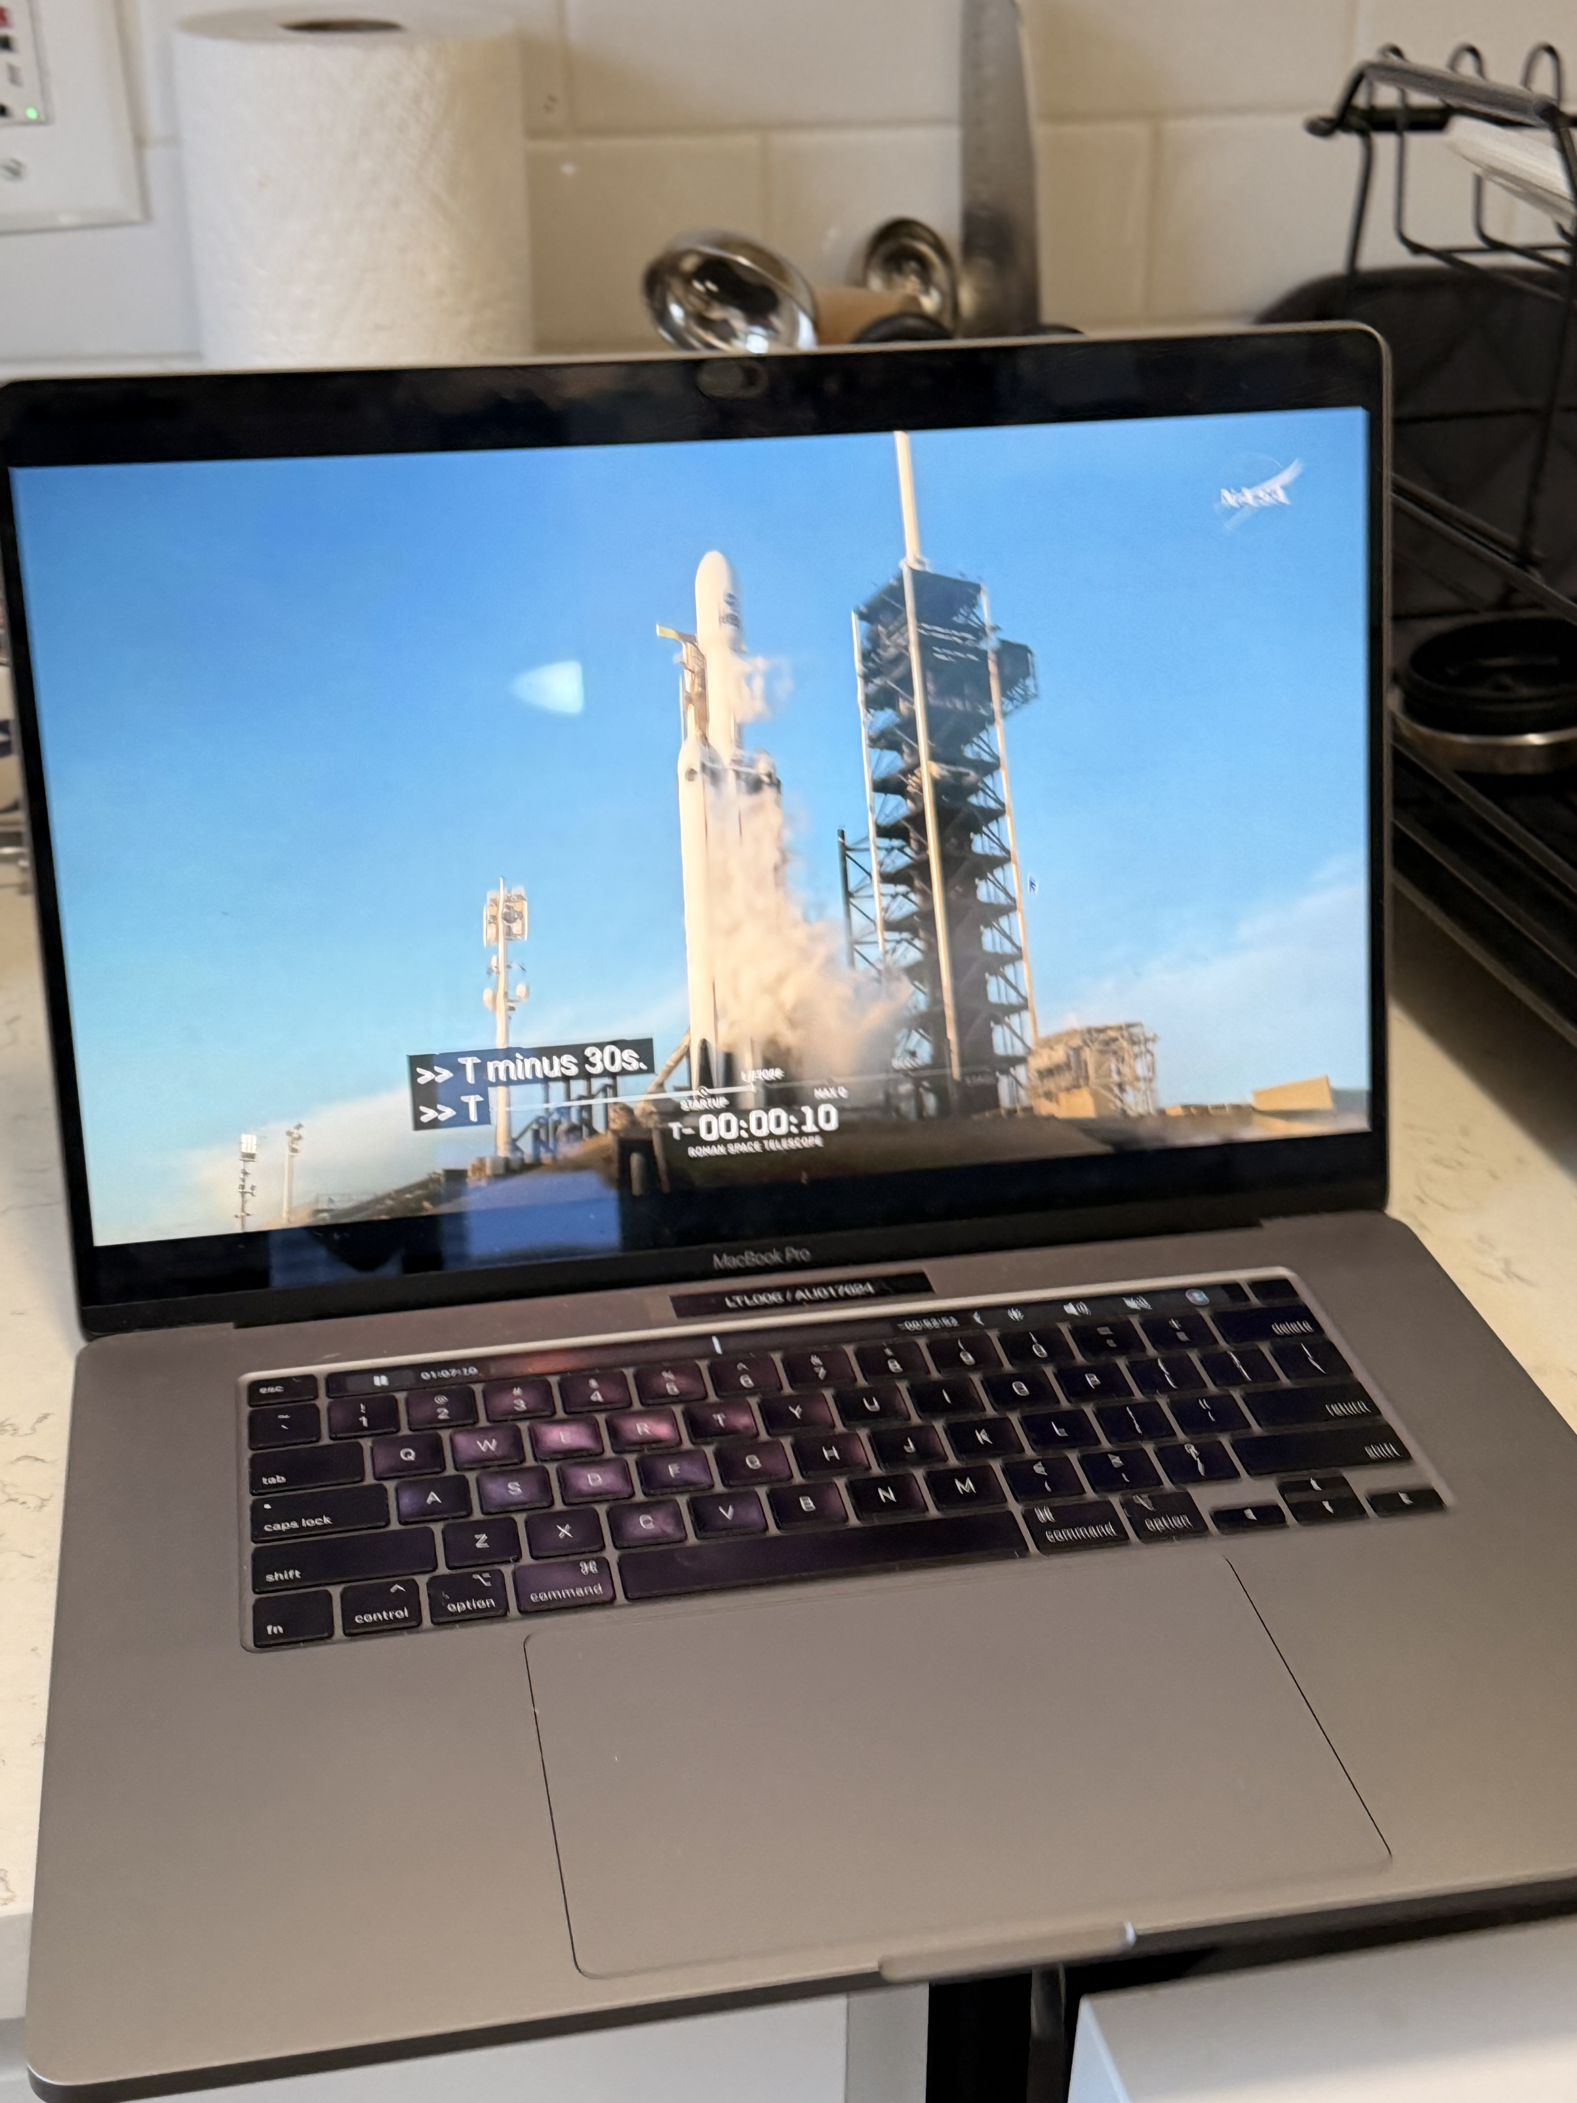

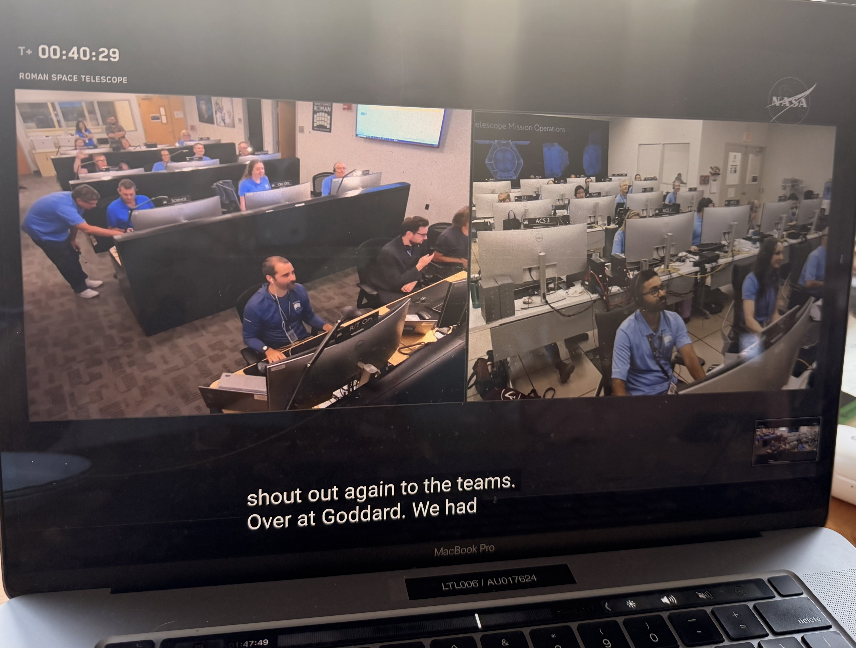
Radio identifies the jet-dominated AGN population
WFSS tells us which of those live in star-forming hosts, what their environments are, and how that incidence evolves

Slide 22
WFSS fields with radio coverage
WFSS survey / instrument
Radio coverage
Field
HST/JWST grism
3D-HST, CANDELS, COSMOS-Web
VLA-COSMOS 3 GHz / MIGHTEE
COSMOS
Euclid/NISP
LOFAR LoTSS Deep / MIGHTEE / EMU
Euclid Deep Fields
Roman/WFI
(future)
ASKAP EMU / SKA
(future)
Roman High Latitude Survey

Slide 23


Conclusions!
My papers!
My website!
BLERGs give us a rare view of jet-mode feedback while cold gas and star formation are still present
In our nearby sample, the strongest warm-H₂ systems are disturbed, the radio sources are compact
  host-gas context matters
The sample appears to contain more than one physical configuration
  interacting systems with excited gas, but also isolated star-forming LERG(s?) that remain poorly constrained
WFSS + radio surveys can tell us whether these configurations are rare accidents, distinct channels, or recurring phases of kinetic-mode AGN evolution.

Slide 24
Backup Slides

Slide 25
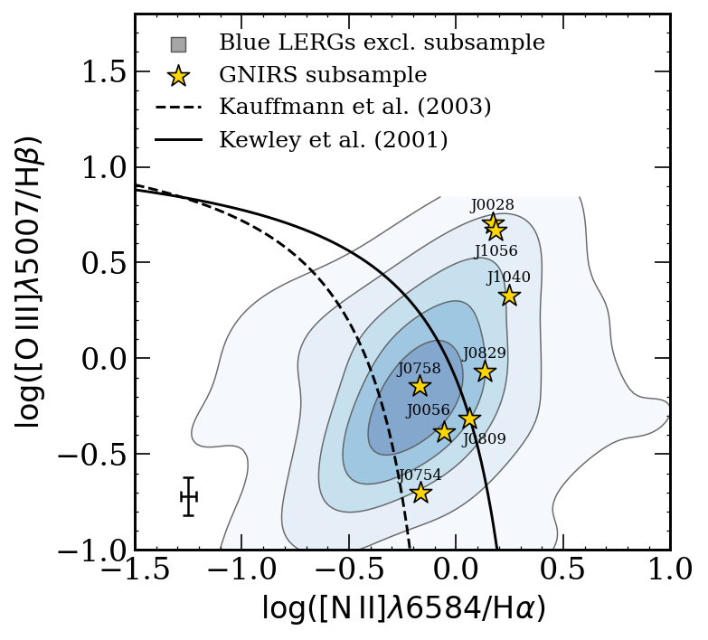

Slide 26
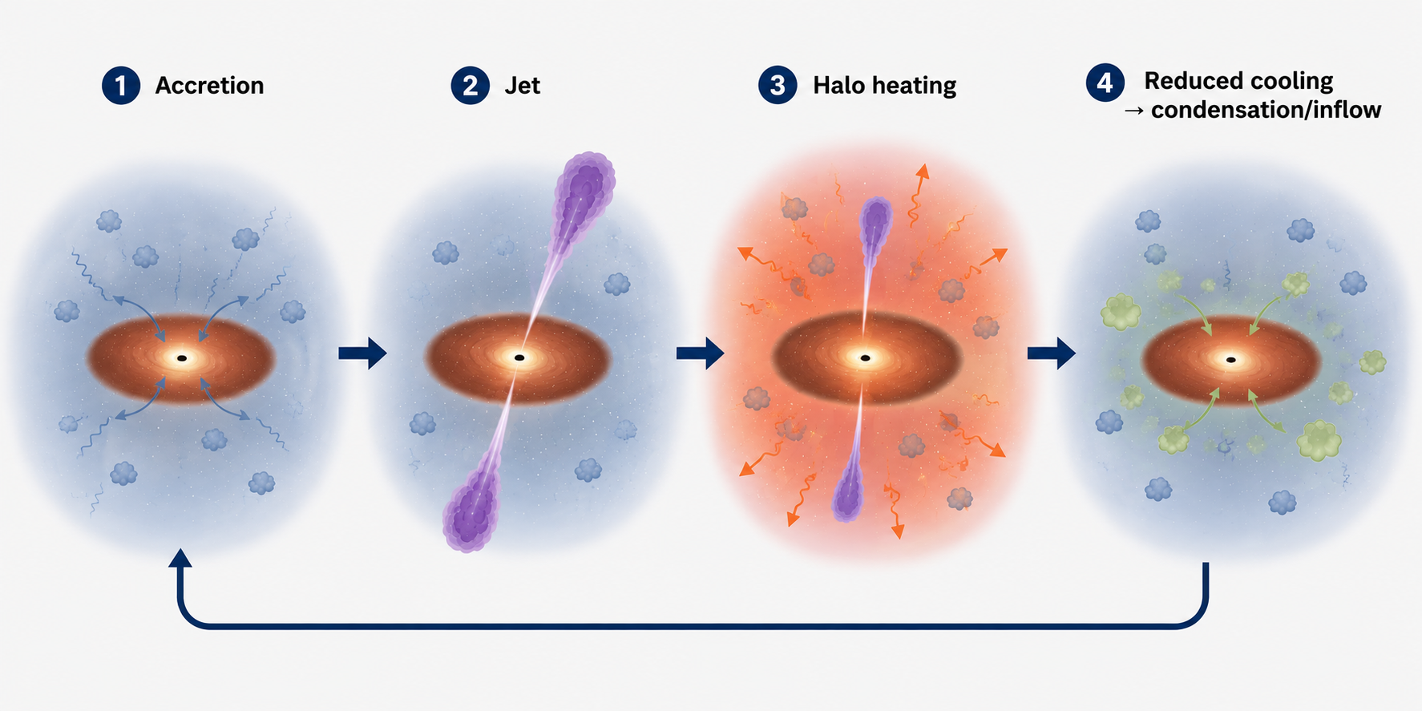
The Expectation: local LERGs occupy massive, quiescent galaxies
NGC 4696
Mechanical energy drives, shocks, turbulence
Hlavacek-Larrondo+2026
radiatively inefficient accretion
low-power, long lived radio jets
condensation, select inflow to SMBH
Self-regulating Feedback Cycle

Slide 27
That, however, is not the case for the entire sample…
Close Companions
Disturbed/ Mergers
Single/ Isolated
$H_{2}$(1-0 S(1))
20 kpc
$H_{2}$(1-0 S(1))
Notes:
Prepare!!! Add SDSS spectra

Slide 28
