Slide 1
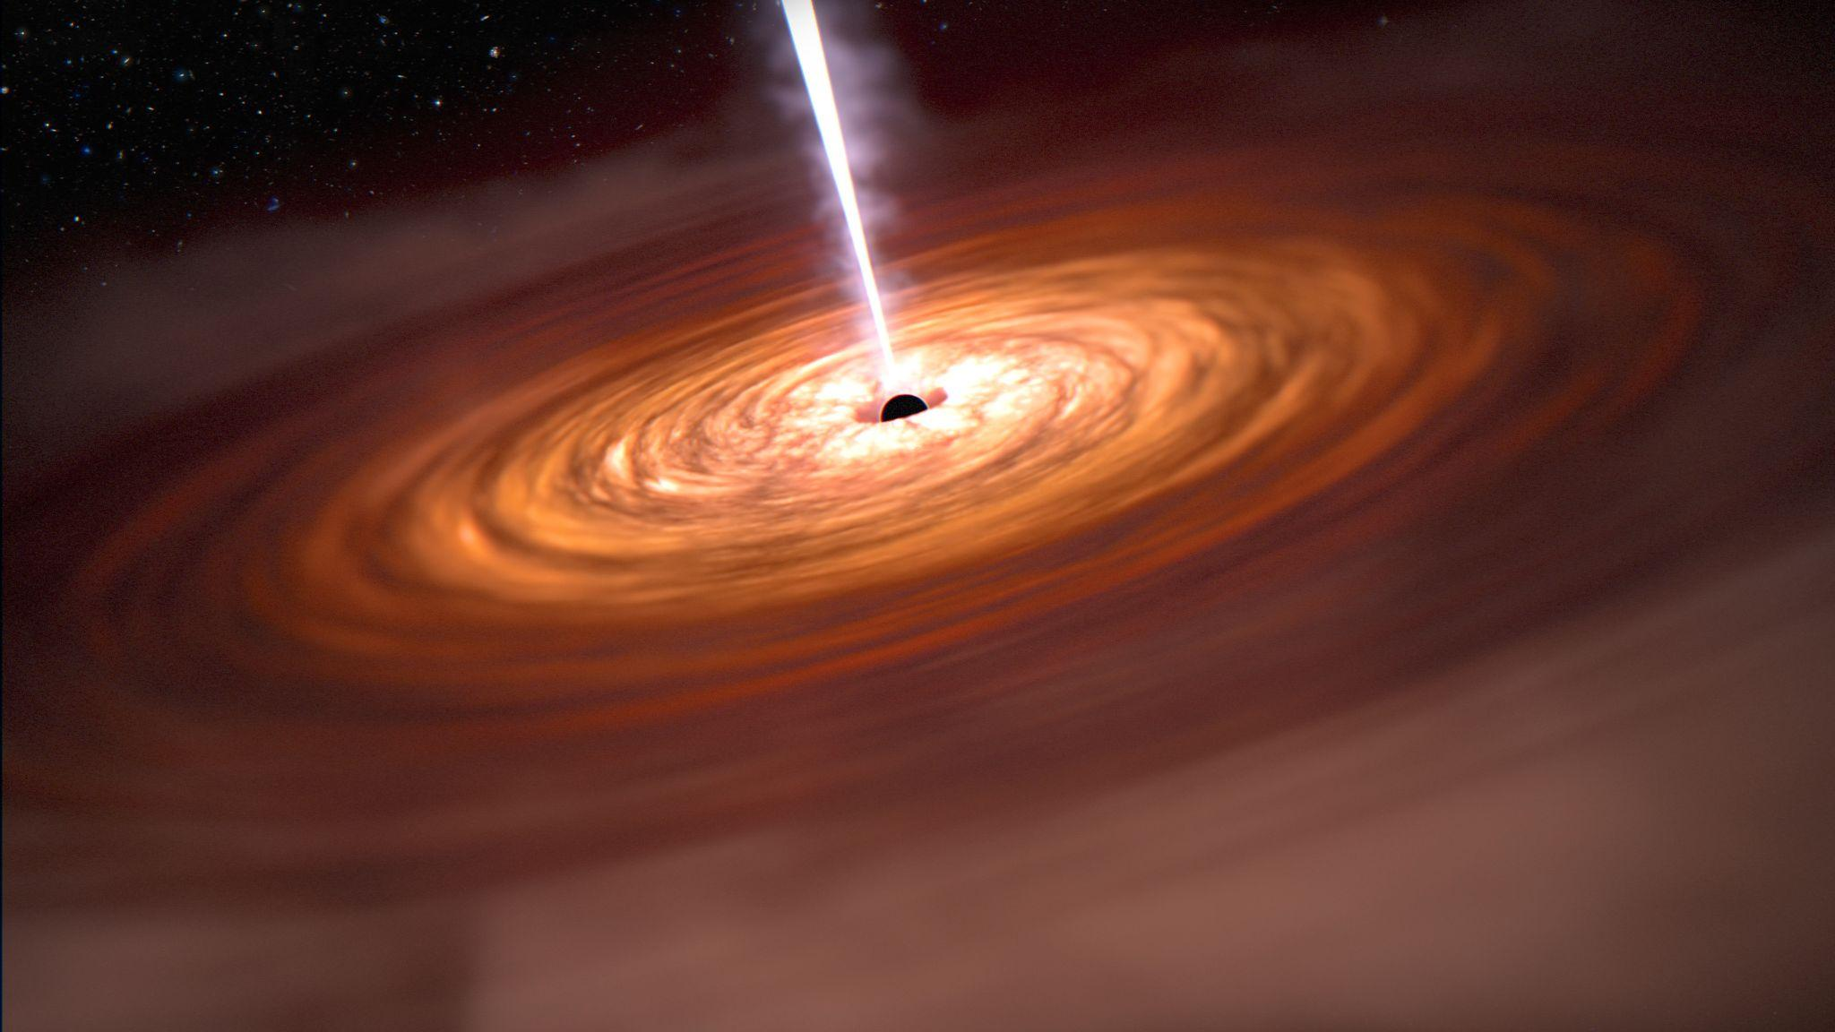





Multi-messenger emission from AGN jets:
Bridging relativistic simulations and observational signatures.
Illuminating the Active Universe: Multi-Wavelength and Multi-Messenger Insights into AGN
Harshita Bhuyan
Indian Institute of Technology Indore
Max Planck Institute for Astronomy Heidelberg
co-authors: Bhargav Vaidya, Christian Fendt, Aditya Sharma
Image Credit: www.nasa.gov/feature/

Slide 2
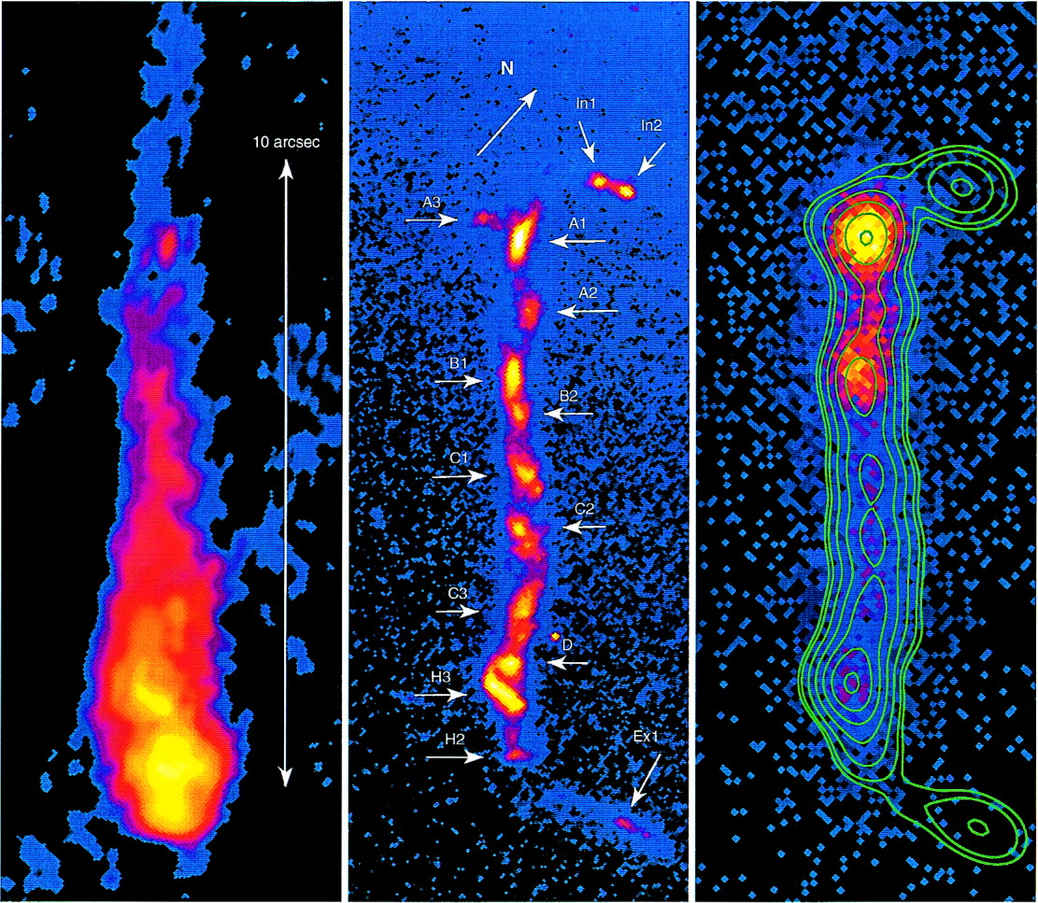
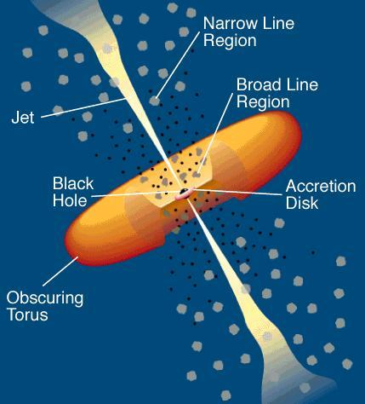
Active Galactic Nuclei
Highly luminous central region to active galaxies.
Emits over entire EM spectrum
Accreting central Supermassive black hole
3C 273 (Marshall et. al. 2000 and references therein)
Relativistic Jets:
Highly collimated, magnetized, relativistic outflows
Extend to kiloparsecs / megaparsec scales
Show moving features: knots, bends, helices: spatial + temporal variations
Jet matter composition: not known !!!!
Illustration of active galaxies
Source: Urry & Padovani 1995
(Romero et al. 2017 and references therein)

Slide 3
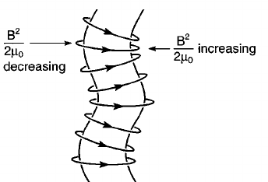
Jet composition models:
Leptonic - (relativistic electrons/positrons)
Neutrino production ❌
Lepto-hadronic/Hadronic: (relativistic electrons +protons)
Neutrino production ✔
(proton-photon, p-p interaction)
Specifically from instabilities
Intrinsic to jet
Internal shocks
AGN
Hadronic component origin
Coronal
Reconnection
Extrinsic
Jet - environment interaction (Entrainment)

Slide 4
Beyond single zone models
Current lepto-hadronic models
Our lepto-hadronic framework
Mostly single-zone
Multi-zone
(Using Katu code)
No dynamics included
Jet-dynamics incorporated via PLUTO code
To study how varying the composition of the jet as well as onset of instabilities effects the emissions.
AGN jet composition is still an open question.

Slide 5
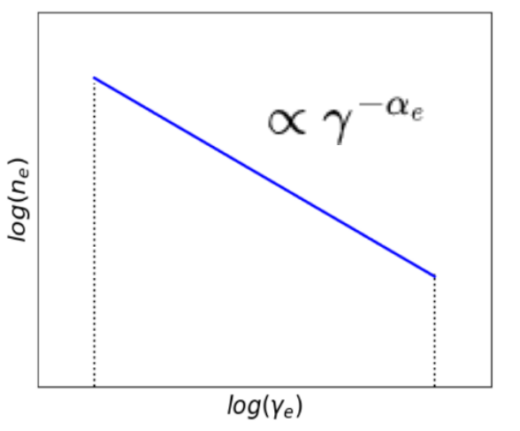


PLUTO
KATU
(Jimenez et al. 2021)
(Mignone et al. 2007, Vaidya et al. 2018)
Numerically solves fluid dynamics (HD, MHD, RMHD) equations. (Mignone et al. 2007)
Electron Lagrangian macro-particle module. (Vaidya et al. 2018)
Solves the Electron Fokker-Planck equation.
Interactions modelled in PLUTO’s particle module:
Acceleration: Diffusive shock acceleration (Vaidya et al. 2018, Mukherjee et al. 2021) ,
Stochastic turbulent acceleration (Kundu et al. 2021).
Electron synchrotron,
External Compton and SSC (Sharma et. al. 2026 [In prep]),
Adiabatic cooling
Used for single zone lepto-hadronic modelling.
Solves Fokker Planck equation for 16 different particle species (leptons + hadrons).
Required inputs: Proton & electron distributions, magnetic field strength,size of zone.
Interactions modelled in KATU:
Synchrotron emission: Due to electron, proton, pion
Inverse Compton: Due to Synchrotron self compton
Hadronic processes: p-𝜸 interaction, pion and muon decay
Lagrangian particle
Ensemble of electrons in spatial proximity.
Distributed over an energy range
Fokker -Planck equation
Energy losses & gains
External, Internal
Injection
Particle escape
Particle decay

Slide 6
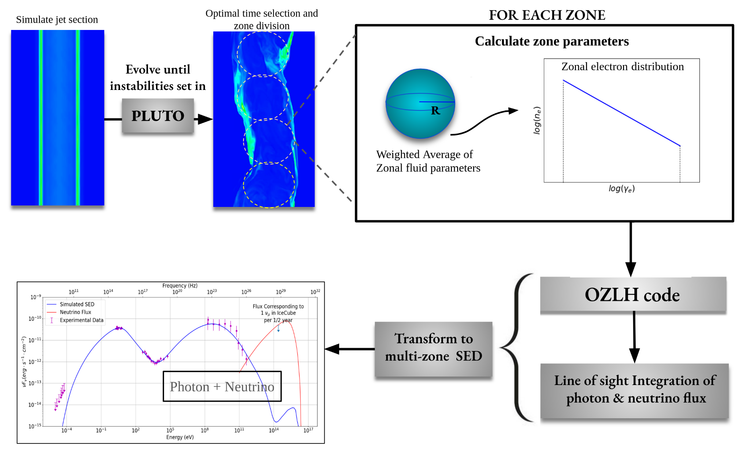
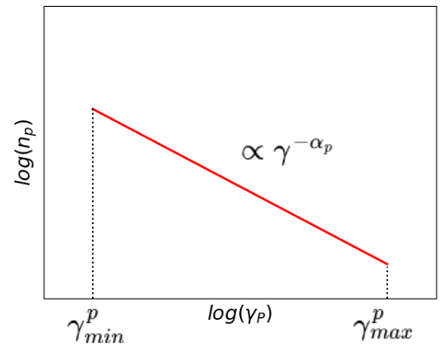
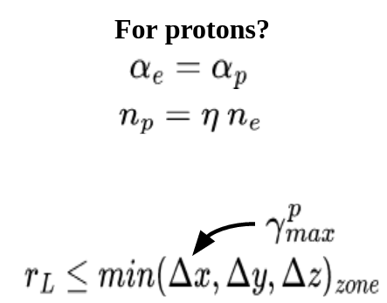
From dynamics to multi-messenger emissions
For protons?
Approx. proton distribution
*
*OZLH = One-zone lepto-hadronic

Slide 7
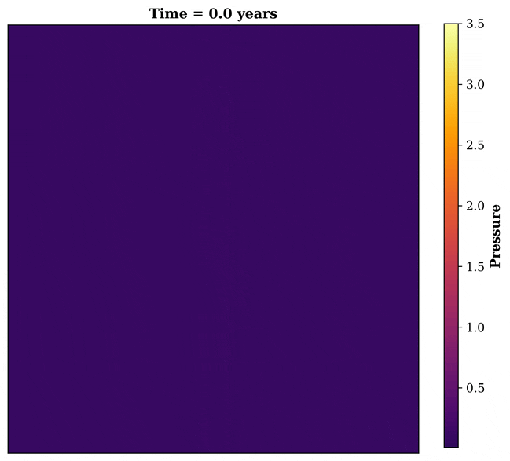
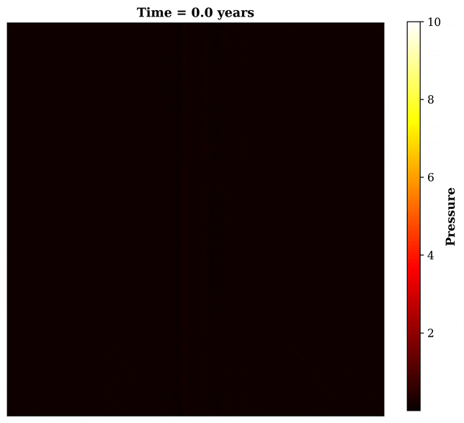
PLUTO Simulations
𝚪c, initial = 5.0
𝚪c, initial = 10.0

Slide 8
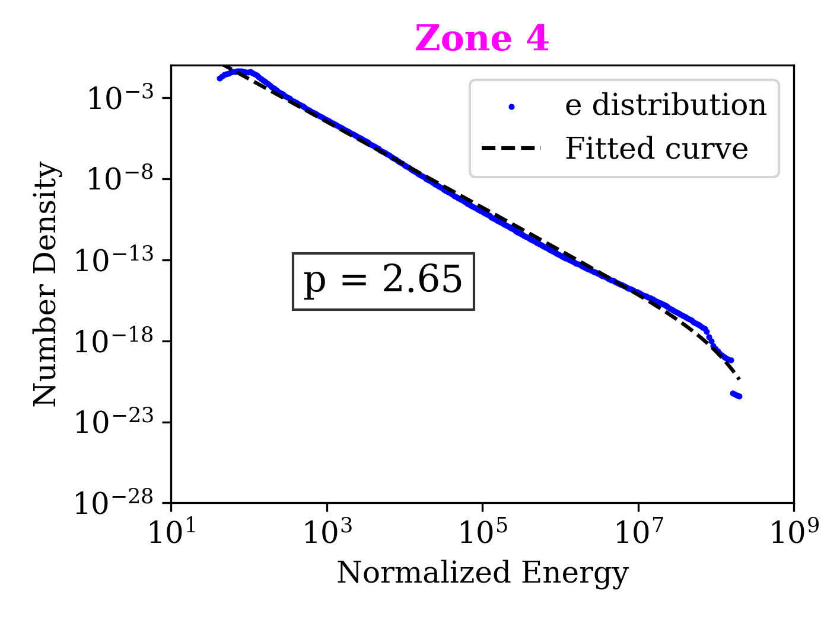
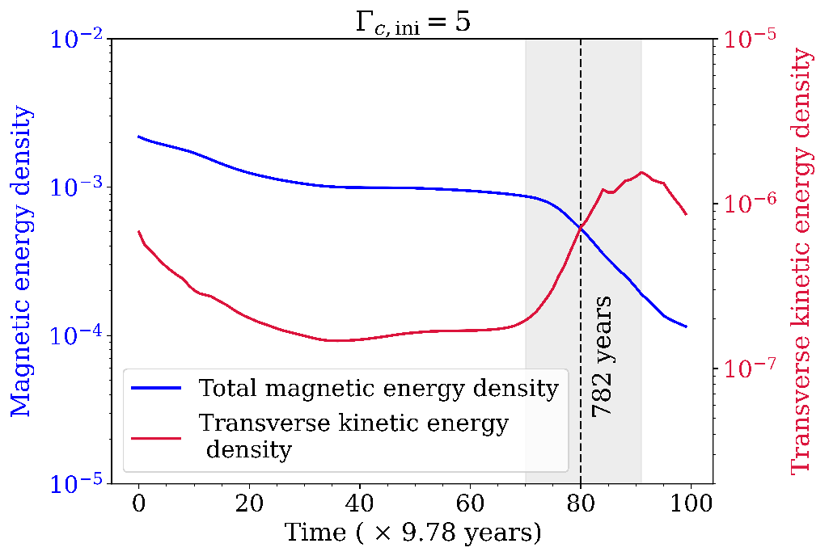
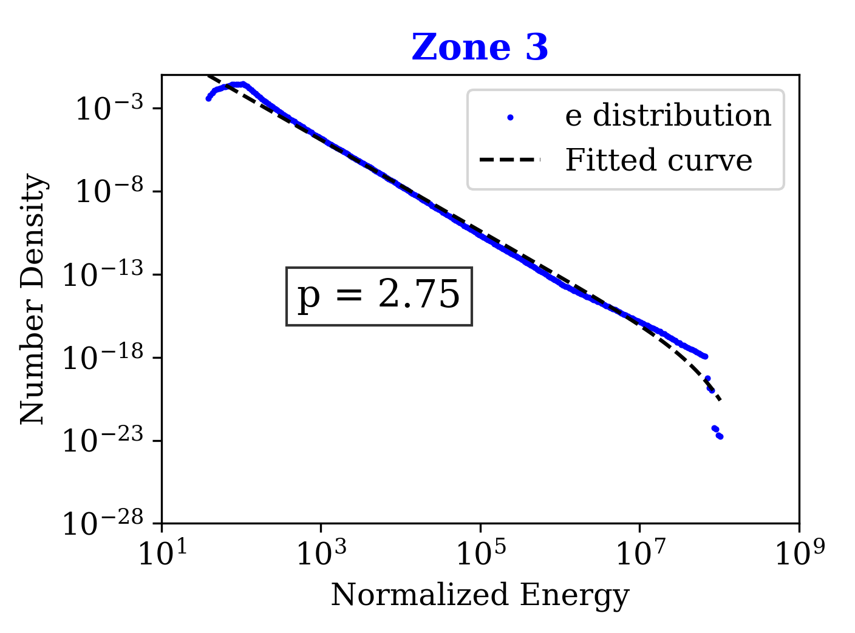
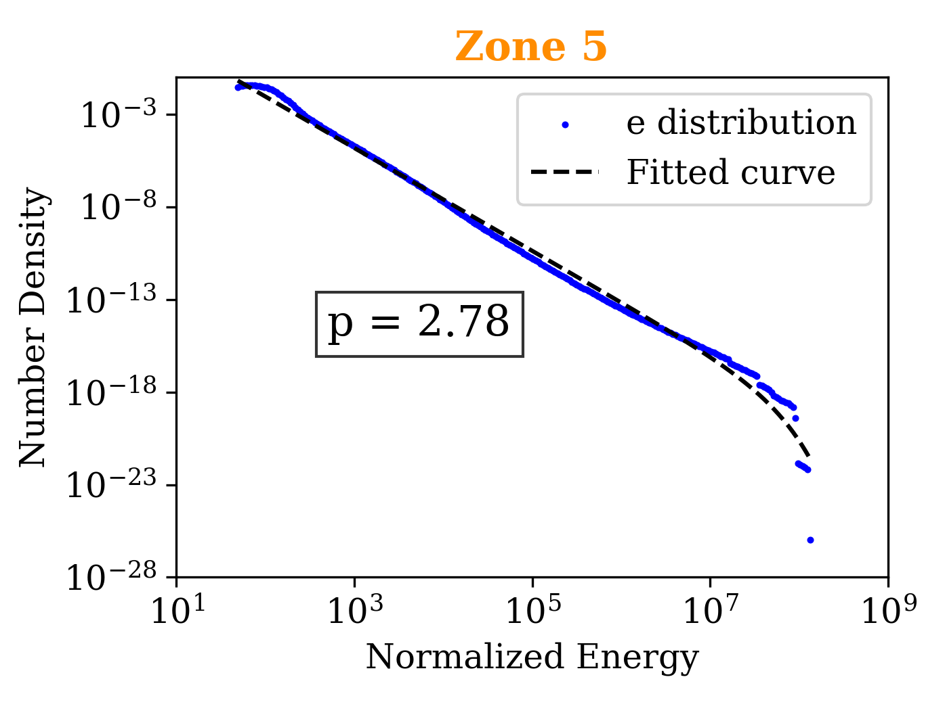
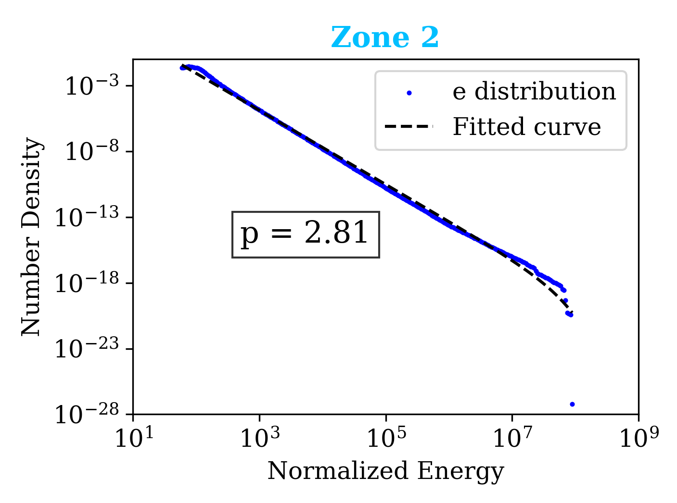
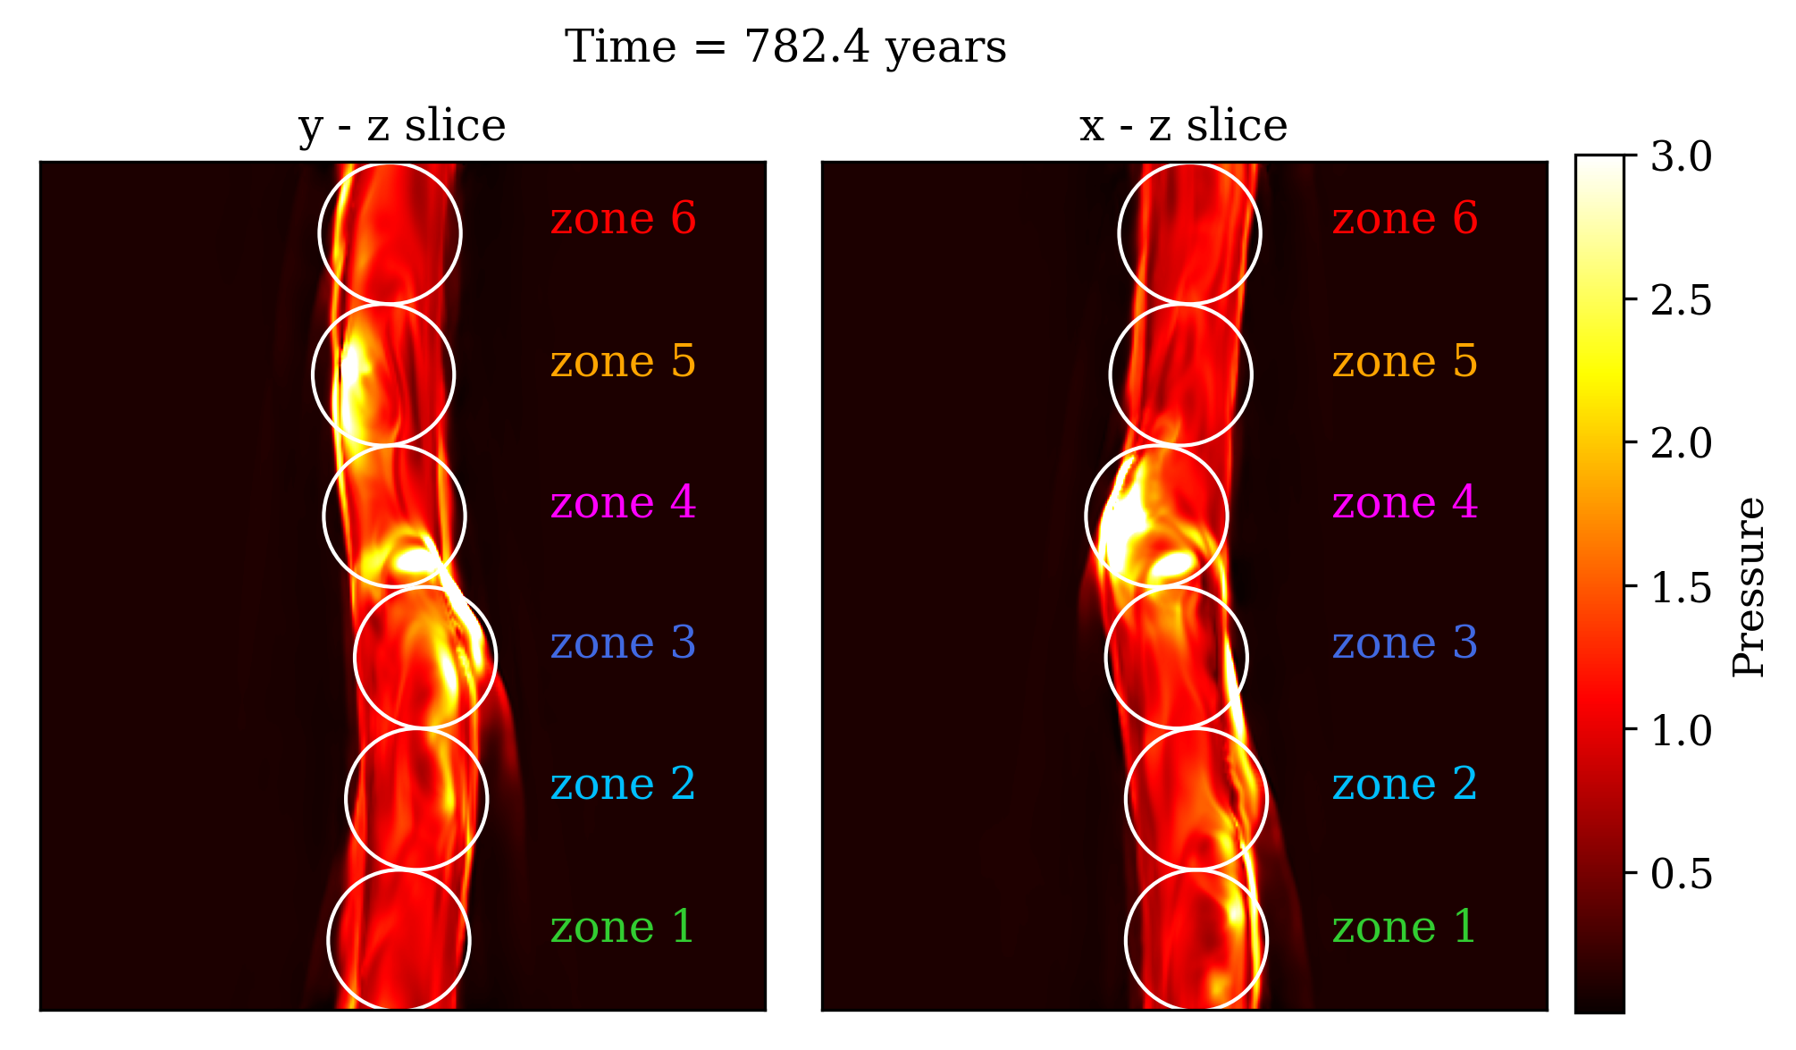
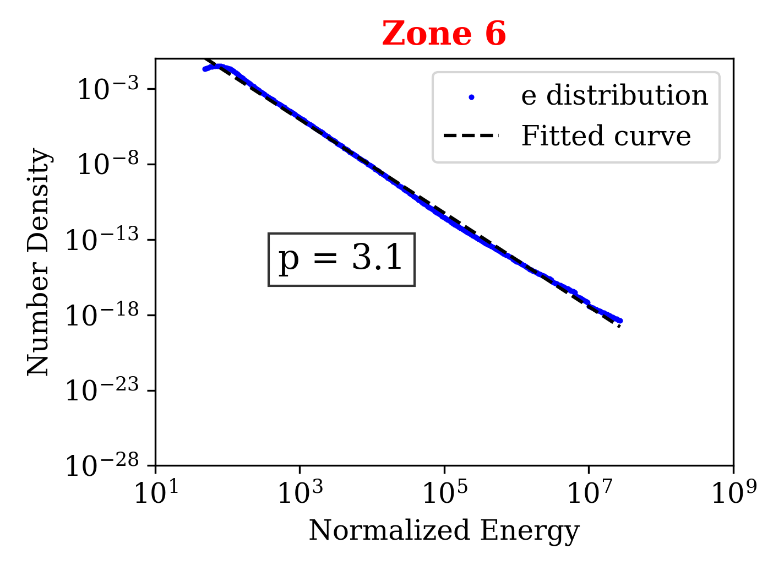
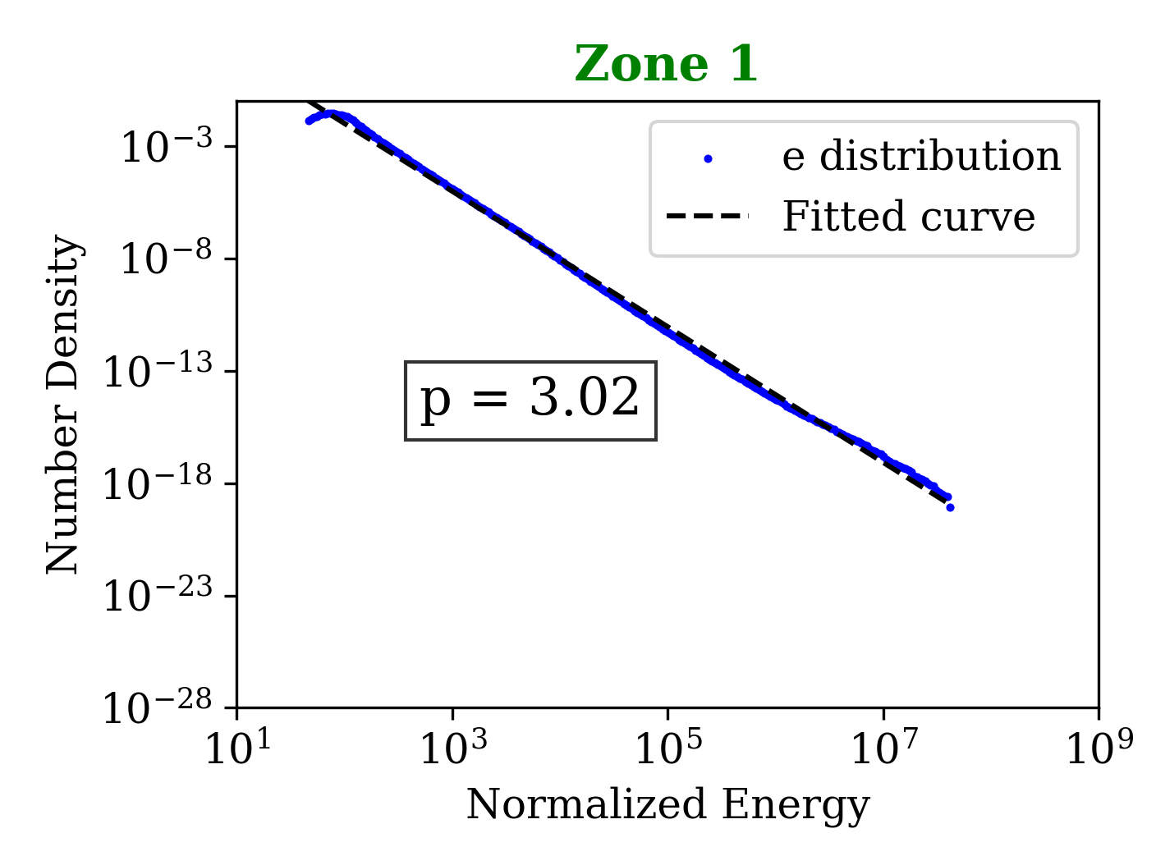
The zones, energetics and particle distribution
Cooling
Cooling
Cooling
Starting to cool

Slide 9
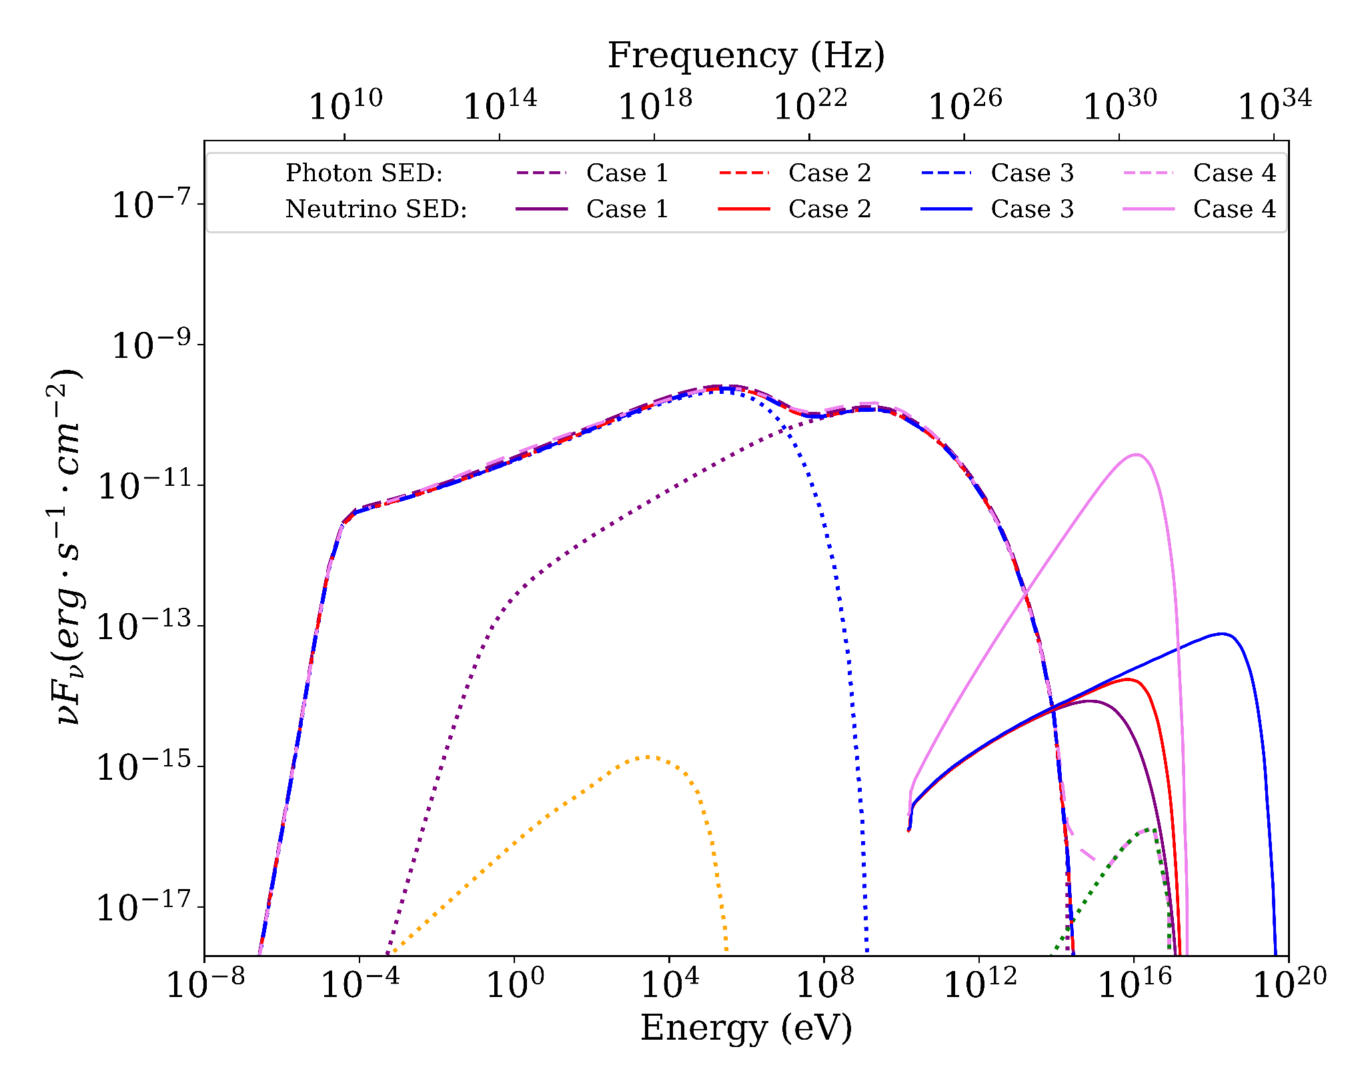
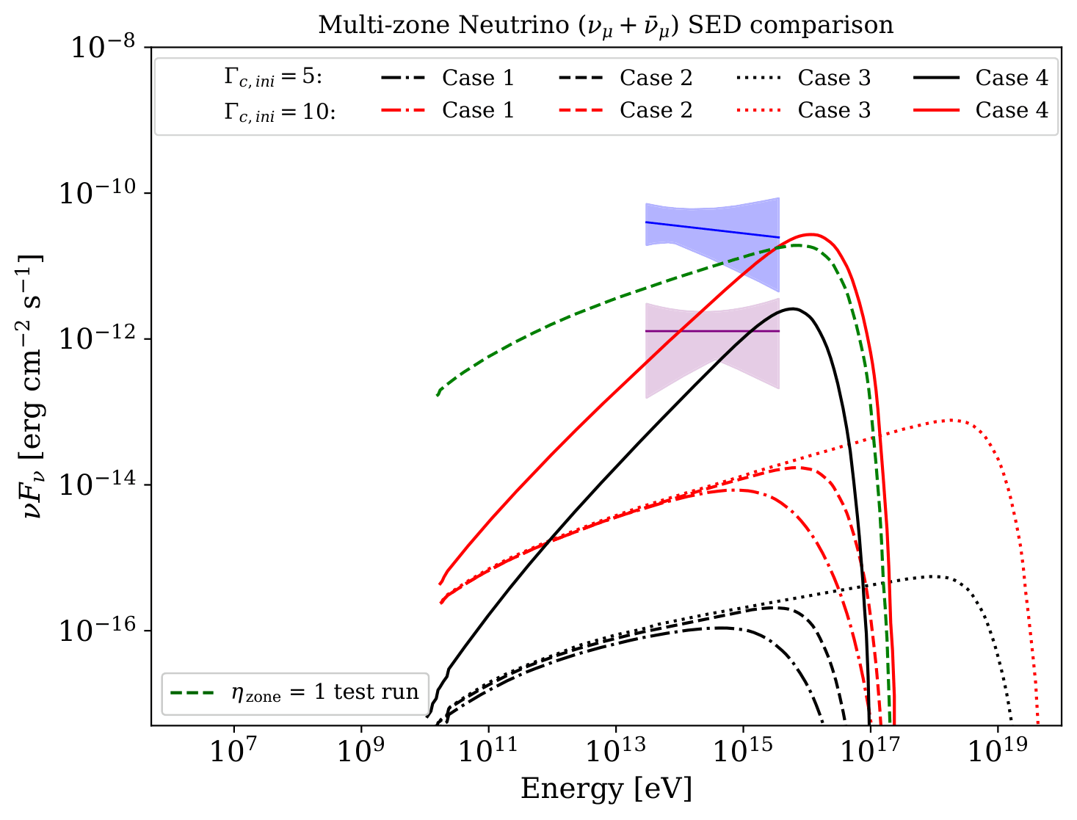

Multi-zone Spectral Energy Distribution (SED)
Proton energy distribution assumptions:
Case 1: Same as electron energy distribution.
Case 2: Less efficient cooling than electrons
Case 3: Max. proton energy constrained by Hillas criteria
Case 4: power law index = 2.0
Inverse Compton
Electron synchrotron
Associated with internal kink driven shocks
Not achieved from internal kink driven shocks
proton synchrotron
For 𝚪c = 10.0 , θ = 1 deg (angle between line of sight and jet axis), z = 0.3365
Only Case 4 reproduces neutrino flux levels comparable to TXS 0506+056 observations.
Case 4 requires extreme proton luminosities/powers.
H. Bhuyan, B. Vaidya, C. Fendt, A. Sharma, 2026 ApJ 1002 166,
Blue bow-tie : TXS 0506+056 2014–2015 flare period,
Pink bow-tie : the 9.5-year archival excess for TXS 0506+056
(Aartsen et al. 2018, IceCube Collaboration 2018)

Slide 10
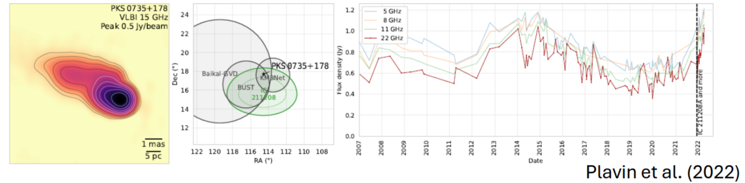
Limitation
A proton Lagrangian Particle module for PLUTO code
To get neutrino emissions we had to take heuristic approximations for proton distribution.
Provide constraints on the possible composition of the AGN jet.
Set up a threshold for baryon loading necessary for the observed neutrino flux.
Disentangle different external pathways for hadronic enrichment in AGN jets.

Slide 11
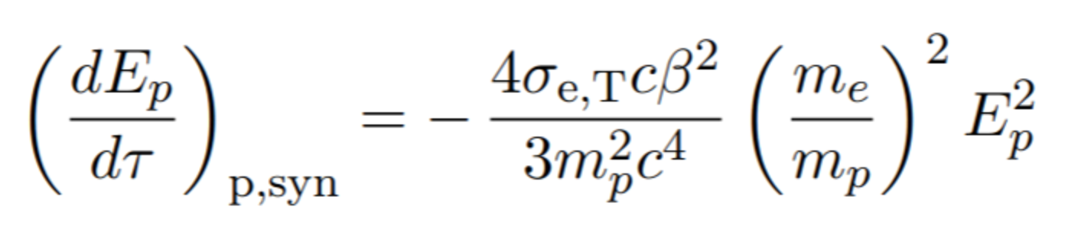
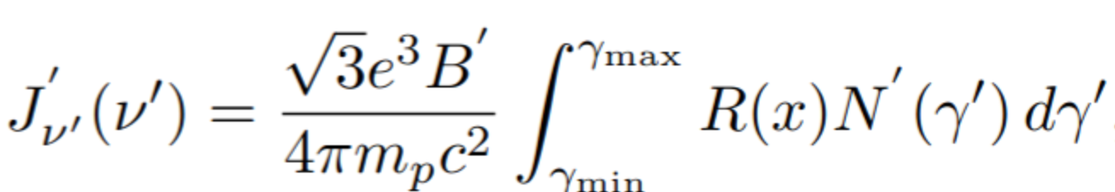
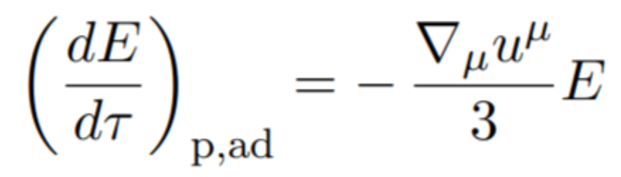
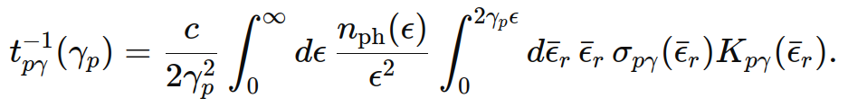
PROTON LAGRANGIAN PARTICLE MODULE
Proton-Synchrotron
Inject protons
Synchrotron
Emissivity deposited on grid
Adiabatic cooling
where, R(x) is the pitch-angle-averaged synchrotron kernel (Aharonian et al. 2010). Verified using Kardashev et.al. 1962 and agnpy (Nigro et. al. 2022)
Ext. Compton
(Klein Nishina) -
CMB, BLR, DT
Proton Fokker - Planck eqn.
Synchrotron
External Compton
Adiabatic cooling
Photo-meson
Neutrino
(In progress)
Diffusive shock acceleration
Photo-meson process
Evolved proton distribution
Using step function approximation (Dermer 2018), Verified with Hummer et. al. 2010
Bhuyan et. al (in prep.)
Vaidya et. al. 2018,Mukherjee et. al. 2021,Suriano et. al. 2026
Kelner and Aharonian 2007, Kimura et. al. 2015

Slide 12
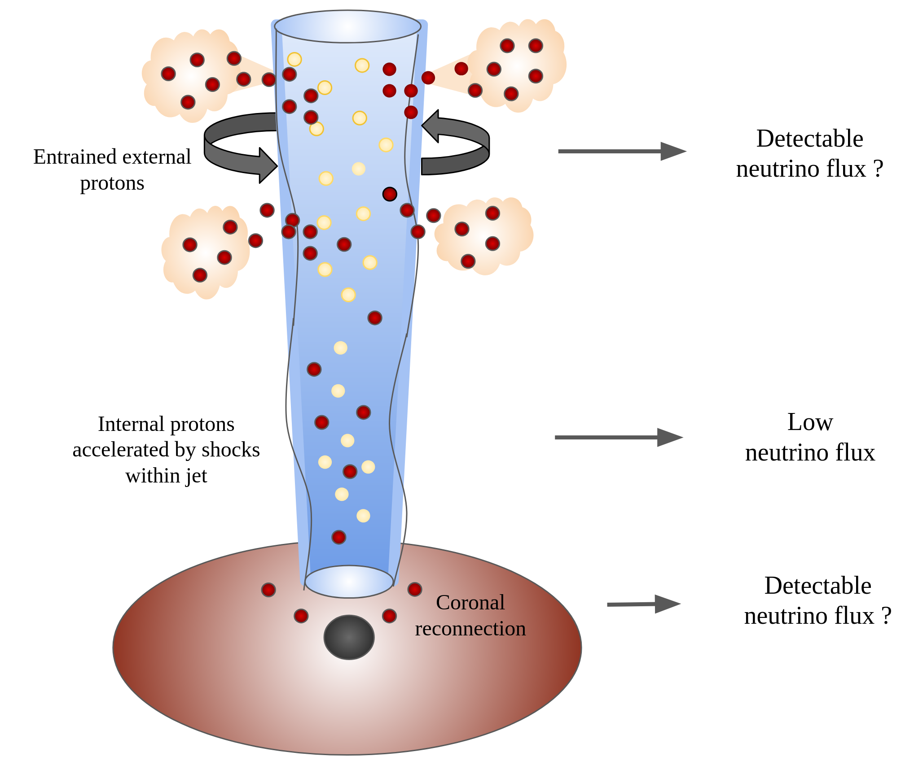
Where does neutrino emission originate in AGN jets?
Local regions of higher L_{p}
Electron macroparticles
Proton macroparticles

Slide 13
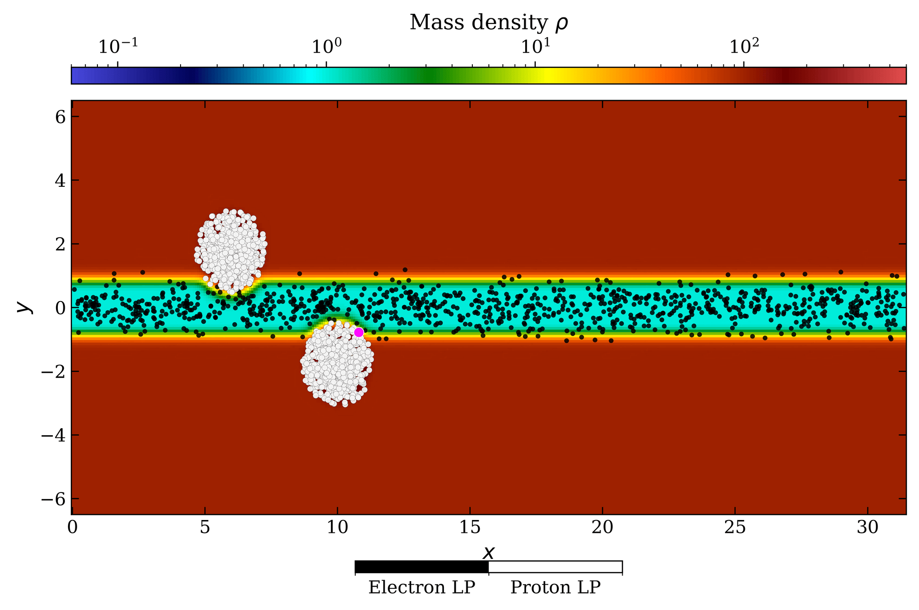
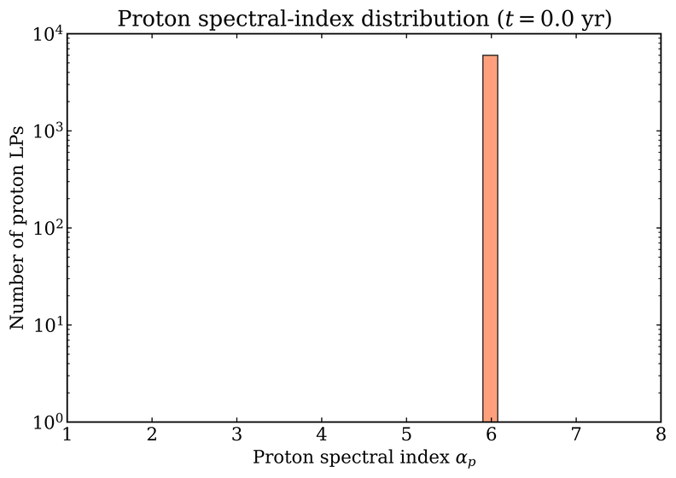
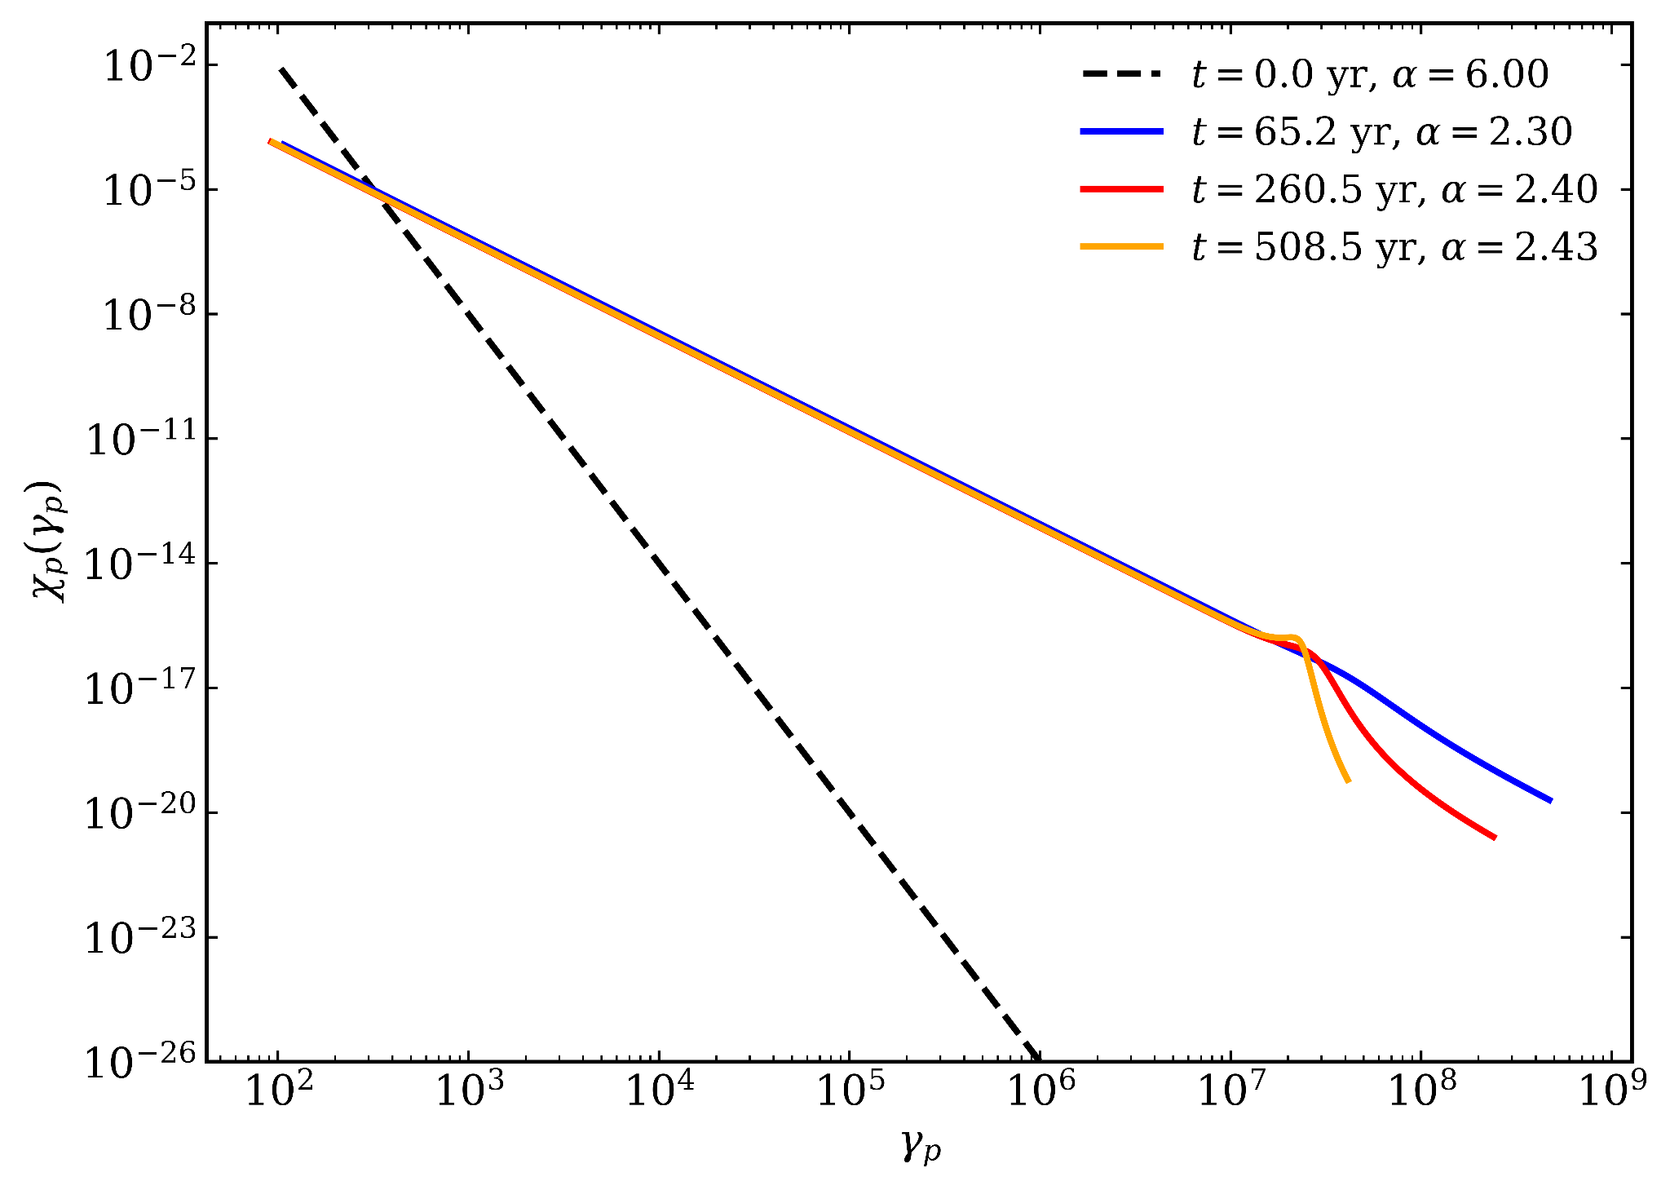
Jet-environment interaction with proton module
Electron LP
Proton LP
Single Proton LP tracked to study cooling

Slide 14
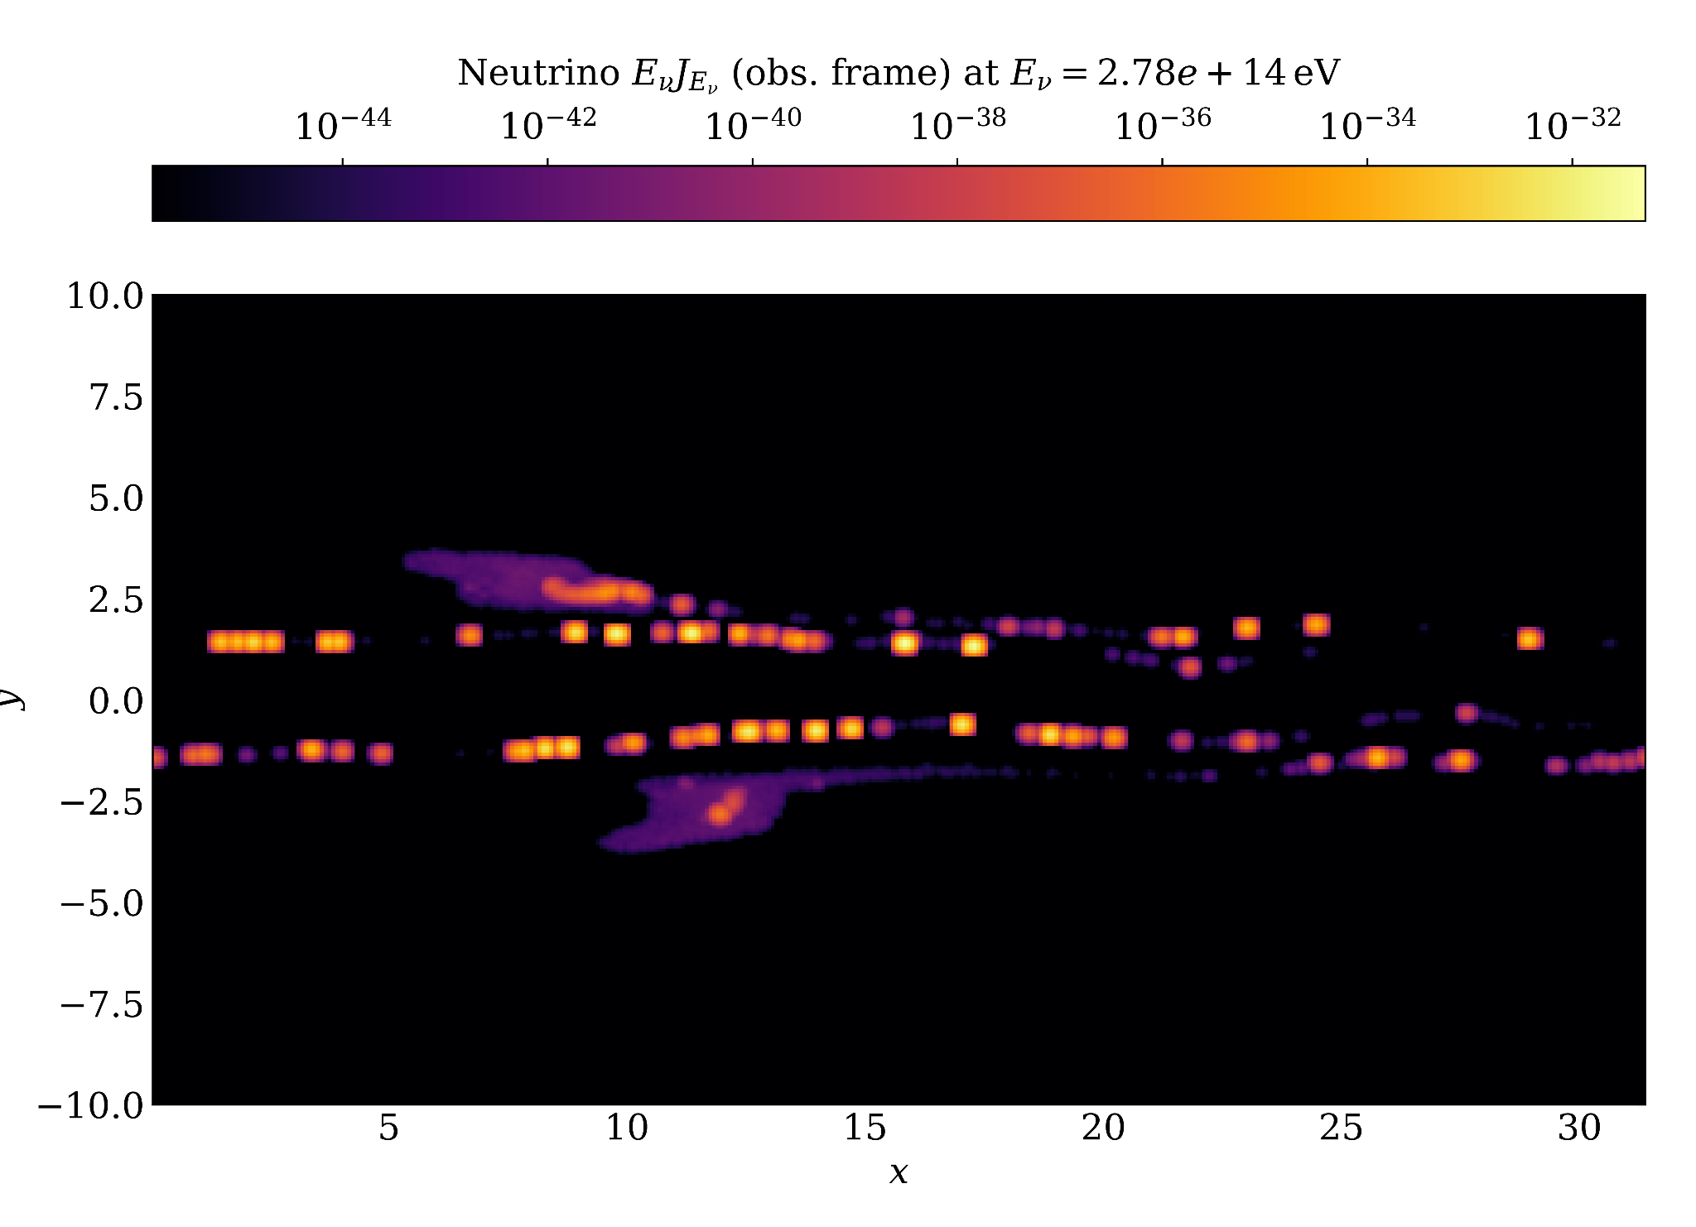
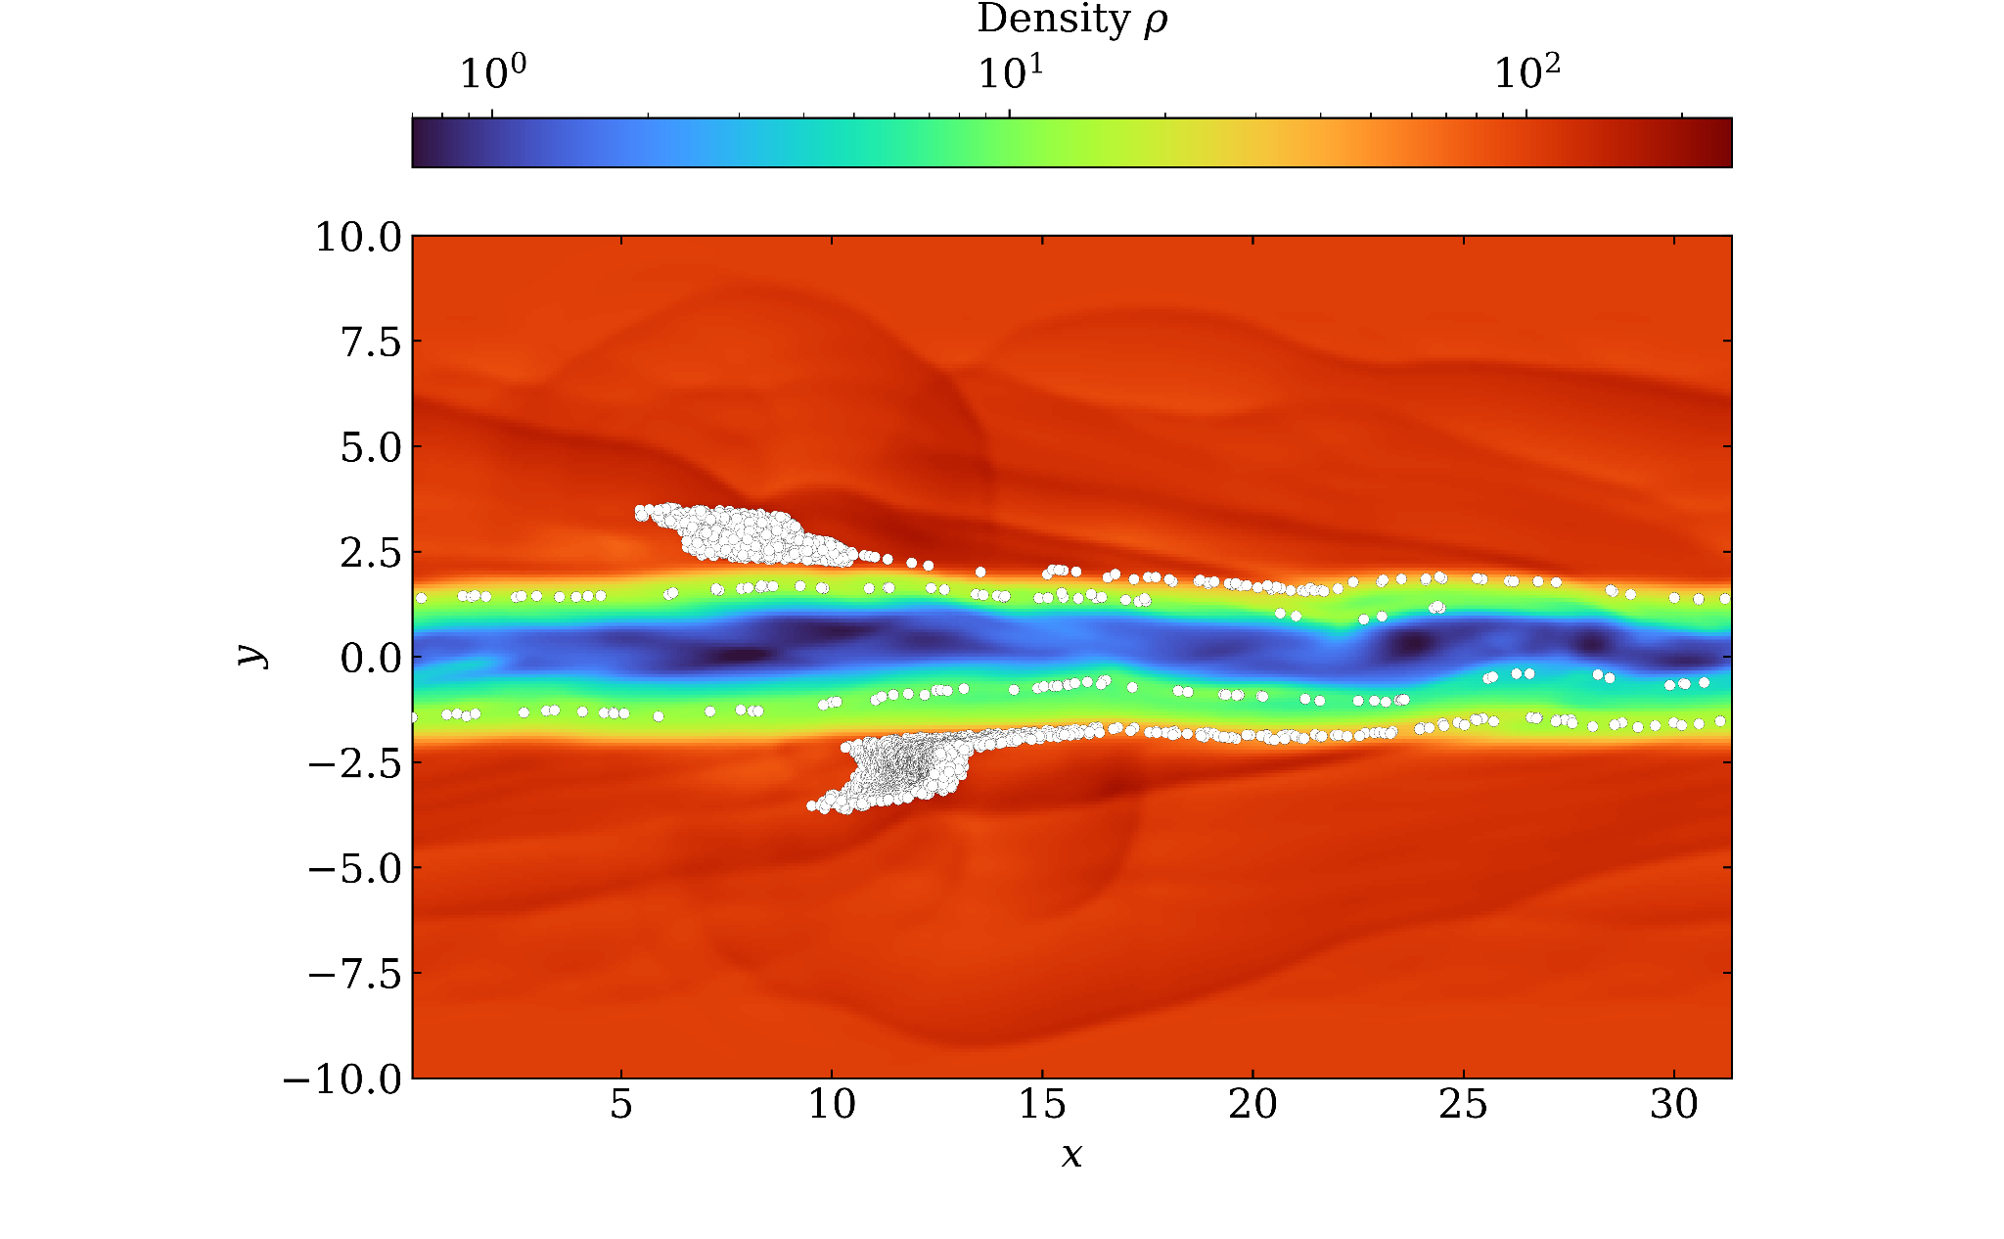
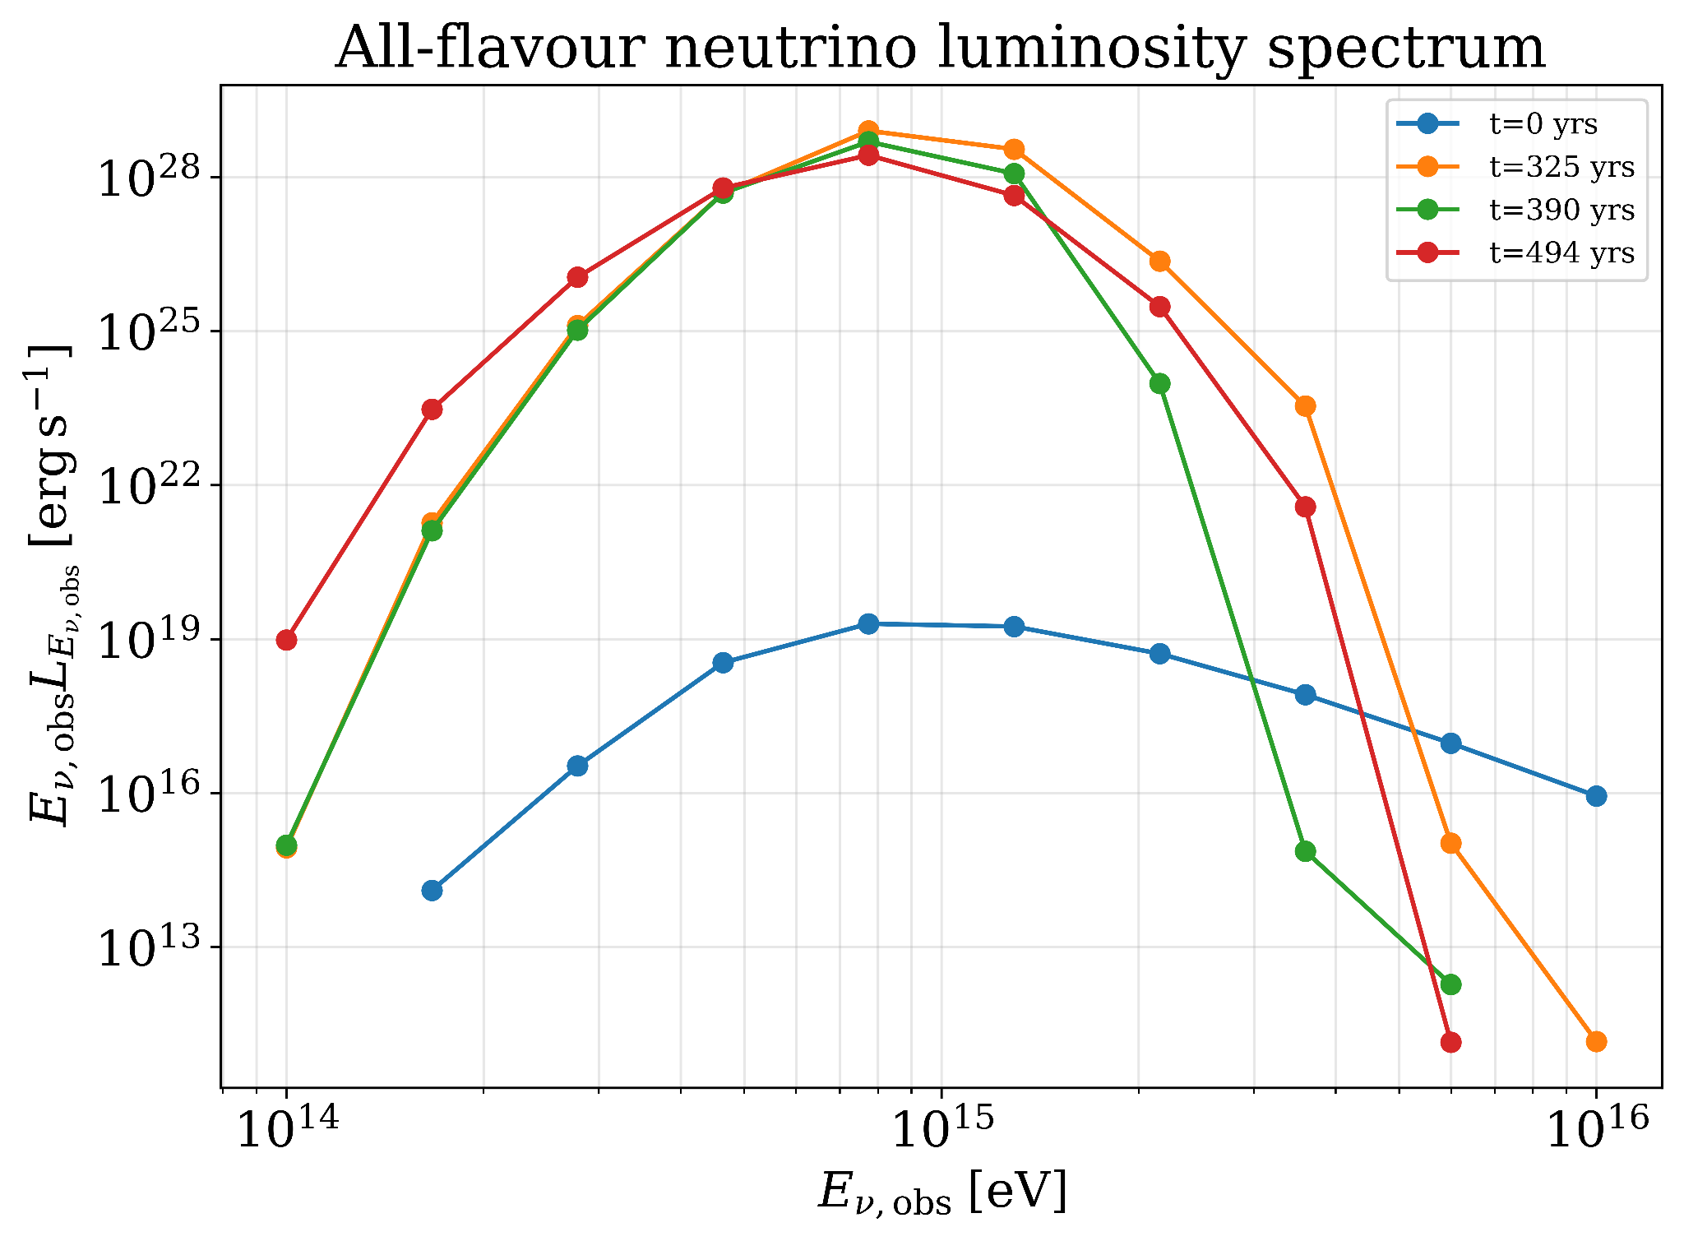
Neutrino emission
t = 325 yrs
Preliminary results!!
Kimura et. al. 2015, Kelner and Aharonian 2007, Hummer et. al. 2010, Dermer et al. 2018,

Slide 15
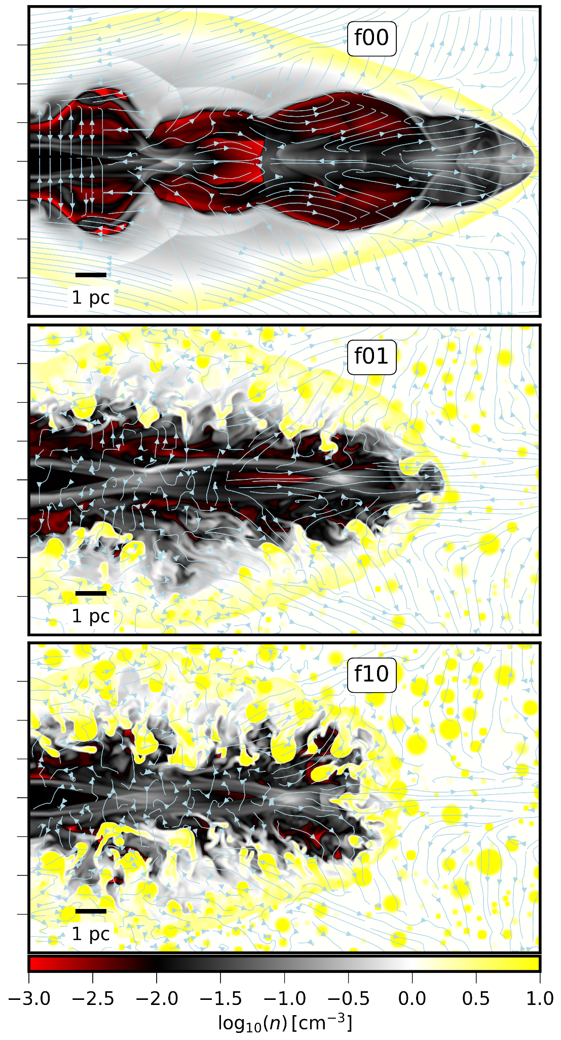
Applications of the module
Full scale jet in clumpy cloud filled proton rich ambient medium
Uniform medium
Clumpy medium
Almeida et. al. (recently submitted)

Slide 16
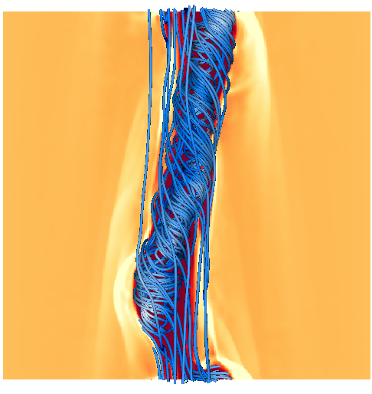
Summary
AGN jet instabilities create diverse magnetic and fluid structures, leading to distinct zones with different particle acceleration and cooling rates.
We have developed lepto-hadronic multizone framework considering the dynamical evolution of the jet which gives synthetic emission signatures.
We find that intrinsic shocks from kink instabilities at pc-scale alone may not produce particle spectra flat enough for observable neutrino flux - May require proton entrainment from jet-environment interactions.
We have developed a proton Lagrangian - particle module for PLUTO code, that can generate synthetic photon and neutrino emission maps for a more detailled multi-zone treatment of AGN jets.

Slide 17
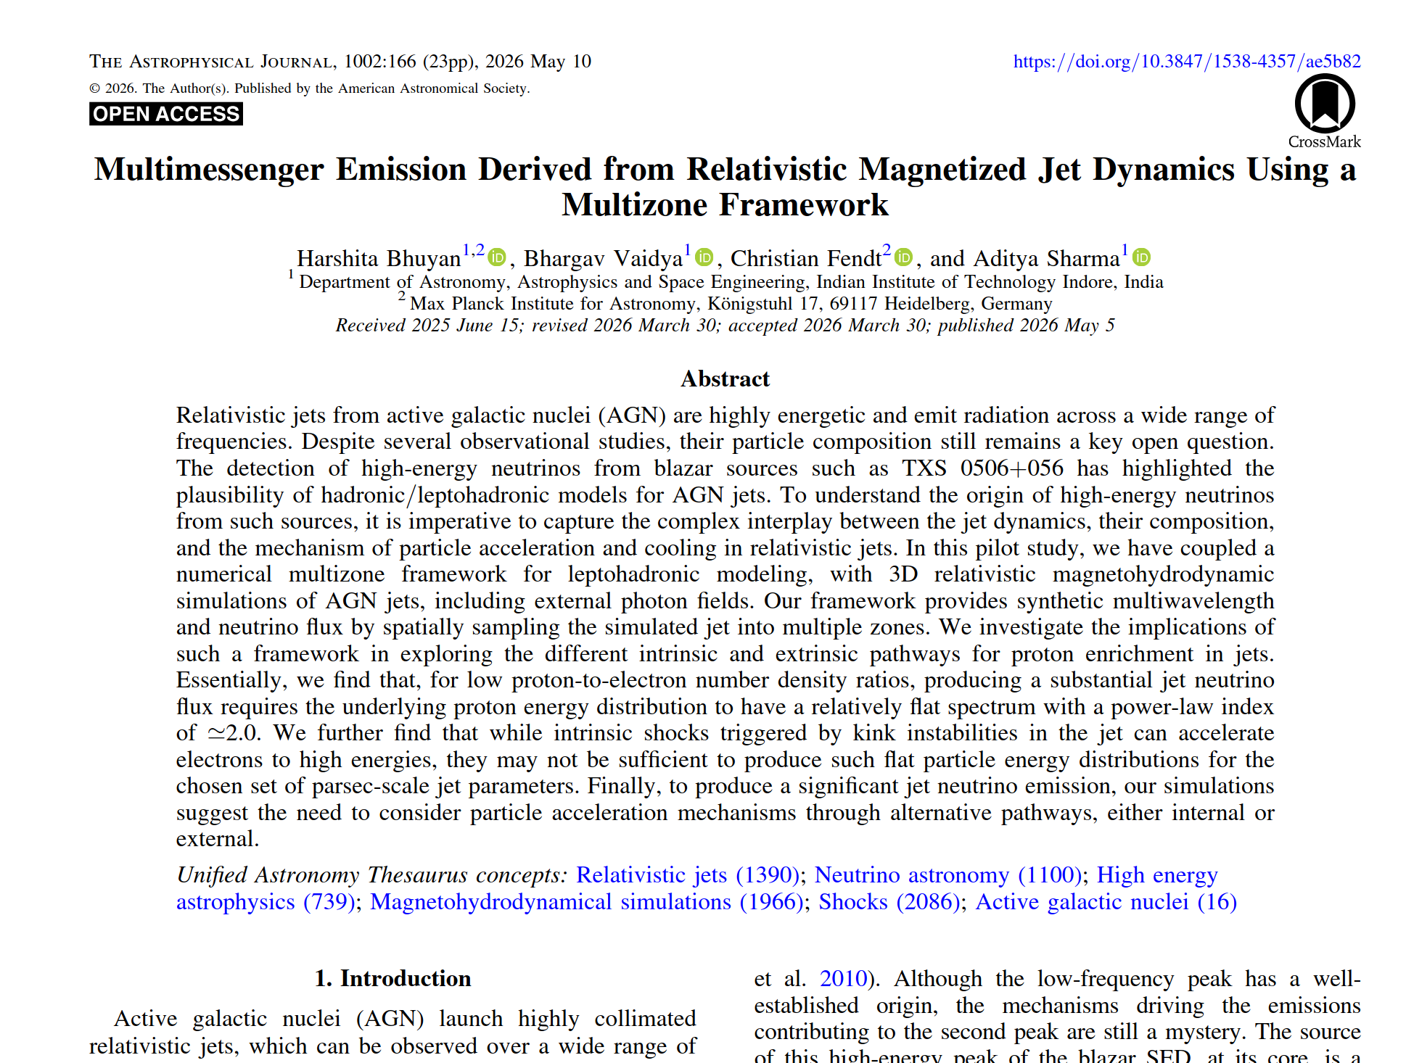

H. Bhuyan, B. Vaidya, C. Fendt, A. Sharma, 2026 ApJ 1002 166,

Slide 18
Thank You!

Slide 19
Backup slides

Slide 20
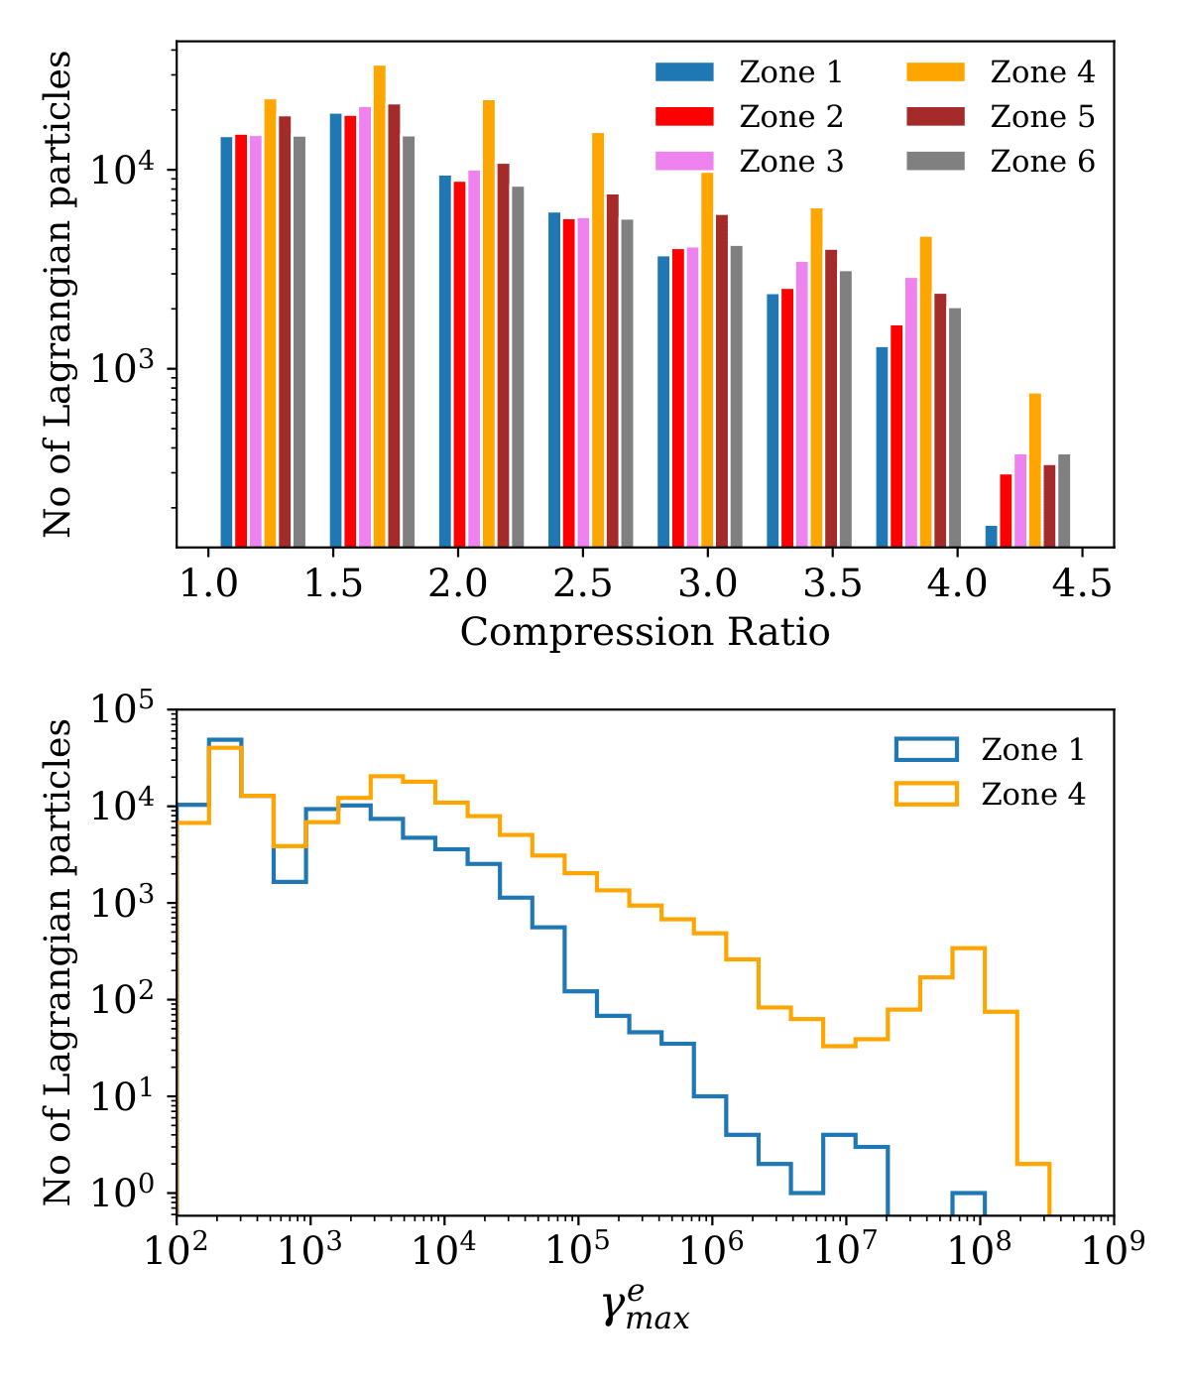
Probing into potential particle acceleration sites
Zone 4: kink + prominent high-pressure region → more macro-particles cross high-compression shocks.
More macro-particles reach higher maximum energy in Zone 4 compared to other zones
Hence kink formation potentially enables stronger acceleration via stronger shocks or a greater number of shocks.

Slide 21
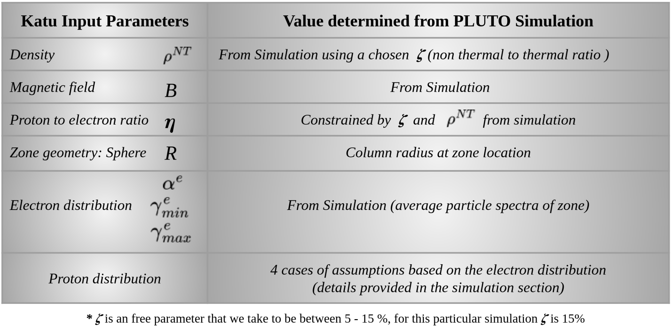
Integrating PLUTO with Katu
Lagrangian particle
Zone

