Slide 1
Kinetic simulations of mildly relativistic weakly magnetized shocks in AGN jets
Artem Bohdan
Max Planck Institute for Plasma Physics, Garching, Germany

Slide 2
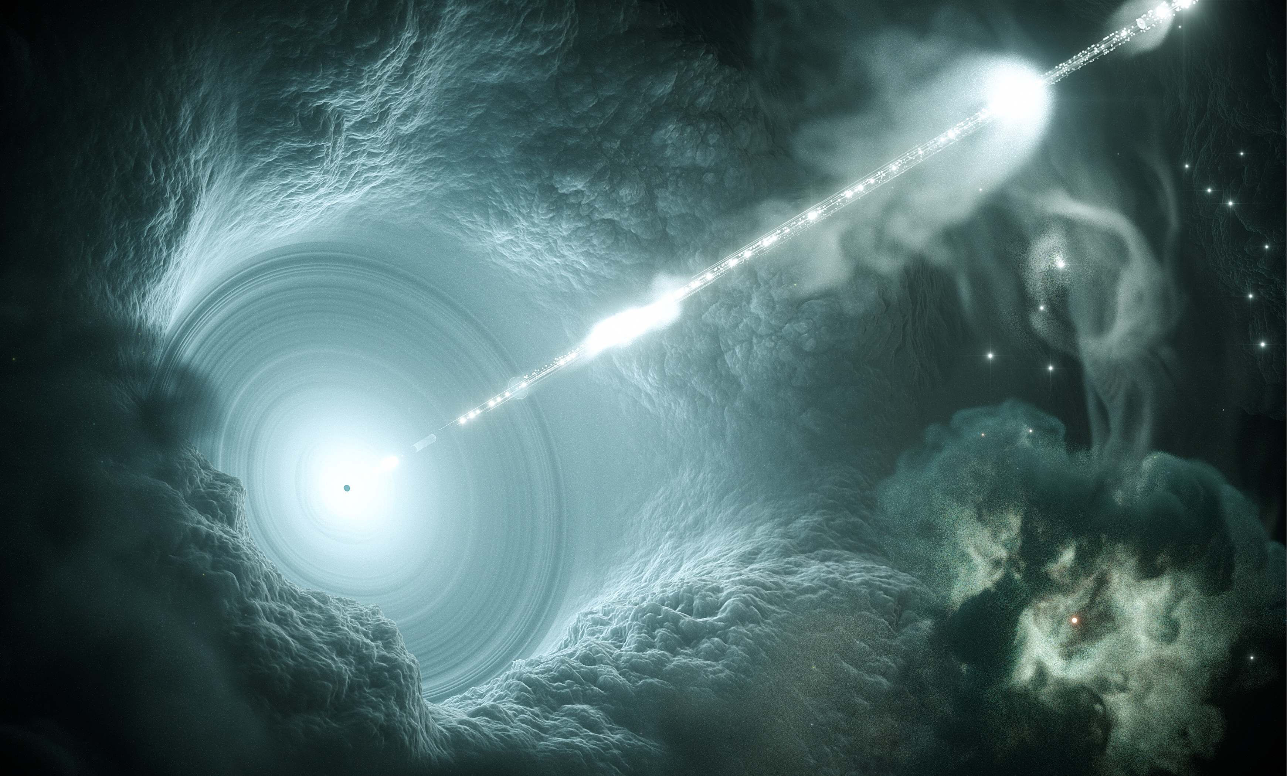


Blazars – An “extreme” flavour of AGNs
Non-thermal emission
up to >TeV
Super massive
Black Hole
(10⁶-10⁹ solar masses)
Observed at small angle relative to the jet axis
→ Strong relativistic beaming
→ Doppler factor δ ≳ 10
Relativistic plasma jet
kpc – Mpc scale
Credit: DESY, Science Communication Lab
Notes:
What are blazars?
They consist of a SMBH, 10⁶ 10⁹ solar masses
The SMBH is launching a relativistic jet, on kpc Mpc scale.
Those jets emit non-thermal radiation from radio to TeV

Slide 3
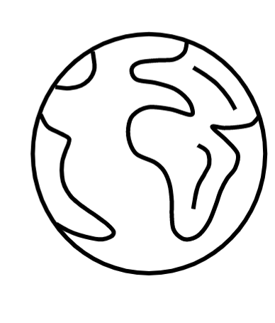
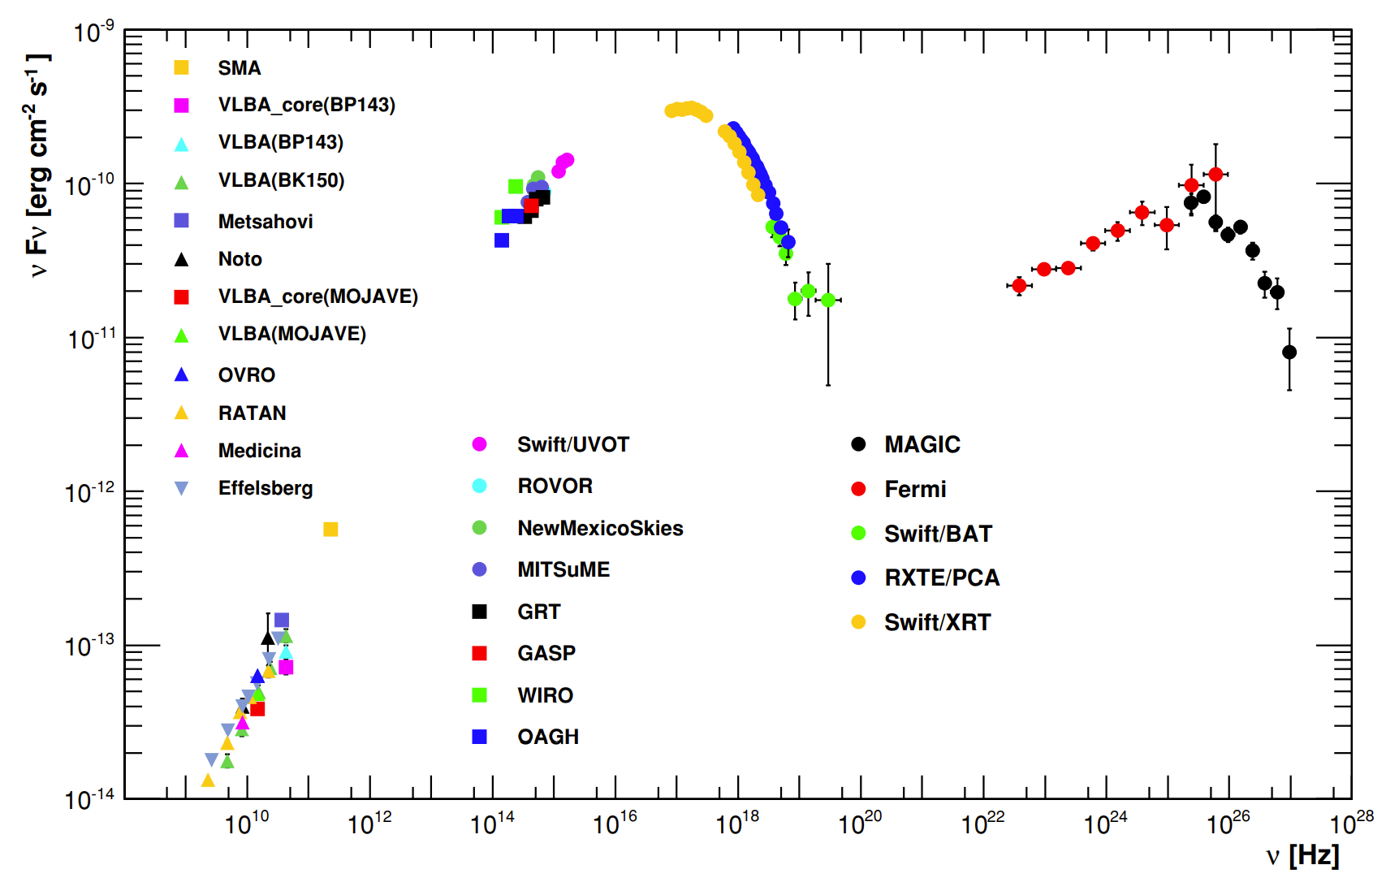
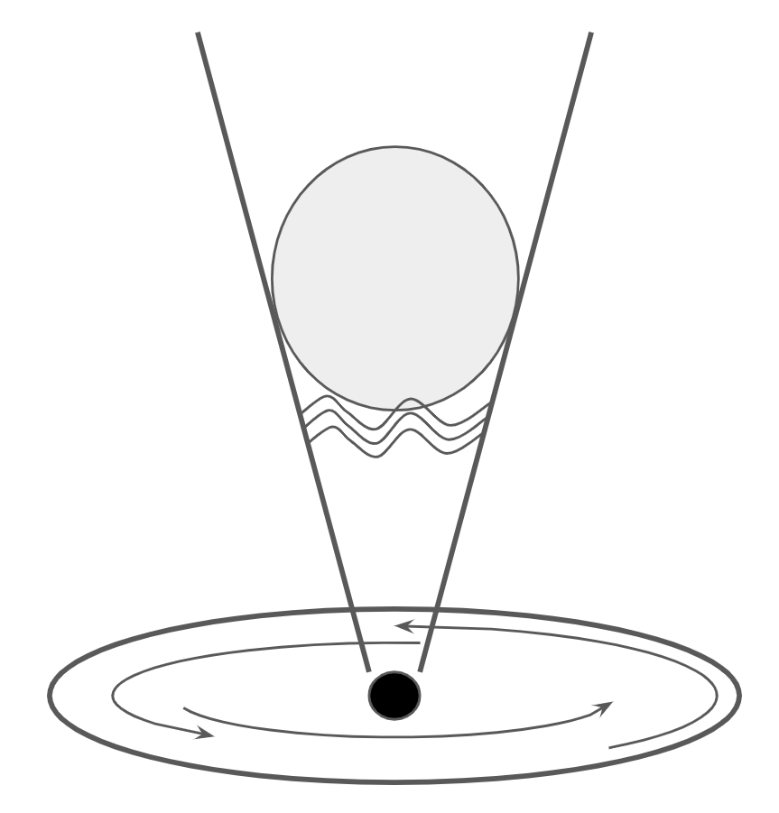
Blazar emission and shocks in AGN jets
Emission of Mrk421
Jet
Emission zone
Shock, reconnection,
turbulence, shear
Black hole
Accretion disk
(Abdo et al. 2011)

Slide 4
Blazar emission and shocks in AGN jets
Emission of Mrk421
Jet
Emission zone
Shock, reconnection,
turbulence, shear
Black hole
Accretion disk
(Abdo et al. 2011)

Slide 5
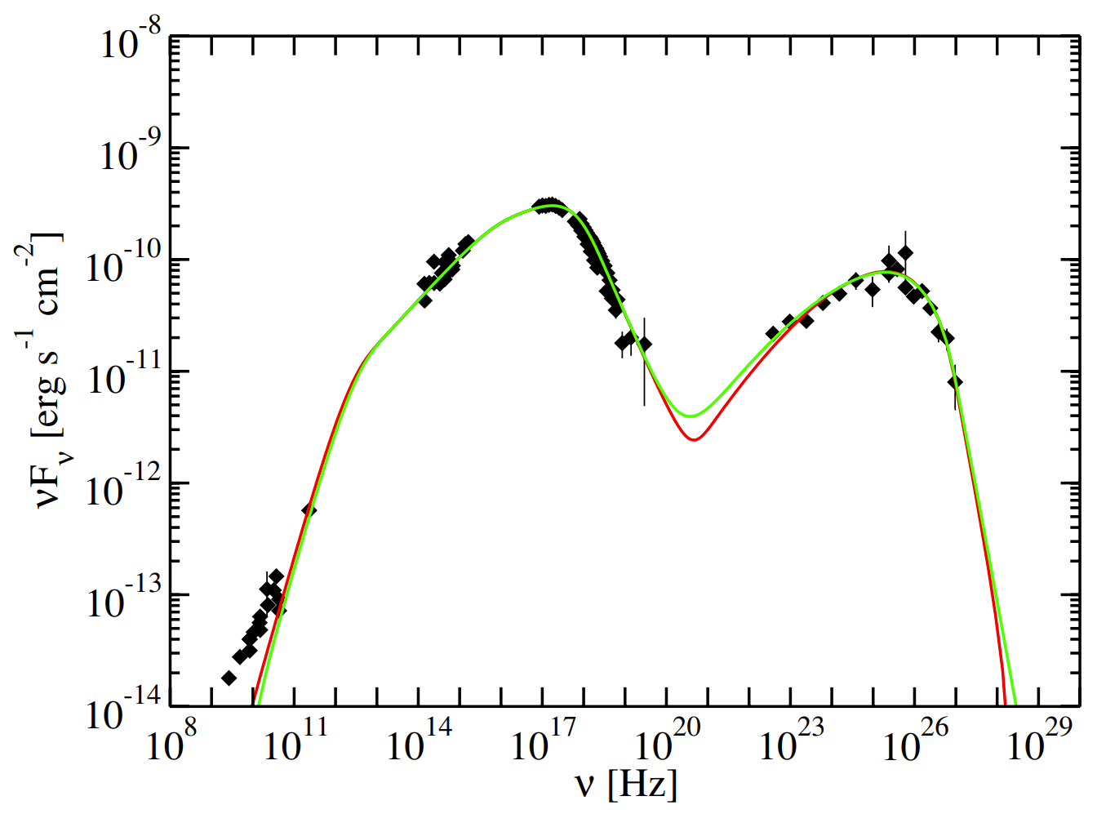
Blazar emission and shocks in AGN jets
Emission of Mrk421 + synchrotron self-Compton model
Jet
Emission zone
Shock
Black hole
Accretion disk
(Abdo et al. 2011)

Slide 6
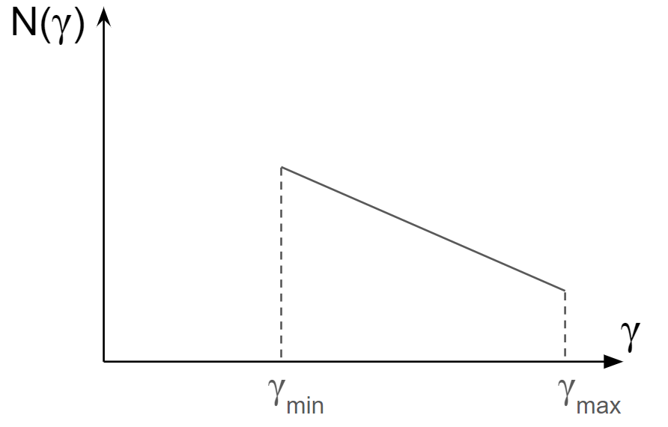
Blazar emission and shocks in AGN jets
Used electron distribution
Emission of Mrk421 + synchrotron self-Compton model

Slide 7
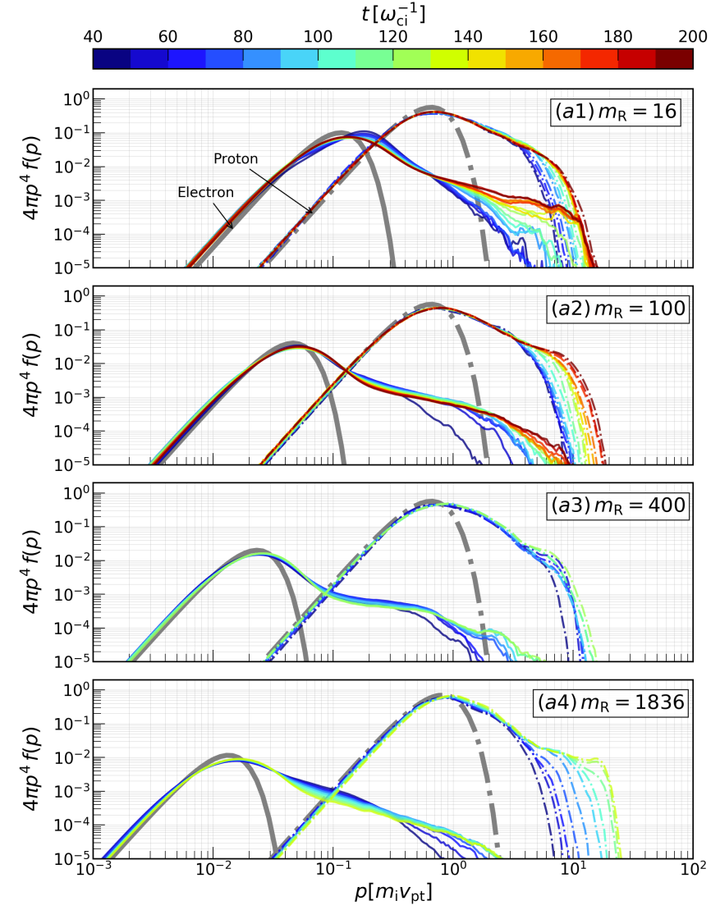
Blazar emission and shocks in AGN jets
Used electron distribution
Emission of Mrk421 + synchrotron self-Compton model
Realistic electron distribution
(Gupta et al. 2024)

Slide 8
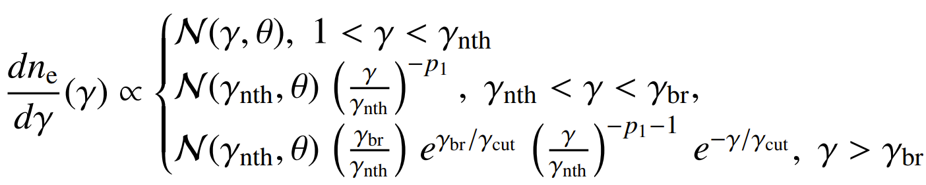
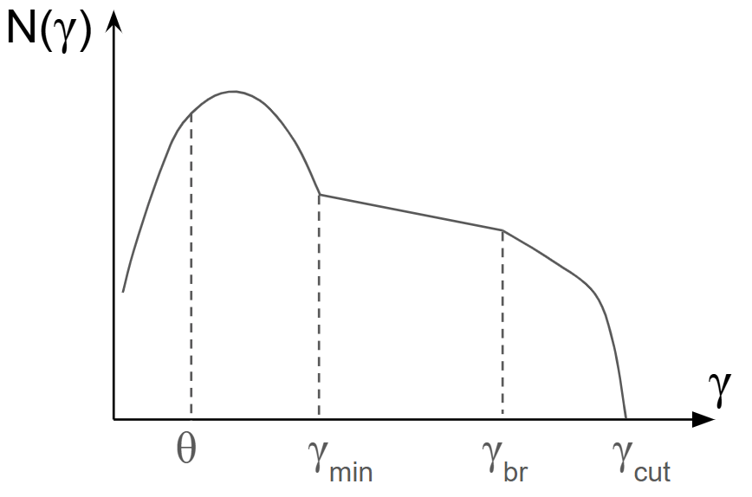
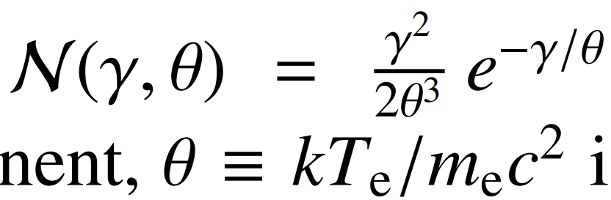

Using realistic electron energy distribution
Where is the Maxwell distribution
and is the dimensionless temperature.

Slide 9
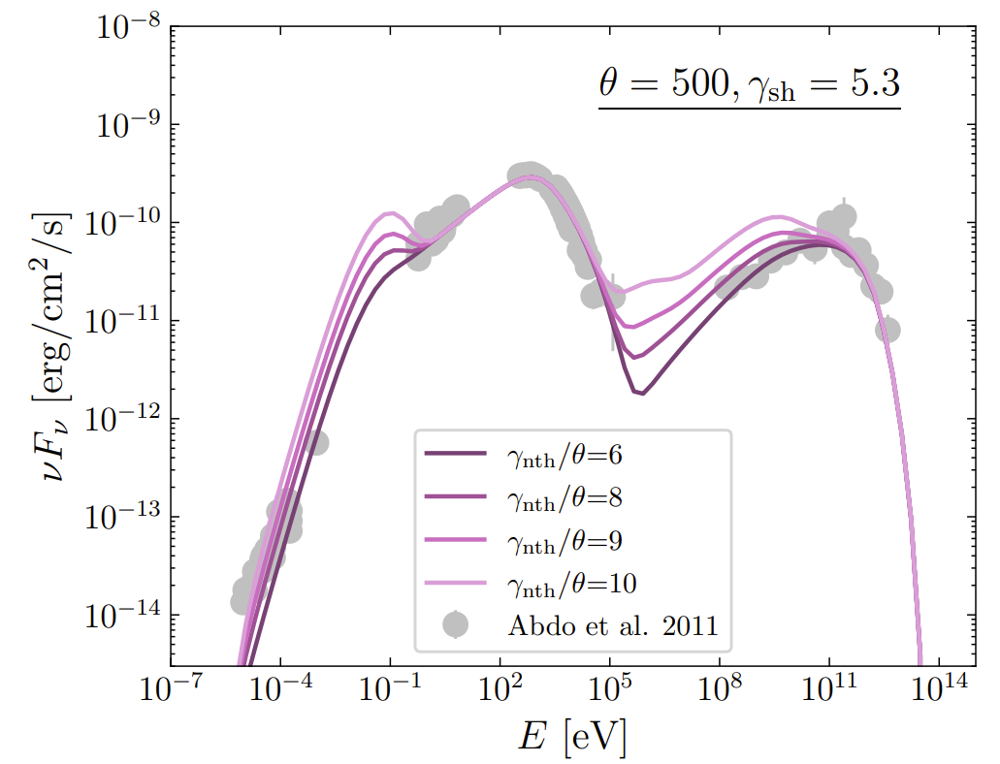
Using realistic electron energy distribution
Where is the Maxwell distribution
and is the dimensionless temperature.
Best-fit parameters:
Temperature θ ≈ 500
Nonthermal population ɣ_{nth} /θ ≈ 8
Power-law index p₁ ≈ 2.4
Electron density n ≈ 1 cm⁻³
Magnetic field B ≈ 0.05 G

Slide 10
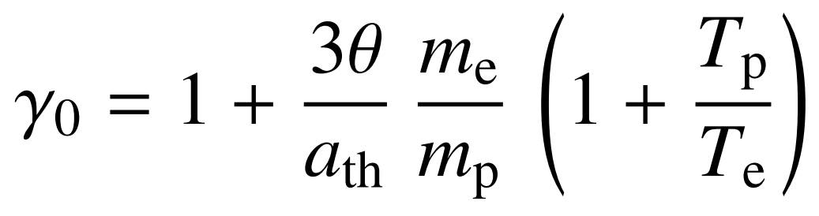
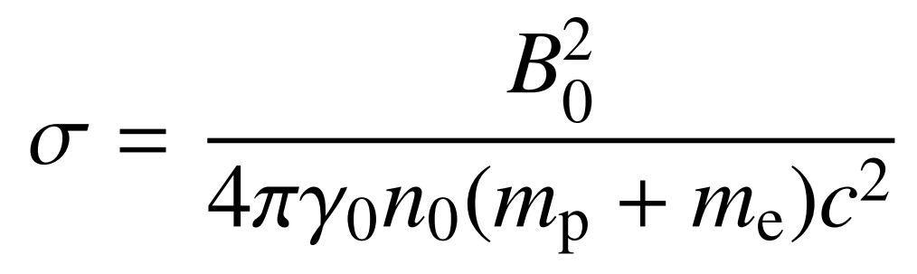
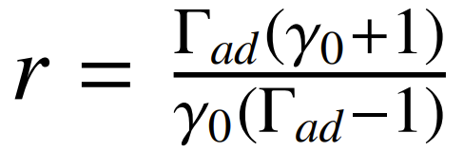
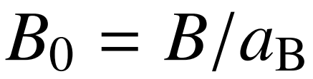
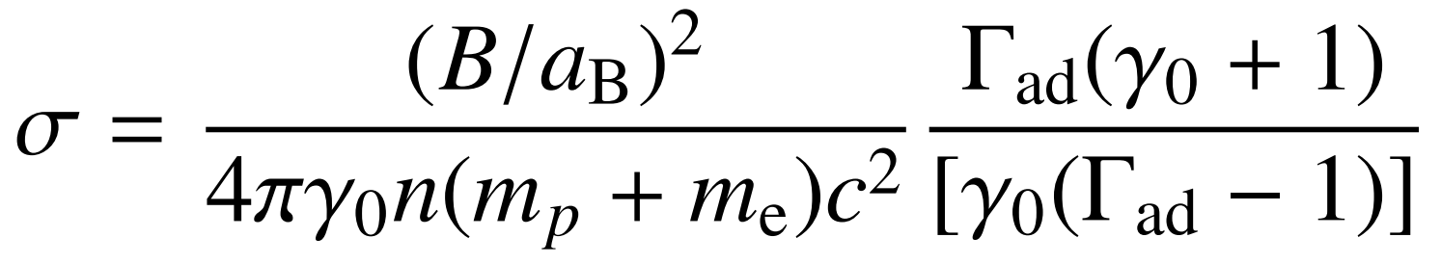
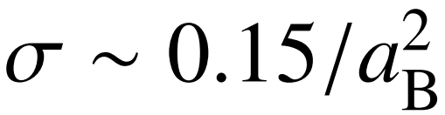
Shock parameters
Shock Lorentz factor
θ ≈ 500 (aka electron temperature) -> ≈ 4 (assuming T_{e}/T_{i} ≈ 0.5)
The upstream plasma magnetization
Using the shock compression ratio and magnetic field amplification factor

Slide 11
Shock parameters for the best-fit model
Best-fit parameters:
Temperature θ ≈ 500
Nonthermal population ɣ_{nth} /θ ≈ 8
Power-law index p₁ ≈ 2.4
Electron density n ≈ 1 cm⁻³
Magnetic field B ≈ 0.05 G
Shock parameters:
The upstream Lorentz factor in d.r.f. ɣ₀ ≈ 4
The shock Lorentz factor ɣ_{sh} ≈ 5.3
Magnetization σ ≈ 0.15/a_{B}
Assumptions:
Fraction of energy in thermal particles a_{th} ≈ 0.8
Downstream temperature ratio T_{e}/T_{i} ≈ 0.5
Magnetic field amplification a_{B} is a free parameter

Slide 12
Shock parameters for the best-fit model
Best-fit parameters:
Temperature θ ≈ 500
Nonthermal population ɣ_{nth} /θ ≈ 8
Power-law index p₁ ≈ 2.4
Electron density n ≈ 1 cm⁻³
Magnetic field B ≈ 0.05 G
Shock parameters:
The upstream Lorentz factor in d.r.f. ɣ₀ ≈ 4
The shock Lorentz factor ɣ_{sh} ≈ 5.3
Magnetization σ ≈ 0.15/a_{B}
Assumptions:
Fraction of energy in thermal particles a_{th} ≈ 0.8
Downstream temperature ratio T_{e}/T_{i} ≈ 0.5
Magnetic field amplification a_{B} is a free parameter
PUBLISHED
Radiative signatures of electron-ion shocks in BL Lac type objects
A. Arbet-Engels, AB, F. Rieger, D. Paneque, and F. Jenko
Astronomy & Astrophysics, Volume 702, id.A255, arXiv:2508.18008

Slide 13
Shock parameters for the best-fit model
Best-fit parameters:
Temperature θ ≈ 500
Nonthermal population ɣ_{nth} /θ ≈ 8
Power-law index p₁ ≈ 2.4
Electron density n ≈ 1 cm⁻³
Magnetic field B ≈ 0.05 G
Shock parameters:
The upstream Lorentz factor in d.r.f. ɣ₀ ≈ 4
The shock Lorentz factor ɣ_{sh} ≈ 5.3
Magnetization σ ≈ 0.15/a_{B}
Assumptions:
Fraction of energy in thermal particles a_{th} ≈ 0.8
Downstream temperature ratio T_{e}/T_{i} ≈ 0.5
Magnetic field amplification a_{B} is a free parameter
Things to test with PIC simulations
(1) Short simulations
Downstream temperature ratio T_{e}/T_{i}
Fraction of energy in thermal particles a_{th}
(2) Long simulations
Nonthermal population ɣ_{nth} /θ
Power-law index p₁
Magnetic field amplification a_{B}

Slide 14
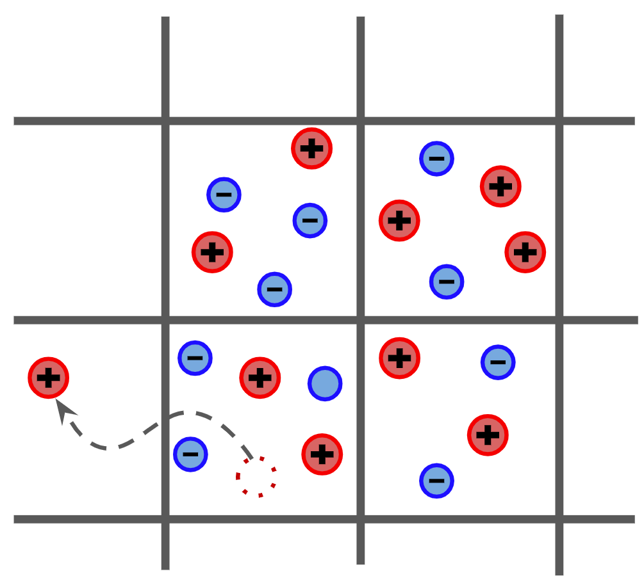
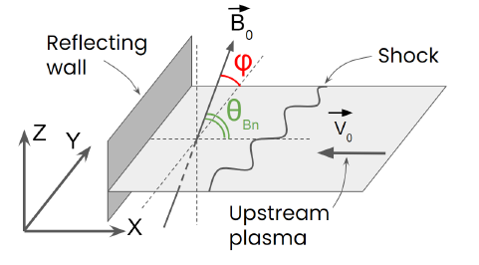
Scanned parameters
60+ 2D3V PIC simulations
The shock Lorentz factor ɣ₀ = 1.5 , 2 , 4 , 8 , 16
The upstream plasma magnetization σ = 10⁻¹ , 10⁻² , 10⁻³ , 10⁻⁴
The shock obliquity θ_{Bn} = 0°, 25°, 50°

Slide 15
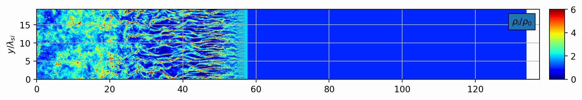
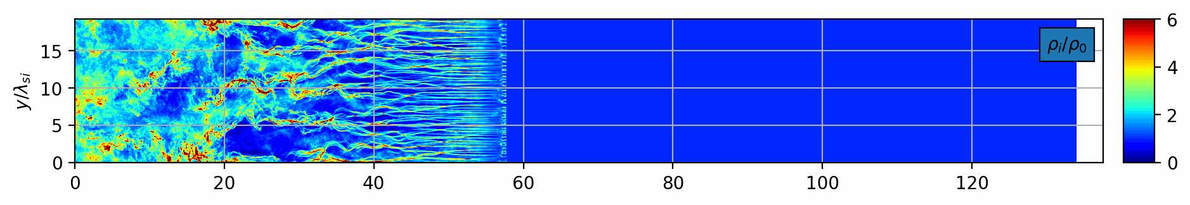
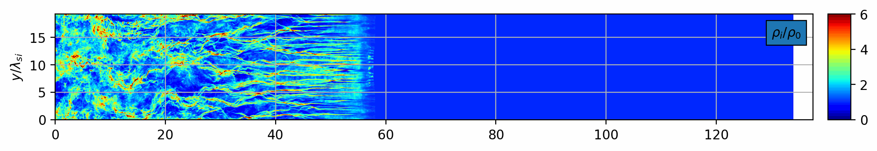
Shock simulations

Slide 16
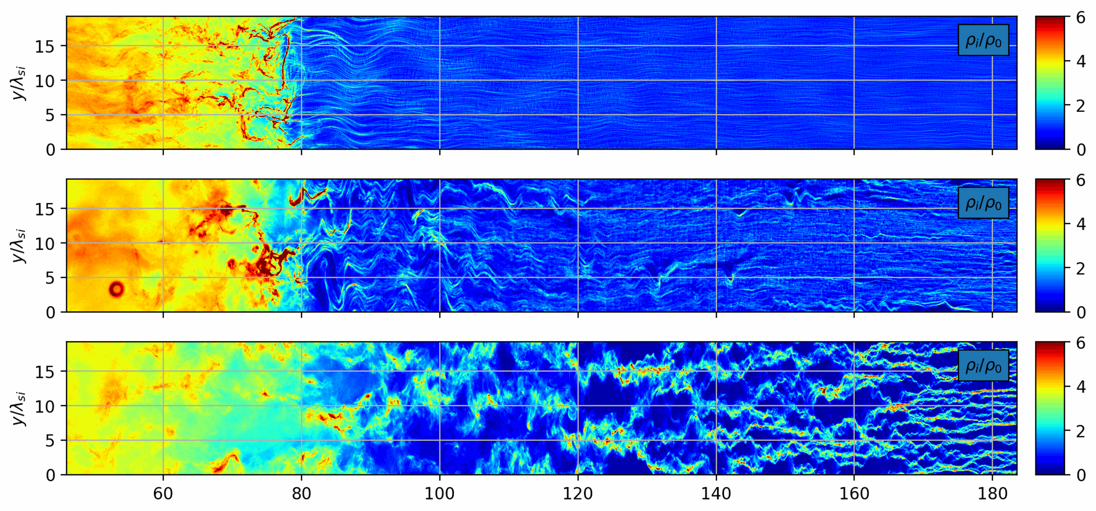
Shock simulations

Slide 17
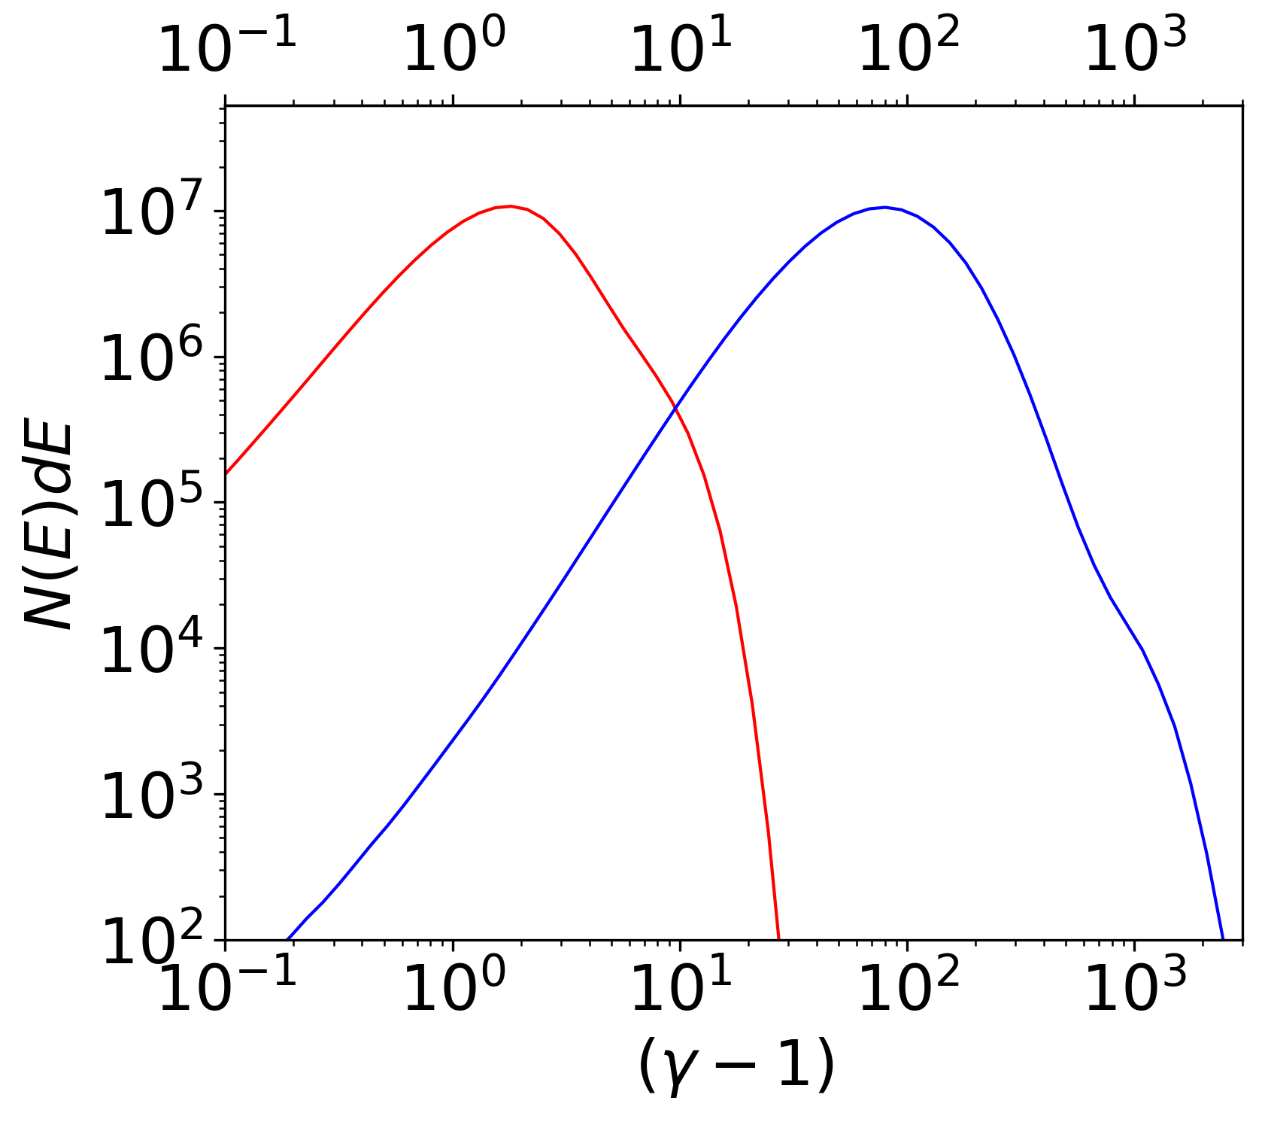
The electron-to-ion temperature ratio

Slide 18
The electron-to-ion temperature ratio
T_{e}/T_{i} = 0.78
T_{e}/T_{i} = 0.48
T_{e}/T_{i} = 0.37

Slide 19
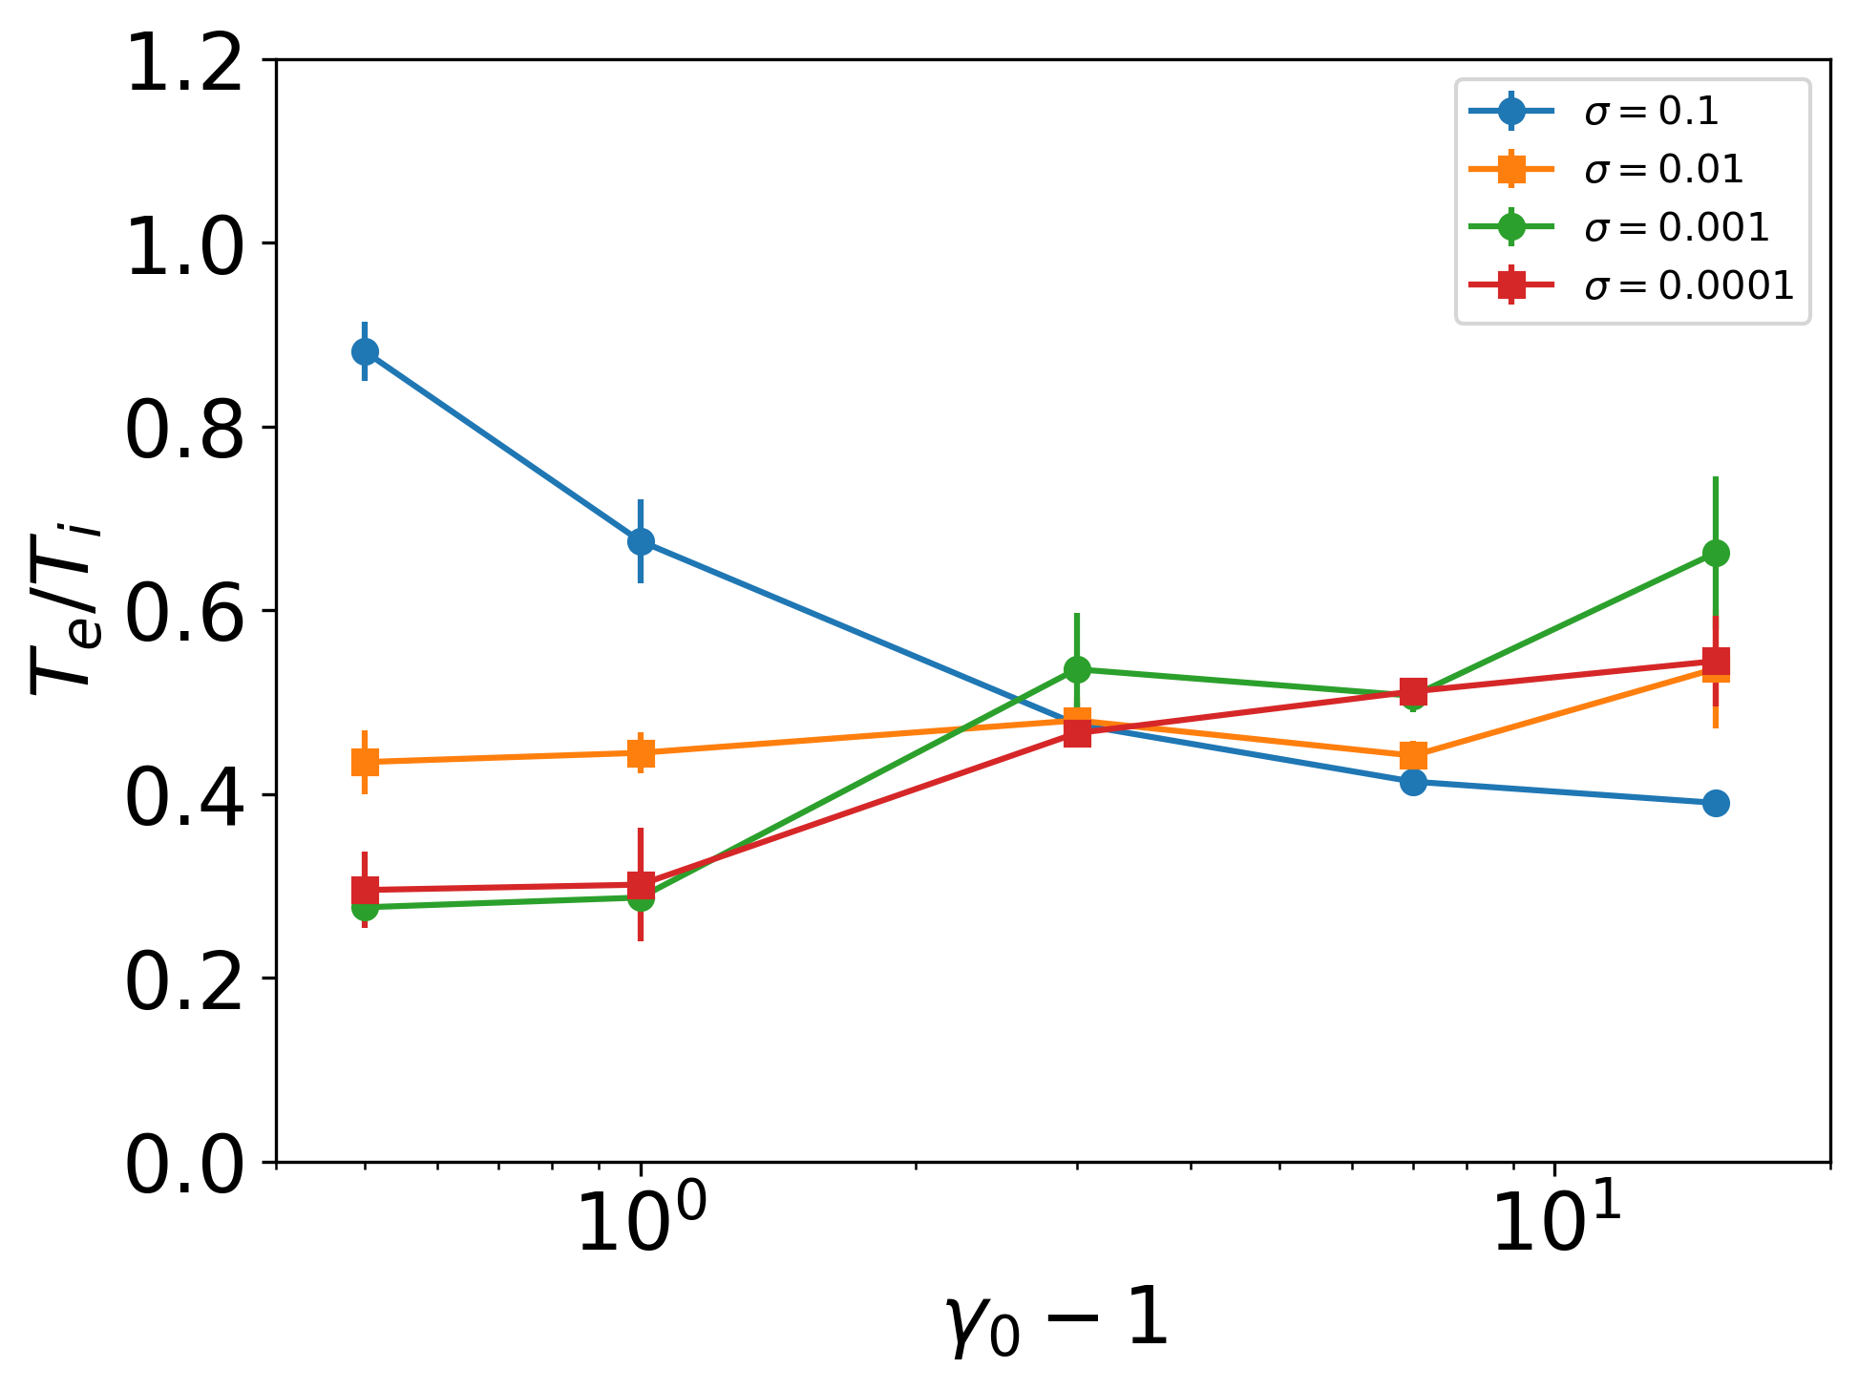
Parallel shocks (θ_{Bn} = 0°)

Slide 20
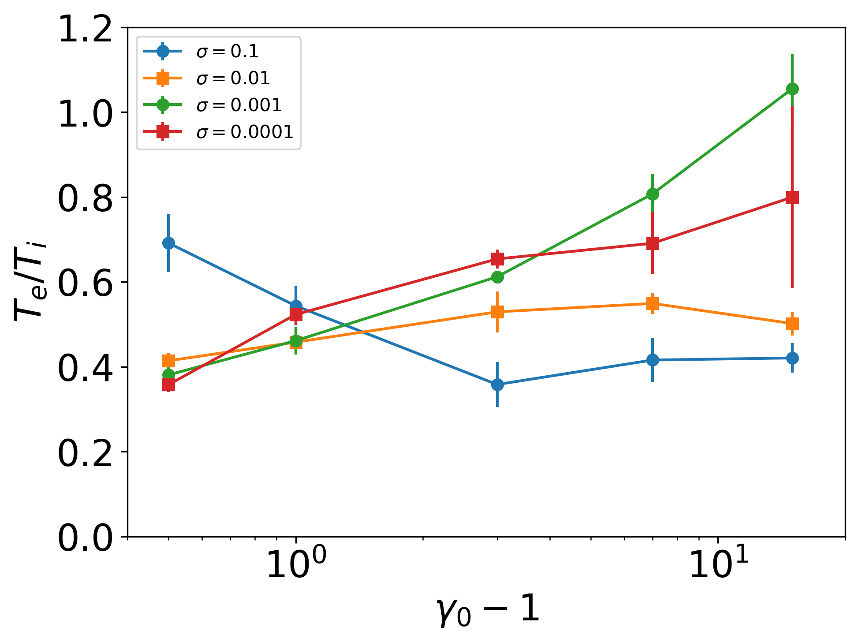
Oblique subluminal shocks (θ_{Bn} = 25°)

Slide 21
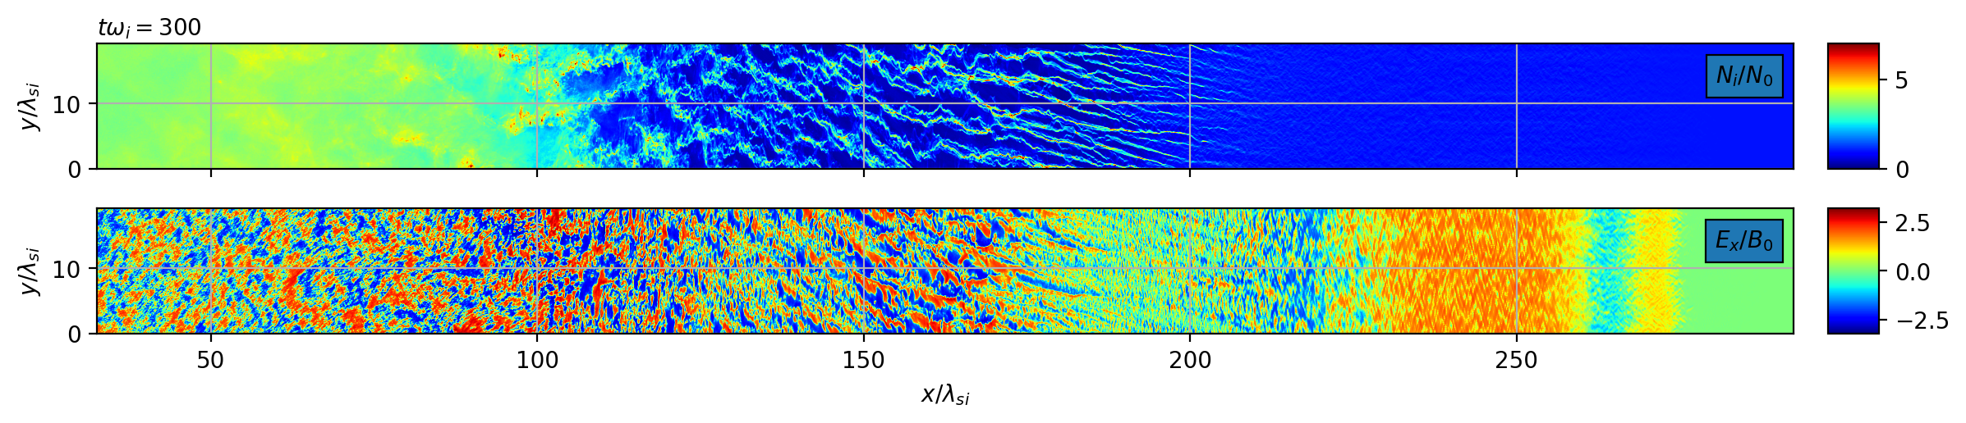
Oblique subluminal shocks (θ_{Bn} = 25°)

Slide 22
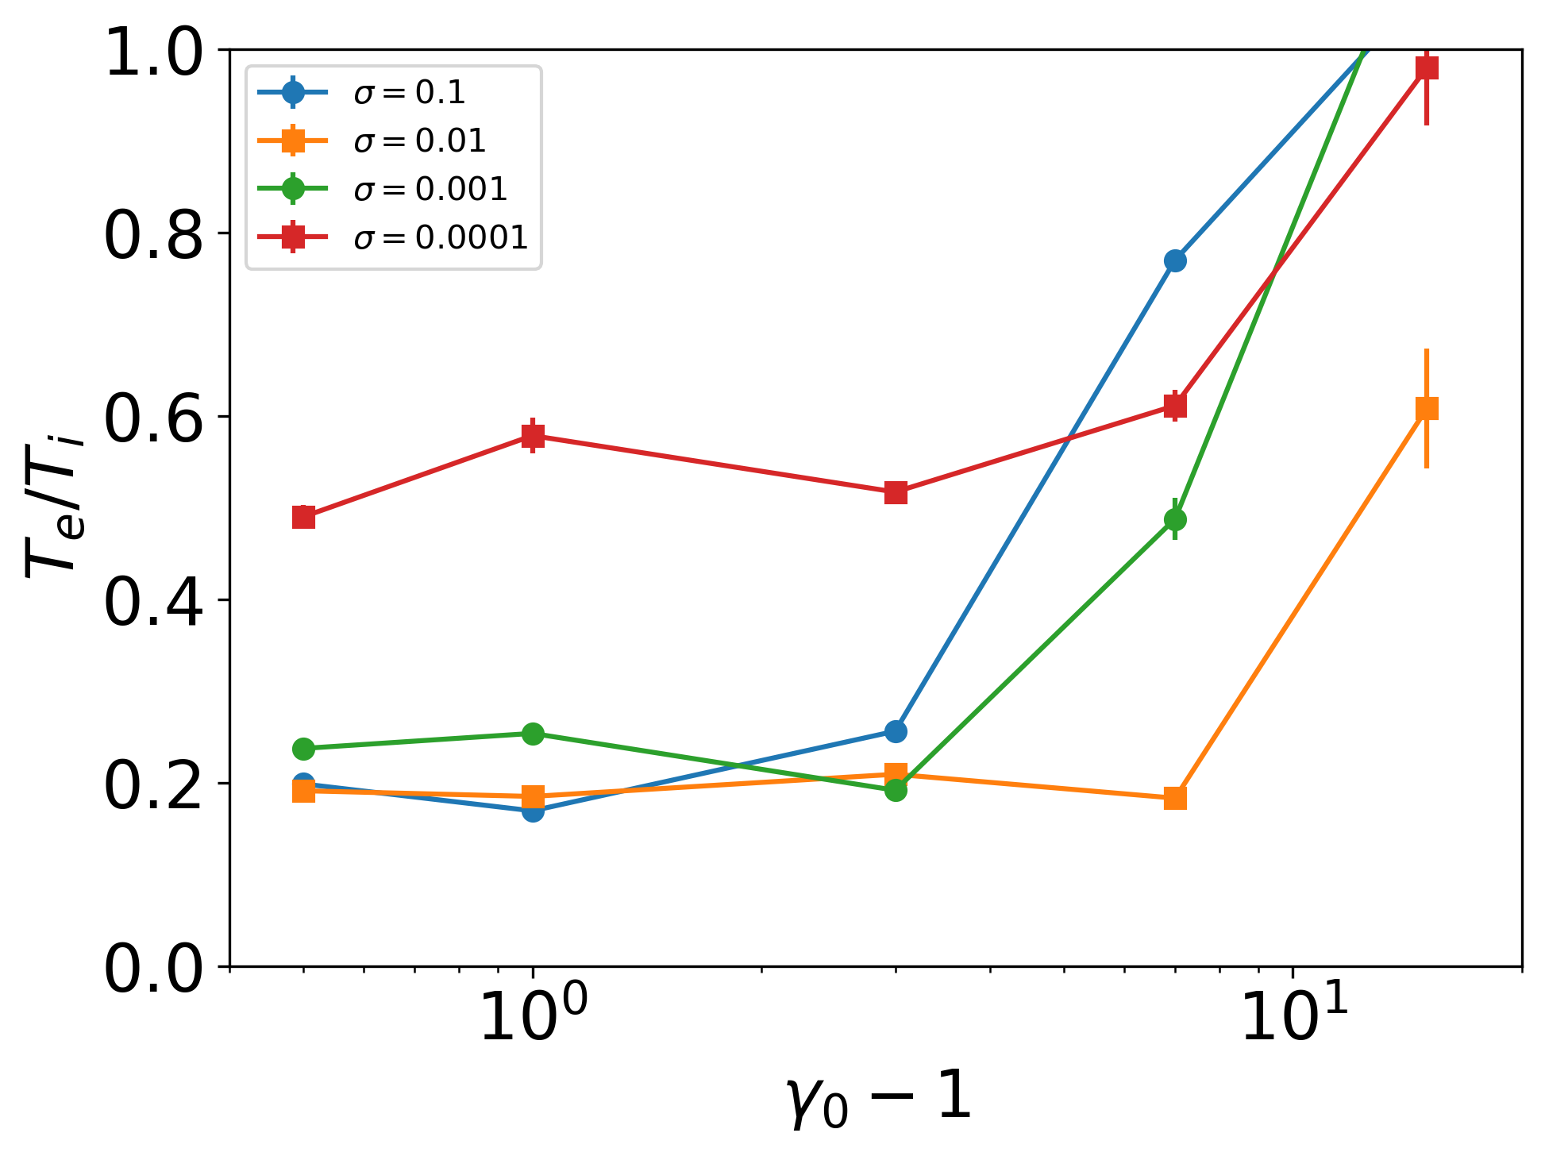
Oblique superluminal shocks (θ_{Bn} = 50°)

Slide 23
Conclusions
(1) Connection of nonthermal emission and PIC simulations is possible
(2) T_{e}/T_{i} d is define by the shock microphysics, which in turn depends on ɣ₀, σ, θ_{Bn}
(3) Even more simulations are needed to determine T_{e}/T_{i} , a_{th}, ɣ_{nth} /θ, p₁

Slide 24
Conclusions
(1) Connection of nonthermal emission and PIC simulations is possible
(2) T_{e}/T_{i} is defined by the shock microphysics, which in turn depends on ɣ₀, σ, θ_{Bn}
(3) Even more simulations are needed to determine T_{e}/T_{i} , a_{th}, ɣ_{nth} /θ, p₁
Thank you

