Slide 1


AGN feedback: a multi-scale and
multi-phase challenge
Vincenzo Mainieri (ESO)

Slide 2

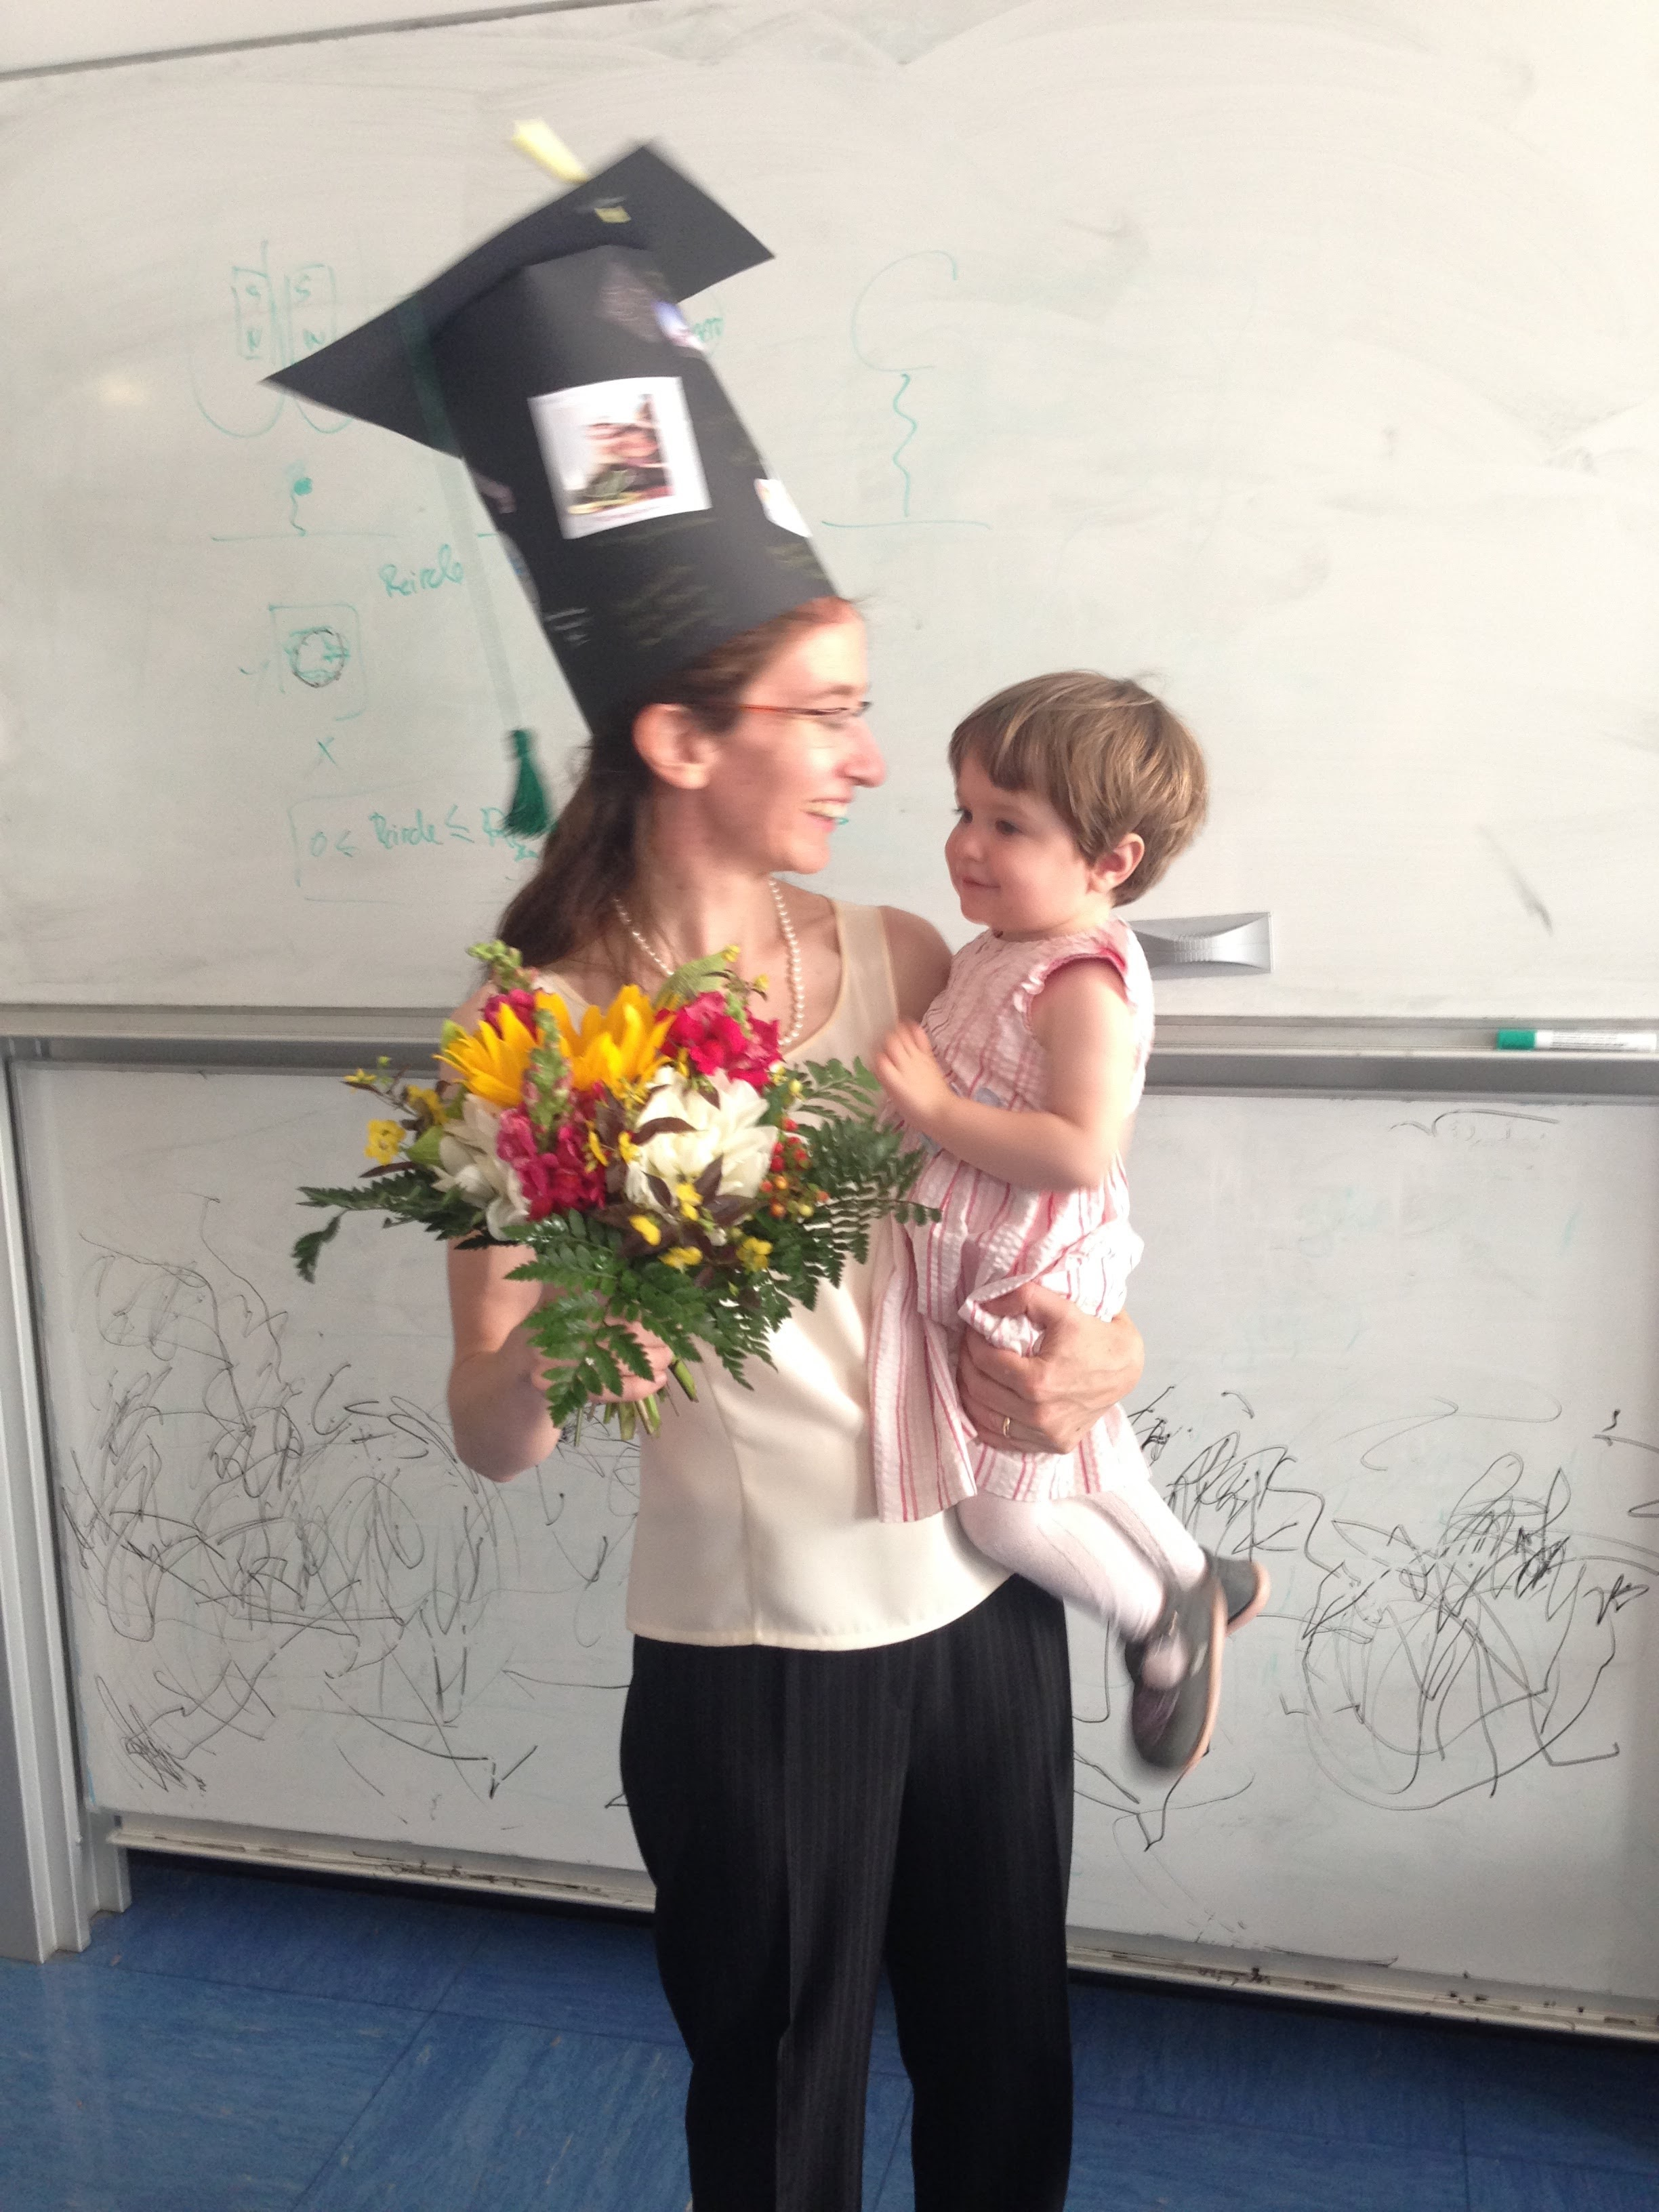

Personal interlude
20+ years working with Paolo from the sub-mJy radio sky to AGN-feedback
Vincenzo Mainieri – Illuminating the Active Universe
Notes:
Focus on the ISM

Slide 3
AGN as a main actor in galaxy evolution?
Jet
Accretion disk
10⁻⁷ of galaxy size
Artist’s Impression
Energy released >> binding energy of galaxy
ESO/M. Kornmesser
Vincenzo Mainieri – Illuminating the Active Universe

Slide 4
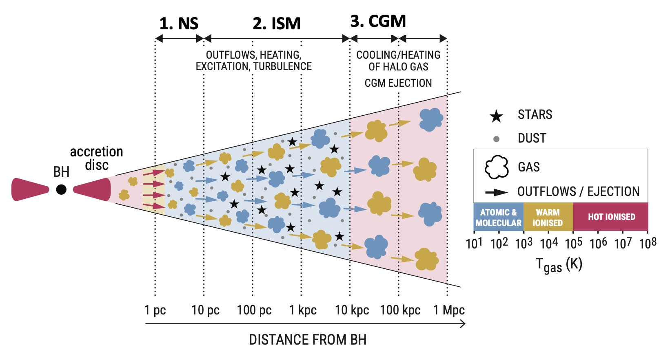
AGN feedback is a multi-scale and multi-phase problem
Harrison & Ramos Almeida 2024
Vincenzo Mainieri – Illuminating the Active Universe
Notes:
Focus on the ISM

Slide 5
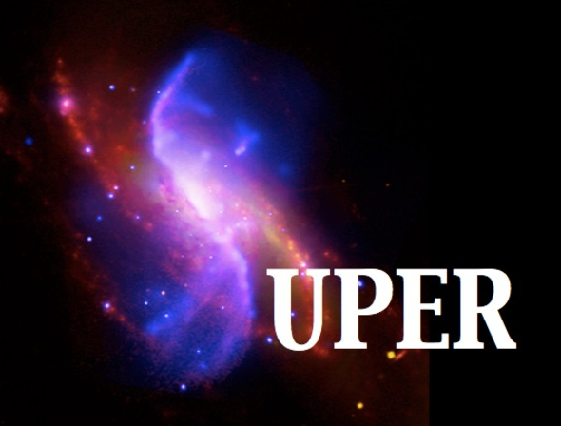
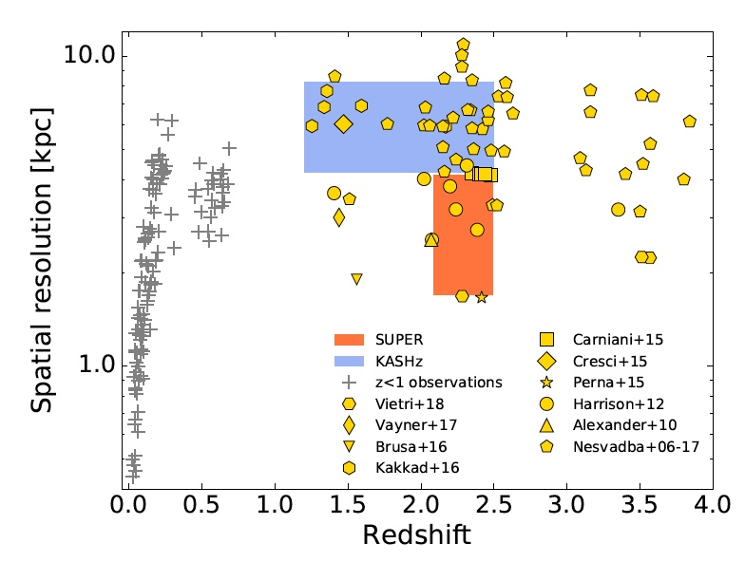
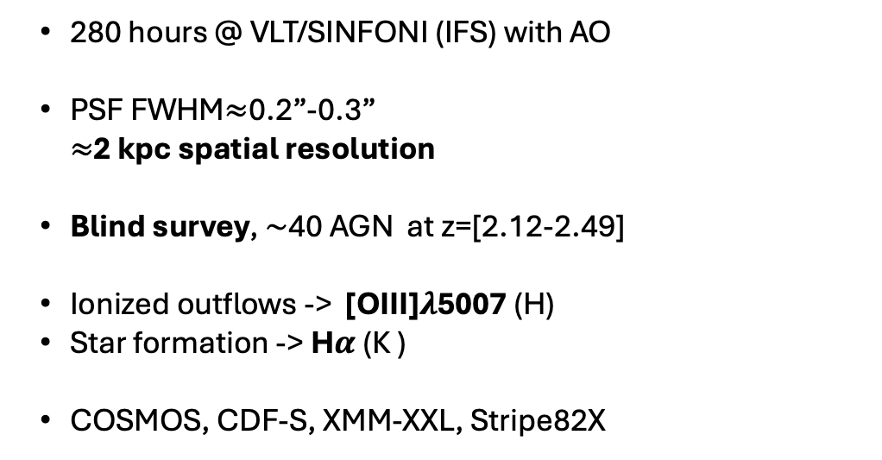
SUPER: a blind ionized outflow study at Cosmic Noon
PI: V. Mainieri
Co-Is: Fiore, Marconi, Balmaverde, Bongiorno, Brusa, Carniani, Cicone, Circosta, Civano, Comastri, Cresci, Feruglio, Georgakakis, Harrison, Husemann, Kakkad, Lamastra, Lamperti, Lanzuisi, Liu, Mannucci, Menci, Menzel, Merloni, Netzer, Padovani, Perna, Piconcelli, Popesso, Puglisi, Salvato, Scholtz, Schramm, Schulze, Silverman, Vietri, Vignali, Zamorani, Zappacosta
280 hours @ VLT/SINFONI (IFS) with AO
PSF FWHM$≈$0.2”-0.3” $≈$2 kpc spatial resolution
Blind survey, $\sim$40 AGN at z=[2.12-2.49]
Ionized outflows -> [OIII]$λ$5007 (H)
Star formation -> H$α$ (K )
COSMOS, CDF-S, XMM-XXL, Stripe82X
Vincenzo Mainieri – Illuminating the Active Universe
Notes:
Focus on the ISM

Slide 6
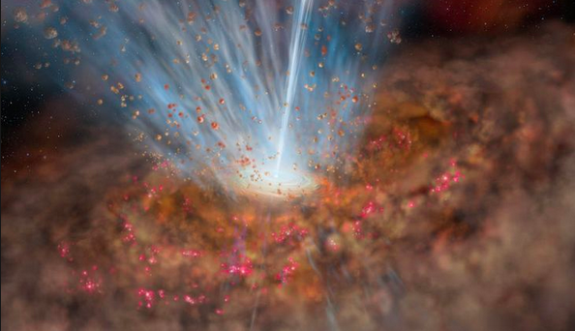
ISM ( 1-10 kpc)
Vincenzo Mainieri – Illuminating the Active Universe
Notes:
Focus on the ISM

Slide 7
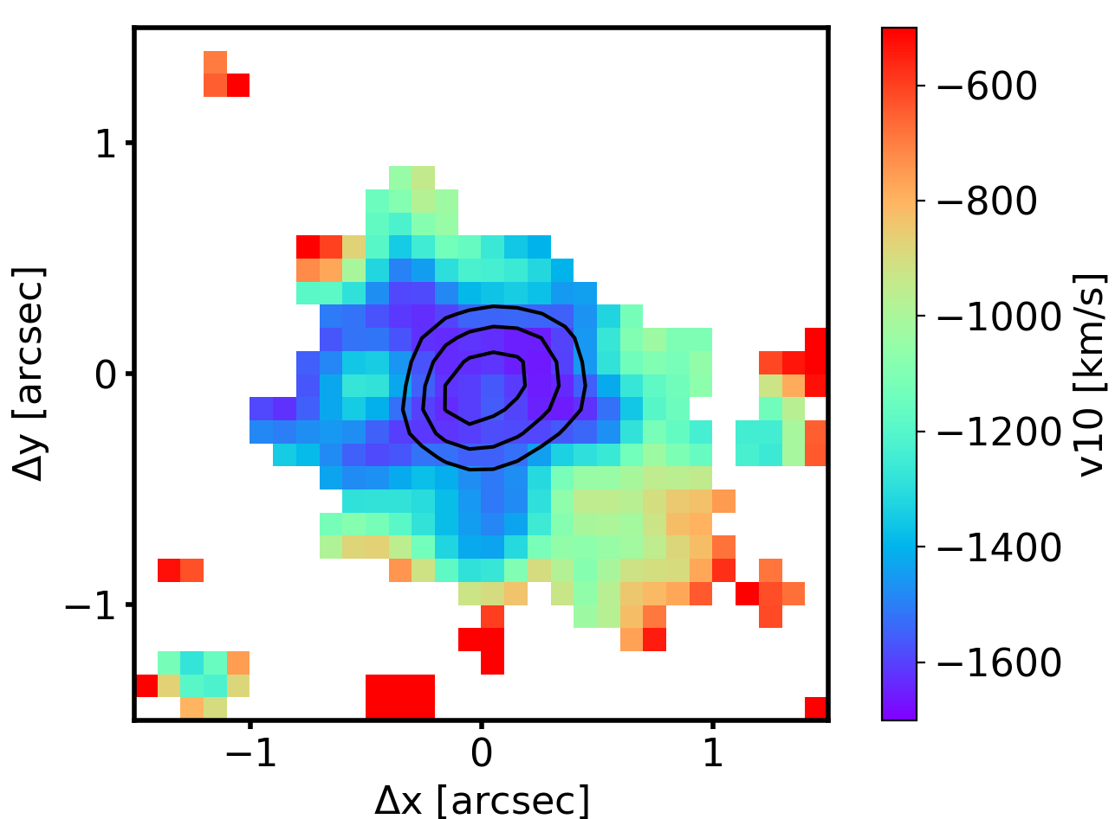
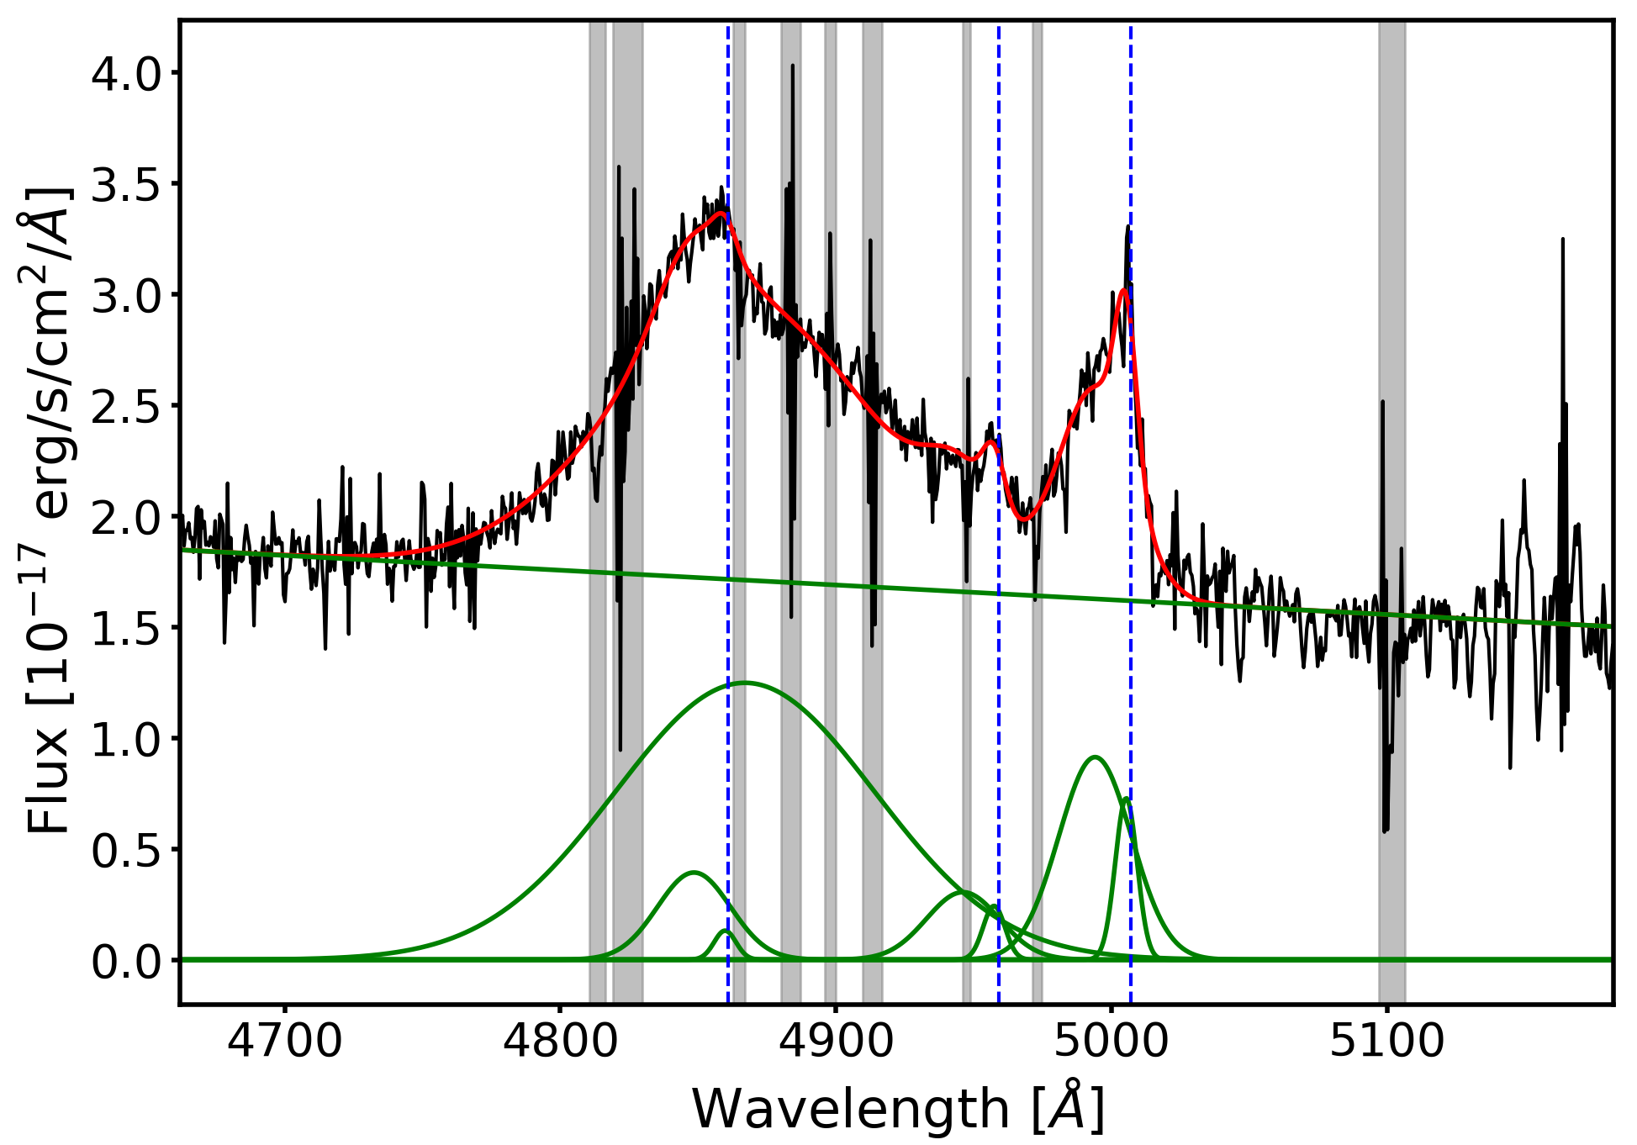
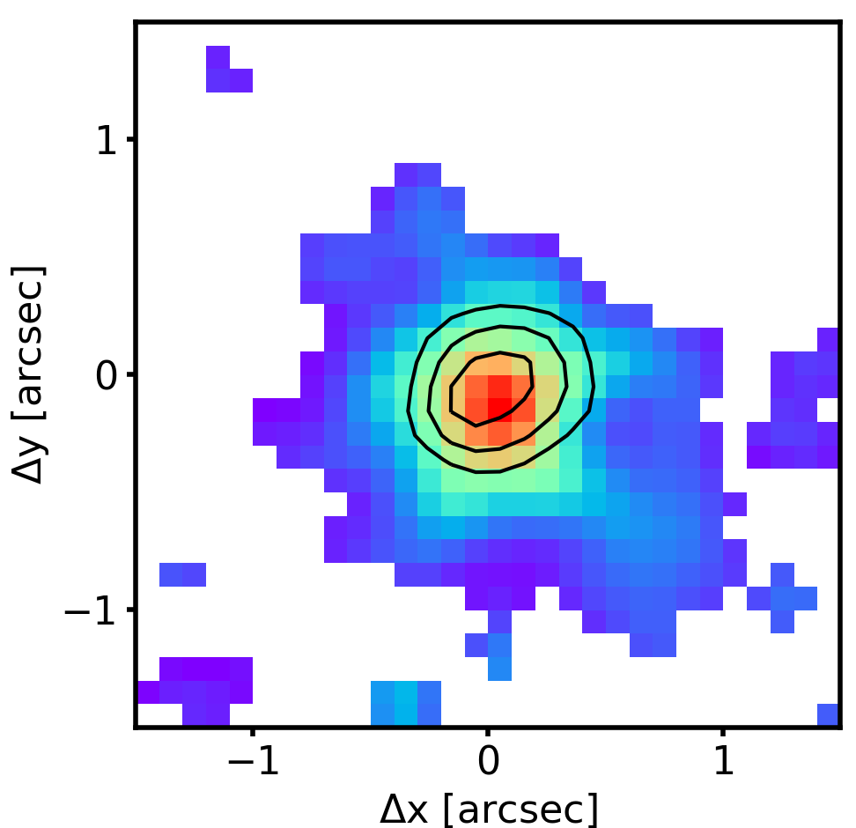
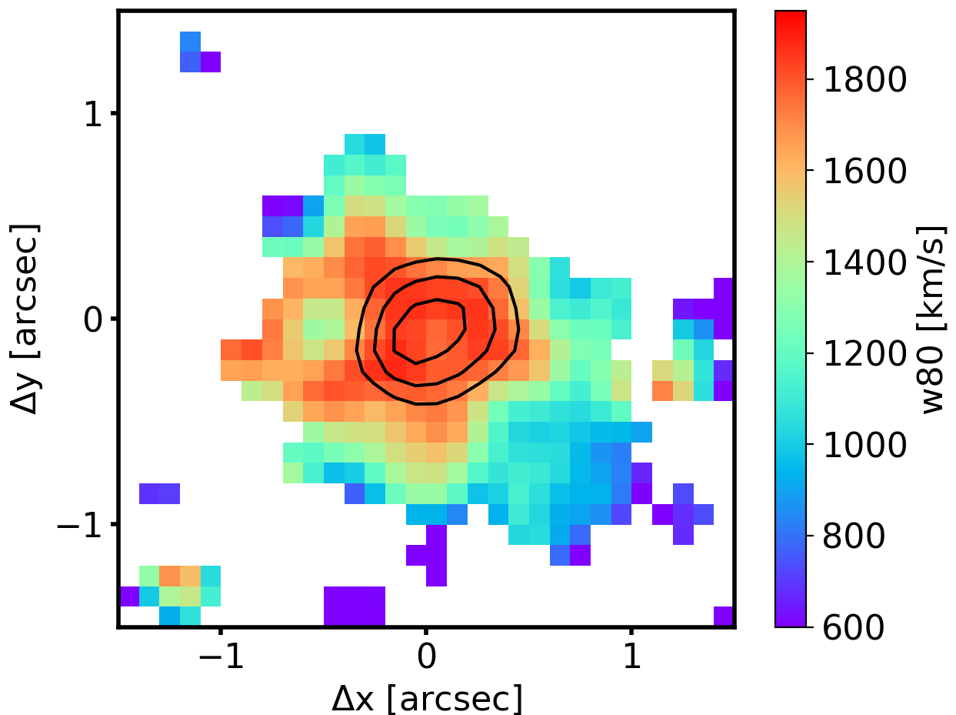
Galactic scale outflow demographic
[OIII]
v10
Kakkad+20
W80
Vincenzo Mainieri – Illuminating the Active Universe
Notes:
Focus on the ISM

Slide 8
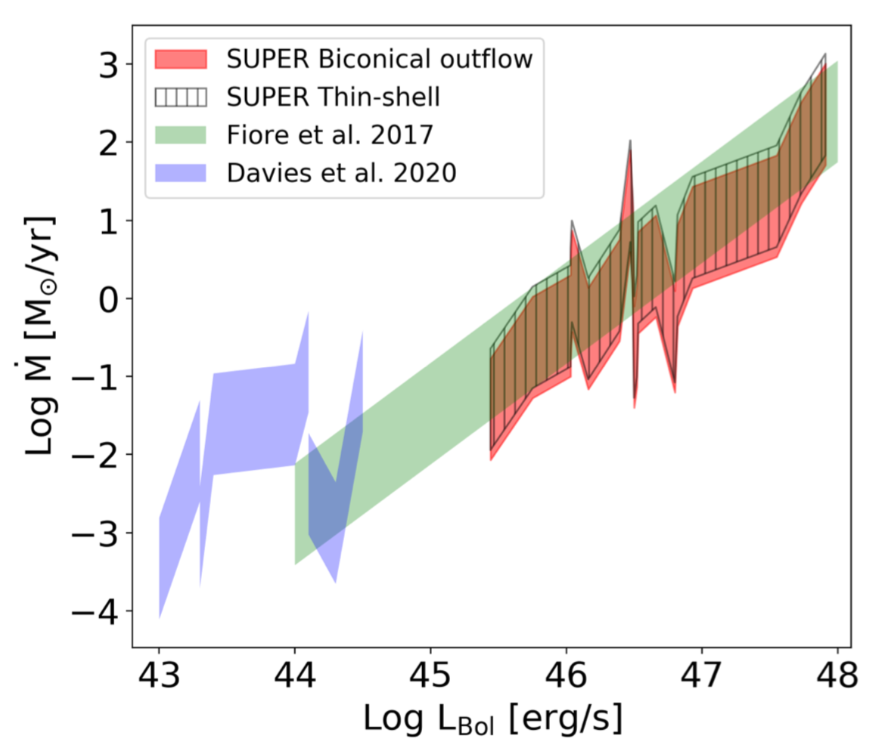
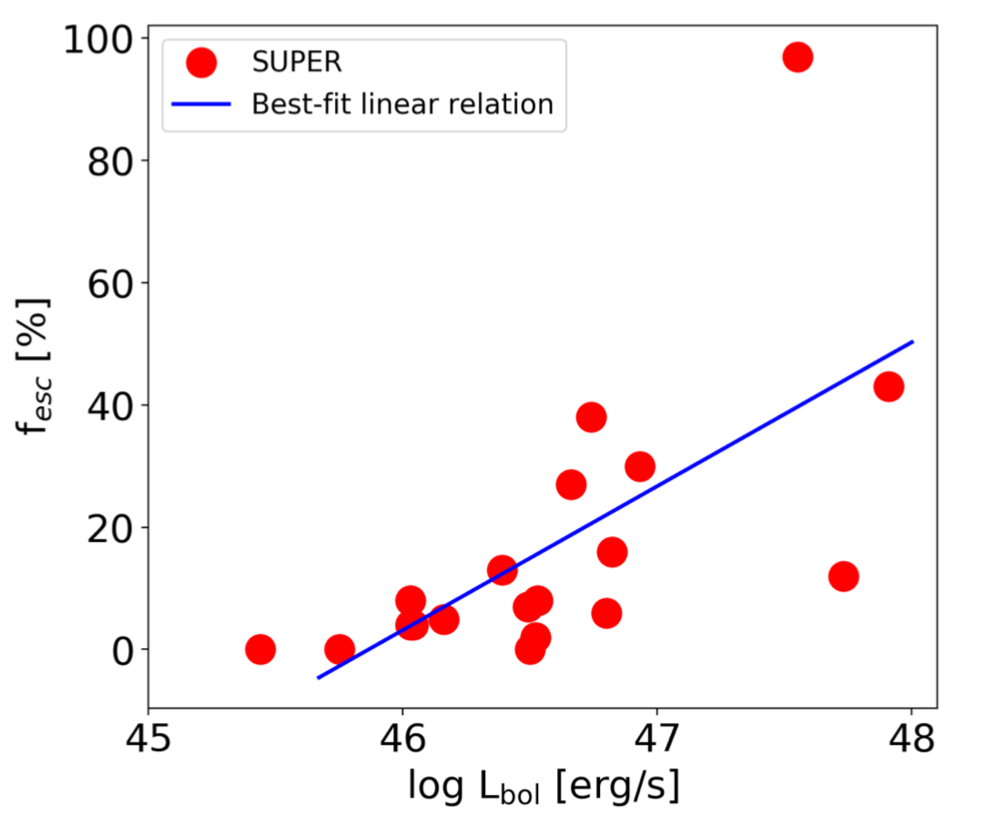
Galactic scale outflow demographic
Kakkad+20
Ṁ_{out} increases with L_{bol}
Ṁ_{out} uncertainties mostly related to the assumption on n_{e}
Most of the ionized gas is not able to escape from the galaxy
Vincenzo Mainieri – Illuminating the Active Universe
Notes:
Focus on the ISM

Slide 9
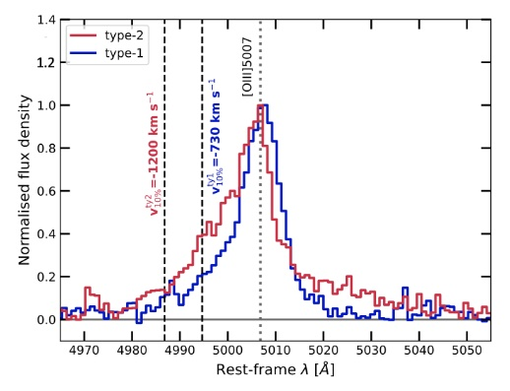
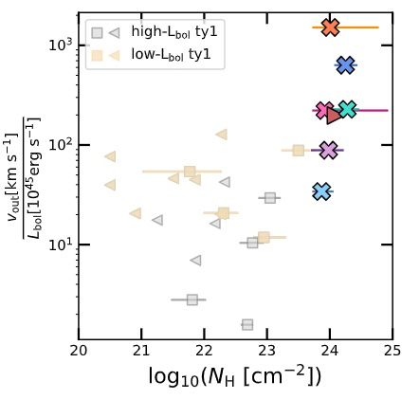
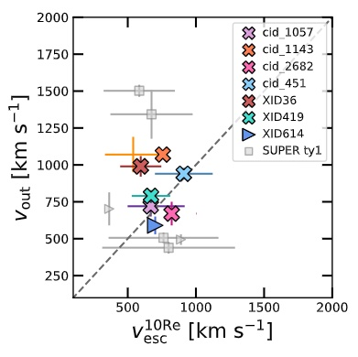
The role of dust
Fast ionized outflows more prevalent in Type-2 than Type-1: radiation pressure on dust as driving mechanism
Outflow velocities comparable with v_{esc}: gas relocated at least to 30-50 kpc from the centre
Tozzi+24
Vincenzo Mainieri – Illuminating the Active Universe
Notes:
We do observe all these different gas phases in the outflows, but for very few objects at the same time. In most studies we cover either one or the other phase.

Slide 10
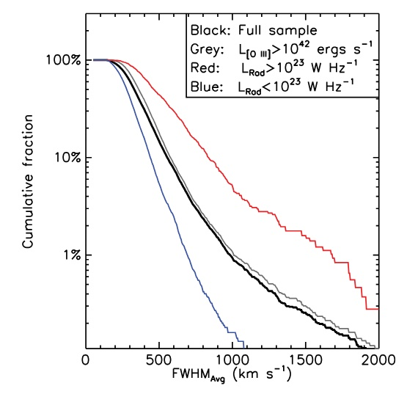
Radio-ISM interaction
Extreme gas kinematics: statistical approach
Higher prevalence of [OIII] outflows in AGN with with moderate radio luminosities (compact rather than extended jets)
Also see, e.g., Zakamska & Greene 2014; Bischetti+17; Molyneux+19; Kukreti+23
Mullaney+13
Vincenzo Mainieri – Illuminating the Active Universe
Notes:
SDSS DR7 optically selected AGN: moderate radio luminous AGN have the broadest [OIII] profile

Slide 11
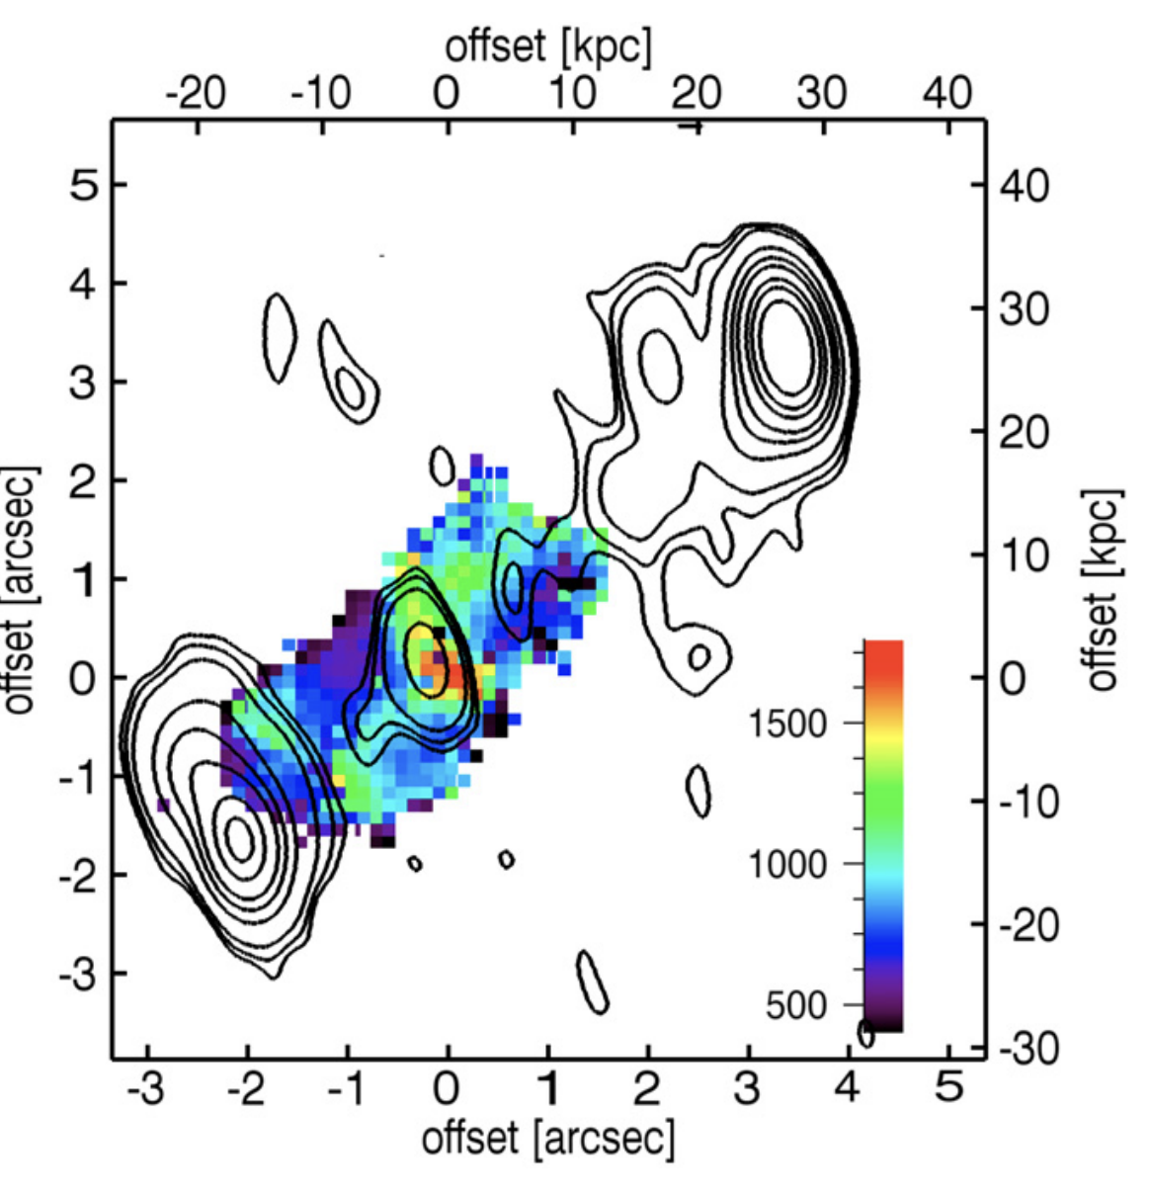
Radio-ISM interaction
Extreme gas kinematics: individual studies
Nesvadba+08; z~2 powerful radio galaxy (and quasar)
[O III] velocity width
Powerful jets
~10⁴⁴ erg s⁻¹
Jet Power
Low power jets
Radiative Power
High velocities (and shocks/ionization) alignment with jets
Vincenzo Mainieri – Illuminating the Active Universe

Slide 12
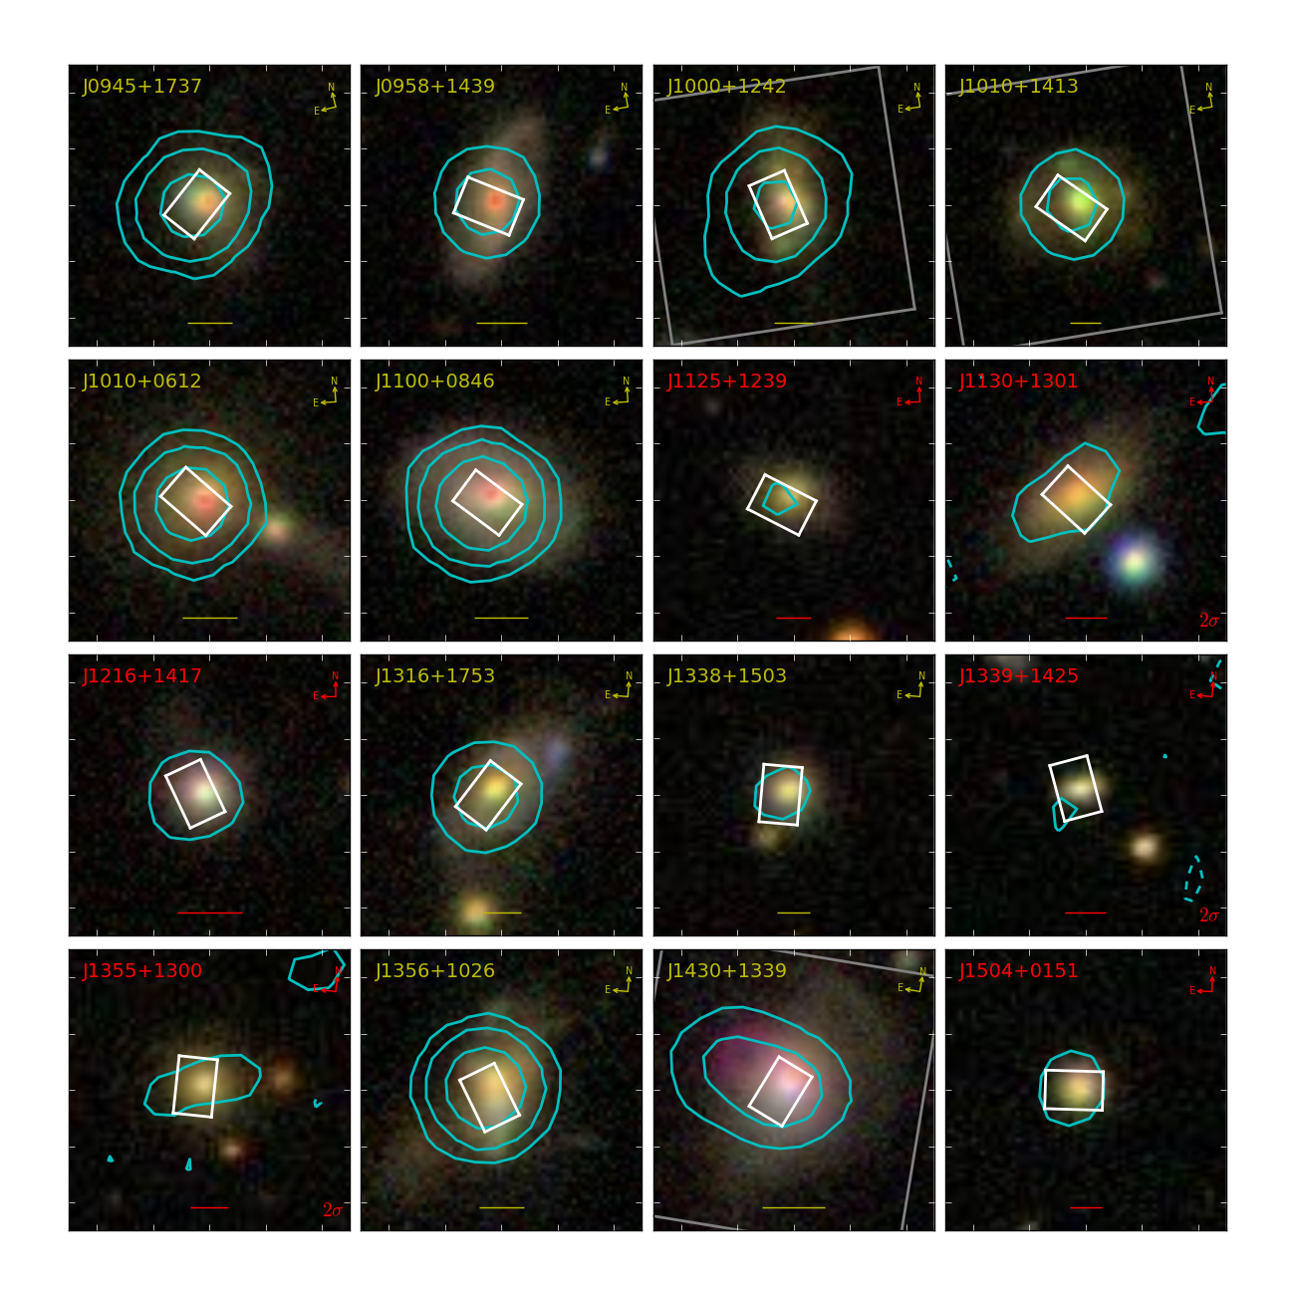
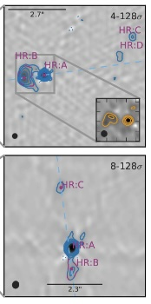
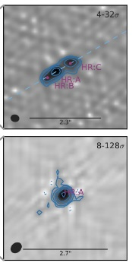
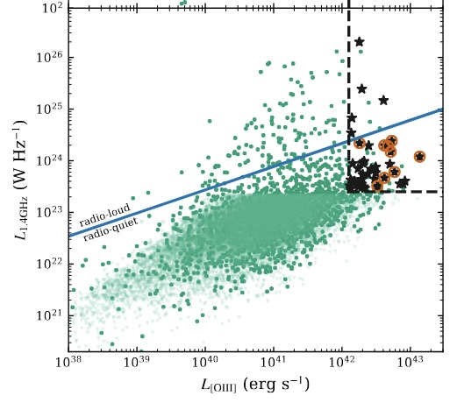
Radio-ISM interaction at z~0.2
High resolution JVLA observations of "radio-quiet" quasars
JVLA (FWHM~0.25")
FIRST (FWHM~5")
Jarvis+19
Vincenzo Mainieri – Illuminating the Active Universe
Notes:
In 7 out of 10 sources we see extended, narrow angle, jet-like radio emission.
J1010+0612 is compact on <0.5 kpc, J1338 is compact on <2kpc scales, J1100 tentative extended emission
The distribution of [O iii] emission (SNR maps) with contours overlaid from the radio images shown in Figures 6 and 7. The beam for each
radio image is shown as a an appropriately coloured ellipse in the top right hand corner. The blue dashed line marks the major axis of the [O iii]
emission defined by fitting a single gaussian to the emission. We observe a close connection between the radio and ionised gas morphologies.

Slide 13
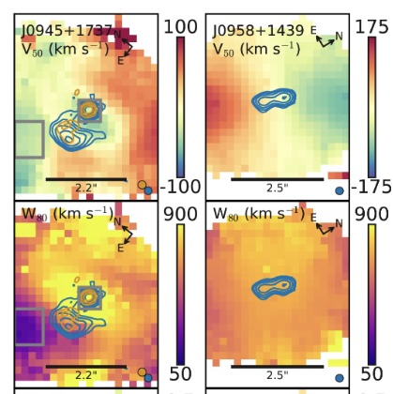
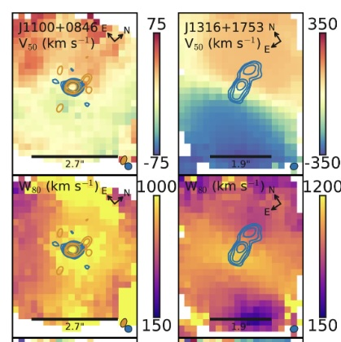
Radio-ISM interaction
[OIII]5007
Jarvis+19
Vincenzo Mainieri – Illuminating the Active Universe
Notes:
In 7 out of 10 sources we see extended, narrow angle, jet-like radio emission.
J1010+0612 is compact on <0.5 kpc, J1338 is compact on <2kpc scales, J1100 tentative extended emission
The distribution of [O iii] emission (SNR maps) with contours overlaid from the radio images shown in Figures 6 and 7. The beam for each
radio image is shown as a an appropriately coloured ellipse in the top right hand corner. The blue dashed line marks the major axis of the [O iii]
emission defined by fitting a single gaussian to the emission. We observe a close connection between the radio and ionised gas morphologies.

Slide 14
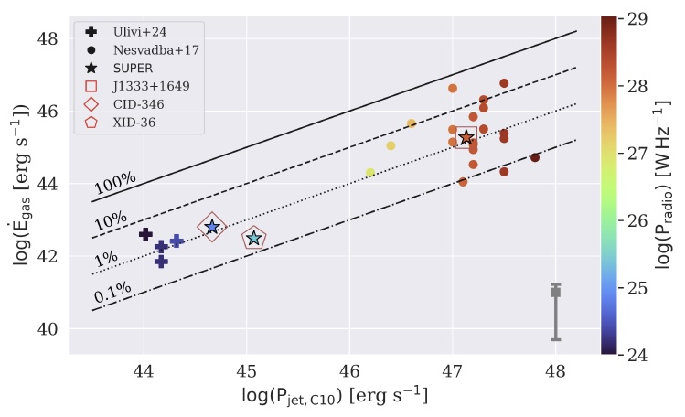
Radio-ISM interaction at z~2
Strong correlation between the kinetic energy of the ionized outflows and the P_{jet}
In average a ~1% coupling between the jet and the ionized ISM
Low-power jets as the driver of the galaxy scale outflows?
Ilha+25
Vincenzo Mainieri – Illuminating the Active Universe
Notes:
The kinetic energy injection rates, scale with kinetic jet power
Kinetic energy injection rates as a function of inferred radio jet power (assuming the radio emission
is attributed to jets) for our targets, Ulivi et al. (2024) and Nesvadba et al. (2017) sample.
The values for our sample were calculated assuming a gas density of 500 cm􀀀3, the same used by
Nesvadba et al. (2017). The gray bar indicates the minimum and
maximum variation in the outflow kinetic power values, considering
electron densities of 104 cm􀀀3 and 300 cm􀀀3, respectively.
The diagonal lines indicate energy coupling efficiencies between the radio jet and
the gas: 100%, 10%, 1%, and 0.1%
coupling efficiencies
around 1%, meaning that approximately 1% of the jet ki- 830
netic power is transferred to the surrounding gas in the form of
outflow kinetic energy, although the values show considerable
scatter. Furthermore, the authors report that no galaxy exhibits a
coupling eciency greater than 100%, indicating that no additional
energy source beyond the radio jet is required to account
for the observed kinetic energy in the gas

Slide 15
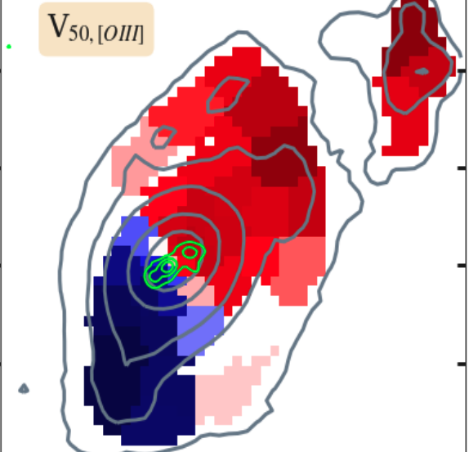
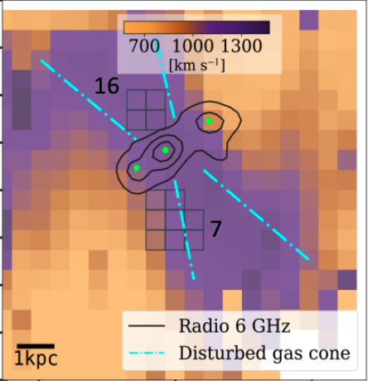
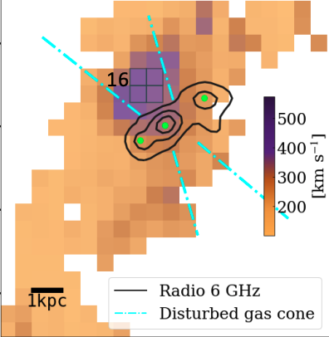
Radio-ISM interaction
The low-power jet inclined into the disk increase the turbulence of the ISM in multiple gas phases.
[OIII] Velocity
[O III] Velocity Width
CO(3-2) Velocity Width
Girdhar et al. (2022); z~0.1 ‘radio quiet’ quasar, ~1kpc low power jet inclined into disk
Also see, e.g., Nesvadba+08,17a,b; Couto+13; Riffel+14; Mahoney+16; Aalto+16; Husemann+19; Bischett+19; Venturi+21; Fernandez-Ontiveros+20; Smethurst+21; Zanchettin+21; Bianchin+22; Speranza+22; Audibert+23; Zanchettin+23; Ulivi+24
Vincenzo Mainieri – Illuminating the Active Universe
Notes:
The turbulent gas is driven perpendicular to the jet axis and is escaping along the galaxy minor axis, reaching 7.5 kpc on both sides. Traced via CO(3–2) emission, the turbulent material in molecular gas phase is one-third as spatially extended and has three times lower velocity-dispersion as compared to ionized gas.

Slide 16
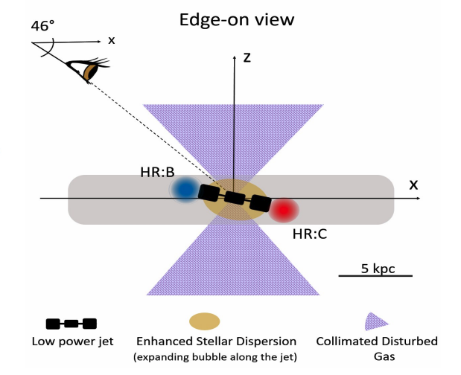
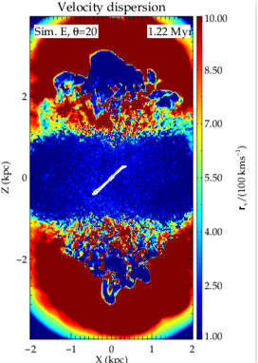
Radio-ISM interaction
Extreme gas kinematics: individual galaxies (spatially resolved)
Girdhar et al. (2022); z~0.1 ‘radio quiet’ quasar, ~1kpc low power jet inclined into disk
Low-power jets are ”trapped” in the disk for longer times: their impact is amplified, stirring of the ISM which may inhibit star-formation
Mukherjee+18
Also see, e.g., Nesvadba+08,17a,b; Couto+13; Riffel+14; Mahoney+16; Aalto+16; Husemann+19; Bischetti+19; Venturi+21; Fernandez-Ontiveros+20; Smethurst+21; Zanchettin+21; Bianchin+22; Speranza+22; Audibert+23; Zanchettin+23; Ulivi+24
Vincenzo Mainieri – Illuminating the Active Universe
Notes:
Unlike high-power jets that escape swiftly, low- and moderate-power jets are seen to
be trapped for longer in simulations. Their effect is amplified due to the development of an energy bubble which is basically a cocoon
of a shocked ISM and plasma. This interaction leads to the constant stirring of the ISM with the energy bubble, thus inhibiting the star
formation (see Mukherjee et al. 2016).

Slide 17
Do AGN triggered outflows affect the level of star formation in the host?
Direct measures
Vincenzo Mainieri – Illuminating the Active Universe
Notes:
Focus on the ISM

Slide 18
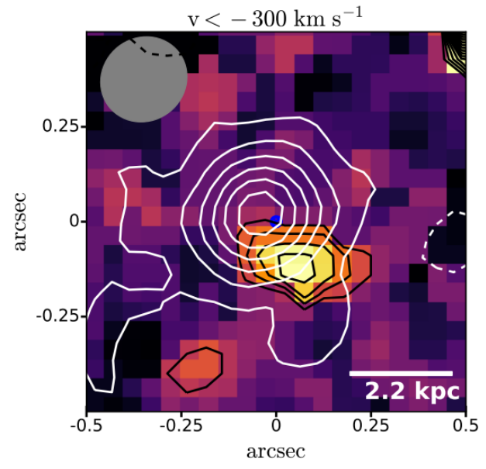
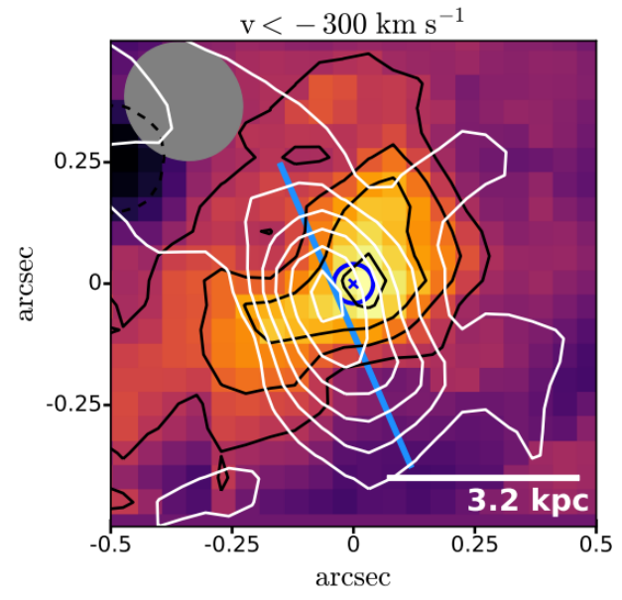
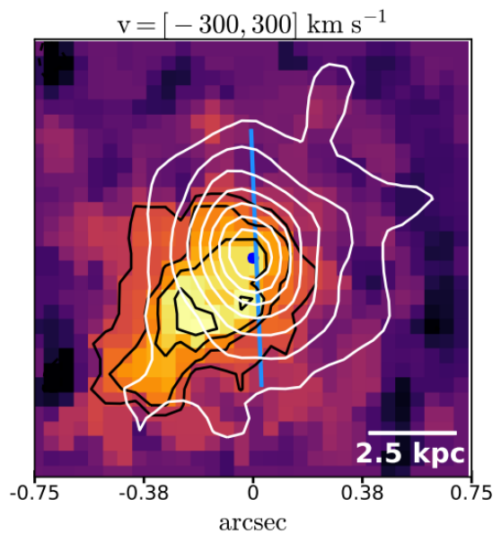
Do AGN triggered outflows affect the level of star formation in the host?
Lamperti+21
No clear sign of suppressed SF at the location of the outflow
  Impact on scales below our resolution (~2 kpc)
  An alternative tracer of “recent” star-formation?
Vincenzo Mainieri – Illuminating the Active Universe
Notes:
Focus on the ISM

Slide 19
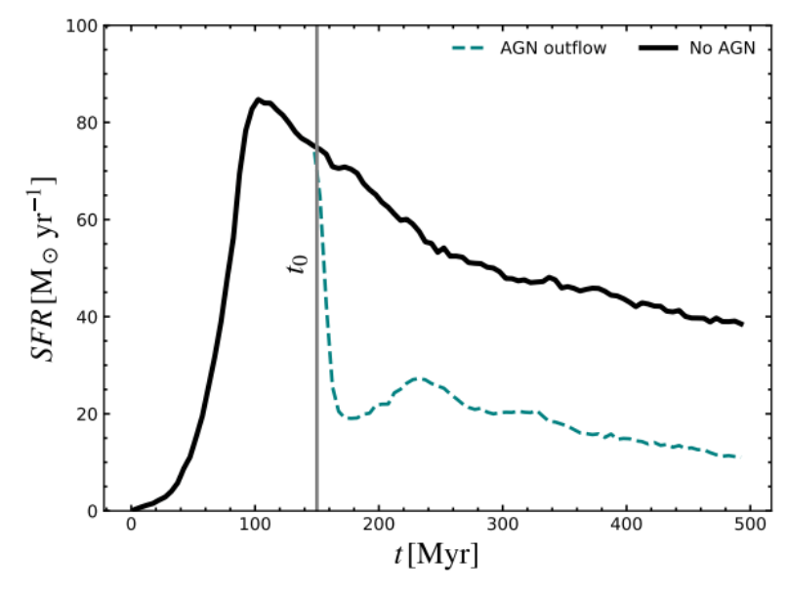
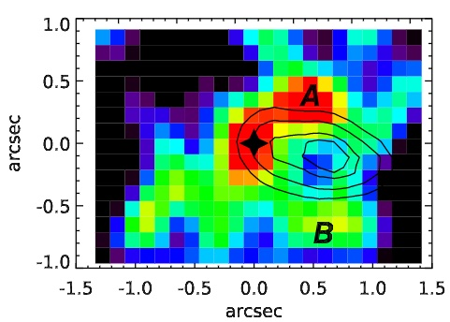
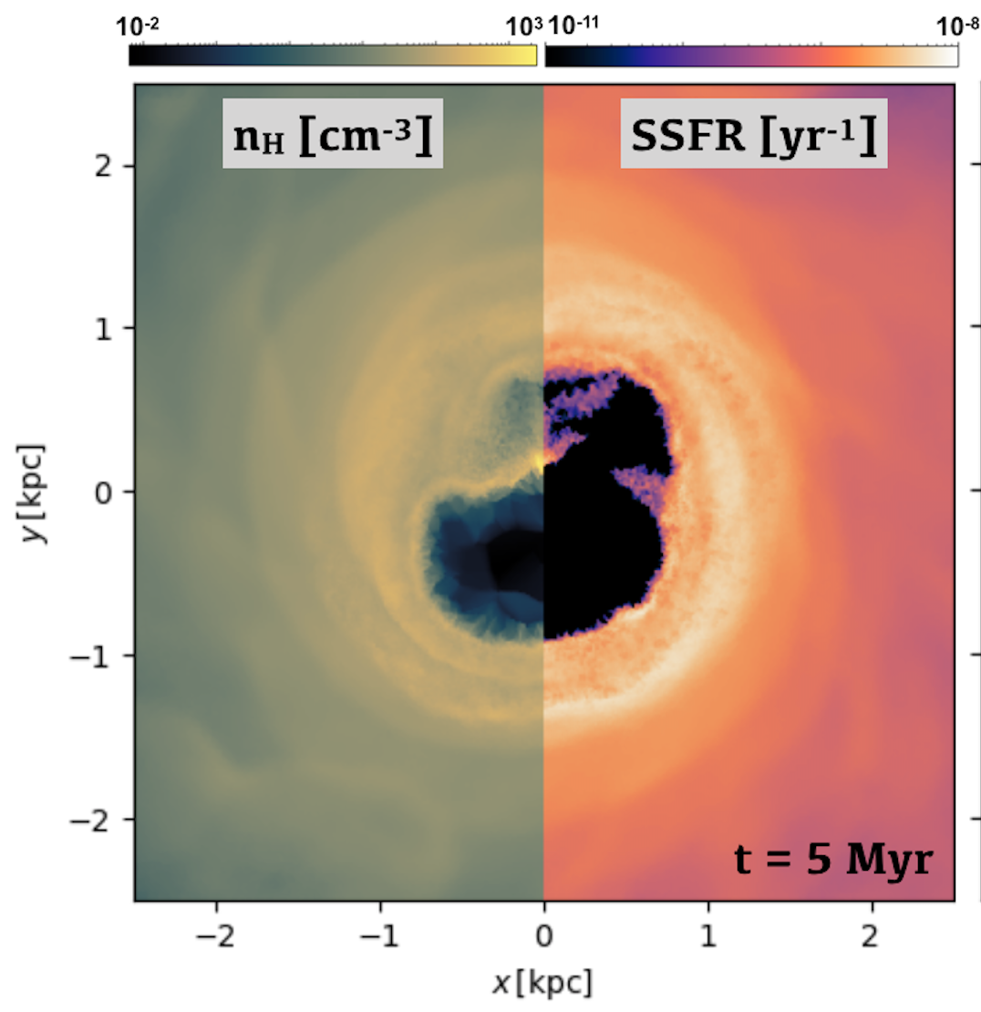
Do AGN triggered outflows affect the level of star formation in the host?
We need an “instantaneous” SFR tracer
H⍺ once removed the AGN contamination
t₀: AGN outflow triggered
H⍺
Costa+20
Outflow
Cresci+15
Vincenzo Mainieri – Illuminating the Active Universe
Notes:
Focus on the ISM

Slide 20
Do AGN triggered outflows affect the level of star formation in the host?
Indirect measures
Vincenzo Mainieri – Illuminating the Active Universe
Notes:
Focus on the ISM

Slide 21
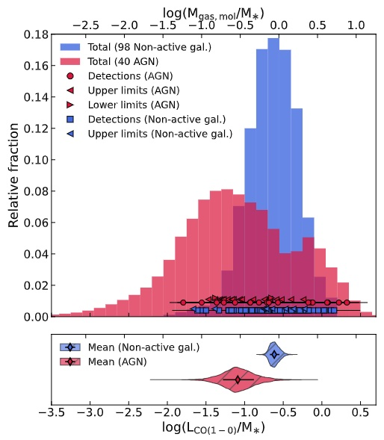
Cold molecular gas reservoir
How is AGN feedback acting:
The molecular gas is dissociated
The molecular gas is pushed outside the galaxy
The molecular gas is excited to higher temperature which are CO-dark
Bertola+24
The molecular gas fraction in AGN and non-AGN galaxies are statistically different: AGN activity depleting the cold gas reservoirs
Also see e.g., Carniani+17; Brusa+18; Vietri+18; Perna+18; Loiaconoi+19; Bischetti+21; Frias Castillo+24
Vincenzo Mainieri – Illuminating the Active Universe
Notes:
Gas heated to a higher temperatures (e.g. see warm molecular gas results)

Slide 22
Cold molecular gas reservoir
How is AGN feedback acting:
The molecular gas is dissociated
The molecular gas is pushed outside the galaxy
The molecular gas is excited to higher temperature which are CO-dark
Bertola+24
The molecular gas fraction in AGN and non-AGN galaxies are statistically different: AGN activity depleting the cold gas reservoirs
Also see e.g., Carniani+17; Brusa+18; Vietri+18; Perna+18; Loiaconoi+19; Bischetti+21; Frias Castillo+24
Vincenzo Mainieri – Illuminating the Active Universe
Notes:
Gas heated to a higher temperatures (e.g. see warm molecular gas results)

Slide 23

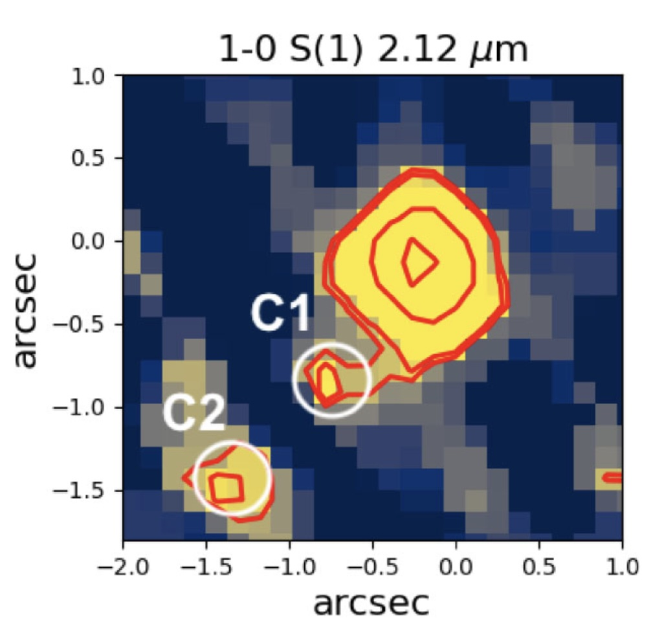
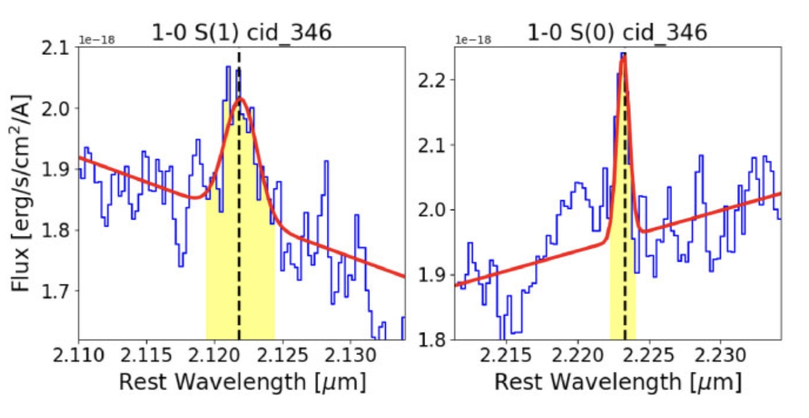
Warm molecular gas in AGN at Cosmic Noon
Warm molecular gas content and kinematics in AGN with ionized outflows
MIRI-MRS follow-up in Cy-1 and Cy-2.
Kakkad+25
Vincenzo Mainieri – Illuminating the Active Universe
Notes:
We do observe all these different gas phases in the outflows, but for very few objects at the same time. In most studies we cover either one or the other phase.

Slide 24
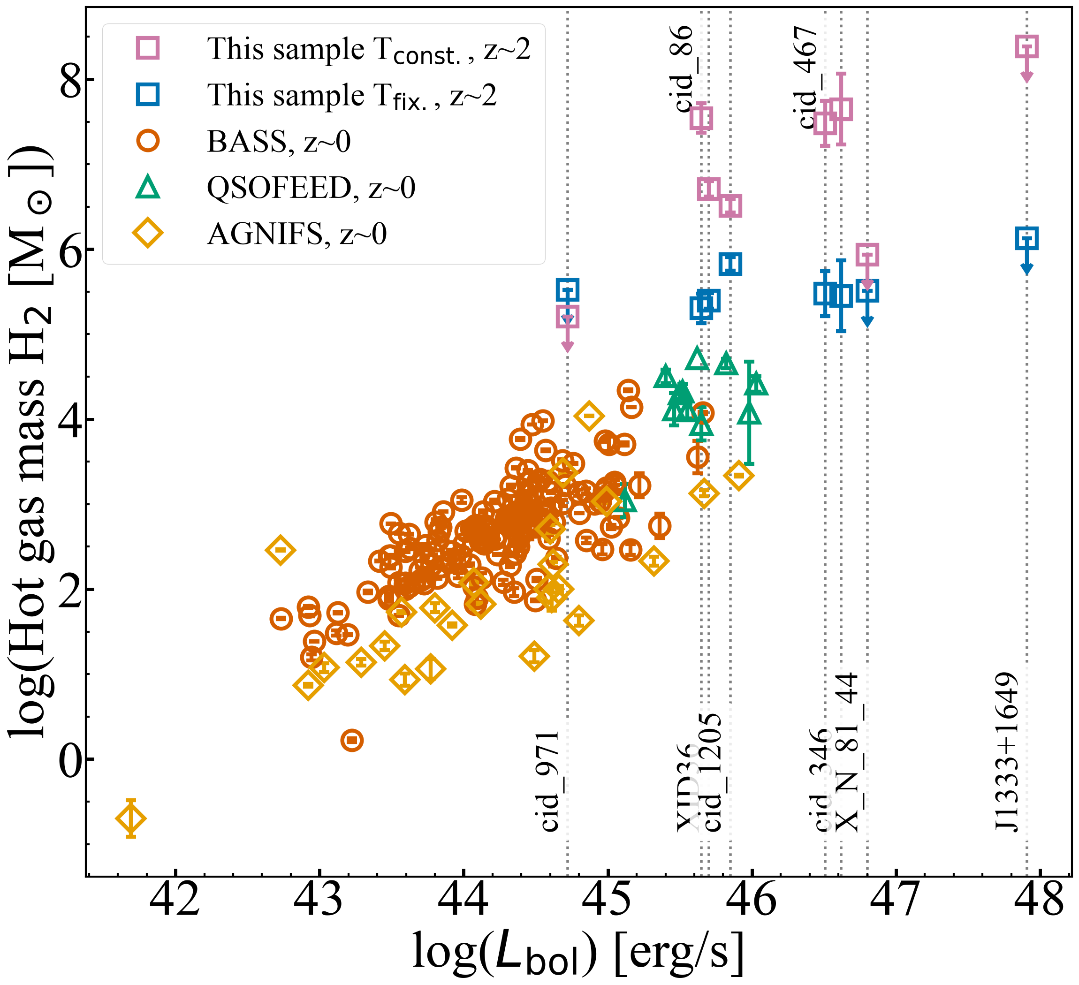
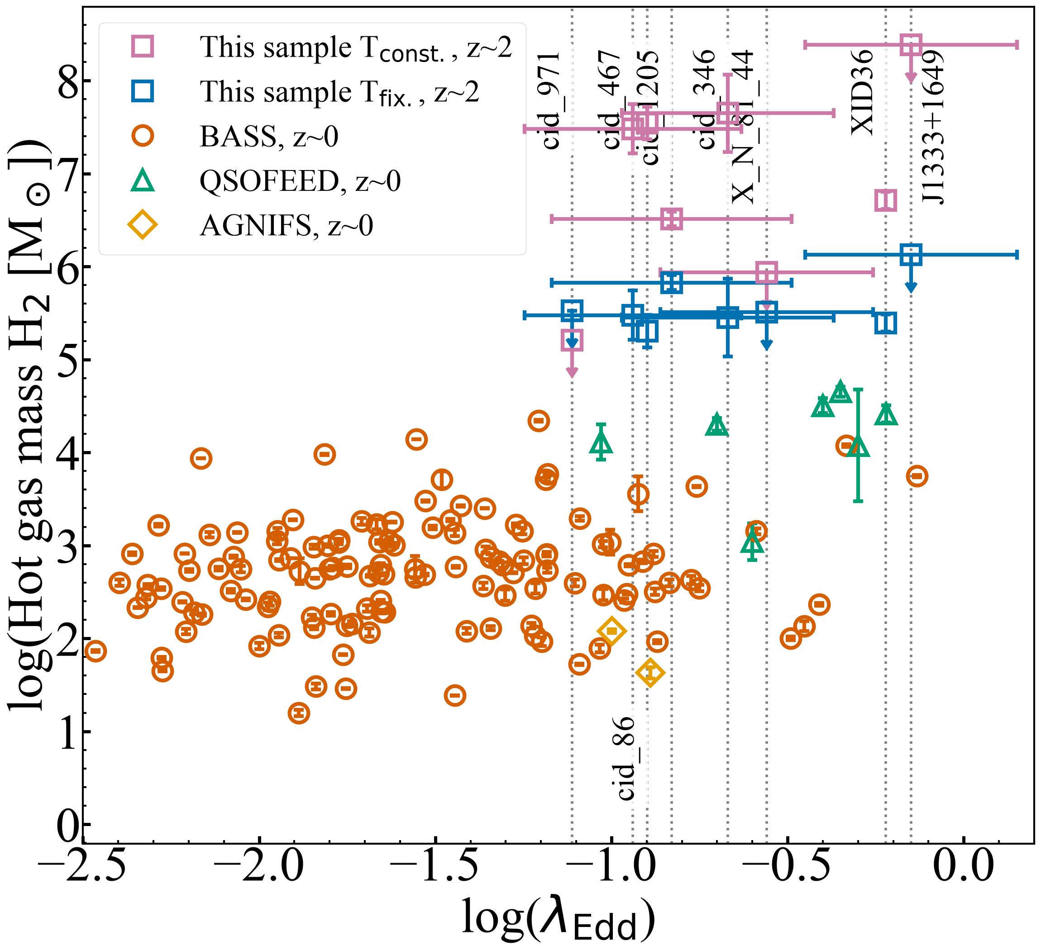
Warm molecular gas in AGN at Cosmic Noon
Warm molecular gas content increase with AGN bolometric luminosity and Eddington ratios.
Rueda Vargas +26
Vincenzo Mainieri – Illuminating the Active Universe
Notes:
We do observe all these different gas phases in the outflows, but for very few objects at the same time. In most studies we cover either one or the other phase.

Slide 25
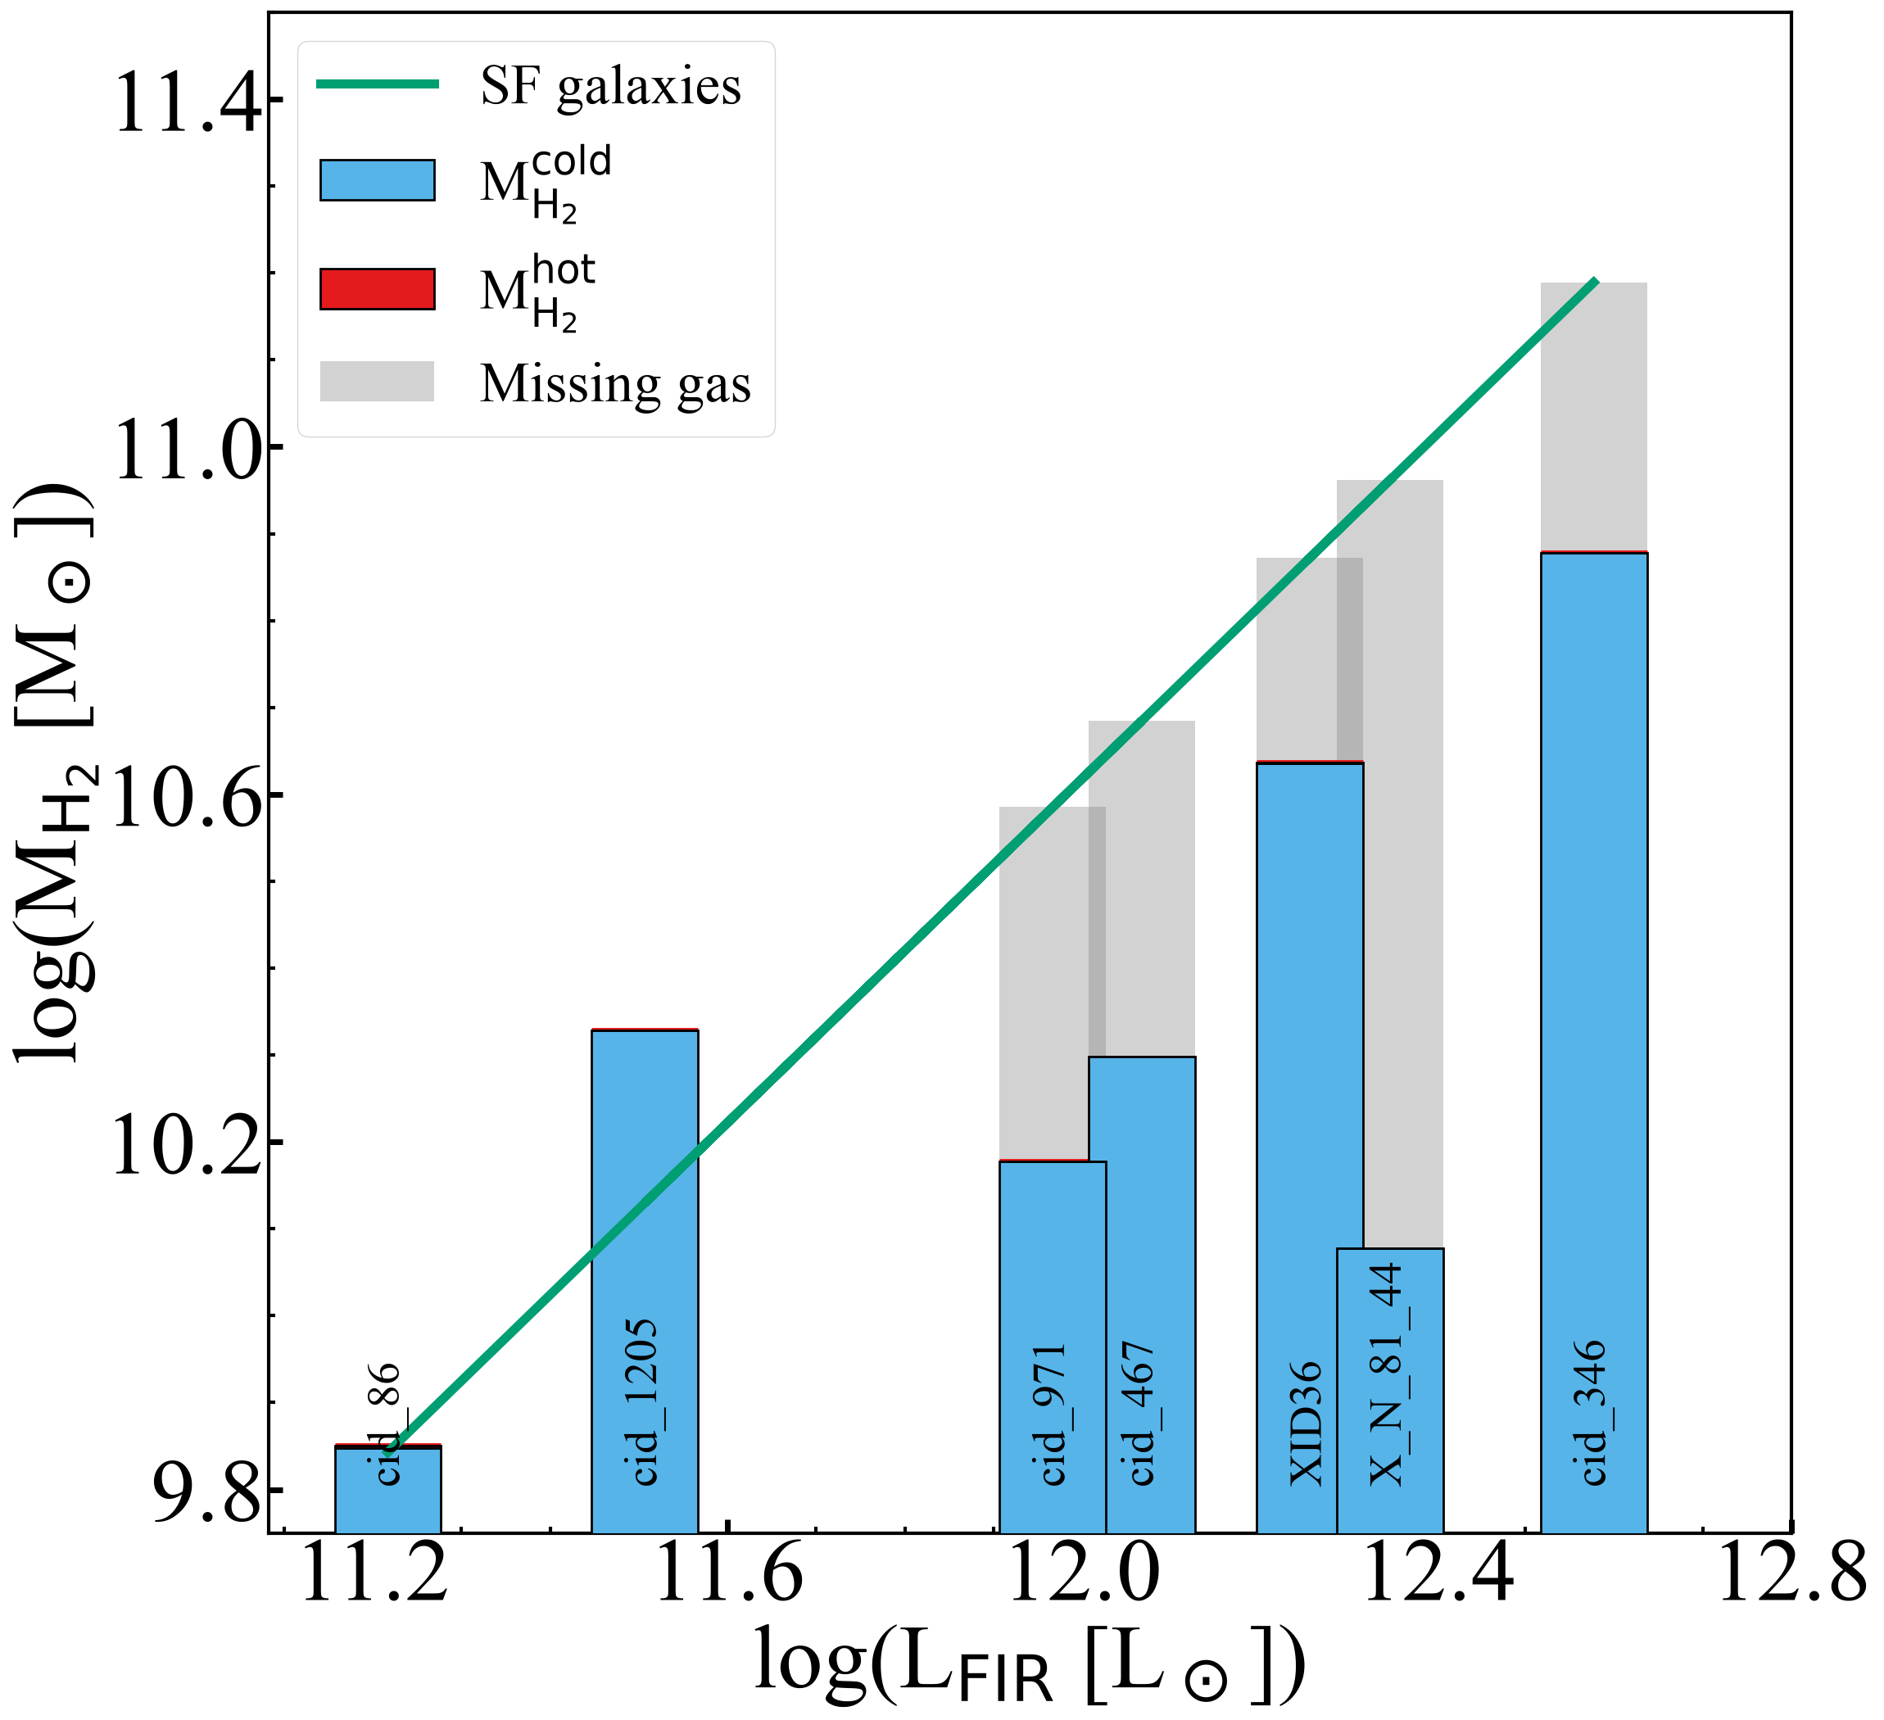
Warm molecular gas in AGN at Cosmic Noon
The detected warm molecular gas account for a small fraction of the "missing" cold molecular gas.
Rueda Vargas +26
Vincenzo Mainieri – Illuminating the Active Universe
Notes:
We do observe all these different gas phases in the outflows, but for very few objects at the same time. In most studies we cover either one or the other phase.

Slide 26

"Observational experiments"
Idealised, hydro-simulations, measure outflow properties “like an observer”
AGN Feedback Model
What can we learn from observed properties?
Ward, Costa, Harrison & Mainieri (2024)
Vincenzo Mainieri – Illuminating the Active Universe

Slide 27
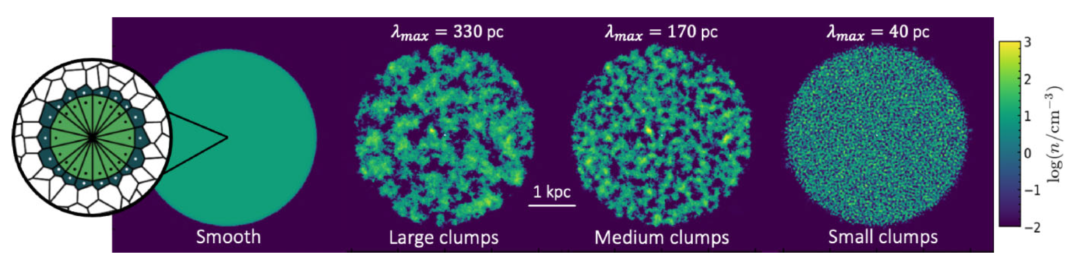

Inject quasar winds into galaxy disks
Inject AGN wind into static disk:
(model from Costa+20)
Fiducial model:
L_{AGN} = 10⁴⁵ erg/s
V_{w} = 10⁴ km/s
Disk: d=4kpc, h=1kpc
Hydro-code: AREPO:
Resolution: reaches ~1pc
Includes primordial cooling
$${\dot{E}}_{w}= \frac{v_{w}}{2c}L_{AGN}$$
Ward, Costa, Harrison & Mainieri (2024)
Vincenzo Mainieri – Illuminating the Active Universe

Slide 28
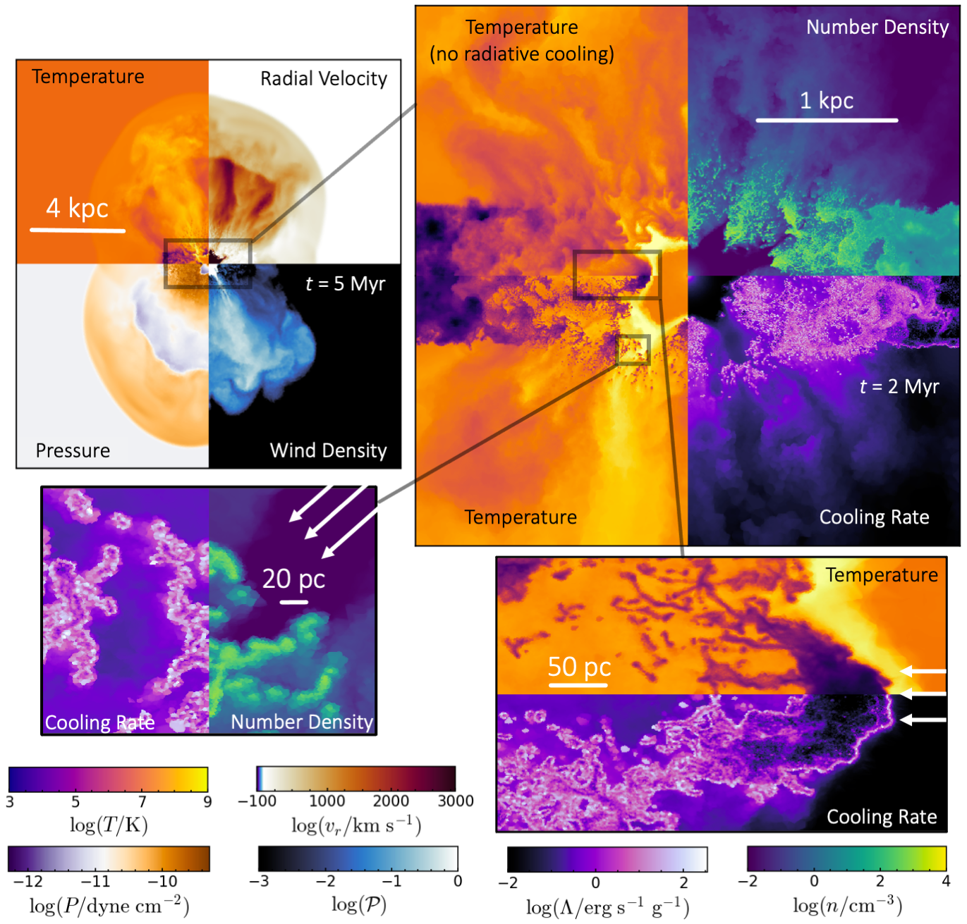
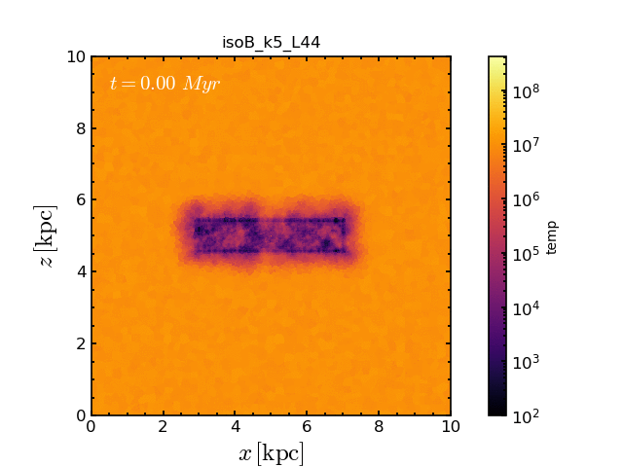
Outflows “vents” through paths of least resistence
Large-scale collimated outflow (wind injected spherically on small scales)
Cold clumps inside hot diffuse outflow
Vincenzo Mainieri – Illuminating the Active Universe

Slide 29
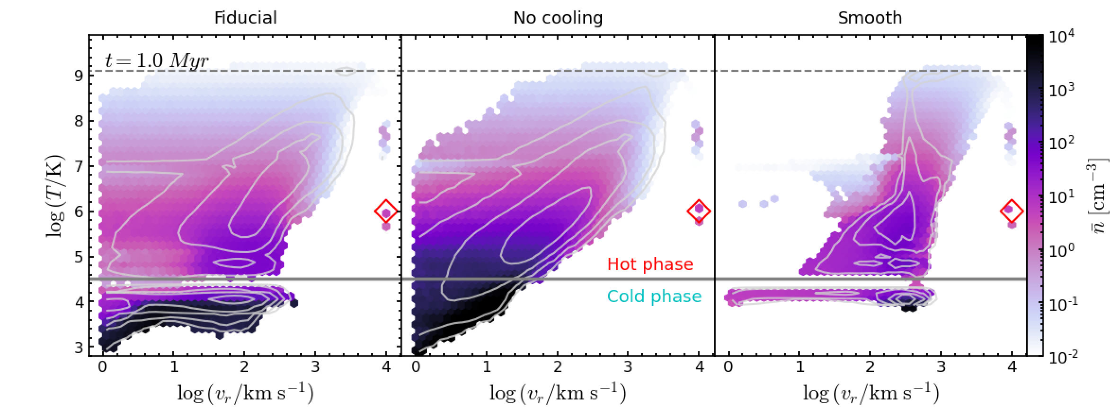
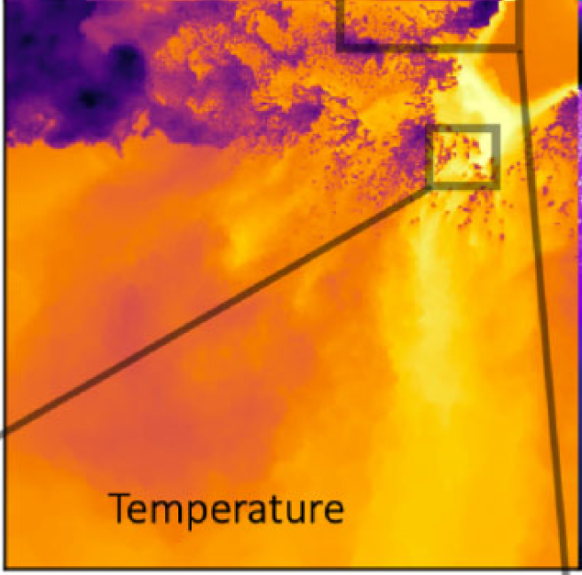
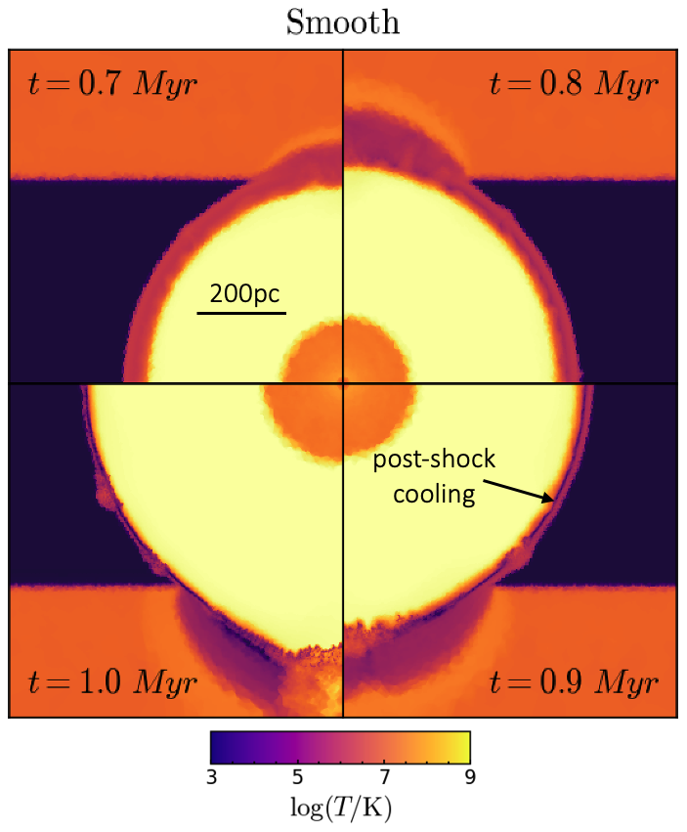
Realistic ISM leads to very different predictions
“Hot”
(hot, invisible or X-ray emitting gas)
Well defined
v_{OF}
in all phases
“Cold”
(warm ionized outflows, cold molecular outflows…)
No characteristic
v_{OF}
Ward, Costa, Harrison & Mainieri (2024)
Vincenzo Mainieri – Illuminating the Active Universe
Notes:
The morphology of this outflow depends strongly on the initial conditions: a smooth disc results in a thin shell of cold gas, formed by post-shock cooling, outflowing at a similar velocity as the shocked ambient medium. An initially clumpy set-up results in high-velocity chimneys of hot gas, as the wind punches through regions of low density. The addition of cooling further results in the initial clumps fragmenting into small (10–20 pc) cloudlets which are then entrained in the hot outflow and can survive, or grow, on Myr time-scales due to efficient cooling at their surface.
The high density of this shell results in a shorter cooling time, creating a multiphase outflow where the hot and cold components are expanding co-spatially with
the same velocity.

Slide 30
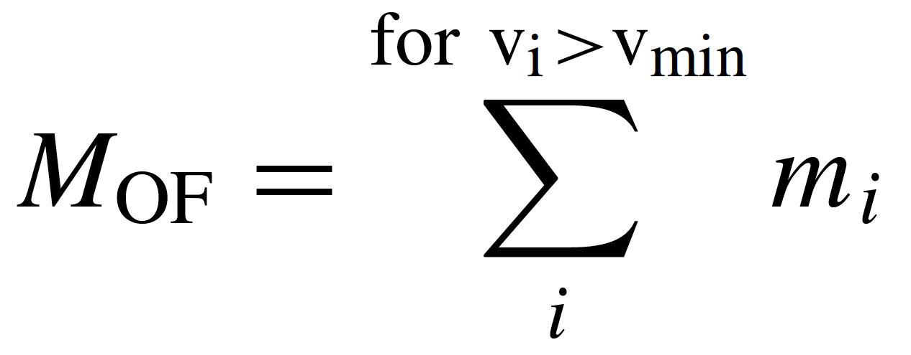
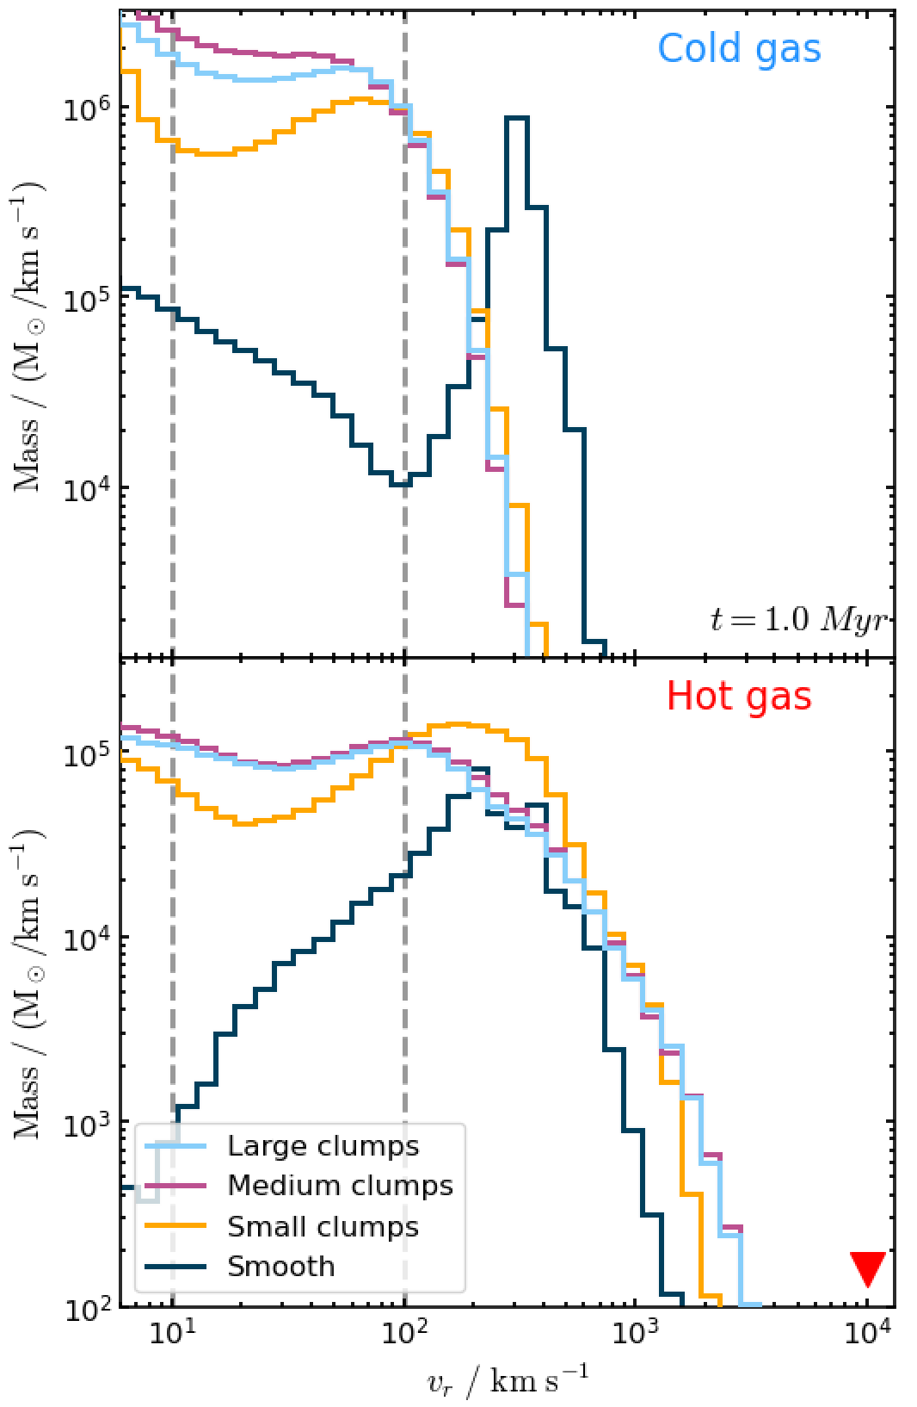
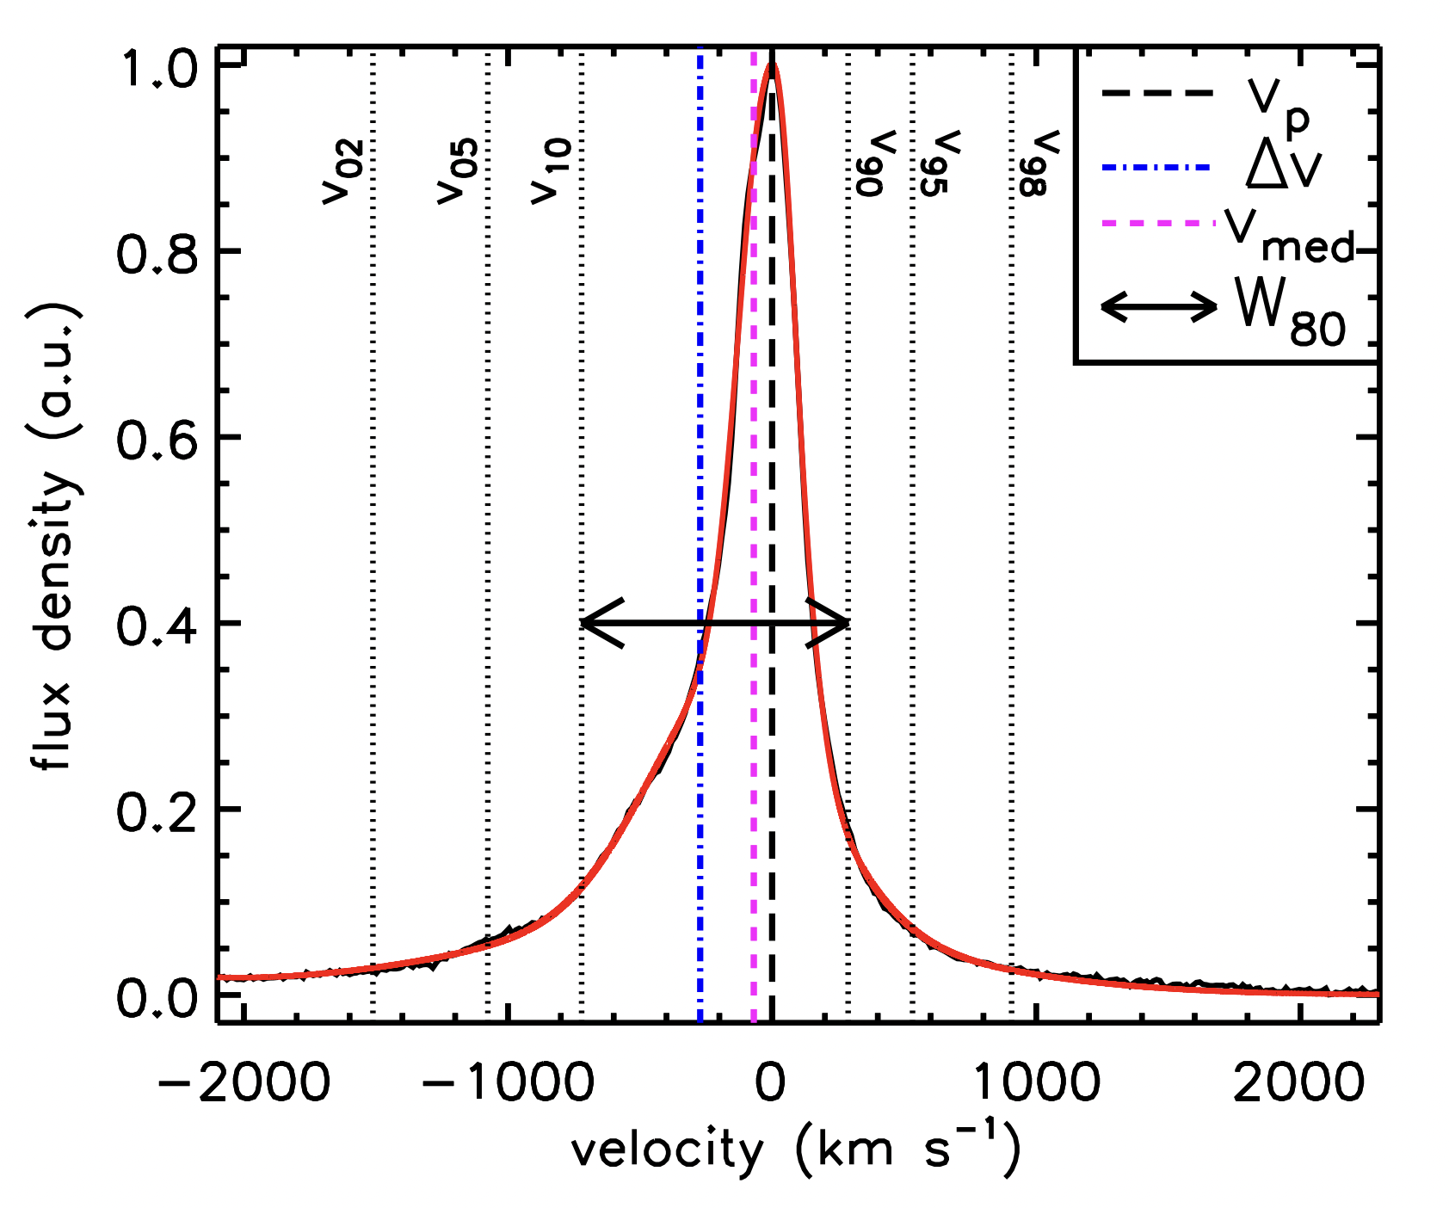
Challenges in defining outflow velocities
Clumpy disks: No characteristic velocity
A lot of outflowing mass at low velocities
v_{min} = 10 km/s (physical & “complete”)
v_{min} = 100 km/s (representative observational limit)
Observationally,
extremely hard to de-couple from host-galaxy dynamics
10
100
400
velocity (km/s
Ward, Costa, Harrison & Mainieri (2024)
See also Marconcini+23
Vincenzo Mainieri – Illuminating the Active Universe
Notes:
In the post-shock cooling regime the smooth case has produced a cold outflow which shows a narrow peak in velocity (400 km/s).
No clear outflow velocity in the clumpy regime.
Incresing the vmin from 10 to 100 km/s can result in a factor of 8-10 difference in the estimate of the mass outflow rate in the cold phase.

Slide 31


Challenges interpreting kinetic powers
How efficiently the AGN wind couples to the ISM?
Low measured kinetics coupling efficiencies:
Energy losses (gravitational work, radiative cooling)
Missing phases
Observed kinetic coupling efficiencies may
provide limited information on potential impact!
Injected energy rate 1.7%
Hot phase
Cold phase
Note: “Feedback Efficiencies” in cosmological feedback models are NOT the same as kinetic coupling efficiencies.
Ward, Costa, Harrison & Mainieri (2024)
Vincenzo Mainieri – Illuminating the Active Universe
Notes:
where, when, and in which phase the outflow is being measured can have a large impact on the inferred kinetic coupling efficiencies.
Compared to the kinetic luminosity of the small-scale wind ( ˙Ek /L=1.7 per cent; equation 2), we can see that the total kinetic luminosity of the large-scale outflow is lower by a factor of 3. If only the cold phase were observed, this difference amounts to two orders of magnitude.

Slide 32

CGM
Vincenzo Mainieri – Illuminating the Active Universe
Notes:
Focus on the ISM

Slide 33



The imprint of AGN-feedback in the CGM
AGN driven outflows are a necessary ingredient to reproduce the observed Ly⍺ halos around quasars on 100 kpc scales.
Costa+22
Vincenzo Mainieri – Illuminating the Active Universe
Notes:
Focus on the ISM

Slide 34



The imprint of AGN-feedback in the CGM
Rueda Varga+25
Hβ
[OIII]
Galaxy scale ionized outflows detected at the centre of all nebulae.
Vincenzo Mainieri – Illuminating the Active Universe
Notes:
Focus on the ISM

Slide 35



ALTERNATIVE POWERING MECHANISMS OF THE Ly-⍺ NEBULAE
The imprint of AGN-feedback in the CGM
Rueda Varga+25
Positive correlation between outflow power and nebulae properties (extension and luminosity)
Vincenzo Mainieri – Illuminating the Active Universe
Notes:
direct emission from collisionally excited gas
as cool gas photo-ionized by the central quasarrecombines, itshould produce a Lyα ‘fuzz’ on scales ∼ 10 kpc.

Slide 36



Future
ELT
ELT
Diffraction limited IFS observations (MICADO and HARMONI) to trace ionized gas kinematics on sub-kpc scales at z>2
SKA low + mid
Continuum: collimated jets resolved at the same level of simulations
HI: spatially resolved atomic gas out to intermediate redshift
Vincenzo Mainieri – Illuminating the Active Universe
Notes:
This should reflect your personal view on the future direction of your research area and the key challenges ahead.
SKA: continuum (SKA low) jet and HI (SKA mid)
WST: ionized gas (IFU), CGM (MOS and IFU), galaxies environment (MOS)

Slide 37

Future
SKA low + mid
Continuum: collimated jets resolved at the same level of simulations
HI: spatially resolved atomic gas out to intermediate redshift
Maccagni, Mainieri et al. 2026, SKAO science book
Vincenzo Mainieri – Illuminating the Active Universe
Notes:
This should reflect your personal view on the future direction of your research area and the key challenges ahead.
SKA: continuum (SKA low) jet and HI (SKA mid)
WST: ionized gas (IFU), CGM (MOS and IFU), galaxies environment (MOS)

Slide 38

Take away messages
AGN feedback is a multi-phase, multi-timescale, and multi-spatial problem.
Observational evidence that AGN radiation/winds/jets may affect the ISM in multiple way: it does not have to be necessarily ejective.
AGN are events in the life of a galaxy: the single AGN feedback episode may have localized impact; the cumulative effect of multiple such events can have a more global impact.
Observed outflow properties can not trivially be used to determine outflow impact and driving mechanisms.
Large spatially resolved surveys across wl: JVLA (SKA), ALMA (WSU), opt-IR IFUs from the ground (ELT), JWST, X-ray (AXIS, Athena)
Carefully-constructed simulations to test “specific” models and reconstruct “observational experiments”
Vincenzo Mainieri – Illuminating the Active Universe

