Slide 1
Origin of Heavy Elements in the Universe
Milan Krtička
Institute of Particle and Nuclear Physics, MFF UK

Slide 2
Origin of Heavy Elements in the Universe (view of a nuclear physicist)
(selected topics)
Milan Krtička
Institute of Particle and Nuclear Physics, MFF UK

Slide 3
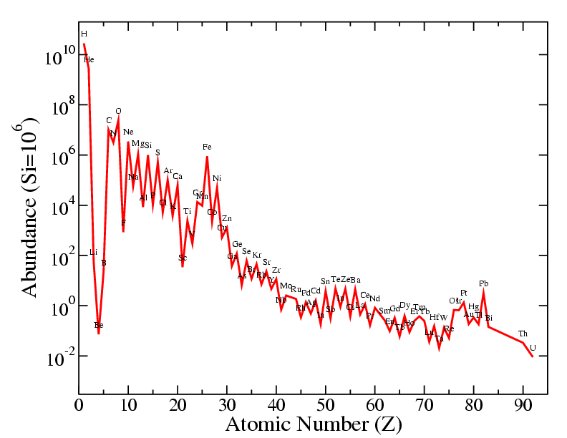
Elements in the solar system
Anders a Grevesse, 1989
Notes:
Nejdrive se dozvime odpoved na prvni otazku. Odpoved na vsechny ostatni otazky by mela byt videt z dalsiho (bez deleni).

Slide 4
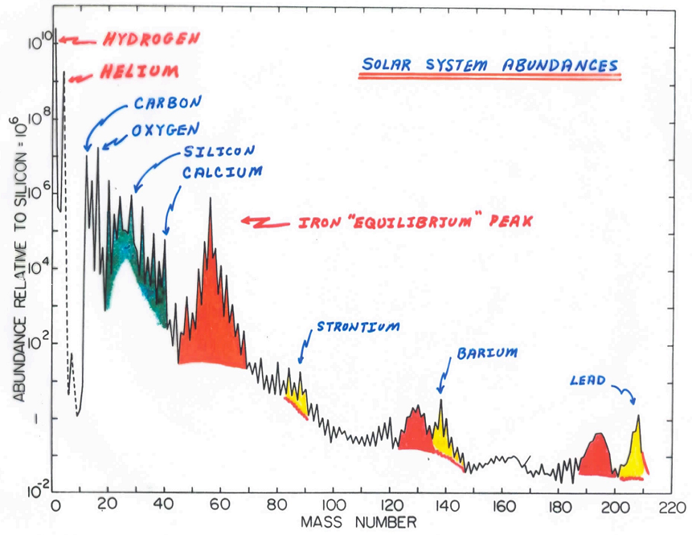
Isotopes in the solar system
Anders a Grevesse, 1989
Notes:
Nejdrive se dozvime odpoved na prvni otazku. Odpoved na vsechny ostatni otazky by mela byt videt z dalsiho (bez deleni).

Slide 5
Isotopes in the solar system
Where do we know the abundance from?
Is abundance the same around the Universe?
If not – is the solar system typical?
Anders a Grevesse, 1989
Where do the elements come from and how?
Why do we observe structures in the abundance?
Only nuclei beyond Fe region (A>60) touched in detail
Notes:
Nejdrive se dozvime odpoved na prvni otazku. Odpoved na vsechny ostatni otazky by mela byt videt z dalsiho (bez deleni).

Slide 6
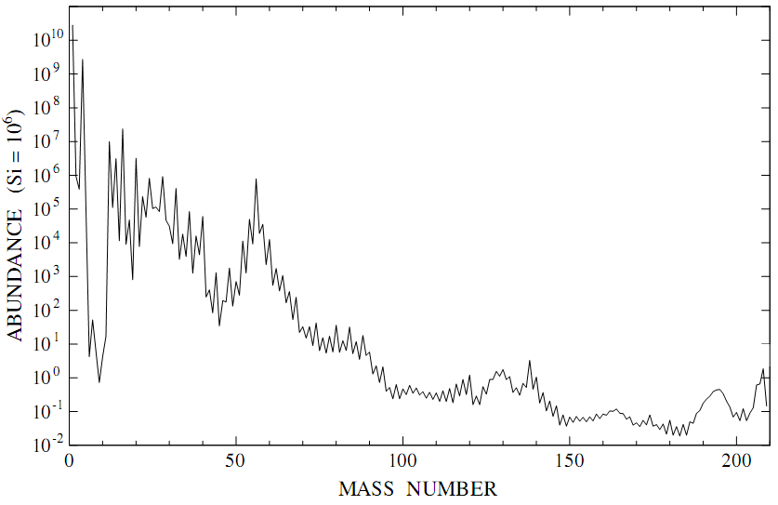
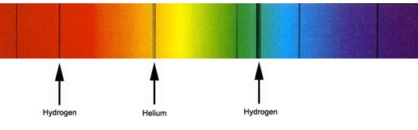
Elemental abundance (in solar system)
Where do we know it from?
Absorption spectra in solar photosphere
H
He
H
Notes:
+ solar wind

Slide 7
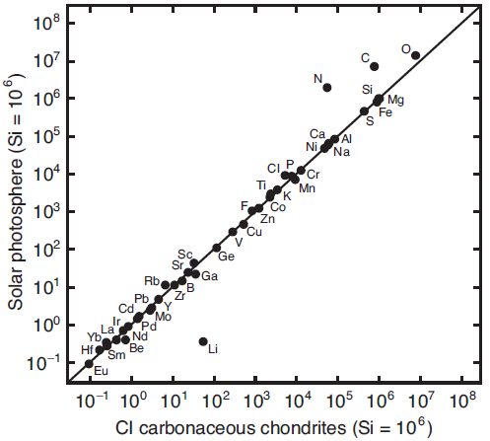
Elemental abundance (in solar system)
Where do we know it from?
Absorption spectra in solar photosphere
CI1 carbonaceous chondrits (meteorites)
Assumed that they were formed during formation of solar system
Isotopic abundance can be deduced
Contain also “pre-solar” grains (see below)
Isotopic abundance is known also from the Earth (agrees with CI1)
H
He
H
Notes:
+ solar wind

Slide 8
Abundance (outside solar system)
Outside solar system:
absorption spectra of stars (limited info on isotopes)
pre-solar grains

Slide 9
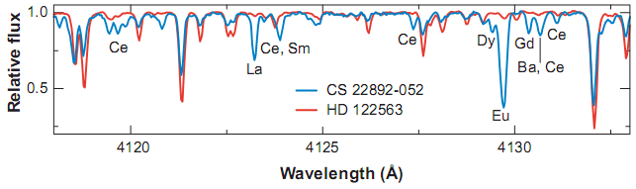
Abundance (outside solar system)
Outside solar system:
absorption spectra of stars (limited info on isotopes)
pre-solar grains
Notes:
Only illustration, composition is not the same…

Slide 10
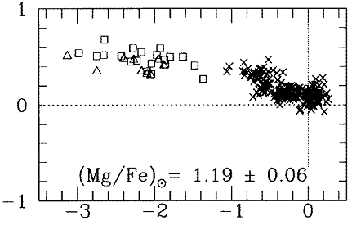
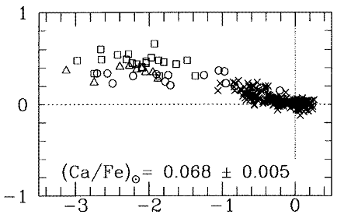
Abundance (outside solar system)
Outside solar system:
absorption spectra of stars (limited info on isotopes)
pre-solar grains
log (Mg/Fe) – log (Mg/Fe)
C. Sneden et al., Ann. Rev. Astron. Astrophys. 46 (2008) 241
log (Ca/Fe) – log (Ca/Fe)
log (Fe/H) – log (Fe/H)
M. Arnould, K. Takahashi, Rep. Prog. Phys. 62 (1999) 395
Notes:
Only illustration, composition is not the same…

Slide 11
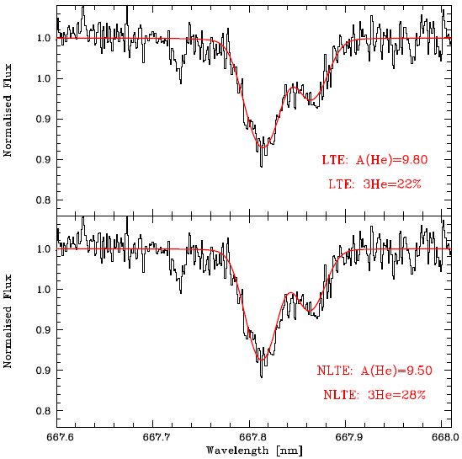
Abundance (outside solar system)
Outside solar system:
absorption spectra of stars (limited info on isotopes)
pre-solar grains
Isotopic ratios might be obtained if isotopic or hyperfine shifts exceed other broadening
Available for a few elements (favorable lines) and in favorable stars
Precision:
Light isotopes (e.g., ¹²C/¹³C, ⁶Li/⁷Li, ³He/⁴He): a few percent to tens of percent
Heavy elements: often only coarse constraints (e.g., s‑ vs r‑process dominated mixes)
⁴He: 667.8154 nm
³He: 667.8652 nm
Feige 86 star (BD+30 2431, Hercules): solid black. LTE (top) and non-LTE (bottom) fit
LTE: local thermodynamical equilibrium
E. Caffau et al., Astron. Nachr. 335 (2014)
Notes:
LTE, non-LTE … different models for stellar atmospheres

Slide 12
Abundance (outside solar system)
Isotope / element | Spectral diagnostic | Practical detectability
H / He | Large isotope shifts in Balmer/He lines | Easily separable in high‑quality spectra
Li (⁶Li/⁷Li) | Li I 670.8 nm doublet (red wing asymmetry) | Detectable but requires very high S/N and 3D non‑LTE modelling; false positives possible.
C (¹²C/¹³C) | CN, CH molecular bands in cool stars | Routine in cool giants and metal‑poor stars; precision depends on model atmosphere.
O (¹⁶O/¹⁷O/¹⁸O) | CO bands in infrared for cool giants | Measured in evolved stars and circumstellar envelopes.
Mg, Ca, Ti (light metals) | Atomic lines and molecular features | Possible in very high‑resolution spectra for favorable lines.
Ba, Eu (heavy s/r elements) | Strong lines with isotopic/hfs splitting (e.g., Ba II 455.4 nm) | Isotopic mixes inferred from line shapes with careful hfs modelling.
Ni, Fe (iron‑peak) | Very small shifts; solar work can constrain isotopic mix | Requires exceptional data and modelling; solar isotopic work exists.

Slide 13
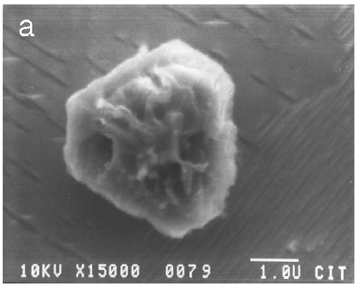
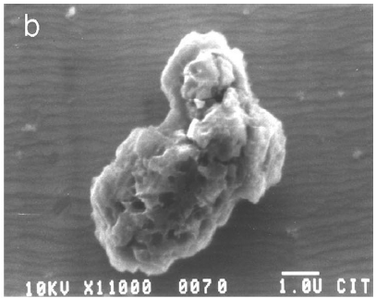
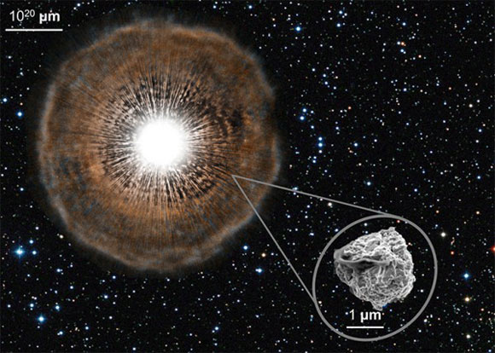
Abundance (outside solar system)
Outside solar system:
absorption spectra of stars (limited info on isotopes)
pre-solar grains (in CI chondrids)
0.5-10 μm dust grains that condensed from gas ejected from stars at the end of their lives (and survived unaltered to be incorporated into solar system materials)
1 μ m
1 μ m
Harry Y. McSween Jr., Gary R. Huss: Cosmochemistry (2022) Cambridge Univ. press

Slide 14
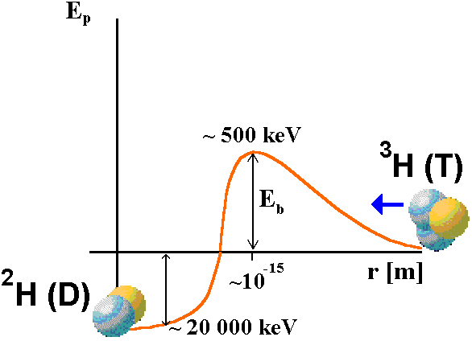
Condition for production of new isotopes
1 eV ≈ 1.16x10⁴K
Coulomb barrier must be penetrated in the case of charged nuclei ⇒ E_{k} should be sufficiently high
- hundreds keV-MeV (T ≈ 10⁹ - 10¹⁰ K, kT ≈ 90-900 keV)
Due to tunneling effect, the reactions take place with sufficient rate already at energies lower by 2 orders of magnitude
Reactions of neutral particles - neutrons, γ – no Coulomb barrier - but these particles are created during interactions of charged particles – the same energy is needed

Slide 15
Conditions for production of isotopes
There are not many suitable places
Big Bang
Stars
Beginning of 1950’s – it became evident that isotopes are produced in stars
1952 – Merill observed Tc in spectra of several stars, all Tc isotopes have t_{1/2} < 10⁶ let – Tc could not survive from the Big Bang
Different elemental abundance observed in stars
Notes:
Stabilní izotop Be je 9 – nelze z dvoučásticové interakce H a He

Slide 16
Conditions for production of isotopes
There are not many suitable places
Big Bang
Stars
Beginning of 1950’s – it became evident that isotopes are produced in stars
1952 – Merill observed Tc in spectra of several stars, all Tc isotopes have t_{1/2} < 10⁶ let – Tc could not survive from the Big Bang
Different elemental abundance observed in stars
Mid 1950’s – possible ways of elemental production formulated
1957 – Burbidge, Burbidge, Fowler, Hoyle & Cameron
Big Bang produced only H (75%), He (25%), Li (10⁻¹⁰)
Notes:
Stabilní izotop Be je 9 – nelze z dvoučásticové interakce H a He

Slide 17
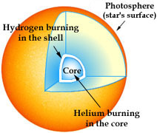
Production of new isotopes
Heavier isotopes come from fusion of lighter ones
All isotopes up to Fe region produced during different “stages” (different T (energy) needed for fusion of different elements)

Slide 18
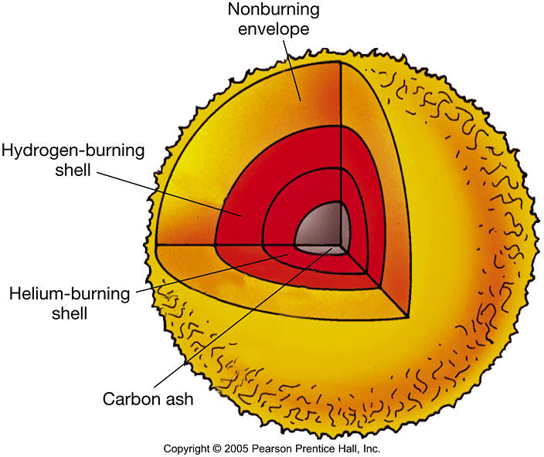
Production of new isotopes
Heavier isotopes come from fusion of lighter ones
All isotopes up to Fe region produced during different “stages” (different T (energy) needed for fusion of different elements)

Slide 19
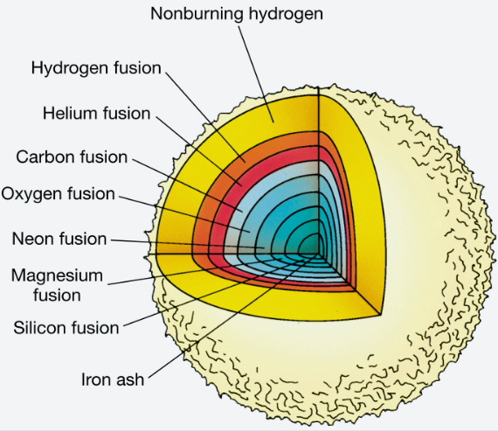
Production of new isotopes
Heavier isotopes come from fusion of lighter ones
All isotopes up to Fe region produced during different “stages” (different T (energy) needed for fusion of different elements)

Slide 20
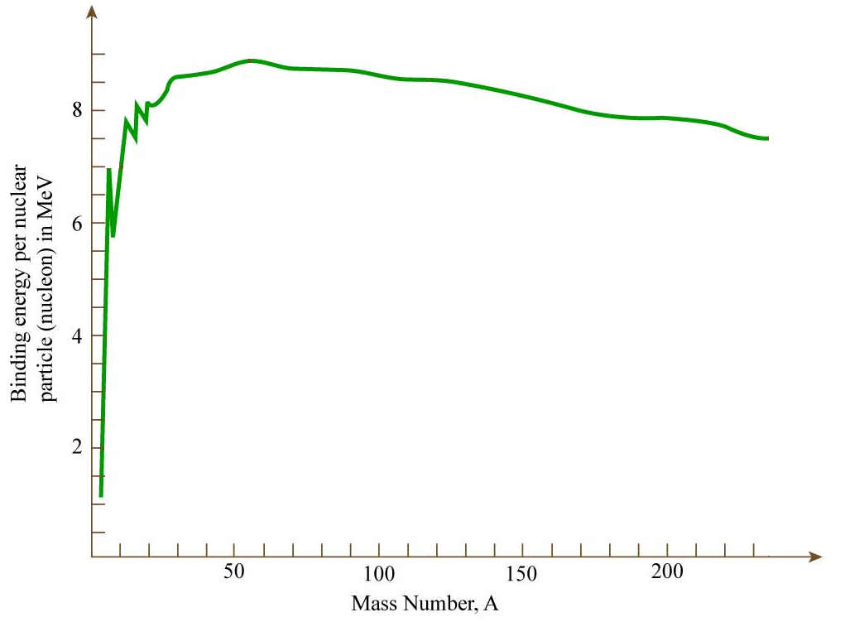
Origin of elements heavier than Fe
E of particles (T) makes γ dissociation possible ⇒ increase of T does not help and charge-particle reactions are already difficult to proceed
No important E would be gained during further fusion
Elements heavier than Fe (Ni) have smaller B/A ⇒ it is not very profitable to create heavier isotopes
How and where are heavier elements produced?
⁵⁶Fe region

Slide 21
Origin of elements heavier than Fe
E of particles (T) makes γ dissociation possible ⇒ increase of T does not help and charge-particle reactions are already difficult to proceed
No important E would be gained during further fusion
Elements heavier than Fe (Ni) have smaller B/A ⇒ it is not very profitable to create heavier isotopes
How and where are heavier elements produced?
During n capture and β-decay some energy is still released
⇒ if free n available, still exothermic reactions
“TD equilibrium” (producing the most stable configurations – Fe region) would be reached by spontaneous fission – it takes place in the time scale for which the lifetime of the Universe is still too short
Elements heavier than Fe are responsible for ≈10⁻⁸ of all nuclei

Slide 22
Origin of neutrons in stars
Dominating reactions are (n,γ) and β-decays
Free neutrons are rare in stars
(no free neutrons during H burning)
Where can we find neutrons suitable for heavy nuclei production?
In „classical nuclear reactions “ – almost exclusively from
¹³C + ⁴He → ¹⁶O + n (kT~ 8 keV)
²²Ne + ⁴He → ²⁵Mg + n (kT~ 20-40 keV)
During „neutronization“ (p + e → n + ν) and subsequent supernova explosion
In neutron stars
“Exotic processes” (neutron star mergers, …)

Slide 23
Origin of neutrons in stars
Dominating reactions are (n,γ) and β-decays
Free neutrons are rare in stars
(no free neutrons during H burning)
Where can we find neutrons suitable for heavy nuclei production?
In „classical nuclear reactions “ – almost exclusively from
¹³C + ⁴He → ¹⁶O + n (kT~ 8 keV)
²²Ne + ⁴He → ²⁵Mg + n (kT~ 20-40 keV)
During „neutronization“ (p + e → n + ν) and subsequent supernova explosion
In neutron stars
“Exotic processes” (neutron star mergers, …)
There exists two “limits” in stars that evidently work
τ(n,γ) >> τ(β decay) … s-process (slow)
τ(n,γ) << τ(β decay) … r-process (rapid)

Slide 24
Origin of neutrons in stars
Dominating reactions are (n,γ) and β-decays
Free neutrons are rare in stars
(no free neutrons during H burning)
Where can we find neutrons suitable for heavy nuclei production?
In „classical nuclear reactions “ – almost exclusively from
¹³C + ⁴He → ¹⁶O + n (kT~ 8 keV)
²²Ne + ⁴He → ²⁵Mg + n (kT~ 20-40 keV)
During „neutronization“ (p + e → n + ν) and subsequent supernova explosion
In neutron stars
“Exotic processes” (neutron star mergers, …)
There exists two “limits” in stars that evidently work
τ(n,γ) >> τ(β decay) … s-process (slow)
τ(n,γ) << τ(β decay) … r-process (rapid)
+ something between … i-process (intermediate)

Slide 25
Different neutron capture processes
There exists two “limits” in stars
τ(n,γ) >> τ(β decay) … s-process (slow)
Neutron density: 10⁷ -10¹² n.cm⁻³
typical time between neutron captures: hours/days-centuries
τ(n,γ) << τ(β decay) … r-process (rapid)
Neutron density: >10²⁰ n.cm⁻³
typical time between neutron captures: μs-ms
+ something between … i-process (intermediate)
Neutron density: 10¹³ -10¹⁵ n.cm⁻³
typical time between neutron captures: seconds-minutes

Slide 26
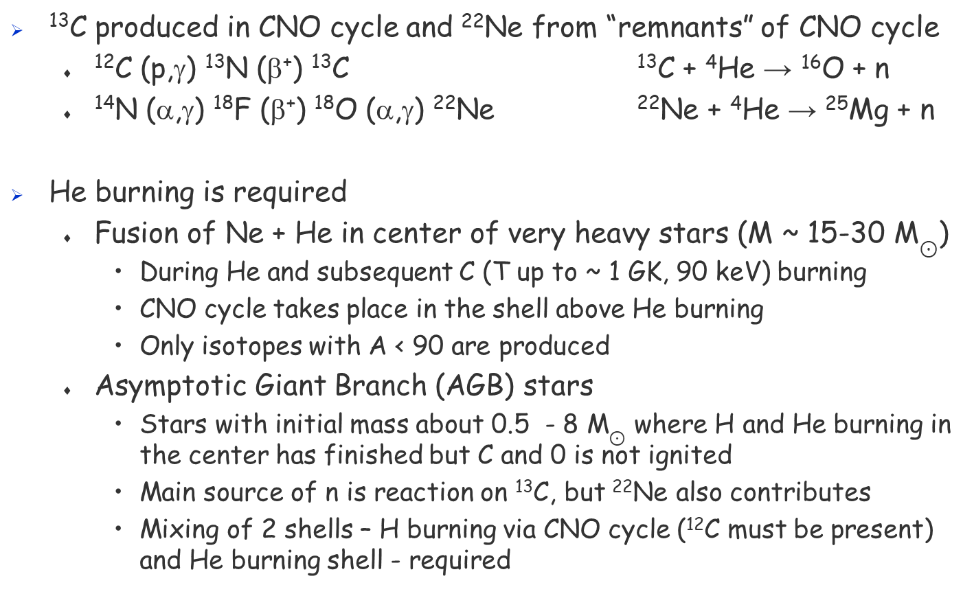
s-process – He burning
¹³C produced in CNO cycle and ²²Ne from “remnants” of CNO cycle
¹²C (p,γ) ¹³N (β⁺) ¹³C ¹³C + ⁴He → ¹⁶O + n
¹⁴N (α,γ) ¹⁸F (β⁺) ¹⁸O (α,γ) ²²Ne ²²Ne + ⁴He → ²⁵Mg + n
He burning is required
Fusion of Ne + He in center of very heavy stars (M ~ 15-30 M$⊙$)
During He and subsequent C (T up to ~ 1 GK, 90 keV) burning
CNO cycle takes place in the shell above He burning
Only isotopes with A < 90 are produced
Asymptotic Giant Branch (AGB) stars
Stars with initial mass about 0.5 - 8 M$⊙$ where H and He burning in the center has finished but C and 0 is not ignited
Main source of n is reaction on ¹³C, but ²²Ne also contributes
Mixing of 2 shells – H burning via CNO cycle (¹²C must be present) and He burning shell - required
Notes:
Nepozoruje se Mg v AGB hvezdach a T tam nedosahne potrebne T – Ne neni hlavni zdroj n

Slide 27
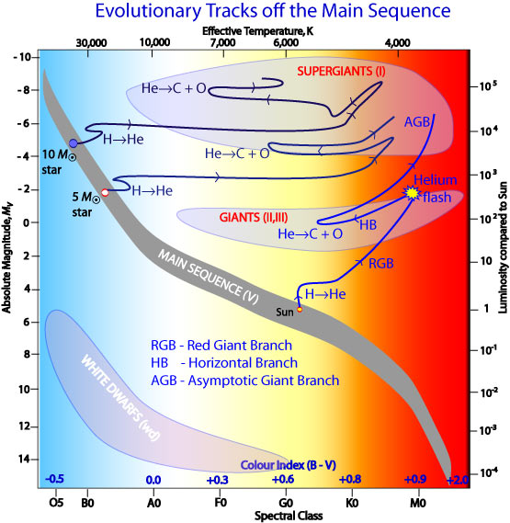
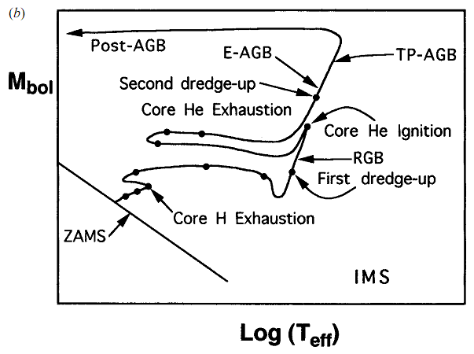
AGB stars
Hertzsprung-Russell Diagram

Slide 28
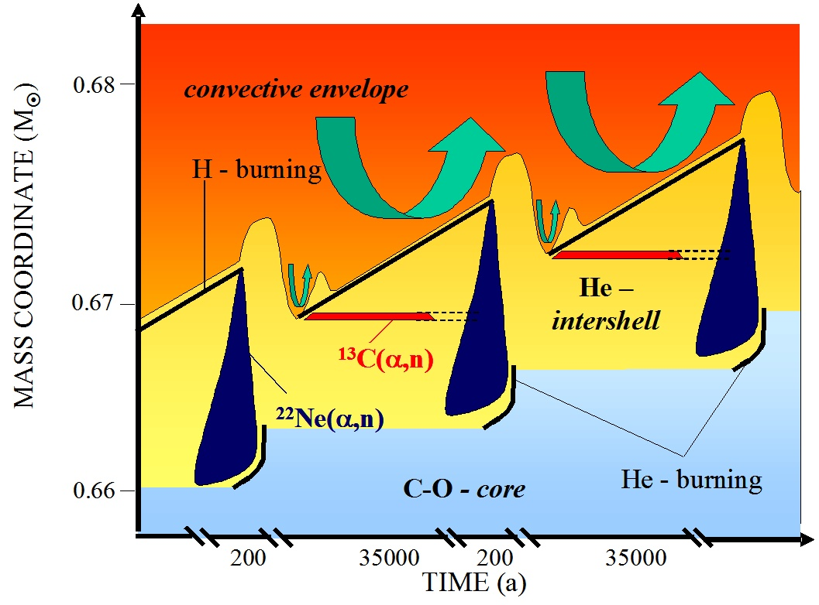
s-process in AGB stars
Interpulse:
H‑burning shell is the star’s main energy source
steadily converts H → He, depositing a growing He layer (intershell) above the degenerate C–O core.
He shell is stable during this time. The star slowly evolves until the He layer becomes thick enough to ignite unstably.
kT ≈ 8 keV (9x10⁷K)
Duration: 10⁴-10⁵ y
During this long phase the slow radiative burning of a possible ¹³C pocket can release neutrons
n density10⁶ -10⁸ n.cm⁻³
time between n captures years to centuries
Heavier nuclei (⁵⁶Fe,…), which the n capture takes place, must be present

Slide 29
s-process in AGB stars
Interpulse:
H‑burning shell is the star’s main energy source
steadily converts H → He, depositing a growing He layer (intershell) above the degenerate C–O core.
He shell is stable during this time. The star slowly evolves until the He layer becomes thick enough to ignite unstably.
kT ≈ 8 keV (9x10⁷K)
Duration: 10⁴-10⁵ y
During this long phase the slow radiative burning of a possible ¹³C pocket can release neutrons
n density10⁶ -10⁸ n.cm⁻³
time between n captures years to centuries
Heavier nuclei (⁵⁶Fe,…), which the n capture takes place, must be present

Slide 30
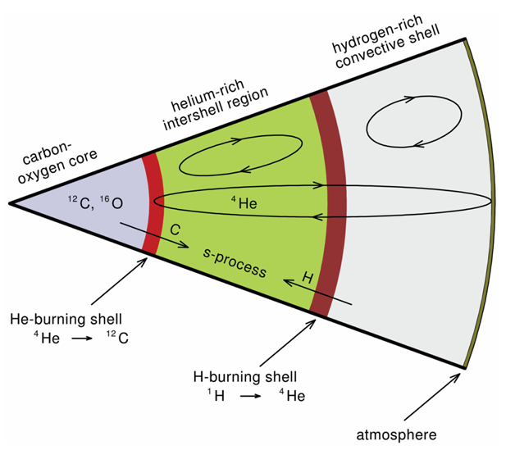
s-process in AGB stars
Thermal pulse:
He‑burning flash and “convective” pulse
T ≈ 25 keV (3x10⁸K) (¹³C)
Duration: 1-100 y
Neutrons are produced during ²²Ne burning
n density10⁹ -10¹¹ n.cm⁻³
time between n captures days to months
Heavier nuclei (⁵⁶Fe,…), which the n capture takes place, must be present

Slide 31
s-process in AGB stars
Thermal pulse:
He‑burning flash and “convective” pulse
T ≈ 25 keV (3x10⁸K) (¹³C)
Duration: 1-100 y
Neutrons are produced during ²²Ne burning
n density10⁹ -10¹¹ n.cm⁻³
time between n captures days to months
Heavier nuclei (⁵⁶Fe,…), which the n capture takes place, must be present

Slide 32
s-process in AGB stars
TP followed with the third dredge‑up:
mixing event occurring after a convective He‑shell flash.
star’s deep convective envelope penetrates inward and brings material from the He‑intershell (products of He burning and s‑process nucleosynthesis) up to the stellar surface, altering surface composition (notably increasing C and s‑process element abundances).
A part of this material is ejected from the star
Heavier nuclei (⁵⁶Fe,…), which the n capture takes place, must be present
Notes:
The name refers to the evolutionary stage in which each dredge‑up occurs, not to a strict sequence that every star experiences:
First dredge‑up: occurs when a star first ascends the red giant branch (mixes H‑burning products).
Second dredge‑up: happens in more massive stars after core He burning (mixes deeper CNO products).
Third dredge‑up: occurs during the thermally pulsing AGB phase following He‑shell flashes. Some low‑mass stars experience only the first and third dredge‑ups; the numbering is historical and tied to the structural state of the star when each mixing episode happens
How the third dredge‑up happens (mechanism)
Thermal pulse: unstable He burning in a thin shell produces a brief, powerful energy release and a convective zone in the intershell (pulse‑driven convection).
Envelope expansion and cooling: the outer layers respond, the H‑burning shell weakens temporarily, and the convective envelope can deepen.
Convective penetration: the convective envelope moves inward and overlaps the former pulse region, mixing He‑intershell material (rich in ${}^{12}$C, some ${}^{16}$O and s‑process elements) into the envelope.
Envelope recedes: convection retreats and the star enters the next interpulse; the surface now shows the dredged‑up composition.

Slide 33
s-process
(n,γ)
Sr
(β⁻)
Rb
proton number
Kr
(β⁺)
Br
Se
As
Ge
Ga
Zn
t(n,γ) >> t(β decay)
t(β)_{not-stable} ~ min - days
t(β)_{branching points} ~ 10-10⁵ years
Cu
Ni
Co
Fe
neutron number

Slide 34
s-process
(n,γ)
Sr
(β⁻)
Rb
proton number
Kr
(β⁺)
Br
Se
As
Ge
Ga
Zn
t(n,γ) >> t(β decay)
t(β)_{not-stable} ~ min - days
t(β)_{branching points} ~ 10-10⁵ years
Cu
Ni
Co
Fe
neutron number

Slide 35
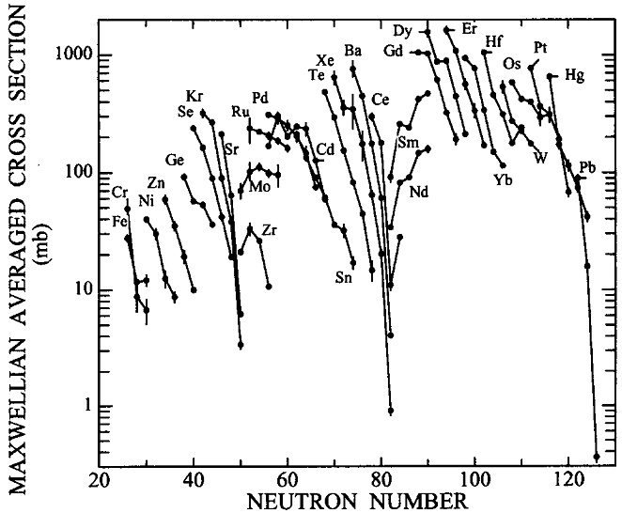
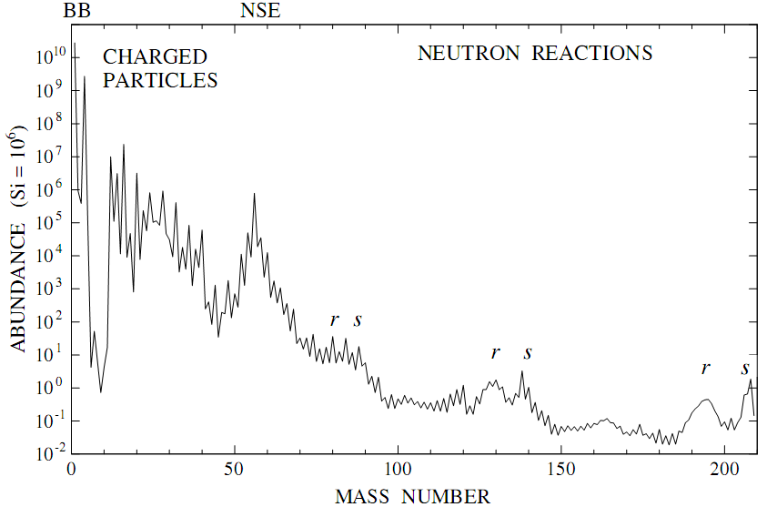
s-process
If t_{s-process} >> τ(n,γ) one can expect similar abundance if n capture has similar probability (cross section) on all nuclei
If this not valid - τ(n,γ) > thousands years ⇒ maximum + subsequent “drops” in abundance
These drops occur for “closed” shells – neutron capture is strongly suppressed
Ends for A = 210 (α-decay) ²⁰⁹Bi + n → ²¹⁰Bi + γ ²¹⁰Bi → ²¹⁰Po + e⁻ + ν ²¹⁰Po → ²⁰⁶Pb + ⁴He (t_{1/2} = 140d) 3 n captures
Notes:
sN = const; z toho vyplyva, ze pri podobnem sigma je N=const

Slide 36
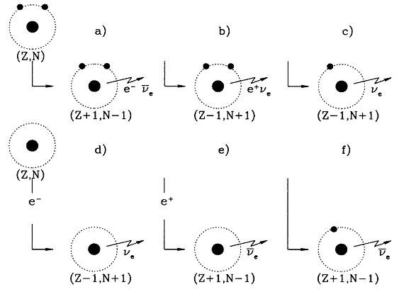
β-decays
Earth:
β⁻
β⁺
orbital e⁻ capture
continuum e⁻ capture
continuum e⁺ capture
bound-state β decay

Slide 37
β-decays
Earth:
β⁻
β⁺
orbital e⁻ capture
Atoms are (fully) ionized in stars ⇒ β-decays not available on Earth may be possible ⇒ interesting consequences
Stars:
continuum e⁻ capture
continuum e⁺ capture
bound-state β decay

Slide 38
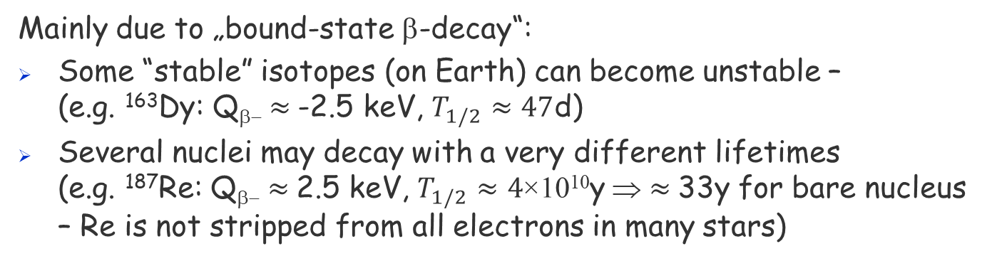
β-decays
Earth:
β⁻
β⁺
orbital e⁻ capture
Atoms are (fully) ionized in stars ⇒ β-decays not available on Earth may be possible ⇒ interesting consequences
Stars:
continuum e⁻ capture
continuum e⁺ capture
bound-state β decay
Mainly due to „bound-state β-decay“:
Some “stable” isotopes (on Earth) can become unstable – (e.g. ¹⁶³Dy: Q_{β−} $≈$-2.5 keV, $T_{1/2}≈47$d)
Several nuclei may decay with a very different lifetimes (e.g. ¹⁸⁷Re: Q_{β−} $≈$2.5 keV, $T_{1/2}≈4$×10¹⁰y ⇒ $≈$33y for bare nucleus – Re is not stripped from all electrons in many stars)

Slide 39
β-decays
In addition, nuclei can be in excited states (excitation via γ) in stars ⇒ may drastically change their T_{1/2} (due to selection rules for β-decays T_{1/2} of excited states may be shorter by several orders of magnitude compared to ground state)

Slide 40
β-decays
In addition, nuclei can be in excited states (excitation via γ) in stars ⇒ may drastically change their T_{1/2} (due to selection rules for β-decays T_{1/2} of excited states may be shorter by several orders of magnitude compared to ground state)
Example (⁹⁴Nb):
Situation on Earth:
79 keV, 7⁺
59 keV, 4⁺
41 keV, 3⁺
0 keV, 6⁺
⁹⁴Nb
1864 keV, 2⁺
1574 keV, 4⁺
100% β⁻
T_{1/2}~20 000y
871 keV, 2⁺
Q(β⁻)=2045 keV
0 keV, 0⁺
⁹⁴Mo

Slide 41
β-decays – example of ⁹⁴Nb
In addition, nuclei can be in excited states (excitation via γ) in stars ⇒ may drastically change their T_{1/2} (due to selection rules for β-decays T_{1/2} of excited states may be shorter by several orders of magnitude compared to ground state)
Example (⁹⁴Nb):
Situation in a star:
T_{1/2} (41 keV) against β decay: ~ 21 h
79 keV, 7⁺
59 keV, 4⁺
T_{1/2}~6.263m
Population of isomer:
kT = 8 keV: P(41 keV) ~ 0.3%
kT = 25 keV: P(41 keV) ~ 9.5%
41 keV, 3⁺
~0.5%
~ 99.5%
0 keV, 6⁺
⁹⁴Nb
1864 keV, 2⁺
1574 keV, 4⁺
100% β⁻
T_{1/2}~20 000y
871 keV, 2⁺
Lifetime (against β decay):
T_{1/2} (⁹⁴Nb, kT= 8 keV) : ~ 270 d
T_{1/2} (⁹⁴Nb, kT= 25 keV) : ~ 10 d
Q(β⁻)=2045 keV
0 keV, 0⁺
⁹⁴Mo
Notes:
9% is from standard Boltzmann factor multiplied by g factors.

Slide 42
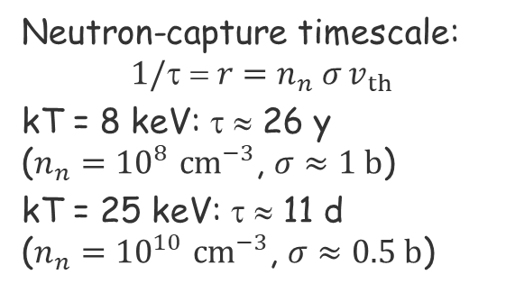
β-decays – example of ⁹⁴Nb
In addition, nuclei can be in excited states (excitation via γ) in stars ⇒ may drastically change their T_{1/2} (due to selection rules for β-decays T_{1/2} of excited states may be shorter by several orders of magnitude compared to ground state)
79 keV, 7⁺
Neutron‑capture timescale: $$1/\text{t}\text{ = }r=n_{n} σ v_{th}$$
kT = 8 keV: τ ≈ 26 y ($n_{n}={10}^{8} cm^{−3}$, $σ≈1 b$)
kT = 25 keV: τ ≈ 11 d ($n_{n}={10}^{10} cm^{−3}$, $σ≈0.5 b$)
59 keV, 4⁺
T_{1/2}~6.263m
41 keV, 3⁺
~0.5%
~ 99.5%
0 keV, 6⁺
⁹⁴Nb
1864 keV, 2⁺
1574 keV, 4⁺
100% β⁻
T_{1/2}~20 000y
871 keV, 2⁺
Lifetime (against β decay):
T_{1/2} (⁹⁴Nb, kT= 8 keV) : ~ 270 d
T_{1/2} (⁹⁴Nb, kT= 25 keV) : ~ 10 d
Q(β⁻)=2045 keV
0 keV, 0⁺
⁹⁴Mo
Notes:
MACS (sigma) the same for both states…

Slide 43
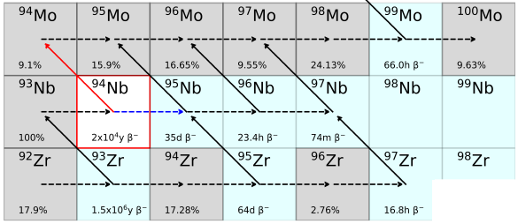
β-decays – example of ⁹⁴Nb
Population of ⁹⁵Nb (bypasses ⁹⁴Mo):
kT = 8 keV: ≈ 2.8%
kT = 25 keV: ≈ 48%
Neutron‑capture timescale: $$1/\text{t}\text{ = }r=n_{n} σ v_{th}$$
kT = 8 keV: τ ≈ 26 y ($n_{n}={10}^{8} cm^{−3}$, $σ≈1 b$)
kT = 25 keV: τ ≈ 11 d ($n_{n}={10}^{10} cm^{−3}$, $σ≈0.5 b$)
Lifetime (against β decay):
T_{1/2} (⁹⁴Nb, kT= 8 keV) : ~ 270 d
T_{1/2} (⁹⁴Nb, kT= 25 keV) : ~ 10 d
Notes:
MACS (sigma) the same for both states…

Slide 44
r-process
Not all isotopes can be produced in s-process

Slide 45
r-process
(n,γ)
Sr
(β⁻)
Rb
proton number
Kr
(β⁺)
Br
Se
As
Ge
Ga
Zn
Cu
Ni
Co
Fe
neutron number

Slide 46
r-process
s-process is responsible for about 1/2 of nuclei heavier than Fe
There are maximums shifted toward smaller A in the abundance plot with respect to maximums from s-process
Can be explained by r-process
τ(n,γ) << τ(β decay)
How does the evolution in ZxN look like in this case?

Slide 47
r-process
(n,γ)
t(n,γ) << t(β⁻)_{near line of stability}
t(n,γ) ~ 10⁻⁵ – 10⁻¹ s
Sr
(β⁻)
Rb
proton number
Kr
(β⁺)
Br
Se
As
s-only
Ge
Ga
Zn
Cu
r-process
Ni
r-only
Co
Fe
neutron number

Slide 48
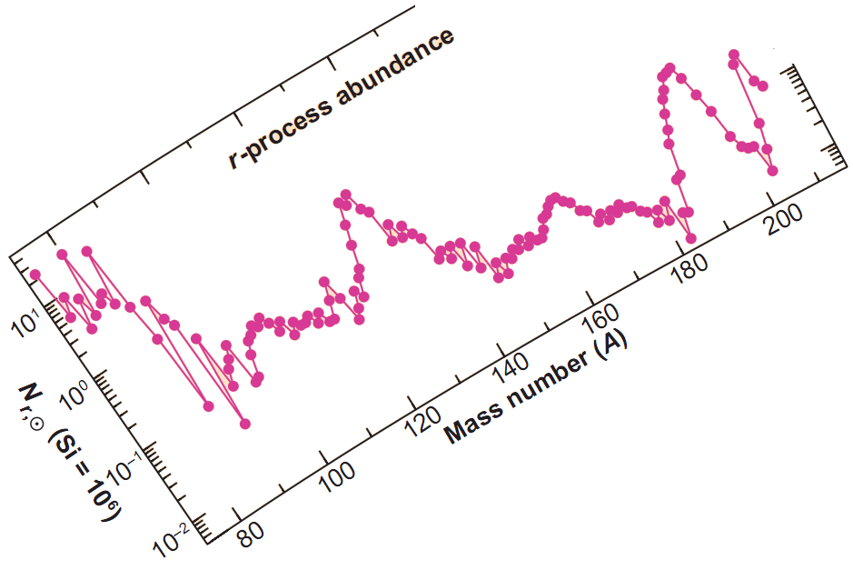
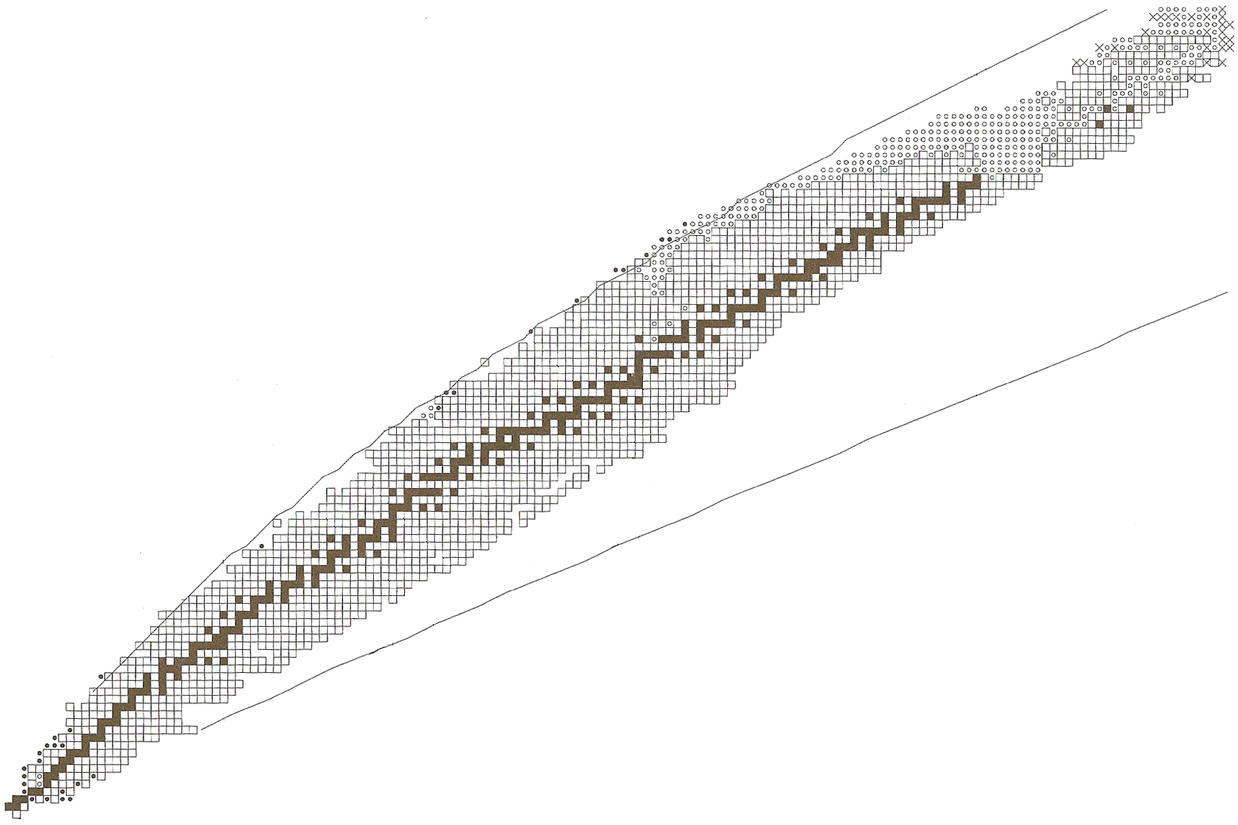
N = 126
Z = 82
N = 82
N = 50
Z = 50
A = 208
A = 195
N = 28
N = 20
proton number
A = 138
Z = 28
A = 130
Z = 20
A = 90
A = 80
neutron number

Slide 49
r-process
Almost whole second half of nuclei heavier than Fe originates from r-process (including nuclei heavier than Pb - Th a U)
Neutron magic numbers reached for smaller values of Z
After “switching-off” n flux the nuclei decay via β-decay toward line of stability
⇒ maximums shifted with respect to those from s-process appear
Huge n flux (10²⁰ n/cm³) and short duration (almost surely t < 10s)
Where does the process take place?

Slide 50
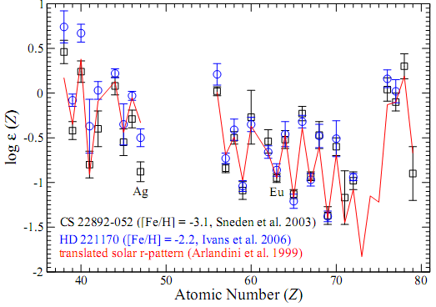
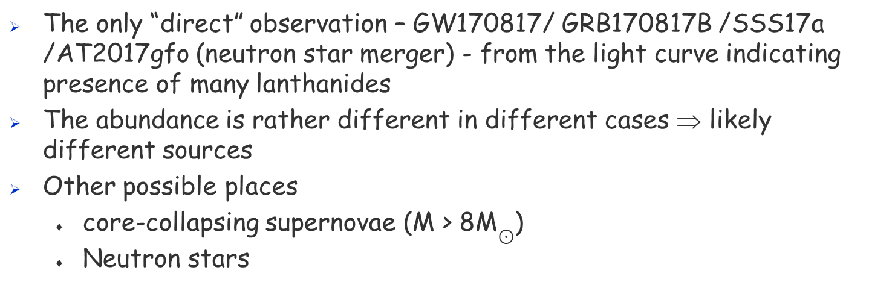
r-process
The only “direct” observation – GW170817/ GRB170817B /SSS17a /AT2017gfo (neutron star merger) - from the light curve indicating presence of many lanthanides
The abundance is rather different in different cases ⇒ likely different sources
Other possible places
core-collapsing supernovae (M > 8M$⊙$)
Neutron stars
s- and r- process can explain almost all isotopes heavier than Fe
A small amount of nuclei (0.1%) cannot be produced ⇒ another process ⇒ p-proces

Slide 51
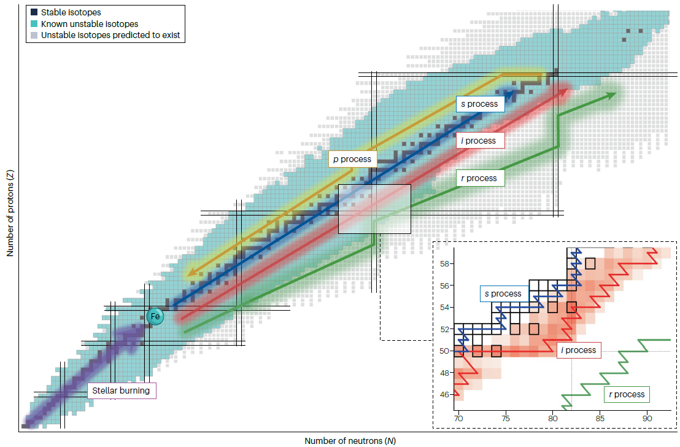
i-process
Spectra of some stars and isotopic composition of pre-solar grains indicates a presence of “additional” neutron-capture process
M. Wiedeking et al., Nature reviews physics 7 (2025) 696

Slide 52
p-process
(n,γ)
(γ,n)
Sr
(β⁻)
p-,rp-process
Rb
proton number
(p,γ)
Kr
(β⁺)
Br
Se
As
p-only
Ge
Ga
Zn
Cu
r-process
Ni
Co
r-only
Fe
neutron number

Slide 53
p-process
In fact, two different processes
rp-process – rapid capture or many p followed by a series of β⁺ decays
p- process – partial γ desintegration via (γ,n), and perhaps even (γ,α)
Where can these processes proceed?
We are not sure at all
Processes last probably for a very short time
Candidates – the same as for r-process:
Core-collapsing supernovae
Merging neutron stars in binary systems

Slide 54
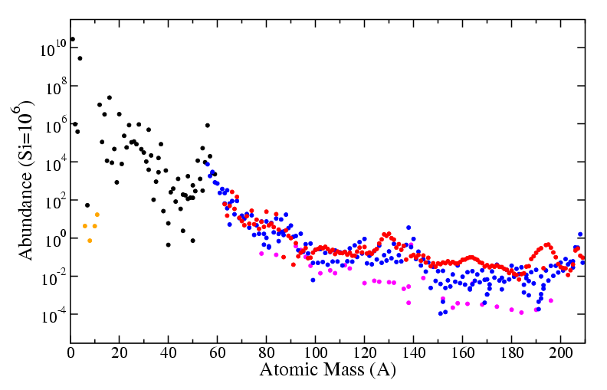
Conclusions
H, He, C, O, Si burning
stars, novae, supernovae
s-process
He burning in AGB stars
He burning in centre of massive stars
r-process
neutron star mergers
(core-collapsing supernovae?)
Cosmic rays
p-proces
site disputed
Anders a Grevesse, 1989 & Käppeler, Beer a Wisshak, 1989

Slide 55
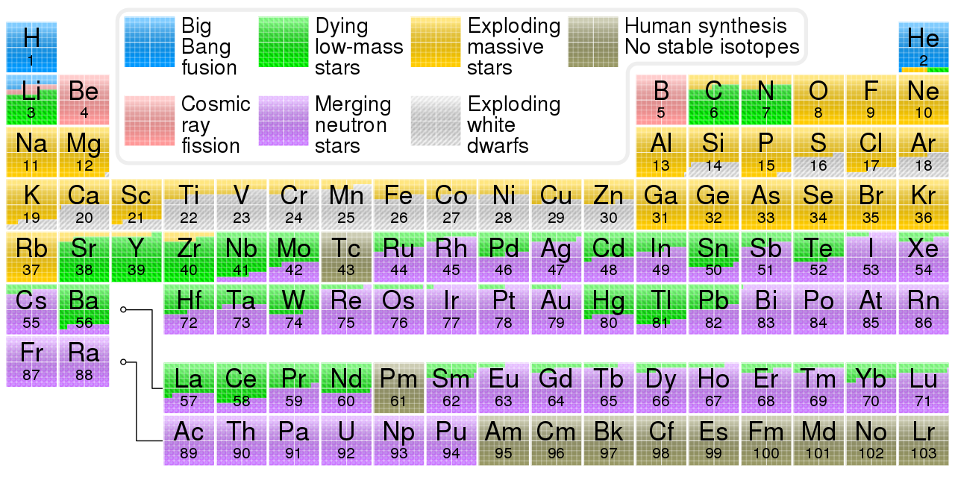
Conclusions
s-process
r-process
Type Ia SNe
Type II SNe (all heavy stars)

Slide 56
Thank you for your attention

