Slide 1


Simulating the Impacts of Space Charge Effects on the LHC Beam Halo
William H. Robinson
Supervisors: Tatiana Pieloni, Dora Veres and Pascal Hermes
Master’s Thesis Defence – 23rd July 2026
Imperial College London – Department of Physics & EPFL – Laboratory of Particle Accelerator Physics
Notes:
Good morning and thank you for coming to my master’s thesis defence. For the past 5 months, I have simulated space charge effects in the LHC and its injector, the SPS, in order to investigate their impact on the LHC beam halo.

Slide 2
Outline
I. Introduction
III. Simulations of Space Charge Effects on the Beam Halo in the LHC
IV. Simulations of Space Charge Effects on the Beam Halo in the SPS
V. Conclusions
II. Methodology
Notes:
In this presentation, I will first introduce a few key concepts – the beam halo, collective effects and space charge. I will then outline the methods used to calculate emittance and halo content, as well as how the simulations themselves were set up. Following this, I will present my results from my simulations of space charge in the LHC and SPS, and then conclude by relating these finding to the results that inspired this project, as well as suggesting future studies.

Slide 3
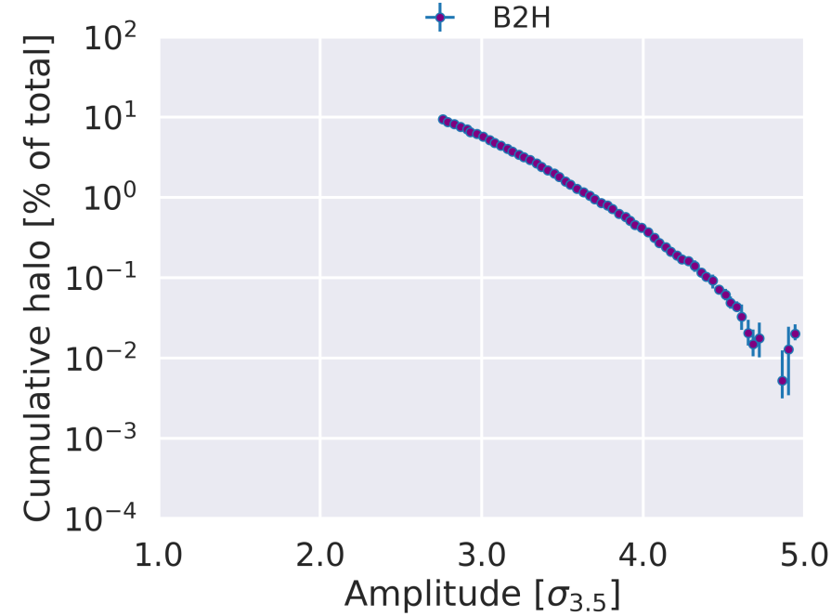
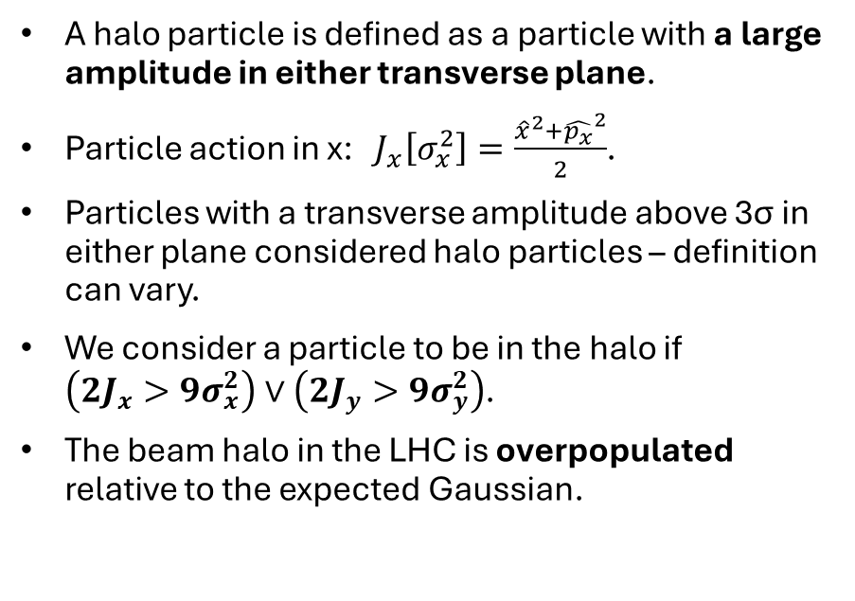
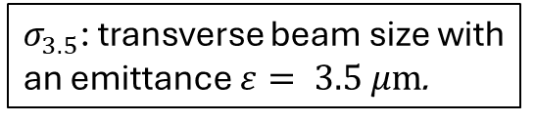
The Beam Halo
I. Introduction
A halo particle is defined as a particle with a large amplitude in either transverse plane.
Particle action in x: $J_{x}\left[σ_{x}^{2}\right]=\frac{{\hat{x}}^{2}+{\hat{p_{x}}}^{2}}{2}$.
Particles with a transverse amplitude above 3σ in either plane considered halo particles – definition can vary.
We consider a particle to be in the halo if $\left(2J_{x}>9σ_{x}^{2}\right)∨\left(2J_{y}>9σ_{y}^{2}\right)$.
The beam halo in the LHC is overpopulated relative to the expected Gaussian.
$σ_{3.5}$: transverse beam size with an emittance $ε= 3.5 μm$.
Figure: M. Rakic (EPFL PhD Thesis)
Notes:
A particle is considered as being in the beam halo if it has a large transverse amplitude in either plane. We define amplitude using action. If we have a plot of momentum on one axis and position on another, the action is half the radius at a point. Any particle with an action greater than 4.5 sigma^2 is considered a halo particle. Data shows that the beam halo is overpopulated relative to an ideal Gaussian – if we start from 3 sigma on this graph, then we observe a halo population of around 5-6% - way higher than what can be expected in the tails.

Slide 4
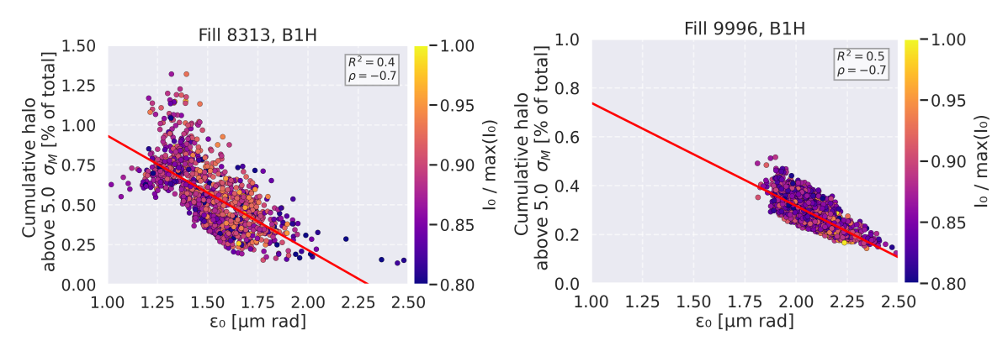
Halo Overpopulation and Scaling with Emittance
Halo particles are of particular concern for machine protection.
Measurements show that bunches with smaller emittances exhibit larger halo populations, and vice versa.
In other words, there is an anti-correlation between halo content and emittance.
Collective effects depend on intensity over emittance (“brightness”). Space charge is the main candidate among the collective effects that could be responsible.
I. Introduction
Figure: M. Rakic
Notes:
Reducing halo overpopulation is particularly pertinent due to the fact that beam losses at large amplitudes can cause even more damage to the machine – this includes quenching the superconducting magnets. Recent measurements by Milica Rakic show that there is an anti-correlation between halo content and emittance. This implies that bunches with smaller emittances have larger halo populations. We can see populations above 5 sigma – well above the halo classification – of around 1%, which is way higher than a Gaussian distribution would show. This points to a collective effect, as they depend on the “brightness” of an accelerator – in other words, collective effects generally scale with luminosity and inversely with emittance.

Slide 5
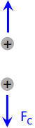
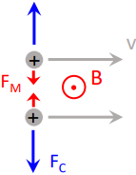
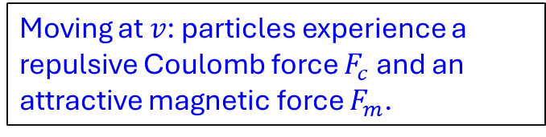
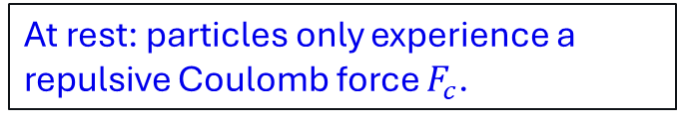
Space Charge
Consider two positively charged particles in free space:
The Coulomb repulsion between like charges with magnetic attraction given by their movement.
Begins to play a role in high-luminosity and high-intensity accelerators, such as the LHC and SPS.
Space charge forces are created by the overlap of Coulomb repulsion and magnetic attraction between the ensemble of charged particles that constitutes a beam.
At rest: particles only experience a repulsive Coulomb force $F_{c}$.
Moving at $v$: particles experience a repulsive Coulomb force $F_{c}$ and an attractive magnetic force $F_{m}$.
I. Introduction
Figure adapted from T. Pieloni
Notes:
Collective effects are particularly important in high luminosity accelerators such as the LHC and SPS. Space charge is defined as the Coulomb repulsion between the set of charged particles constituting a beam with magnetic attraction given by their movement. Space charge is a collective effect due to space charge forces depending on the charge density of the whole bunch.
Space charge forces are a combination of the repulsive Coulomb force and attractive magnetic force.

Slide 6
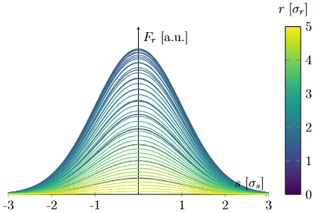
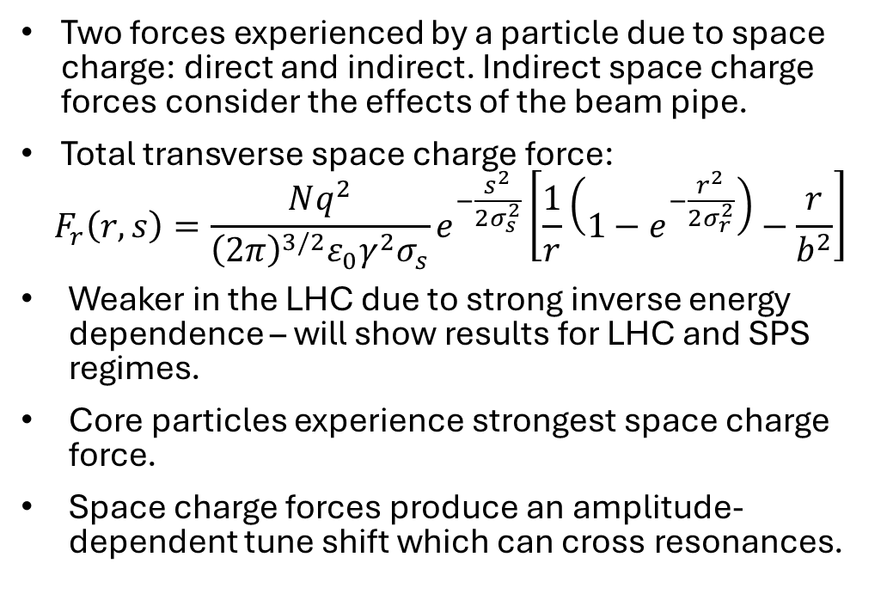
Space Charge Forces
Two forces experienced by a particle due to space charge: direct and indirect. Indirect space charge forces consider the effects of the beam pipe.
Total transverse space charge force:
$$F_{r}\left(r,s\right)=\frac{Nq^{2}}{{\left(2π\right)}^{3/2}ε_{0}γ^{2}σ_{s}}e^{−\frac{s^{2}}{2σ_{s}^{2}}}\left[\frac{1}{r}\left(1−e^{−\frac{r^{2}}{2σ_{r}^{2}}}\right)−\frac{r}{b^{2}}\right]$$
Weaker in the LHC due to strong inverse energy dependence – will show results for LHC and SPS regimes.
Core particles experience strongest space charge force.
Space charge forces produce an amplitude-dependent tune shift which can cross resonances.
Direct term
Indirect term
I. Introduction
Notes:
We split space charge forces into two forces – direct and indirect. When we combine these forces into one single force term, we can observe that the direct term is highly non-linear. Indirect space charge forces also consider the effects of the beam pipe that the beam travels through, which is a vacuum – this term is linear with respect to the transverse amplitude. There is also a very strong inverse energy dependence – meaning that in the LHC, with a gamma of around 7500, these forces are weaker than in the SPS, and as particles are accelerated closer and closer to the speed of light, it tends towards zero.
I will show the results for the two different regimes in the SPS and the LHC. Since this force is strongest for particles with smaller transverse amplitudes, core particles are the ones shifted the most by space charge forces, but halo particles also experience modified dynamics. This force is also stronger for high intensities represented by N and short bunch lengths represented by sigma_s.

Slide 7
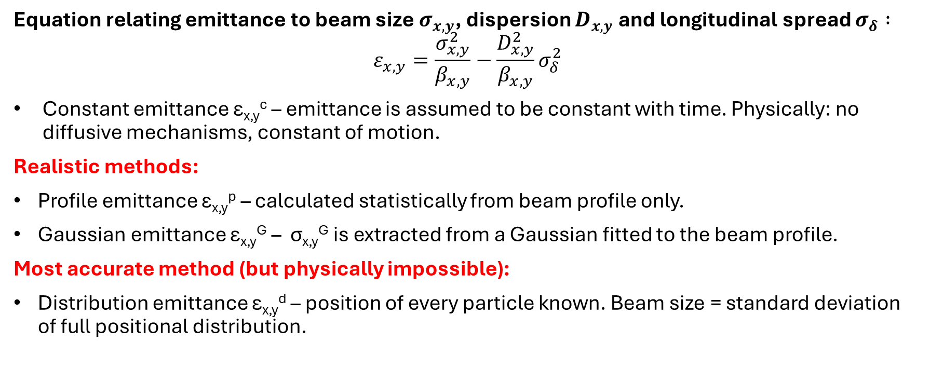
Methods for Calculating ε_{x,y} in Simulations
II. Methodology
Equation relating emittance to beam size $σ_{x,y}$, dispersion $D_{x,y}$ and longitudinal spread $σ_{δ} :$
$$ε_{x,y}=\frac{σ_{x,y}^{2}}{β_{x,y}}−\frac{D_{x,y}^{2}}{β_{x,y}}σ_{δ}^{2}$$
Constant emittance ε_{x,y}^{c} – emittance is assumed to be constant with time. Physically: no diffusive mechanisms, constant of motion.
Realistic methods:
Profile emittance ε_{x,y}^{p} – calculated statistically from beam profile only.
Gaussian emittance ε_{x,y}^{G} – σ_{x,y}^{G} is extracted from a Gaussian fitted to the beam profile.
Most accurate method (but physically impossible):
Distribution emittance ε_{x,y}^{d} – position of every particle known. Beam size = standard deviation of full positional distribution.
Notes:
I will now move onto the methodology behind these investigations. First of all, emittance is related to beam size, dispersion, momentum spread and the Twiss beta function at a certain point using this equation. We have three realistic methods for calculating emittance. The most trivial is assuming that in the machine there are no diffusive mechanisms, so emittance is a constant of motion that does not change with time and is preserved through the machines. The profile emittance is calculated statistically using only the beam profile. This includes the statistical calculation of the longitudinal spread sigma_delta. Dispersion is significant due to quadrupoles focusing and defocusing particles differently depending on their amplitudes.
There is also the simpler approach of calculating the emittance by fitting a Gaussian to the beam – known as the Gaussian emittance. However, this also fails to account for dispersion. The most theoretically accurate method is known as the distribution emittance – we know the position, momentum, dispersion and Twiss parameters of every particle. However, this method is physically impossible. The knowledge behind these methods is more important for the SPS section of this project – the LHC section primarily used the distribution emittance for simplicity in presenting these results.

Slide 8
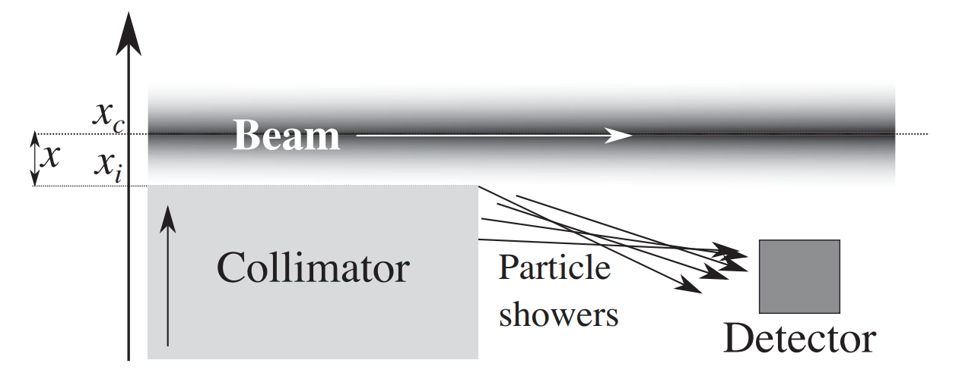
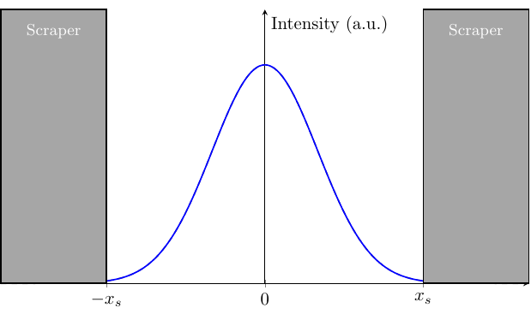
Calculating Halo Content from Full Distribution
Scraping Measurement Setup
Positions and momenta of all particles known in normalised coordinates.
Action computed directly for each particle.
Scraping measurements involve moving collimator jaws inwards in small steps towards the beam core, removing beam tails.
This method is evidently destructive to the beam.
Figure: A. Gorzawski et al.
Beam Profile Scraped at 3σ
II. Methodology
Notes:
There are also two different methods we can use to calculate the fraction of halo particles. We will be explaining both – scraping methods and beam profile analysis. The former employs knowledge of the full distribution – where we know the positions and momenta of all particles in normalised coordinates. Action is expressed in sigma^2 – with this formula also being valid in the y-plane, and particles in the halo limit are classified as such. The physical equivalent of this method is using scraping.
Scraping measurements involve moving graphite collimator jaw-like blades inwards in small steps, removing the beam halo. Measurements of scraped particles can then be taken. They are also used to remove the tails of the beam before particles are injected from the SPS into the LHC. This method is obviously destructive to the beam, so scraping measurements are not always possible.
The lower diagram shows how collimator jaws truncate the tails of a beam profile – here, it is assumed that this process is instantaneous.

Slide 9
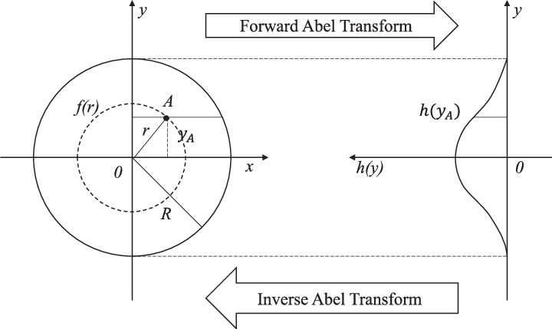

Calculating Halo Content from Profile
Knowledge of only the horizontal and vertical beam profiles is assumed – this method is non-destructive.
Inverse Abel transform of beam profile reconstructs particle distribution.
Underlying assumption: circularly symmetric 2D distribution – not always guaranteed.
Fraction of halo particles calculated by integrating the action distribution above the halo limit and dividing by the total area.
This mirrors profile measurements taken using Beam Wire Scanners (BWS) or Beam Synchrotron Radiation Telescopes (BSRT).
Figure: Y. Zhang et al.
$$f_{t}=f_{x}+f_{y}−f_{x}f_{y}$$
II. Methodology
Notes:
There is another method where halo content may be calculated using only the transverse beam profile. The action distribution is reconstructed by performing an inverse Abel transform on the beam profile, with the underlying assumption that the 2D particle distribution is circularly symmetric – which is not always guaranteed. The possible inaccuracies of this assumption may be outweighed by the convenience of always being able to perform beam profile measurements, using BWSs and BSRTs.
Halo content is calculated by integrating the particle distribution above the halo limit, and dividing by the total area of the aforementioned distribution. We assume that there is no coupling between the two planes, hence the coefficient of the first-order correction term being set to 1.

Slide 10
Simulation Setup
Frozen Model | PIC Model
Uses a fixed Gaussian bunch distribution to compute space charge forces. Assumes that initially computed space charge forces are constant throughout tracking. May not hold if particle distribution significantly diverges from a Gaussian. Fastest and least computationally intensive. | No assumptions made on bunch shape. Uses average momenta to recompute space charge forces. Space charge forces recomputed throughout tracking. Highly computationally intensive.
Long-term, multi-particle tracking simulations were performed using XSuite.
Frozen space charge model used.
Particle-in-cell (PIC) model may have produced more accurate results.
100,000 particles for each case presented – on computationally feasible and operationally relevant timescales.
10⁵ particles is statistically significant in order to observe effects in the tails of the distribution.
II. Methodology
Notes:
The Xsuite library was used in order to perform long-term tracking simulations of 100,000 particles. We chose to use the frozen space charge model for its computational efficiency and speed. However, some of the assumptions made by the frozen model, including the bunch distribution being Gaussian and fixed throughout, may not always hold – in this case, when space charge perturbs the tails of the distribution.
The particle-in-cell or PIC model may have yielded more accurate results, but it is far more computationally expensive. The PIC model is an integrator that makes no assumptions on the bunch shape and uses average momenta to continuously recompute space charge forces. If we were to use fewer than 10^5 particles, our results would no longer be statistically significant in order to observe events in the tails of the particle distribution.

Slide 11
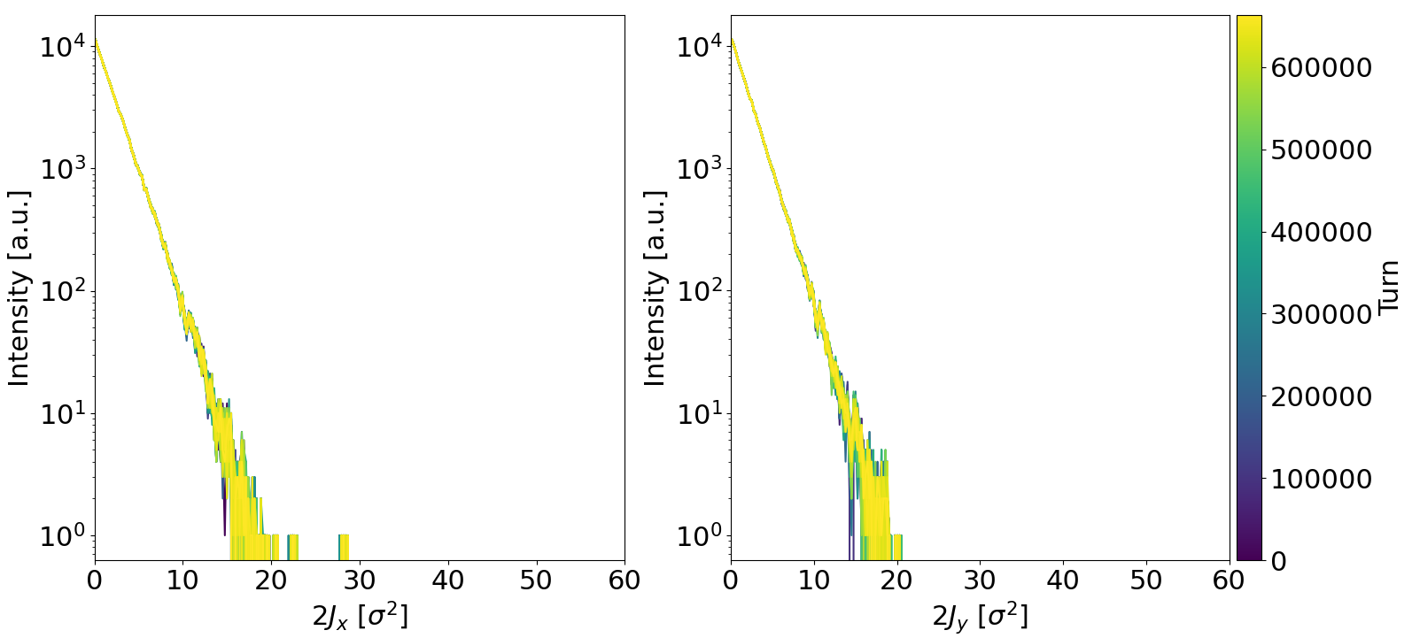
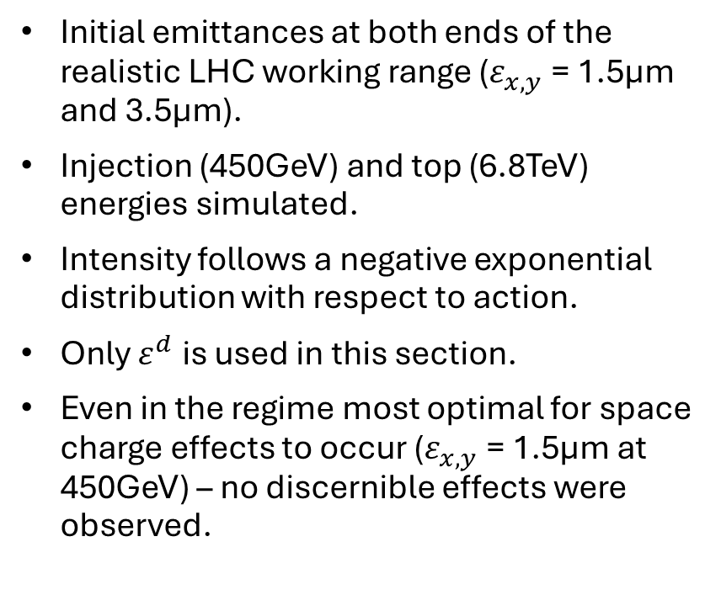
Initial LHC Simulations: Results and Parameters
III. Simulations of Space Charge Effects on the Beam Halo in the LHC
Action Distribution (at injection, $ε^{d}=1.5μm$):
Initial emittances at both ends of the realistic LHC working range ($ε_{x,y}$= 1.5µm and 3.5µm).
Injection (450GeV) and top (6.8TeV) energies simulated.
Intensity follows a negative exponential distribution with respect to action.
Only $ε^{d}$ is used in this section.
Even in the regime most optimal for space charge effects to occur ($ε_{x,y}$= 1.5µm at 450GeV) – no discernible effects were observed.
Notes:
I will now begin to present the results of the first part of our simulations – modelling space charge in the LHC. Using solely the distribution emittance calculation method, we simulated initial emittances representing the lower and upper ends of the typical working range of the LHC – that is 1.5 and 3.5um respectively. We also simulated both emittances at two stages – injection with an energy of 450GeV, and beta* - levelling with an energy of 6.8GeV. Space charge effects have a strong inverse energy dependence and also a dependence on emittance, so if they were to occur in the LHC, the most pertinent case would be injection energy with a low emittance. However, even with these parameters, no discernible space charge effects were observed.

Slide 12
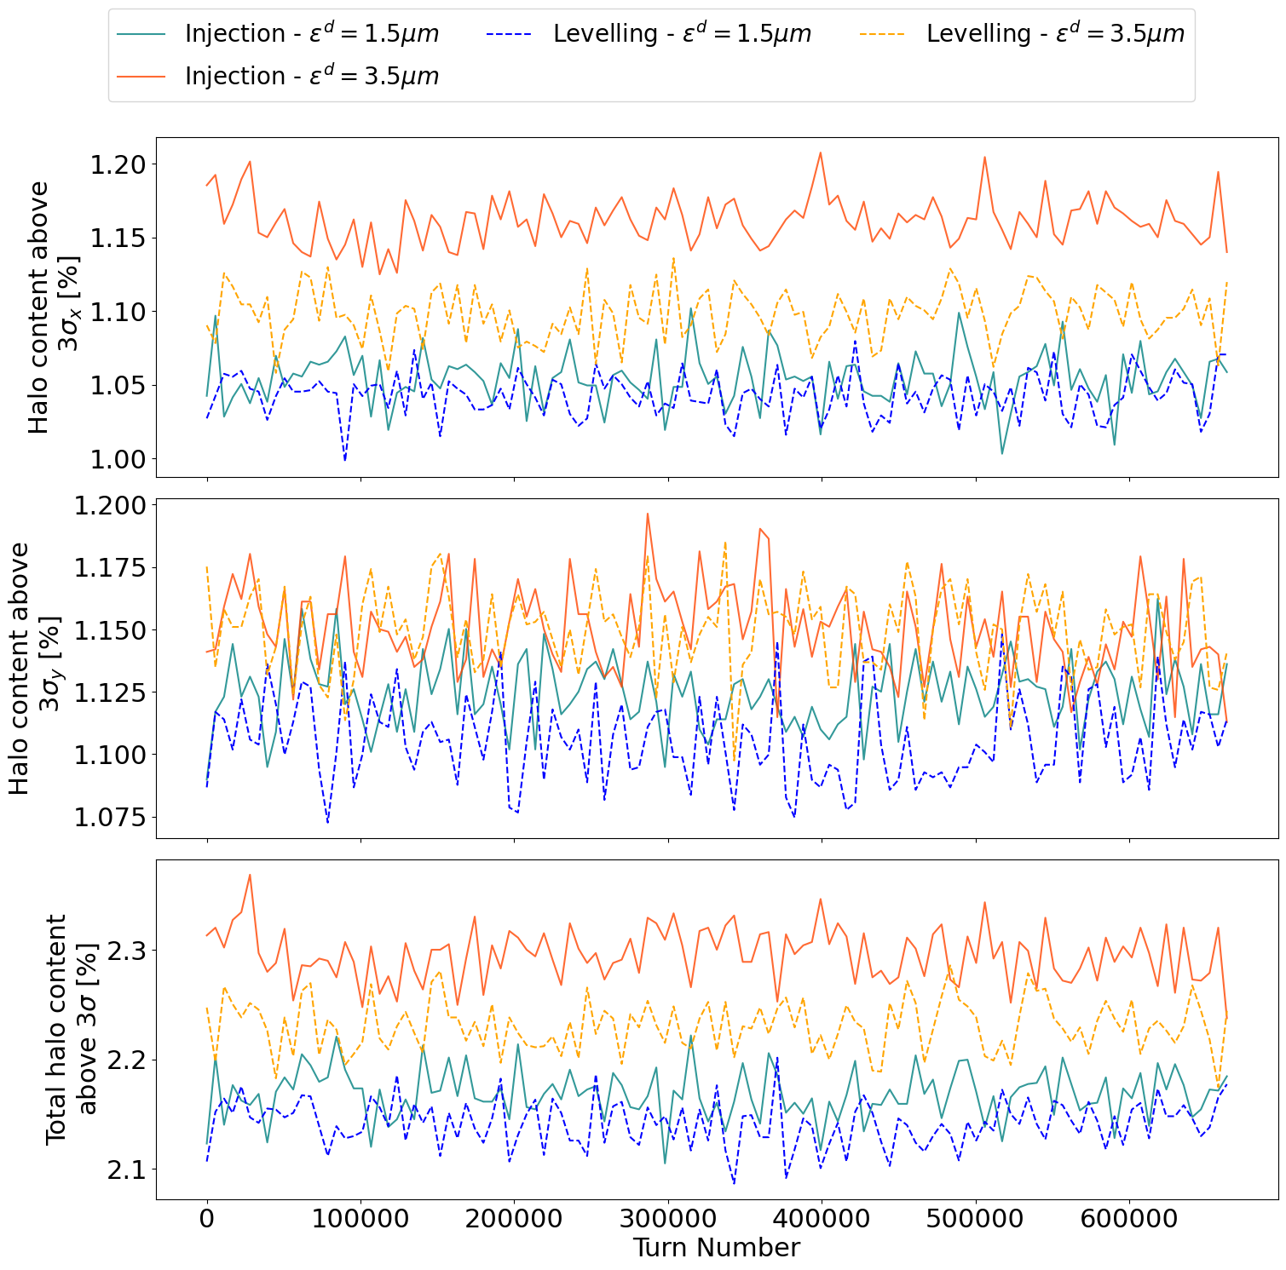
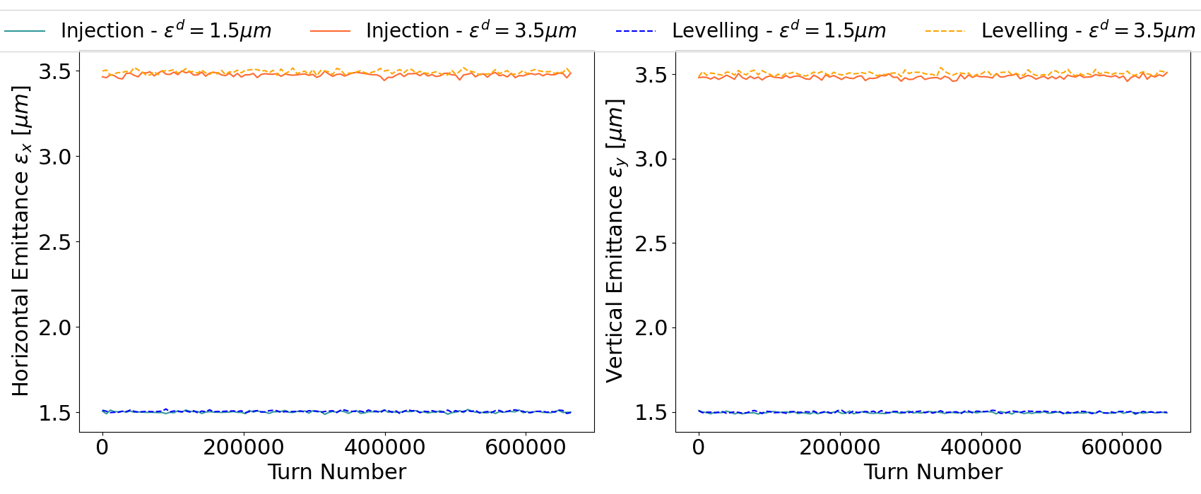
Results of Initial LHC Simulations (cont.)
Halo Content Evolution
Halo content and emittance do not increase or decrease significantly with time.
Emittance Evolution
Two extreme regimes were explored to make space charge relevant with unrealistic parameters (backup slides).
III. Simulations of Space Charge Effects on the Beam Halo in the LHC
Notes:
From the plots of halo content and emittance respectively against time, we can consider both of these quantities to be constant at both stages and both emittances – fluctuations in emittance and halo content are just noise. I also explored two extreme cases which can be seen in the backup slides – one with an emittance 3x lower, and another with an intensity 10x higher. The only regime which showed any sign of space charge effects was the extreme intensity at injection energy and the lower emittance, but I opted not to display it here, as an intensity on the order of 10^12 particles cannot be attained in the LHC.

Slide 13
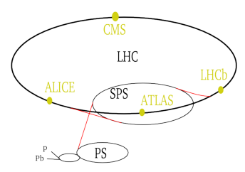
Introduction to SPS Simulations
IV. Simulations of Space Charge Effects on the Beam Halo in the SPS
Even the injection energy in the LHC is far too low for space charge effects to occur with realistic intensities and emittances.
The SPS is known to exhibit strong space charge effects.
If the halo develops during the SPS flat-bottom, then it is conserved if not enhanced during the energy ramp and injection into the LHC.
Initial emittances between 0.6 and 2.0µm inclusive were simulated, in increments of 0.2µm.
Two different tune working points covered.
Figure: A. Horvath
Notes:
The SPS is known to exhibit strong space charge effects, as its relativistic gamma is sufficiently low for this to occur. Since we could not observe space charge effects under nominal working parameters in simulations of particle tracking in the LHC, the next hypothesis we investigated was that of the halo developing due to space charge effects at the SPS flat-bottom stage, and being conserved through the SPS energy ramp and injection into the LHC.
The halo is preserved throughout these stages if there are no diffusive processes. I simulated a range of initial emittances with smaller intervals of 0.2um this time, between 0.6 and 2.0 um. I also studied two different tune working points, and this analysis covers the change to the newer one.

Slide 14
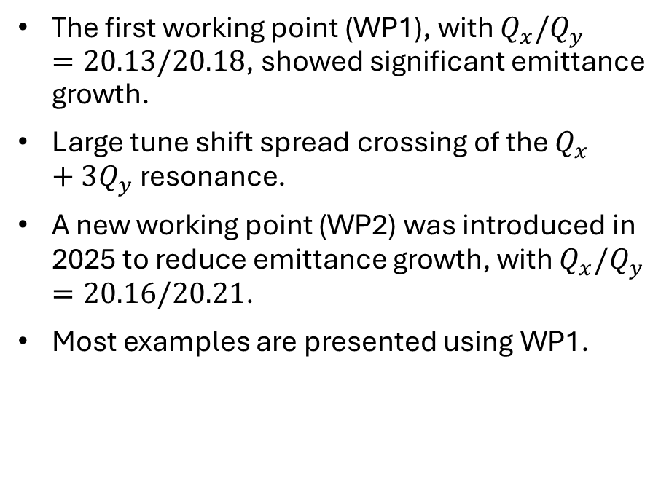
Working Points and Field Errors
Old vs. New Working Point
Field Errors
The first working point (WP1), with $Q_{x}/Q_{y}=20.13/20.18$, showed significant emittance growth.
Large tune shift spread crossing of the $Q_{x}+3Q_{y}$ resonance.
A new working point (WP2) was introduced in 2025 to reduce emittance growth, with $Q_{x}/Q_{y}=20.16/20.21$.
Most examples are presented using WP1.
Higher-order multipolar field errors can be present in magnets due to their inherent manufacturing imperfections.
Field errors can excite resonances – worsening emittance blow-up and losses.
Two models of the machine used: one ideal, and one introducing field errors based on past measurements.
IV. Simulations of Space Charge Effects on the Beam Halo in the SPS
Notes:
We had access to four different lattice models of the SPS. There were two models for both tune working points – the older working point (WP1) exhibited a large tune shift spread crossing a fourth-order resonance. This resonance crossing caused significant emittance blow-up, Therefore, it was superseded last year by a new working point (WP2) with tunes further away from this resonance. The tunes were optimised to mitigate the issue of emittance blow-up significantly.
We also had access to a model introducing higher-order multipolar field errors based on past measurements resulting from manufacturing imperfections in magnets for each working point. This is due to field errors having the potential to excite resonances themselves.

Slide 15
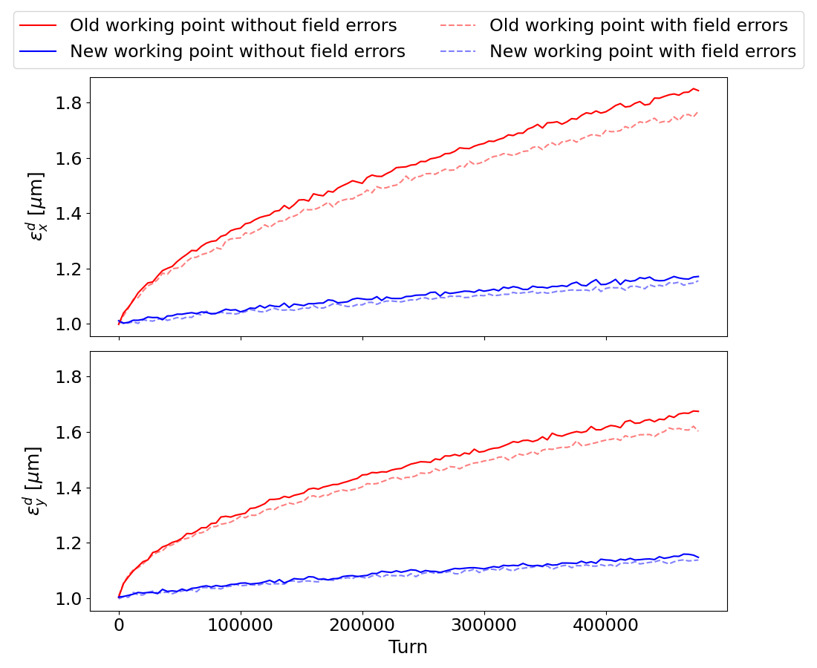
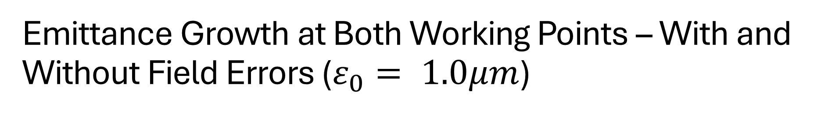
Emittance Growth at Both Working Points – With and Without Field Errors ($ε_{0}= 1.0μm$)
WP1 exhibits significant emittance blow-up compared to WP2 – the tunes in the latter were successfully optimised to reduce this phenomenon.
Field errors do not have a major effect on emittance growth – particularly at WP2.
IV. Simulations of Space Charge Effects on the Beam Halo in the SPS
Notes:
These two graphs show the emittance growth from an intermediate value in both transverse planes at both working points, with the x-axis representing the number of turns the beam has been transported through in the machine. WP2 shows much lower emittance growth than WP2, showing that the tune optimisation when selecting this working point was successful. Field errors also did not have a major effect on emittance growth.

Slide 16
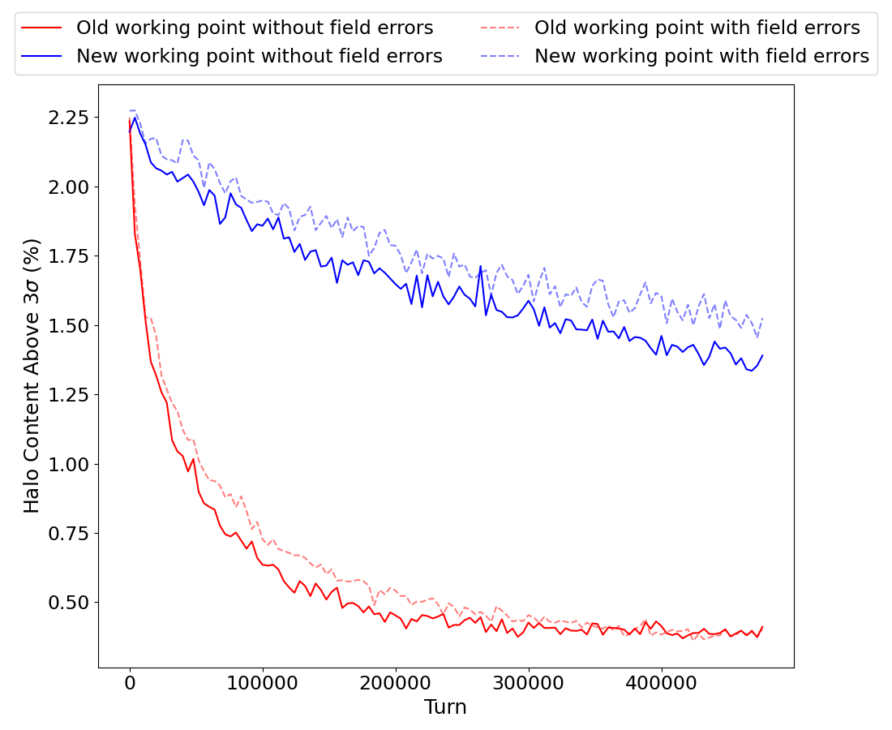
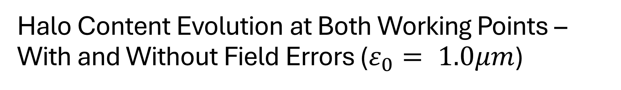
Halo Content Evolution at Both Working Points – With and Without Field Errors ($ε_{0}= 1.0μm$)
Much larger halo content despite lower emittance growth in WP2.
Field errors did not have a significant effect on halo content either. Ideal models used exclusively from now on.
IV. Simulations of Space Charge Effects on the Beam Halo in the SPS
Notes:
Despite WP2 exhibiting much lower emittance growth, it has much larger content in the tails of the distribution. There is clearly something inversely proportional to emittance shifting particles from the reference orbit – this is caused by space charge. Field errors also did not affect halo content significantly, so only the ideal lattice models were used from now on. WP1 was also used to present most examples, as it demonstrated the space charge effects we were looking for more strongly.

Slide 17
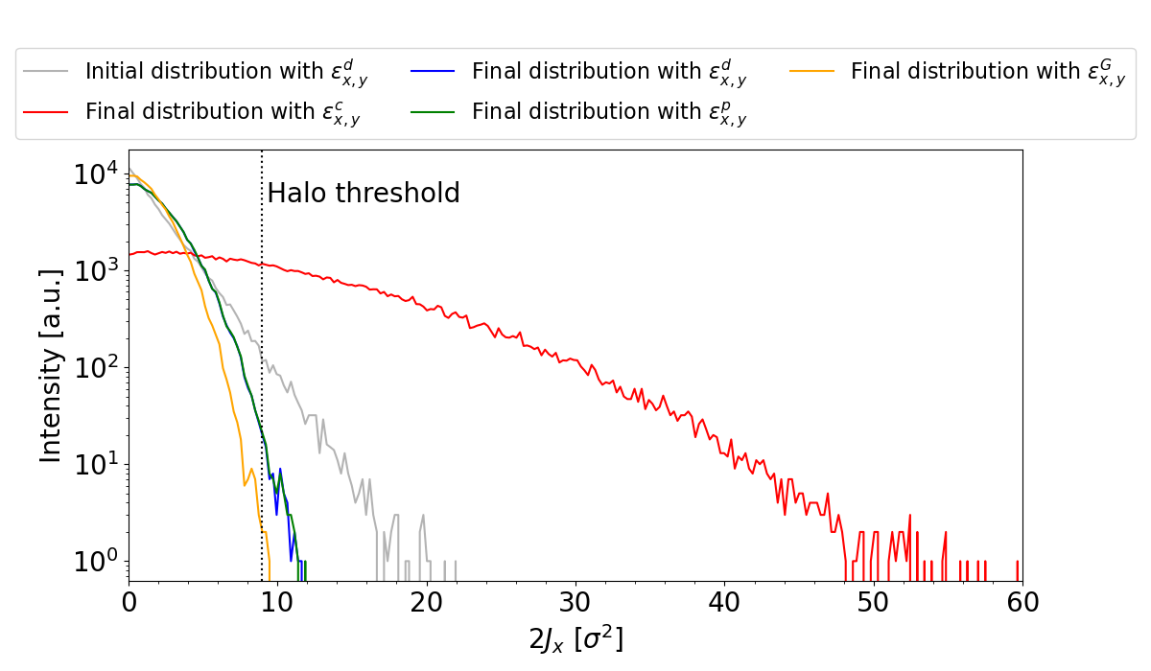
Emittance Calculation Method Comparison
Action Distributions at End of Tracking ($ε_{0}$= 0.6µm):
Emittance calculation methods have a significant effect on the final action distribution.
The constant emittance (ε_{x,y}^{c} ) greatly overestimates halo content due to failing to account for emittance growth.
The profile emittance (ε_{x,y}^{p} ) closely approximates the distribution emittance (ε_{x,y}^{d} ).
The emittance taken from a Gaussian fit of the profile (ε_{x,y}^{G} ) underestimates halo content – it does not account for tails being flattened by space charge effects.
Same phenomena in y-plane.
IV. Simulations of Space Charge Effects on the Beam Halo in the SPS
Notes:
The different emittance calculation methods become relevant in the SPS simulations, particularly at the lowest emittance, where emittance growth is the most significant – so a comparison is provided here. The initial action distribution is the same for every method, but the final action distributions show significant differences. The profile method is the best among the three physically possible methods investigated, as it computes dispersion statistically – being the only method to account for this important phenomenon.
Since taking the emittance as constant fails to account for emittance growth, more particles are wrongly classified as halo particles due to the beam profile becoming wider. Computing the emittance as the standard deviation of a fitted Gaussian is also an insufficient approximation for distributions that have been perturbed from a Gaussian, as we will see soon.

Slide 18
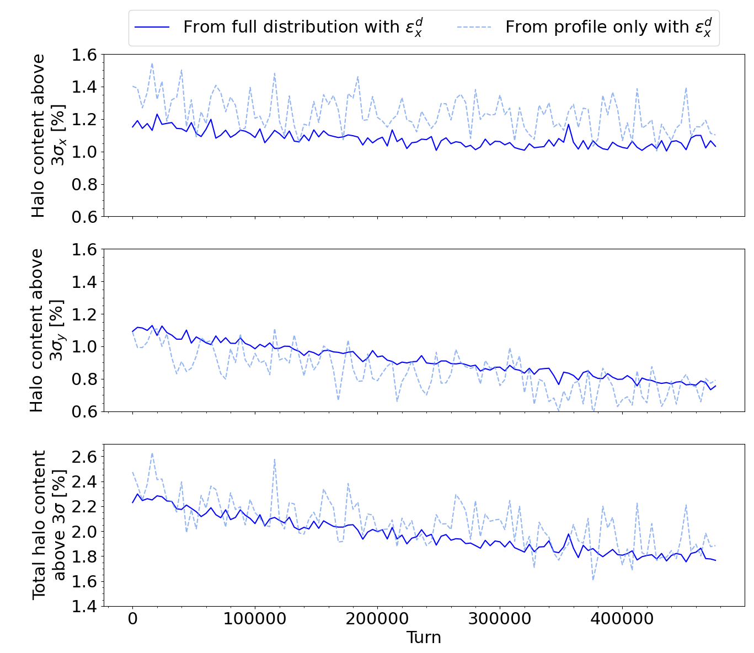
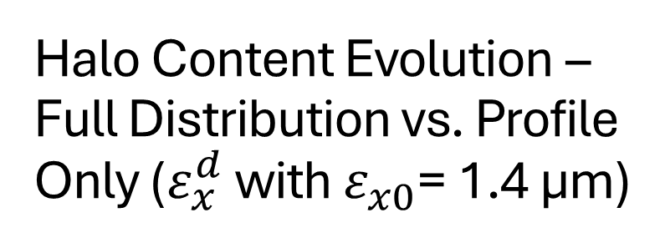
Halo Content Evolution – Full Distribution vs. Profile Only ($ε_{x}^{d}$ with $ε_{x0}$= 1.4 µm)
The agreement between the two methods is strong.
While halo content from the beam profile only is noisy, it can reproduce true halo content well in most cases.
Although the agreement decreases in cases where halo content is very low, the trends are captured correctly.
Different regimes are visible in x and y – this could be due to model input, different tunes, errors, etc.
IV. Simulations of Space Charge Effects on the Beam Halo in the SPS
Notes:
Measuring halo content using analysis of the beam profile with BSRTs and WS yields noisier results than those employing knowledge of the full distribution through performing scraping measurements, however the agreement between these methods is strong, and the former can reproduce true halo content well in most cases, even though the agreement decreases in cases where the halo content is very low. It is notable that the halo content in both planes is very different in this case – this could be due to the two regimes having different tunes or being affected by errors differently.

Slide 19
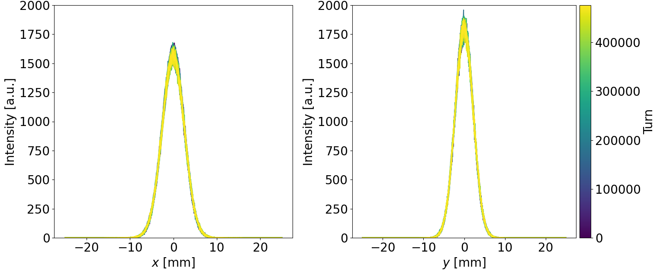
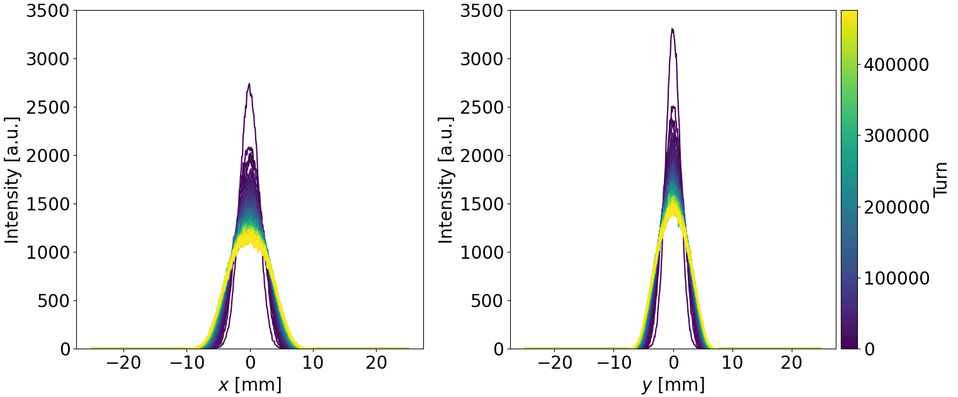
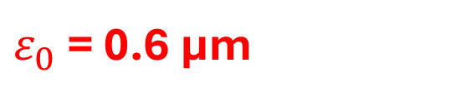
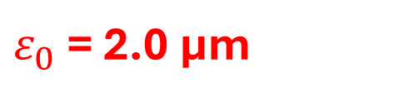
Beam Profile Evolution (I)
$ε_{0}$ = 2.0 µm
For larger initial emittances, space charge effects are negligible, and the distribution does not change much with time.
$ε_{0}$ = 0.6 µm
Space charge effects are clearly very strong for small initial emittances, so the distortion of the distribution is significant.
IV. Simulations of Space Charge Effects on the Beam Halo in the SPS
Notes:
For low initial emittances, we observe the beam profile decreasing in amplitude and increasing in width. The tails are also visibly lighter than in the initial Gaussian. For high initial emittances, the profile remains nearly constant throughout.

Slide 20
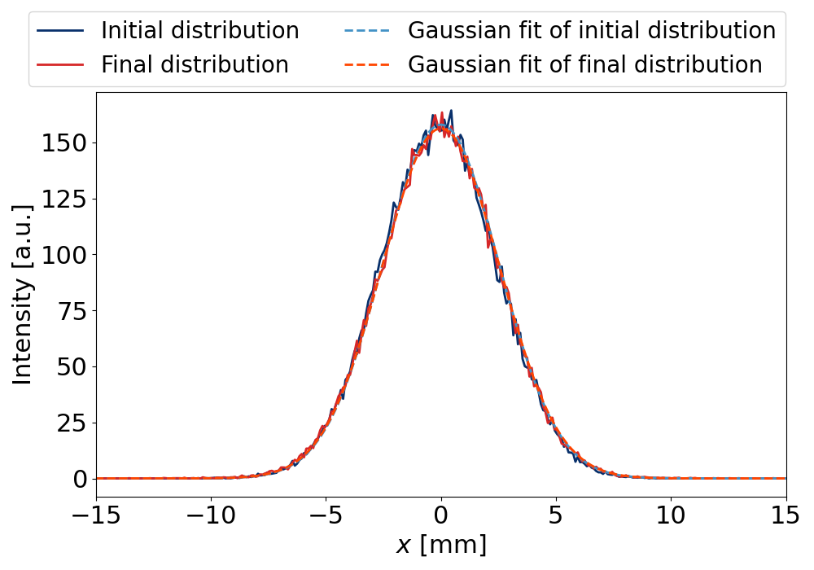
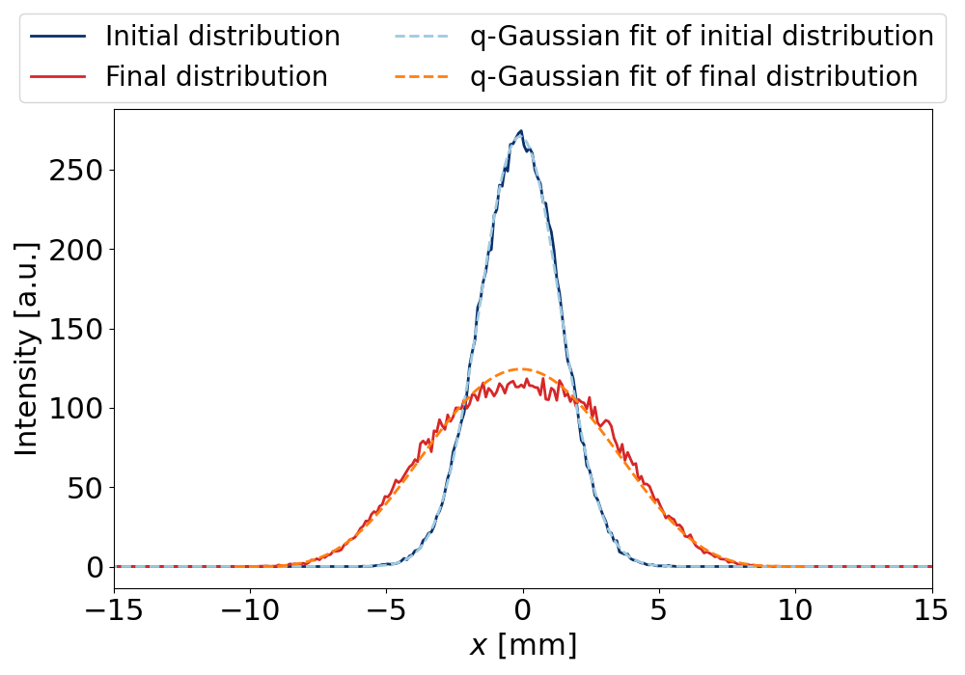
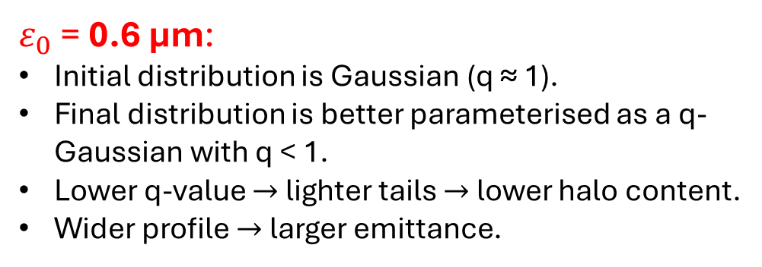
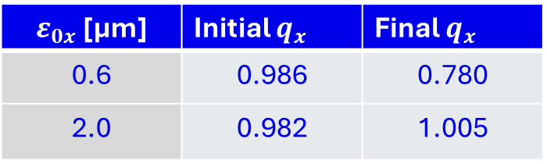
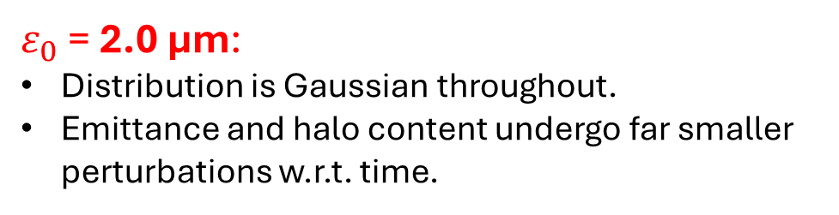
Beam Profile Evolution (II)
$ε_{0x}$ [µm] | Initial $q_{x}$ | Final $q_{x}$
0.6 | 0.986 | 0.780
2.0 | 0.982 | 1.005
$ε_{0}$ = 2.0 µm:
Distribution is Gaussian throughout.
Emittance and halo content undergo far smaller perturbations w.r.t. time.
$ε_{0}$ = 0.6 µm:
Initial distribution is Gaussian (q ≈ 1).
Final distribution is better parameterised as a q-Gaussian with q < 1.
Lower q-value $→$ lighter tails $→$ lower halo content.
Wider profile $→$ larger emittance.
IV. Simulations of Space Charge Effects on the Beam Halo in the SPS
Notes:
One way to parameterise the perturbed profile without overfitting is the q-Gaussian distribution. The q-Gaussian distribution introduces another parameter to the Gaussian, to account for lighter or heavier tails. A q-Gaussian with q=1 is simply a Gaussian, as is the case throughout tracking with the largest initial emittance. For the smallest initial emittance, the final distribution has a q-value around 0.8, which corresponds to a distribution with lighter tails than a Gaussian. This is a poor fit for the core but a good fit for the tails.
Physically, this once again relates to lower halo content and higher emittance. The same phenomenon is visible in the y-plane – this is included in the backup slides.

Slide 21
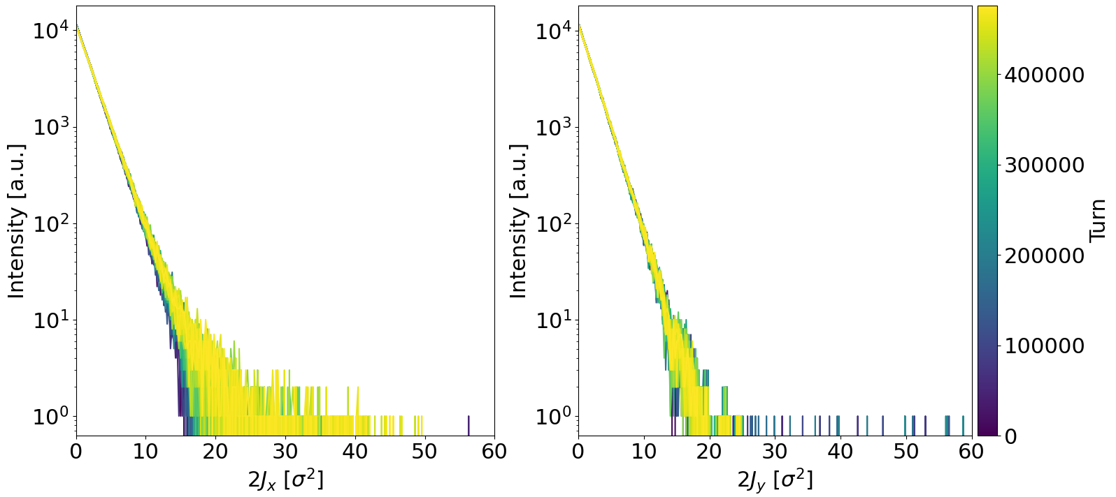
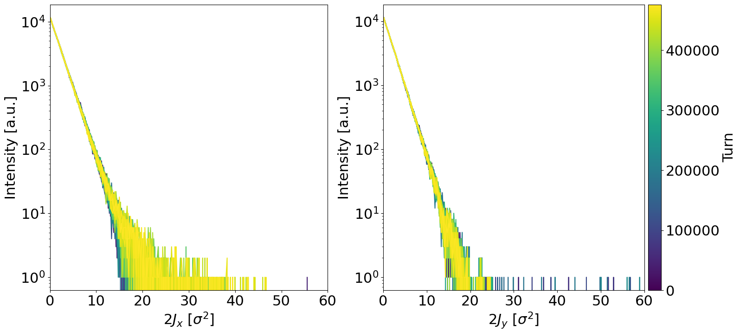
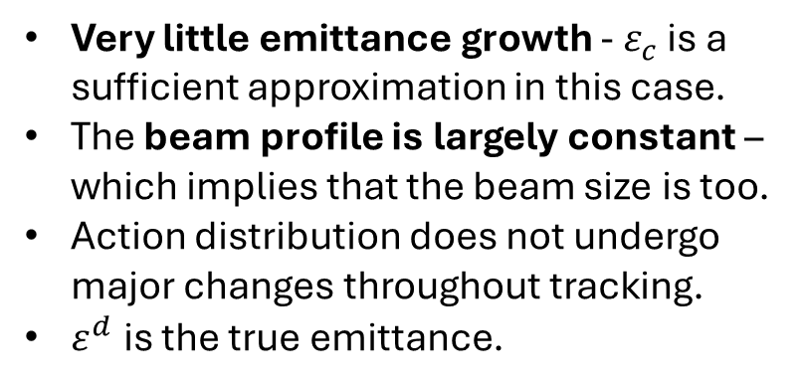
Action Distribution: ε₀ = 2.0 µm
Constant Emittance ε^{c}_{x,y}
Very little emittance growth - $ε_{c}$ is a sufficient approximation in this case.
The beam profile is largely constant – which implies that the beam size is too.
Action distribution does not undergo major changes throughout tracking.
$ε^{d}$ is the true emittance.
Distribution Emittance ε^{d}_{x,y}
IV. Simulations of Space Charge Effects on the Beam Halo in the SPS
Notes:
Constant emittance is a much better approximation for the highest initial emittance. The emittance undergoes much smaller perturbations, so the action distribution does not undergo major changes throughout tracking. Therefore, we do not see many differences from when the action distribution is computed using the true emittance.

Slide 22
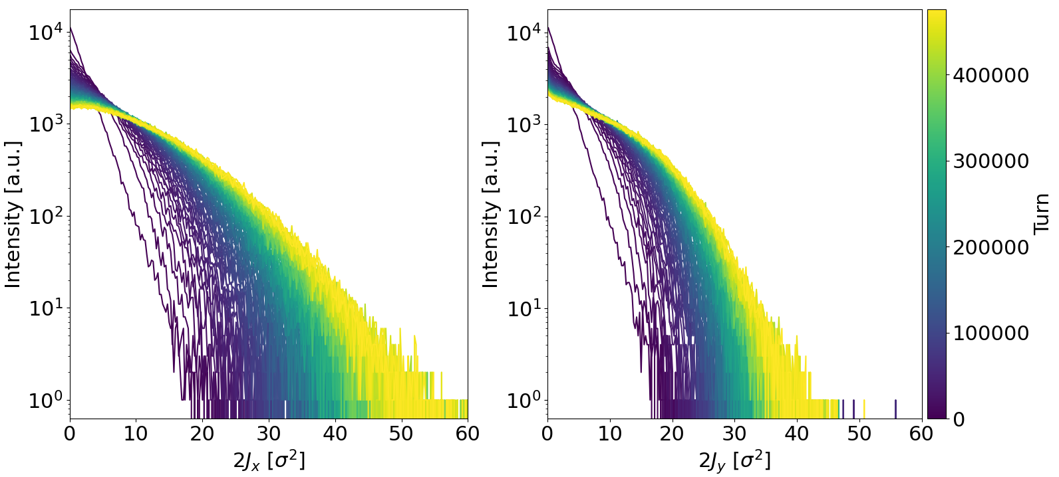
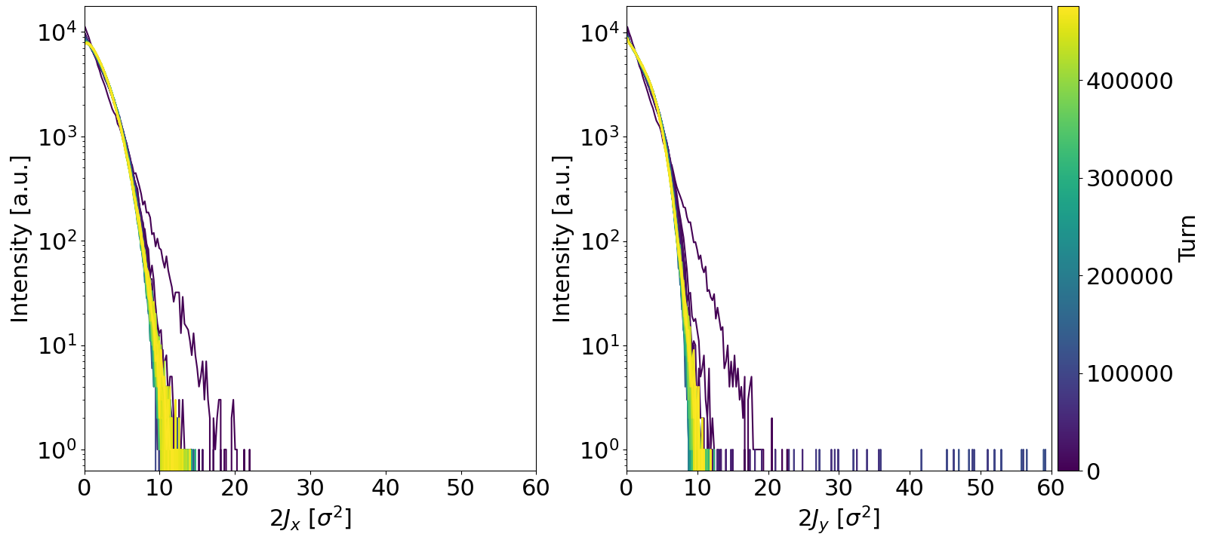
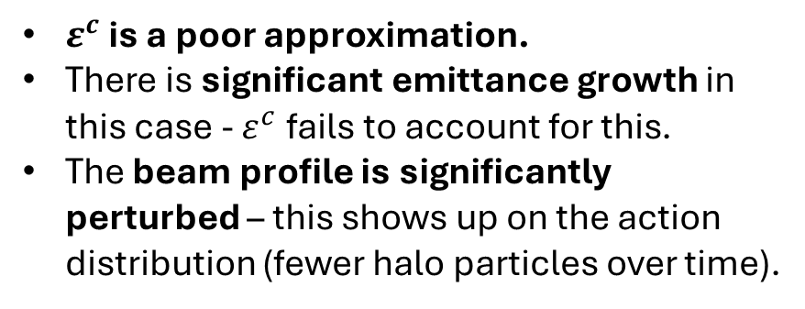
Action Distribution: ε₀ = 0.6 µm
Constant Emittance ε^{c}_{x,y}
$ε^{c}$ is a poor approximation.
There is significant emittance growth in this case - $ε^{c}$fails to account for this.
The beam profile is significantly perturbed – this shows up on the action distribution (fewer halo particles over time).
Distribution Emittance ε^{d}_{x,y}
IV. Simulations of Space Charge Effects on the Beam Halo in the SPS
Notes:
However, when computing the action distribution while the lowest initial emittance as constant, we see that this is a poor approximation – the perturbation of the distribution by space charge results in significant emittance growth, which increases the beam size, thereby widening the halo limit, which must change according to its definition using normalised coordinates.

Slide 23
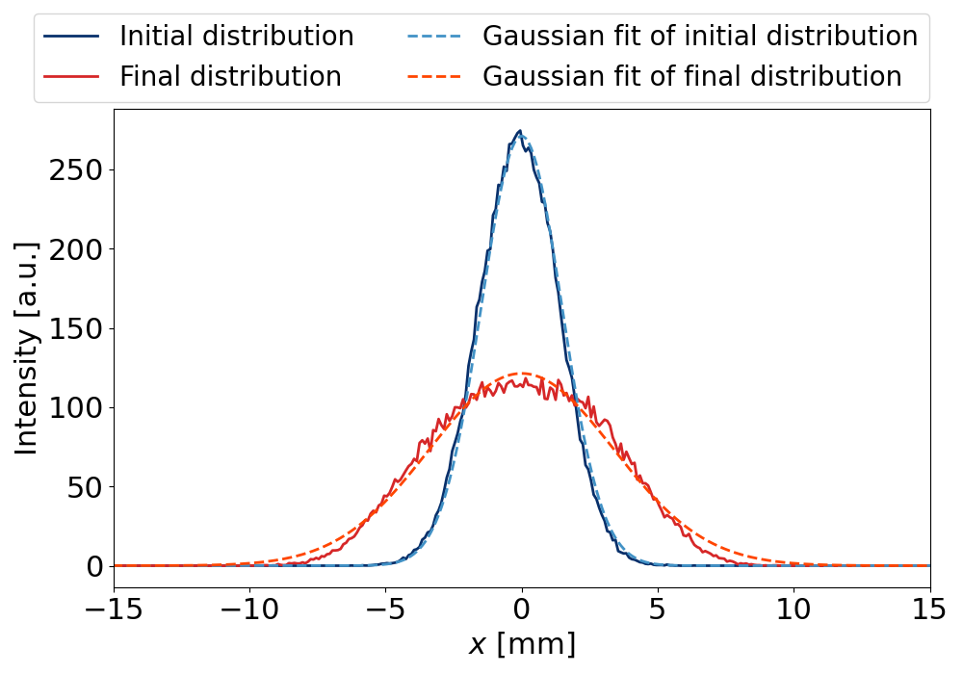
Gaussian Fit of Profile
ε₀ = 2.0 µm
ε₀ = 0.6 µm
Good fit throughout particle tracking.
Sufficient approximation due to almost negligible emittance growth.
Poor fit for final distribution.
Not ideal for calculating emittance evolution – emittance is overestimated.
IV. Simulations of Space Charge Effects on the Beam Halo in the SPS
Notes:
When we visualise fitting a Gaussian to the beam profile at the beginning and end of particle tracking, we see that the poor fit at the end of tracking for the smallest initial emittance results in the emittance being computed inaccurately if it is simply calculated using the standard deviation. However, this emittance calculation method is valid for the largest initial emittance due to the beam profile remaining Gaussian throughout.

Slide 24
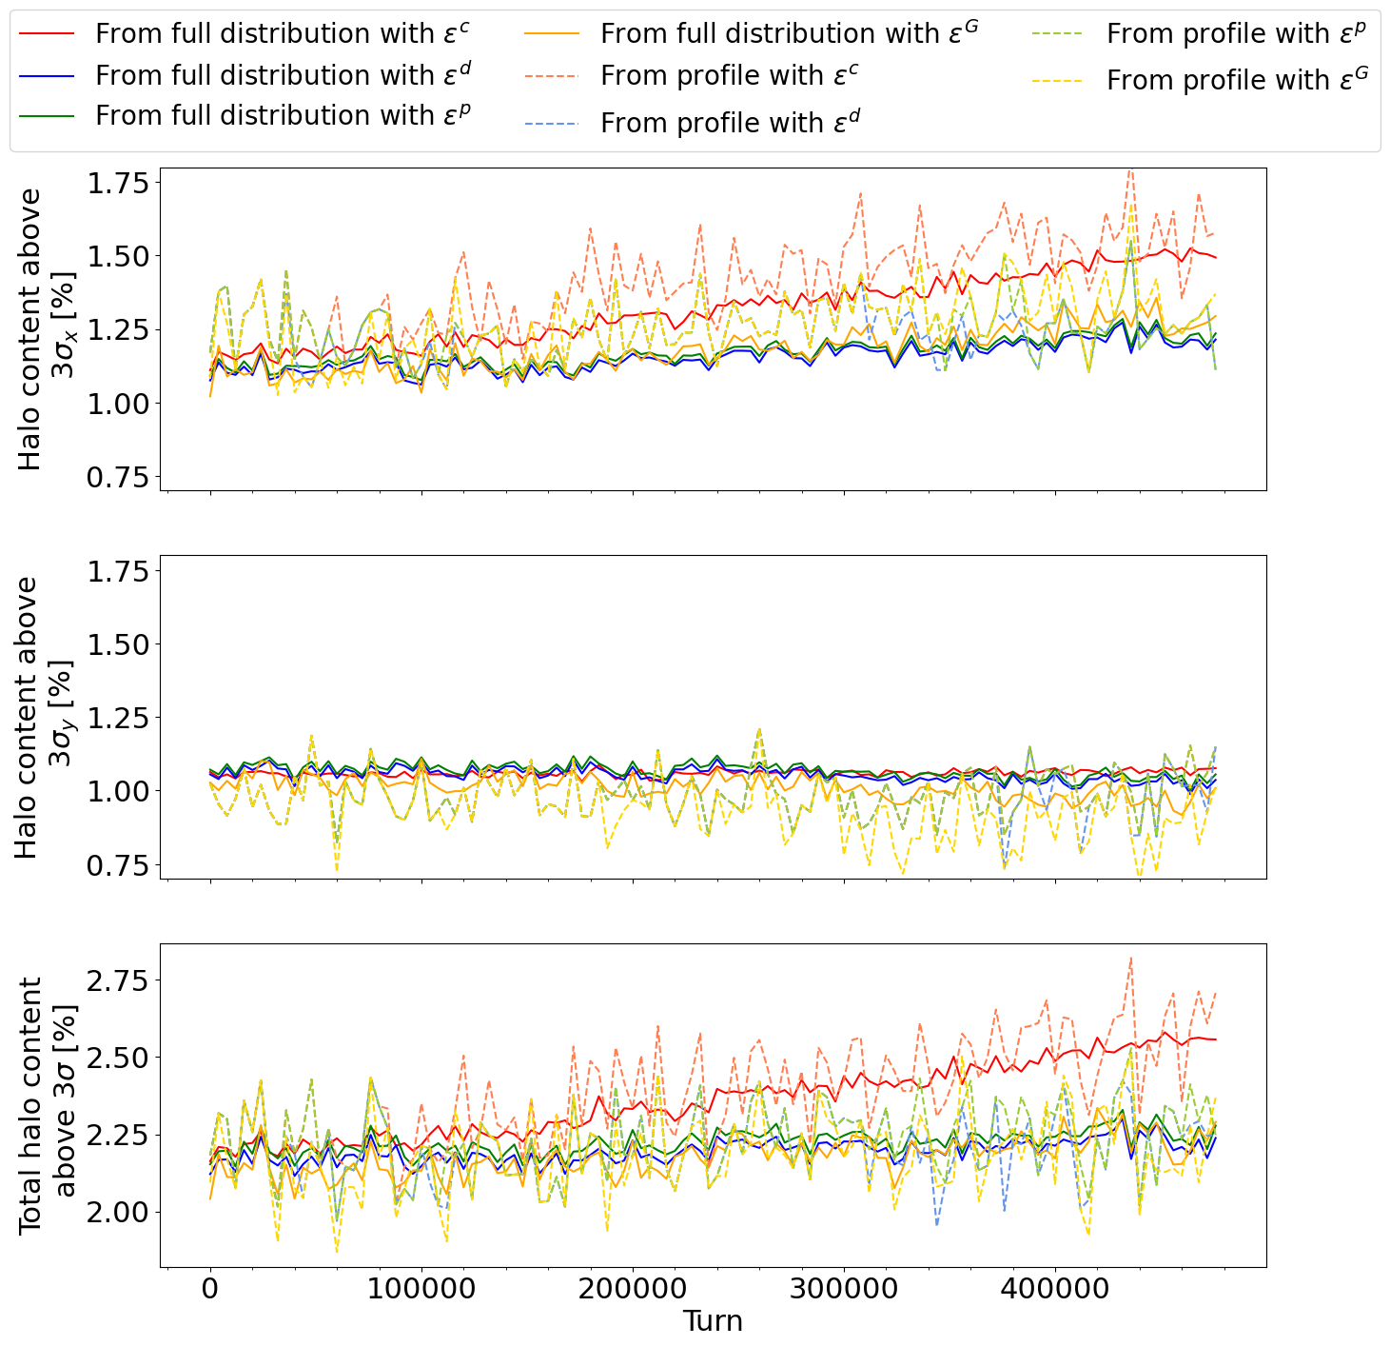
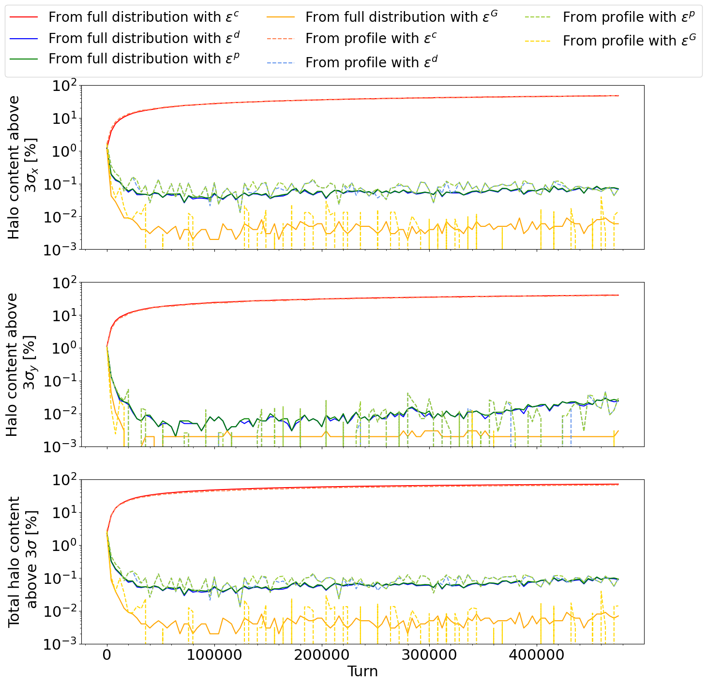
Halo Content Evolution
2.0 µm
0.6 µm
Halo is either approximately constant or slightly increases over time due to weak space charge effects.
Halo decreases over time due to significant space charge effects.
IV. Simulations of Space Charge Effects on the Beam Halo in the SPS
Notes:
Focusing on the blue and green curves corresponding to the two accurate emittance calculation methods, we can observe that for the larger initial emittance, the halo content is either approximately constant or increases over time – this shows that the space charge effects are negligible. For the smaller initial emittance, strong space charge effects cause the halo content to decrease over time. The x-plane dominates the total halo content in the case with the lowest initial emittance.

Slide 25
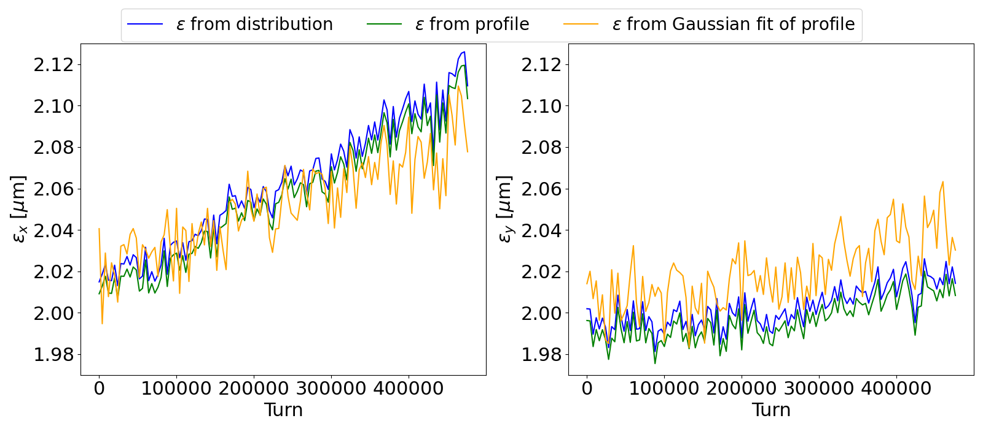
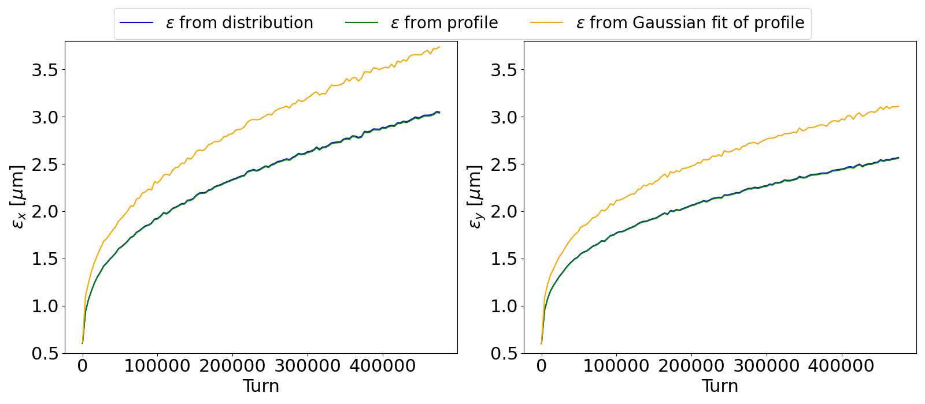
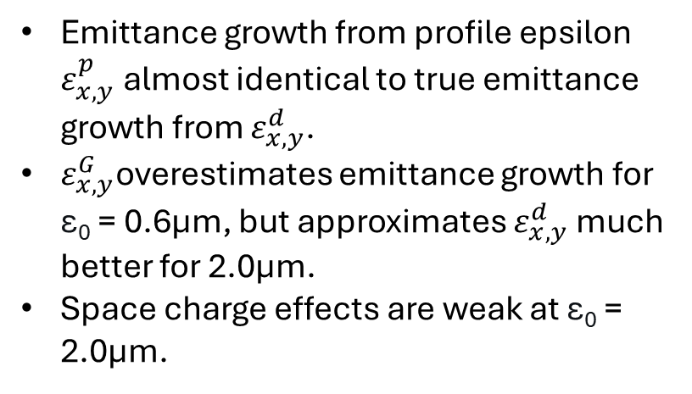
Emittance Growth
2.0 µm
Emittance growth from profile epsilon $ε_{x,y}^{p}$ almost identical to true emittance growth from $ε_{x,y}^{d}$.
$ε_{x,y}^{G}$overestimates emittance growth for ε₀ = 0.6µm, but approximates $ε_{x,y}^{d}$much better for 2.0µm.
Space charge effects are weak at ε₀ = 2.0µm.
0.6 µm
IV. Simulations of Space Charge Effects on the Beam Halo in the SPS
Notes:
Starting from an initial emittance of 2.0um, the emittance growth is closer to 5%, due to very weak space charge effects. On the other hand, space charge effects cause the emittance to blow up to more than 4x its initial value at 0.6um. Once again, these effects are more pronounced in the horizontal transverse plane, and these plots illustrate the failure of the Gaussian emittance to account for dispersion.

Slide 26
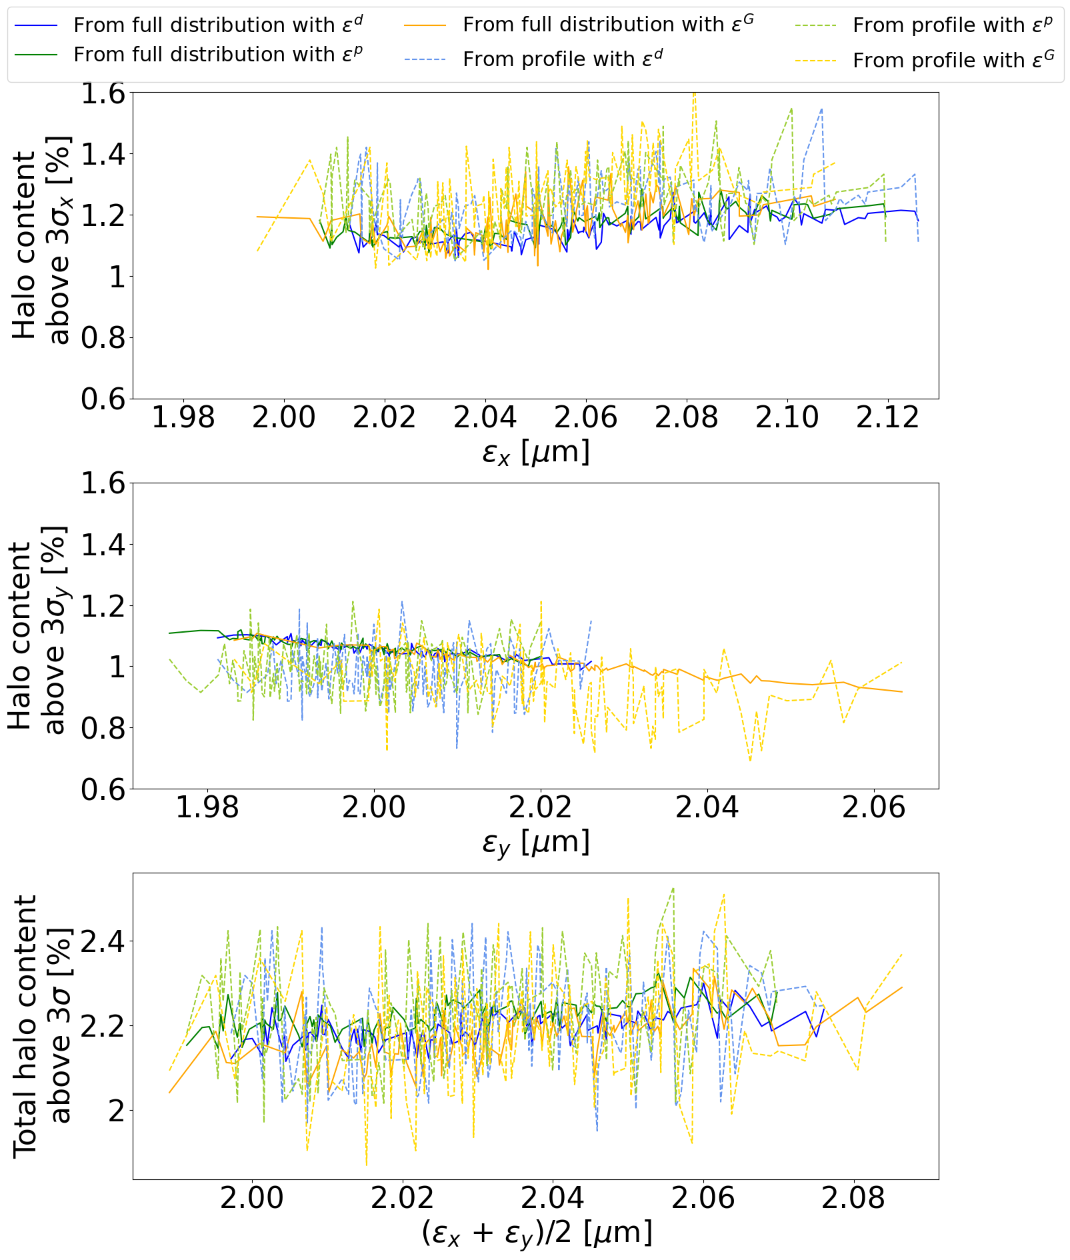
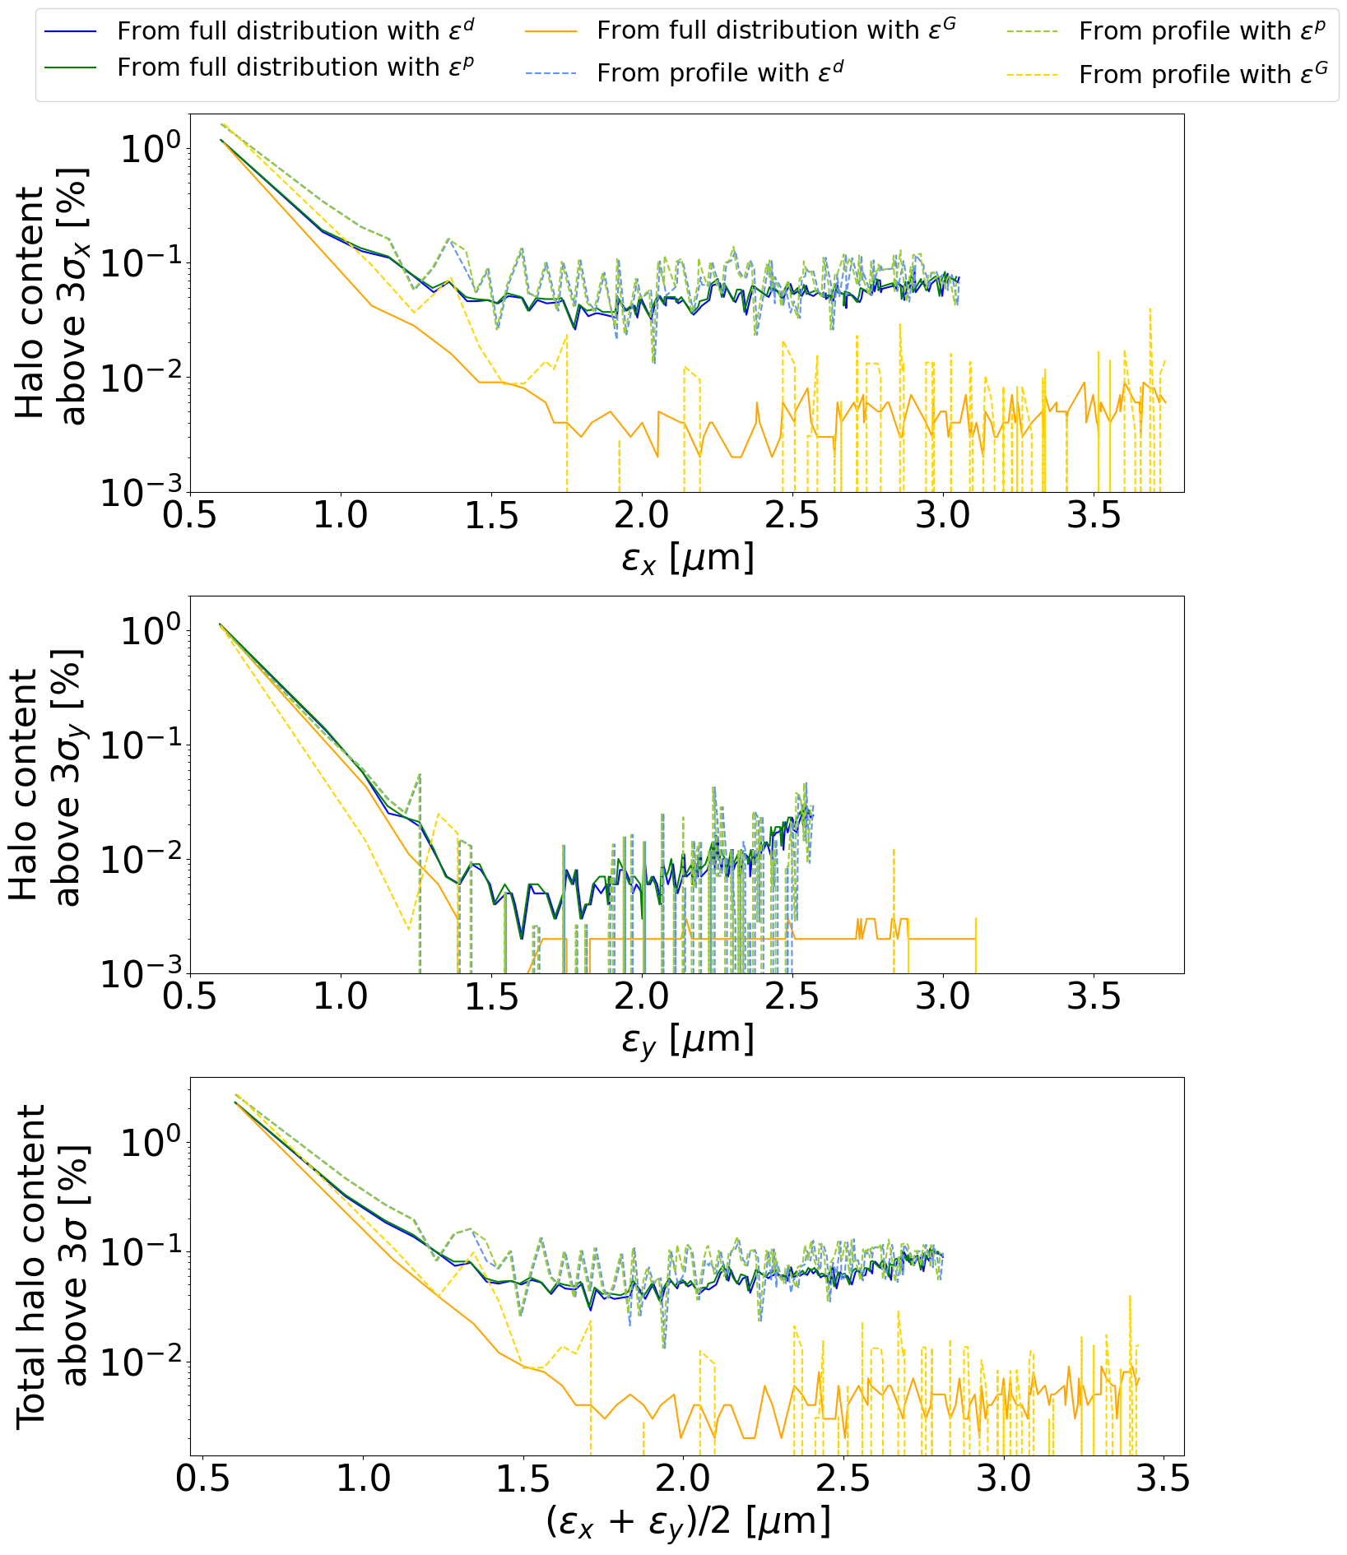

Halo Evolution with Emittance
$ε^{G}$ underestimates halo content evolution.
2.0 µm
0.6 µm
Calculations from profile are particularly noisy – but both approximations work well.
IV. Simulations of Space Charge Effects on the Beam Halo in the SPS
Horizontal plane dominates
Notes:
Now I will finally begin to present plots of halo content against emittance. These plots illustrate the previous observations of the different emittance and halo calculation methods effectively. For the highest initial emittance, halo content was approximately constant with respect to emittance. For the lowest, we can observe an anticorrelation between halo content and emittance dominated by the x-plane.

Slide 27


Emittance Growth – Old and New Working Points
Lower initial emittances exhibit much higher emittance growth, as before.
WP2 shows lower emittance growth throughout.
Emittance growth becomes roughly negligible around $ε_{0}=1.6μm$ at both working points.
IV. Simulations of Space Charge Effects on the Beam Halo in the SPS
Notes:
At both working points, emittance blow-up is much greater for smaller initial emittances, then becomes negligible at around 1.6um. We can also see that the new working point exhibits weaker space charge effects throughout the range of initial emittances tested. The dotted line represents the case of no emittance growth throughout the range of initial emittances tested.

Slide 28


Halo Content – Old and New Working Points
Two regimes of increasing and decreasing halo content against final emittance.
Smaller $ε_{0}$: anti-correlation between halo content and final emittance. Could be a source of LHC halo formation.
Larger $ε_{0}$: halo content approximately constant or slightly increasing.
Former regime could be a source of halo formation.
IV. Simulations of Space Charge Effects on the Beam Halo in the SPS
Notes:
When we plot halo content against final emittance, we observe two distinct regimes. Between the two working points, the main difference is that these regimes converge around an initial emittance of 1.4um for WP1, and 1.0-1.2um for WP2. For smaller initial emittances, the first regime is an anti-correlation between halo content and final emittance. For larger initial emittances, this relationship is approximately constant or a slightly positive correlation. The former regime mirrors the behaviour in the LHC that this project was based on. However, the halo content values are not an exact quantitative match, which I will go into more detail on in the conclusions and outlook.

Slide 29


Conclusions
V. Conclusions
Simulated (SPS)
This investigation involved simulating space charge effects using models of the LHC - and its injector, the SPS – using the frozen space charge model (fixed Gaussian bunch distribution).
Space charge effects are negligible in the LHC due to even its injection energy being too high. Therefore, space charge effects in the LHC cannot have contributed to the formation of the beam halo.
The second part of the investigation focused on the SPS, which has a low enough energy for space charge effects to be exhibited.
Space charge effects in the SPS could be a source of the observed halo, assuming the halo forms at the flat-bottom energy (26 GeV); and is conserved during ramping to 450GeV, extraction & injection into the LHC, and ramping to 6.8TeV.
Measured (LHC, M. Rakic)
Notes:
Now I will begin to draw conclusions from this investigation, where I simulated space charge effects using models of the LHC, and its injector, the SPS. The first conclusion we can draw is that the halo cannot have formed due to space charge effects in the LHC, as even the injection energy is too high for space charge to occur under nominal parameters. The second part of the investigation focused on the hypothesis that the halo develops in the SPS and is conserved upon injection into the LHC and energy ramping.
This is because the SPS has a low enough injection gamma for space charge forces to be significant. Space charge effects were indeed observed in the SPS simulations – this is consistent with previous observations. Therefore, this could have been a source of the observed halo, but there are quantitative disparities between the simulated and measured results.

Slide 30
Backup and References
Contents:
Space Charge Tune Shift (I)
LHC Simulations – Extreme Cases (10x higher intensity and 3x lower emittance). Action distributions, Gaussian fits, halo content and emittance against time, and halo content vs. emittance. (III)
Beam Profile Evolution (q-Gaussian): both planes (IV)
Gaussian Fit of Profile: both planes (IV)
Outlook (V)
References

Slide 31




Space Charge Tune Shift
Working point – optimised for tune spread to avoid resonances.
Initial tune footprint
Tune shift of zero-amplitude particle in the centre due to transverse space charge effects: $ΔQ_{x,y}=−\frac{ρ^{2}eλ_{0}}{8πε_{0}β^{2}γ^{2}E_{0}Q_{x0,y0}σ_{x,y}^{2}}$
Tune shift also depends on longitudinal charge density.
Resulting spread in betatron tunes can result in some values being close to rational numbers – resulting in the crossing of resonances, where the tune shift decreases.
Resonant conditions: $mQ_{x}+nQ_{y}=l$, where $m, n, l ∈ℤ$, and $|m|+|n|$ is the order of the resonance.
Crossing of resonances results in the beam losing particles or blowing up.
Integer resonances
Half-integer resonances
Vertical tune
Core particles crossing integer resonance: blow-up
Horizontal tune
Halo particles crossing half-integer resonance: beam losses
I. Introduction
Figure adapted from K. Li
Notes:
Space charge forces produce a tune shift dependent on the amplitude of the particle, where tune is defined as the number of oscillation periods for one turn of the machine. This formula represents the tune shift experienced by a zero-amplitude particle, incorporating reasonable assumptions. Tune shift also depends on longitudinal charge density. When the tune spread crosses resonances, the tune shift decreases, and the beam experiences emittance blow-up or beam losses depending on the type of resonance crossing.
This is illustrated here with 3 necktie diagrams of vertical against horizontal tunes, where the green necktie shows the tune footprint and the red dot is the working point chosen to optimise tunes – the top one shows the initial tune footprint. Optimising the working point and space charge is fundamental to preserve beam quality and brightness for experiments.
The middle one shows the core particles in the bottom left-hand corner crossing an integer resonance, leading to emittance blow-up. The bottom one shows the halo particles in the top right-hand corner of the necktie crossing a half-integer resonance, which leads to beam losses.

Slide 32





LHC Simulations: Extreme Cases
Action Distributions (at injection)
$$ε^{d}=1.5μm, N=2.1×{10}^{12}$$
First extreme case: increasing the intensity by an order of magnitude ($N=2.1×{10}^{11}→2.1×{10}^{12}$ particles).
Second extreme case: decreasing the emittances to below the operational range of the LHC ($ε_{x,y}=1.5→0.5μm$).
Increasing the intensity distorted the action distribution – there is a visible perturbation around $2J_{x}=8−11σ_{x}^{2}$.
Decreasing the emittances had no visible effect on the action distribution.
No major particle losses were observed in either case – only ~1% for the higher intensity.
$$ε^{d}=0.5μm, N=2.1×{10}^{11}$$
III. Simulations of Space Charge Effects on the Beam Halo in the LHC

Slide 33




Results of LHC Simulations in Extreme Cases (cont.): $N=2.1×{10}^{12}$
Far more particles in tail than expected Gaussian.
Halo Content vs. Emittance
Gaussian Fit of Beam profile
Halo Content vs. Time
Emittance Evolution
Halo content increases then slowly decreases with emittance.
III. Simulations of Space Charge Effects on the Beam Halo in the LHC
Halo content also increases then slowly decreases with time.
Significant emittance growth.

Slide 34




Results of LHC Simulations in Extreme Cases (cont.): $ε_{0}= 0.5 μm$
Gaussian Fit of Beam Profile
Halo Content vs. Emittance
Halo Content vs. Time
Emittance Evolution
Halo content and emittance largely constant with time – no halo growth with emittance.
III. Simulations of Space Charge Effects on the Beam Halo in the LHC

Slide 35





Beam Profile Evolution (II)
$ε_{0}$ = 0.6 µm:
Initial distribution is Gaussian (q ≈ 1).
Final distribution is better parameterised as a q-Gaussian with q < 1.
Lower q-value $→$ lighter tails $→$ lower halo content.
Wider profile $→$ higher emittance.
$ε_{0}$ = 2.0 µm:
Distribution is Gaussian throughout.
Emittance and halo content undergo far smaller perturbations w.r.t. time.
 | Initial | Final
$q_{x}$: 0.6µm | 0.986 | 0.780
$q_{y}$: 0.6µm | 0.993 | 0.790
$q_{x}$: 2.0µm | 0.982 | 1.005
$q_{y}$: 2.0µm | 0.988 | 0.986
IV. Simulations of Space Charge Effects on the Beam Halo in the SPS

Slide 36


Gaussian Fit of Profile
ε₀ = 2.0 µm
Good fit throughout particle tracking.
Sufficient approximation due to almost negligible emittance growth.
ε₀ = 0.6 µm
Good fit for initial distribution, but poor fit for final distribution.
Not ideal for calculating emittance evolution.
IV. Simulations of Space Charge Effects on the Beam Halo in the SPS

Slide 37
Outlook
Space charge effects in the SPS could be a source of the observed halo in the LHC.
However, there are quantitative disparities between the measurements and simulations.
Errors in the SPS-LHC transfer could have contributed.
Effects in the SPS: noise (e.g. power supply ripple in main quadrupoles and dipoles)
Effects in the LHC: β-beating, intra-beam scattering (IBS) and beam-beam effects.
Simulations of these effects should be considered, in addition to the use of the more accurate particle-in-cell (PIC) model in lieu of the frozen model for the computation of space charge forces.
V. Conclusions and Outlook
Notes:
Space charge effects in the SPS could be a possible reason behind the observed halo in the LHC, but it is not a complete explanation – there are many other effects which could have played a part. Other possible physical origins of the halo include various errors upon the extraction of the beam from the SPS and its transfer and injection into the LHC. Beta-beating and noise could have also contributed, as one of the main sources of noise, power supply ripple, can be present at any energy. This is known to be strong in the main quads and bending dipoles of the SPS. IBS and beam-beam interactions are other mechanisms of performance degradation – with IBS being a primary one in the LHC.
Future studies should also consider using the PIC model of space charge in order to avoid the main approximation of the frozen model – which is that the bunch distribution is a fixed Gaussian. This does not account for the cases where the particle distribution was perturbed from the initial Gaussian.

Slide 38
References
M. Rakic, “Limitations from the transverse beam halo at the HL-LHC and its mitigation,” CERN, Ph.D. dissertation, École Polytechnique Fédérale de Lausanne, 2026.
M. Migliorati, Chapter I.12: Collective effects, Accessed: 2026-02-20.
M. Conte and W. W. Mackay, An Introduction to the Physics of Particle Accelerators, 2nd. Singapore: World Scientific Publishing, 2008.
H. Bartosik and S. Kostoglou, “I.9 — transverse nonlinear effects,” CERN Yellow Reports: School Proceedings, vol. 3, 2024. [Online].
G. Iadarola et al., “Xsuite: An Integrated Beam Physics Simulation Framework,” JACoW, vol. HB2023, TUA2I1, 2024.
M. Rakic et al., “Assessing the Origin of the LHC Beam Halo,” in Proc. 16th Int. Particle Accelerator Conf. (IPAC’25), (Taipei, Taiwan), International Particle Accelerator Conference, JACoW Publishing, Geneva, Switzerland, May 2025
I. M. Sole, C. Zannini, F. Asvesta, H. Bartosik, K. Li, and G. Franchetti, “Optimization of beam performance by correction of impedance driven tune shifts at the CERN SPS,” in Proc. 71st ICFA Advanced Beam Dynamics Workshop on High-Intensity and High-Brightness Hadron Beams (HB’23), Huizhou, China: JACoW Publishing, Oct. 2025.
H. Burkhardt, G. Rumolo, and F. Zimmermann, Investigation of space charge effects in the SPS, 2003.
H. Bartosik, “Beam Dynamics and Optics Studies for the LHC Injectors Upgrade,” CERN-THESIS-2014-354. Supervisors: M. Benedikt and Y. Papaphilippou. E141, Atominstitut der Österreichischen Universitäten, Ph.D. dissertation, Technische Universität Wien, Oct. 2014, ch. 4.4. [Online].
S. D. Carlo et al., “Commissioning of the LHC injectors upgrade fast wire scanners and first experimental results,” Nuclear Instruments and Methods in Physics Research Section A: Accelerators, Spectrometers, Detectors and Associated Equipment, vol. 1056, p. 168 328, 2023.
A. Goldblatt, E. Bravin, F. Roncarolo, and G. Trad, “Design and performance of the upgraded LHC synchrotron light monitor,” CERN, Geneva, Switzerland, CERN Accelerator Note CERN-ACC-2013-0300, Dec. 2013. [Online].

