Slide 1


Imperfections Model of the FCC-ee with Corrections and Beam-Beam Effects
Master’s Thesis Oral Defence
15th July 2026
Lara Sophie Sievert
Imperial College London (Blackett Laboratory) & EPFL (Laboratory of Particle Accelerator Physics)
Supervisors:
T. Prebibaj, T. Pieloni, M. Seidel
Many thanks to:
K. André, S. Jagabathuni, W. Herr,
G. Katsanevakis, P. Raimondi, K. Skoufaris,
L. van Riesen-Haupt, Y. Wu
lara.sievert23@imperial.ac.uk

Slide 2
Outline
Introduction and Overview
Imperfections Model of the FCC-ee
Global Orbit and Optics Correction
Impact of Beam-Beam Effects
Conclusions

Slide 3
Introduction and Overview

Slide 4
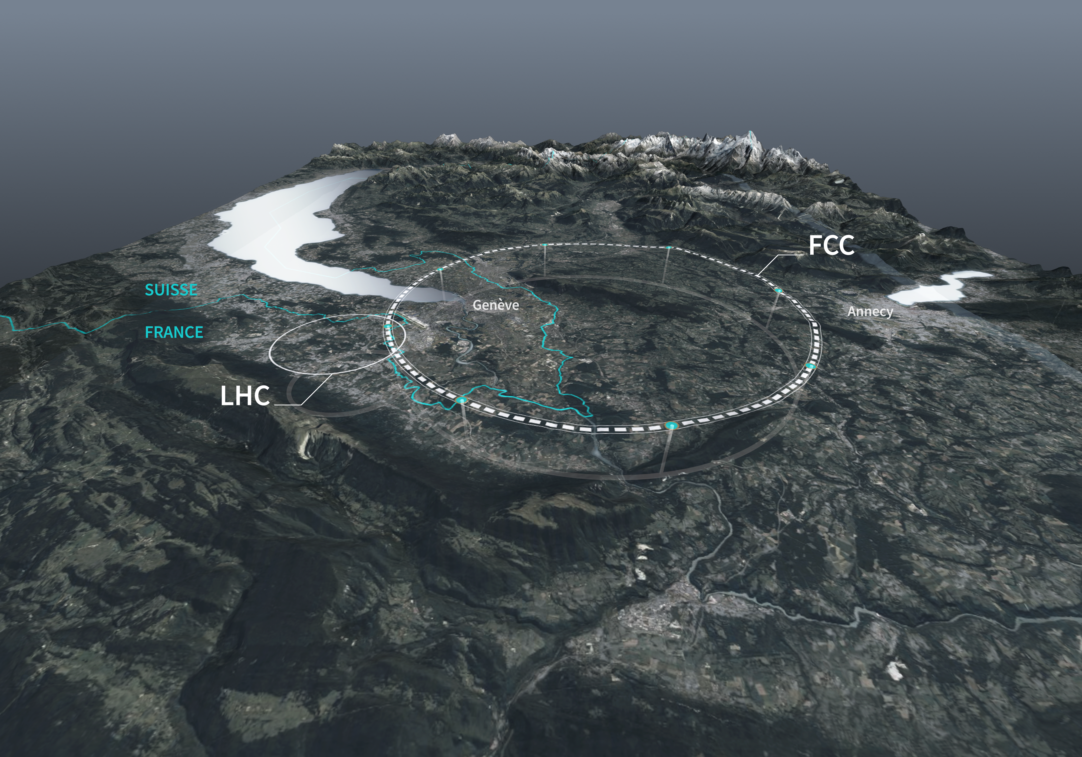
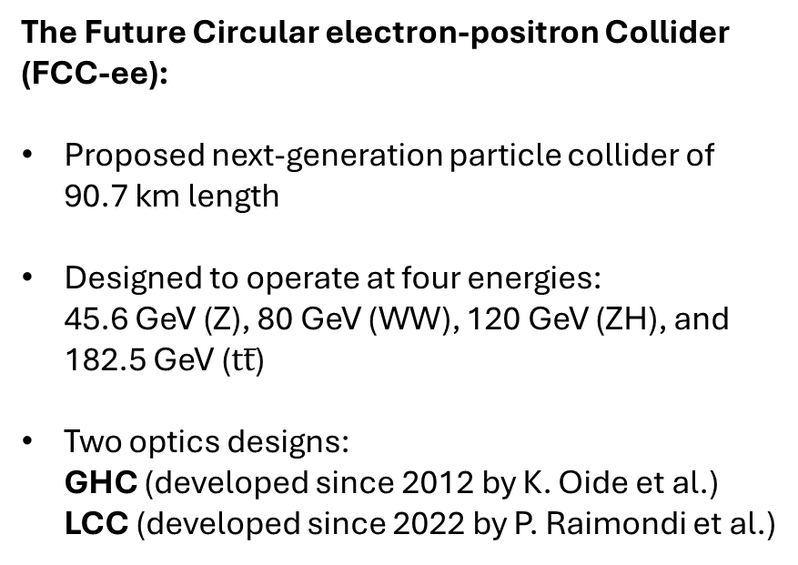
I. Introduction and Overview
A. FCC-ee Overview
The Future Circular electron-positron Collider (FCC-ee):
Proposed next-generation particle collider of 90.7 km length
Designed to operate at four energies:
45.6 GeV (Z), 80 GeV (WW), 120 GeV (ZH), and 182.5 GeV ($tt̅$)
Two optics designs:
GHC (developed since 2012 by K. Oide et al.)
LCC (developed since 2022 by P. Raimondi et al.)
Source: CERN Future Circular Collider
2014-2018:
Conceptual Design Study
2021-2025: Feasibility Study
Early 2026:
Optics Evaluation
2028:
Expected decision point
Late 2040s:
Start of operations (?)
GHC as the optics baseline
LCC chosen as the new baseline
LCC lattice at Z pole

Slide 5
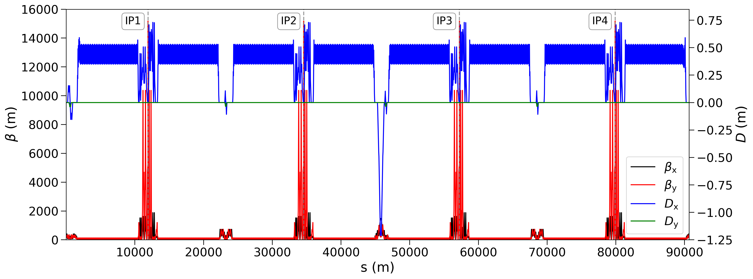
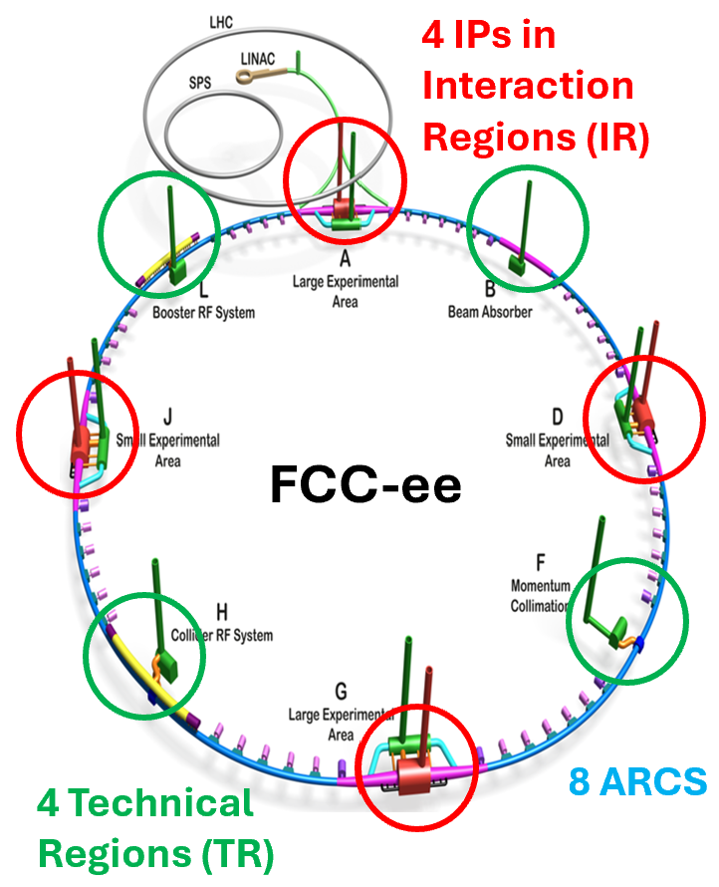
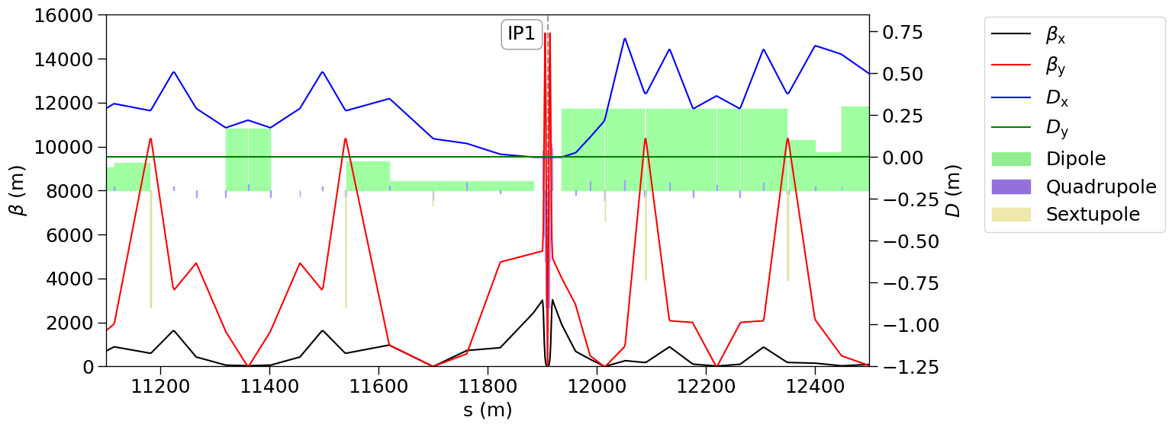
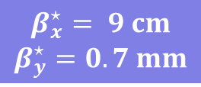
I. Introduction and Overview
B. LCC Optics
Adapted from FCC Feasibility Study Report.
$$β_{x}^{⋆}= 9 cm$$
$$β_{y}^{⋆}=0.7 mm$$
LCC lattice at Z pole

Slide 6
II. Imperfections Model
of the FCC-ee

Slide 7
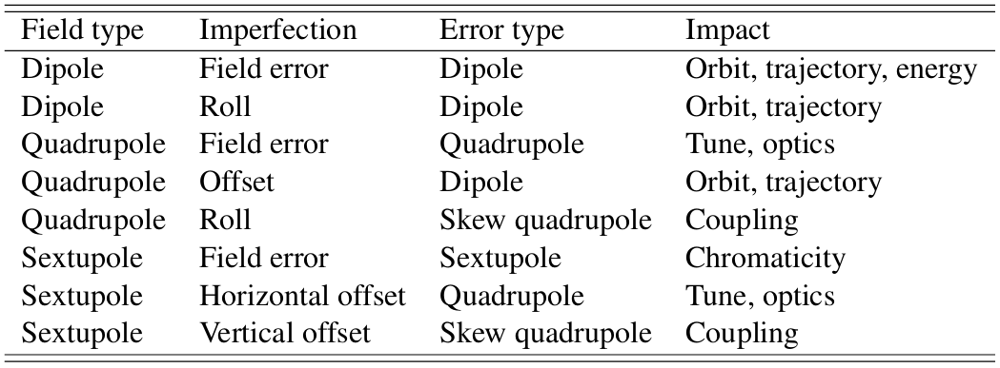
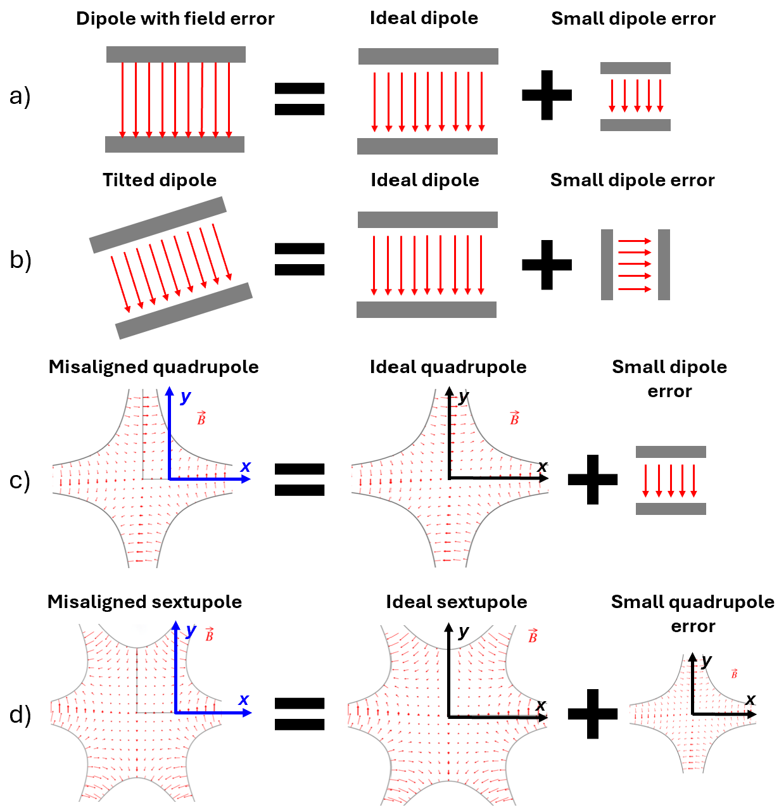

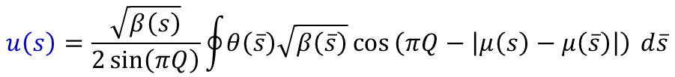
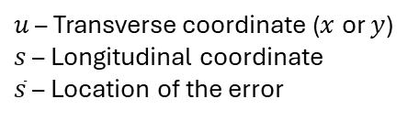


II. Imperfections Model of the FCC-ee
A. Theory
a)
b)
c)
d)
J. Wenninger, “Linear Imperfections”, CAS 2020.
Orbit Distortion
$$u\left(s\right)=\frac{\sqrt{β\left(s\right)}}{2\sin\left(πQ\right)}\oint{θ\left(\overline{s}\right)\sqrt{β\left(\overline{s}\right)}}\cos{​\left(πQ−\left|μ\left(s\right)−μ\left(\overline{s}\right)\right|\right)} d\overline{s}$$
Kicks $θ$ at locations $\overline{s}$
Optics Distortion
Tune shift
$u$ – Transverse coordinate ($x$ or $y$)
$s$ – Longitudinal coordinate
$\overline{s}$ – Location of the error
$$ΔQ=\frac{1}{4π}\oint{δK\left(\overline{s}\right)β\left(\overline{s}\right)} d\overline{s}$$
Field errors $δK$ at locations $\overline{s}$
Beta-beating
$$\frac{Δβ\left(s\right)}{β\left(s\right)}=\frac{1}{2\sin\left(2πQ\right)}\oint{β\left(\overline{s}\right)} δK\left(\overline{s}\right)\cos\left(2\left|μ\left(s\right)−μ\left(\overline{s}\right)\right|−2πQ\right) d\overline{s}$$
Adapted from J. Wenninger.

Slide 8
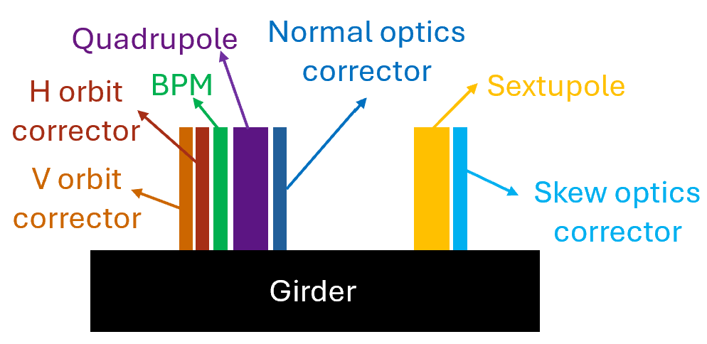
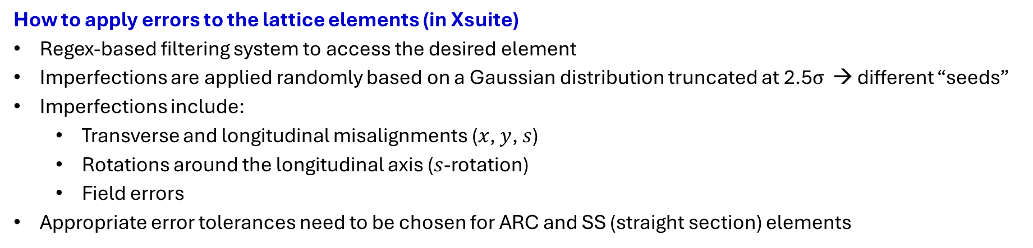
II. Imperfections Model of the FCC-ee
B. Modelling Imperfections
Element type | # Elements
Dipole | 2436
Quadrupole | 2684
Sextupole | 1952
BPM | 2219
H orbit corrector | 2259
V orbit corrector | 2259
Normal optics corrector | 2668
Skew optics corrector | 1950
Relevant LCC lattice elements
Schematic of an arc section (not to scale)
How to apply errors to the lattice elements (in Xsuite)
Regex-based filtering system to access the desired element
Imperfections are applied randomly based on a Gaussian distribution truncated at 2.5$σ$ → different “seeds”
Imperfections include:
  Transverse and longitudinal misalignments ($x$, $y$, $s$)
  Rotations around the longitudinal axis ($s$-rotation)
  Field errors
Appropriate error tolerances need to be chosen for ARC and SS (straight section) elements

Slide 9
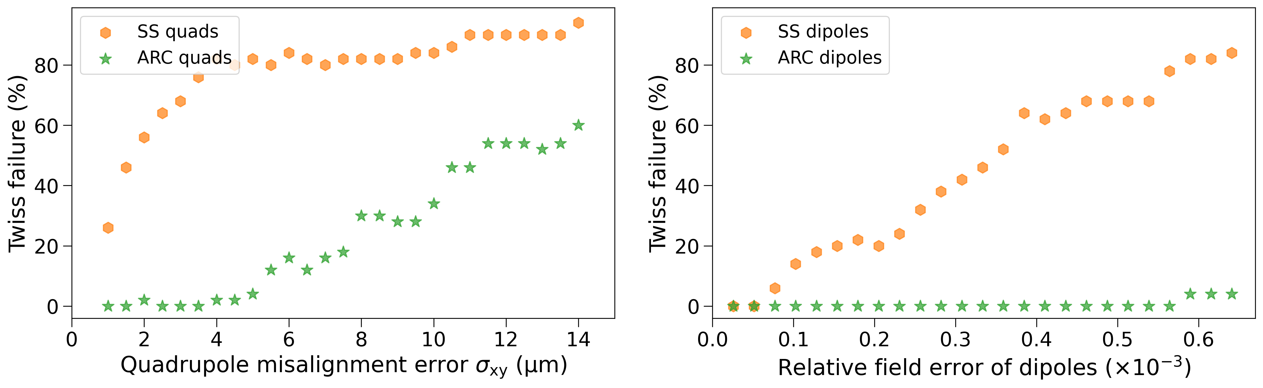
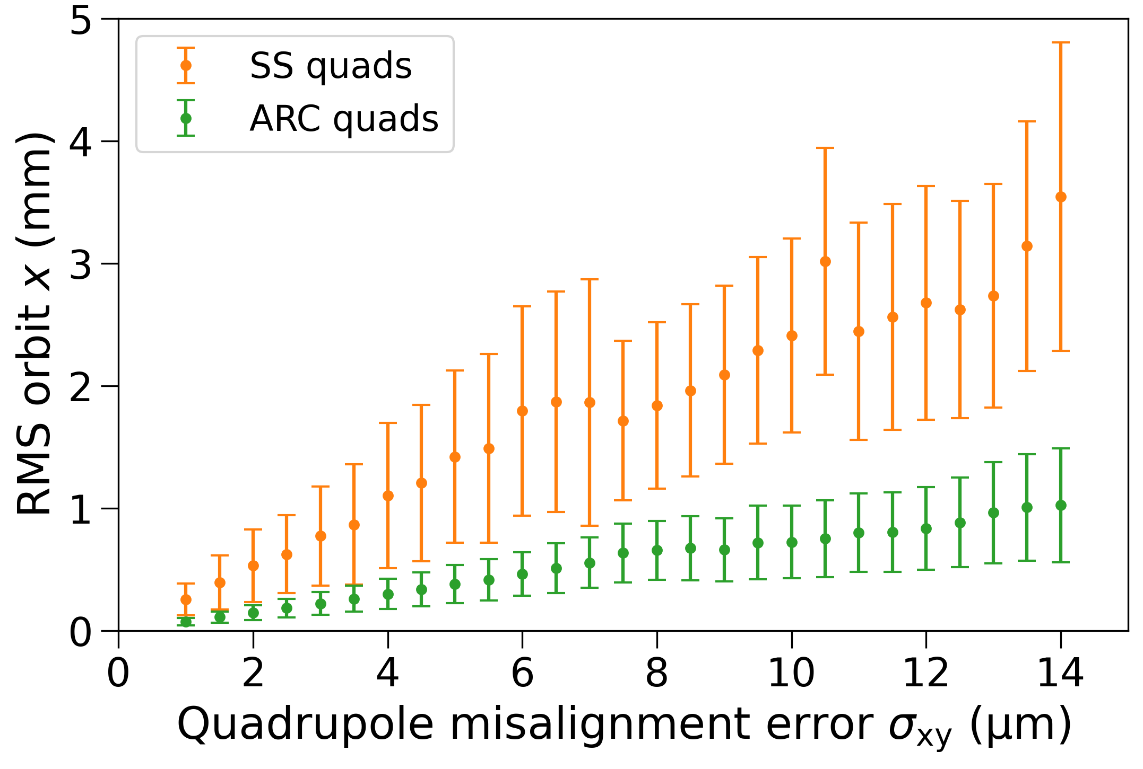
II. Imperfections Model of the FCC-ee
C. Sensitivity Analysis (Orbit)
Imperfections leading to orbit perturbations: Quadrupole misalignments
Twiss failure:
Twiss method fails as Twiss matrix becomes unstable and no closed orbit is found
Twiss failure more likely for SS quadrupole misalignments
Orbit seems more sensitive towards SS quadrupoles → Tighter alignment tolerances

Slide 10
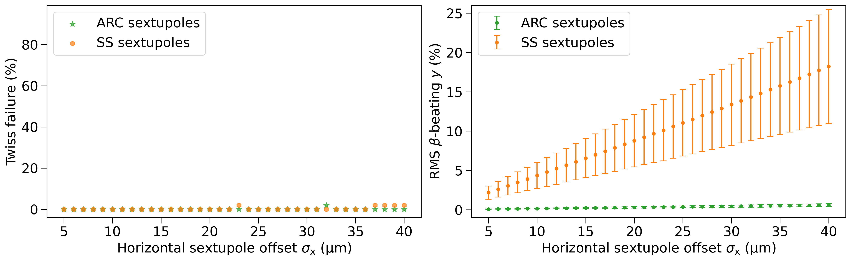
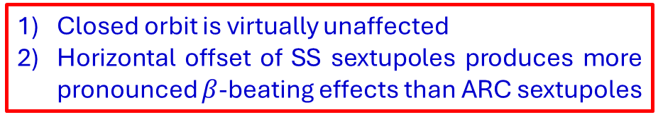
II. Imperfections Model of the FCC-ee
C. Sensitivity Analysis (Optics)
Imperfections affecting the optics parameters (such as the $β$-function): Sextupole misalignments
Closed orbit is virtually unaffected
Horizontal offset of SS sextupoles produces more pronounced $β$-beating effects than ARC sextupoles

Slide 11
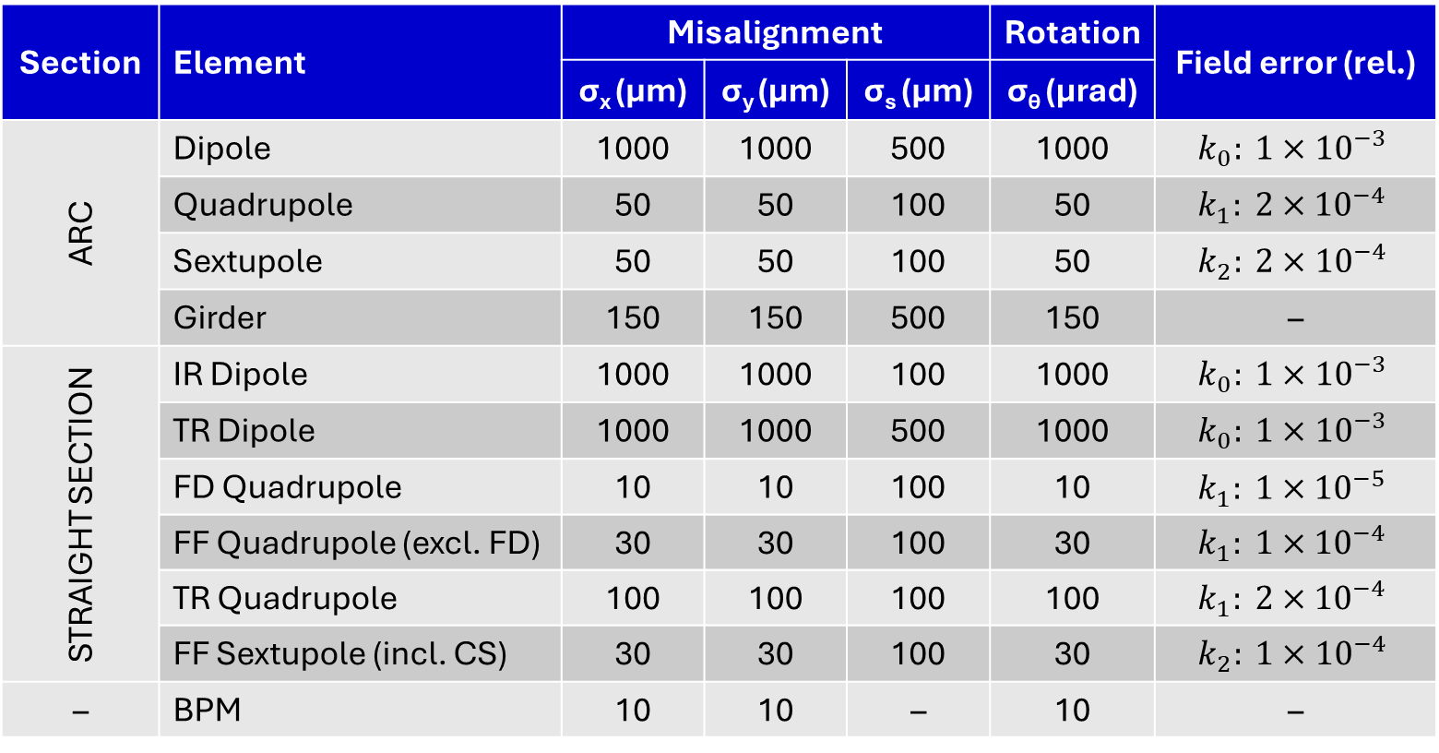
II. Imperfections Model of the FCC-ee
D. Error Tolerances
Section | Element | Misalignment |  |  | Rotation | Field error (rel.)
 |  | σ_{x} (μm) | σ_{y} (μm) | σ_{s} (μm) | σ_{θ} (μrad)
ARC | Dipole | 1000 | 1000 | 500 | 1000 | $$k_{0}: 1×{10}^{−3}$$
 | Quadrupole | 50 | 50 | 100 | 50 | $$k_{1}: 2×{10}^{−4}$$
 | Sextupole | 50 | 50 | 100 | 50 | $$k_{2}: 2×{10}^{−4}$$
 | Girder | 150 | 150 | 500 | 150 | –
STRAIGHT SECTION | IR Dipole | 1000 | 1000 | 100 | 1000 | $$k_{0}: 1×{10}^{−3}$$
 | TR Dipole | 1000 | 1000 | 500 | 1000 | $$k_{0}: 1×{10}^{−3}$$
 | FD Quadrupole | 10 | 10 | 100 | 10 | $$k_{1}: 1×{10}^{−5}$$
 | FF Quadrupole (excl. FD) | 30 | 30 | 100 | 30 | $$k_{1}: 1×{10}^{−4}$$
 | TR Quadrupole | 100 | 100 | 100 | 100 | $$k_{1}: 2×{10}^{−4}$$
 | FF Sextupole (incl. CS) | 30 | 30 | 100 | 30 | $$k_{2}: 1×{10}^{−4}$$
– | BPM | 10 | 10 | – | 10 | –
IR = Interaction Region TR = Technical Region FD = Final Doublet
FF = Final Focussing CS = Crab Sextupole BPM = Beam Position Monitor

Slide 12
III. Global Orbit and
Optics Correction

Slide 13
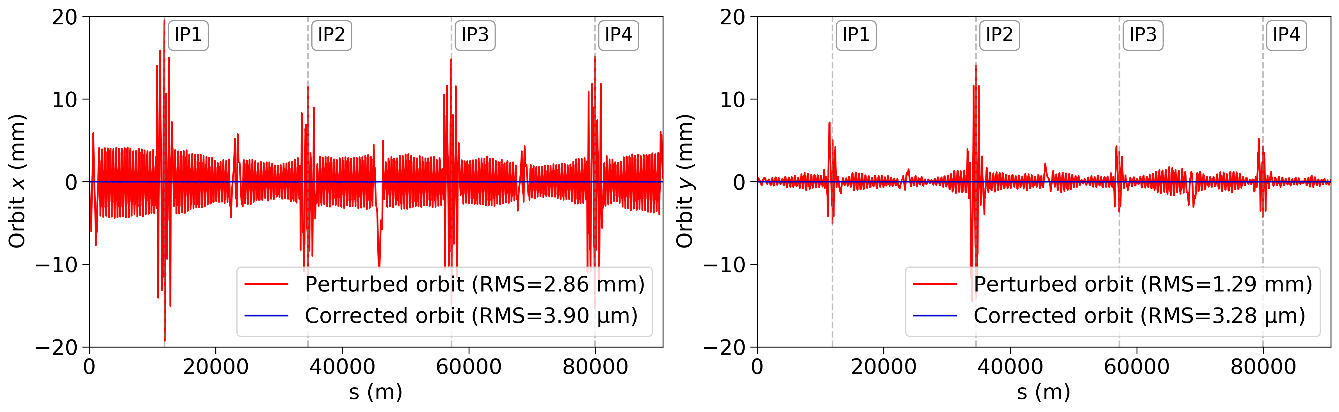
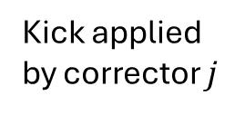
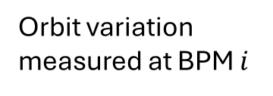


III. Global Orbit and Optics Correction
A. Orbit Correction
Aim: Compensating for the unintended distortions caused by lattice imperfections by using dedicated corrector magnets
$$Δu_{i}=R_{ij} Δθ_{j}$$
Orbit correction steps
Orbit variation measured at BPM $i$
Kick applied by corrector $j$
Construction of orbit RM
Pseudo-inversion via singular value decomposition (SVD)
Application of the required corrector strengths to modify the beam trajectory
Response matrix (RM)
Pseudo-inversion of RM using SVD:
$$Δ\vec{θ}=R^{†} Δ\vec{u}$$
Lattice with arc quadrupole misalignments before (red) and after (blue) orbit correction

Slide 14
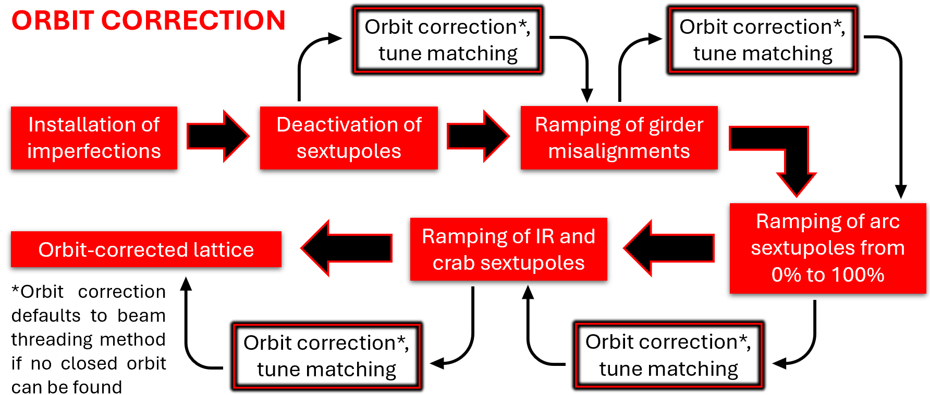
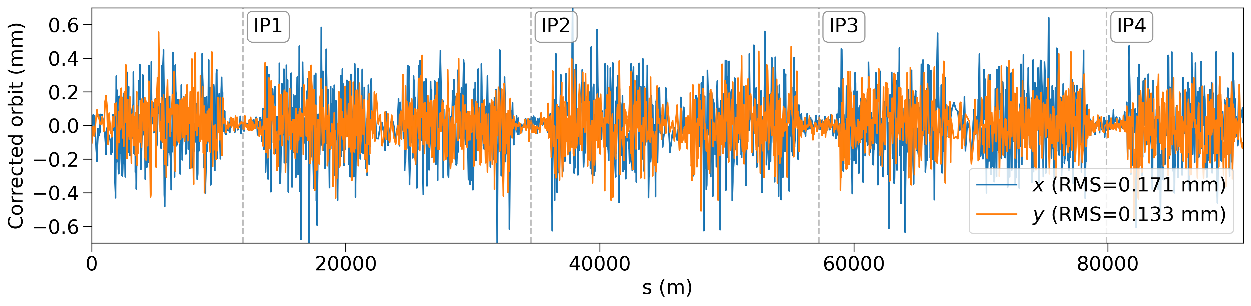
III. Global Orbit and Optics Correction
A. Orbit Correction
Transverse orbits after correction of a lattice with imperfections (no closed orbit exists before correction)

Slide 15
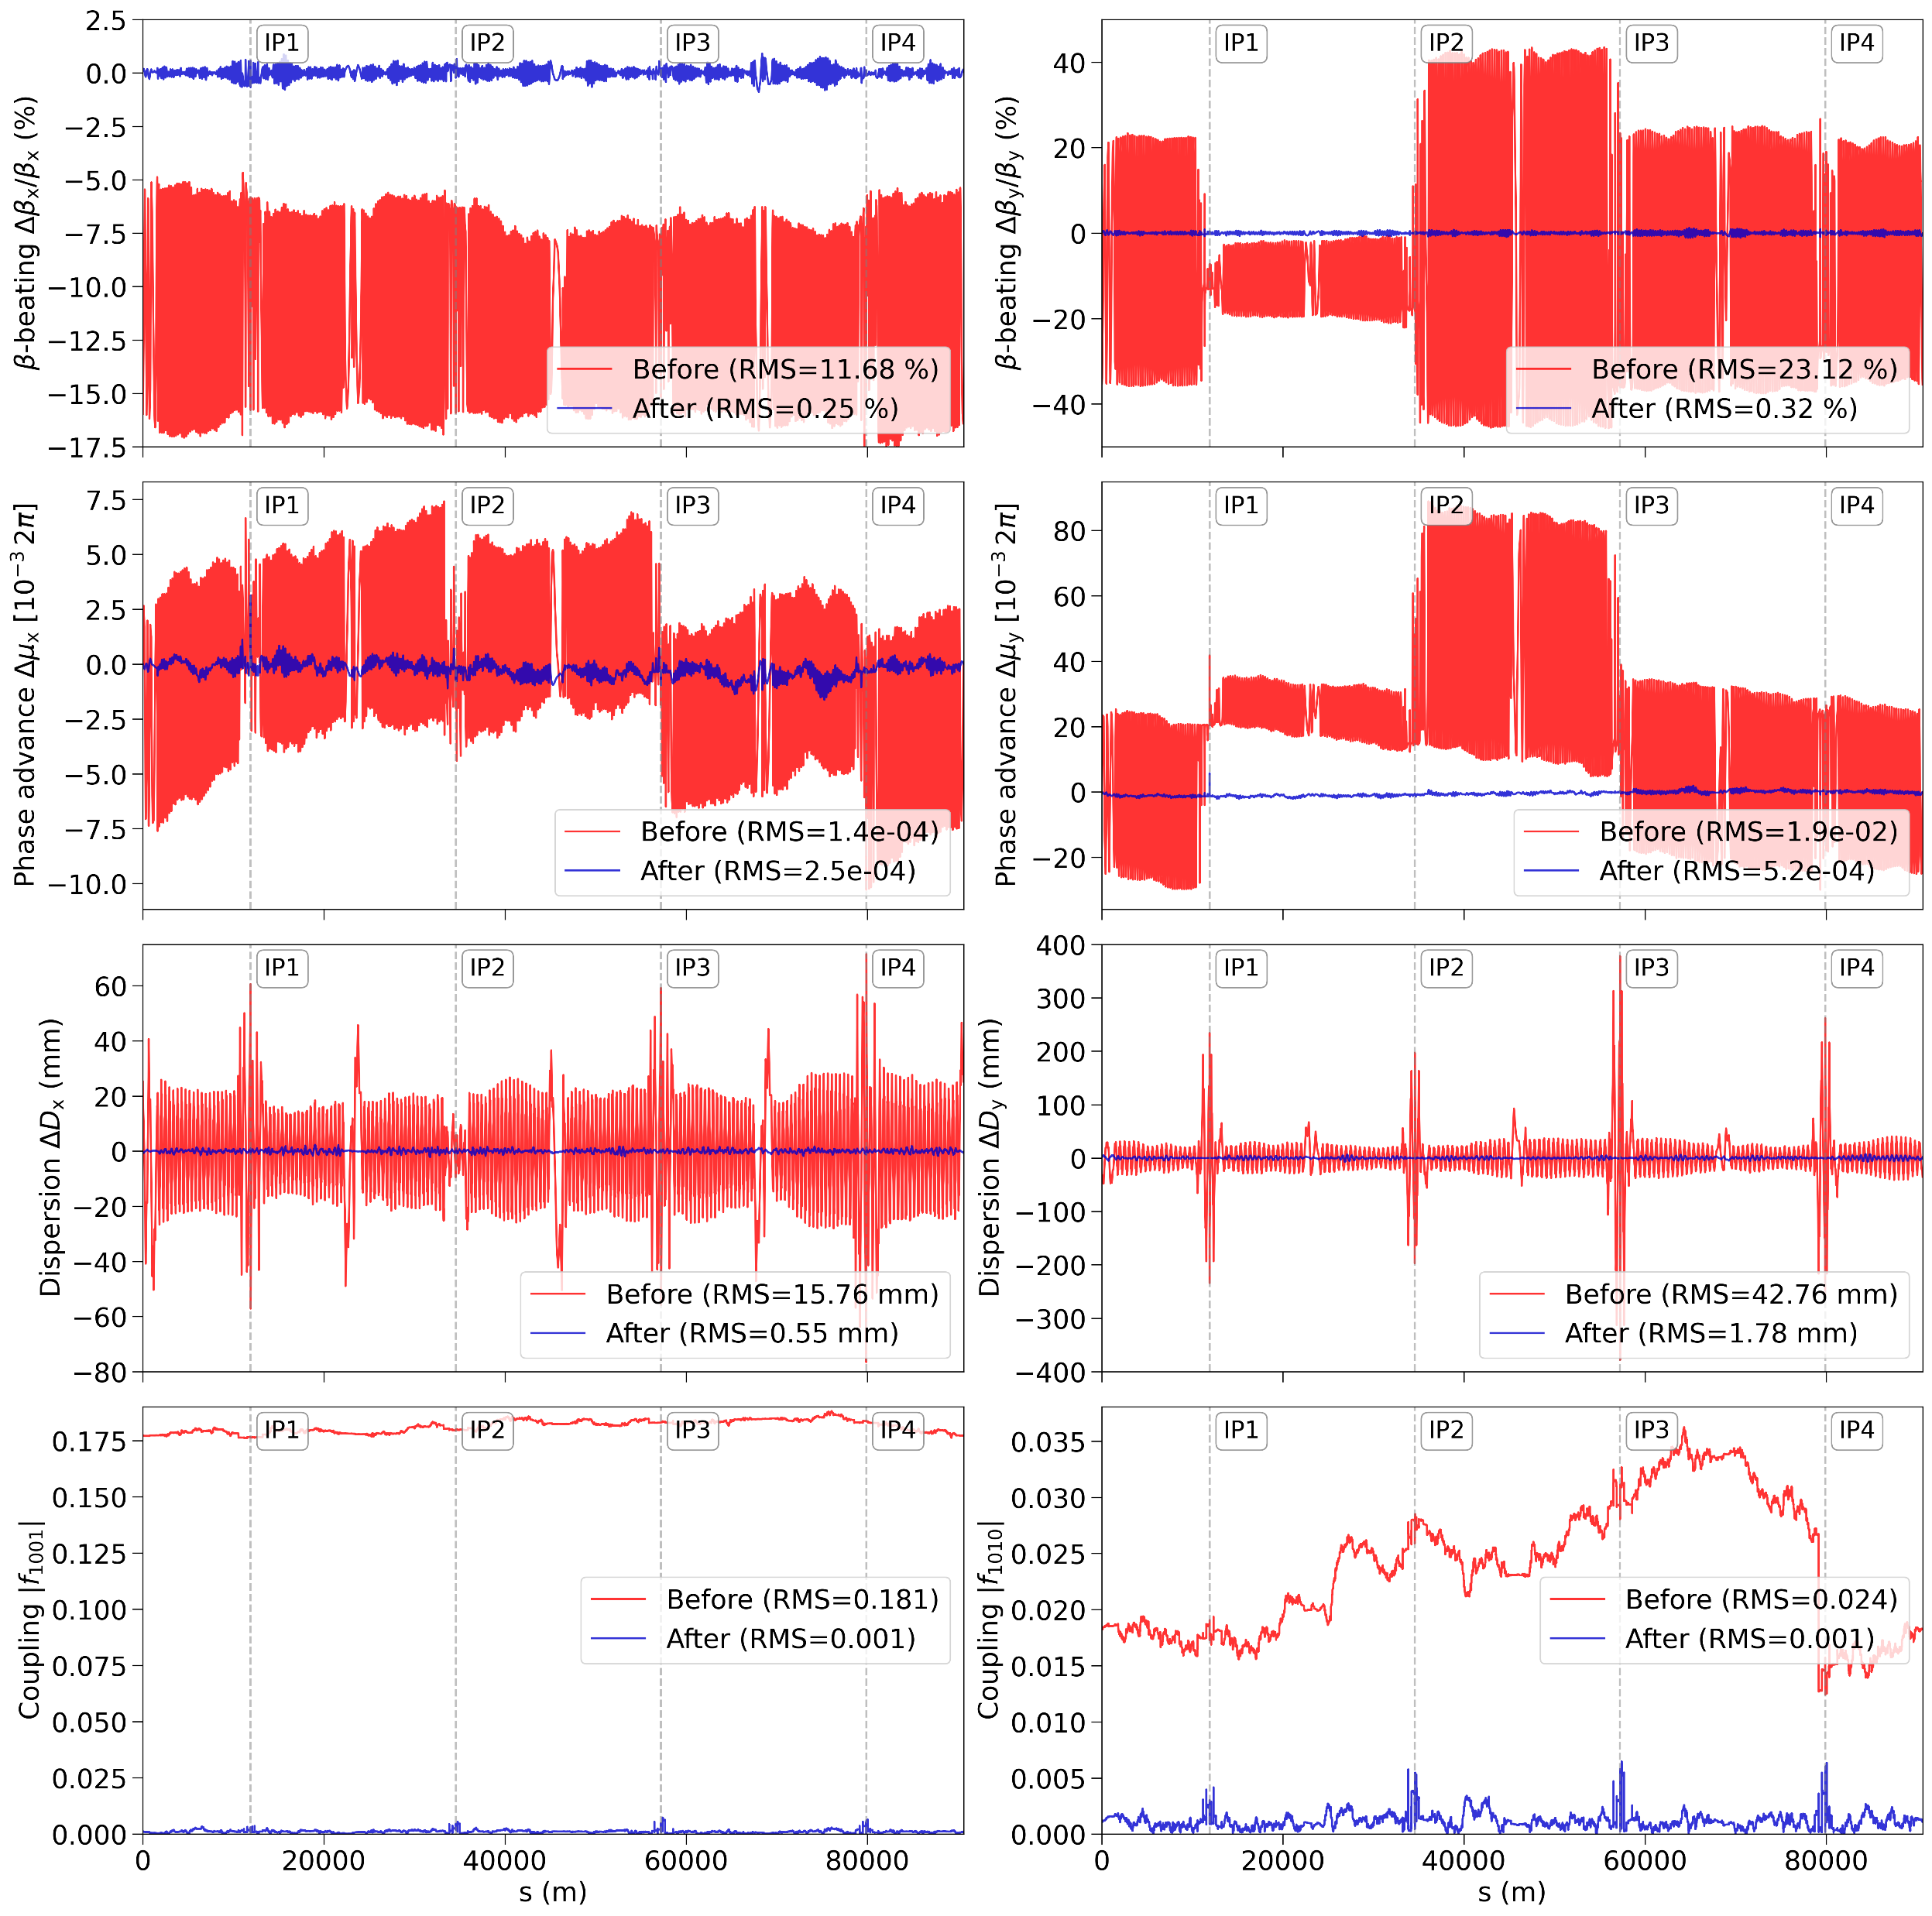
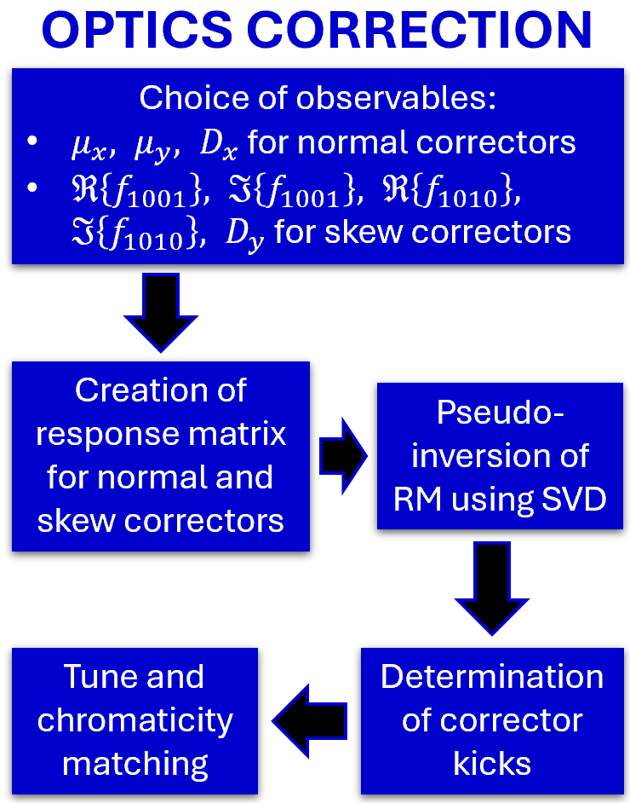
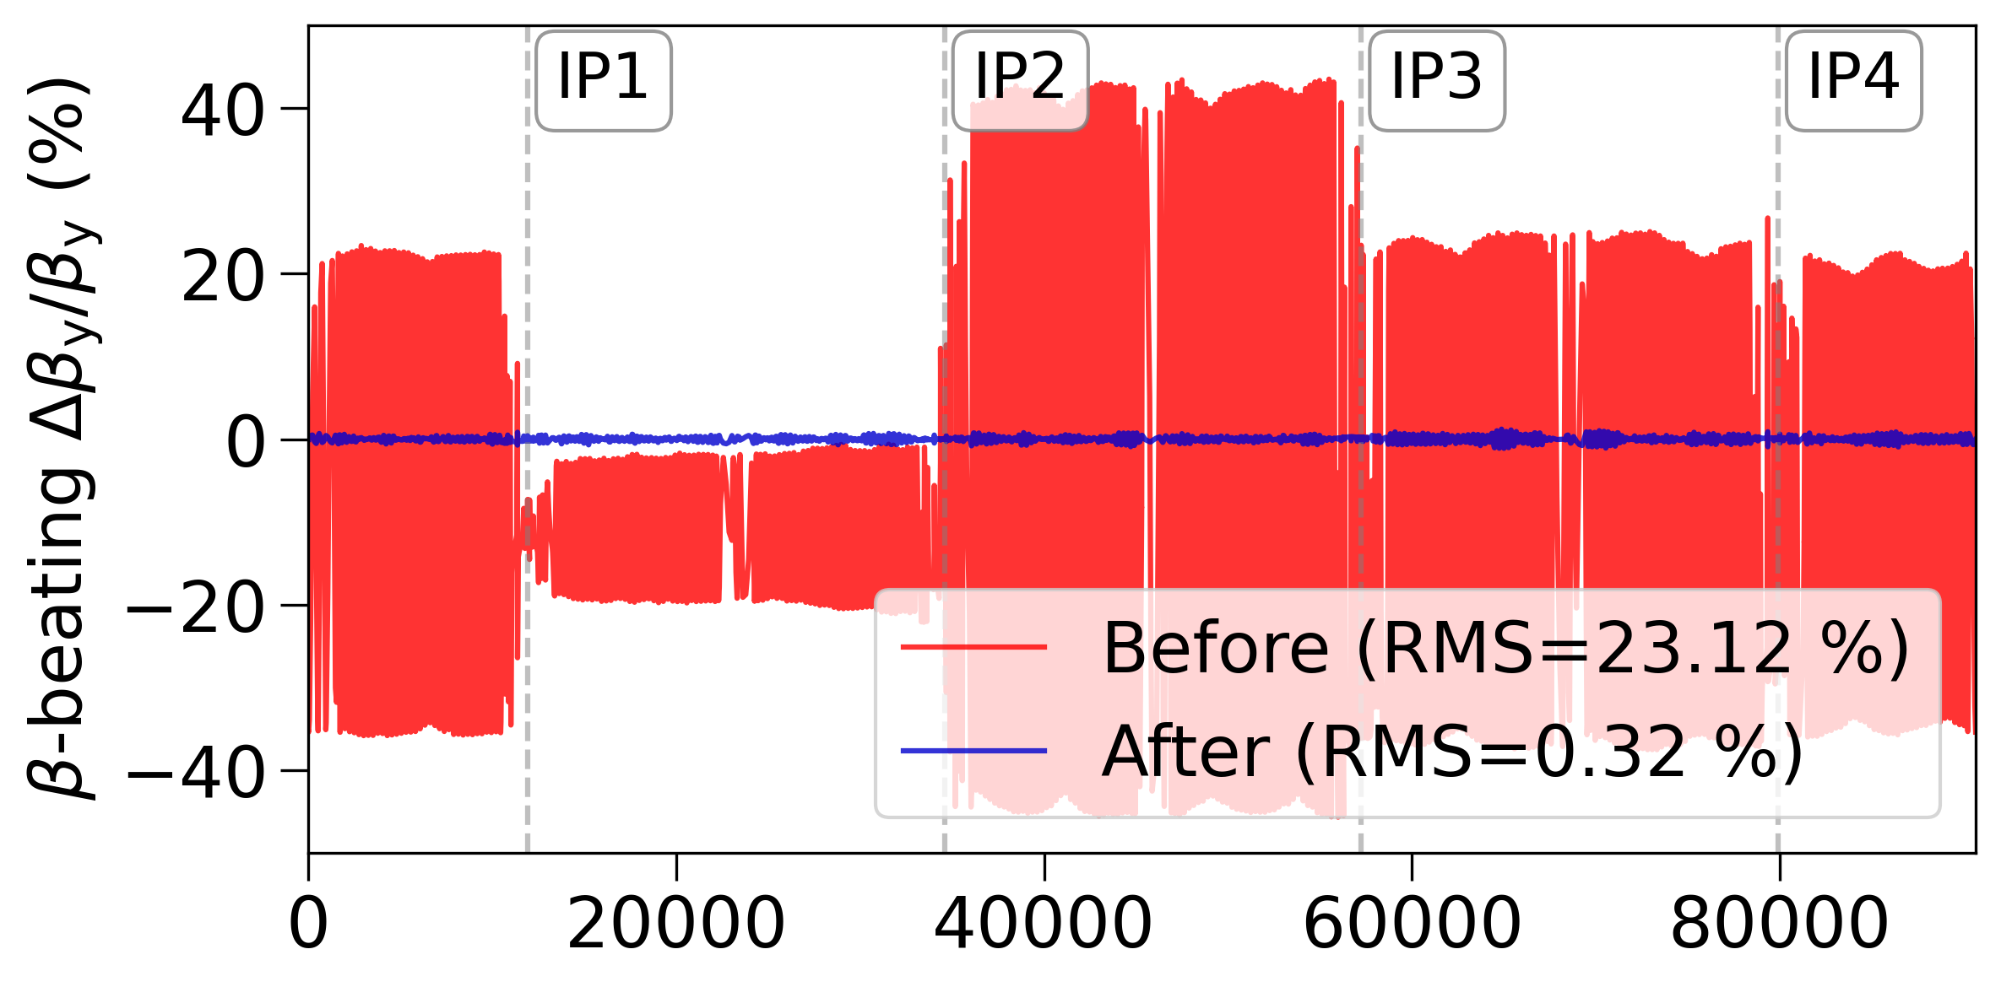




III. Global Orbit and
Optics Correction
$β$-beating
B. Optics Correction
$$Phase adv.$$
$$Dispersion$$
s (m)
$$Coupling$$

Slide 16
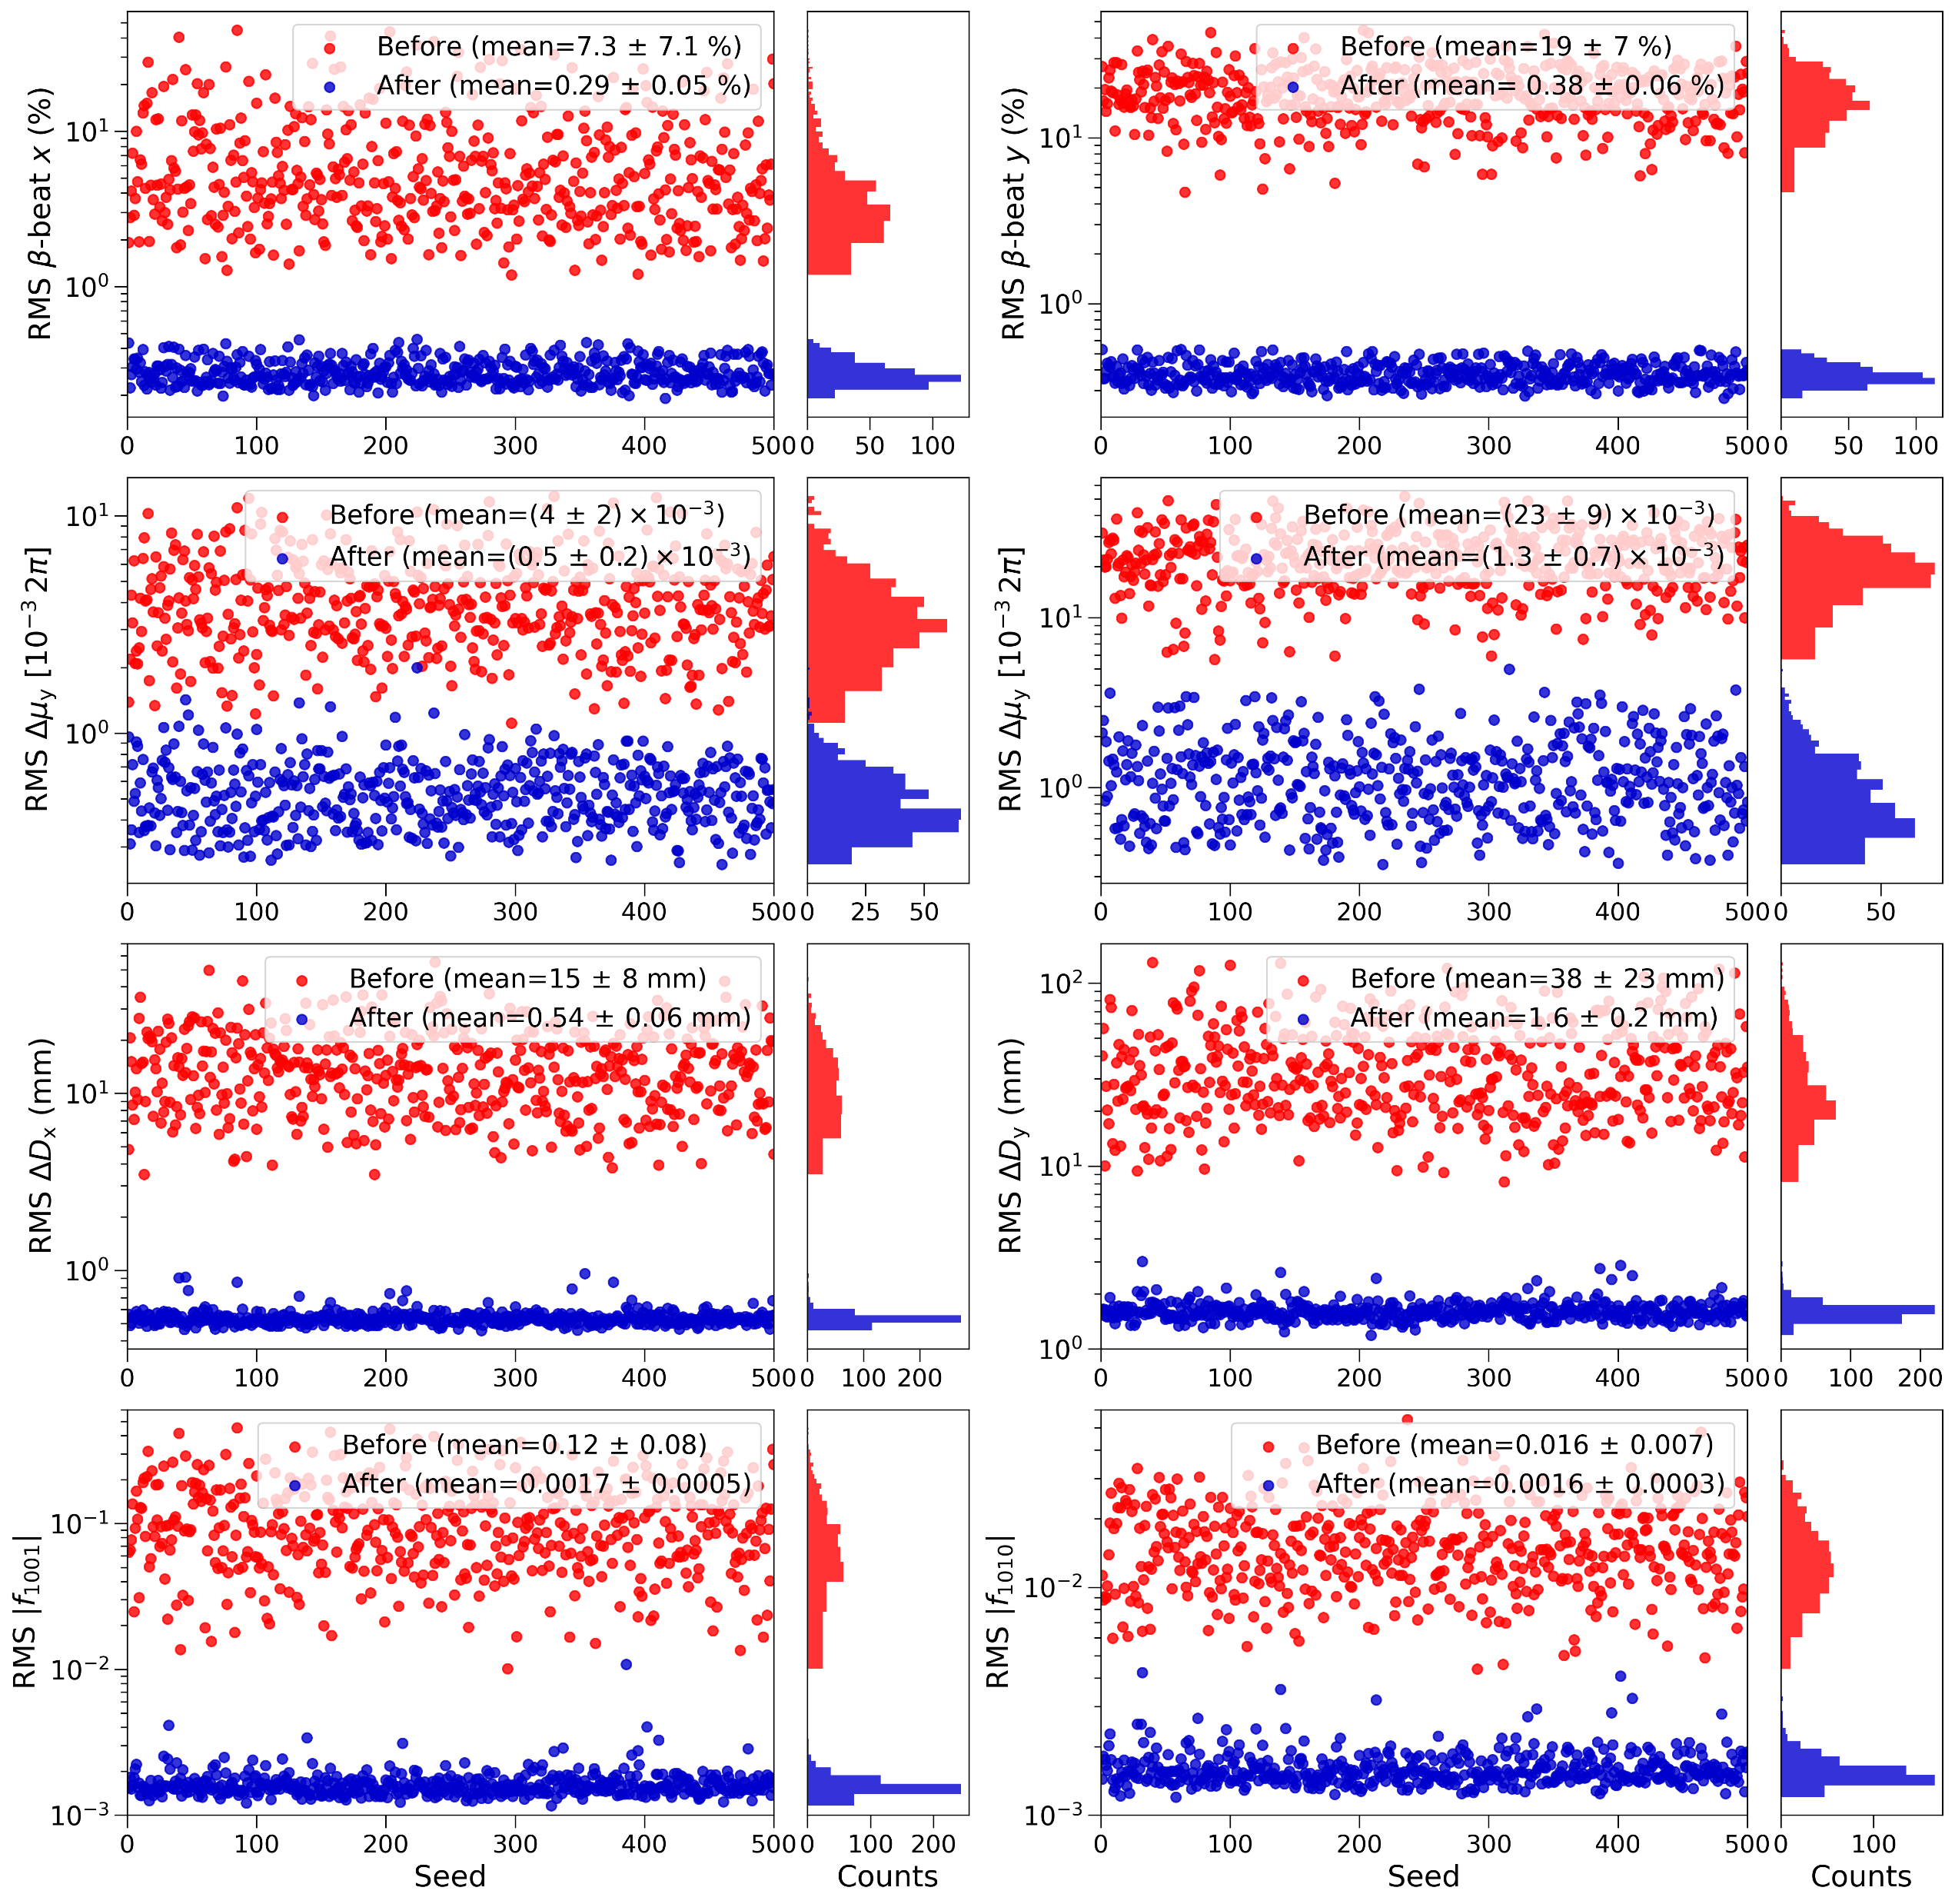
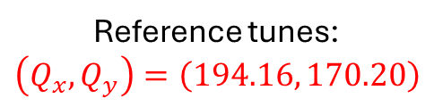





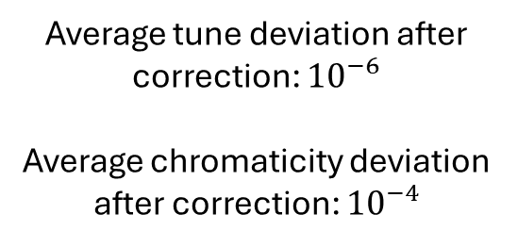
III. Global Orbit and
Optics Correction
$β$-beating
C. Statistical Analysis of Corrected Lattices
$$Phase adv.$$
$$Tune and Chromaticity$$
Reference tunes:
$$\left(Q_{x},Q_{y}\right)=\left(194.16, 170.20\right)$$
Average tune deviation after correction: ${10}^{−6}$
Average chromaticity deviation after correction: ${10}^{−4}$
$$Dispersion$$
Seed
Counts
The correction routine successfully mitigates the optics distortions across the set of generated lattices.
$$Coupling$$

Slide 17
IV. Impact of Beam-Beam Effects

Slide 18
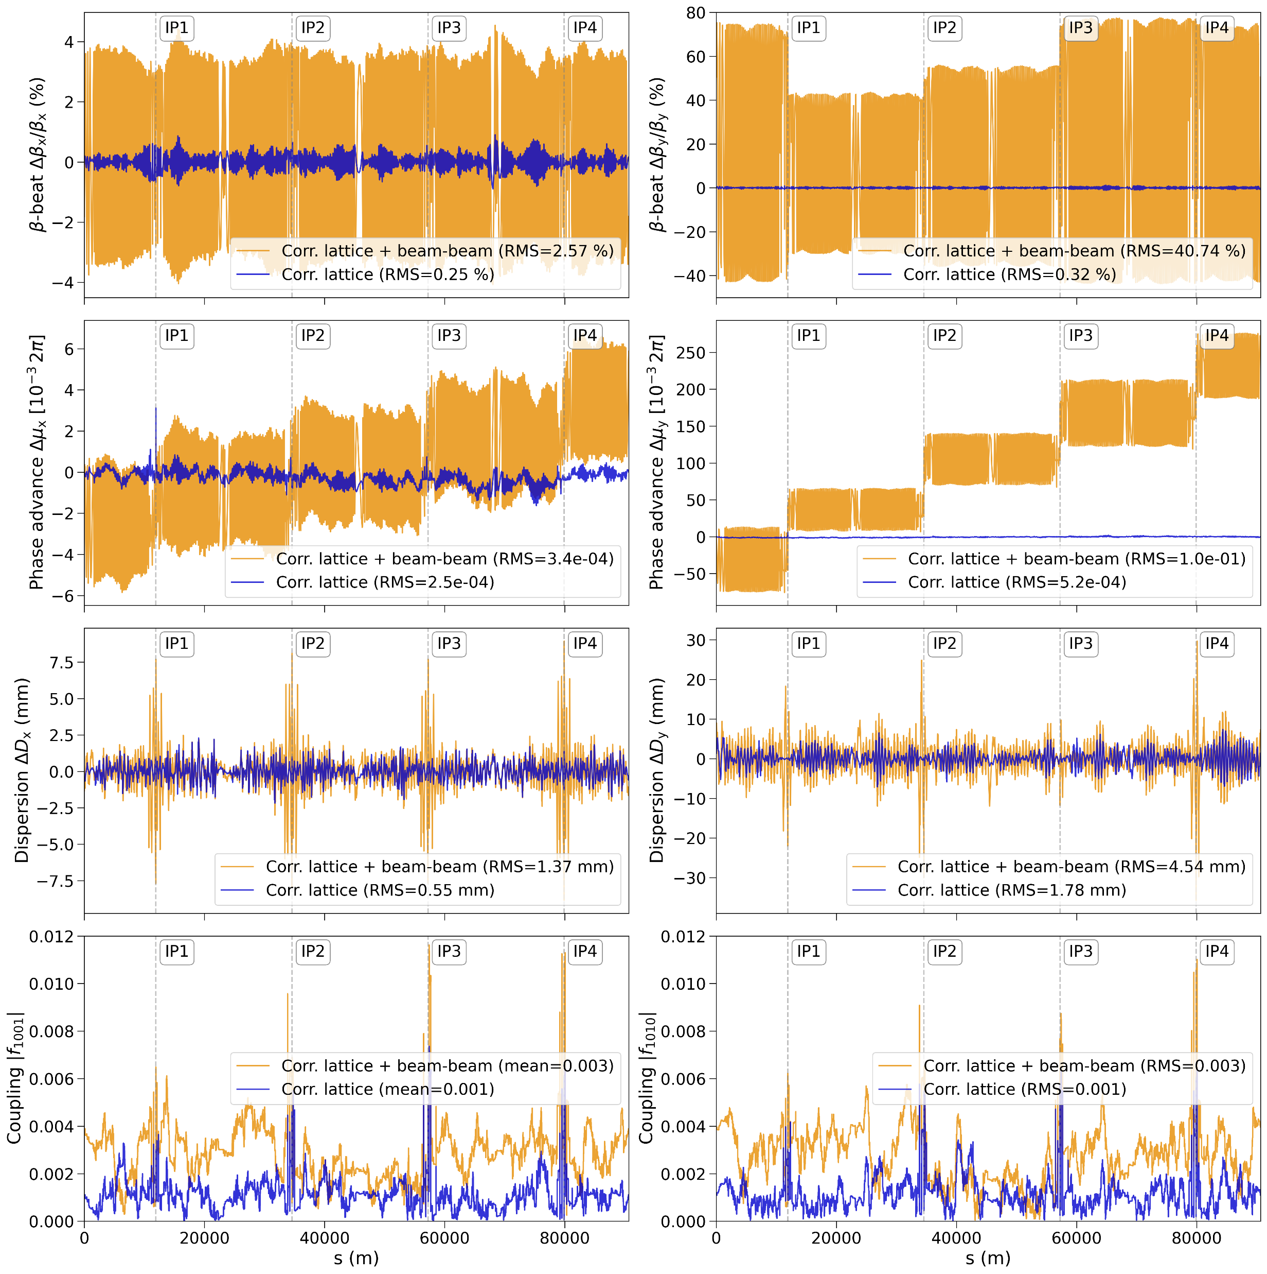
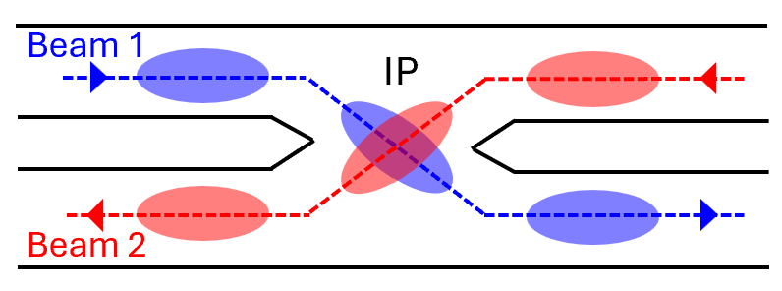
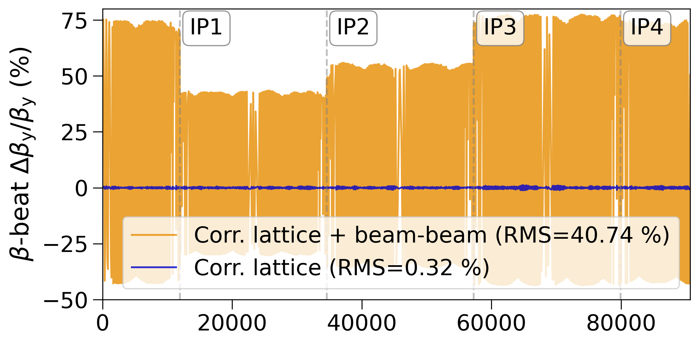
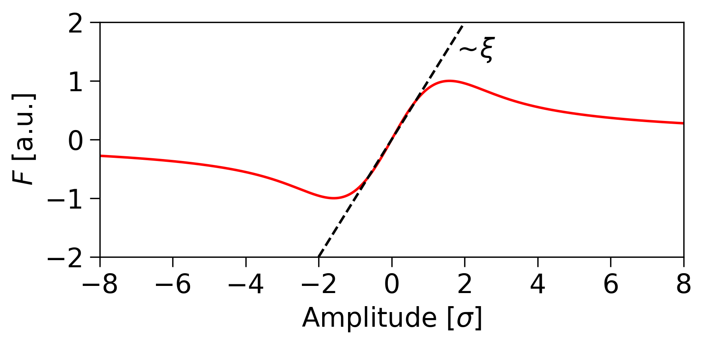





IV. Impact of Beam-Beam Effects
$β$-beating
A. Optics Distortions
Collision of two beams at IP
$$Phase adv.$$
Beam-beam induced optics distortions
Beam-beam force
$$Dispersion$$
s (m)
$$Coupling$$
Beam-beam parameter
$ξ_{x}=0.0014$ and $ξ_{y}=0.09$

Slide 19
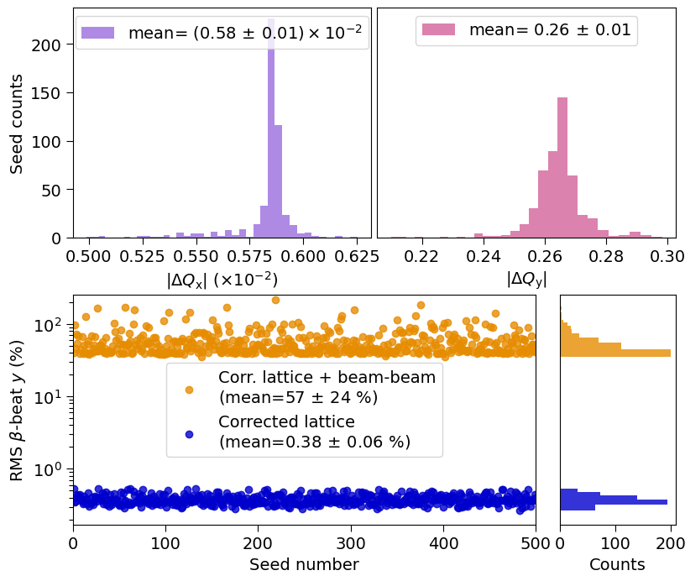



IV. Impact of Beam-Beam Effects
A. Optics Distortions
Statistical analysis of 500 corrected lattices for selected optics parameters
Reference tunes: $\left(Q_{x},Q_{y}\right)=\left(194.16, 170.20\right)$
$$Tunes$$
$β$-beating

Slide 20
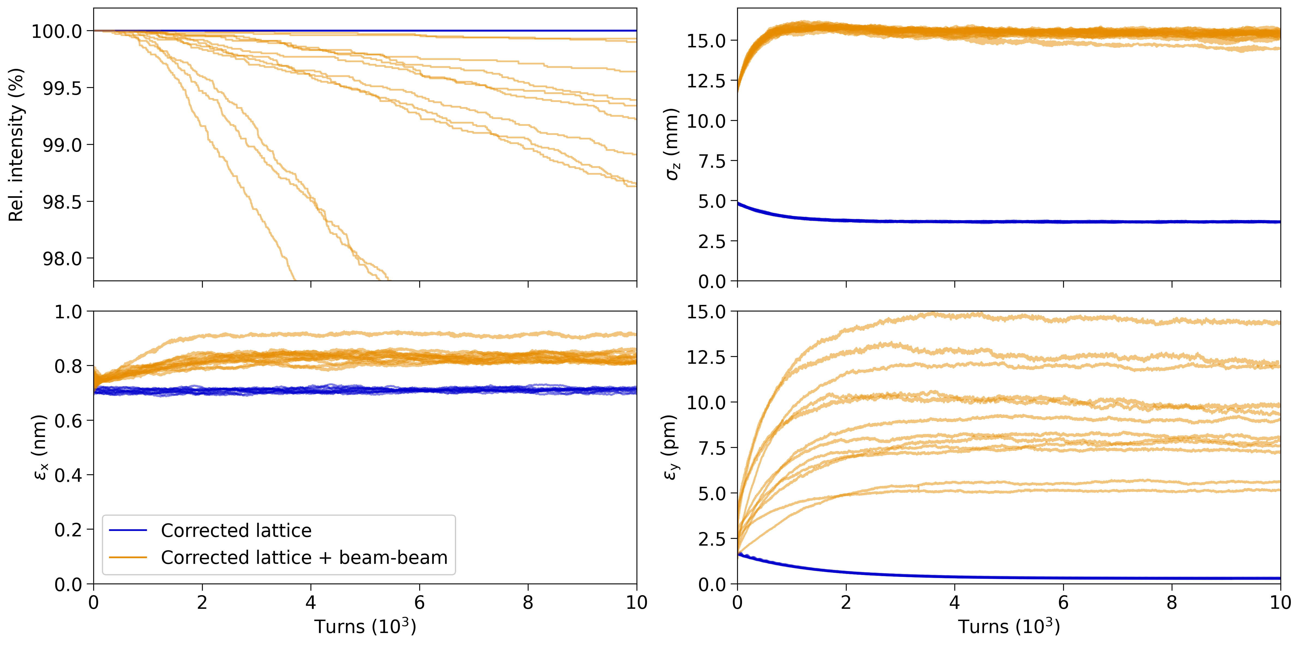
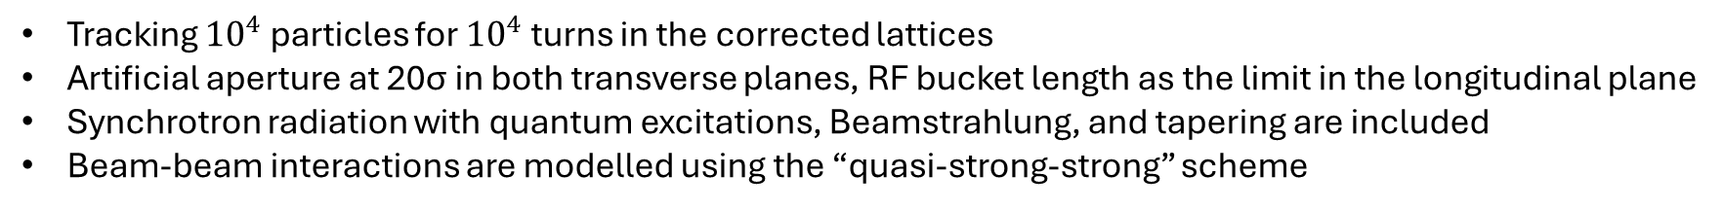




IV. Impact of Beam-Beam Effects
B. Performance Evaluation
Tracking ${10}^{4}$ particles for ${10}^{4}$ turns in the corrected lattices
Artificial aperture at 20σ in both transverse planes, RF bucket length as the limit in the longitudinal plane
Synchrotron radiation with quantum excitations, Beamstrahlung, and tapering are included
Beam-beam interactions are modelled using the “quasi-strong-strong” scheme
$$Relative intensity$$
$$Bunch length$$
$$Horizontal emittance$$
$$Vertical emittance$$

Slide 21
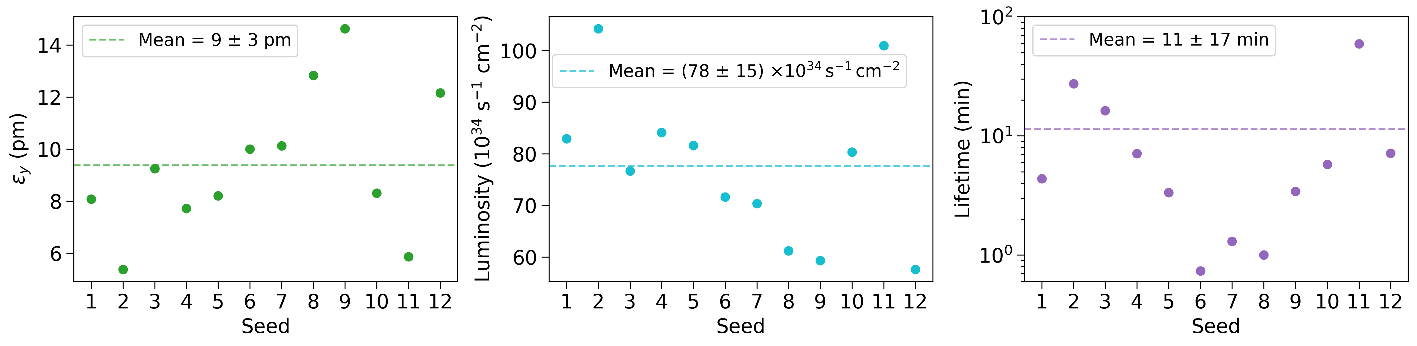
IV. Impact of Beam-Beam Effects
B. Performance Evaluation
Principal metrics of collider performance: Luminosity and Beam Lifetime
Tracking simulations demonstrate the large distortions induced by beam-beam effects in lattices with corrected imperfections and the resulting degradation in collider performance.

Slide 22
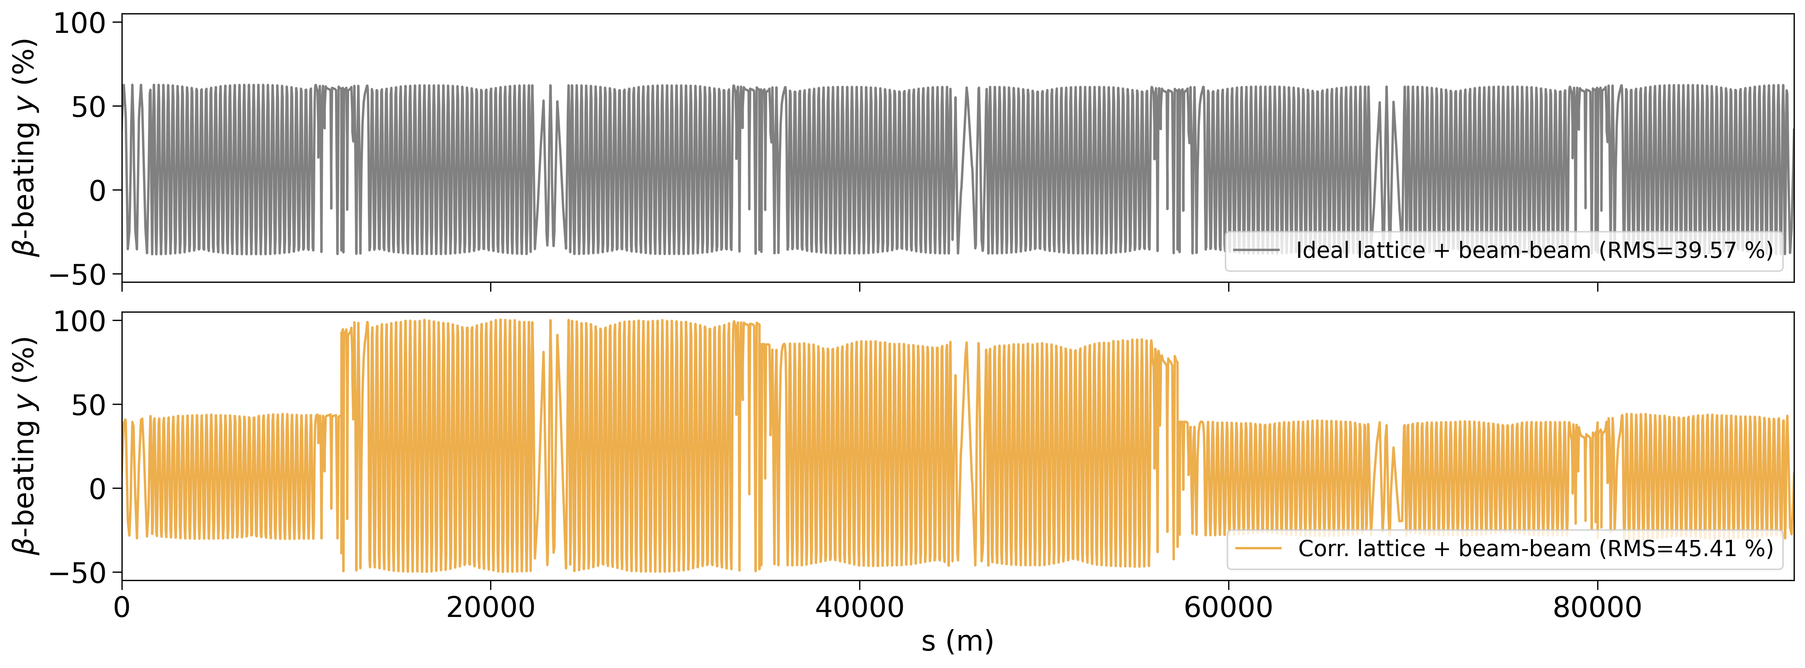
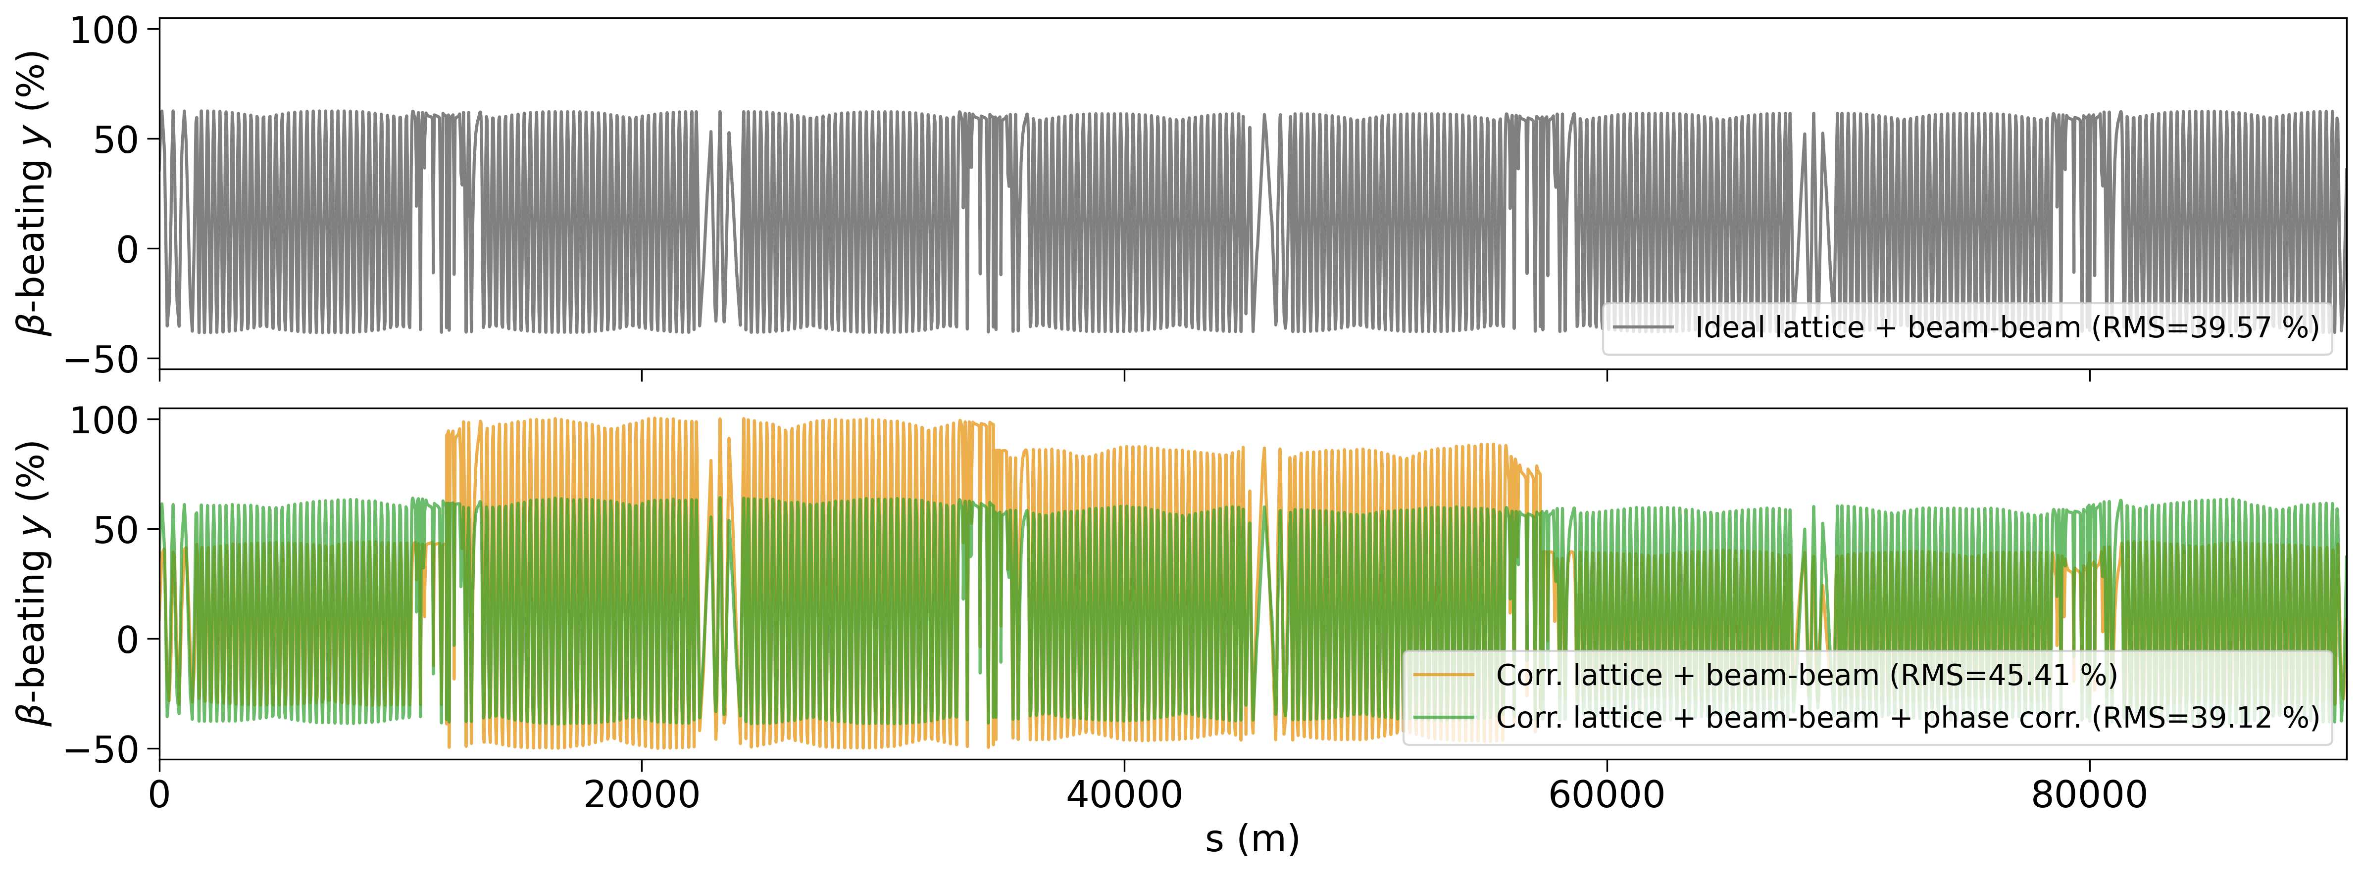
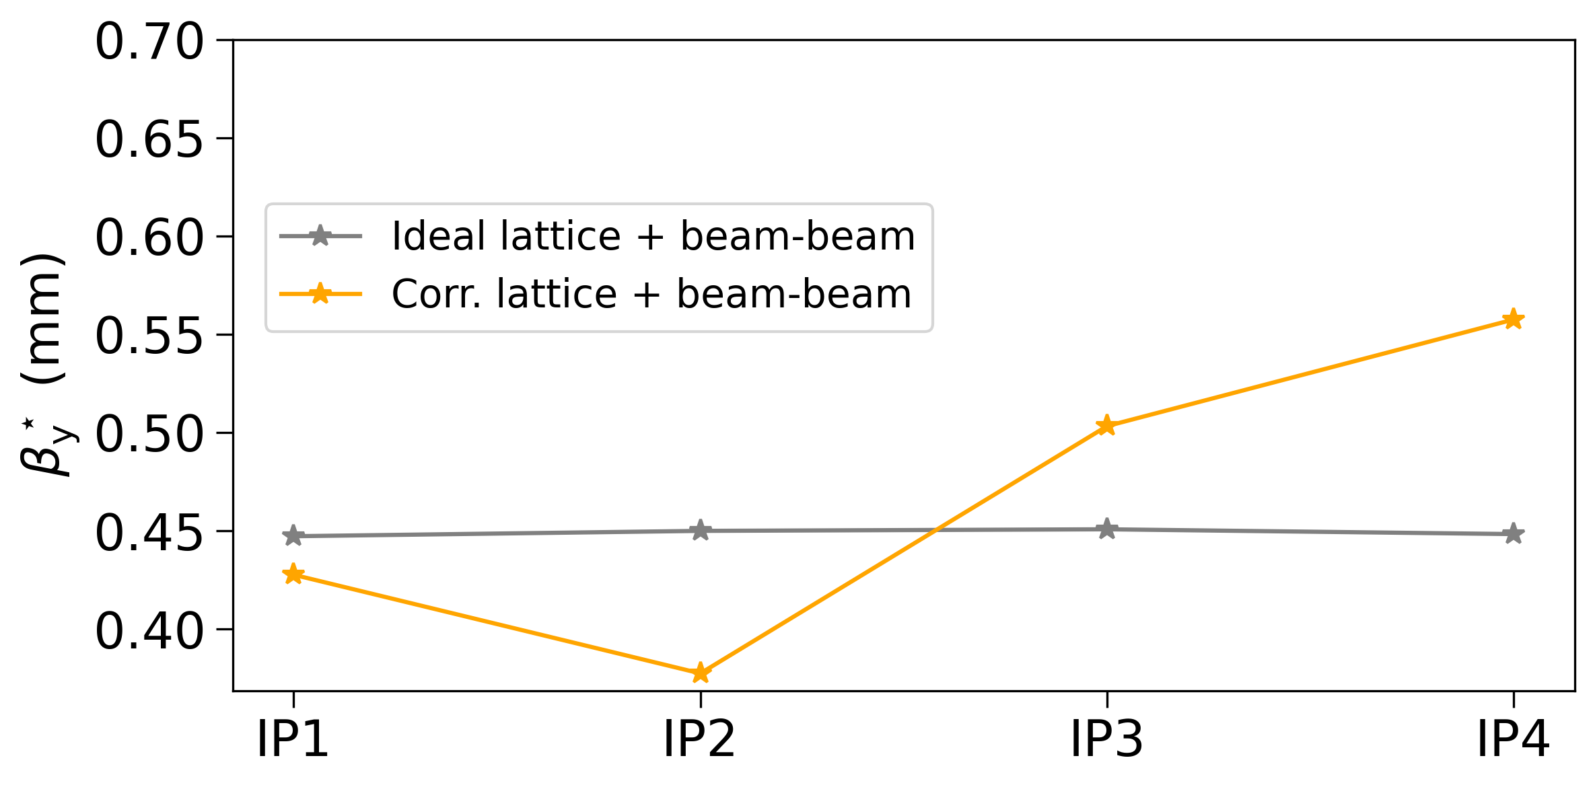
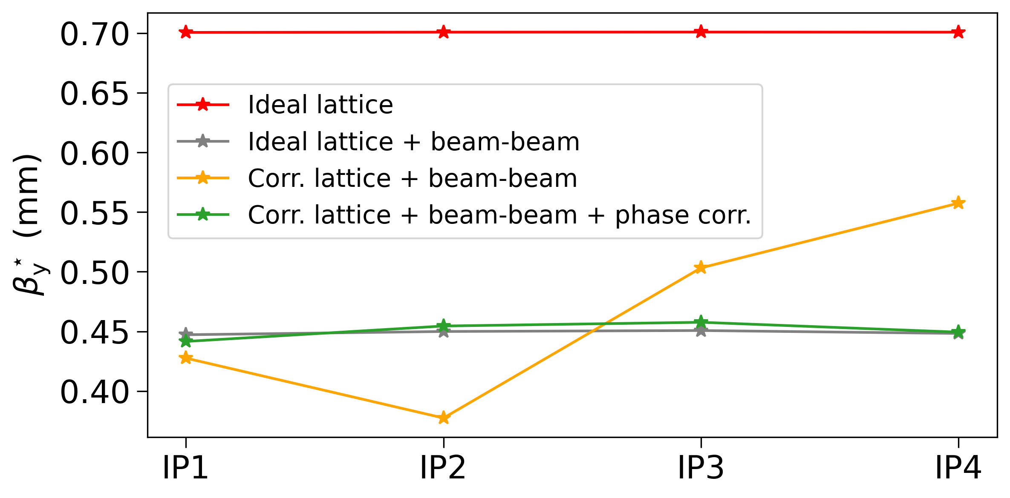
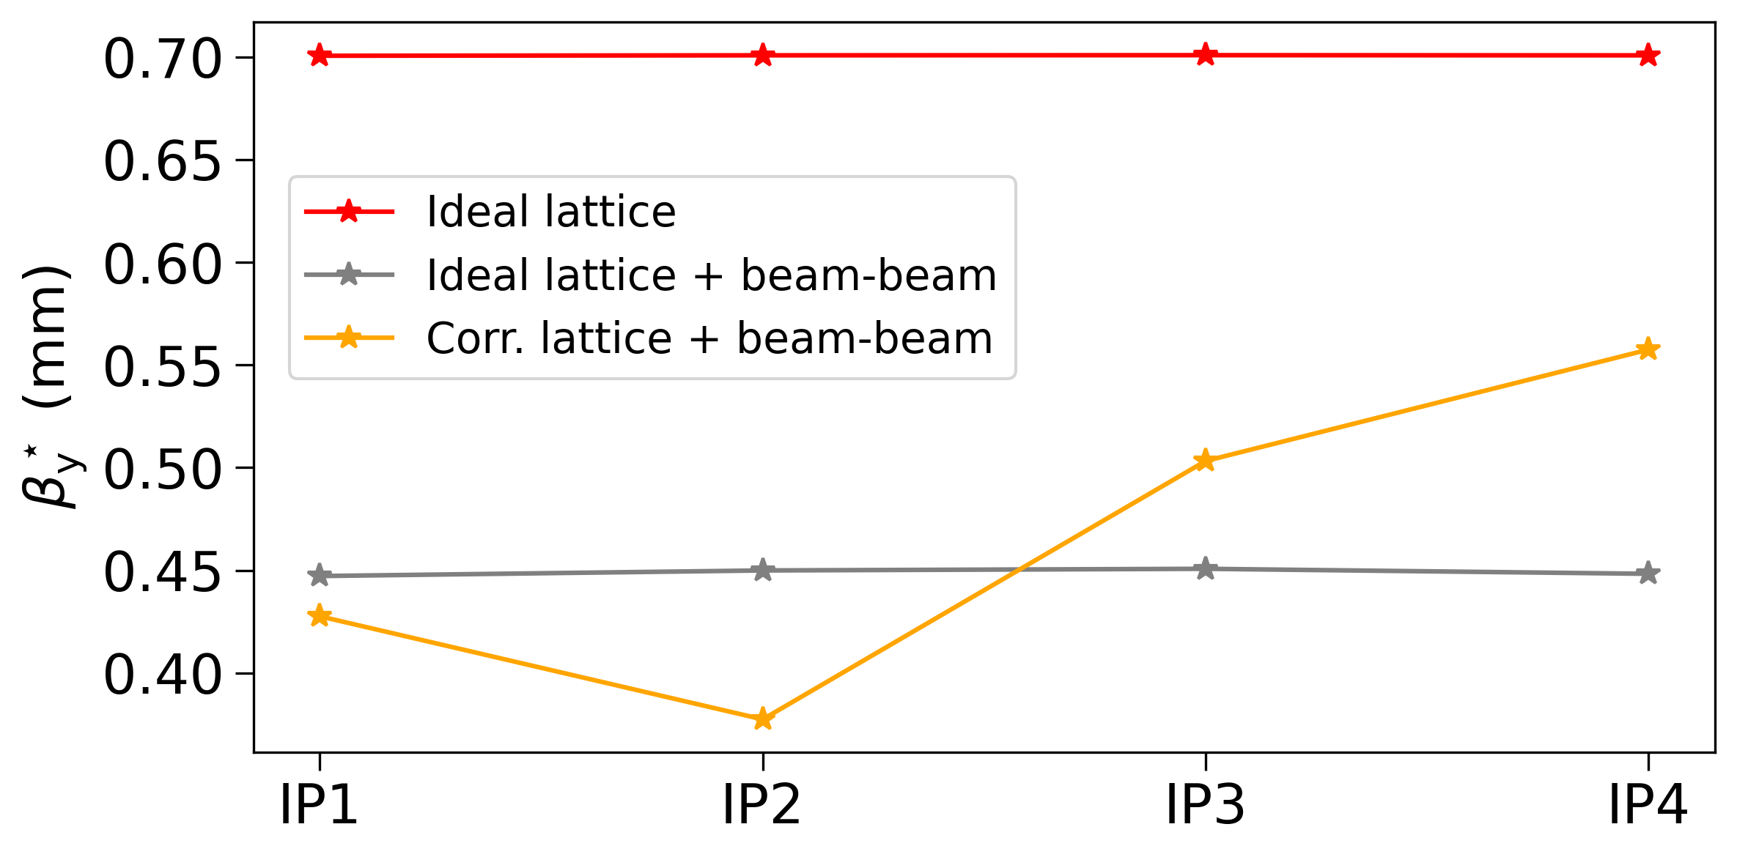
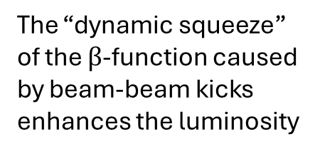
IV. Impact of Beam-Beam Effects
C. Phase-Matching Routine
Aim: Addressing the phase advance distortions between the IPs with a phase-matching routine
Phase-Matching:
9 individually powered trim quadrupoles in the dispersion suppression regions are used to match the inter-IP phase advance back to the design value
The “dynamic squeeze” of the $β$-function caused by beam-beam kicks enhances the luminosity

Slide 23
V. Conclusions

Slide 24
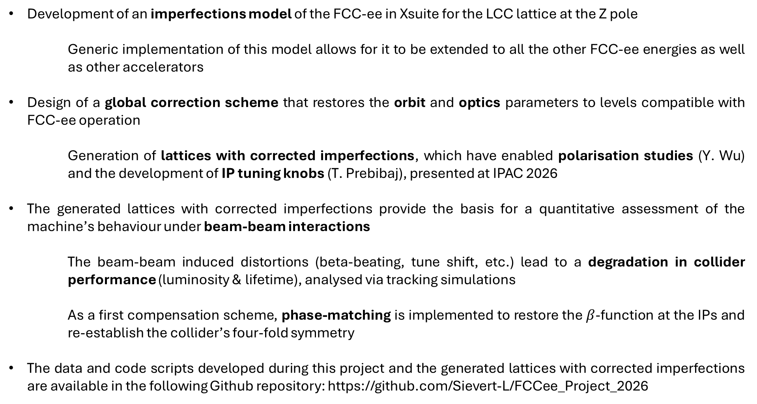
V. Conclusions
Development of an imperfections model of the FCC-ee in Xsuite for the LCC lattice at the Z pole
Generic implementation of this model allows for it to be extended to all the other FCC-ee energies as well as other accelerators
Design of a global correction scheme that restores the orbit and optics parameters to levels compatible with FCC-ee operation
Generation of lattices with corrected imperfections, which have enabled polarisation studies (Y. Wu) and the development of IP tuning knobs (T. Prebibaj), presented at IPAC 2026
The generated lattices with corrected imperfections provide the basis for a quantitative assessment of the machine’s behaviour under beam-beam interactions
The beam-beam induced distortions (beta-beating, tune shift, etc.) lead to a degradation in collider performance (luminosity & lifetime), analysed via tracking simulations
As a first compensation scheme, phase-matching is implemented to restore the $β$-function at the IPs and re-establish the collider’s four-fold symmetry
The data and code scripts developed during this project and the generated lattices with corrected imperfections are available in the following Github repository: https://github.com/Sievert-L/FCCee_Project_2026

Slide 25
Thank you!

Slide 26
Backup

Slide 27
Outlook
Further refinement of the imperfections model, including systematic errors, missing BPMs, etc.
Implementation of updated / more relaxed error tolerances
Further optimisation of the correction algorithms and comparison of SVD with MICADO
Development of additional beam-beam compensation methods to recover the nominal collider performance
Extension towards the LCC lattices at higher beam energies

Slide 28
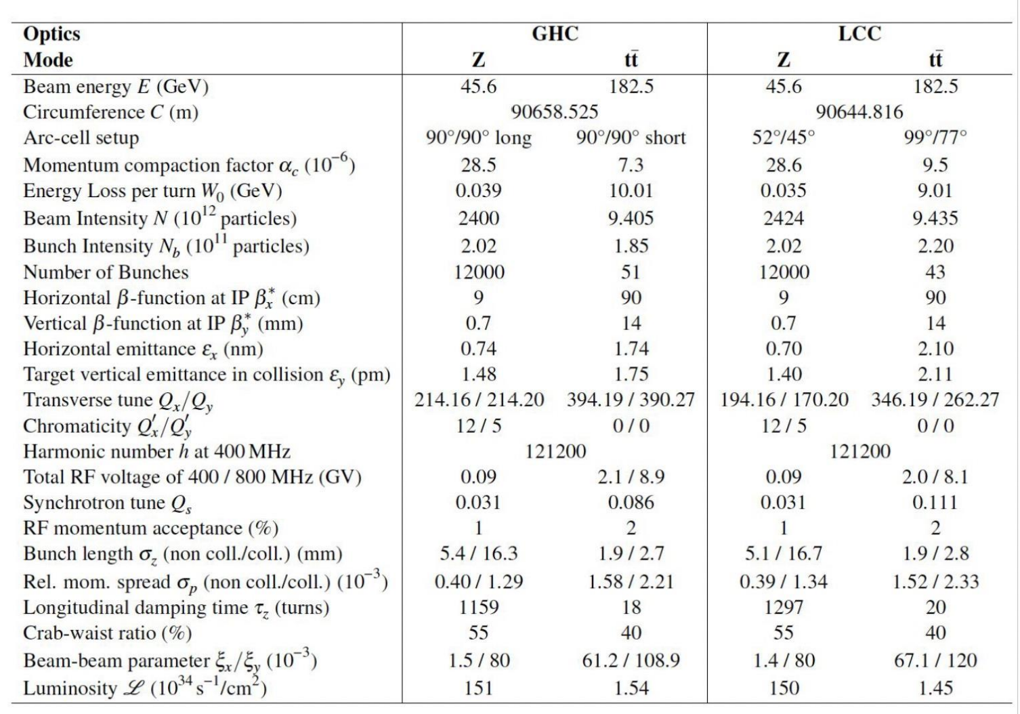
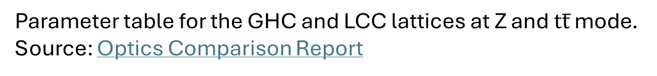
Parameter Table for GHC & LCC Lattices
Parameter table for the GHC and LCC lattices at Z and $tt̅$ mode.
Source: Optics Comparison Report

Slide 29


Twiss Failure
Twiss method = Xsuite’s method to compute the Twiss parameters from the one-turn transfer matrix and derive a range of important beam and lattice properties (using the finite difference method around the closed orbit)
Twiss failure may be due to one of the following:
Numerical instabilities in Xsuite (finite different method fails)
One-turn matrix violates the stability criterion due to unstable optics:
$$\left|\text{Tr}\left(M\right)\right|=\left|2\cos{μ}\right|≤2$$
where $M=\left[\begin{matrix}\cos{μ}+α_{0}\sin{μ} & β_{0}\sin{μ} \\ −γ_{0}\sin{μ} & \cos{μ}−α_{0}\sin{μ}\end{matrix}\right]$
Main tricks used to prevent the method from becoming numerically unstable:
Using 4D instead of 6D Twiss
Disabling radiation and tapering
Cycling of line to dispersion-free RF cavity
Setting chromatic properties = False
Introducing very small, non-zero equilibrium emittances

Slide 30
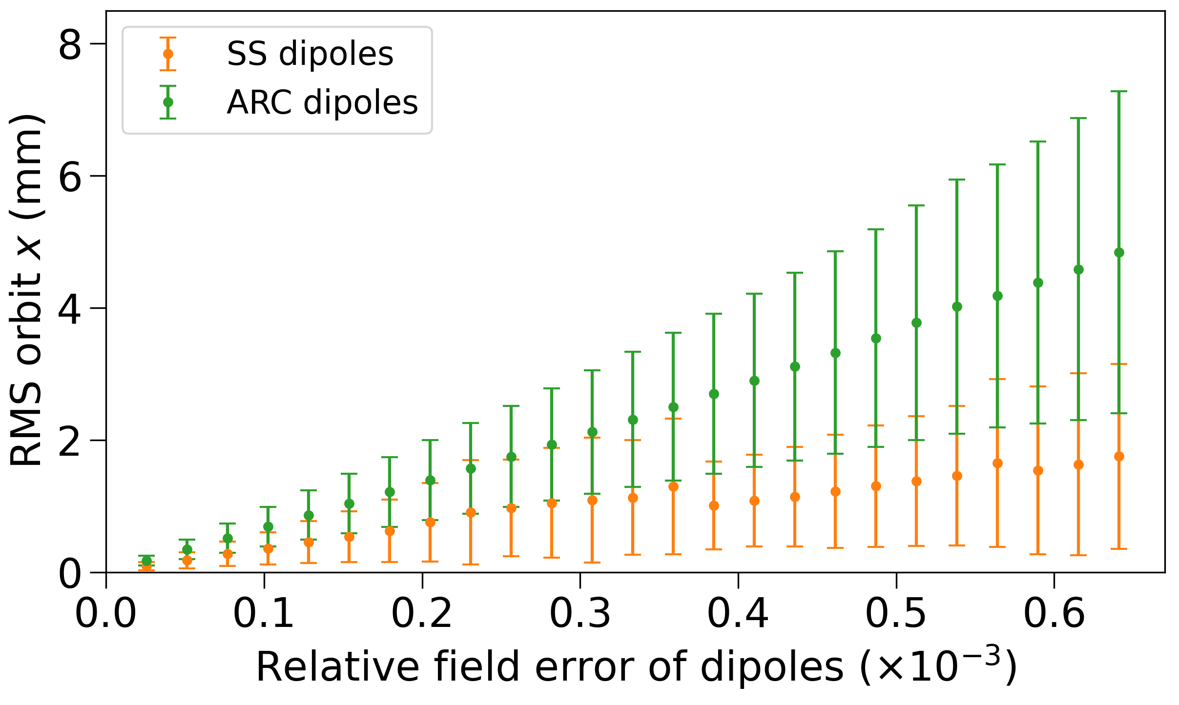
Sensitivity Analysis (Orbit)
Imperfections leading to orbit perturbations: Dipolar field errors

Slide 31
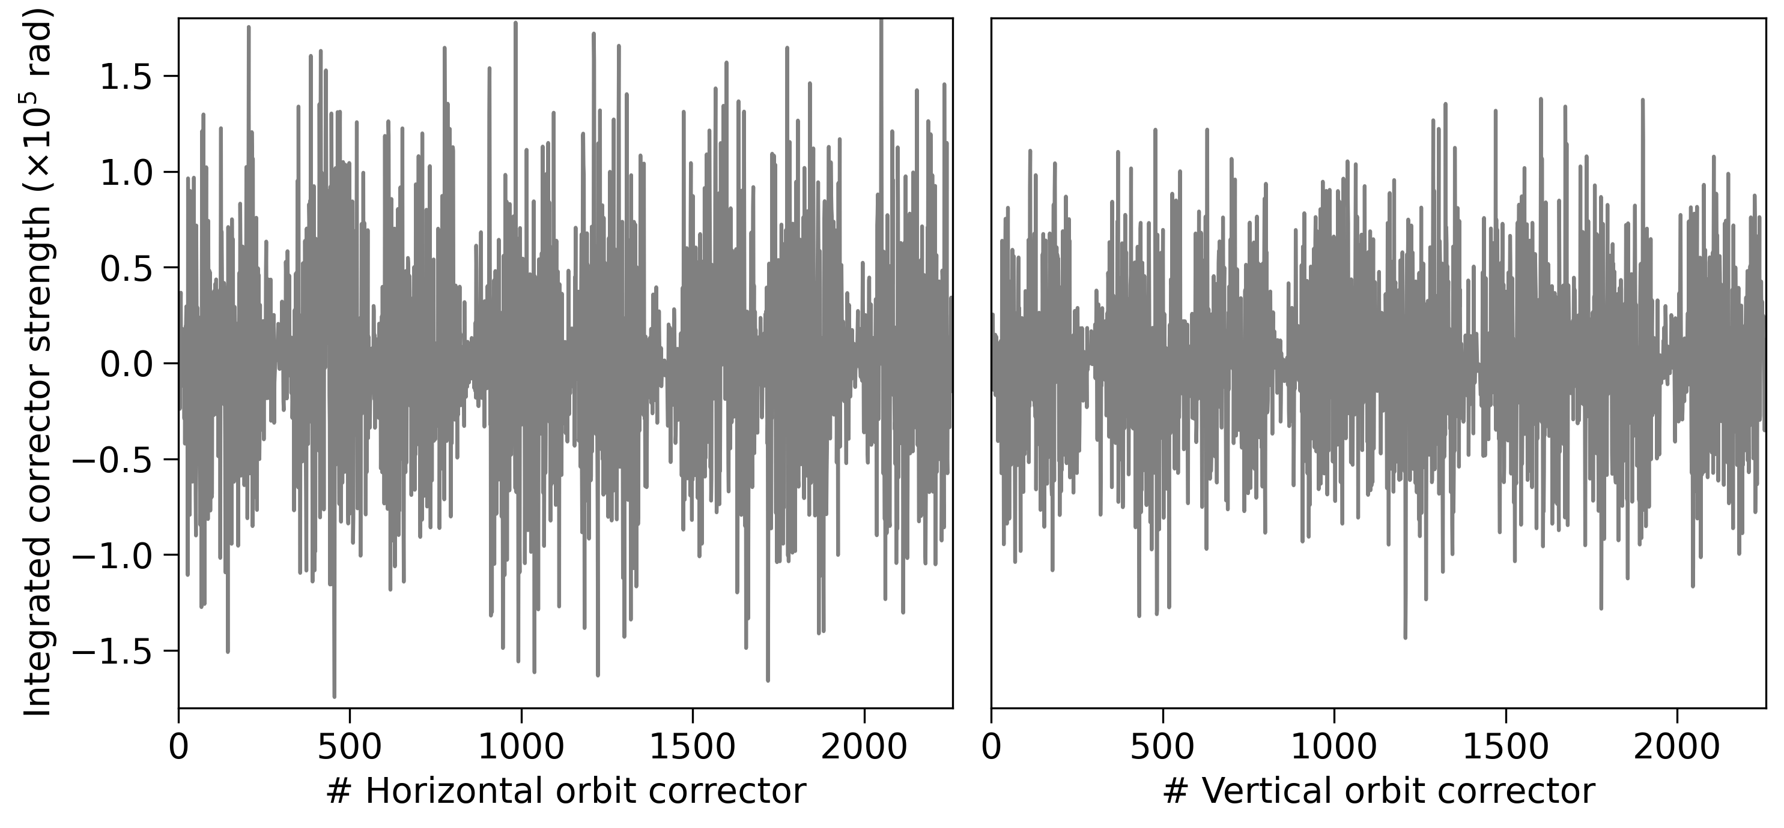
Orbit Correction
Corrector strengths
Tricks used to make the orbit correction more stable:
No radiation / tapering
4D Twiss
Lattice cycled to RF cavity
Chromatic properties disabled until sextupoles are fully ramped up
Optimisation of sextupole ramping increments and threading steps
Details on the steps of the correction routine:
Success of the correction routine is strongly seed-dependent: studies indicate that failing cases can primarily be attributed to girder misalignments
Despite optimising various measures targeting the stability of the procedure, no satisfactory improvement is achieved
Singling out the girder misalignments and ramping them up separately bypasses these difficulties and allows for the successful generation of a large number of lattices → Seed success rate: 89 %
Without girder misalignment ramping: smaller seed success rate, but very similar correction levels achieved

Slide 32
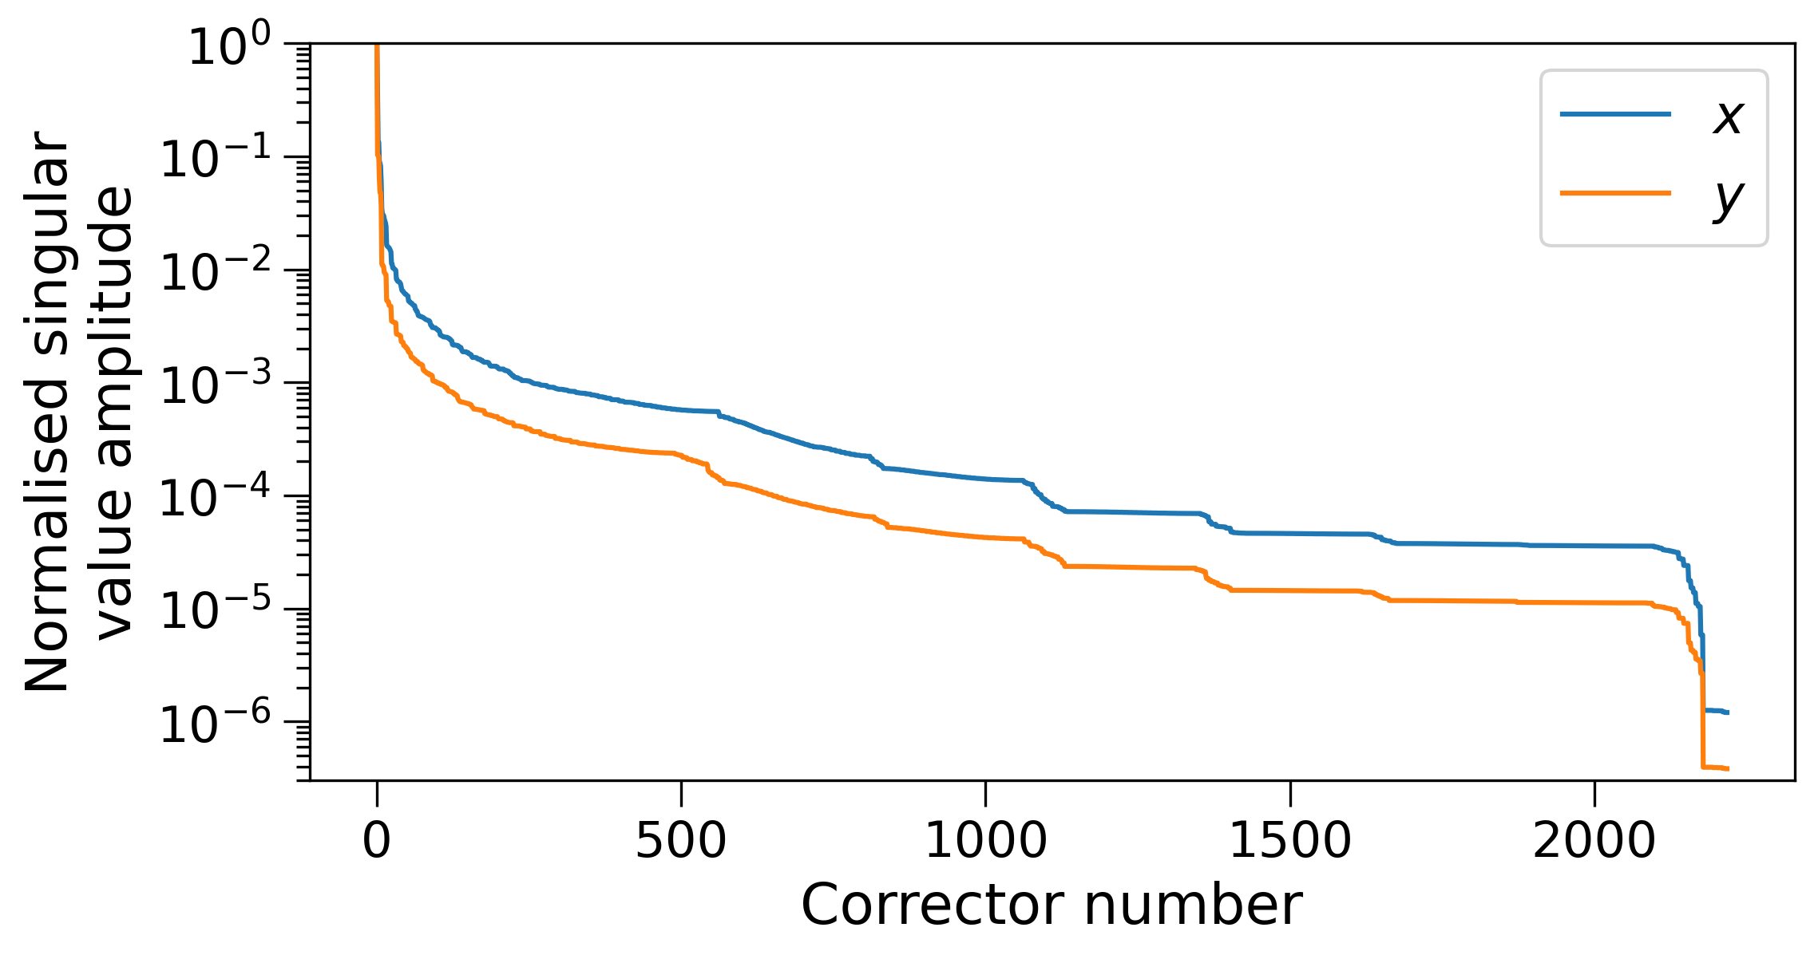
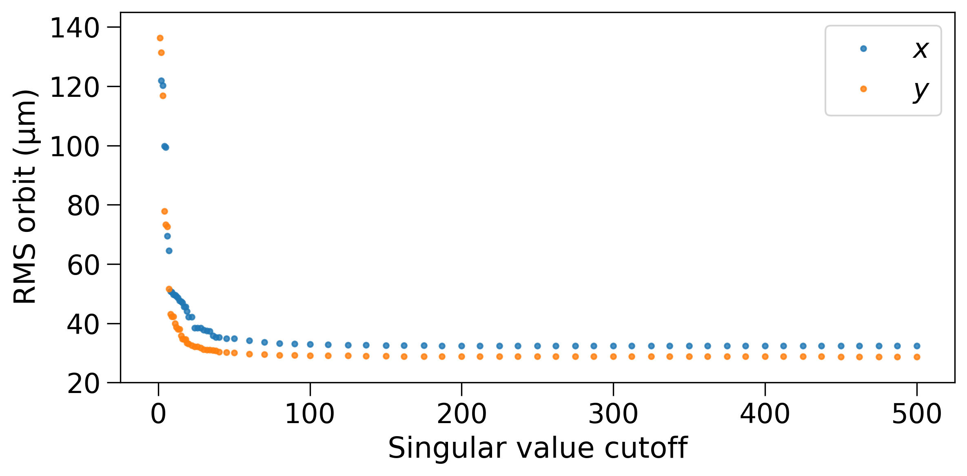
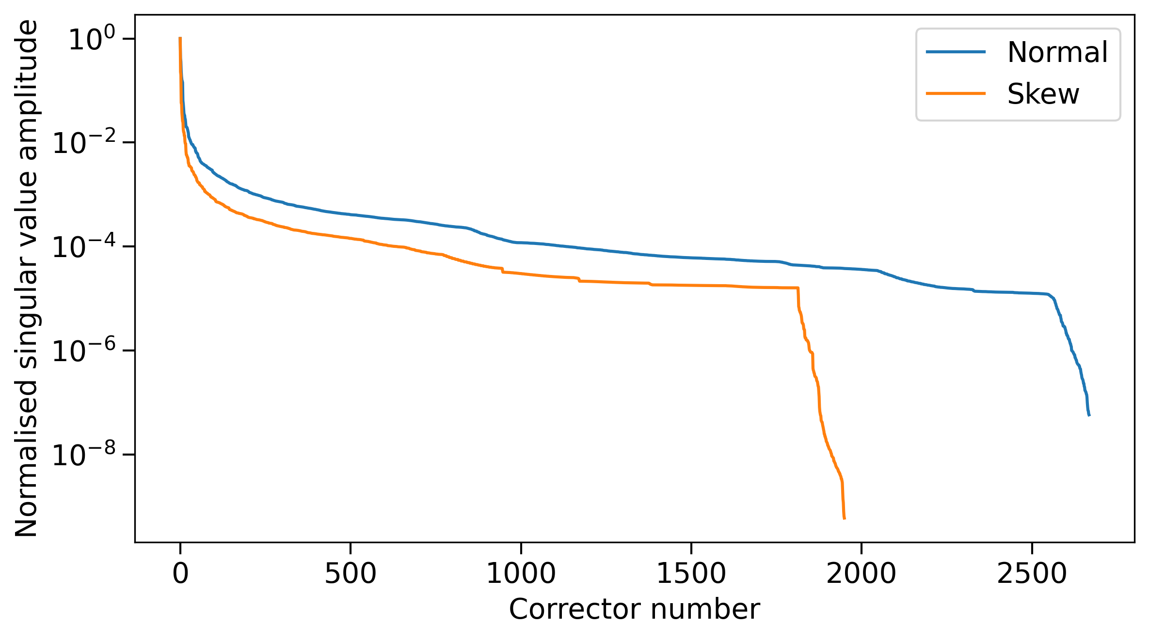
Singular Value Decomposition
Singular value spectrum of the orbit response matrix for the horizontal and vertical correctors.
SVD of the orbit response matrix. Optimisation of the required number of singular values by analysing the corrected RMS orbit.
Singular value spectrum of the optics response matrix for the normal and skew correctors.

Slide 33

Response Matrix Construction
Construction of the optics response matrix for normal correctors. The response matrix for the skew optics correctors is built in the same way, but with a different set of observables.

Slide 34

Statistical Analysis of Corrected Lattices: Tune and Chromaticity

Slide 35




Phase-Matching Routine: DA and MA
Key indicators of beam stability: Dynamic Aperture and Momentum Acceptance
$$Dynamic Aperture$$
$$Momentum Acceptance$$
The phase-advance correction does not cause the DA and MA to degrade within the statistical uncertainty of the scans.

