Slide 1

Imperfections Model with Corrections and Beam-Beam Effects of the FCC-ee
Lara Sievert
Supervisors: Tirsi Prebibaj, Tatiana Pieloni
Many thanks to:
W. Herr, S. Jagabathuni, G. Katsanevakis
EPFL-LPAP Activity Meeting
Thursday 28th May 2026
lara.sievert@epfl.ch

Slide 2
Outline
Overview of FCC-ee (LCC lattice)
Imperfections model
Correction procedure
Impact of beam-beam effects
Impact on Performance

Slide 3
Overview of FCC-ee (LCC lattice)

Slide 4
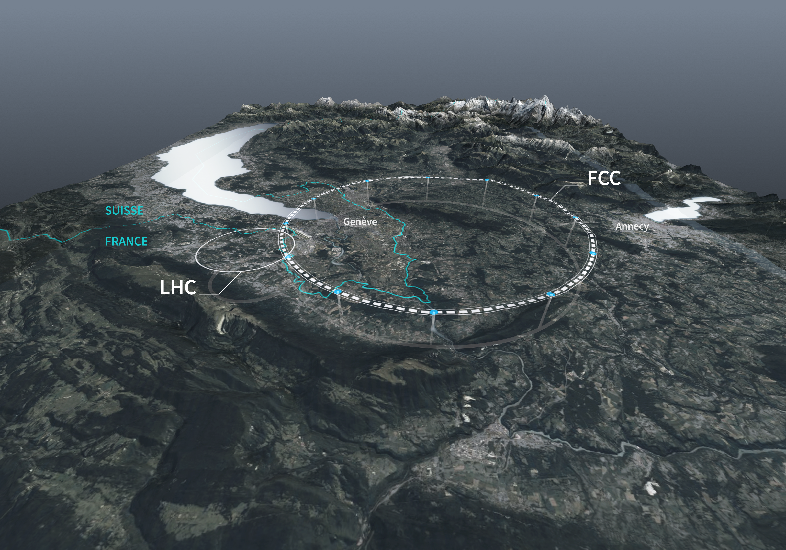
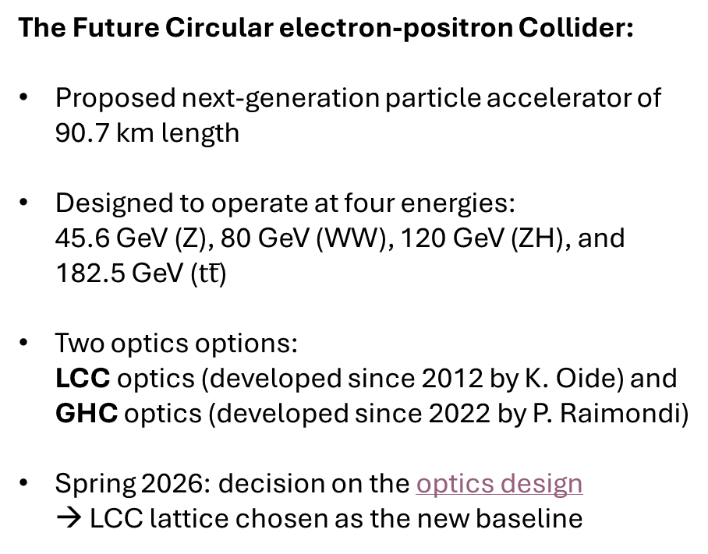
I. Overview of FCC-ee (LCC lattice)
The Future Circular electron-positron Collider:
Proposed next-generation particle accelerator of 90.7 km length
Designed to operate at four energies: 45.6 GeV (Z), 80 GeV (WW), 120 GeV (ZH), and 182.5 GeV ($tt̅$)
Two optics options: LCC optics (developed since 2012 by K. Oide) and GHC optics (developed since 2022 by P. Raimondi)
Spring 2026: decision on the optics design → LCC lattice chosen as the new baseline
CERN Future Circular Collider
2021-2025: Feasibility Study
Early 2026:
Optics Evaluation
2028:
Expected decision
Early 2030s:
Construction start (?)
Late 2040s:
Start of operations (?)

Slide 5
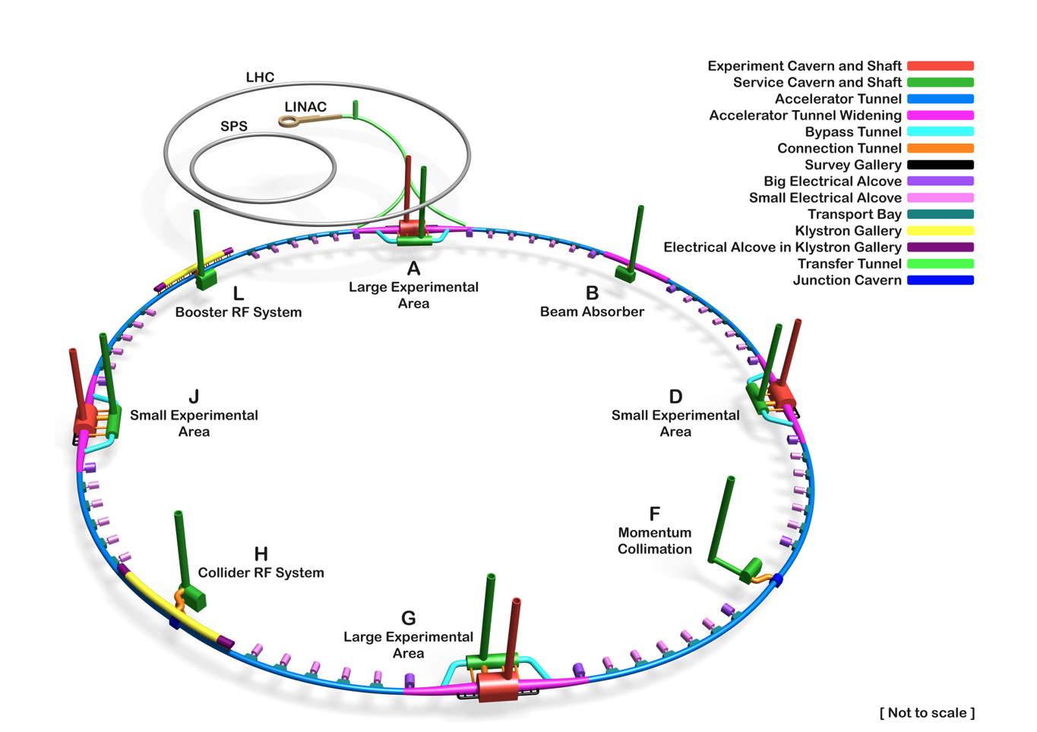
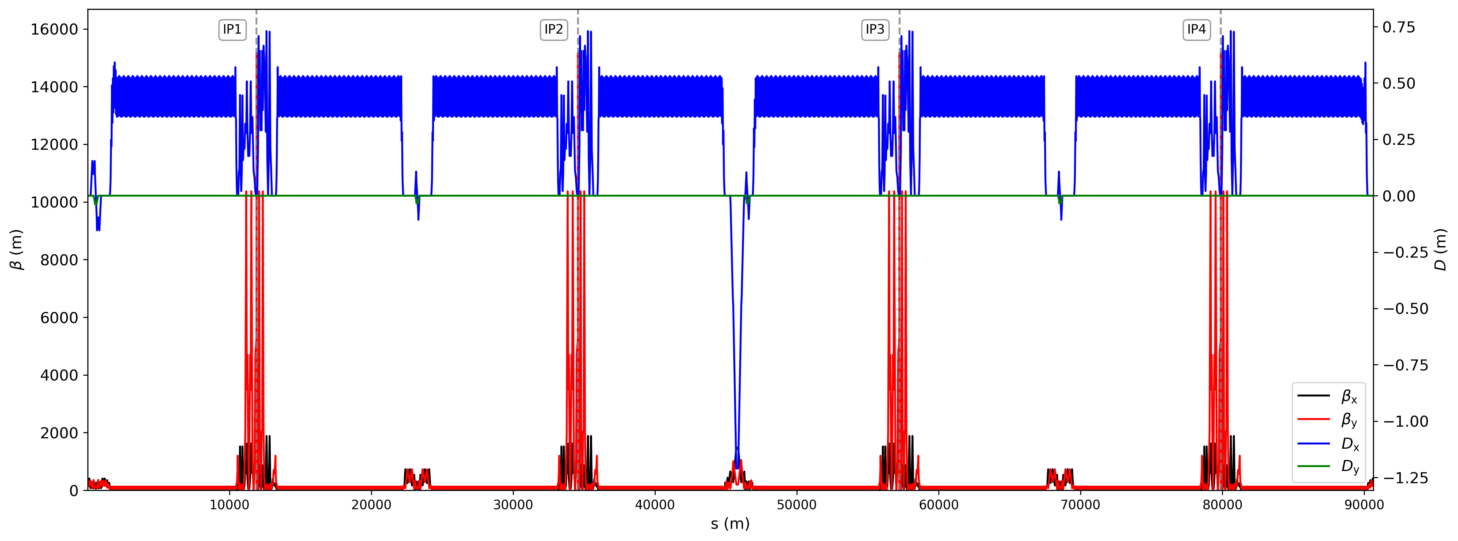
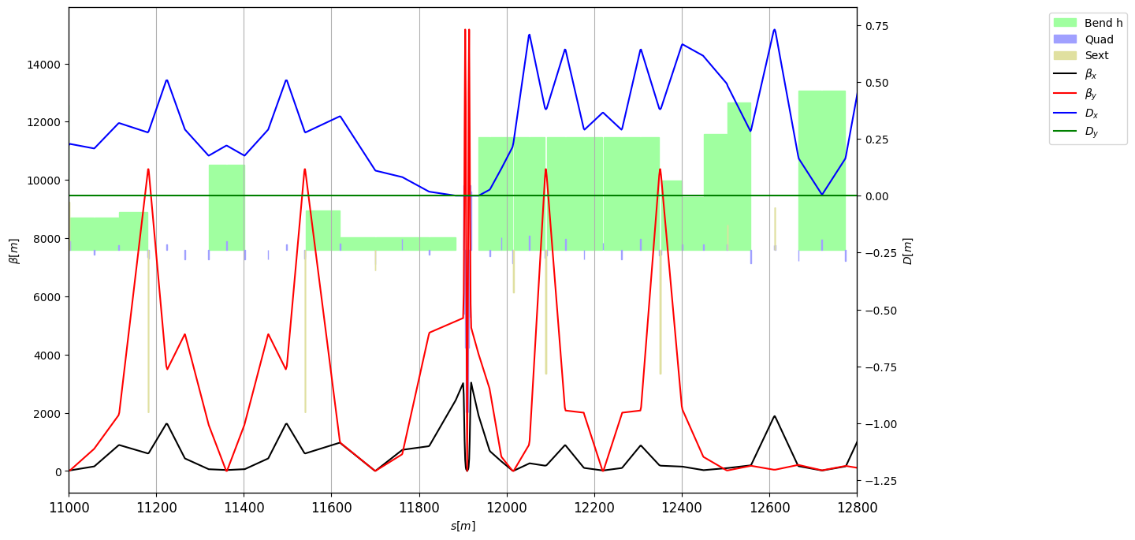
I. Overview of FCC-ee (LCC lattice)
4 Interaction Points (IP)
FCC-ee
4 technical regions (TR)
8 arcs
FCC Feasibility Study Report
We study the LCC lattice @ Z pole

Slide 6
II. Imperfections Model

Slide 7
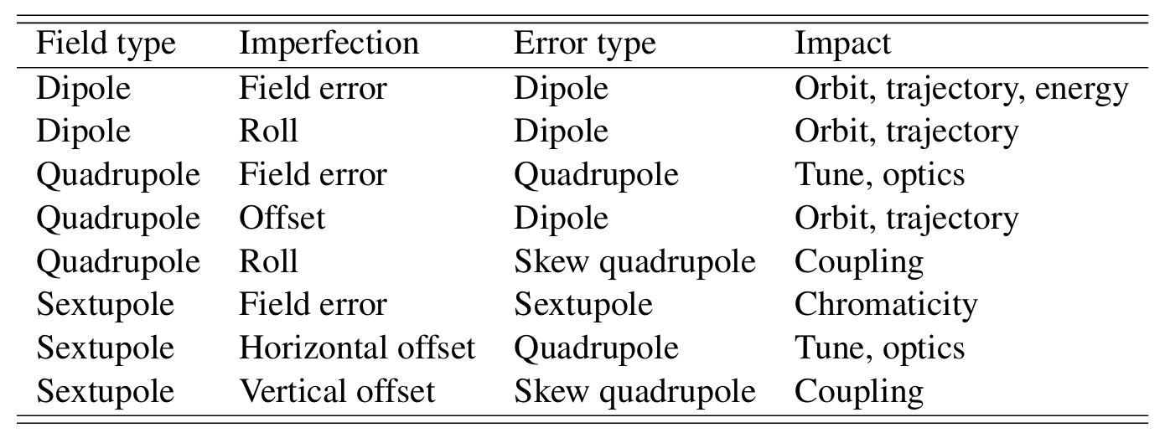
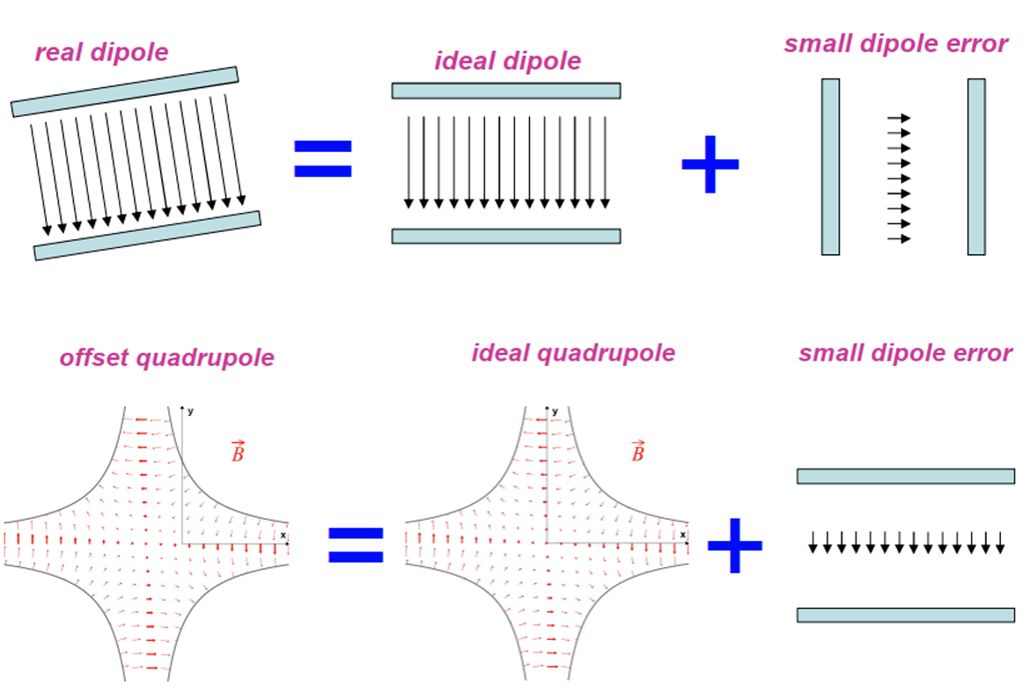
II. Imperfections model
Aim: Develop a model of the LCC lattice with imperfections (misalignments, rotations, and field errors) and analyse their impact
J. Wenninger, “Linear Imperfections ”, CAS 2018.
Small dipole error
Misaligned quad
Ideal quad
Small dipole error
Rotated dipole
Ideal dipole
Depending on the type of imperfection, the orbit and/or optics of the lattice are affected

Slide 8
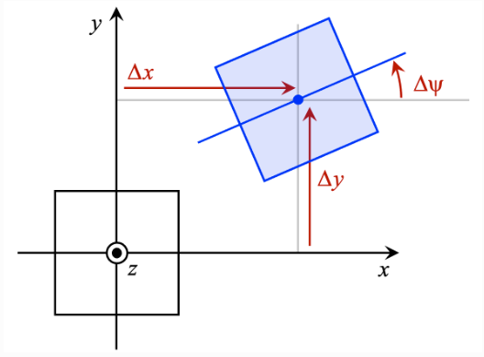
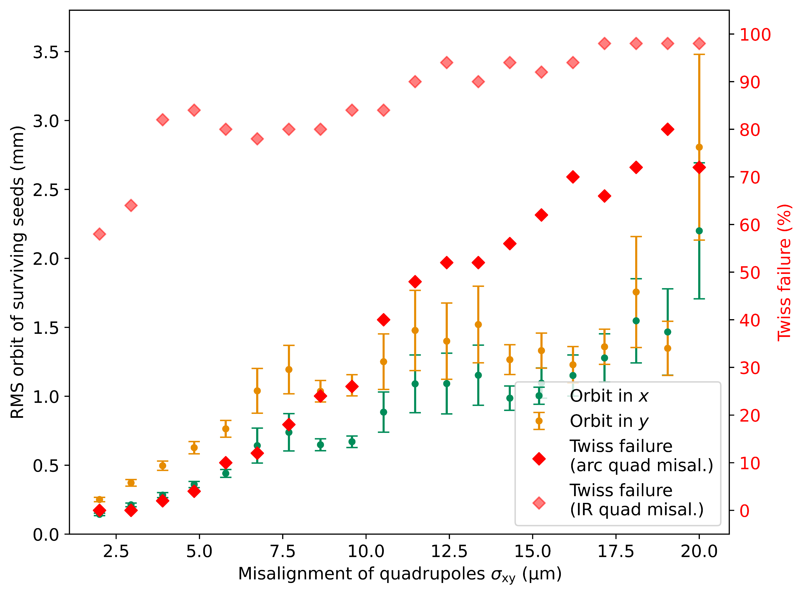
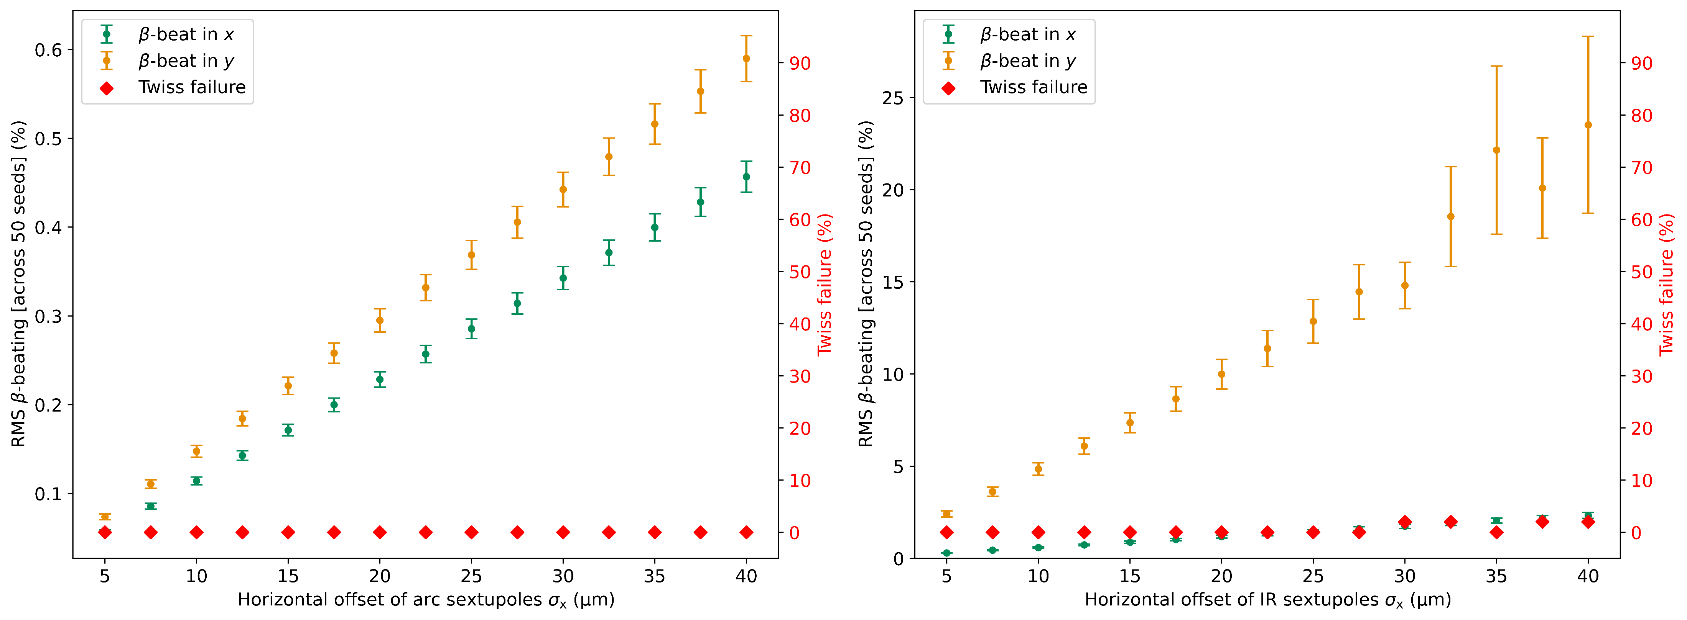
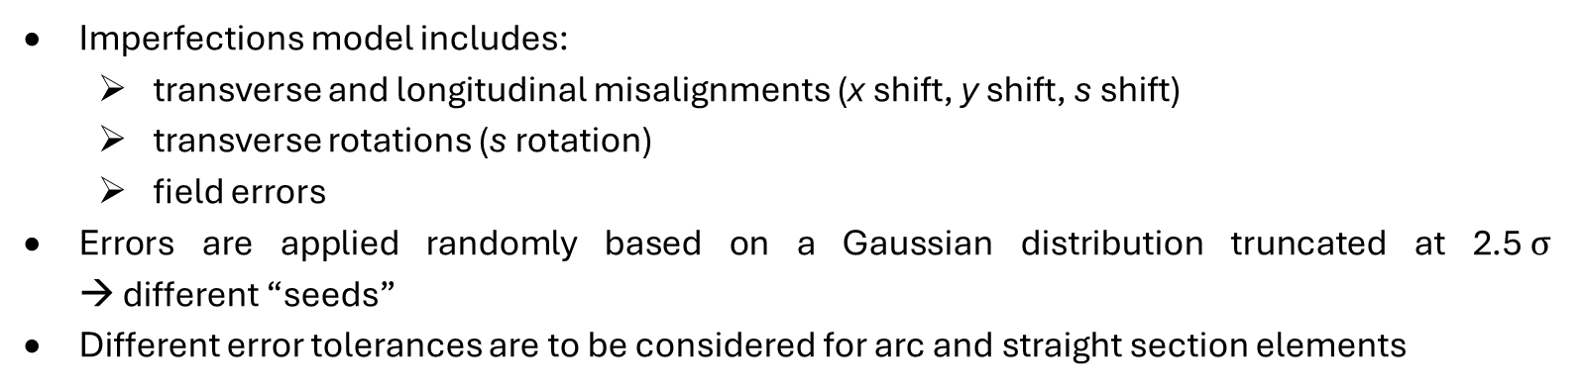
II. Imperfections model
Imperfections model includes:
transverse and longitudinal misalignments (x shift, y shift, s shift)
transverse rotations (s rotation)
field errors
Errors are applied randomly based on a Gaussian distribution truncated at 2.5$σ$ → different “seeds”
Different error tolerances are to be considered for arc and straight section elements
XSUITE Physics manual

Slide 9
II. Imperfections model
Element type | Number of elements
Dipole | 2436
Quadrupole | 2684
Sextupole | 1952
BPM | 2219
H orbit corrector | 2259
V orbit corrector | 2259
Normal optics corrector | 2668
Skew optics corrector | 1950
Quadrupole
Normal optics corrector
H orbit corrector
BPM
Sextupole
V orbit corrector
Skew optics corrector
Girder
Structure of an arc section
Misalignments and rotations are also applied to the girders in the arcs
Elements mounted on top of a girder receive their own imperfections plus the misalignments from the girder
BPMs inherit the misalignments from the quadrupoles to which they are attached and are assumed to have an additional position resolution error

Slide 10
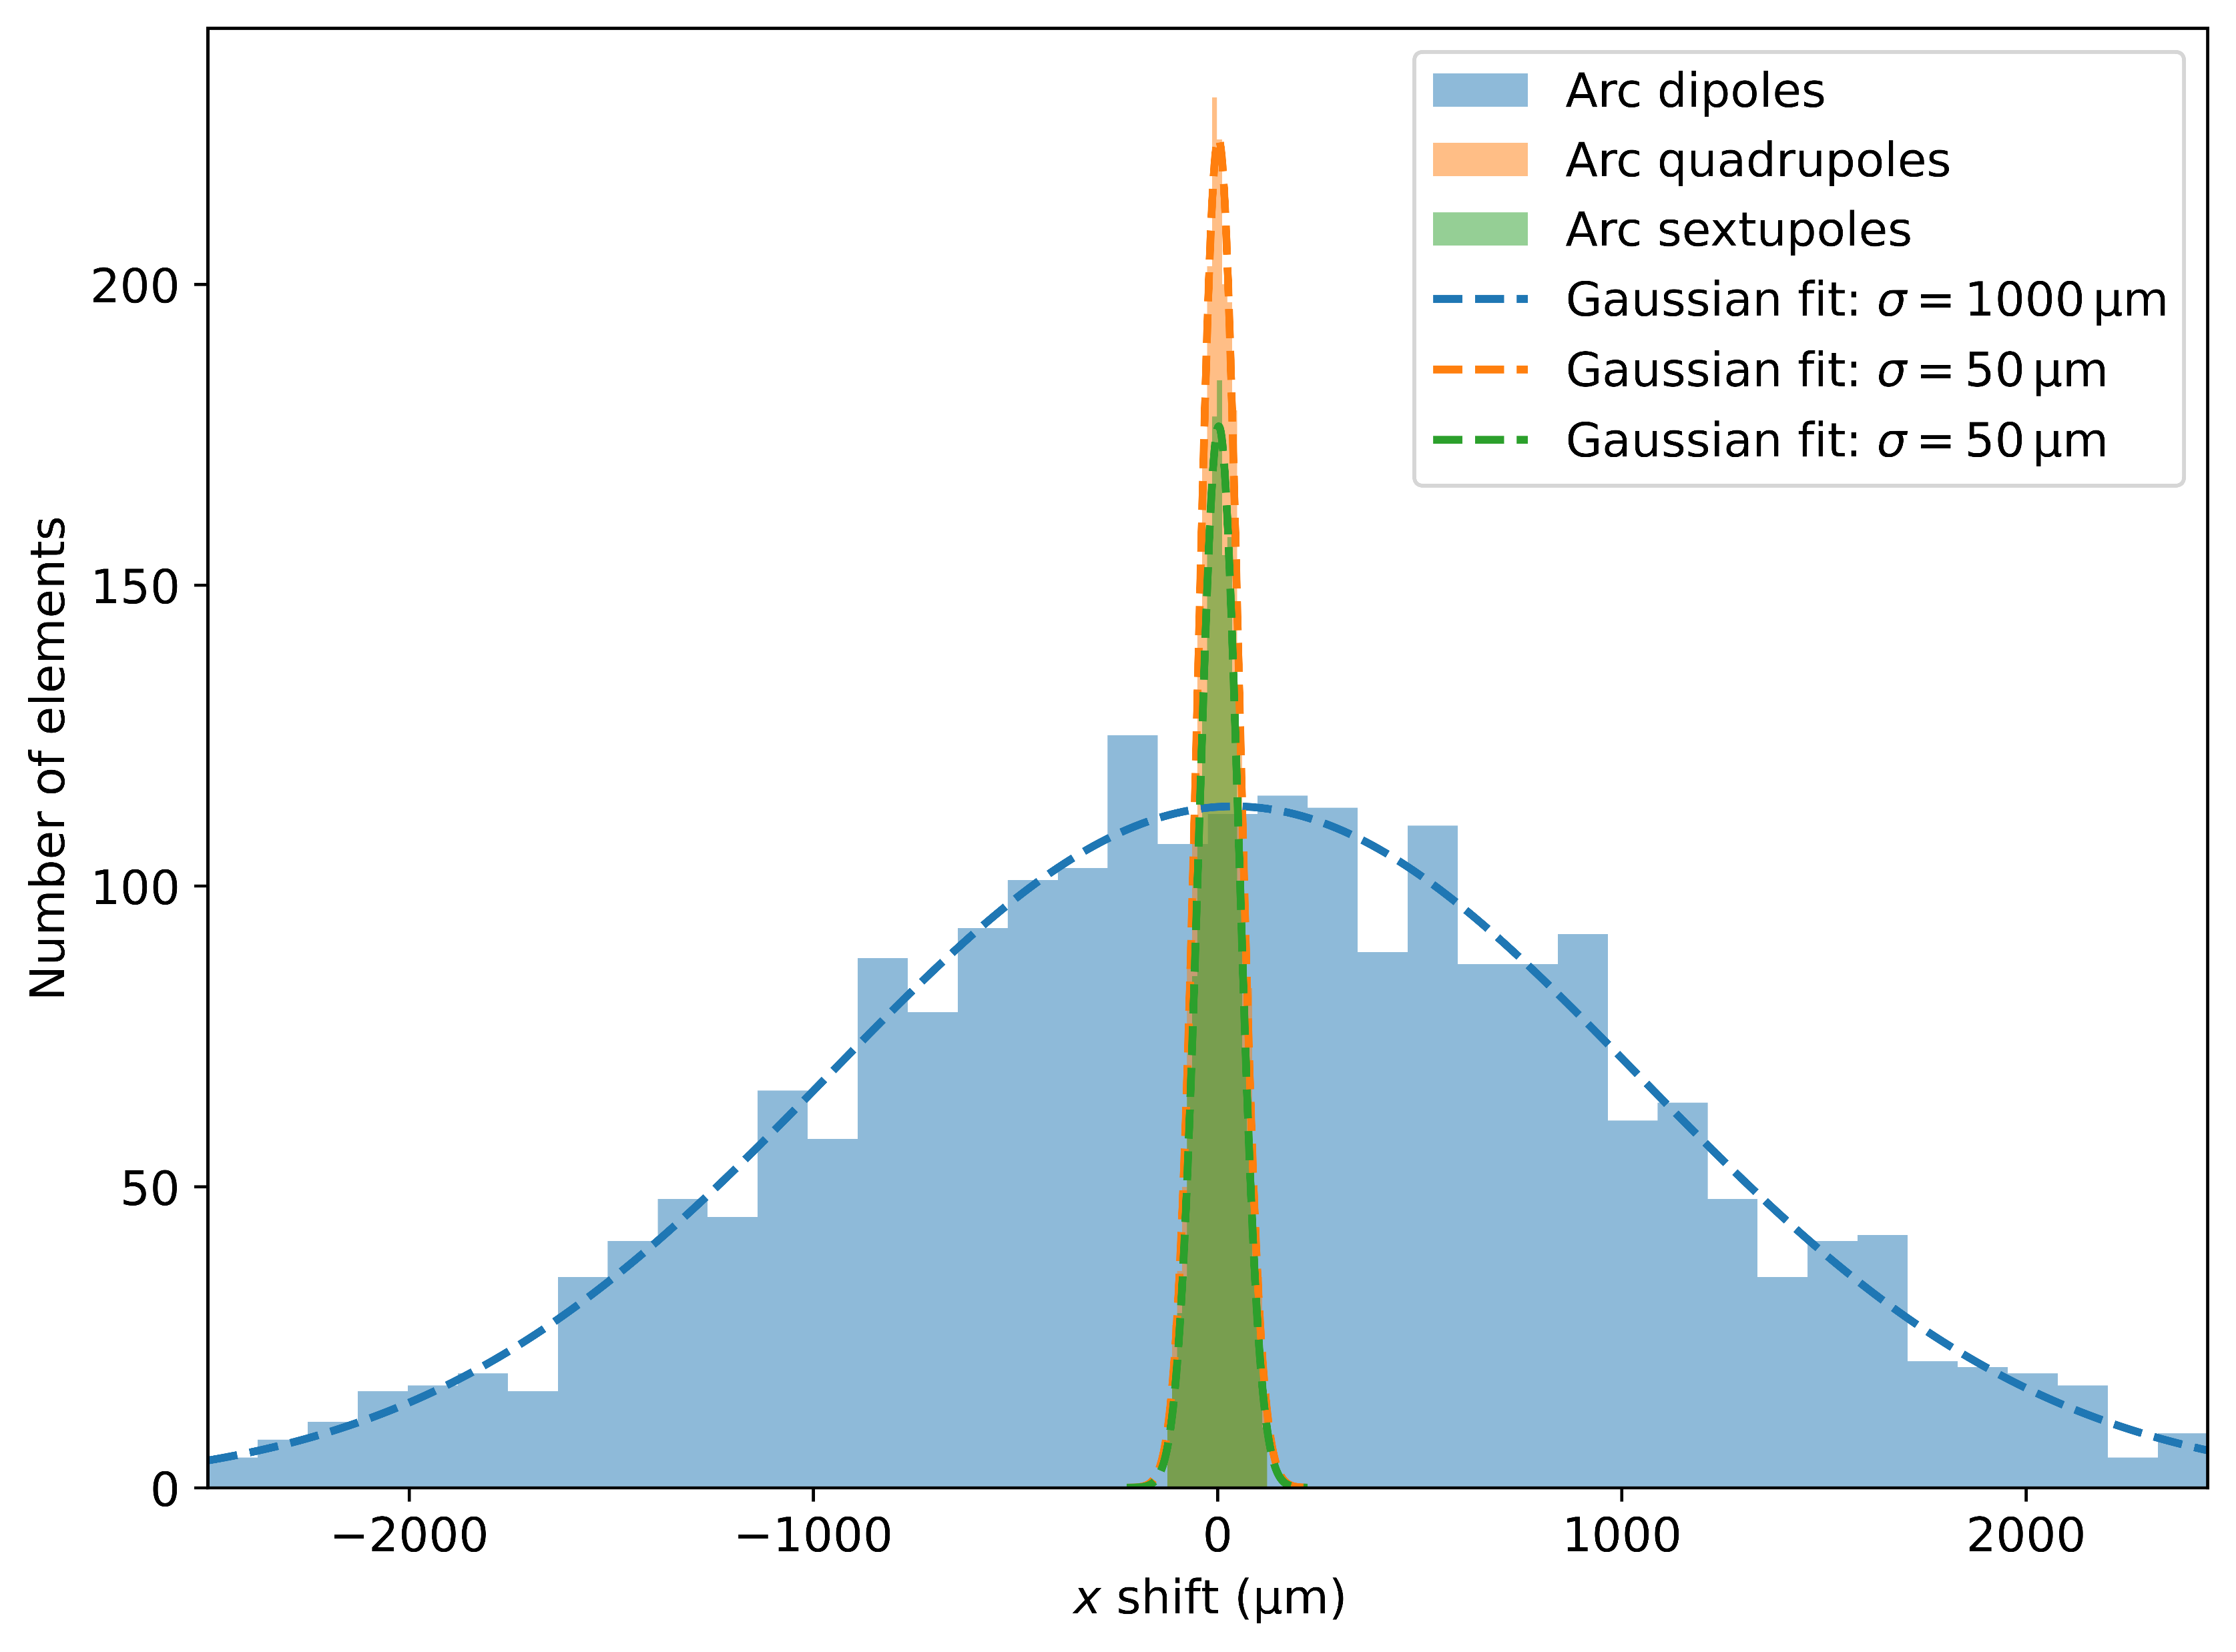
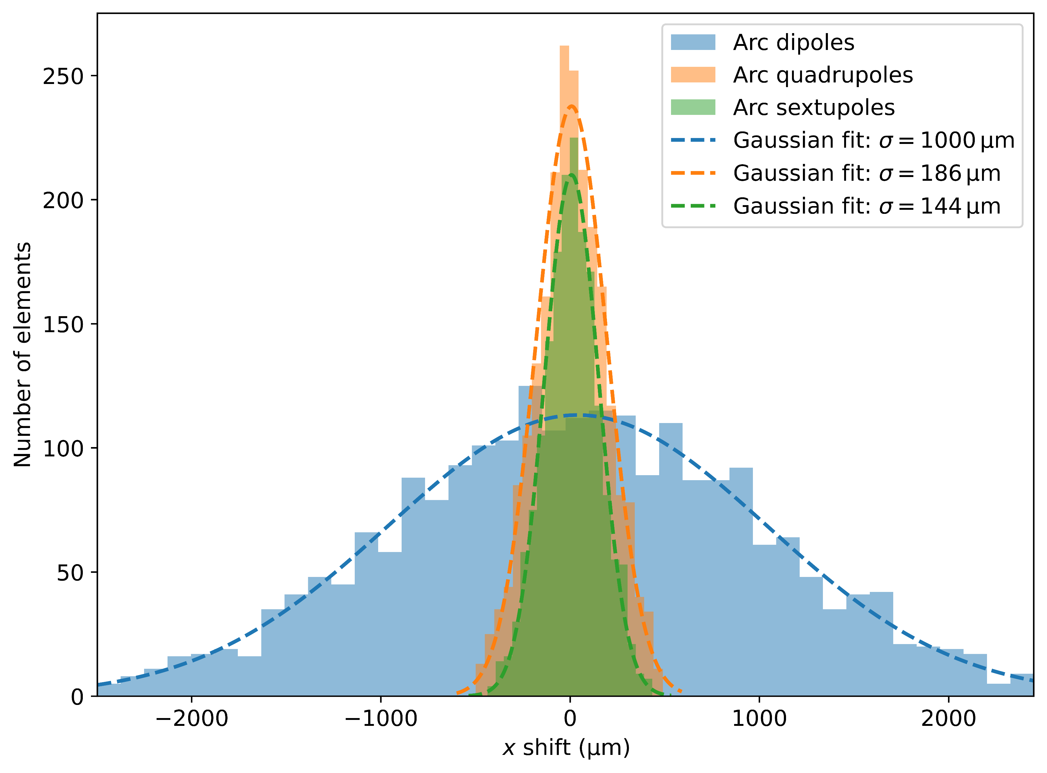
II. Imperfections model
 | Element | σ_{x} (μm) | σ_{y} (μm) | σ_{s} (μm) | σ_{θ} (μrad) | Field error (rel.)
ARC | Dipole | 1000 | 1000 | 500 | 1000 | k0: 1e-3
 | Quadrupole | 50 | 50 | 100 | 50 | k1: 2e-4
 | Sextupole | 50 | 50 | 100 | 50 | k2: 2e-4
 | Girder | 150 | 150 | 500 | 150 | –
STRAIGHT SECTION | IP Dipole | 1000 | 1000 | 100 | 1000 | k0: 1e-3
 | TR Dipole | 1000 | 1000 | 500 | 1000 | k0: 1e-3
 | FD Quadrupole | 10 | 10 | 100 | 10 | k1: 1e-5
 | FF Quadrupole | 30 | 30 | 100 | 30 | k1: 1e-4
 | DS/TR Quadrupole | 100 | 100 | 100 | 100 | k1: 2e-4
 | FF Sextupole | 30 | 30 | 100 | 30 | k2: 1e-4
OTHER | BPM | 10 | 10 | – | 10 | –
IP = Interaction Point
TR = Technical Region
FD = Final Doublet
FF = Final Focussing
DS = Dispersion Suppression

Slide 11
III. Correction Procedure

Slide 12
III. Correction Procedure
ORBIT CORRECTION
Orbit correction*, tune matching
Orbit correction*, tune matching
Installation of all imperfections switches
Deactivation of sextupoles
Ramping of girder misalignments
Ramping of BPM resolution errors
Ramping of IR and crab sextupoles from 0% to 100%
Ramping of arc sextupoles from 0% to 100%
Orbit correction*, tune matching
*Orbit correction defaults to beam threading method if no closed orbit can be found
Orbit correction*, tune matching
Orbit correction*, tune matching

Slide 13
III. Correction Procedure
Applied imperfections: Quadrupole misalignments @ 10 % of the chosen error tolerances

Slide 14
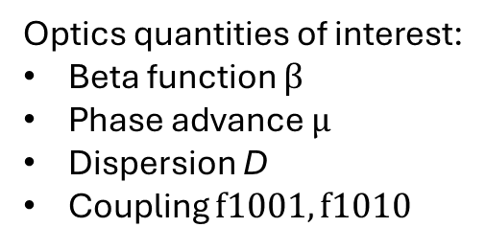
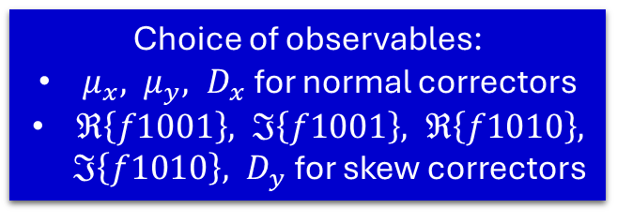
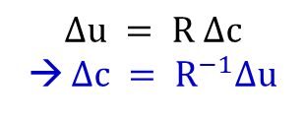
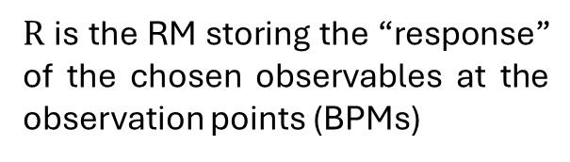
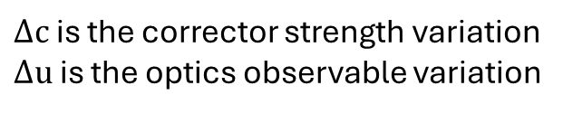
III. Correction Procedure
OPTICS CORRECTION
Optics quantities of interest:
Beta function $β$
Phase advance $μ$
Dispersion D
Coupling $f1001, f1010$
5 loops
First without synchrotron radiation, then with SR
RM = Response matrix
SVD = Singular Value Decomposition
Choice of observables:
$μ_{x}, μ_{y}, D_{x}$ for normal correctors
$ℜ\left\{f1001\right\}, ℑ\left\{f1001\right\}, ℜ\left\{f1010\right\}, ℑ\left\{f1010\right\}, D_{y}$ for skew correctors
Creation of response matrix for normal and skew correctors
Pseudo-inversion of RM using SVD
Determination of corrector strengths
Tune and chromaticity matching
$Δu = R Δc$
→ $Δc = R^{−1}Δu$
Normal correctors at quadrupoles
Skew correctors at sextupoles
$R$ is the RM storing the “response” of the chosen observables at the observation points (BPMs)
Using the arc quadrupoles and arc sextupoles
$Δc$ is the corrector strength variation
$Δu$ is the optics observable variation

Slide 15





III. Correction Procedure
$$Orbit$$
$β$-beating
A representative seed after global orbit and optics correction
$$Phase adv.$$
$$Dispersion$$
$$Coupling$$

Slide 16
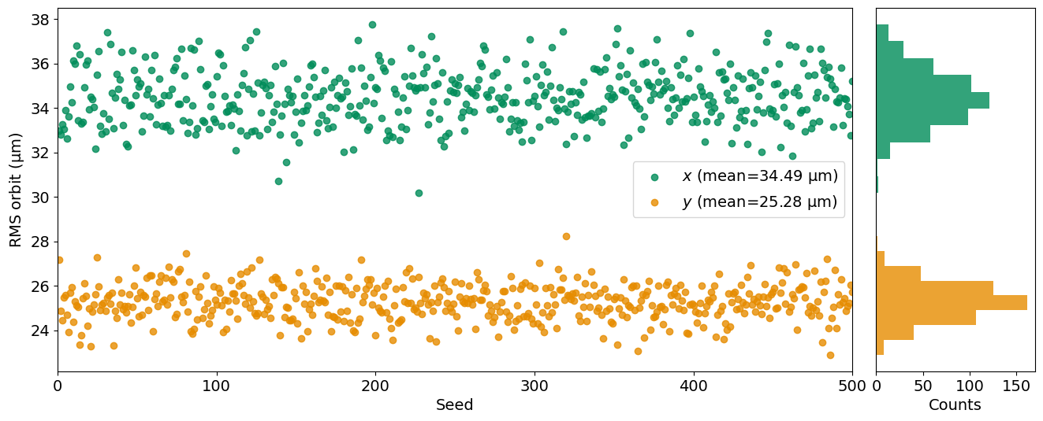
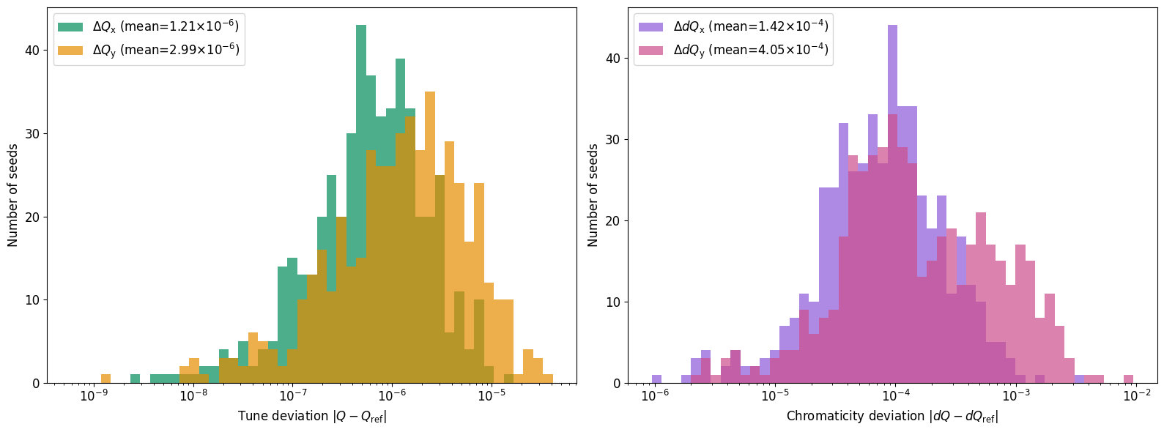



III. Correction Procedure
Statistics analysis on 500 corrected lattices
$$Orbit$$
Reference tunes:
$$Q_{x}= 194.17$$
$$Q_{y}=170.20$$
$$Tune and Chromaticity$$

Slide 17
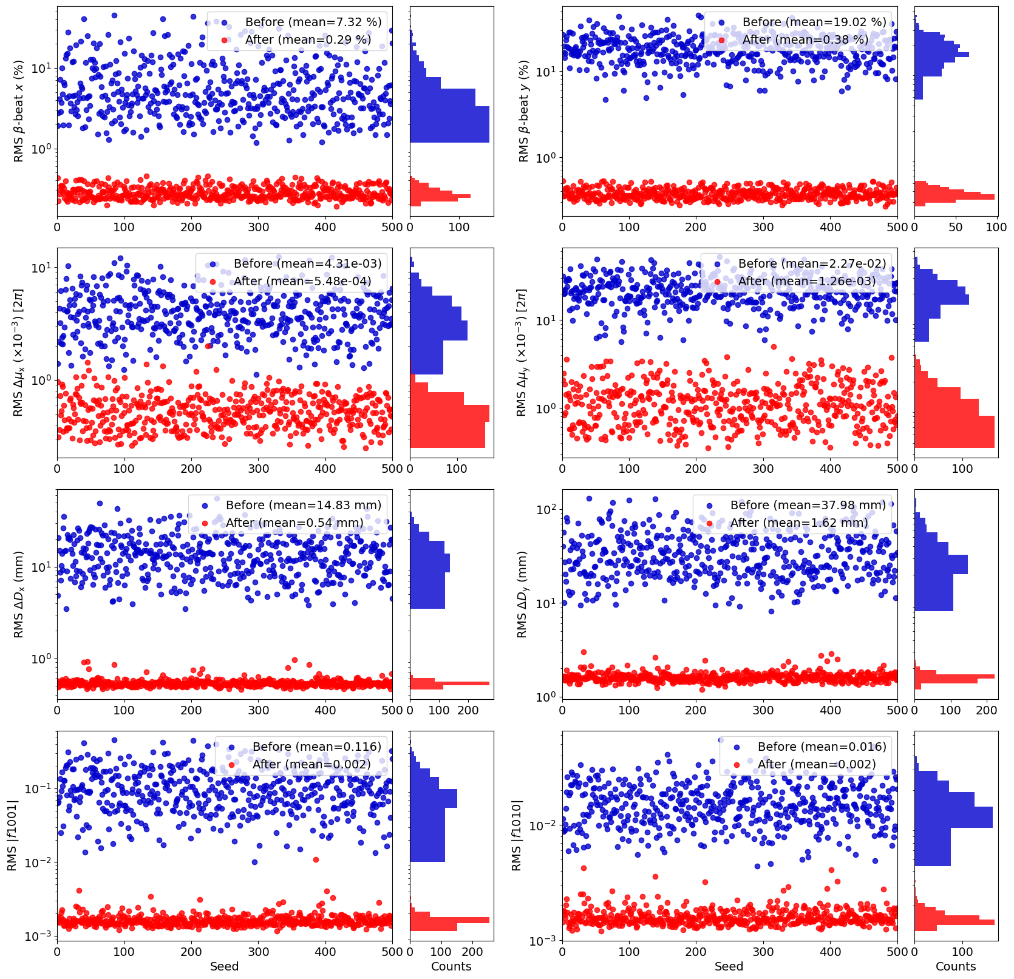




III. Correction Procedure
$β$-beating
$$Phase adv.$$
Statistics analysis on 500 corrected lattices
$$Dispersion$$
$$Coupling$$

Slide 18
IV. Impact of Beam-Beam Effects

Slide 19
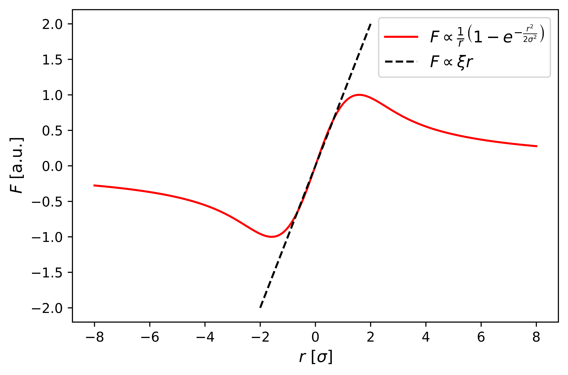
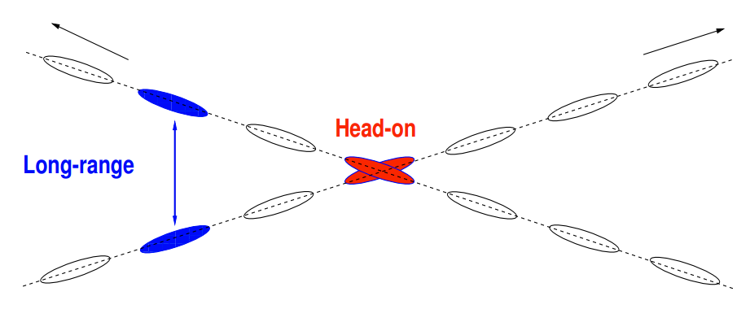
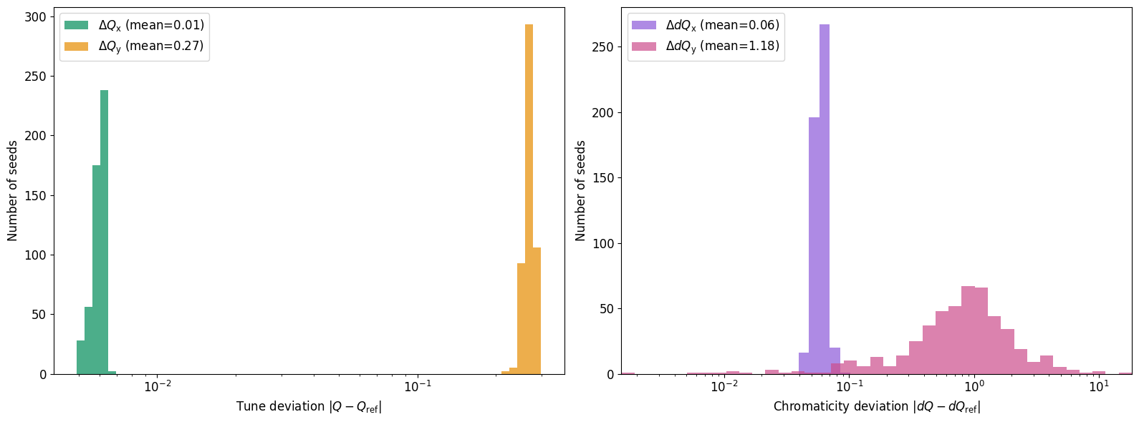
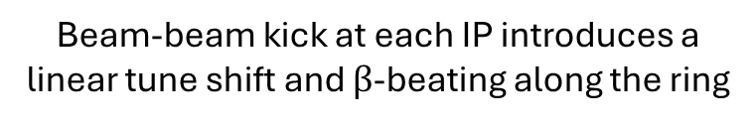
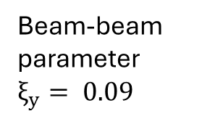
IV. Impact of Beam-Beam Effects
Electromagnetic perturbations as two beams cross each other
Beam-beam parameter $ξ_{y}= 0.09$
W. Herr, T. Pieloni, “Beam-beam effects”, CAS 2013.
Beam-beam kick at each IP introduces a linear tune shift and $β$-beating along the ring

Slide 20
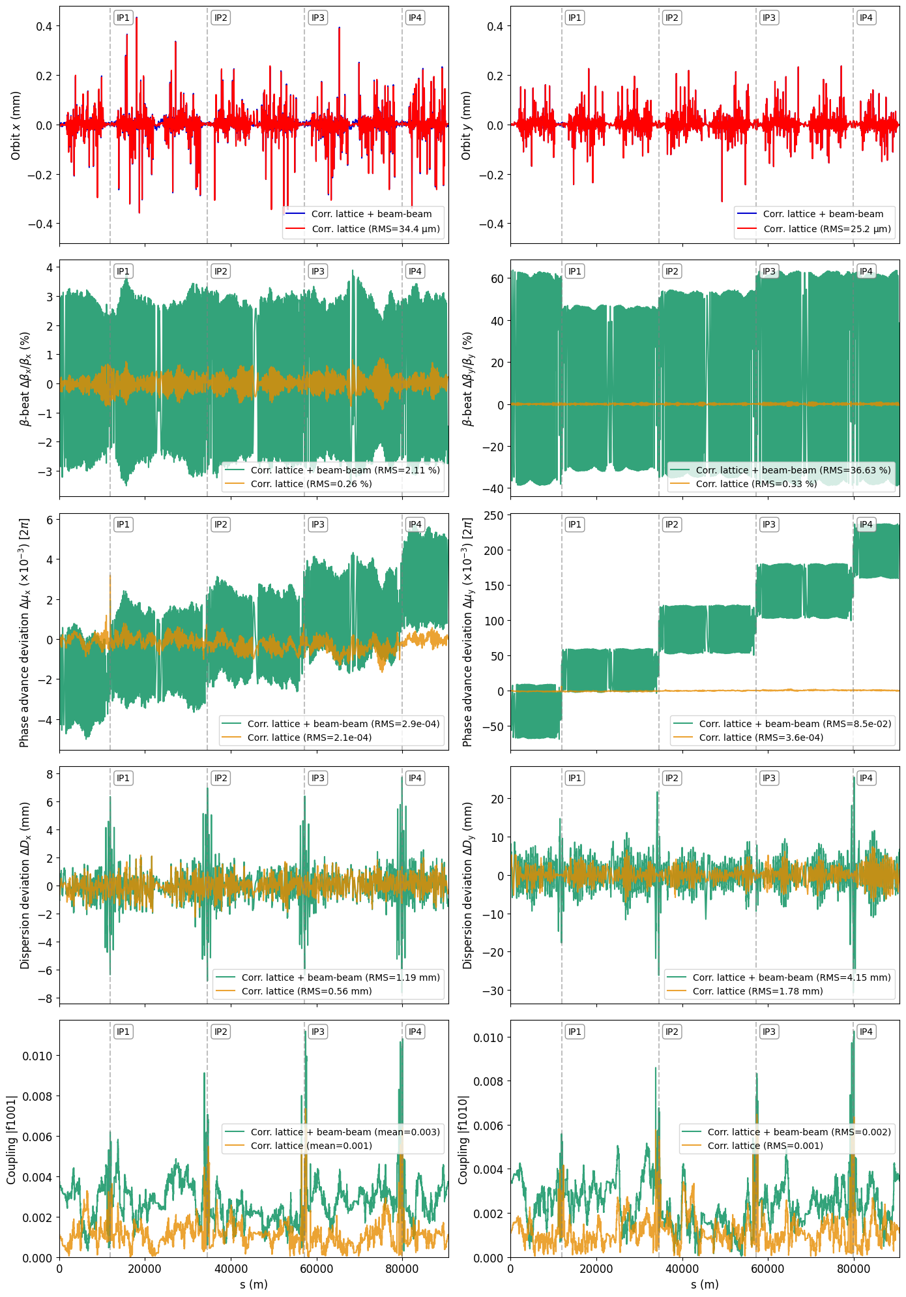





IV. Impact of Beam-Beam Effects
$$Orbit$$
$β$-beating
A corrected lattice (global orbit and optics correction) with beam-beam effects
$$Phase adv.$$
$$Dispersion$$
$$Coupling$$

Slide 21
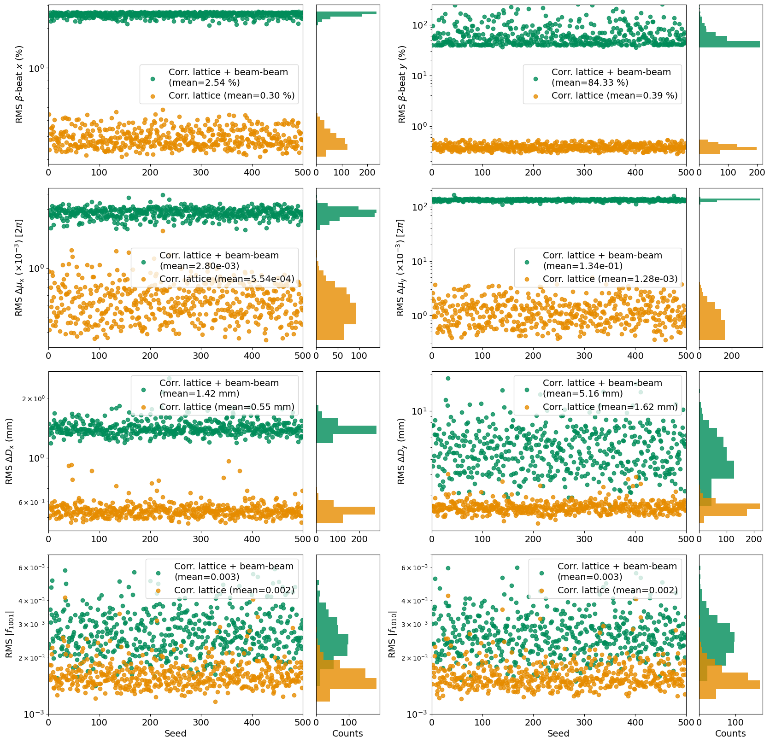
IV. Impact of BB Effects
$β$-beating
$$Phase adv.$$
Statistics analysis on 500 corrected lattices with beam-beam effects
$$Dispersion$$
$$Coupling$$

Slide 22
V. Impact on Performance

Slide 23
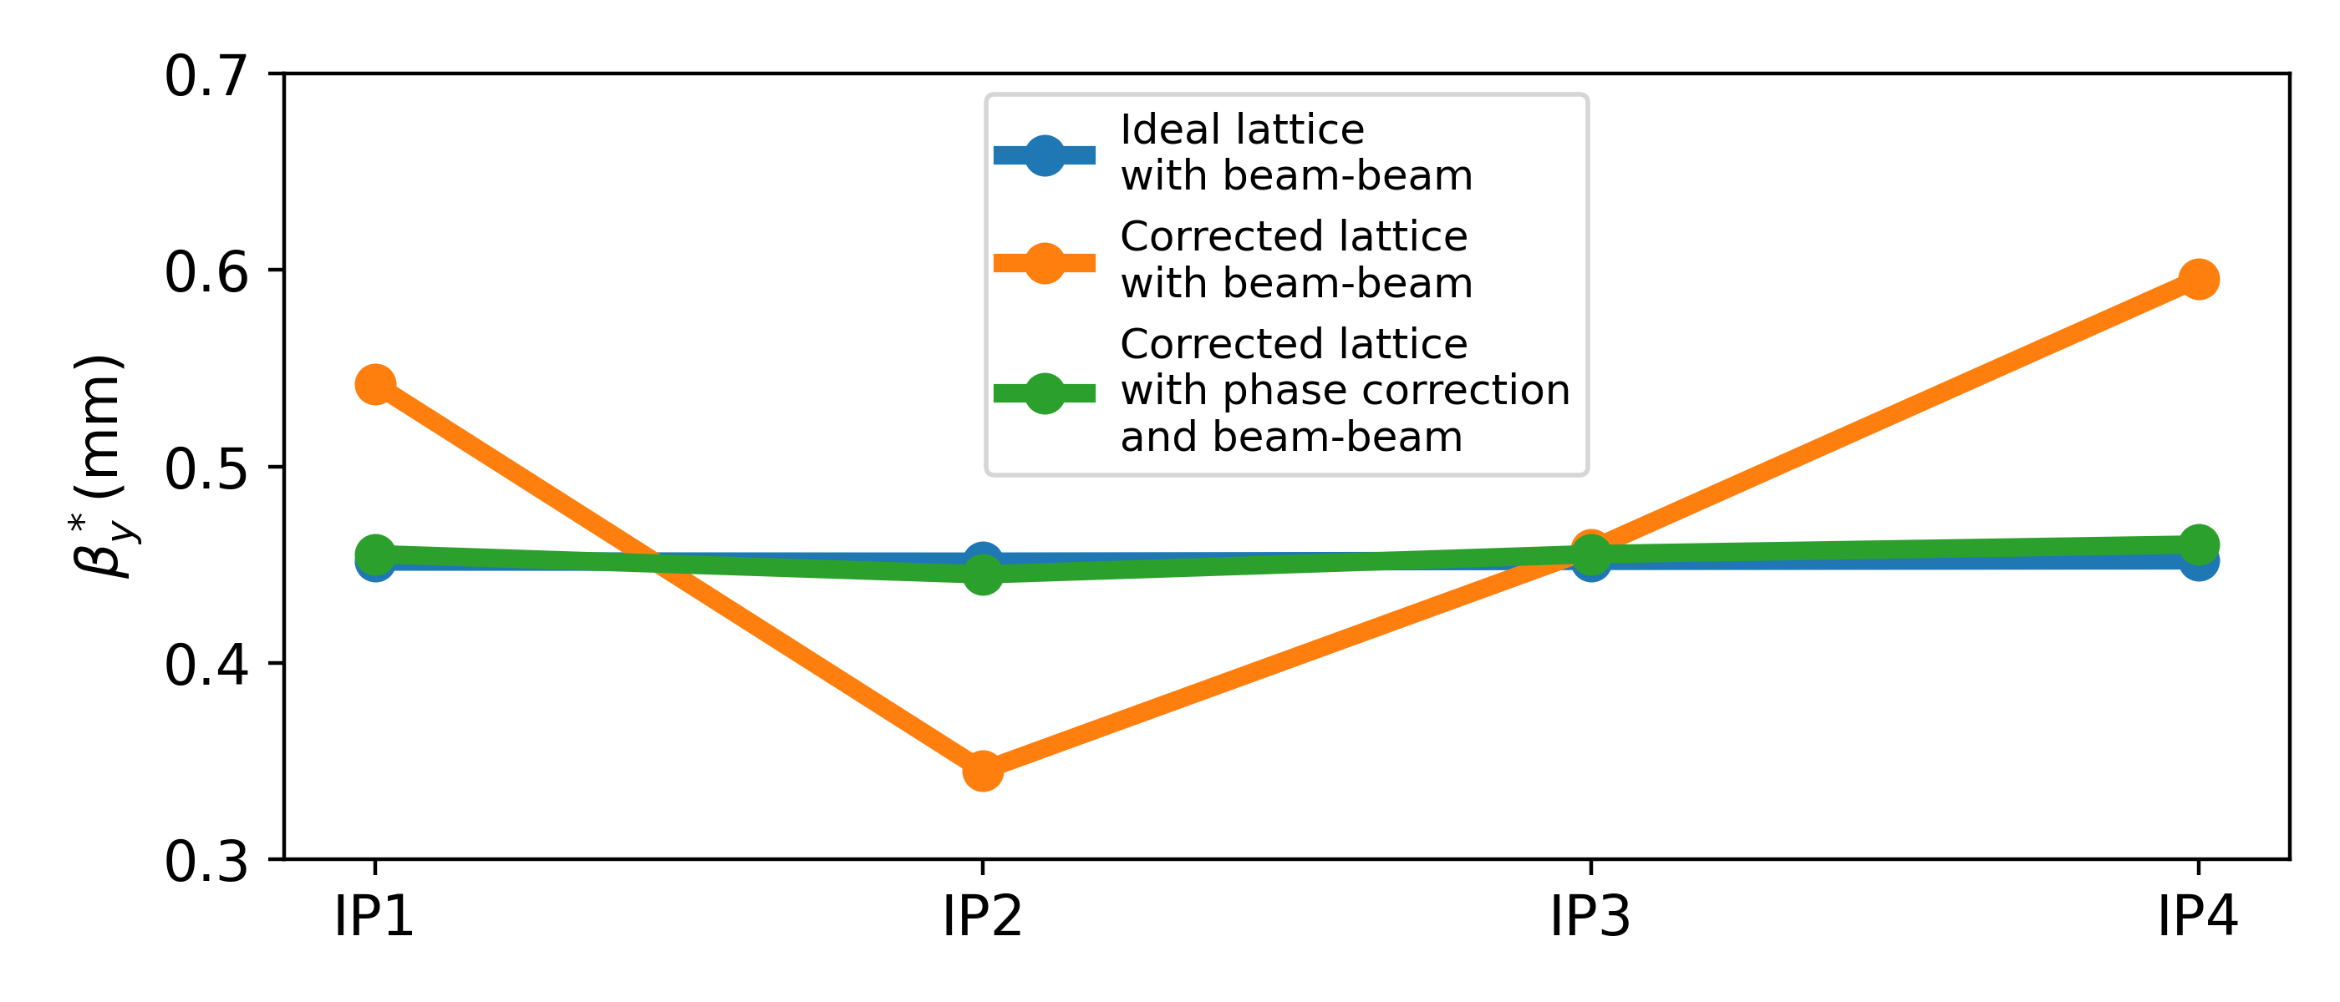
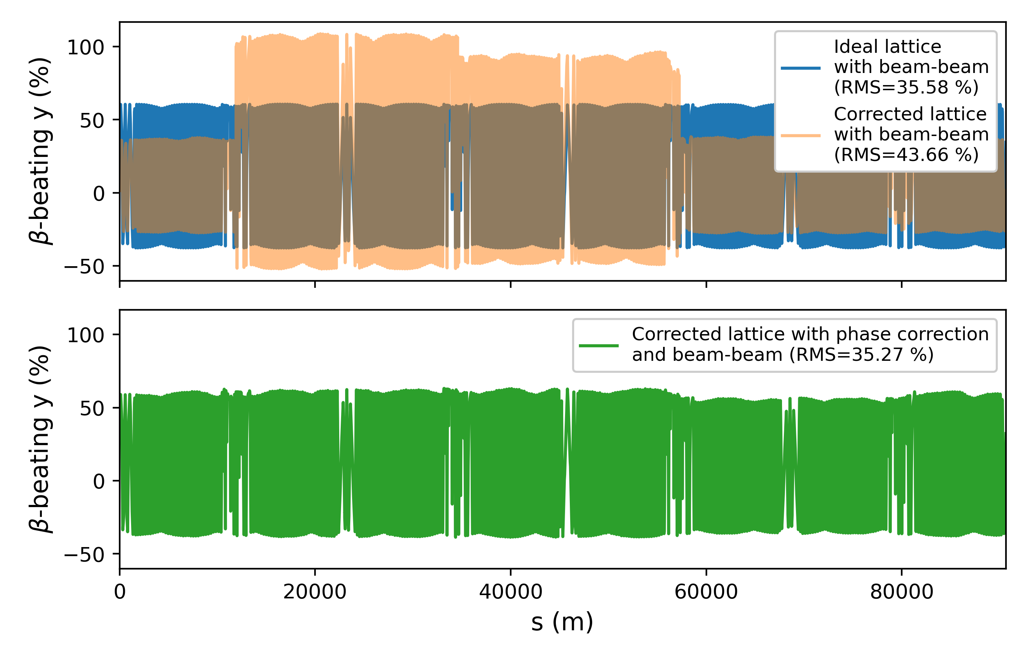
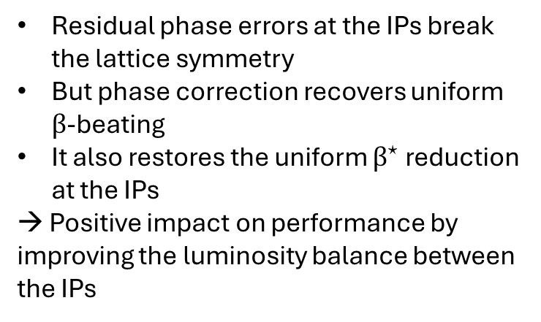
V. Impact on Performance
A first attempt of restoring the nominal optics in the lattices with beam-beam effects:
by correcting the phase advance between IPs on top of the global correction
using certain trim quadrupoles in the DS regions
Courtesy of T. Prebibaj
Residual phase errors at the IPs break the lattice symmetry
But phase correction recovers uniform $β$-beating
It also restores the uniform $β^{⋆}$ reduction at the IPs
→ Positive impact on performance by improving the luminosity balance between the IPs

Slide 24
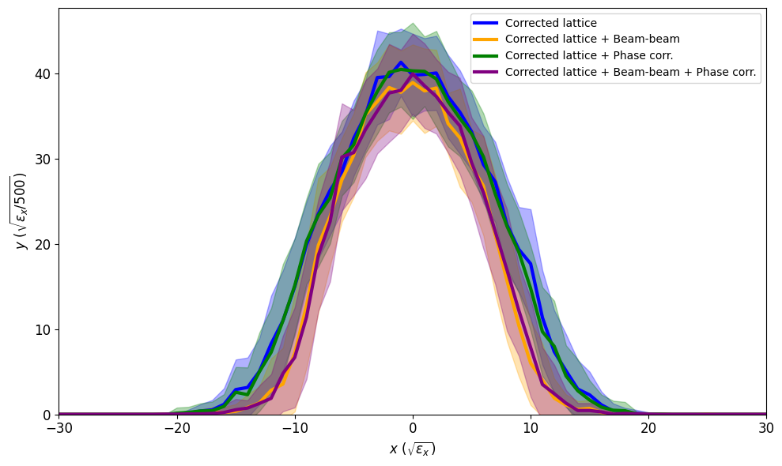
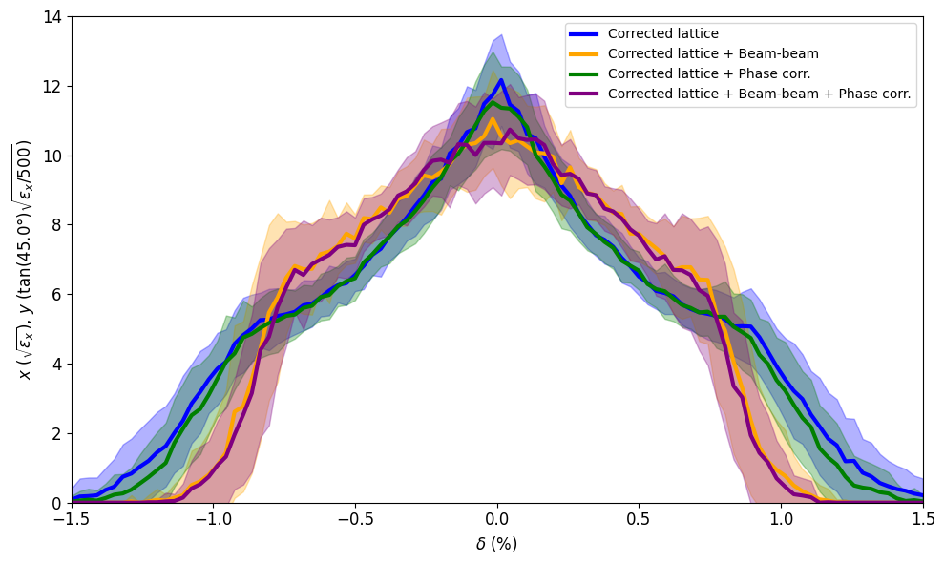
V. Impact on Performance
Tracking for 2500 turns (across 50 different seeds) to determine the “stability region” of the lattice
DA = Dynamic Aperture
MA = Momentum Acceptance

Slide 25
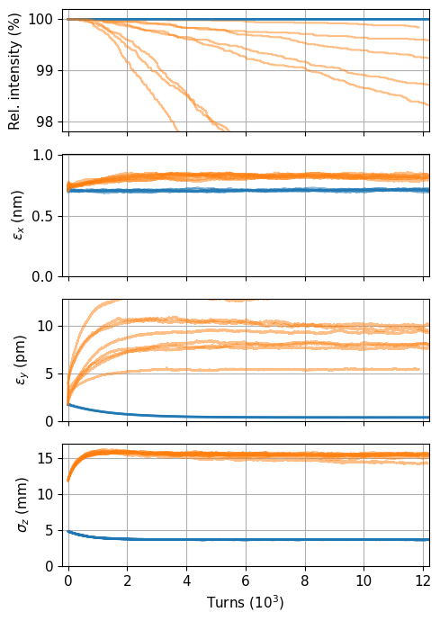
V. Impact on Performance
Blue: w/o beam-beam
Orange: with beam-beam
Tracking of 10 000 particles (8 seeds)

Slide 26
Summary and Outlook
SUMMARY
Development of an imperfections model of the LCC lattice for the FCC-ee
Implementation of a global orbit and optics correction procedure
Generation of 500 corrected lattices
Statistics analysis of various optics parameters around the ring
Introduction of beam-beam effects and investigation of their impact
Analysis of the impact on collider performance via DA/MA scans and tracking
OUTLOOK
Development of local correction knobs to counteract the distortions arising from beam-beam effects
Comparison of different algorithms for the global correction procedure (SVD, MICADO) and further optimisation
Use of tracking to study correlations between different performance metrics and lattice properties

Slide 27
Thank you!

Slide 28
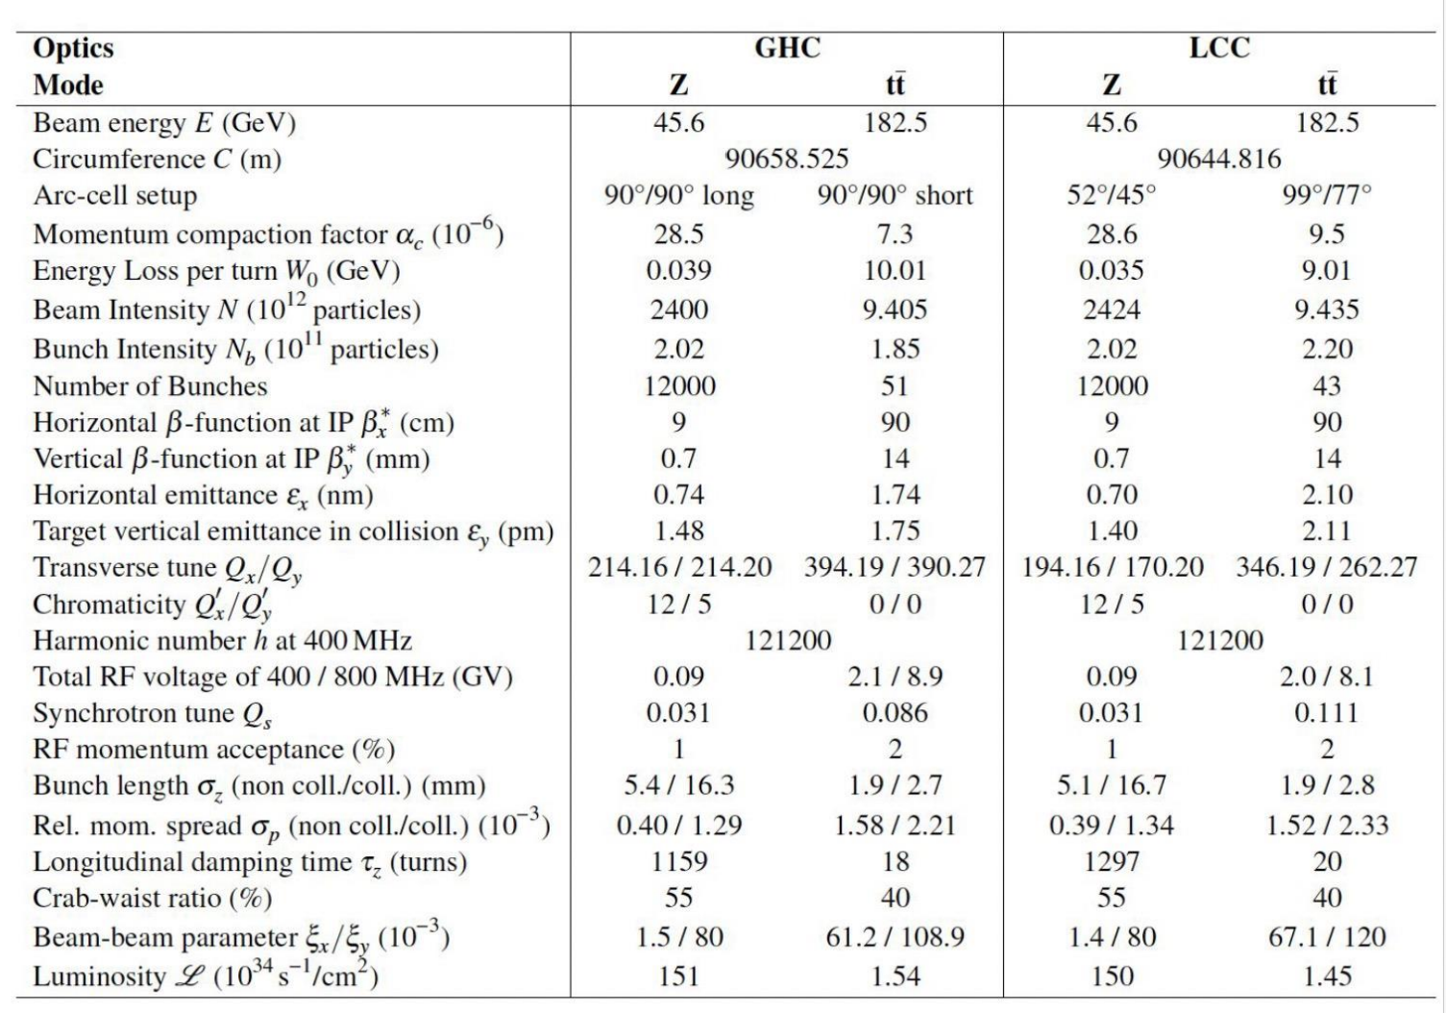
Parameter table of the LCC lattice

Slide 29
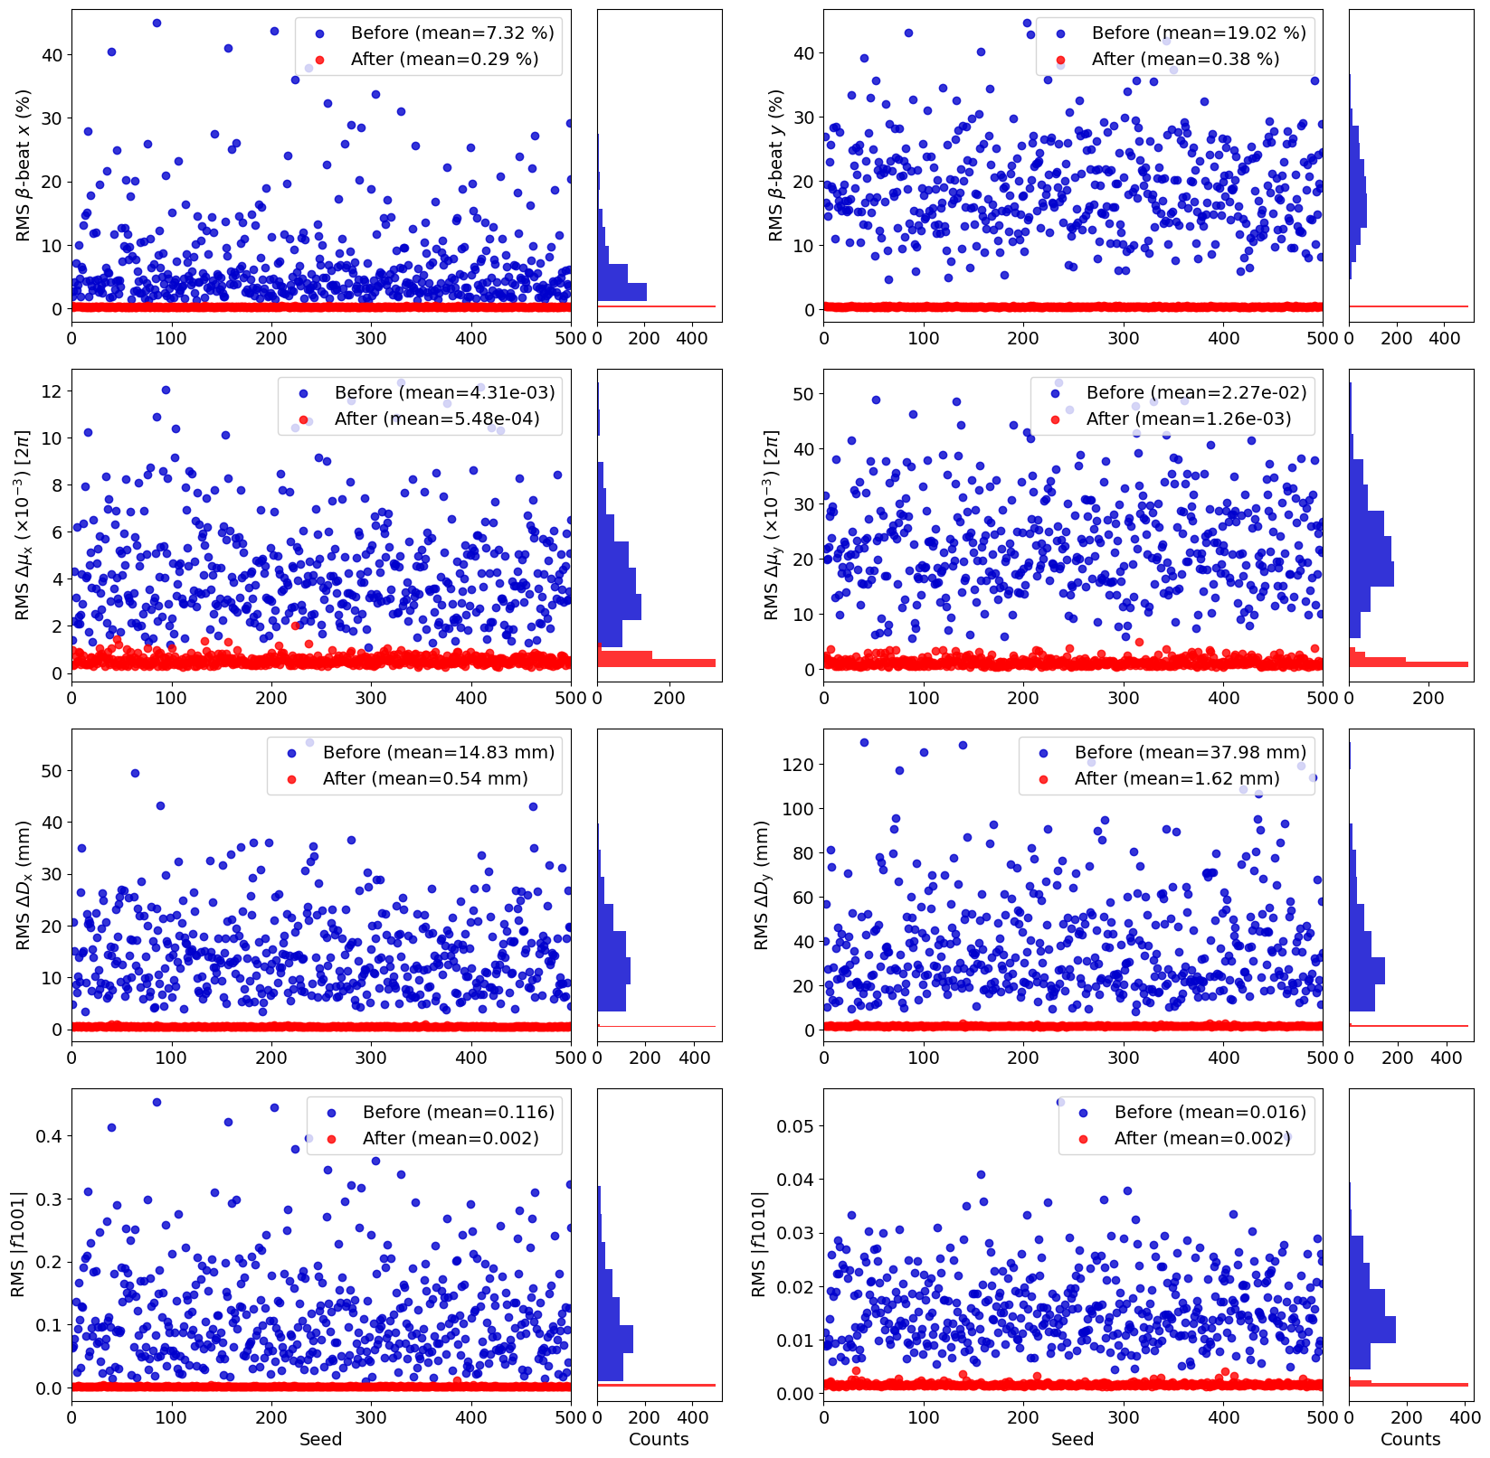
Statistics analysis on 500 corrected lattices (without log-scale)

Slide 30
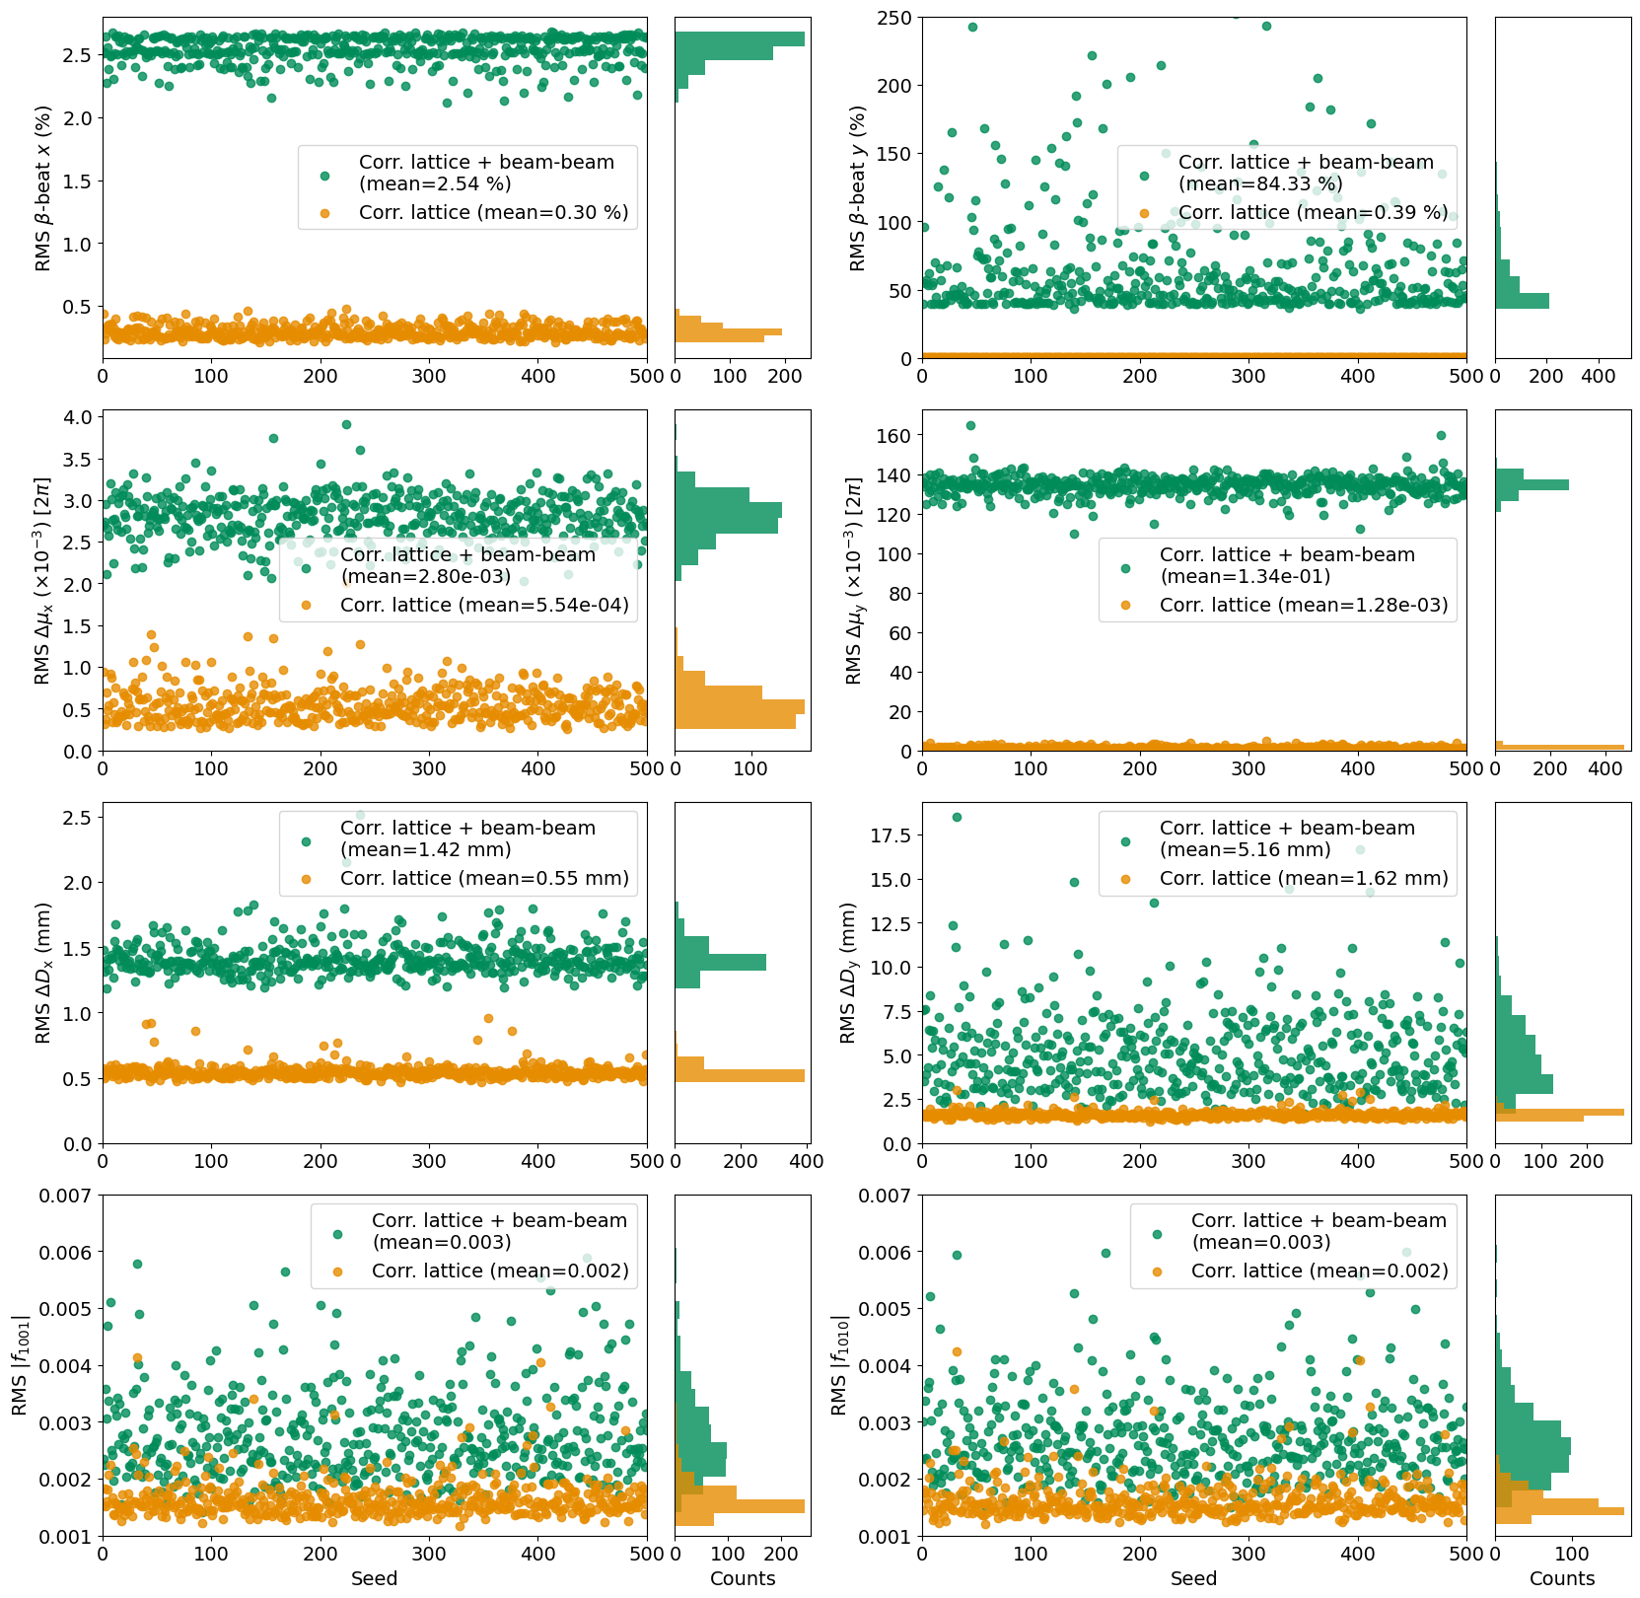
Statistics analysis on 500 corrected lattices with beam-beam effects (without log-scale)

Slide 31
