Slide 1



Parametrization of Electron Cloud Buildup Models
Adam Furman Lotta Mether, Luca Sabato, Tatiana Pieloni, Mike Seidel
LPAP Activity Meeting 07 May 2026

Slide 2
Overview
A brief overview of electron clouds.
Electron cloud buildup simulations, using PyECLOUD.
Modelling electron cloud buildup.
Predicting model parameter values a priori.
Observations, limitations, and strategies.
Tools you can use.

Slide 3
A brief overview of electron clouds
Electron clouds occur when the conditions inside a particle accelerator facilitate the buildup of electrons over time.
Beam Chamber
Synchrotron Radiation

Slide 4
A brief overview of electron clouds
Some amount of initial electrons (from synchrotron radiation or residual gas collisions) is present in the beam chamber.
Beam Chamber
Synchrotron Radiation

Slide 5
A brief overview of electron clouds
The electrons are kicked by the electromagnetic force of a passing bunch and hit the beam chamber wall.
Beam Chamber
Synchrotron Radiation

Slide 6
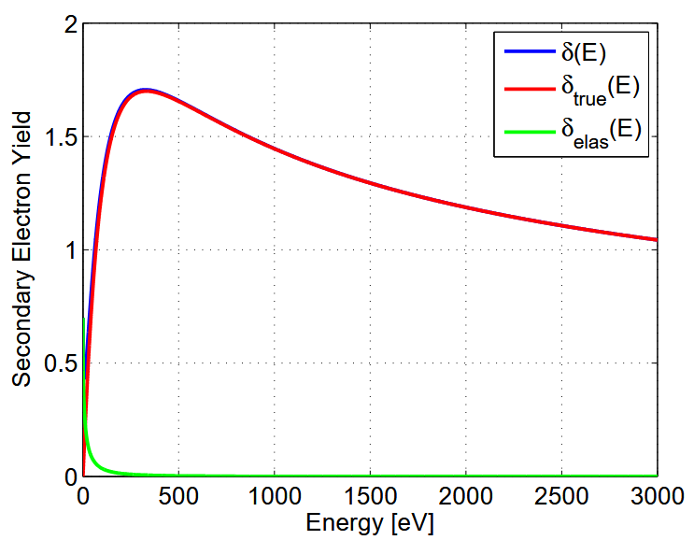
A brief overview of electron clouds
The secondary electron yield (SEY) curve, a material property, defines secondary electron emission based on incident energy.
Image: Giovanni Iadarola

Slide 7

A brief overview of electron clouds
Some (low energy) electrons are reflected off the wall. Higher energy electrons trigger the emission of true secondaries.
Image: Giovanni Iadarola

Slide 8
A brief overview of electron clouds
Image: Giovanni Iadarola

Slide 9
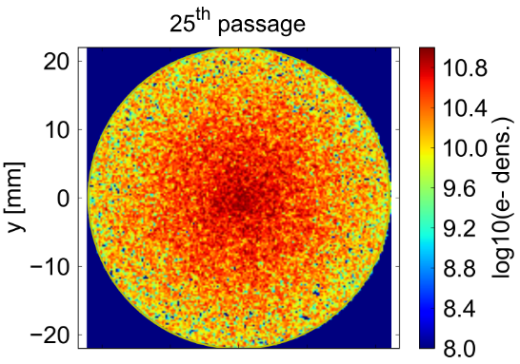
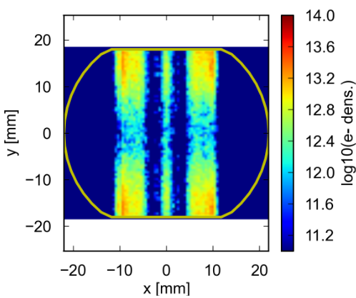
A brief overview of electron clouds
Magnetic fields influence the shape of the electron cloud.
Images: Giovanni Iadarola

Slide 10
A brief overview of electron clouds
The cloud saturates when its field is strong enough to prevent the extraction of new electrons at the surface.
When? Depending on…
The bunch intensity.
The secondary electron yield curve (material properties).
Photoemission from synchrotron radiation.
Magnetic field type and strength.

Slide 11
Electron cloud buildup simulations
Bunch Intensity
Filling Scheme
PyECLOUD
Magnets
Secondary Electron Yield

Slide 12
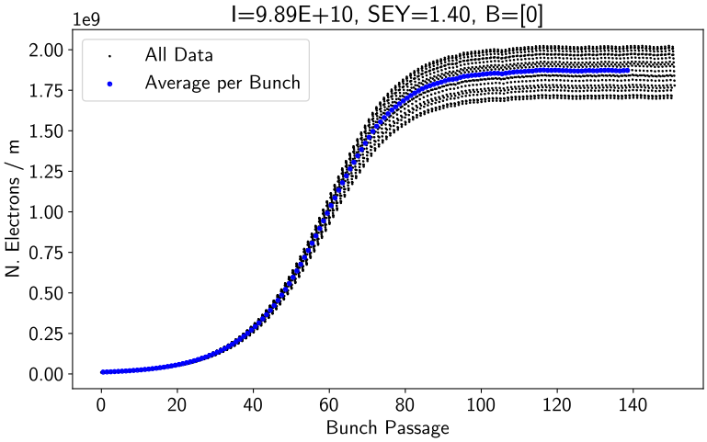
Electron cloud buildup simulations
PyECLOUD
One of the simulation outputs is the electron cloud linear density over time – this is what we will focus on modelling.

Slide 13
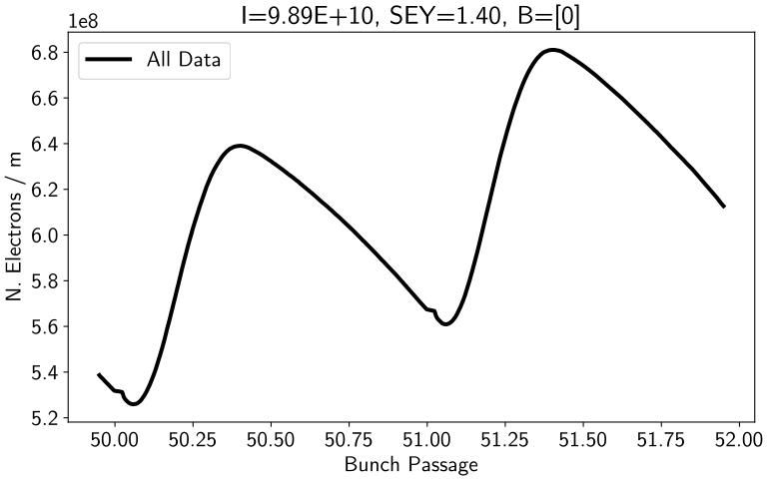
Electron cloud buildup simulations
There is one oscillation per bunch passage.

Slide 14
Electron cloud buildup simulations
Intensity
SEY
We often perform parameter sweeps to study e-cloud buildup in a new machine configuration.

Slide 15
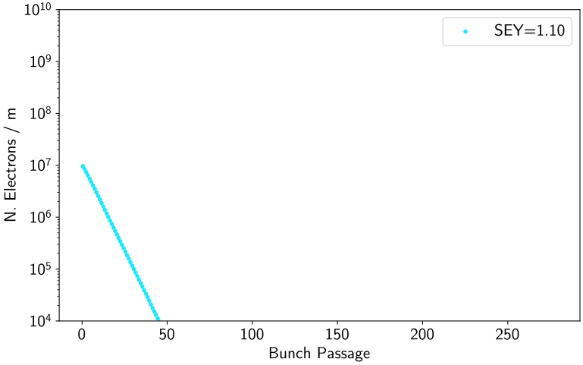
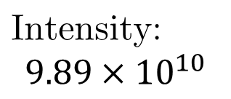
Sensitivity to parameters: SEY
A low SEY value can lead to the electron cloud decaying. Note, here SEY > 1.0

Slide 16
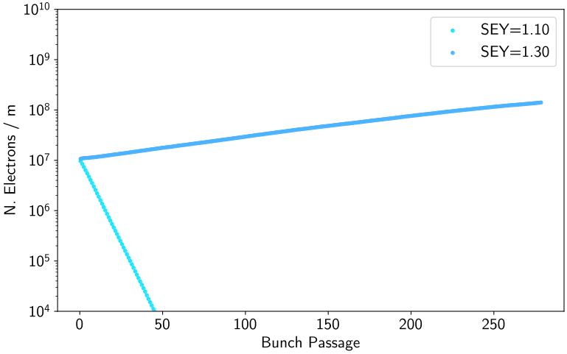
Sensitivity to parameters: SEY
The buildup can be quite slow.

Slide 17
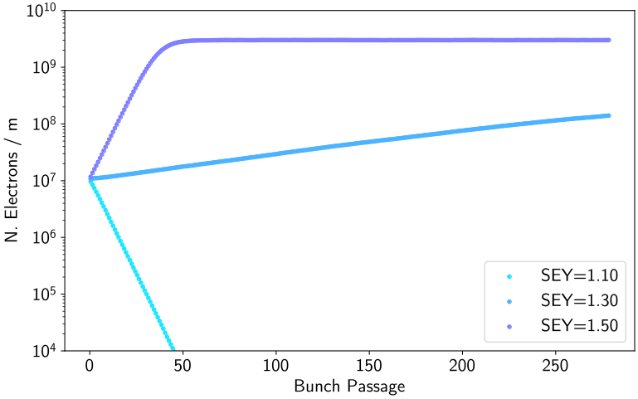
Sensitivity to parameters: SEY
The characteristic shape of a buildup curve looks a lot like a “logistic” or “sigmoid” curve.

Slide 18
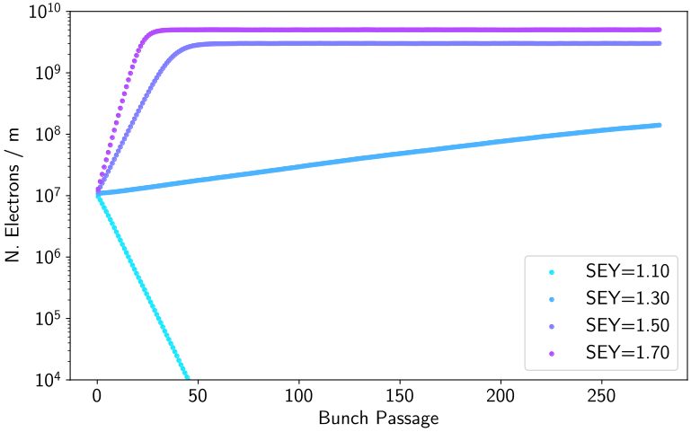
Sensitivity to parameters: SEY
Note that both the saturation density and the time to reach it change as a function of SEY.

Slide 19
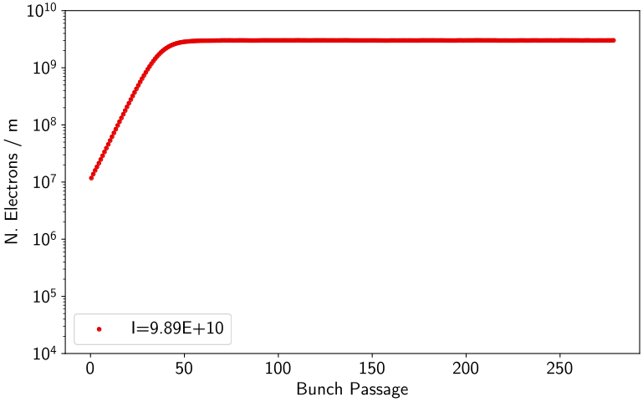

Sensitivity to parameters: Intensity
Let’s start with one of the curves we already saw.

Slide 20
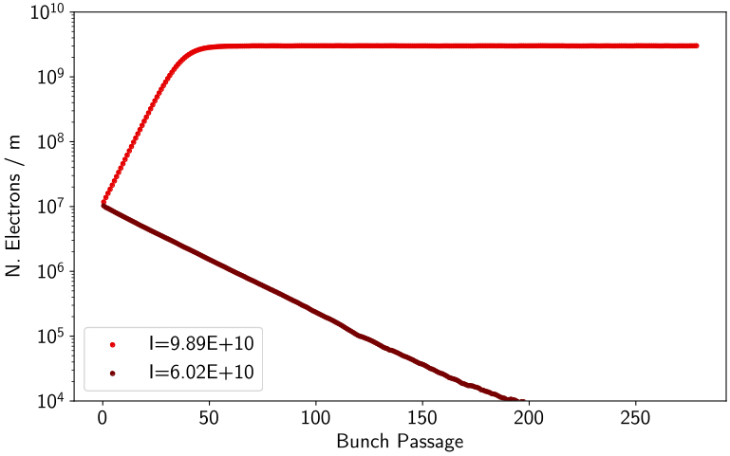
Sensitivity to parameters: Intensity
Stepping down in intensity, we again fail to build up.

Slide 21
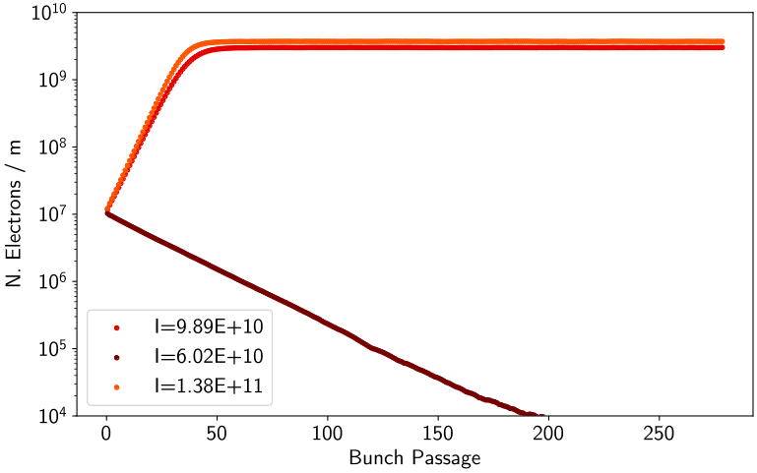
Sensitivity to parameters: Intensity
Stepping up, the saturation density increases.

Slide 22
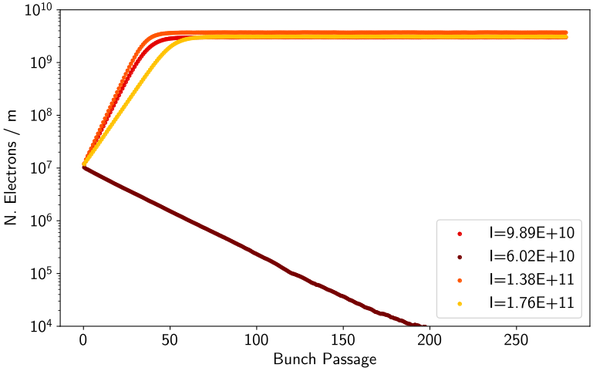
Sensitivity to parameters: Intensity
We increase the intensity again – and the saturation density decreases! There must exist some critical intensity…

Slide 23
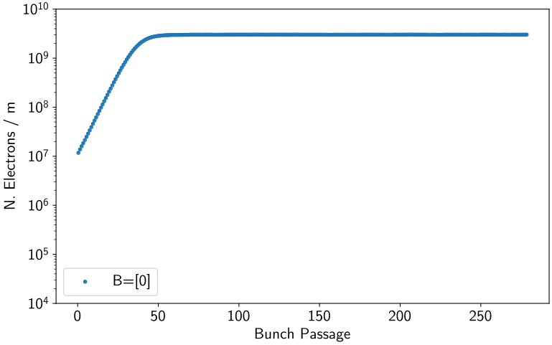
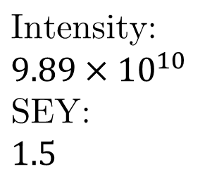
Sensitivity to parameters: Magnets
So far, we have only shown plots in drift sections.

Slide 24
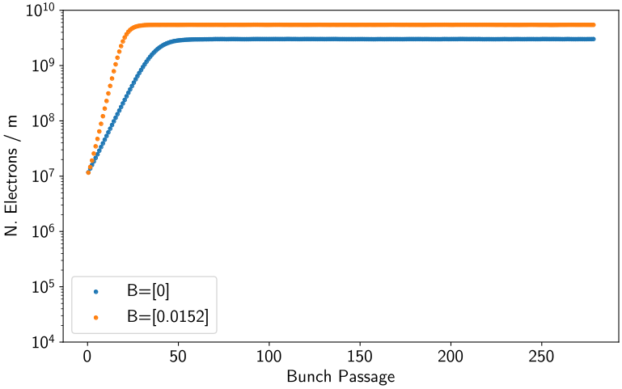
Sensitivity to parameters: Magnets
In a dipole, the saturation density increases.

Slide 25
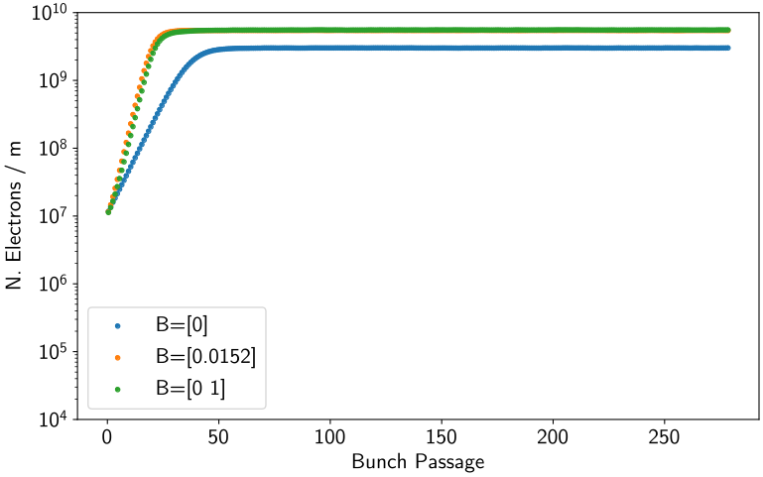
Sensitivity to parameters: Magnets
… as in a quadrupole.

Slide 26
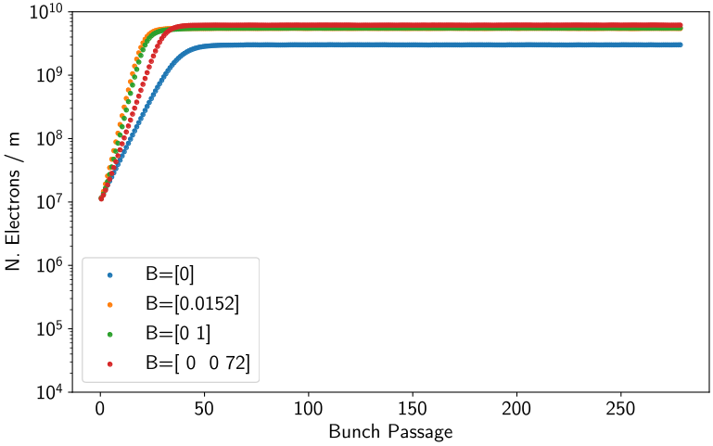
Sensitivity to parameters: Magnets
In a sextupole, there is a noticeable effect on the time to reach saturation as well as the saturation density.

Slide 27
Modelling buildup curves
Desired Features
Saturation.
Independent of initial N.
Increase with SEY.
Critical (worst) intensity.
Response to magnets.
Can we reduce the buildup curve data to a (simple) model? Will such a model capture the trends seen in parameter sweeps?

Slide 28
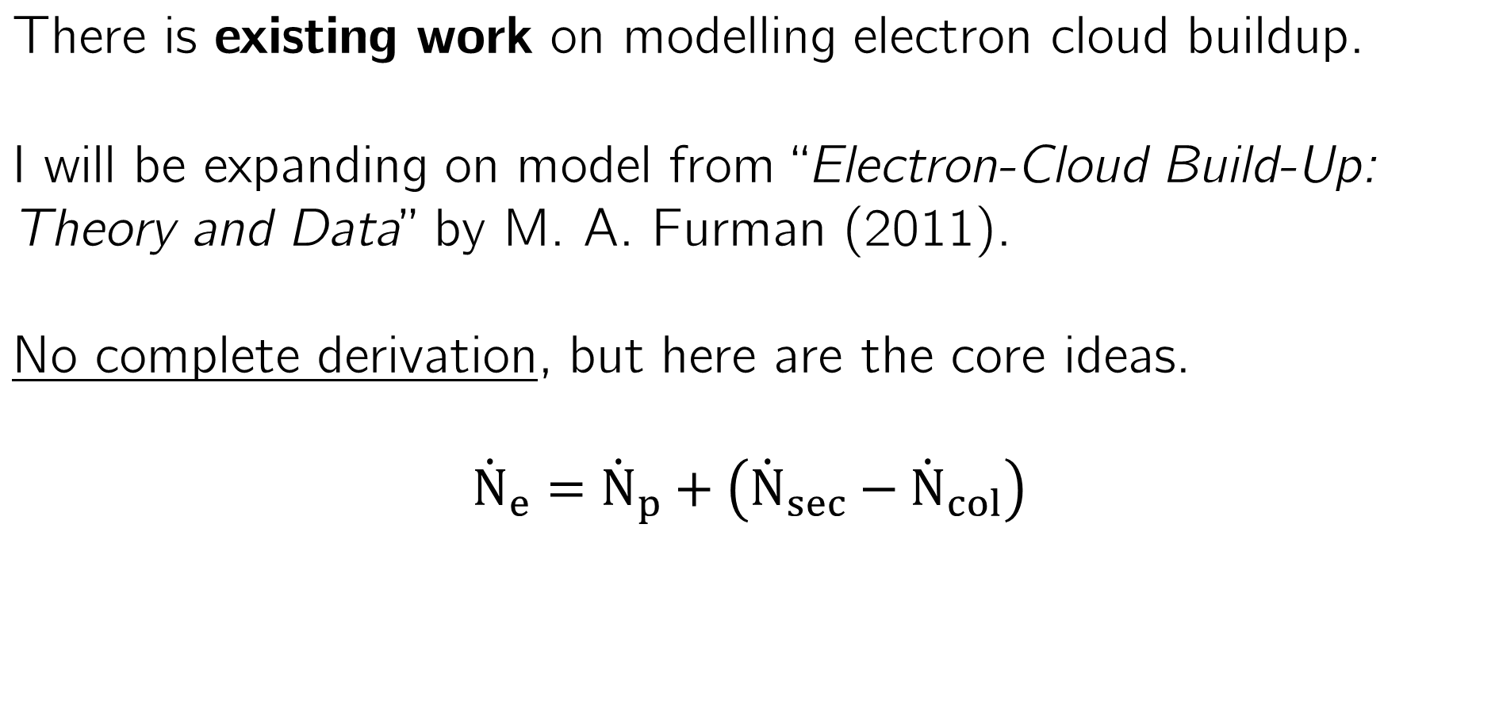
Modelling buildup curves
Total change in N. of e-
Rate of primary e- (photoemission)
Rate of secondary e- (SEY)
Rate of collisions with walls.

Slide 29
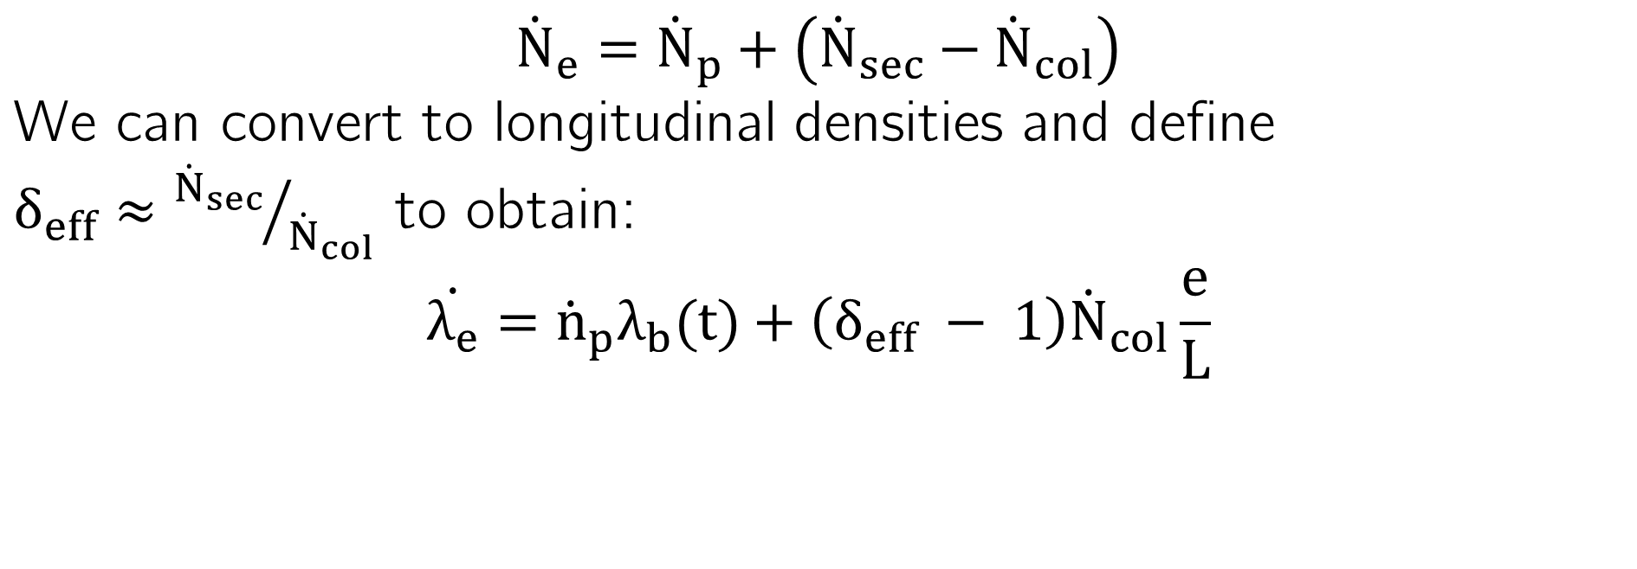
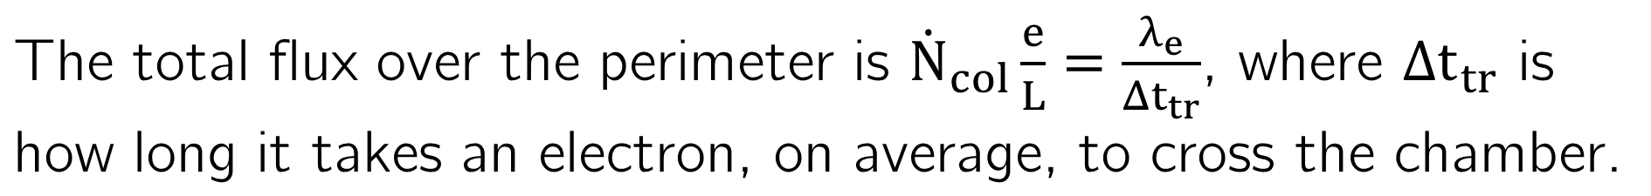
Modelling buildup curves
Beam density.
Flux over whole perimeter

Slide 30
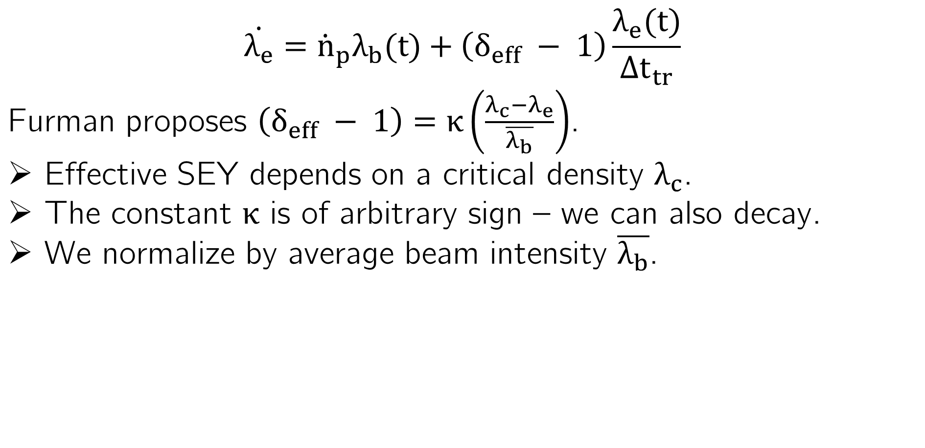
Modelling buildup curves
This automatically limits the model to describing average density within each bunch passage.

Slide 31
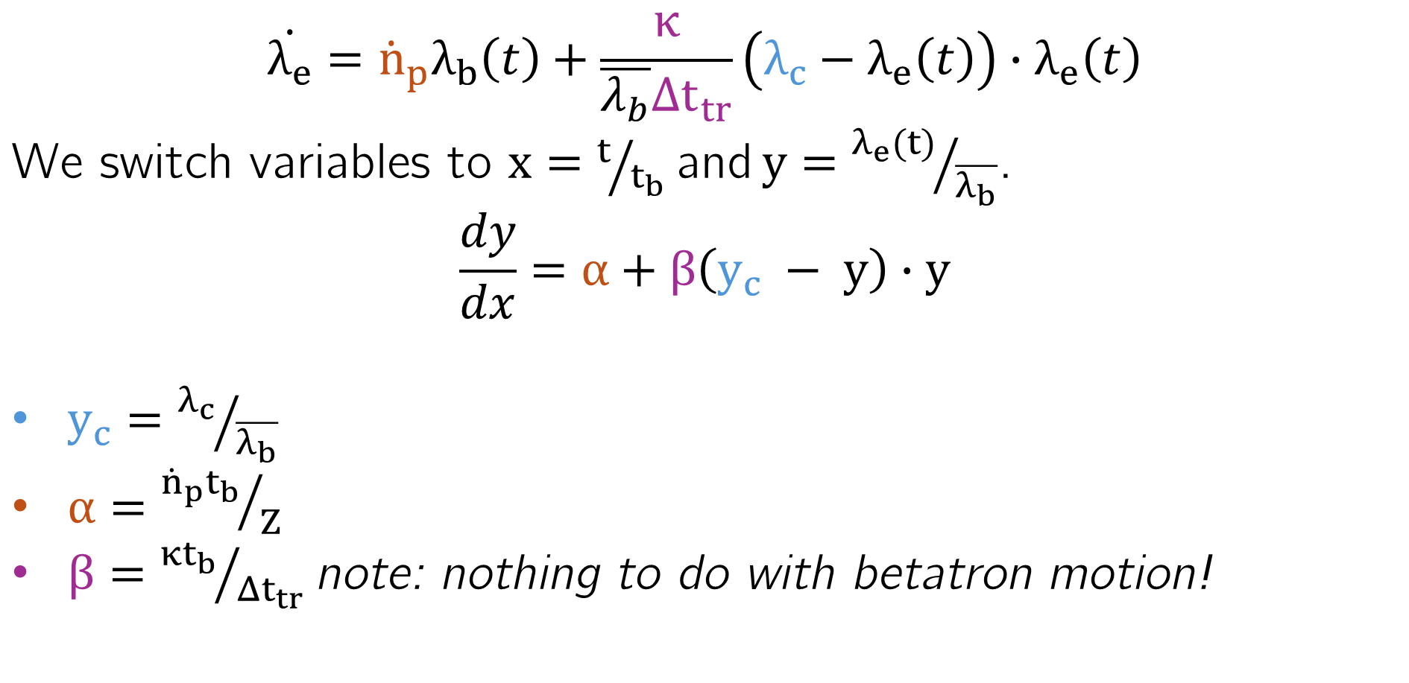
Modelling buildup curves

Slide 32
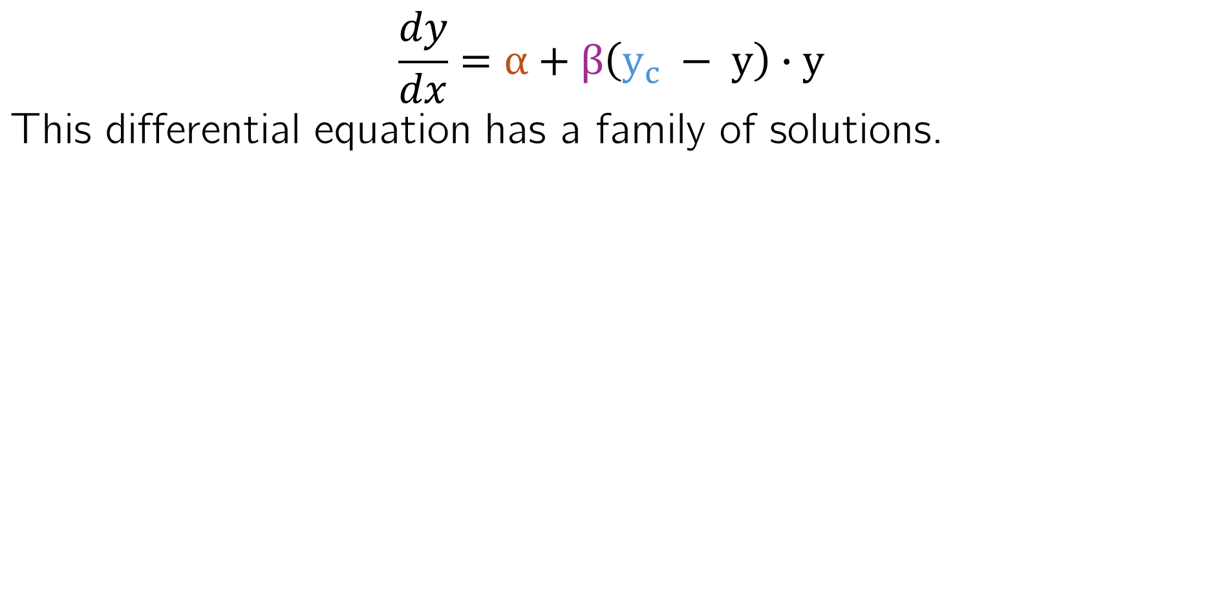

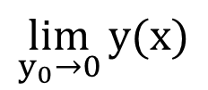
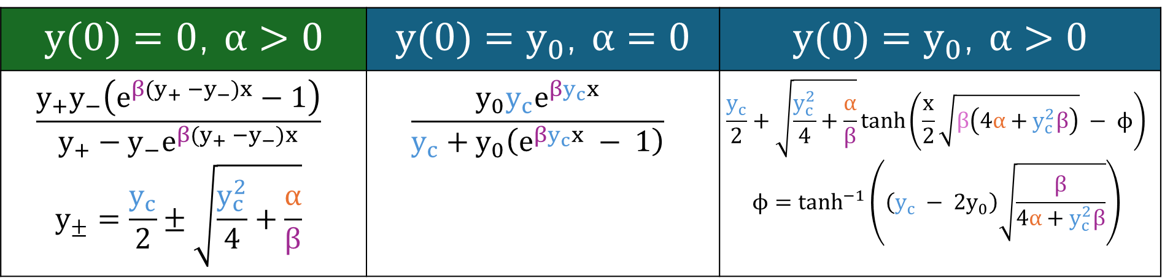
Modelling buildup curves

Slide 33
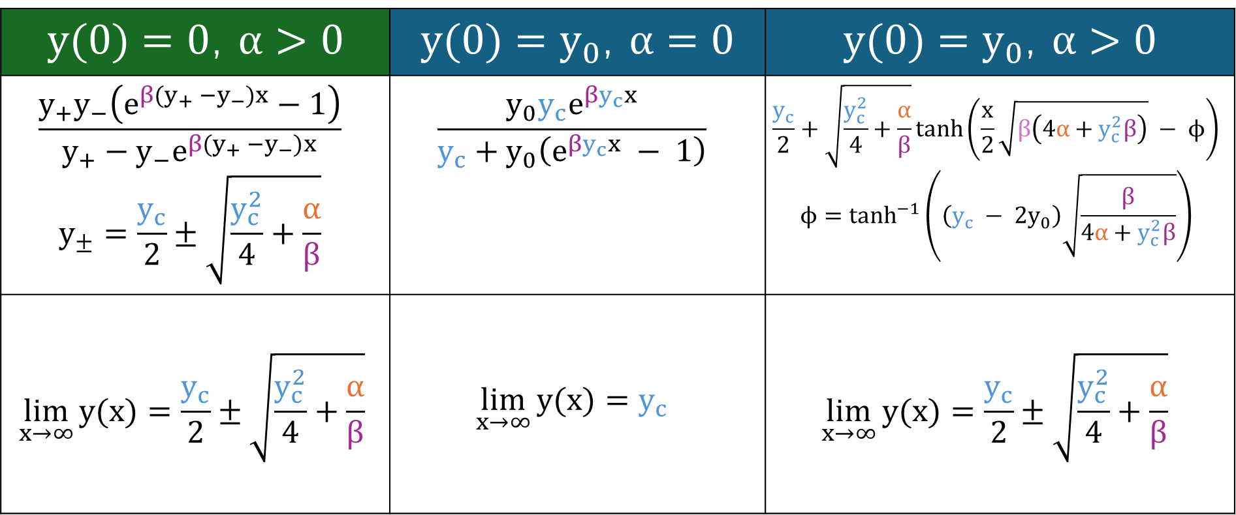
Modelling buildup curves
No dependance on initial density!

Slide 34
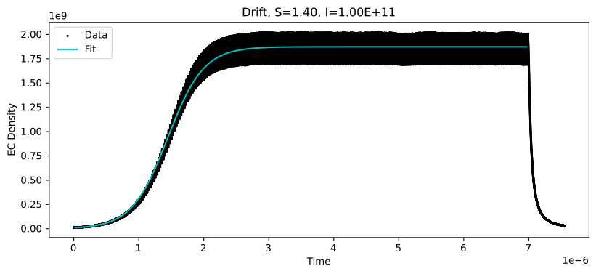

Modelling buildup curves
The model captures the average density well.

Slide 35
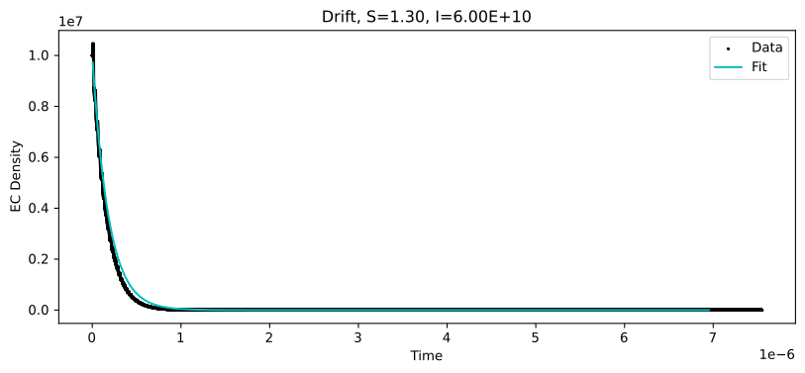

Modelling buildup curves
… and it works even when we don’t build up.

Slide 36
Modelling buildup curves
… and it works even when we don’t build up.

Slide 37
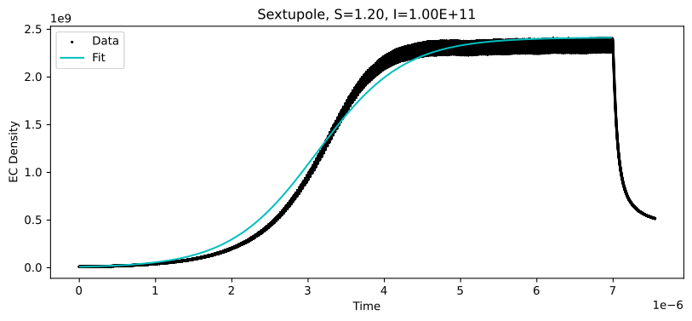
Modelling buildup curves
For magnets, the curve fit does not work as well (expected).

Slide 38
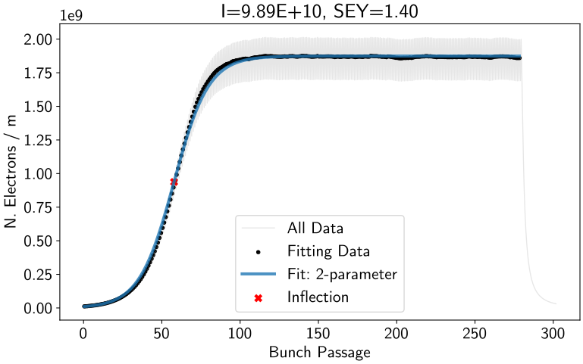
Modelling buildup curves
Desired Features
✅Saturation
✅Independent of initial N.
❓Increase with SEY.
❓Critical (worst) intensity.
🚫Response to magnets.
To understand dependance on SEY and intensity, we need to turn a parameter sweep into predictive models.

Slide 39
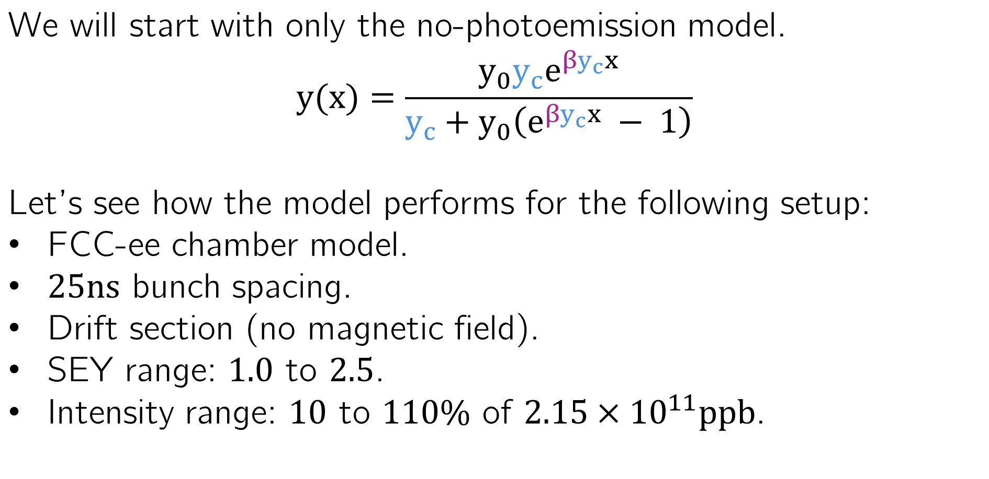
Predictive models

Slide 40
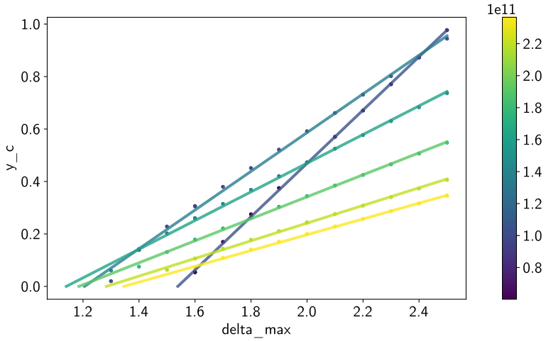
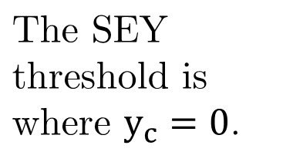

Predictive models: Critical Intensity
The slope of the correlation is highest for low intensities.

Slide 41
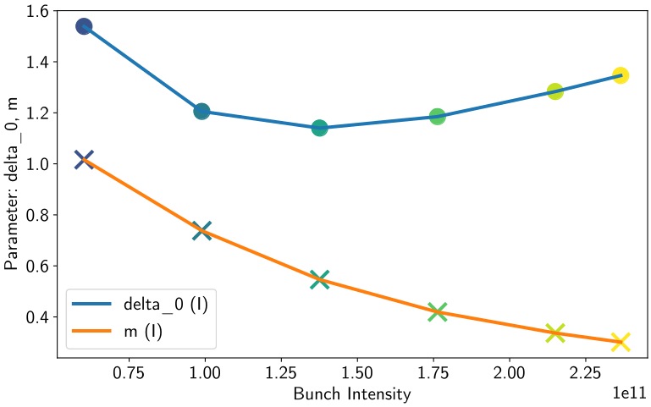
Predictive models: Critical Intensity

Slide 42
Predictive models: Critical Intensity
As intensity increases, its effect on the saturation density diminishes.
At some critical intensity, buildup occurs for the lowest SEY.

Slide 43
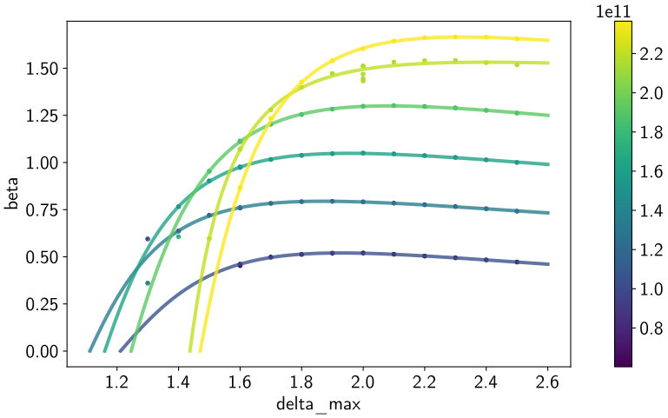
Predictive models: Beta
These shapes look familiar(?)

Slide 44
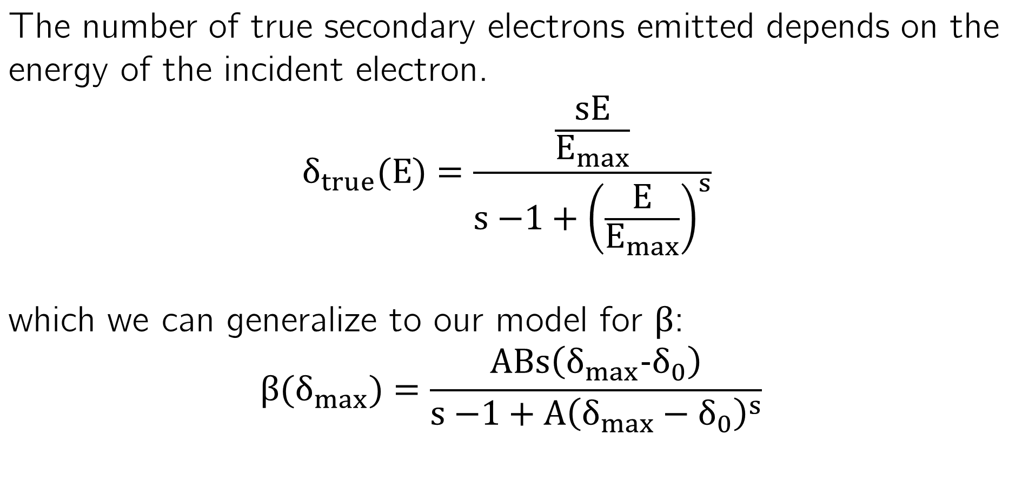
Aside: the SEY function

Slide 45
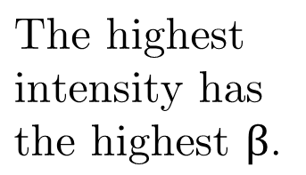
Predictive models: Beta
For low intensities, there are not many points in the “steep” region.

Slide 46
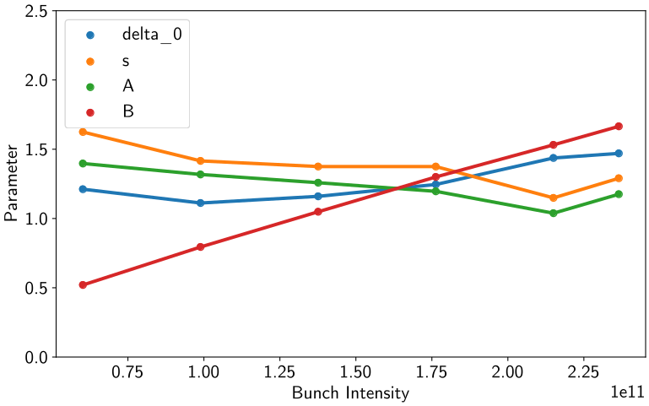
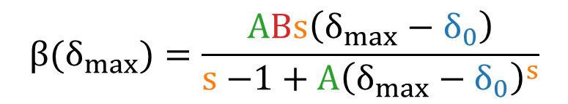
Predictive models: Beta
The other parameters have less clear, possibly linear trends.
The scale factor B of the function increases with intensity.

Slide 47
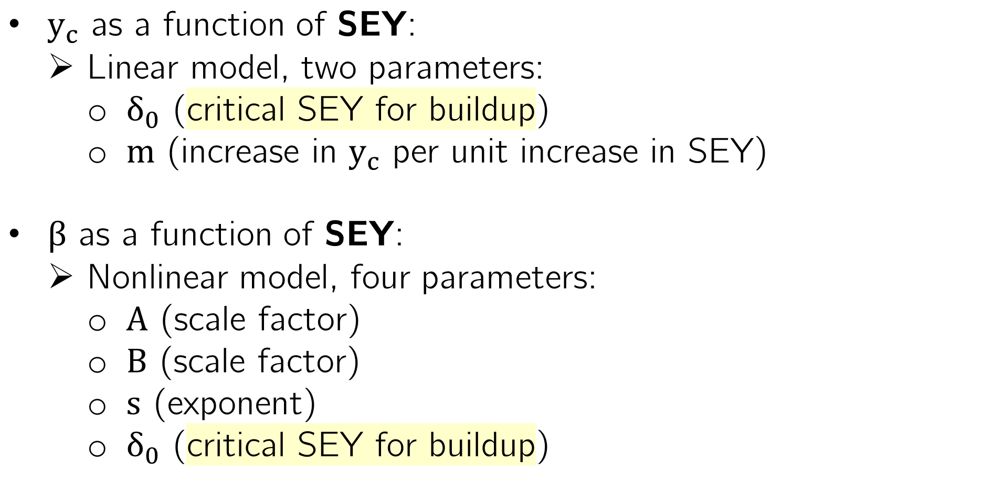
Summary of predictive models

Slide 48
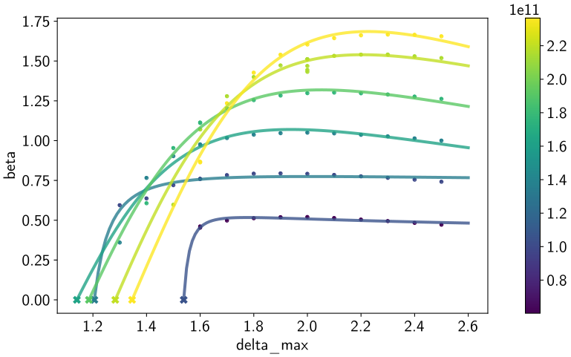
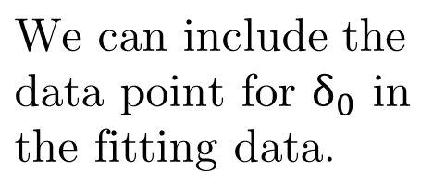
Predictive models: Beta
Visually, the quality of some fits appears to degrade.

Slide 49
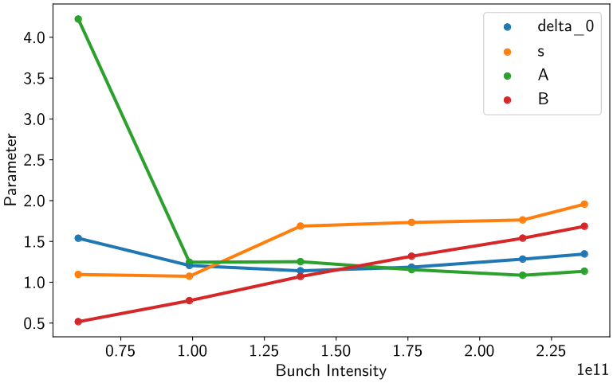
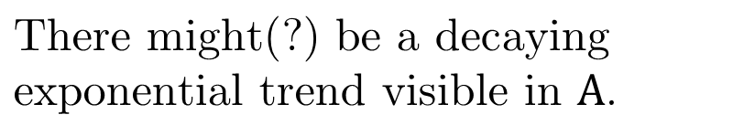

Predictive models: Beta
We largely still see the same behavior of the parameters.
However, now we only really have three new parameters.

Slide 50
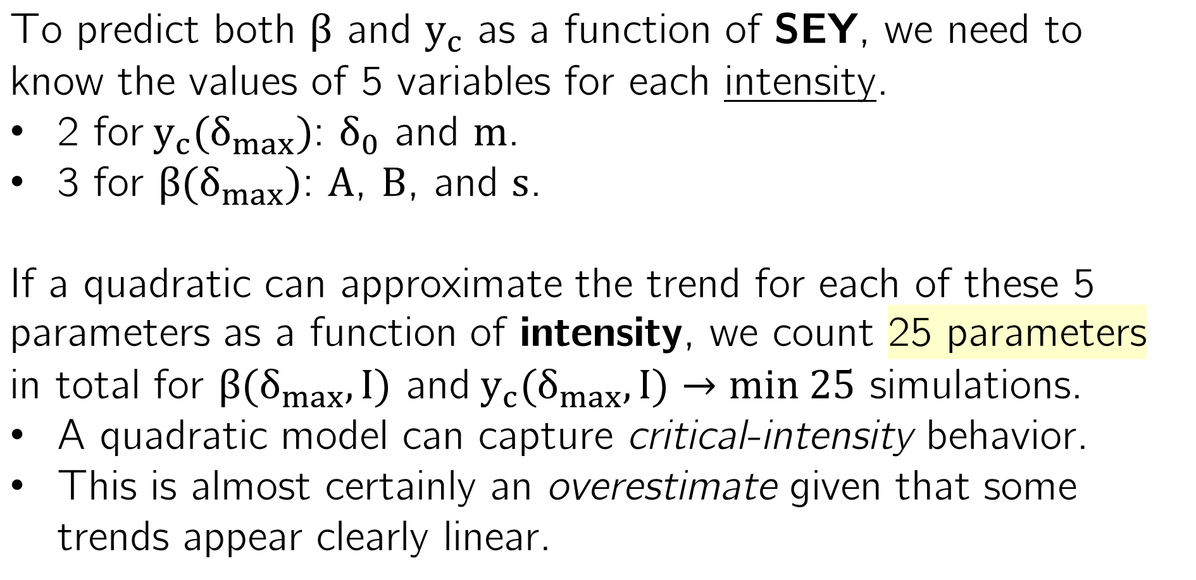
Counting parameters

Slide 51
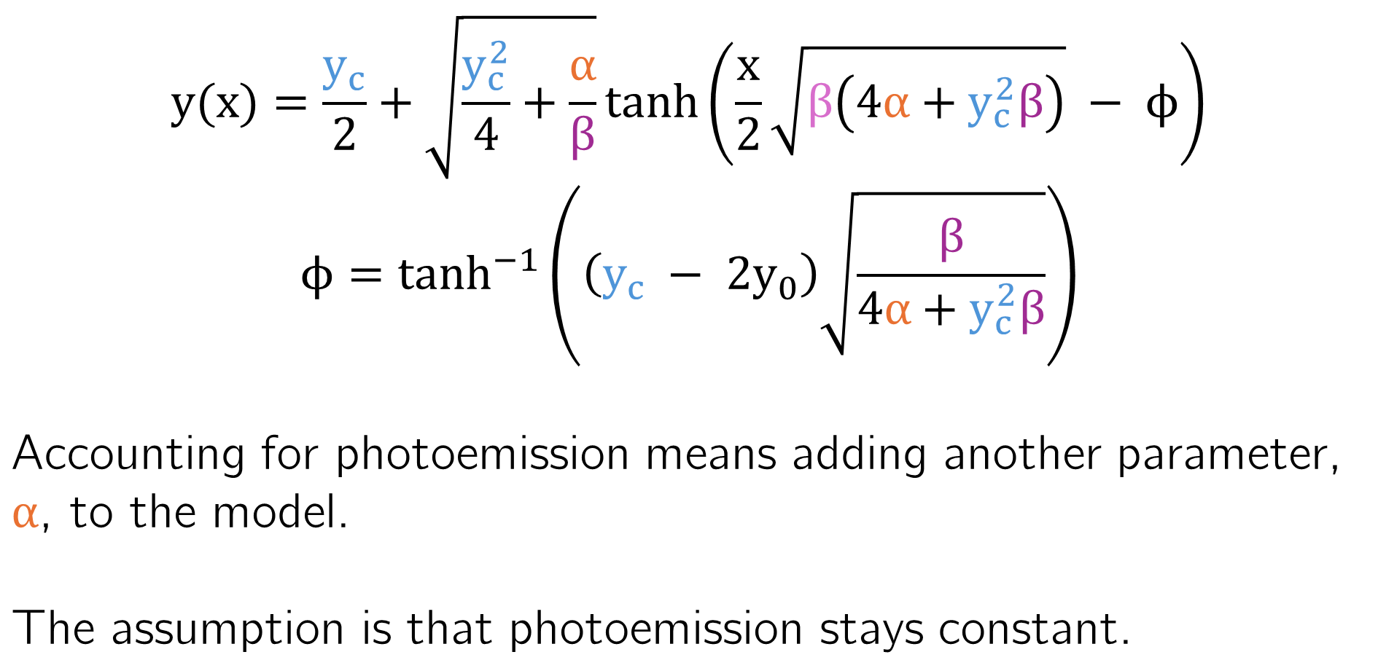
Including photoemission

Slide 52
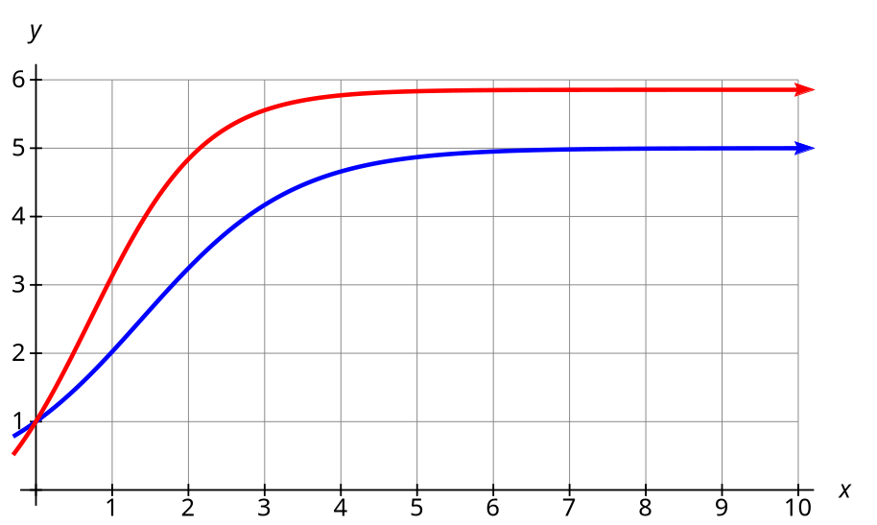
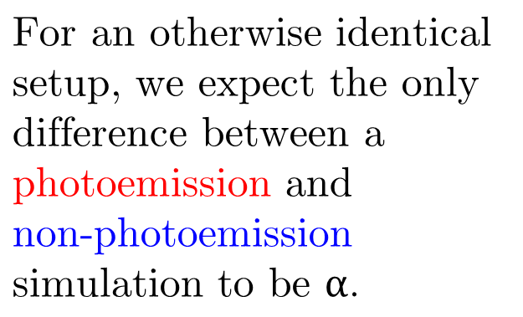
Including photoemission

Slide 53


Including photoemission

Slide 54


Including photoemission

Slide 55



Prediction correct.

Slide 56

Simulations that build up slowly are more sensitive to photoelectrons.
May be another instance of “critical intensity” behavior.
Photoemitted electrons are a tiny fraction of total.
Increases the complexity of predicting simulations with photoemission.

Slide 57


Photoemission distributions
Absorber structures in the FCC-ee lattice.

Slide 58

Photoemission distributions
LCC lattice synchrotron radiation flux distributions.

Slide 59

Evaluating Filling Schemes
The model easily compares different design options.

Slide 60
In summary
We understand how different parameters can change electron cloud behavior.
We adopt and expand an existing model for average electron cloud density over time.
We fit this model successfully to simulations.

Slide 61
In summary
We can predict our model parameters from simulation inputs…
… as a function of both SEY and bunch intensity, finding clear trends.
And we understand how photoemission can be added and when it has a strong effect.

Slide 62



But there are some limitations.
We know the model cannot fully account for magnetic fields (but a fix is coming soon!).
We don’t capture any information about the spatial distribution of electrons.

Slide 63

Outlook

Slide 64


Tools developed
Developed the Electron Cloud Analysis package.
Generating, running, curve fitting, and working with PyECLOUD simulations made much easier through a common API.
Transforms hundreds of individual output files into a single database which can easily be queried.
https://github.com/furmada/Electron-Cloud-Analysis

Slide 65
Thank you.
LPAP Activity Meeting 07 May 2026

