Slide 1

Beam-beam and optics studies in FCC-ee
T. Prebibaj
In collaboration with:
K. Andre, X. Buffat, H. Barotsik, M. Jebramcik,
J. Keintzel, S. Kostoglou, E. H. Maclean, T. Pieloni,
P. Raimondi, L. Sievert, K. Skoufaris, R. Tomas,
W. Van Goethem, L. Van Riesen-Haupt, Y. Wu
EPFL-LPAP Activity Meeting
16/04/2026
Work supported by the Swiss Accelerator Research and Technology (CHART)

Slide 2
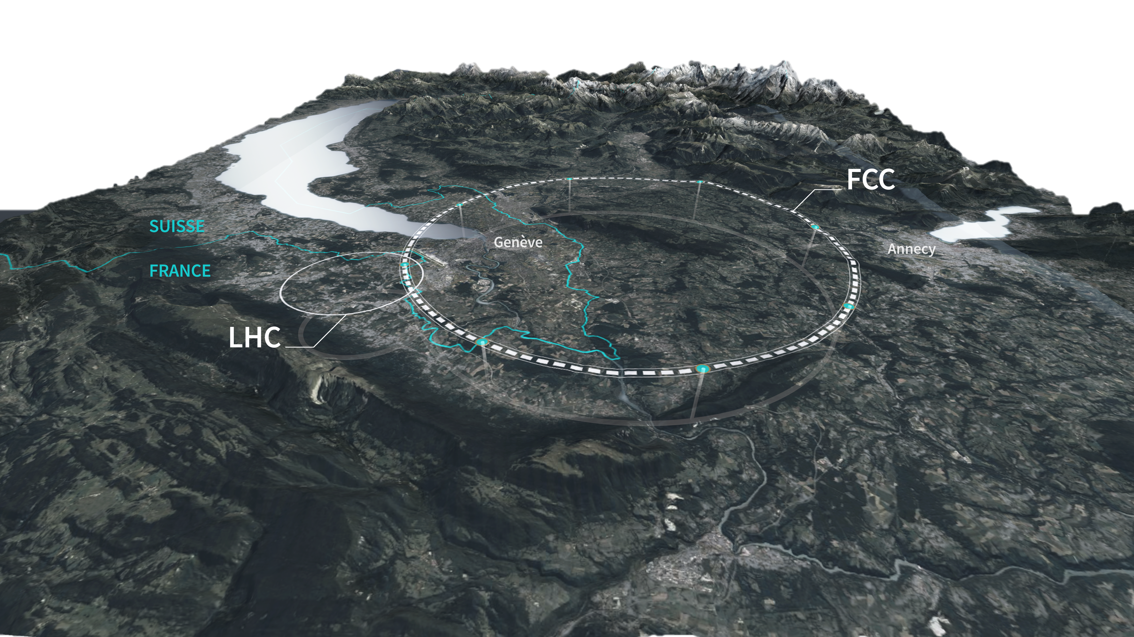
FCC-ee
fcc.web.cern.ch
The Future Circular electron-positron Collider (FCC-ee) is a proposed 90.7 km circumference collider designed to operate at four energies: 45.6 GeV (Z), 80 GeV (WW), 120 GeV (ZH), and 182.5 GeV (ttbar)
Conceptual Design Report published in 2019
Feasibility Study Report in 2025
Decision point expected in 2028.

Slide 3
A very brief overview of relevant beam dynamics concepts

Slide 4
Beam dynamics in FCC-ee
Performance
Beam-beam
Imperfections
Corrections
Radiation
Optics

Slide 5
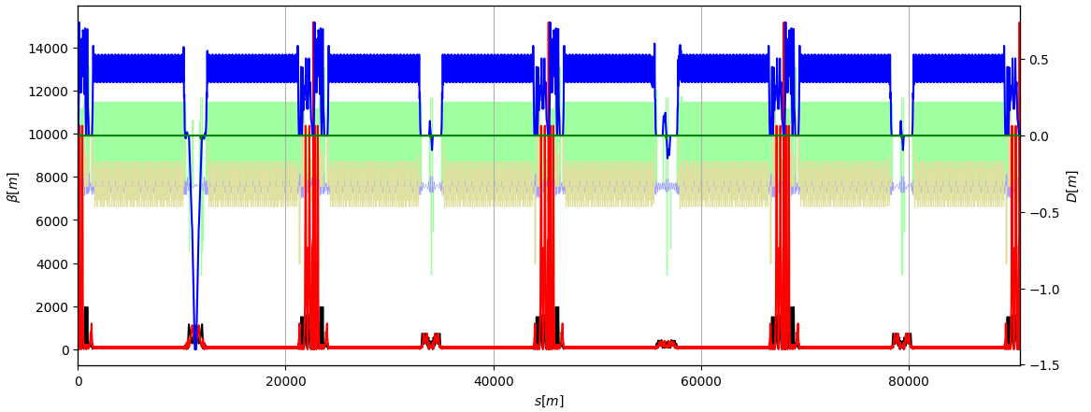
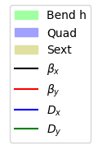
The collider lattice
Performance
Collider lattice is fundamental for all systems (e.g. magnets, insertions, …) & performance.
  Two main variants: GHC (“Global Hybrid Correction”) by K. Oide and LCC (Local Chromaticity Correction) by P. Raimondi.
  A review panel recommended adopting the LCC optics as the new baseline (read advantages).
Beam-beam
Imperfections
LCC v106.2.1 at Z
Corrections
Radiation
Optics

Slide 6
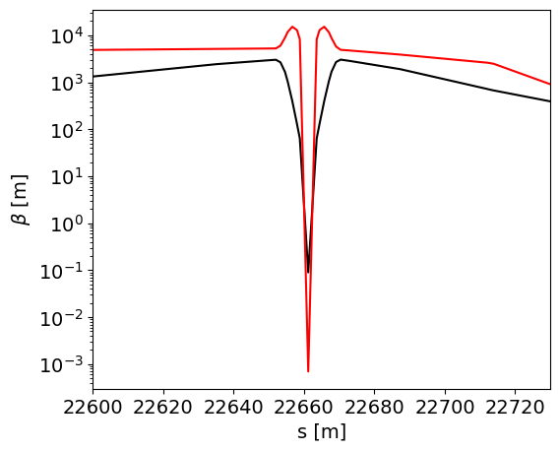

The collider lattice
Performance
Collider lattice is fundamental for all systems (e.g. magnets, insertions, …) & performance.
  Two main variants: GHC (“Global Hybrid Correction”) by K. Oide and LCC (Local Chromaticity Correction) by P. Raimondi.
  A review panel recommended to adopt the LCC optics as the new baseline (read advantages).
Beam-beam
Imperfections
LCC v106.2.1 at Z
Corrections
$β_{x}^{∗}=9$ cm
$β_{y}^{∗}=0.7$ mm
Radiation
Optics

Slide 7
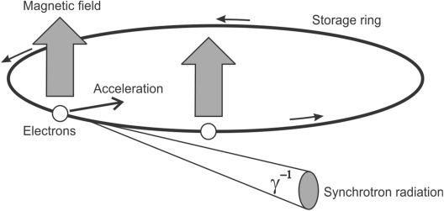
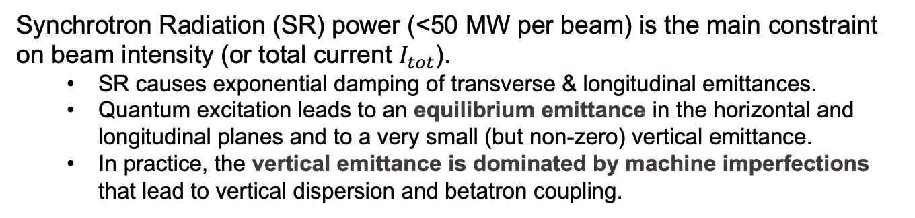
Synchrotron Radiation
Performance
Synchrotron Radiation (SR) power (<50 MW per beam) is the main constraint on beam intensity (or total current $I_{tot}$).
  SR causes exponential damping of transverse & longitudinal emittances.
  Quantum excitation leads to an equilibrium emittance in the horizontal and longitudinal planes and to a very small (but non-zero) vertical emittance.
  In practice, the vertical emittance is dominated by machine imperfections that lead to vertical dispersion and betatron coupling.
Beam-beam
Imperfections
Corrections
Radiation
Image source
Optics

Slide 8
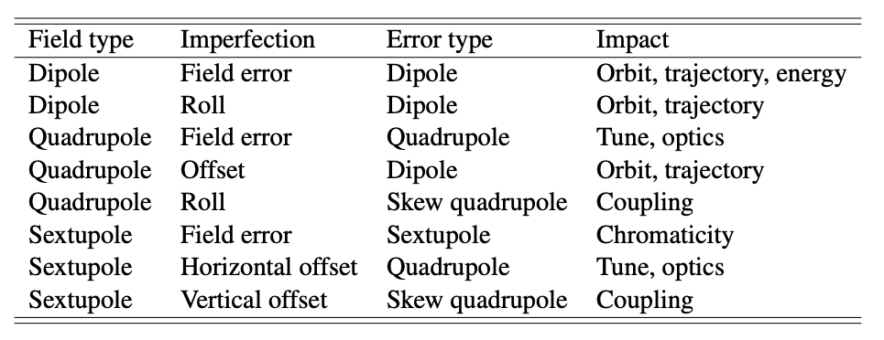
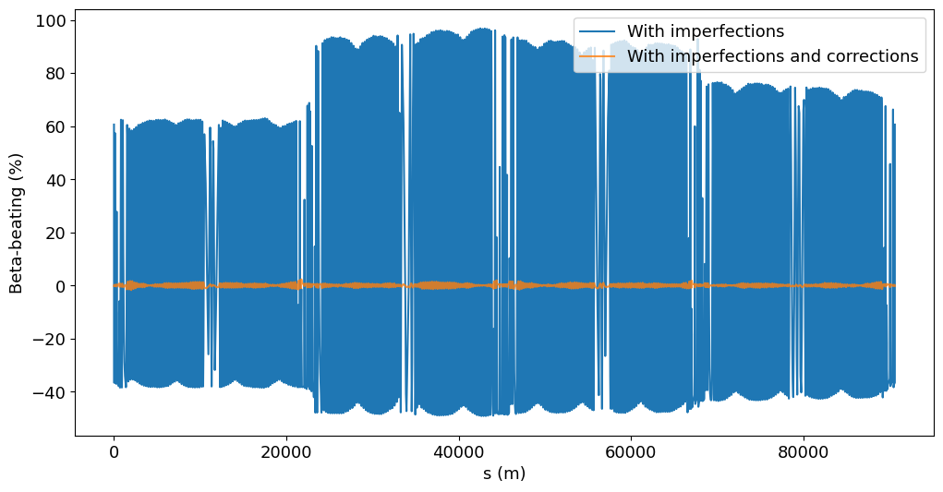
Lattice imperfections
Performance
Lattice imperfections give rise to numerous undesired effects!
  Orbit & optics distortions (e.g. coupling, beta-beating, …) → emittance increase and/or losses → loss of performance.
  Developing correction schemes to keep these effects under control is a major challenge.
  Lara is working on
  modelling these
  imperfections
  and understanding
  their impact on
  performance in
  presence of
  beam-beam.
Beam-beam
Imperfections
J. Wenninger, “Linear Imperfections”, CAS 2018.
Courtesy of L. Sievert
Corrections
Radiation
Optics

Slide 9
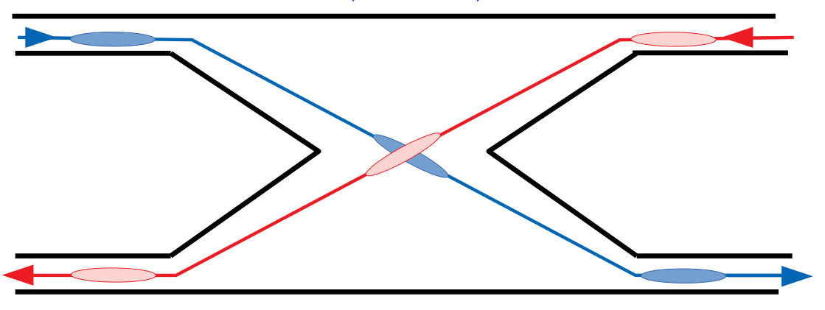
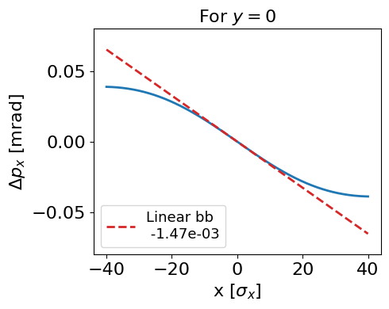
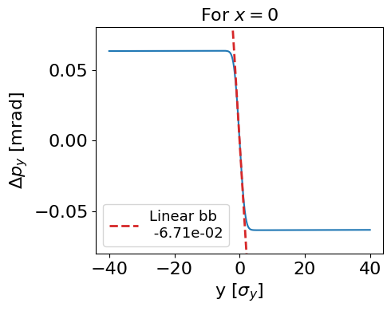
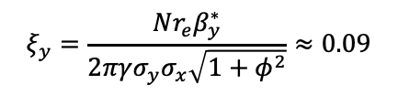

Beam-beam effects
Performance
Beam-beam interactions modify key lattice properties (e.g. tunes, beta-beating, …) and can degrade beam quality (e.g. emittance blow-up, instabilities, …).
  Minimizing these effects is essential for maximizing luminosity.
Beam-beam
Imperfections
Corrections
Typical for FCC-ee at Z:
Radiation
$$ξ_{x}=\frac{Nr_{e}}{2πγε_{x}\left(1+φ^{2}\right)}≈0.001\text{5}$$
$$ξ_{y}=\frac{Nr_{e}β_{y}^{∗}}{2πγσ_{y}σ_{x}\sqrt{1+φ^{2}}}≈\text{0.09}$$
Optics

Slide 10
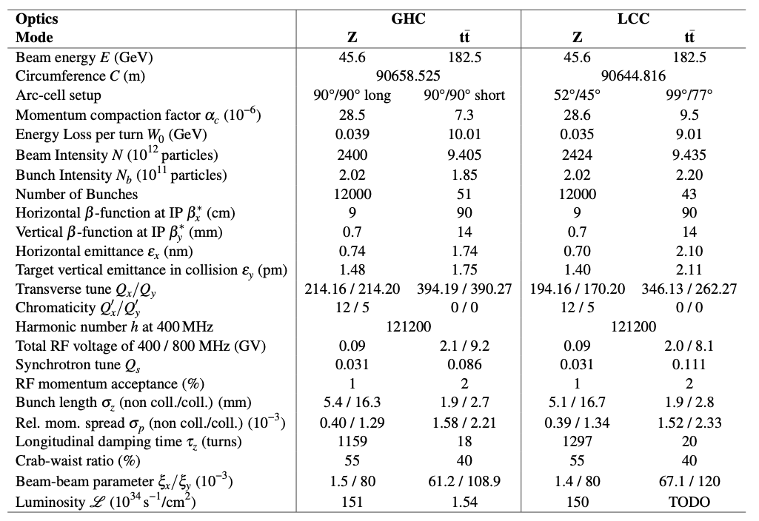
FCC-ee parameters & performance
Performance
Luminosity is given by: $L=\frac{γ}{2er_{e}}\frac{I_{tot}ξ_{y}}{β_{y}^{∗}}R_{G}$
Beam-beam
Imperfections
Corrections
Radiation
Parameters from optics comparison report, values may have been updated since then.
Optics

Slide 11
Beam dynamics in FCC-ee
Performance
Beam-beam
Imperfections
Corrections
Radiation
Optics

Slide 12
Beam dynamics in FCC-ee
Performance
Imperfections
Beam-beam
Corrections
Radiation
Optics

Slide 13
Focus of my studies
Performance
Analyze current FCC-ee lattices to identify sensitivities to beam-beam forces & machine imperfections.
Develop correction schemes / tuning knobs for
improving beam stability and performance in
beam-beam dominated regimes.
Imperfections
Beam-beam
Corrections
Radiation
Optics

Slide 14
Sensitivity of vertical emittance on a lattice with beam-beam

Slide 15
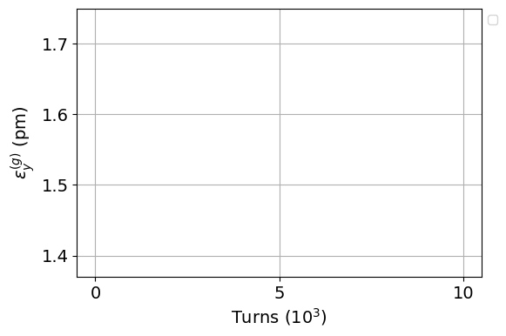
A tracking example without radiation
(i.e. like a proton accelerator)

Slide 16
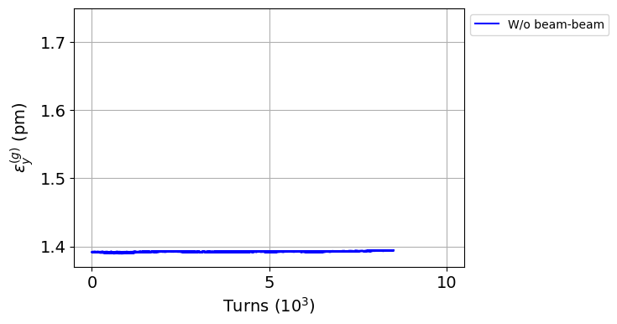
A tracking example without radiation
Without beam-beam

Slide 17
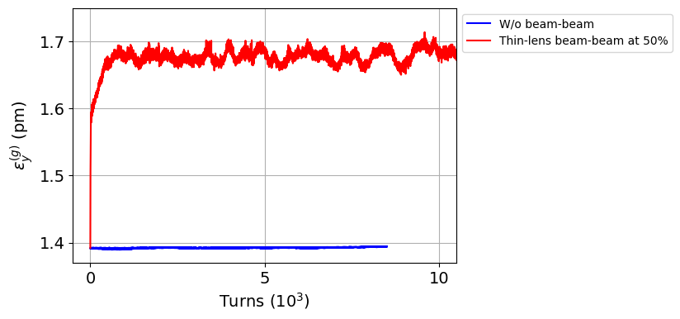
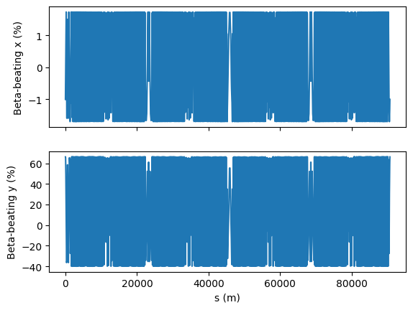
A tracking example without radiation
With beam-beam (only linear): phase space mismatch
Beta-beat from beam-beam
Without beam-beam

Slide 18
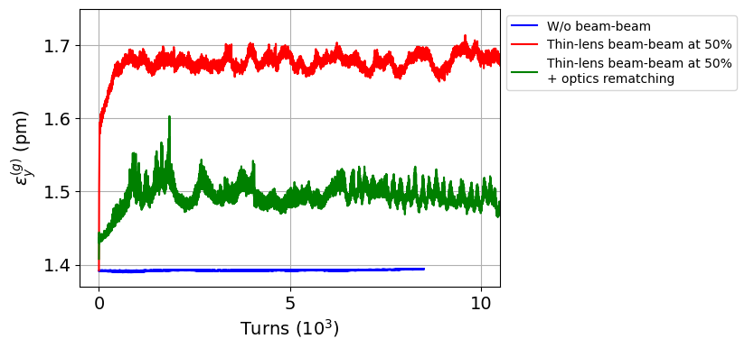
A tracking example without radiation
With beam-beam (only linear): phase space mismatch
After rematching linear optics (we will see later how…)
Without beam-beam

Slide 19
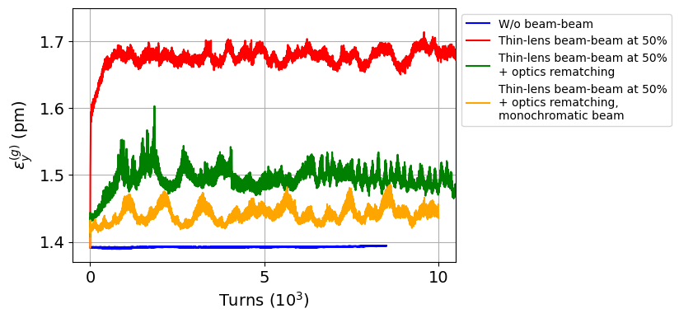
A tracking example without radiation
With beam-beam (only linear): phase space mismatch
After rematching linear optics (we will see later how…)
Removing off-momentum dependence (by forcing a monochromatic beam…)
Without beam-beam

Slide 20
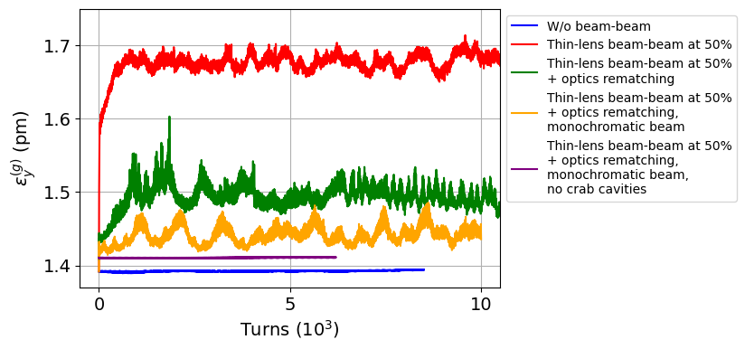
A tracking example without radiation
With beam-beam (only linear): phase space mismatch
After rematching linear optics (we will see later how…)
Removing off-momentum dependence (by forcing a monochromatic beam…)
Removing strong non-linear elements (crab sextupoles)
Without beam-beam
Strong linear optics distortions from beam-beam would lead to a phase space mismatch.
Non-linear properties of the lattice are not negligible on the beam emittance.
Beam-beam
Optics

Slide 21
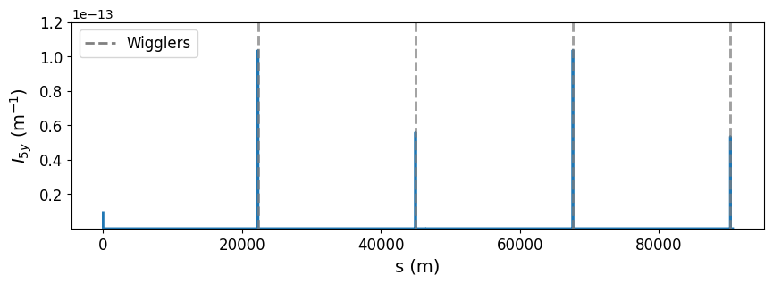
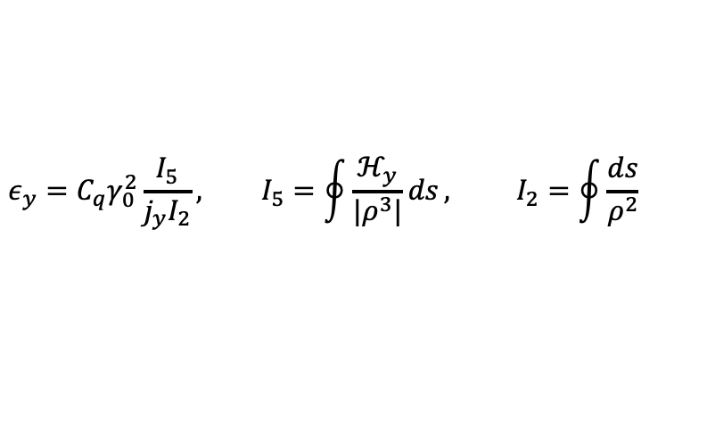
A tracking example with radiation
Beam emittance ↔ equilibrium emittance
$$ε_{y}=C_{q}γ_{0}^{2}\frac{I_{5}}{j_{y}I_{2}}, I_{5}=\oint{\frac{ℋ_{y}}{|ρ^{3}|}ds}, I_{2}=\oint{\frac{ds}{ρ^{2}}}$$
Emittance source in ideal lattice: four vertical wigglers distributed around the lattice

Slide 22
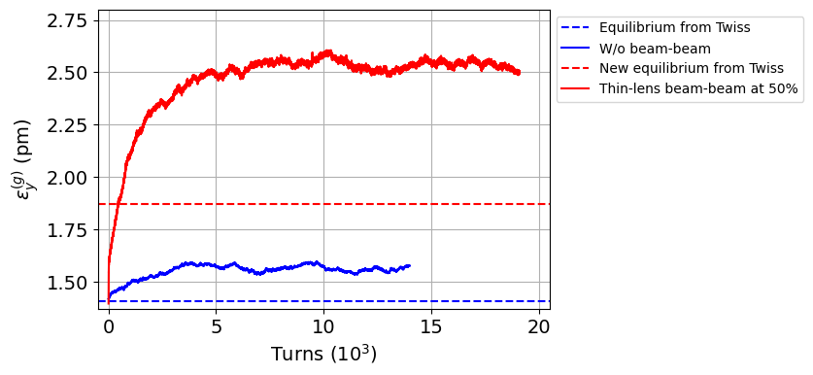
A tracking example with radiation
Tracking with beam-beam (only linear)
Equilibrium with beam-beam (only linear)
Tracking w/o beam-beam
Equilibrium w/o beam-beam
Strong linear optics distortions from beam-beam lead to different equilibrium emittance.
Non-linear properties of the lattice are not negligible to equilibrium emittance.

Slide 23
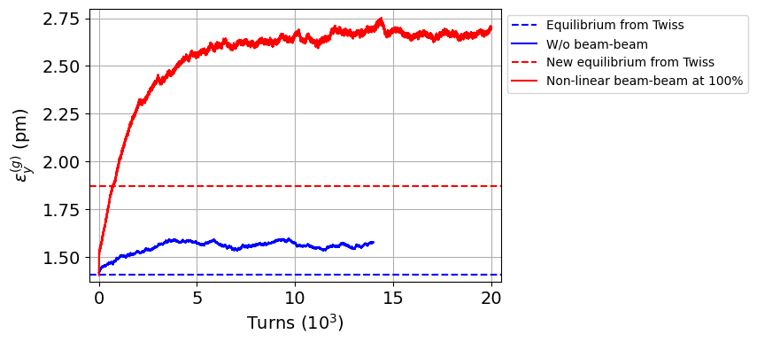
A tracking example with radiation
Tracking with beam-beam
Equilibrium with beam-beam
Tracking w/o beam-beam
Equilibrium w/o beam-beam
Strong linear optics distortions from beam-beam lead to different equilibrium emittance.
Non-linear properties of the lattice are not negligible to equilibrium emittance.
Non-linear contribution of beam-beam and beamstrahlung (BS) are also not negligible.
Beam-beam
Optics
Radiation

Slide 24
An example of a tuning knob with beam-beam

Slide 25
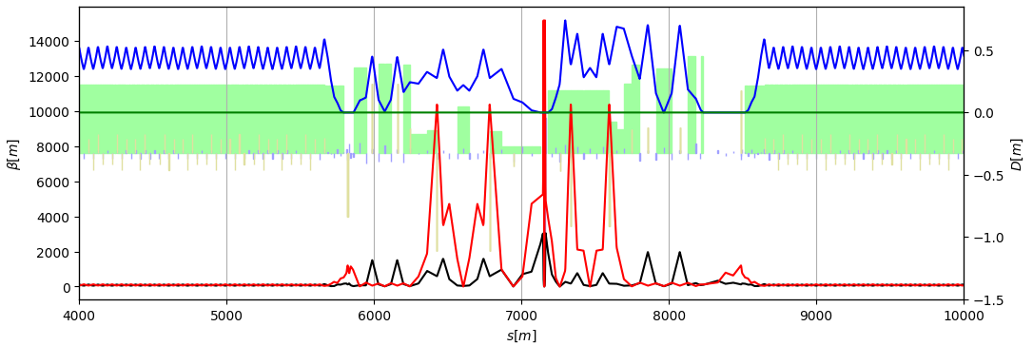
Rematching linear optics
Rematching quadrupoles

Slide 26
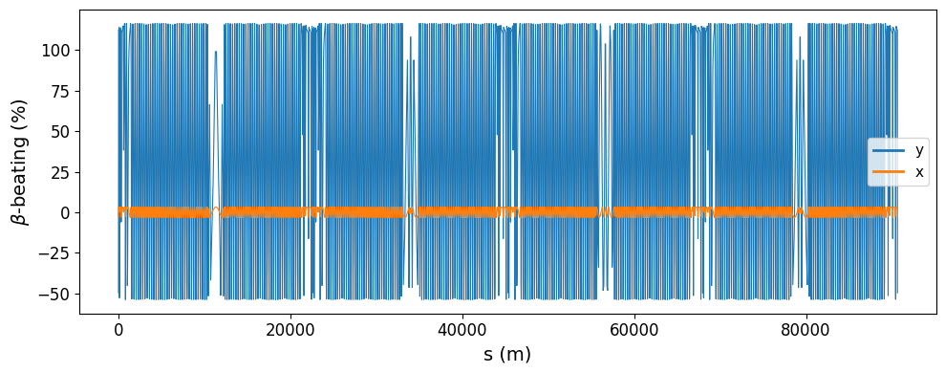
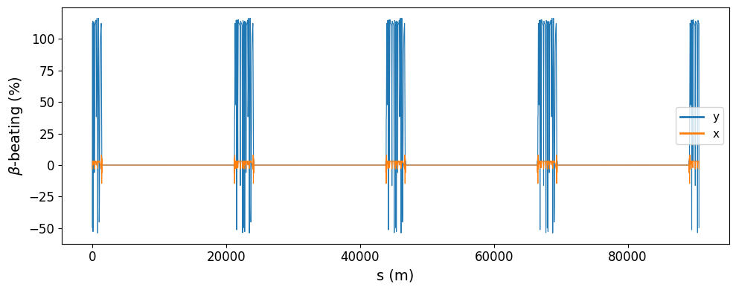
Rematching linear optics
Rematched lattice:
  Optics distortions compensated in arcs and technical insertions.
  Maintained additional focusing induced by beam-beam at IPs (“dynamic β*”)

Slide 27
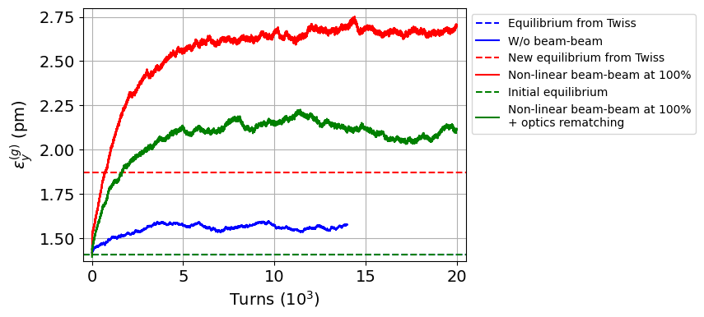
Reducing vertical emittance blow-up
Tracking with beam-beam
Rematching linear optics
Equilibrium with beam-beam
Tracking w/o beam-beam
Equilibrium w/o beam-beam

Slide 28
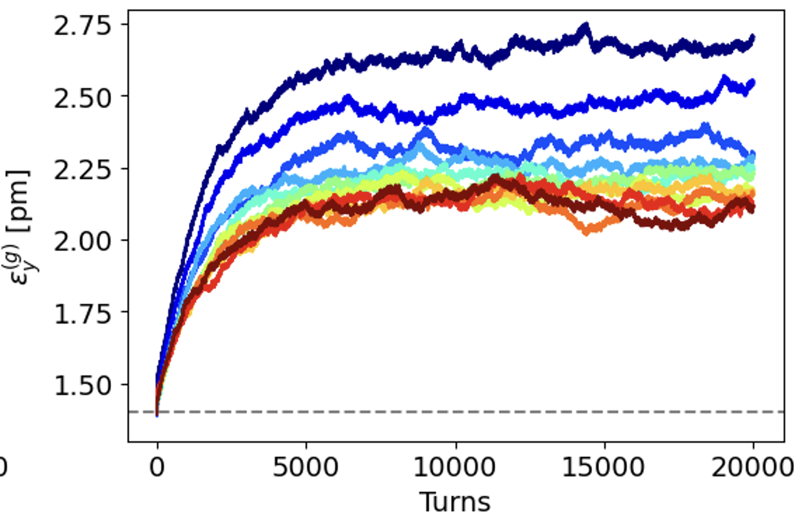
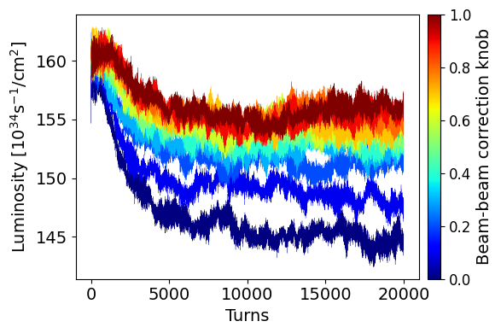
Tuning-knob and luminosity

Slide 29
Reducing vertical emittance blow-up
Tracking with beam-beam
Some considerations:
  Beam-beam forces are very non-linear → optics distortions are amplitude dependent → correcting the zero-amplitude optics leads to overcorrection of higher amplitudes → some intermediate correction?
  Rematching the non-linear properties?
  So far: ideal lattice with “fake” emittance sources (vertical wigglers). What will matter in a lattice with lattice imperfections?
Rematching linear optics
Equilibrium with beam-beam
Tracking w/o beam-beam
Equilibrium w/o beam-beam

Slide 30
Lattices with imperfections and beam-beam

Slide 31
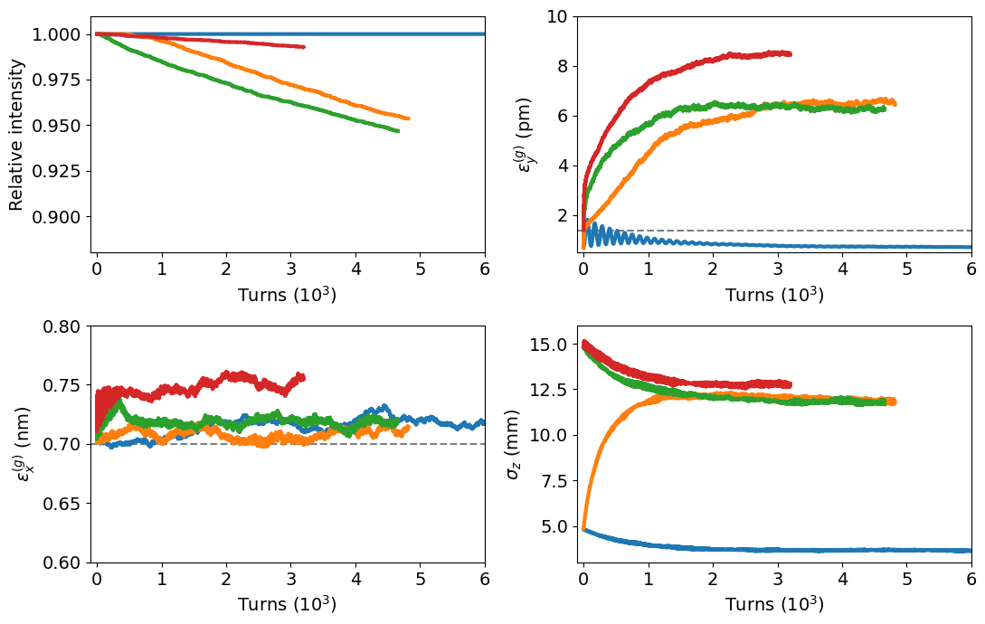
Tracking in lattices with imperfections (in progress…)
with beam-beam and partial optics rematching
with beam-beam
with beam-beam
w/o beam-beam
Performance
Imperfections
Beam-beam
Corrections
Radiation
Optics

Slide 32
Summary & Outlook

Slide 33
Summary & Outlook
Vertical emittance blow-up in the ideal lattice with beam-beam
  Multiple effects contribute to emittance growth in tracking with beam–beam, even in an ideal lattice.
  How much we want to control these effects in practice?
Tracking tuned lattices with beam-beam
  Initial exploratory tracking simulations with “quasi-strong” beam-beam.
  Plan to study/understand source of losses and emittance increase (as in the ideal lattice) and propose potential mitigations.
RDT sensitivity scans with beam-beam (in backup slides)
  Ongoing work towards understanding which RDTs drive performance with beam-beam and how to compensate them.
Thank you for your attention!

Slide 34
Backup

Slide 35
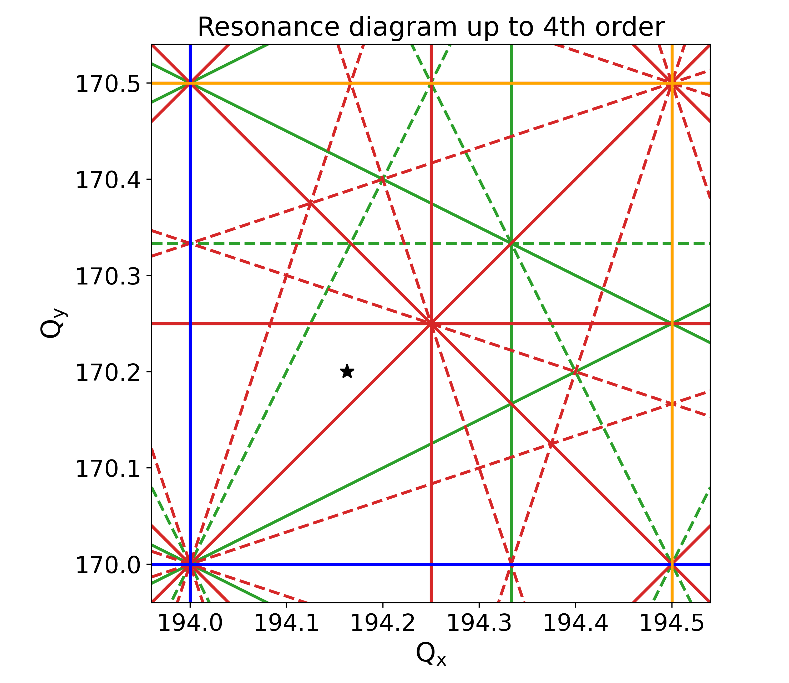
Beam-beam and RDT scans
2Q_{y}
RDTs:
  3rd order normal: f1020, f1011, f1002, f3000, f2100
  3rd order skew: f0030, f0012, f2010, f2001, f1110
  4th order normal: f4000, f3100, f2020, f2011, f2002, f1120, f0040, f0031
  4th order skew: f3010, f3001, f2110, f2101, f1021, f1012, f1030, f1003
  …
Q_{x}+2Q_{y}
2Q_{x}
2Q_{x}+2Q_{y}
3Q_{y}
3Q_{x}
Q_{x}
4Q_{y}
2Q_{x}-Q_{y}
2Q_{x}-2Q_{y}
3Q_{x}-Q_{y}
Q_{x}-Q_{y}
Q_{x}-3Q_{y}
Q_{x}-2Q_{y}
1st order resonances
2nd order resonances
3rd order resonances
4th order resonances
4Q_{x}
2Q_{x}+Q_{y}
Q_{y}

Slide 36
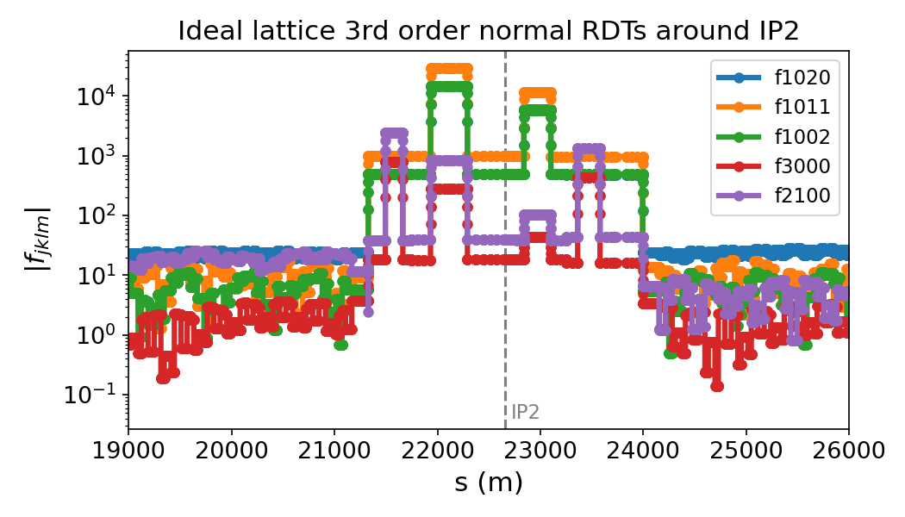
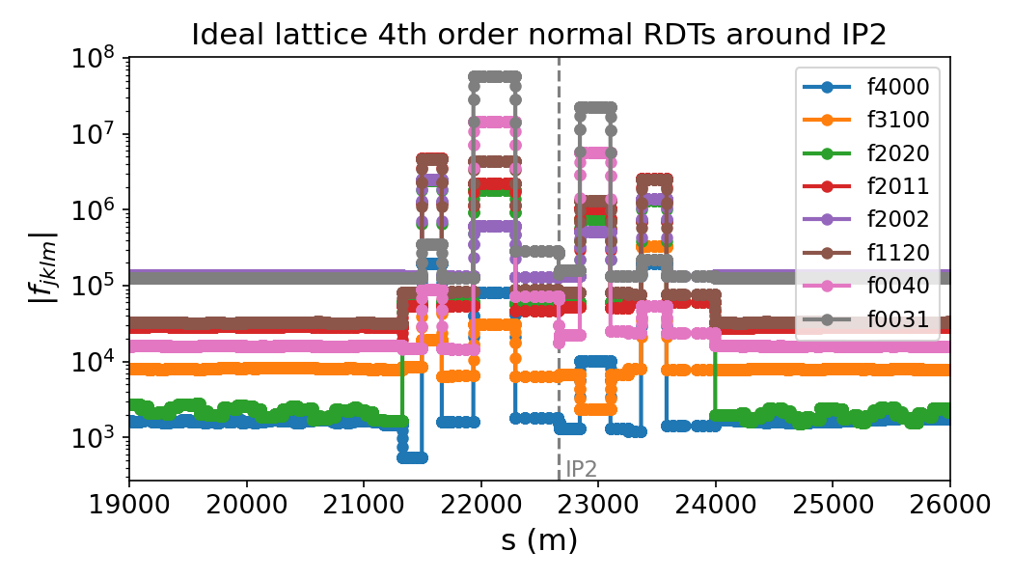
RDTs of ideal lattice
RDTs:
  3rd order normal: f1020, f1011, f1002, f3000, f2100
  3rd order skew: f0030, f0012, f2010, f2001, f1110
  4th order normal: f4000, f3100, f2020, f2011, f2002, f1120, f0040, f0031
  4th order skew: f3010, f3001, f2110, f2101, f1021, f1012, f1030, f1003
  …
“Agnostic” approach:
  Change individual RDTs either locally (e.g. at IPs) or globally
  Track with beam-beam and see impact on performance (lifetime, emittance, lumi, …)
(m^{-1/2})
(m⁻¹)
Notes:
fjklm units of [m]^(1-n/2), n = j+k+l+m
e.g.: sextupole m ^ -1/2. octupole is m^-1

Slide 37
Changing a single RDT
RDTs:
  3rd order normal: f1020, f1011, f1002, f3000, f2100
  3rd order skew: f0030, f0012, f2010, f2001, f1110
  4th order normal: f4000, f3100, f2020, f2011,
  f2002, f1120, f0040, f0031
  4th order skew: f3010, f3001, f2110, f2101, f1021, f1012, f1030, f1003
  …
“Agnostic” approach:
  Change individual RDTs either locally (e.g. at IPs) or globally
  Track with beam-beam and see impact on performance (lifetime, emittance, lumi, …)

Slide 38
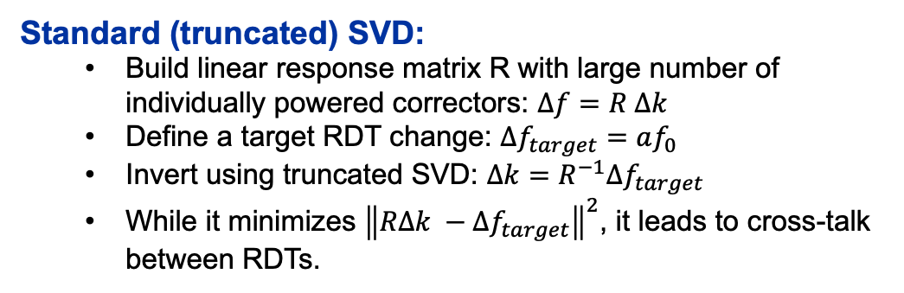
Changing a single RDT
Standard (truncated) SVD:
  Build linear response matrix R with large number of individually powered correctors: $Δf=R Δk$
  Define a target RDT change: $Δf_{target}=af_{0}$
  Invert using truncated SVD: $Δk=R^{−1}Δf_{target}$
  While it minimizes ${\left\|RΔk −Δf_{target}\right\|}^{2}$, it leads to cross-talk between RDTs.
RDTs:
  3rd order normal: f1020, f1011, f1002, f3000, f2100
  3rd order skew: f0030, f0012, f2010, f2001, f1110
  4th order normal: f4000, f3100, f2020, f2011,
  f2002, f1120, f0040, f0031
  4th order skew: f3010, f3001, f2110, f2101, f1021, f1012, f1030, f1003
  …
“Agnostic” approach:
  Change individual RDTs either locally (e.g. at IPs) or globally
  Track with beam-beam and see impact on performance (lifetime, emittance, lumi, …)

Slide 39
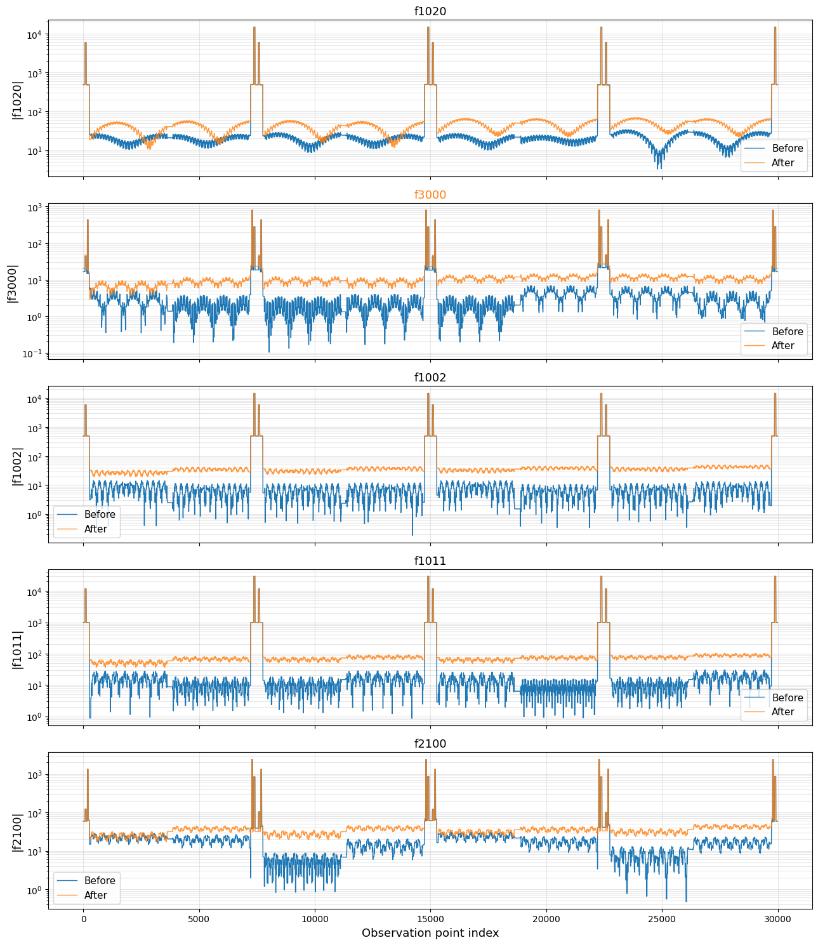
Changing a single RDT
Standard (truncated) SVD
Standard (truncated) SVD:
  Build linear response matrix R with large number of individually powered correctors: $Δf=R Δk$
  Define a target RDT change: $Δf_{target}=af_{0}$
  Invert using truncated SVD: $Δk=R^{−1}Δf_{target}$
  While it minimizes ${\left\|RΔk −Δf_{target}\right\|}^{2}$, it leads to cross-talk between RDTs.
Target

Slide 40
Changing a single RDT
Standard (truncated) SVD:
  Build linear response matrix R with large number of individually powered correctors: $Δf=R Δk$
  Define a target RDT change: $Δf_{target}=af_{0}$
  Invert using truncated SVD: $Δk=R^{−1}Δf_{target}$
  While it minimizes ${\left\|RΔk −Δf_{target}\right\|}^{2}$, it leads to cross-talk between RDTs.
RDTs:
  3rd order normal: f1020, f1011, f1002, f3000, f2100
  3rd order skew: f0030, f0012, f2010, f2001, f1110
  4th order normal: f4000, f3100, f2020, f2011,
  f2002, f1120, f0040, f0031
  4th order skew: f3010, f3001, f2110, f2101, f1021, f1012, f1030, f1003
  …
“Agnostic” approach:
  Change individual RDTs either locally (e.g. at IPs) or globally
  Track with beam-beam and see impact on performance (lifetime, emittance, lumi, …)

Slide 41
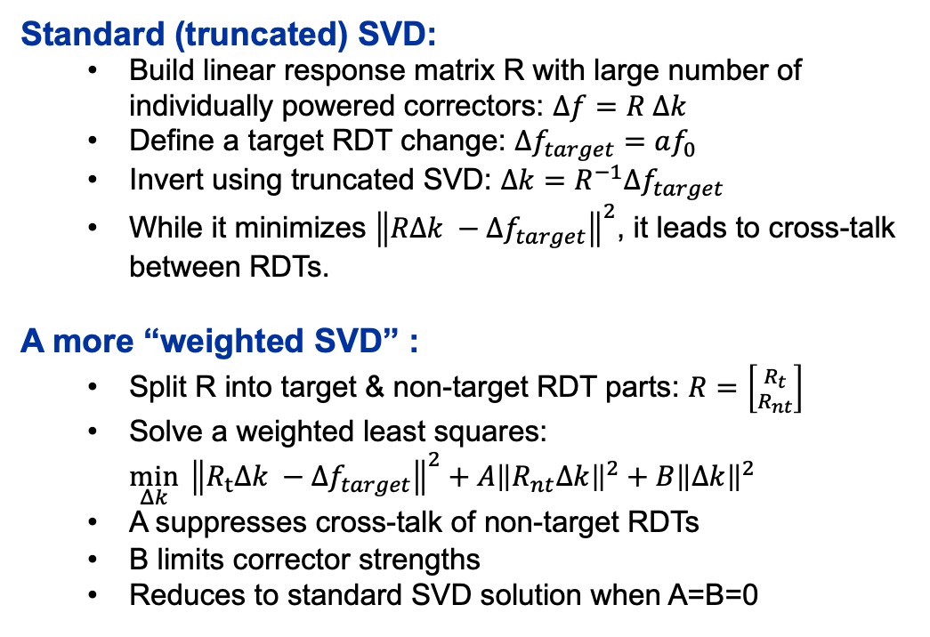
Changing a single RDT
Standard (truncated) SVD:
  Build linear response matrix R with large number of individually powered correctors: $Δf=R Δk$
  Define a target RDT change: $Δf_{target}=af_{0}$
  Invert using truncated SVD: $Δk=R^{−1}Δf_{target}$
  While it minimizes ${\left\|RΔk −Δf_{target}\right\|}^{2}$, it leads to cross-talk between RDTs.
A more “weighted SVD” :
  Split R into target & non-target RDT parts: $R=\left[{R_{t} \atop R_{nt}}\right]$
  Solve a weighted least squares:
  $\min_{Δk}{ {\left\|R_{t}Δk −Δf_{target}\right\|}^{2}}+A{\left\|R_{nt}Δk\right\|}^{2}+B{\left\|Δk\right\|}^{2}$
  A suppresses cross-talk of non-target RDTs
  B limits corrector strengths
  Reduces to standard SVD solution when A=B=0
RDTs:
  3rd order normal: f1020, f1011, f1002, f3000, f2100
  3rd order skew: f0030, f0012, f2010, f2001, f1110
  4th order normal: f4000, f3100, f2020, f2011,
  f2002, f1120, f0040, f0031
  4th order skew: f3010, f3001, f2110, f2101, f1021, f1012, f1030, f1003
  …
“Agnostic” approach:
  Change individual RDTs either locally (e.g. at IPs) or globally
  Track with beam-beam and see impact on performance (lifetime, emittance, lumi, …)

Slide 42
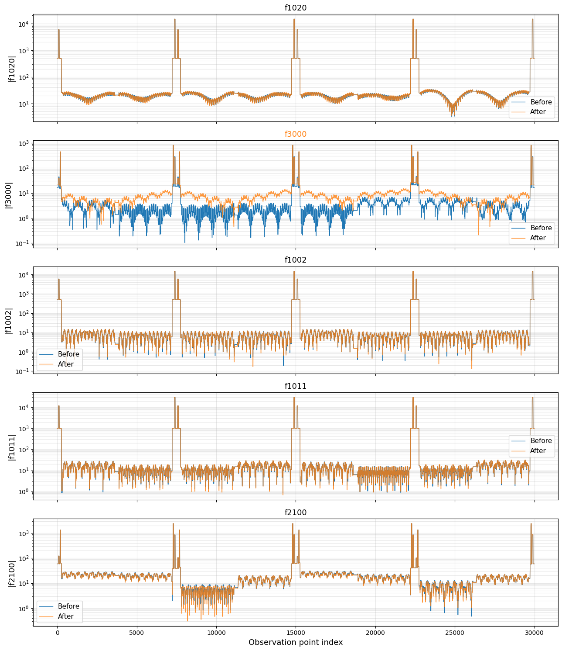
Example: changing f3000 by +25%
“Weighted” SVD
Standard (truncated) SVD
Target
Target

Slide 43
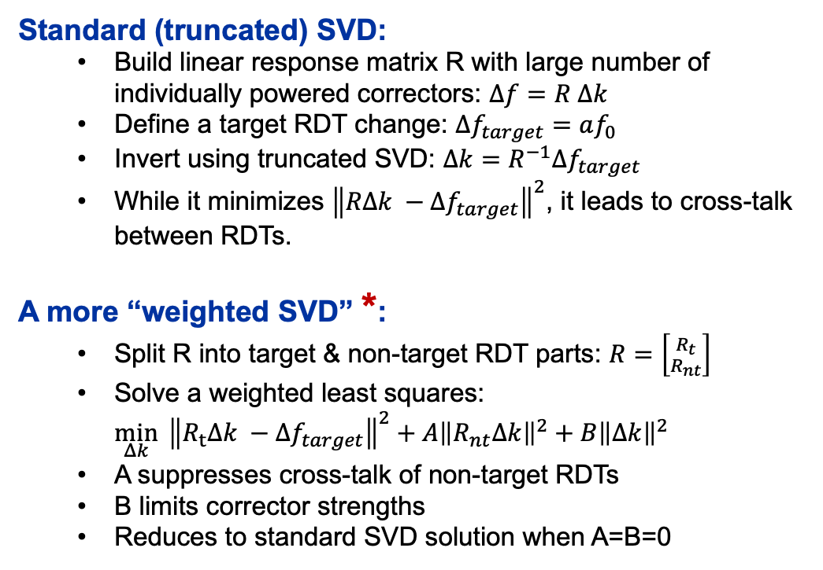
Changing a single RDT
Standard (truncated) SVD:
  Build linear response matrix R with large number of individually powered correctors: $Δf=R Δk$
  Define a target RDT change: $Δf_{target}=af_{0}$
  Invert using truncated SVD: $Δk=R^{−1}Δf_{target}$
  While it minimizes ${\left\|RΔk −Δf_{target}\right\|}^{2}$, it leads to cross-talk between RDTs.
A more “weighted SVD” *:
  Split R into target & non-target RDT parts: $R=\left[{R_{t} \atop R_{nt}}\right]$
  Solve a weighted least squares:
  $\min_{Δk}{ {\left\|R_{t}Δk −Δf_{target}\right\|}^{2}}+A{\left\|R_{nt}Δk\right\|}^{2}+B{\left\|Δk\right\|}^{2}$
  A suppresses cross-talk of non-target RDTs
  B limits corrector strengths
  Reduces to standard SVD solution when A=B=0
RDTs:
  3rd order normal: f1020, f1011, f1002, f3000, f2100
  3rd order skew: f0030, f0012, f2010, f2001, f1110
  4th order normal: f4000, f3100, f2020, f2011,
  f2002, f1120, f0040, f0031
  4th order skew: f3010, f3001, f2110, f2101, f1021, f1012, f1030, f1003
  …
“Agnostic” approach:
  Change individual RDTs either locally (e.g. at IPs) or globally
  Track with beam-beam and see impact on performance (lifetime, emittance, lumi, …)
*Need to make sure tunes, chroma, second order dispersions, higher order RDTs, … remain unperturbed.

Slide 44
Tracking
RDTs:
  3rd order normal: f1020, f1011, f1002, f3000, f2100
  3rd order skew: f0030, f0012, f2010, f2001, f1110
  4th order normal: f4000, f3100, f2020, f2011,
  f2002, f1120, f0040, f0031
  4th order skew: f3010, f3001, f2110, f2101, f1021, f1012, f1030, f1003
  …
“Agnostic” approach:
  Change individual RDTs either locally (e.g. at IPs) or globally
  Track with beam-beam and see impact on performance (lifetime, emittance, lumi, …)
  Xsuite
  LCC 106.1.0 at Z
  Tapered lattice, no imperfections
  Quantum radiation + beamstrahlung, no Bhabha scattering
  Weak-strong beam-beam: strong beam initialized with equilibrium lattice emittances and 251 slices.
  8000 particles tracked for 8000 turns
  Monitoring in RF sections (dispersion-free)
  Artificial aperture at 20σ in both transverse plane (LimitRect) and at the bucket length (LongitudinalLimitRect).

Slide 45
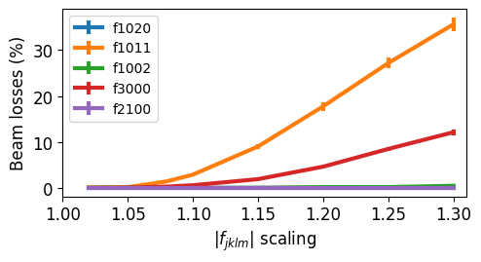
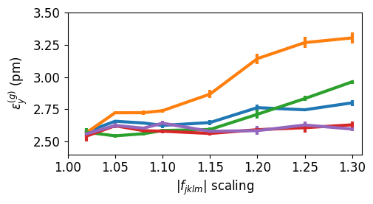
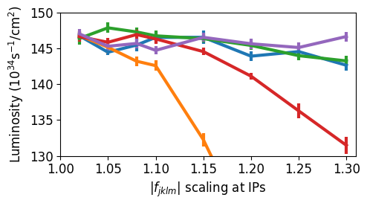
RDT scans with beam-beam
3rd order normal

Slide 46
RDT scans with beam-beam
3rd order normal
Even with an agnostic/numerical approach, one can:
  Rank relative importance of individual RDTs with beam-beam
  (e.g. f1011<f3000<f1002)
  Quantify their impact on observables
  (e.g. f3000 causes mainly losses).
Caveats:
  Difficult to disentangle local RDT effects (e.g. IP geometric aberrations) from global effects (e.g. losses)
  Single-RDT scans are not fully isolated due to coupling to higher-order RDTs
Outlook / potential directions:
  Understand why specific RDTs drive performance with beam-beam
    Resonance excitation?
    coupling to higher-order terms (e.g. 2nd-order dispersion)
  Can the numerical scans guide us to specific corrector configurations?
Also work in progress!

