Slide 1

Final thoughts
D. Bortoletto

Slide 2
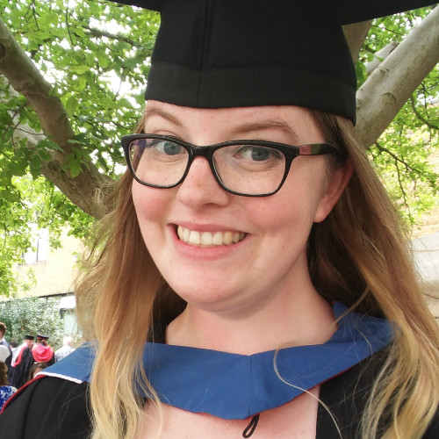
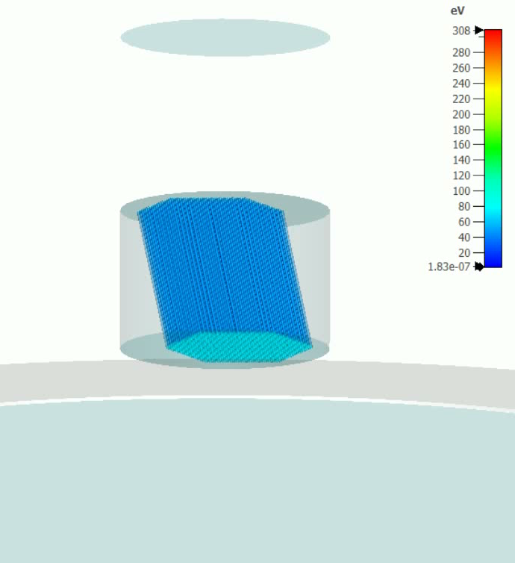

Poster competition winner (I)
Summary
MCP-PMT simulation produced using CST Studio Suite
919 pores simulated, 25 incident photons
Uniform magnetic fields applied in different directions, with different field strengths
Gain, timing and spatial performance are produced
Magnetic Field Direction: ↓
Magnetic Field Strength: 0.5 T
Emily Baldwin
Simulating Performance of Microchannel Plate Photomultipliers in Magnetic Fields
Notes:
Looking at STEM subjects together, 81% of male students named a STEM subject as leading to the highest salary, compared to 77% of females. So while females perceived STEM subjects to be more profitable, they believed non-STEM subjects were more likely to lead to a job in the future.

Slide 3
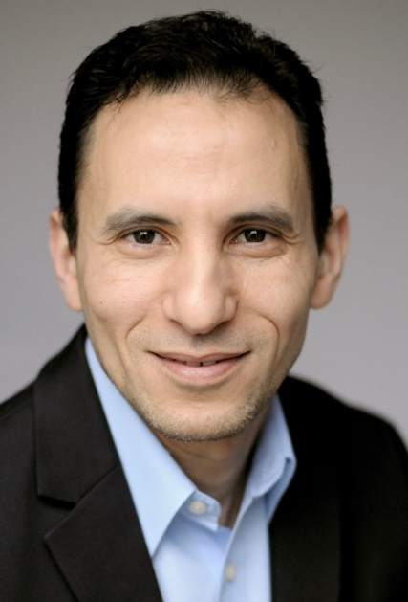
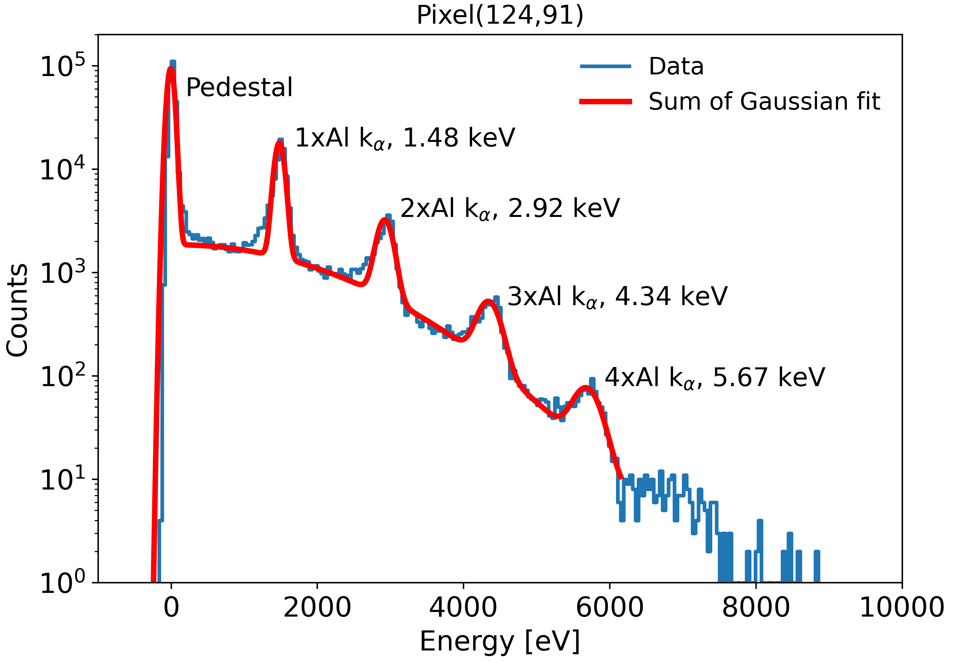
Poster competition winner (II)
Ibrahym Dourki
Experimental investigation of the imaging capabilities of a DEPFET ladder of the DSSC X-ray camera at the European XFEL

Slide 4
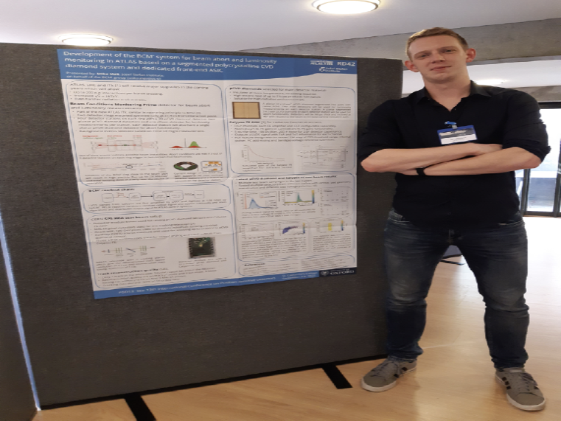
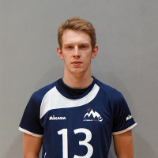
Poster competition winner (III)
Miha Mali
Development of the BCM system for beam abort and luminosity monitoring in ATLAS based on a segmented polycrystalline CVD diamond system and dedicated front-end ASIC
Notes:
Looking at STEM subjects together, 81% of male students named a STEM subject as leading to the highest salary, compared to 77% of females. So while females perceived STEM subjects to be more profitable, they believed non-STEM subjects were more likely to lead to a job in the future.

Slide 5
Proceedings
Published by NIM A
Submission Open Date: 10/09/2023
Instructions will appear shortly on our web site
  Keynote presentation: 6 pages
  Talk:4 pages
  Posters: 3 pages

Slide 6
PSD14 in 2026

Slide 7
PSD14
Queen Mary University of London
A research intensive university: 33000 students and 5400 staff
Three Faculties:
  - Science and Engineering
  - Medicine and Dentistry
  - Humanities and Social Sciences
Five campuses in East/Central London:
  - MileEnd
  - Whitechapel
  - West Smithfield
  - Charterhouse Square
  Lincolns Inn
Compact campus with excellent connections to Central London and Airports
Close to Liverpool St station
Mile End tube station - 7 minutes walk from campus
Quick connections to Elizabeth Line which runs to Reading & Heathrow in the West.

Slide 8
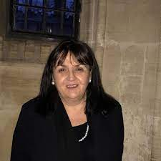
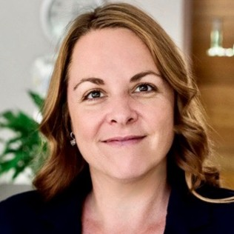
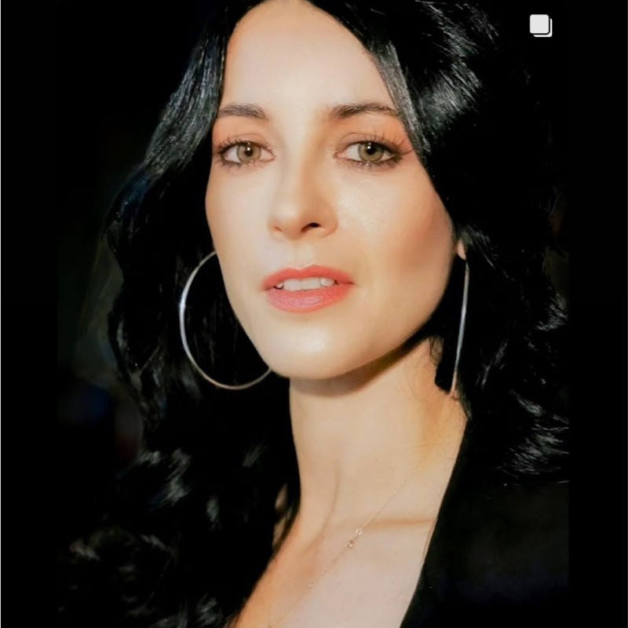
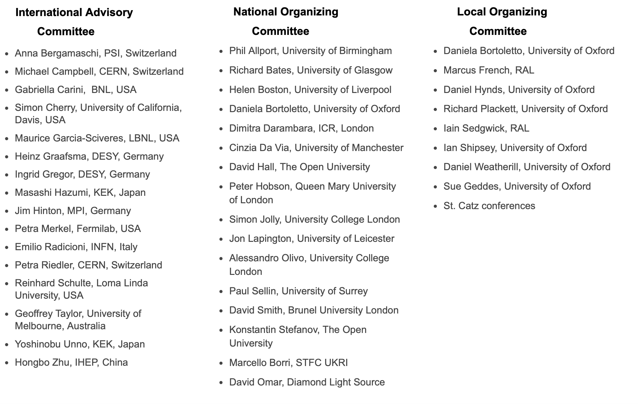
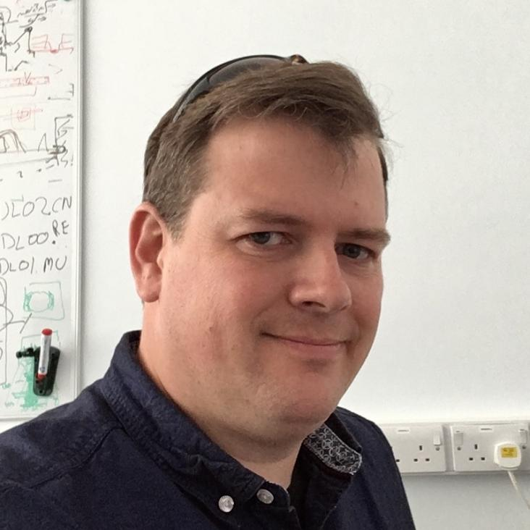
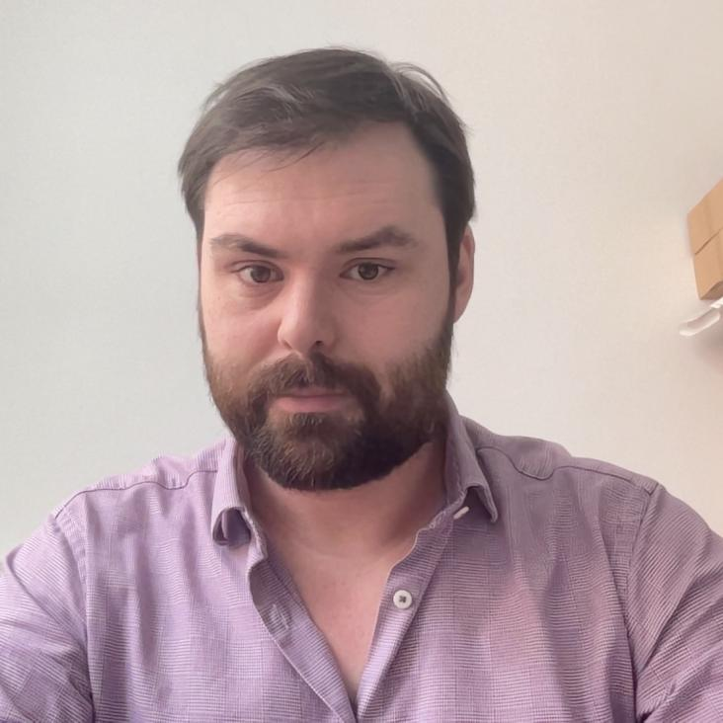
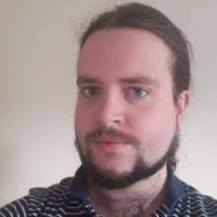
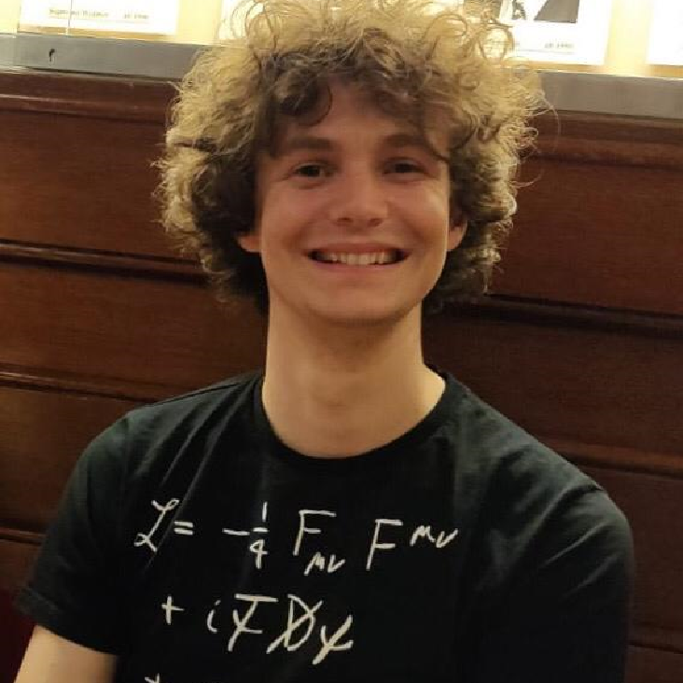
Many thanks
The support of Sue Geddes and the excellent team at Catz (especially Belinda, Fatima,…..)
The excellent work of the Local, National, and International organizing committees
The speaker and the poster presenters
The OPMD team who gave you a great visit of our facility

Slide 9
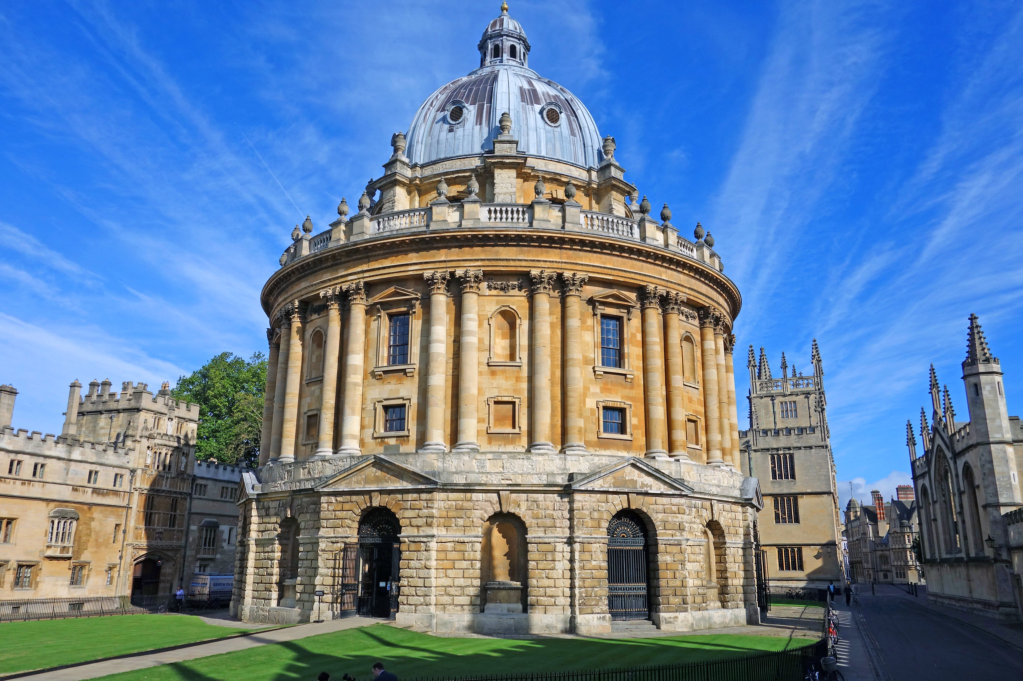
Have a safe trip home!

