Slide 1
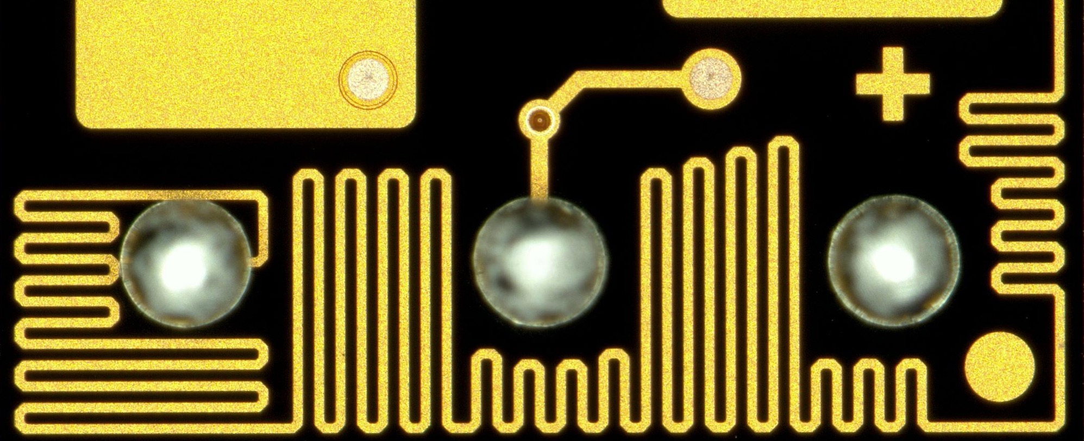
Broadcom’s NUV-MT SiPM technology
Martin Sharratt – Director, AP Technologies
PSD13, September 2023

Slide 2







Broadcom at a Glance
FY22 net revenue of $33.2B
One of the industry’s broadest IP portfolios with >17,000 patents in FY22
$4.9B investment in R&D in FY22
22 Category-Leading Semiconductor and Infrastructure Software Divisions

Slide 3
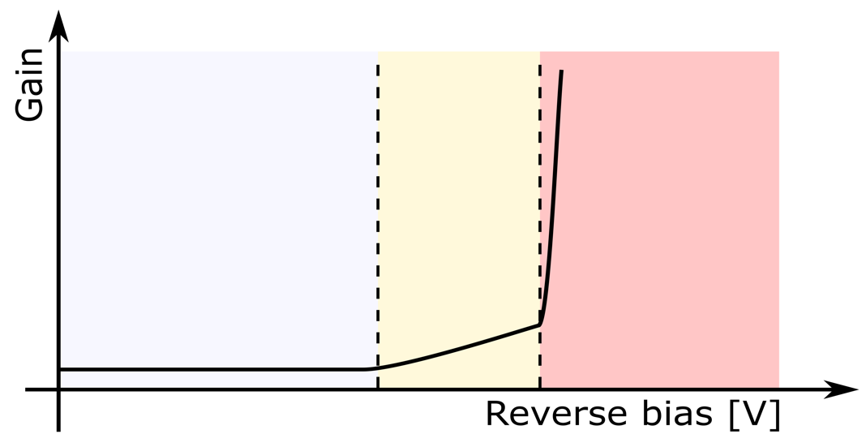


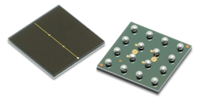
From photodiode to SPAD
p-n junctions in semiconductors are the basis of
  Photodiodes
  APDs
  SPADs
Can be differentiated by gain
Gain can be driven by reverse bias
APD: Avalanche Photodiode internal gain 10 to 100
SPAD: Single Photon Avalanche Diode Geiger mode internal gain up to 10M
Broadcom
AFBR-S5
Broadcom
AFBR-S4
-
+
Geiger mode:
1 photon → millions of electrons
1 photon
→ 100 electrons
Photodiode
APD
SPAD / SiPM
1 photon
→ 1 electron
Breakdown voltage

Slide 4
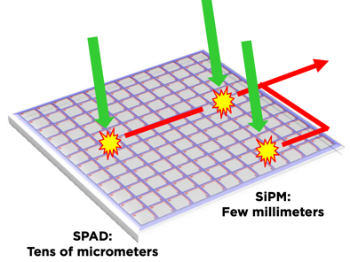
From SPAD to SiPM
SPAD working in Geiger mode
Silicon Photomultiplier (SiPM)
…
Single SPAD discharge signal regardless of number of incident photons
Sum of individual SPAD dischargesignals
current
current
t
t

Slide 5
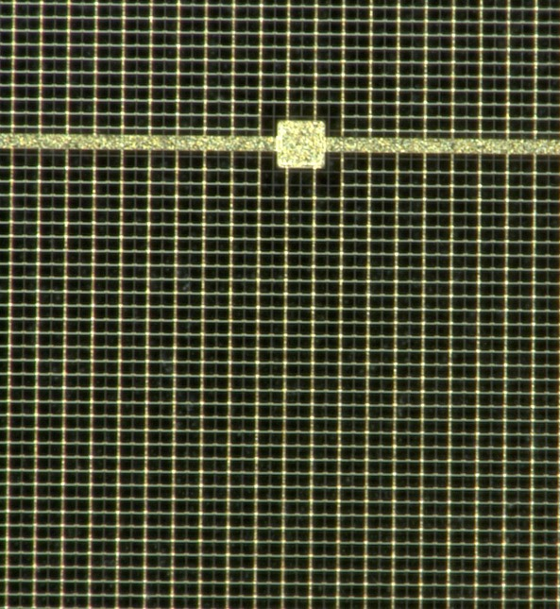
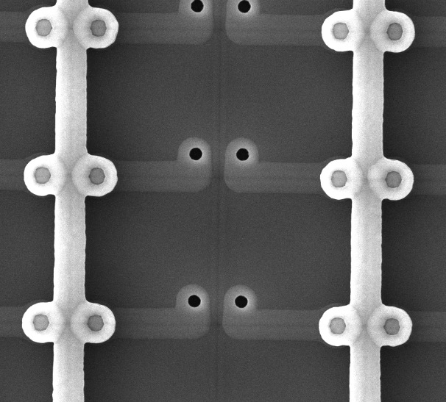
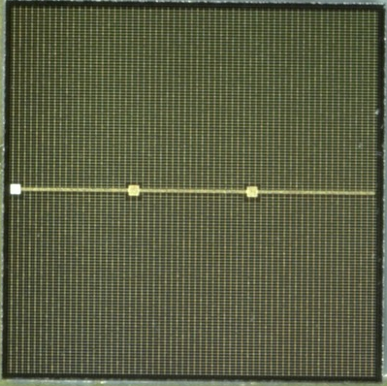
SiPM Images
…
Quenching resistor
Metal readout line
3.89 mm
30 µm
SPAD

Slide 6
AFBR-S4N: NUV-MT SiPM

Slide 7
NUV-MT – Performance Overview
25°C,12V_{OV}
 | NUV-MT
Sensitivity range (nm) | 250 to 900
Peak sensitivity (nm) | 420
PDE at 420nm (%) | 63
Gain (M) | 7.3
DCR (kcps/mm²) | 120
SPAD pitch (µm) | 40
CT (%) | 23
AP (%) | 1
𝛕_{recharge} (ns) | 55
Typ. OV | 12
Temp. coefficient (mV/°C) | 30
Vbreak (V) | 32.5
PDE (%)
Wavelength (nm)
12 V OV, 25°C
25°C,12V_{OV}
/mm²)
PDE @ 420nm (%)
420nm PDE is >55% at 7V_{OV}
Overvoltage

Slide 8
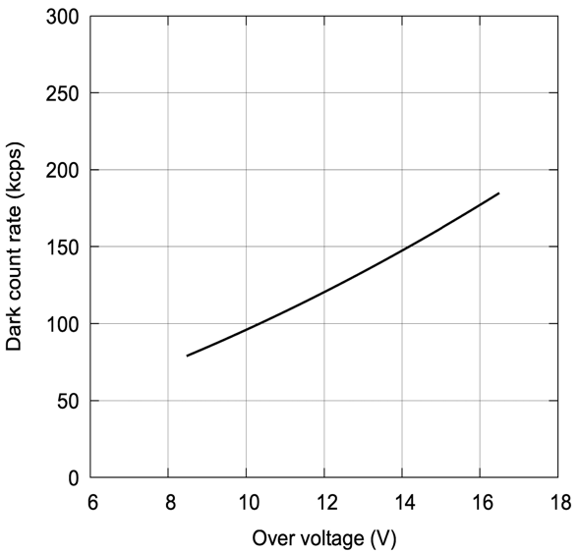
NUV-MT – Performance Overview
25°C,12V_{OV}
 | NUV-MT
Sensitivity range (nm) | 250 to 900
Peak sensitivity (nm) | 420
PDE at 420nm (%) | 63
Gain (M) | 7.3
DCR (kcps/mm²) | 120
SPAD pitch (µm) | 40
CT (%) | 23
AP (%) | 1
𝛕_{recharge} (ns) | 55
Typ. OV | 12
Temp. coefficient (mV/°C) | 30
Vbreak (V) | 32.5
Dark count-rate (kcps/mm²)
~65kcps @ 7V_{OV}
Overvoltage
Dark Current
-0V to >50V
-20°C to +60°C

Slide 9
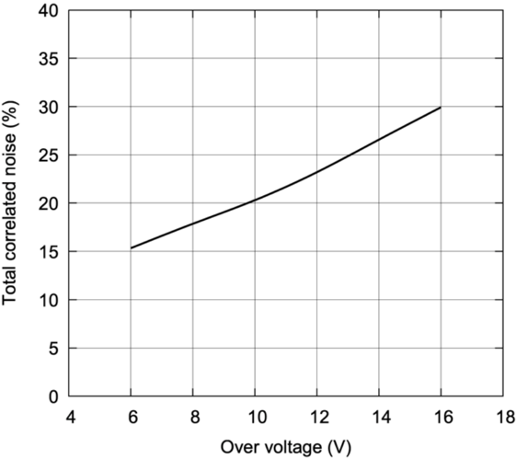
NUV-MT – Performance Overview
 | NUV-MT
Sensitivity range (nm) | 250 to 900
Peak sensitivity (nm) | 420
PDE at 420nm (%) | 63
Gain (M) | 7.3
DCR (kcps/mm²) | 120
SPAD pitch (µm) | 40
CT (%) | 23
AP (%) | 1
𝛕_{recharge} (ns) | 55
Typ. OV | 12
Temp. coefficient (mV/°C) | 30
Vbreak (V) | 32.5
25°C,12V_{OV}
Total correlated noise (%)
~17% @ 7V_{OV}
Overvoltage
AP < 1%

Slide 10
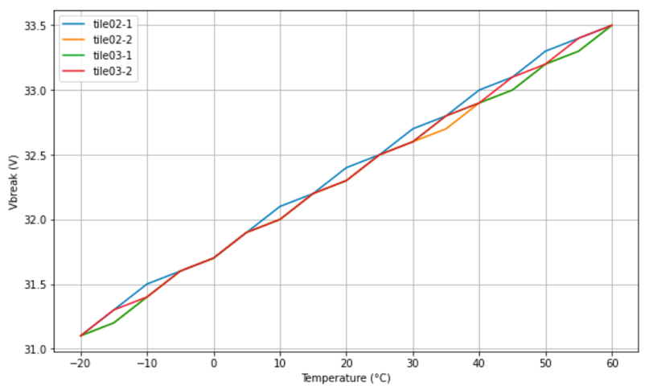
NUV-MT – Performance Overview
 | NUV-MT
Sensitivity range (nm) | 250 to 900
Peak sensitivity (nm) | 420
PDE at 420nm (%) | 63
Gain (M) | 7.3
DCR (kcps/mm²) | 120
SPAD pitch (µm) | 40
CT (%) | 23
AP (%) | 1
𝛕_{recharge} (ns) | 55
Typ. OV | 12
Temp. coefficient (mV/°C) | 30
Vbreak (V) | 32.5
33.5
V_{break} (V)
dV_{BD}/dT = 30mV/°C
31
-20°C
Temperature (°C)
60°C

Slide 11
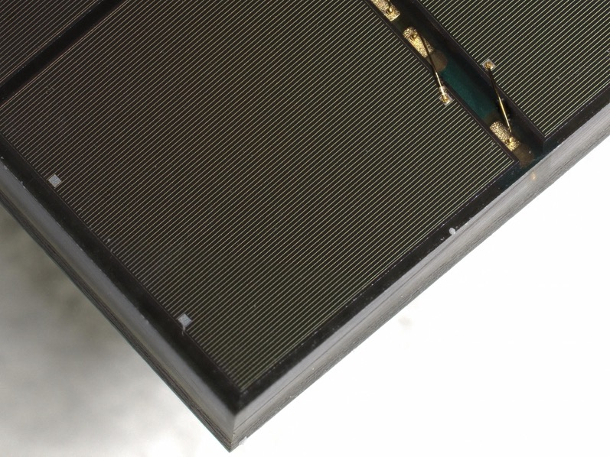
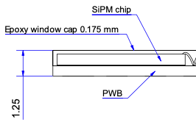
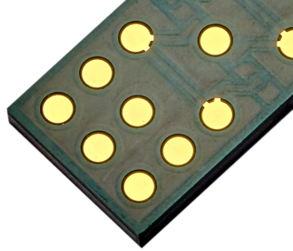
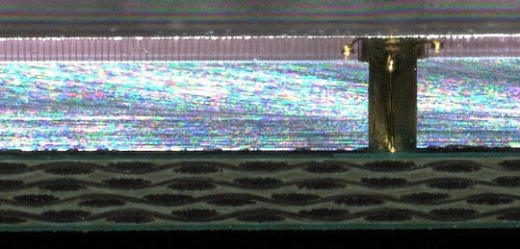
NUV-MT: New Package Design
Overmolded PCB with bond wire
Focus:
  Highest transmittance of mold compound in UV-blue
  Long term stability (no yellowing)
  High reliability & ruggedness
  Cost efficiency & Simple + Flexible supply-chain
  High Package Fill Factor
Typical Backside (LGA)
175µm
0.1mm

Slide 12
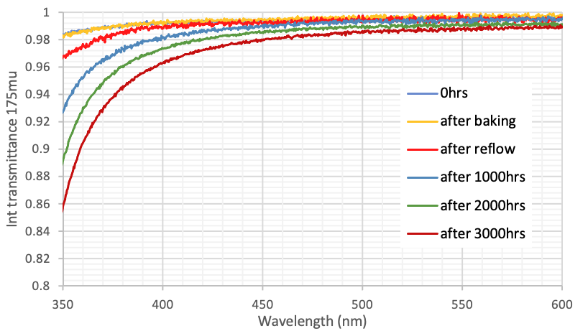
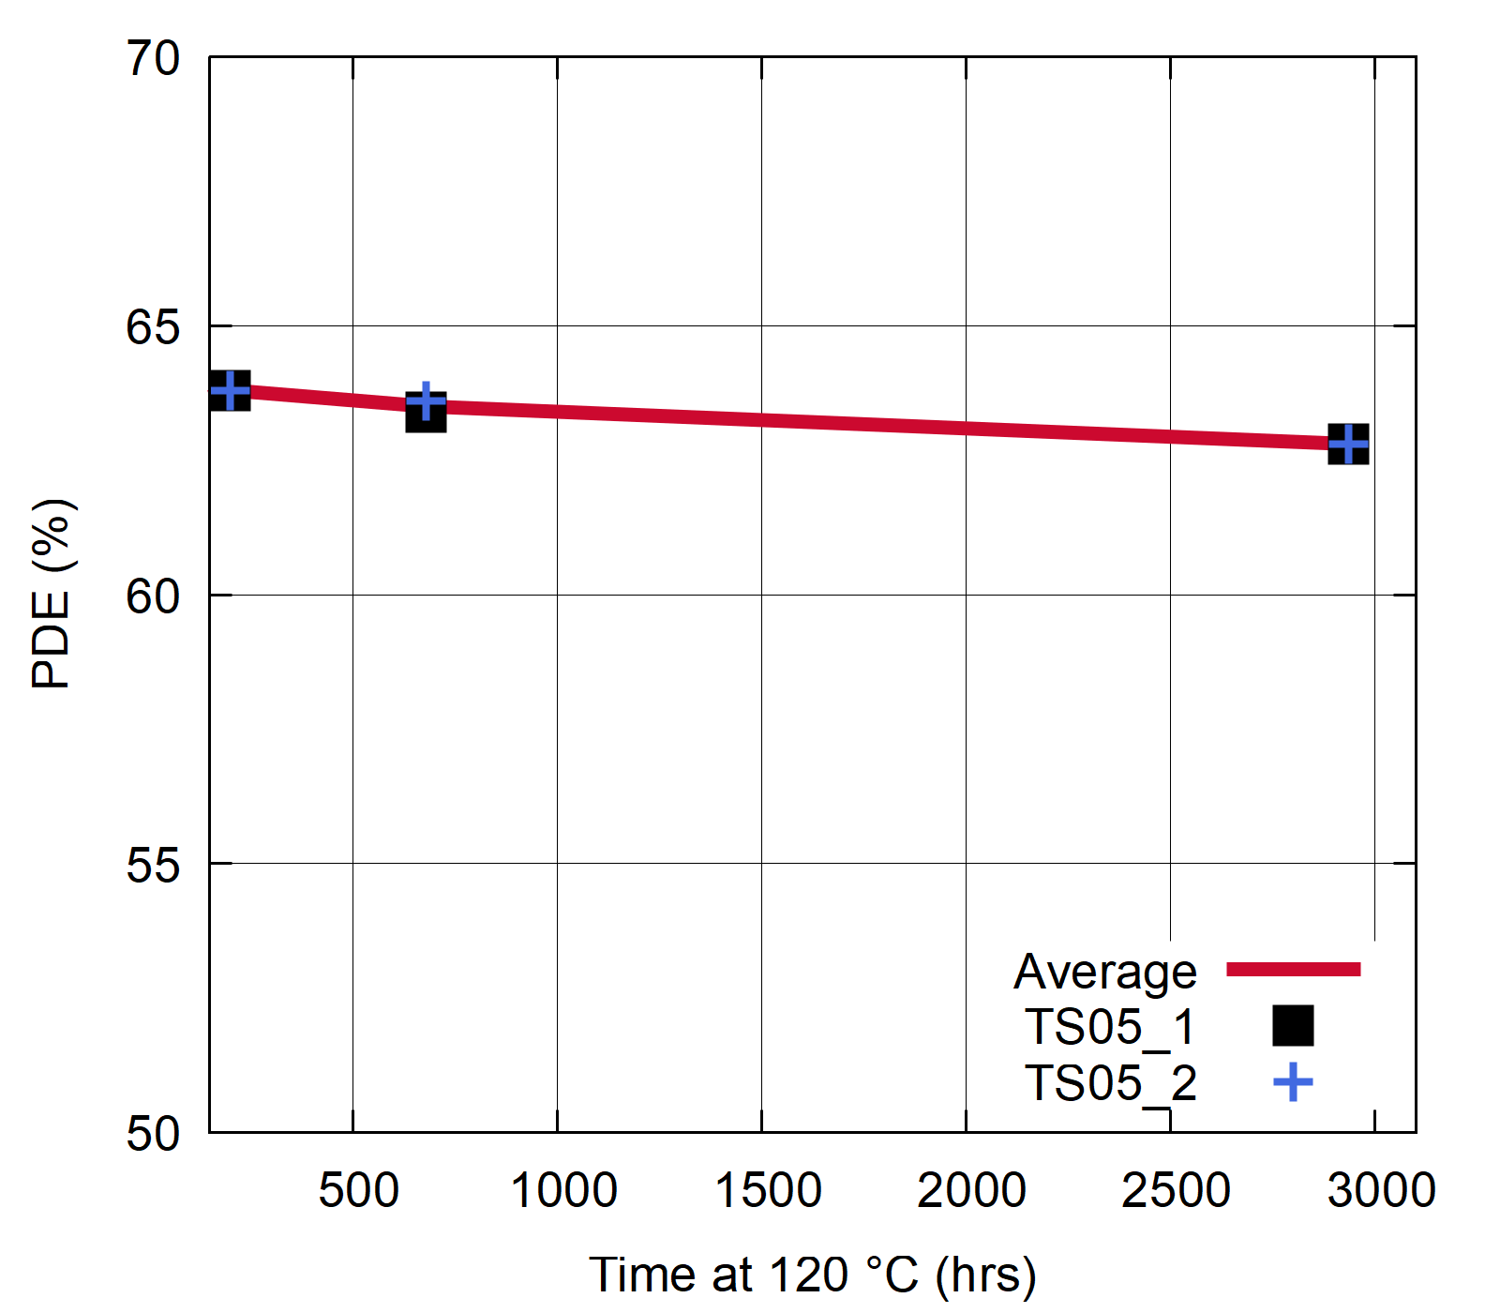
NUV-MT: Overmold Material
Candidates selected for best optical peformance over lifetime
  3000hrs at 120°C correspond to lifetime of about 20 years at 25°C
PDE vs time Production package
420nm
PDE vs. Time
at 420 nm
97% transmittance
200 hrs
3000 hrs
63.8%
680 hrs
62.8%
90% transm.

Slide 13


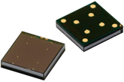
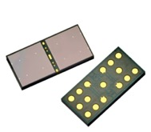
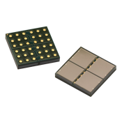
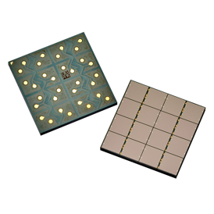
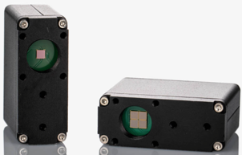
NUV-SiPM Product Summary & Outlook
Part no | Technology | Size (mm²) | Channels | Package | Status
AFBR-S4N22P014M | NUV-MT | 2 x 2 | 1 | Overmolded PCB | E-Samples
AFBR-S4N44P014M | NUV-MT | 4 x 4 | 1 | Overmolded PCB | in production
AFBR-S4N66P014M | NUV-MT | 6 x 6 | 1 | Overmolded PCB | in production
AFBR-S4N66P024M | NUV-MT | 13 x 6 | 2 x 1 | Overmolded PCB | in production
AFBR-S4N44P044M | NUV-MT | 8 x 8 | 2 x 2 | Overmolded PCB | in production
AFBR-S4N44P164M | NUV-MT | 16 x 16 | 4 x 4 | Overmolded PCB | in production
AFBR-S4KTIA3315B | NUV-B* | 3 x 3 | 1 | TIA-module | in production
*TIA module to be upgraded to NUV-MT

Slide 14
Thank you!
Please come and talk to me in the industrial exhibit
mjs@aptechnologies.co.uk

