Slide 1







Recent results from the
MIMOSIS-1 CMOS MAPS
M. Deveaux on behalf of the
IPHC-IKF-GSI (CBM-MVD) Collaboration
Supported by
(05P19RFFC1)

Slide 2
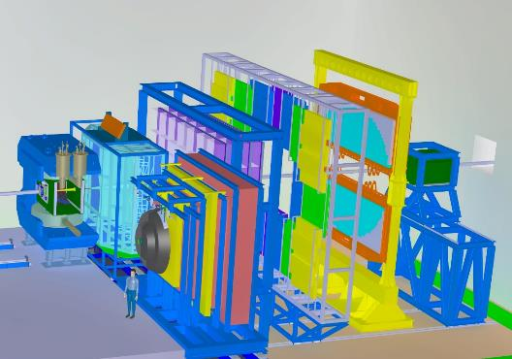
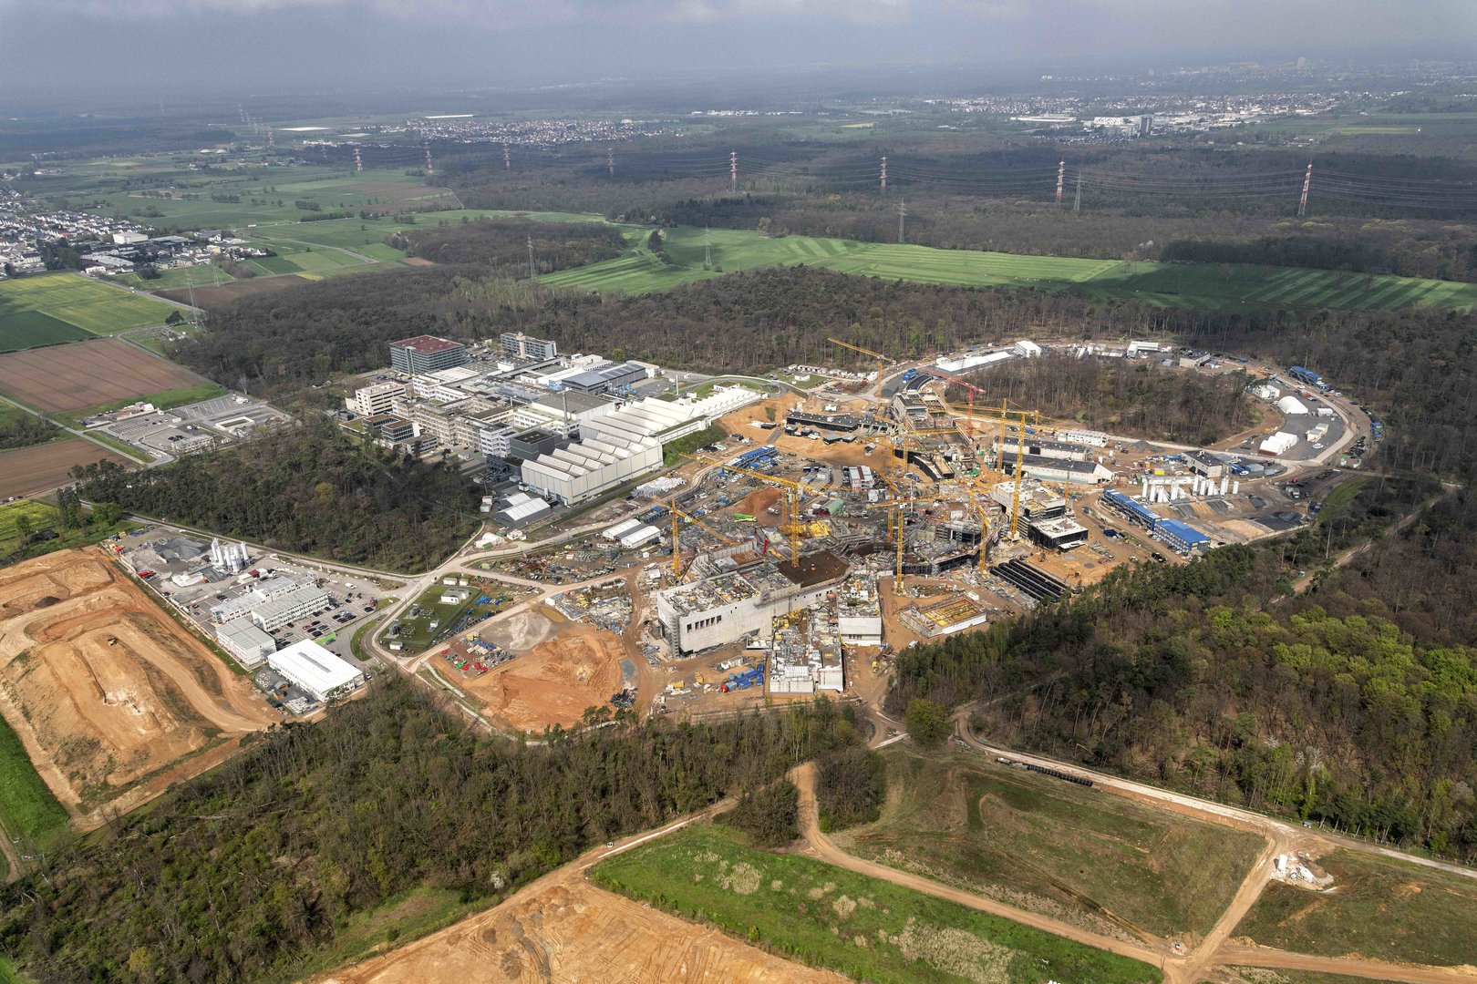
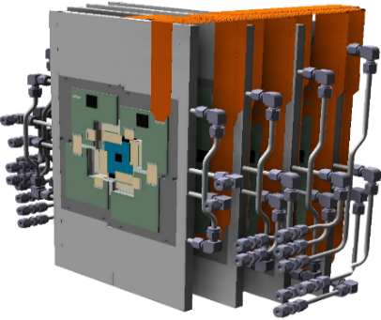

The CBM Micro Vertex Detector (MVD)
CBM-MVD
CBM
Darmstadt, Germany
M. Deveaux
13th POS conference, Oxford, Sept 2023

Slide 3
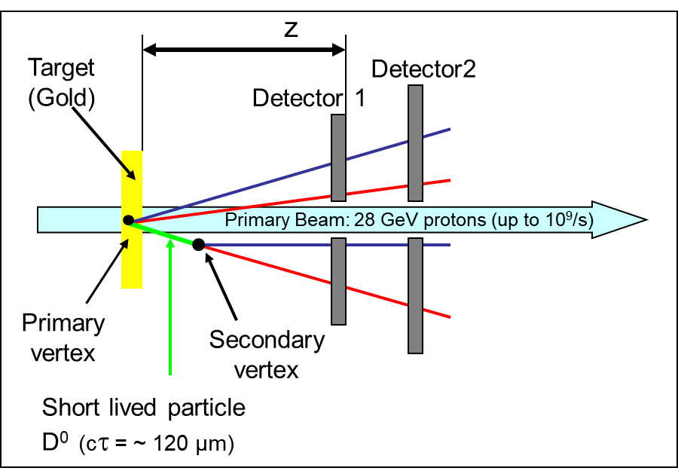
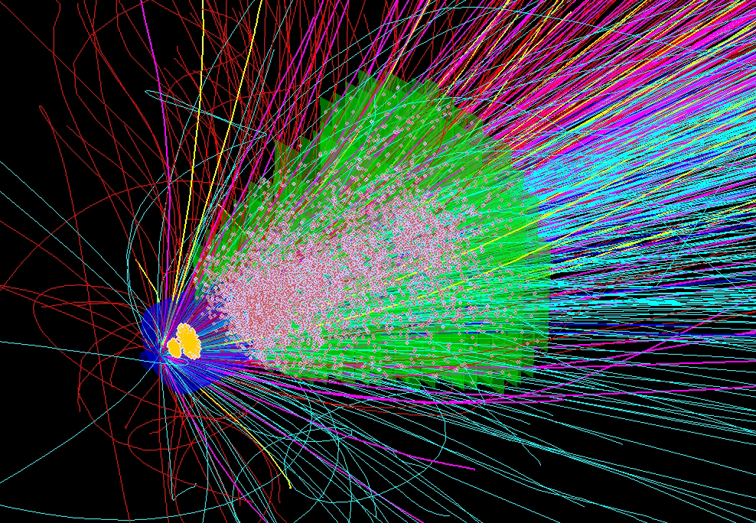
The (initial) mission: Reconstruct short - lived particles
Compute mother particle properties by:
Adding energy + momentum of daughters (invariant mass).
Challenge:
Select good daughter particles by separating primary and secondary vertex.
Need 5µm spatial resolution,
Need 300 - 500 µm Si equivalent material per station (0.3% X₀).
… like ALICE ITS-2…
High rate capability needed:
5µs time resolution.
20 MHz/cm² (peak 80 MHz/cm²).
~10¹⁴ n_{eq}/cm² radiation tolerance.
Tolerance to heavy ion hits (direct beam impacts).
(Find full list of requirements in the backup)
We are here
~10 x ALPIDE
Conclusion (2003, still true today):
Need specifically designed CMOS Monolithic Active Pixel Sensors.
CBM 8 AGeV: ~10% of all particles shown
13th POS conference, Oxford, Sept 2023

Slide 4



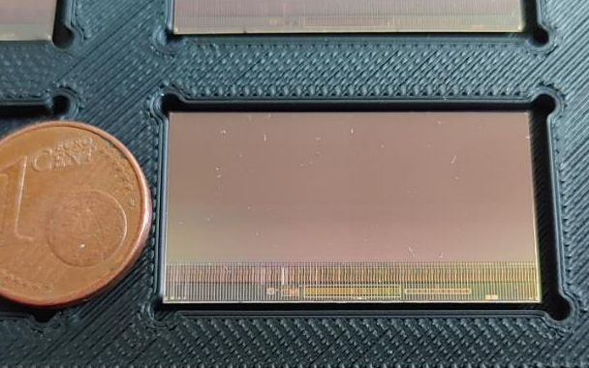

MIMOSIS R&D plan
MIMOSIS-0 (2018)
Demonstrate pixel concept.
Demonstrate zero suppression.
Demonstrate readout concept.
In synergy with:
MIMOSIS-1 (2020)
Full dimension sensor
Add buffer structure.
SEE hardening 1/2
Discussed today
MIMOSIS-2 (Q2/2023)
On-chip pixel grouping.
Final pixels.
SEE hardening 2/2
MIMOSIS-1, 60µm thick
MIMOSIS-1
MIMOSIS-3
Final sensor for mass production
All submissions:
Additional CE18 test structures to study specific design questions.
13th POS conference, Oxford, Sept 2023

Slide 5
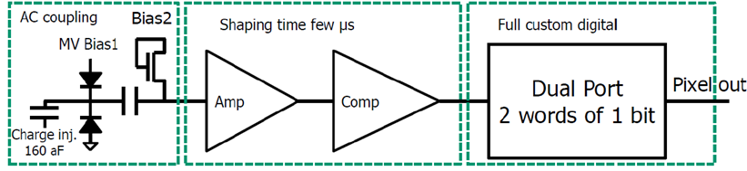
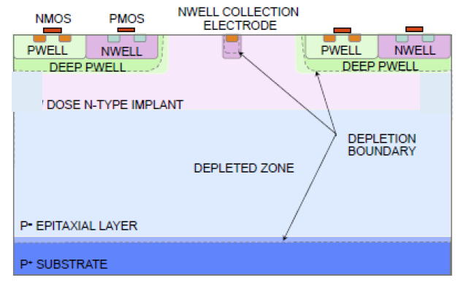
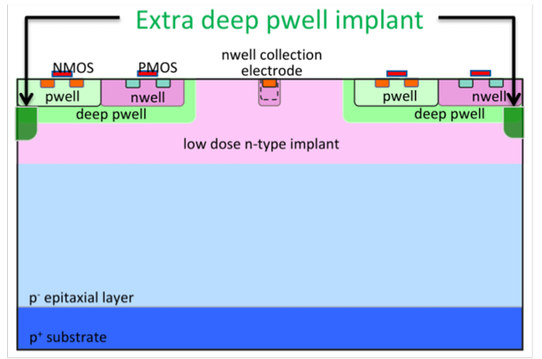
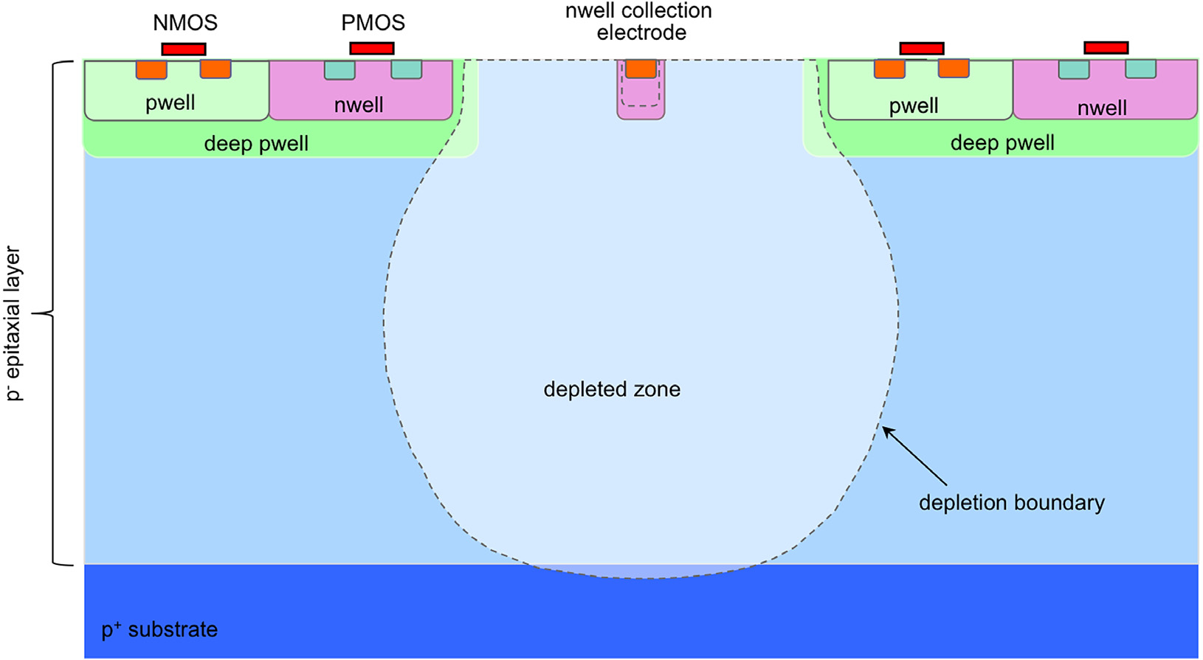

MIMOSIS-1
Size: 504 x 1024 pixels (27x30µm²)
FEE integrated.
Pixels types: 2x DC, 2x AC (>20V depletion voltage)
A
B
C
D
AC-pixel
>20V HV top bias
MIMOSIS-1, 60µm thick
Back bias possible.
P-Well bias (ALPIDE) possible
Capacitor blocks HV
Most likely Fully Depleted
standard
p-stop
First proposed by W. Snoeys et al.
H. Pernegger et al., 2017 JINST 12 P06008
n-gap
Standard
Rad. hard, candidate 2
Rad. hard, candidate 1
13th POS conference, Oxford, Sept 2023

Slide 6
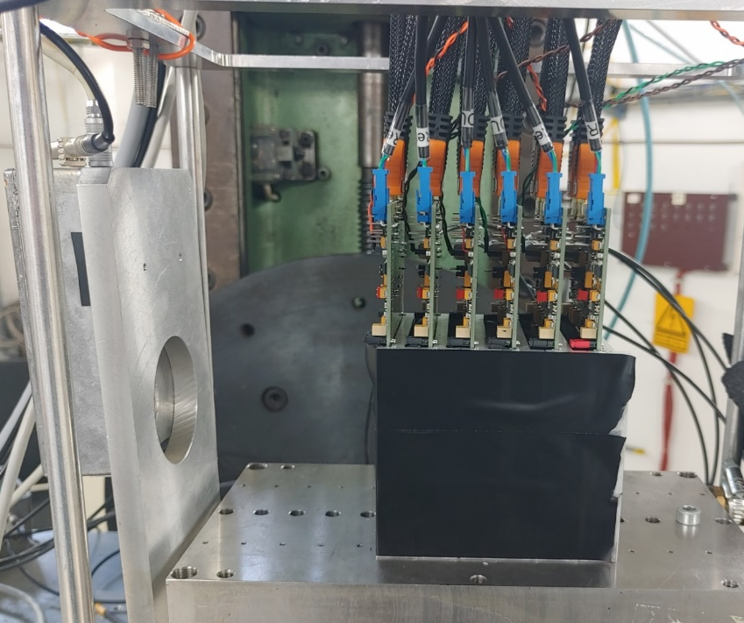
MIMOSIS-1 beam test setup
MIMOSIS-1 beam telescope:
6 MIMOSIS-1 sensors
4 reference sensors (standard epi-layer)
2 device under test
Reference Track Uncertainty:
  2.5 µm + 1.5 µm Mult. Scattering (DESY only)
Irradiation:
1 MeV reactor neutrons (TRIGA, Ljubjana).
Few 10 keV X-rays (KIT)
Storage at room temperature.
Beam test:
5 GeV e- Beam @ DESY
120 GeV Pion Beam @SPS-CERN
~ 1 GeV d – beam @ COSY
Stabilized room temperature
preliminary
13th POS conference, Oxford, Sept 2023

Slide 7
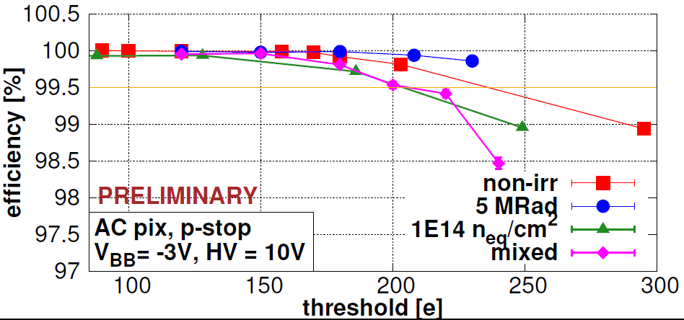
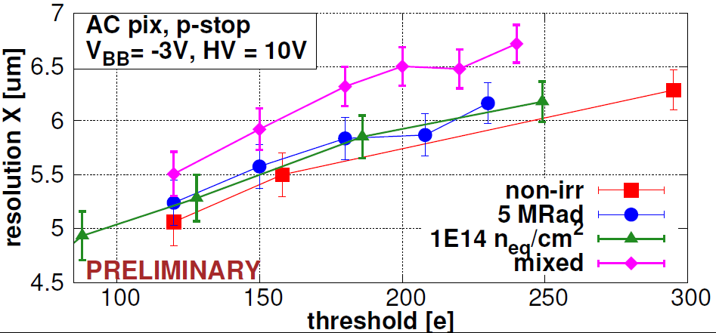
Sensor performance: New and after 5 MRad + 10¹⁴n_{eq}/cm²
CBM
Best performing pixel: AC P-stop
Efficiency >99% (end of life-time).
Spatial resolution: ~6 µm
Dark rate (not shown, see backup):
  Marginal before irradiation.
  <10⁻⁶ after irradiation.
Short dimension
of 27x30µm² pixel.
Conclusion on sensor performance:
All pixels work excellent before irradiation.
Standard pixels show best spatial resolution. (see backup)
P-stop AC pixel most radiation hard, matches requirements of CBM.
13th POS conference, Oxford, Sept 2023

Slide 8
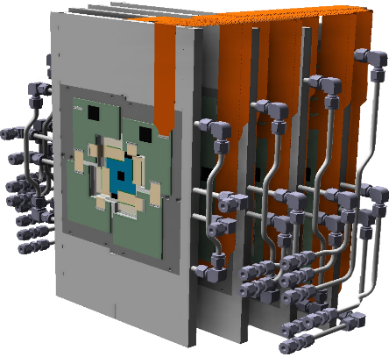
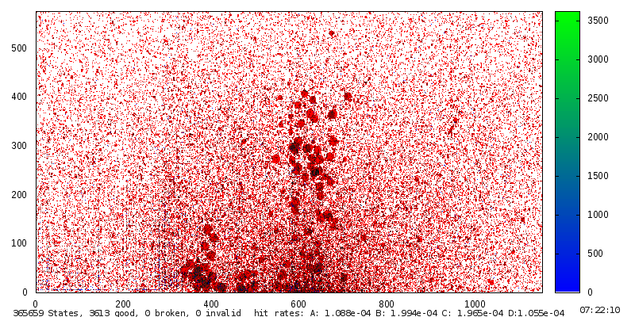
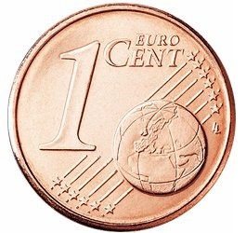
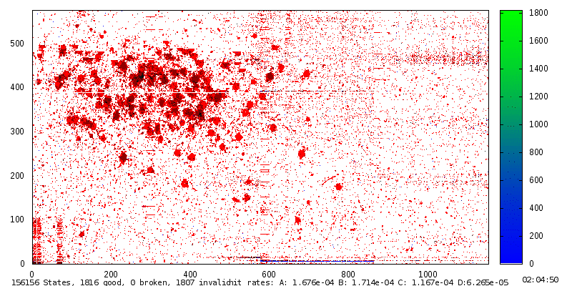
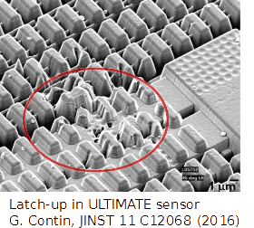
Immunity to heavy ions (Single Event Effects)
Beam halo
Origin:
Limited focus - few ions miss hole all the time.
Beam impact.
1 cm
Beam
~2x2 mm
M. Deveaux for NA61/SHINE, SQM 2017
Heavy ion:
~200 fired pixels
Beam hole: 11 mm
MIP (proton)
~2 fired pixels
SPS Pb beam halo @ NA61/SHINE
as seen with MIMOSA-26
Minority charge carriers excited by ions may:
Switch digital electronics => Bit flip
Open unwanted conduction paths => Latch-up
(like short cut, extinguish by power cycle)
Macroscopic damage by individual ion: Single Event Effect.
Malfunction if ignored
Thermal destruction if ignored
13th POS conference, Oxford, Sept 2023

Slide 9
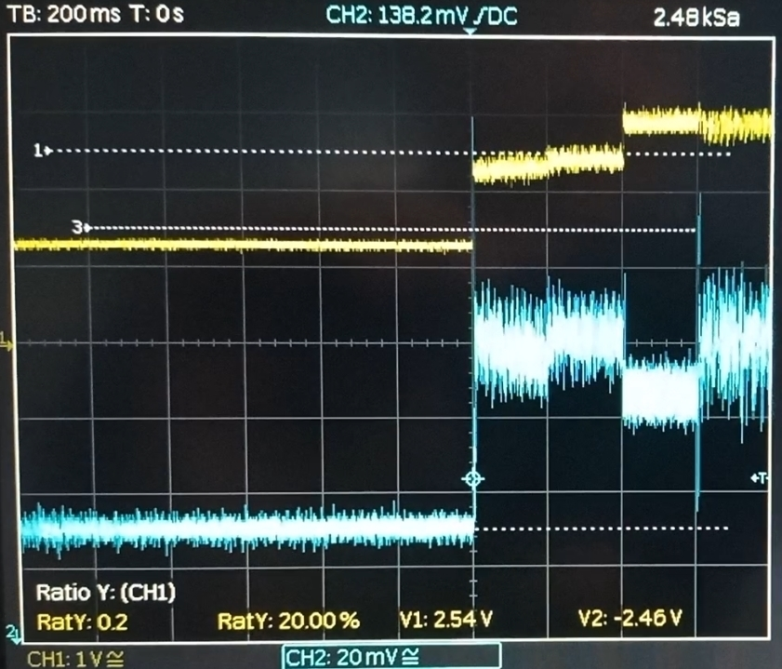
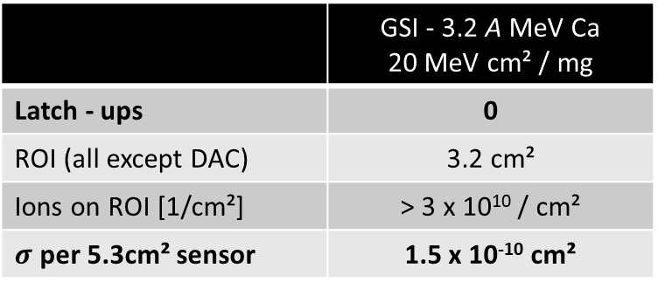
Observation on Single Event Effects
Latch-up (Ion generated short circuit, recover by power cycle):
 | GSI - 3.2 A MeV Ca 20 MeV cm² / mg
Latch - ups | 0
ROI (all except DAC) | 3.2 cm²
Ions on ROI [1/cm²] | > 3 x 10¹⁰ / cm²
$σ$ per 5.3cm² sensor | 1.5 x 10⁻¹⁰ cm²
Current [a.u.]
preliminary
MIMOSIS-1
ROI = DAC
No latch-ups observed.
Observation on DAC:
Bit flips in DAC generate current fluctuation.
  Bit correction bug to be fixed with MIMOSIS-2.
No beam
Pulses: Few 10⁶/cm²
MIMOSIS-1 seems to tolerate up to 300 MHz/cm² Ions at 20 MeV cm² / mg .
Latch-up cross-section orders of magnitude better than required (all structurs except DAC) .
Protection of steering registers to be fixed.
Data registers not protected – Expect occasional data corruption.
13th POS conference, Oxford, Sept 2023

Slide 10
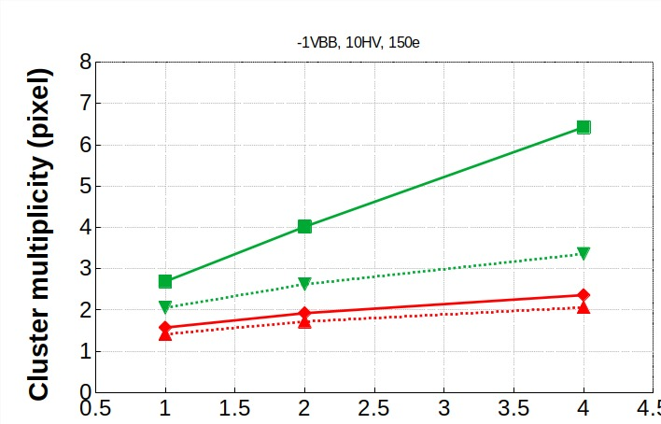
Response to different dE/dx
Known for elder sensors:
Individual pixel is not energy sensitiv but:
Pixel multiplicity scales with dE/dx [1,2].
Does this hold for MIMOSIS (dependence on depletion)?
~2x2 mm
Heavy ion:
~200 fired pixels
MIP (proton)
~2 fired pixels
[2] M. Deveaux for NA61/SHINE, SQM 2017
Experimental approach:
Use deuterium beam of COSY to create dE/dx higher than m.i.p.
Histogram multiplicity of hits associated to a identified track.
[1] C. A. Reidel et al., "Response of the Mimosa-28 pixel sensor to a wide range of ion species and energies", NIM-A Vol. 1017 (2021) 165807
m.i.p
1.4 GeV d
0.8 GeV d
DC - pixel
First observation:
Fully depleted pixels (p-stop) show marginal sensitivity to dE/dx.
Standard DC-pixel (lowest depletion) shows response. Significant?
Standard pixel
AC - pixel
Fully depleted
dE/dx [m.i.p]
13th POS conference, Oxford, Sept 2023

Slide 11
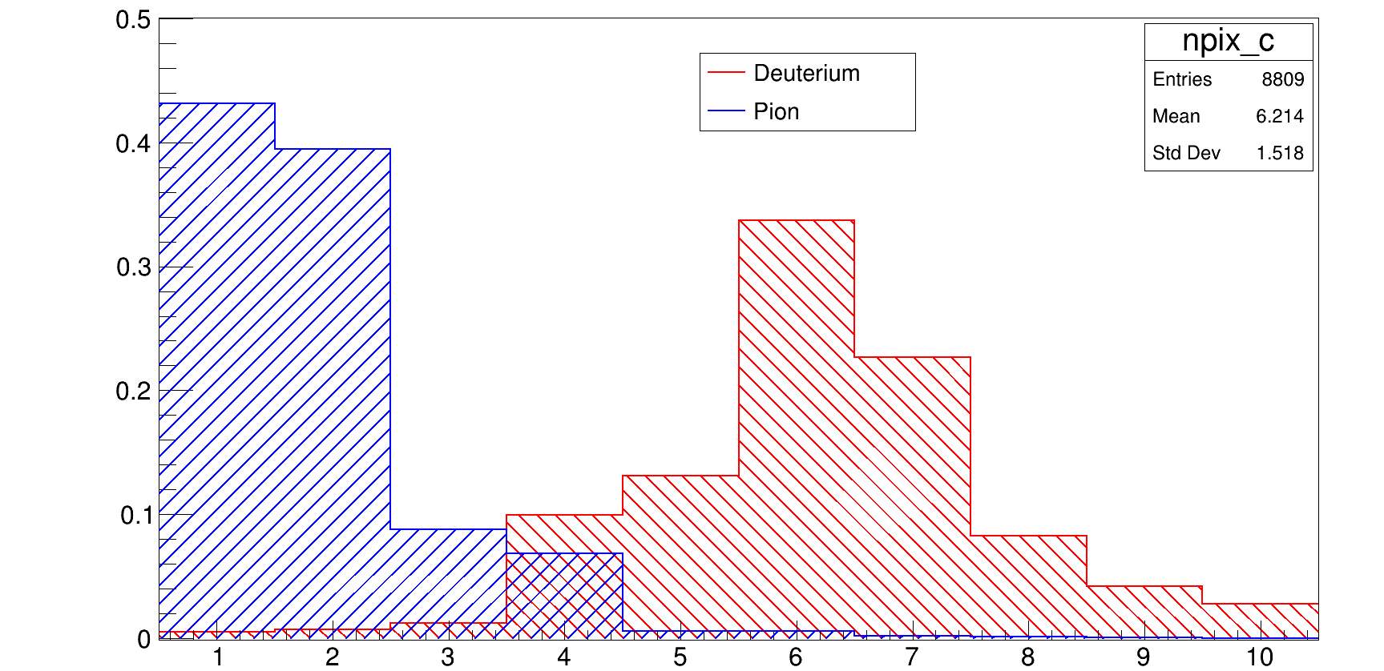


Response to different dE/dx
Cluster distribution (DC standard, normalized)
50%
CERN SPS pion
40%
COSY 0.8 GeV d
30%
20%
10%
$$N>70k$$
$$N=8.8k$$
1
5
10
Pixels/cluster
Preliminary conclusion:
Response to increasing dE/dx observed (usefulness for PID to be studied in detail).
High rad. tolerance configuration with high depletion not compatible with good dE/dx response.
Next step: Reproduce findings in device simulation.

Slide 12
Summary and conclusion
MIMOSIS-1 forms the first full size prototype of the MIMOSIS sensor for the CBM-MVD.
    5 µs / 5 µm time/spatial resolution.
    80 MHz/cm² peak rate.
MIMOSIS-1 irradiated with up to 3x10¹⁴ n_{eq}/cm² were tested in laboratory and in beam.
    >> 99% detection efficiency after 10¹⁴ n_{eq}/cm², 5 MRad and a combination of both
    <10⁻⁶ fake hit rate (after 10¹⁴ n_{eq}/cm², <0.05% of all pixels masked)
    ~5 µm spatial resolution before and after irradiation => Matches requirement.
    Tolerates HI with up to LET=20 MeV cm² / mg without observed latch-up.
    Response of partially depleted MIMOSIS-1 to different dE/dx may add information to CBM-PID
      (to be followed up).
MIMOSIS-1 matches the requirements of the CBM-MVD…
… and forms a mile-stone toward a sensor for higgs-factories.
13th POS conference, Oxford, Sept 2023

Slide 13




CBM-MVD collaboration members
Supported by:
Julio Andary¹, Benedict Arnoldi-Meadows¹, Ole Artz¹, Jérôme
Baudot², Grégory Bertolone², Auguste Besson², Norbert Bialas¹,
Roma Bugiel², Gilles Claus², Claude Colledani², Hasan
Darwish^{1,2,3}, Michael Deveaux^{1,3,6}, Andrei Dorokhov², Guy Dozière²,
Ziad El Bitar², Ingo Fröhlich^{1,3}, Mathieu Goffe², Benedict Gutsche¹, Fabian Hebermehl¹, Abdelkader Himmi², Christine Hu-Guo², Kimmo
Jaaskelainen², Oliver Michael Keller⁶, Michal Koziel¹, Franz
Matejcek¹, Jan Michel¹, Frédéric Morel², Christian Müntz¹, Hung
Pham², Christian Joachim Schmidt³, Stefan Schreiber¹, Matthieu
Specht², Dennis Spicker¹, Joachim Stroth^{1,3,4}, Isabelle Valin², Roland Weirich^{1,} Marc Winter⁵and Yue Zhao²
¹Goethe-Universität Frankfurt, Germany
²Université de Strasbourg, CNRS, IPHC UMR 7178, Strasbourg, France
³GSI Helmholtzzentrum für Schwerionenforschung GmbH, Germany
⁴Helmholtz Forschungsakademie Hessen für FAIR, Germany
⁵IJCLab, UMR9012 – CNRS / Université Paris-Saclay / Université de Paris, France
⁶Facility for Antiproton and Ion Research in Europe GmbH,Germany
(05P21RFFC2)
13th POS conference, Oxford, Sept 2023

Slide 14
Backup

Slide 15
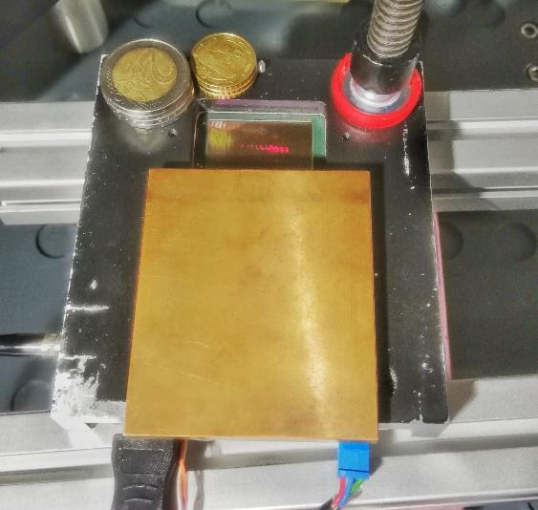
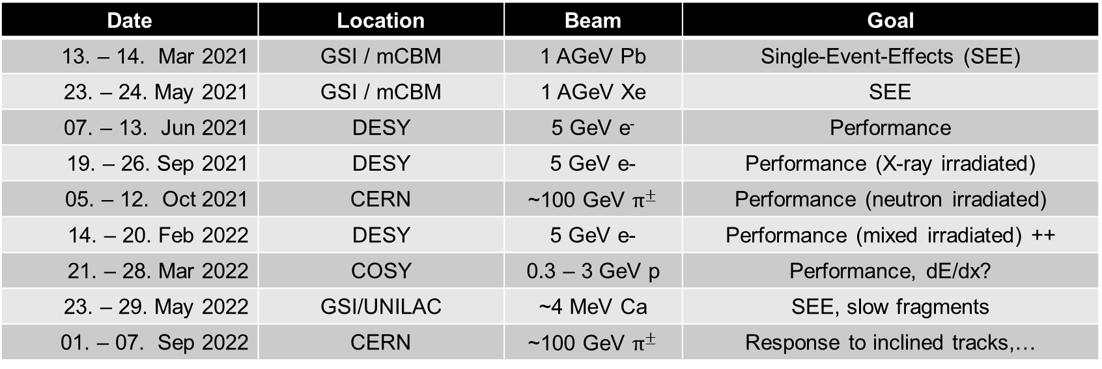
Beam tests (MIMOSIS-1)
Date | Location | Beam | Goal
13. – 14. Mar 2021 | GSI / mCBM | 1 AGeV Pb | Single-Event-Effects (SEE)
23. – 24. May 2021 | GSI / mCBM | 1 AGeV Xe | SEE
07. – 13. Jun 2021 | DESY | 5 GeV e⁻ | Performance
19. – 26. Sep 2021 | DESY | 5 GeV e- | Performance (X-ray irradiated)
05. – 12. Oct 2021 | CERN | ~100 GeV $π^{±}$ | Performance (neutron irradiated)
14. – 20. Feb 2022 | DESY | 5 GeV e- | Performance (mixed irradiated) ++
21. – 28. Mar 2022 | COSY | 0.3 – 3 GeV p | Performance, dE/dx?
23. – 29. May 2022 | GSI/UNILAC | ~4 MeV Ca | SEE, slow fragments
01. – 07. Sep 2022 | CERN | ~100 GeV $π^{±}$ | Response to inclined tracks,…
Irradiation campaigns:
Shielding for PCB-ICs
(X-rays @ KIT)
Date | Location | Radiation
Jul – Aug 2021 | Ljubjana (TRIGA) | ~1 MeV reactor neutrons
Sep 2021 | Karlsruhe (KIT) | ~10 keV X-rays
Aug 2022 | Karlsruhe (KIT) | ~10 keV X-rays
Special thanks to IPHC for massive support in beam time preparation.
Meanwhile: 14 IPHC people (9-10 FTE) involved in MIMOSIS.

Slide 16
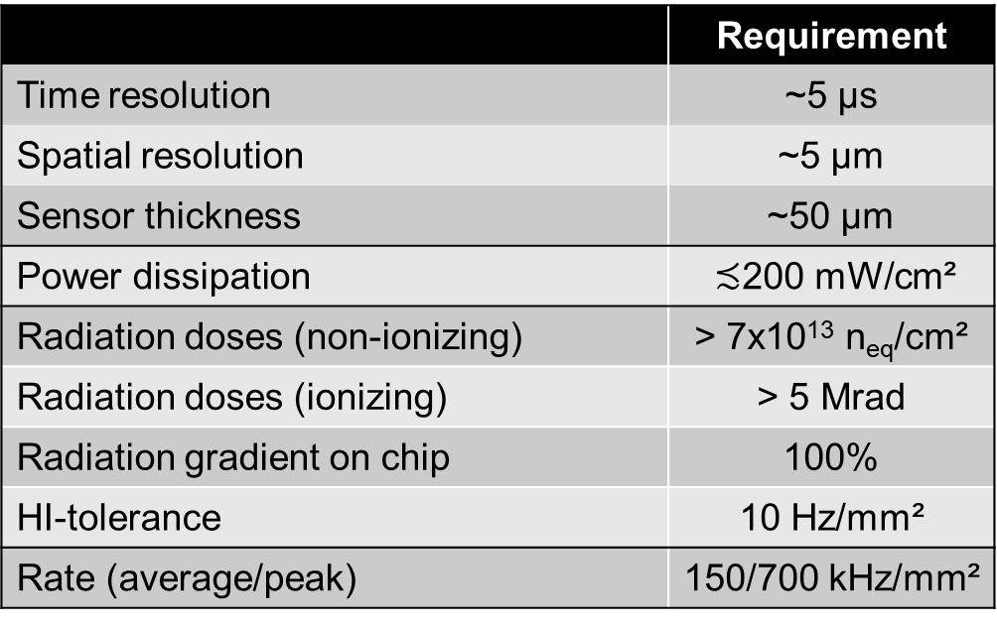

CBM-MVD Sensor requirements
 | Requirement
Time resolution | ~5 µs
Spatial resolution | ~5 µm
Sensor thickness | ~50 µm
Power dissipation | $≾$200 mW/cm²
Radiation doses (non-ionizing) | > 7x10¹³ n_{eq}/cm²
Radiation doses (ionizing) | > 5 Mrad
Radiation gradient on chip | 100%
HI-tolerance | 10 Hz/mm²
Rate (average/peak) | 150/700 kHz/mm²
Mostly established by ALPIDE
(Sensor of ALICE ITS2 upgrade)
per year
no safety factor
$≈$10 x ALPIDE
Incompatible with ALPIDE
> 20x internal bandwidth needed
How to arrive there (starting from ALPIDE) based on 180 nm technology?
3rd High-D consortium meeting, 9-10 Feb. 2023

Slide 17
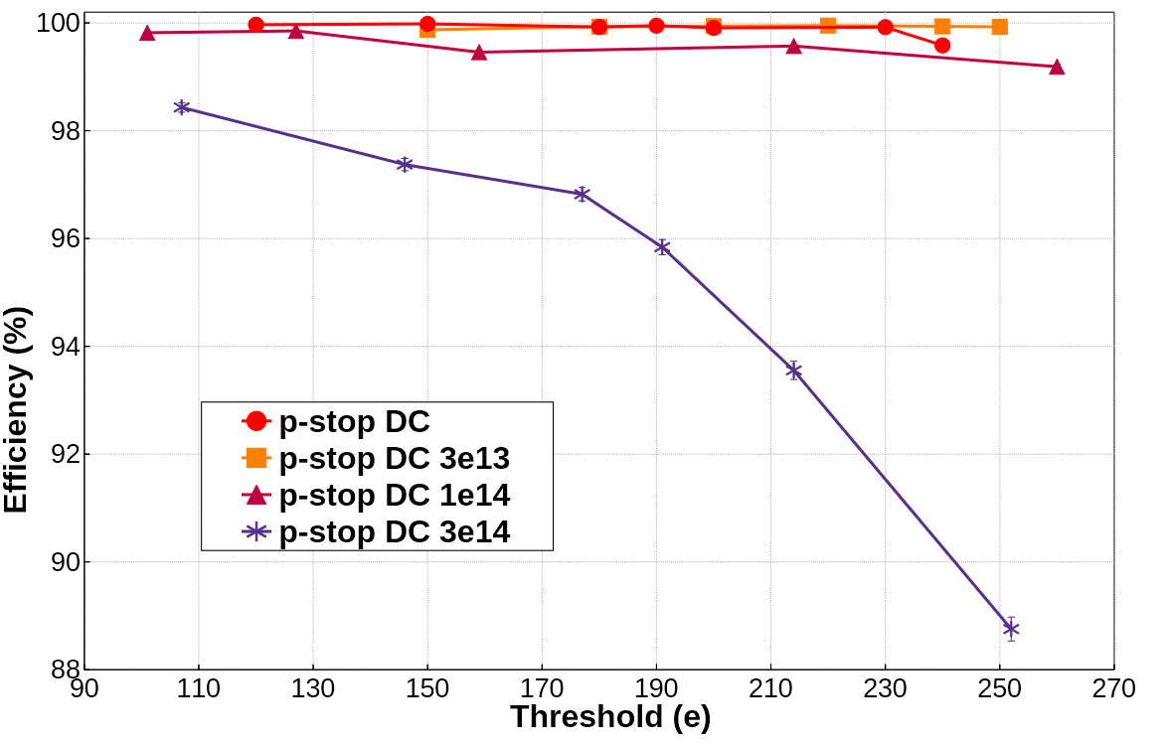
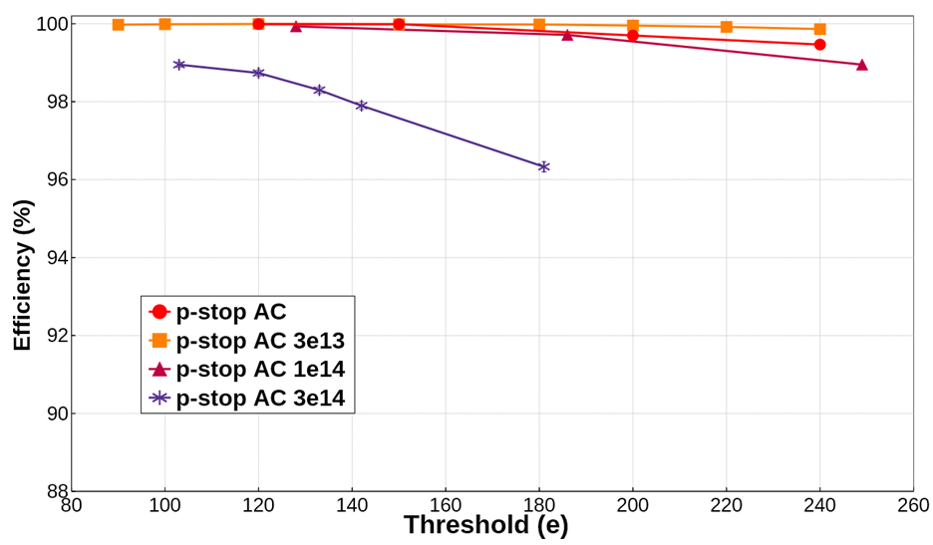
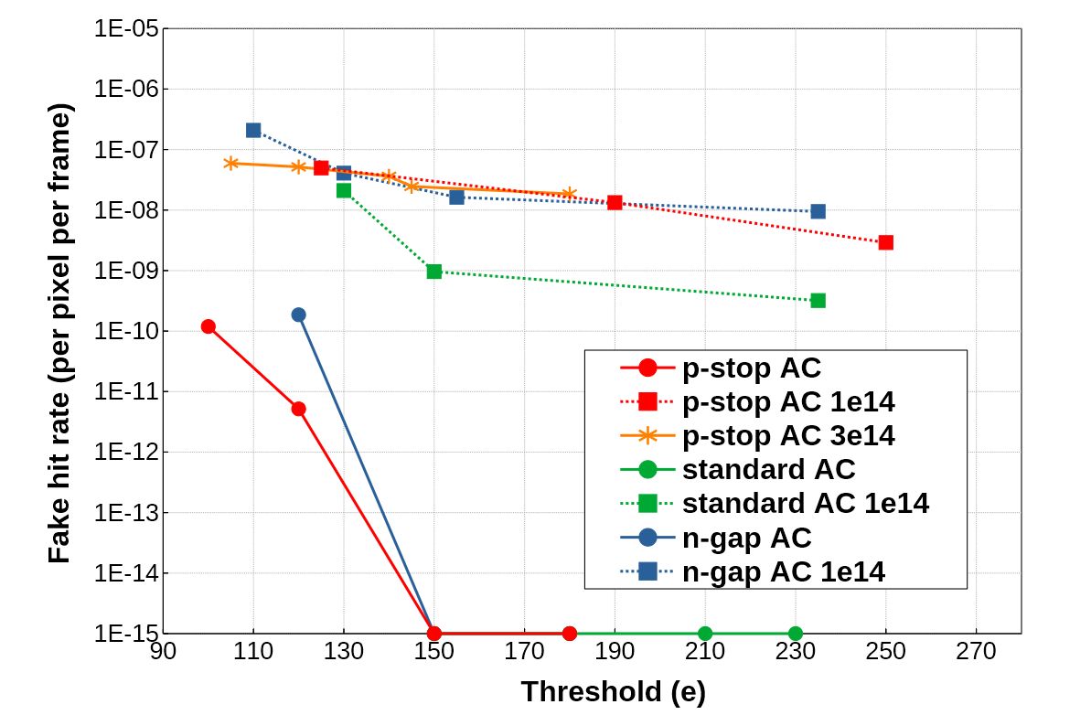
MIMOSIS-1: Tolerance to non-ionizing radiation
Preliminary
Preliminary
Vbb=-3V
HV=10V
Vbb=-3V
Preliminary
Observation:
Det eff. >> 99% for 10¹⁴ n_{eq}/cm².
Resonable performance after 3x 10¹⁴ n_{eq}/cm².
AC-pixel shows better efficiency (as expected).
Dark rate < 10⁻⁶ for all pixels tested.
  => Holds for DC-pixels (not shown).
  => Matches requirements.
1 hit/frame
<0.05% of all pixels masked
13th POS conference, Oxford, Sept 2023

Slide 18
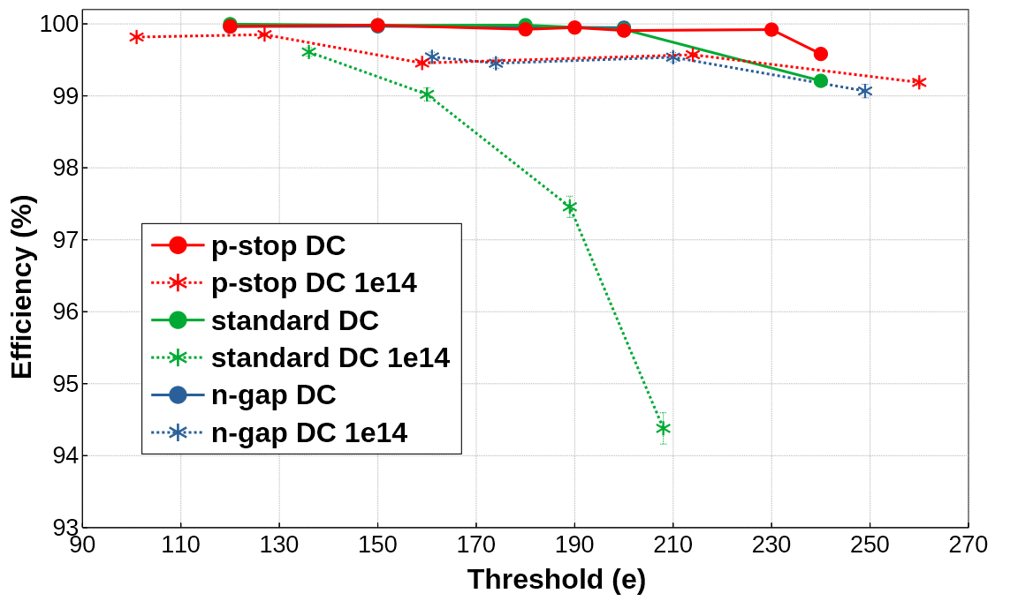
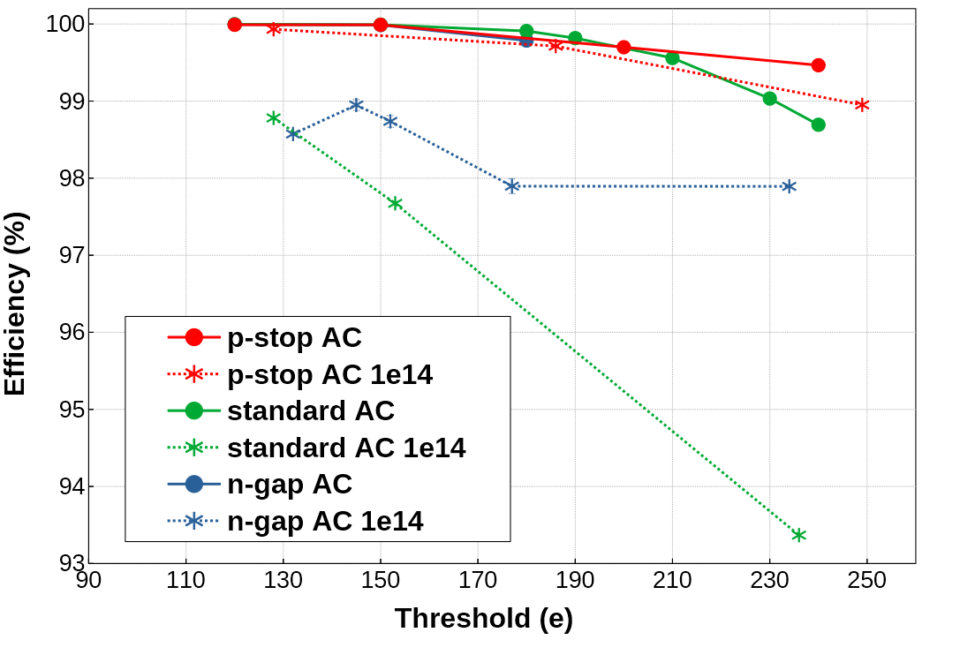
Mimosis-1: In beam performance
Before irradiation:
All pixels show excellent performance.
Vbb=-3V
Preliminary
After 10¹⁴n_{eq}/cm² (end-of-lifetime):
Standard epi-layer reaches limits.
Good performance for p-stop, n-gap.
Best performance: p-stop AC pixel.
  n-gap AC worse than n-gap DC => follow up.
Vbb=-3V
HV=10V
Preliminary
13th POS conference, Oxford, Sept 2023

Slide 19
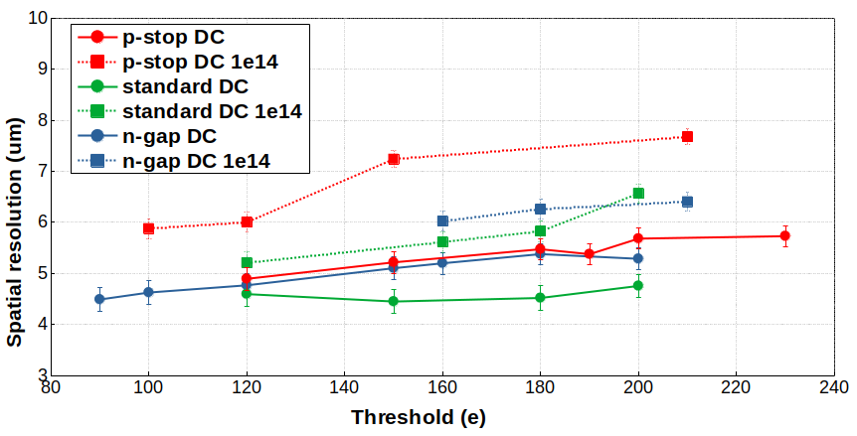
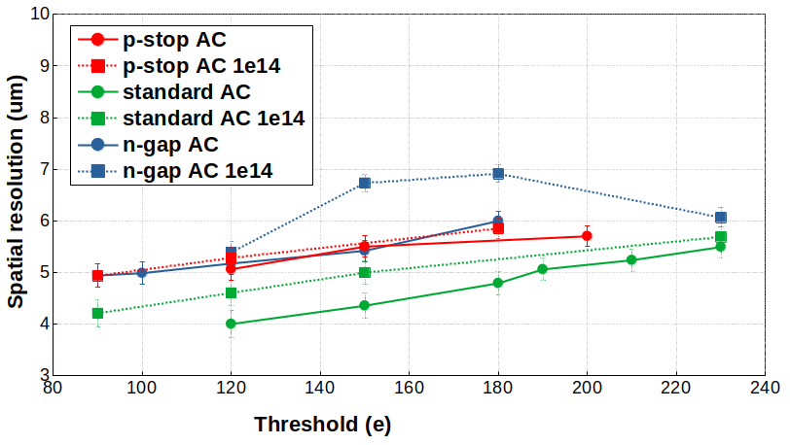
MIMOSIS-1 spatial resolution
Preliminary
Observation:
Best resolution for standard epi.
  Larger charge sharing (measured, not shown).
Resolution mildly worse after irradiation.
  Bulk damage reduces cluster size.
Plots hold for small dimensions of pixel
  ~10 % worse resolution for long dimension (not shown).
Results for all pixels match CBM requirements at default 120 – 150 e threshold.
Note: Preliminary results
Still preliminary alignment.
  Fixing this may or may not eliminate outlayers
  (work in progress).
Preliminary
?
?
Approx. alignment
uncertainty.
3rd High-D consortium meeting, 9-10 Feb. 2023

Slide 20
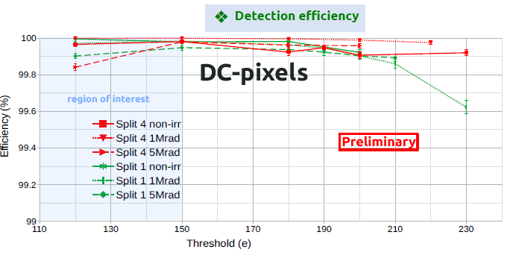
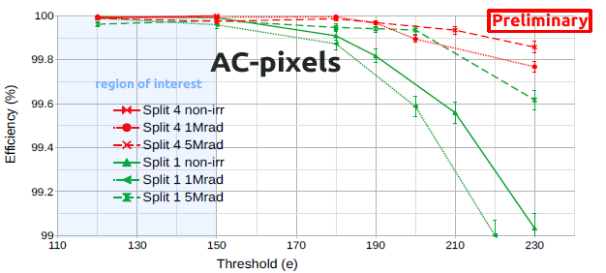
MIMOSIS-1: Tolerance to ionizing radiation
Observation:
Good detection efficiency also after ionizing doses.
Radiation seems to improve performance sometimes
  Radiation may modify pixel tuning (7 parameters)
  Probably room for improvement.
Dark rate stays below 10⁻⁷
No impact on spatial resolution within uncertainties
p-stop
standard
p-stop
standard
3rd High-D consortium meeting, 9-10 Feb. 2023

Slide 21
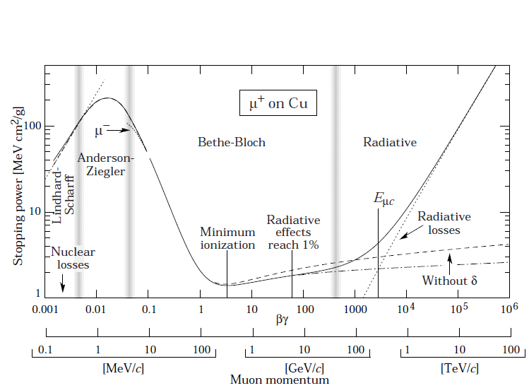
4x m.i.p
2x m.i.p
m.i.p
0.8 GeV d
1.4 GeV d

