Slide 1


High granularity resistive Micromegas for future detectors
M. Biglietti³, M. Alviggi^{1,2}, M.T. Camerlingo¹ , M. Della Pietra^{1,2}, R. Di Nardo^{3,5}, P. Iengo³, M. Iodice³, F. Petrucci^{3,5}, G. Sekhianidze¹, M. Sessa^{3,5}
1 INFN Napoli
2 Univ. di Napoli «Federico II»
3 INFN Roma Tre
4 Univ. di Napoli «Parthenope»
5 Univ. Roma Tre

Slide 2

The RHUM project
Consolidation of resistive Micromegas for measurements at rates up to several MHz/cm²
High-granularity low occupancy readout on pads of the order of mm², for good spatial resolution and capable of withstanding high radiation
Optimize the spark protection resistive scheme to achieve stable operation at high rate and gain
Demonstration of the scalability of detectors on large surfaces
Simplification of the construction technique for industrial production

Slide 3
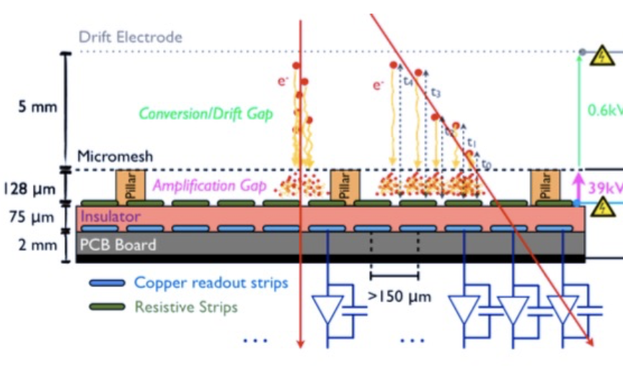
Micromegas Detectors
Resistive Micromegas developed from a dedicated R&D for ATLAS NSW →
  resistive anode strips on the top of the readout strips (with insulator in between) to suppress discharge intensity
  The signal is capacitively induced to the readout strips
now operational in ATLAS → demonstrated to be a solid detector technology for HEP experiments

Slide 4
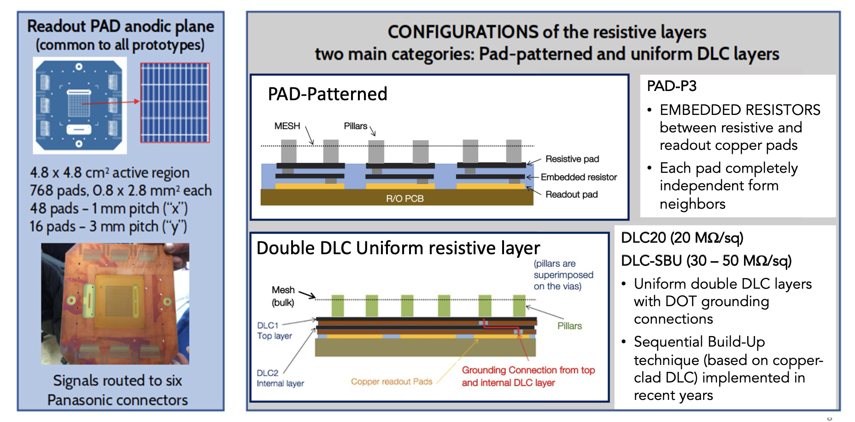
The small-size Prototypes

Slide 5
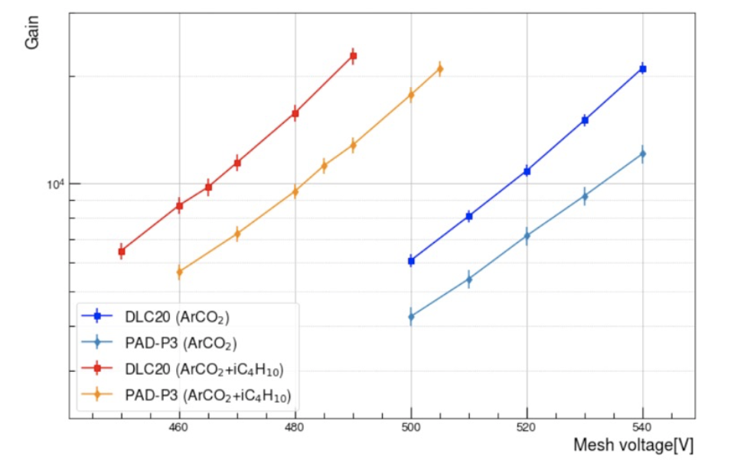
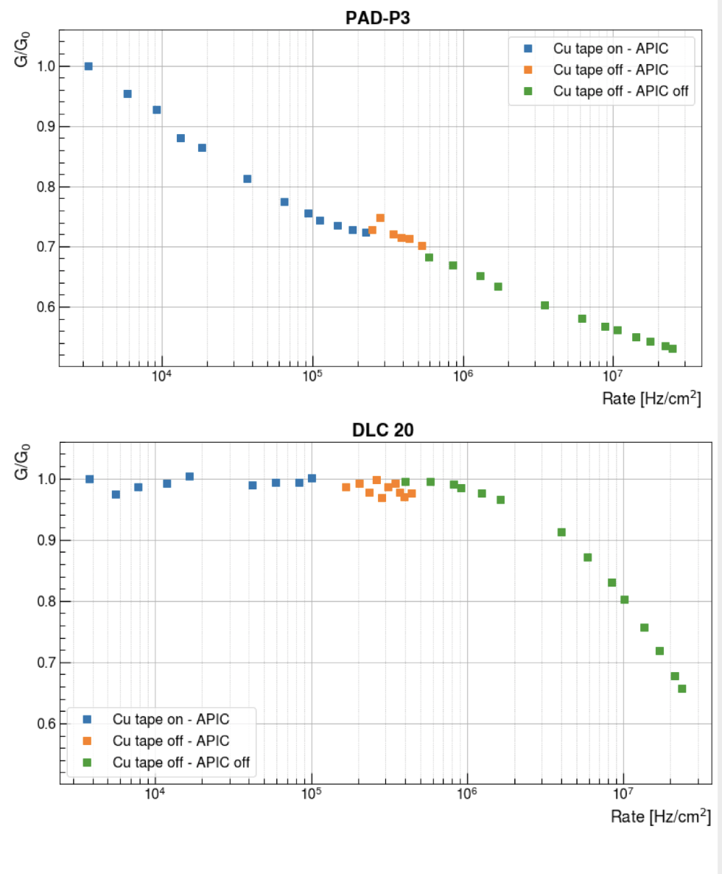
Lab Measurements : Gain and Rate Capability
Gain measurements with ⁵⁵Fe source with ~20kHz rate
measurement with 8keV X-rays (x4 ionisation wrt MIPs)
G₀=8000
Lower gain of PAD-P type wrt DLC type due to the dielectric charging-up of the kapton surrounding the resistive pads.
PAD-P resistive scheme: relatively fast gain loss due to charging-up
DLC resistive scheme : Gain stable up to >1MHz/cm²
loss at high rate from ohimc voltage drop
Gain ~20k reached at very high rates (>10 MHz/cm²) in stable conditions

Slide 6
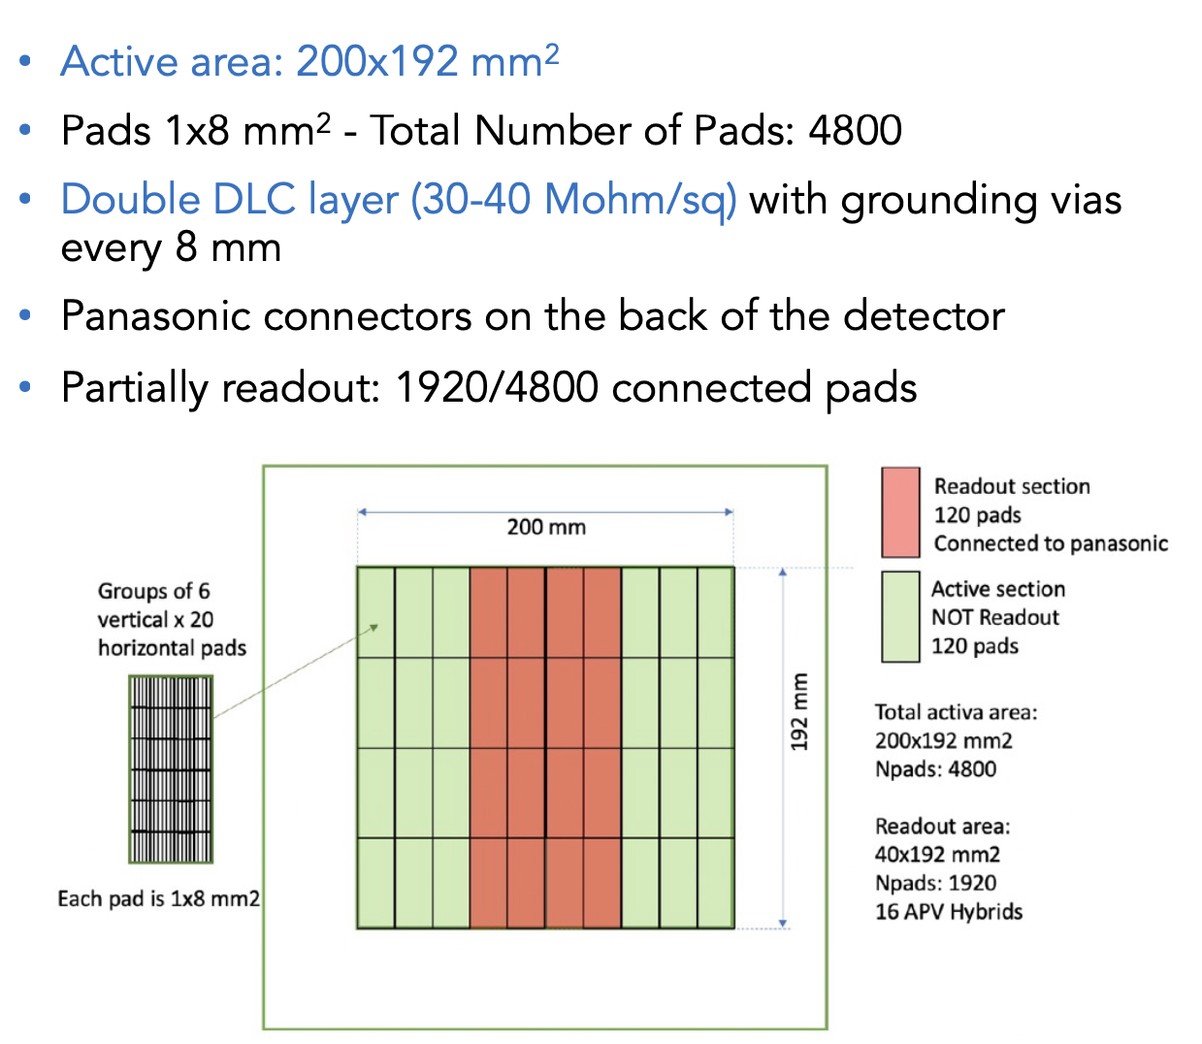
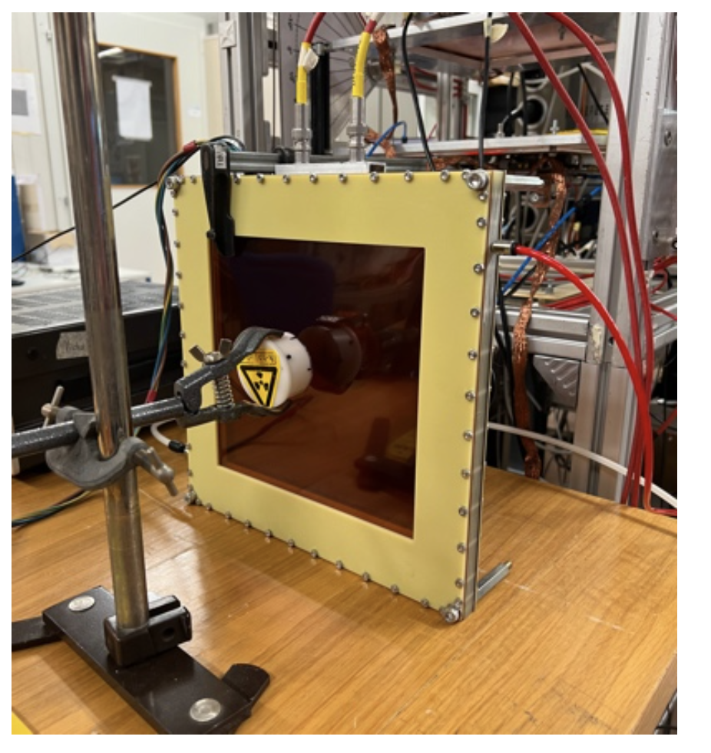
Paddy400: The 20x20 cm² Prototype

Slide 7
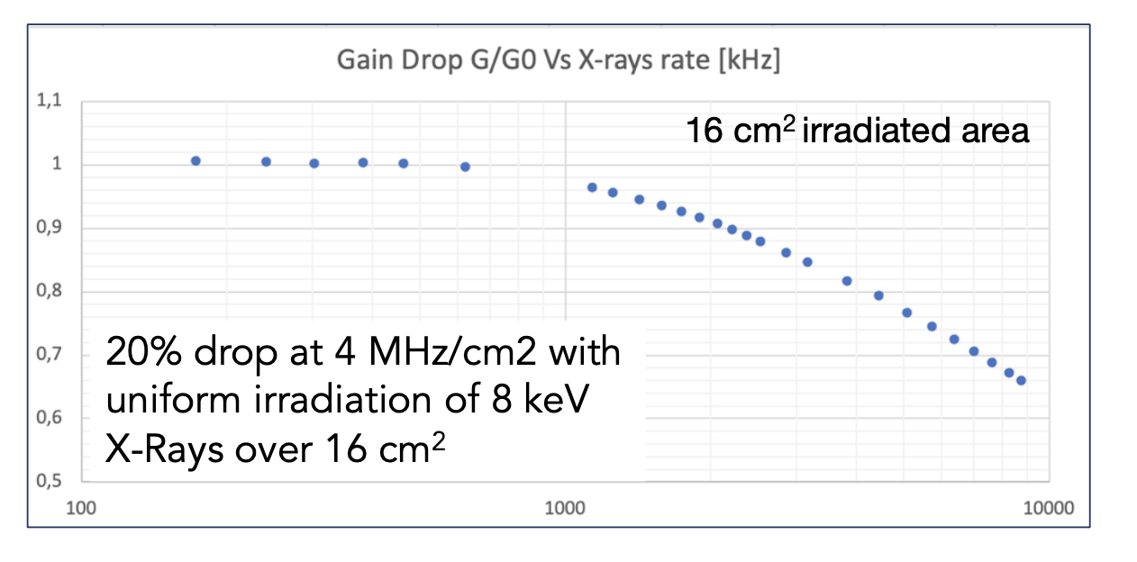
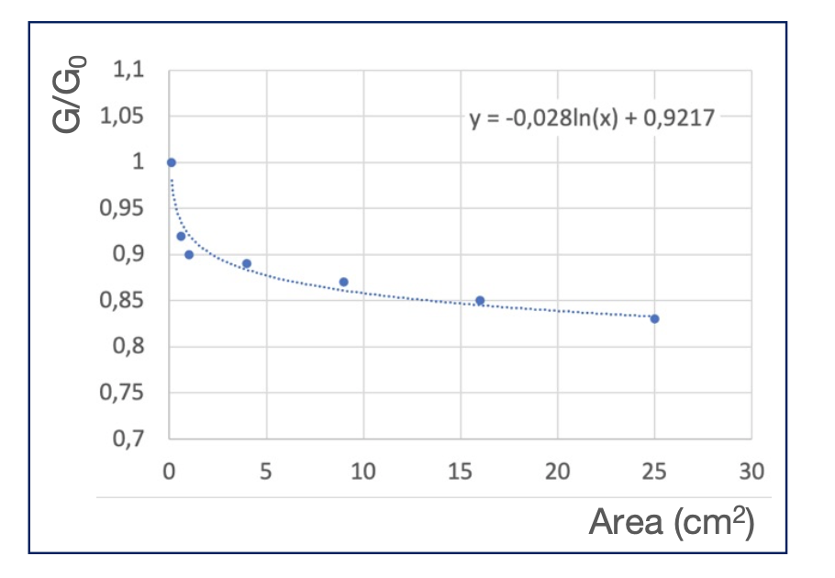
Paddy400: Rate Capability
Rate Capability : behaviour similar
to small DLC prototypes
G₀=5000
Fixed rate: 3 MHz/cm²
(Equivalent to > 10 MHz/cm2 for MIPs)
Logarithmic dependence
G/G0 ~75% extrapolated to 20x20 cm²
  Can be compensated with +10 V
Dependence on the
irradiated area

Slide 8
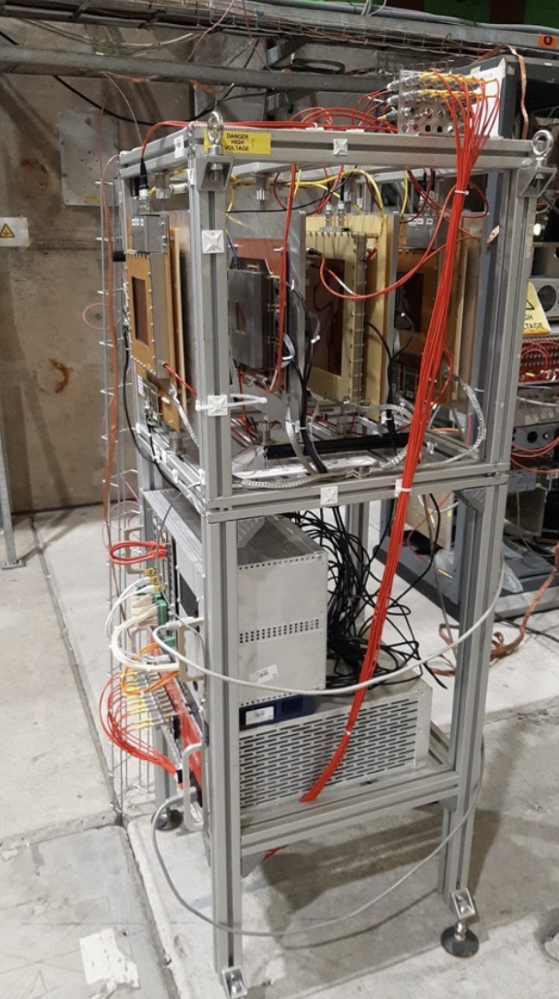
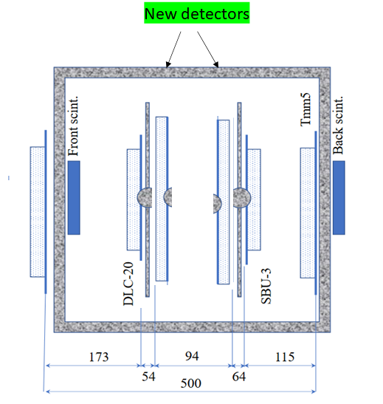
Test Beams @ CERN H4 beam line
several Testbeams,
different configurations and studies
July 2023
  muon beam, 2 small-size prototypes with reduced drift gaps, 2 20x20cm² large prototypes, different beam incident angles, fast gas mixure Ar:CF4:iC4H10 (88:10:2)
October 2022
  muon and pion beams, 3 small-size prototypes, 1 20x20cm² large prototypes, different beam incident angles , different gas mixure for timining studies Ar:CO2: iC4H10 (93:5:2) and Ar:CF4: iC4H10 (88:10:2)
October 2021
  muon and pion beams, 4 small-size prototypes, different beam incident angles, different gas for optimisation Ar:C02(93:7) Ar:C02: iC4H10 (88:10:2)
… 2021 (at GIF++), 2018, 2017, 2016

Slide 9
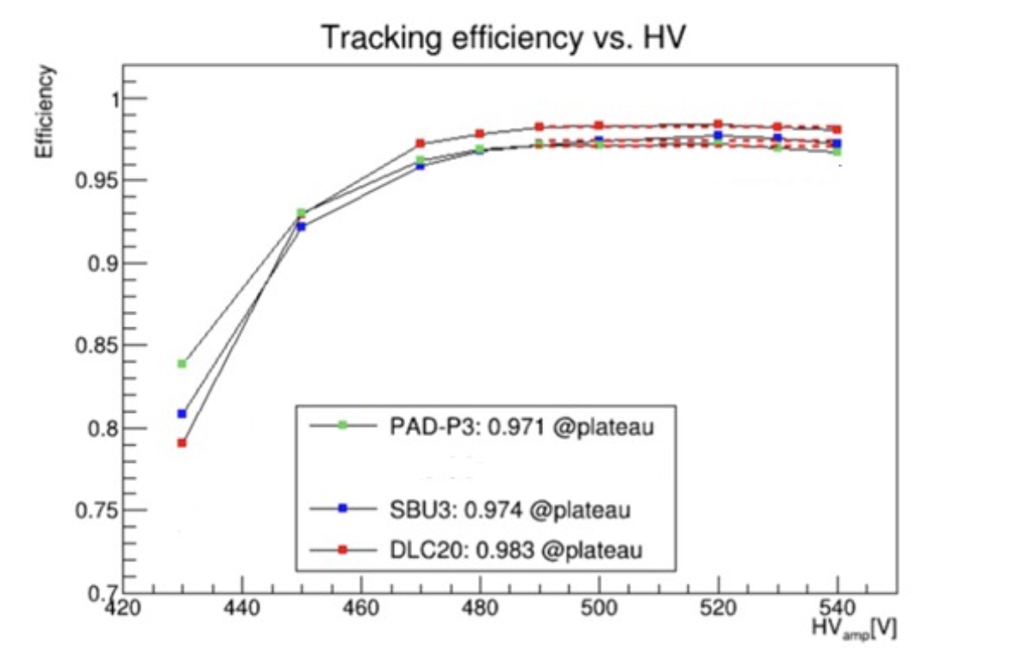
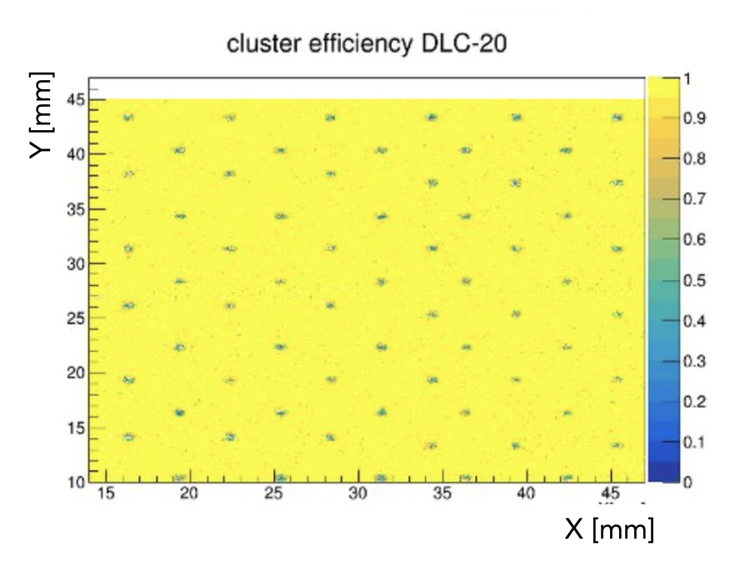
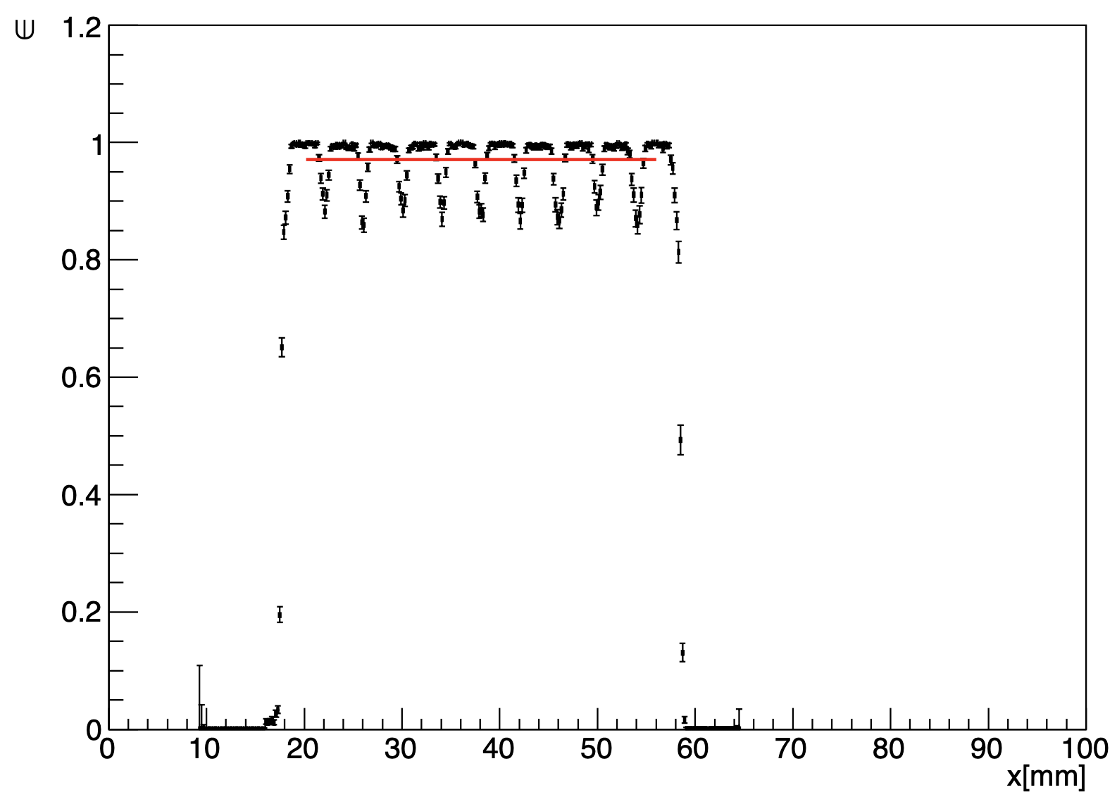
Performances at Test-Beam
Tracking efficiency:
1.5 mm fiducial range of the clusters wrt extrapolated position from external tracking chambers
0.3mm pillars
0.7mm pillars
INEFFICIENCIES from local circular pillars
Paddy400

Slide 10
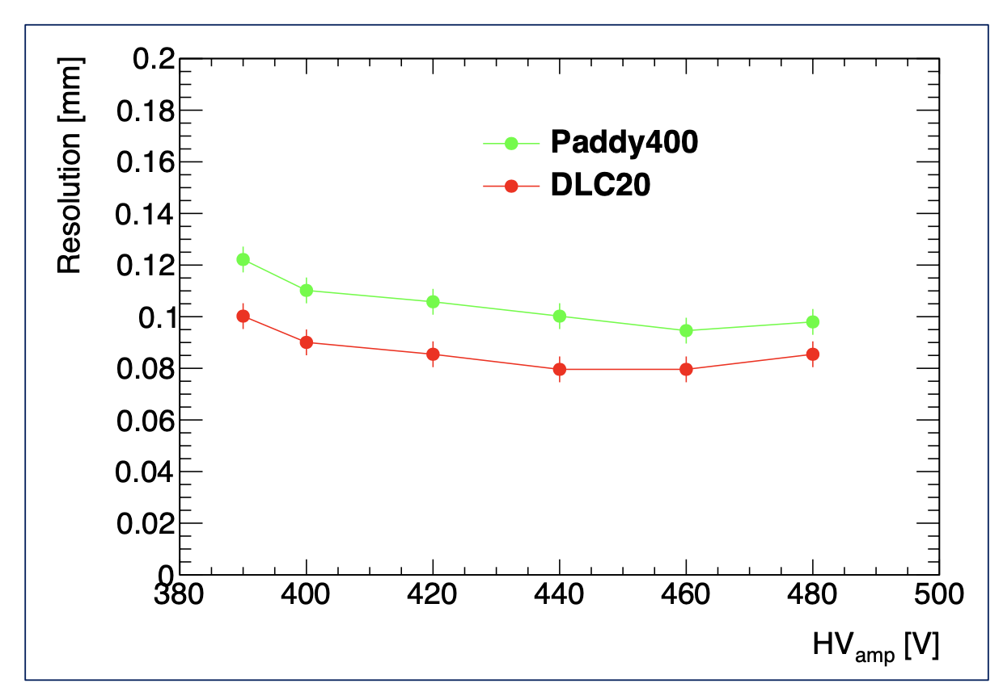
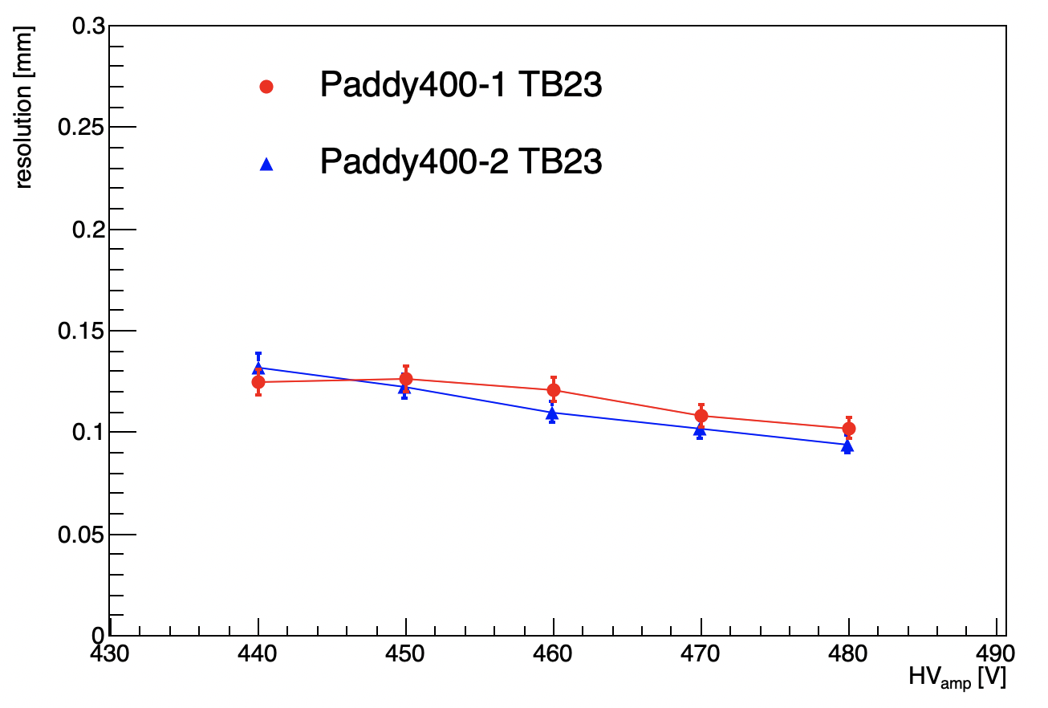
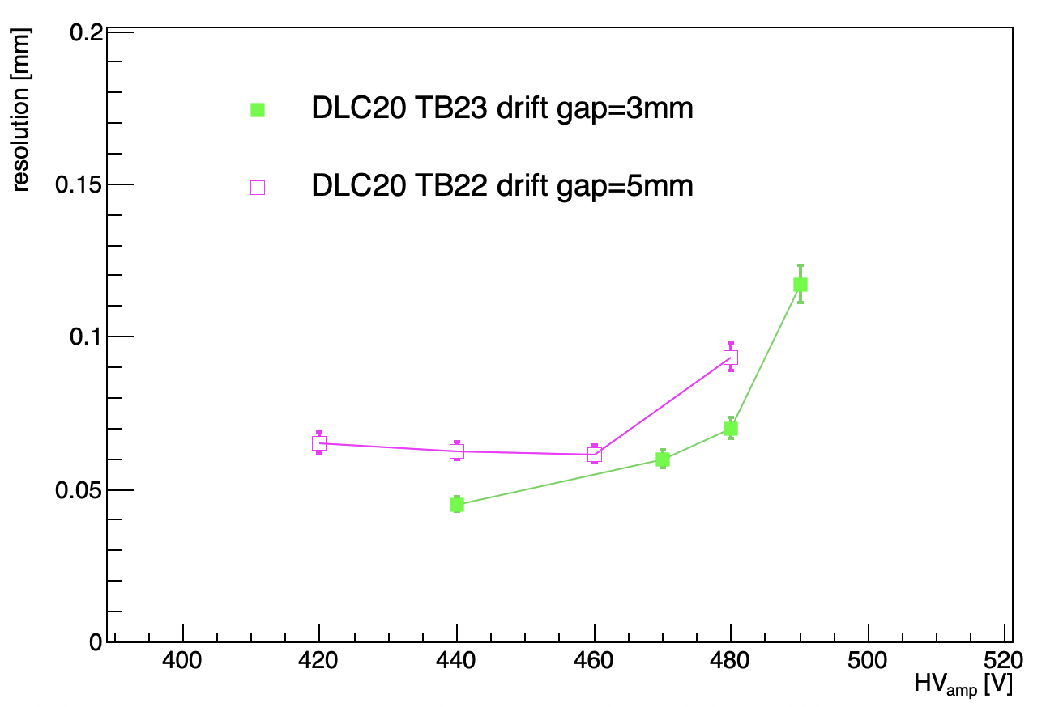
Spatial Resolution
Preliminary
TB2022
  Ar:C02: iC4H10 (93:5:2)
  Ar:CF4: iC4H10 (88:10:2)
Unbias position resolution from cluster residuals wrt extrapolated position from external tracking chamber
extrapolation uncertainty subtracted (~50μm)
systematic uncertainty (fit procedure) ~5%
Different resolution according to resistive/coupling scheme
Large area detector resolution around 100μm
Stable with different gas mixures and drift gap sizes
Optimisation charge centroid algorithms to determine the cluster position can improve the resolution
Preliminary
  Ar:CF4: iC4H10 (88:10:2)

Slide 11
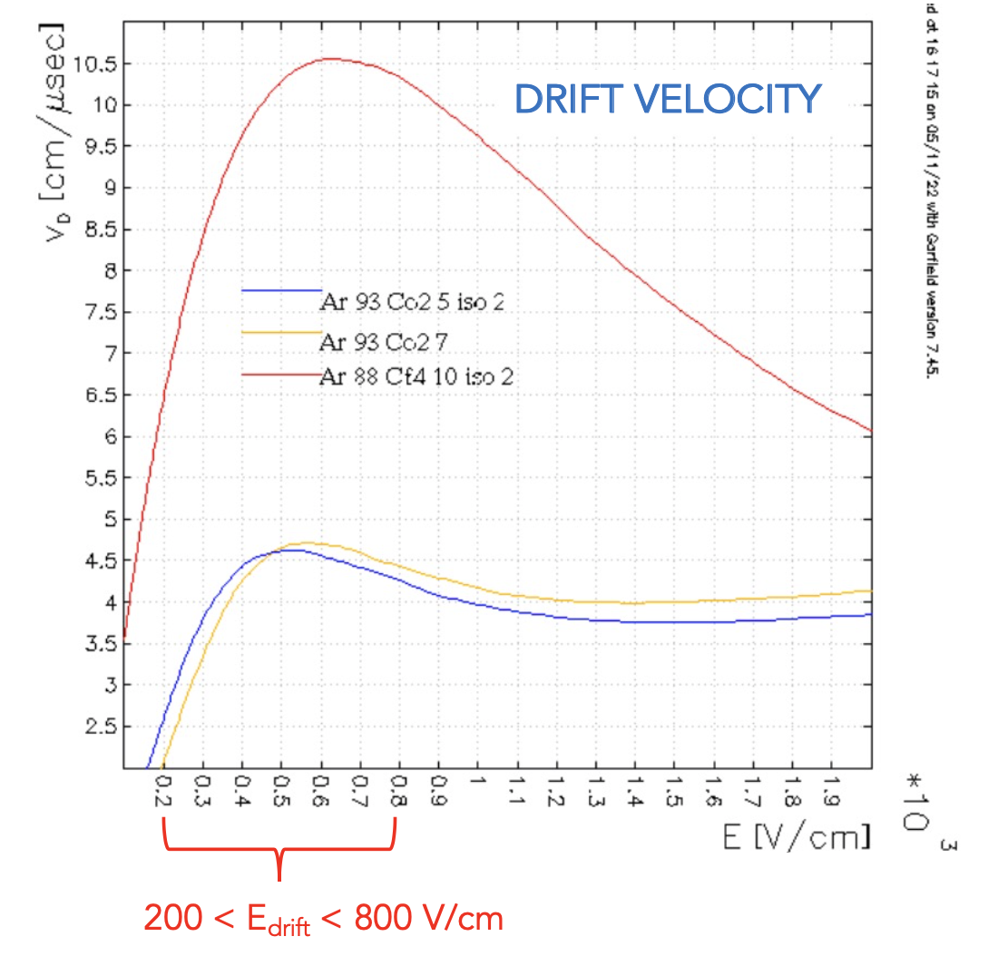
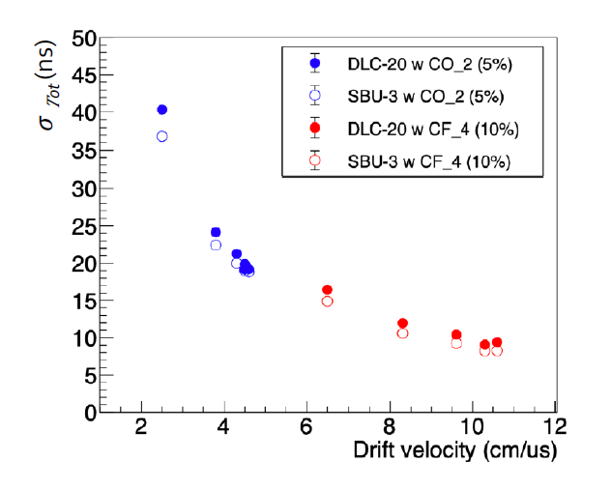
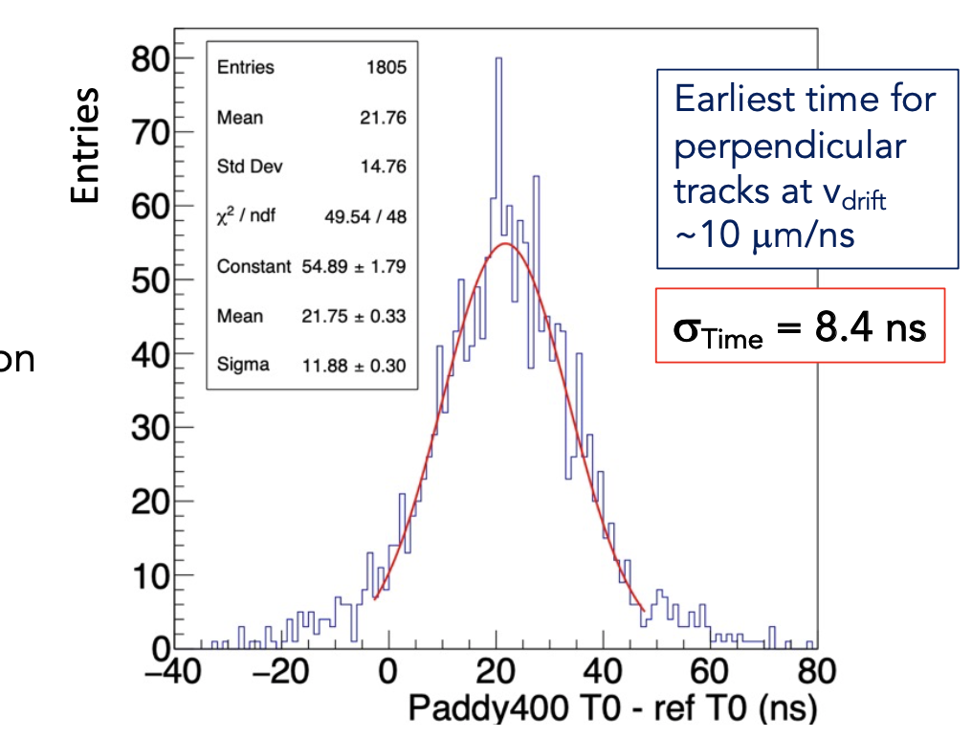
Timing Performance
Measurement of the time resolution as a function of the drift velocity
Scan in Edrift: [200: 800] V/cm
Time resolution from differences between the weighted mean time of clusters in two chambers all the pads in the cluster
𝜎_{T} = 𝜎_{∆T} ⁄ sqrt(2)
Includes contribution from electronics
Paddy400
  Ar:CF4: iC4H10 (88:10:2)

Slide 12
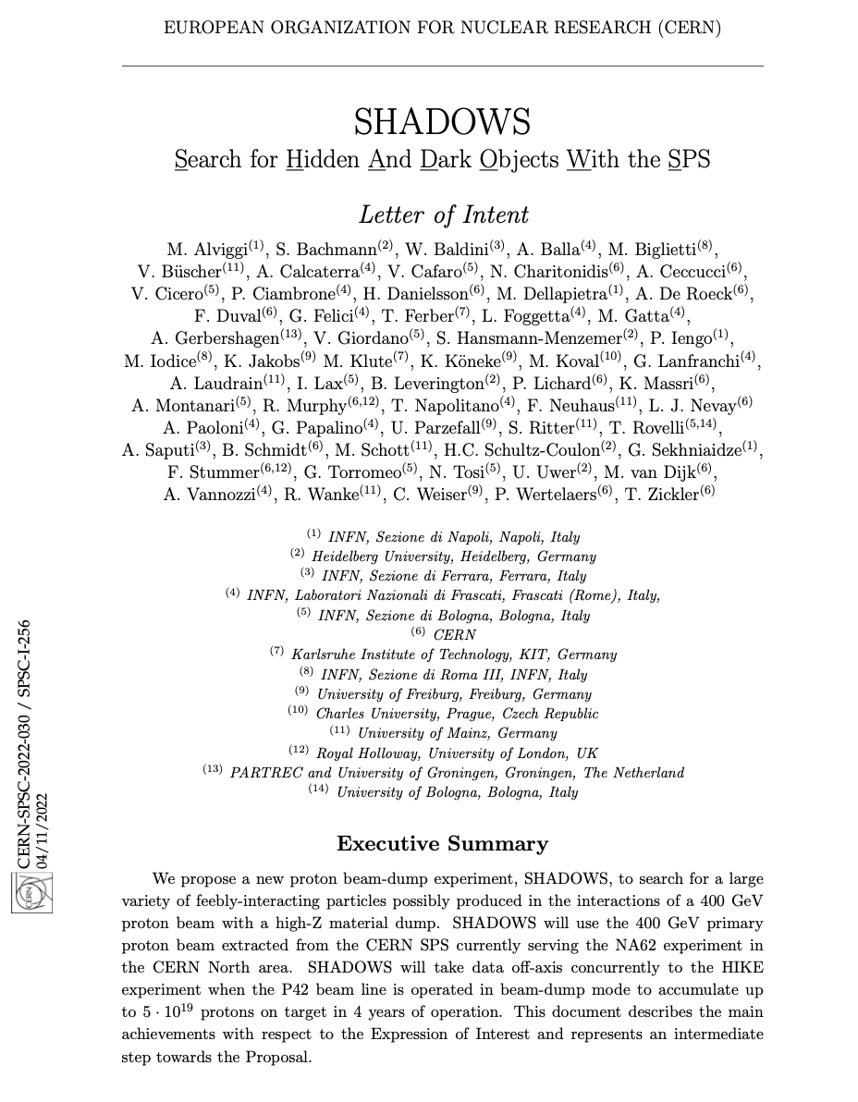
Applications
Proposed for muon veto for SHADOWS (proposal document in preparation)
Under consideration : replacement of Muon detectors for AMBER (successor of Compass)
Ongoing : R&D for sampling Hadron Calorimetry for the Muon Collider
Possible future applications: detectors for high energy (tens/hundreds TeV scale) and very high intensity new particle accelerators (FCC-ee/hh) or for the Electron-Ion-Collider (EIC)

Slide 13
Summary and Outlook
Several Small Pads Micromegas prototypes were built and tested using different resistive layout for spark protection: embedded resistors or using uniform double DLC resistive foils
Performance achieved:
stable operation up to 10 MHz/cm² with gain >10⁴
detector efficiency > 97%
position resolution < 100 μm
Very promising new large(r) area prototypes built
Rate capability well beyond 1 MHz/cm² with large area irradiation
Future R&D activities:
tracking in high rate environment, performance studies with larger area prototype, time resolution and ageing studies
< 10 ns time resolution
Resolutions and efficiencies compatible with smaller prototypes

