Slide 1
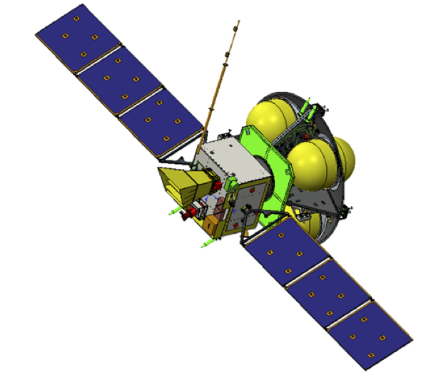
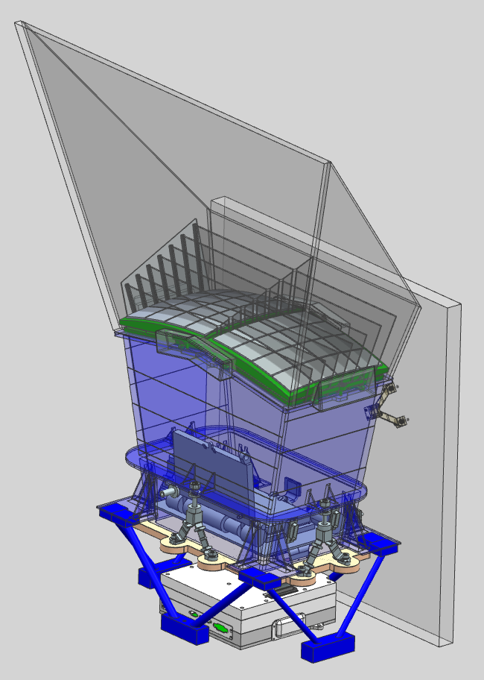
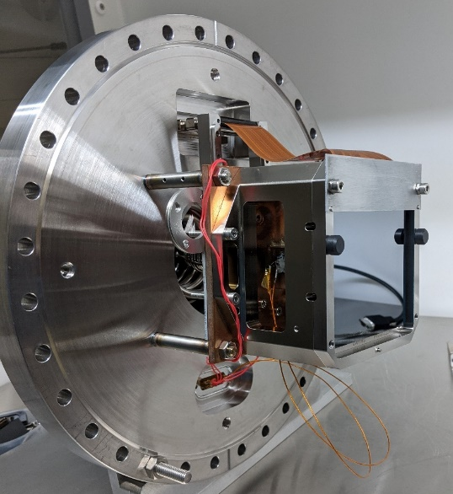
X-ray performance of a soft X-ray optimised charge-coupled device for astronomy
Tom Buggey – Position Sensitive Detectors 2023

Slide 2
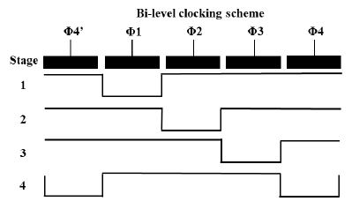
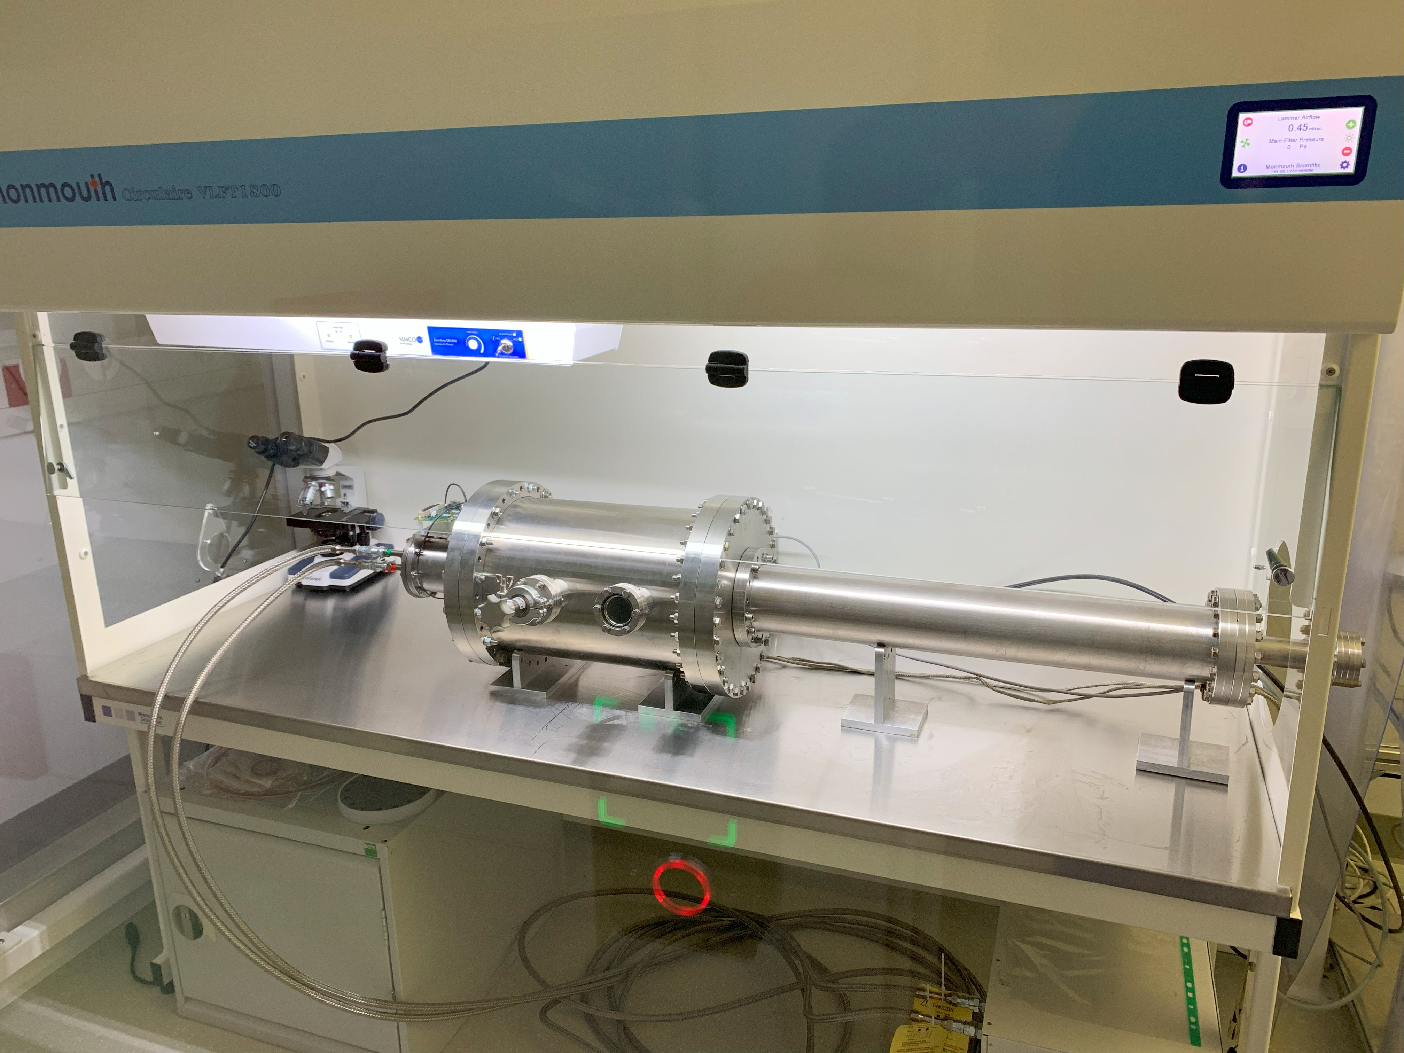

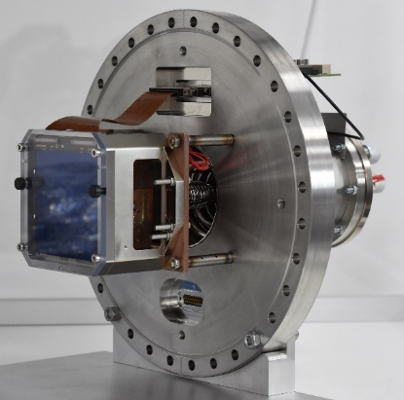
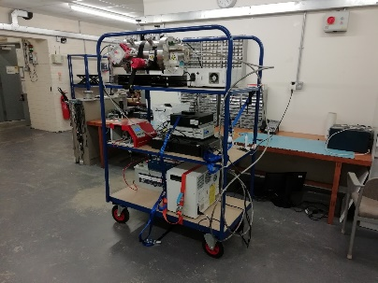
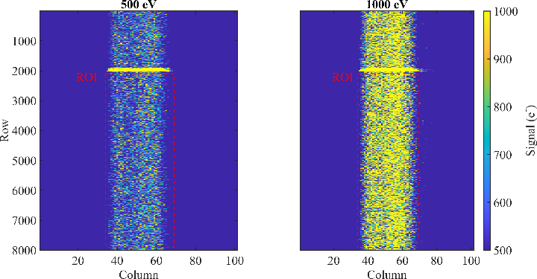
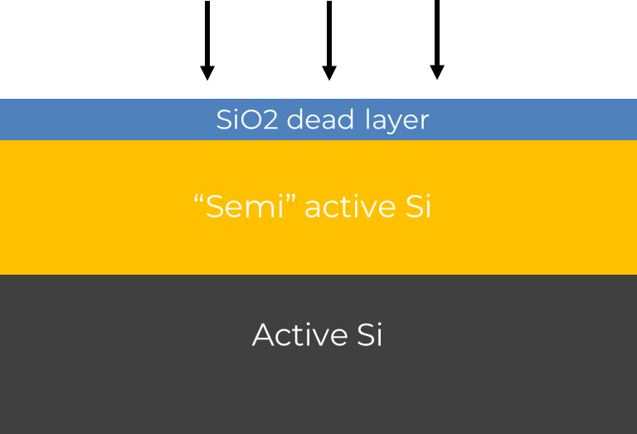
Summary
1) SMILE mission and the Soft X-ray Imager CCDs
2) CCD principles and experimental activities
3) Experimental methods + techniques
4) Results, discussion and future work

Slide 3
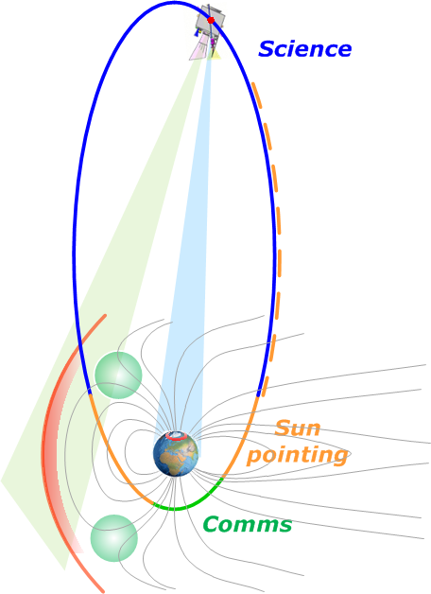
SMILE Mission Overview
ESA mission with 4 instruments – 3 by China (CAS), and 1 ESA.
Highly elliptical orbit will allow images of the entire Sun-Earth Magnetosphere interaction to be taken simultaneously, including in-situ measurements of Solar Wind strength and local magnetic field strength
The Soft X-ray Imager (SXI) will observe X-rays produced in the cusps and Magnetopause boundary

Slide 4

SMILE spacecraft and SXI
SMILE Spacecraft
Light Ion Analyser (LIA)
Soft X-ray Imager (SXI)
Propulsion Module
Solar Panels
Ultraviolet Imager (UVI)
Magnetometer (MAG)

Slide 5
SMILE spacecraft and SXI
SMILE Spacecraft
Light Ion Analyser (LIA)
Soft X-ray Imager (SXI)
Propulsion Module
SXI
Solar Panels
Optical baffle
Ultraviolet Imager (UVI)
Optics
Magnetometer (MAG)
Radiation shutter mechanism (RSM)
Focal plane
Radiator

Slide 6
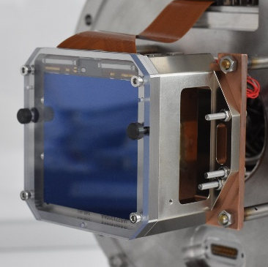
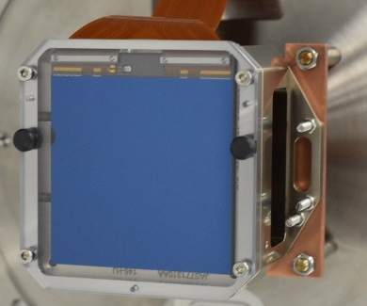
SMILE spacecraft and SXI
Focal plane – 2x CCD370s
SMILE Spacecraft
Light Ion Analyser (LIA)
Soft X-ray Imager (SXI)
Propulsion Module
SXI
Solar Panels
Optical baffle
Ultraviolet Imager (UVI)
Optics
Magnetometer (MAG)
Radiation shutter mechanism (RSM)
Focal plane
Radiator

Slide 7
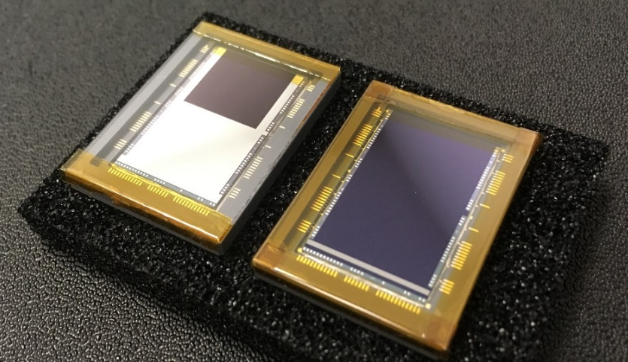

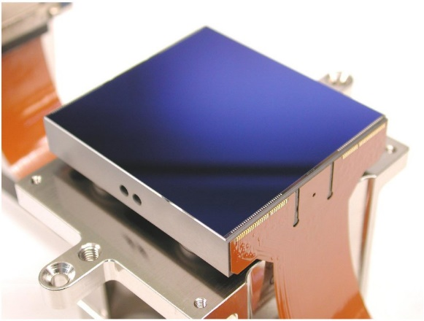
Charge-coupled devices (CCDs)
The technology is comprised of an array of silicon pixels which make up the sensitive imaging region
Readout of the image is performed via moving charge to and across the serial register
CCD201
CCD301
NASA RST
CCD273
CCD270/370
ESA SMILE/PLATO
ESA EUCLID

Slide 8
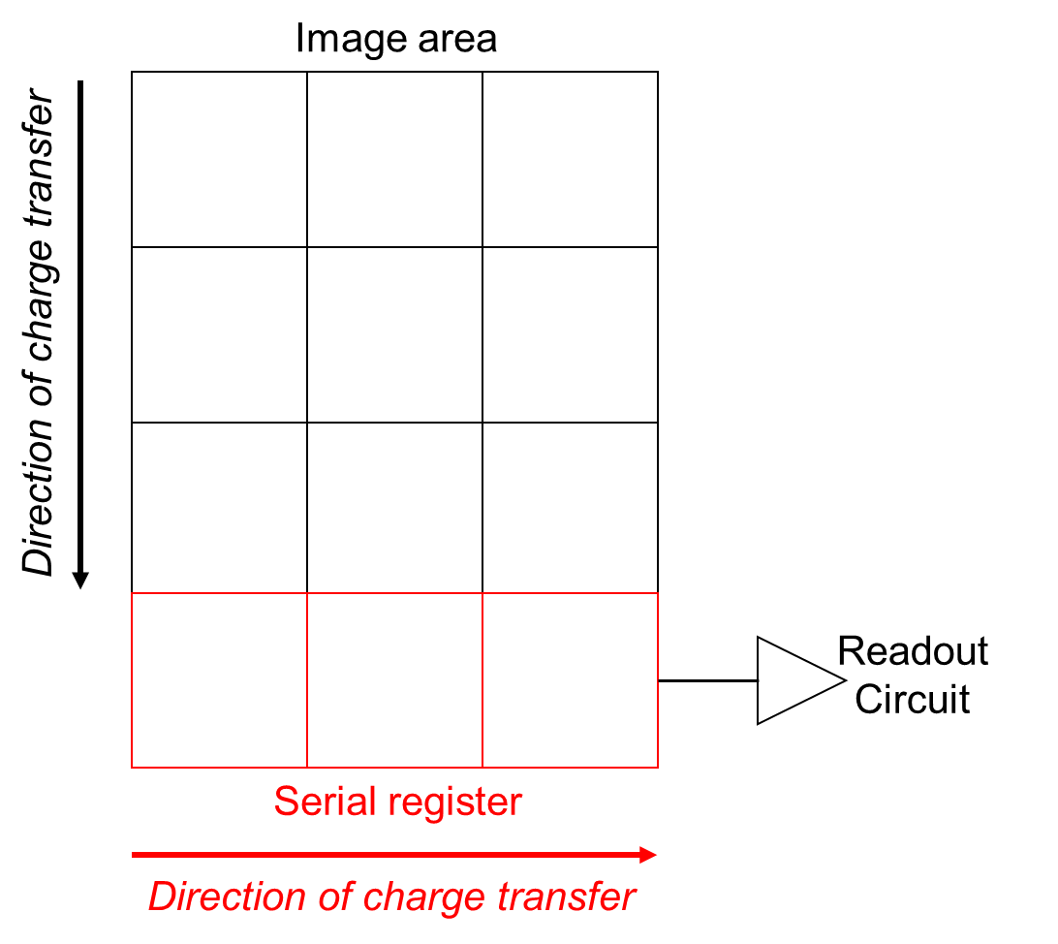
Charge-coupled devices (CCDs)
The technology is comprised of an array of silicon pixels which make up the sensitive imaging region
Readout of the image is performed via moving charge to and across the serial register
CCD201
CCD301
NASA RST
CCD273
CCD270/370
ESA SMILE/PLATO
ESA EUCLID

Slide 9
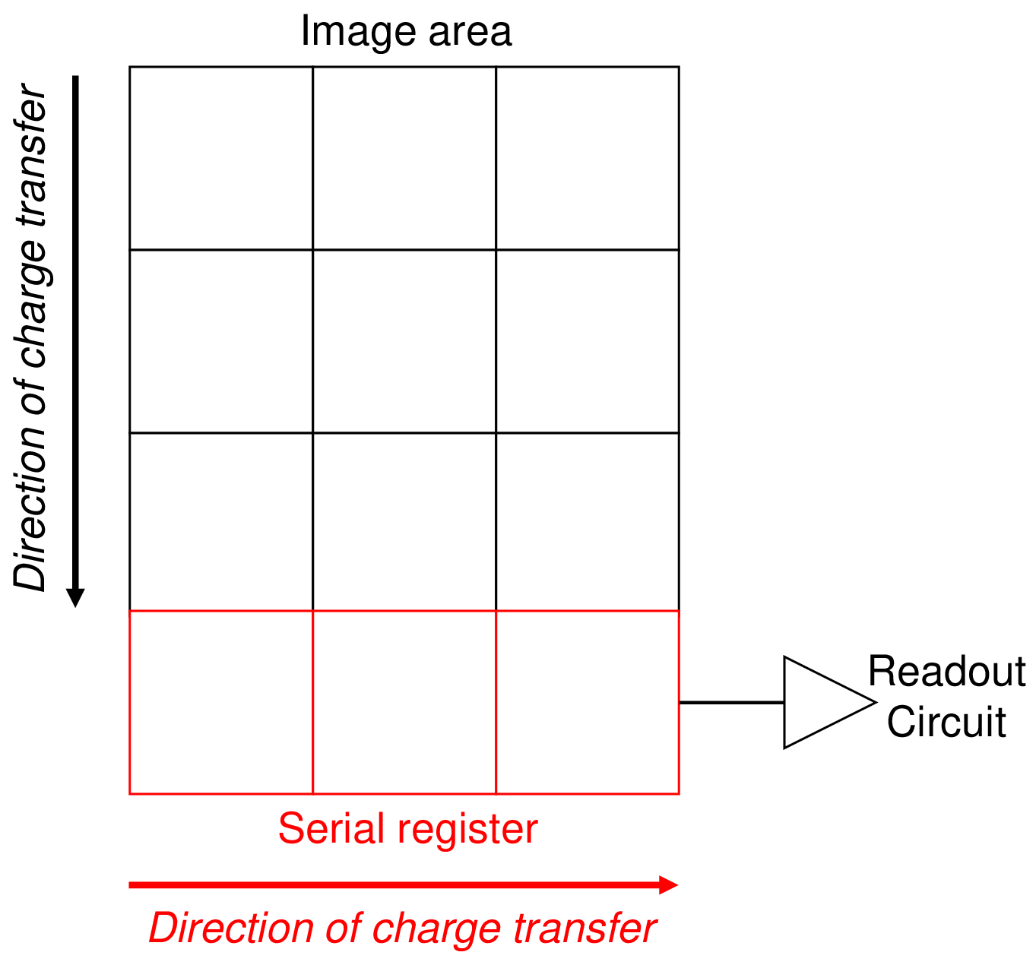
Charge-coupled devices (CCDs)
The technology is comprised of an array of silicon pixels which make up the sensitive imaging region
Readout of the image is performed via moving charge to and across the serial register
CCD201
CCD301
NASA RST
CCD273
CCD270/370
ESA SMILE/PLATO
ESA EUCLID

Slide 10
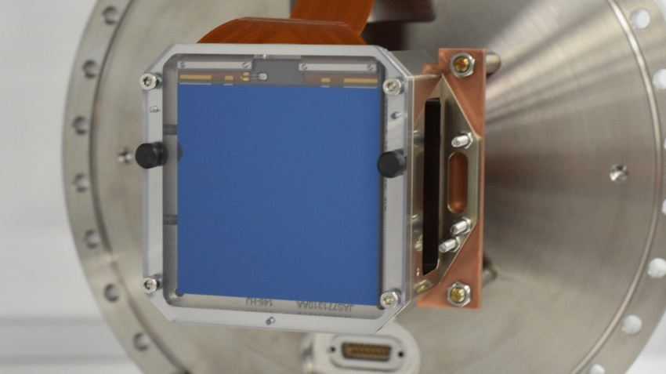
Charge-coupled devices (CCDs)
The technology is comprised of an array of silicon pixels which make up the sensitive imaging region
Readout of the image is performed via moving charge to and across the serial register
CCD201
CCD301
NASA RST
CCD273
CCD270/370
ESA SMILE/PLATO
ESA EUCLID

Slide 11
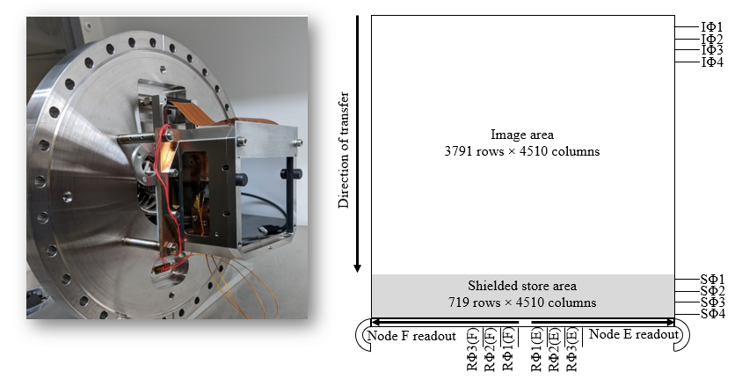
SMILE CCD370s
Key quantities:
  18 µm square pixels
  16 µm thick silicon
  2 output nodes
  Frame transfer operation mode with 6x6 on-chip binning – Excellent for energy resolution

Slide 12
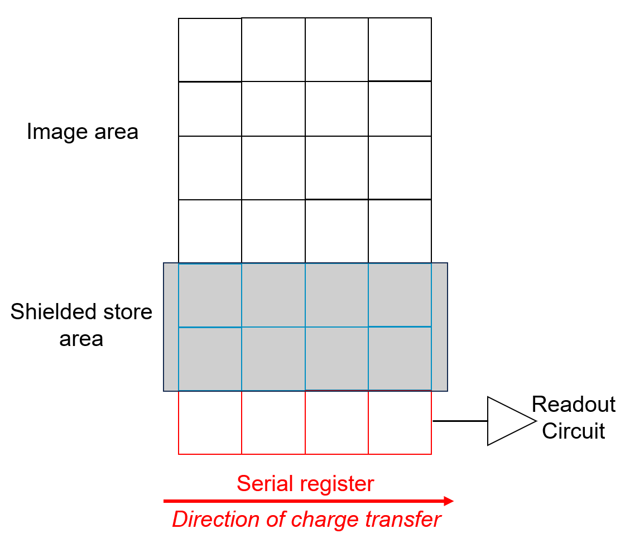
SMILE CCD370s
Key quantities:
  18 µm square pixels
  16 µm thick silicon
  2 output nodes
  Frame transfer operation mode with 6x6 on-chip binning – Excellent for energy resolution

Slide 13
SMILE CCD370s – Modifications
Radiation hardness
Supplementary buried channel – Smaller signals are confined to a smaller volume of silicon -> Less radiation induced defects encountered
S. Parsons et al., (2022) JINST 17 P10025.

Slide 14
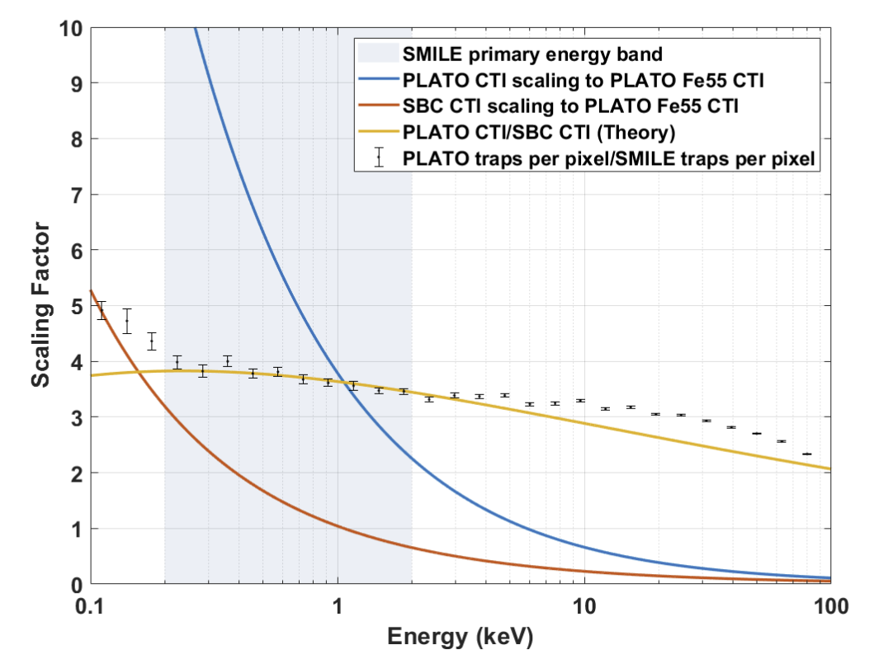
SMILE CCD370s – Modifications
Radiation hardness
Supplementary buried channel – Smaller signals are confined to a smaller volume of silicon -> Less radiation induced defects encountered
S. Parsons et al., (2022) JINST 17 P10025.

Slide 15
SMILE CCD370s – Modifications
Radiation hardness
X-ray performance
Supplementary buried channel – Smaller signals are confined to a smaller volume of silicon -> Less radiation induced defects encountered
Enhanced backside passivation process offered by Te2v – P+ implant at the back surface with a built-in potential is etched away
S. Parsons et al., (2022) JINST 17 P10025.

Slide 16
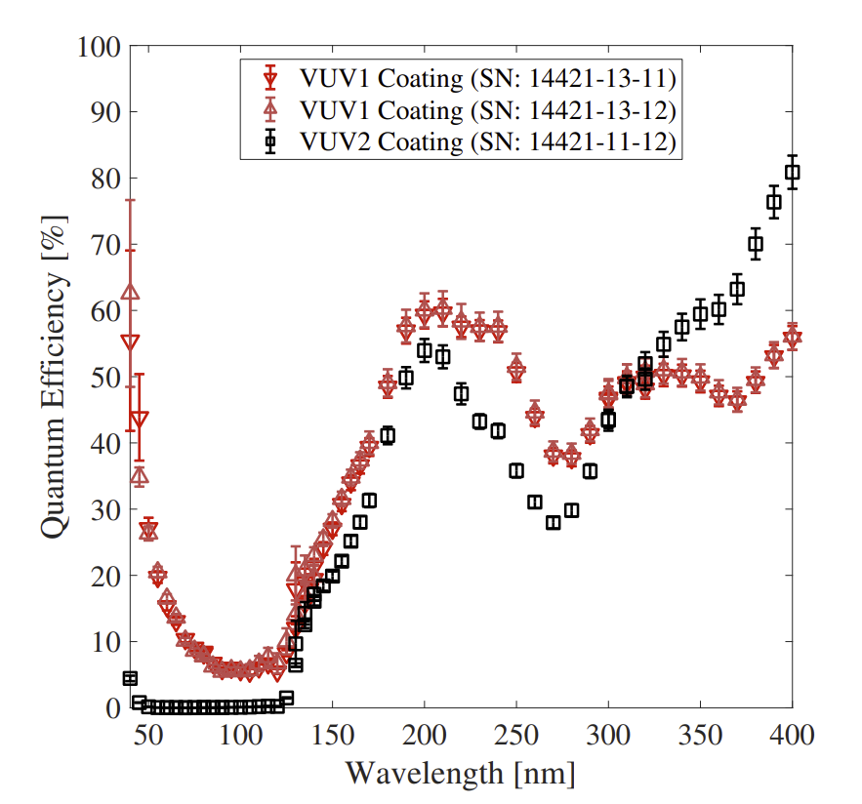
SMILE CCD370s – Modifications
Radiation hardness
X-ray performance
Supplementary buried channel – Smaller signals are confined to a smaller volume of silicon -> Less radiation induced defects encountered
Enhanced backside passivation process offered by Te2v – P+ implant at the back surface with a built-in potential is etched away
J. Heymes et al., (2020) SPIE
S. Parsons et al., (2022) JINST 17 P10025.

Slide 17
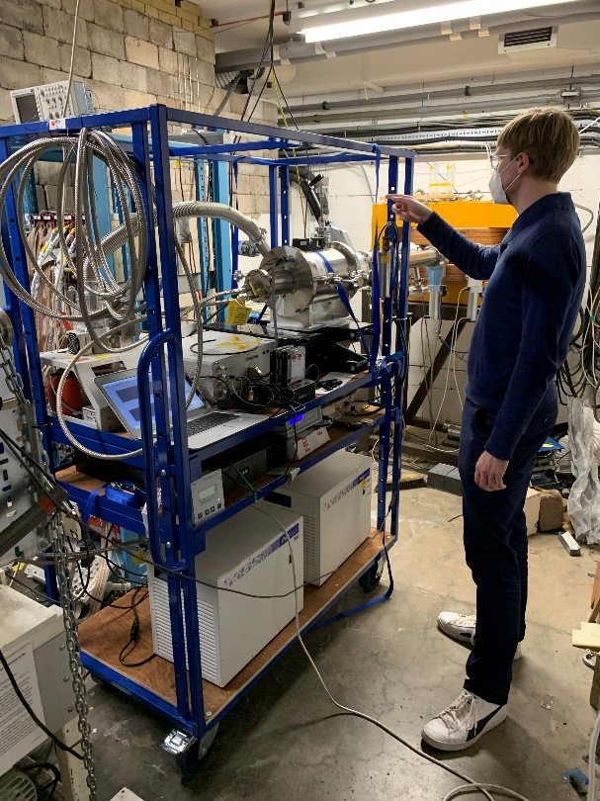
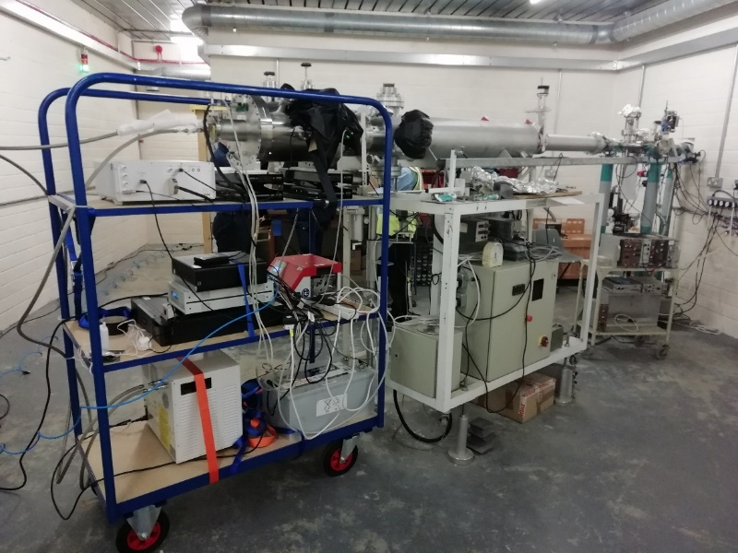
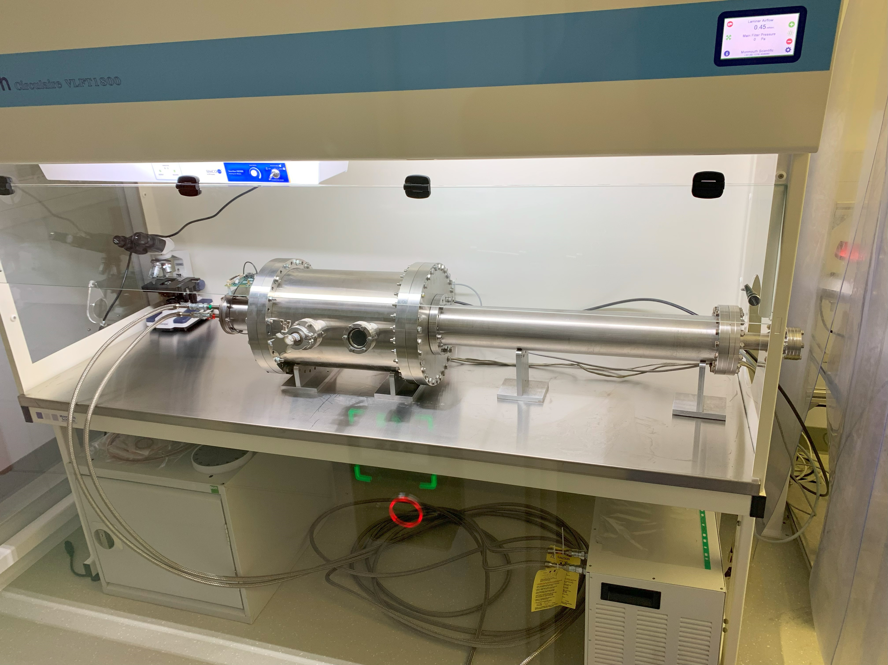
SMILE CCD characterisation campaigns
Main experimental campaigns:
  3 irradiation campaigns, 1 more incoming
  FM characterisation campaign
  BESSY Synchrotron soft X-ray QE/RMF campaign
Birmingham irradiation setup
Harwell irradiation setup
Iso class 4 clean room – FM characterisation

Slide 18
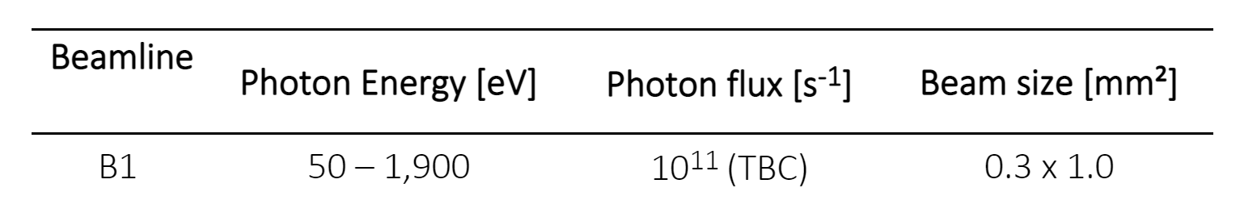
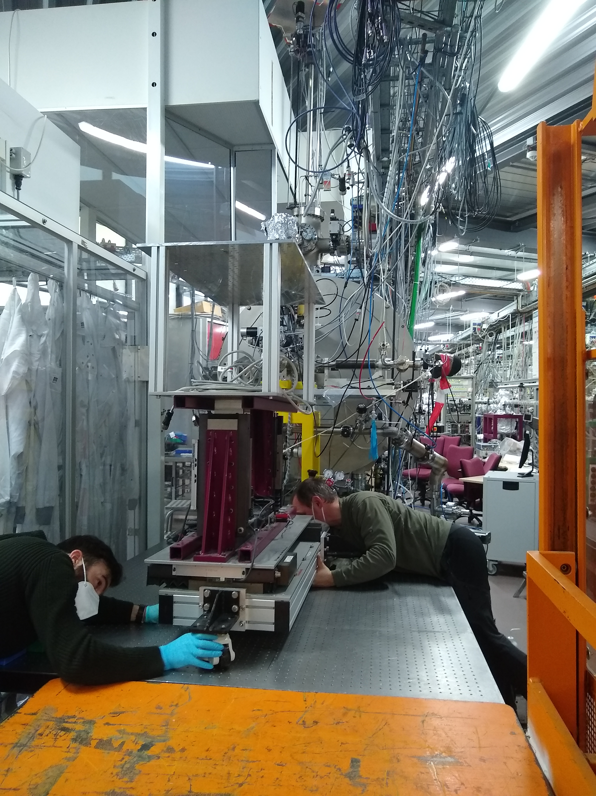
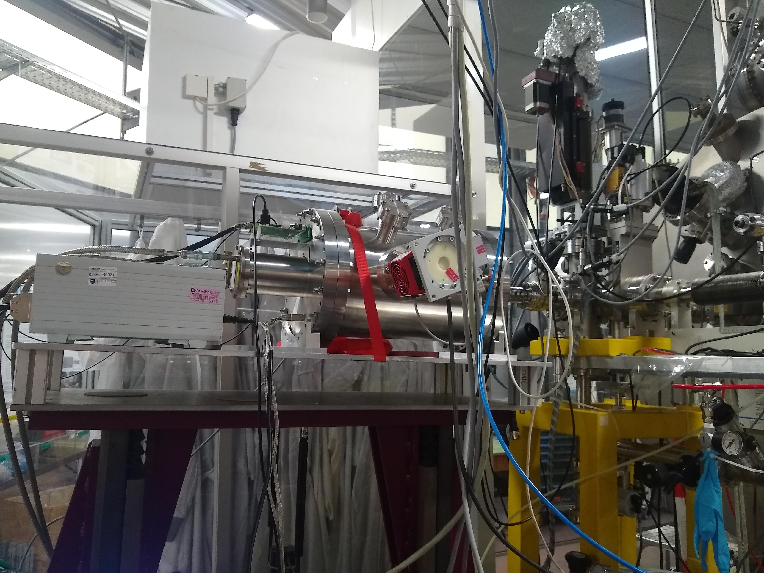
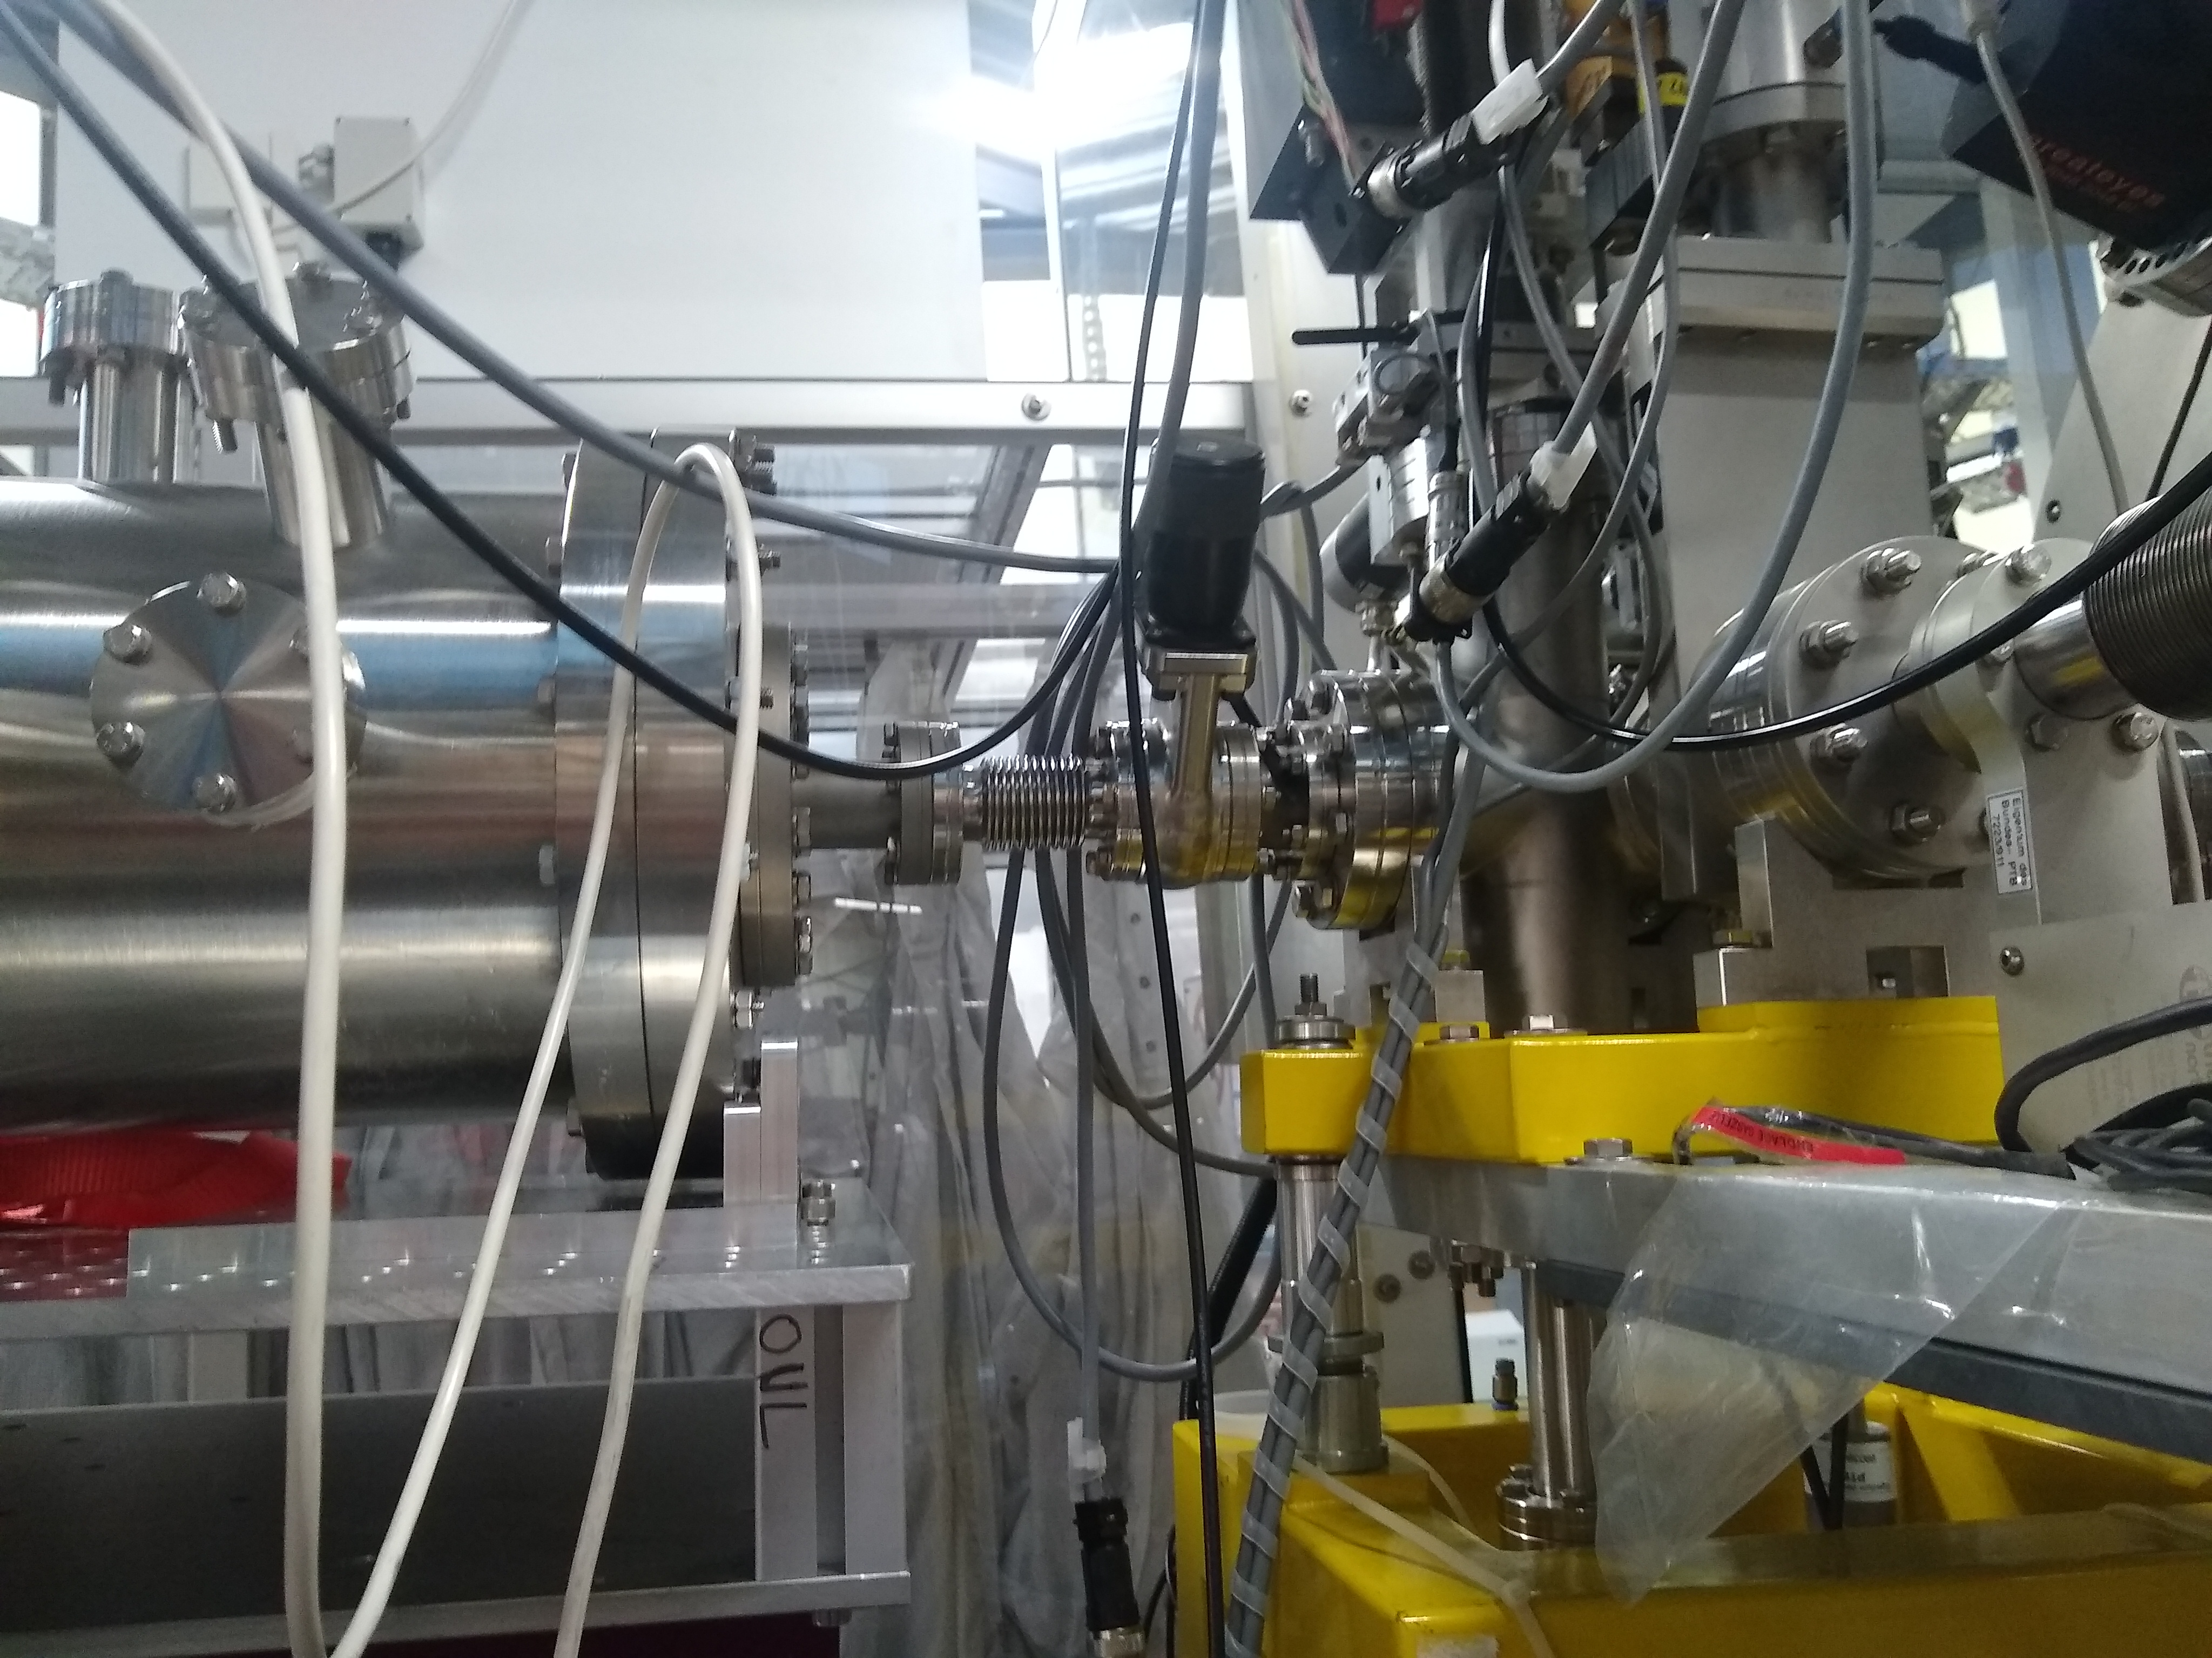
X-ray test campaign
Chamber setup
Full-setup with beamline
Beamline-chamber interface

Slide 19
QE measurements
Integral charge method used (Moody 2017) -> Assuming the pixel/ADC is not saturated the total charge deposited in an area/unit time can be compared to the reference flux level
Detector readout in binned time-delay integration mode:
  1 parallel shift
  Serial register readout
  Repeat 8000 times
I. Moody et al., (2017)

Slide 20
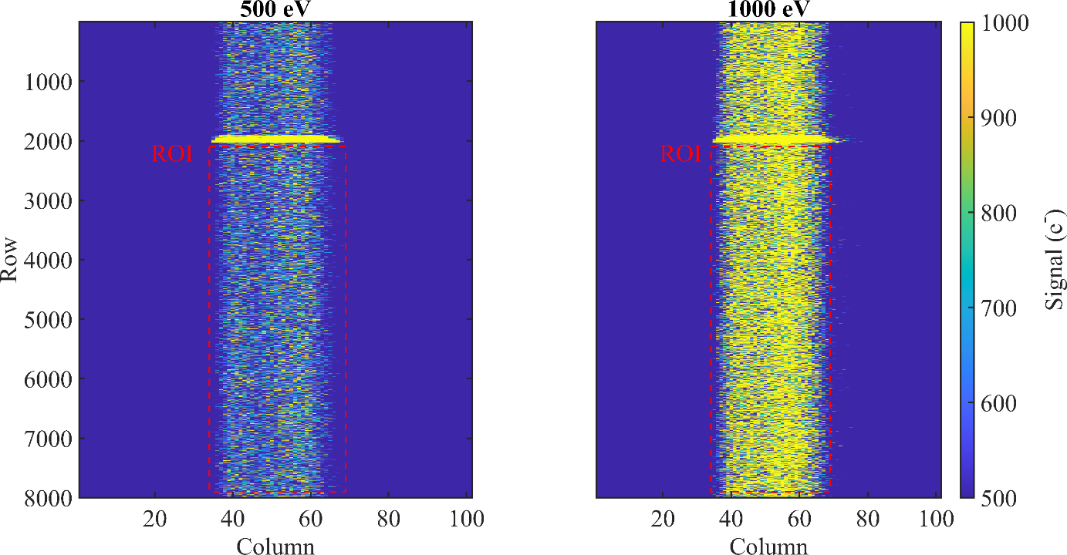
Integral charge measurement method
Integral charge method used (Moody 2017) -> Assuming the pixel/ADC is not saturated the total charge deposited in an area/unit time can be compared to the reference flux level
Detector readout in binned time-delay integration mode:
  1 parallel shift
  Serial register readout
  Repeat 8000 times
BESSY provide a calibrated photodiode for absolute charge measurement values
I. Moody et al., (2017)

Slide 21
QE data: 50 eV – 1900 eV
QE shown with error bars computed from the standard deviation of the signal deposited in each row
QE at these energies has a distinct shape, with 2 significant drops in QE at ~100 eV and 1800 eV attributed to the known absorption edges
What should the theoretical QE be across these energies?
  Simple transmission QE model
  Model based upon the layers in the pixel

Slide 22
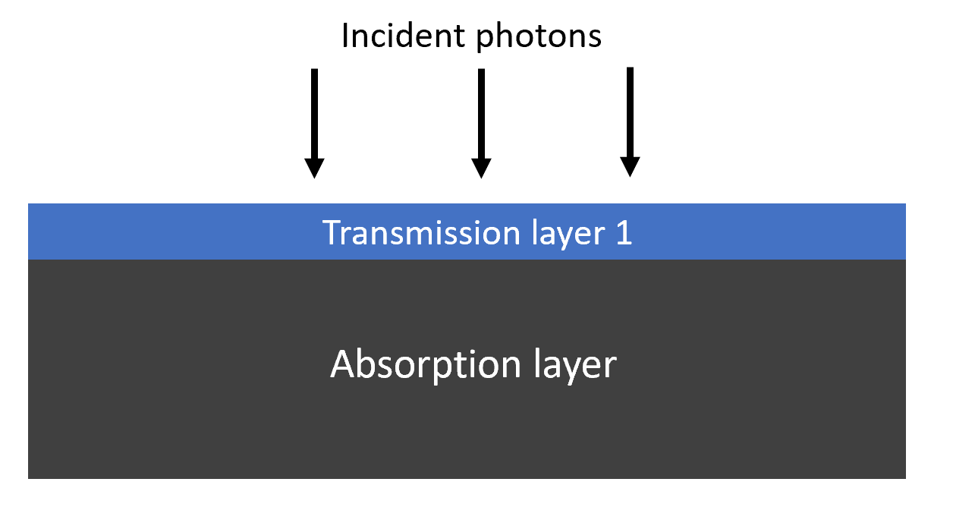

Transmission model
Intensity equation – Based upon attenuation length in silicon
  I₀ = Initial intensity
  λ(E) = Attenuation length as a function of energy
  t = thickness, summed over layers i
For a photon to be absorbed, it must transmit through the non-sensitive layers
Compute intensity through a given number of layers/materials, which make up the pixel architecture
$$I=I_{0}e^{\sum_{i}{\frac{−t}{λ(E)}}}$$

Slide 23
QE data + model
Initial model is the active silicon (16 microns), and a 4 nm dead layer of oxide – Poor match at lower energies

Slide 24
QE data + model
Initial model is the active silicon (16 microns), and a 4 nm dead layer of oxide – Poor match at lower energies
What is causing the extra charge losses?
  Try an extra Si layer which is not photosensitive?

Slide 25
QE data + model
Initial model is the active silicon (16 microns), and a 4 nm dead layer of oxide – Poor match at lower energies
What is causing the extra charge losses?
  Try an extra Si layer which is not photosensitive?
3 thicknesses tried, 20 – 40 nm – A much improved match particularly at lower energies!

Slide 26
QE data + model
Initial model is the active silicon (16 microns), and a 4 nm dead layer of oxide – Poor match at lower energies
What is causing the extra charge losses?
  Try an extra Si layer which is not photosensitive?
3 thicknesses tried, 20 – 40 nm – A much improved match particularly at lower energies!
But what physics does this represent, is it correct?

Slide 27
Back surface charge losses
Moody paper suggested that X-rays interacting close to the p+ implant could reduce the effectiveness of the back surface passivation.
  The mechanism would be the potential of the charge cloud being momentarily higher than the P+ built-in potential – This would lead to some charge losses to the back surface
I. Moody et al., (2017)

Slide 28
Back surface charge losses
Moody paper suggested that X-rays interacting close to the p+ implant could reduce the effectiveness of the back surface passivation.
  The mechanism would be the potential of the charge cloud being momentarily higher than the P+ built-in potential – This would lead to some charge losses to the back surface
This means the “dead” silicon layer implemented in the QE model, is more akin to a semi-active layer – A more physics-based model is required
I. Moody et al., (2017)

Slide 29
Back surface charge losses
Moody paper suggested that X-rays interacting close to the p+ implant could reduce the effectiveness of the back surface passivation.
  The mechanism would be the potential of the charge cloud being momentarily higher than the P+ built-in potential – This would lead to some charge losses to the back surface
This means the “dead” silicon layer implemented in the QE model, is more akin to a semi-active layer – A more physics-based model is required
PhD student working on X-ray physics in EMCCDs has been working on an analytical model for this – Results coming soon!
I. Moody et al., (2017)

Slide 30

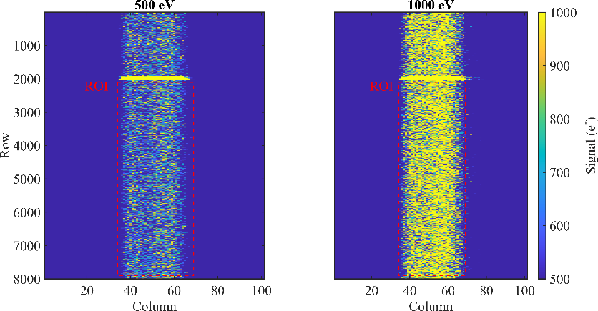
Conclusions
A successful X-ray test campaign was carried out at the PTB beamline at BESSY
The QE measured was close to the expected value and will be used as part of the SXI pipeline. This was also the first QE measurement on these devices so gives confidence to the manufacturing processes
A transmission model was generated with an additional non-active Si layer, but some additional physics will be needed to improve the model-fit further

Slide 31
THANK YOU

