Slide 1



13th International Conference on Position Sensitive Detectors
Evaluation of Compton recoil electron tracking capability of fine-pitch pixel silicon detector with a Monte Carlo simulation
○Mizuki Uenomachi¹, Kenji Shimazoe²
¹Kyoto University, ²The Univ. of Tokyo
2023.09.07

Slide 2
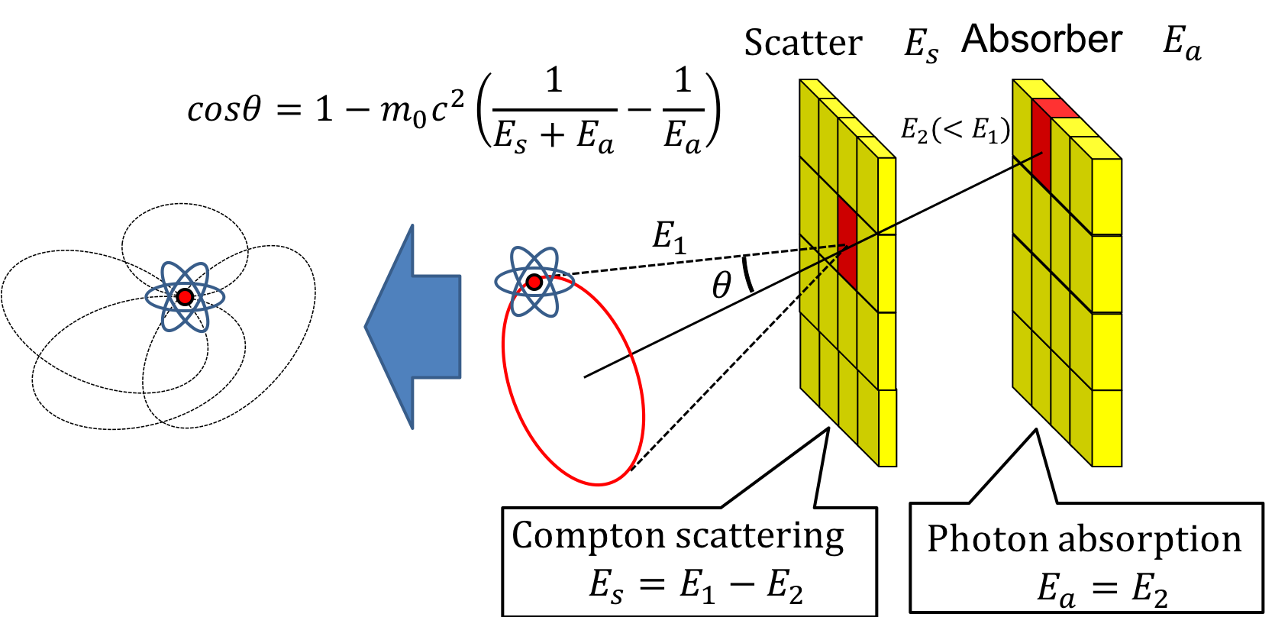
Research Background
Scatterer
Absorber
Compton imaging
One of gamma-ray imaging techniques based on Compton scattering kinematics
Scattering angle information can be calculated from deposited energies in a scatterer and an absorber
No collimators required
Wide photon energy range for imaging
Wide field of view
Application
Astrophysics, Medical field, Nuclear field

Slide 3
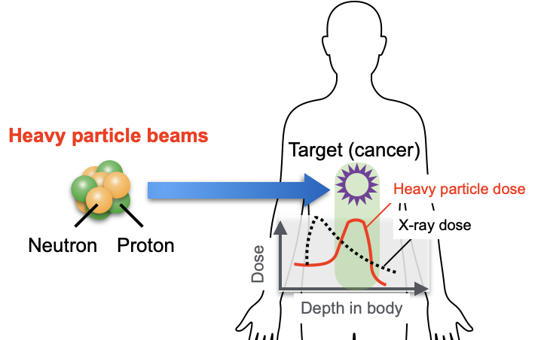
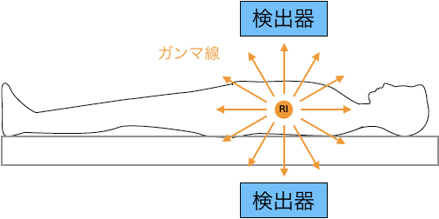
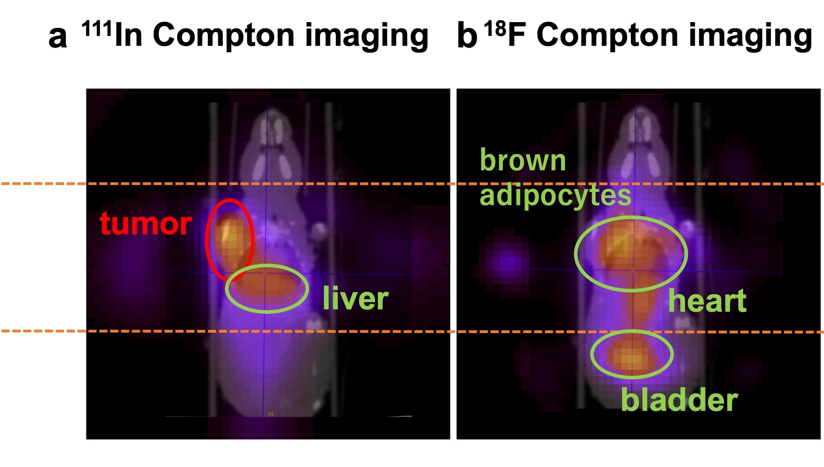
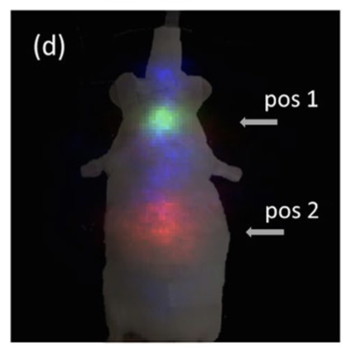
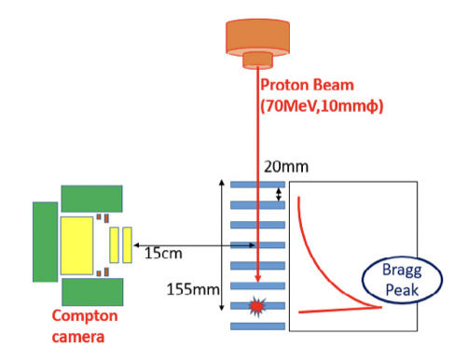
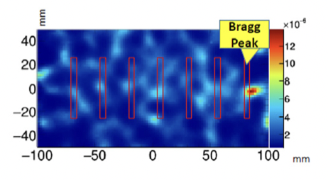
Research Background
Compton imaging in medical field
Nuclear Medicine
Heavy particle therapy
→Diagnosis, therapy
Prompt gamma-ray imaging
Detector
Gamma-rays
Prompt
Gamma-rays
Gamma-rays
Radiopharmaceutical accumulation imaging
Detector
4.4 MeV Prompt gamma imaging
¹³¹I
⁸⁵Sr
⁶⁵Zn
A. Kishimoto et al., Sci. Rep., (2017): 2110
M. Uenomachi et al., Sci. Rep., (2021):17933
S. Mochizuki et al., NIMA., (2019);936:43-45

Slide 4
Research Background
Compton imaging in medical field
Nuclear Medicine
Heavy particle therapy
→Diagnosis, therapy
Prompt gamma-ray imaging
Detector
Gamma-rays
Prompt
Gamma-rays
Compton imaging is a promising method in medical field due to the wide energy range and collimator-less imaging
However, still in under research because of the low signal-to-background ration (SBR) caused by drawing a lot of Compton cones.
Gamma-rays
Radiopharmaceutical accumulation imaging
Detector
4.4 MeV Prompt gamma imaging
¹³¹I
⁸⁵Sr
⁶⁵Zn
A. Kishimoto et al., Sci. Rep., (2017): 2110
M. Uenomachi et al., Sci. Rep., (2021):17933
S. Mochizuki et al., NIMA., (2019);936:43-45

Slide 5
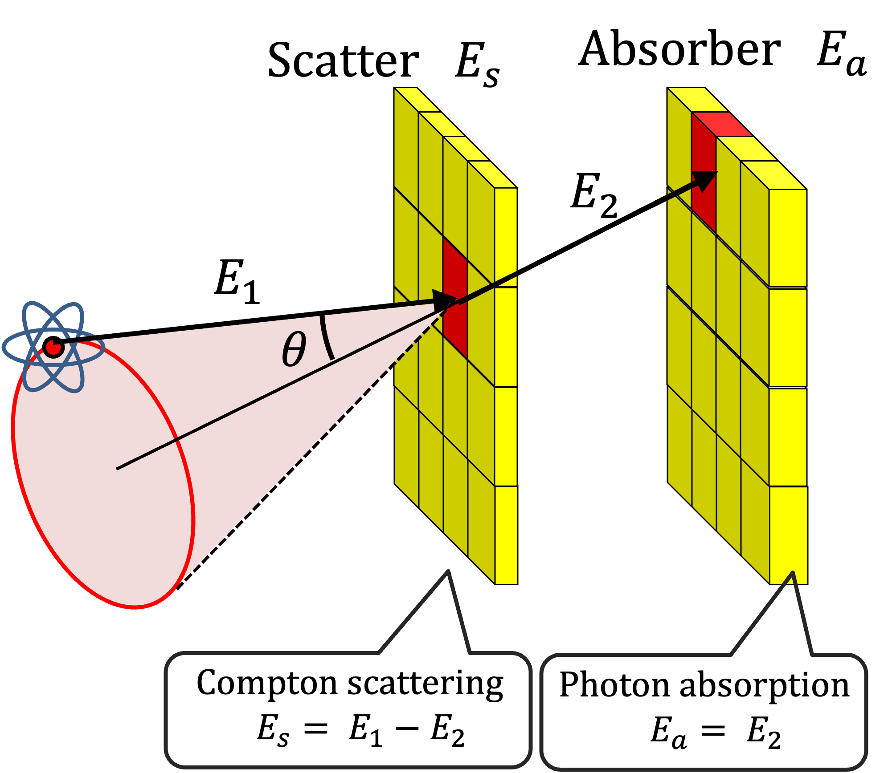
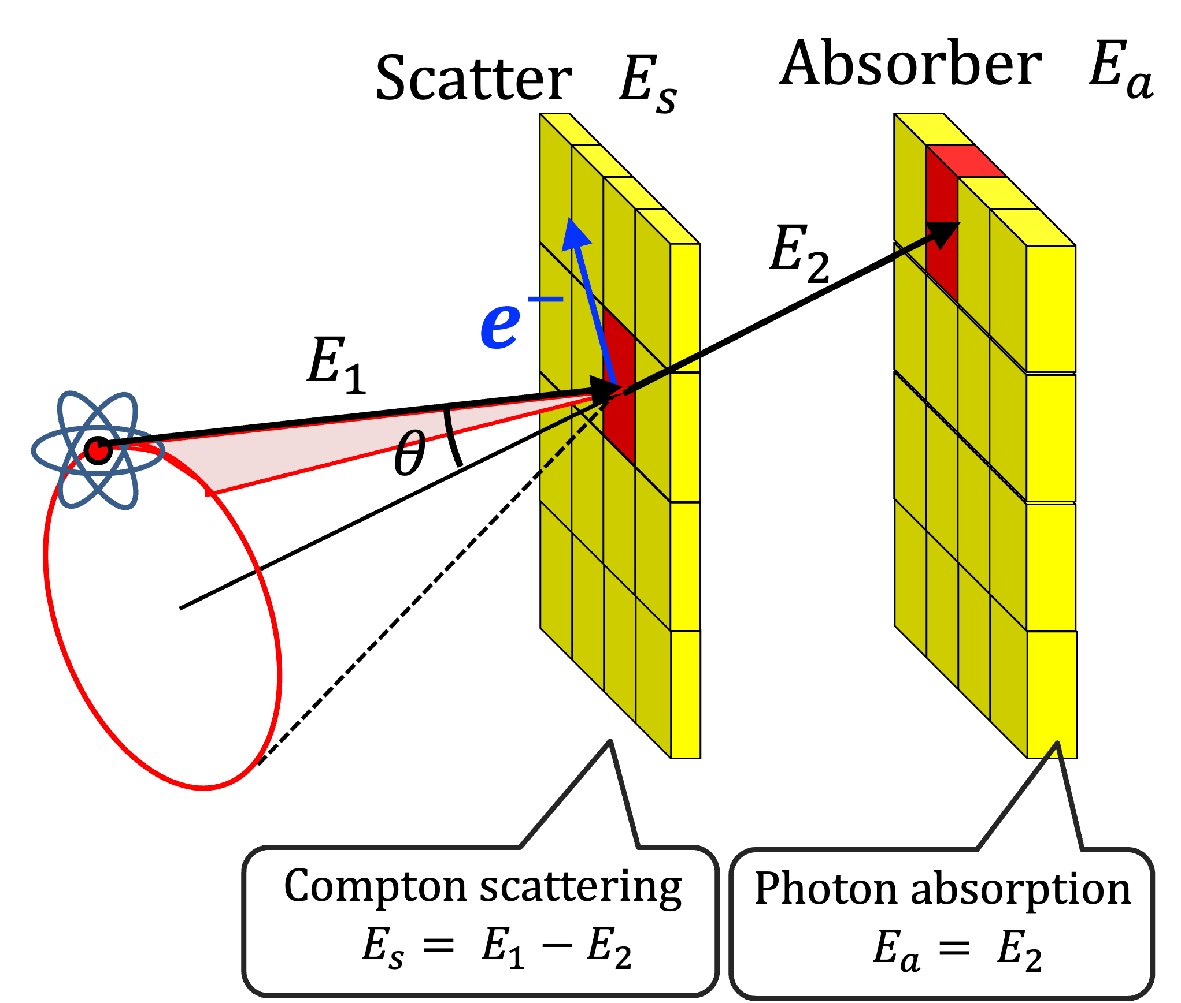
Recoil electron tracking Compton imaging
Measurement of a recoil electron trajectory when a photon is Compton scattered in a scatterer
Constrains the radionuclide position on from a Compton conical surface to an arc surface
Conventional imaging
Electron tracking imaging

Slide 6
Recoil electron tracking Compton imaging
Electron tracking Compton camera succeeded to be developed with gaseous detectors by Kyoto University Tanimori group for high energy gamma-ray astrophysics.
For medical imaging, semiconductor detector is ideal
However, the high spatial resolution (a few tens of µm) is required for electron tracking with a semiconductor detector
Objective
In this study, we developed a Compton imaging system with SOI (silicon on insulator) fine-pitch pixel sensor and GFAG scintillator detector for electron tracking Compton imaging

Slide 7
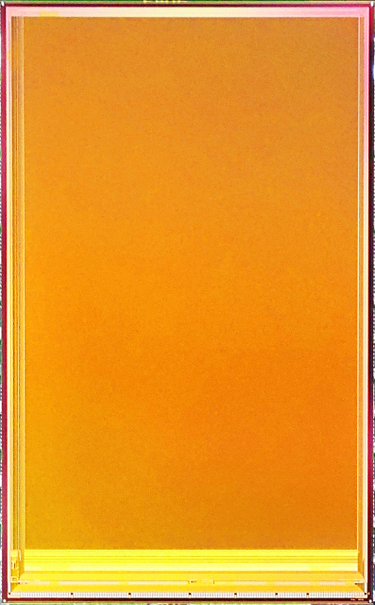
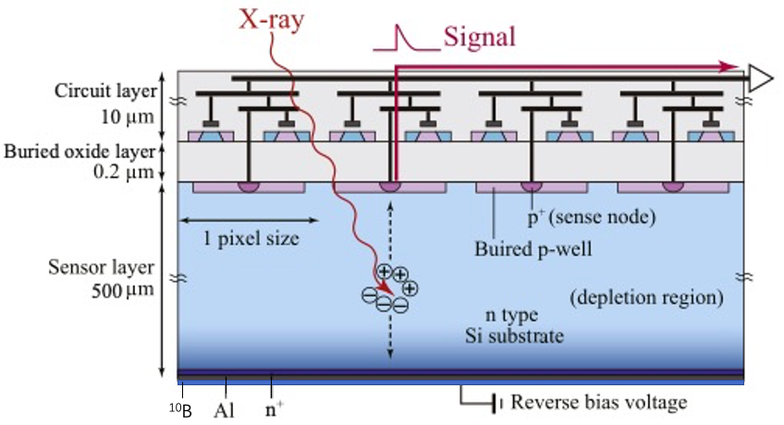
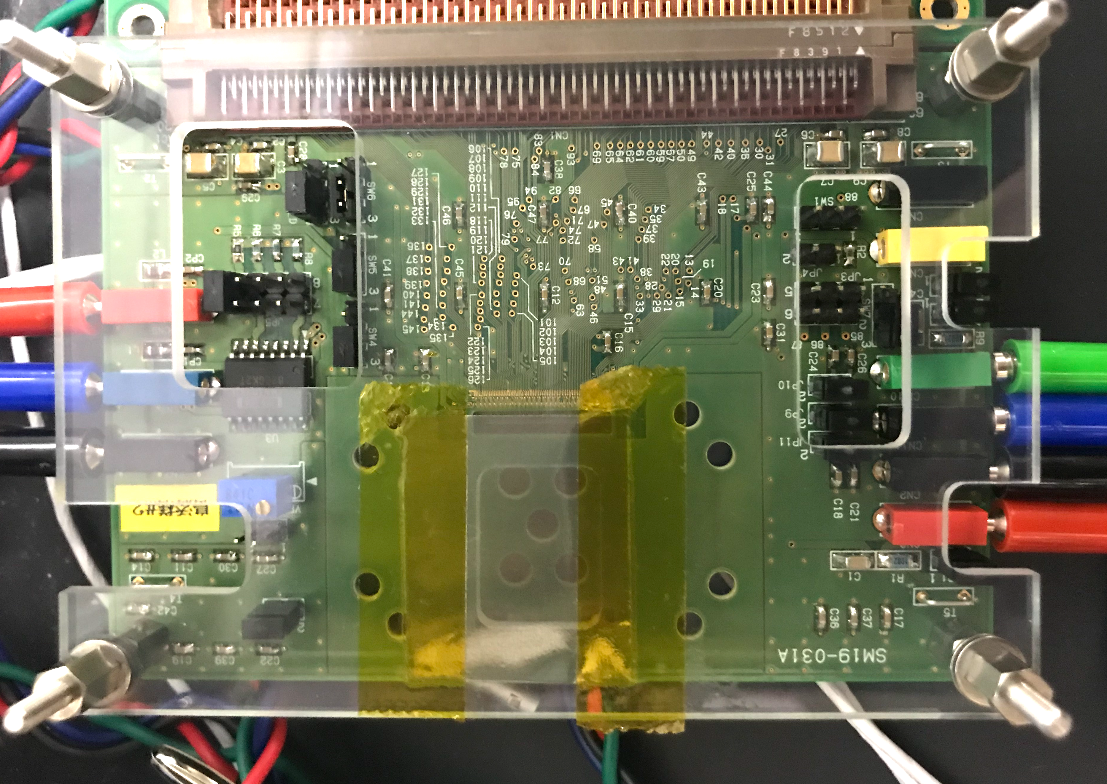
SOI pixel sensor with 36 µm pixels
Silicon on Insulator (SOI) technique → Monolithic circuit integrated silicon sensor
Large area X-ray SOI sensor "XRPIX7”
15.3 mm
13.8 mm
Sensor information
- Chip size：24.6 mm x 15.3 mm
（Active area：21.9 mm x 13.8 mm）
- Pixel size：36 µm sq.
- Pixel number：608 x 384 (= ~233k)
- Sensor thickness：300 µm
DECODER
&
TRIGGER PROCESSOR
XRPIX7
Event driven mode → coincidence detection
608 x 384 pixel array
1 Pixel : 36 µm sq.
21.9 mm
24.6 mm
Bias Gen.
PGA
OUT BUF
DECODER & TRIGGER PROCESSOR
S/H Cap.

Slide 8
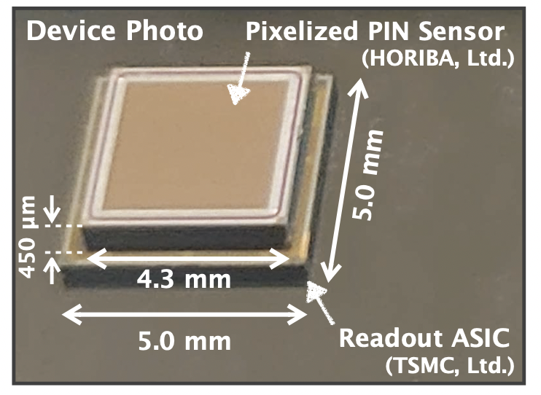
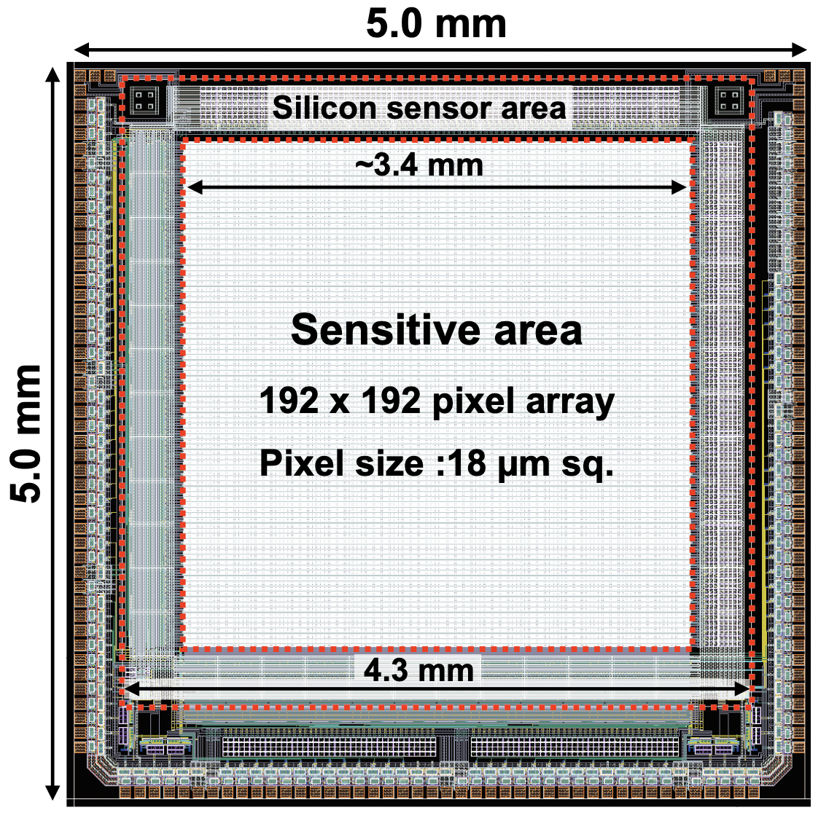
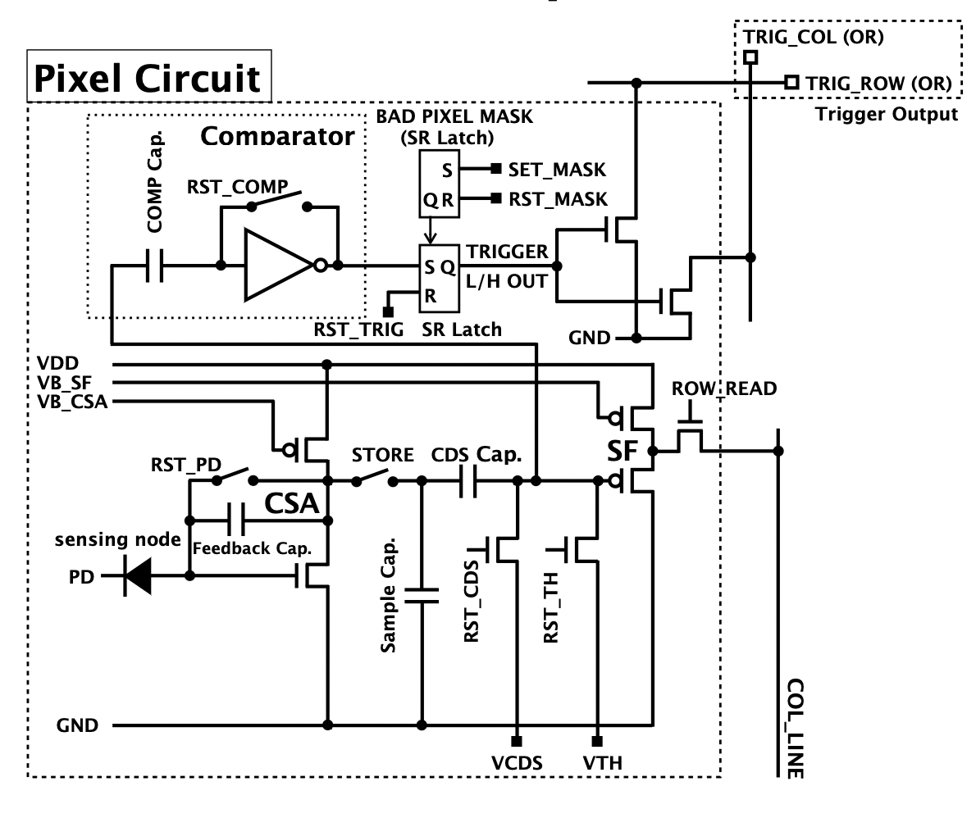
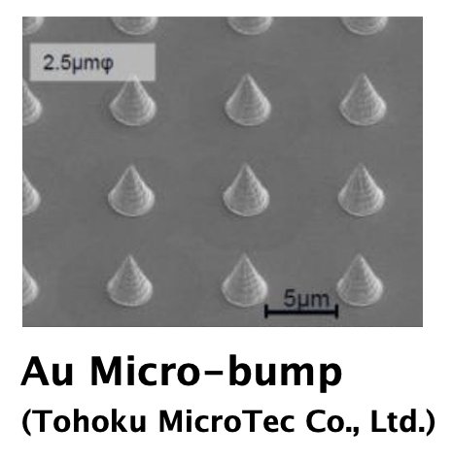
Si-ASIC hybrid pixel sensor with 18 µm pixels
Hybrid pixel sensor → Si sensor coupled to pixel ASIC with 18 µm pixels
Sensor information
- Chip size (Si)：4.3 mm x 4.3 mm
- Sensor thickness：450 µm
- ASIC size : 5.0 mm x 5.0 mm
- Pixel size：18 µm sq.
- Pixel number：192 x 192 (= ~233k)

Slide 9
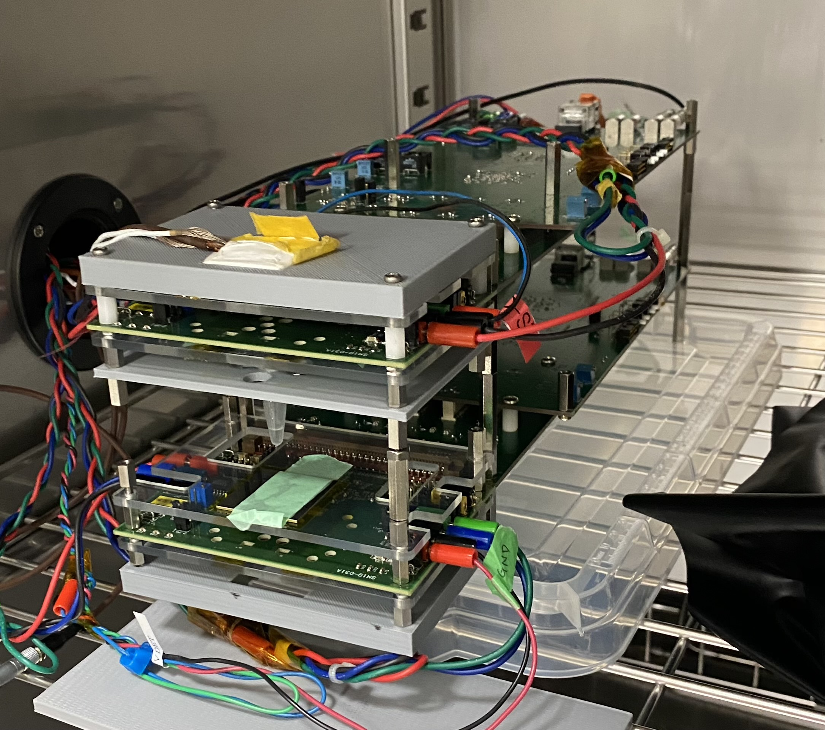
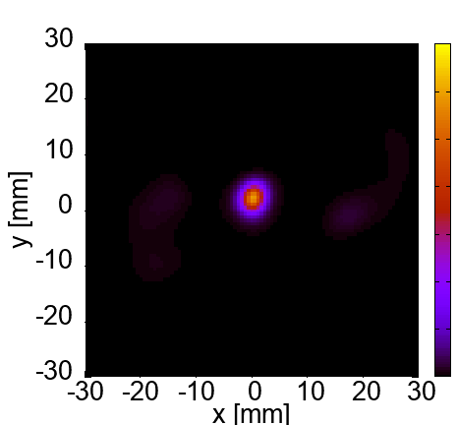
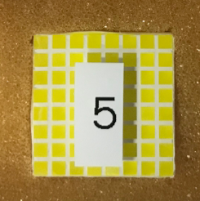
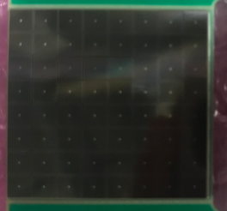
Development of SOI-GFAG Compton camera
140.5 keV Compton imaging
GFAG detector (absorber)
Experimental Setup
GFAG
SiPM
Absorber1
19 mm
Scatterer1
35 mm
^{99m}Tc source
XRPIX7 (scatterer)
^{99m}Tc Source
35 mm
Scatterer2
19 mm
Absorber2

Slide 10
A Monte Carlo simulation by geant4 toolkit
Simulation setup
Si detector
(same size of XRPIX7)
GAGG scintillator detector
(same size of XRPIX7)
100 M injection × 3 set
GPS source
17 mm
511 keV
1274.5 keV
30 mm
300 µm
5 mm
(²²Na gamma-rays)

Slide 11
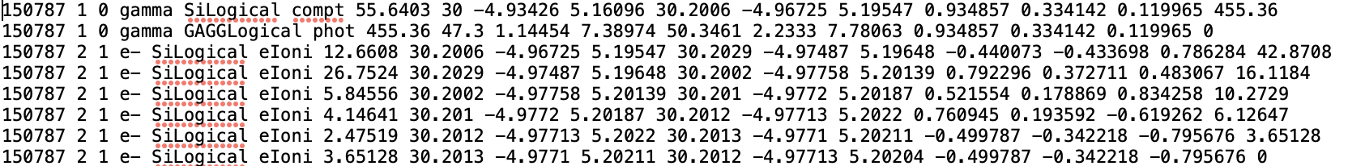
A Monte Carlo simulation by geant4 toolkit
Data format
Si + GAGG Coincidence data
[event ID, track ID, parent ID, process name, detector name, deposit energy,
step start position (x,y,z) [mm] , step end position (x,y,z) [mm], momentum direction (x,y,z),
kinetic energy]
Recoil direction =
(x_end, y_end, z_end)
-
(x_start, y_start, z_start)

Slide 12
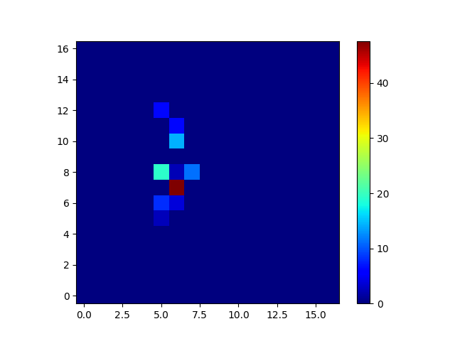
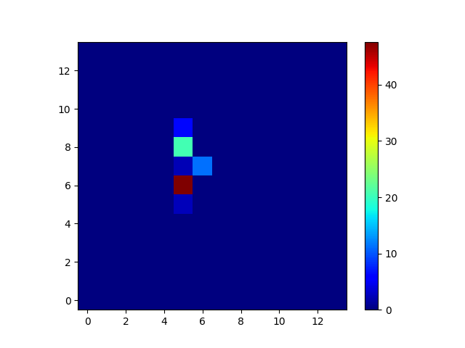
2D image of electron trajectory
511 keV
18 µm pixels
36 µm pixels
 | Coincidence events | 1-2 pixels event | 3 < pixels event
18 µm pixels | 8166 | 3220 | 4946
36 µm pixels |  | 1564 | 6602

Slide 13
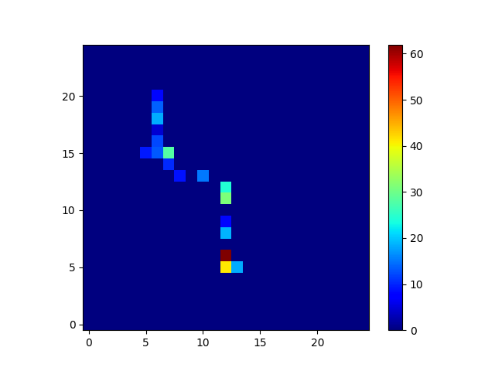
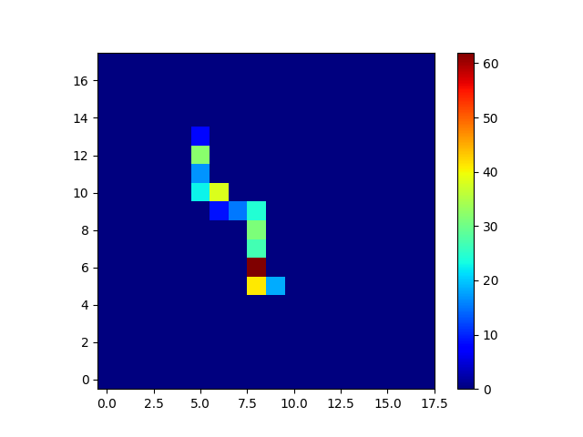
2D image of electron trajectory
1274.5 keV
18 µm pixels
36 µm pixels
 | Coincidence events | 1-2 pixels event | 3 < pixels event
18 µm pixels | 1886 | 71 | 1815
36 µm pixels |  | 16 | 1870

Slide 14
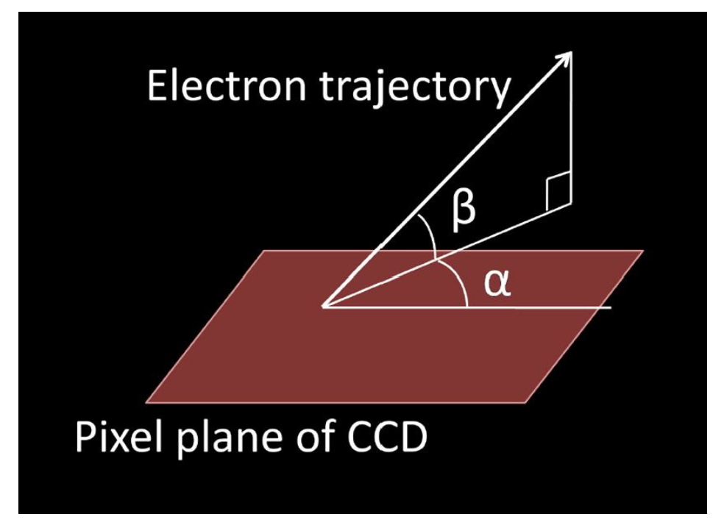
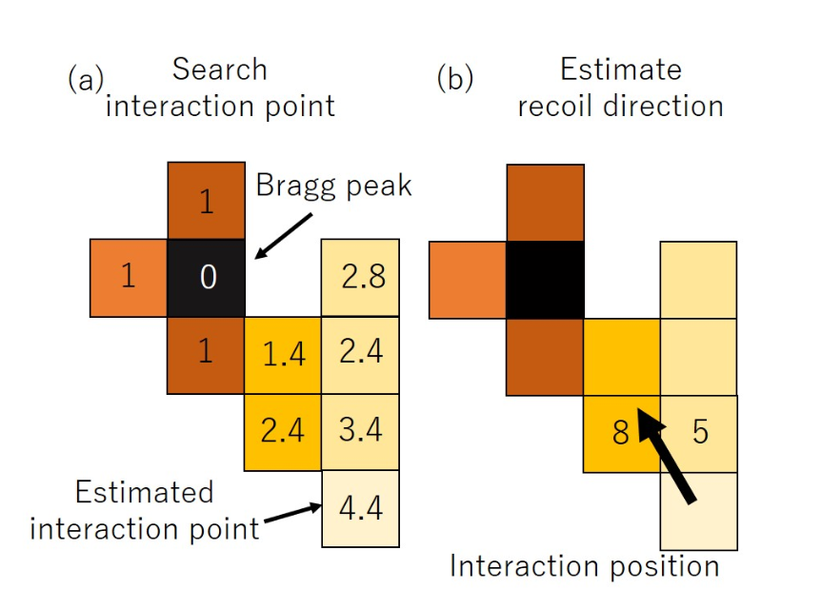
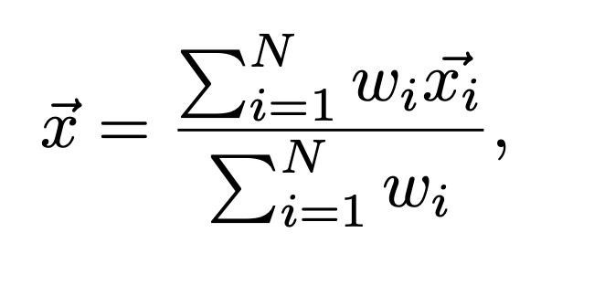
Estimation of 2D recoil direction
Estimation method of α angle
Pixel plane of Si detector
Vector of the adjacent pixel from start pixel
M. Kagaya et al., proceedings of 2021 IEEE NSS/MIC, (2021)
Deposited energy in a pixel

Slide 15
Accuracy of 2D recoil direction
511 keV
18 µm pixels
36 µm pixels
Mean : 33.5 deg
σ : 10.7 deg
Mean : 38.1 deg
σ : 15.3 deg
Difference of simulated and calculated α angles [degree]

Slide 16
Accuracy of 2D recoil direction
1274.5 keV
18 µm pixels
36 µm pixels
Mean : 39.3 deg
σ : 11.6 deg
Mean : 40.7 deg
σ : 10.7 deg
Difference of simulated and calculated α angles [degree]

Slide 17
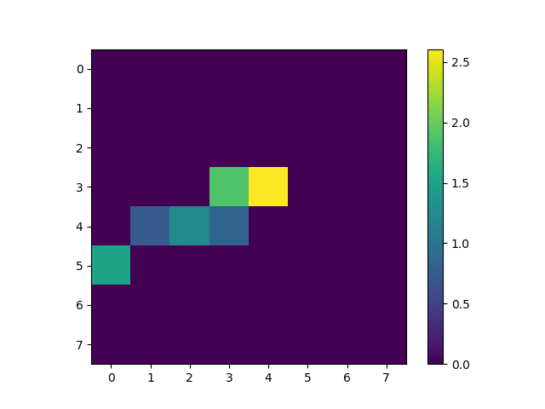
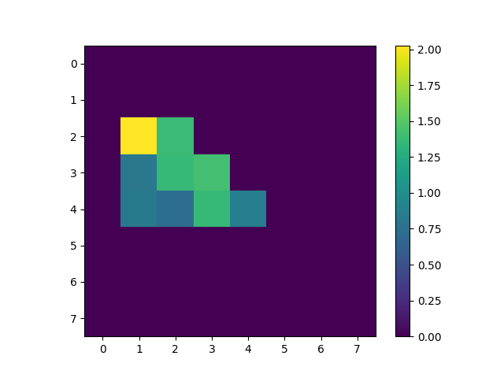
Electron Trajectory in XRPIX7
Recoil electron trajectories of 511 keV gamma-ray (²²Na)
Column
Energy [keV]
Column
Energy [keV]
e-
e-
Row
Row
XRPIX7 could detect some of recoil electron trajectories of 511 keV gamma-ray.
For future work, we need to establish the method to extract the correct electron trajectory because XRPIX7 can measure only 2D trajectory.

Slide 18
Summary and future works
We are developing SOI pixel detectors with pixel size of 36 µm
We also developed Si-ASIC hybrid sensor with pixel size of 18 µm
The Monte Carlo simulation by geant4 shows that the estimation accuracy of 2D recoil direction is not significantly improved by 18 µm measurements compared to by 36 µm measurements although the recoil trajectory can be measured more finely.
The estimation method of 3D recoil direction (B.C Plimley, UC Berckley Ph.D thesis, 2014) will be implemented
XRPIX7 can detect a recoil electron trajectory of 511 keV gamma-ray (but not full depletion)

Slide 19
Thank you for your attention

Slide 20
Basic performance of XRPIX7
²⁴¹Am spectrum of all pixels
5.3 % (FWHM) @13.9 keV
13.9 keV
17.7 keV
Gain correction
17.7 keV
740 eV
20.8 keV
20.8 keV
Temperature : 0 deg
Vdet : -25V (not full depletion)

