Slide 1

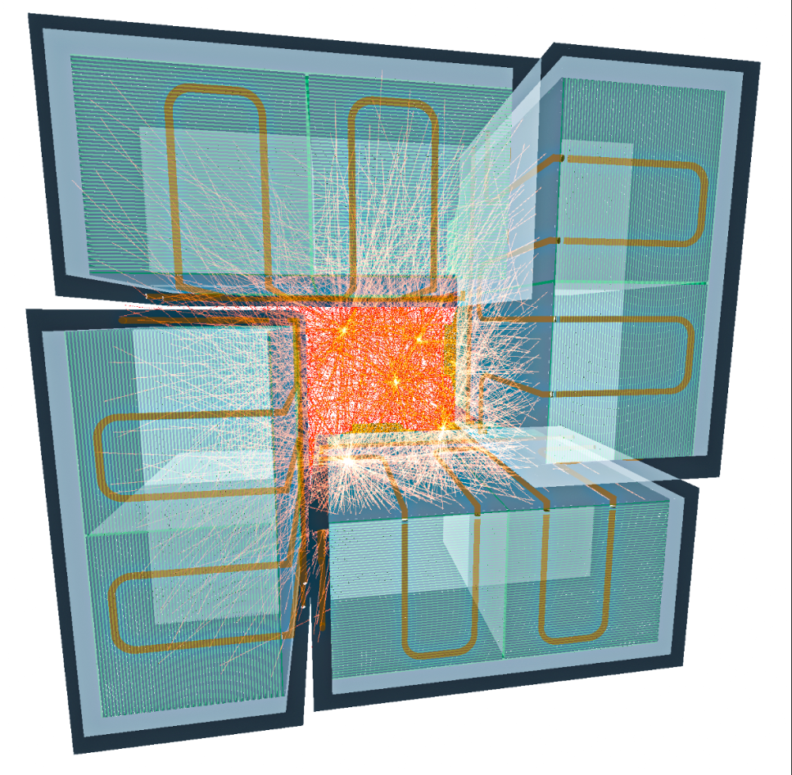
100μPET:
Ultra-high-resolution PET imaging with MAPS
D. Ferrere, University of Geneva
On behalf of 100µPET collaborators

Slide 2
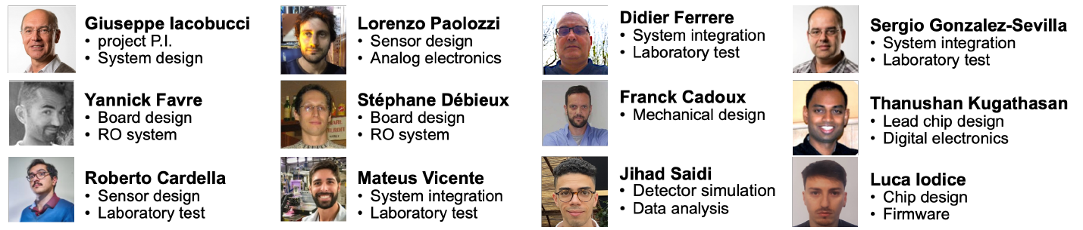

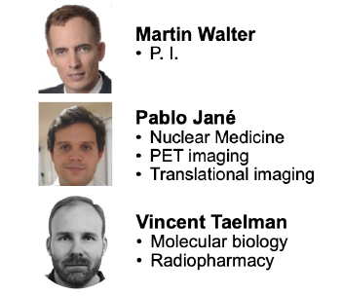




The Project & Collaborators
The 100μPET project: molecular imaging with ultra-high resolution
SNSF SINERGIA grant among UNIGE (scanner construction) EPFL (imaging) and UNILU (medical application studying atherosclerosis in ApoE+/- mice)
Deliverable: Small-animal PET scanner with monolithic silicon pixel detectors
2

Slide 3
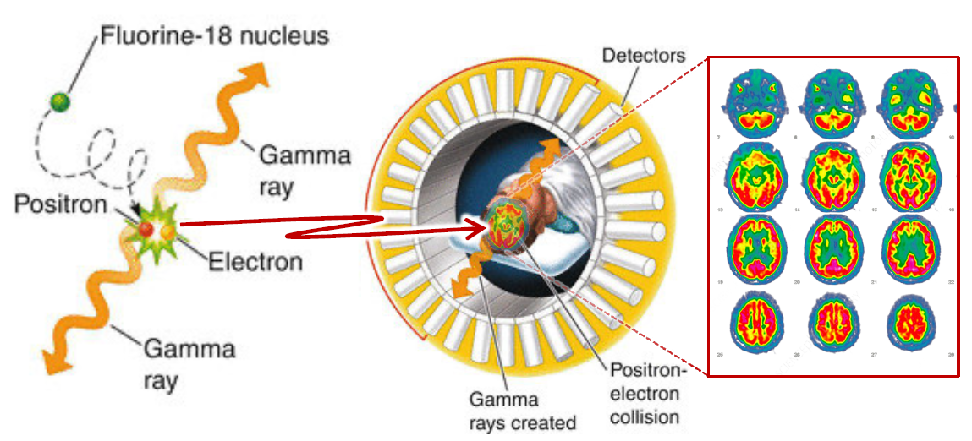
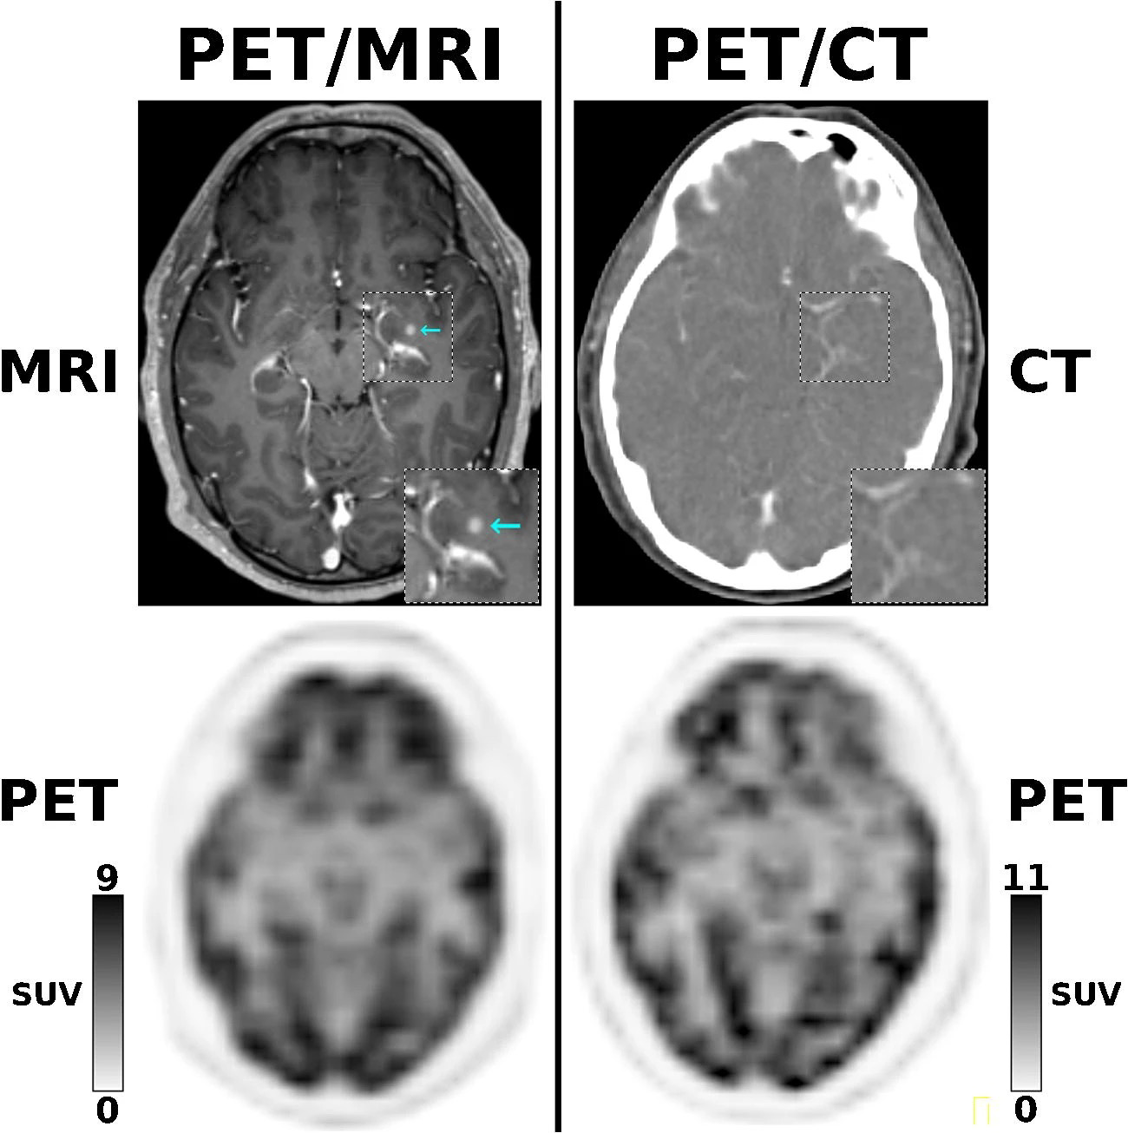
Positron Emission Tomography (PET)
PET is a nuclear medicine method to study metabolic processes in the body
Radiotracer is injected in a body → Positrons from the radionuclide annihilates with electrons of the nearby tissue → Two back-to-back 511 KeV photons are emitted and detected in coincidence
Lines-of-Response (LoR) are defined by the volume between the sensitive elements detecting the two photons
  Lines-of-response are processed to generate density maps of the detected annihilations
  Today, due to the lack of spatial resolution, PET imaging must be done in hybrid mode (combining MRI or CT measurements)
PET
PET + MRI
3
Ref

Slide 4
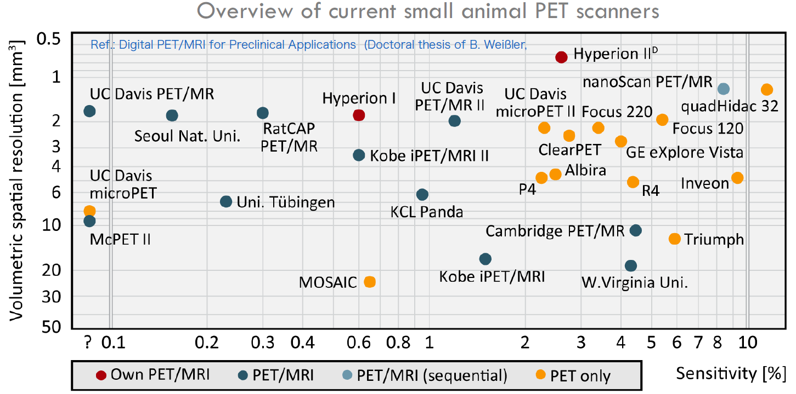
Positron Emission Tomography (PET)
PET is a nuclear medicine method to study metabolic processes in the body
Radiotracer is injected in a body → Positrons from the radionuclide annihilates with electrons of the nearby tissue → Two back-to-back 511 KeV photons are emitted and detected in coincidence
Lines-of-Response (LoR) are defined by the volume between the sensitive elements detecting the two photons
  Lines-of-response are processed to generate density maps of the detected annihilations
  Today, due to the lack of spatial resolution, PET imaging must be done in hybrid mode (combining MRI or CT measurements)
  → Goal: improve the spatial resolution of PET scanner
Typical resolution today: 1 – 2 mm
Volumetric spatial resolution and sensitivity are the two key ingredients for performance
4

Slide 5
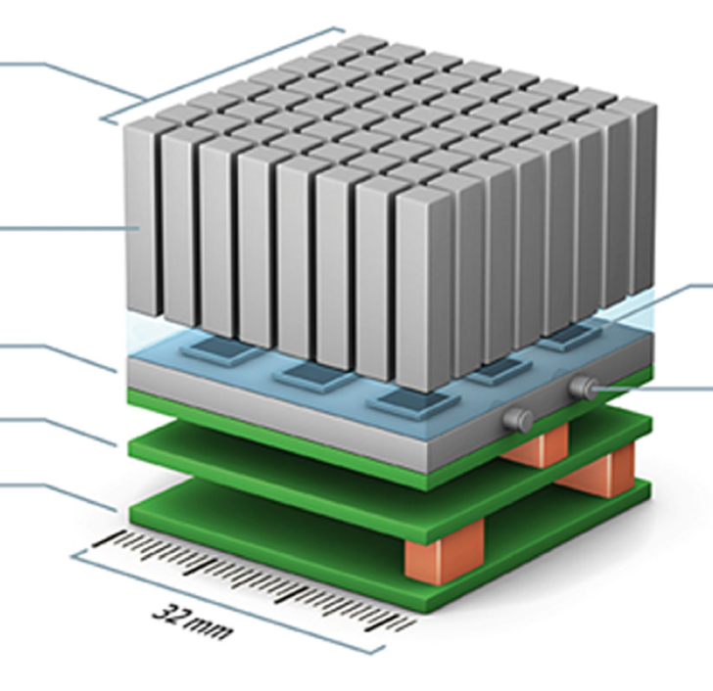
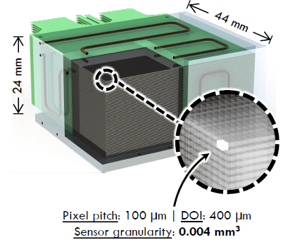
Detector Granularity - DOI and LOR
→ Ultra-high resolution is obtained by increasing the granularity inside a detection volume thanks to small silicon pixel size (~100 microns)
PET tower with LSO crystals
100µPET stack
LSO array
Crystals
4x4x20 mm³
3x3 APD
array
Courtesy of Siemens Healthcare
DOI: 20 mm
Sensor granularity: 320 mm³
Scanner granularity: ~80’000 times finer with silicon pixel sensors LOR volume: ~1’600 times smaller & DOI: 50 times smaller
5

Slide 6
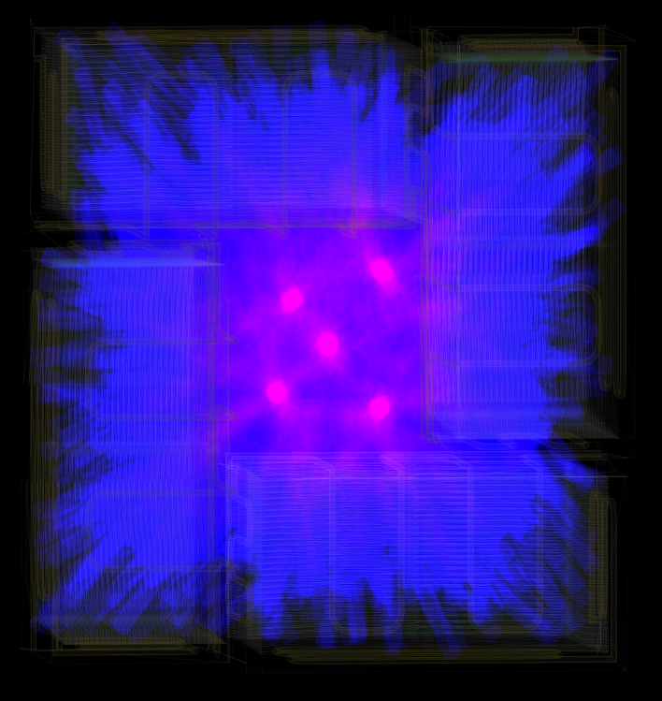
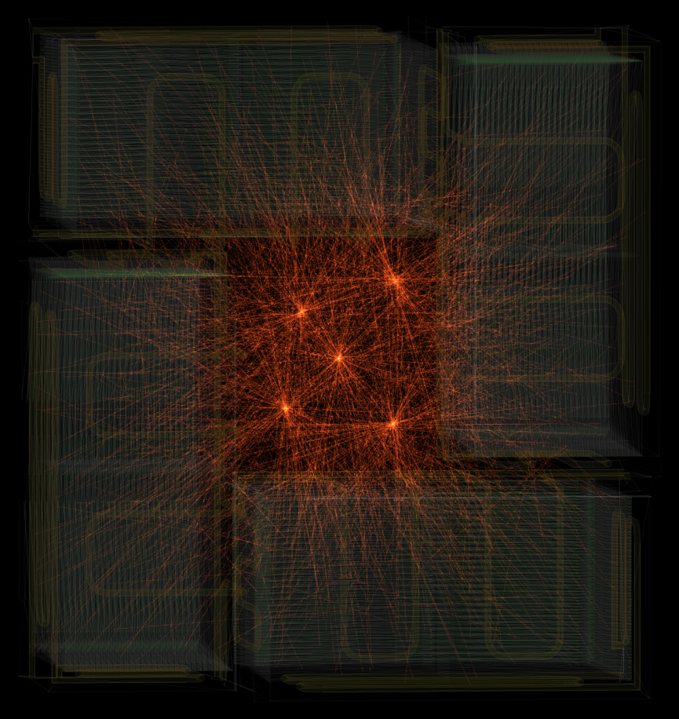
Detector Granularity - DOI and LOR
→ Ultra-high resolution is obtained by increasing the granularity inside a detection volume thanks to small silicon pixel size (~100 microns)
5 point sources with 2 mm thick LOR
5 point sources with 0.1 mm thick LOR
Only a factor of 20
6

Slide 7
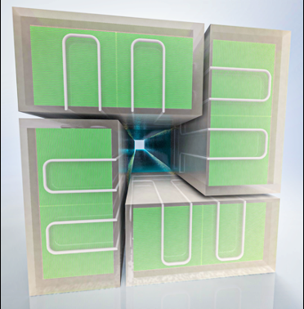
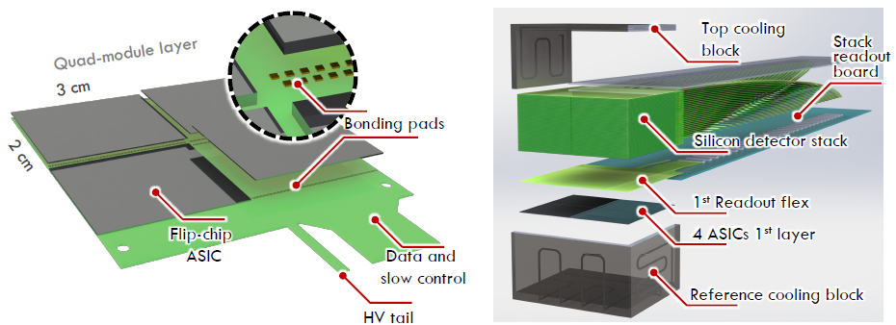
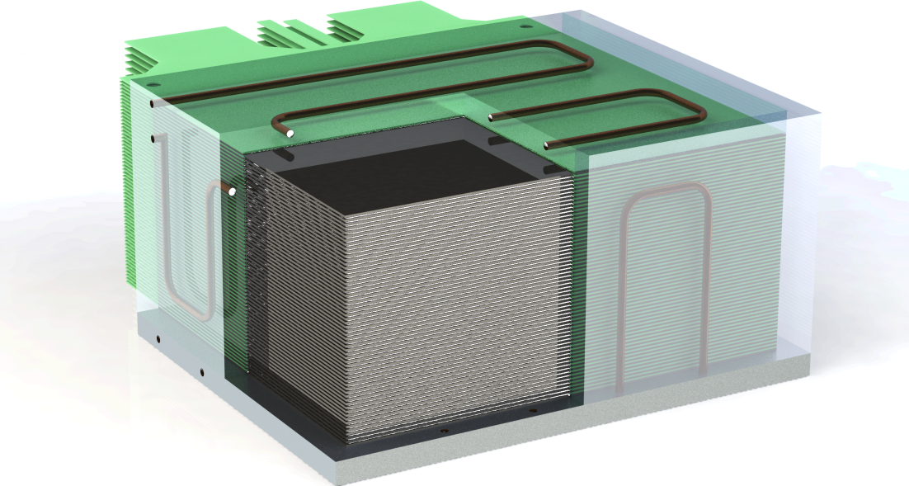
100µPET Layout using MAPS
The 100µPET Scanner consists of 4 towers with a total of 960 chips!
A tower is composed of 60 Si-detection layers
Multi-layer stack of CMOS imaging sensors based on silicon pixel detectors used in HEP
  Monolithic 100μPET ASIC: 130 nm SiGe BiCMOS* using high resitivity wafer ( 4 kΩ.cm)
  Large size reticle sensor-asic: 30 x 22 mm²
  Optional 50 μm thick Bismuth layer to increase the photon conversion efficiency (w.r.t. only silicon)
7

Slide 8
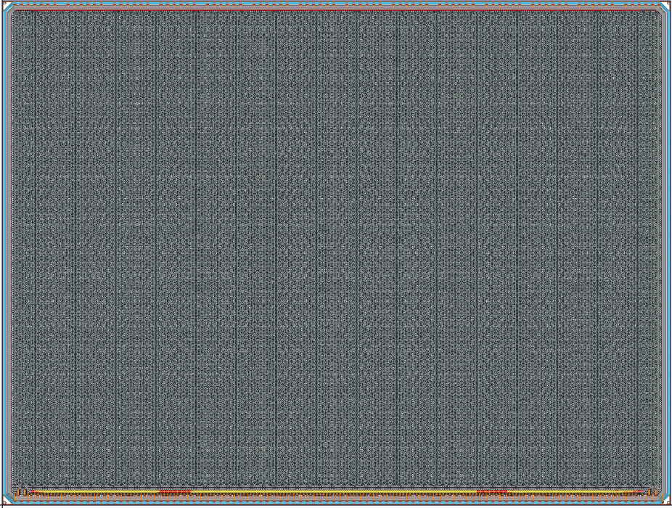
The Sensor-Asic Design - MAPS
SiGe technology developed in the framework of monolithic timing pixel development profited from ~8 years of R&D development now used for FASER preshower upgrade and for 100µPET (Monolith talk this afternoon)
Asic design largely inspired from the FASER chip (tomorrow’s talk) – In-house design and submission booked for October 24th
Main features
Depletion depth | 250 [µm]
Pixel (hexagonal) pitch | ~ 160 [µm]
Nb of pixels | 25344
Max cluster size | < 25 pixels (5x5)
Front end noise (ENC) | 200 [electrons]
Operation Threshold | 3000 [electrons]
Power consumption | 70 [mW/cm²]
Time resolution RMS (Qin > 5 ke-) | 200 [ps]
TOA and TOT | Per each super-pixel line
Readout speed | 50 [Mb/s]
Event size | 143 [bits]
Max expected data rate | 40 kHit/s @ 20 MBq
Chip readout daisy chained | 1 readout line / 4 chips
Chip size: ~ 30.2 x 22.8 mm²
16 Super columns of 11 Super pixels
of 144 pixels
8

Slide 9
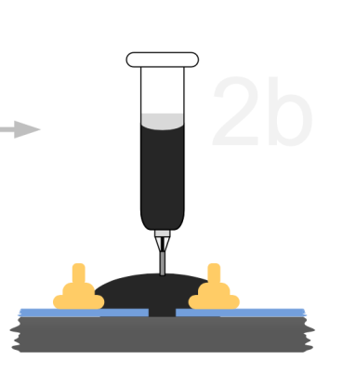
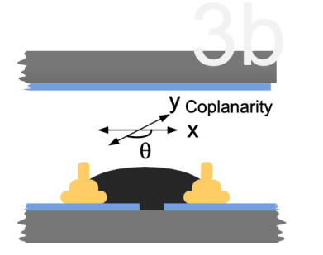
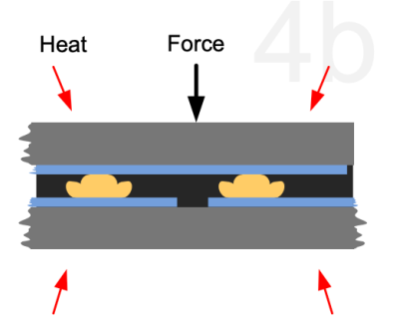
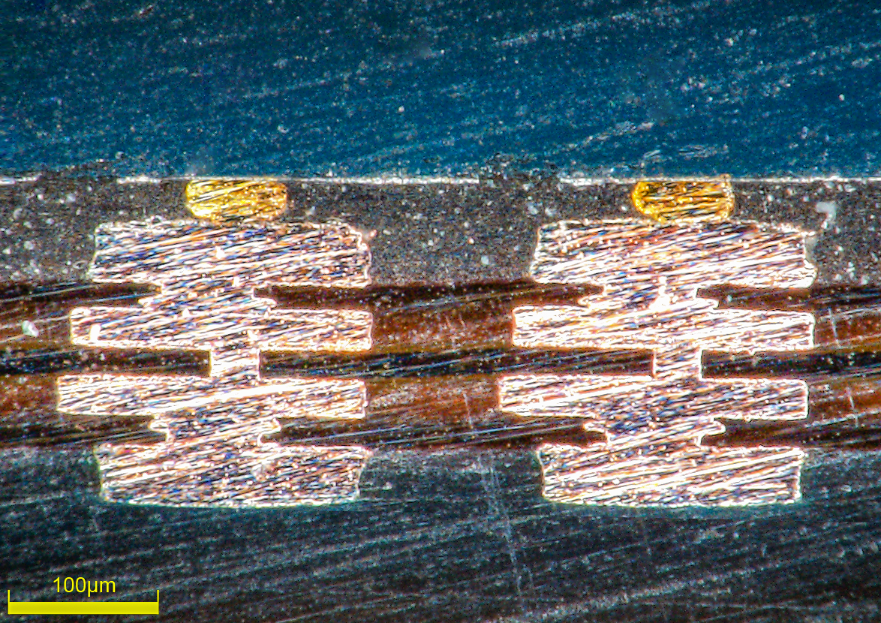
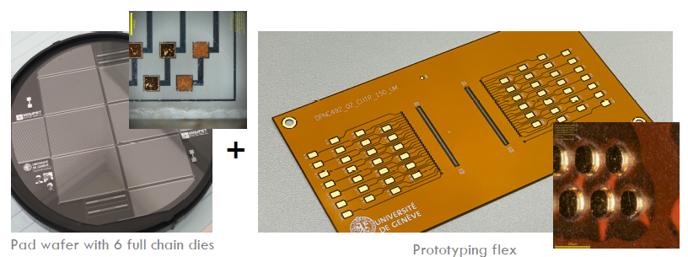
100µPET Module Construction
Baseline concept: Single module layer → Si to FCP interconnection
Flip-chip bonding thanks to:
SET ACCURA100 machine
Fused silica detector pattern matching flex PCB structure
Flex PCB design on purpose to match the qualification bonding test
9

Slide 10
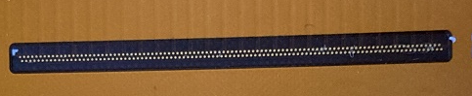
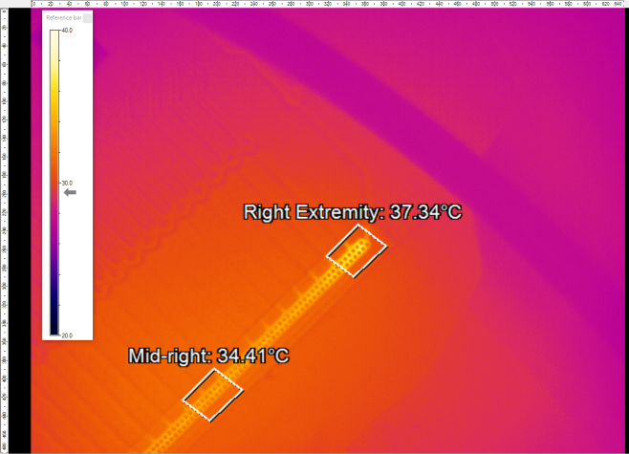
Interconnection Qualification
Several interconnections techniques were tested with the optimal method → Gold stud bumps with NCP
Most reliable electrical contact and passed all the qualification tests including current stress test up to 300 mA
After coining with 200gf / bump
After coining with 200gf / bump
Gold Stud Bump made at Campus Biotech
During current stress tests → IR image checked
IR Inspection area (Interconnection pads underneath)
IR during current stress
@ up to 300 mA/pad
10

Slide 11
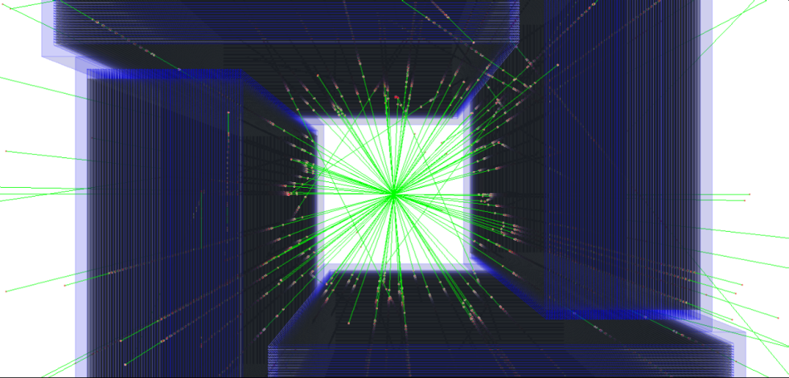
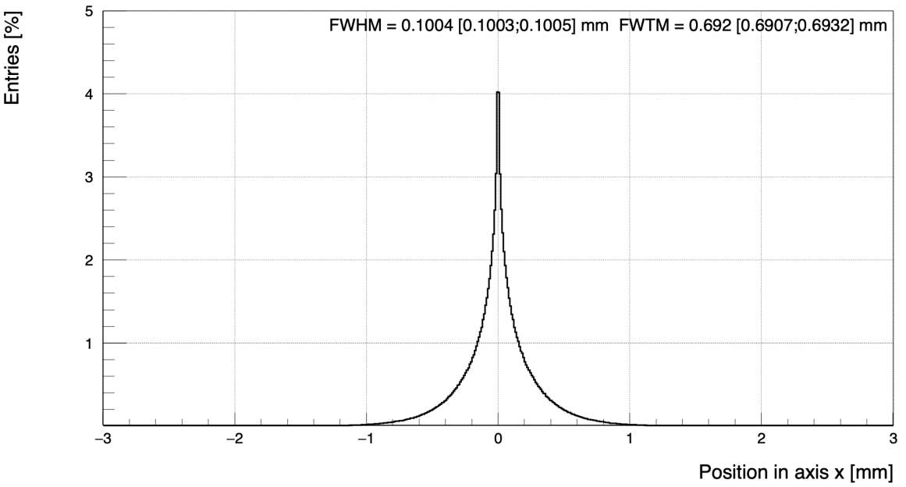
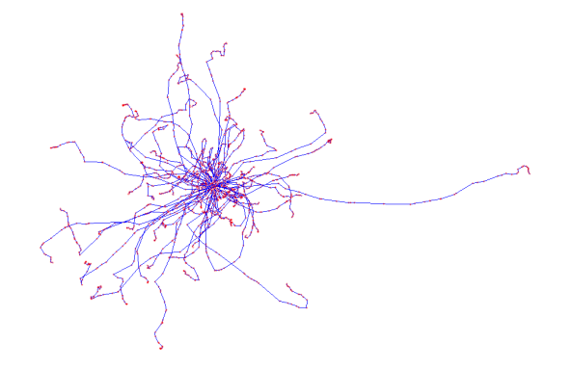
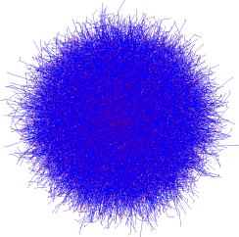
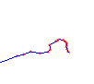
100µPET – Performance Simulation (1/2)
Monte Carlo simulation with Geant4 and Allpix2 allows:
Positron emission & photon conversion
Detector performance with pixel asic
Detector effects on sensitivity and resolution
Full scanner geometry (w/ or w/o Bi layers) + water volume
Positron mean free path and annihilation from [¹⁸F]FDG with acolineaity effect
Photon interactions (scattering and photoelectric effect)
Sensor/ASIC response + pixel clustering
Positron trajectory
Photon 1
180°
± 0.5 °
1 mm
e⁺ MPF in water (1000 events, photons not shown)
Photon 2
11

Slide 12
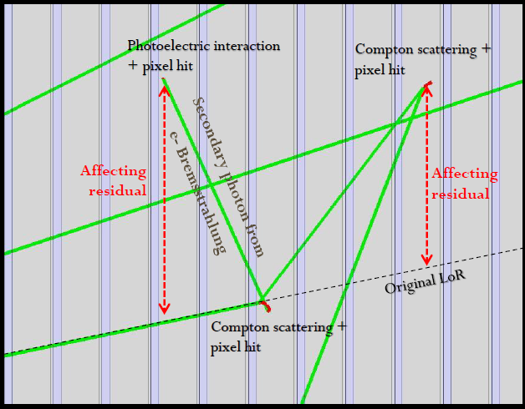
100µPET – Performance Simulation (2/2)
Monte Carlo simulation with Geant4 and Allpix2 allows:
Positron emission & photon conversion
Detector performance with pixel asic
Detector effects on sensitivity and resolution
Single positron annihilation per event:
Event filtering for unambiguous line-of-response acceptance
Only events with two scanner towers having each a single cluster charge
No energy window for discriminating signals form Compton or Photoelectric interactions
Resolution of the positron source:
Single point → Point Spread Function
Derenzo phantom → assess image reconstruction
Event with 3 possible clusters within a tower
non interacting photon
1st interacting photon
12

Slide 13
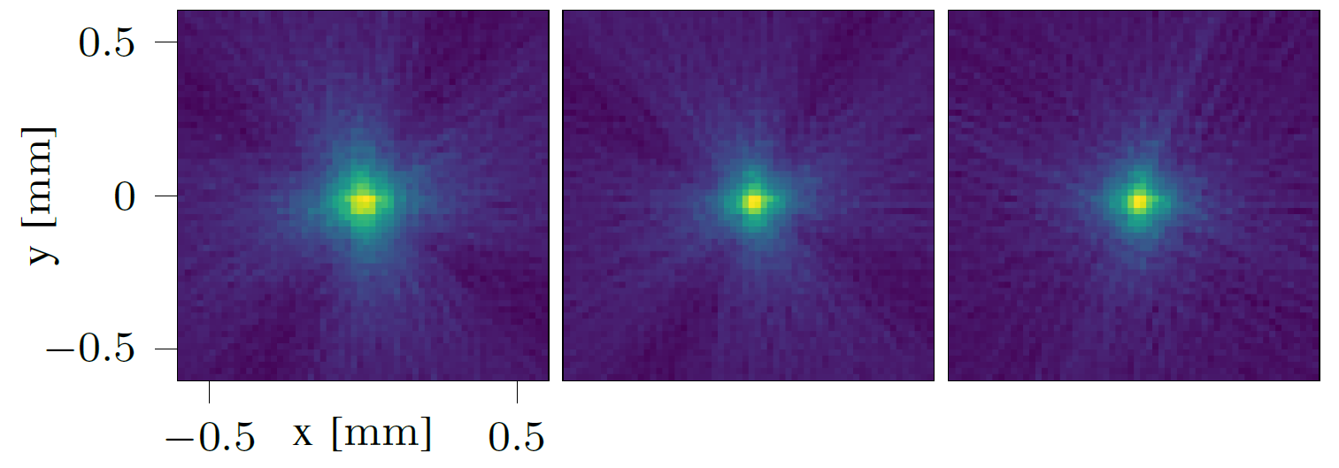
Performance with Single Point Source
Point Spread Function from FBP
(values in mm)
Sensitivity: amount of unambiguous LoR measured as a function of the total number of positrons
  3.3% and 4.8% detection efficiency, without and with Bi respectively
Spatial resolution: Point Spread Function with FBP (Filtered Back Projection)
  0.22 mm at minimum and 0.25 mm with Bi
  Due to acolinearity of the 2 photons → not a big change between 100 vs 150 µm pitch
  Negligible parallax distortion
off-axis (mm) |  | 0 | 5 | 10 | 15
FWHM (100 µm) | No Bi | 0.22 | 0.23 | 0.24 | 0.24
 | Bi | 0.25 | 0.26 | 0.27 | 0.28
FWHM (150 µm) | No Bi | 0.24 | 0.25 | 0.26 | 0.25
 | Bi | 0.27 | 0.28 | 0.28 | 0.28
NB: The mean-free path of the positron (100 µm FWHM and 1000 µm FWTM) is included in the simulation as well as the acolineraity
→ Only unambiguous event were used
W. Bi
Wo. Bi
Wo. Bi +
sensitivity correction
13

Slide 14
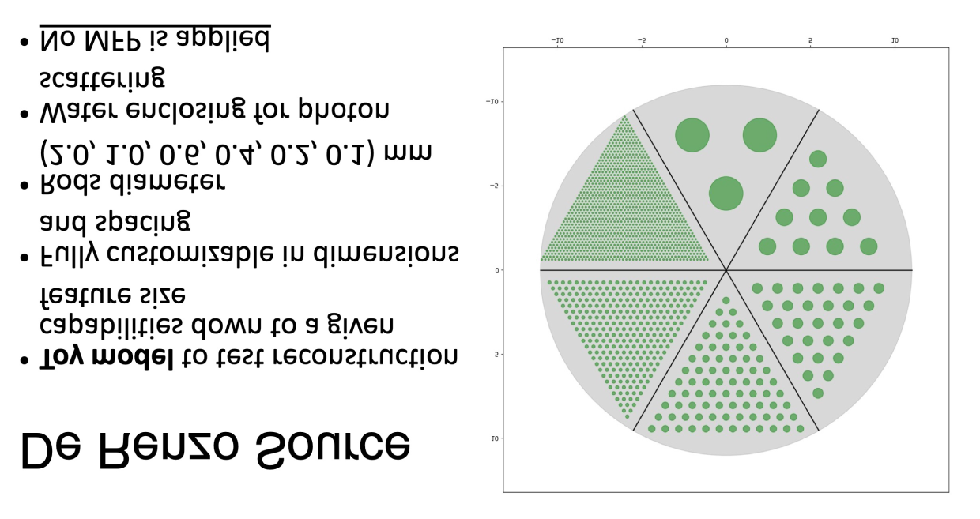
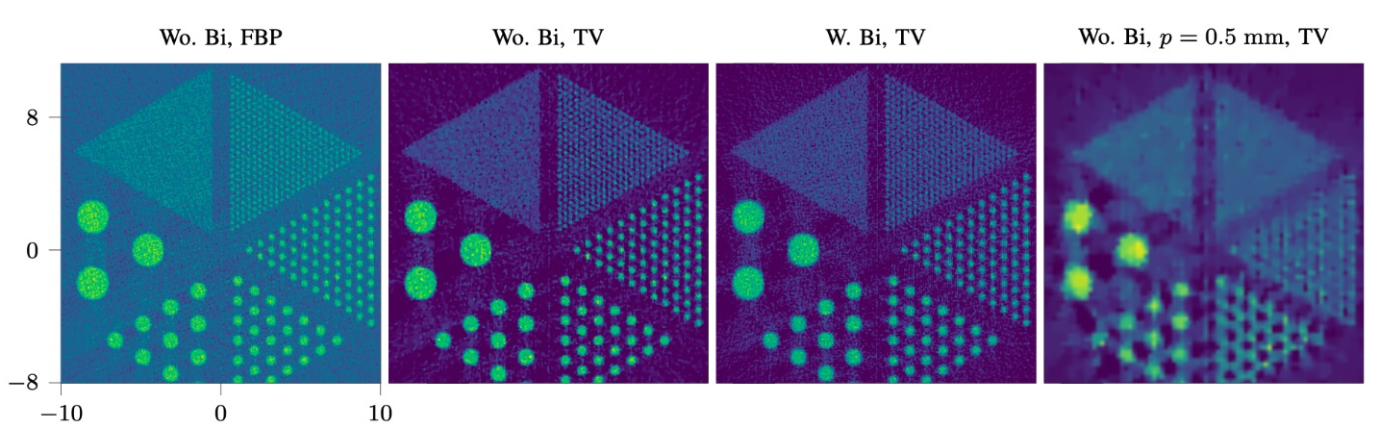
Derenzo Phantom for Imaging Reconstruction
Derenzo template
Size [mm]
Derenzo phantom to test reconstruction to a given feature size:
  2.0, 1.0, 0.6, 0.4, 0.2, 0.1 mm rods (no positron mean free path)
Reconstruction using the 100muPET scanner
FBP: Filtered back projection
TV: Total Value
0.1
0.2
2
0.4
1
0.6
100 µm pitch
1.
2.
3.
4.
14

Slide 15
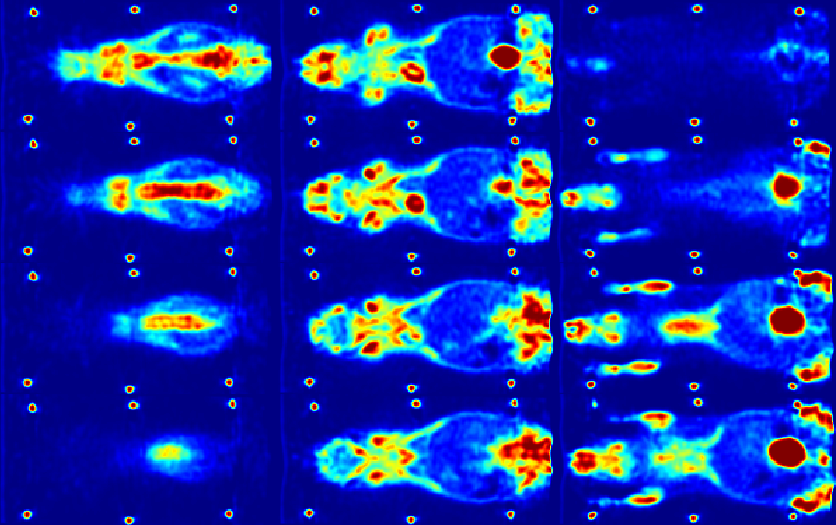
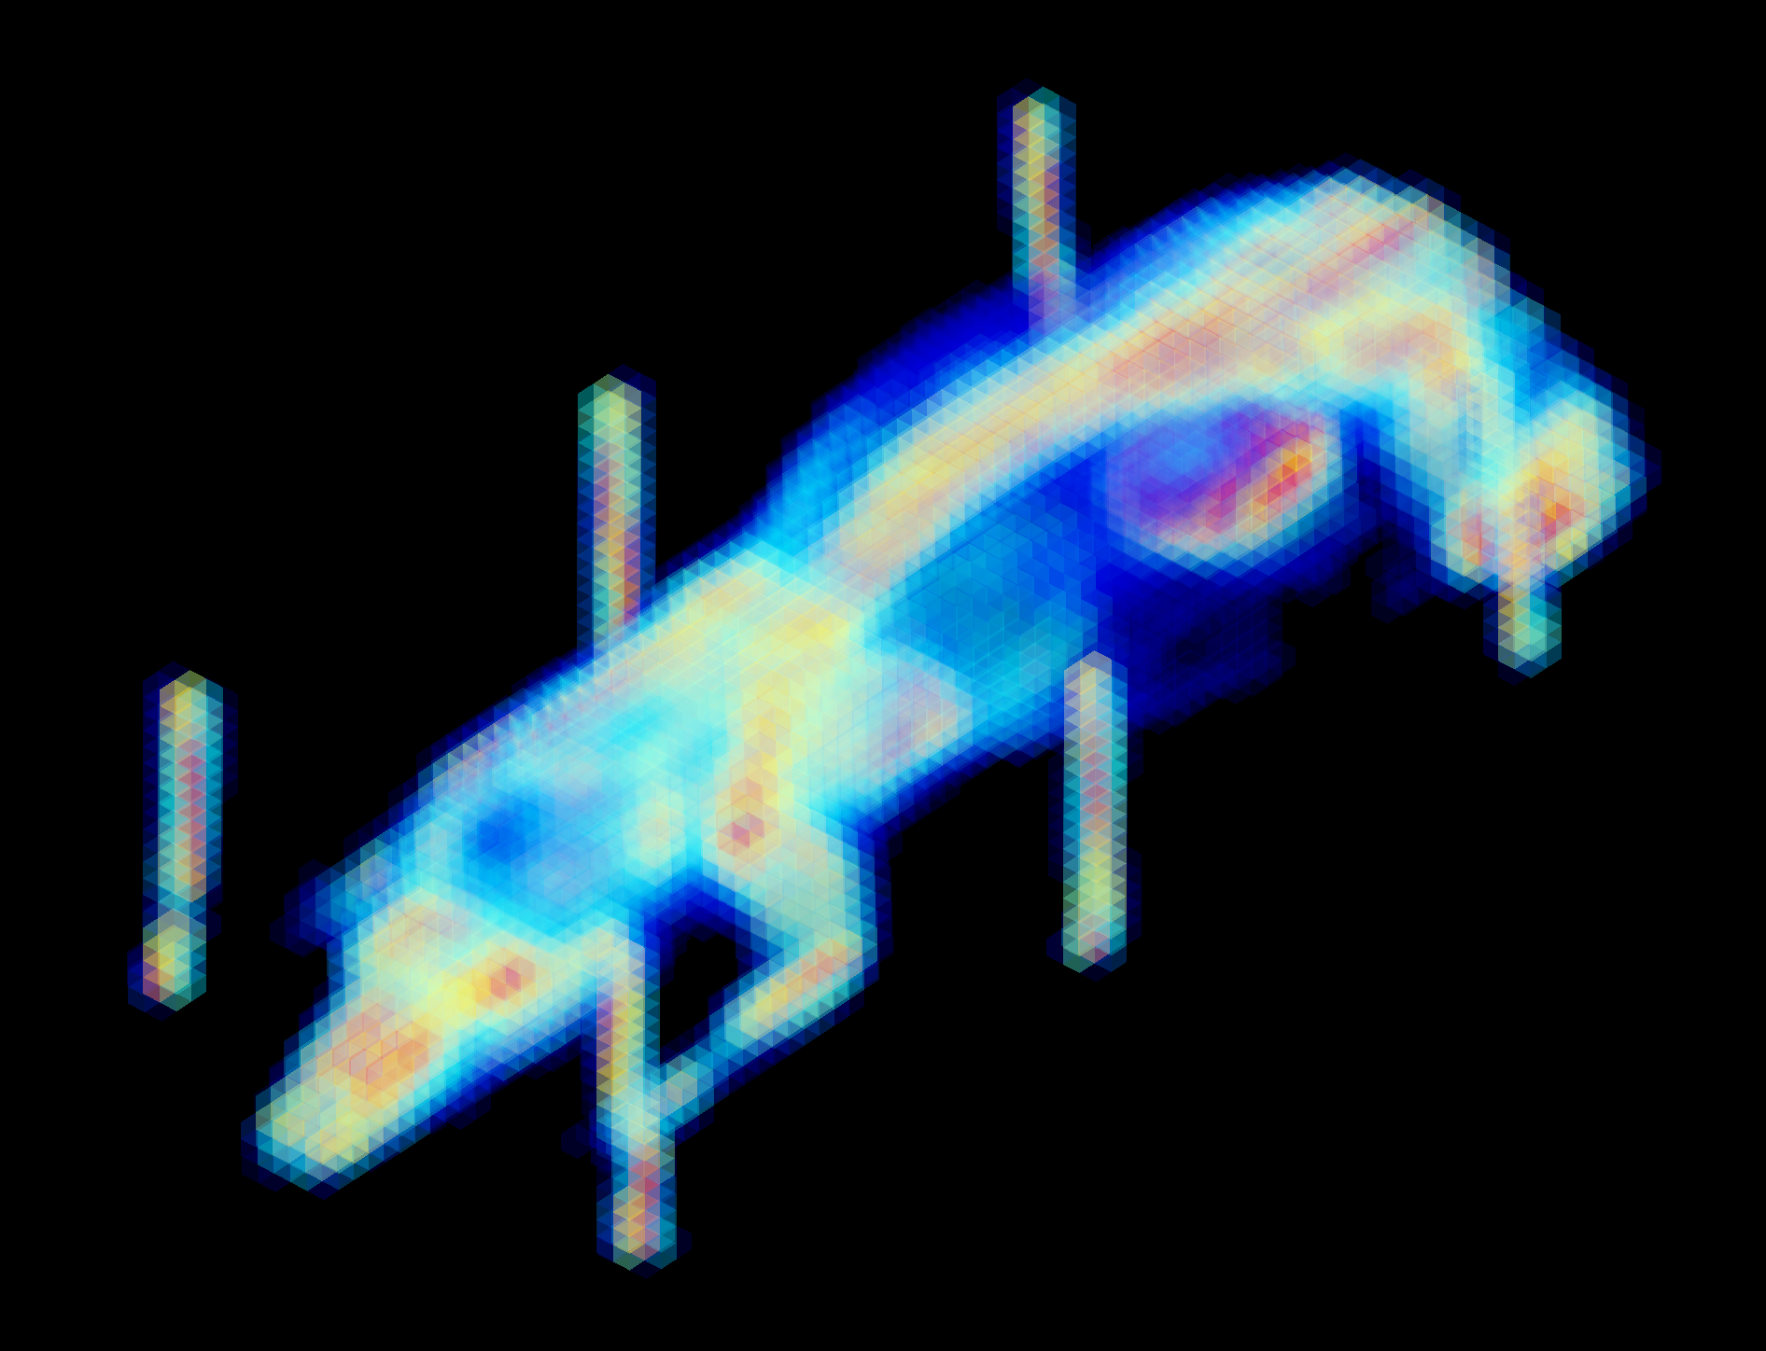
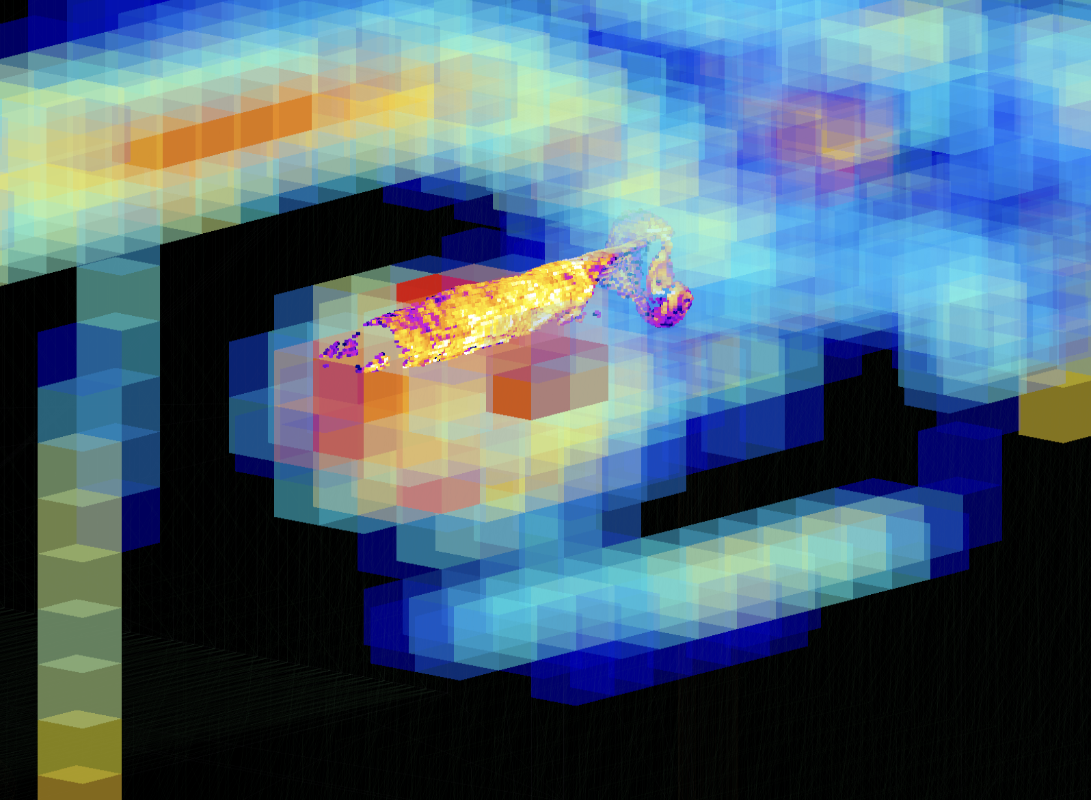
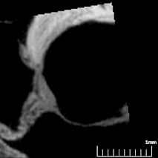
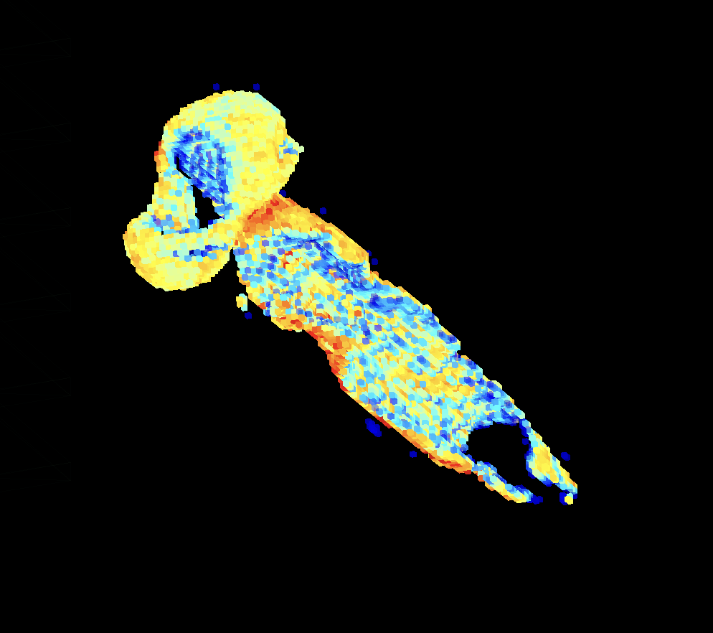
100µPET Artery Plaque
Digimouse: a 3D whole body mouse atlas from CT and cryosection data. doi: 10.1088/0031-9155/52/3/003
3D voxels from Digimouse PET scan (1 mm wide voxels)
Combined parts
A volumetric method for quantifying atherosclerosis in mice by using microCT doi: 10.1371/journal.pone.0018800
3D voxels from plaque (50 µm wide voxels)
Plaque
Digimouse heart
15

Slide 16
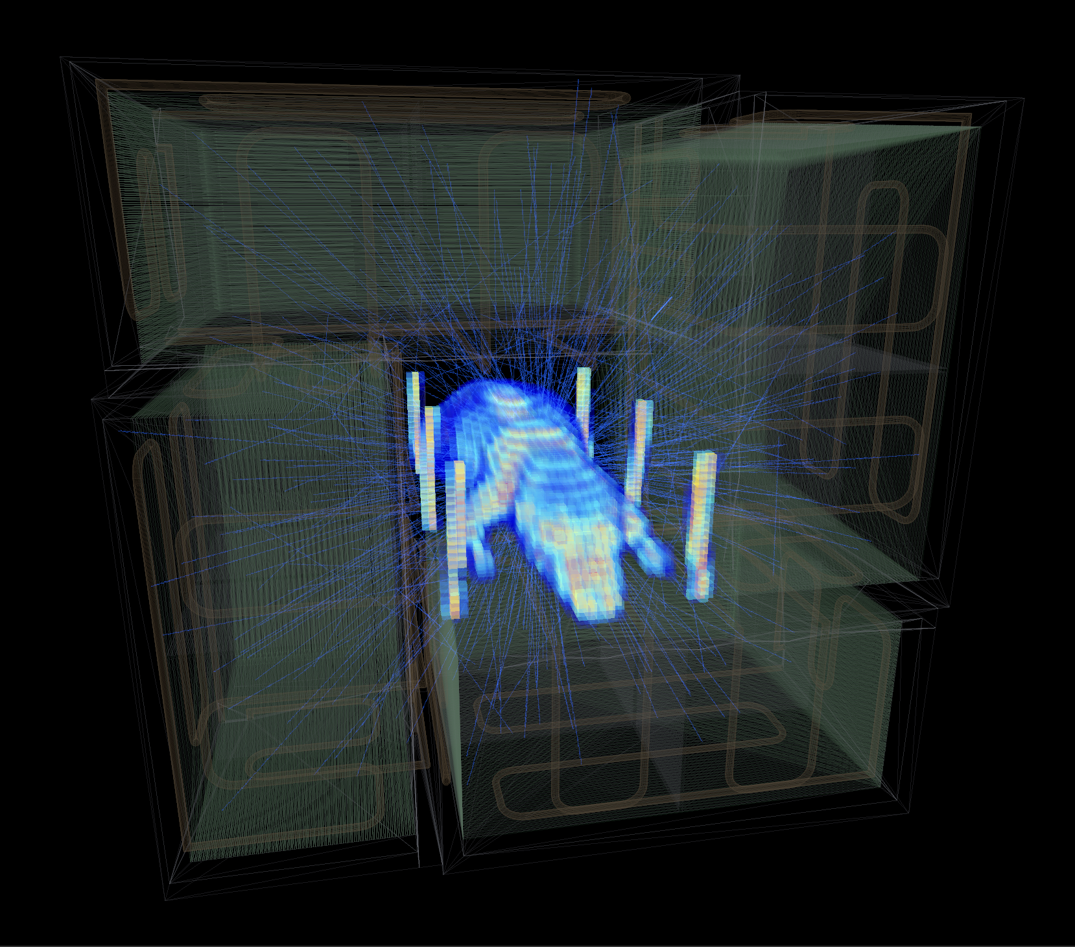
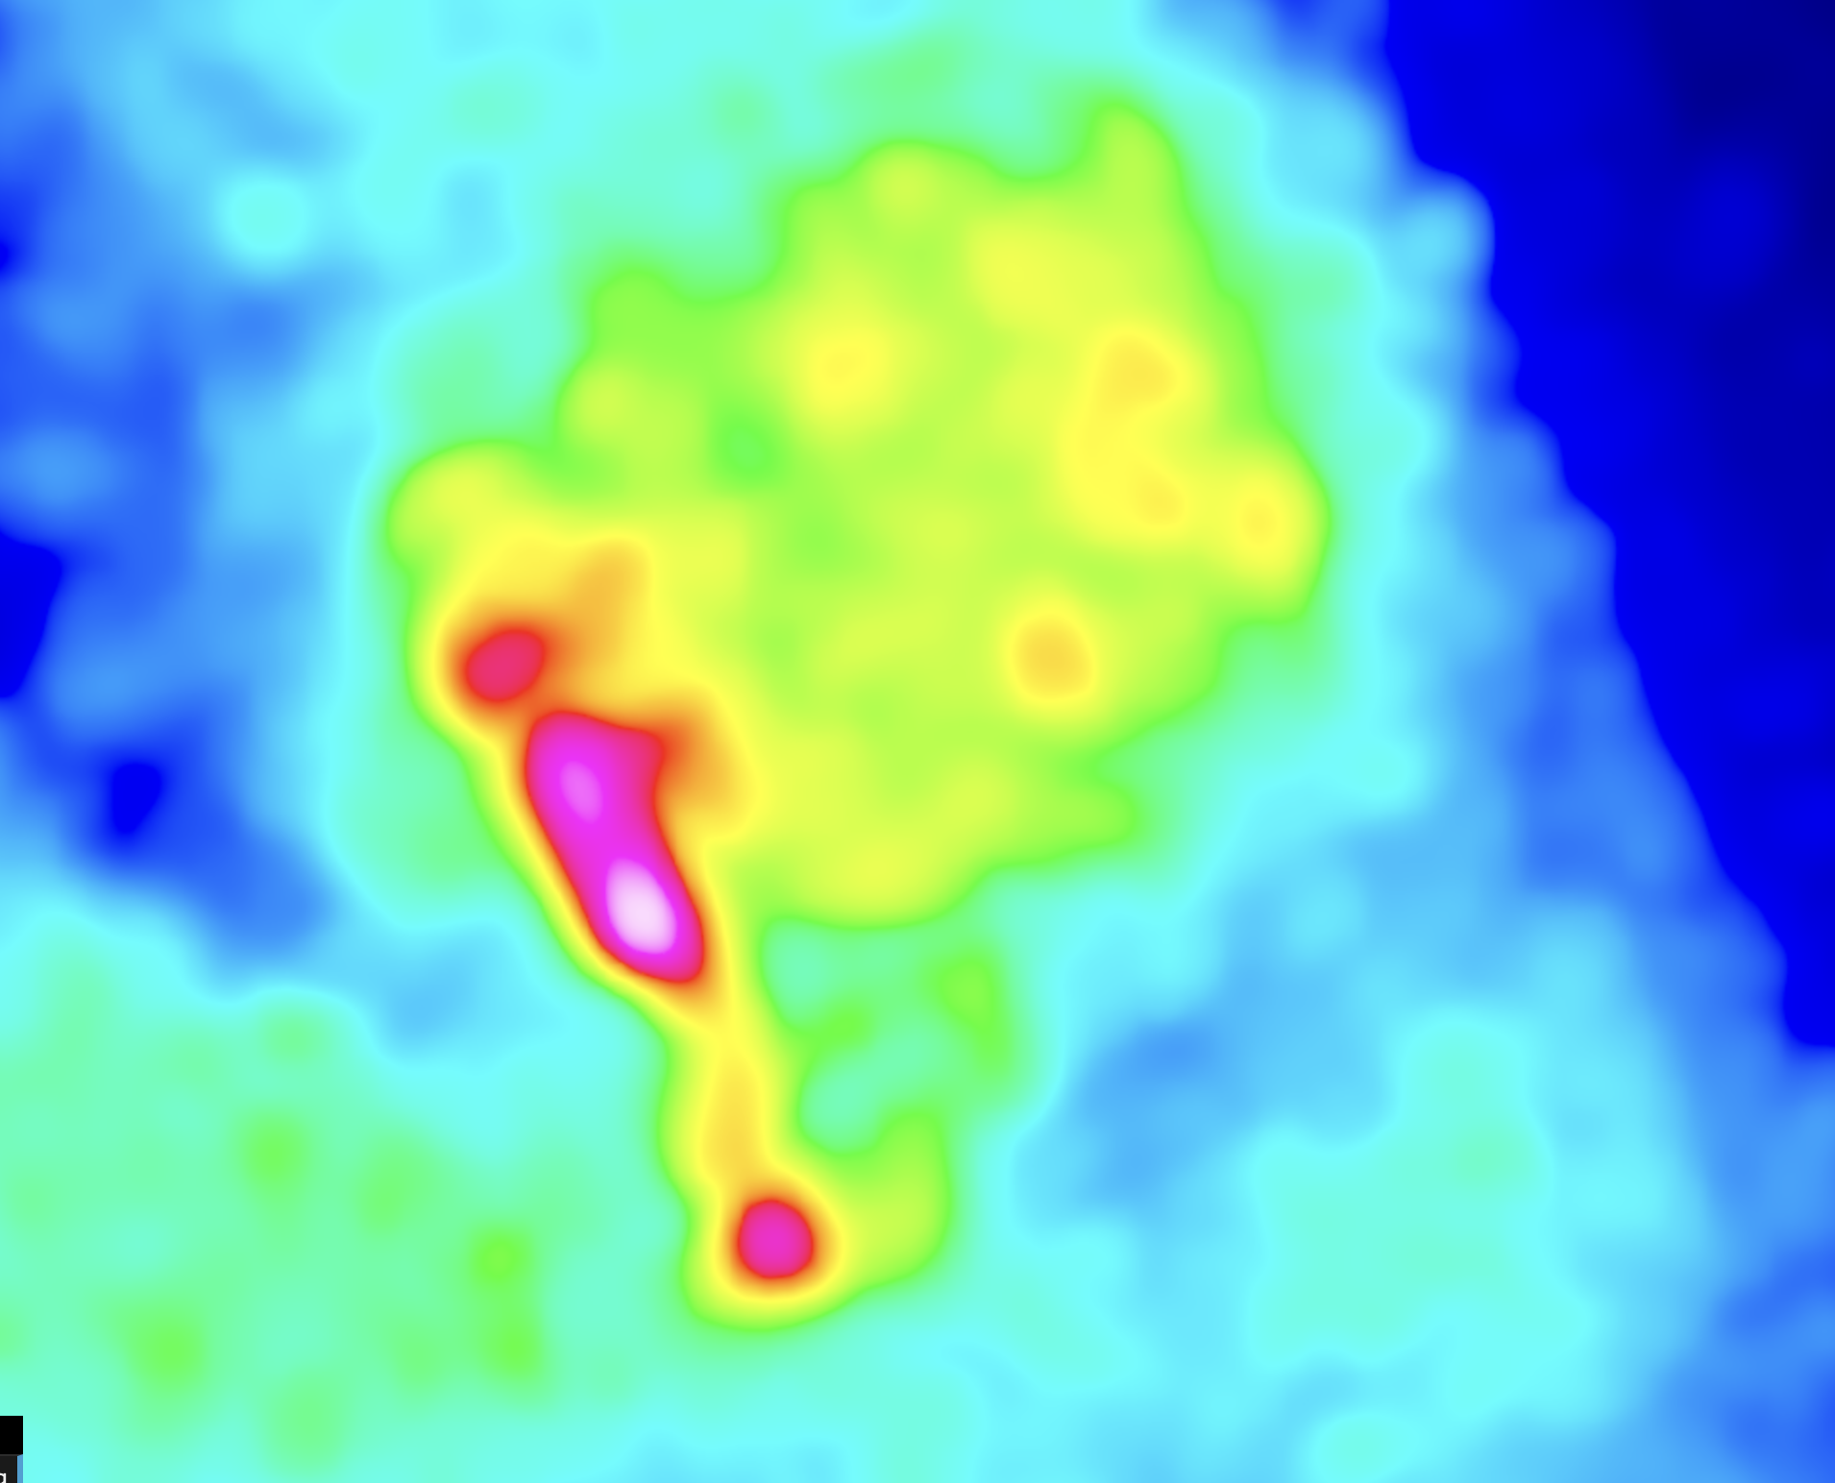
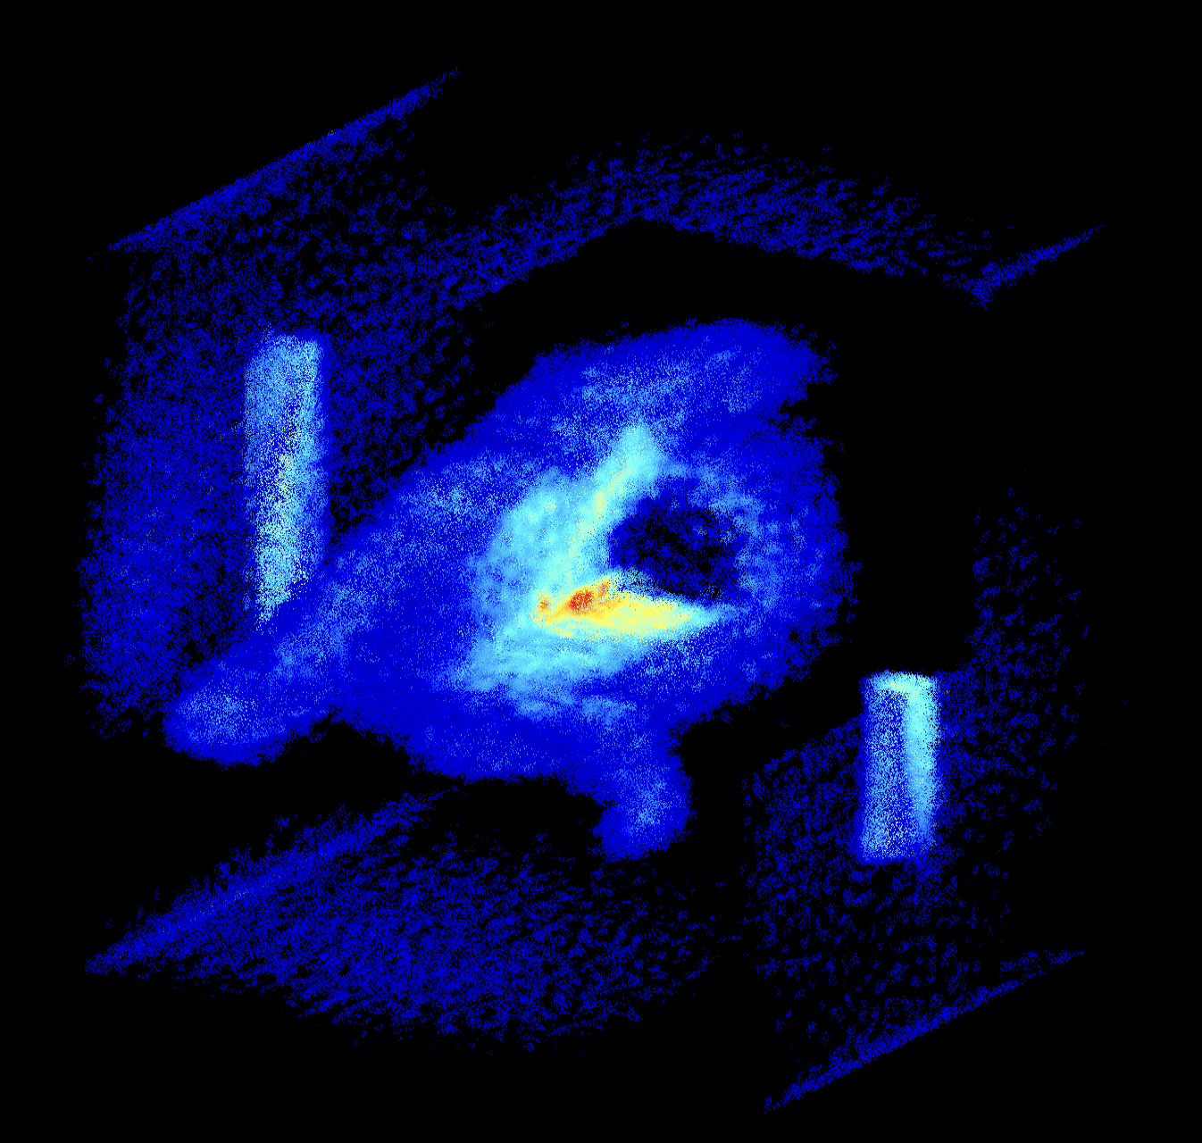
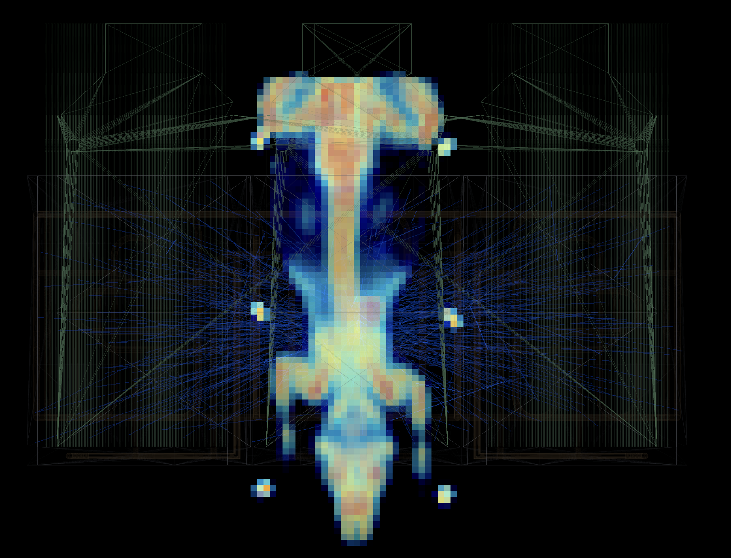
100µPET Artery Plaque
Reconstructed volume (110 µm voxels)
Monte Carlo simulation of Mouse +
Plaque within scanner detectors
16

Slide 17
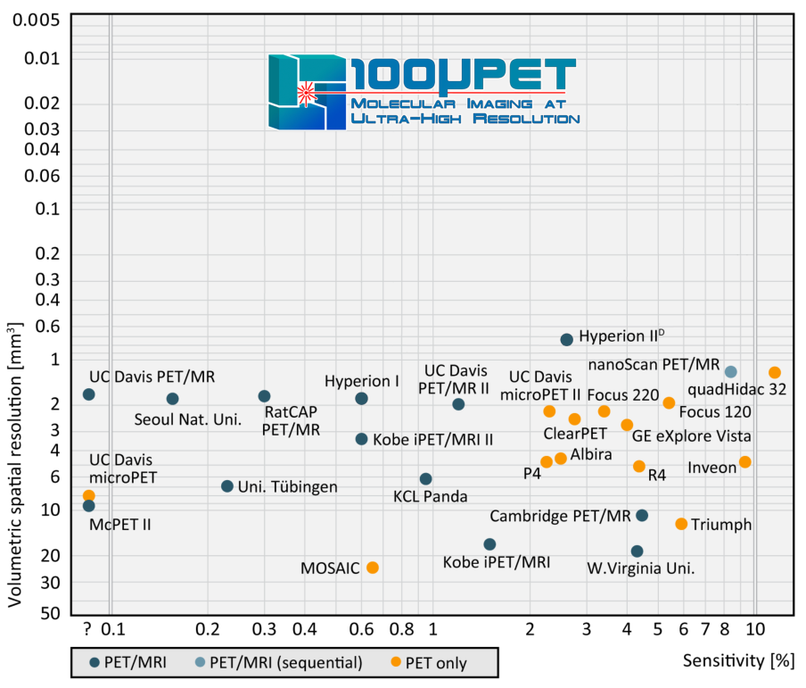
Summary & Conclusions
PET scanners are important diagnostic tools for metabolic process imaging
Potential ultra-high-resolution molecular imaging using MAPS
  ASIC designed within the UniGE DPNC group (together with the FASER and MONOLITH projects)
  Development of module construction technique based on flip-chip bonding for compactness
  Monte Carlo simulation and imaging reconstruction are showing very promising performance
4.8% and 3.3% scanner sensitivity (w/ or w/o Bismuth layer)
  0.22-0.28 mm PSF → 0.010 - 0.022 mm3 volumetric spatial resolution
Delivery of a proof-of-concept scanner for small animals in 2025
  Silicon-sensor technology, specially with MAPS, advances and its cost will go down while larger scanners can be envisaged in the future
  In the whish-list → additional feature: TOF ≲ 10ps, when delivered by the MONOLITH project
wo Bi
Bi
17

Slide 18
Back-up
18

Slide 19
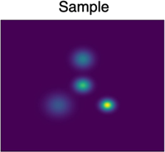
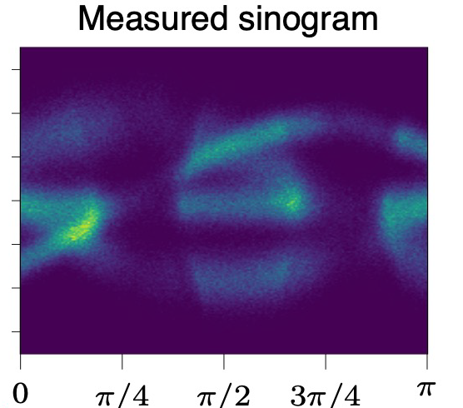
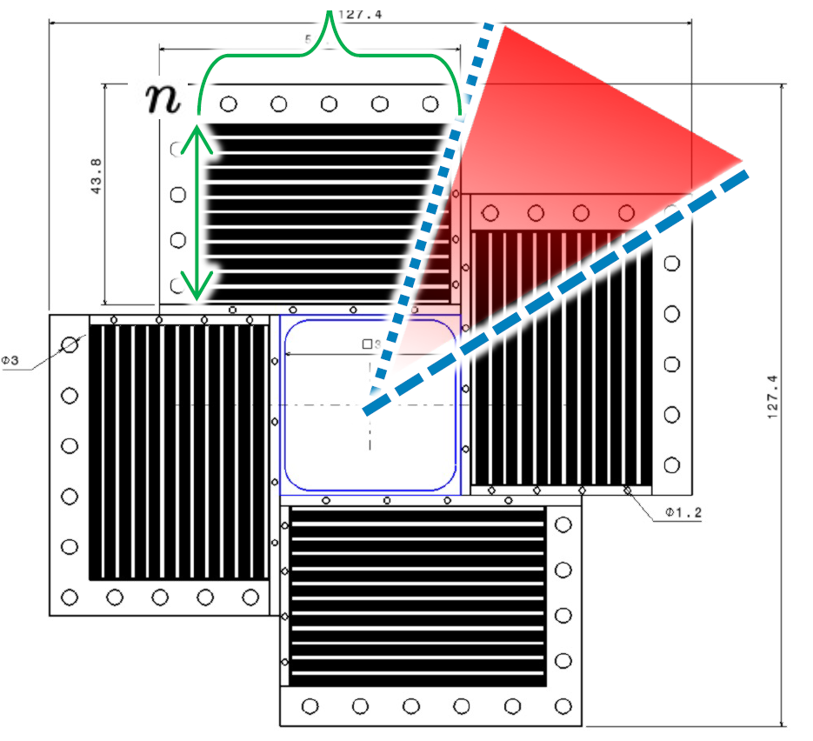
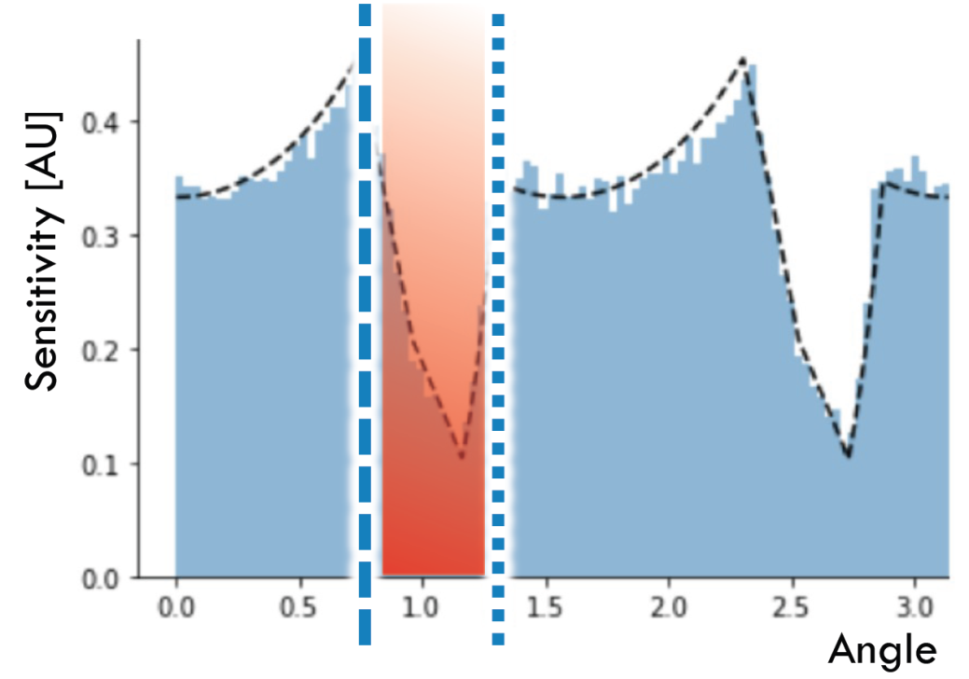
100µPET Detection Efficiency
The scanner sensitivity is driven by the photon stopping power of silicon detectors across all the stack
Gain of efficiency is optimal at ~60 silicon layers, with 60 mm width
Efficiency can be further increased if heavy materials (high atomic number, as bismuth) are inserted between the silicon detection layers
Holes in the scanner’s acceptance have large impact in the sensitivity and Sinograms
19

Slide 20
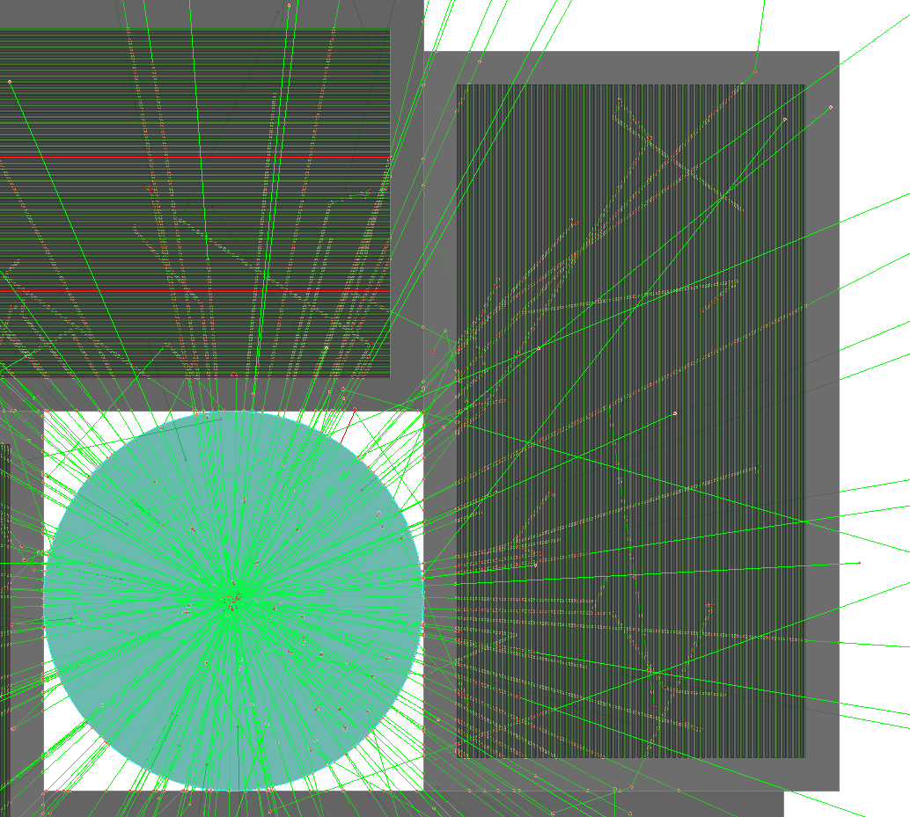
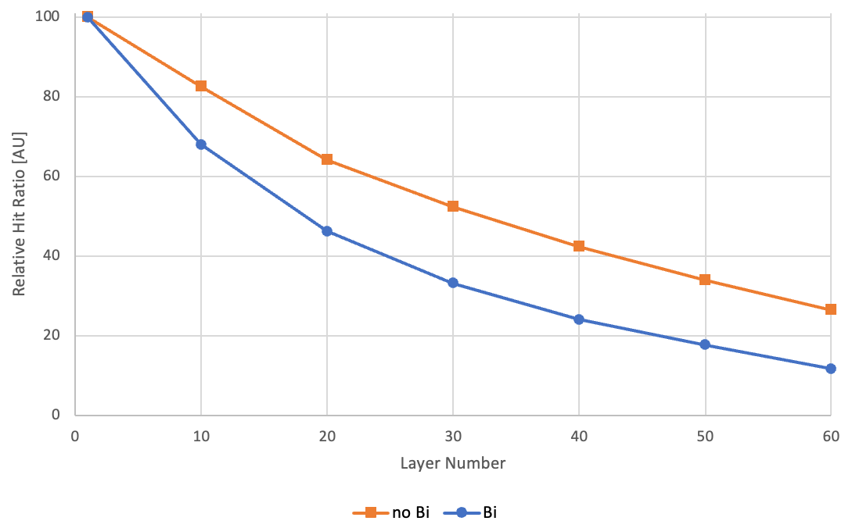
Hit Rate with Layer Number
Empirical strategy to estimate the maximum Hit Rate that a chip will reach during operation.
Simulate Some Events
Check Layer with highest number of Clusters.
Obtain the map of the position of each cluster on that plane
Define Hit rate of the equivalent chip.
20

Slide 21
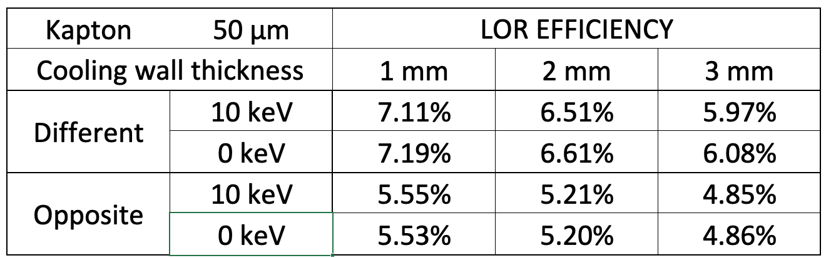
Cooling Wall Thickness
21

Slide 22
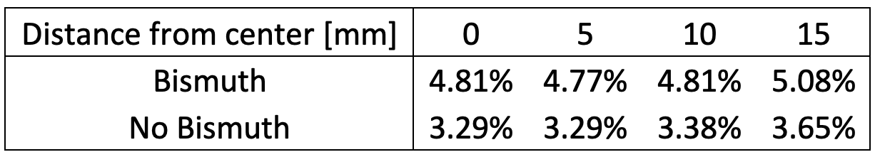
LOR Efficiency along the Scanner
22

Slide 23
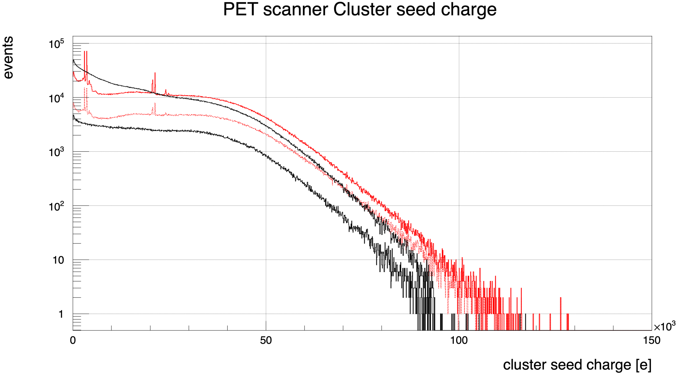
Cluster Seed Charge
–– No Bi (all)
- - No Bi (LoR – pe)
–– Bismuth (all)
- - Bismuth (LOR – pe)
23

Slide 24
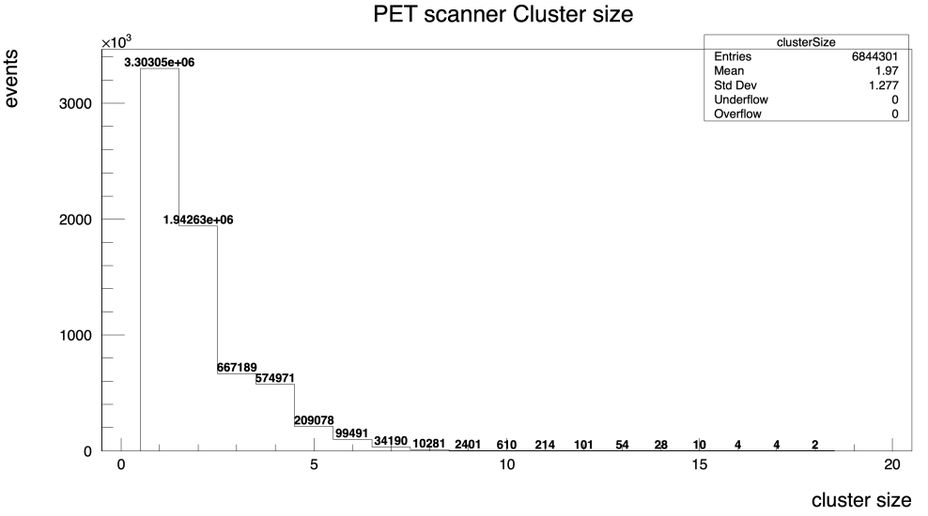



Cluster Size
100 µm pitch
200 µm pitch
24

Slide 25



100µPET Human Brain Reconstruction
Original brain MRI image Source: Openneuro dataset
Random brain slide with 68 mm disk diameter was selected
Image reduced to 34 mm with artificial 50 µm resolution
Conversion of the MRI grey scale to annihilation events
Each pair and reconstructed within the 100µPET MC simulation reconstruction
Image reconstruction algorithm used finally
MRI image of a human brain
Reconstruction if 1 mm resolution
MC simulation with the
geometry of 100µPET
2 billion annihilation events generated
25

Slide 26

100µPET Human Brain Reconstruction
Original brain MRI image Source: Openneuro dataset
Random brain slide with 68 mm disk diameter was selected
Image reduced to 34 mm with artificial 50 µm resolution
Conversion of the MRI grey scale to annihilation events
Each pair and reconstructed within the 100µPET MC simulation reconstruction
Image reconstruction algorithm used finally
MRI image of a human brain
Image reconstruction algorithm with 100 µm pitch
MC simulation with the
geometry of 100µPET
2 billion annihilation events generated
26

Slide 27



100µPET Module Construction
Asic
Baseline concept: Single module layer → Si to FCP interconnection
ENIG
ACF
ENIG
Flex
Alternative concept: Super-module with 5 layers of 2x2 sensor asics
→ wire bonding interconnection
5 staggered layers of 4 sensor-asics
1st test show that it is
electrically operating fine
27

Slide 28


Thermal Management
~100 W heat dissipation expected in a tower
FEA made with 250 W (below)
Assuming using water:
Tcool: 12°C
HTC: 8000 W/mK
A max temperature of ~39°C with 250 W/ tower
Extrapolating max temp of ~ 25°C for 100 W
Like for FASER project the blocks can be manufactures in 3D metal printing in order to have an optimal heat exchange.
28
Abaqus Unified FEA

Slide 29

Silicon to Flex PCB Interconnection
29

Slide 30
Silicon to Flex PCB Interconnection – Cross Section
Chip substrate
Chip’s Au stud bumps
Flex’s bonding pads (FPC top layer)
via
FPC layer 3
via
FPC layer 2
via
FPC bottom layer
30

