Slide 1





High-Flux CdZnTe at MHz XFEL Pulse Rates
M Bishop ^{1,3} ; C Milne²; D Khakhulin²; H Yousef²; I Klackova²; M Ramilli²; M Hart¹; M Veale¹; M Wilson¹; M Turcato²; R M Wheater¹; X Huang²; S Bugby³; F Dejene³
1: STFC
2: European XFEL
3: Loughborough University

Slide 2
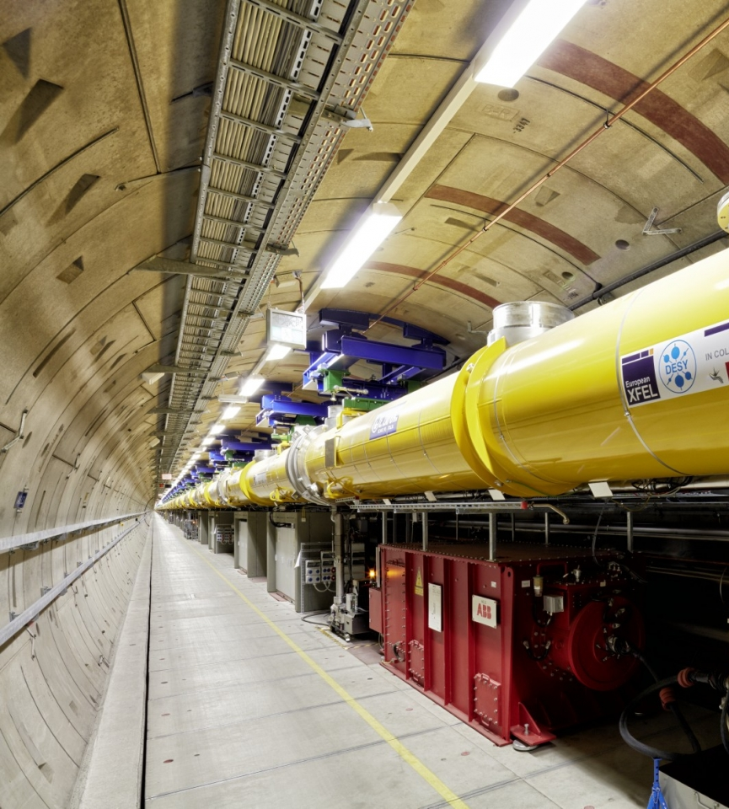

Outline
1 Background
2 Motivation
3 Experimental Setup
4 Results
5 Conclusion
(Image: D Nölle/DESY)
Notes:
put more in slides
leave out background - not xray generation and more about the xrays produced
LCLS and LPD - go slower and explan
LSLS where is it and what it is

Slide 3
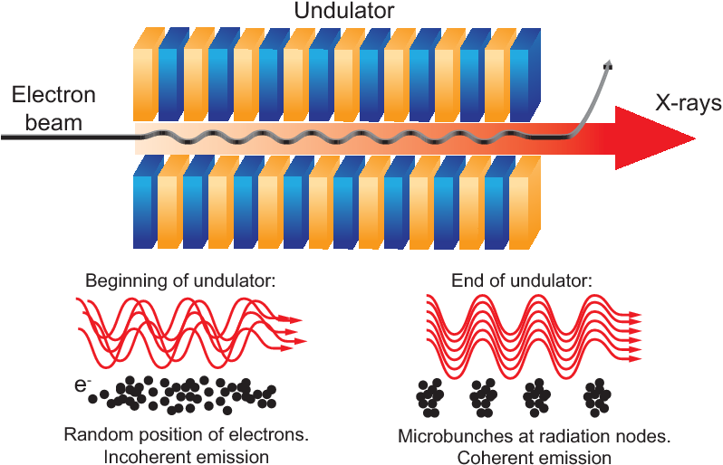
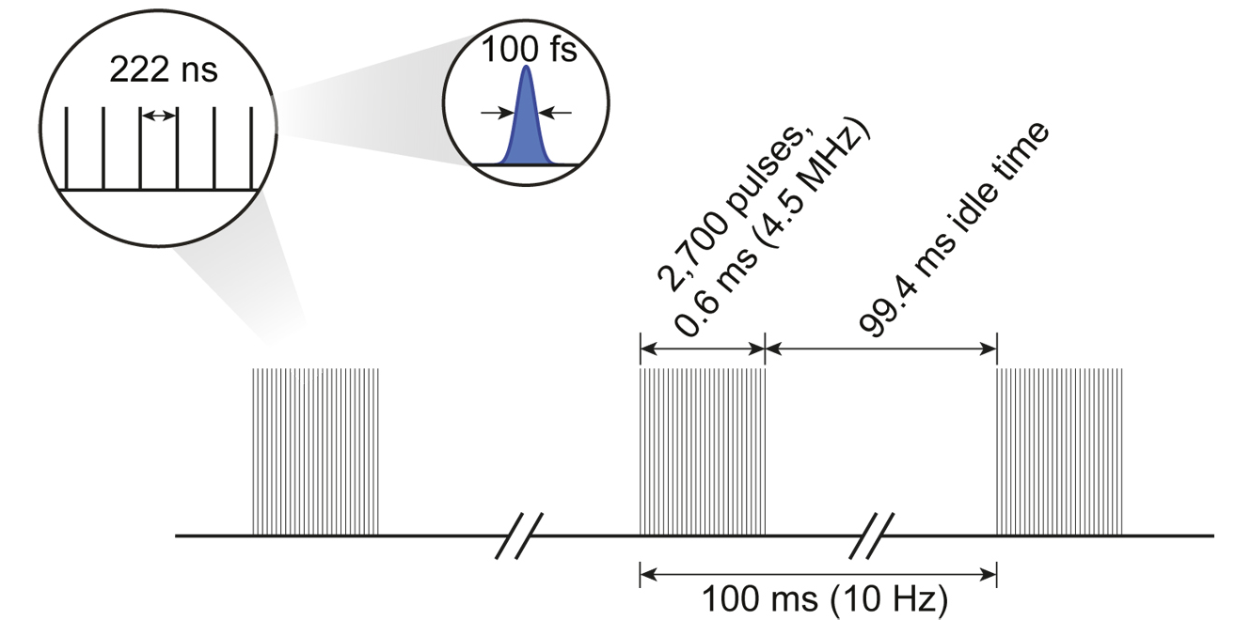
European XFEL
Extremely bright x-ray light source
3.4km long accelerator
Able to probe the atomic structure of viruses, molecular composition of cells and planetary processes
Non continuous free electron laser - Bunch structure
10Hz repetition rate of trains
Up to 2700 4.5MHz pulses per train
Image © STFC Max Bishop

Slide 4
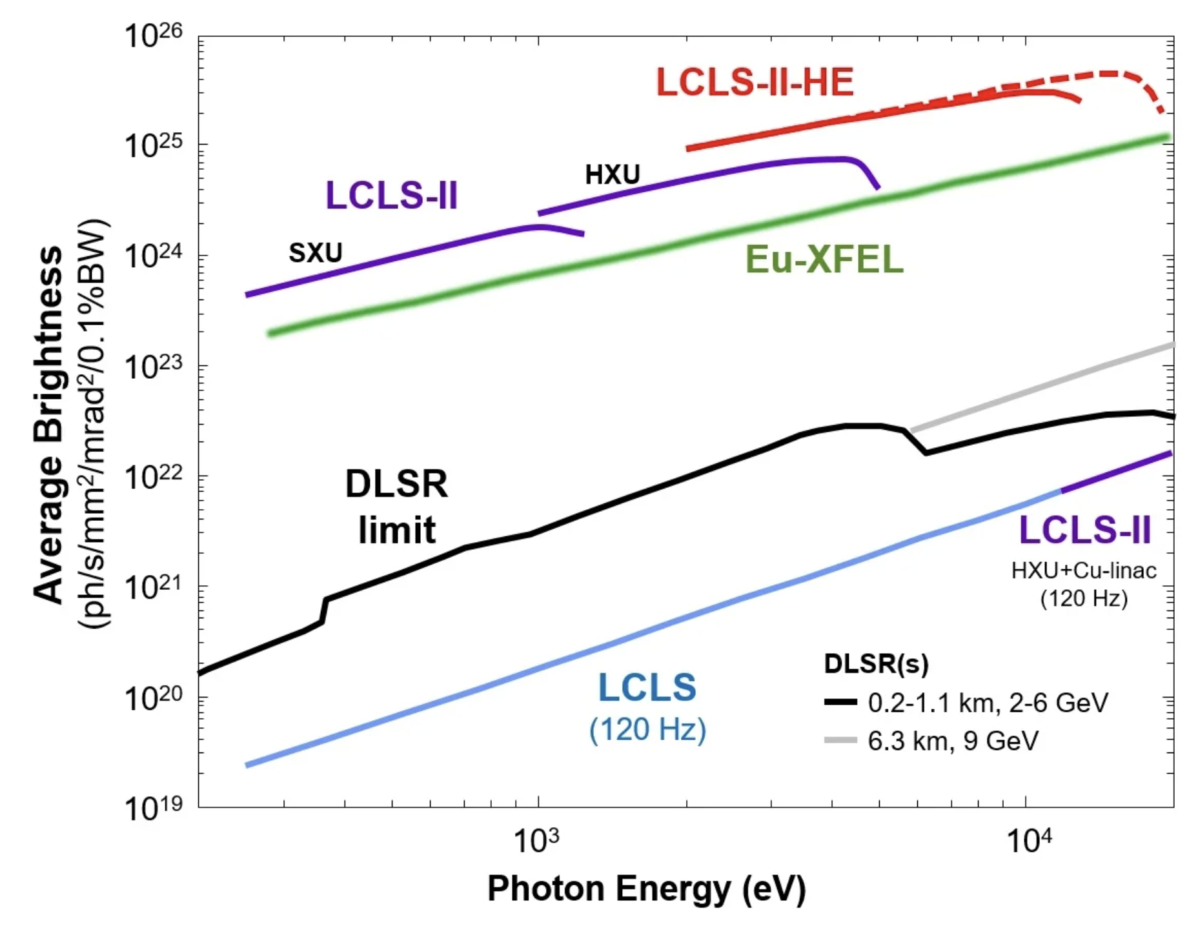
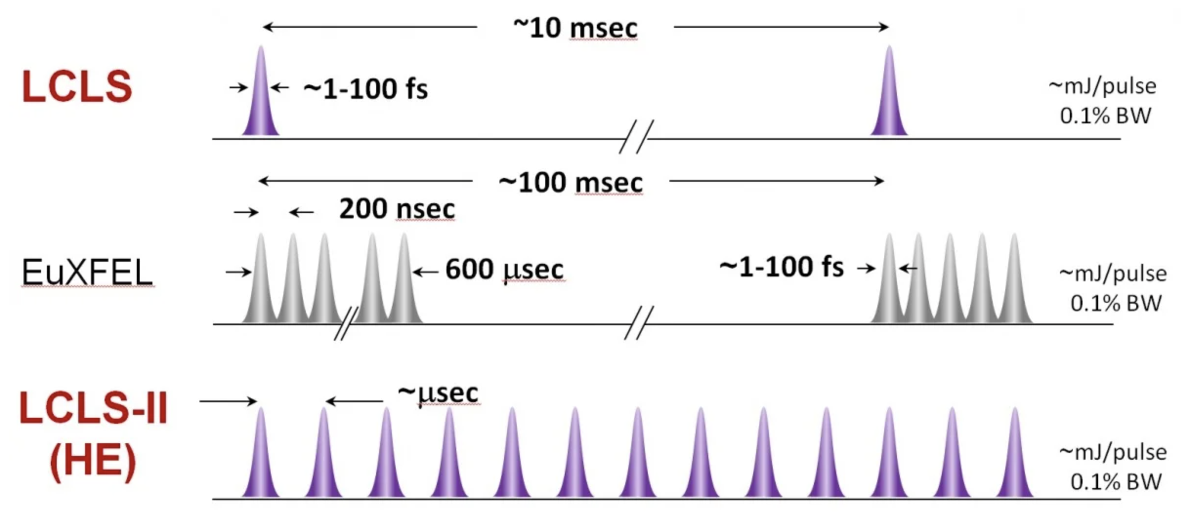
Future XFEL upgrades
Planned XFEL upgrades include continuous wave operation and higher photon energies
LCLS is another free electron laser located in California currently operating at 120Hz
LCLS-II plans to move to 1MHz continuous wave <12keV
LCLS-II-HE a higher energy upgrade to >20keV
EuXFEL new instrumentation, plans for higher energies and continuous wave further in the future
Image (SLAC-R-1098 )
Image © STFC John Dawson
Notes:
Future XFELs
LCLS-II > 1MHz continuous wave (<12keV) >> High Energy upgrade (>12keV)
XFEL - New Instruments > Higher Energies >> Continuous Wave
UKFEL = MHz continuous wave + higher energies (but unlikely to happen!)
Common problems > high repetition rates + measuring at > 12keV
quote repetition rate in Hz not times

Slide 5

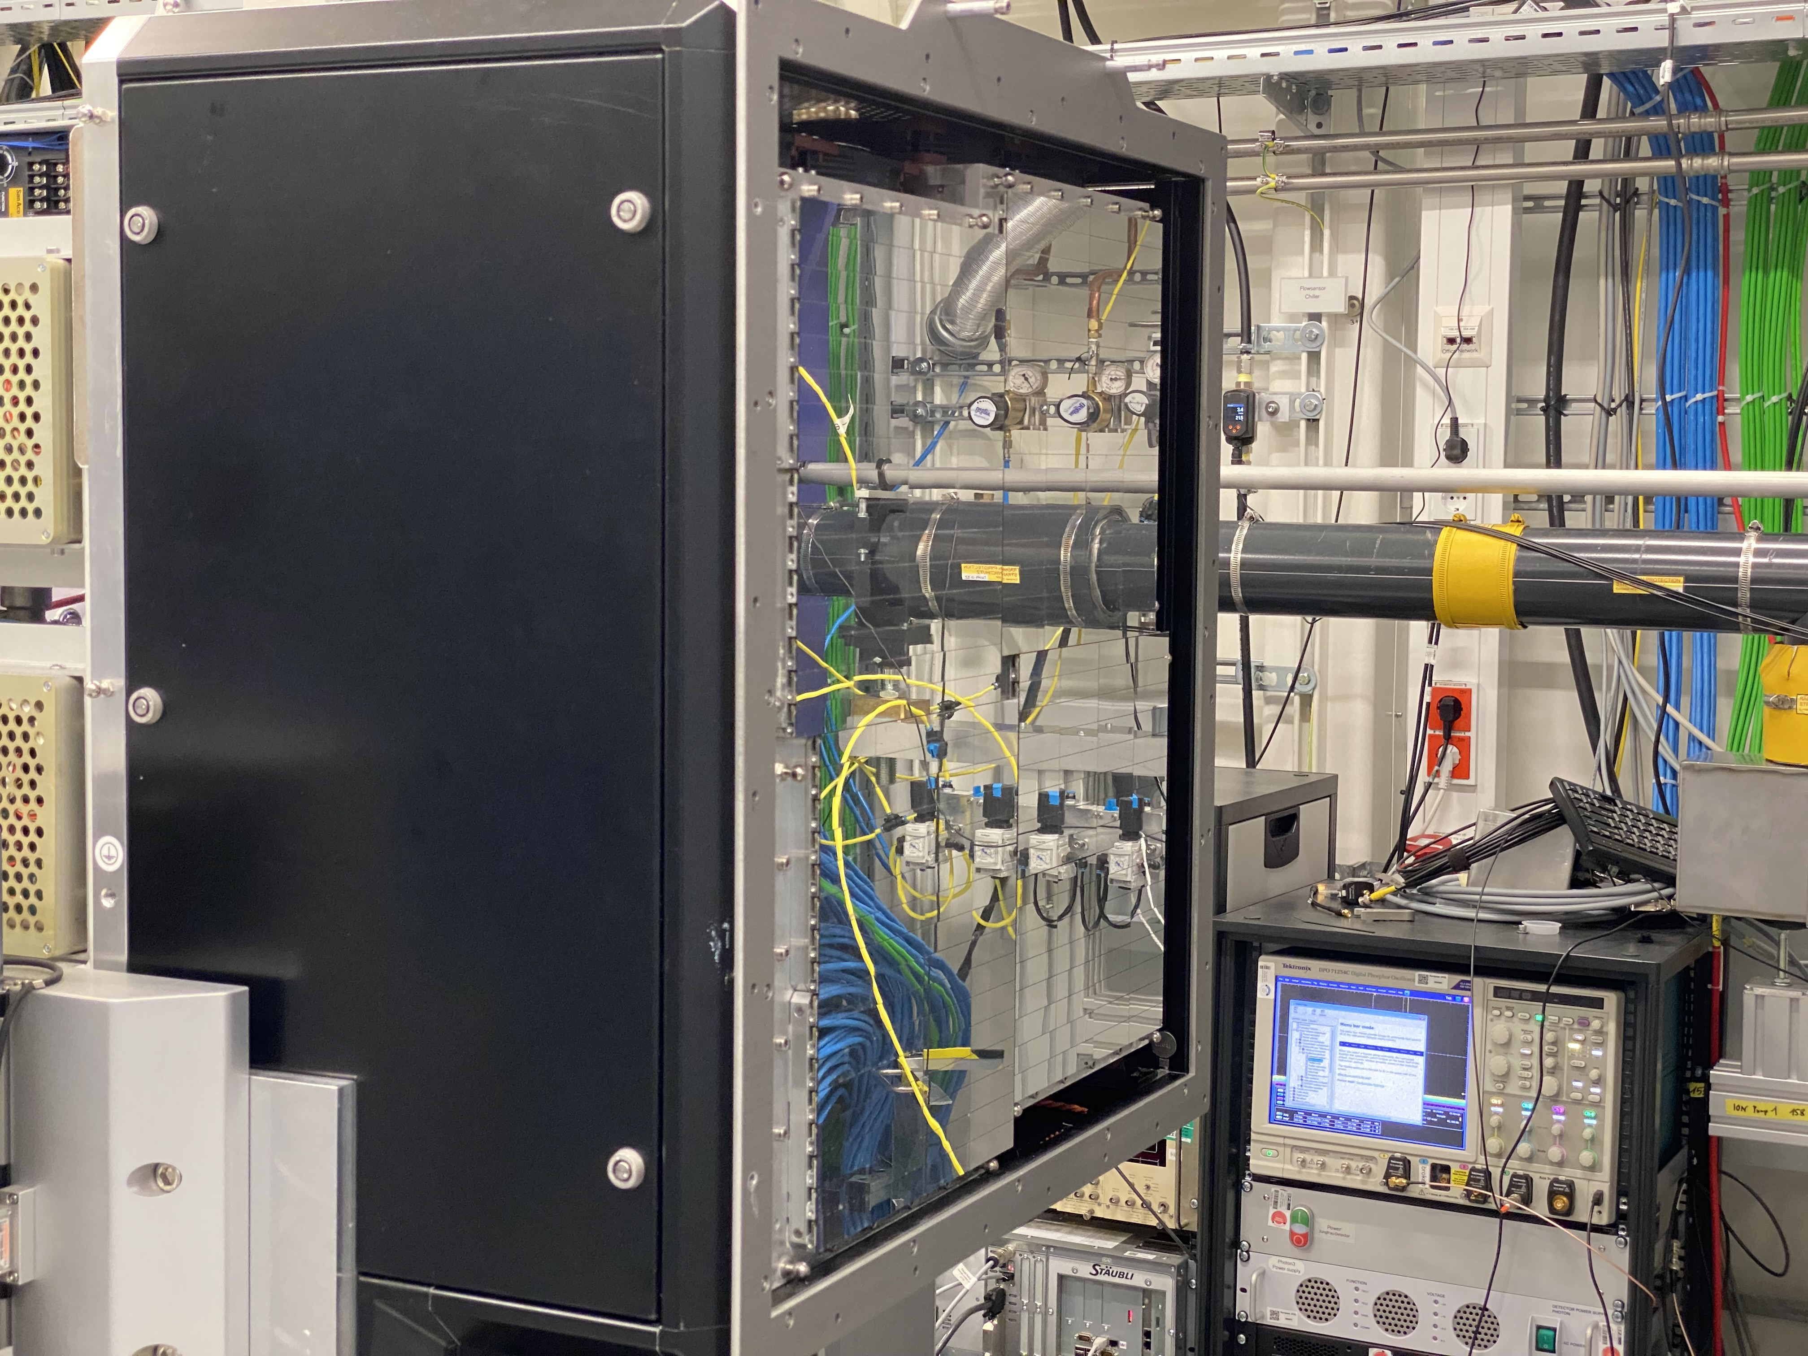
The Large Pixel Detector (LPD)
High Dynamic range instrument for FXE
Delivered to European XFEL in 2017 by STFC
1 Megapixel of 500μm pixels
4.5MHz frame rate
1 to 1×10⁵ photons per pixel per pulse. Using parallel gain stages
Signal amplification occurs in parallel meaning all 3 gains can be saved independently
First science papers published this year (2023)
Image © STFC Max Bishop
Notes:
Introduction to LPD
Who built it, when
How it works
How has it performed so far
instrument is a took for what they want to look at in the future
ref the paper

Slide 6
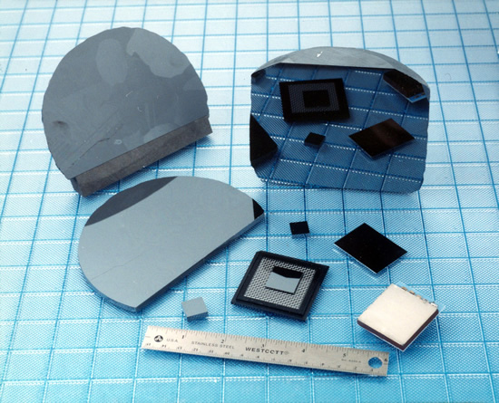
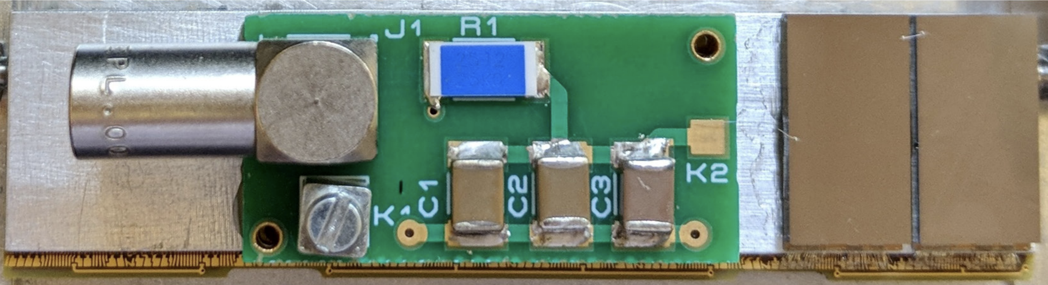
High-Flux CdZnTe
Higher energy XFELs will require a new detector material
At >12keV silicon has a low stopping power therefore high energy XFELs need a new detector material
CdZnTe has a higher Z therefore making it a suitable candidate
CdZnTe susceptible to polarisation and incomplete charge collection – High Flux CdZnTe improves upon this
First testing of HF-CdZnTe completed at XFELs by Veale et al. 2018 and synchrotrons by O. Baussens et at. 2022
LPD HF-CdZnTe test modules
Notes:
High-Flux CdZnTe
What is high flux CdZnTe, advantages over Si, disadvantages and how is it different from low flux?
https://iopscience.iop.org/article/10.1088/1748-0221/12/12/C12045/meta
What testing has been done previously?
https://iopscience.iop.org/article/10.1088/1361-6463/aaf556/meta
https://iopscience.iop.org/article/10.1088/1748-0221/17/11/C11008/meta
What still needs to be tested?
Operation at MHz pulse rates
Operation at energies > 10 keV at a FEL
Add LPD czt sensor

Slide 7
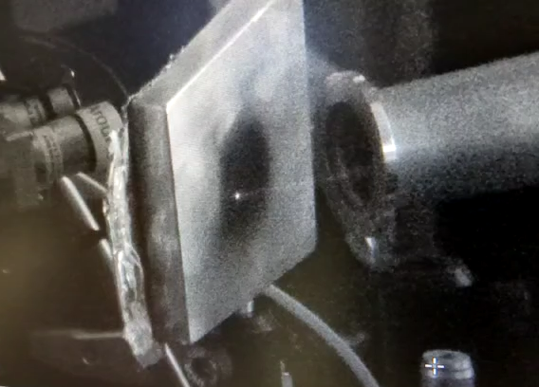
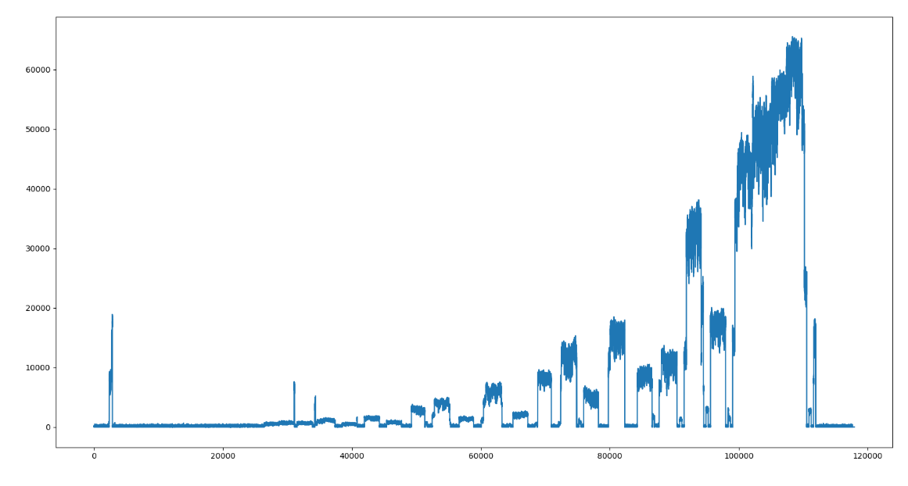
Aims of Experiment
How does the response of HF-CdZnTe compare with Si at MHz pulse rates
Compare timing of HF-CdZnTe with Si detectors
  Timing sweeps at different voltages
Investigate linearity across the dynamic range of LPD
  Detector response as a function of beam intensity
XFEL pulses hitting copper target
XFEL Intensity sweep
Notes:
Replace this guidance text with your own bullet pointed content.
For further guidance please see https://www.bdadyslexia.org.uk/advice/employers/creating-a-dyslexia-friendly-workplace/dyslexia-friendly-style-guide

Slide 8
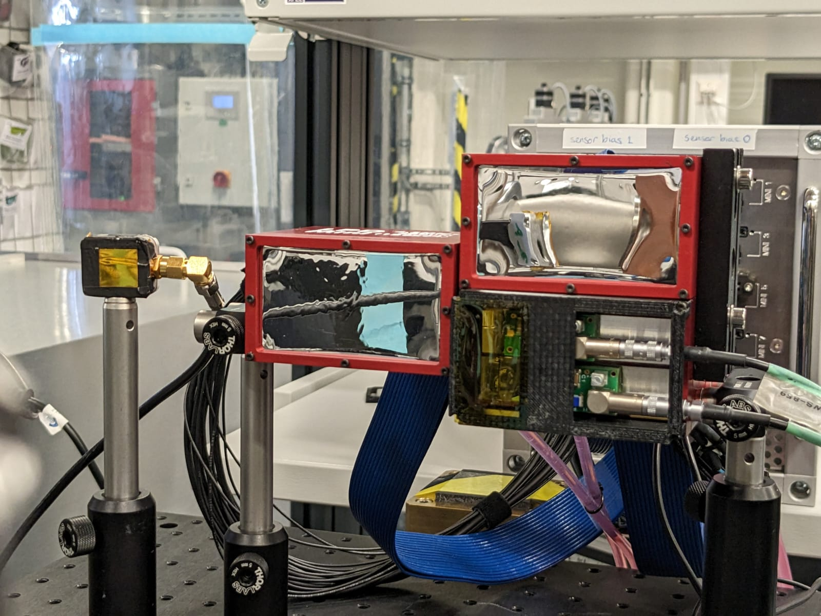
Detectors Used
LPDmini – a smaller version of LPD
2× silicon Hamamatsu detectors 500μm thick
3× high-flux CdZnTe test devices 1.5mm thick
Silicon 500μm pixels bonded to LPD ASIC using an interposer
High-flux CdZnTe 400×250μm pixels without interposer bonded to LPD ASIC
Silicon is hole readout and High-flux CdZnTe is electron readout leading to opposite polarity signals, LPD ASIC can read both signals at once
Silicon
CdZnTe
Notes:
The detectors
Si Vs. HF-CdZnTe
Way they were bonded and differences (thickness, pixel size...)
Explain the difference in signal polarity and how we achieved dual polarity readout
one layer of metal is available during fabrication
Need to talk about thickness of the materials
Need to make clear that the detector is at 90 degrees
Use rectangle shape and put text next to boxes

Slide 9
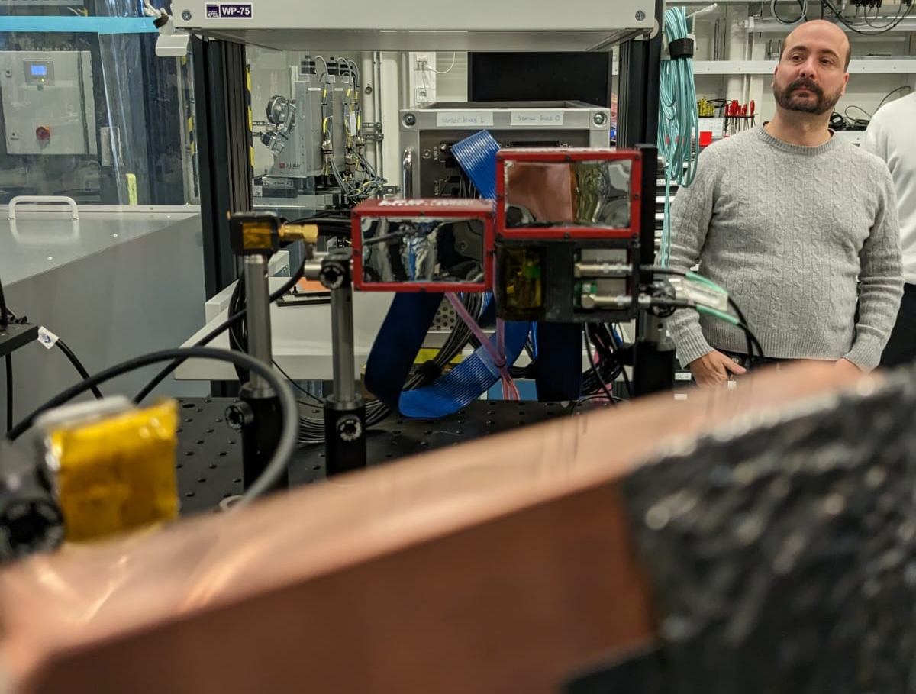
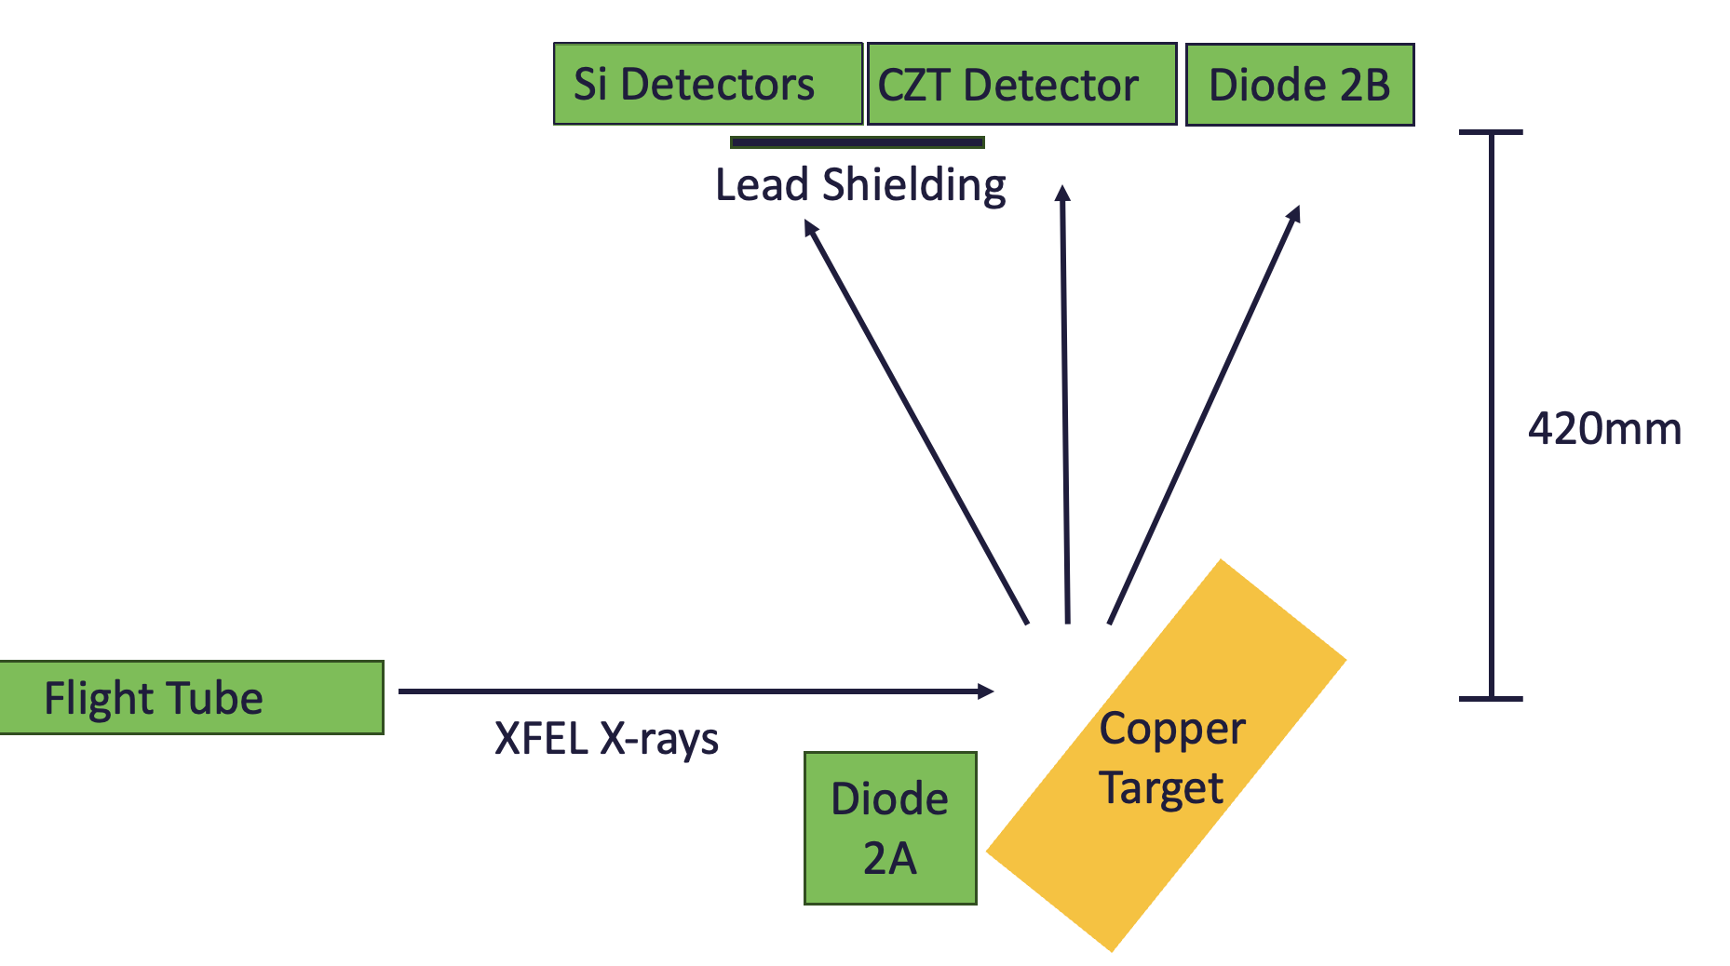
Experimental Setup
2B
LPD Detectors
2 × photodiodes used as independent reference measurements
Hamamatsu S3590-9 silicon photodiode with a 10 × 10 mm photosensitive area
Placed opposite copper target and in the plane of the detectors
Lead shielding placed over portions of the detectors- investigate common mode effects
2A
Copper Target
Notes:
Diodes for I0 correction
What were they?
Where were they?
How were they processed?
i havent explained why - we need to look at the nonlinearities in CZT or LPD done by comparing with the diode
take out information of processing

Slide 10
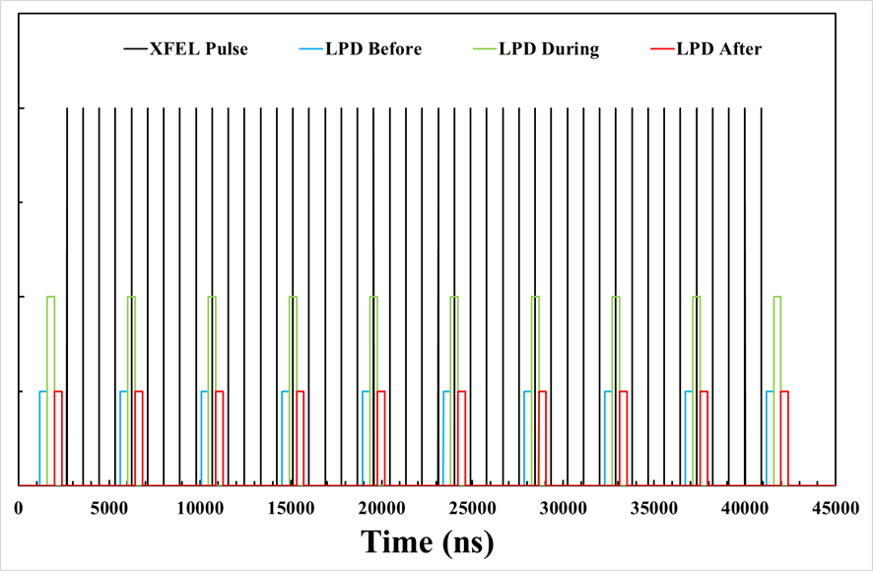
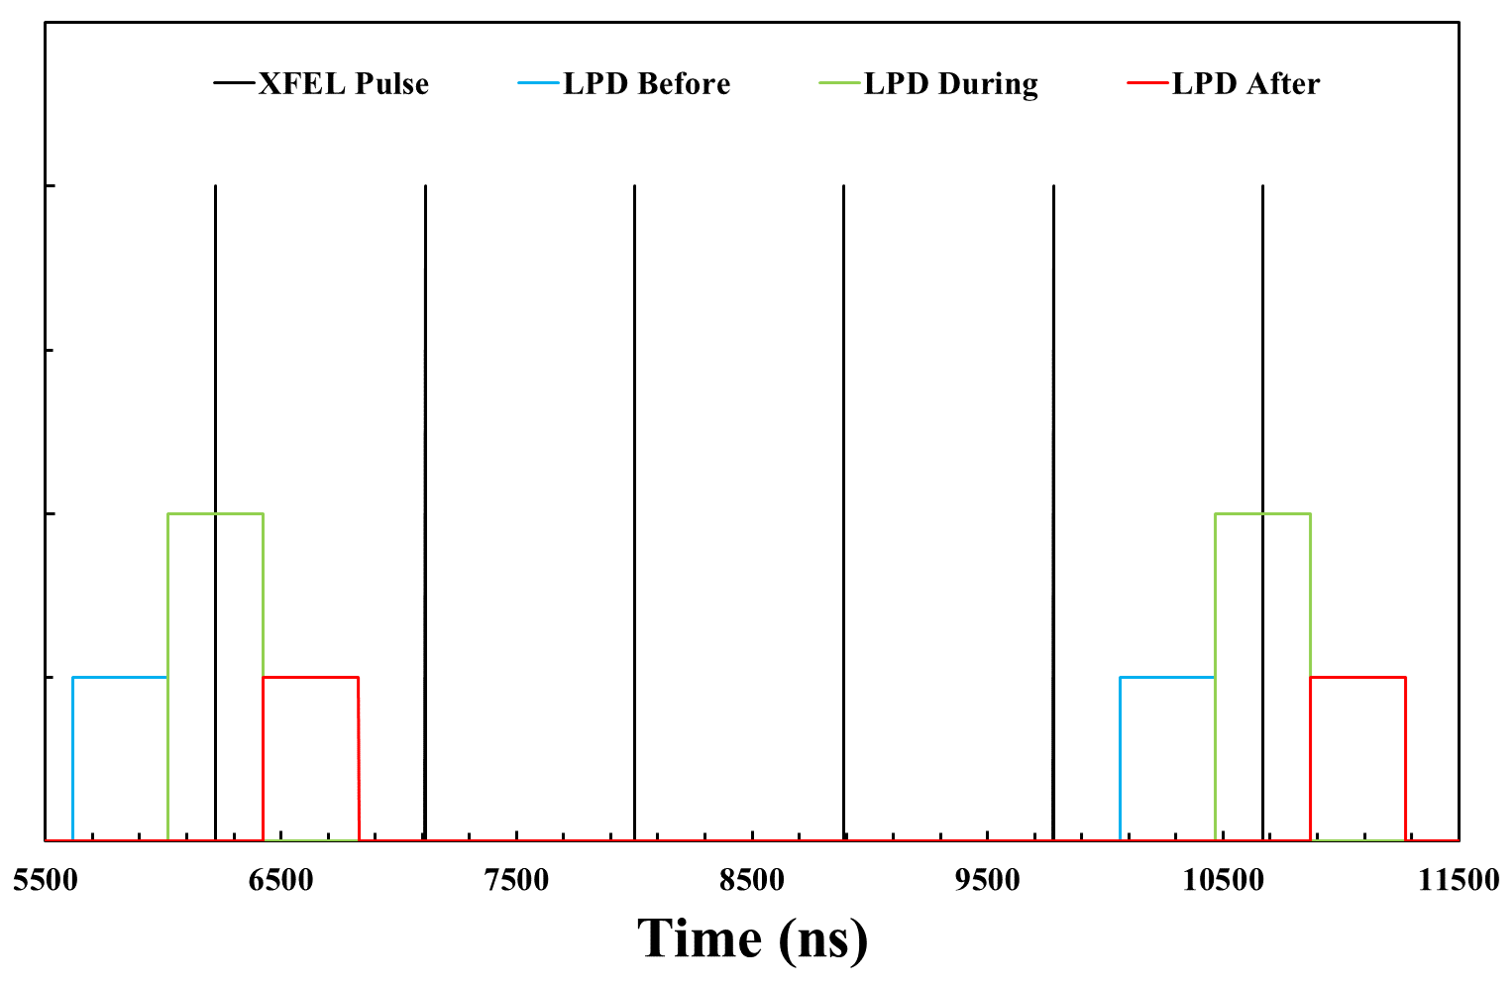
Pulse and data structure
Experiment at FXE February 2023
Each train consists of 44 x-ray pulses delivered at 1.125MHz
LPD recorded images at 2.25MHz
This allows a before and after image to be taken every 5 pulses
Read in parallel gain mode i.e. all images are saved, this produces 90 images per train
Images before and after the XFEL pulse allow for residual photocurrent to be investigated.
Notes:
The Pulse and Data Structure
The choice of pulse repetition rate and why
Parallel gain readout - how it works
Images before and after
state on slide the pulse repetition rate and frame rate on the slides
Add a slide - what is the motiviation - to test high fluxes at mhz pulse rates

Slide 11
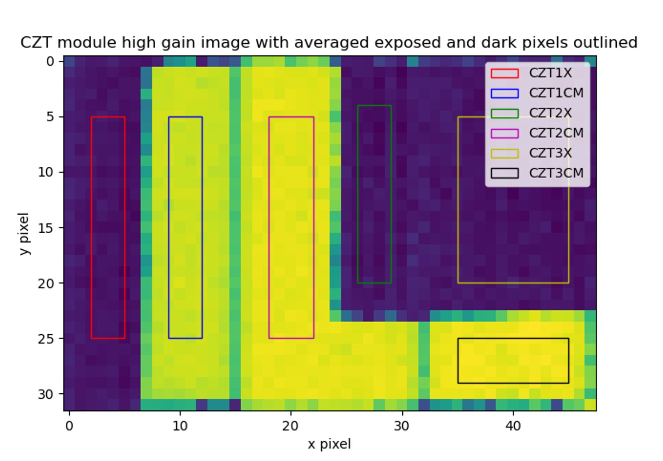
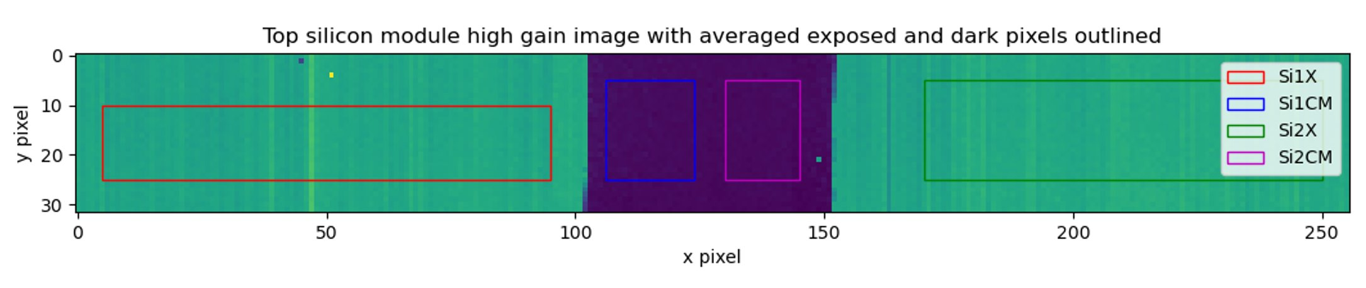
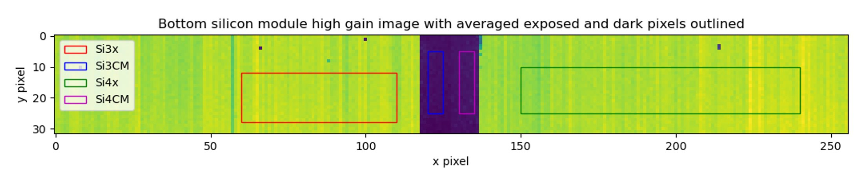
Regions of Interest
3 × CdZnTe modules
Lead shielding was placed over portions of the detector giving common mode regions
Areas of interest selected to average over
Areas chosen exclude edge pixels and defective pixels
Silicon signal is due to holes (+ve)
CdZnTe signal due to electrons (-ve)
Si module 1
Si module 2
Notes:
Slide 1 - Images recorded with Si and CdZnTe
Explain the masked regions
Show your regions of interest
Explain the difference in signal polarity again
bold titles and simplify

Slide 12
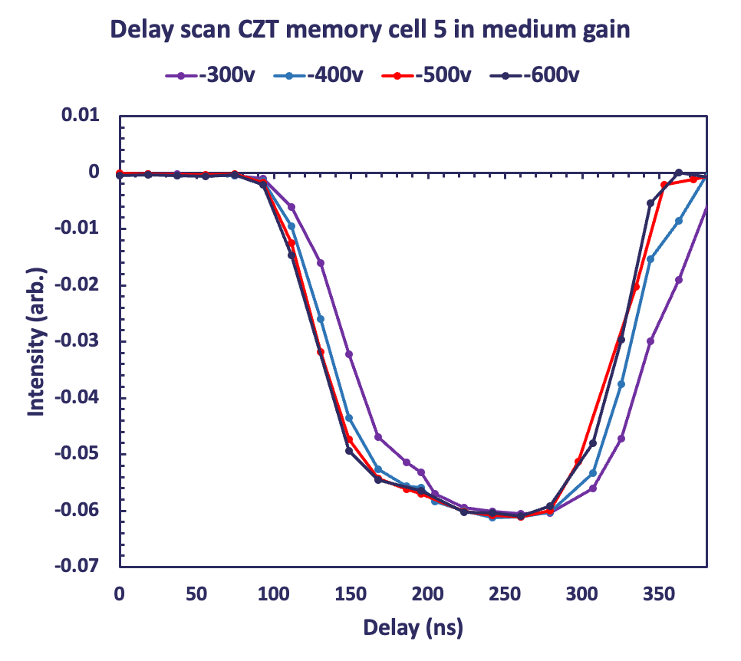
Results – Timing Sweep
Rise times improve with voltage
Timing scans completed at different voltages
Shows signal rise time – a combination of amplifier speed and signal induction
Higher voltage shows faster rise times
Lower signal in CdZnTe compared to silicon due to smaller pixels
Bias Voltage (V) | 10% to 90% rise time (ns)
-300 | 87.01
-400 | 78.49
-500 | 74.30
-600 | 72.75
Notes:
Slide 2 - Delay Scans
Show the silicon delay scan - does it look sensible? Does it match the integration time?
Show the CdZnTe as a comparison with different voltages - what do we conclude?
Conclude that higher voltages are best > prompt signals and stable
change delay to time
title the table- do in time
not direct comparison - thicker materials and different pickle size
change title 'delay scan in medium gain ”
Only have rising edge in interp data
Add 500v rise time back in
Convert to nanosecs

Slide 13
Results – Timing Sweep
Rise times improve with voltage
Timing scans completed at different voltages
Shows signal rise time – a combination of amplifier speed and signal induction
Higher voltage shows faster rise times
Lower signal in CdZnTe compared to silicon due to smaller pixels
Bias Voltage (V) | 10% to 90% rise time (ns)
-300 | 87.01
-400 | 78.49
-500 | 74.30
-600 | 72.75
Notes:
Slide 2 - Delay Scans
Show the silicon delay scan - does it look sensible? Does it match the integration time?
Show the CdZnTe as a comparison with different voltages - what do we conclude?
Conclude that higher voltages are best > prompt signals and stable
change delay to time
title the table- do in time
not direct comparison - thicker materials and different pickle size
change title 'delay scan in medium gain ”
Only have rising edge in interp data
Add 500v rise time back in
Convert to nanosecs

Slide 14
Results – Timing Sweep
Observed faster rise time in silicon -
Shows signal rise time – a combination of amplifier speed and signal induction
Rise time of Si faster than CdZnTe
Suggests higher voltages are needed to match Si timing
Future experiments to use an external power supply
Detector Material | 10% to 90% rise time (ns)
CdZnTe (-600V) | 72.75
silicon | 41.28
Notes:
Slide 2 - Delay Scans
Show the silicon delay scan - does it look sensible? Does it match the integration time?
Show the CdZnTe as a comparison with different voltages - what do we conclude?
Conclude that higher voltages are best > prompt signals and stable
not direct comparison - thicker materials and different pickle size
change title 'delay scan in medium gain ”
Compare CZT to silicon directly

Slide 15
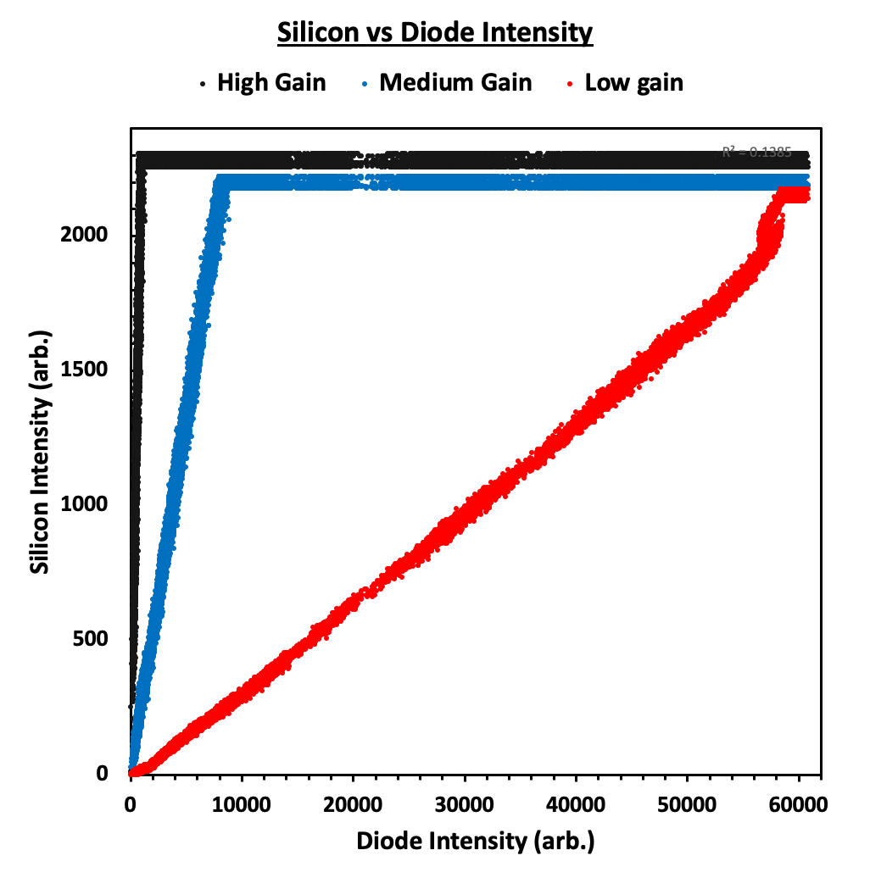
Intensity plot of silicon
Graph showing the intensity measured by silicon LPD compared to the silicon diode
Data is of a single pixel within Si1X
Data is dark corrected
Linear up to saturation for all gain stages
Roughly 10⁴ photons per pixel per pulse at low gain saturation
Gain | R²
High | 0.977
Medium | 0.998
Low | 0.998
Notes:
Slide 3 - Intensity Sweep
Show intensity sweep for Si - show all three gains for a single pixel - explain saturation etc.
around 10^4 photons state a rough estimate

Slide 16
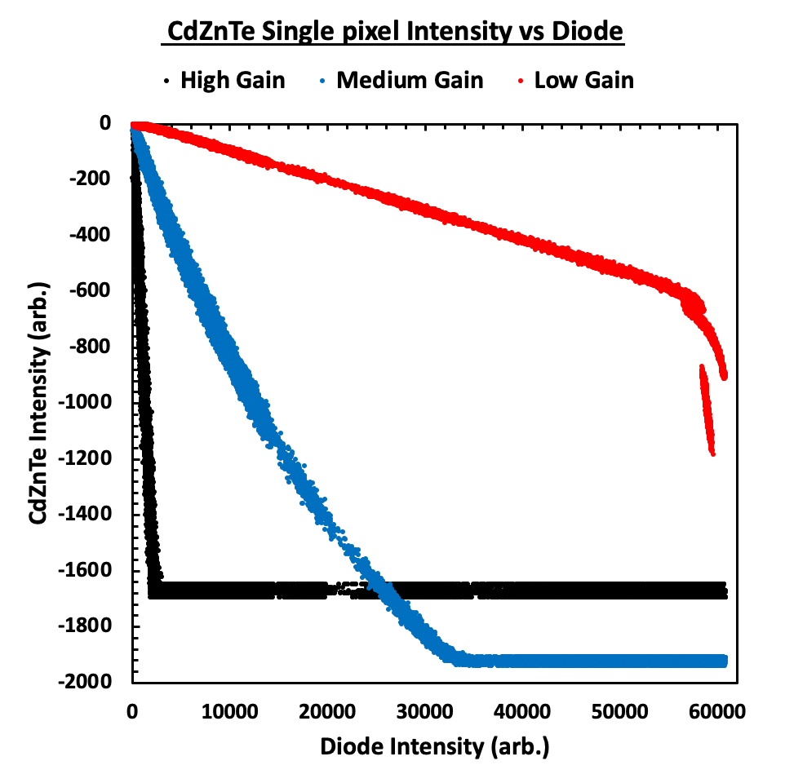
Intensity plot of high-flux CdZnTe
Gain | R²
High | 0.977
Medium | 0.978
Low | 0.998
Negative signal due to electron readout
Smaller signal in CdZnTe compared to silicon due to smaller pixel size
Medium gain shows non-linearity – more investigation is needed to determine the cause
Non-linearity not present in silicon – could be a material effect
Reference diode saturated
Notes:
Show intensity sweep for CdZnTe - show all three gains for a single pixel - explain why are the signals smaller CdZnTe?
16161616
add slide numbers
Fit line and r^2 values

Slide 17
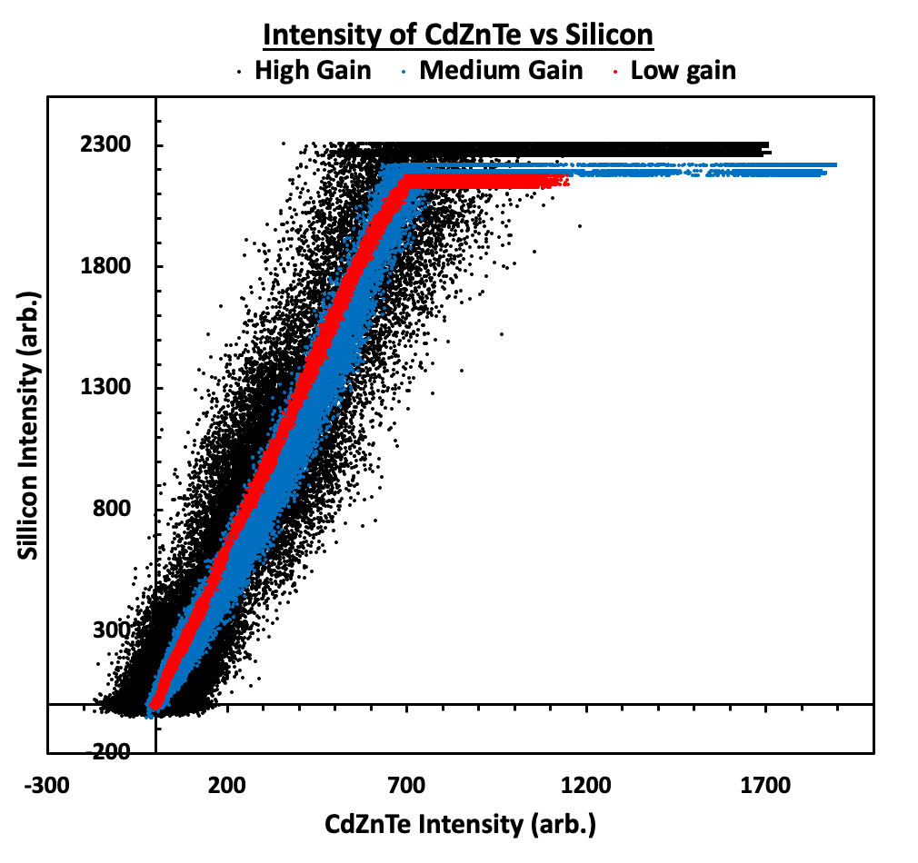
Silicon LPD vs High Flux CdZnTe
High gain has a much lower signal to noise ratio
Good linearity observed when comparing the two detector materials
Consistency across linearity results
m = 3.0 ≈ difference in pixel size
Gain | R²
High | 0.905
Medium | 0.991
Low | 0.999
Notes:
Show comparison of Si Vs. CdZnTe signal
add caption to the plot

Slide 18
Conclusion & future work
Conclusion
Investigated XFEL pulse repetition rates 4 orders of magnitude higher than previously studied
Successfully shown that high-flux CdZnTe is an effective detector material up to 10⁴ 8keV photons per pixel per pulse
Future Work
Investigate sources of non-linearities
Investigate next frame effects
Push to higher photon energies, higher dynamic range and higher bias voltages – new data has been collected, beamtime in June 2023
Notes:
Conclusions - What did I show?
CdZnTe worked at MHz FEL pulse repetitions rates!!!
What still needs to be done?
Higher energies > Plug for recent beam time results to follow
Understanding non-linearities
Exploring next image effects etc..
add appendix for next frame effects
print out notes

Slide 19






Science and Technology Facilities Council
@STFC_matters
Science and Technology Facilities Council
Notes:
Thanks to the group at Eupopean XFEL and STFC

