Slide 1




A Spectroscopic Imaging Camera with a 1 MHz Frame Rate Continuous Readout
Ben Cline et al.
Detector Development Group, UKRI STFC
Email: ben.cline@stfc.ac.uk
07/09/2023

Slide 2

Detector Development
Ivan Church
Ben Cline
Matt Hart
Sion Richards
Paul Seller
Dave Sole
Matt Wilson
Rhian Wheater
Matt Veale
Interconnect
Paul Adkin
Paul Booker
Toby Brookes
Navid Ghorbanian
John Lipp
Andreas Schneider
Detector Systems Software
Dominic Banks
Victor Bozhinov
Adam Davies
Josh Harris
Ashley Neaves
Tim Nicholls
Joseph Nobes
Electronic Systems Design
Adam Barcock
Rob Halsall
John Holden
Chris Lyford
Sooraj Pradeep
Matt Roberts
Funded by the: Centre for Instrumentation (CFI) run by Marcus French
PCB Design Office
Darren Ballard
Dan Becket
Chris Day
ASIC Design
Stephen Bell
Thomas Gardiner
Lawrence Jones
Mark Prydderch
Detector Systems
William Helsby

Slide 3
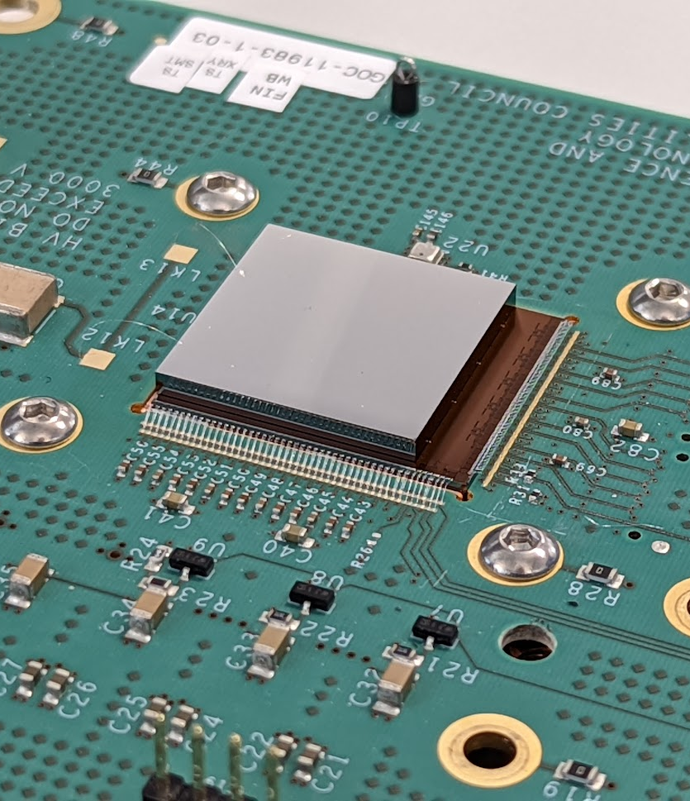
Agenda
1 HEXITEC vs HEXITEC_{MHz}
The next generation of HEXITEC systems
2 HEXITEC_{MHz} Overview
An introduction to our new HEXITEC_{MHz} ASIC including its architecture and specification
3 Test Results
Characterisation of spectroscopic performance using a lab-based X-Ray source and Diamond Light Source synchrotron X-Rays
4 Next Steps
A look to the next 12 months

Slide 4
Agenda
1 HEXITEC vs HEXITEC_{MHz}
The next generation of HEXITEC systems
2 HEXITEC_{MHz} Overview
An introduction to our new HEXITEC_{MHz} ASIC including its architecture and specification
3 Test Results
Characterisation of spectroscopic performance using a lab-based X-Ray source and Diamond Light Source synchrotron X-Rays
4 Next Steps
A look to the next 12 months

Slide 5

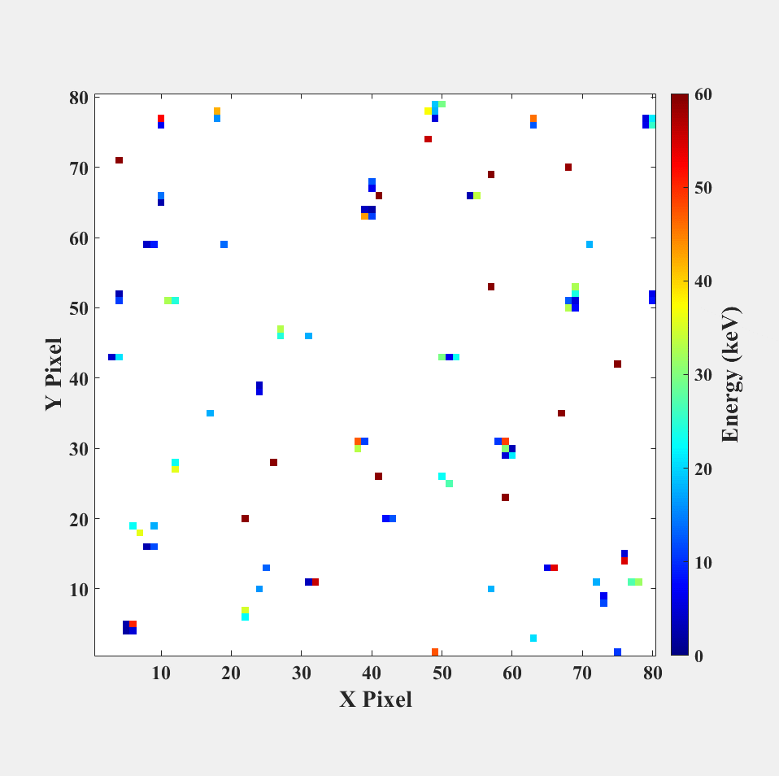
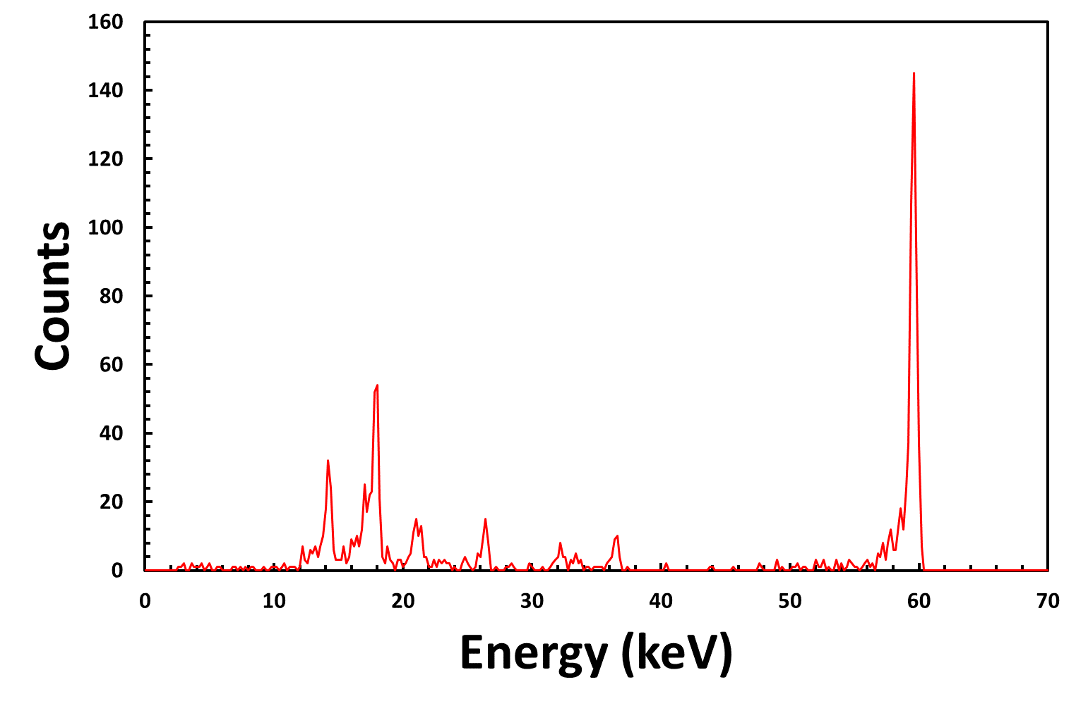

HEXITEC specifications
Parameter | HEXITEC
Pixel Pitch (µm) | 250
Array Size | 80 × 80
Max Frame Rate (kHz) | ~10
Max Spectroscopic Flux (ph s⁻¹ mm⁻²) | ~10⁴
Digitisation | Off-chip
Detector Type | Peak Track + Hold
Gain stages (keV in CZT) | 200
 | 600
FWHM_{@60keV} (keV) | HF-CZT: 0.79 keV [1] p-type Si: 0.59keV [2]
Fully spectroscopic X-Ray Imaging with CdTe/ CdZnTe (CZT) detectors
80 × 80 pixel array on a 250 μm pitch
Analogue readout via a rolling shutter to 4 ADCs in the DAQ
Maximum ~10 kHz data output (~100 MB s⁻¹)
AMS 0.35 µm - since 2010
Multiple frames
Per-pixel/ global histograms
[1] DOI: 10.3390/s20102747 [2] DOI: 10.1088/1748-0221/17/05/P05030

Slide 6
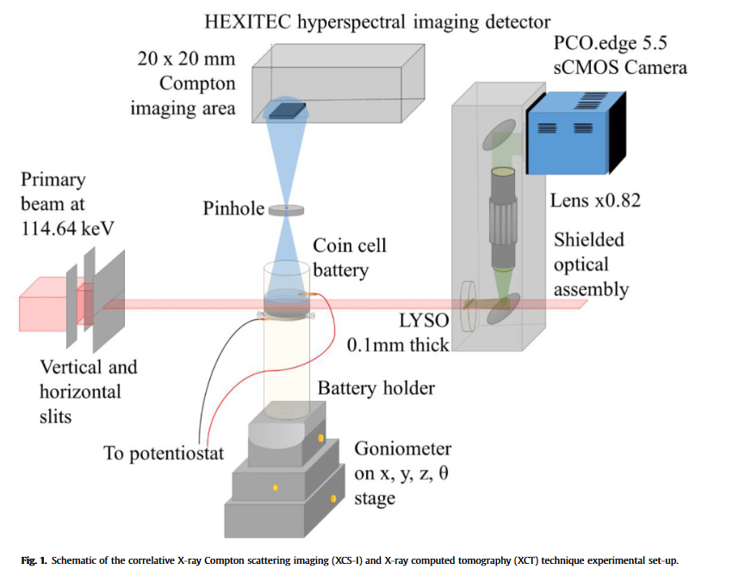
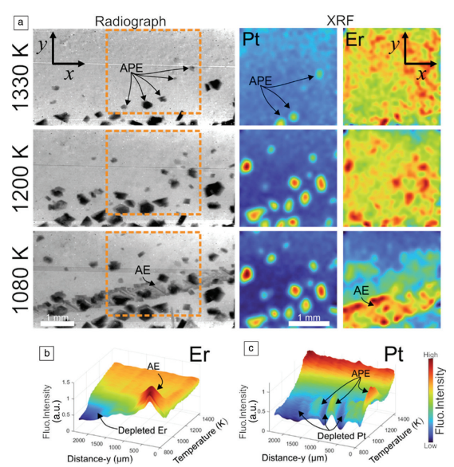
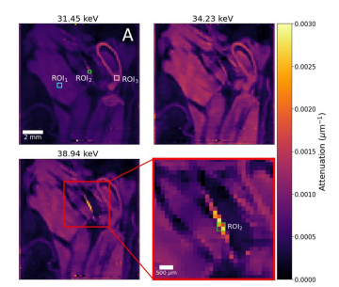
Examples from
HEXITEC has been used across many applications including:
Compton X-Ray Imaging [3]
X-Ray Fluorescence Imaging [4]
Hyperspectral X-Ray Tomography [5]
Figure 7. (a) Pt and Er XRF intensity maps as a function of temperature during the solidification of an Al-23Pt-20Er alloy at 0.1 Ks^{–1}.
Figure 2. Voxel spectra analysis for double-stained hindlimb specimen. (A) Single image slice in the sagittal plane across three monochromatic energy channels, following iterative reconstruction. A set of three regions-of-interest (ROIs) are highlighted for voxel spectra analysis.
Figure 1. Schematic of the correlative X-Ray Compton scattering imaging (XCS-I) and X-Ray computed tomography (XCT) technique experimental set-up
[3] DOI: 10.1016/j.mtener.2022.101224 [4] DOI: 10.1557/mrs.2020.270 [5] DOI: 10.1038/s41598-022-23592-0

Slide 7
BUT …
HEXITEC is frame-rate and therefore flux limited
  Charge-sharing corrections require <10 % frame occupancy
  This limits spectroscopic imaging @10 kHz to a max X-Ray flux of ~10⁴ ph s⁻¹ mm⁻²
→ There is a need for a continuous spectroscopic X-Ray detector that operates at faster frame rates
Faster (MHz) imaging requires:
  In-pixel digitisation
  High-speed serialisers
  Dedicated FPGA processing
These requirements apply to a large number of STFC’s upcoming detector development projects
  E.g. DynamiX, C100

Slide 8
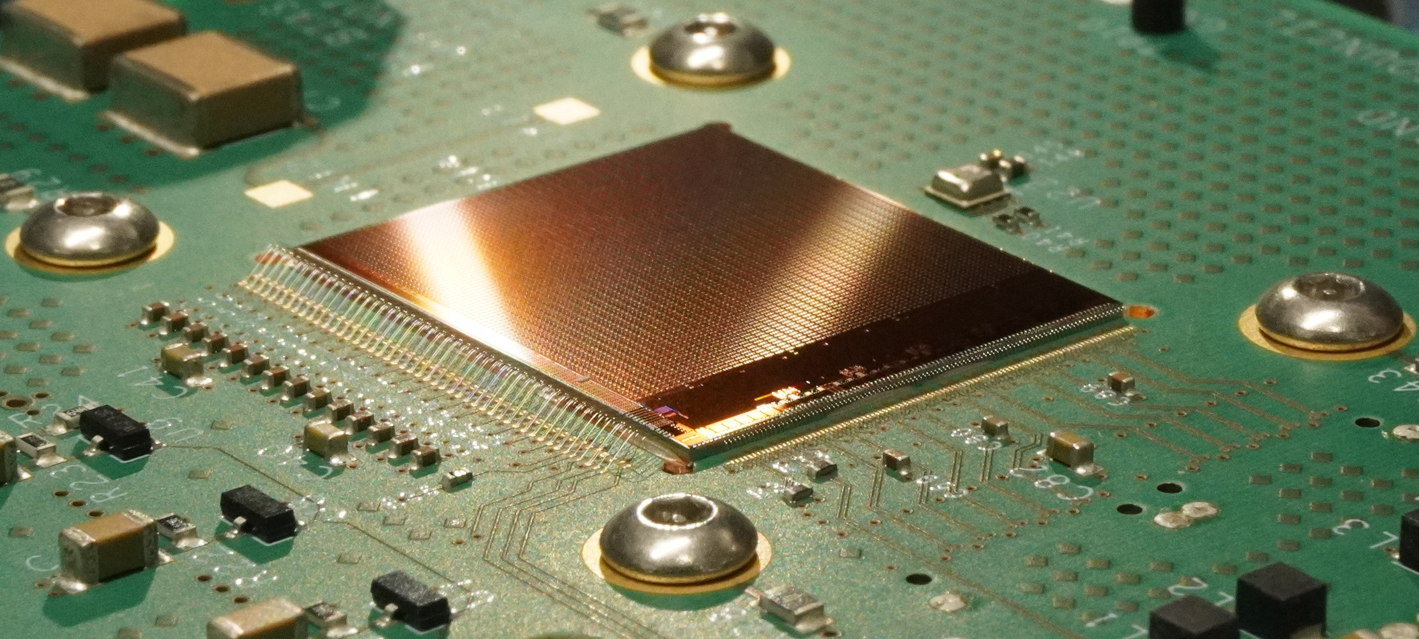
Comparison of HEXITEC and HEXITEC_{MHz} specifications
A new fully spectroscopic X-Ray imaging detector:
  80×80 pixels on a 250 μm pitch
  New front-end design – now an integrating detector
  On-chip 12-bit digitisation (no external ADCs)
    Data outputted via 20 × 4.1 Gbps serialisers
  1 MHz continuous frame rate
    Spectroscopic X-Ray fluxes of >10⁶ ph s⁻¹ mm⁻²
Parameter | HEXITEC | HEXITEC_{MHz}
Pixel Pitch (µm) | 250 | 250
Array Size | 80×80 | 80×80
Max Frame Rate (kHz) | ~10 | 1000
Max Spectroscopic Flux (ph s⁻¹ mm⁻²) | ~10⁴ | >10⁶
Digitisation | Off-chip | On-chip
Detector Type | Track + Hold | Integrating
Gain Stages (keV in CZT) | 200 | 100
 | 600 | 200
 |  | 300
FWHM@100keV (keV in CZT) | < 1 | < 1
Power Consumption (W) | 1.5 | 15
Photo of ASIC

Slide 9
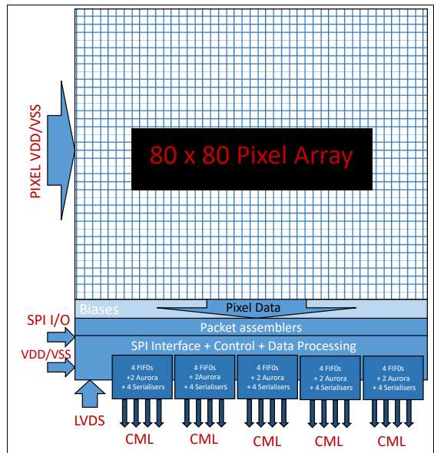
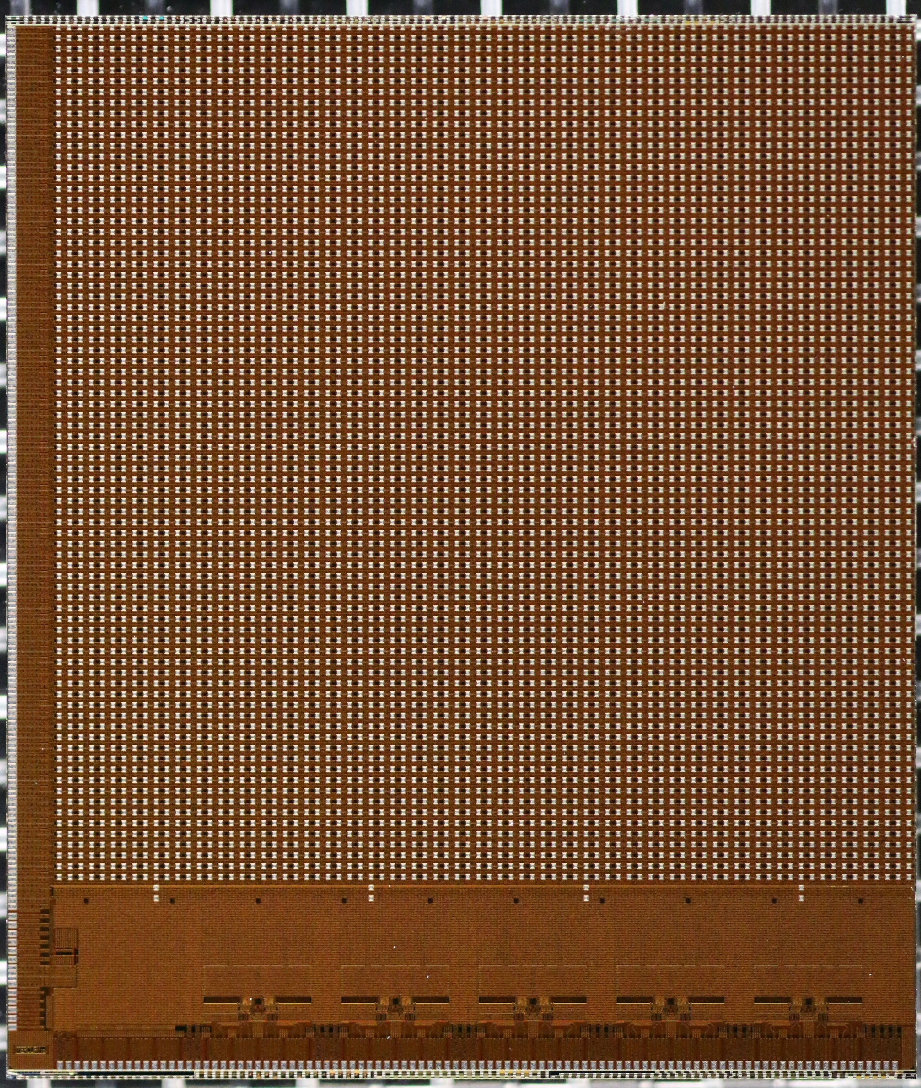
(Left) ASIC block diagram, (Right) HMHz ASIC

Slide 10
Agenda
1 HEXITEC vs HEXITEC_{MHz}
The next generation of HEXITEC systems
2 HEXITEC_{MHz} Overview
An introduction to our new HEXITEC_{MHz} ASIC including its architecture and specification
3 Test Results
Characterisation of spectroscopic performance using a lab-based X-Ray source and Diamond Light Source synchrotron X-Rays
4 Next Steps
A look to the next 12 months

Slide 11
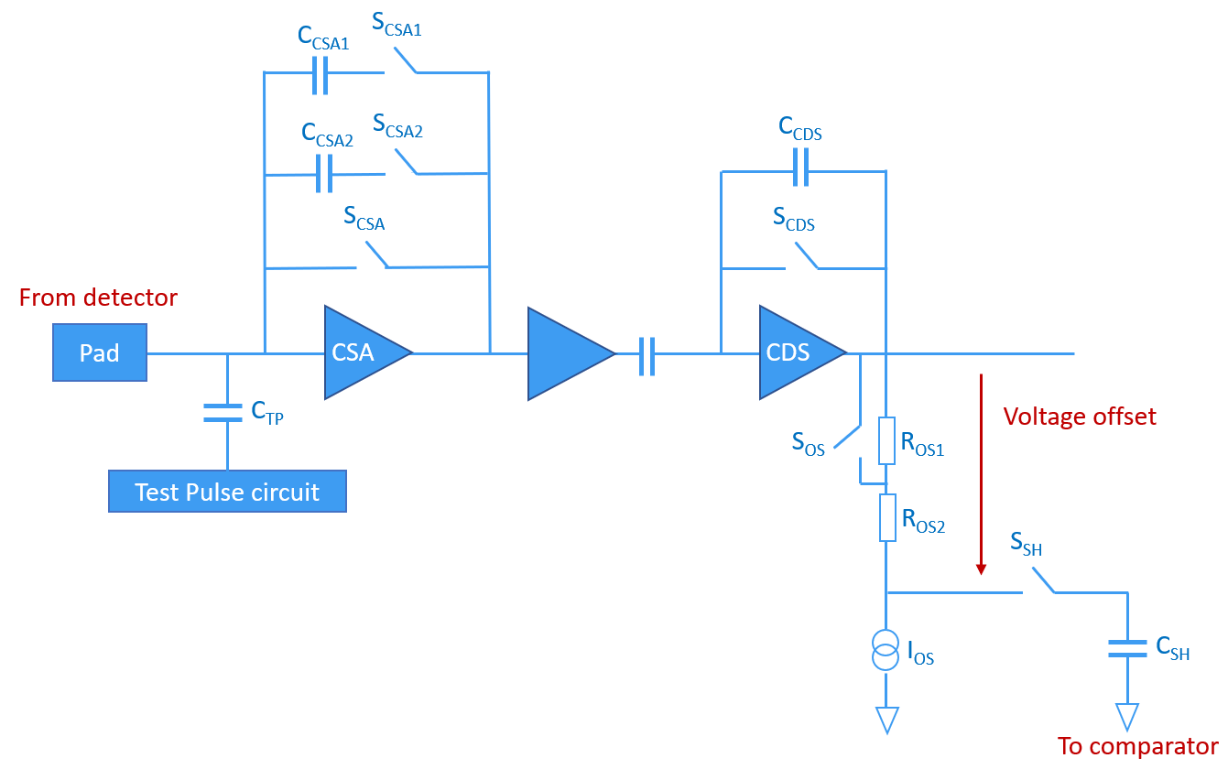
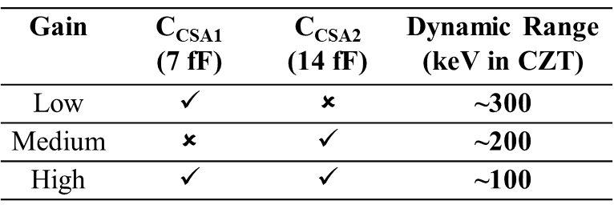
- Integrating Front End
  Properties:
  CSA + CDS amplifier
  3 static dynamic ranges
  t₁₀₋₉₀ = 50 ns
  t_{reset} ≈ 90 ns
  ENC < 70 e⁻
Front end schematic

Slide 12
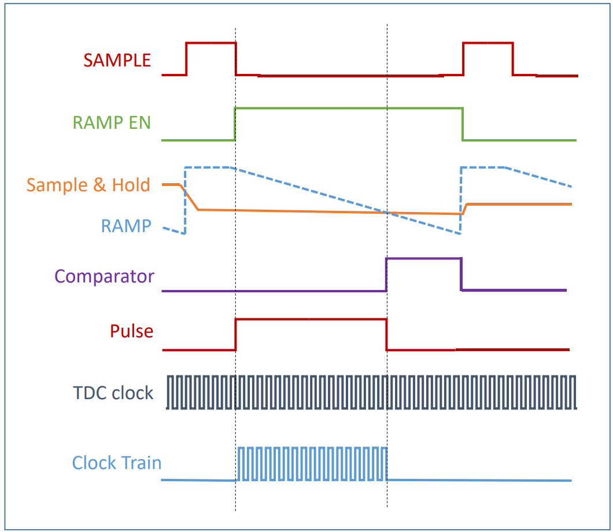
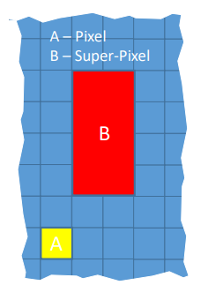
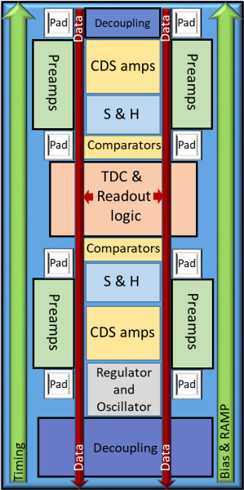
- In-Pixel TDC
12-bit digitisation
  The Sample & Hold signal is compared with a ramp with a programmable slew
The ASIC comprises 800 super-pixels of 2 × 4 pixels
  These contain one TDC block and shared readout logic
TDC signal timing
Super-pixel schematics

Slide 13
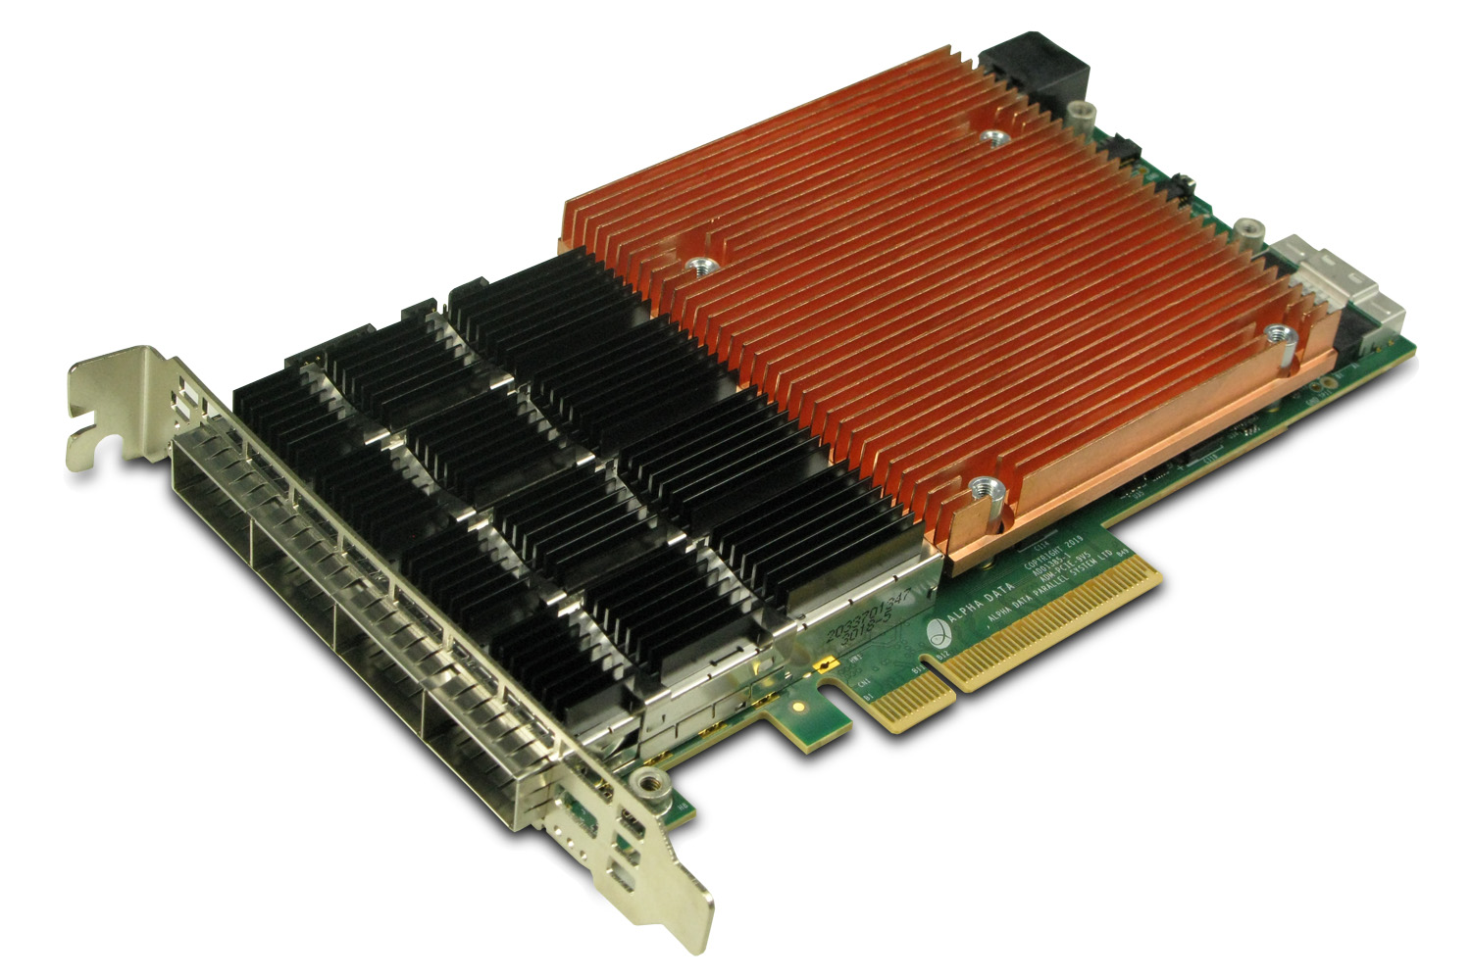

- Data Output
80×80 array is divided into divisions of 4 columns
  Each division has packet-assembler and dedicated serialiser
  Packets constructed using Xilinx’s Aurora 64B/66B protocol
  Serialisers operate at 4.1 Gb s⁻¹ (total data rate ≈ 10 GBs⁻¹)
What to do with all this data?
Two receiving data planes:
  First-stage FPGA – Alpha Data card
    Recovers and reorders the received optical data
  Second-stage FPGA – Xilinx Alveo U50 board
    Data corrections (darks, energy calibration)
    Data reduction (charge-sharing discrimination, histogramming)
Then received by ODIN Data, a scalable data-processing and acquisition network
4.1Gb Aurora × 20 lanes
Alpha Data card
100GbE
100GbE
Alveo board
Processed
Data

Slide 14
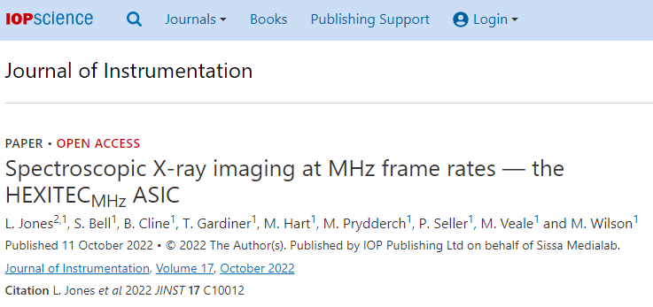
- Data Output
80×80 array is divided into divisions of 4 columns
  Each division has packet-assembler and dedicated serialiser
  Packets constructed using Xilinx’s Aurora 64B/66B protocol
  Serialisers operate at 4.1 Gb s⁻¹ (total data rate ≈ 10 GBs⁻¹)
What to do with all this data?
Two receiving data planes:
  First-stage FPGA – Alpha Data card
    Recovers and reorders the received optical data
  Second-stage FPGA – Xilinx Alveo U50 board
    Data corrections (darks, energy calibration)
    Data reduction (charge-sharing discrimination, histogramming)
Then received by ODIN Data, a scalable data-processing and acquisition network
4.1Gb Aurora × 20 lanes
Alpha Data card
100GbE
100GbE
Alveo board
Processed
Data
DOI: 10.1088/1748-0221/17/10/C10012

Slide 15
Agenda
1 HEXITEC vs HEXITEC_{MHz}
The next generation of HEXITEC systems
2 HEXITEC_{MHz} Overview
An introduction to our new HEXITEC_{MHz} ASIC including its architecture and specification
3 Test Results
Characterisation of spectroscopic performance using a lab-based X-Ray source and Diamond Light Source synchrotron X-Rays
4 Next Steps
A look to the next 12 months

Slide 16
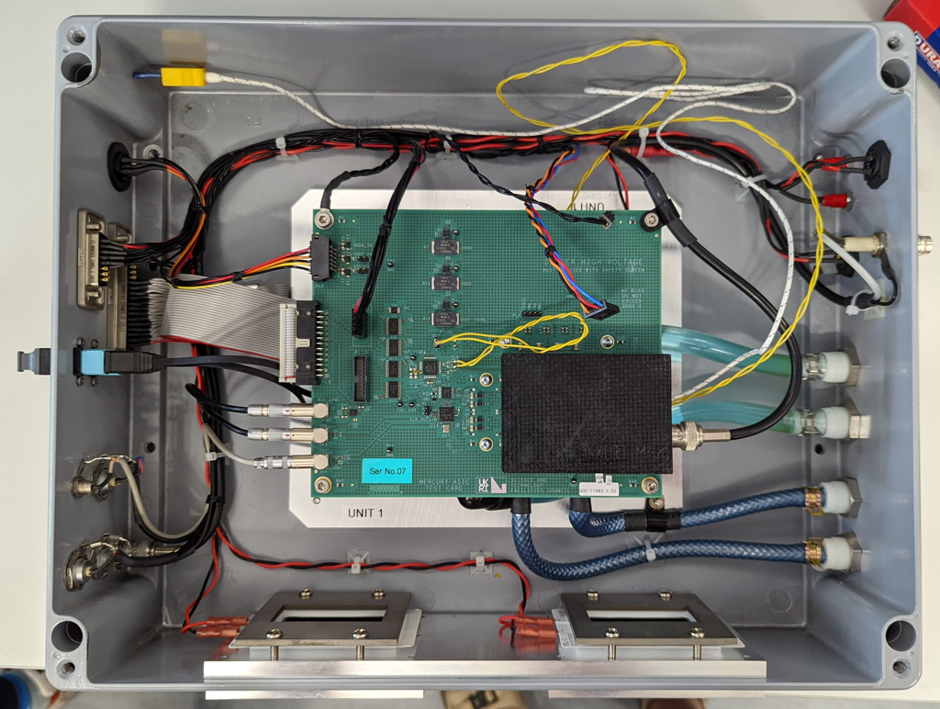
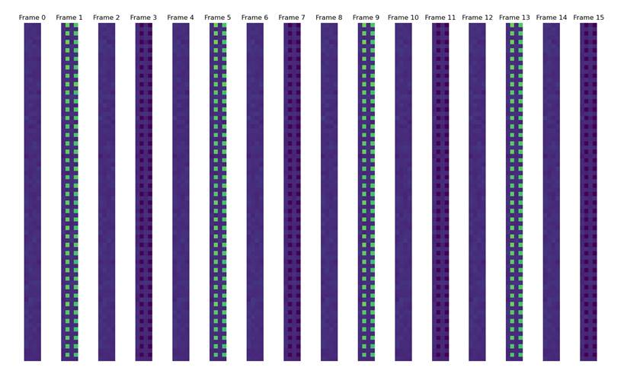
Current Status
50 cm
ASIC is fully functioning
Using test enclosure
FPGA firmware in development – at present, 1 channel (4 × 80 pixels) over fast data
30 cm
15 μs
HEXITEC_{MHz} test enclosure
Fast data output
1 μs

Slide 17
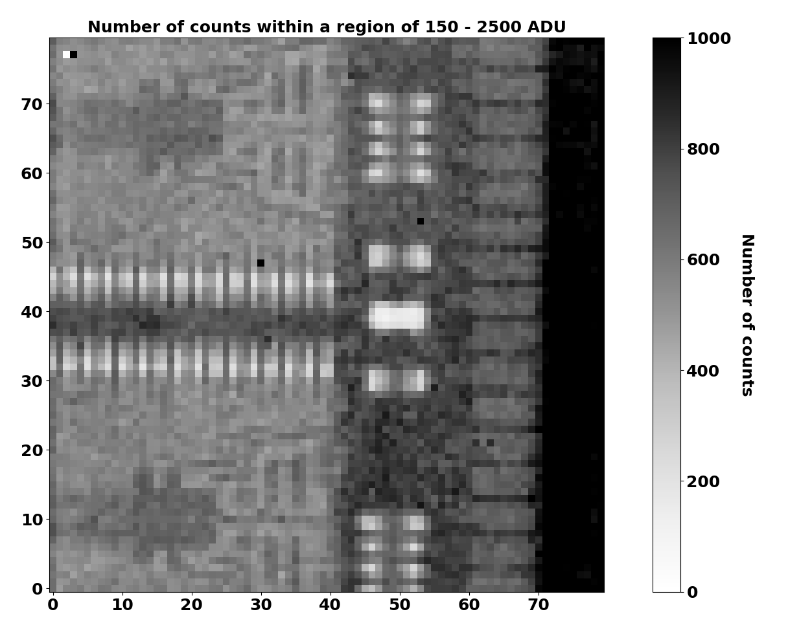
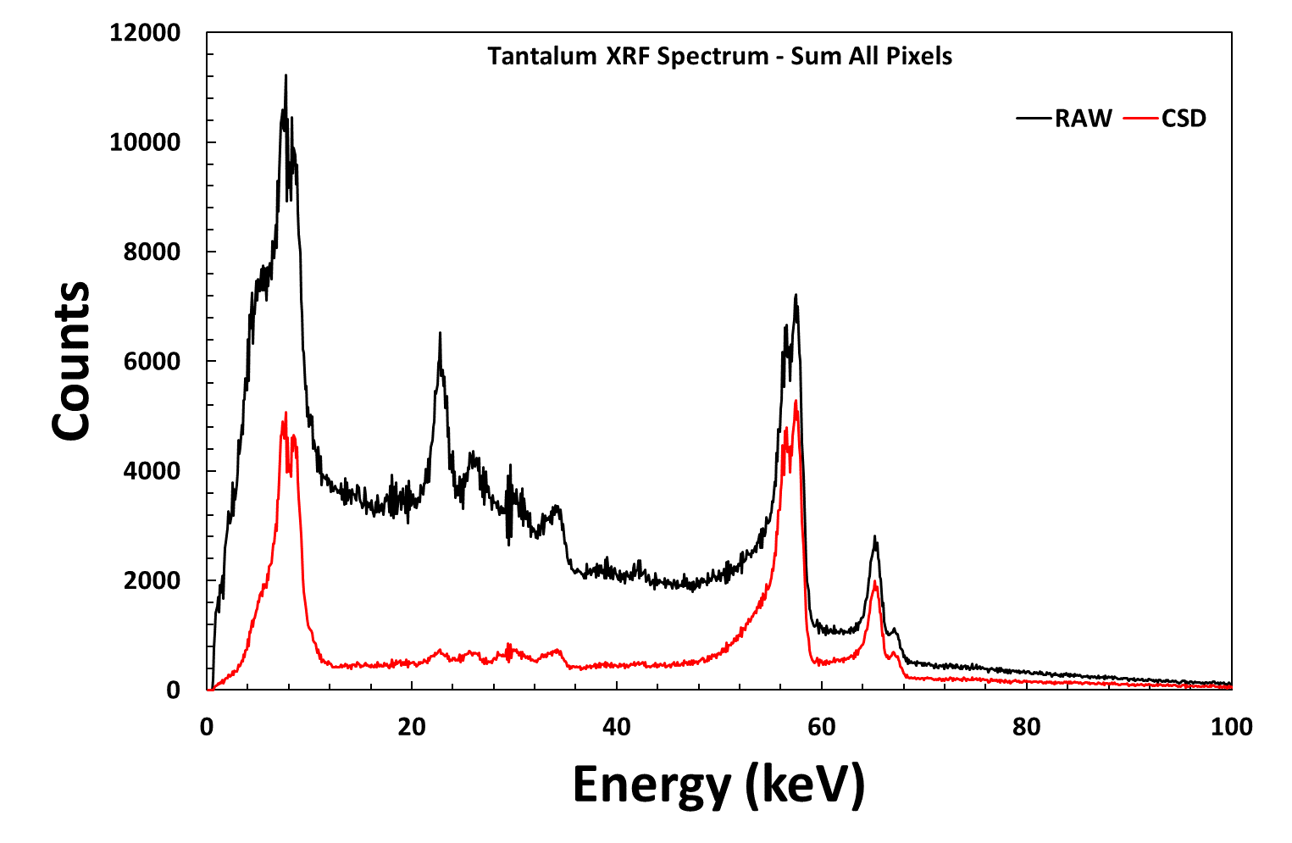
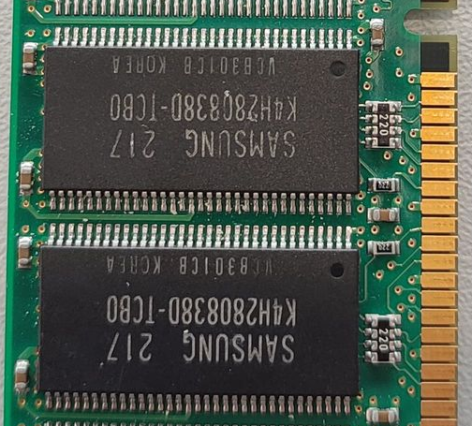
Testing – Initial X-Ray Tests
Ta L lines
Ta K_{α} and K_{β} XRF
Cd & Te XRF + Escape
X-Ray transmission measurements of a DDR Ram Card using a HEXITEC_{MHz} HF-CZT sensor
X-Ray Fluorescence (XRF) measurements of Ta foil using a HEXITEC_{MHz} HF-CZT sensor in medium-gain mode

Slide 18

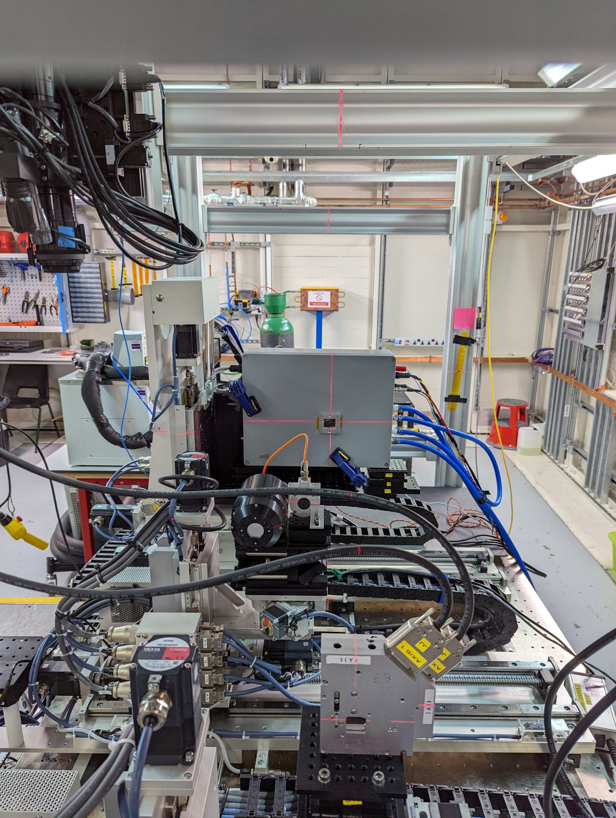
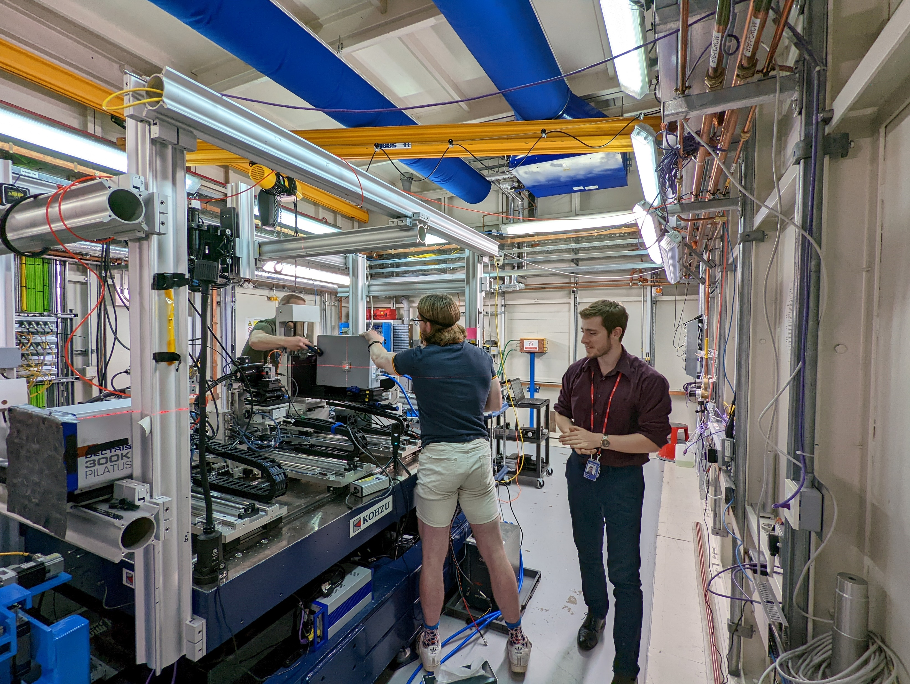
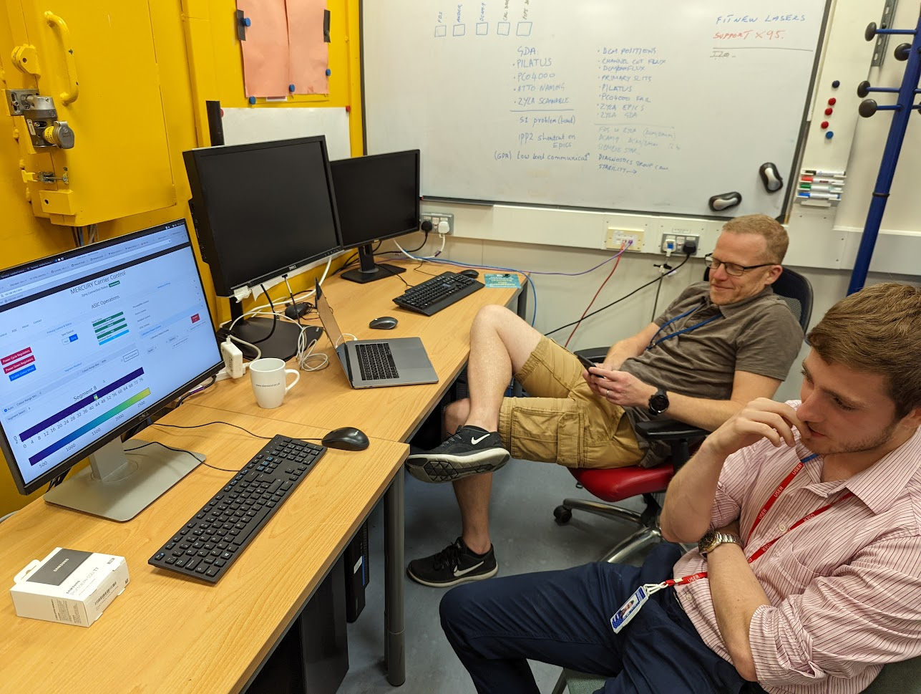
Experimentation at
B16 Beamline: August and December 2022
  Monochromatic X-Rays: 10 – 20 keV
  Photon fluxes: 10⁵ – 10⁸ ph s⁻¹ mm⁻²
  1 MHz data stream on one fast-data channel
  Tested HF-CZT (2 mm), p-type Si (300 µm), GaAs (500 µm) devices
Beamline scientists: Vishal Dhamgaye, Oliver Fox, Kawal Sawhney
B16 setup photos

Slide 19
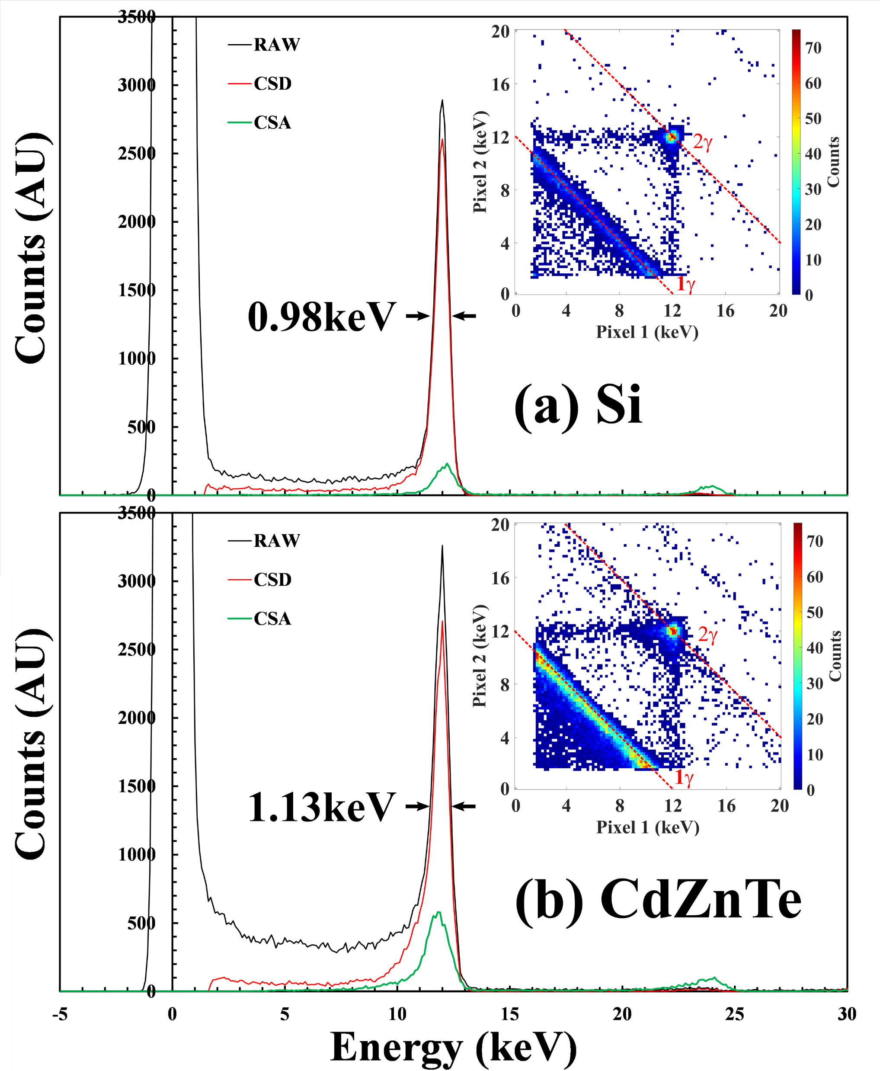
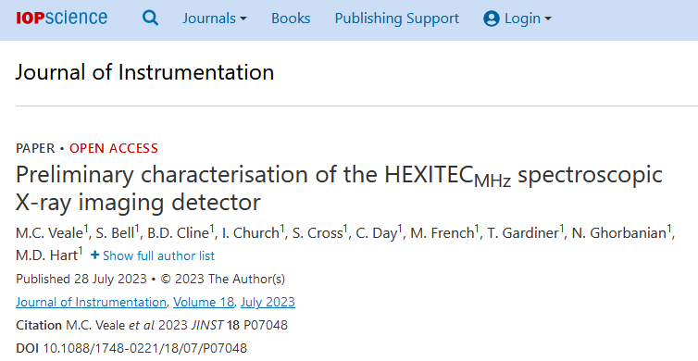
Experimentation at
B16 Beamline: August and December 2022
  Monochromatic X-Rays: 10 – 20 keV
  Photon fluxes: 10⁵ – 10⁸ ph s⁻¹ mm⁻²
  1 MHz data stream on one fast-data channel
  Tested HF-CZT (2 mm), p-type Si (300 µm), GaAs (500 µm) devices
Beamline scientists: Vishal Dhamgaye, Oliver Fox, Kawal Sawhney
DOI: 10.1088/1748-0221/18/07/P07048
B16 setup photos

Slide 20
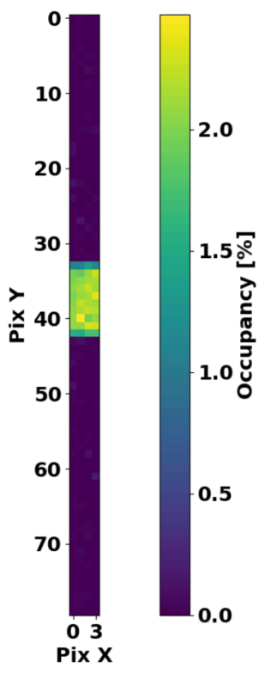
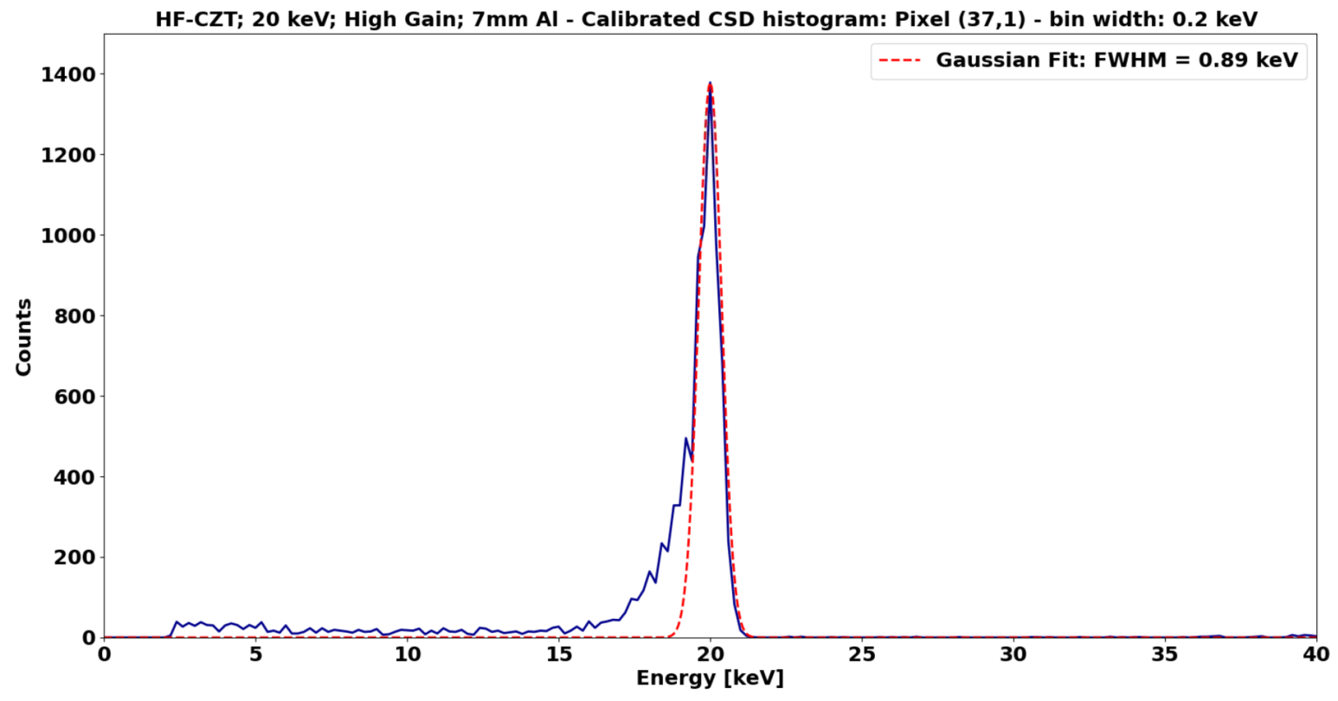
–Characterisation
HF-CZT; 20 keV; High Gain; 7 mm Al
Occupancy across fast-data channel
Calibrated CSD histogram of Pixel (37,1) @ 21 keV – 0.2 keV bin width. Gaussian FWHM fit shown

Slide 21
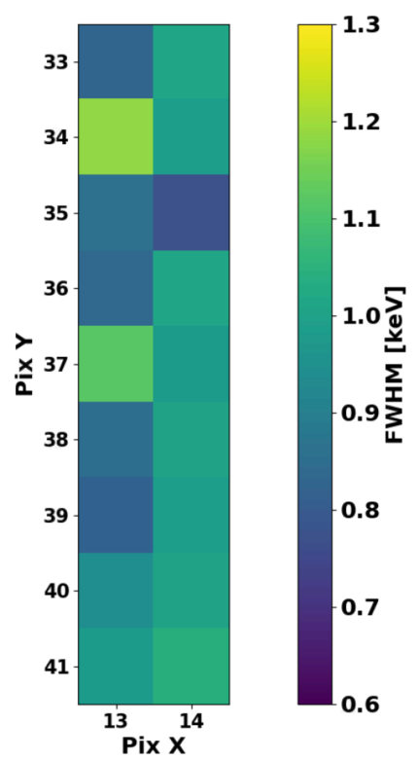
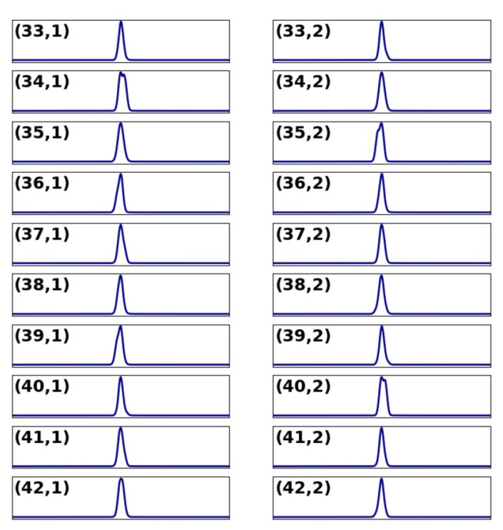
– Characterisation
Occupancy across fast-data channel
Calibrated CSD histograms in beam area
Single photon FWHM in beam area

Slide 22
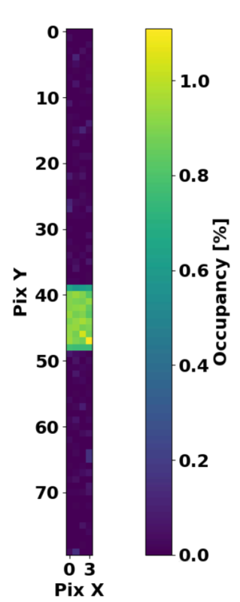
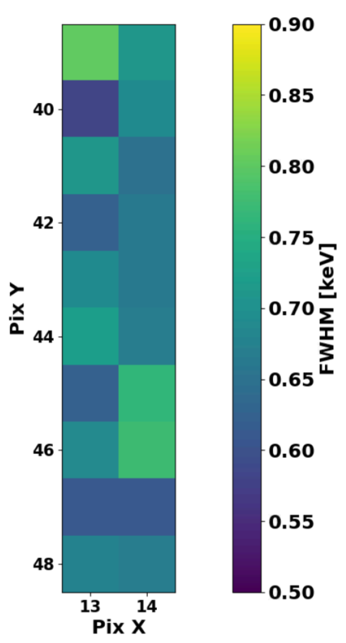
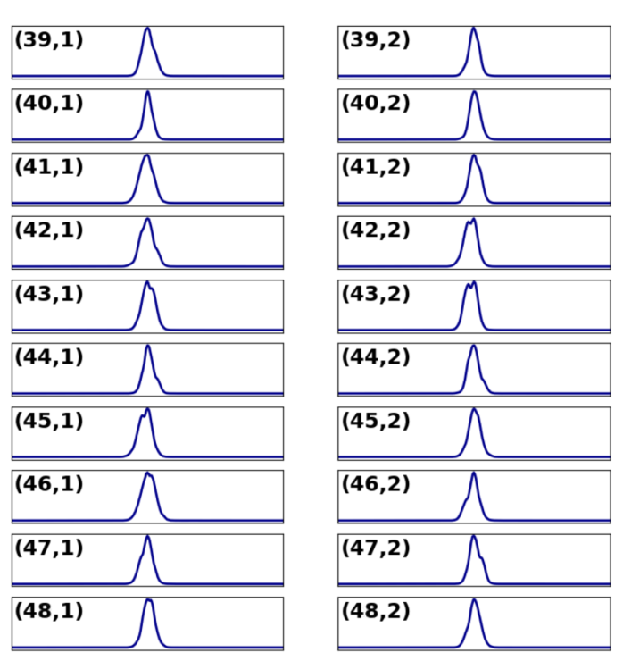
– Characterisation
p-type Si; 15 keV; High Gain; 3 mm Al
Occupancy across fast-data channel
Calibrated CSD histograms in beam area
Single photon FWHM in beam area

Slide 23
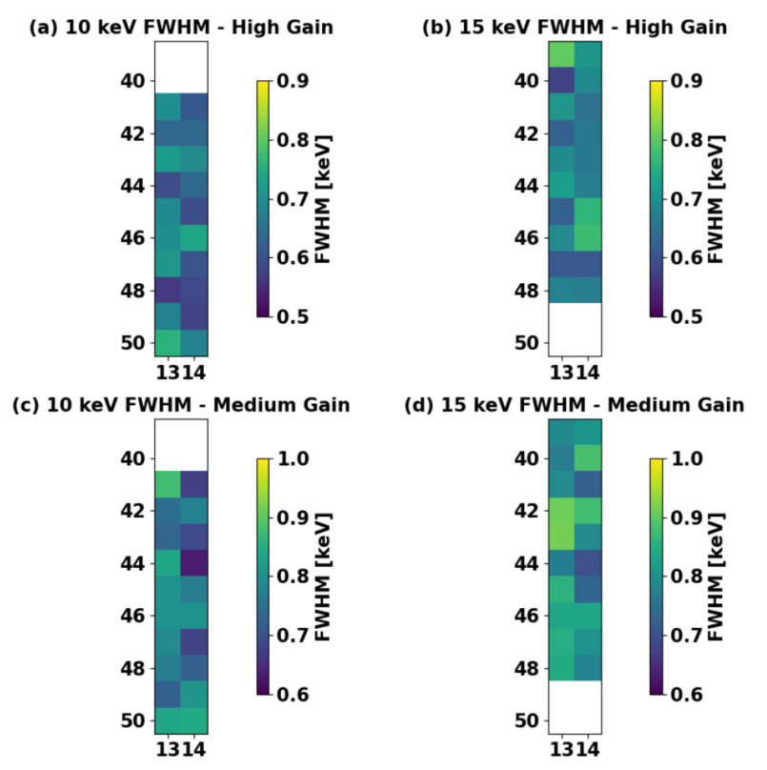
– Characterisation Results
HF-CZT
Peak Energy [keV] | HG FWHM [keV] | MG FWHM [keV] | LG FWHM [keV]
20 | 0.85 ± 0.10 | 0.92 ± 0.11 | 1.13 ± 0.12
p-type Si
Peak Energy [keV] | HG FWHM [keV] | MG FWHM [keV]
10 | 0.66 ± 0.06 | 0.77 ± 0.06
15 | 0.68 ± 0.06 | 0.81 ± 0.06
Electron-hole pair generation energies
CZT – 4.6 eV (e-h pair)⁻¹
Si – 3.6 eV (e-h pair)⁻¹
p-type Si FWHM in beam area

Slide 24
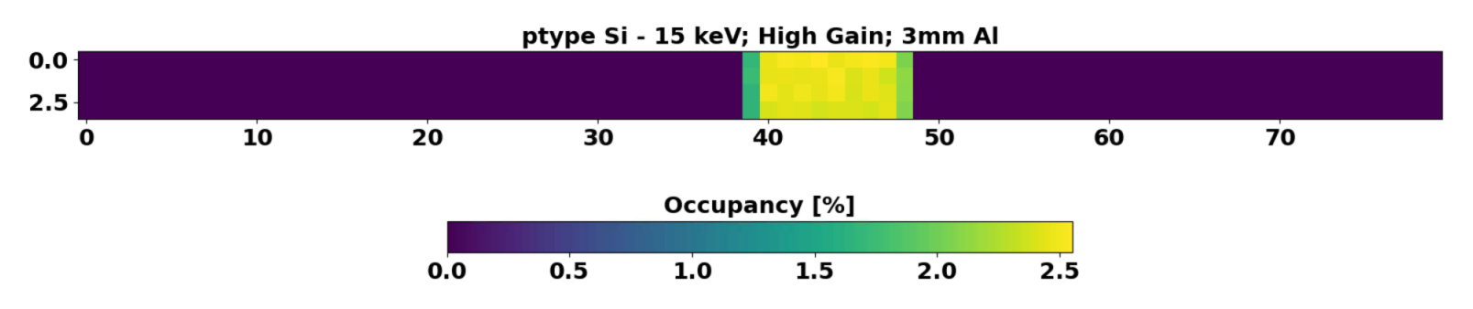
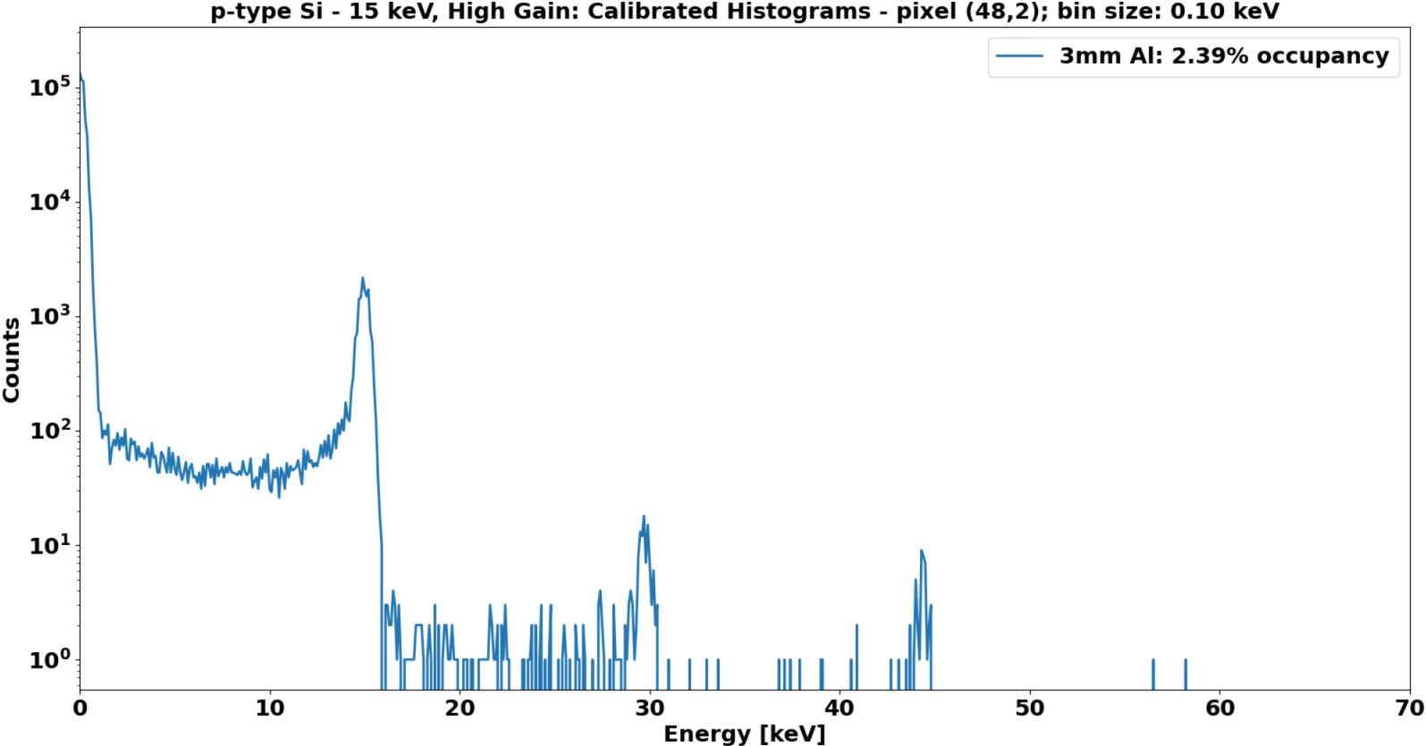
– Integrating Measurements
P-type Si; 15 keV; High Gain; 3 mm Al – 0 mm Al
Occupancy across fast-data channel
0.4 × 10⁶ ph s⁻¹ mm⁻²
Calibrated histograms of pixel (48,2)

Slide 25
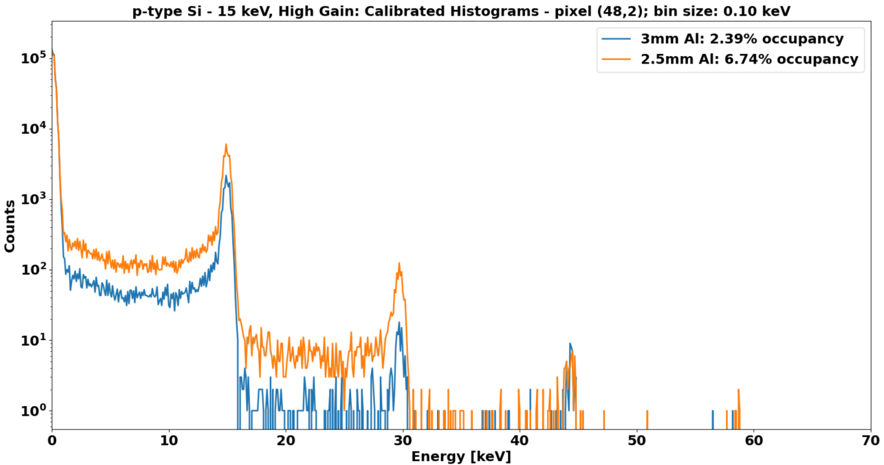
– Integrating Measurements
P-type Si; 15 keV; High Gain; 3 mm Al – 0 mm Al
Occupancy across fast-data channel
1.0 × 10⁶ ph s⁻¹ mm⁻²
Calibrated histograms of pixel (48,2)

Slide 26
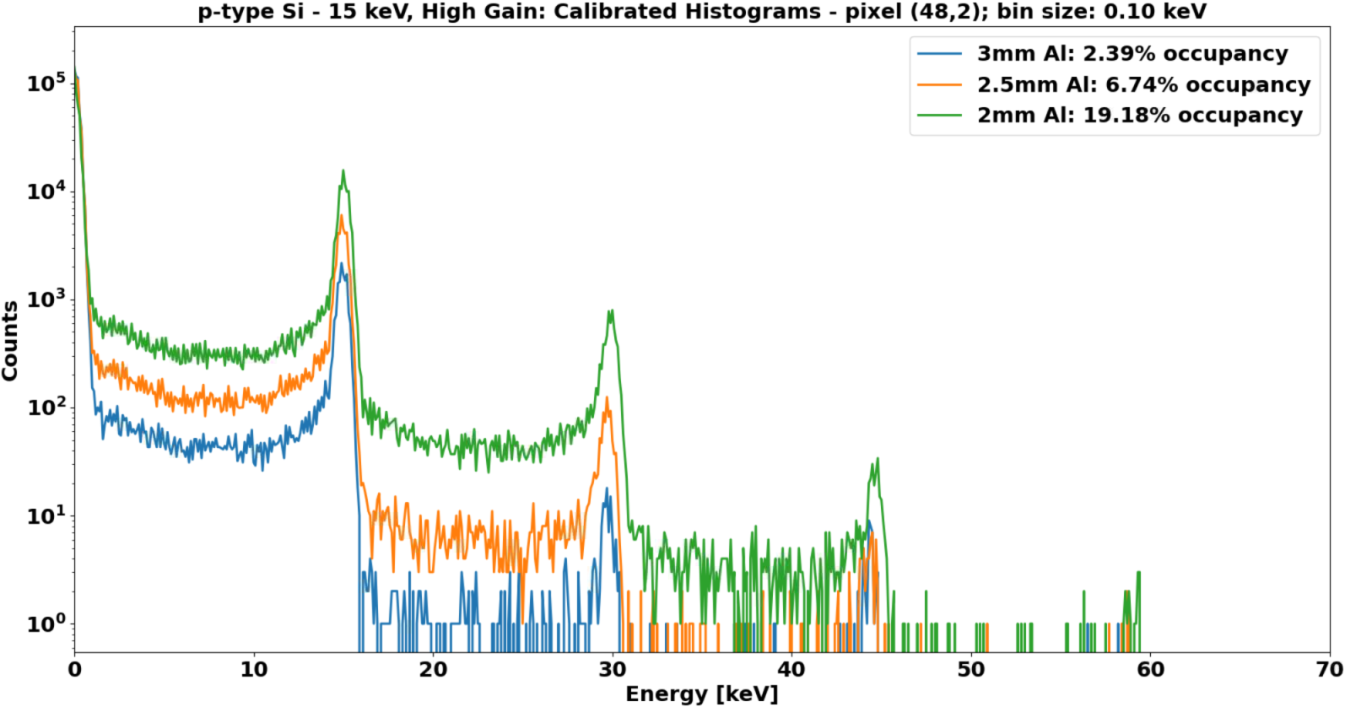
– Integrating Measurements
P-type Si; 15 keV; High Gain; 3 mm Al – 0 mm Al
Occupancy across fast-data channel
3.0 × 10⁶ ph s⁻¹ mm⁻²
Calibrated histograms of pixel (48,2)

Slide 27
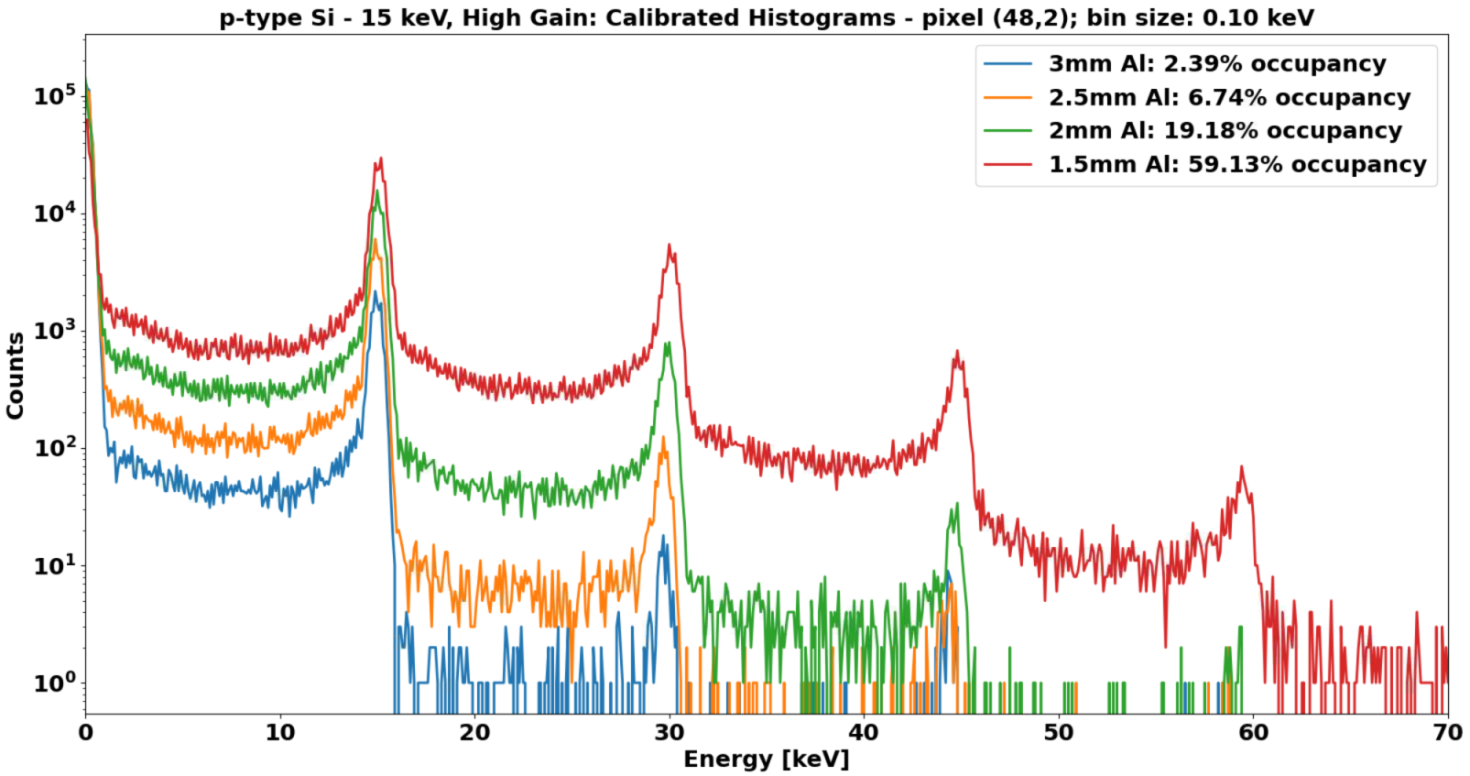
– Integrating Measurements
P-type Si; 15 keV; High Gain; 3 mm Al – 0 mm Al
Occupancy across fast-data channel
9.0 × 10⁶ ph s⁻¹ mm⁻²
Calibrated histograms of pixel (48,2)

Slide 28
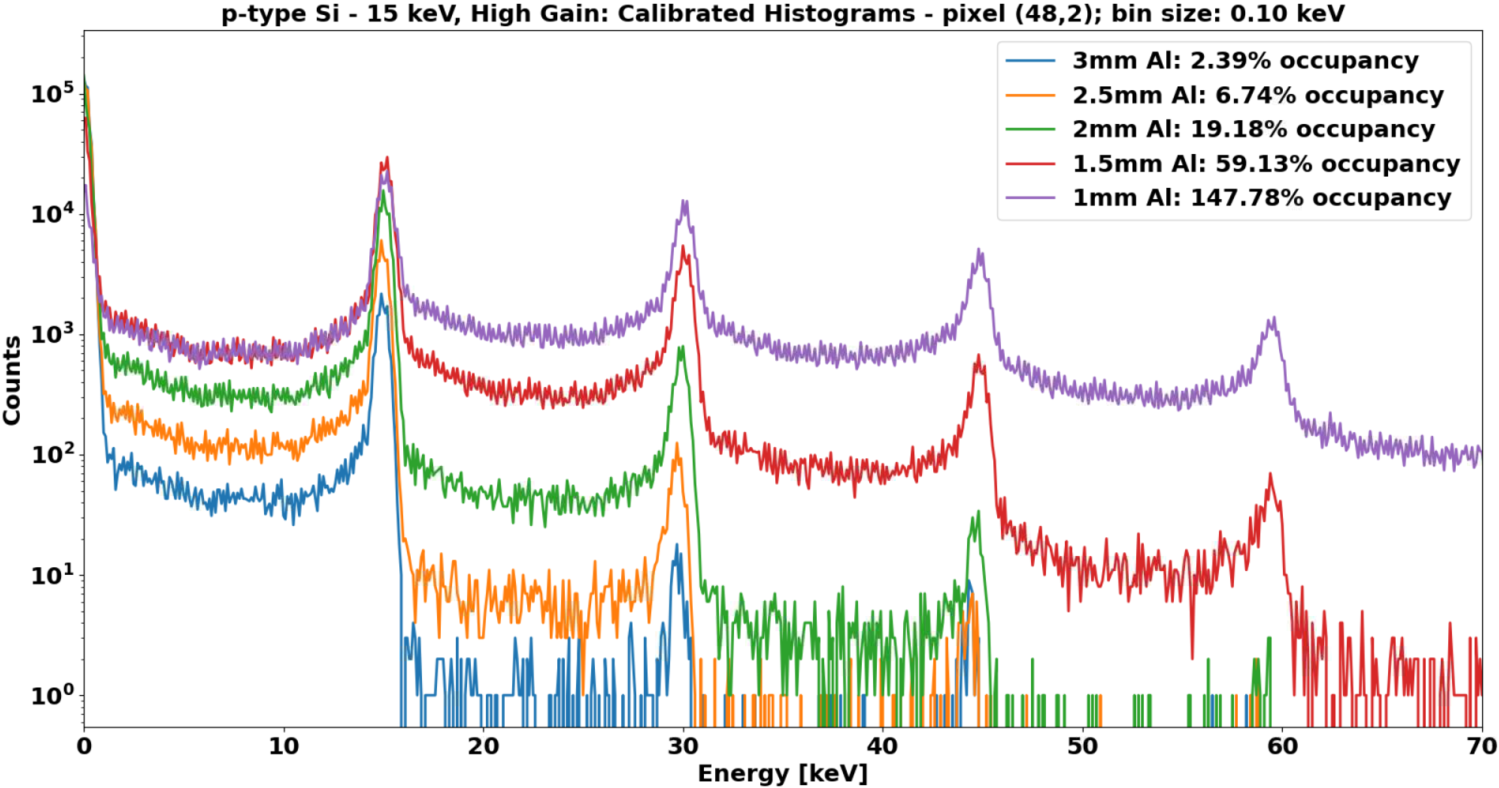
– Integrating Measurements
P-type Si; 15 keV; High Gain; 3 mm Al – 0 mm Al
Occupancy across fast-data channel
20 × 10⁶ ph s⁻¹ mm⁻²
Calibrated histograms of pixel (48,2)

Slide 29
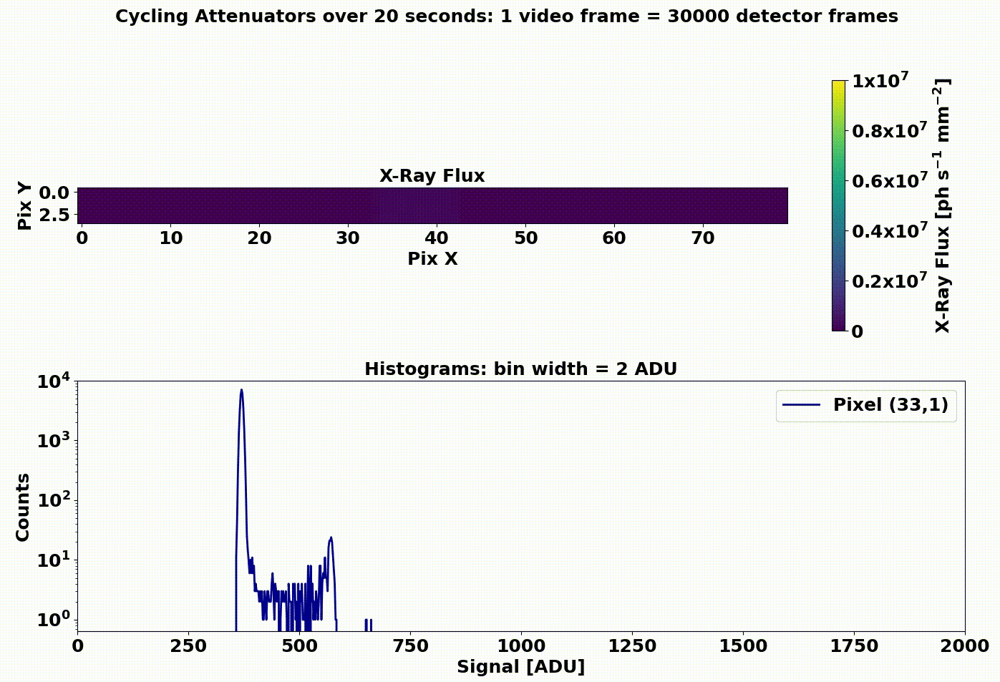
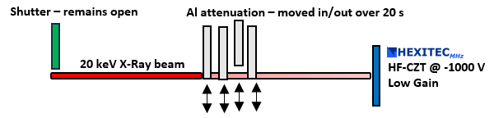
– Dynamic Measurements
HF-CZT: Changing attenuators over 20 seconds (30 ms/video frame)
Dynamic measurement schematic

Slide 30
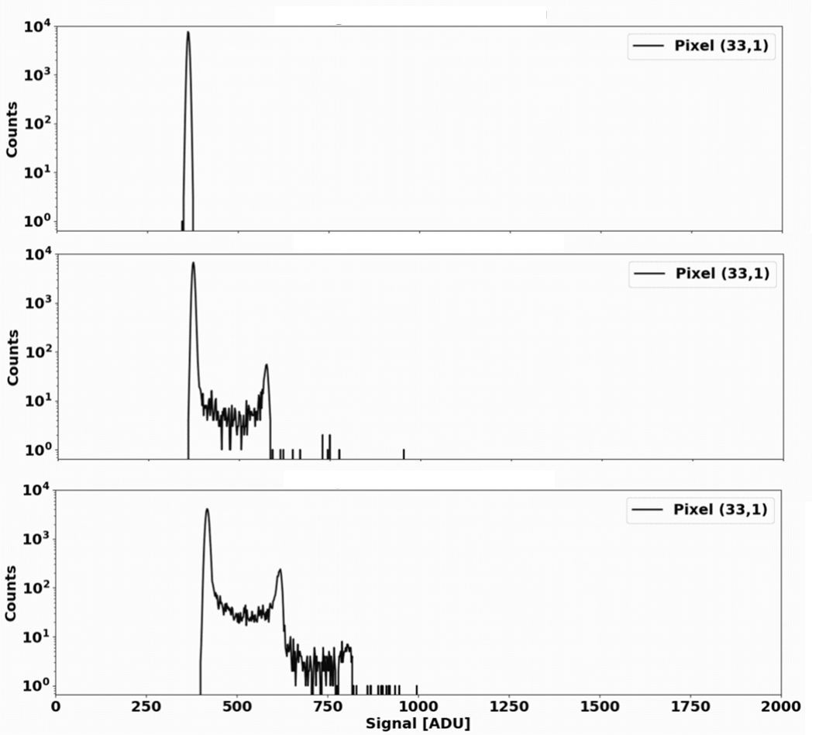
– Dynamic Measurements
HF-CZT: Changing attenuators over 20 seconds (30 ms/video frame)
Dynamic measurement schematic

Slide 31
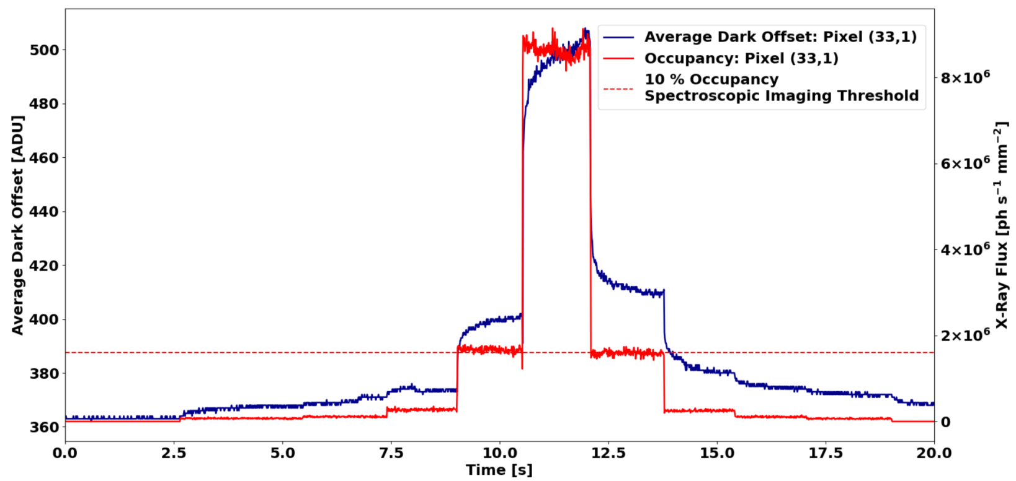
– Dynamic Measurements
HF-CZT: Changing attenuators over 20 seconds (30 ms/video frame)
Dynamic measurement schematic
Dark Offset varies with incident flux
Dark Offset varies with time at a given flux
More details at HiZPAD Workshop
20th – 21st September, DESY
https://indico.esrf.fr/event/18/
Real time Xilinx U50 FPGA processing will enable live corrections of this effect

Slide 32
Agenda
1 HEXITEC vs HEXITEC_{MHz}
The next generation of HEXITEC systems
2 HEXITEC_{MHz} Overview
An introduction to our new HEXITEC_{MHz} ASIC including its architecture and specification
3 Test Results
Characterisation of spectroscopic performance using a lab-based X-Ray source and Diamond Light Source synchrotron X-Rays
4 Next Steps
A look to the next 12 months

Slide 33
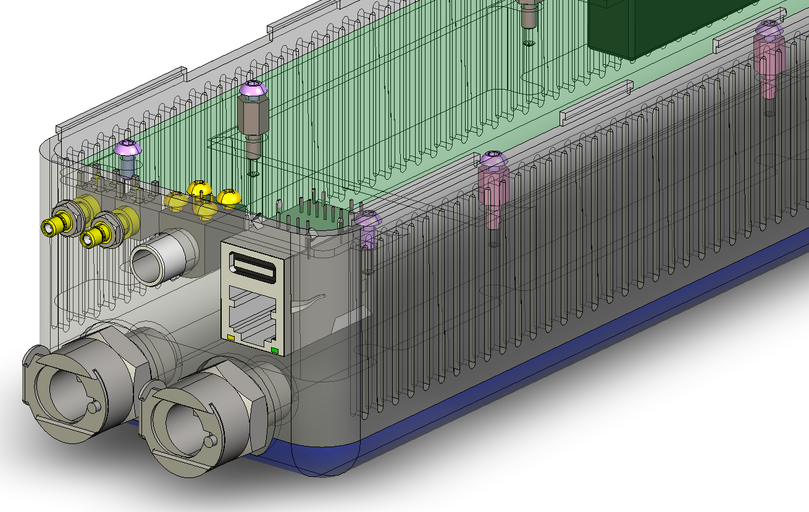
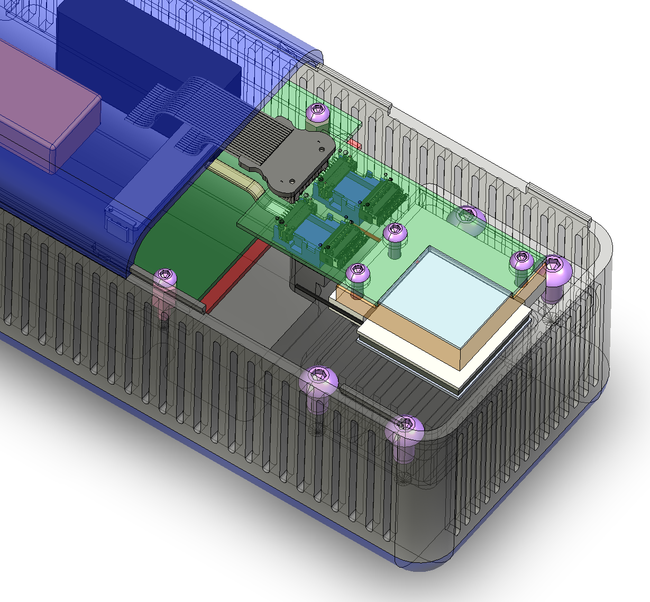
Next Steps
Achieving a 20-channel fast data output
  Reading out the full 80 × 80 array using the fast data
Further lab-based ASIC and sensor characterisation
Implementation of in-FPGA histogramming
Delivery of HEXITEC_{MHz} detector system
  Smaller, form factor production-grade system
Delivering Science
  5D-CT for Materials Science – University of Manchester
  Mammography – Institute of Cancer Research, UK
  Security imaging – Nottingham-Trent University
Matt Hart
Possible designs for HEXITEC_{MHz} detector system

Slide 34
Summary
HEXITEC_{MHz} is a fully-spectroscopic X-Ray detector capable of operating continuously at 1 MHz
Parameter | HEXITEC_{MHz}
Max Frame Rate (MHz) | 1
Max Spectroscopic Flux (ph s⁻¹ mm⁻²) | >10⁶
Digitisation | On-chip
Detector Type | Integrating
Measured FWHM (High Gain) | 0.68 keV @ 15 keV in p-type Si 0.85 keV @ 20 keV in HF-CZT
  Testing underway to characterise the ASIC and optimise register settings
  The next year will include delivery of a full 80 × 80 pixel readout and a new smaller form-factor system
  CdZnTe offsets to be presented at HiZPAD
If you have any further questions, please contact me at: ben.cline@stfc.ac.uk

Slide 35
Backup Slides

Slide 36
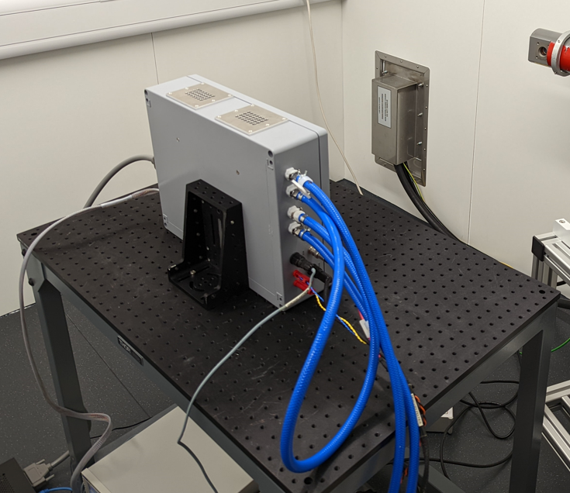
Testing – Test Setup
50 cm
30 cm
HEXITEC_{MHz} test enclosure (interior)
HEXITEC_{MHz} test enclosure (exterior)

Slide 37
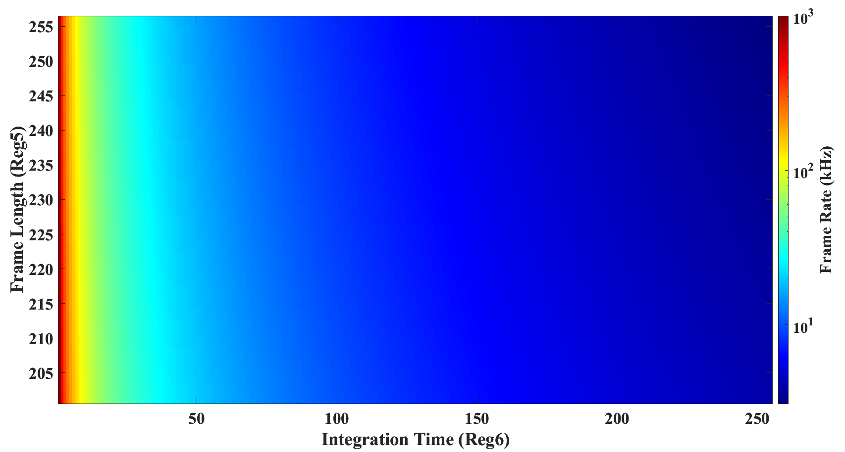
Available Frame Rates
Two chip registers can be altered:
  Frame Time: 200→255 clocks frame⁻¹
  Integration Length: 1 →255 frames
Default values
Available Frame Rates

Slide 38
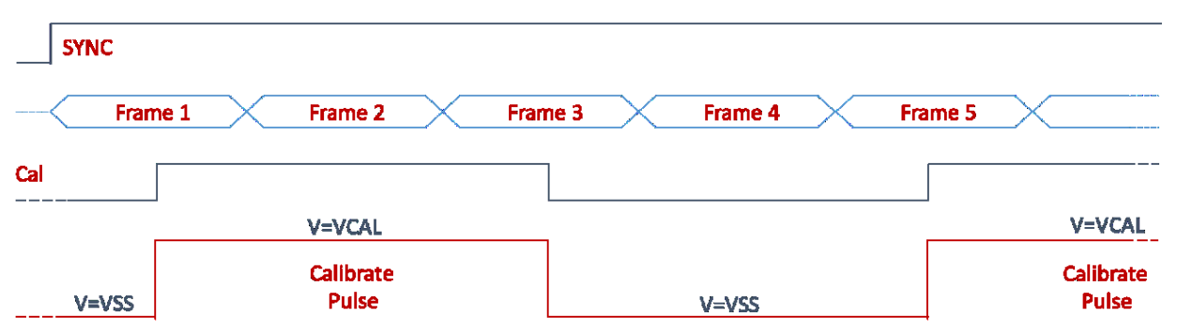
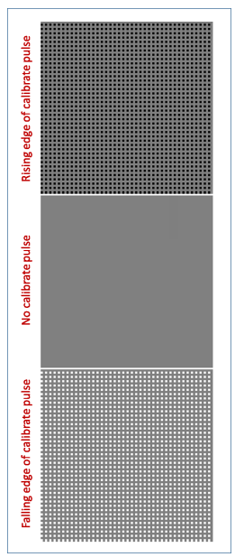
Test Pulse Sequence
15 μs
Fast Data output using test pulse sequence
1 μs
Test pulse sequence

Slide 39





Front End – Negative Offset Circuit
Potential application - Results from Veale et al., 2019;
  Data collected with STFC’s PIXIE ASIC (DOI: 10.1016/j.nima.2019.01.045)
Negative offset circuit

Slide 40






Data Output Plane
2nd Level Processing FPGA
Control
Data
ODIN Control
1st Level Receiver FGPA
ODIN Data
Zynq SoC
ASIC
2x 100G Optical Network Protocol
20x 4.1G Optical
Aurora (10m+)
Image © STFC John Dawson
Data output path schematic

Slide 41

Synchronising the ASIC
ASIC synchronised by controlling transition of SYNC input
  Logic 0 → logic 1
  Synchronisation occurs on 3rd subsequent rising clock edge
Used for external synchronisation and multi-ASIC systems
Synchronisation circuit

Slide 42

Electronic Noise Contribution
HF-CZT FWHM @ 20 keV ≈ 0.9 keV
HF-CZT w factor = 4.67 eV
→ ENC = $\sqrt{900×4.67}≈65 e^{−}$

Slide 43



– Charge Sharing
P-type Si; 10 keV; High Gain; ~2 % occupancy; 0.2 keV bin width
The distribution of energies in two-pixel charge sharing events using a 10 keV beam energy at an occupancy of ~2% - 0.2 keV bin width

Slide 44


– Temporal Stability
Evolution of high-gain calibrated global CSD spectra during exposure @ 10 keV for ~8 h – 0.2 keV bin width. Inset plot shows uncalibrated CSD spectra for pixel (14,45) – 1 ADU bin width
Change in performance of p-type HEXITEC_{MHz} device during exposure @ 10 keV for ~8 h. Plots show fluctuation in peak position (a), change in FWHM (b), and fractional change in peak counts (c) of 10 keV photo peak. Peak counts comprise events within the FWHM of peak, and error bars given by standard deviation across beam region

Slide 45



TSVs on HEXITEC
https://doi.org/10.1016/j.nima.2021.166083
(a) I/O pads on reverse of the 200 mm HEXITEC4S wafer post-TSV-last processing. (b) RDL pads dimensions on ASIC’s reverse. (c) SEM micrograph of exposed TSVs in cleaved test chip. (d) SEM micrograph showing contact between TSV and ASIC’s bottom metal layer
Wafer maps showing results of probe testing. Green – functioning; Red – non-functioning

Slide 46







Next steps – Current Applications
New Project: 5DCT – Dynamic Colour X-ray Computed Tomography
MIC-12-434: On the feasibility of using HEXITEC_{MHZ} and fully-spectral x-ray imaging to detect breast tumours: an in-silico study

Slide 47

Testing – SPI vs Fast Data Comparison
Comparison of fast data and SPI measurements using test pulse
Fast data matches SPI output ☺

Slide 48


Offset effect – Incrementing beam size within a pixel

Slide 49



Offset effect – Impeding CSA reset
0 Reset – 0R | 1 1R | 2 2R | 3 3R | 4 4R | 5 5R | 6 6R | 7 7R | 8 8R | 9 9R
10 Reset – 0R | 11 1R | 12 2R | 13 3R | 14 4R | 15 5R | 16 6R | 17 7R | 18 8R | 19 9R
20 Reset – 0R | 21 1R | 22 2R | 23 3R | 24 4R | 25 5R | 26 6R | 27 7R | 28 8R | 29 9R
30 Reset – 0R | 31 1R | 32 2R | 33 3R | 34 4R | 35 5R | 36 6R | 37 7R | 38 8R | 39 9R
Group + histogram
all 1R frames

Slide 50




Offset effect – Impeding CSA reset
Finding the centroids of each of the noise peak distributions
Now showing all pixels in channel
Illuminated Area
Plotting noise peak centroid against frames following reset

Slide 51

Offset effect – Impeding CSA reset
Pixel outside of beam region
6.85 ADU frame⁻¹ gradient of fit
Using a gradient of ~ 0.036 keV ADU
  0.036 × 6.85 = 0.2466 keV frame⁻¹
CZT w-factor = 4.6 eV per e-h pair
  0.2466/(4.6/1000) = 53 e⁻
  53 e⁻ = 8.48 × 10⁻¹⁸ C frame⁻¹
1 frame = 1 µs
  8.48 x 10⁻¹² A ≈ 8.5 pA
This is a sensible value for the leakage current
Pixel within beam region
23.87 ADU frame⁻¹ gradient of fit
Using a gradient of ~ 0.036 keV ADU
  0.036 × 23.87 = 0.8593 keV frame⁻¹
CZT w-factor = 4.6 eV per e-h pair
  0.8593/(4.6/1000) = 195 e⁻
  195 e⁻ = 3.12 × 10⁻¹⁷ C frame⁻¹
1 frame = 1 µs
  3.12 x 10⁻¹¹ A ≈ 31.2 pA
This is ~24 pA higher than outside of the beam

