Slide 1
Progress towards seamless large area X-ray and gamma-ray detectors
M. Campbell¹, J. Alozy, R. Ballabriga, P. Christodoulou, X. Llopart, F. Piernas Dias, V. Sriskaran, and L. Tlustos
CERN,
EP Department
1211 Geneva 23
Switzerland
¹ Honorary Professor at Glasgow University

Slide 2
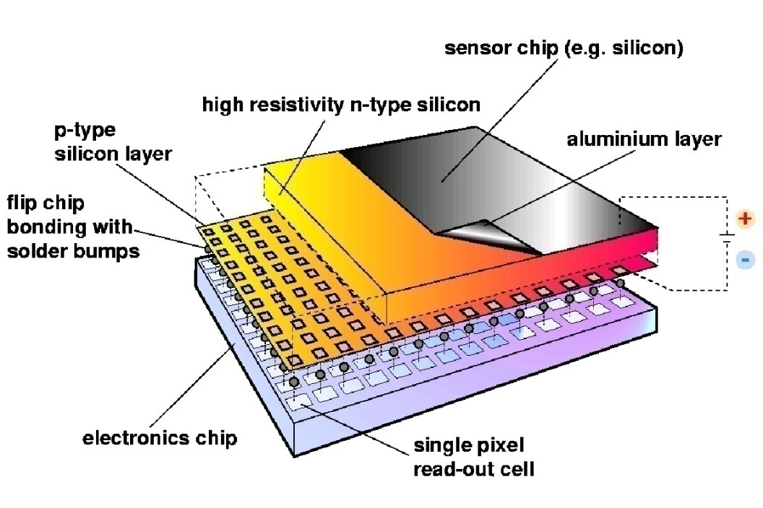
Hybrid Silicon Pixel Detectors
Standard CMOS can be used allowing on-pixel signal processing
Sensor material can be changed (Si, GaAs, CdTe..)
Notes:
Mention signal generation Add X section?

Slide 3
Gas detector readout - InGrid
Semiconductor detector is replaced with charge amplification grid
Permits lower energy events to be detected
NB: GEM foils may be used in place of the InGrid foils
If placed in a photo tube together with a MCP visible photons may be detected
(see: M. Fiorini et al 2018 J.Instrum 13 C12005)

Slide 4
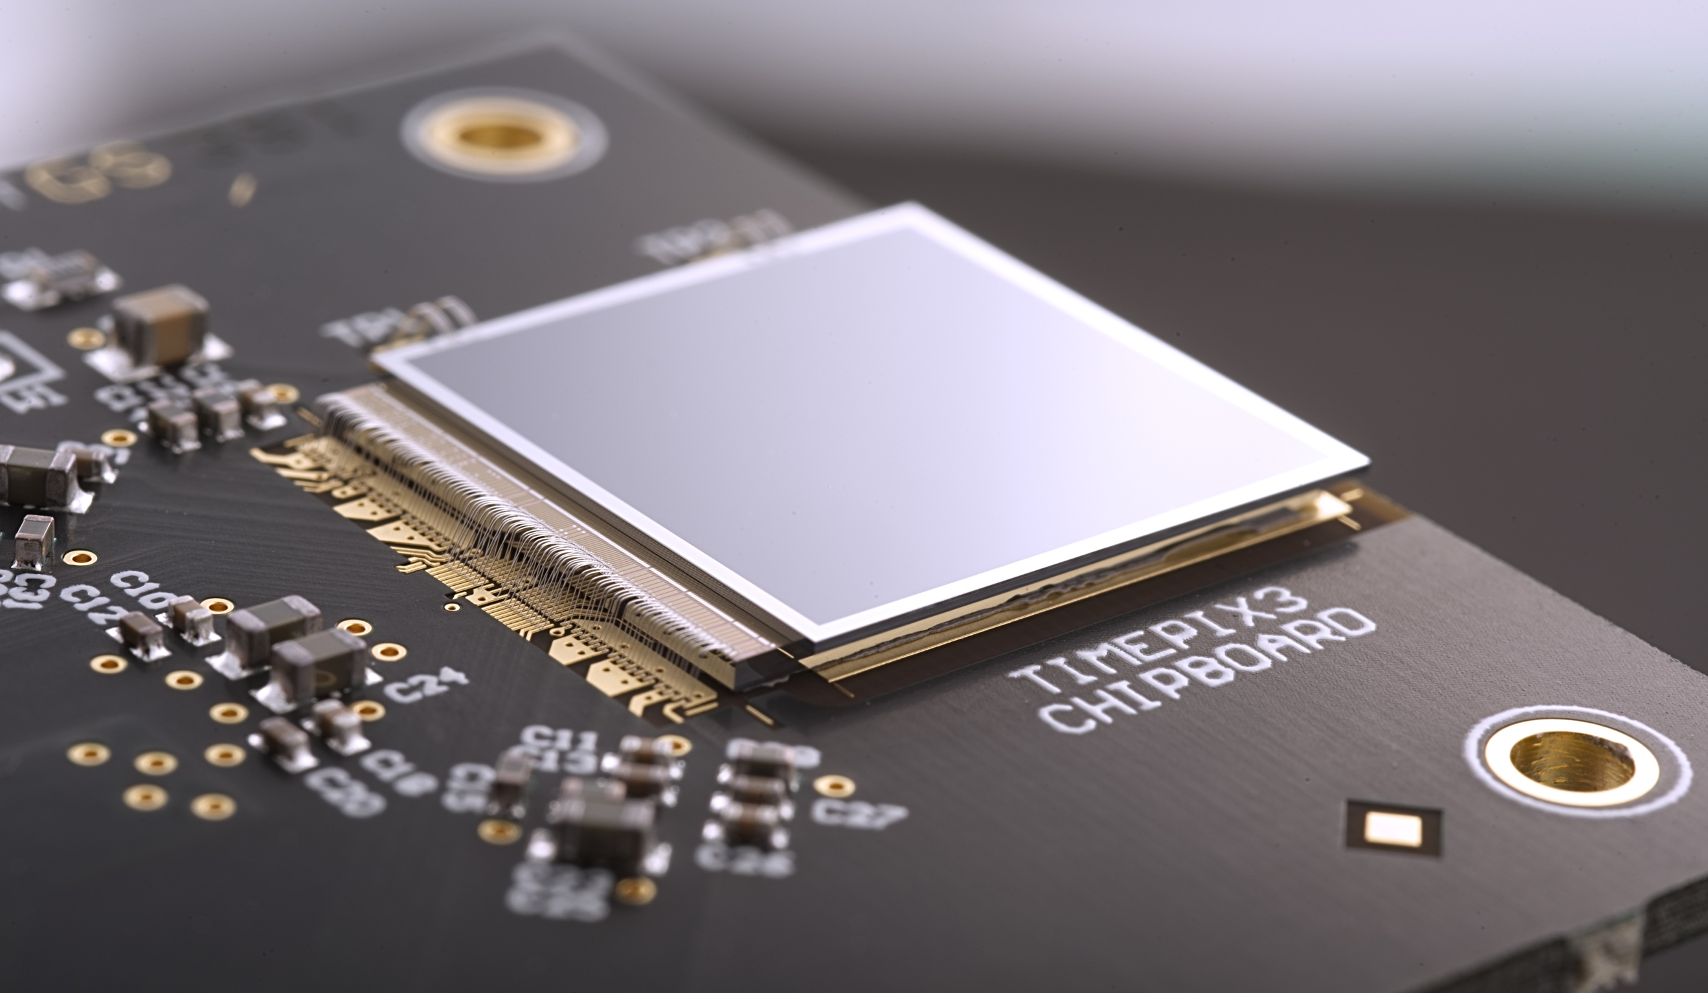
Timepix3 Photo

Slide 5
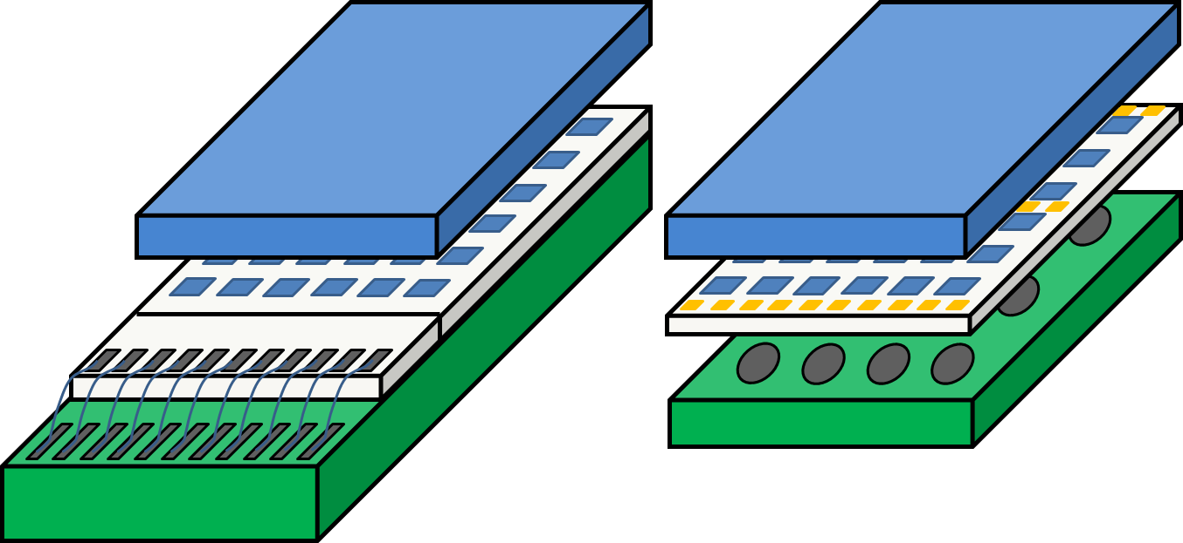
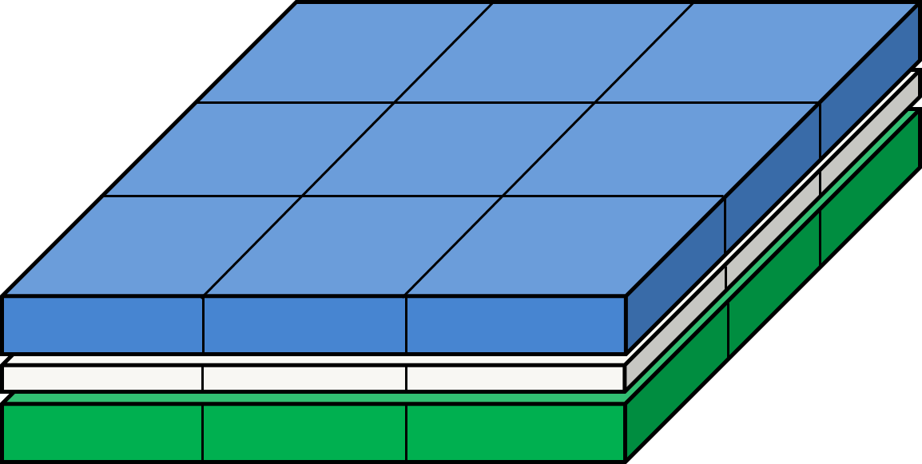
Tiling larger areas
Sensor
FC
FC
BGA
ASIC
Wire Bonding
PCB
Target to build large area detectors by combining single chip modules.
Through-silicon vias (TSVs) are the key technology enabler.
Medipix4 and Timepix4 use on-chip interposer for bump to pixel redistribution layer (RDL).
The detector is fully sensitive: even above the peripheral circuit and I/O pads.

Slide 6
Medipix2 (1999 -> ) | Medipix3 (2005 -> ) | Medipix4 (2016 -> )
Albert-Ludwig Universität Freiburg, Germany | Albert-Ludwig Universität Freiburg, Germany | CEA, Paris, France
CEA, Paris, France | AMOLF, Amsterdam, The Netherlands | CERN, Geneva, Switzerland
CERN, Geneva, Switzerland | Brazilian Light Source, Campinas, Brazil | DESY-Hamburg, Germany
Czech Academy of Sciences, Prague, Czechia | CEA, Paris, France | Diamond Light Source, England, UK
ESRF, Grenoble, France | CERN, Geneva, Switzerland | IEAP, Czech Technical University, Prague, Czeciah
IEAP, Czech Technical University, Prague, Czech Republic | DESY-Hamburg, Germany | IFAE, Barcelona, Spain
IFAE, Barcelona, Spain | Diamond Light Source, England, UK | JINR, Dubna, Russian Federation
Mid Sweden University, Sundsvall, Sweden | ESRF, Grenoble, France | NIKHEF, Amsterdam, The Netherlands
MRC-LMB Cambridge, England, UK | IEAP, Czech Technical University, Prague, Czech Republic | University of California, Berkeley, USA
NIKHEF, Amsterdam, The Netherlands | KIT/ANKA, Forschungszentrum Karlsruhe, Germany | University of Canterbury, Christchurch, New Zealand
University of California, Berkeley, USA | Mid Sweden University, Sundsvall, Sweden | University of Geneva, Switzerland
Universität Erlangen-Nurnberg, Erlangen, German | NIKHEF, Amsterdam, The Netherlands | University of Glasgow, Scotland, UK
University of Glasgow, Scotland, UK | Univesridad de los Andes, Bogota, Columbia | University of Houston, USA
University of Houston, USA | University of Bonn, Germany | University of Maastricht, The Netherlands
University and INFN Section of Cagliari, Italy | University of California, Berkeley, USA | University of Oxford, England, UK
University and INFN Section of Pisa, Italy | University of Canterbury, Christchurch, New Zealand | INFN, Italy
University and INFN Section of Napoli, Italy | Universität Erlangen-Nurnberg, Erlangen, German | Chinese Spallation Neutron Source, Dongguan City,China
 | University of Glasgow, Scotland, UK | Brazilian Light Source, Campinas, Brazil
 | University of Houston, USA | Philippine Nuclear Research Institute, Manila, Philippines
 | University of Leiden, The Netherlands
 | Technical University of Munich, Germany
 | VTT Information Technology, Espoo, Finland

Slide 7
Acknowledgements – Commercial Partners
COLLABORATION NAME | Medipix2 |  |  | Medipix3 |  | Medipix4
ASICS | Medipix2 | Timepix | Timepix2 | Medipix3 | Timepix3 | Medipix4 | Timepix4
ADVACAM s.r.o., Czech Republic | X | X | X | X | X |  | X
Amsterdam Scientific Instruments, The Netherlands | X | X | X | X | X |  | X
Kromek, UK | X | X | X |  | X
Malvern-Panalytical, The Netherlands | X | X | X | X
MARS Bio Imaging, New Zealand |  |  |  | X
PITEC, Brazil |  |  |  | X |  |  | X
Quantum Detectors, UK |  |  |  | X | X |  | X
Sydor Technologies, USA |  |  |  |  |  |  | X
X-ray Imaging Europe, Germany | X | X | X
X-spectrum, Germany |  |  |  | X |  |  | X
X = commercial licensee X = R and D licensee

Slide 8
The Medipix and Timepix ASICs - Timeline
1st large high resolution photon counting chip
1st chip with multiple energy bins
Tileable on 4 sides (timestamp 200ps)
Tileable on 4 sides (8 energy bins)
Add possibility to measure time or energy
Data driven readout (timestamp 1.6ns)
Year | 1999 | 2003 | 2006 | 2013 | 2014 | 2017 | 2018 | 2020 | 2023 | 2025?
ASIC | Alice1LHCb | Medipix2 | Timepix | Medipix3 | Timepix3 |  | Timepix2 | Timepix4 | Medipix4
LHCb |  |  |  |  |  | VELOpix |  |  |  | VELOpix2
Medipix chips aim at energy sensitive photon counting and typically use frame-based readout
Timepix chips are more oriented towards single particle detection
This talk will focus on Timepix4 and our efforts towards large area tiling

Slide 9
Timepix3 Specs
CMOS node | 130nm
Pixel Array | 256 x 256
Pixel pitch | 55μm
Charge collection | e⁻, h⁺
Pixel functionality | TOT (Energy) and TOA (Arrival time)
Preamp Gain | ~47mV/ke⁻
ENC | ~60e⁻
FE Linearity | Up to 12ke⁻
TOT linearity (resolution) | Up to 200ke⁻ (<5%)
TOA resolution* | Up to 1.6ns
Time-walk | <20ns
Minimum detectable charge | ~500e⁻ → 2 KeV (Si Sensor)
Max Analog power (1.5V) | 500 mA/chip
Digital Power (1.5V) | ~400mA data driven
Maximum hit rate | 80Mhits/sec (in data driven)
Readout | Data driven (44-bits/hit @ 5Gbps)
* Thanks to V. Gromov, et al. Nikhef, C. Brezina et al., Bonn

Slide 10
Timepix3 Specs
CMOS node | 130nm
Pixel Array | 256 x 256
Pixel pitch | 55μm
Charge collection | e⁻, h⁺
Pixel functionality | TOT (Energy) and TOA (Arrival time)
Preamp Gain | ~47mV/ke⁻
ENC | ~60e⁻
FE Linearity | Up to 12ke⁻
TOT linearity (resolution) | Up to 200ke⁻ (<5%)
TOA resolution* | Up to 1.6ns
Time-walk | <20ns
Minimum detectable charge | ~500e⁻ → 2 KeV (Si Sensor)
Max Analog power (1.5V) | 500 mA/chip
Digital Power (1.5V) | ~400mA data driven
Maximum hit rate | 80Mhits/sec (in data driven)
Readout | Data driven (44-bits/hit @ 5Gbps)
* Thanks to V. Gromov, et al. Nikhef, C. Brezina et al., Bonn

Slide 11
Timepix3 Specs
CMOS node | 130nm
Pixel Array | 256 x 256
Pixel pitch | 55μm
Charge collection | e⁻, h⁺
Pixel functionality | TOT (Energy) and TOA (Arrival time)
Preamp Gain | ~47mV/ke⁻
ENC | ~60e⁻
FE Linearity | Up to 12ke⁻
TOT linearity (resolution) | Up to 200ke⁻ (<5%)
TOA resolution* | Up to 1.6ns
Time-walk | <20ns
Minimum detectable charge | ~500e⁻ → 2 KeV (Si Sensor)
Max Analog power (1.5V) | 500 mA/chip
Digital Power (1.5V) | ~400mA data driven
Maximum hit rate | 80Mhits/sec (in data driven)
Readout | Data driven (44-bits/hit @ 5Gbps)
* Thanks to V. Gromov, et al. Nikhef, C. Brezina et al., Bonn

Slide 12
Timepix3 Specs
CMOS node | 130nm
Pixel Array | 256 x 256
Pixel pitch | 55μm
Charge collection | e⁻, h⁺
Pixel functionality | TOT (Energy) and TOA (Arrival time)
Preamp Gain | ~47mV/ke⁻
ENC | ~60e⁻
FE Linearity | Up to 12ke⁻
TOT linearity (resolution) | Up to 200ke⁻ (<5%)
TOA resolution* | Up to 1.6ns
Time-walk | <20ns
Minimum detectable charge | ~500e⁻ → 2 KeV (Si Sensor)
Max Analog power (1.5V) | 500 mA/chip
Digital Power (1.5V) | ~400mA data driven
Maximum hit rate | 80Mhits/sec (in data driven)
Readout | Data driven (44-bits/hit @ 5Gbps)
* Thanks to V. Gromov, et al. Nikhef, C. Brezina et al., Bonn

Slide 13
Timepix3 Specs
CMOS node | 130nm
Pixel Array | 256 x 256
Pixel pitch | 55μm
Charge collection | e⁻, h⁺
Pixel functionality | TOT (Energy) and TOA (Arrival time)
Preamp Gain | ~47mV/ke⁻
ENC | ~60e⁻
FE Linearity | Up to 12ke⁻
TOT linearity (resolution) | Up to 200ke⁻ (<5%)
TOA resolution* | Up to 1.6ns
Time-walk | <20ns
Minimum detectable charge | ~500e⁻ → 2 KeV (Si Sensor)
Max Analog power (1.5V) | 500 mA/chip
Digital Power (1.5V) | ~400mA data driven
Maximum hit rate | 80Mhits/sec (in data driven)
Readout | Data driven (44-bits/hit @ 5Gbps)
* Thanks to V. Gromov, et al. Nikhef, C. Brezina et al., Bonn

Slide 14
Timepix3 Specs
CMOS node | 130nm
Pixel Array | 256 x 256
Pixel pitch | 55μm
Charge collection | e⁻, h⁺
Pixel functionality | TOT (Energy) and TOA (Arrival time)
Preamp Gain | ~47mV/ke⁻
ENC | ~60e⁻
FE Linearity | Up to 12ke⁻
TOT linearity (resolution) | Up to 200ke⁻ (<5%)
TOA resolution* | Up to 1.6ns
Time-walk | <20ns
Minimum detectable charge | ~500e⁻ → 2 KeV (Si Sensor)
Max Analog power (1.5V) | 500 mA/chip
Digital Power (1.5V) | ~400mA data driven
Maximum hit rate | 80Mhits/sec (in data driven)
Readout | Data driven (44-bits/hit @ 5Gbps)
* Thanks to V. Gromov, et al. Nikhef, C. Brezina et al., Bonn

Slide 15
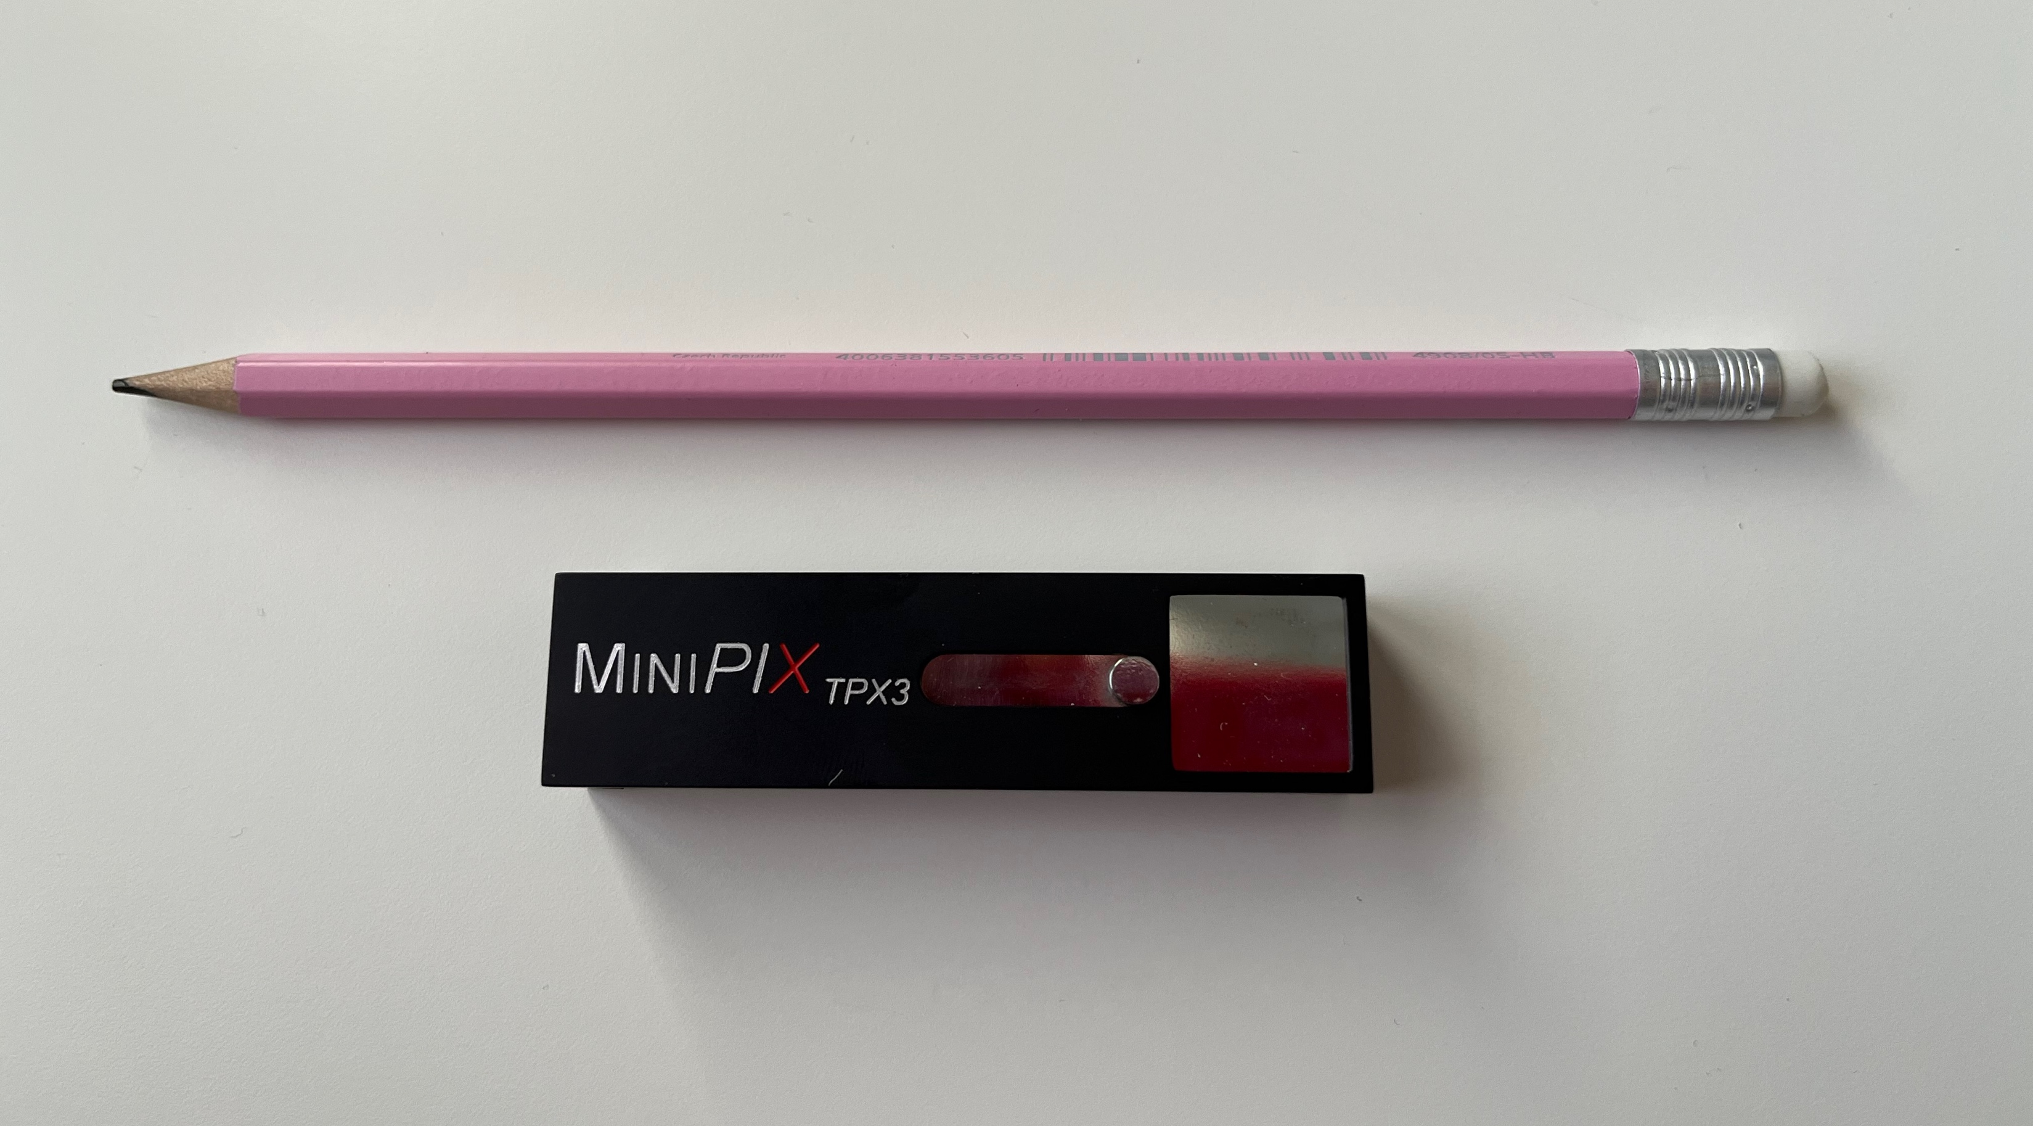
Timepix3 miniaturised readout
Advacam s.r.o., Prague

Slide 16
Timepix3 Demo

Slide 17
Tracking in a single Si layer

Slide 18
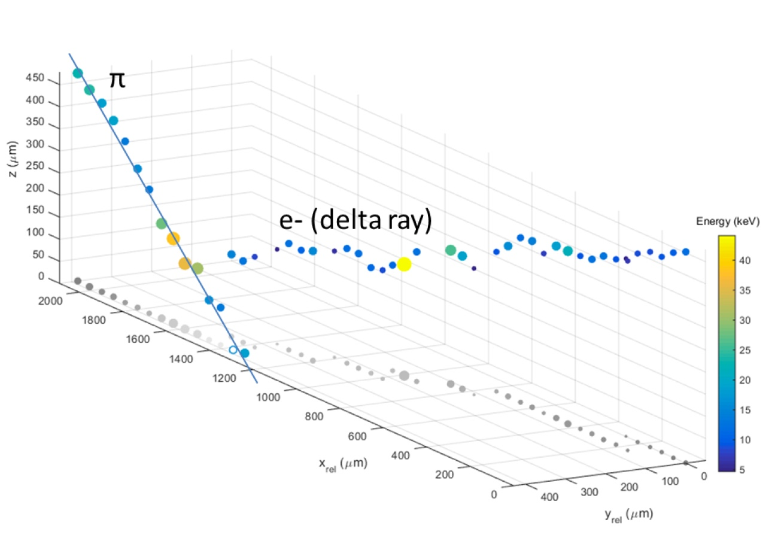
Test with 120GeV/c Pion Track
60 deg
p+ in n Si sensor
500μm thick
V_{bias} = 130V
Colour (and diameter) indicate charge
Measured z resolution ~50μm
Slide courtesy of B. Bergmann, S. Pospisil, IEAP, CTU, Prague

Slide 19
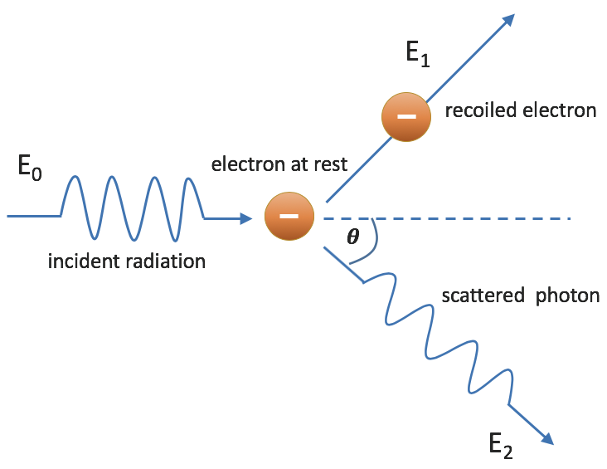
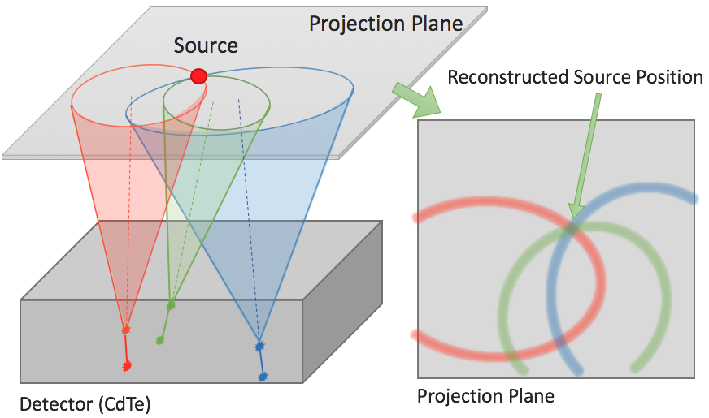
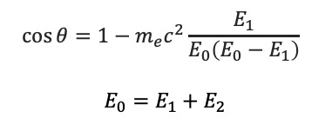
Single Layer Compton Camera with MiniPIX TPX3
Compton camera principle
Typical two detectors
primary gamma is scattered in first detector (position and energy recorded), scattered gamma continues to second detector (absorbed, position and energy recorded)
from energies - > scattering angle calculated
from position and energies -> possible position of the source on the surface of a cone
Multiple cones intersection - > source position
Single Timepix3 layer camera
  Instead of 2 detectors, only single TPX3
  Using time of charge collection to determine relative depth
$$\cos{θ=1−m_{e}c^{2}\frac{E_{1}}{E_{0}\left(E_{0}−E_{1}\right)} }$$
$$E_{0}=E_{1}+E_{2}$$
Courtesy of D. Turecek, Advacam s.r.o

Slide 20
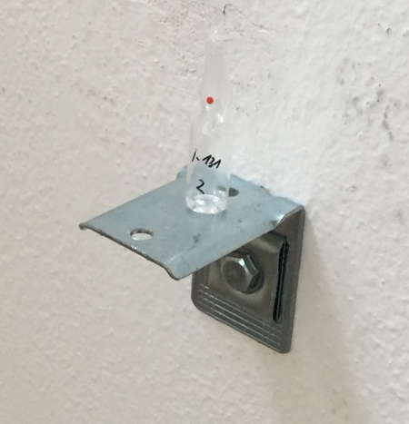
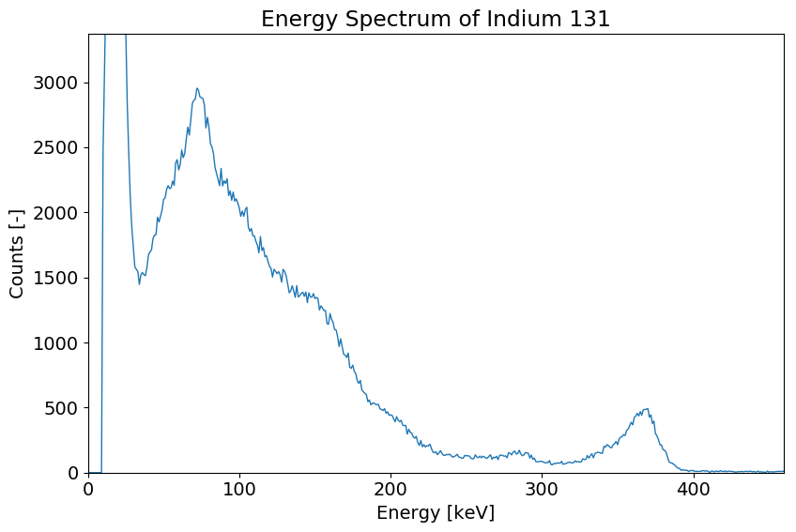
Single Layer Compton Camera with MiniPIX TPX3
¹³¹Iodine gamma source
3 different Iodine solution in small bottles positioned in a room at different positions
Distance from detector 3.5 m (activity 10’s of MBq)
Mapped on photograph of the room
Sources located correctly within minutes
Image took hours to collect
Energy Spectrum of ¹³¹I
Reconstruction of position of three ¹³¹I gamma sources (364 keV)
Courtesy of D. Turecek, Advacam s.r.o

Slide 21
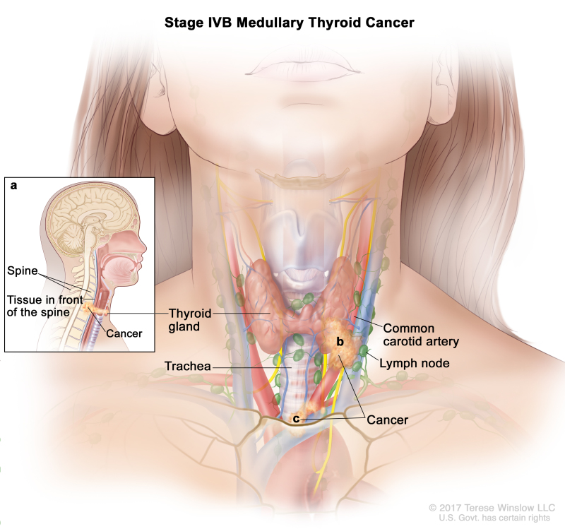
Gamma camera application: Thyroid diagnostics
Thyroid cancer diagnostics and treatment monitoring:
The second most frequent cancer for women (after breast cancer)
Current imaging methods offer resolution of about 12 mm in 2D
Our technology allows
  5 times better resolution and 3D (2.5 mm)
  4 times lower dose
Courtesy of D. Turecek, Advacam s.r.o

Slide 22
Timepix3 → Timepix4
 |  |  | Timepix3 (2013) | Timepix4 (2018/19)
Technology |  |  | 130nm – 8 metal | 65nm – 10 metal
Pixel Size |  |  | 55 x 55 µm | 55 x 55 µm
Pixel arrangement |  |  | 3-side buttable 256 x 256 | 4-side buttable 512 x 448
Sensitive area |  |  | 1.98 cm² | 6.94 cm²
Readout Modes | Data driven (Tracking) | Mode | TOT and TOA
 |  | Event Packet | 48-bit | 64-bit
 |  | Max rate | <80 Mhits/s | <365 MHz/cm²/s
 |  | Max pix rate | 1.3kHz/pixel | 10.6kHz/pixel
 | Frame based (Imaging) | Mode | PC (10-bit) and iTOT (14-bit) | CRW: PC (8 or 16-bit)
 |  | Frame | Zero-suppressed (with pixel addr) | Full Frame (without pixel addr) CRW (8-bit / 16-bit) Up to 44 KHz frame @8b
 |  | Max count rate | 82 Ghits/cm²/s | ~800 Ghits/cm²/s
TOT energy resolution |  |  | < 2KeV | < 1Kev
Time resolution (bin size) |  |  | 1.56ns | ~200ps
Readout bandwidth |  |  | ≤5.12Gb (8 x SLVS@640 Mbps) | ≤163 Gbps (16 x 10.24 Gbps)
Target global minimum threshold |  |  | <500 e⁻ | <500 e⁻

Slide 23
Timepix4 Pixel Schematic
1 pixel
8 pixels
32 pixels
Front-end
Front-end
Super pixel
SPG
8-bits
Leakage
Current
compensation
Counters
&
Latches
 | bits
ADDR | 9
ToA | 16
ufToA_r | 4
ufToA_f | 4
fToA_r | 5
fToA_f | 5
ToT | 12
Pileup | 1
8-bits
Clock
local
Sync
Readout
ADB
Input
pad
2.5fF
Synchronizer
&
Clock gating
Preamp
TestBit
~50mV/ke⁻
MaskBit
14-bits
VCO
@640MHz
8-bits
8
5-bit Local
Threshold
4
3fF
640MHz
TpA
TpB
Time stamp
OP Mode
Control
voltage
Data out
to EOC
clock
(40MHz)
Global threshold

Slide 24
Pixel Operation in TOA & TOT [DD]
Tpeak < 25ns
Preamp Out
Disc Out
Clk (40MHz)
Global TOA (16-bit)
65533
65534
65535
0
1
2
3
4
VCO Clk (640MHz)
FTOA_R (4 bits)=7
FTOA_F (4 bits)=11
TOA (16-bit)
X
65534
TOA (16 bits)=65534
TOT Clk (40MHz)
TOT (10 bits) =4
UFTOA_Start (4-bits)
X
0
UFTOA_Stop (4-bits)
X
8

Slide 25
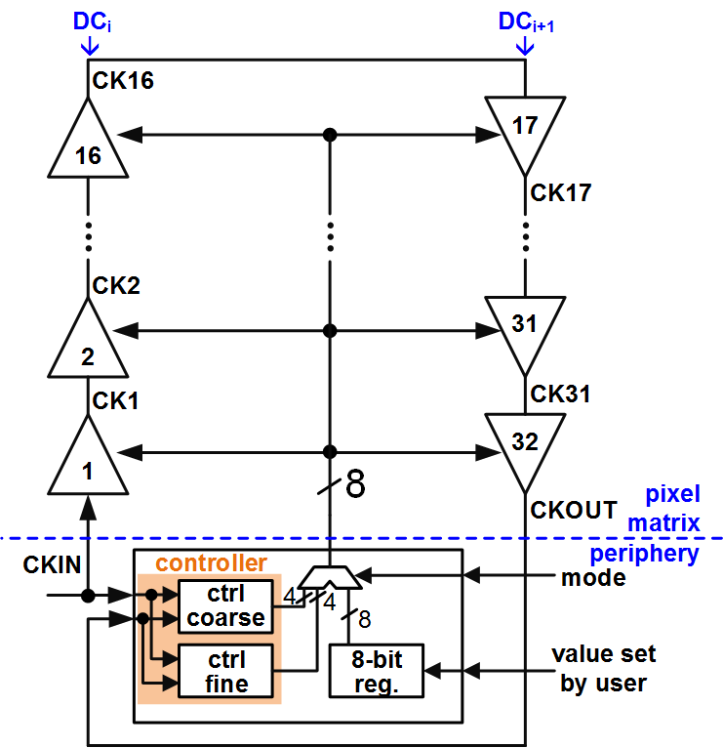
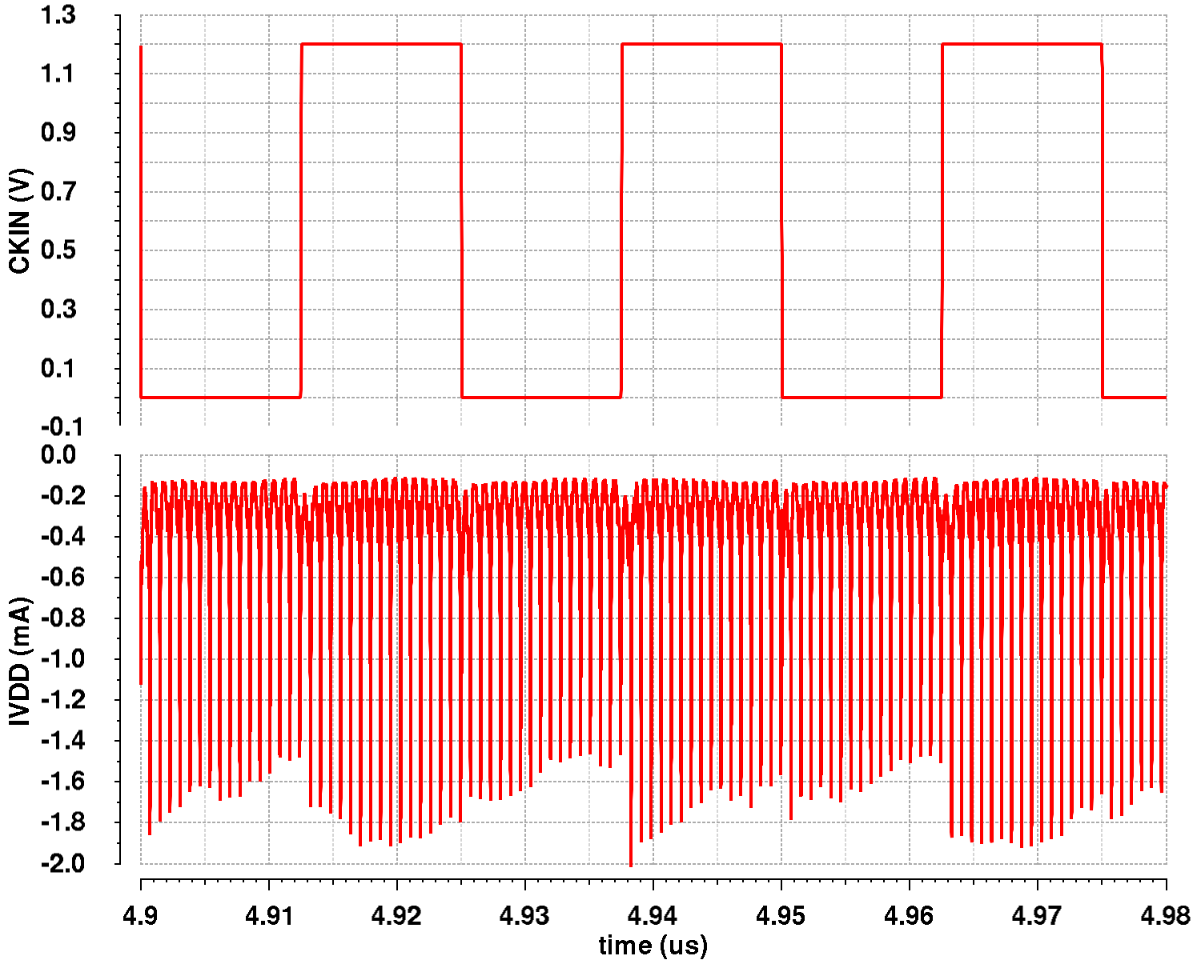
Full digital double column DLL
[448 dDLL: 224 Top Matrix and 224 Bottom Matrix]
iWoRID 2018
X. Llopart et al 2019 JINST 14 C01024
ADB
in
coarse
delay
section
fine
delay
section
out
output buffer
14
15
ctrl_coarse
ctrl_fine
Measured in Timepix4v2
Timepix4 ~23 mW/cm² @40MHz clock with a 100 ps_{rms}
Timepix3 ~100mW/cm² @40MHz clock with ~1.2ns skew
Dynamic digital power consumption is distributed across the clock period

Slide 26

Timepix4 floorplan
256 x 256
55 µm²
(65 Kpixels)
512 x 448 of 55 x 55 µm pixels
  2 Matrices (TOP and BOTTOM)
3 ‘peripheries’ with TSV (Through-Silicon-Vias):
  TOP, BOTTOM (TSV, WB): Data Readout (16x 10.24 Gbps Serializers)
  CENTER (TSV): Analog Blocks (DACs, ADC, Band-Gap…)
On-chip bump to pixel redistribution layer (RDL):
  Pixel matrix pixels are shorter (51.4 µm) than sensor pixels (55 µm)
  Equalized Cin for all pixels → ~46 fF increase for a 460 µm periphery
Edge peripheries include 1mm Wire Bond Extender
Dicing options:
  With WB (Wire-Bonds Extenders): 29.96 mm x 24.7 mm
    >93.7% active area (28.16mm x 24.64mm)
  Without WB (TSV Only) : 28.22 mm x 24.7 mm
    >99.5% active area (28.16mm x 24.64mm)
    Through Silicon Vias (TSV) requires post processing at wafer level to create TSV and on the ASIC back sides RDL + BGA pads
Timepix3
Periphery
24.64 mm
WB Extender
TOP Periphery + TSVs
TOP Matrix
256 x 448
55 µm²
28.16 mm
CENTER Periphery + TSVs
BOTTOM Matrix
256 x 448
55 µm²
Timepix4
BOTTOM Periphery + TSVs
WB Extender

Slide 27
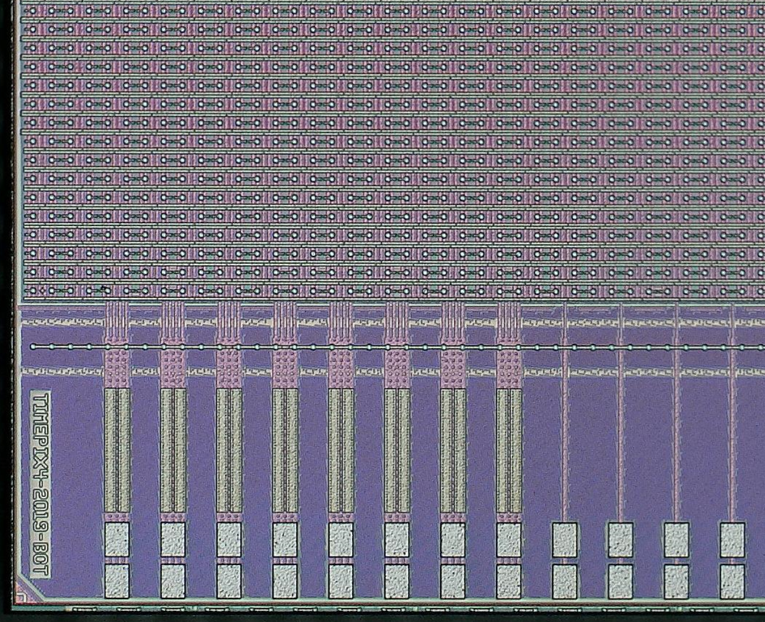
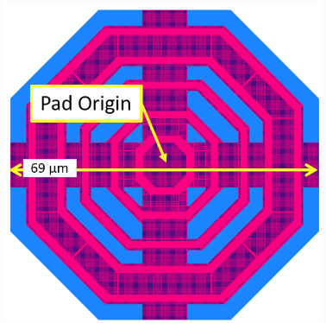
Timepix4 Bottom left detail
BOTTOM Matrix
BOTTOM Periphery
TSVs landing pads in M1
460 µm
Dicing lane #1
BOTTOM
WB Extender
Dicing lane #2

Slide 28
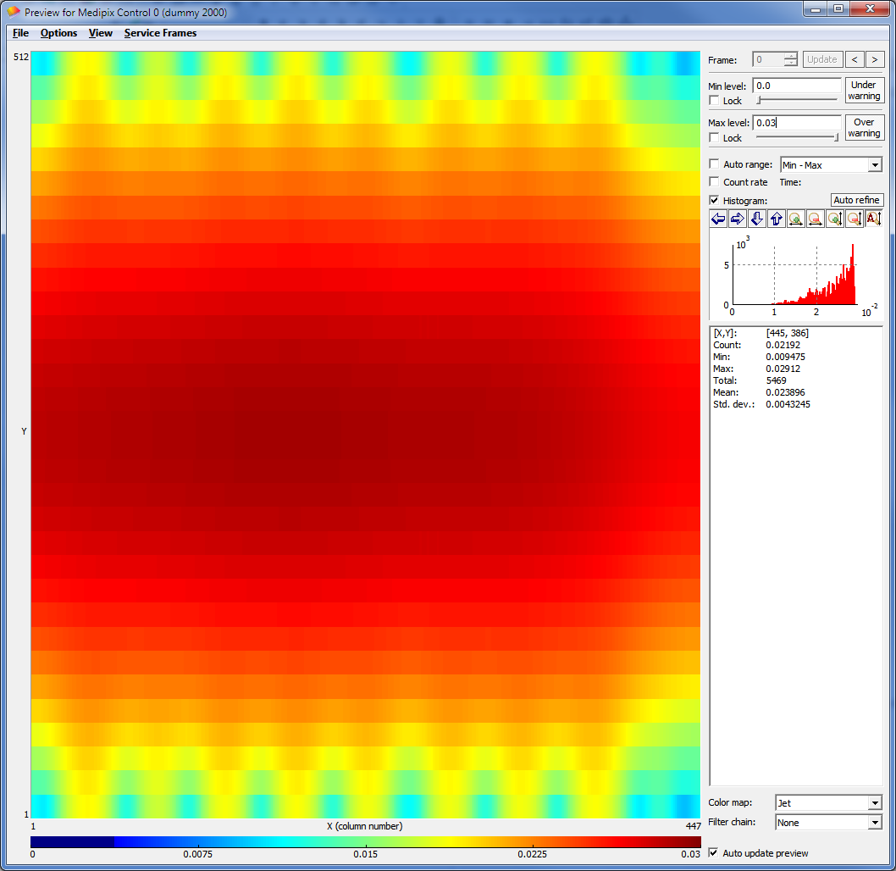
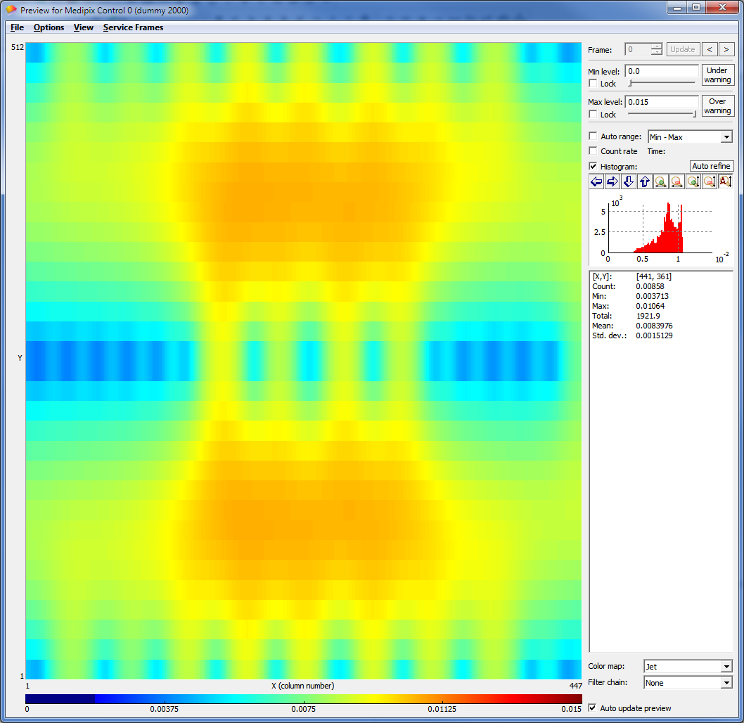
Analog (static) power supply distribution
 | Total I (chip) |  | 2 WB | 3 TSV
Nominal Analog Power [10 µA/pixel] | ~2300 mA | V_{drop} [VDDA-GNDA] | 19.6 mV | 6.9 mV
 |  | Imax pad | 60 mA | 57 mA
Low Analog Power [1 µA/pixel] | ~230 mA | V_{drop} [VDDA-GNDA] | 1.96mV | 0.69mV
 |  | Imax pad | 6 mA | 5.7 mA
2 wire bonds
3 TSV

Slide 29
Timepix4 submissions
Timepix4v0
Full mask engineering run
6 wafers received
Timepix4v1
4 BEOL masks changed
Small test VCO chip
6 wafers received
Timepix4v2
4 FEOL + 4 BEOL masks changed
19 wafers received
Timepix4v3
2 BEOL masks changed
25 wafers received
Q4 2019
Q3 2020
Q2 2021
Q3 2022
Chip is operational
Improved RDL shielding in peripheries
640MHz in peripheries recovered
TDC and High speed links working as expected
Further improvement in RDL shielding in peripheries
Chip at its final version
Larger IO Pads
Chip at its final version
Excess noise coupling from peripheries to FE
640 MHz clock in edge peripheries
VCO not oscillating at nominal frequency
VCO not oscillating at nominal frequency

Slide 30
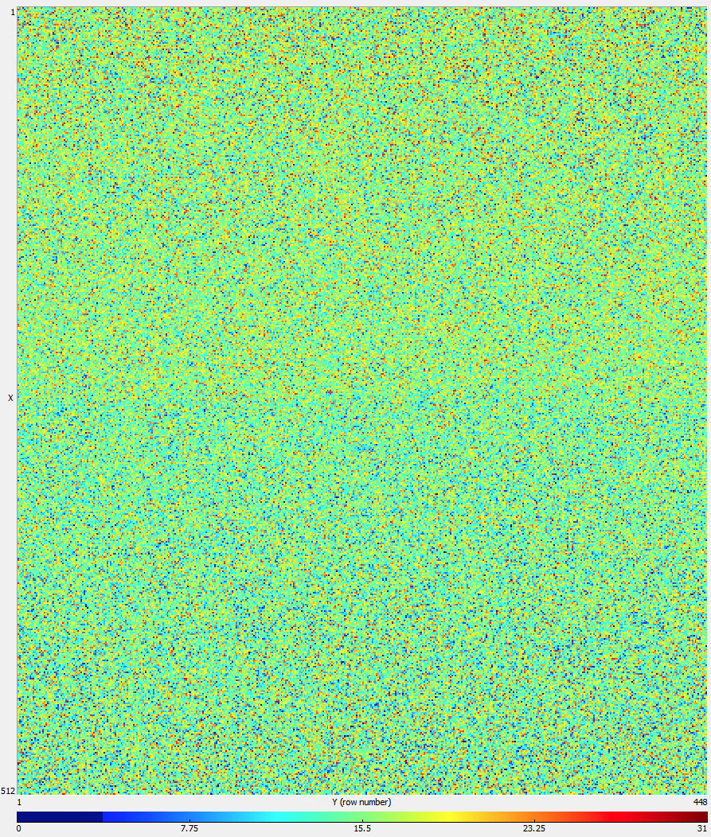
Uniformity of response Timepix4 (all versions)
(a)
Threshold adjustment bits

Slide 31
Gain slopes for different FE Gain
[TOA-TOT, few pixels]
Hole collection
Electron collection
High gain mode
~35.8 mV/ke-
High gain mode
~34.5 mV/ke-
Low/LOG gain mode
~20.5 mV/ke-
Low gain mode
~20.5 mV/ke-
kh⁺
ke⁻

Slide 32
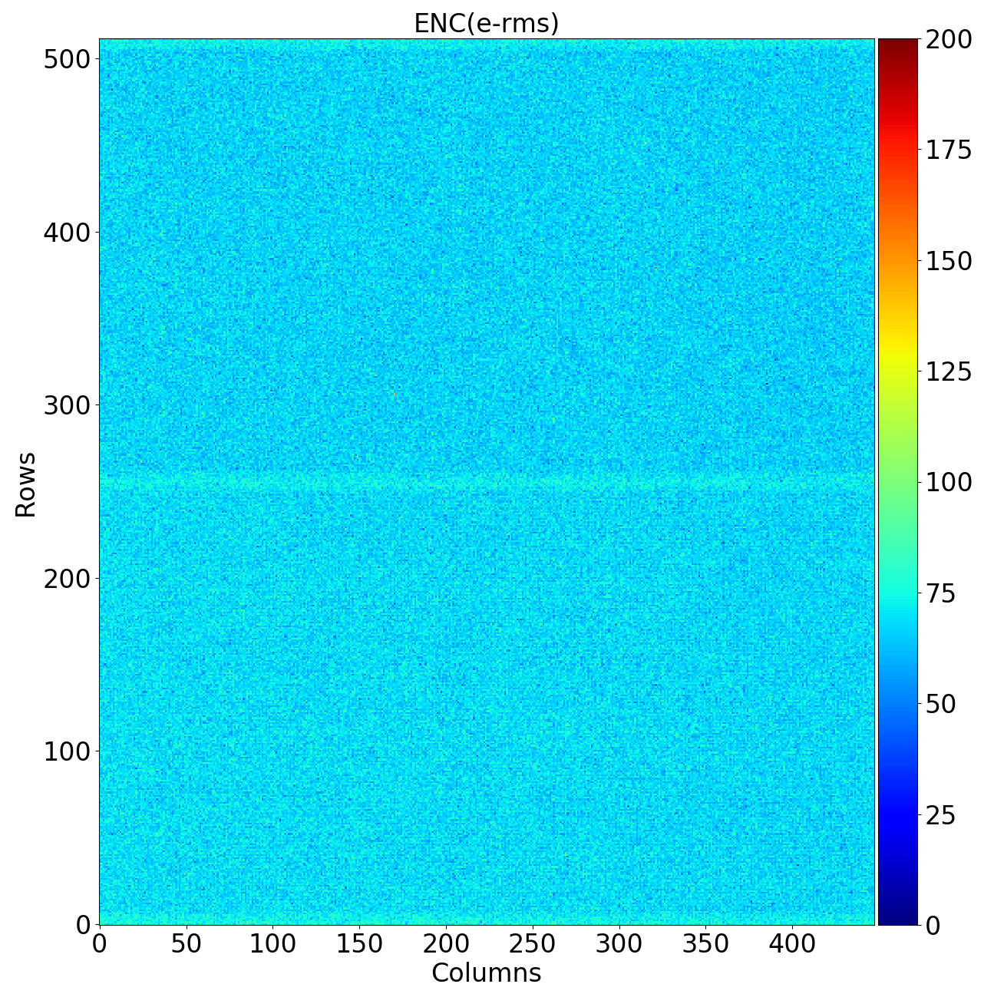
Noise uniformity - Timepix4v0, v1 and v2
v2
When a Si sensor is attached the noise slightly increase ~3e⁻ / pixel

Slide 33
Timepix4v1 and v2: Number of Noisy pixels (>1 count)
Data-Driven mode [DD]
Less than 40 noisy pixels @ 550 e-

Slide 34
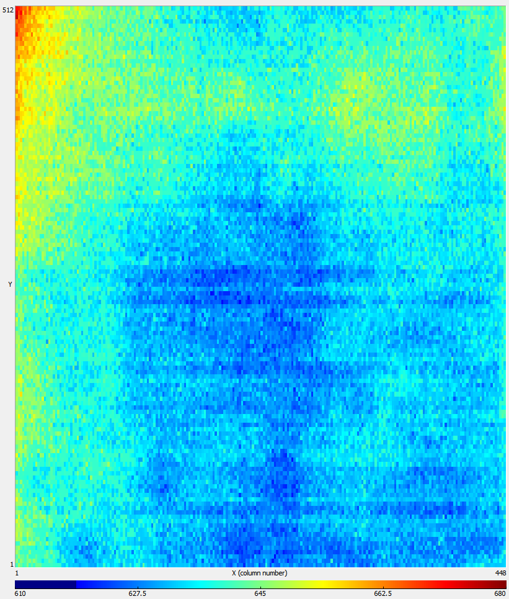
Timepix4v2 2D VCO frequency distribution
Measured VCO oscillation frequency in Timepix4
Calibration is required in order to get to the designed time resolution (~60psrms)
How could this be improved/simplified?
Mean=639.5 MHz
σ=6.6 MHzrms

Slide 35
TOA Resolution
[TOA-TOT, 1 pixel, 10000 samples, HG e-]
Digital TestPulse
TOA resolution
TPulse=2 ke-
Timepix3 TOA resolution limit
TPulse=15 ke-

Slide 36
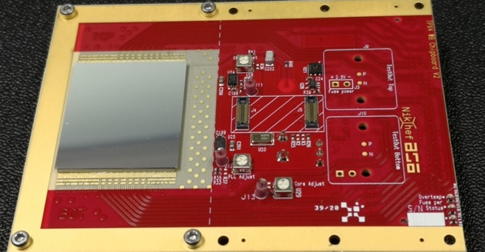
Timepix4 assembly (300μm Si sensor)

Slide 37
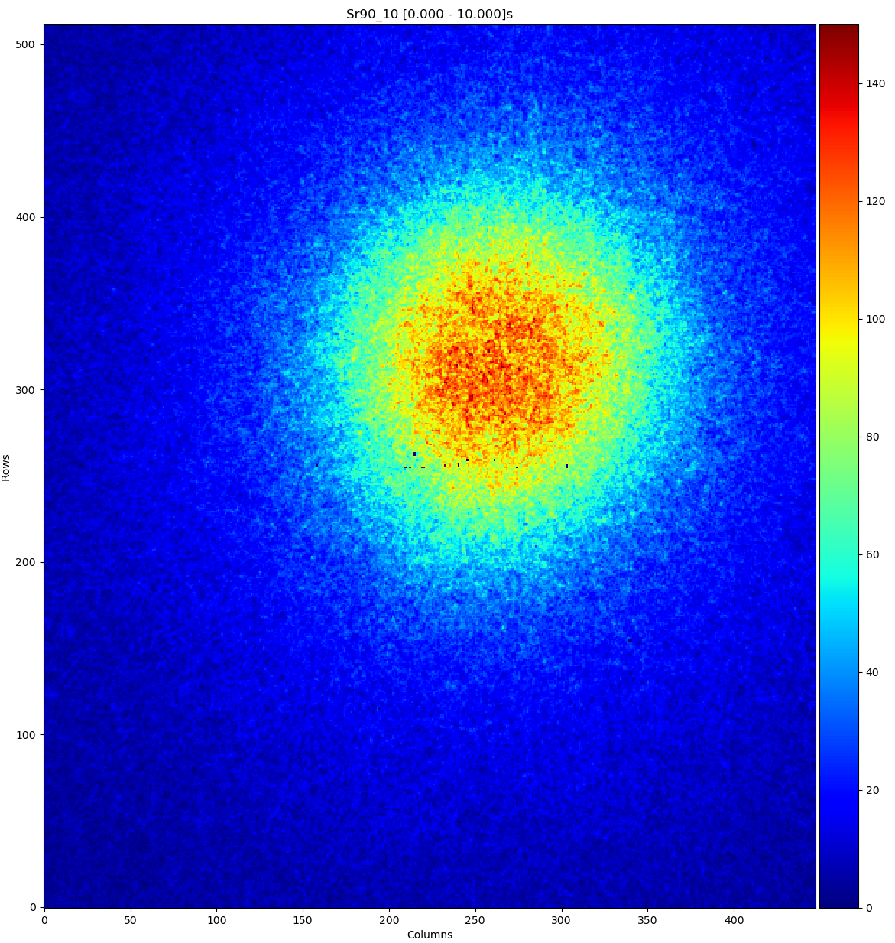
Data driven mode
10s exp. ⁹⁰Sr
Threshold ~ 800e⁻
6.1 M packets @ 5 Gbps

Slide 38
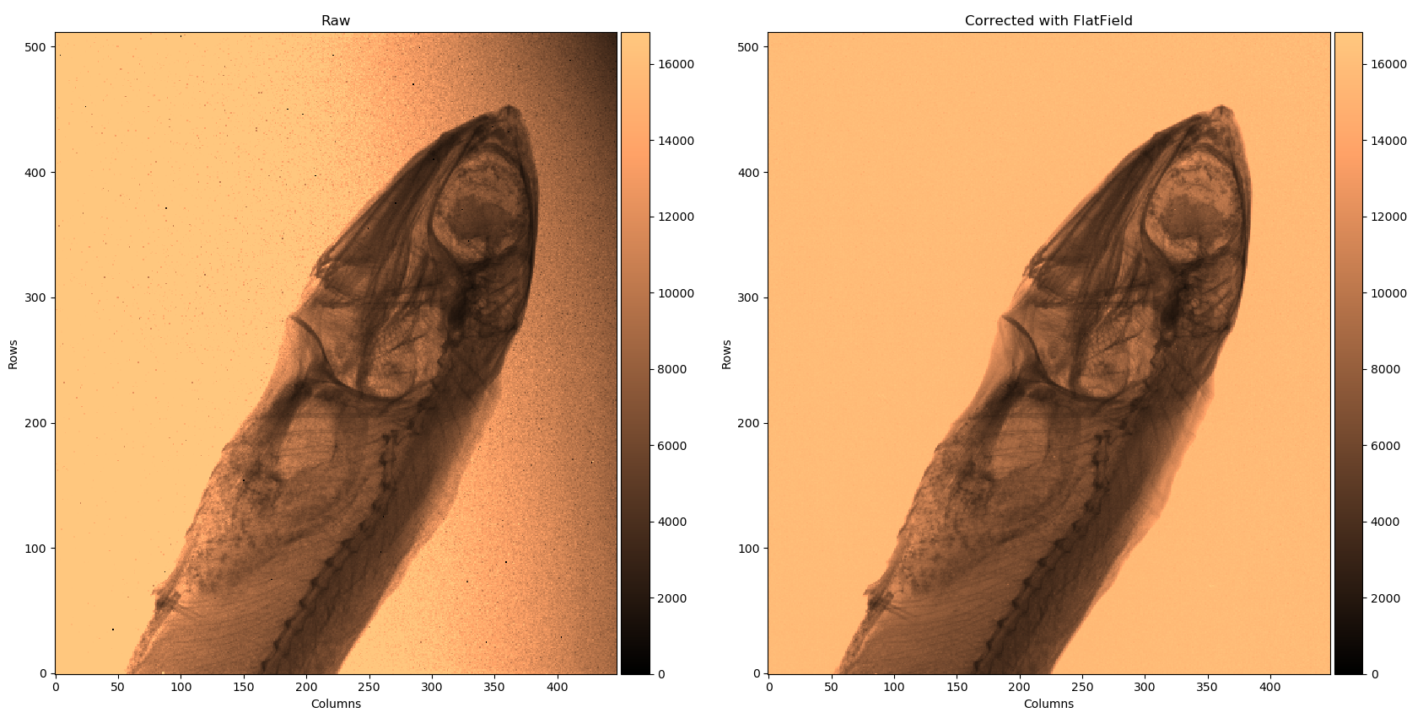
Photon counting image Timepix4

Slide 39
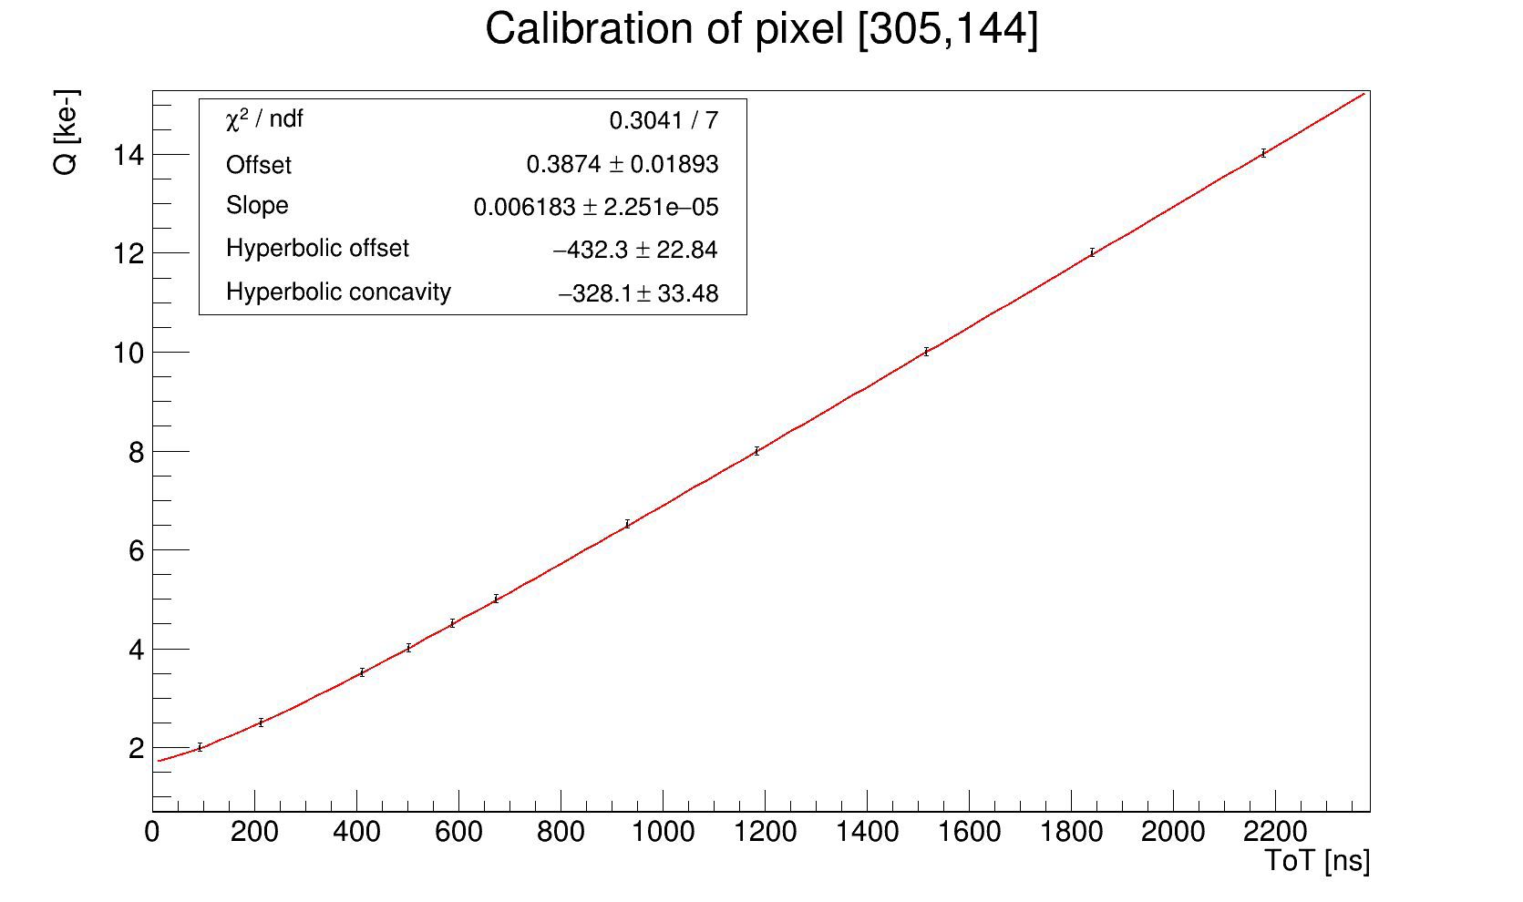
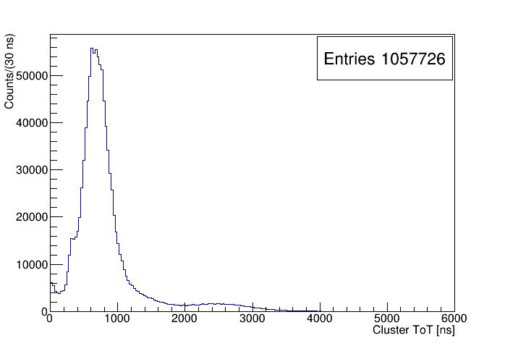
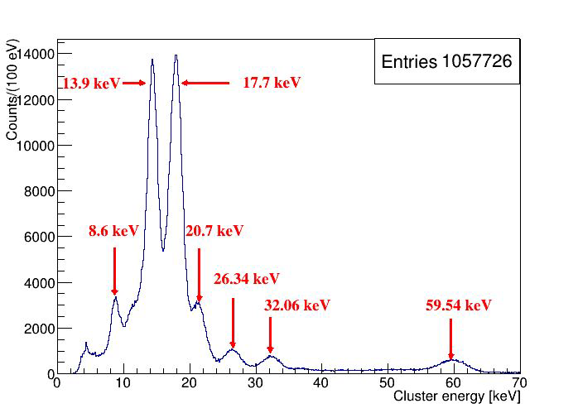
Energy calibration using test pulses
R. Bolzonella et al., TIPP Cape Town, 4-8 Sept
Under submission to JINST
Per-pixel energy vs ToT calibration using test pulses
¹³⁷Cs and ²⁴¹ Am
All pixel clusters
¹³⁷Cs and ²⁴¹ Am
All pixel clusters
After test pulse
calibration

Slide 40
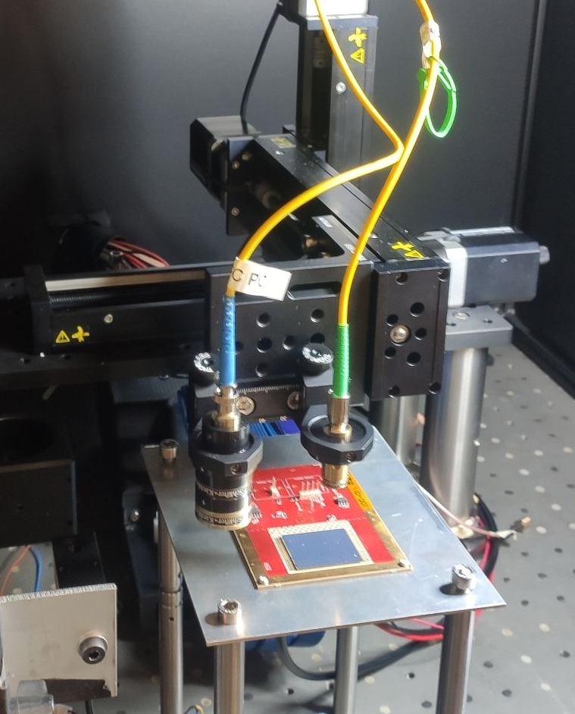
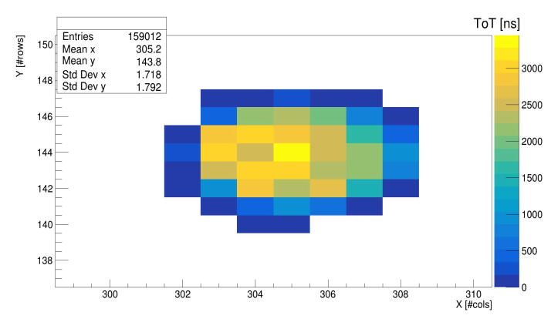
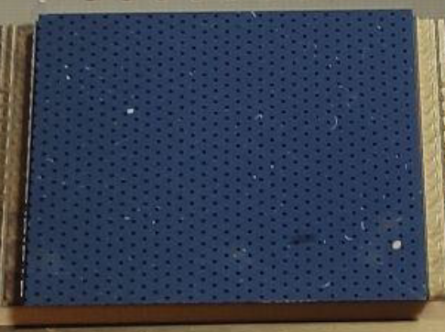
Timing test setup with laser
σ = 1.4 pixel = 77 μm
most of the charge is released in 4-5 pixels
Wide range of released charge covered
Rear side metallization with holes
Timepix4V2 bonded to a 100μm thick n-on-p Si detector:
Biased at -150 V
1020nm laser pulsed with 6ps jitter generator
Generator connected to electrical test pixels
R. Bolzonella et al., TIPP Cape Town, 4-8 Sept
Under submission to JINST

Slide 41
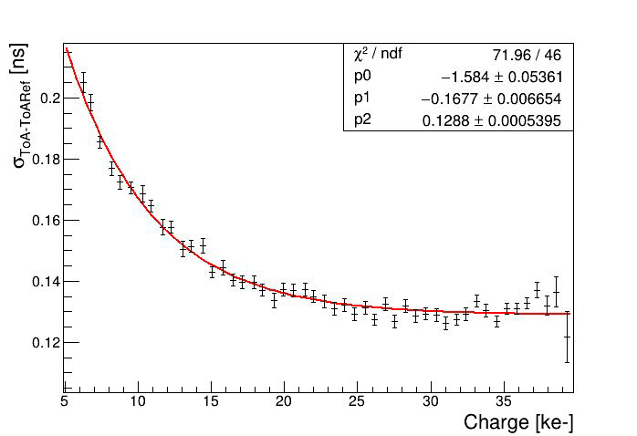
Single pixel pulse resolution
R. Bolzonella et al., TIPP Cape Town, 4-8 Sept
Under submission to JINST
For the pixel [305,144], where the laser is focused, the standard deviation saturates at 129±1 ps rms
Subtracting the contribution of the reference TDC (60 ps), a resolution of 111±1 ps rms is obtained
Timing resolution dependency on cluster charge best result: σ_{ToADiffAvg}=79 ± 1 ps rms
Timing resolution subtracting reference TDC contribution: σ_{ToAAvg}=49 ± 1 ps rms

Slide 42
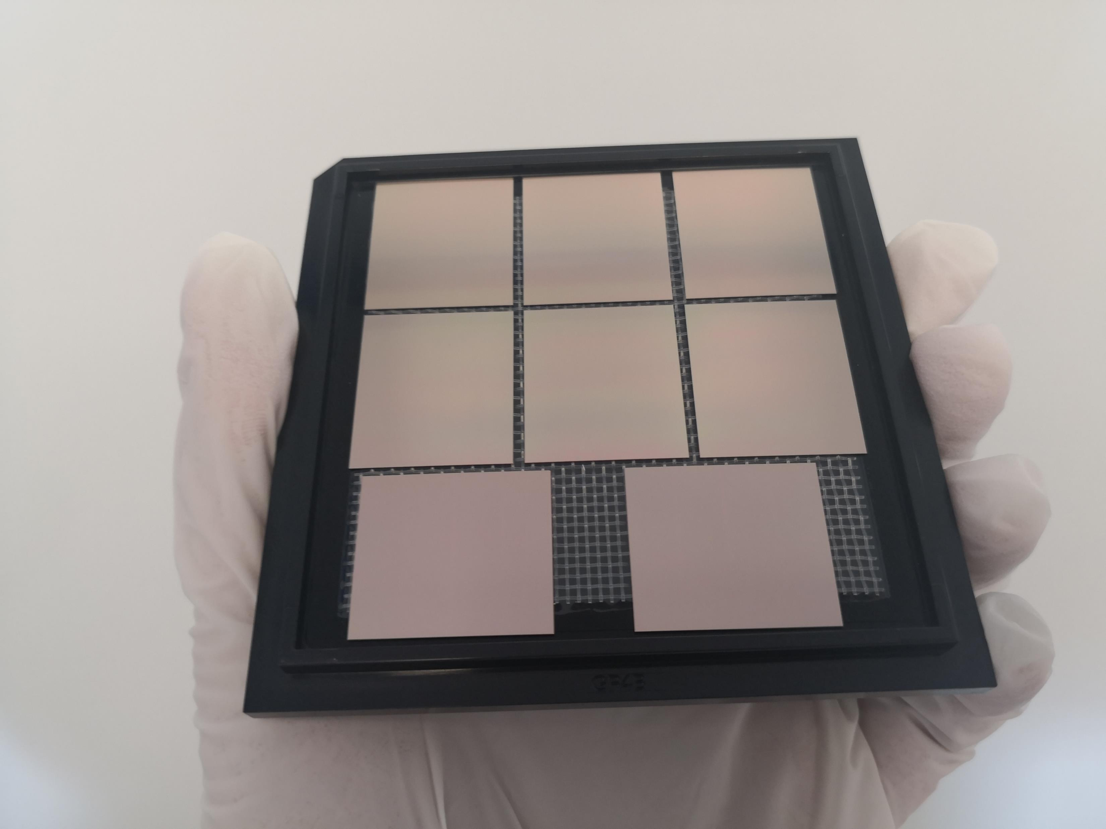
June 2023 – TSV processes TPIX4v0 delivered

Slide 43
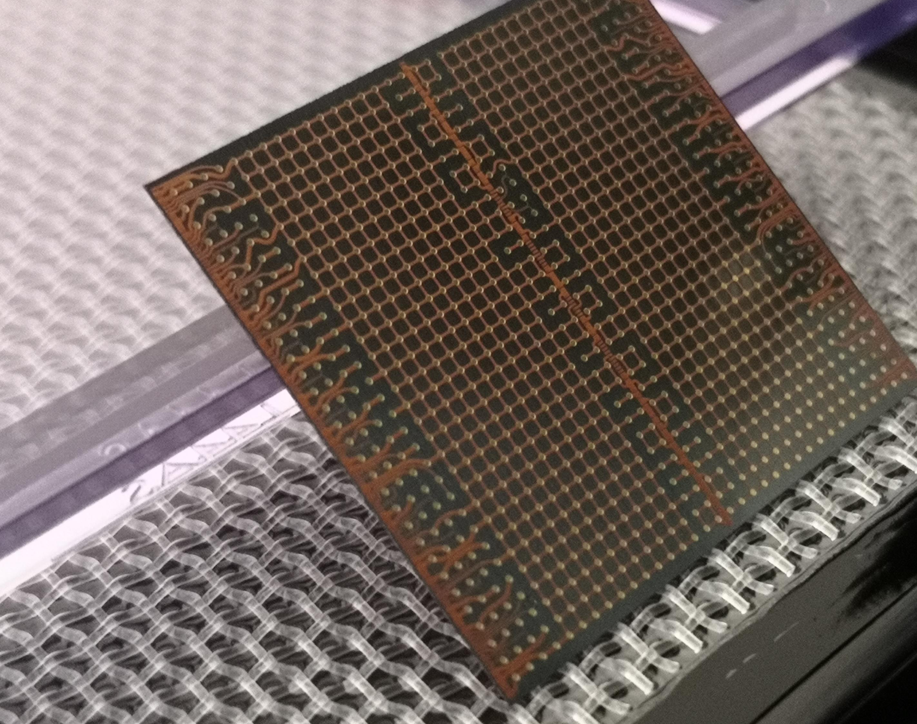
Rear side Re-Distribution Layer (RDL)

Slide 44

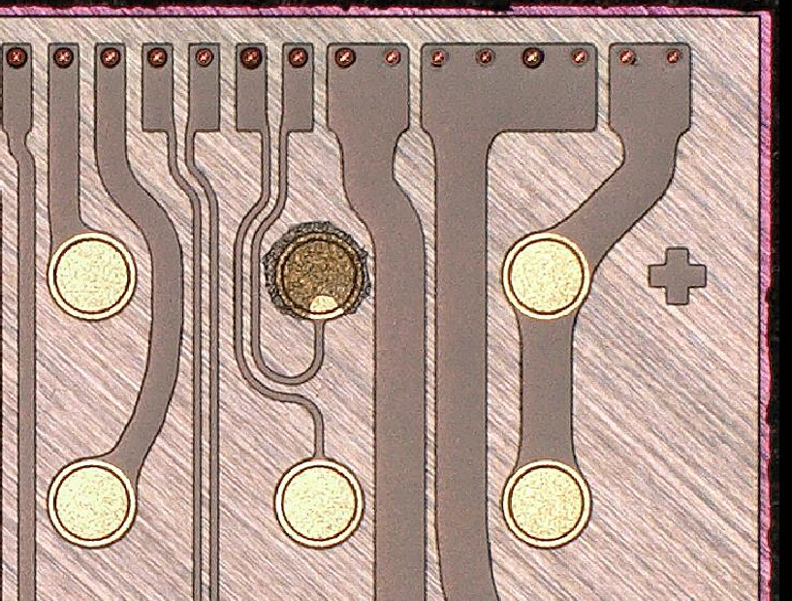


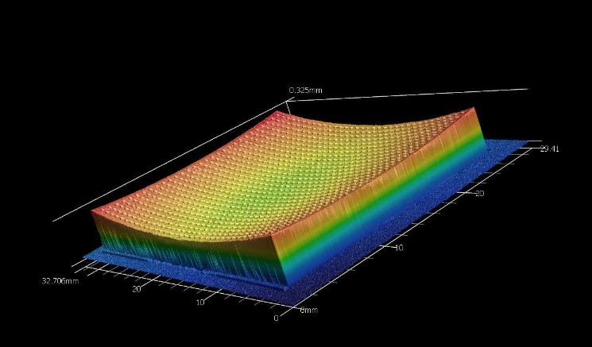
Visual Inspection – front and rear side
Redistribution Layer
1020 BGA pads
TSV
Residues of dicing tape
Pixel side
Back Side
Front Side
Chip bow ~ 100μm (over 3cm)
Magnified bowing (the chip is thin: ~120μm)
/14

Slide 45
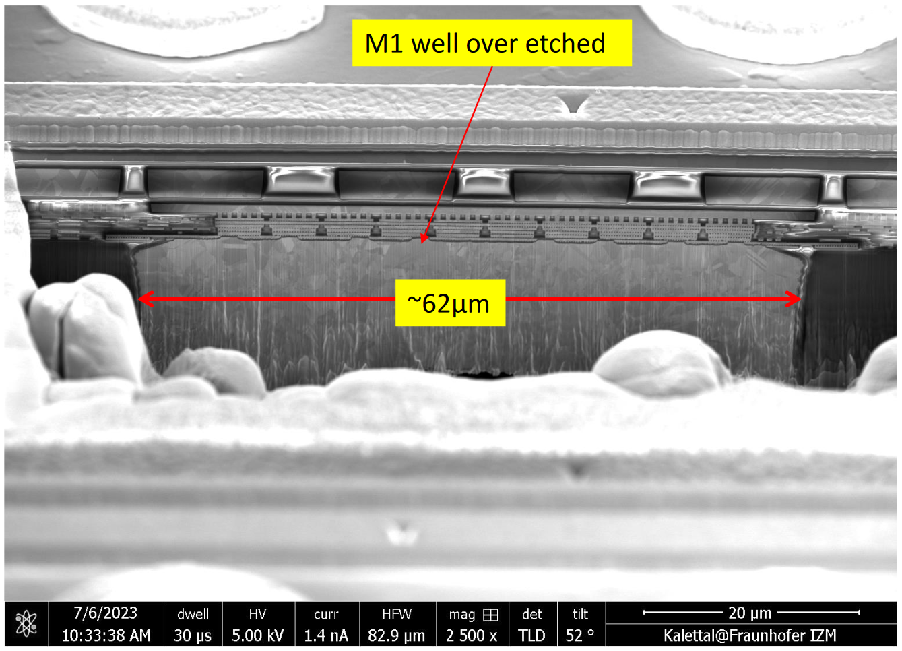
Inspection with Electron Microscope of one TSV
Pixel pads
Landing pad of the TSV
Bottom of the TSV
Courtesy of IZM
/14

Slide 46
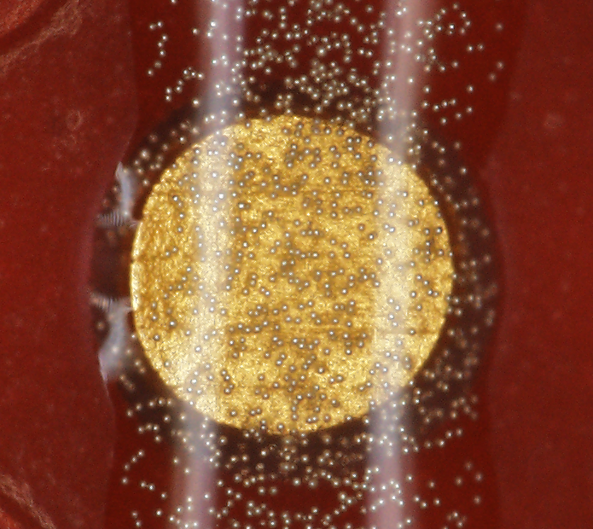
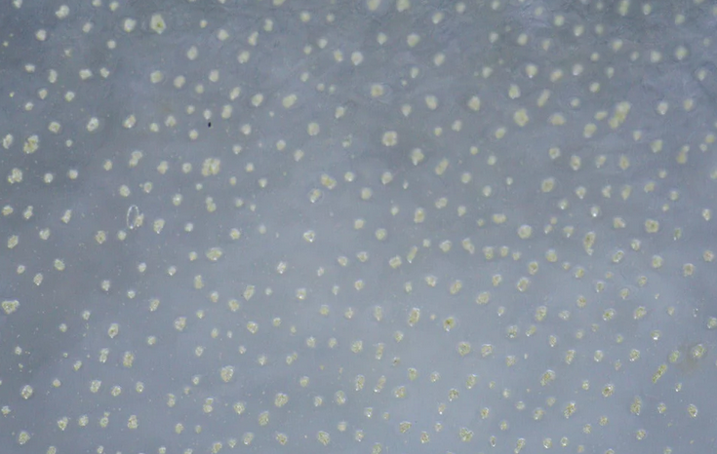
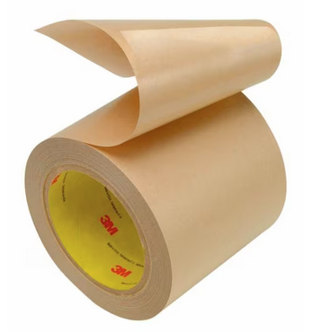
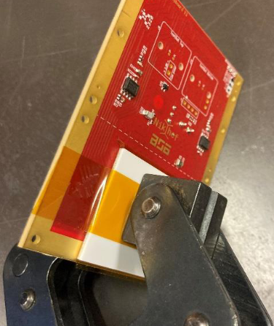
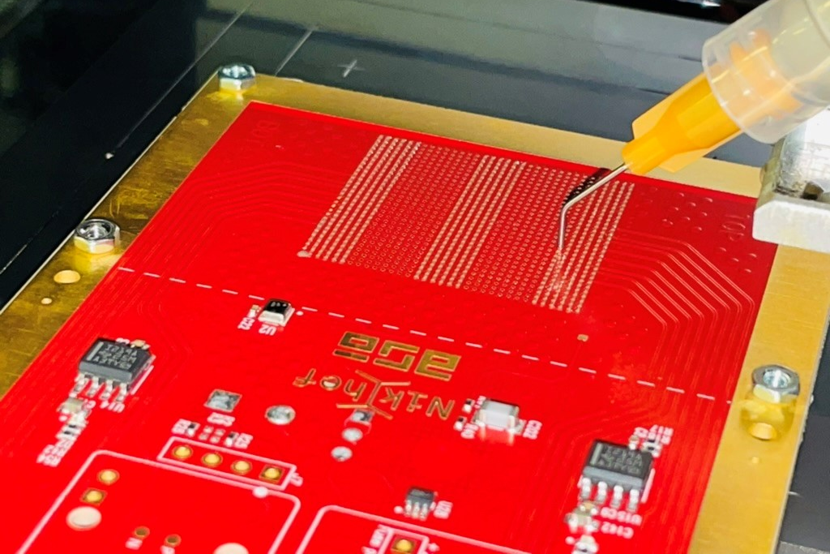
Mounting of TSV processed chips on Nikhef carrier board
ACF: Anisotropic Conducting Film
ACP: Anisotropic Conducting Paste
Araldite with conducting particles
Done at UniGe (Mateus Vicente Barreto Pinto m.vicente@cern.ch)
Flip chip bond machine
Conductive particles
Pressure needed
Temporary bonding
3M
We could communicate with the chip, test the DAC…
After releasing the clamp and putting it again, chip not responding, maybe due to reusing the tape.
Work in progress
Results Timepix4V0:
Good communication with the chip
Promising low cost approach

Slide 47
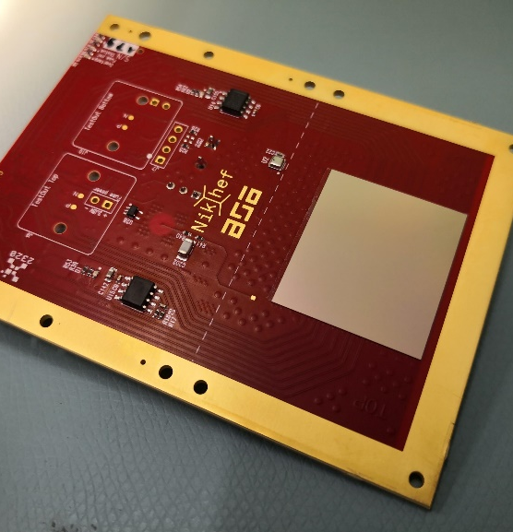
TSV-processed successfully mounted
Chip behaves identically to a wire bonded version

Slide 48
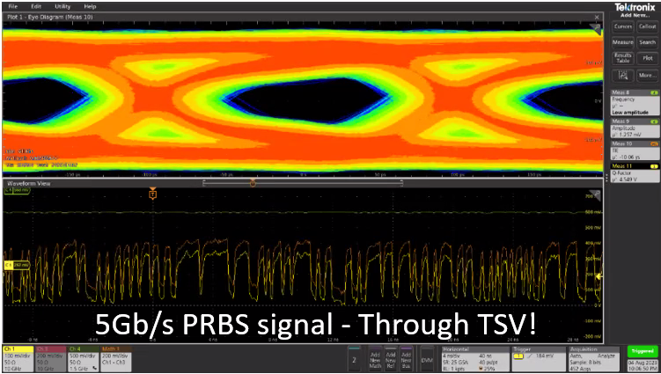
Output from TSV processed Timepix4v0

Slide 49
Medipix3 → Medipix4
 | Medipix3RX (2013) | Medipix4 (2022)
Technology | CMOS 130nm | CMOS 130nm
Pixel Size | 55/110 µm | 75/150 µm
Matrix Size | 256 x 256 / 128 x 128 | 320 x 320 / 160 x 160
Tile-ability | 3-side | 4-side buttable
Thresholds | 1/4 Continuous RW | 2/8 Continuous RW
Readout scheme | Sequential RW & Continuous RW
Count Rate (10% deadtime loss) | 4.3 x 10⁶ ph/mm²/s (CSM 110) | 19 x 10⁶ ph/mm²/s (CSM 140)
Dynamic Range | 25 Ke- | 32 Ke-
CSM energy resolution (FWHM) | ~ 4.4 KeV (CSM 110) | ~ 2.5KeV (CSM 150)
Readout bandwidth | <1.6 Gbps (8x LVDS) | 1,2 Serializers @5.12 or 2.56 Gbps
Power | <1W @1.5V | <1W/cm² @1.2V
Status: Medipix4 chip first version under test – bugs being addressed

Slide 50
Conclusions
Hybrid pixel detectors offer unique solutions for X-ray and gamma-ray imaging and have found widespread applications
The Timepix4 (and Medipix4) chips are designed explicitly for tiling in 2 dimensions using Through Silicon Vias for IO
Measurements with Timepix4 in data driven mode are consistent with the design values
Single pixel time resolution is ~111ps rms
TSVs have been successfully implemented on Timepix4v0 and the chip behaves as normal
Future work includes demonstrating a large area implementation with minimal dead area

Slide 51
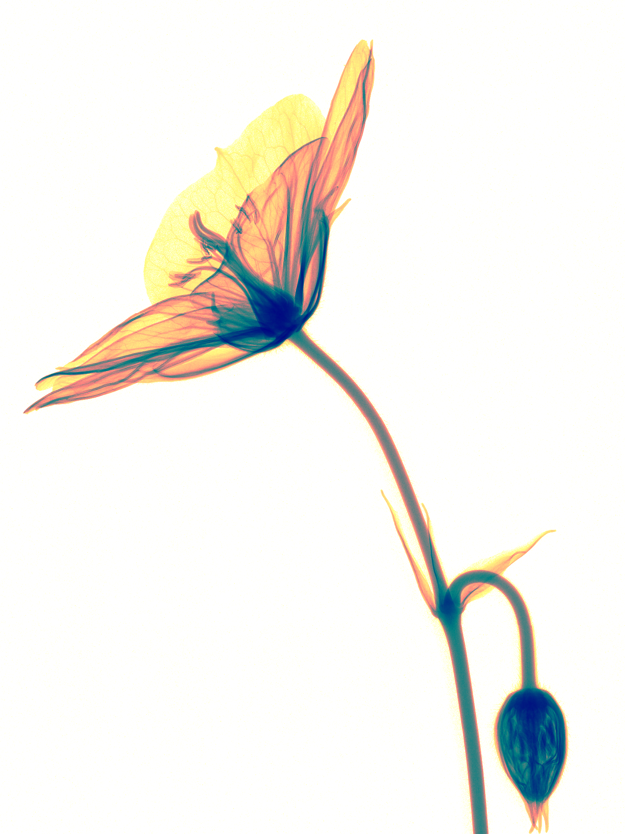

Thank you for your attention!
Medipix3RX images: S. Procz et al.

