Slide 1
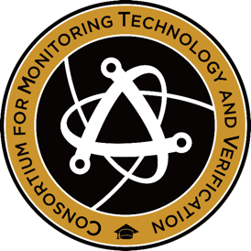
Applications in Security and Environmental Imaging
PSD 13 Keynote
September 8, 2023
Prof. Sara A. Pozzi
University Diversity and Social Transformation Professor
Director, Consortium for Monitoring, Technology, and Verification
Director, Diversity, Equity, and Inclusion, College of Engineering
University of Michigan

Slide 2
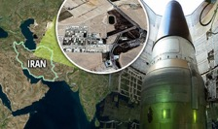
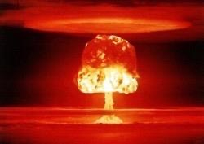
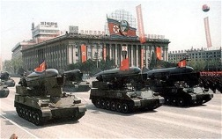
Motivation
Preventing the further spread of nuclear weapons and related technology is paramount to our national security
Recent world events have significant impact on the nonproliferation landscape
  North Korea nuclear weapons program and recent rocket tests
  Possible revival of the Joint Comprehensive Plan of Action with Iran
  Russia/Ukraine war putting nuclear facilities and nonproliferation at risk
Timely detection of nuclear proliferation requires a deep understanding of the associated signatures and technology
S. A. Pozzi, Applications in Security and Environmental Imaging

Slide 3
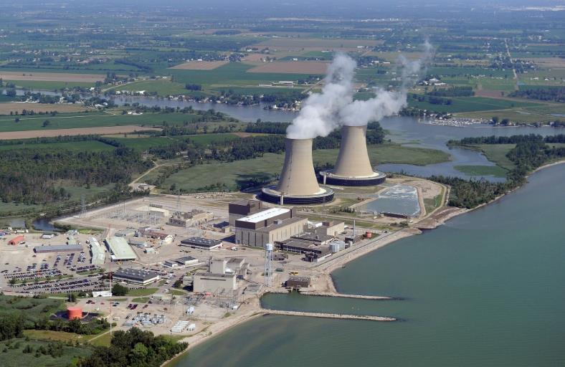
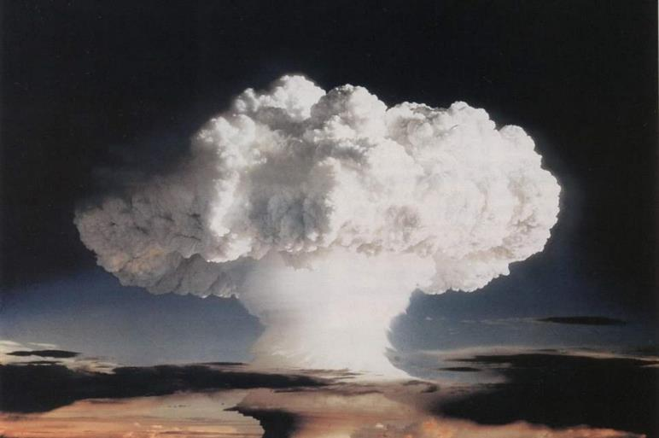
Dual Use Technology
Enrico Fermi Nuclear Power Plant, Michigan, USA
Ivy Mike, the first successful hydrogen bomb, USA, 1952
A tension exists between the pursuit of nuclear energy and the effort to prevent the spread of nuclear weapons.
S. A. Pozzi, Applications in Security and Environmental Imaging
Notes:
3
A tension exists between the pursuit of nuclear energy and the effort to prevent the spread of nuclear weapons

Slide 4
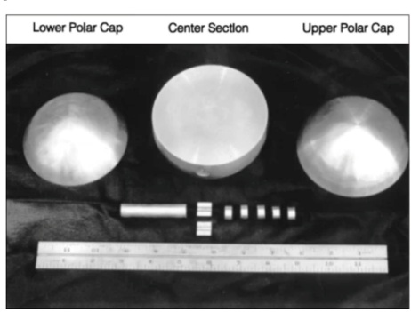
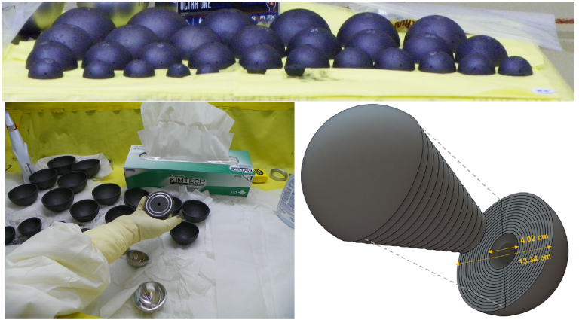
Special Nuclear Material (SNM)
Plutonium assembly
Plutonium sphere
plutonium
uranium-233
uranium enriched in the isotope 235 by more than 20%
Necessary component of nuclear weapons
Highly-enriched uranium shells
S. A. Pozzi, Applications in Security and Environmental Imaging

Slide 5
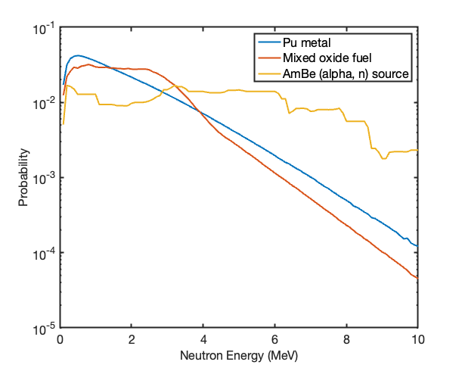
Neutron Energy Spectra
Emitted neutron energy spectra
Various nuclear material forms can be distinguished by their neutron energy spectra
Neutron emitted from industrial sources such as AmBe or PuBe (alpha, n) reactions have a higher average energy than those from fission
(alpha, n)
Fission and (alpha, n)
Fission
S. A. Pozzi, Applications in Security and Environmental Imaging

Slide 6
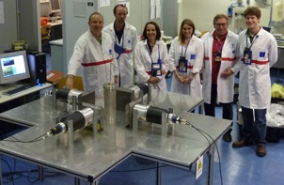
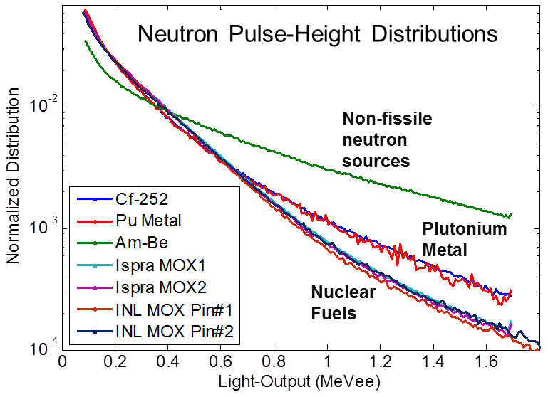
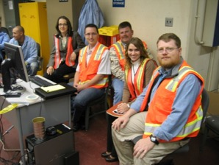
Detecting SNM Signatures
Distinguishing Pu Metal from Other Neutron Sources
* Measurements using liquid scintillators at INL(2009) and JRC-Ispra (2010)
Joint Research Centre, Ispra Italy
Idaho National Laboratory
J. L. Dolan, M. Flaska, A. Poitrasson-Riviere, A. Enqvist, P. Peerani, D. L. Chichester, S. A. Pozzi, “Plutonium measurements with a
fast-neutron multiplicity counter for nuclear safeguards applications”, Nucl. Instr. Meth. A 763, 565-574 (2014).
S. A. Pozzi, Applications in Security and Environmental Imaging

Slide 7
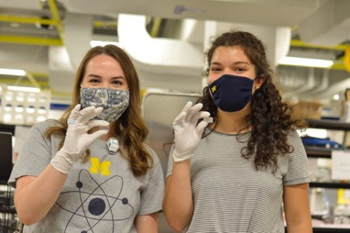
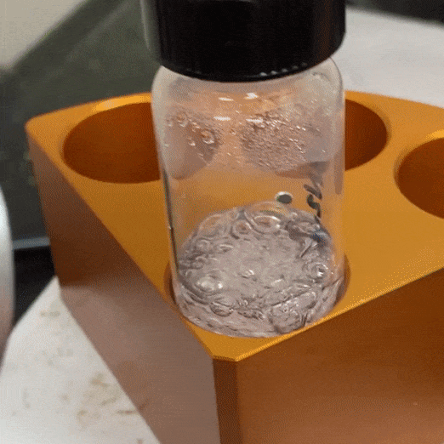

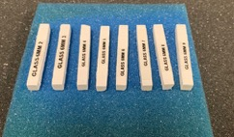
Organic Glass Scintillators for Radiation Detection
Glass heating and degassing
Novel organic glass (OGS) compound recently developed by Sandia National Labs and a casting facility has been developed at UM
This OGS has demonstrated high light-output and excellent detection efficiency relative to other organic scintillators, such is stilbene
The OGS can be melt-cast into a variety of shapes and sizes, making it suitable for a wide variety of applications
A prototype neutron and gamma-ray imaging system has been developed and tested
Glass bars used in out imaging system
N. P. Giha, W. M. Steinberger, L. Q. Nguyen, J. S. Carlson, P. L. Feng, S. D. Clarke, S. A. Pozzi, “Organic glass scintillator bars with dual-ended readout”, Nucl. Instr. Meth. A 1014, 165676, ISSN 0168-9002 (2021).
S. A. Pozzi, Applications in Security and Environmental Imaging

Slide 8
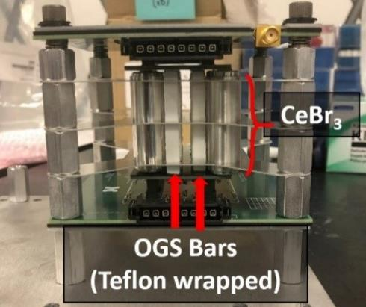
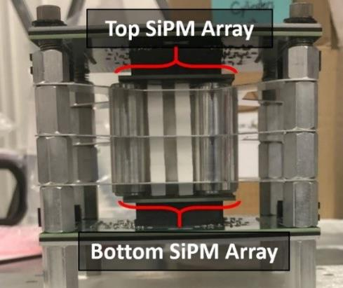
Handheld Dual-Particle Imaging System
Handheld system to detect, localize, characterize neutrons and gamma rays from special nuclear material (SNM)
Detectors are solid scintillation pillars coupled to silicon photomultipliers (SiPMs)
  Combination of inorganic (CeBr) and organic (stilbene or organic glass) scintillators
W. M. Steinberger, M. L. Ruch, N. P. Giha, A. Di Fulvio, P. Marleau, S. D. Clarke, S. A. Pozzi, “Imaging of special nuclear material using a handheld dual particle imager”, Sci. Rep. 10, 1855 (2020).
S. A. Pozzi, Applications in Security and Environmental Imaging

Slide 9
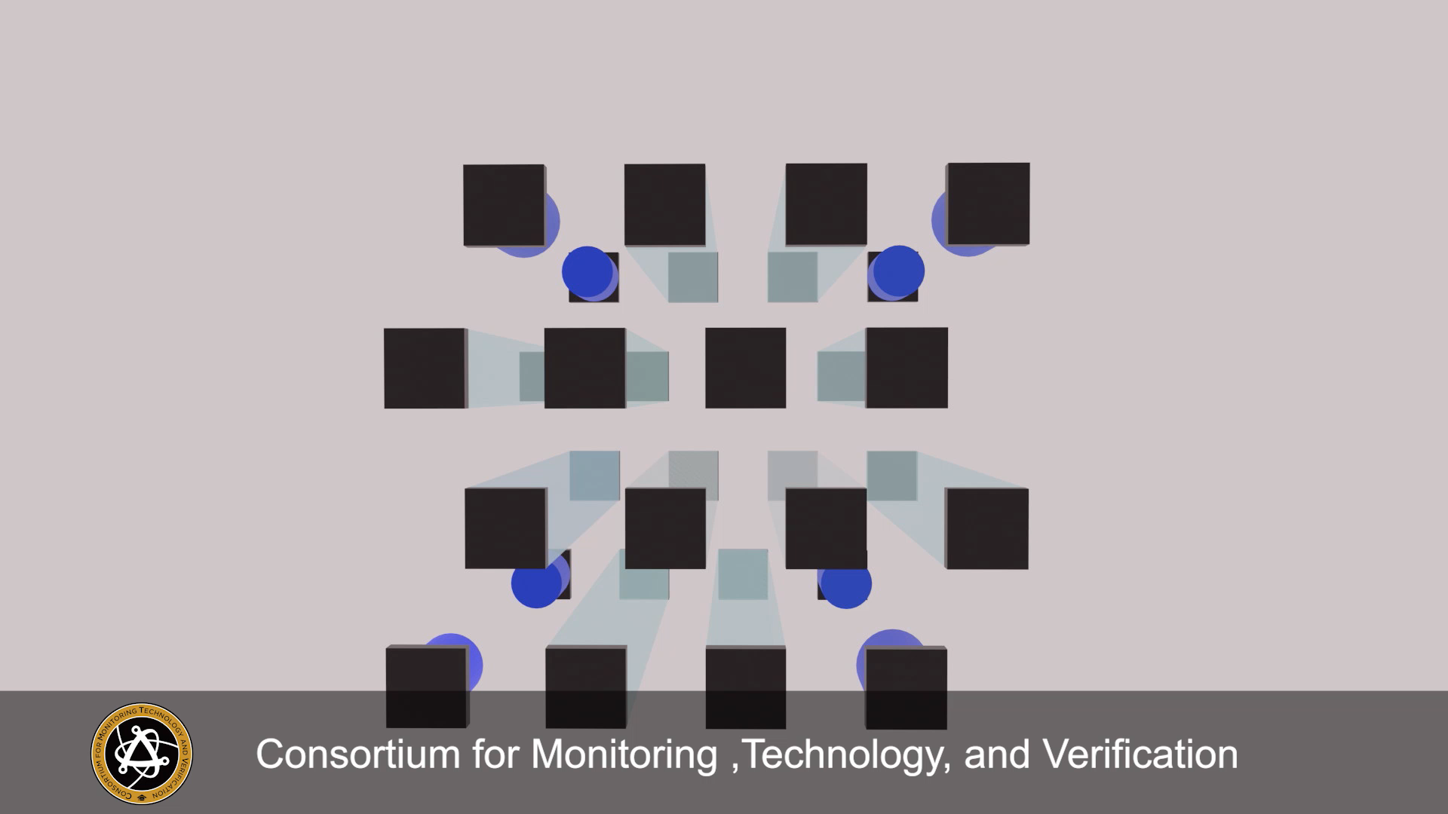

Slide 10
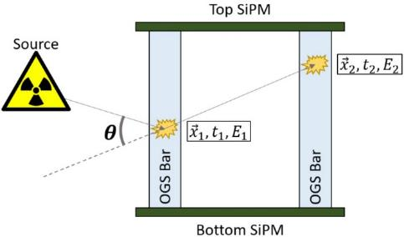
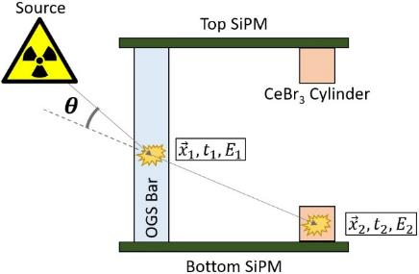
Technical Approach – Imaging
Scatter-based OGS imager consists of:
  12 OGS bars (6x6x50 mm³) w/ diffuse reflector
  8 CeBr₃ (6 mm height, 6 mm Ø) cylinders
  Silicon photomultiplier arrays for output
Reconstruct double scatter events using simple backprojection (SBP)
then apply converging algorithm (LM-MLEM)
Neutron Imaging
(Elastic scattering)
Gamma Imaging
(Compton scattering)
R. Lopez, W. M. Steinberger, N. Giha, P. Marleau, S. D. Clarke, S. A. Pozzi, “Neutron and gamma imaging using an organic glass scintillator handheld dual particle imager”, Nucl. Instr. Meth. A 1042, 167407 (2022).
S. A. Pozzi, Applications in Security and Environmental Imaging

Slide 11
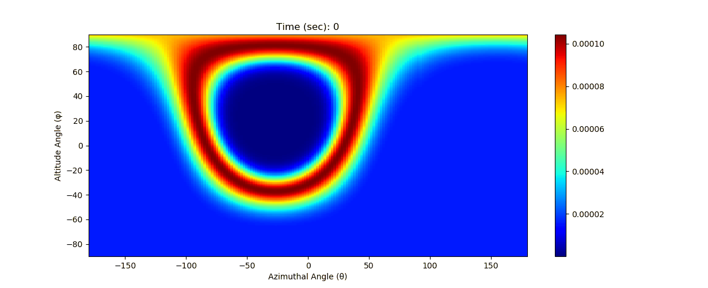
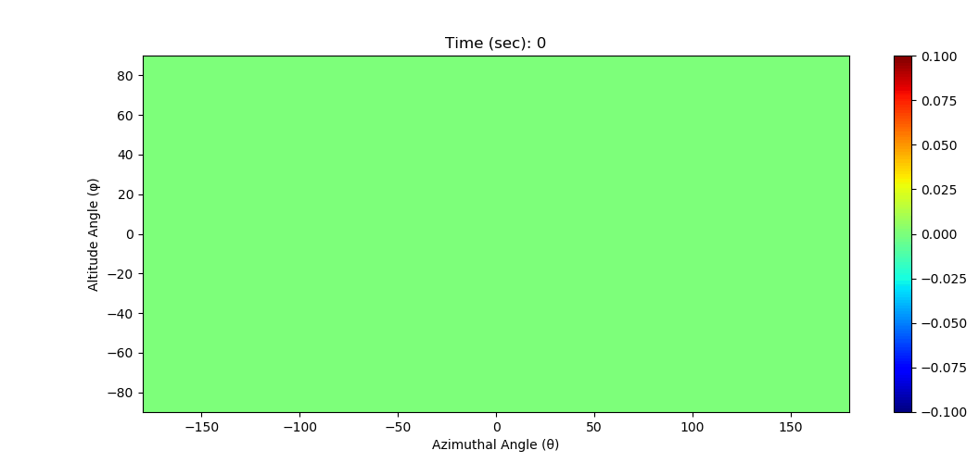
Neutron Imaging – Simple Backprojection
Cone projections are summed to produce a simple backprojection (SBP) image
Measurement of a 6x10⁶ n/s ²⁵²Cf source at 58.4 cm, 10 cone projections in 4.3 seconds
Background neutron measurement
S. A. Pozzi, Applications in Security and Environmental Imaging

Slide 12
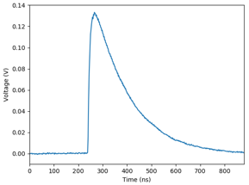
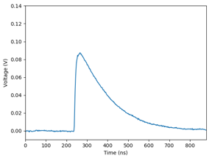
Technical Approach – Data Acquisition
Particle interactions create pulses from each SiPM
Pulse analysis (example)
Particle integral ratio determines axial position
Time stamps are calculated using digital constant fraction discrimination
Differences in these time stamps are used to form coincident detections
S. A. Pozzi, Applications in Security and Environmental Imaging

Slide 13
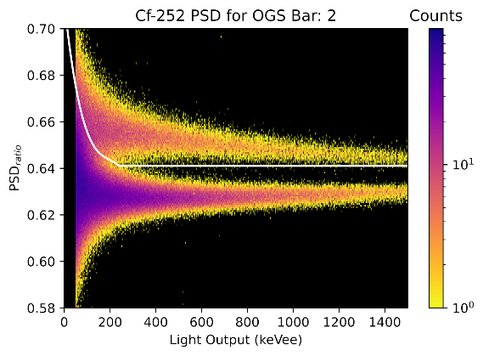
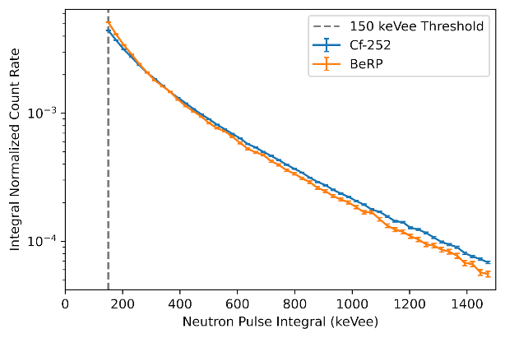
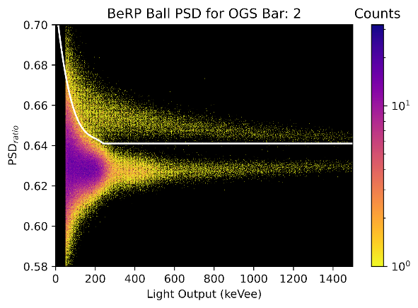
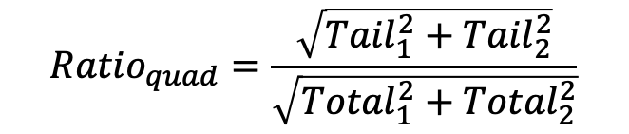
Detecting Neutrons and Gamma Rays
Tail and total integrals are calculated for each of the two SiPM pulses collected for each detected event
A pulse shape discrimination (PSD) ratio is calculated for each detected event
$${Ratio}_{quad}=\frac{\sqrt{{Tail}_{1}^{2}+{Tail}_{2}^{2}}}{\sqrt{{Total}_{1}^{2}+{Total}_{2}^{2}}}$$
S. A. Pozzi, Applications in Security and Environmental Imaging

Slide 14
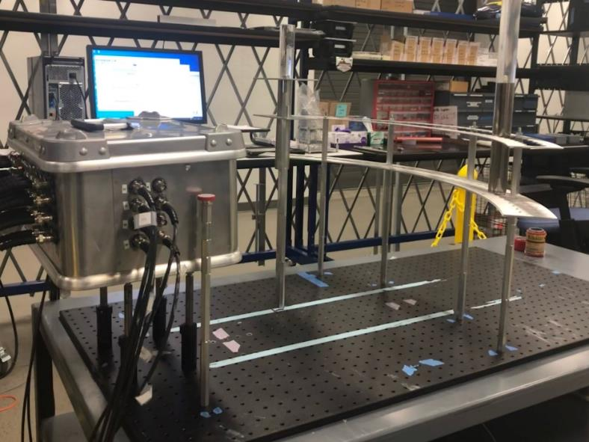
Imaging Multiple Neutron Sources
PuBe
Cf
Cs
θ = -25°
θ = 0°
θ = 25°
Source Location
Actual: (-25°, 0°) & (25°, 0°)
Converged: (-25.14°, 1.51°) & (25.14°, 1.51°)
θ = 90°
S. A. Pozzi, Applications in Security and Environmental Imaging

Slide 15
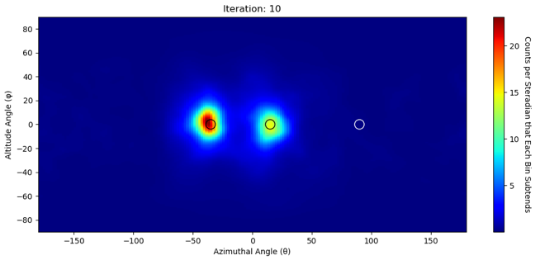
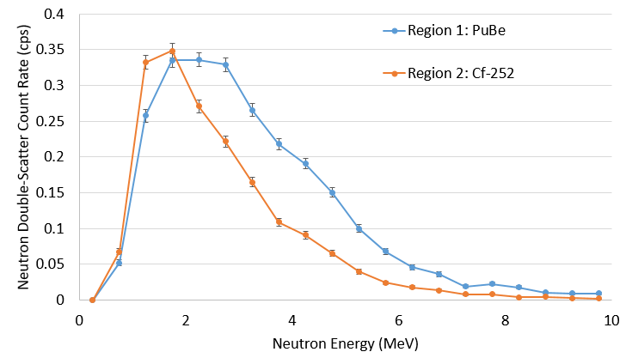

Neutron Spectrometry
H2DPI imaging methodology allows for neutron spectrometry capabilities
Measurement of a 200 µCi ¹³⁷Cs source, 6x10⁶ n/s ²⁵²Cf source and a
1x10⁶ n/s PuBe source in the same field of view
Extracted neutron energy spectra from the ²⁵²Cf ($\left\langle E\right\rangle =2.63 MeV$) and PuBe ($\left\langle E\right\rangle =3.22 MeV$)
Region 1: PuBe
Region 2: Cf-252
S. A. Pozzi, Applications in Security and Environmental Imaging
Notes:
Label the sources and add their locations

Slide 16
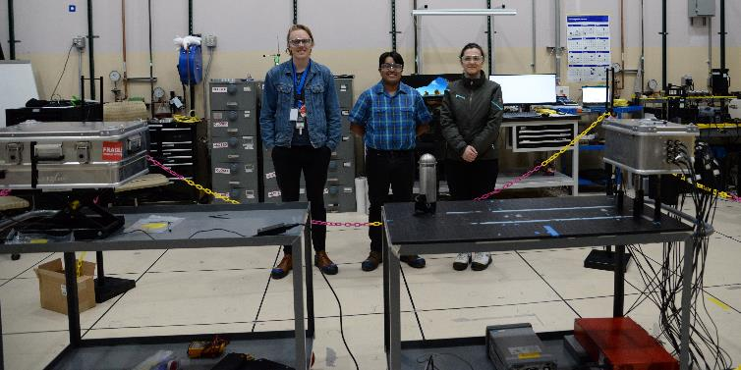
Experiments with Special Nuclear Material
National Criticality Experiments Research Center
The National Criticality Experiments Research Center (NCERC) was founded in 2011 and is located inside the Device Assembly Facility (DAF) at the Nevada National Security Site (NNSS)
The only general-purpose critical experiments facility in the U.S.
Houses a variety of kilogram-quantity,
unclassified special nuclear material
objects
Annual experiments made possible
through our DOE/NNSA-funded consortia
S. A. Pozzi, Z. He, J. Hutchinson, I. Jovanovic, R. Lopez, K. Ogren, J. Nattress, D. Shy, S. D. Clarke, “Detecting and characterizing special nuclear material for nuclear nonproliferation applications”, Nat. Sci. Rep. 13, 10432, (2023).
S. A. Pozzi, Applications in Security and Environmental Imaging

Slide 17
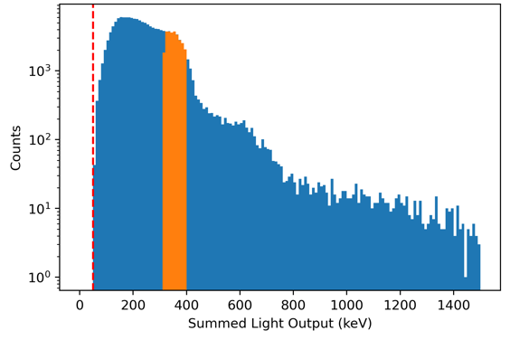
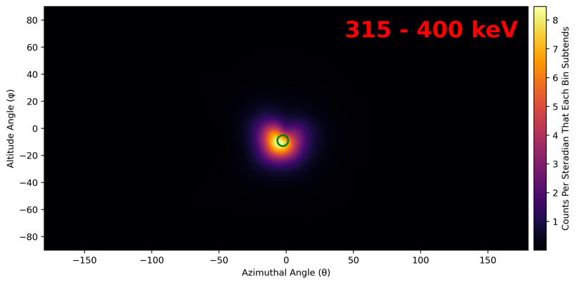
Imaging Special Nuclear Material – Plutonium
Measured gamma-ray spectrum
BeRP Ball
~4.5 kg sphere of α-phase Pu metal
  ρ = 19.86 g/cm³
93.3 wt% ²³⁹Pu and 6 wt% ²⁴⁰Pu
Distance: 57 cm
Neutron signature possible to image
Gamma emissions of interest for imaging:
  375/414 keV
  646 keV
315 – 400 keV
S. A. Pozzi, Applications in Security and Environmental Imaging

Slide 18
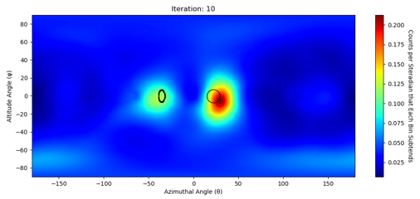
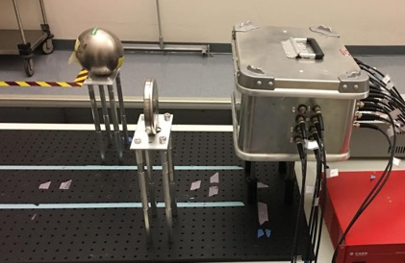
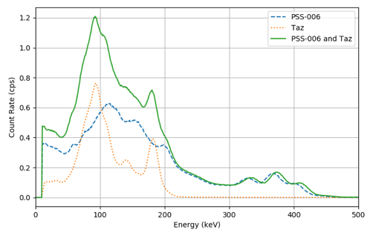
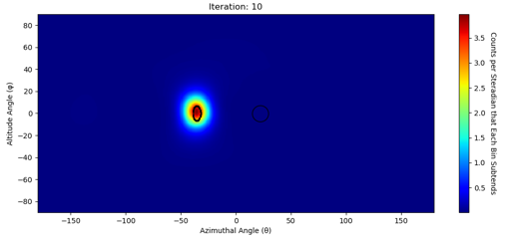
Characterizing SNM: Plutonium vs. Uranium
167 – 205 keV
The 185.7 keV gamma ray emitted by ²³⁵U is present in the measured spectrum from both sources
The plutonium region of the image is isolated when the energy window is increased
10-kg Mock HEU Source
Plutonium Disk
10-kg Mock HEU Source
356 – 394 keV
10-kg Mock HEU Source
185.7 keV
Plutonium Disk
Plutonium Disk
S. A. Pozzi, Applications in Security and Environmental Imaging

Slide 19
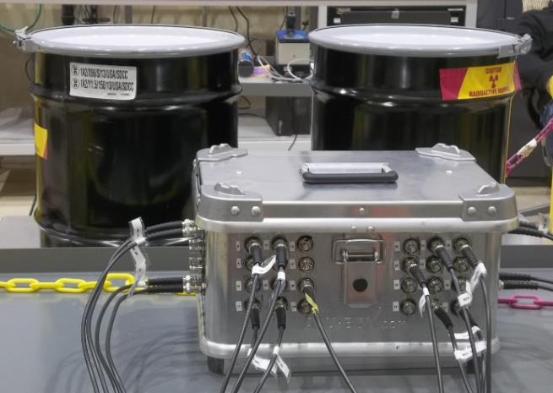
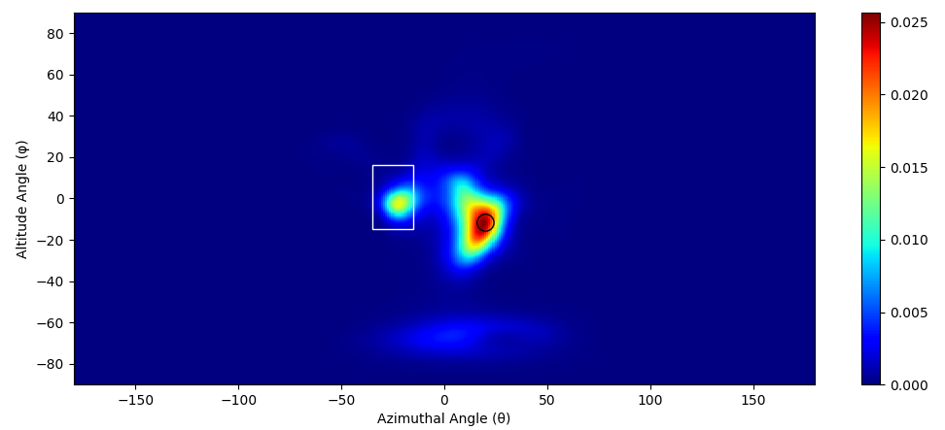
Characterizing SNM
Multiple Plutonium Objects
Plutonium oxide and metal samples were placed 50 cm from the H2DPI
The measured neutron image was processed using a list-mode maximum-likelihood expectation algorithm
4.5-kg plutonium metal
3.4-kg plutonium oxide
Plutonium oxide
Plutonium metal
S. A. Pozzi, Applications in Security and Environmental Imaging

Slide 20
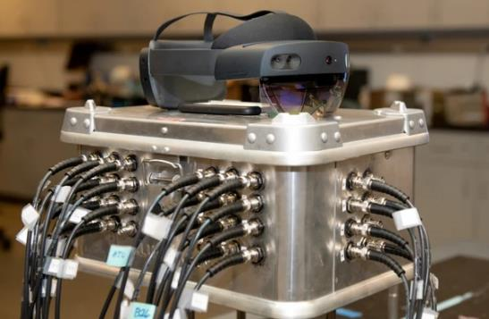
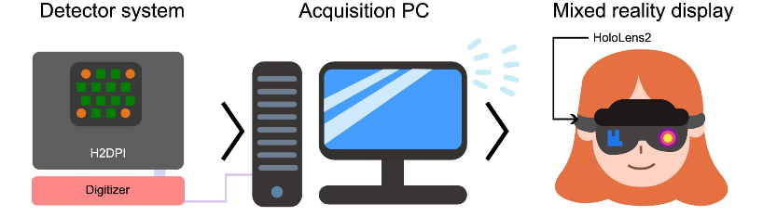
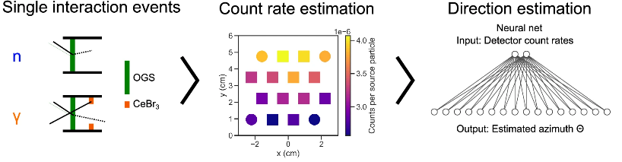
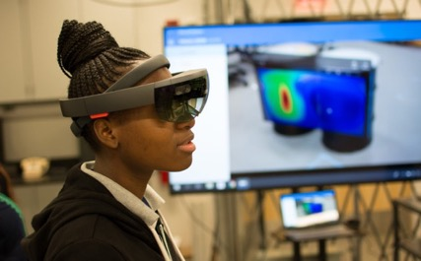
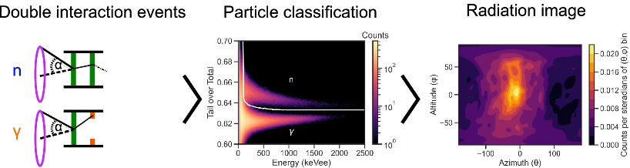
Imaging into Augmented Reality
O. Pakari, R. Lopez, et al., “Real-time mixed reality display of dual particle radiation detector data”, Sci Rep 13, 362 (2023).
S. A. Pozzi, Applications in Security and Environmental Imaging

Slide 21
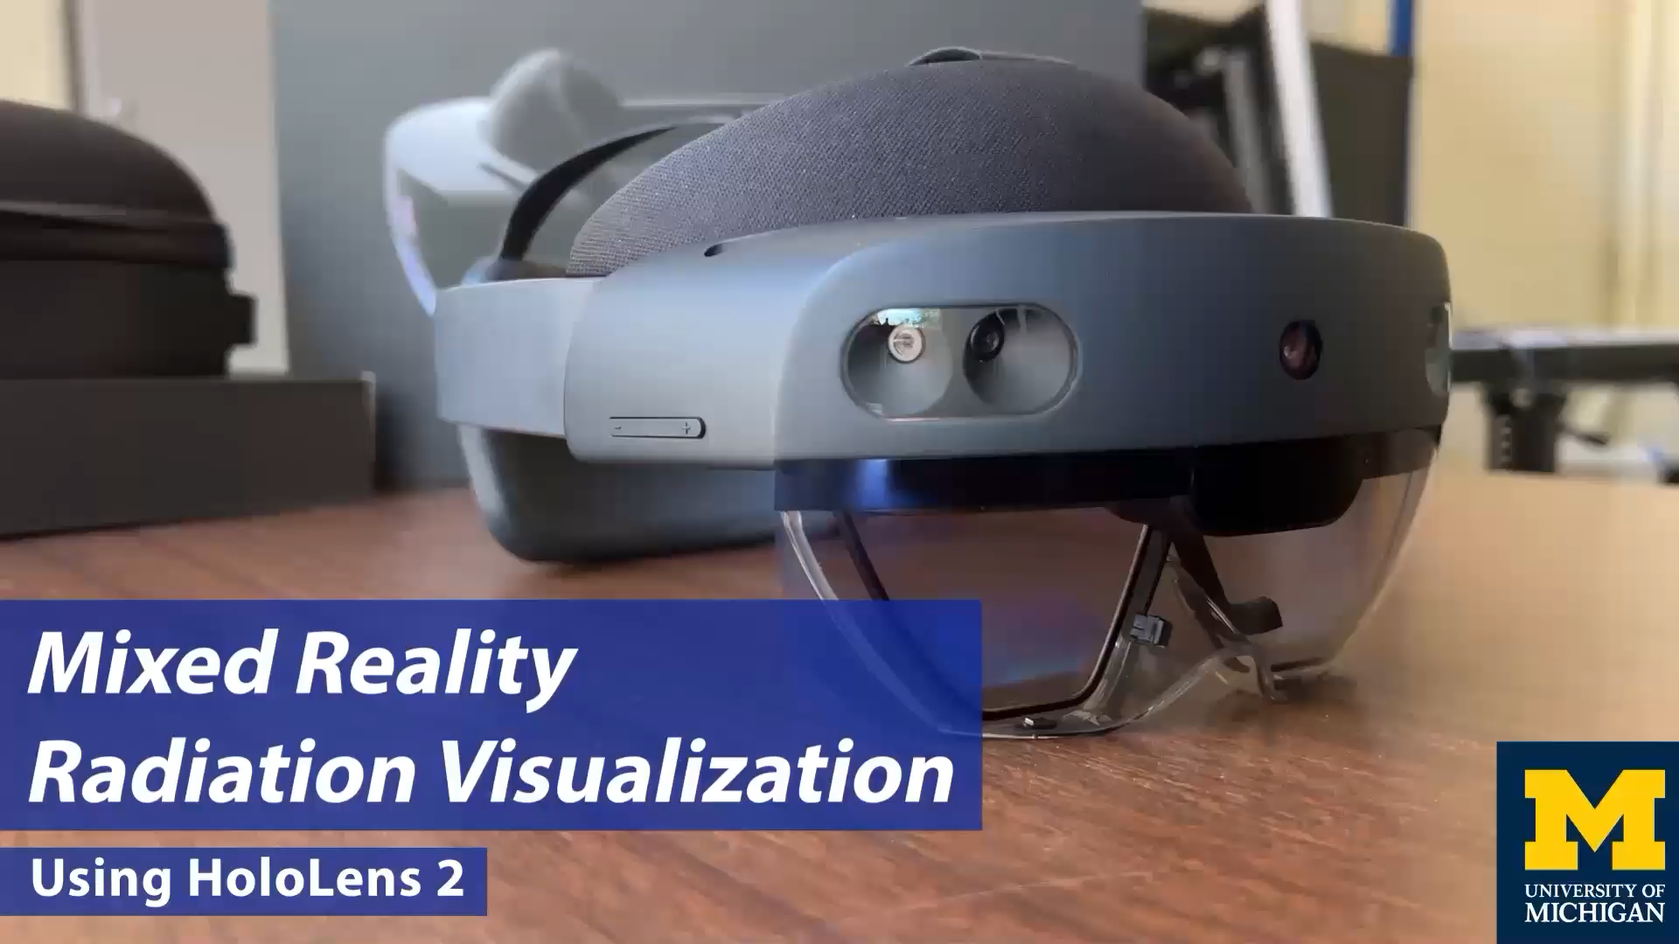
Imaging into Augmented Reality

Slide 22
Areas of Impact
A handheld dual-particle imaging system has been developed based on organic-glass and cerium-bromide scintillators
Results demonstrate the capability of a compact dual particle imager based on an active volume of OGS
  Localized kg quantities of plutonium using neutrons imaging
  Performed simultaneous gamma-ray imaging and spectroscopy to distinguish HEU from plutonium
A real-time augmented reality interface has been
developed for dual-particle imaging and spectroscopy
Applications include treaty monitoring and verification
S. A. Pozzi, Applications in Security and Environmental Imaging

Slide 23
Acknowledgements
The Consortium for Monitoring, Technology, and Verification would like to thank the DOE/NNSA for the continued support of these research activities.
  This work was funded by the Consortium for Monitoring, Technology, and Verification under Department of Energy National Nuclear Security Administration award number DE-NA0003920
S. A. Pozzi, Applications in Security and Environmental Imaging

