Slide 1
Applications of Position Sensitive Detectors in Life Sciences, Biology & Medicine
Reinhard W. Schulte, MD, MS
Loma Linda University
On Behalf of the US pCT Collaboration (UC Santa Cruz, Baylor University, NIU, Haifa University)

Slide 2
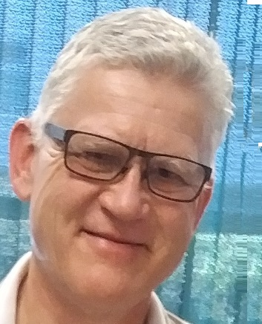
My Profile: EU-US Physician Scientist
Educated as physicist (Diploma, CMOS detectors), and medical doctor (Dr. med. 1986), DFG Fellowship at Loma Linda University (1989-92)
20+ years experience in proton therapy and R&D (1990-2014)
2014-present: researcher, teacher, collaborator, mentor, LLU, Basic Sciences (LLU)
Grant Funding (excluding various SBIR, DOE, BSF grants)
  1999-2003: Nanodosimetry (DOD, NMTB, R01-equivalent)
  2011-2016: proton CT (NIBIB, R01)
  2015-2017: NAPTA: Optimizing clinical trial design & delivery of particle therapy for cancer (P20), LLU, UCSF, LBNL
  2022-2026: Ionization Detail – Biologically based treatment planning for particle therapy beyond (R01, 4th percentile)

Slide 3
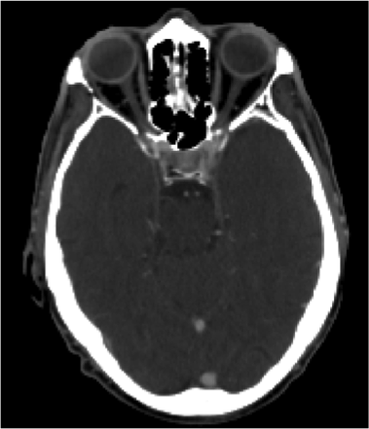



You shall not aim with a proton beam at an Organ at Risk
X
Tumor
Tumor
Organ at risk
(Brain stem)
Organ at risk
(Brain stem)
Ideal
Real
Courtesy C-A Collins Fekete, LLU Algorithm Workshop 2017

Slide 4
Outline
Theme: How can position sensitive detector physicists help reducing uncertainties in proton therapy?
Project 1: Develop successive phases of pCT scanners and learn from their performance
Project 2: Addressing uncertainties in biological by characterizing clustering of ionizations on the nanometer scale with a gaseous hole pattern detector
Outlook

Slide 5
Proton and ion therapy in perspective
Prologue

Slide 6
Status of Proton Therapy
Proton therapy (PT) uses energetic beams of protons to treat cancer with higher precision and lower side effects than conventional photon therapy.
PT has seen rapid growth in recent years, due to improved access, technical advances, and recognition of its dosimetric benefits.
However, PT also faces challenges and limitations, such as cost, availability, range and motion uncertainty, and lack of evidence.
Conducting randomized clinical trials to compare PT and photon therapy is difficult and costly, leaving photons with unfair advantage.
Today, I will present how position sensitive detector technology can help overcome some of the most pressing challenges in PT and also the even more expensive but potentially more effective ion therapy.

Slide 7
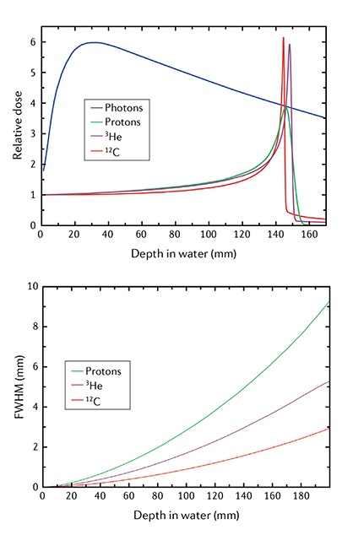
Understanding Proton and Ion Therapy
PT and ion therapy is a powerful tool used to treat cancer.
The Bragg peak of protons and ions, leads to tighter dose distributions.
But there's a problem: the body isn't static. Tumors shift, grow, or shrink, and our organs can move as we breathe or digest.
This inter- and intra-fraction movement/changes can affect the accuracy of any radiation therapy, but PT is most sensitive to these changes.
Photons (X-rays)
Protons, Helium, Carbon

Slide 8
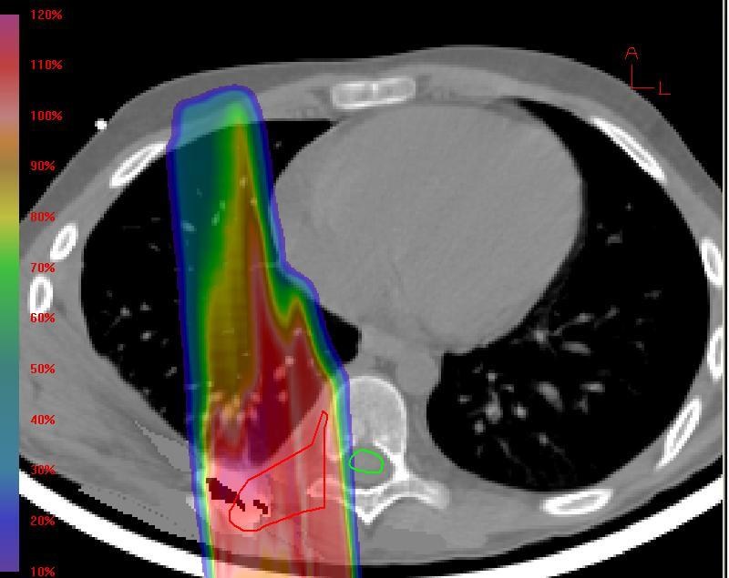
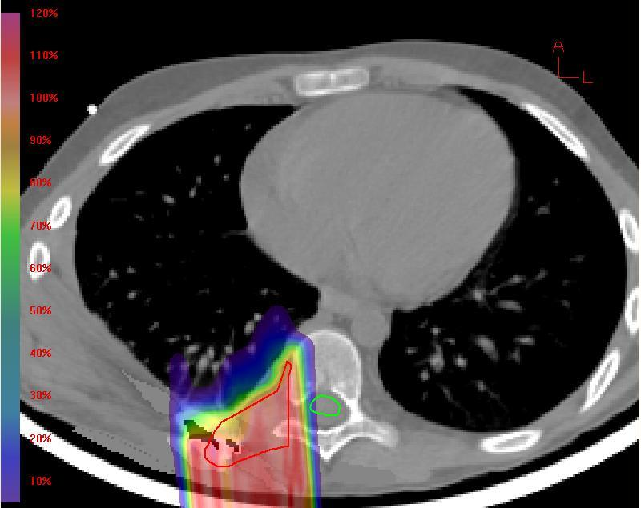
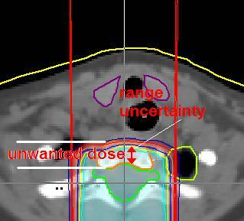
Understanding the Impact of Range Uncertainties and Their Mitigation
Range uncertainties are often mitigated by overshooting protons by 3-5% of the nominal proton beam range, or including entire structures
For example, range uncertainties force us fully expose vertebral bodies of children treated with CSI
Range uncertainties at soft-tissue lung interfaces can cause unwanted dose in lung and heart
There are many other examples where range uncertainties interfere with treatment planning goals and put PT

Slide 9
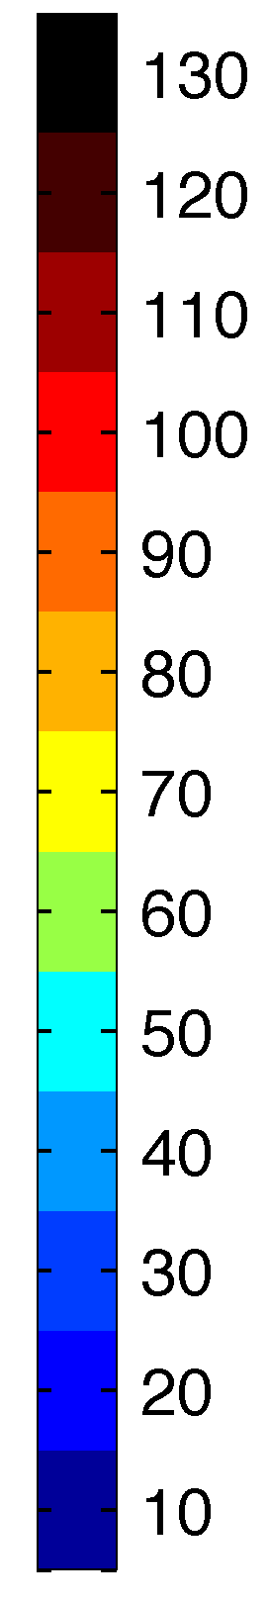
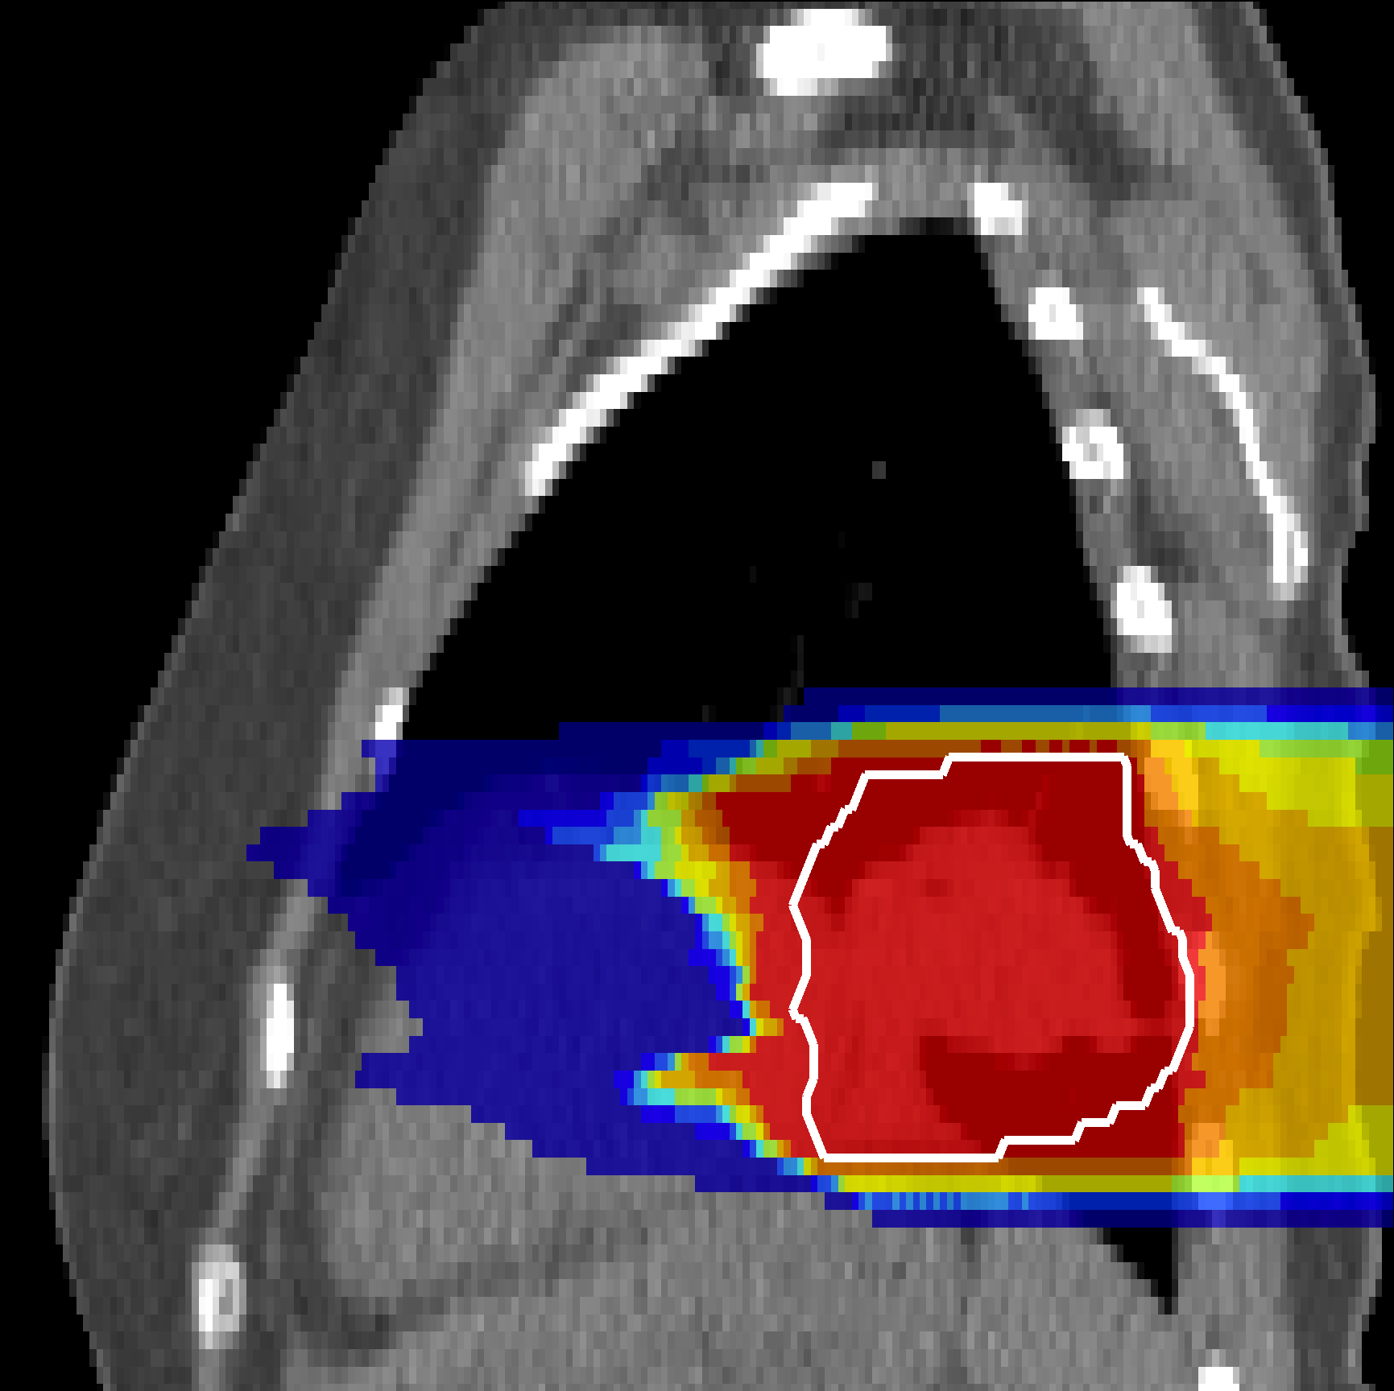
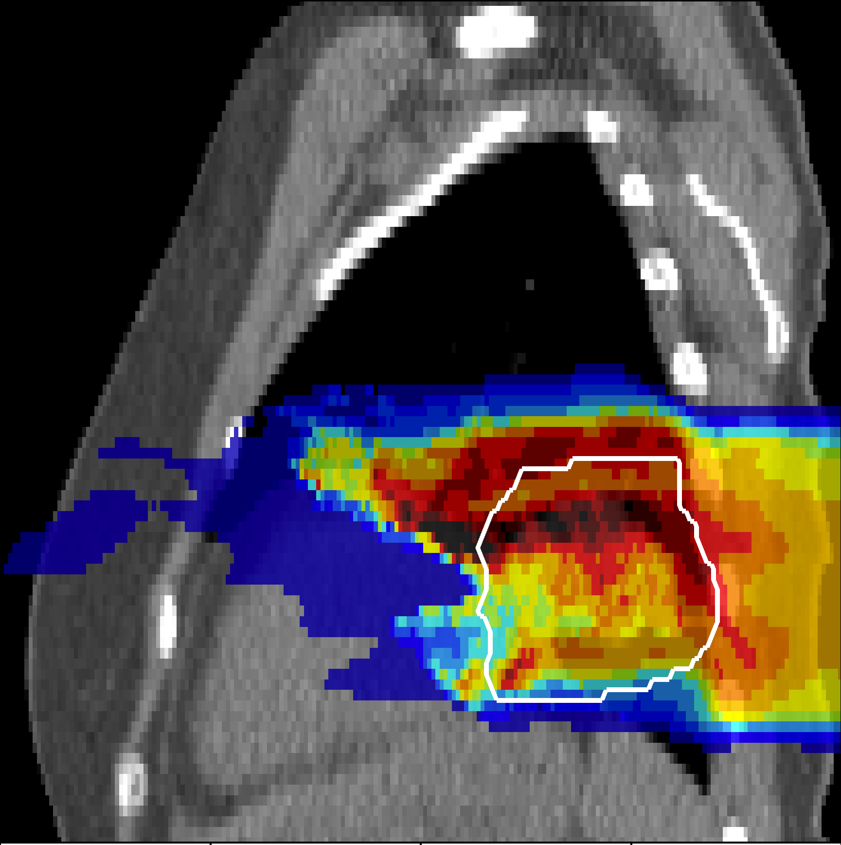
Hitting the Tumor at the Right Moment
Eley JG, et al. 4D optimization of scanned ion beam tracking therapy for moving tumors. 2014. doi: 10.1088/0031-9155/59/13/3431
Dose (%)
Lung cancer patient
Target
John G. Eley, proposed 4D tracking of lung tumors to mitigate respiratory motion effects to prevent unwanted dosimetric effects of motion interfering with active pencil beam scanning of proton or carbon ions.

Slide 10
Develop Successive phases of pCT scanners and learn from their performance
Project 1

Slide 11
Phase I pCT (US pCT Collaboration)
2008 - 2010

Slide 12
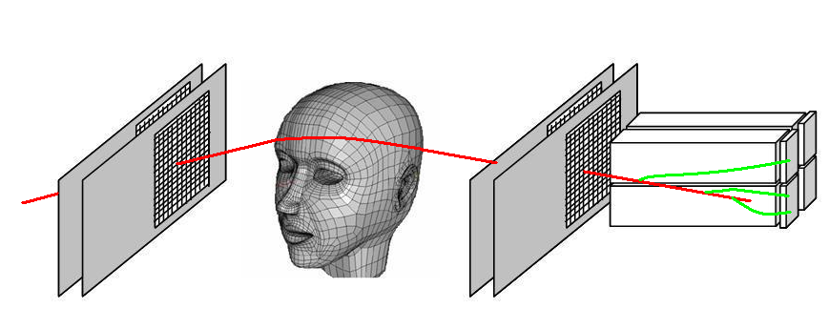
Proton CT Scanner: Design Principle
Protons of sufficient energy can penetrate the human body
Protons can be tracked on the entry and exit side using modern Si detectors
Residual energy detector to measure energy loss of individual protons
Rotational detector arrangement in synchrony with proton gantry
Low intensity proton beam
Tracking of individual protons
Design of a Proton CT Scanner rotating with the proton gantry

Slide 13
Single Particle Concept: Advantages and Challenges
Single particle detection allows for
  rejection of unsuitable events (“data cuts”)
  estimation of individual proton paths
  use of iterative reconstruction algorithms based on single proton histories
Challenges of single particle detection
  Requires high data rates (fast DAQ systems)
  Requires computation tools exploiting sparsity and massive parallelism

Slide 14
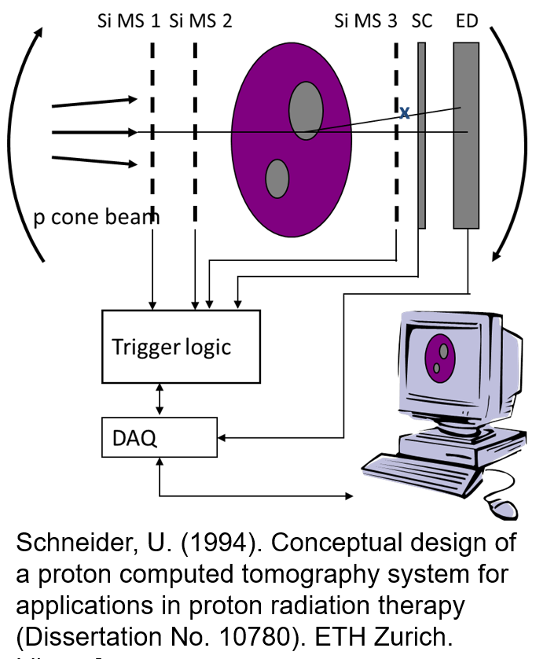
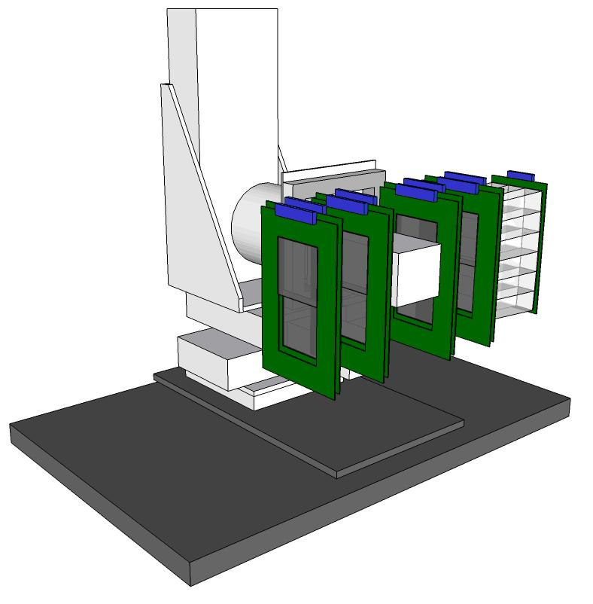
A Prototype Proton CT with Single Particle Detection (Phase 1)
The initial concept was derived from proton radiography systems developed at PSI
Fully developed concept of pCT (IEEE NSS/MIC 2003)
This pCT concept is realized in the Phase 1 scanner

Slide 15
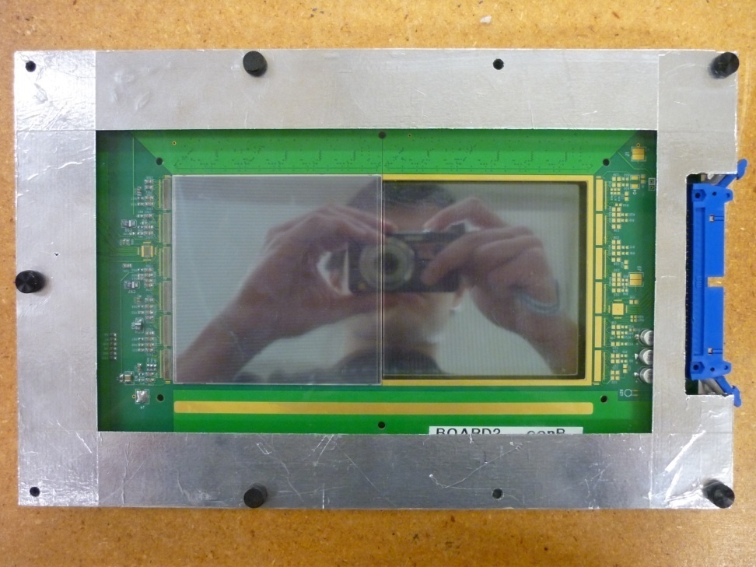
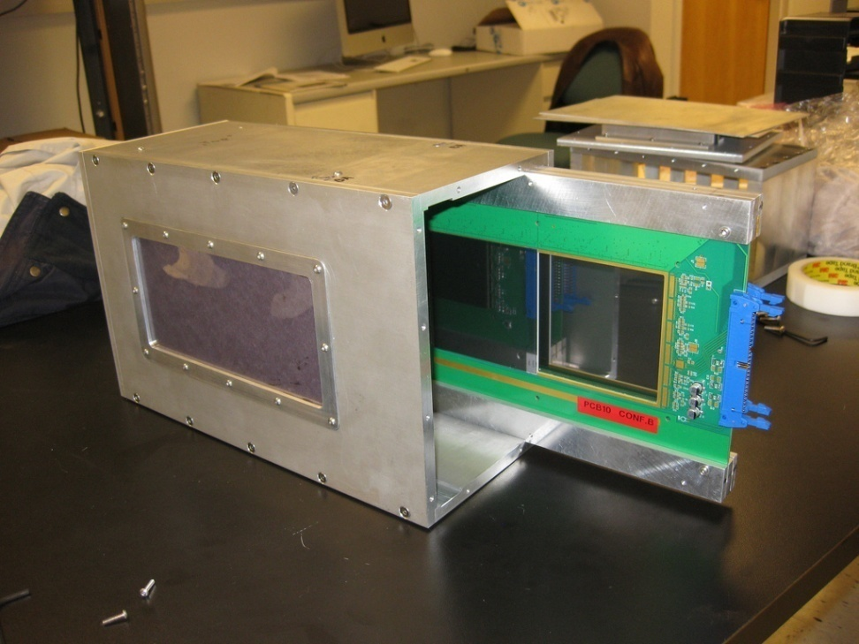
Phase I pCT Tracker
The Phase 1 pCT tracker consists of front and rear module for location and direction measurements
Modules: two detector boards measuring the X-Y position in two locations => direction
Detector boards: 4 Si Strip Detectors (SSDs), 9 cm x 9 cm, 384 strips, 0.23 mm pitch
Strips of one SSD oriented in either vertical or horizontal direction (X and Y sensitivity)
Total sensitive area 9 cm x 18 cm
Modified GLAST/Fermi readout chip, max rate 200 kHz
Detector board with 2 SSDs in the front (visible) and 2 SSDs in the back of the board
Phase I pCT scanner front module

Slide 16
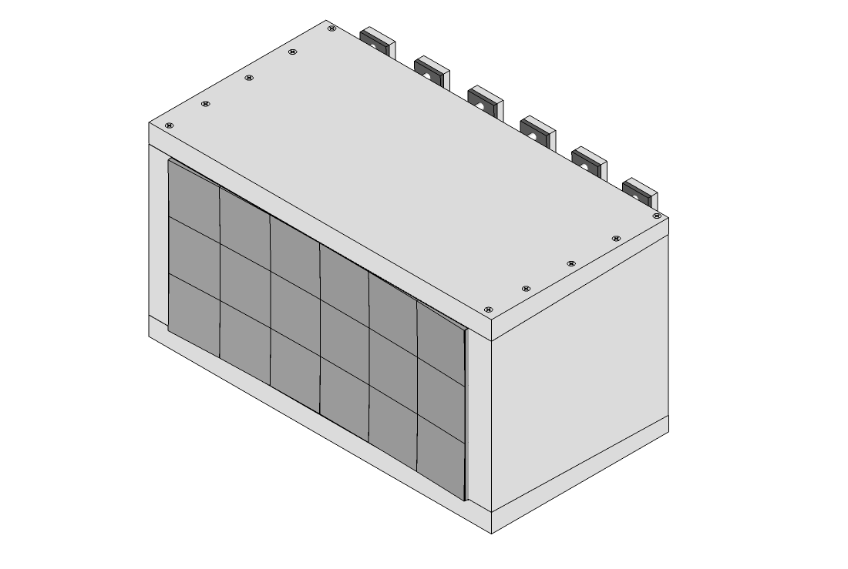
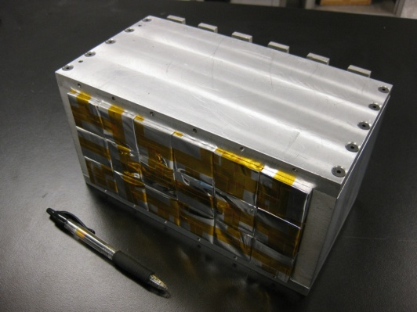
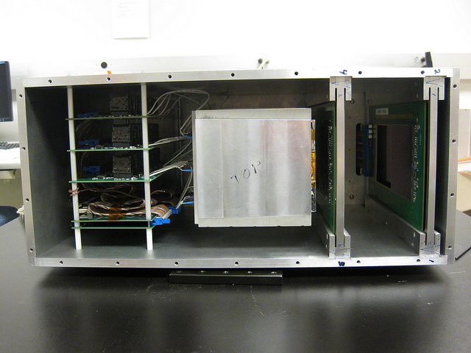
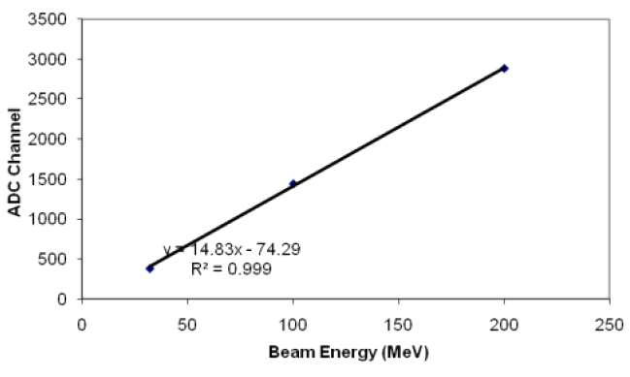
Phase I Energy Detector: Crystal Calorimeter
Crystal matrix with 18 thallium-doped cesium-iodide (CsI(Tl)) crystals (~3.6 cm x 3.6 cm x 12.5 cm)
Each crystal read out by area-matched Si photodiode
Si photodiode => preamp/shaper => ADC
Excellent linearity and energy resolution < 1% above 40 MeV
Integrated with rear tracker module

Slide 17
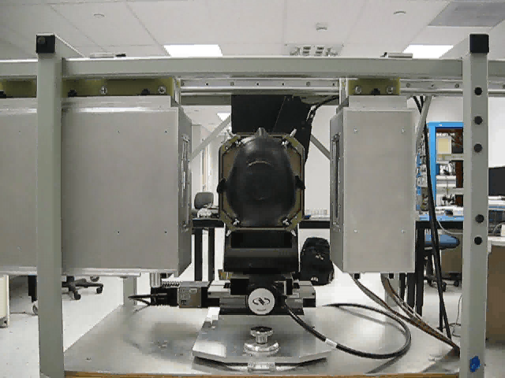
Phase I pCT Scanner at LLU (completed in 2010)
System component integration & mounting (April 2010)
Tested initially with radioactive source and cosmic rays (muons)
Installation on proton research beam line & 1st test runs (May 2010)
Spill uniformity optimization (June 2010)
Scanner calibration (July 2010)
Experience collected with phantom scans since Dec 2010, leading to Phase II pCT scanner

Slide 18
Phase II pCT (US pCT Collaboration)
2011 - 2020

Slide 19
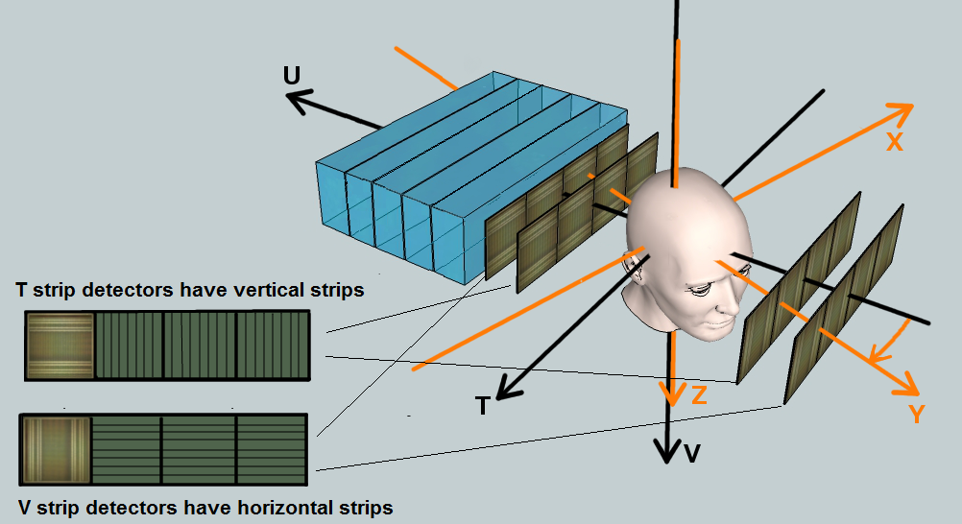
Phase II Preclinical pCT Scanner
The Phase II tracker had 8 planes of Si strip detectors: 4 for measuring the T coordinates and 4 for the V coordinates of each proton at a rate of ~1 MHz (1 M p per sec)
Each p track was time-correlated to the angle of the rotational platform (not shown), which rotated at 1 RPM.
The residual energy of each proton exiting the last tracker plane was measured with a 5-stage plastic scintillator with (PMT) readout. The energy of the ‘stopping stage’ was converted to WEPL
Schematic of the Phase II preclinical pCT system with tracking and energy detectors

Slide 20
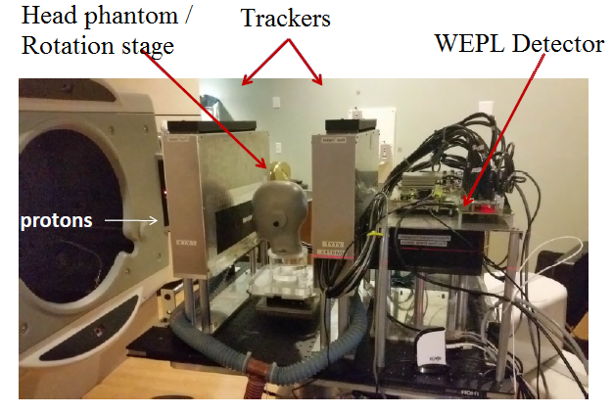
Phase II System at the NM Chicago Proton Center
The experimental Phase II pCT scanner was used for testing at the Northwestern Medicine Chicago Proton Therapy Center from 2015-2020
The system was tested with standard QA phantoms (Catphan), custom phantoms and a CIRS head phantom
A single pCT scan took 6 minutes and a pRad image acquisition about 10 seconds
The pCT Phase II scanner at the Chicago Proton Treatment Center on the horizontal uniform scanning (wobbling) beam line of the 235 MeV IBA cyclotron.

Slide 21
Ultra-Low Intensity Beam for p-Imaging
The imaging beam intensity was 10⁴ times lower than the clinical treatment intensity.
A protocol operating in (non-clinical) ‘service mode’ was established to lower the intensity for imaging by reducing the source current to 2 nA and narrowing the collimators (slits) of the Energy Selection System (ESS), so that that only 10⁶ protons per second pass through at 200 MeV output energy.
This creates a very stable low-intensity beam monitored by the pCT detector.
The beam spot (4 cm FWHM) was magnetically wobbled to a rectangular, pyramidal shape of 10 cm (in V) by 30 cm (in T).
Time structure of the proton rate, i.e., the trigger rate (blue) and the recorded event rate (red) over a time interval of 30 seconds, sampled approximately every 100 msec. The recorded event rate was ~ 5% lower than the trigger rate due to dead time in the DAQ system.

Slide 22
Tracking Detector
The tracker consisted of 8 planes with four 9 cm x 9 cm individual SSDs mounted with minimal gap (< 0.5 mm); 2T and 2 V planes before and after the phantom in beam direction.
Each tracker plane had an active area of 9 cm (vertically) by 36 cm (horizontally) with an rms spatial resolution of 70 μm.
The four pairs of (T,V) tracking planes determined the entry and exit location and angle on the phantom’s surface for each proton.
The innermost tracking planes were separated by 30 cm leaving enough room for QA and head phantoms.
The detector strips were read out by FPGAs on the printed circuit boards that carry the detectors
Example of a V- tracker plane with horizontal strip orientation. There are 4 individual Si strip detectors (SSD) mounted with minimal gap between them. The gaps are staggered in beam direction to allow for reconstruction of missing hits when the proton was detected in the other 3 planes.

Slide 23
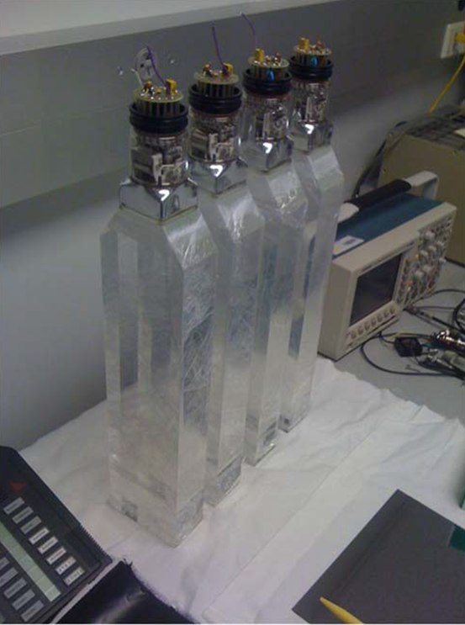
Energy Detector
The energy detector was assembled from 5 rectangular polystyrene scintillators with 10 cm x 40 cm cross-sectional area and 5.2 cm thickness and polished surfaces.
Each scintillator was wrapped with light-tight reflective material for optical insulation and a PTM was attached to one end as shown. The material budget across the interfaces was kept minimal (~0.07 mm WET) to minimize insensitive areas for stopping protons.
This is a preassembly photo of the energy detector before wrapping and placing them stacked inside the metal housing.

Slide 24
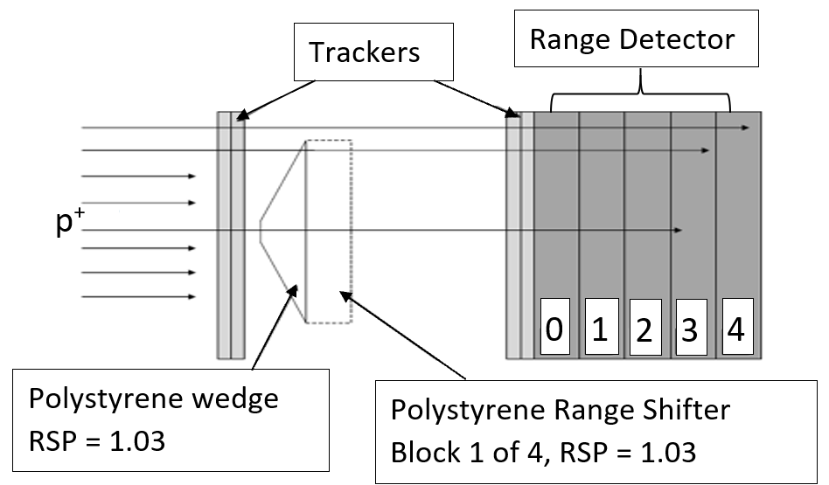
WEPL Calibration
Since we did not want to include detector components in the WEPL determination, the initial energy was not exactly known.
Also the I-value of the Bethe-Bloch stopping power formula is not known with high enough accuracy.
A simple, fast, and accurate WEPL calibration was obtained at the beginning of a session by measuring the signal of the 5 stages to tracked protons that passed a polystyrene wedge with known WET geometry (calibration object, RSP = 1.030).
Each stage covered a WEPL interval of ~5.3 cm. Divergent incidence is taken into account.
Adjustments to PMT gain (due to warming) were made by measuring “empty” protons passing the phantom.

Slide 25
Develop and Evaluate pCT for adaptive Proton Therapy Treatment Planning
Project 2

Slide 26
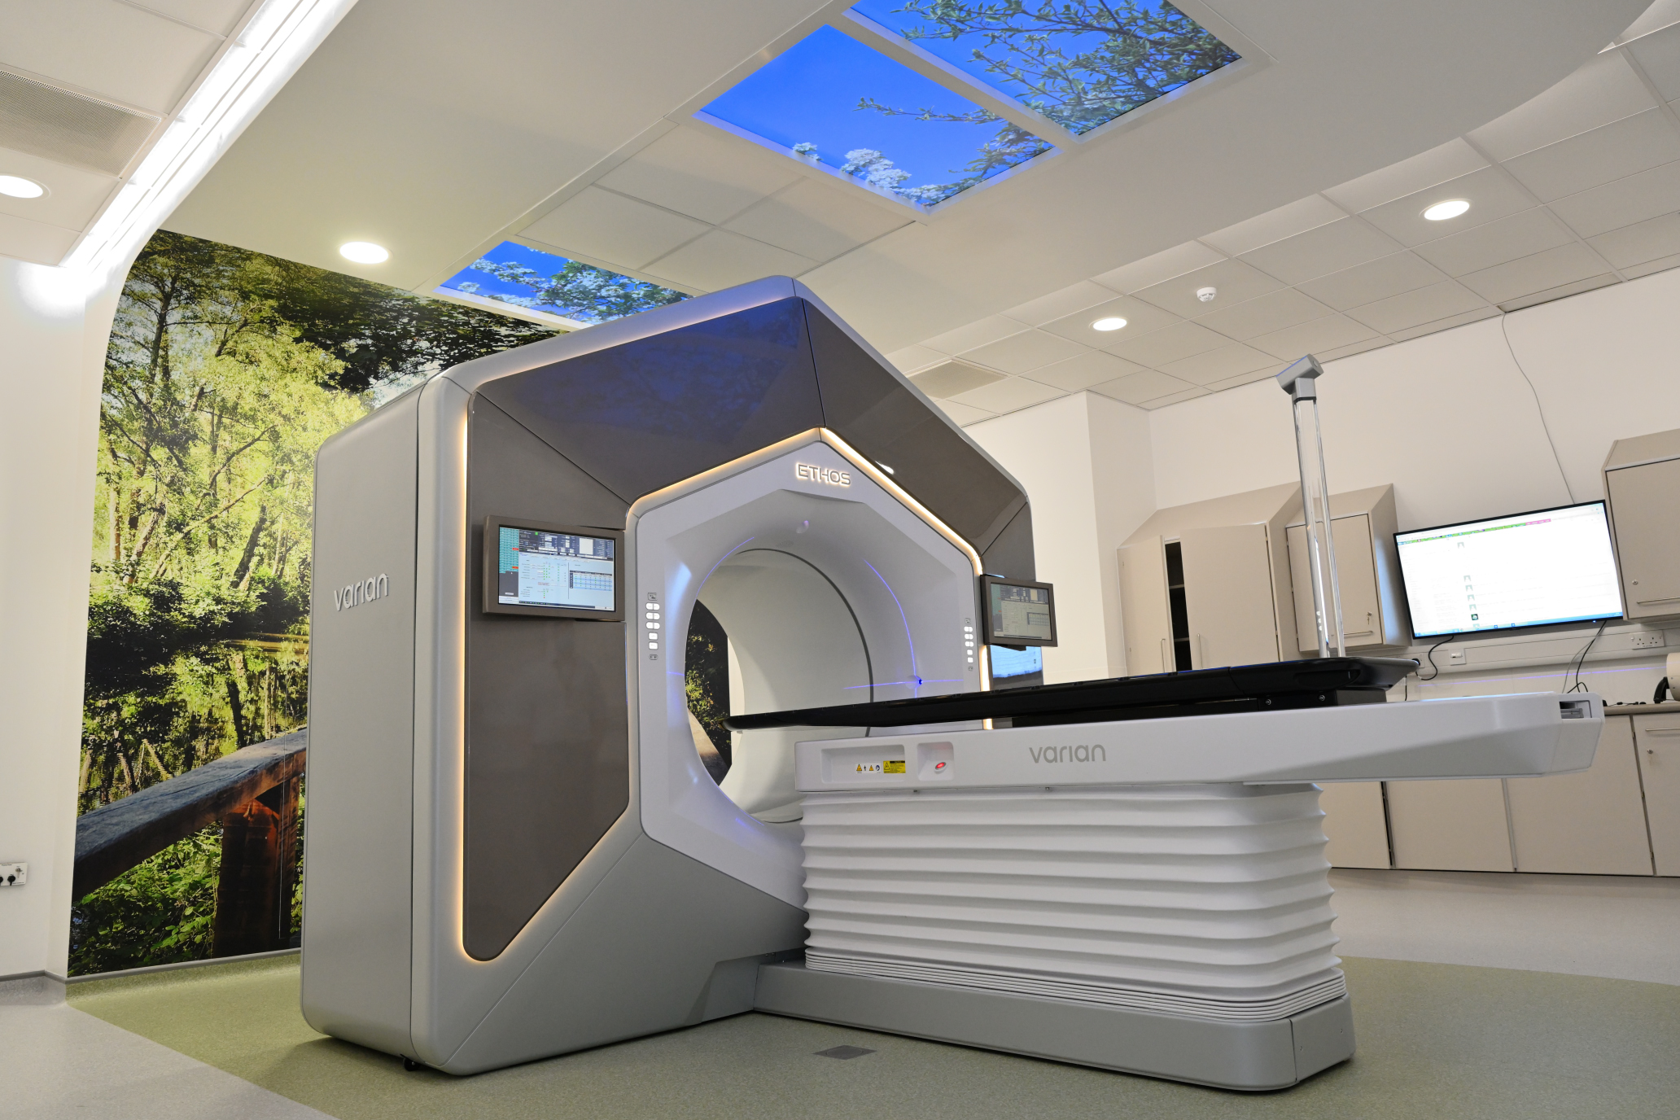
Online Adaptive Radiation Therapy (ART)
Online ART is an evolving technique that uses real-time imaging and data analysis to adapt the radiation dose and shape to the patient’s daily condition
Online ART accounts for interfraction changes in tumor size, shape, location, and biology, as well as intrafraction patient movement and breathing motion
We are planning to develop a pCT based online pART system
A commercial system for online ART installed in a UK hospital

Slide 27
Phase Iii pCT (EU-US pCT Collaboration, llu, LMU, UCSC, Baylor, utsw, ucla-Cedars sinai)
2022 - 2032

Slide 28
Phase III Clinical pCT Scanner
Phase III is the final and clinical phase of the pCT project, which aims to develop a new pCT system with improved performance and accuracy compared to previous phases
Phase III will consist of a pCT scanner micromegas for tracking and scintillators for measuring the water-equivalent path-length (WEPL) of individual protons. The scanner will have a clinically relevant active area of 40 x 40 cm² and complete a full pCT scan < 1min
Phase III will feature a multi-channel readout electronics, FPGA-based event-building, and data-preprocessing system handling event rates >5-times higher than Phase II pCT
Phase III will be supported by a multilayer GEANT4-based simulation platform for initial development and later serve as an open access platform

Slide 29
Phase III pCT Project Timeline
The project will (hopefully) be funded by a P01 program grant from the US National Cancer Institute
The first 5 years will consist of technical development and testing of the Phase III pCT platform
The next 5 years will work with proton accelerator technology vendors to develop the clinical implementation, including a clinical delivery of a very low-intensity proton beam and rapid switching between imaging and treatment of online pART.

Slide 30
Phase III pCT is coming
Stay tuned for more!
rschulte@llu.edu

