Slide 1
Position Sensitive Detectors in Astrophysics
Tools for dark energy and dark matter
Juan Estrada
PSD13 - Oxford
05 Sep. 2023

Slide 2
Race towards the development of instruments with more pixels, higher efficiency, faster readout, and lower noise.

Slide 3
Outlook
Sensors in imaging surveys : DES,LSST,…
    Sensors with good QE in VIS-NIR
Applications for direct dark matter
The skipper-CCD (zero noise)
      SENSEI, DAMIC-M
      Oscura
New Technologies/Ideas with low noise.
Super exciting, but not included here:
  All the superconducting technologies TES, MKID in CMB instruments.
  Intensity mapping ideas (for cosmology).

Slide 4
Science Driver

Slide 5
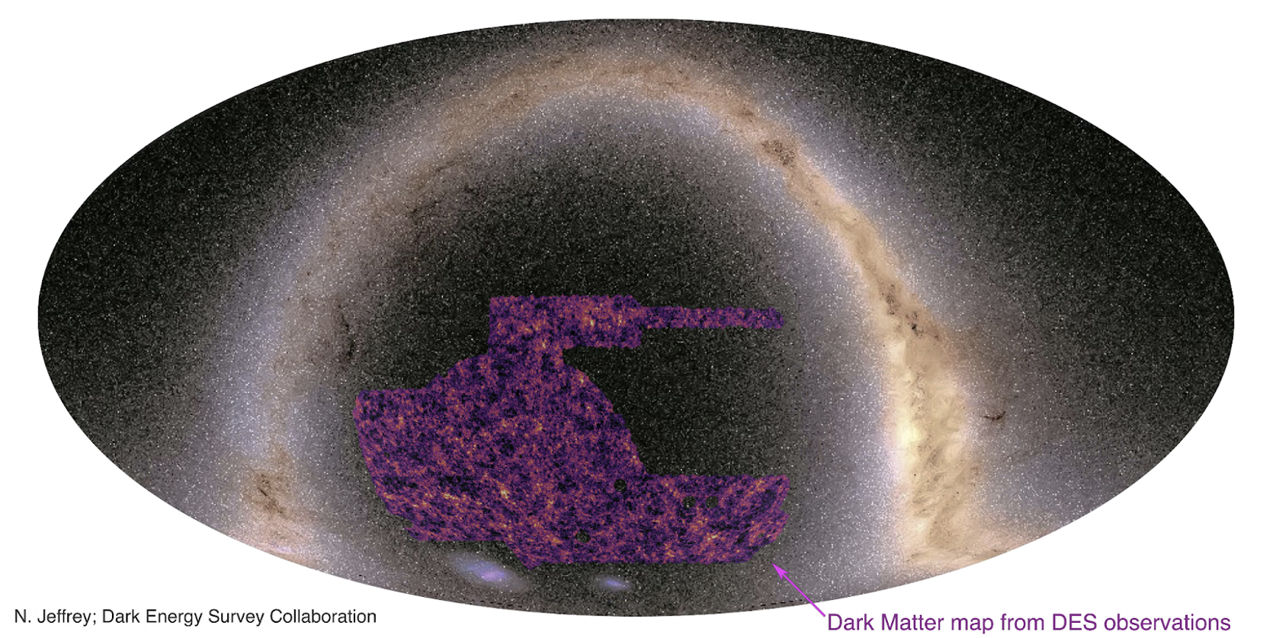
Methods : Cosmic Surveys
Weak lensing map Y3
We try to answer these dark energy and dark matter question by performing precise mapping of visible objects (structure and geometry).

Slide 6
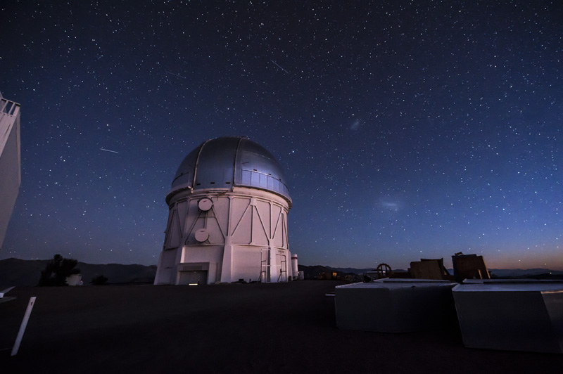
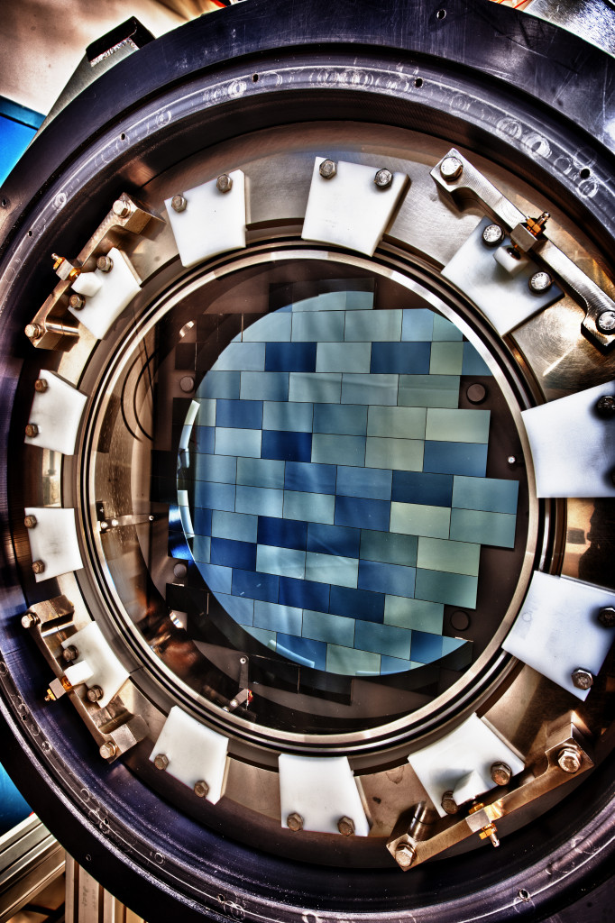
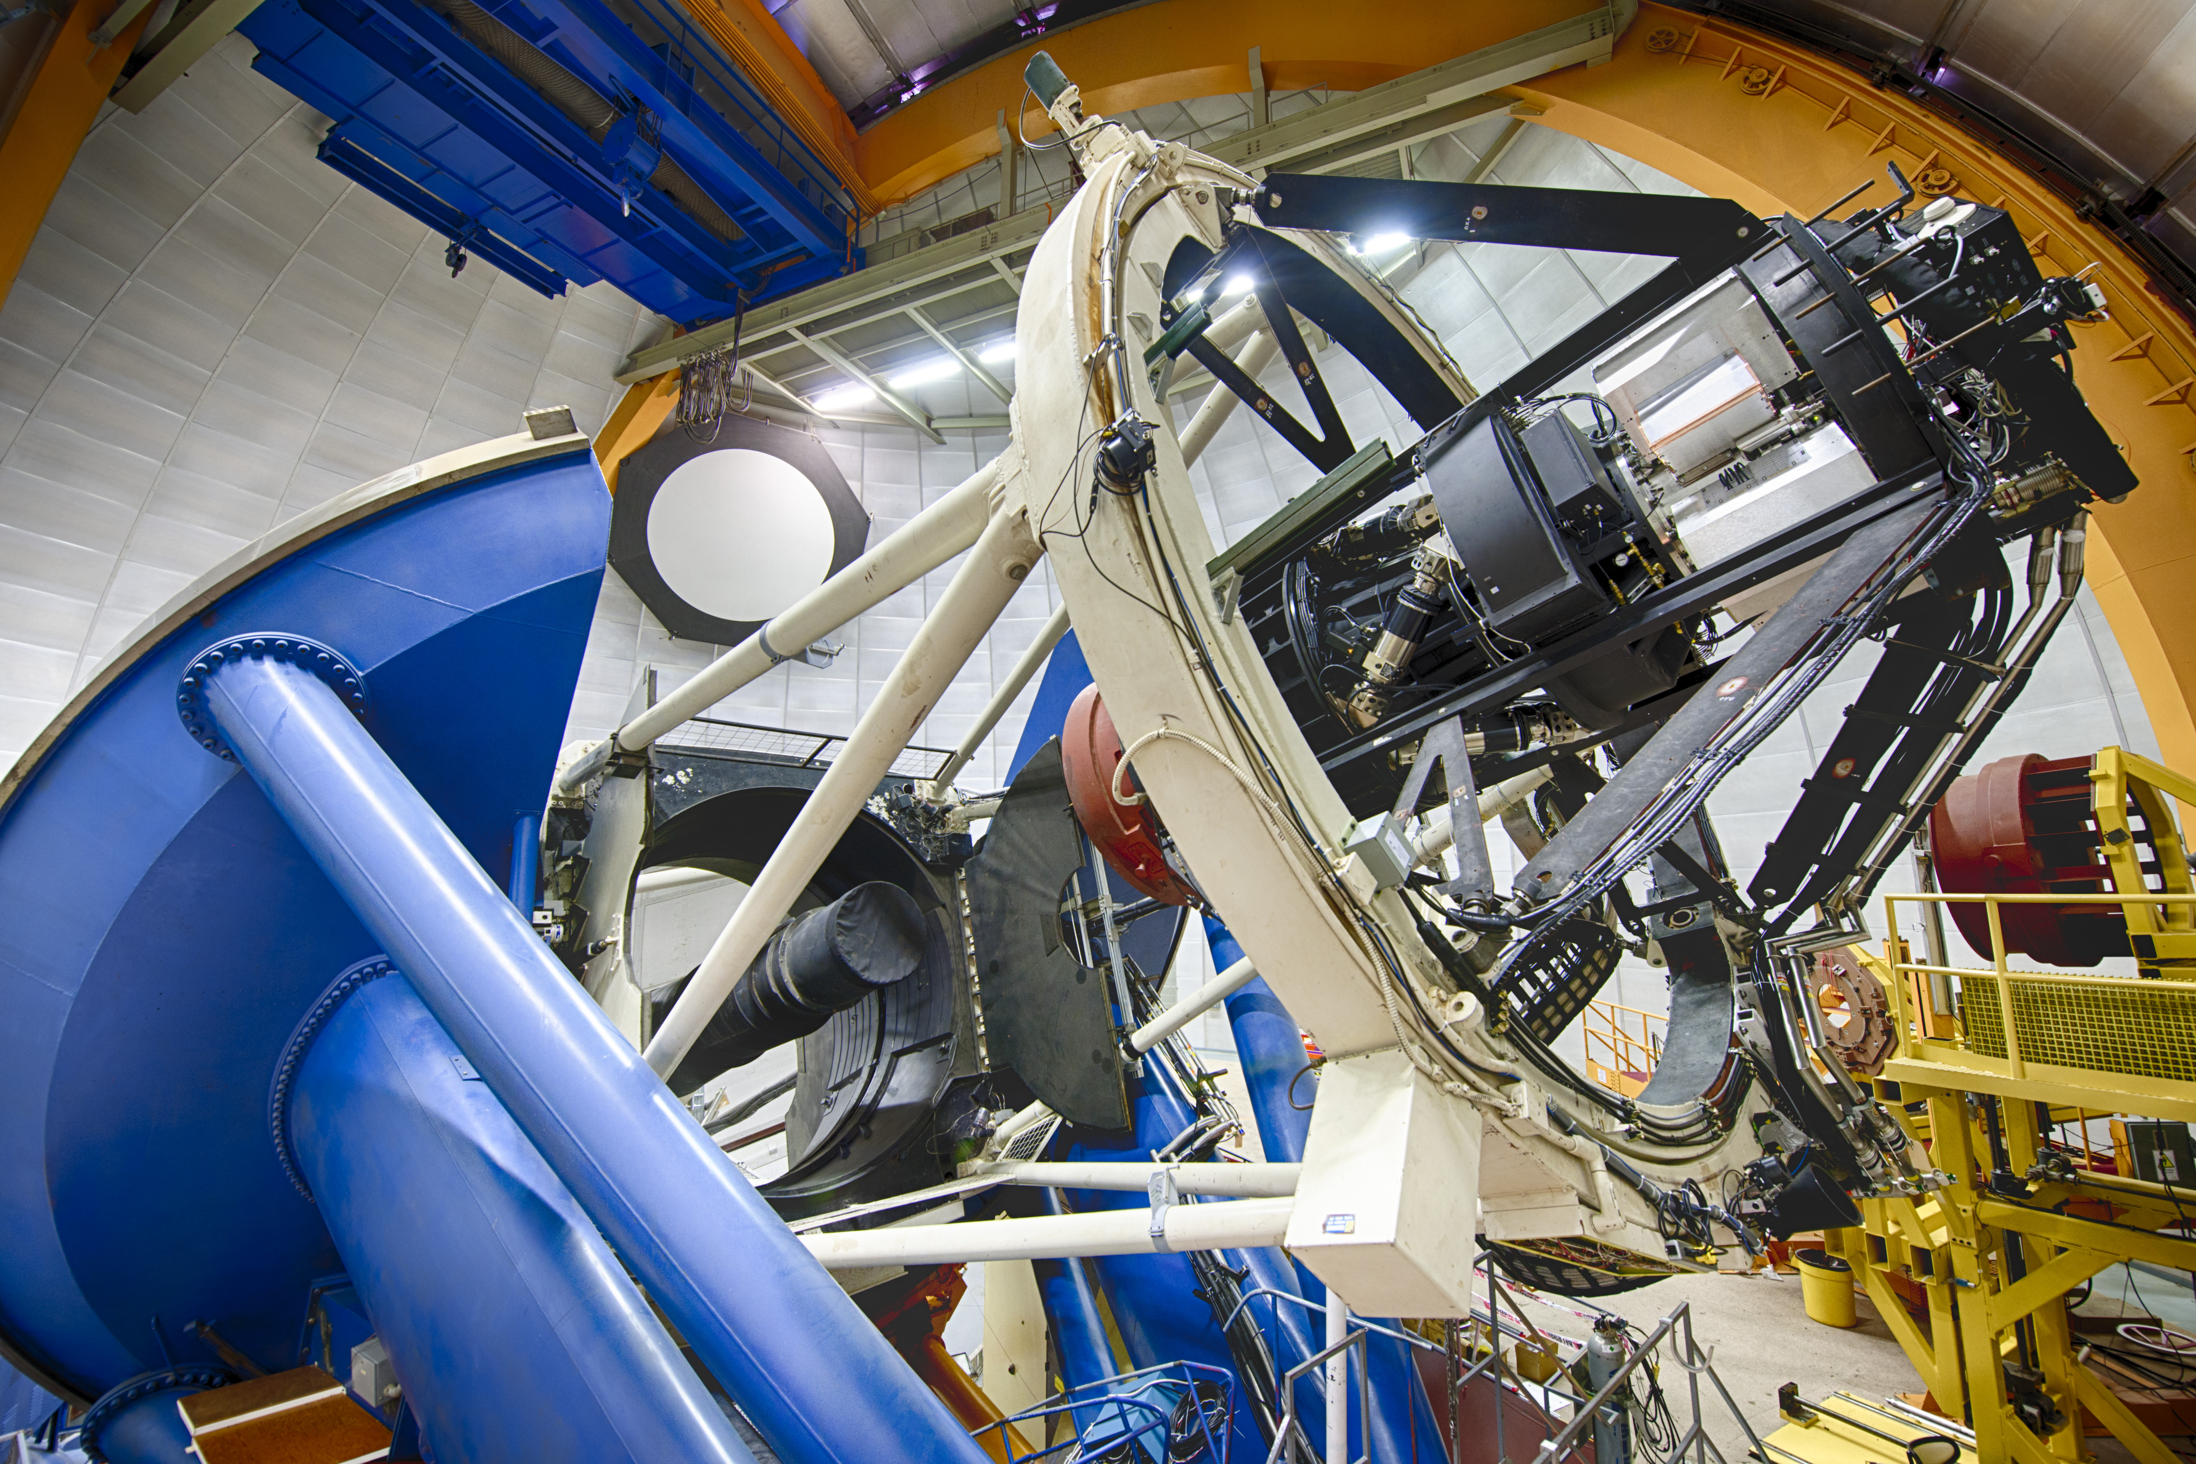
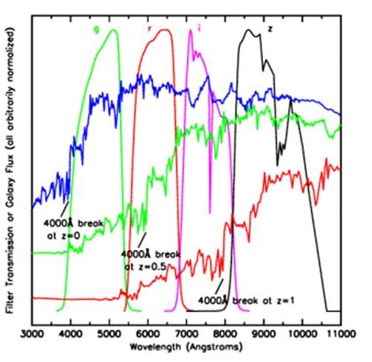
Imaging surveys in ~2010s ( Dark Energy Survey)
Dark Energy Camera
4m Telescope (Blanco)
DES surveyed a 5000 square degree area of the southern sky (roughly 1/8 of the total sky) over 525 nights.
recorded over 300 million galaxies, most so faint that their light is around 1 million times fainter than the dimmest star that can be seen with the naked eye.
DES also discovered and measured the brightness of thousands of supernovae by repeatedly targeting ten regions of the sky every six nights.
~500M pix imaging (CCDs)

Slide 7
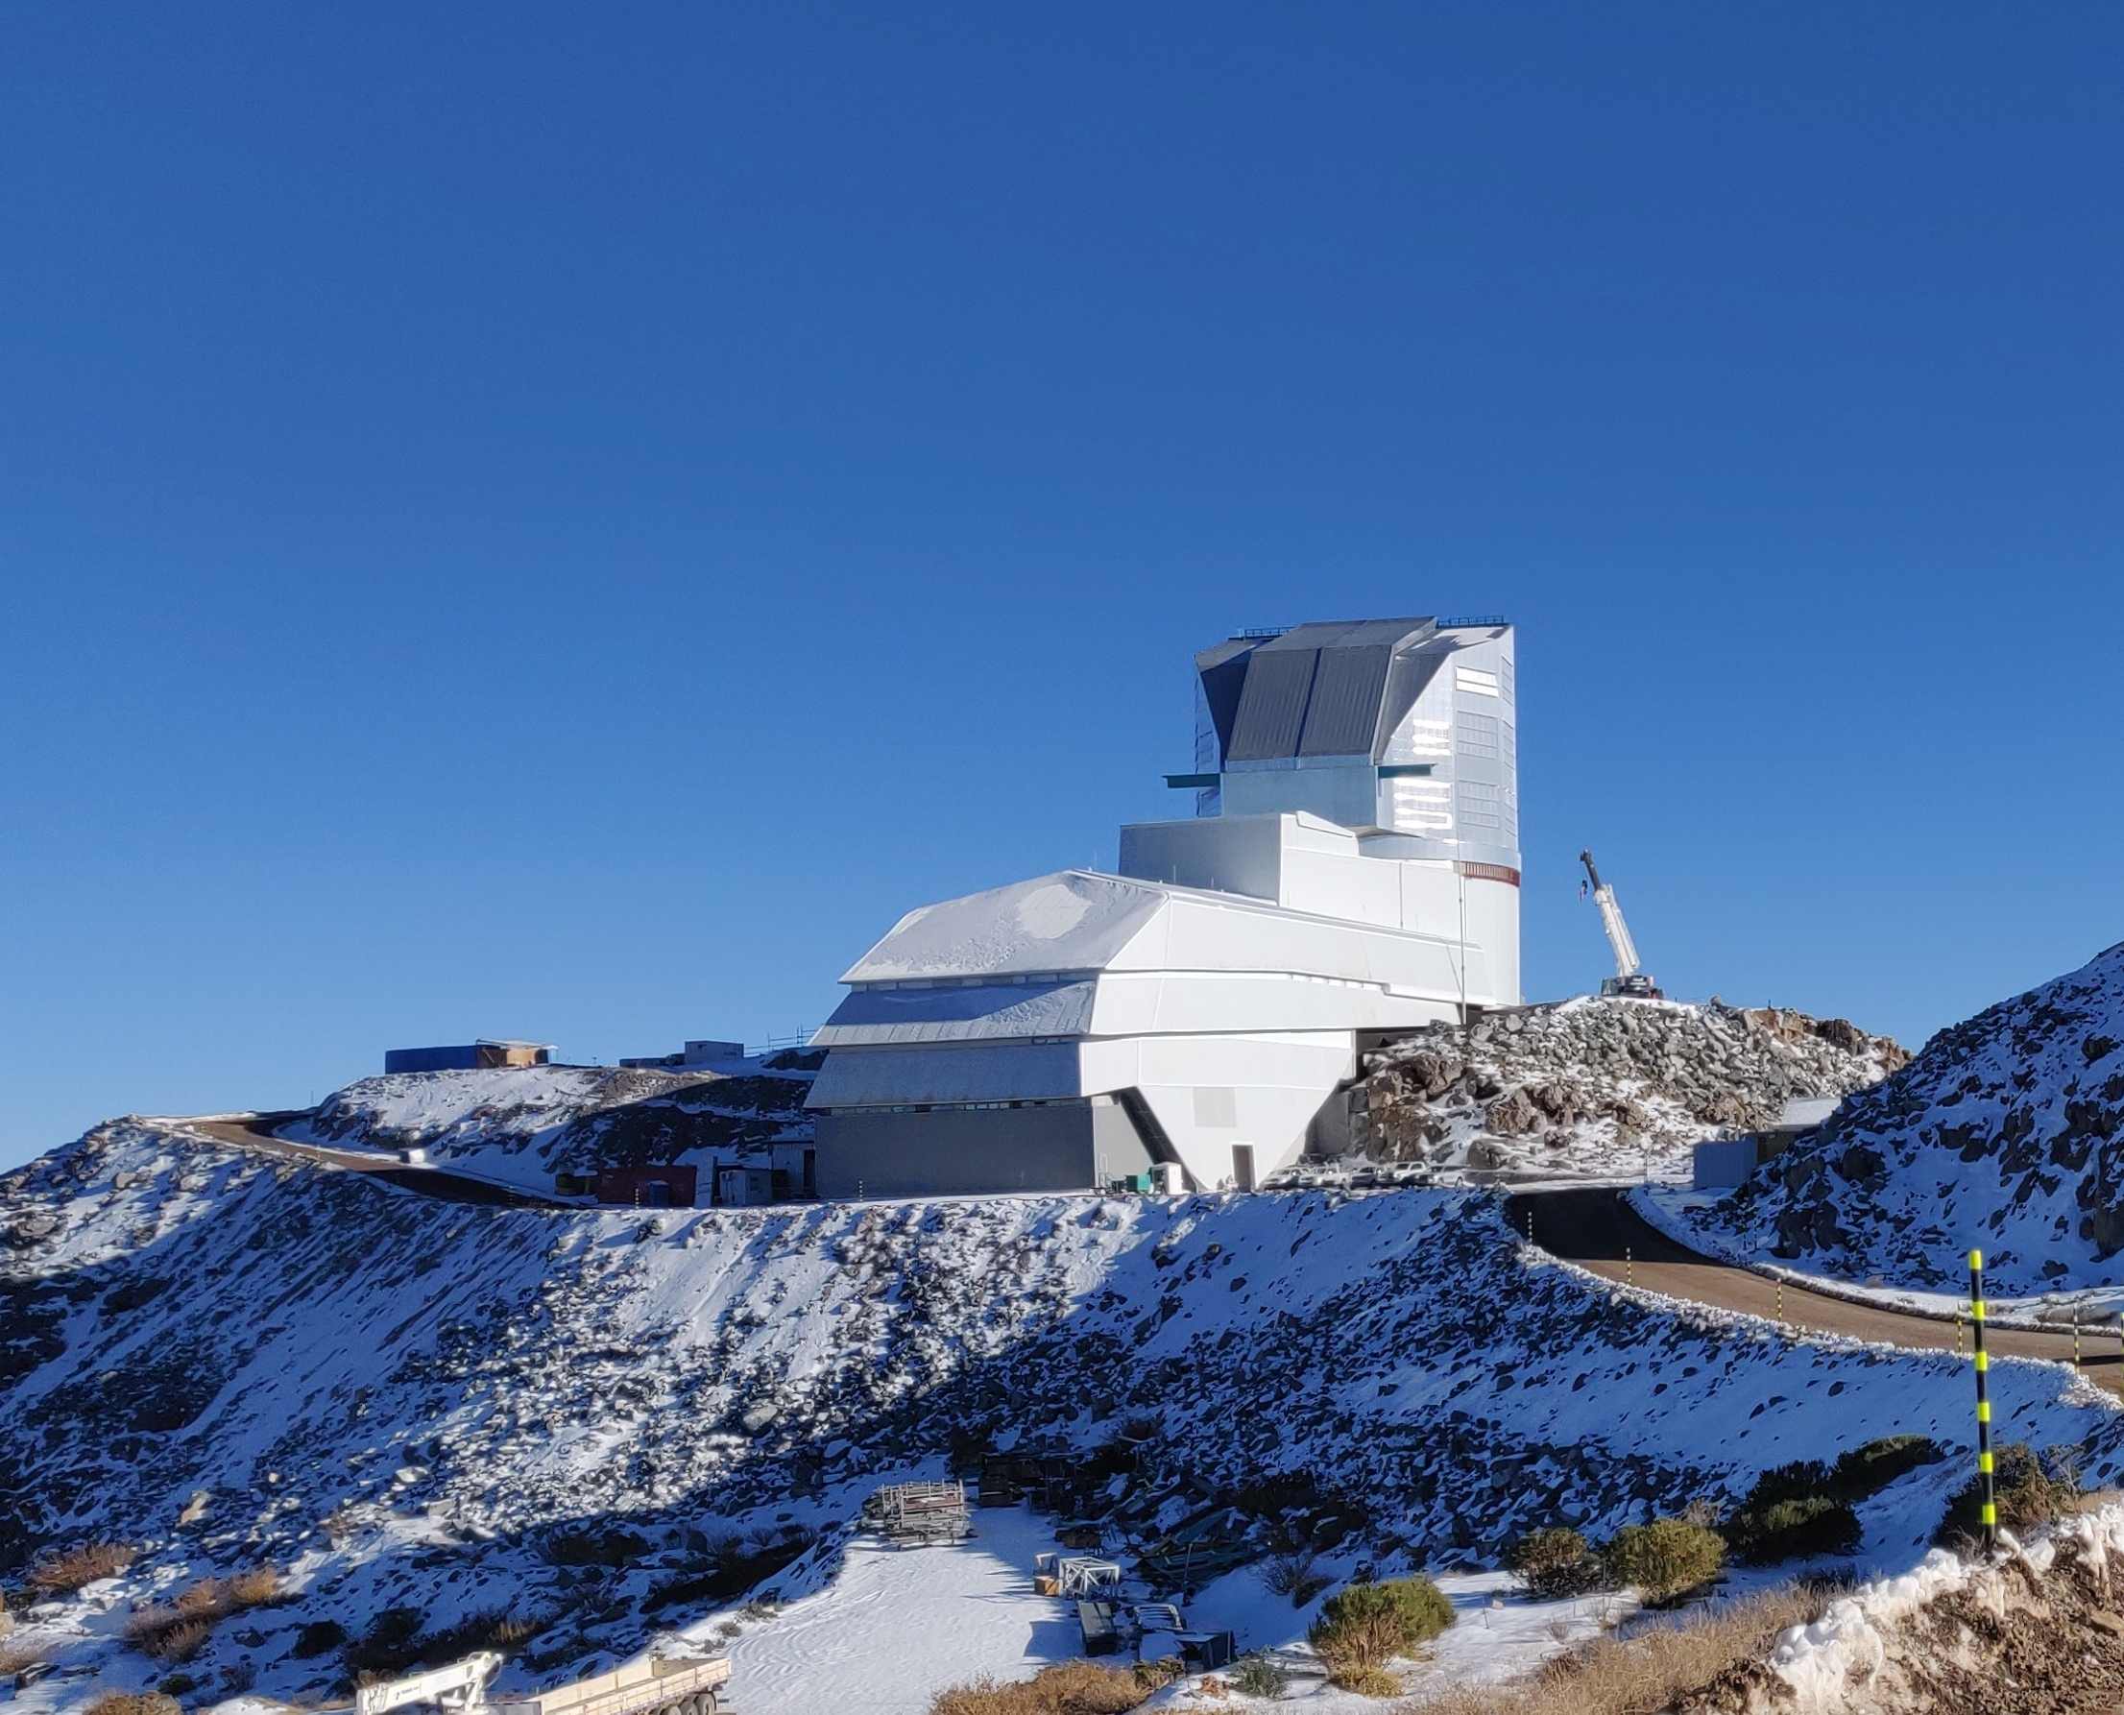
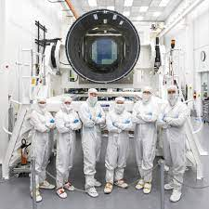
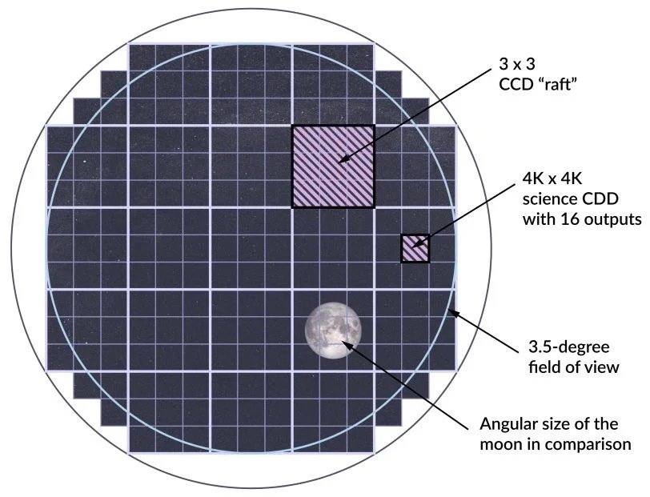
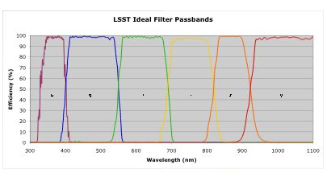
Imaging surveys in ~2020s ( LSST)
8m Telescope (Rubin)
15-second exposure every 20 seconds
37 billions stars and galaxies
Larger camera ever constructed!
Moving to Chile soon.
~3,200M pix imaging (CCDs)
See also EUCLID discussion from yesterday…

Slide 8
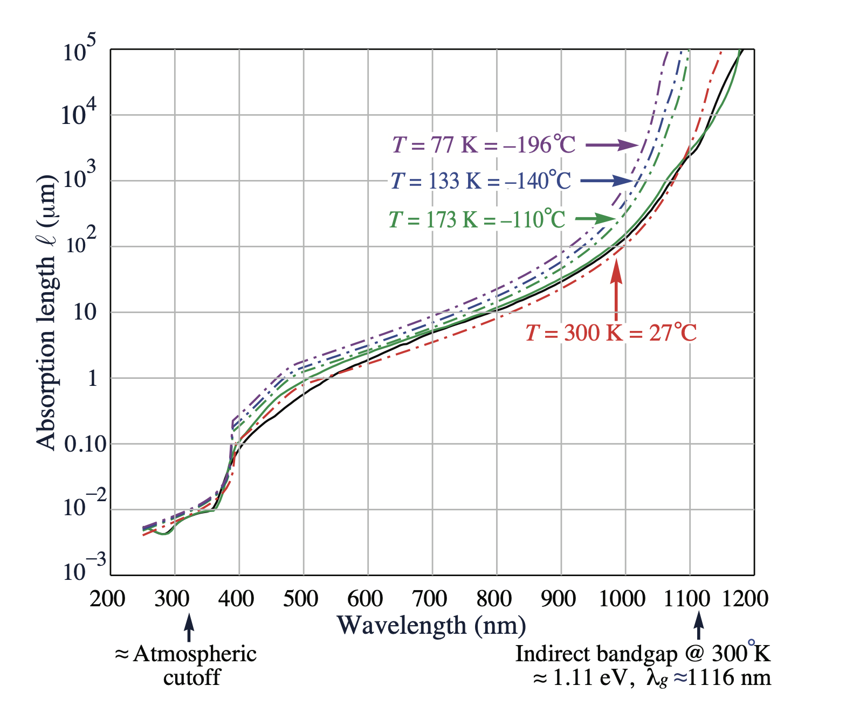
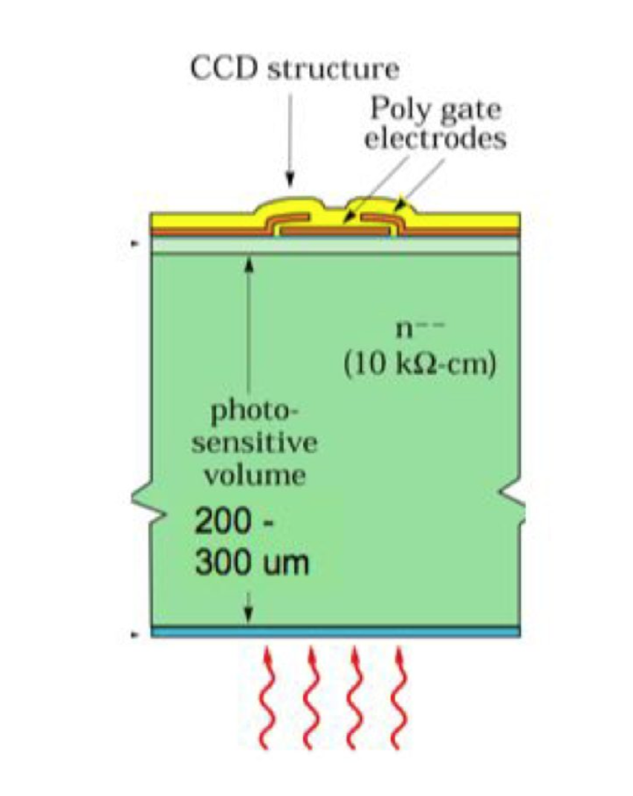
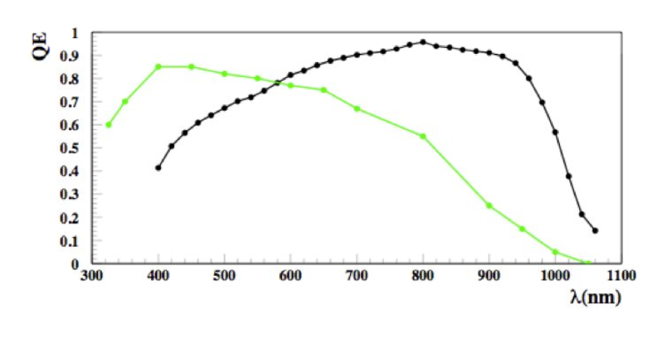
1um detection with silicon, means thick detectors.
Key enabling technology
Holland, S., Groom, D., Palaio, N., Stover, R., & Wei, M. (2003), IEEE Transactions on Electron Devices, 50(1), 225-238.
250 um
30um
DECam used 250 um thick sensors (designed by S. Holland LBNL)
LSST uses 100 um (ITL + E2V)
Also extensive effort to improve optical entrance window, for the blue QE.
Journal of Applied Physics 122, 055301 (2017)

Slide 9
…new thicker sensors present new opportunities.

Slide 10
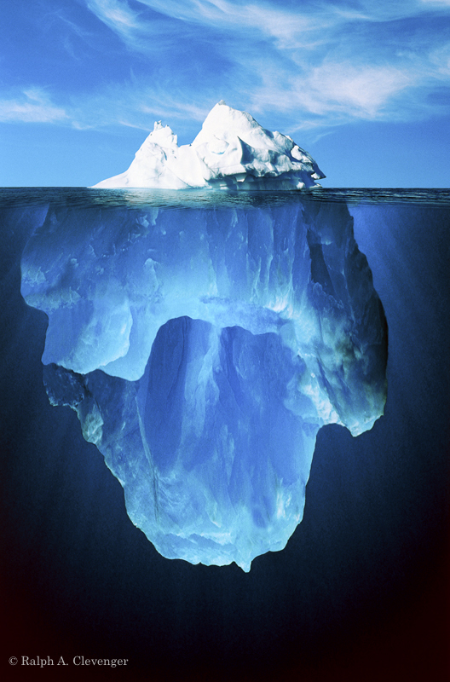
The dark matter problem
85% Dark Matter

Slide 11
The dark matter problem with CCDs
“Massive” sensors with low noise are good tool for a direct dark matter search…

Slide 12
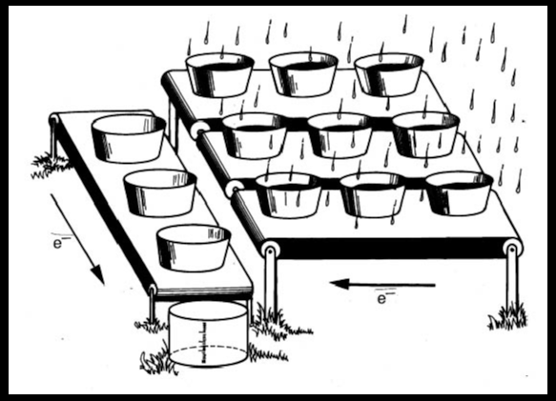
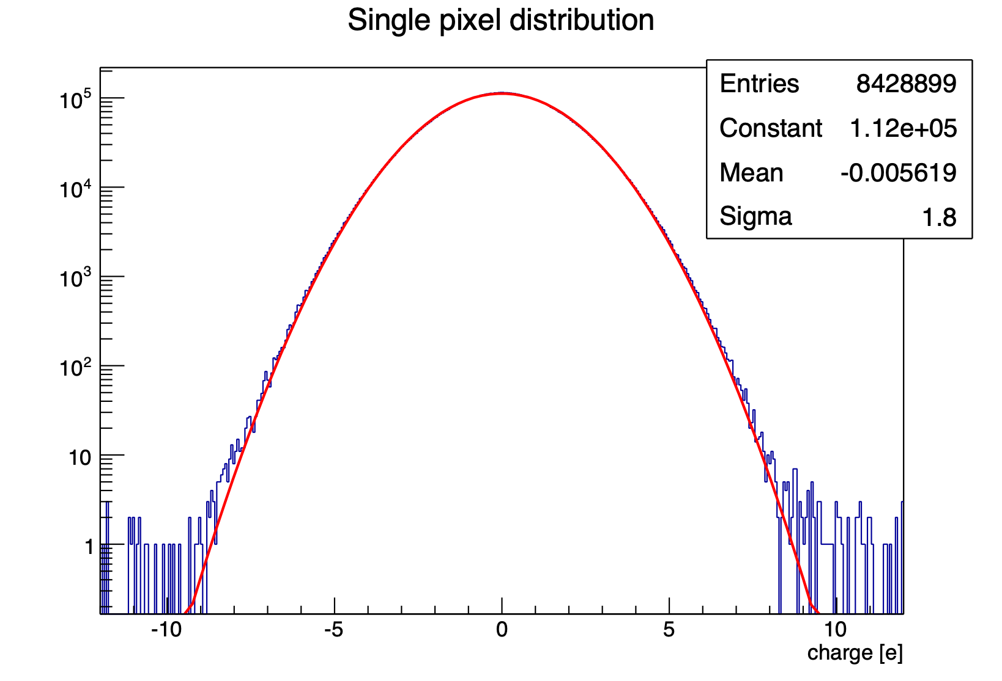
Charge-Coupled Device (CCD)
Janesick
Charge coupling makes the detectors ideal for low noise measurements, typical noise for scientific CCDs is 2e- RMS (7.2eV).

Slide 13
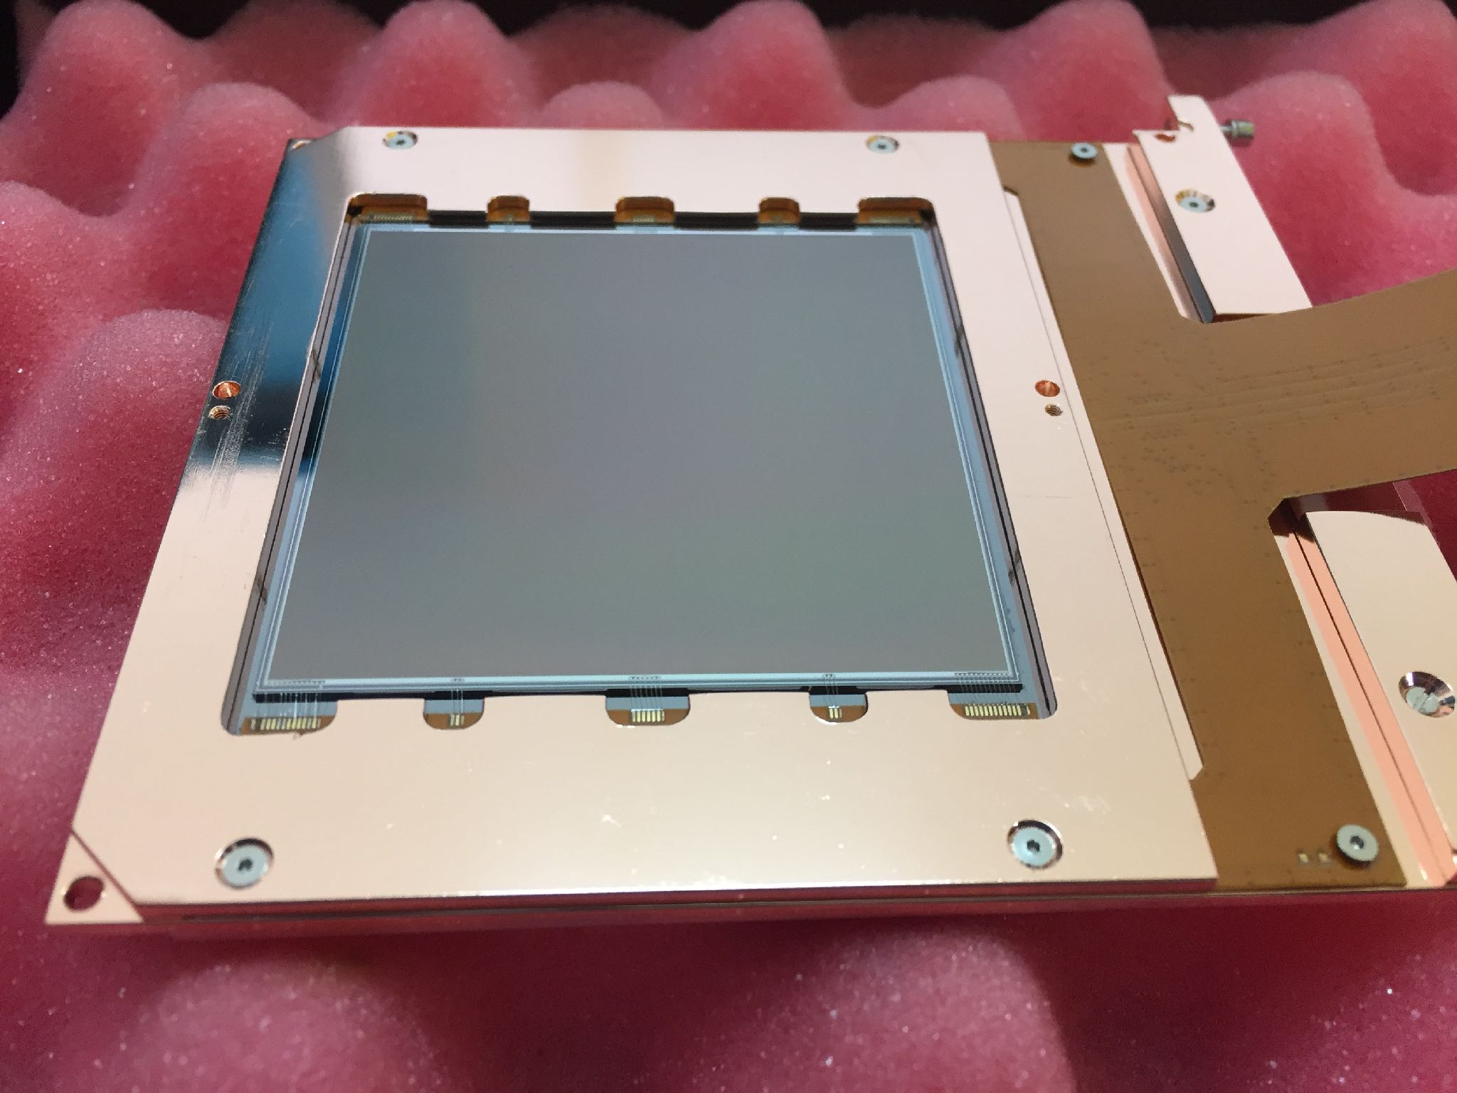
DAMIC 2016 sensors
4 amplifiers
2e- noise
low background package
16 Mpix — 6g

Slide 14
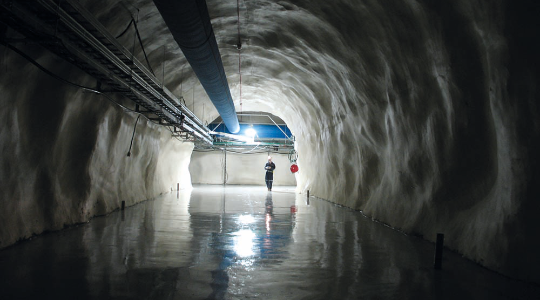
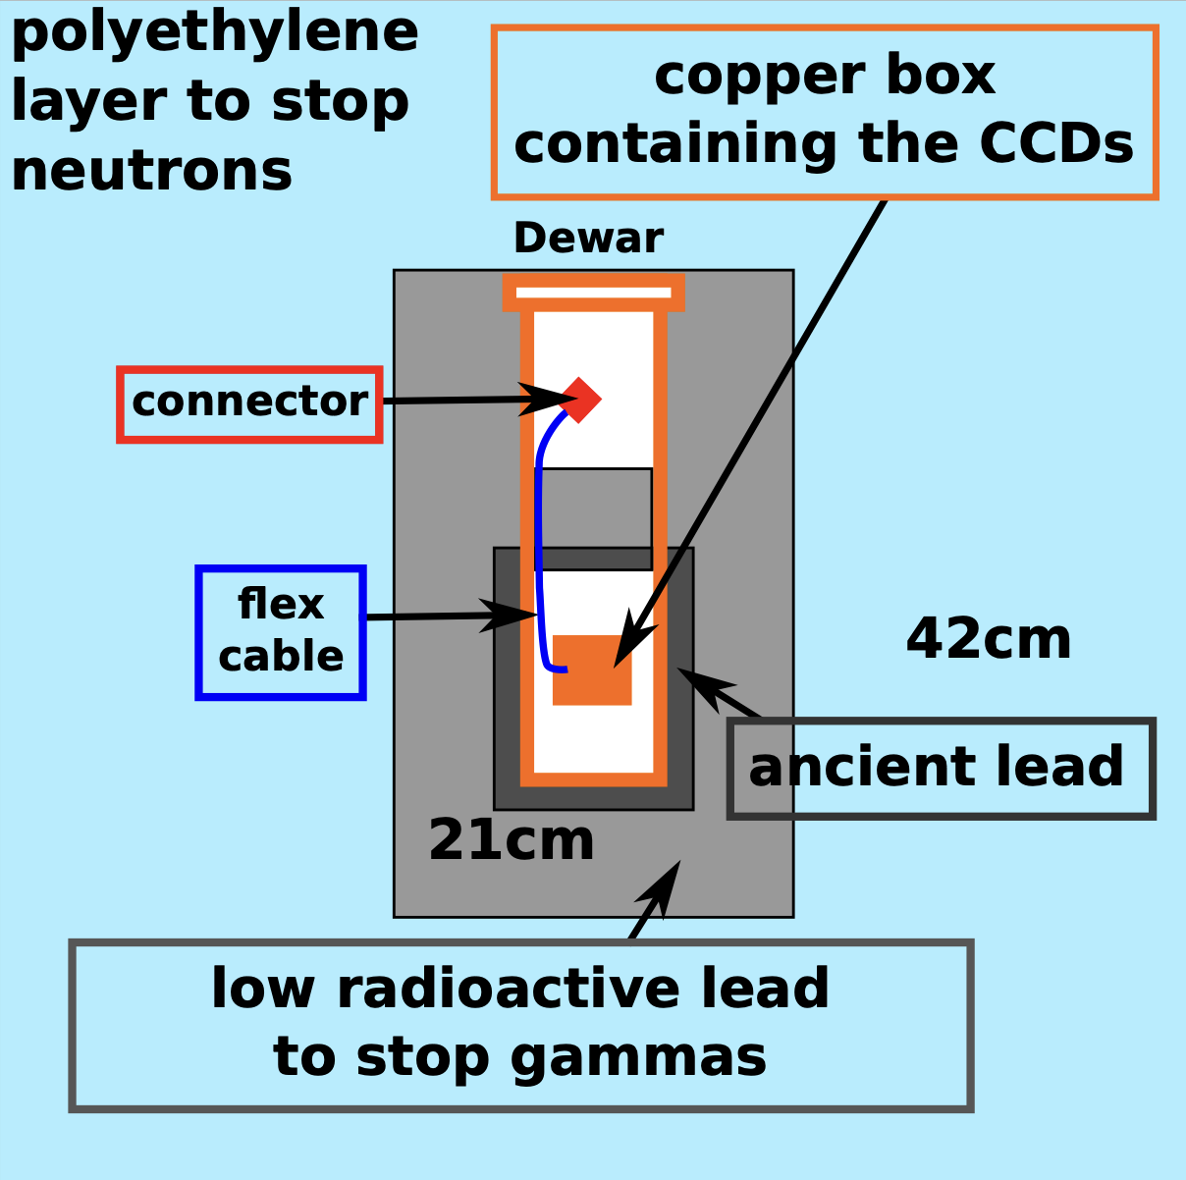

Go Deep : 2000 mts underground
And shield
Sensors at ~140K

Slide 15

Particle identification in a CCD image
muons, electrons and diffusion limited hits.

Slide 16
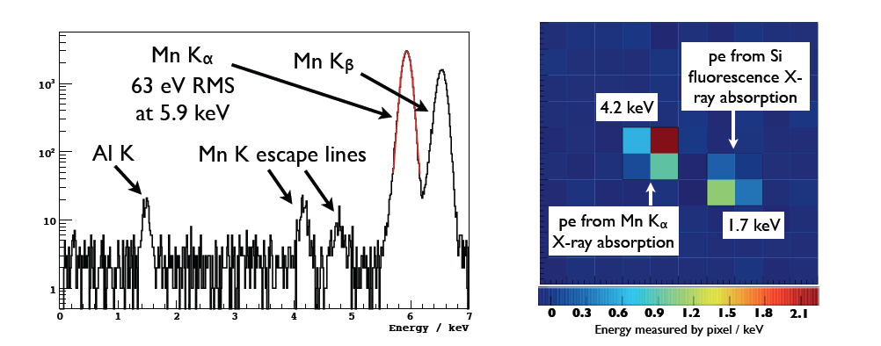
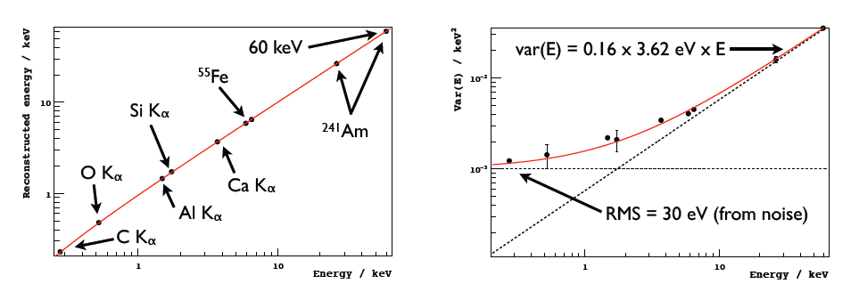

Slide 17
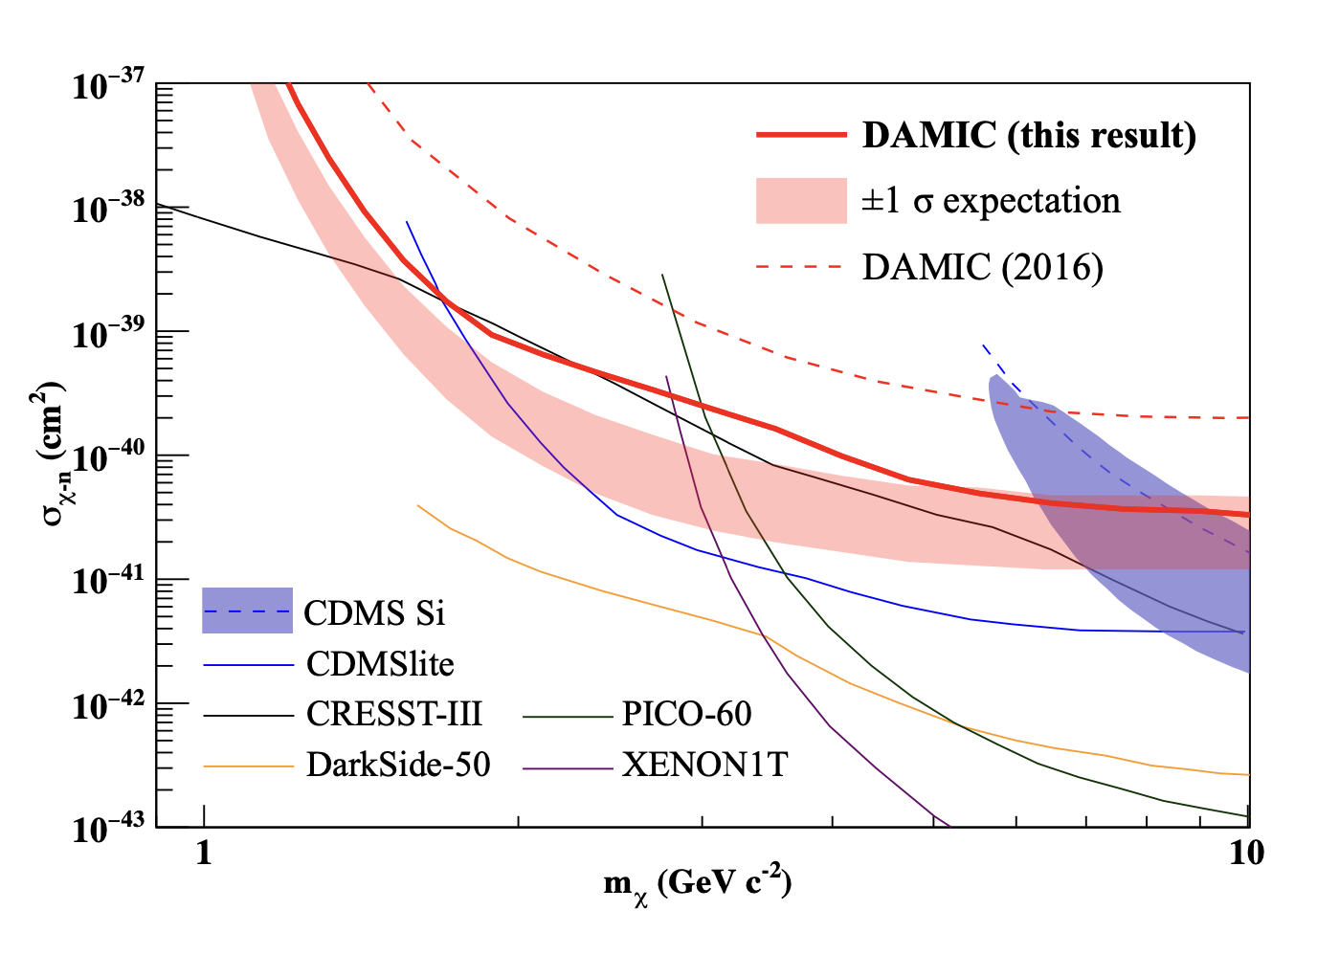
DAMIC 2020 results summary : 11 kg-day
Phys. Rev. Lett. 125, 241803 (2020).

Slide 18
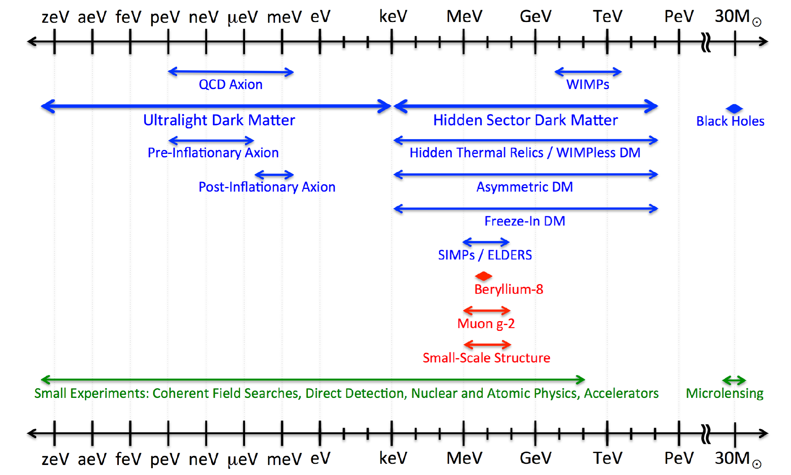
Around 2019… we started to look elsewhere for dark matter.

Slide 19
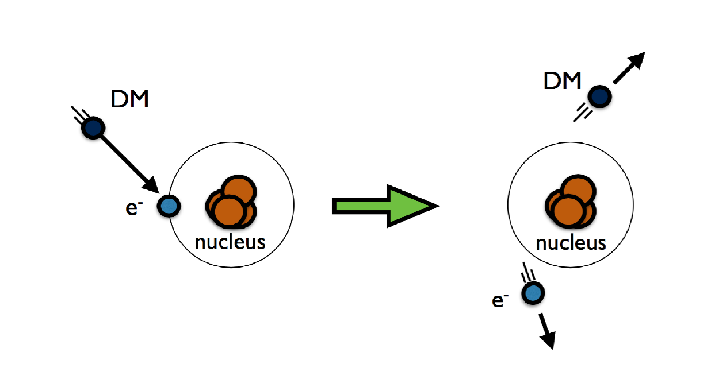
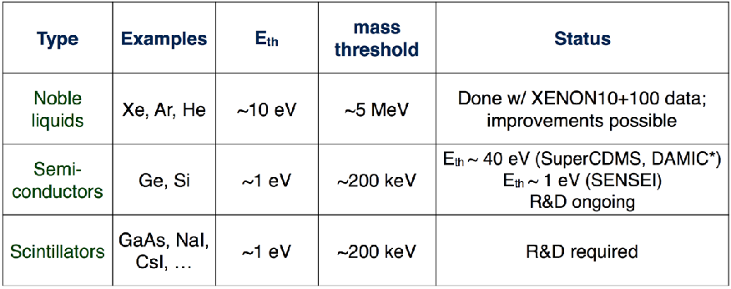
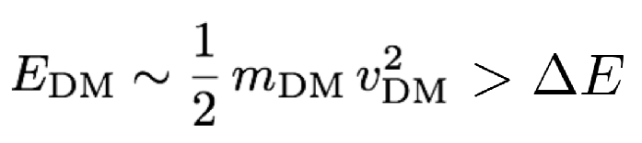
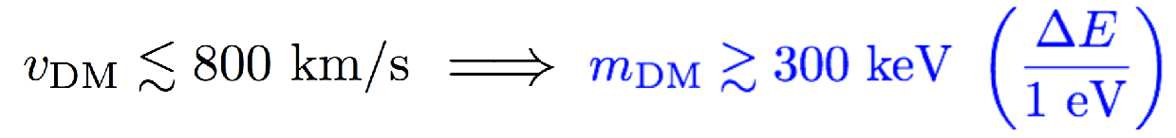
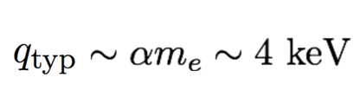

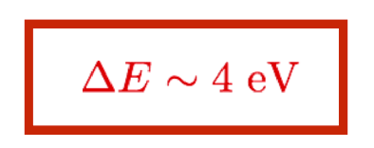
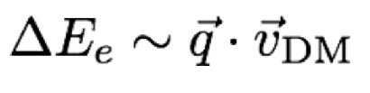
the “classic” search for wimps looks for nuclear recoil, but when looking at lower mass particles the e-recoil channel could be more competitive.
biding energy (~1 eV)
for outer shell e-
typical recoil energy:

Slide 20
skipper-CCD a “new” tool to push for lower threshold in DM searches.

Slide 21
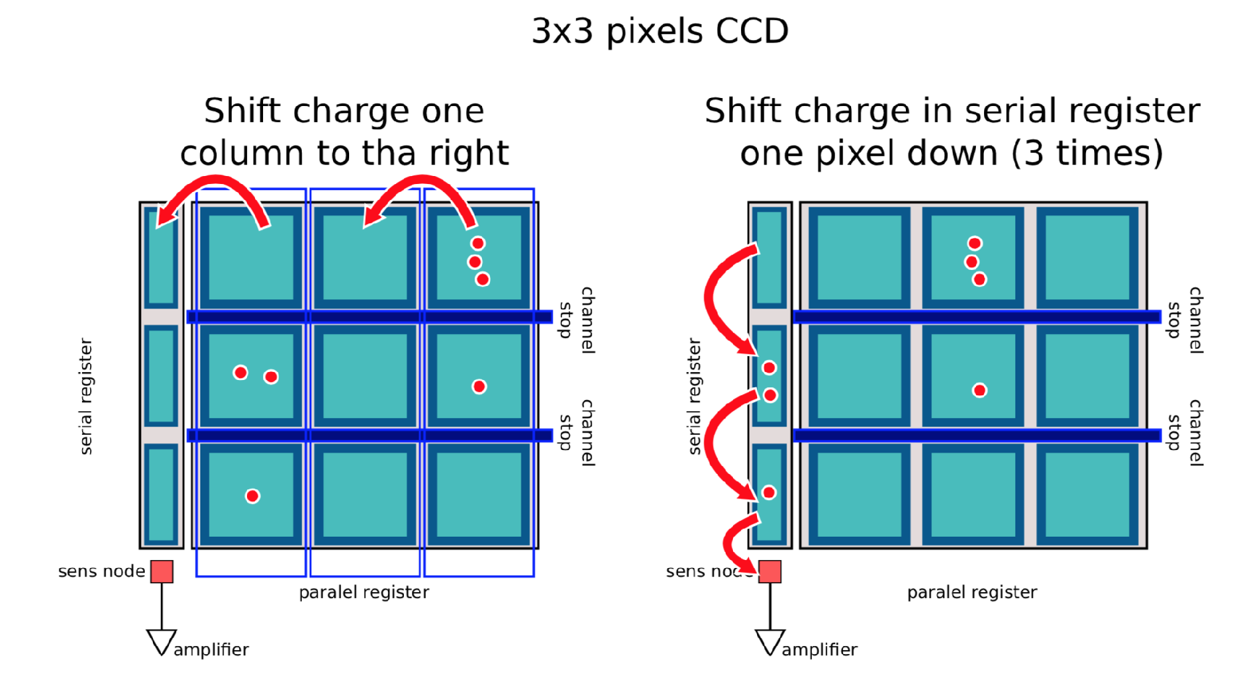
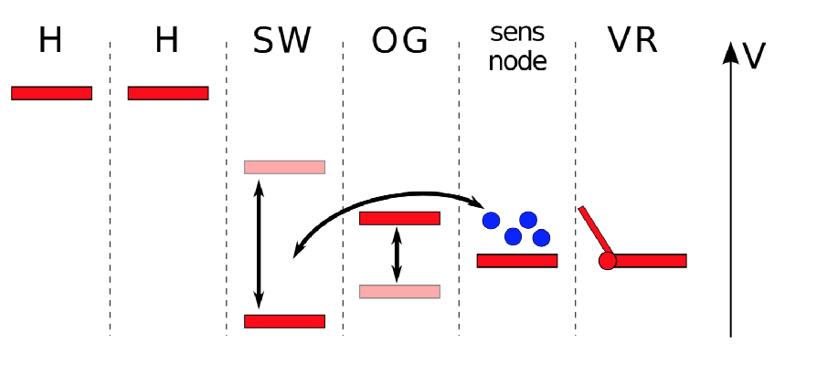
The skipper-CCD is a modification of the output stage of a CCD (Janesik et al -1990). It allows for multiple non-destructive readout of the charge in a pixel.

Slide 22
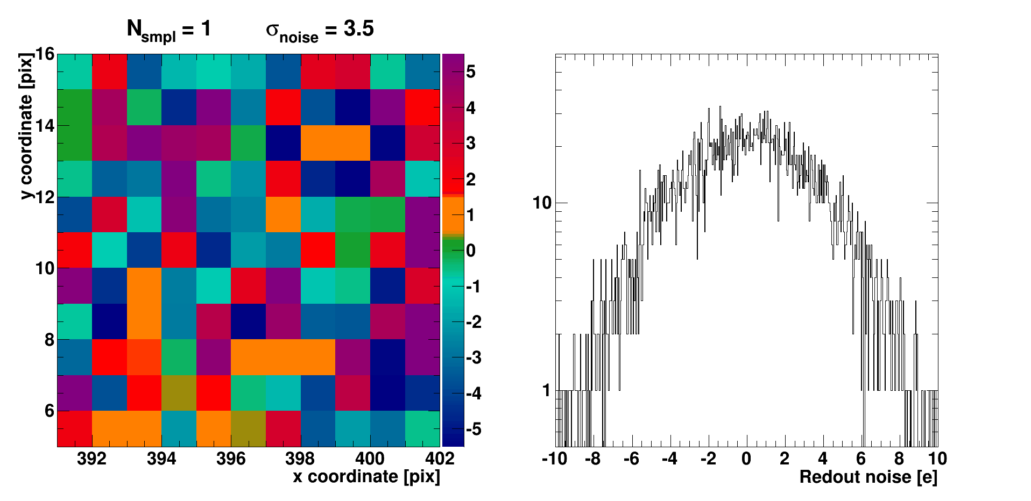
skipper-CCD

Slide 23
DAMIC 2016
skipper CCD
𝛔 = 0.06 e
Phys. Rev. Lett. 119, 131802 (2017)
Designed ~30 years ago, but technology first demonstrated summer 2017 by Javier Tiffenberg et al allows reduction of the threshold by another factor of 10.

Slide 24
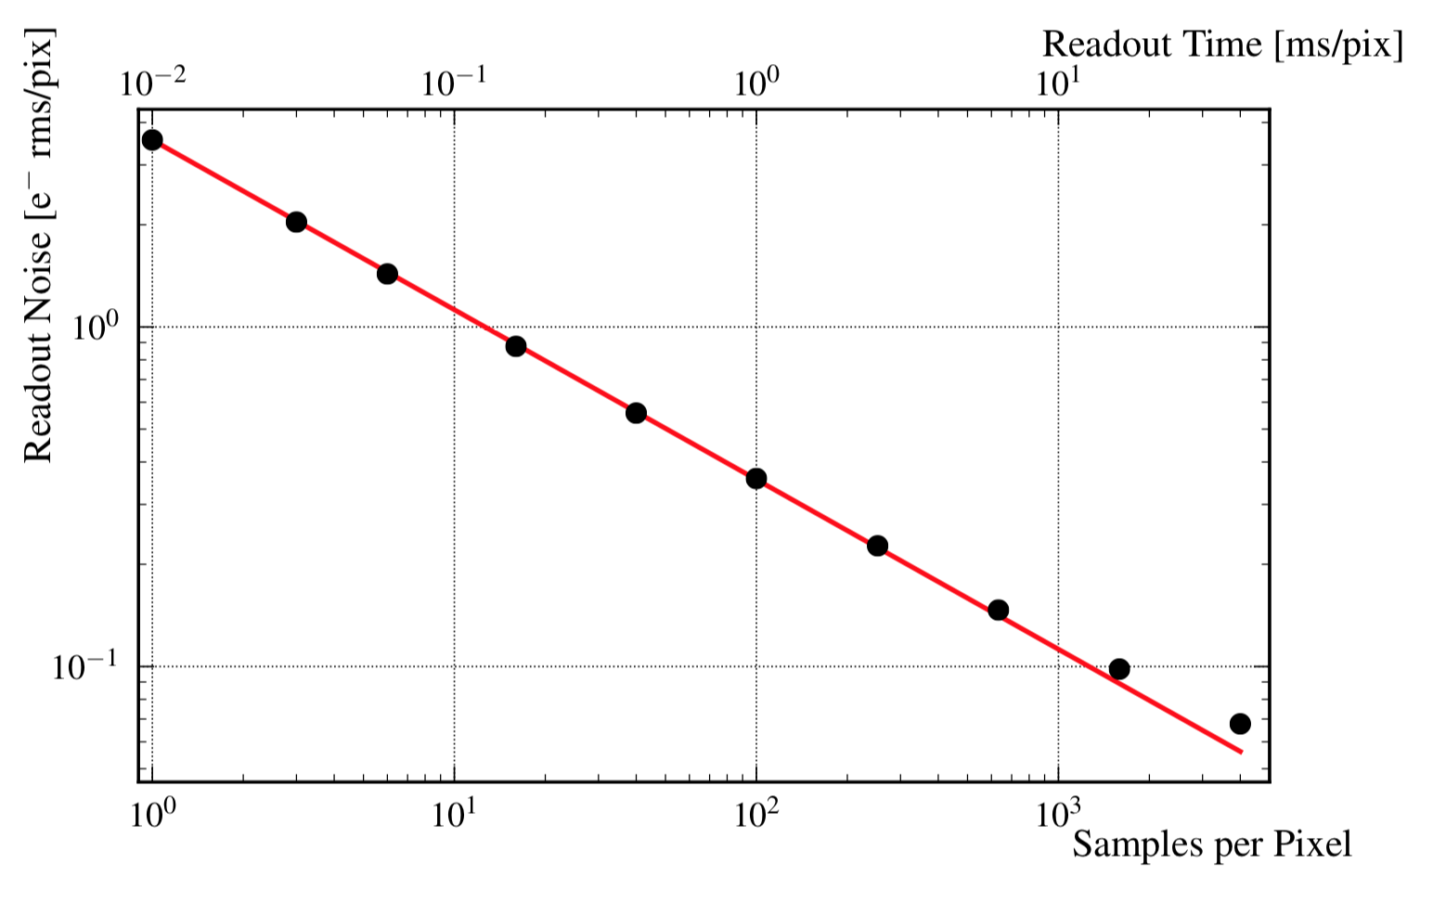

Slide 25
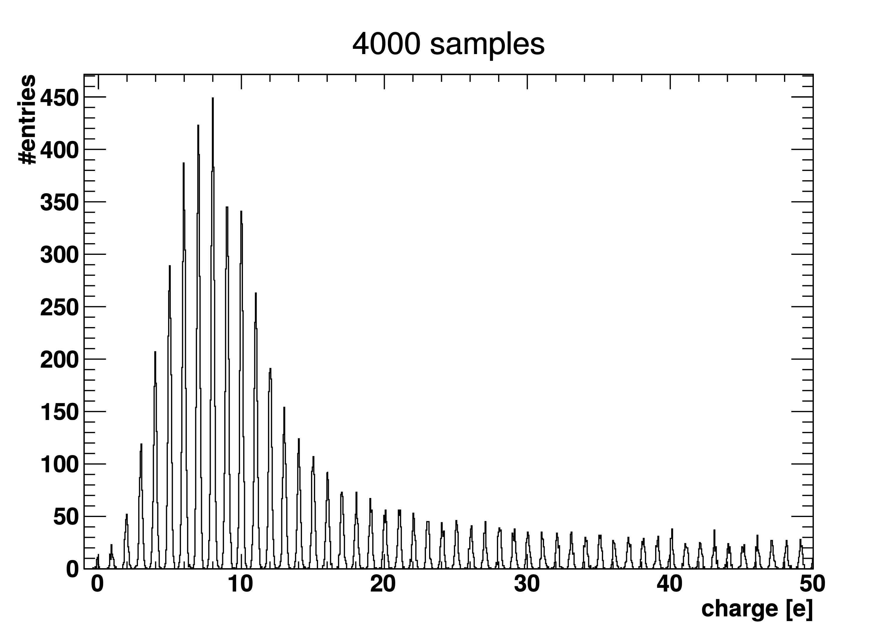
impressive ability to count electrons!

Slide 26
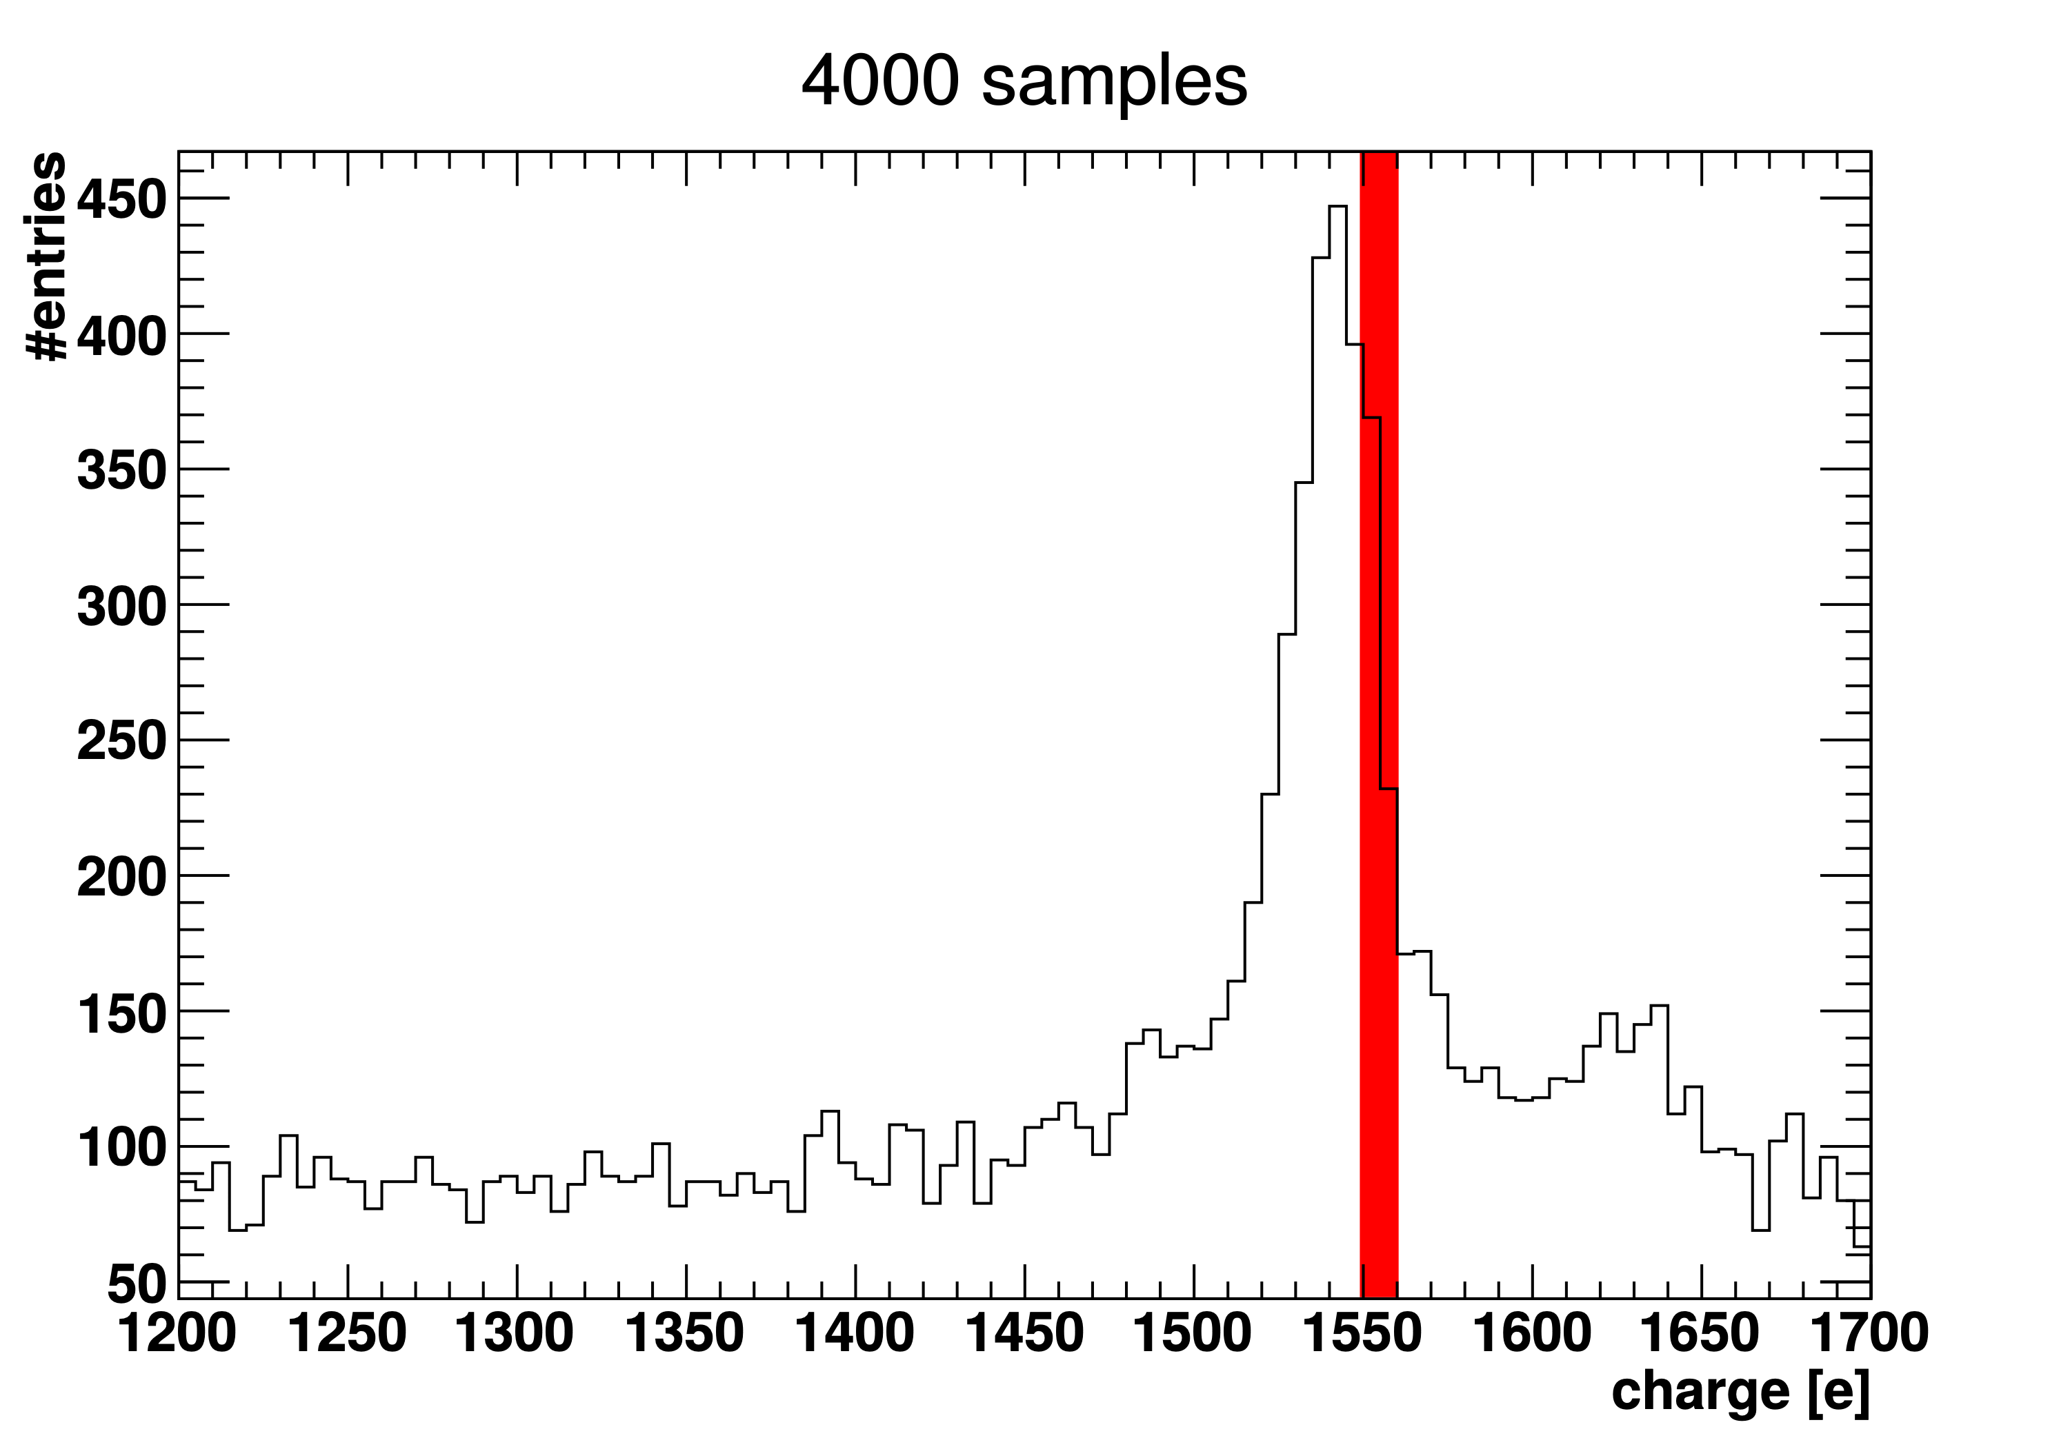
⁵⁵Fe X-ray line 5.9 keV

Slide 27
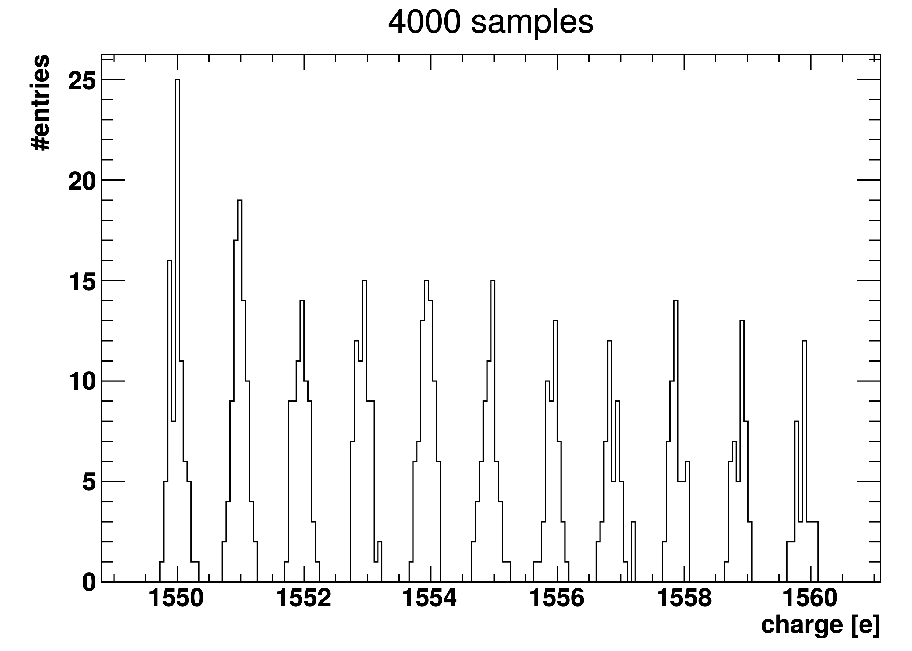
⁵⁵Fe X-ray line 5.9 keV

Slide 28
dark sector searches

Slide 29
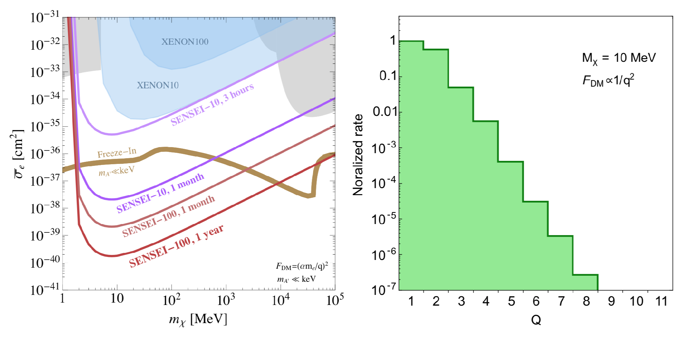
Once you can count electrons, you can search for electron recoils produced by very low mass dark matter (dark sector searches). As done with skipper-CCD in the SENSEI experiment.

Slide 30
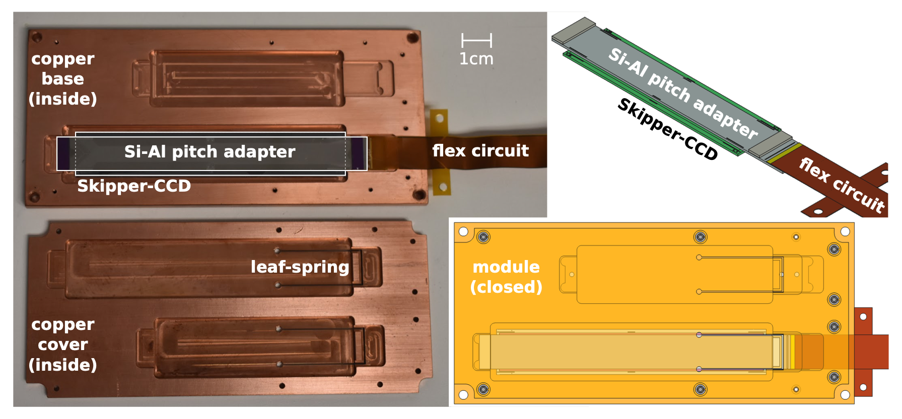
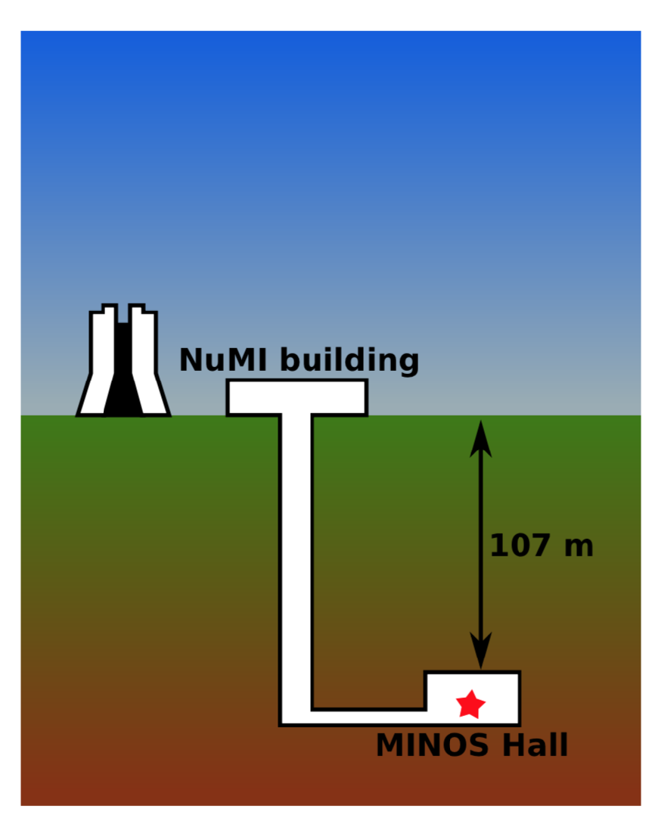
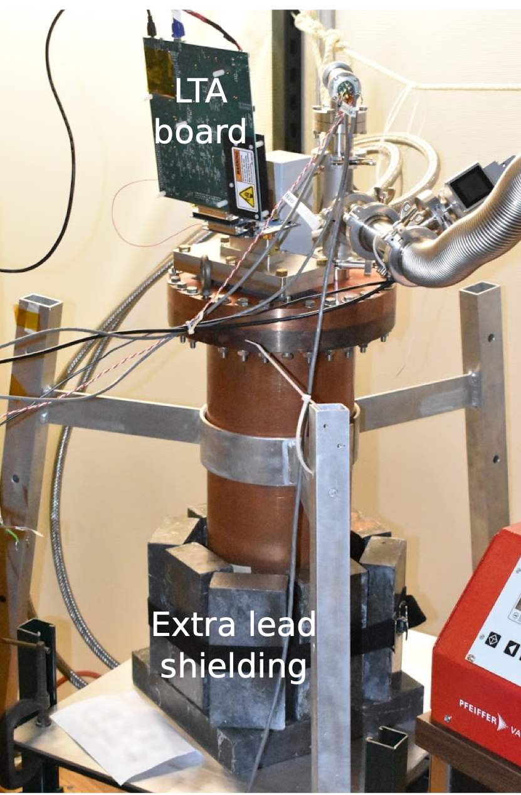
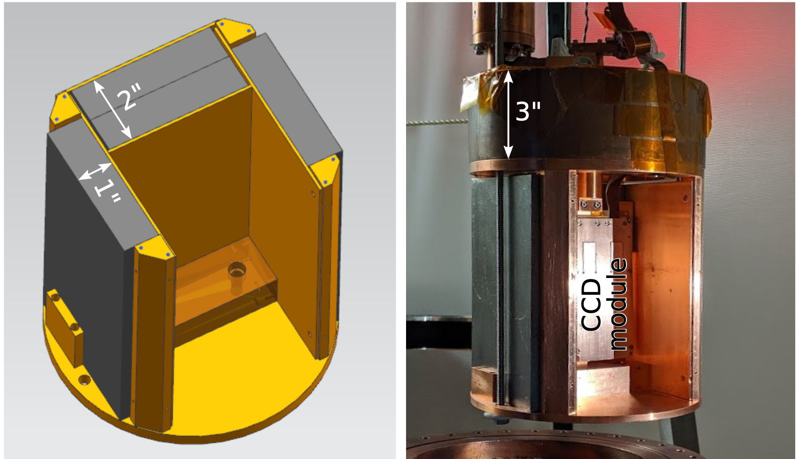
SENSEI 2020 results
arXiv:2004.11378

Slide 31
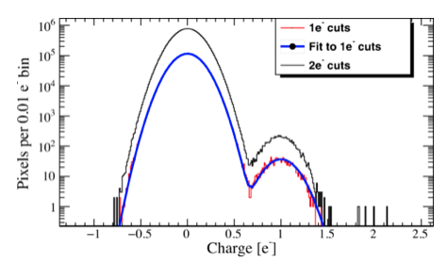
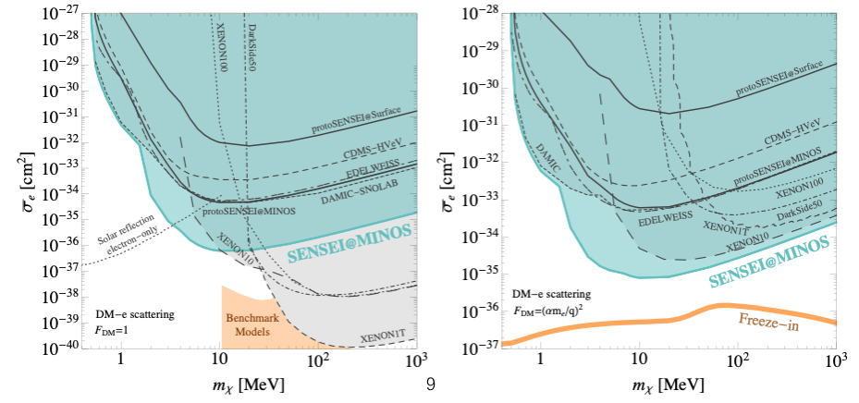
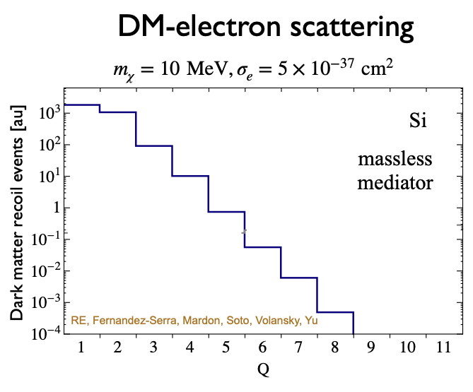
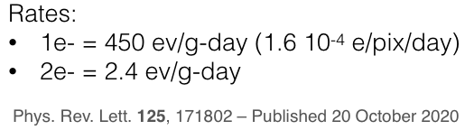
Skipper-CCD enabling technology
Skipper-CCD is an electron counting silicon detector device.
SENSEI-2g
e-recoil DM spectrum

Slide 32
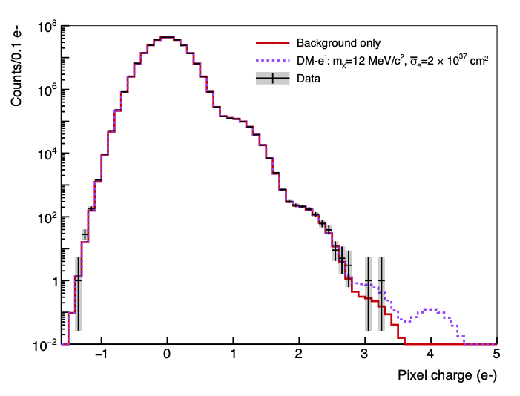
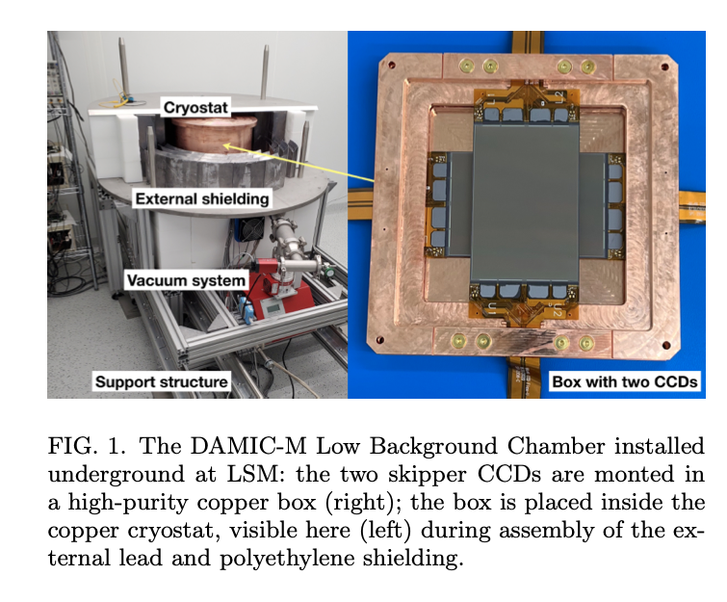
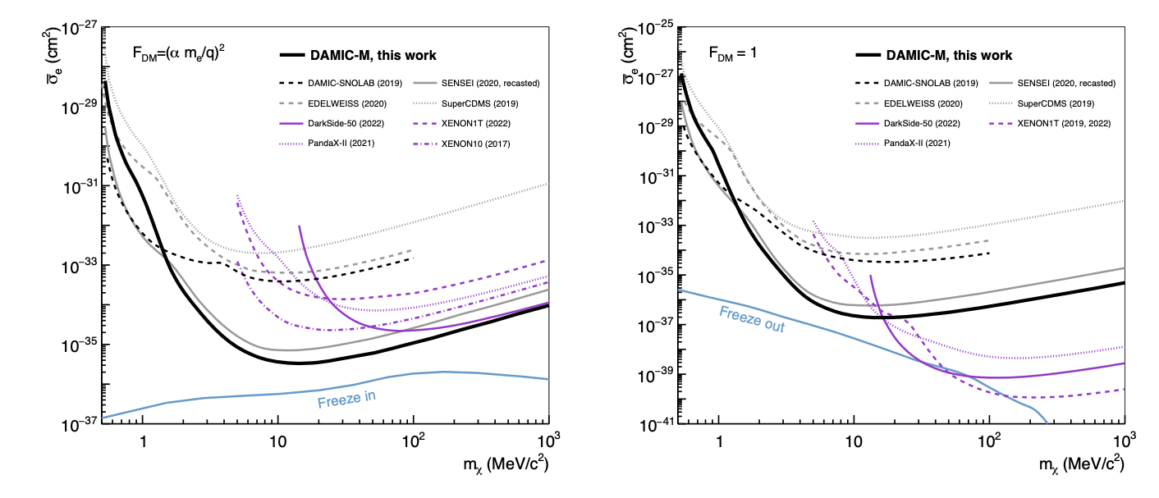
Update from DAMIC-M (@Modane)
Phys. Rev. Lett. 130, 171003 – Published 28 April 2023
Improvement over SENSEI 2020.
arXiv:2302.02372
85 g-day 10 dru

Slide 33
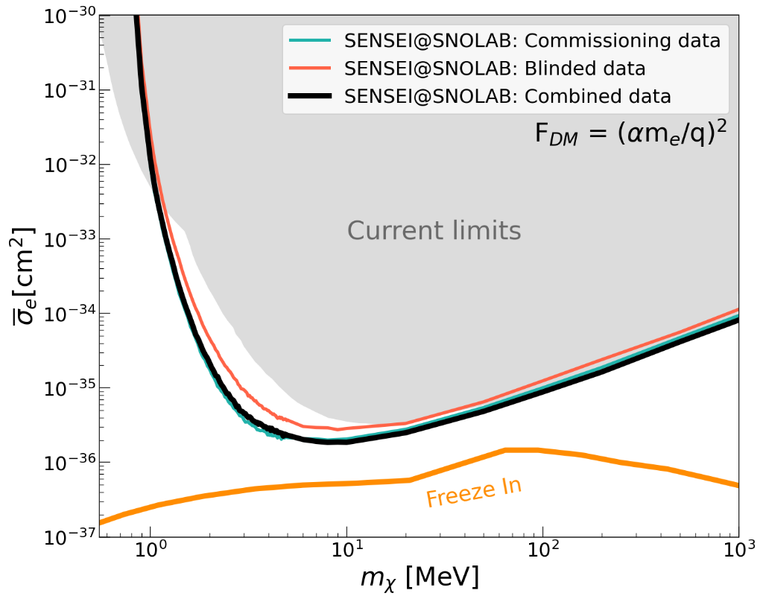
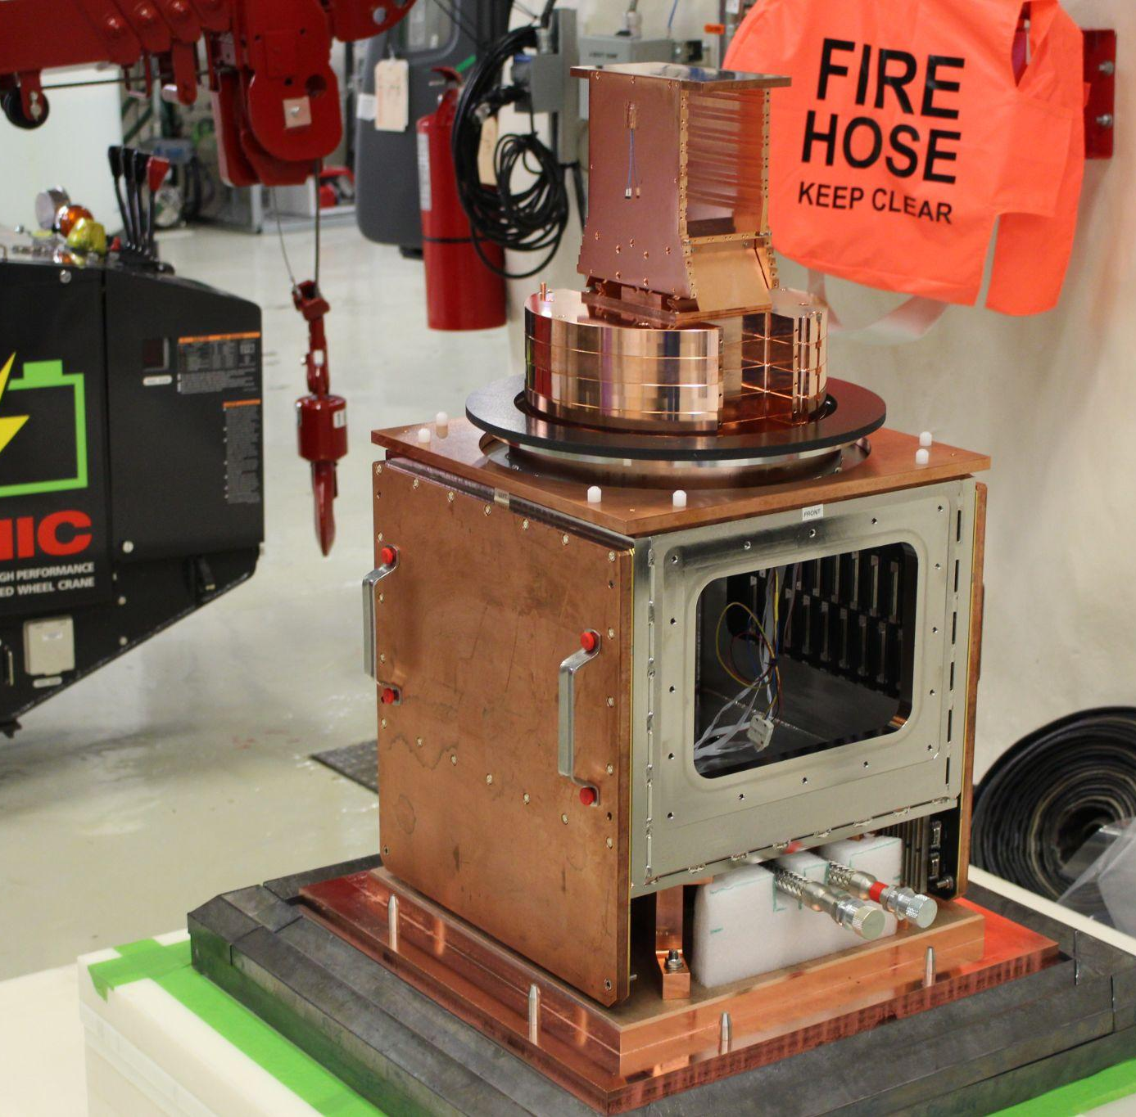


Update from SENSEI-2023 (@SNOLAB)
2023 April APS meeting
Improvement over DAMIC-M
Data: 45 unblinded commissioning images, 37 blinded images, 2-10 e⁻ channels
Exposure ~70 g-days per electron channel
Three limits: blinded dataset, commissioning dataset, and combined commissioning + blinded exposure
Paper in preparation to present full results

Slide 34

Skipper-CCD DM program : technology roadmap
Oscura is an ambitious program that brings together the DAMIC, SENSEI and DAMIC-M teams for the development of ultimate DM experiment with skipper-CCDs.

Slide 35

From sensor performance to science
arXiv:2304.0440
prototypes
requirement
goal

Slide 36





Completed R&D : electronics/packaging Multi Chip Module
Functional test cold
Low background solution (Silicon)
Circuit layout
MCM concept 2021
6” ceramic MCM 2022
6” Si MCM 2022 : fabs and ANL + FNAL
Mechanical prototype of the Oscura Supermodule with 130g of CCDs (16 MCMs)
After a few iterations on the design of the Si-MCM we have now tested it, and are confident we can achieve the Oscura specs.

Slide 37




Completed R&D : electronics
Cold front end:
Back end : Designed and tested a multiplexer solution for the back end. Operated 160 CCDs with single readout channel.
Sensors 2022, 22(11), 4308
Designed, Fabricated and Tested the MIDNA ASIC. Cold front end electronics for skipper-CCD. 4-channel.
https://arxiv.org/abs/2304.13088

Slide 38
Next : Faster Non-destructive readout.

Slide 39




mas-CCD
arXiv:2308.09822

Slide 40

Others sensors in the works
No paper with electron counting yet… but soon.

Slide 41



Double-sided CCD (no fab yet)
Suppresses surface dark current, also provides timing.
Reading sides in opposite directions.
arXiv:2307.13723

Slide 42

Now skipper-CCDs for cosmic surveys
It has now become evident that non-destructive readout (skippers) allow adaptive noise on the readout of spectroscopic data. This could have a huge impact in the noise limited cosmic spectroscopic surveys of the future. See arXiv:2103.07527 arXiv:2210.03665).
First test of skipper-CCD in a telescope coming soon (SIFS at SOAR 4m, Alex Drlica-Wagner et al). These sensors could also play an important role in photon counting for future large space telescopes (working with NASA/GSFC)

Slide 43
Conclusion
Future looks exciting for silicon detectors with non destructive readout NDR (skipper-CCDs and more).
Originally developed for astronomy, NDR has found extensive use in dark matter (and low threshold experiments, Quantum imaging).
Recently commercial companies are starting to fabricate skipper-CCDs (STA).
Now, with faster readout architectures, NDR is coming back to the telescopes in the ground and in space.

Slide 44



DAMIC : excess over expected background
Phys. Rev. Lett. 125, 241803 (2020)
Phys. Rev. D 105, 062003 (2022)

Slide 45



Design: outer shield and installation inside SNOLAB
Outer shield assembly
In the SNOLAB drift
Detail of helium lines

Slide 46
tremendous progress over 30 years
Xenon1T
Snowmass report (2013)

