Slide 1
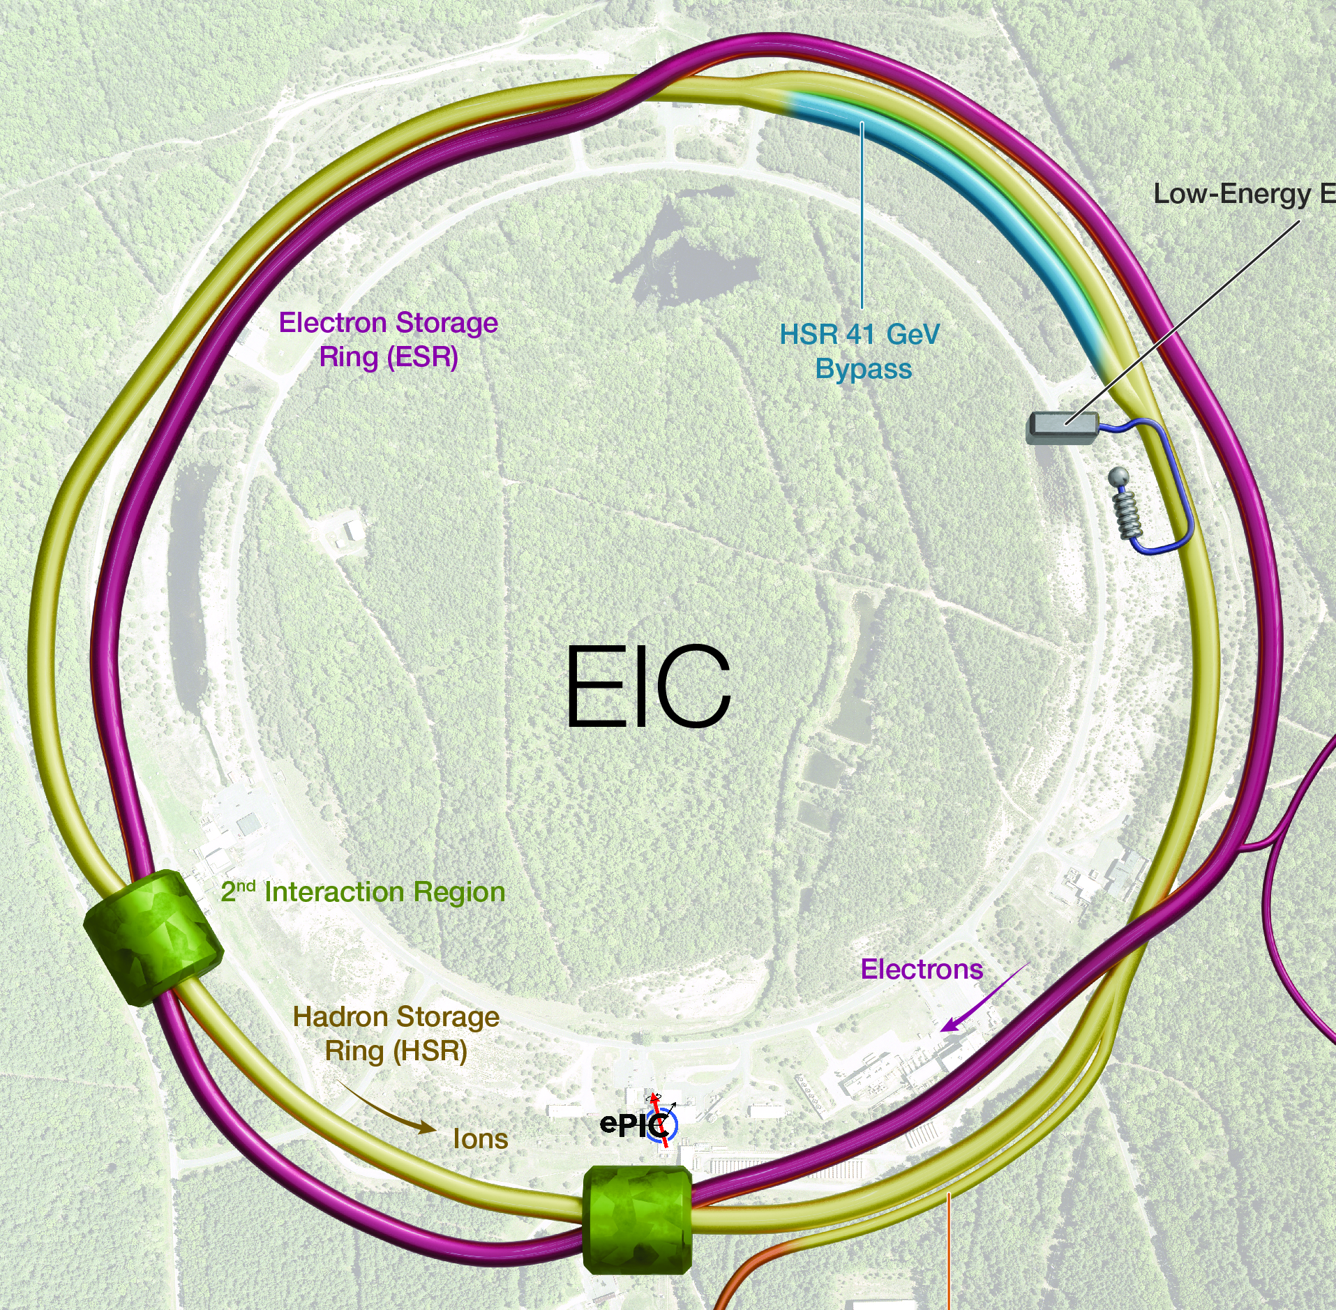
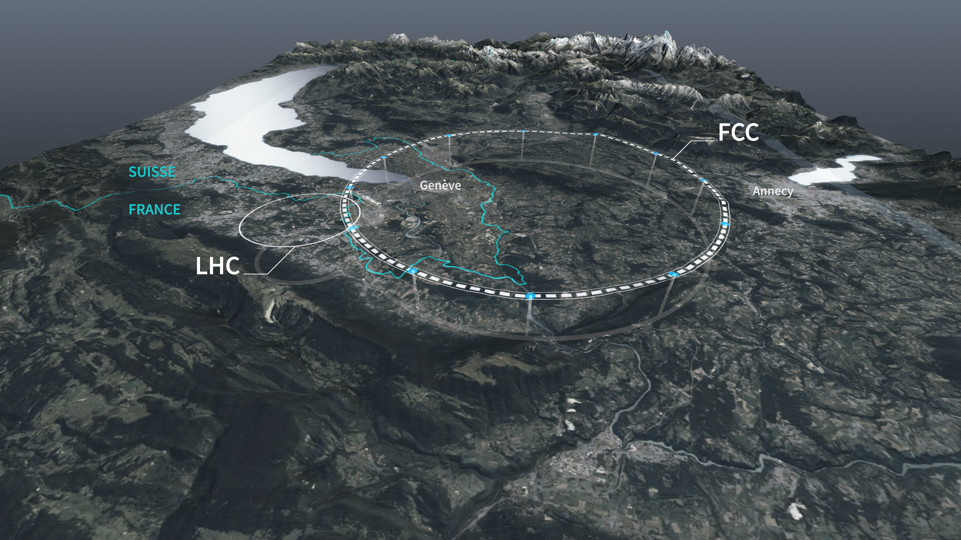
FCC-EIC Synergies
Frank Zimmermann, CERN
IPAC’26, Deauvillle, 20 May 2026

Slide 2

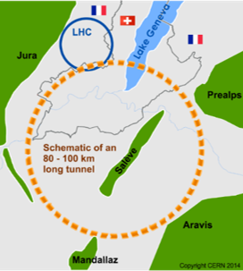
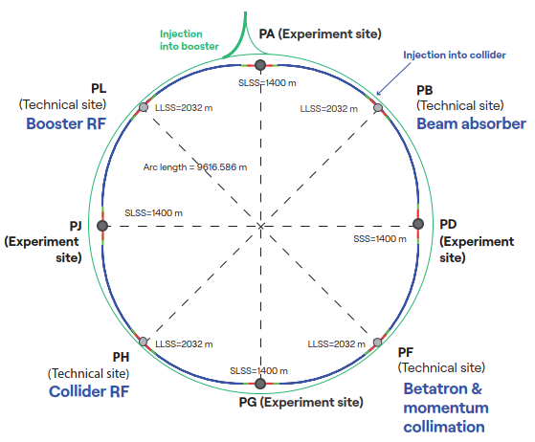
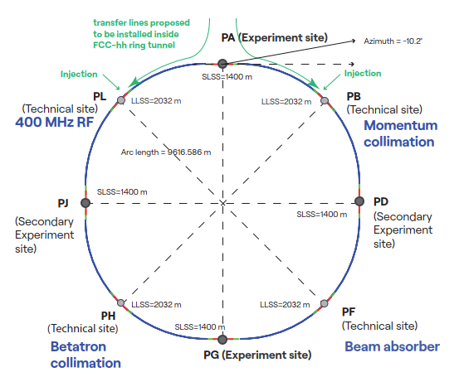
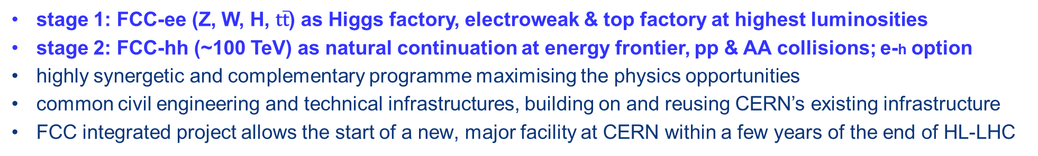
Future Circular Collider integrated program – scope
stage 1: FCC-ee (Z, W, H, $\text{t}\overline{\text{t}}$) as Higgs factory, electroweak & top factory at highest luminosities
stage 2: FCC-hh (~100 TeV) as natural continuation at energy frontier, pp & AA collisions; e-h option
highly synergetic and complementary programme maximising the physics opportunities
common civil engineering and technical infrastructures, building on and reusing CERN’s existing infrastructure
FCC integrated project allows the start of a new, major facility at CERN within a few years of the end of HL-LHC
FCC-ee
FCC-hh
2020 - 2045
2048 - 2062
~2075 - ~2100

Slide 3
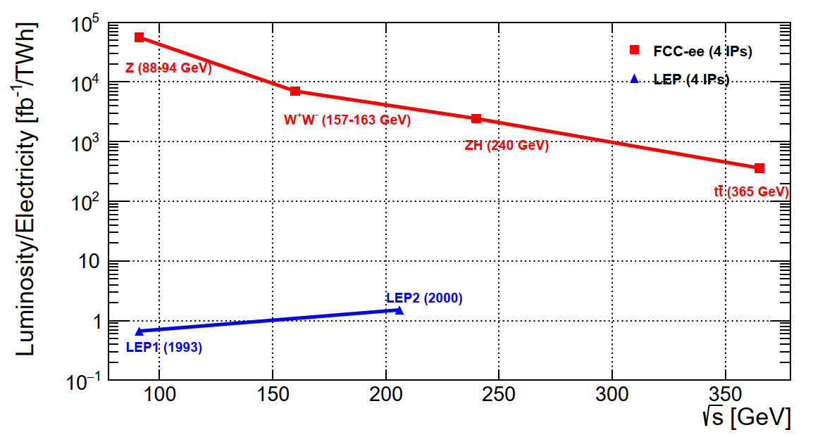
FCC-ee basic design choices and performance
Combining concepts from past and present lepton colliders and using high-efficiency SRF system results in a giant step in efficiency:
Double ring e⁺e⁻ collider, allowing many bunches, high current, like LHC and B factories, different from LEP
Synchrotron radiation power 50 MW/beam at all beam energies. Energy loss ΔE per turn:
ΔE ~ γ⁴/ρ = (E/m₀)⁴/ρ
Asymmetric IR layout and optics to limit synchrotron radiation towards the detector and to provide large horizontal crossing angle 30 mrad for crab-waist collision optics, demonstrated at DAFNE (Italy) and SuperKEKB (Japan)
Top-up injection scheme as at modern light sources (APS, SLS,…) and as at recent e⁺e⁻ colliders, PEP-II (USA), KEKB & SuperKEKB (Japan), BEPCII (China), requires booster synchrotron in collider tunnel
→10⁴–10⁵x luminosity/el.energy of LEP
→ sustainable physics
Notes:
In situ , not in- place

Slide 4

FCC design with Xsuite
Powerful modular modern successor of MAD-8 (LEP design) and MAD-X (LHC design) etc.
tutorials in form of Jupyter notebooks
G. Iadarola

Slide 5
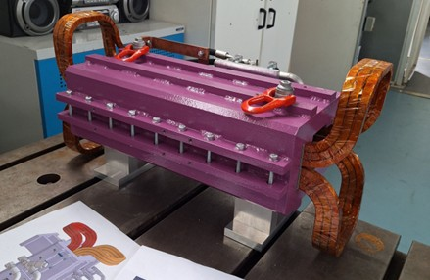
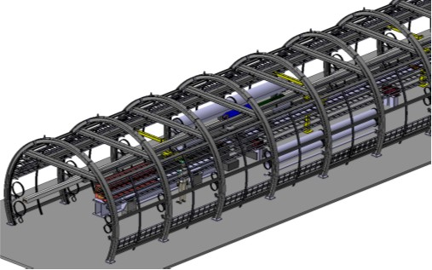
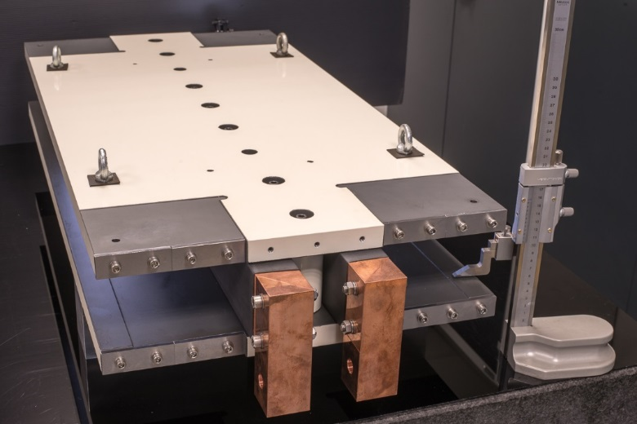
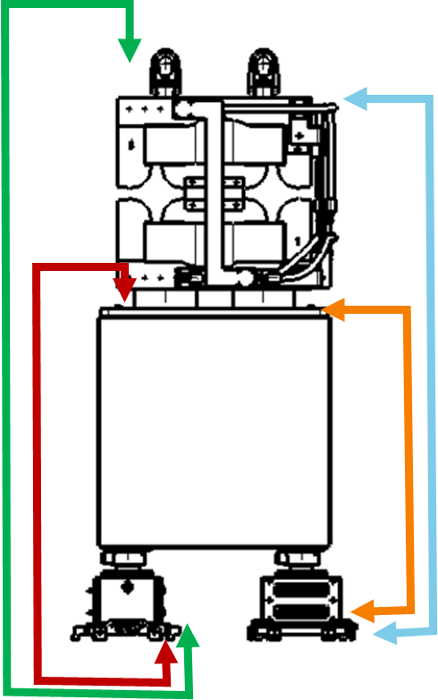
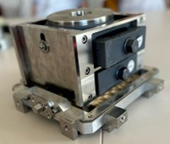
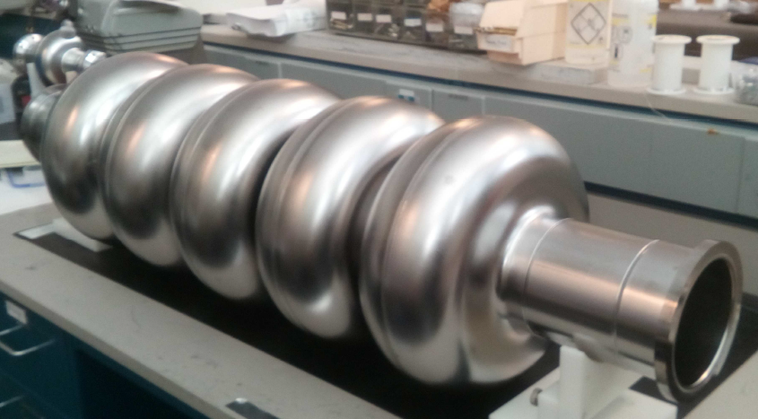
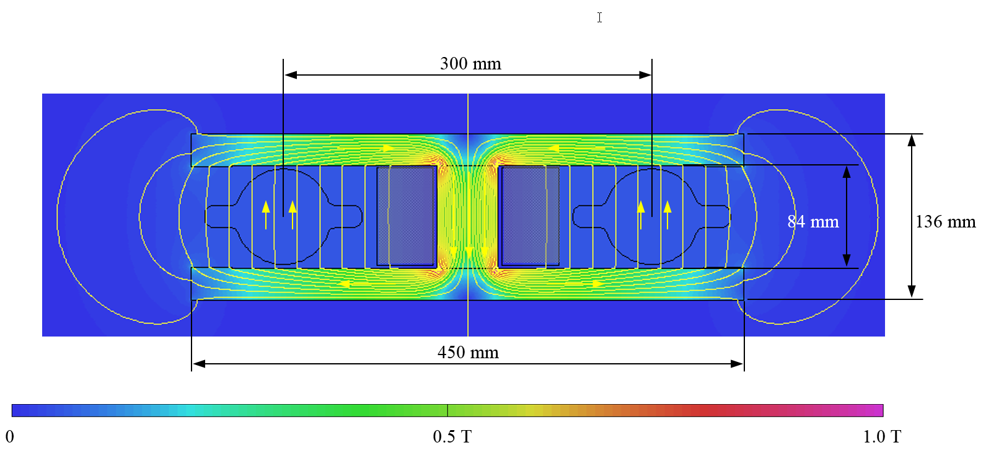
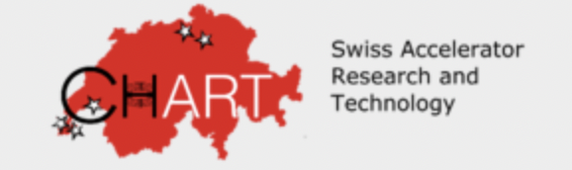

R&D on arc magnets, girders, cavities, prototypes, mock-ups
Arc half-cell =
the most repeated region of mechanical hardware in the tunnel: → 77 km over 90 km are arc cells
Booster dipole
low-field cycling magnet
F. Carra & A. Piccini
A. Milanese
800 MHz bulk Nb 5-cell cavity
Prototype fulfilling FCC specs
JLAB, F. Marhauser
Twin-dipole design with 2× power saving 16 MW
(at 175 GeV)
Vibration studies with girder on PSI jacks

Slide 6
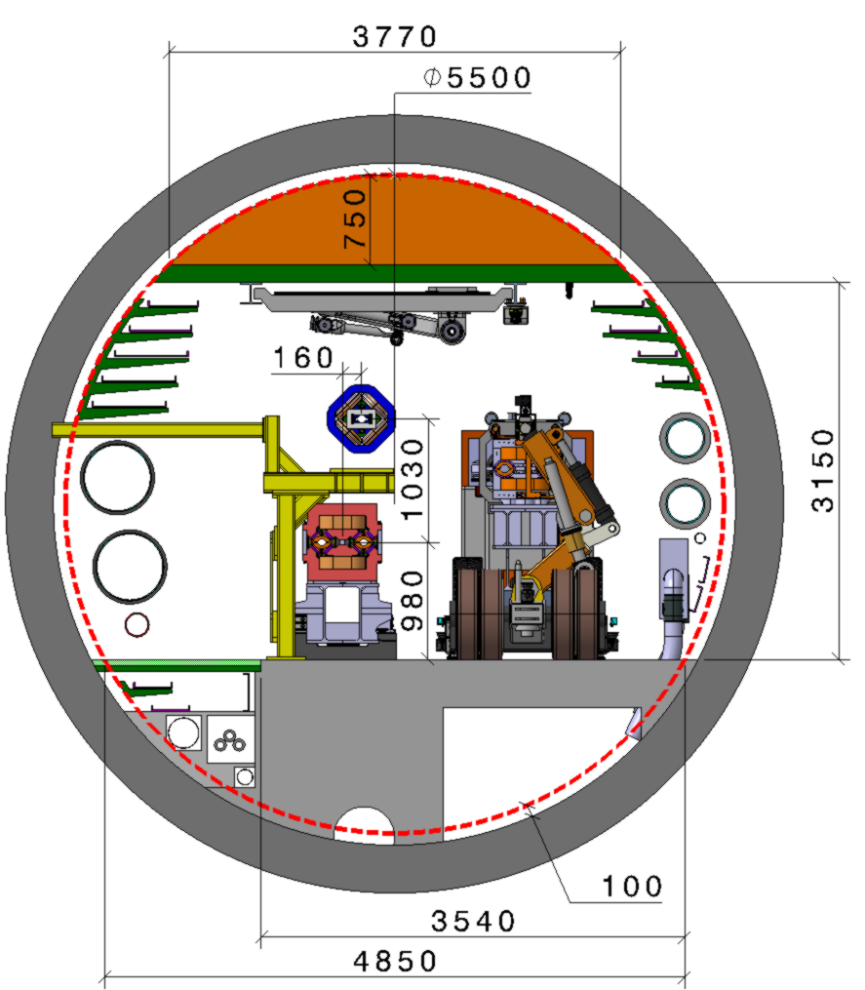
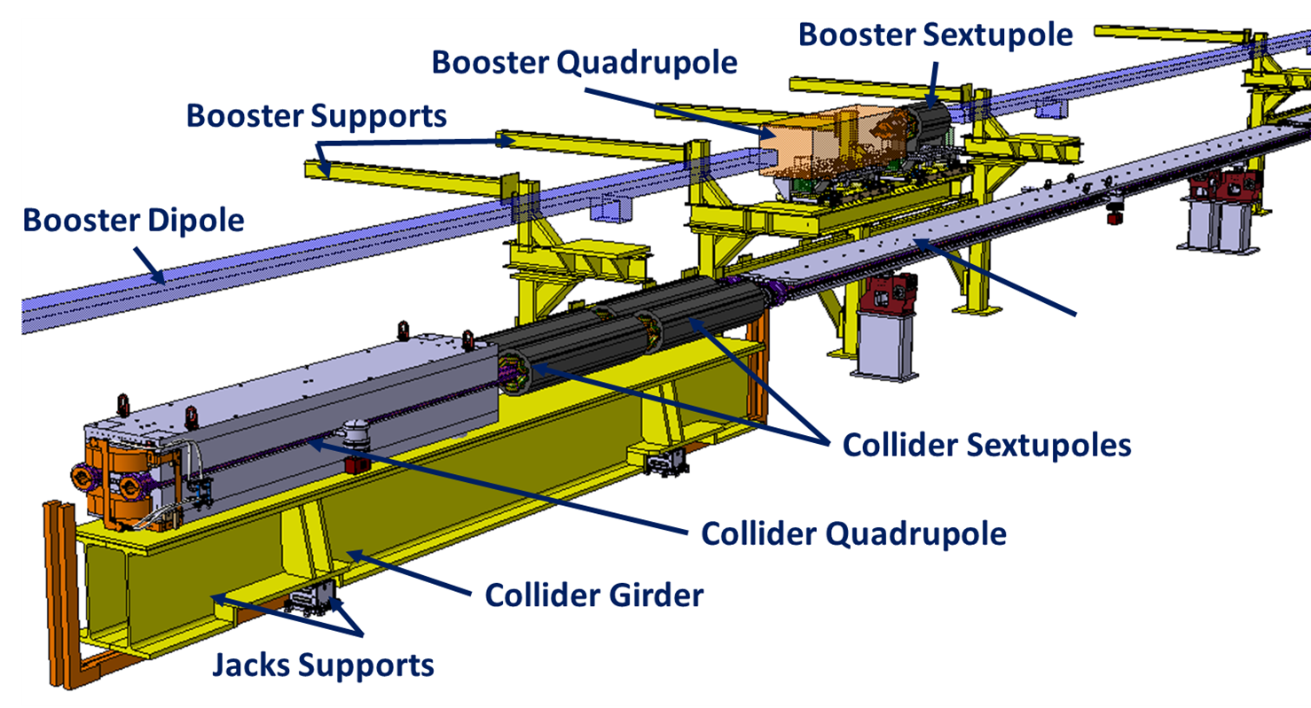
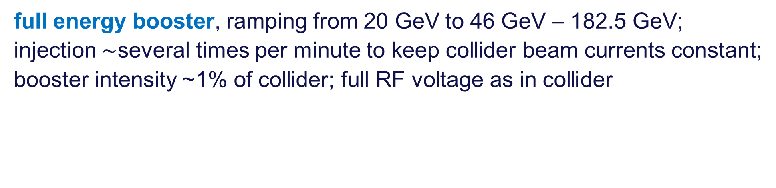
FCC-ee booster
full energy booster, ramping from 20 GeV to 46 GeV – 182.5 GeV;
injection $\sim$several times per minute to keep collider beam currents constant;
booster intensity ~1% of collider; full RF voltage as in collider
Booster
Collider

Slide 7

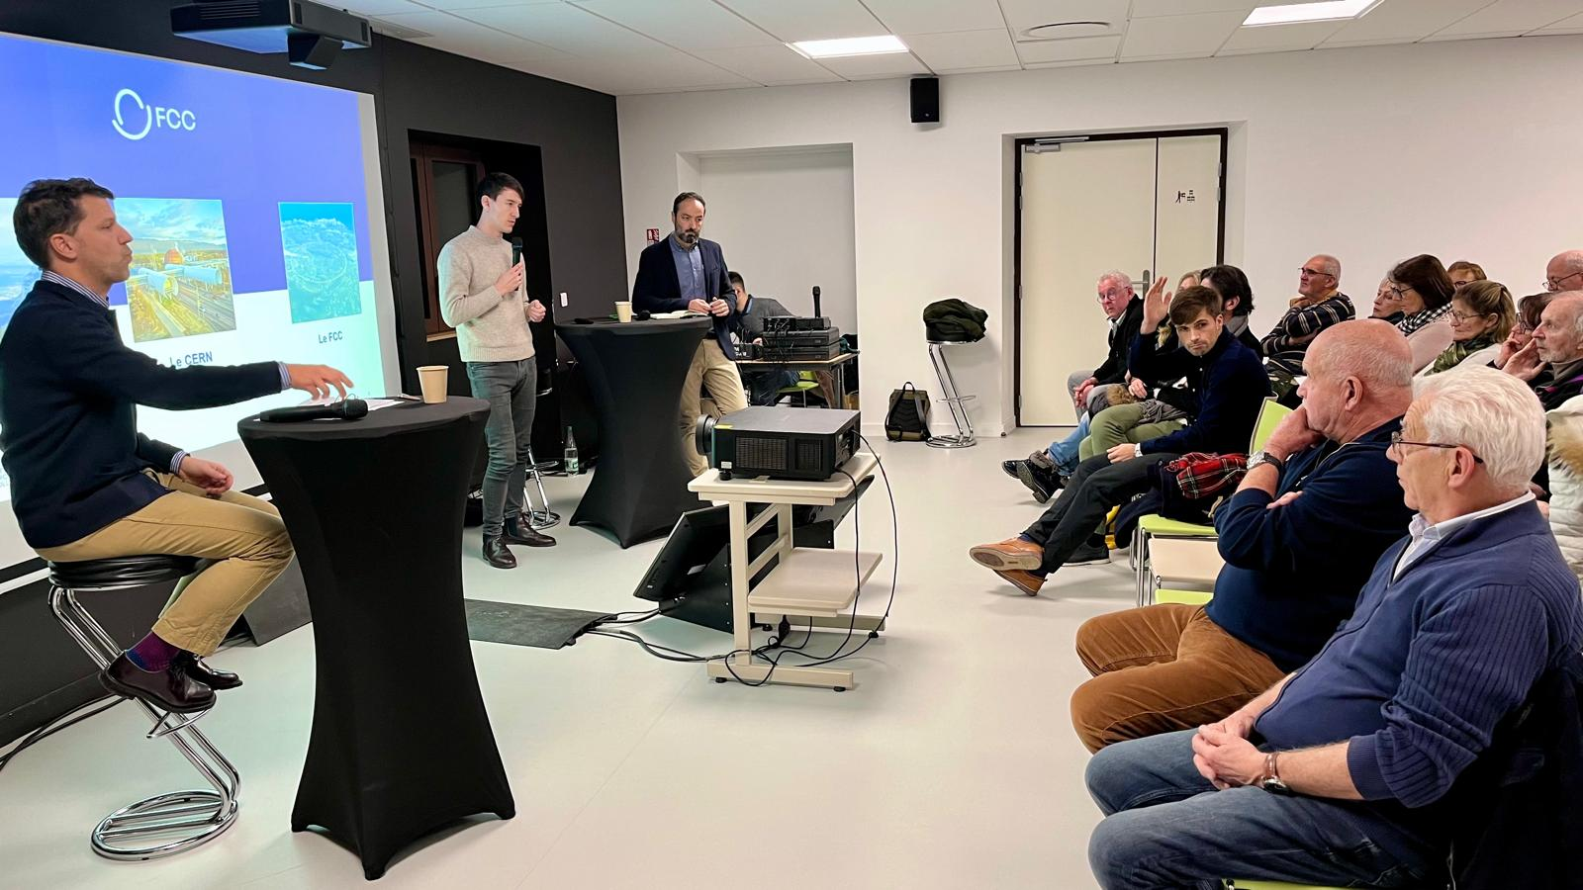
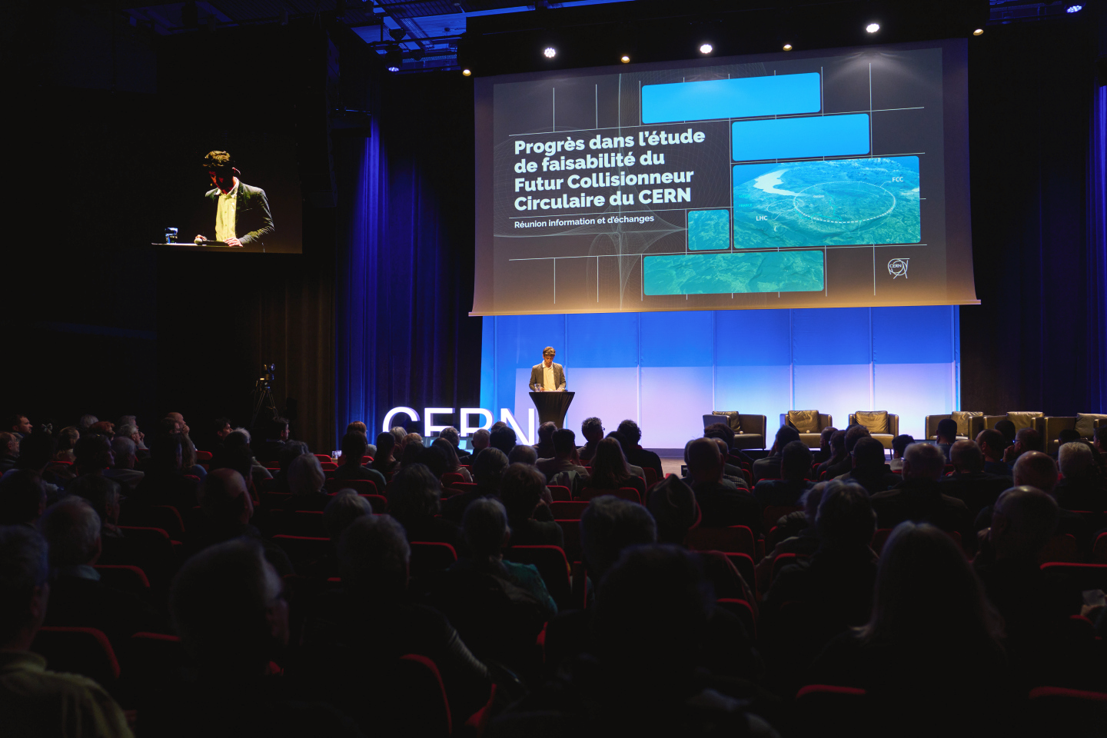
Territorial dialogue and public participation
First cycle of public information meetings completed (April 2024 – March 2025)
11 sessions reached over 1,500 people in France & Switzerland
During 2025:
Second cycle of public information meetings.
Presence days in municipalities affected by surface sites to enable discussion with habitants.
Meetings with stakeholders of the territory.
Dialogue
Website
During 2026:
Formal public participation process planned in France (Débat Public) and Switzerland (public concertation).

Slide 8
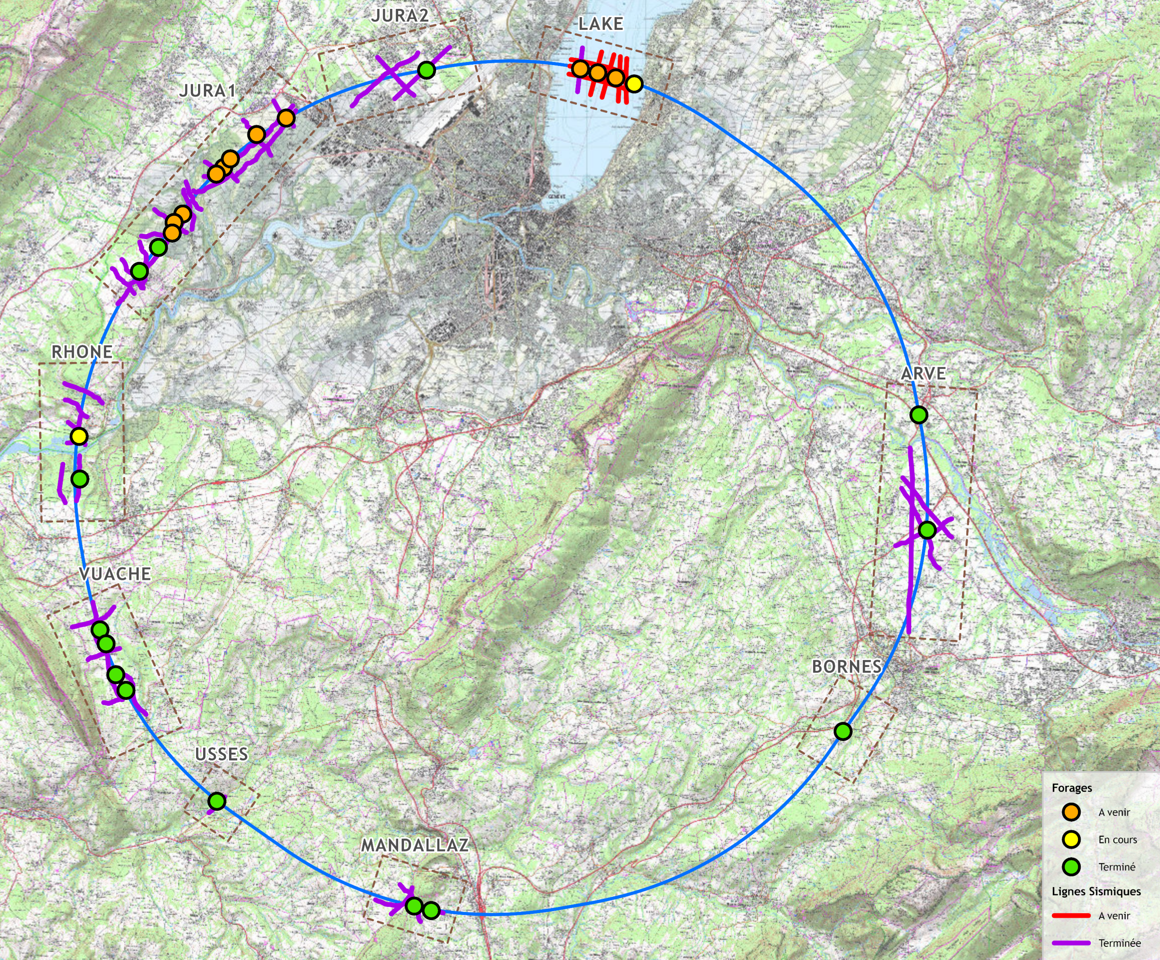
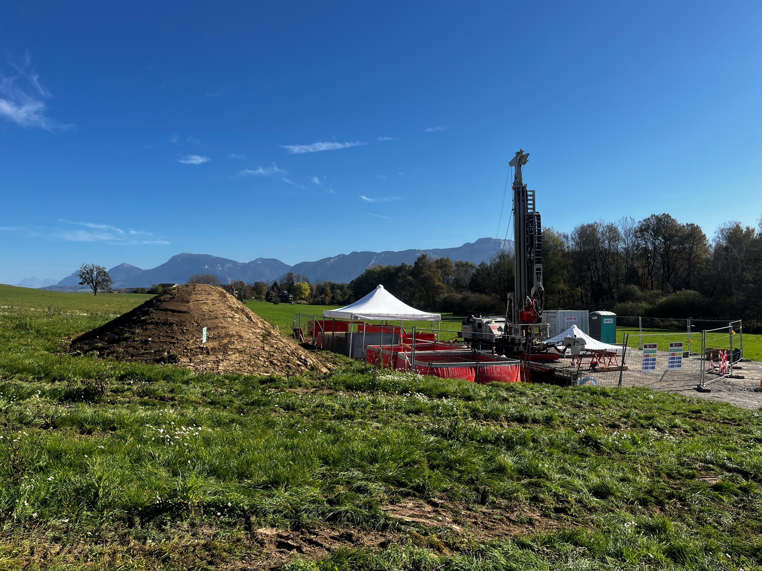
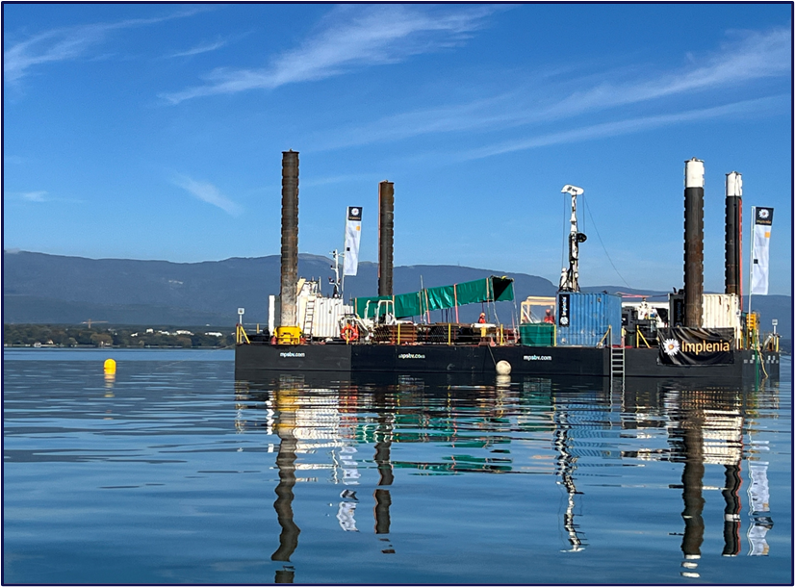
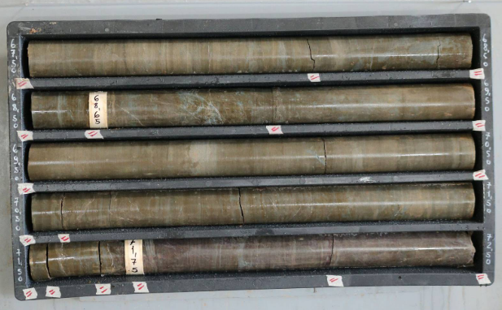
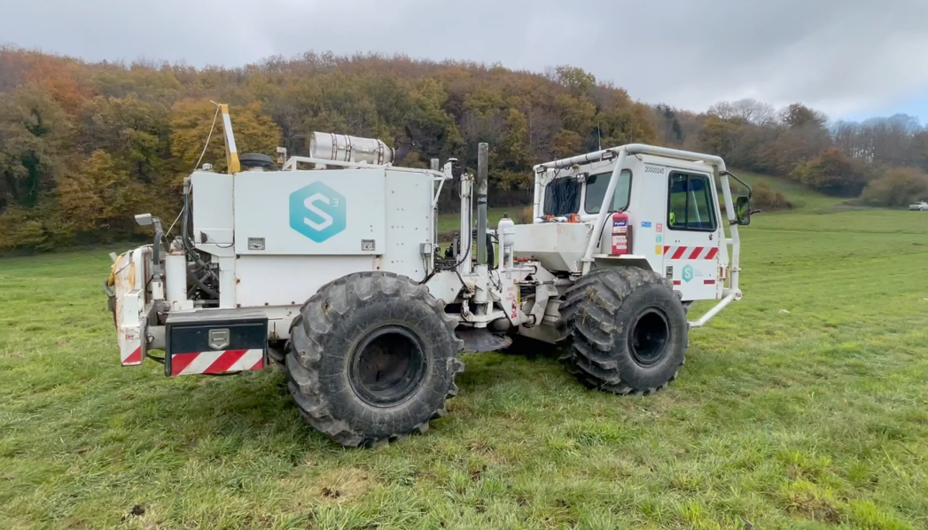
Geological investigations
Focused on 8 zones to improve precision of geological model and identify the interfaces moraine – molasse and molasse – limestone
86 km of seismic investigations completed
15 of 27 bore holes completed
1st lake bore hole completed
Completion of all bore holes ~June 2026
Results so far confirm geological model
Lake Geneva –
November 2025

Slide 9


timeline till start of construction
2024 |  |  |  | 2025 |  |  |  | 2026 |  |  |  | 2027 |  |  |  | 2028 |  |  |  | 2029 |  |  |  | 2030 |  |  |  | 2031 |  |  |  | 2032 |  |  |  | 2033
Q1 | Q2 | Q3 | Q4 | Q1 | Q2 | Q3 | Q4 | Q1 | Q2 | Q3 | Q4 | Q1 | Q2 | Q3 | Q4 | Q1 | Q2 | Q3 | Q4 | Q1 | Q2 | Q3 | Q4 | Q1 | Q2 | Q3 | Q4 | Q1 | Q2 | Q3 | Q4 | Q1 | Q2 | Q3 | Q4 | Q1 | Q2 | Q3 | Q4
Released FSR
Cost update
Feasibility Study
Reference Design Phase
TDR Design
FS Report
TDR
Site Investigations
Site Investigations
CE Tender Design
CE Design
Start construction
Complete accelerator design
Approval
Environmental Impact & Authorization Process
ESPPU 2025/26

Slide 10
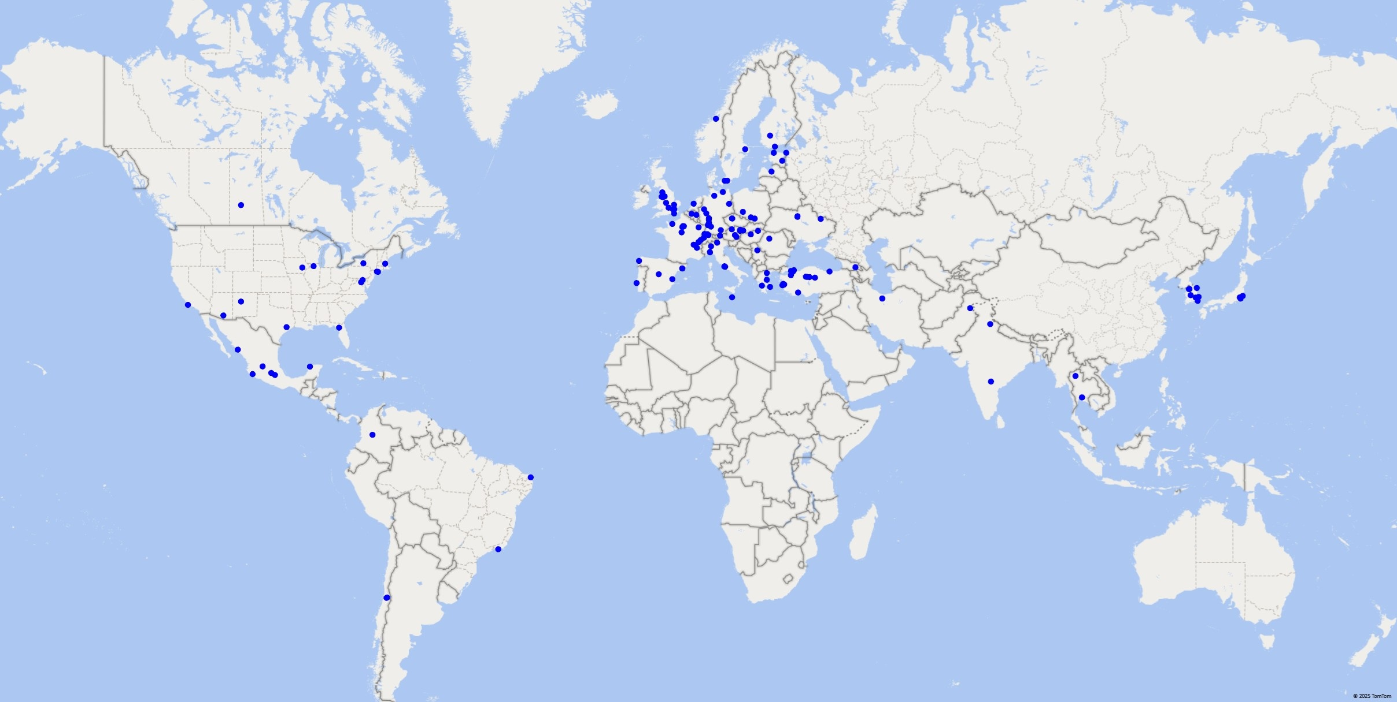


Status of the FCC Global Collaboration
Increasing international collaboration is a prerequisite for success:
→links with science, research & development and high-tech industry will be essential to further advance and prepare the implementation of the FCC
→Next step is preparation of a plan with national laboratories for in-kind contributions to the project
39 Participating Countries
Austria – Belgium – Brazil – Canada – Chile – Colombia – Czech Republic – Denmark – Estonia – Finland – France – Georgia – Germany – Greece – Hungary – India – Iran – Italy – Japan – Latvia – Lithuania – Malta – Mexico – Netherlands – Norway – Pakistan – Poland – Portugal – Republic of Korea – Romania – Serbia – Spain – Sweden – Switzerland – Thailand – Türkiye – Ukraine – United Kingdom – United States of America
180 Institutes
39 Countries
+
CERN

Slide 11

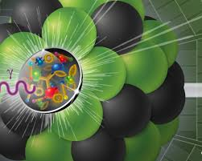

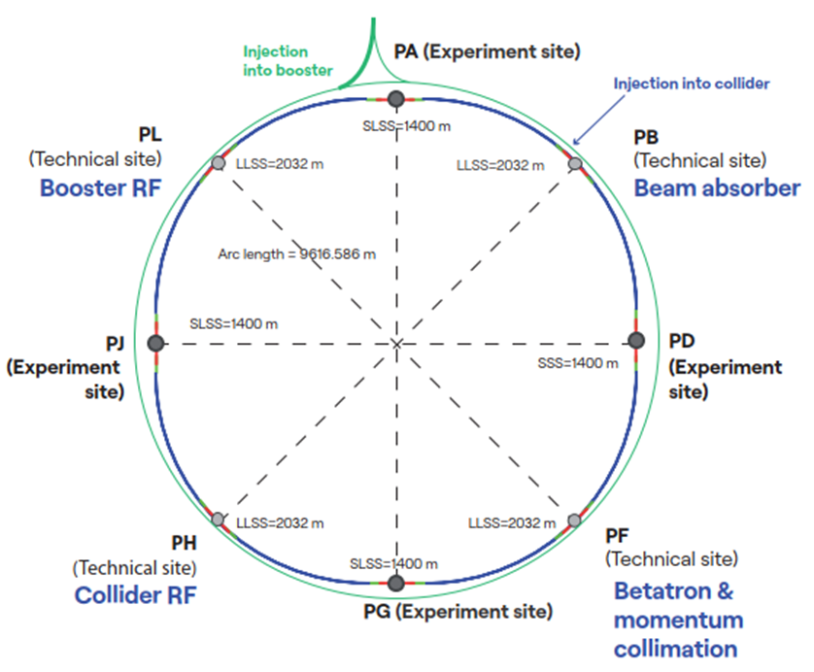
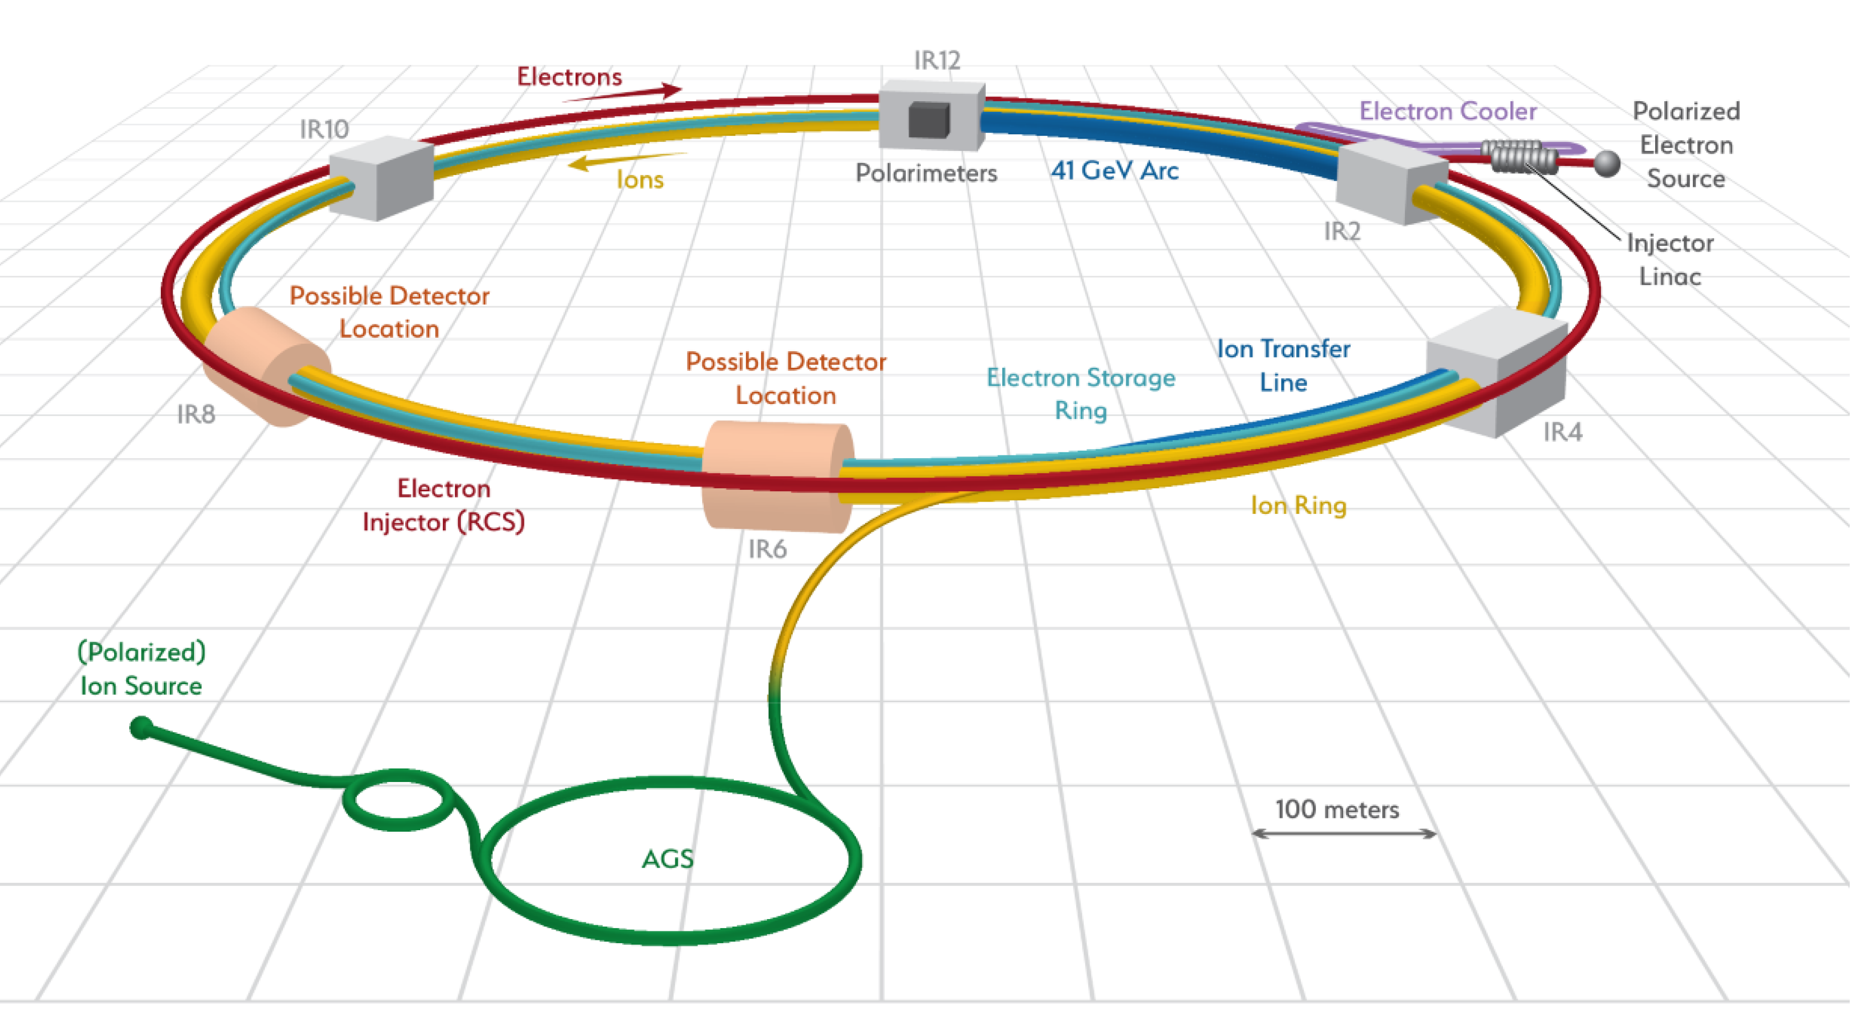
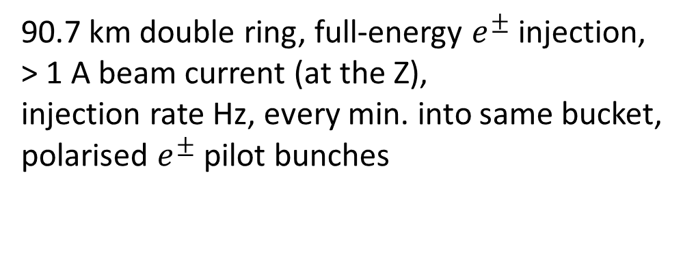
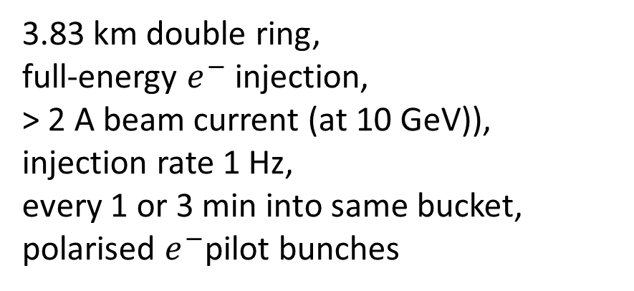
FCC & EIC similarities
FCC-ee
EIC
3.83 km double ring,
full-energy $e^{−}$ injection,
> 2 A beam current (at 10 GeV)),
injection rate 1 Hz,
every 1 or 3 min into same bucket,
polarised $e^{−}$pilot bunches
90.7 km double ring, full-energy $e^{±}$injection,
> 1 A beam current (at the Z),
injection rate Hz, every min. into same bucket,
polarised $e^{±}$pilot bunches

Slide 12
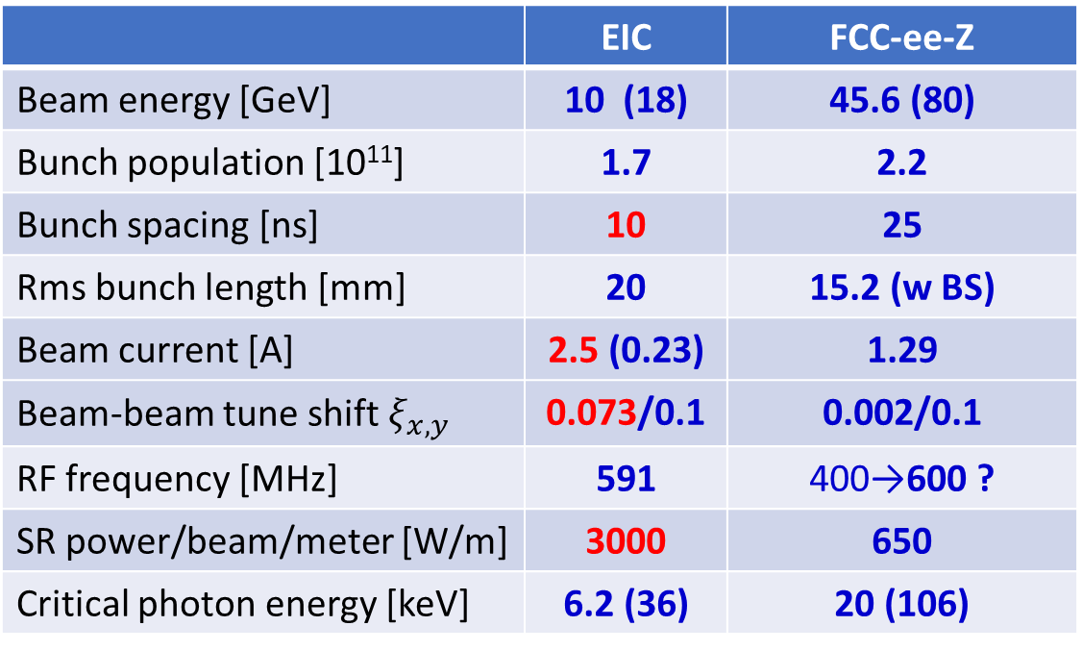
Electron Ion Collider (EIC)
US EIC Electron Storage Ring similar to, but more challenging than, FCC-ee
beam parameters almost identical, but twice the maximum electron beam current, or half the bunch spacing, and lower beam energy
 | EIC | FCC-ee-Z
Beam energy [GeV] | 10 (18) | 45.6 (80)
Bunch population [10¹¹] | 1.7 | 2.2
Bunch spacing [ns] | 10 | 25
Rms bunch length [mm] | 20 | 15.2 (w BS)
Beam current [A] | 2.5 (0.23) | 1.29
Beam-beam tune shift $ξ_{x,y}$ | 0.073/0.1 | 0.002/0.1
RF frequency [MHz] | 591 | 400→600 ?
SR power/beam/meter [W/m] | 3000 | 650
Critical photon energy [keV] | 6.2 (36) | 20 (106)
>10 areas of common interest identified by the FCC and EIC design teams, which had been meant to be addressed through joint EIC-FCC working groups – mostly not really active
EIC will start beam operation about a decade prior to FCC-ee
The EIC will provide another invaluable opportunity to train next generation of accelerator physicists on an operating collider, to test hardware prototypes, beam control schemes, etc.

Slide 13
CERN FCC – EIC collaboration, contact persons - to be updated
Domain | CERN/FCC contacts | BNL/EIC contacts | JLAB/EIC contacts | Other contacts FCC | Other contacts EIC
impedance model, instabilities, HOM, ion instability | Mauro Migliorati (INFN), Ivan Karpov (CERN) | Mike Blaskiewicz, Alexei Blednykh, Silvia Verdu (?) | Todd Satogata | Alexander Novokhatski (SLAC)
polarization | Jorg Wenninger (CERN), Jacqueline Keintzel (CERN) | Vadim Ptitsyn | Todd Satogata | Eliana Gianfelice (FNAL), Guy Wilkinson (Oxford)
beam instrumentation, SR monitors (BPMs) | Thibaut Levefre (CERN), Manfred Wendt (CERN) | David Gassner, Dany Padrazo | Todd Satogata | Anke Susanne Mueller (KIT)
beam feedback systems | Wolfgang Hofle (CERN) | Mike Blaskiewicz (BNL), Another ? | Todd Satogata | John Fox (SU)
vacuum system | Roberto Kersevan, Cedric Garion (CERN) | Charles Hetzel | Mark Wiseman
final focus quadrupoles |  | Brett Parker, Holger Witte | Walter Wittmer | Mike Koratzinos (MIT, PSI)
SRF | Erk Jensen, Frank Gerigk, (CERN) | Kevin Smith | Robert Rimmer
MDI, IR shielding, handling equipment associat’d w IR | Manuela Boscolo (INFN), Helmut Burkhardt (CERN) | Holger Witte | Walter Wittmer | Mike Sullivan (SLAC), John Seeman (SLAC)
Collimation – beam tails | ­Andrey Abramov (CERN), Roderik Bruce (CERN) |  |  | Dmitry Shatilov (BINP, NIU)
Beam-beam interactions (limits with multiple IPs) | Xavier Buffat (CERN) |  |  | Dmitry Shatilov (BINP, NIU)
to be updated

Slide 14
FCC-EIC Joint Working Meetings
1st working meeting EIC-FCC on polarized beam operation
CERN, 19-23 September 2022, in conjunction with the 2nd FCC EPOL workshop https://indico.cern.ch/event/1181966/
2nd FCC-EIC joint working meeting on beam dynamics, stability, impedances, feedback, vacuum and MDI
CERN, 17-21 October 2022, in conjunction with the FCC-ee MDI working meeting https://indico.cern.ch/event/1186798/
2nd FCC Polarisation workshop
CERN, 19-30 Sept. 2022, https://indico.cern.ch/event/1181966
V. Ranjbar: EIC e-Injector Polarization; E. Gianfelice: EIC esr Polarization; M. Signorelli: EIC ESR Tracking Studies;
V. Ptitsin: Physics with polarized beams at the EIC; F. Zimmermann, V. Ptitsin: Synergies EIC-FCC
3rd FCC-FNAL-US joint working meeting on SRF
FNAL, 29-30 March 2023 800 MHz RF cavities, SRF Cryomodules, SSA, HOMs

Slide 15
topics of common interest
simulation code development
collaboration on Xsuite
code benchmarking
MDI concepts & simulations
IR optics, IR magnet design
mechanical integration
beam losses and SR in the MDI
collimation, detector backgrounds
tuning, mechanical stabilization
impedance, heat load evaluation
det. solenoid compensation scheme
polarisation
simulation & code development
suppressing spin resonance
  lattice design
  knobs: harmonic spin matching
  polarisation transport thru booster
  resonant depolarisation & spin flip
  coherent spin precession as tool
  beam-beam effect on polarisation
  polarimetry
    integration, detector, bkgd, laser
accelerator design & beam dynamics
DA, tolerances, machine learning
mechanical alignment & BBA
impedance, collective effects, e-cloud
sudden beam loss events as in SKEKB
machine protection

Slide 16
more topics of common interest
injector
S-band linac & S-band rf structures
(FCC/PSI, EIC)
polarised e- source
MDI hardware
final quadrupole technology
  & production, cryostat design
choice of IR cryogenic temperature
SRF
    RF cavities (2-cell?)
    RF power source
      tristron R&D
vacuum systems
automated production & NEG coating
beam-intercepting devices
primary, secondary & tertiary collimators – design & materials
collision debris collimators
protection devices, beam dumps
beam diagnostics
    BPMs
    BLM system
    emittance measurements, halo
    bunch length measurement
    polarimeters & lasers
training
working visits of young scientists

Slide 17

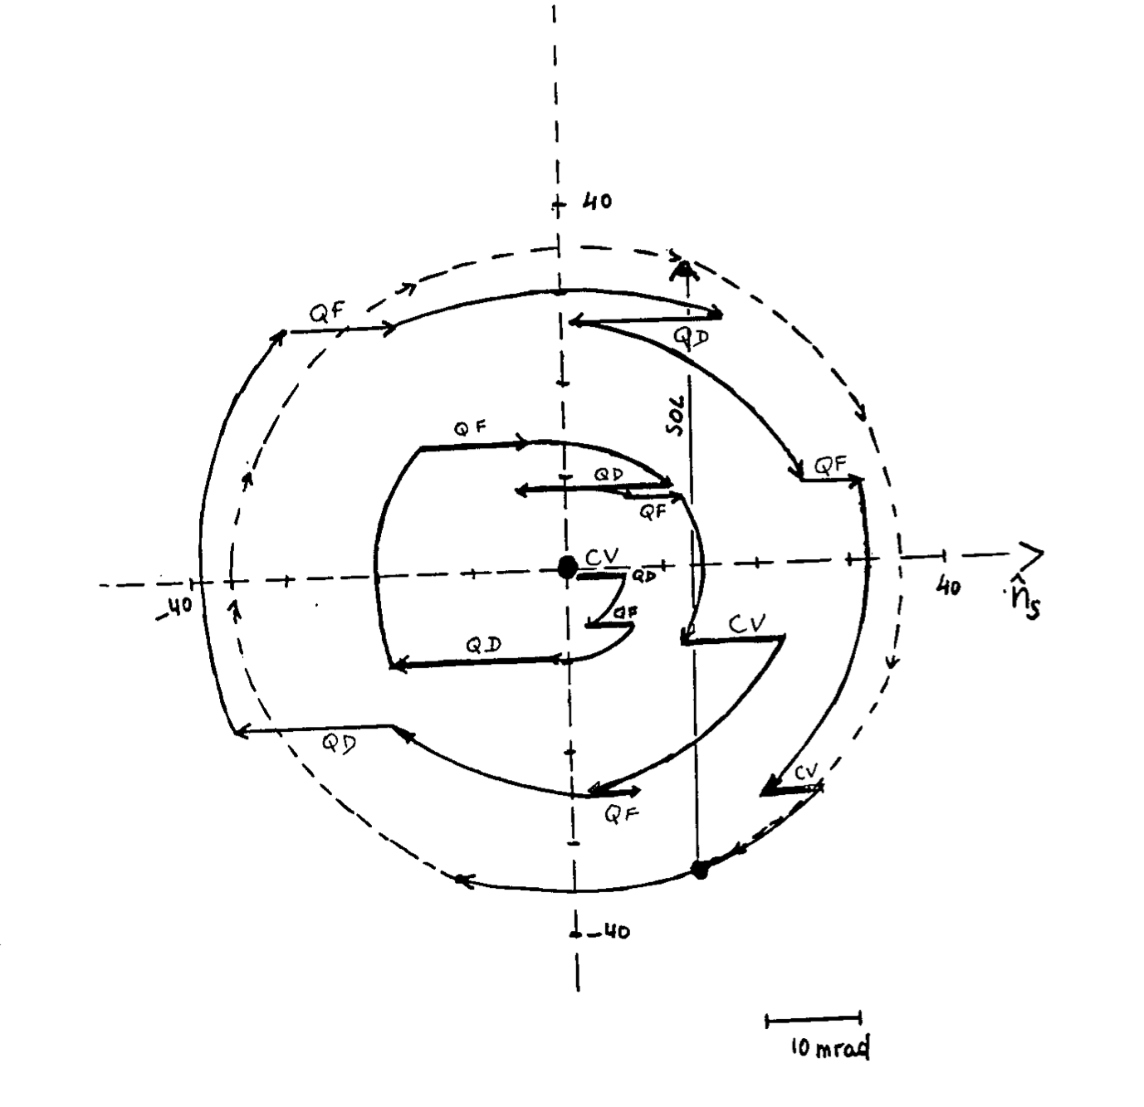
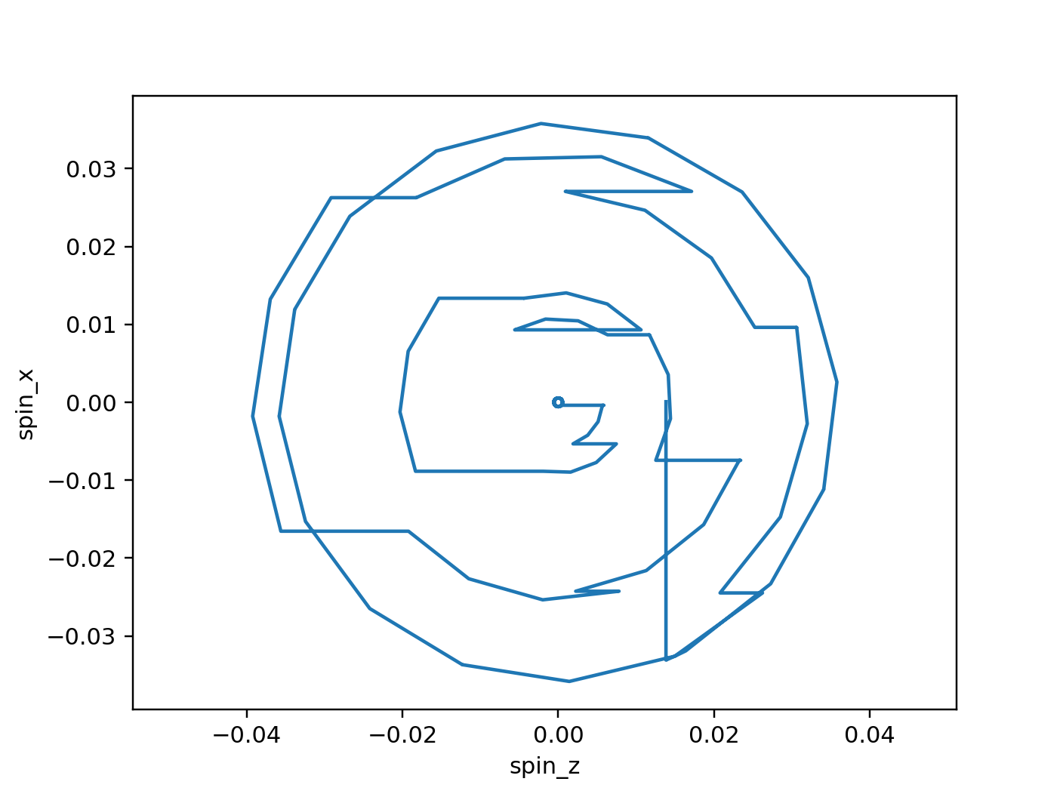
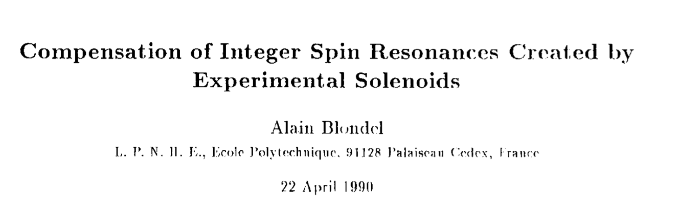
spin tracking: a success story
spin tracking implemented in Xsuite !
Benchmarking case of LEP1 with orbit bumps to compensate precession in the experimental solenoids → good agreement found against SLIM simulations
tests, benchmarking,
and first simulation studies ongoing
Xsuite 2025
SLIM 1990
G. Iadarola,
K. Hock,
Y. Wu,
J. Keintzel,
T. Pieloni,
J. Wenninger
17

Slide 18
conclusions & outlook
a lot of FCC-EIC synergies in many areas & mutual interest to collaborate
formal agreement between CERN and DOE/NP on EIC upcoming ?
CERN/FCC has agreement for HEP and with DOE Office of Science
may common successful work on Xsuite usher in a new era ?
suggest continuing joint effort on polarisation and adding themes:
- S-band linac
- collimator design
- beam-beam studies
- electron-cloud studies
- MDI ?, beam diagnostics ?
- mechanical alignment ? e⁻ polarimetry ?
Next satellite event in Detroit!?

