Slide 1
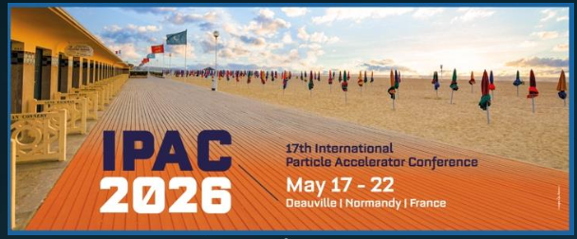
The Electron-Ion Collider Accelerator Collaboration
Wolfram Fischer
Deputy Associate Lab Director for Accelerators in Nuclear and Particle Physics
Collider-Accelerator Department Chair
Co-Chair EIC Accelerator Collaboration
with Tatiana Pieloni (EPFL)
20 May 2026
IPAC’26 – the 17th International Particle Accelerator Conference

Slide 2
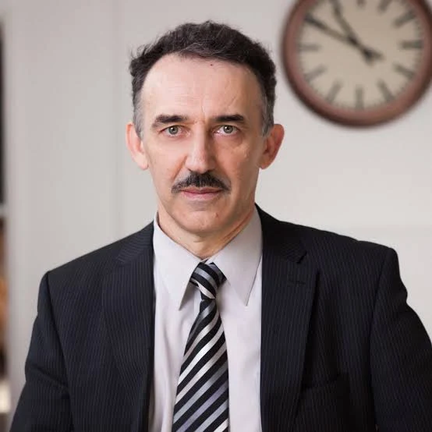
Thank you Andrei
Andrei Seryi,
Old Dominion University
EIC Accelerator Collaboration
Co-Chair 2024-2026

Slide 3
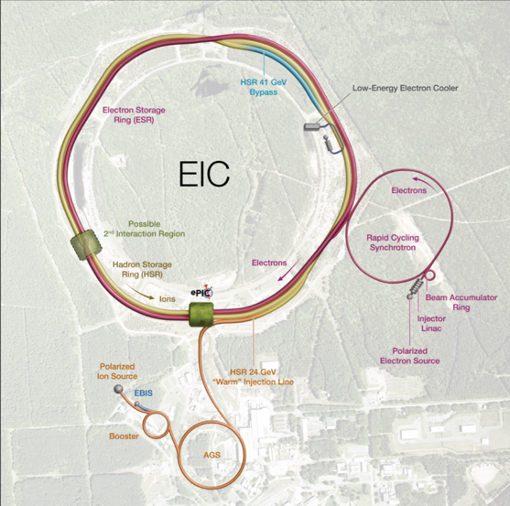
EIC Facility Requirements
Ultimate Performance Parameters
High Luminosity: L= 10³³ – 10³⁴cm⁻²sec⁻¹
Highly Polarized Beams: 70%
Large Center of Mass Energy Range: Ecm = 28 – 140 GeV
Large Ion Species Range: protons – Uranium
Large Detector Forward Acceptance and Low-Background Conditions
Possibility to Implement a Second Interaction Region (IR)
3

Slide 4
What is the EIC Accelerator Collaboration
We would like to collaborate with other labs in the world
  to realize the EIC, and
  for mutual benefit
On topics of common interest in
  Beam dynamics
  Technology

Slide 5
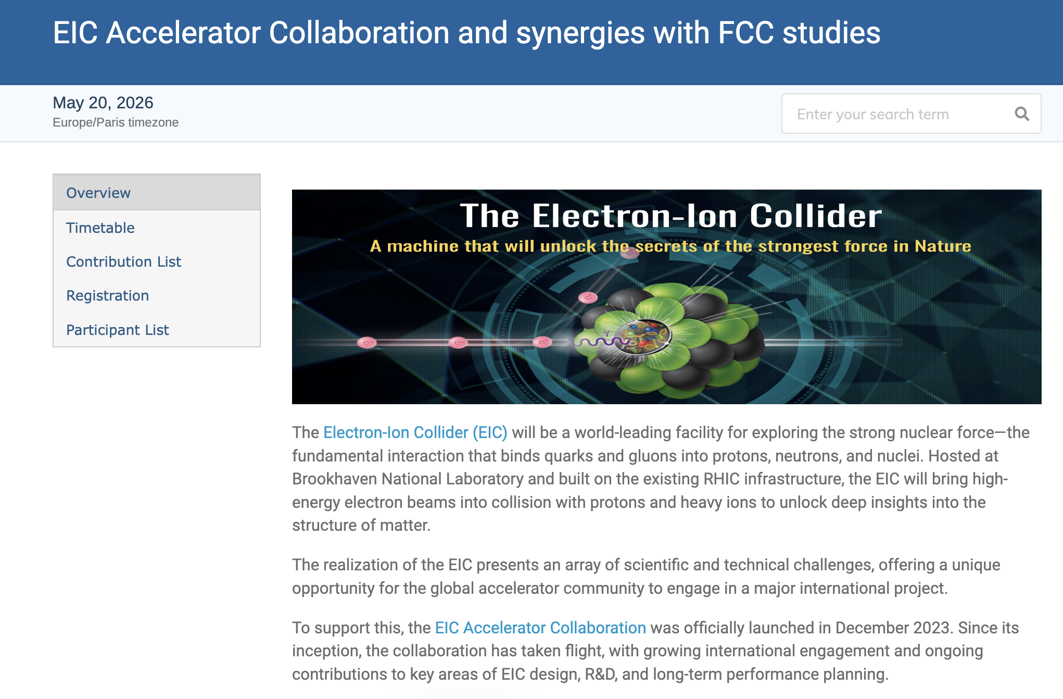

Slide 6
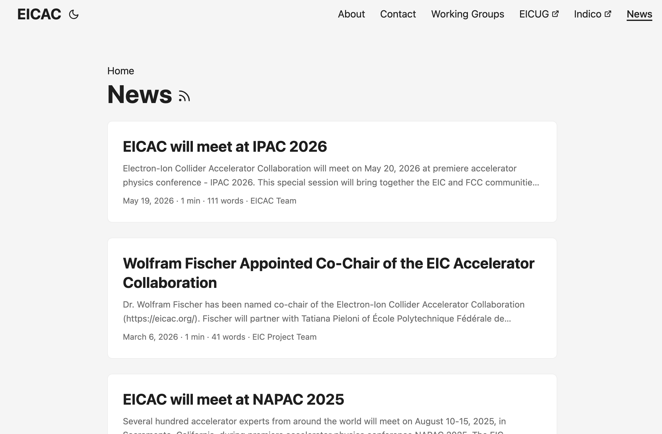
What is the EIC Accelerator Collaboration
https://eicac.org/

Slide 7
EIC Accelerator Collaboration Working Groups
Beam-beam - Christoph Montag & Xavier Buffat
Polarized Beams & Polarimetry - Frank Rathmann & Georg Hoffstaetter
Commissioning Tools - Yue Hao and Jean-Luc Vay
Possible additional working group
Second Interaction Region
Electron injectors
High Energy Beam Cooling
FCC-EIC Forum
More WGs are coming

Slide 8
EIC AC Institutional Board
Lin Liu | LNLS | Brazil
Oliver Kester | TRIUMF | Canada
Guillaume Olry | IJCLab | France
Pierre Vedrine | CEA Saclay | France
Qing Qin | ESRF | France
Ralph Assmann | GSI/FAIR | Germany
Lucio Rossi | INFN Milano | Italy
Roberto Cimino | INFN-LNF | Italy
Moses Chung | Pohang Accelerator Lab | South Korea
Amalia Ballarino | CERN | Switzerland
Graeme Burt | Lancaster University | UK
Carsten Welsch | University of Liverpool | UK
Nik Templeton | STFC | UK
Phil Burrows | John Adams Institute | UK
Stewart Boogert | Cockcroft Institute | UK
Georg Hoffstaetter | Cornell University | United States
Jean Delayen | Old Dominion University | United States
John Power | ANL | United States
Mei Bai | SLAC | United States
Sam Posen | Fermilab | United States
Sarah Cousineau | ORNL | United States
Soren Prestemon | LBNL | United States
Young-Kee Kim | University of Chicago | United States
Yue Hao | FRIB | United States
First meeting
on 29 May 2026

Slide 9
Planned Fellowships for EIC-FCC collaboration
Working on setting up 2 Fellowships (post-doc level)
1 based in US (BNL or JLab)
1 based in Europe (CERN)
Focus on topics common to EIC and FCC
With significant stay period (>= 3 months/year) on other side of pond

Slide 10
EIC Accelerator Collaboration
EIC and FCC are the next generation of colliders
Your input and ideas are essential
We need your collaboration to realize the EIC

