Slide 1
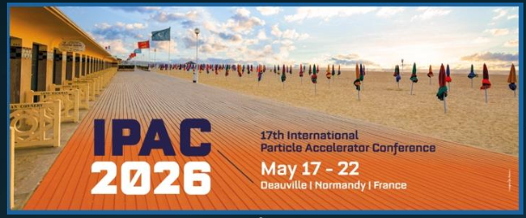
The Electron-Ion Collider Project Status
Luisella Lari
EIC Project Manager transitioning to EIC Associate Director for Strategic Partnership
Sr. Scientist
May 20, 2026
IPAC’26 – the 17th International Particle Accelerator Conference

Slide 2
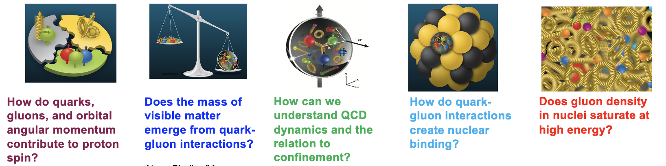
What is the Electron-Ion Collider (EIC)?
What is the EIC?
A next-generation particle collider at Brookhaven National Laboratory
Collides electrons with atomic nuclei or protons
Acts as a precision microscope for studying quarks and gluons
Designed to answer how mass, spin, and nuclear structure emerge from the strong force (QCD)
Why electrons + ions?
Electrons probe structure cleanly and precisely
Protons/nuclei contain quarks and gluons
Polarized beams reveal spin and motion in 3D
2

Slide 3
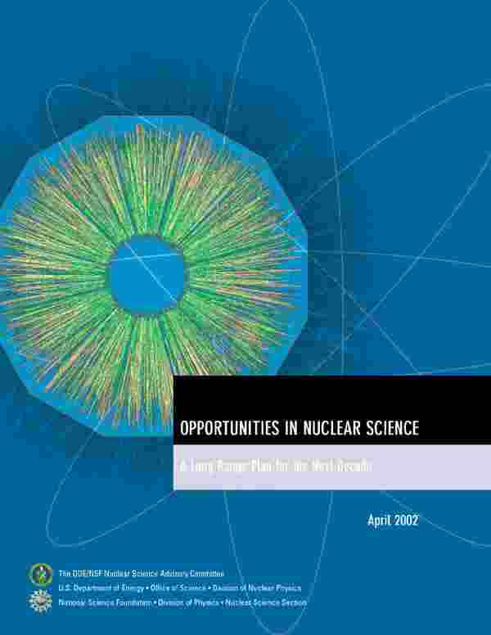
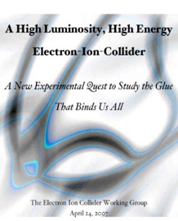
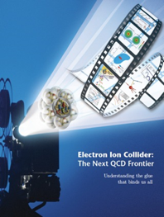

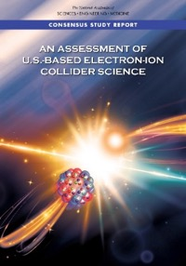

EIC Scientific Case Built Over Decades
2002
2007
2009
“We recommend the expeditious completion of the EIC as the highest priority for facility construction.” (Nuclear Science Advisory Committee, 2023)
2010
2012
Gluons and the Quark Sea at High Energies
2013
NSAC
2015
Major Nuclear Physics Facilities for the Next Decade
2018
2021
2023
March 14, 2013
“The science questions that an EIC will answer are central to completing an understanding of atoms as well as being integral to the agenda of nuclear physics today.” (National Academy of Sciences, 2018)
arXiv:2103.05419
EIC will be the only operating particle collider in the U.S. in the next decade/s.

Slide 4
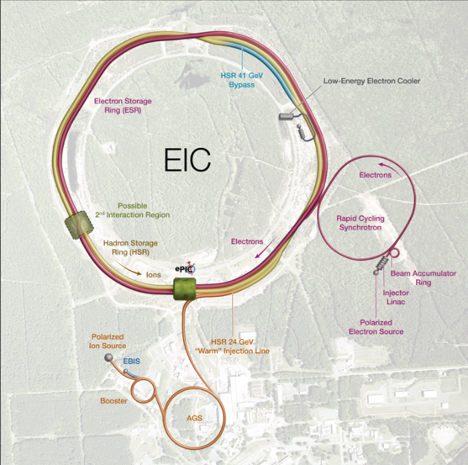
EIC Facility Requirements
Ultimate Performance Parameters
High Luminosity: L= 10³³ – 10³⁴cm⁻²sec⁻¹
Highly Polarized Beams: 70%
Large Center of Mass Energy Range: Ecm = 28 – 140 GeV
Large Ion Species Range: protons – Uranium
Large Detector Forward Acceptance and Low-Background Conditions
Possibility to Implement a Second Interaction Region (IR)
4

Slide 5
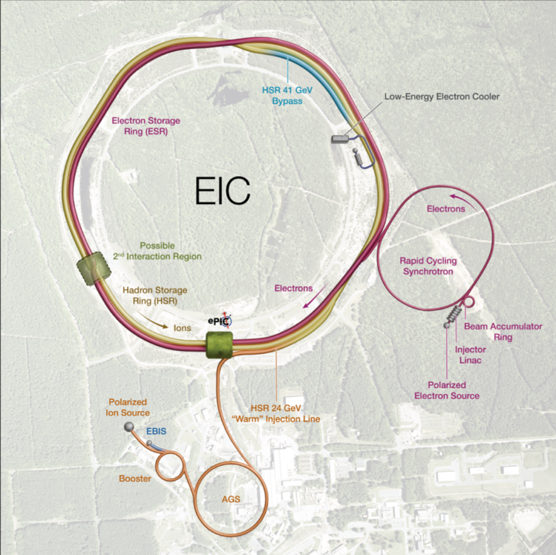


Accelerator Status at a glance
Polarized ion/proton source
Ion injection and initial acceleration systems – Linac (200 MeV), Booster (1.5 GeV), AGS (25 GeV)
Hadron Storage Ring (40-275 GeV) – HSR
Electron Pre-Injector (750 MeV linac)
Beam Accumulation Ring (750 MeV) – BAR
Electron Rapid Cycling Synchrotron (0.75 GeV – top energy) – RCS
Electron Storage Ring (5 GeV – 10 GeV) – ESR
Interaction Region(s) – IR
Hadron Cooling System
Reuse of RHIC Facility components
Valued at ~$2B
5

Slide 6
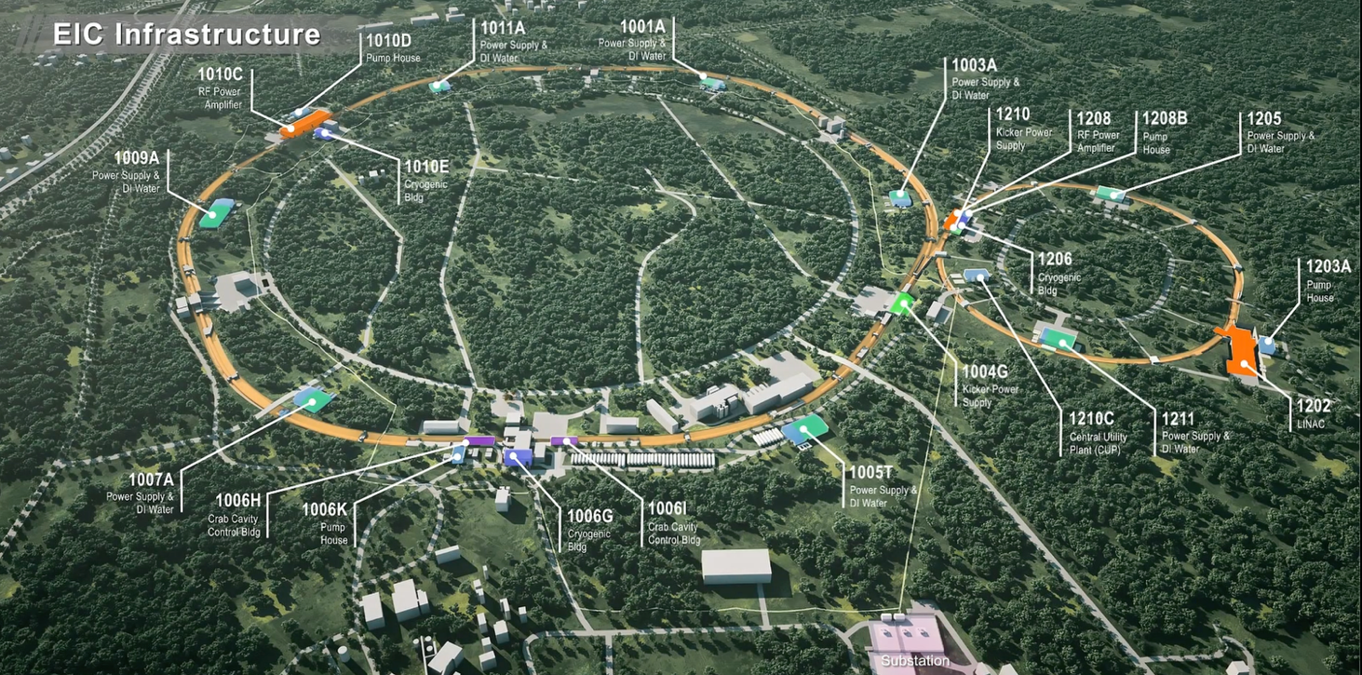
EIC Infrastructure Project Scope
100% Design completed for the infrastructure around EIC/RHIC tunnel.
6

Slide 7
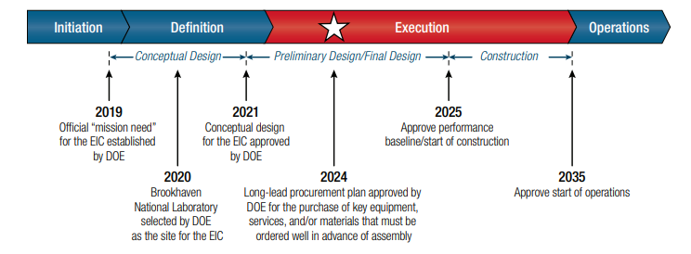


Project Milestones
We are here today
CD-0
CD-1
CD-3b 2026
CD-2/3
End 2026
Of infrastructure
around RHIC/EIC tunnel
CD-3a 2024
CD-4
~2035
e-hadron collisions
7

Slide 8
EIC Accelerator Challenges
Overview
8

Slide 9
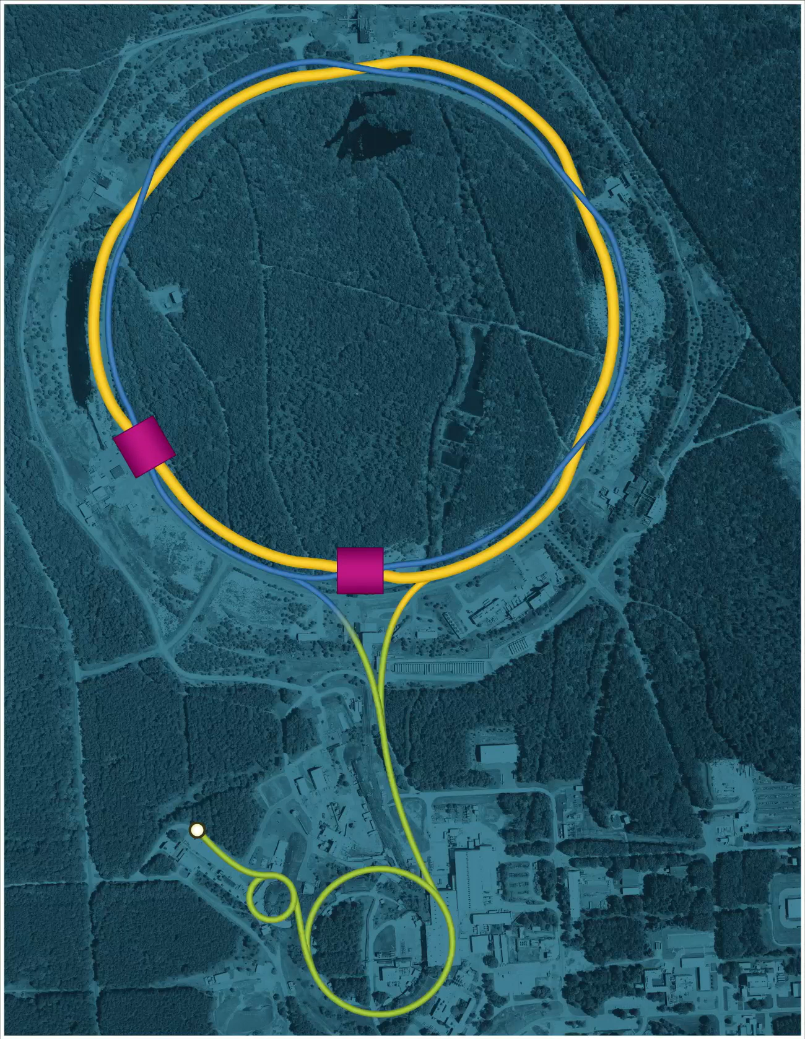
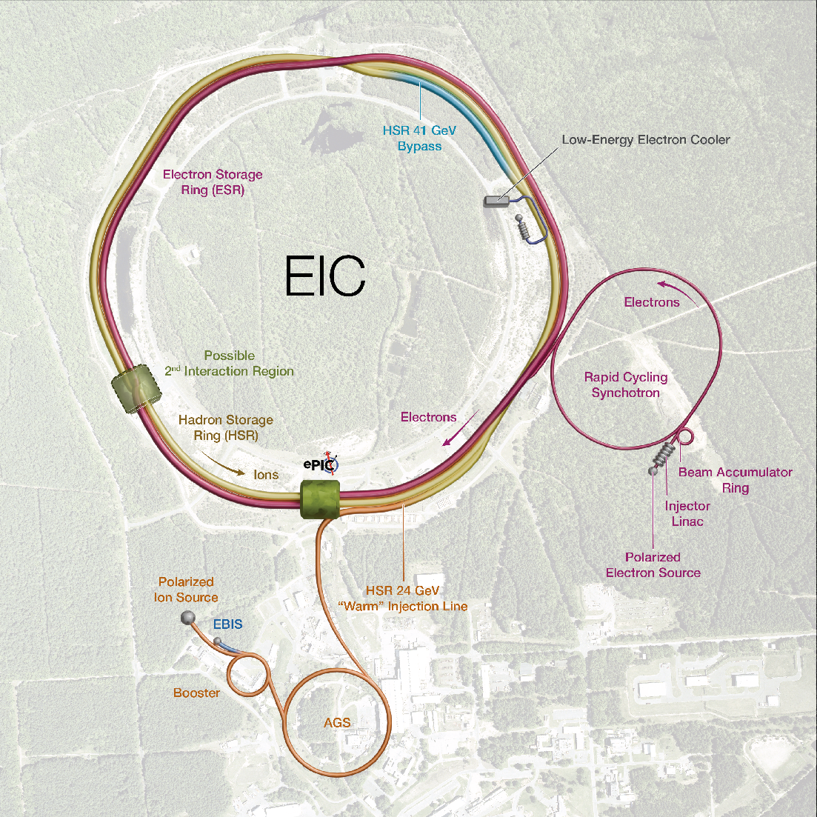
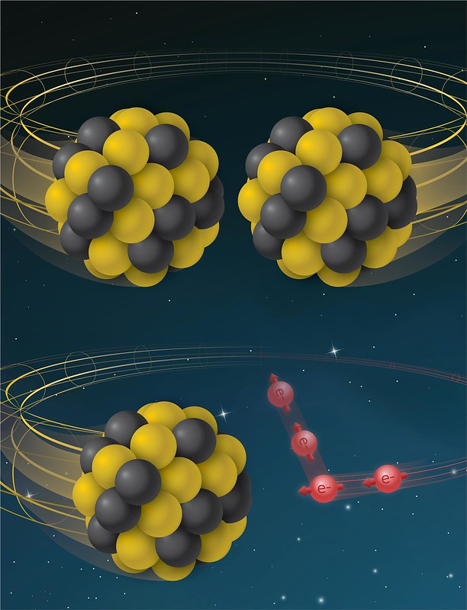
From RHIC to EIC
RHIC
RHIC
Ion species:
proton – Uranium
60% p polarization
EIC
Protons: ~40 – 275 GeV
Electrons: 5 – 18 GeV

Slide 10
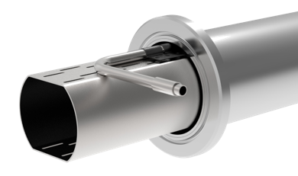
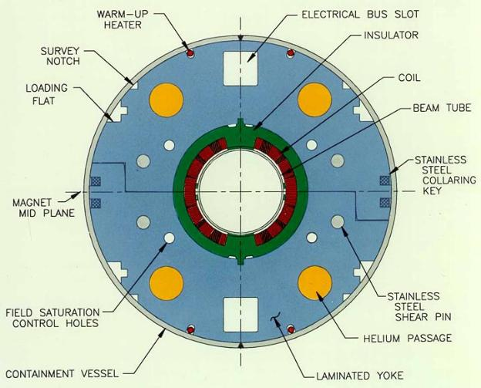
From RHIC (yellow ring) to EIC HSR
Tripled beam current, shorter bunch length, shorter bunch distance, ‘flat’ beams with small vertical emittance
EIC HSR to be composed of existing arcs of the Yellow RHIC ring (remove unused magnets)
Insert sleeves coated with copper and amorphous carbon into superconducting magnet beam pipes to improve conductivity and reduce secondary electron yield (-> electron cloud)
Add new RF cavities
Add hadron cooling to create flat beam
Add crab cavities, new IR SC magnets
Add a collimation system
Add extra ‘snakes’
Actively Cooled Beam
Screen Material procurement

Slide 11
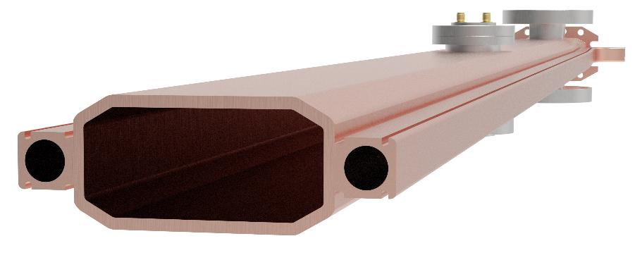
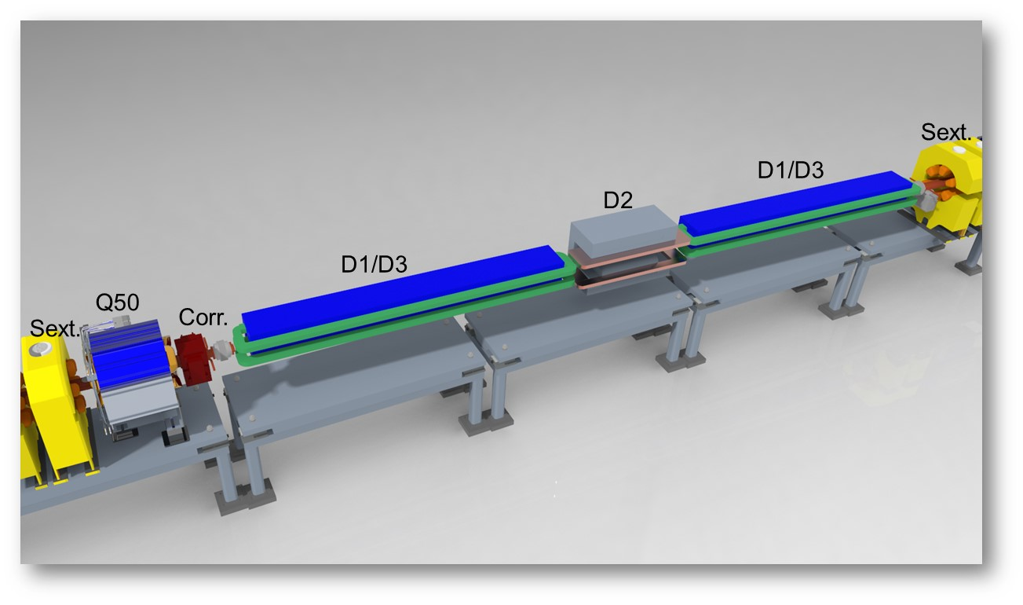
EIC Electron Storage Ring
Electron Storage Ring (ESR) consists of six FODO-cell arcs, and six straight sections (IRs)
High-intensity (28 nC), short (7 mm) bunches
add many interesting accelerator challenges
Circulating beam current ~2.5 A and the synchrotron
radiation power of ~10MW
BPM mount
Pump port
36mm
80mm
Heater wire groove
EIC needs nearly constant (20 to 24 nm) emittance from
5 to 18 GeV for optimum luminosity, but equilibrium
emittance in an electron storage ring depends on beam energy.
We will use ‘super bends’ (reverse bends) for emittance
control below 10 GeV

Slide 12
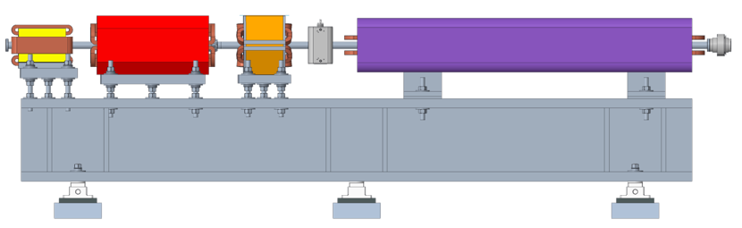
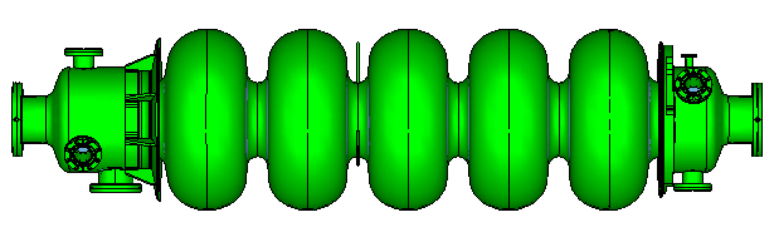
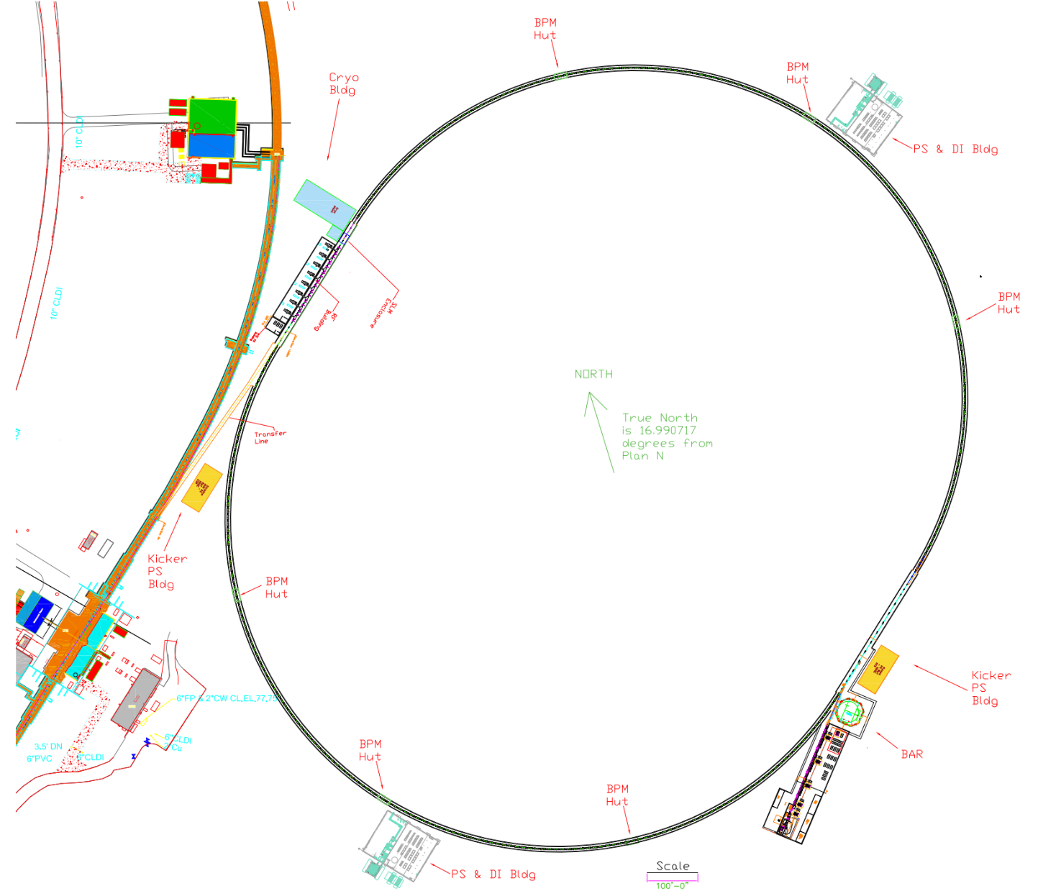
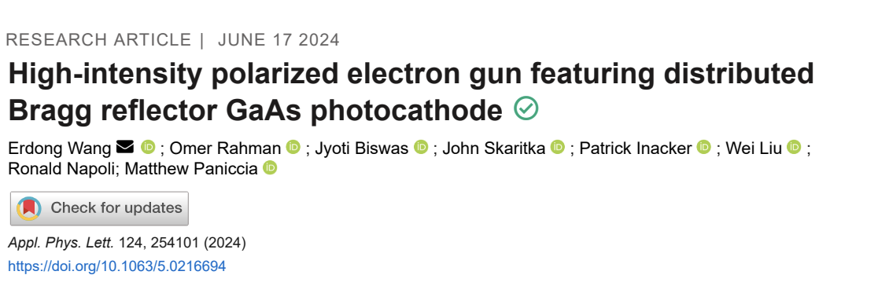
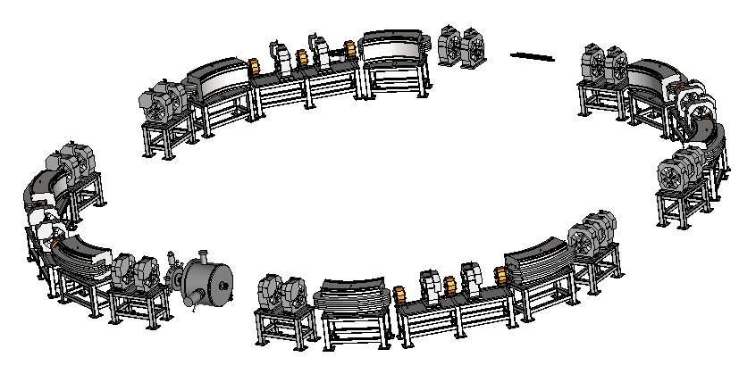
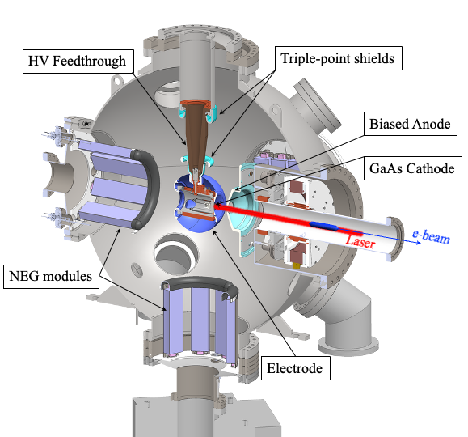
Electron Injector
Concept modeled after the ANL APS-U injector
Function: Deliver electron bunches of up to 28 nC at a 1 Hz repetition rate for injection into the ESR at various energies of 5 – 10 GeV (upgradeable to 18 GeV).
RCS magnet assembly
Vacuum chamber: stainless steel, copper coated (50 um)
RCS SRF Cavity, 591 MHz
RCS
750 MeV – 18 GeV
28 nC, 1 Hz
85% polarization
1.4 km
Beam Accumulator Ring
750 MeV, 40 m
Polarized Electron Gun
1-nC, 30 Hz
S-band linac, 750 MeV, 30 Hz, 1 nC single bunch

Slide 13
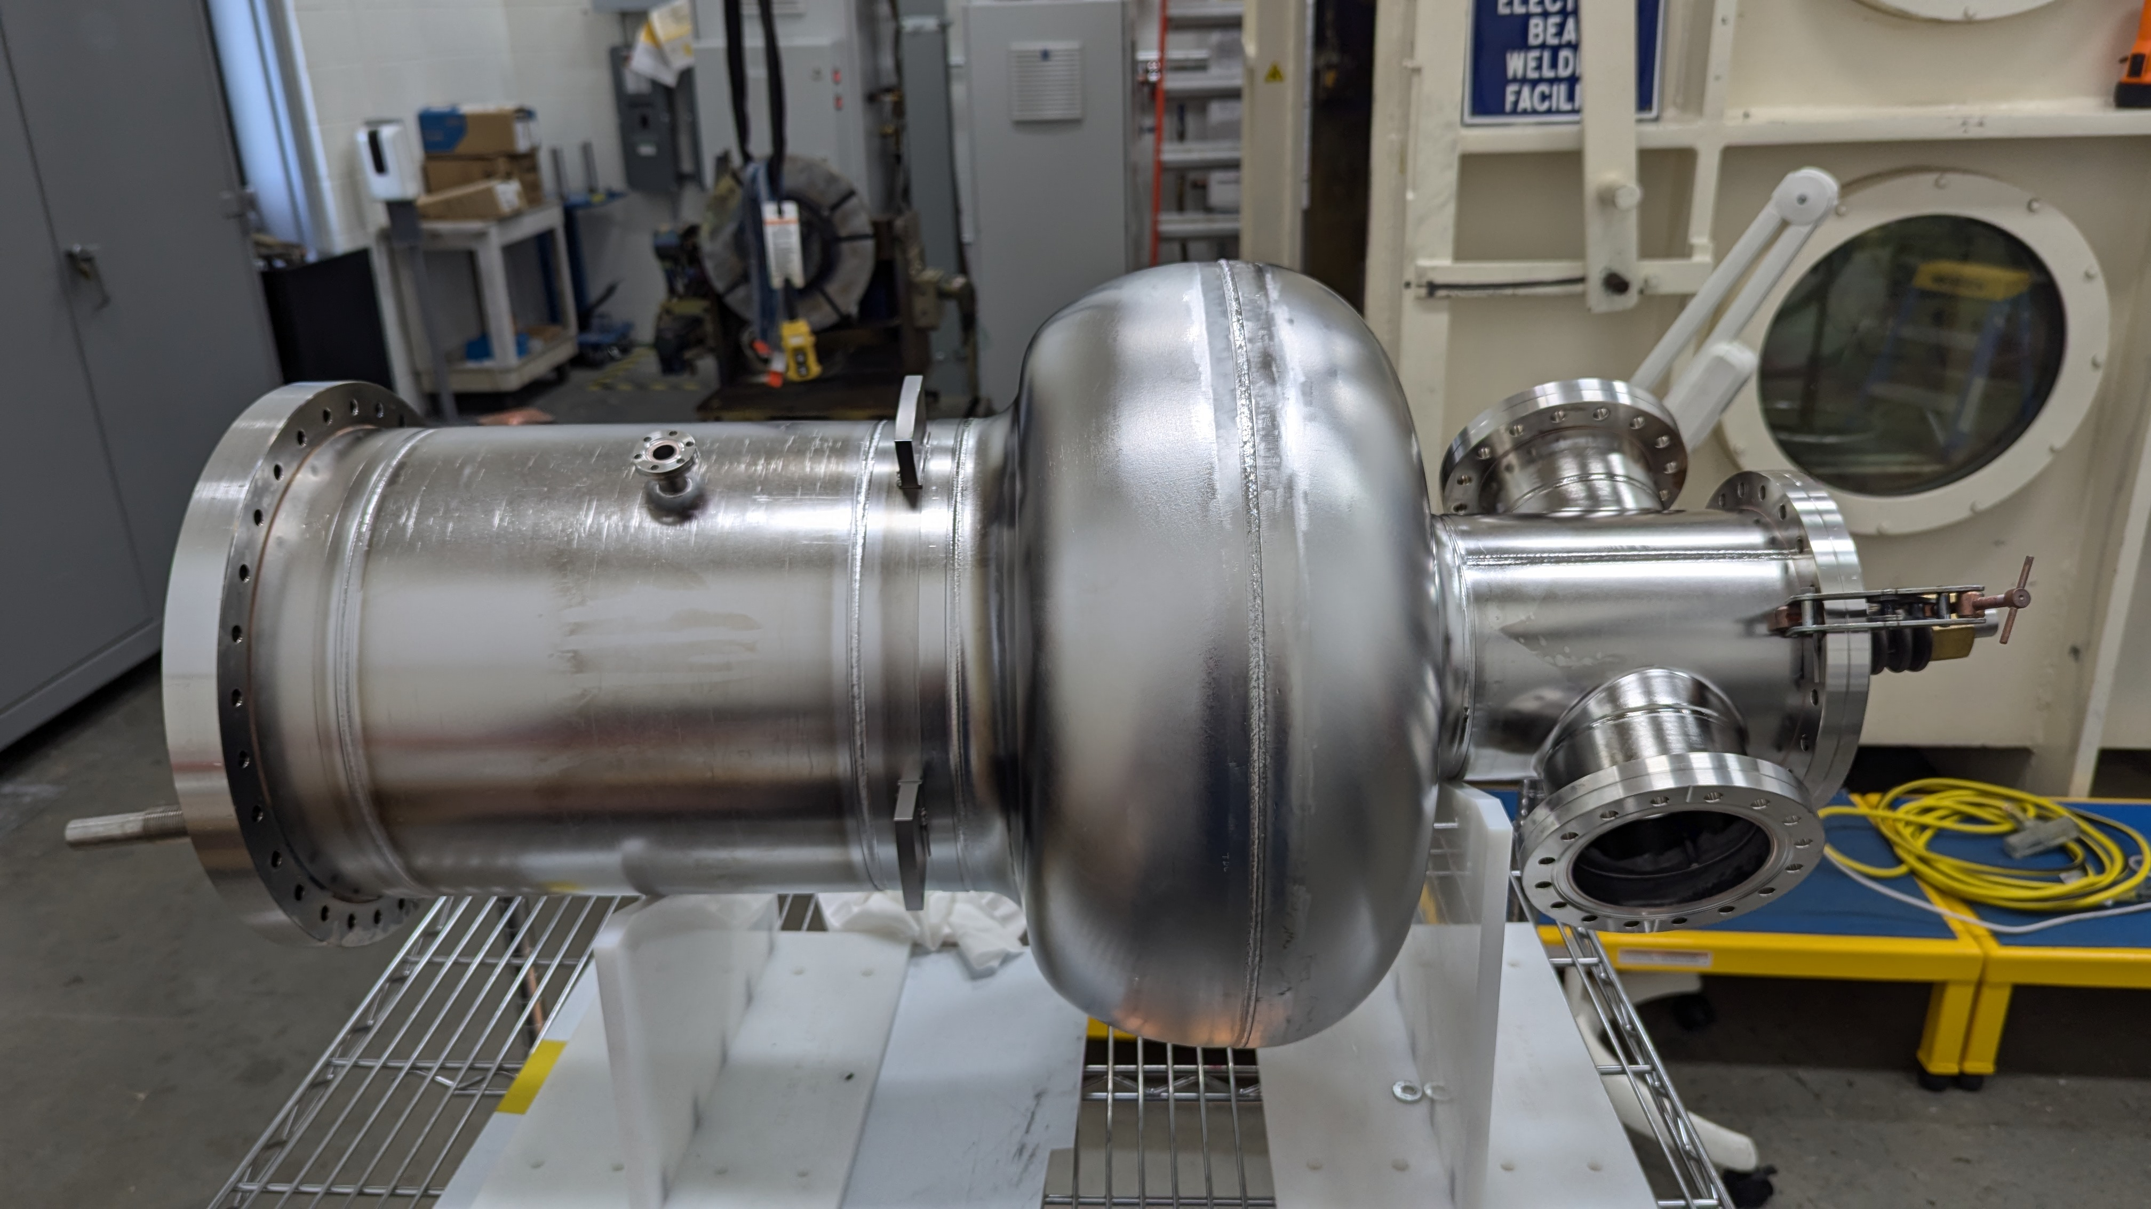
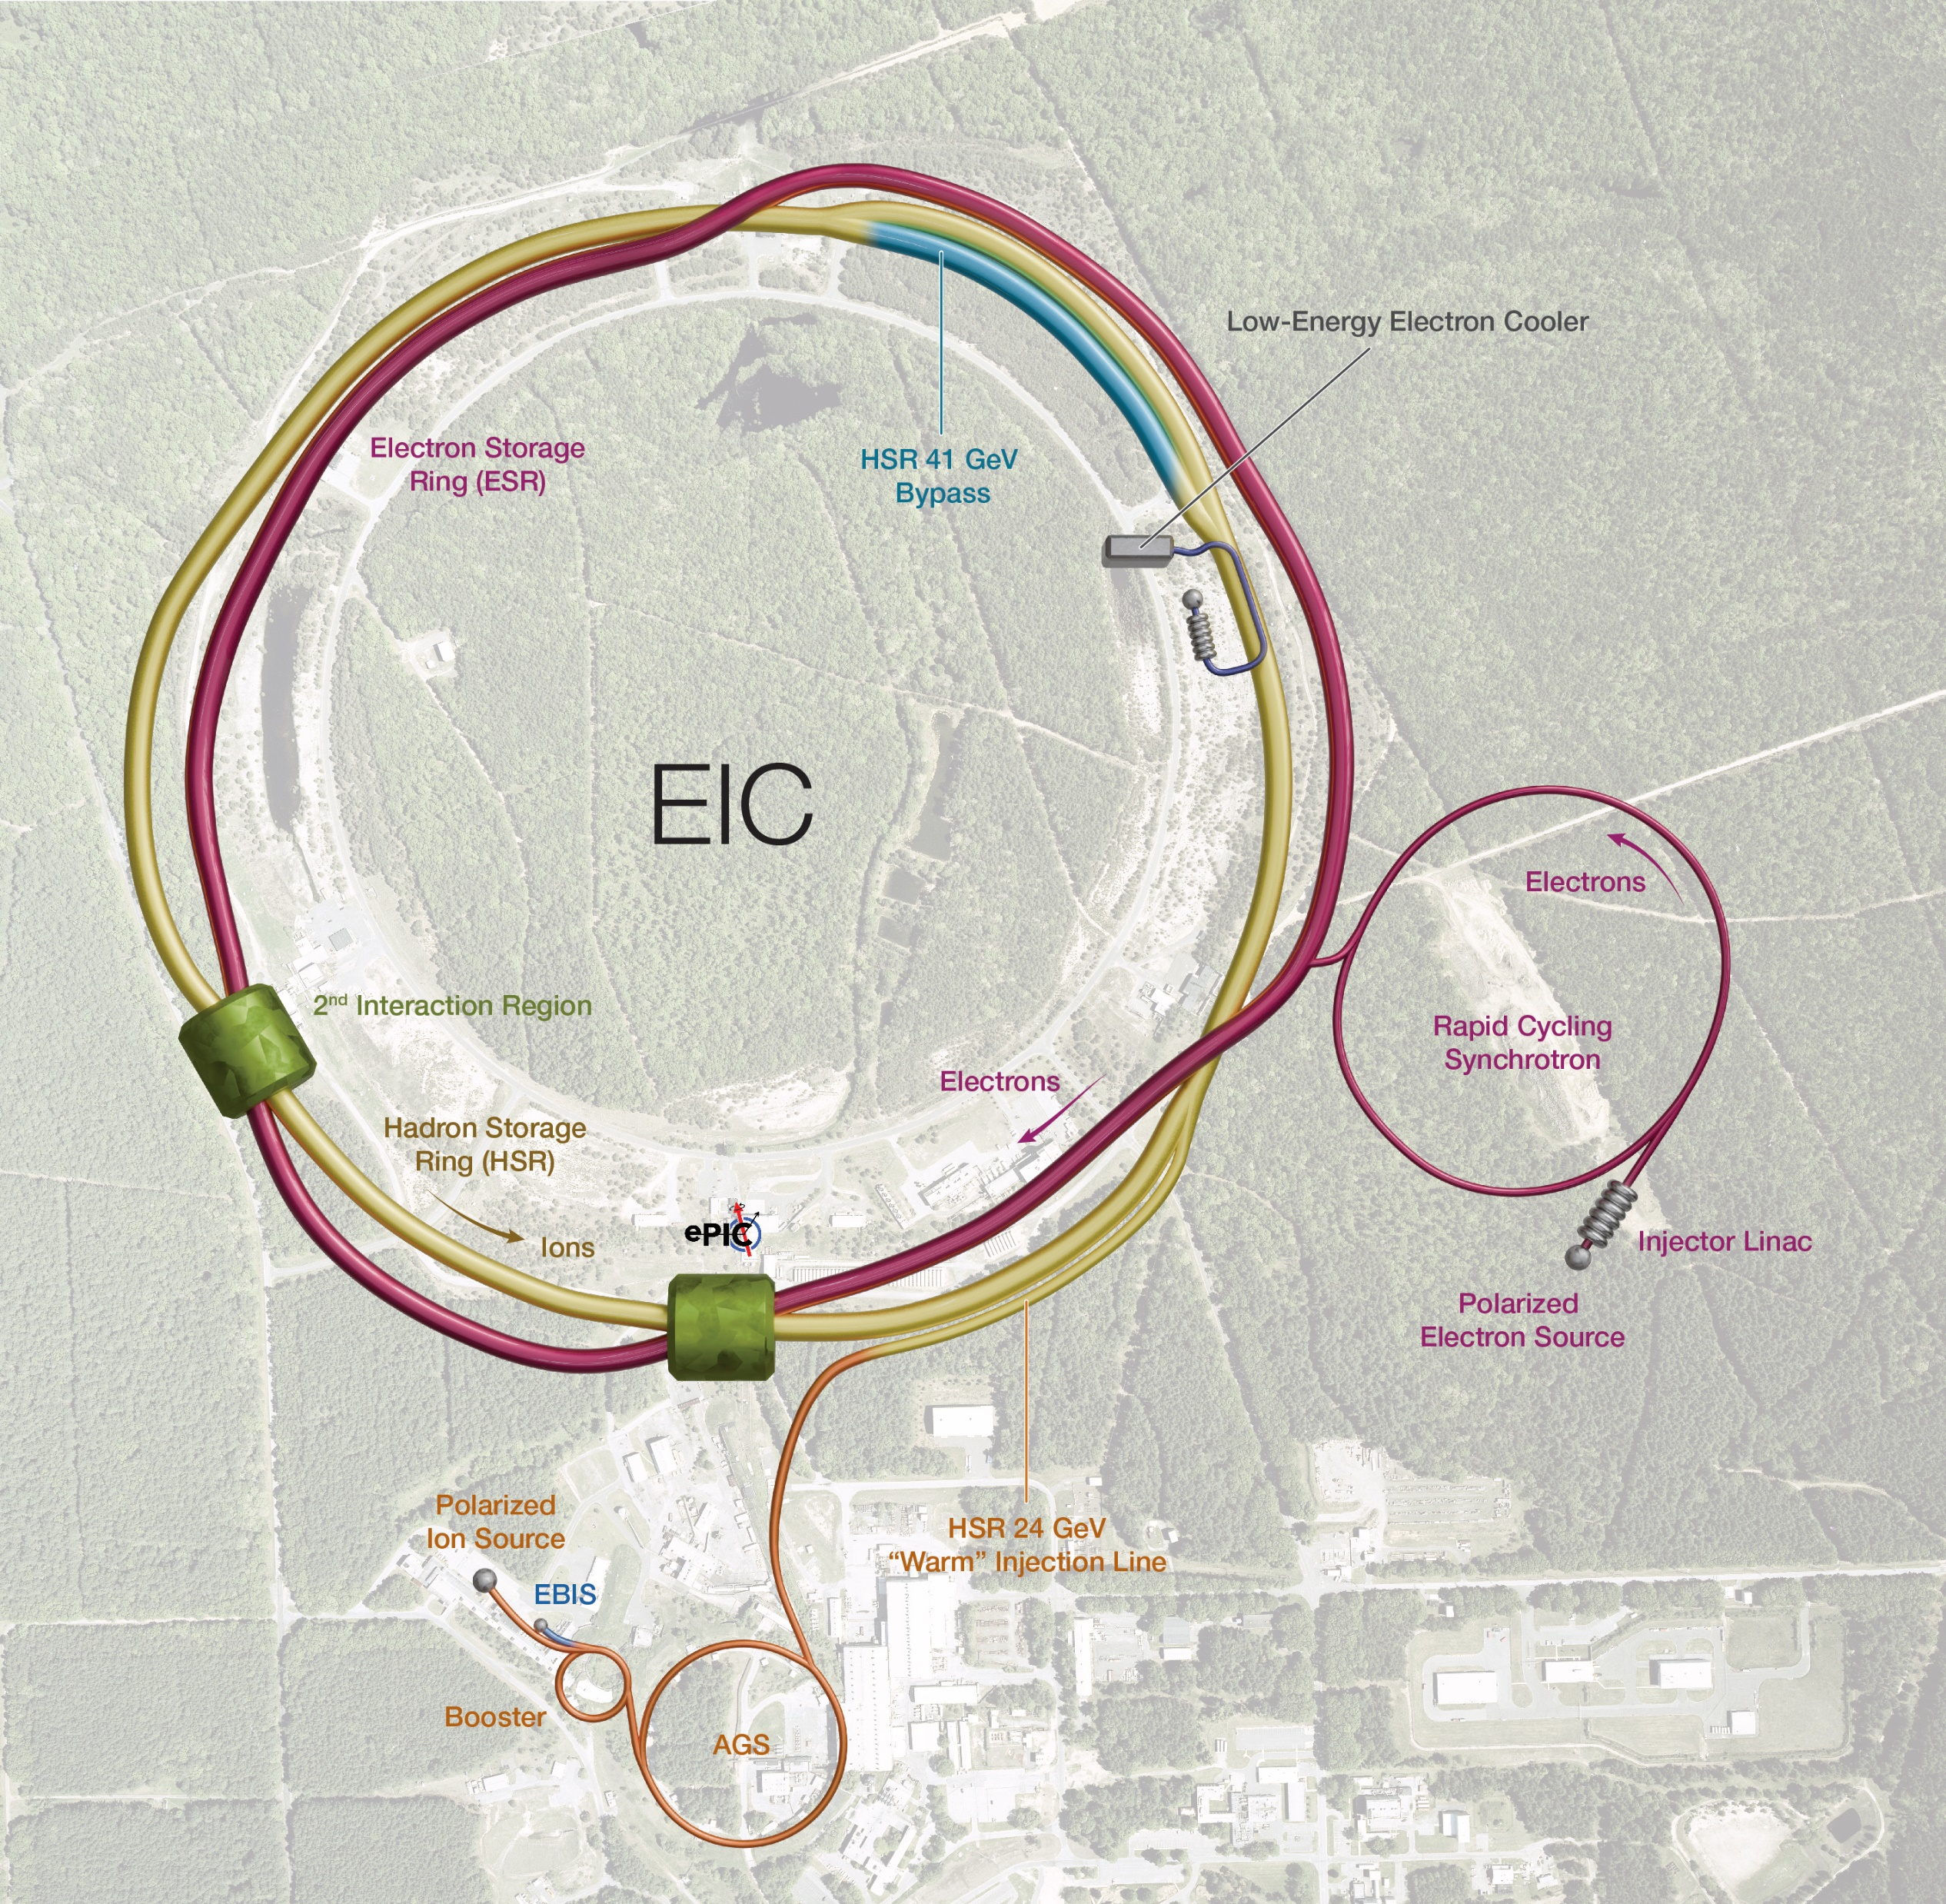

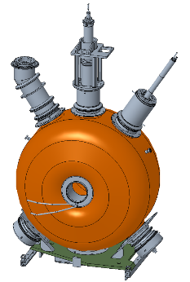
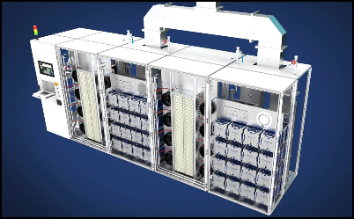
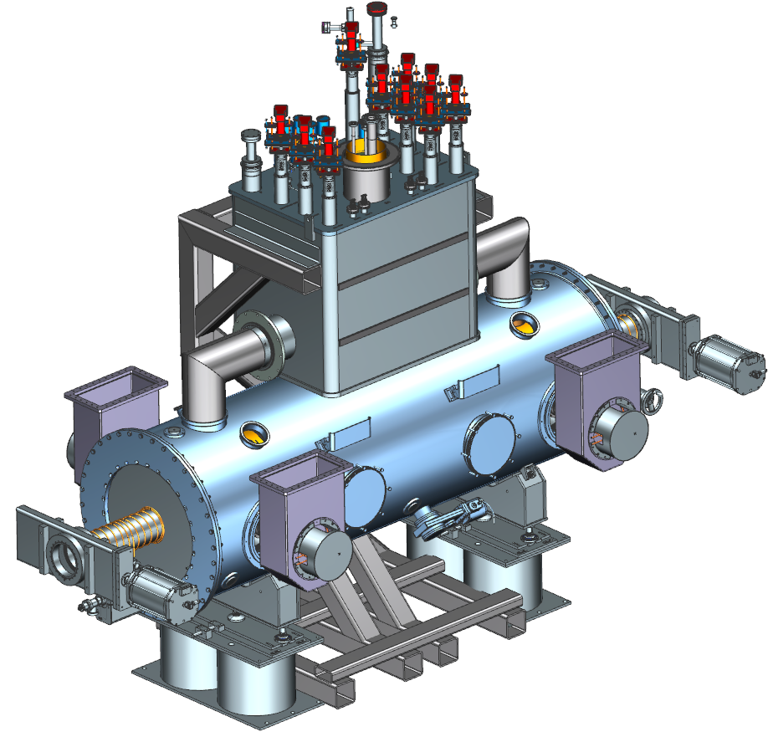
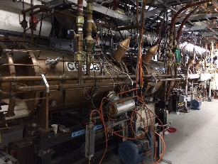
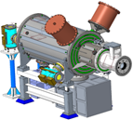
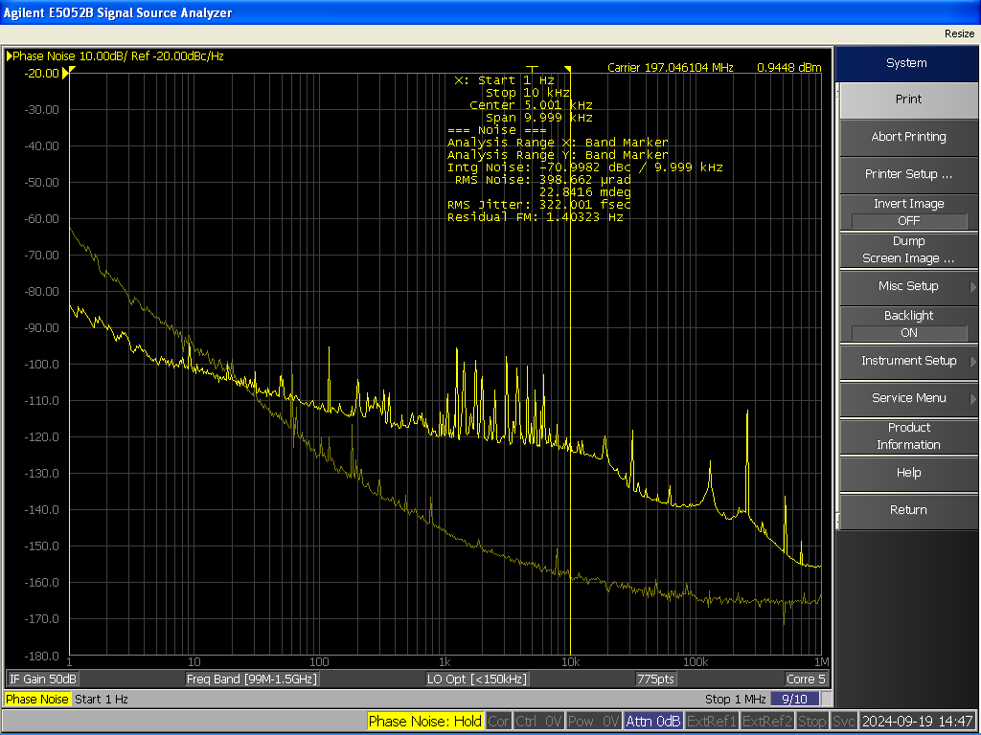
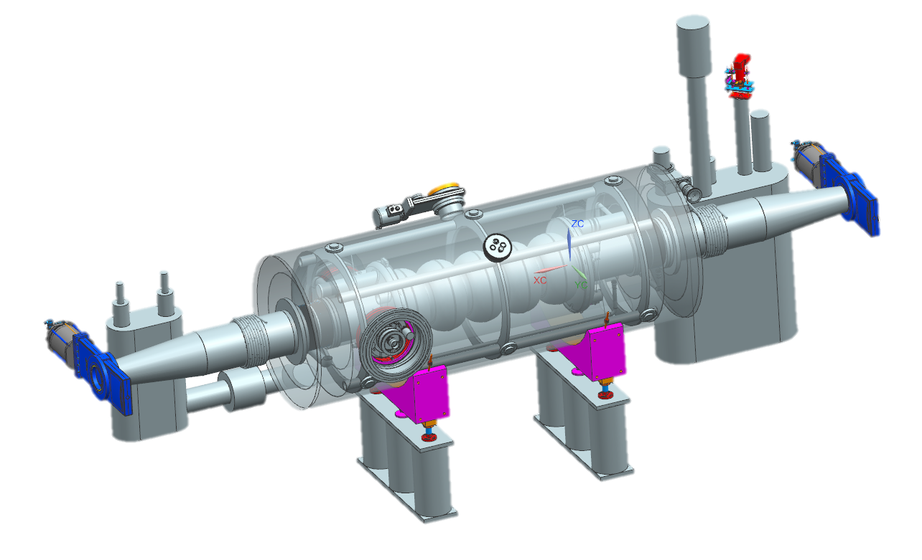
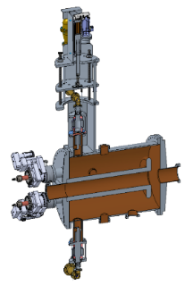
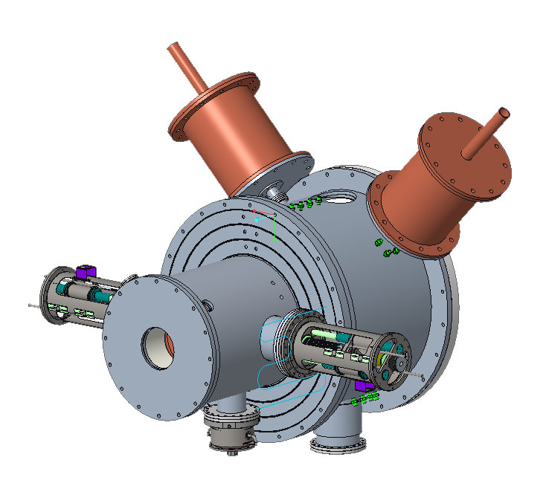
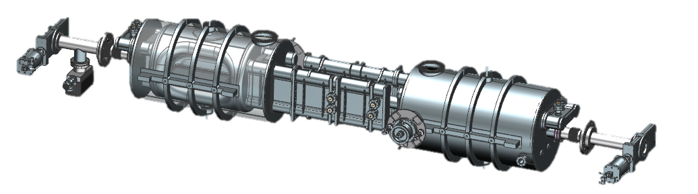
EIC - RF Systems
Low-Energy Cooler, IR02 -
16 197 QWR NCRF,
4 591 NCRF,
1 24 MHz NCRF,
And 1 591 MHz Deflecting Cavity
Electron Storage Ring & Hadron Storage Ring – IR10
591 MHz 800 kW 2 K
1-Cell Cavity Cryomodules
ESR = 8 CMs, 16 Cav
HSR = 2 CMs, 4 Cav
400 kW Solid State Amplifier
HSR NCRF – IR04
EIC LLRF DAC Clock for Crab Cavities
IR06
RHIC – 28 MHz acceleration cavity
4 24.6 MHz Capture & Accel Cavity, IR04
Crab Cavities (per IR) | HSR (Cavities/CMs) | ESR (Cavities/CMs)
197 MHz | 8/4 | –
394 MHz | 4/4 | 2/2
RCS
591 MHz 5-Cell Cavity Cryomodules
2 CMs
Bunch Splitting
3 49.2 MHz NCRF
4 98.5 MHz NCRF Capture & Accel
8 197 MHz NCRF

Slide 14
IR6 (Crab Cavities)
RF Controls
Facilities
Crab Cavity Cryomodules
Crabbing System | Quantity
197 MHz HSR | 4 & 4
394 MHz HSR | 2 & 2
394 MHz ESR | 1 & 1
HPRF Amplifiers and Distribution
c/o: Karim Hamdi
Notes:
Add extra verbiage on issues

Slide 15
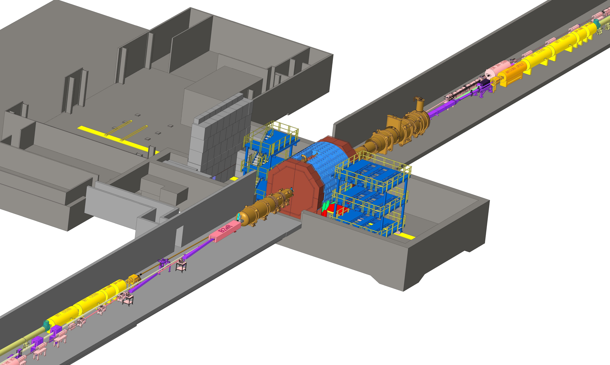
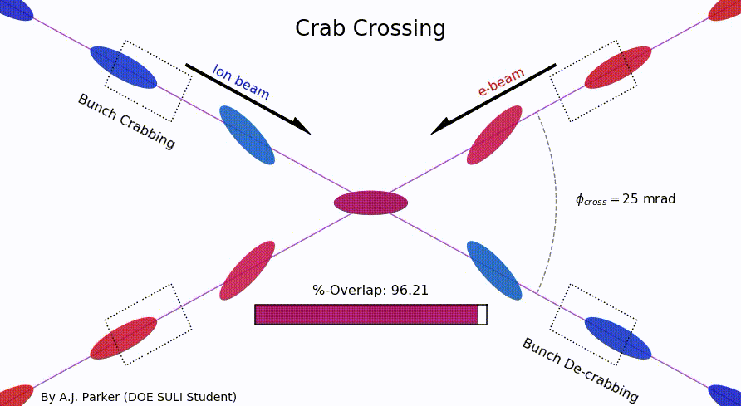
EIC IR Layout
High Luminosity:
  25 mrad crossing angle
  Small β* for high luminosity
  with limited IR chromaticity contributions
  Large final focus quadrupole aperture
  Machine Detector Interface
  Large detector acceptance
  Forward spectrometer
  No magnets within - 4.5 / +5 m from IP
  Space for luminosity detector, neutron detector, “Roman Pots”

Slide 16
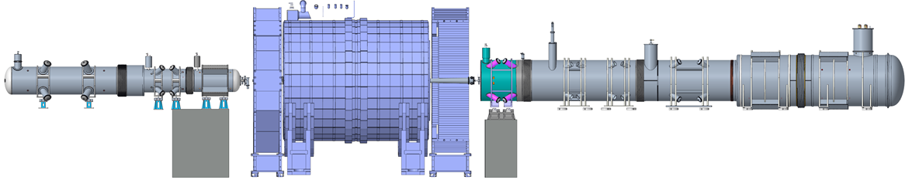
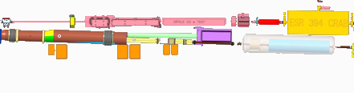
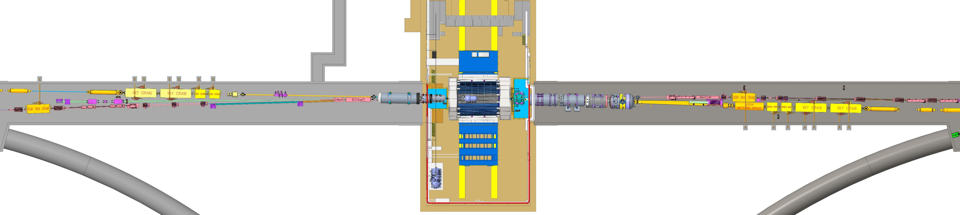
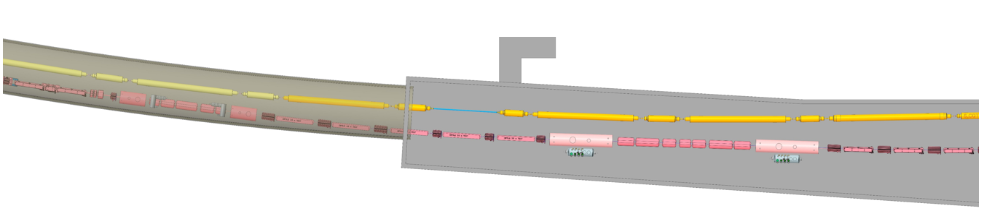
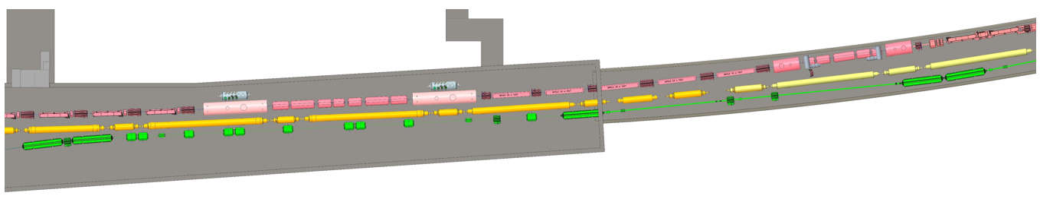
EIC IR layout
9 cryostats housing 11 cold masses (2 K)
  15 magnets (dipole, quadrupole, and combined-function)
    6 “cos-theta” magnets with Rutherford cables, 9 magnets fabricated with Direct Wind technique (DW)
Interaction Region – Rear
Interaction Region - Forward
RC-3
RC-2
RC-1
B0pF
FC-1
FC-2
FC-3
FC-4
B2pF
8 cryostats (4 per side) which contain the spin rotators (solenoids 8.5 T, 2K)
  2 long and 2 short per side
Interaction Region – Rear
Interaction Region - Forward

Slide 17
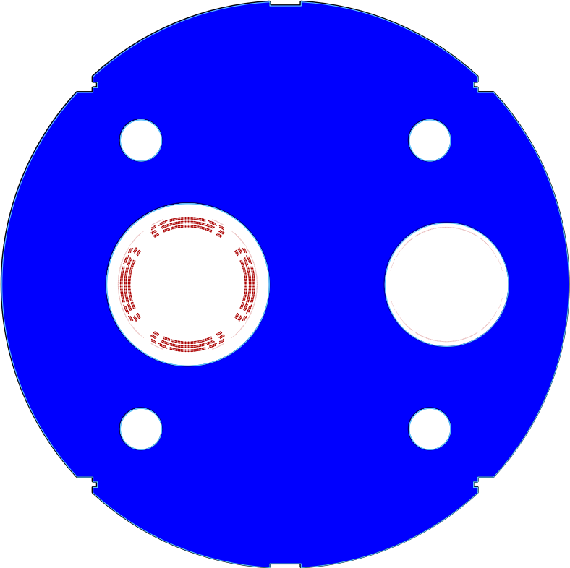
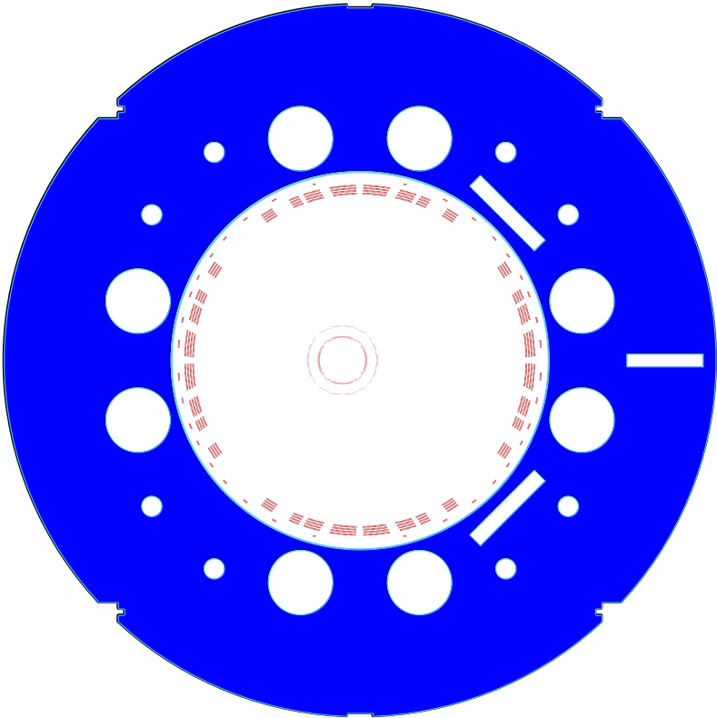
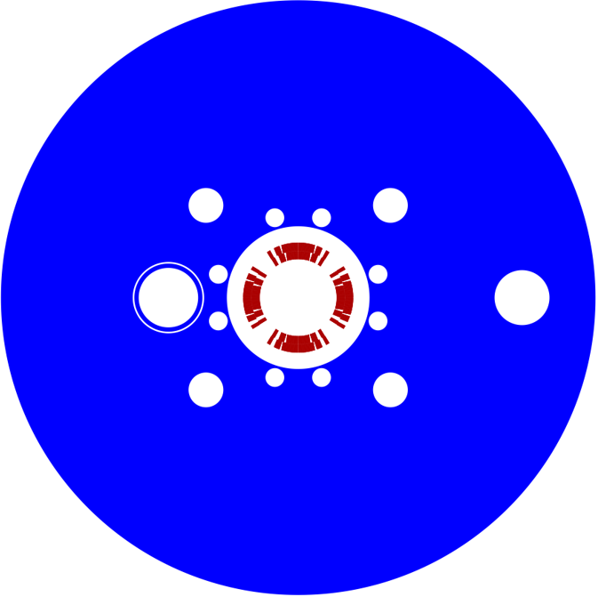
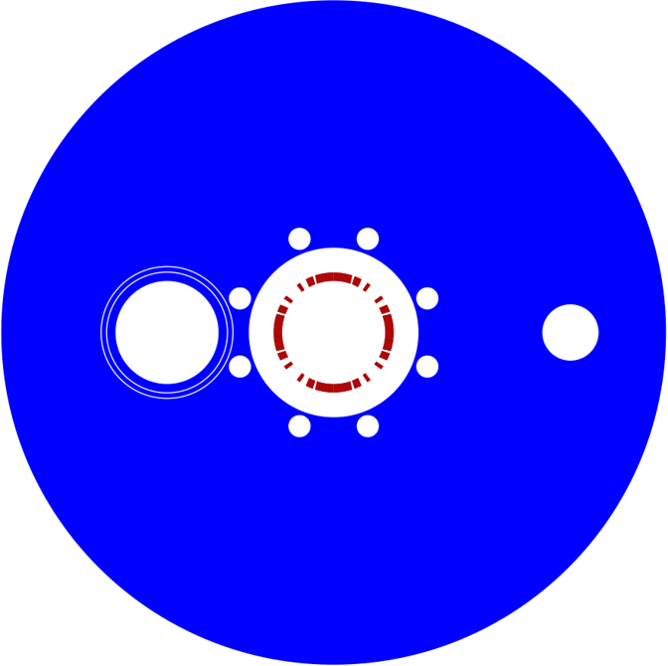
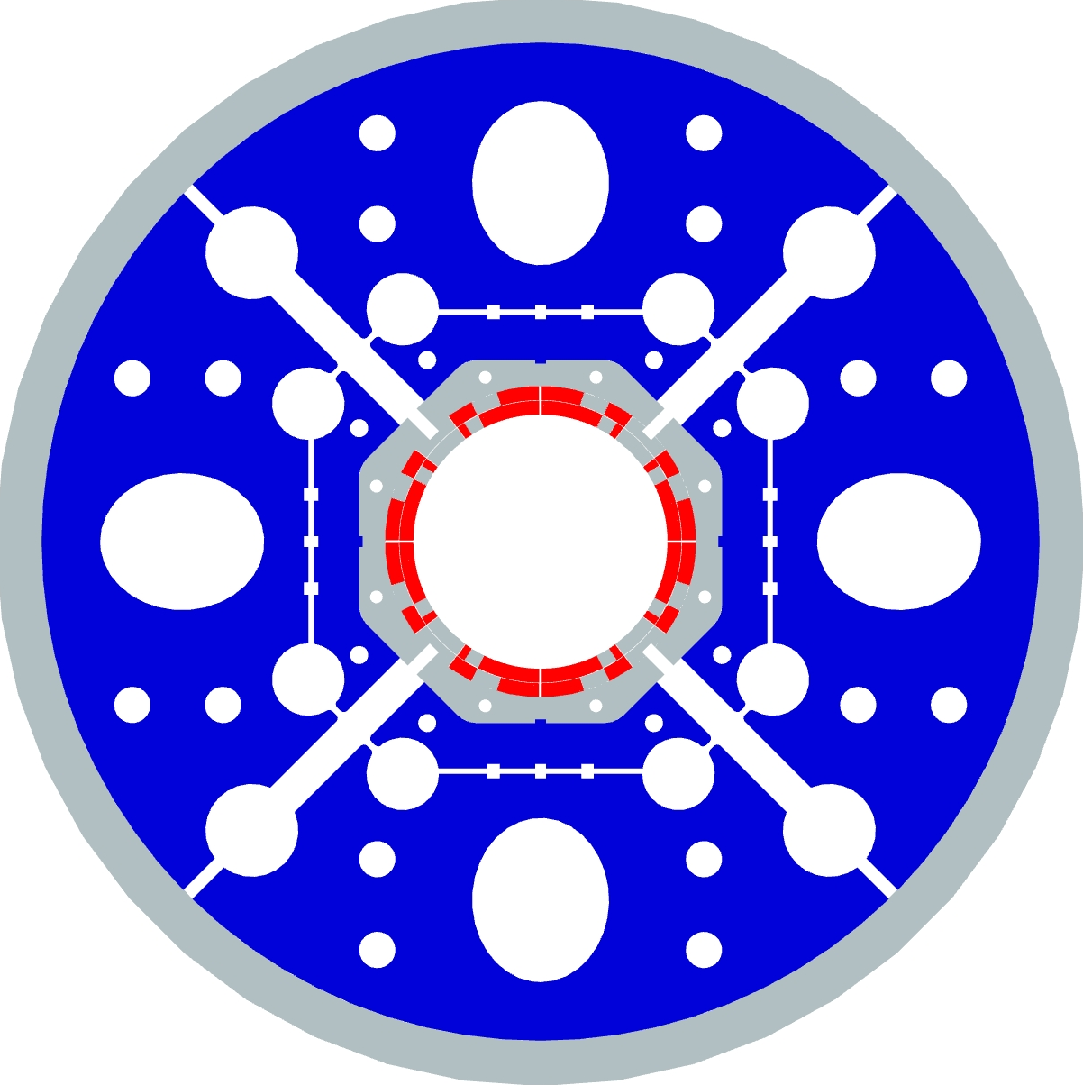
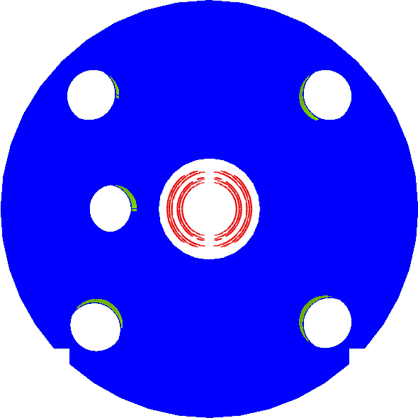
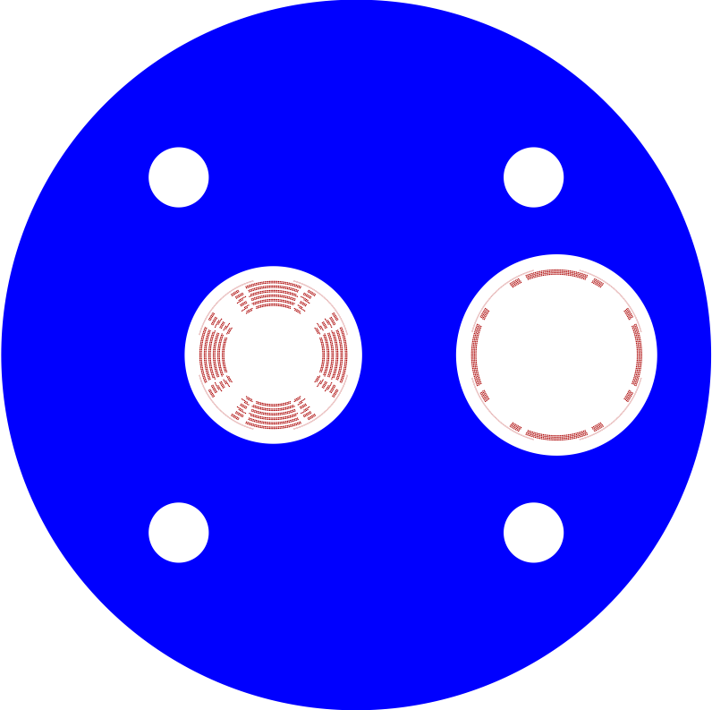
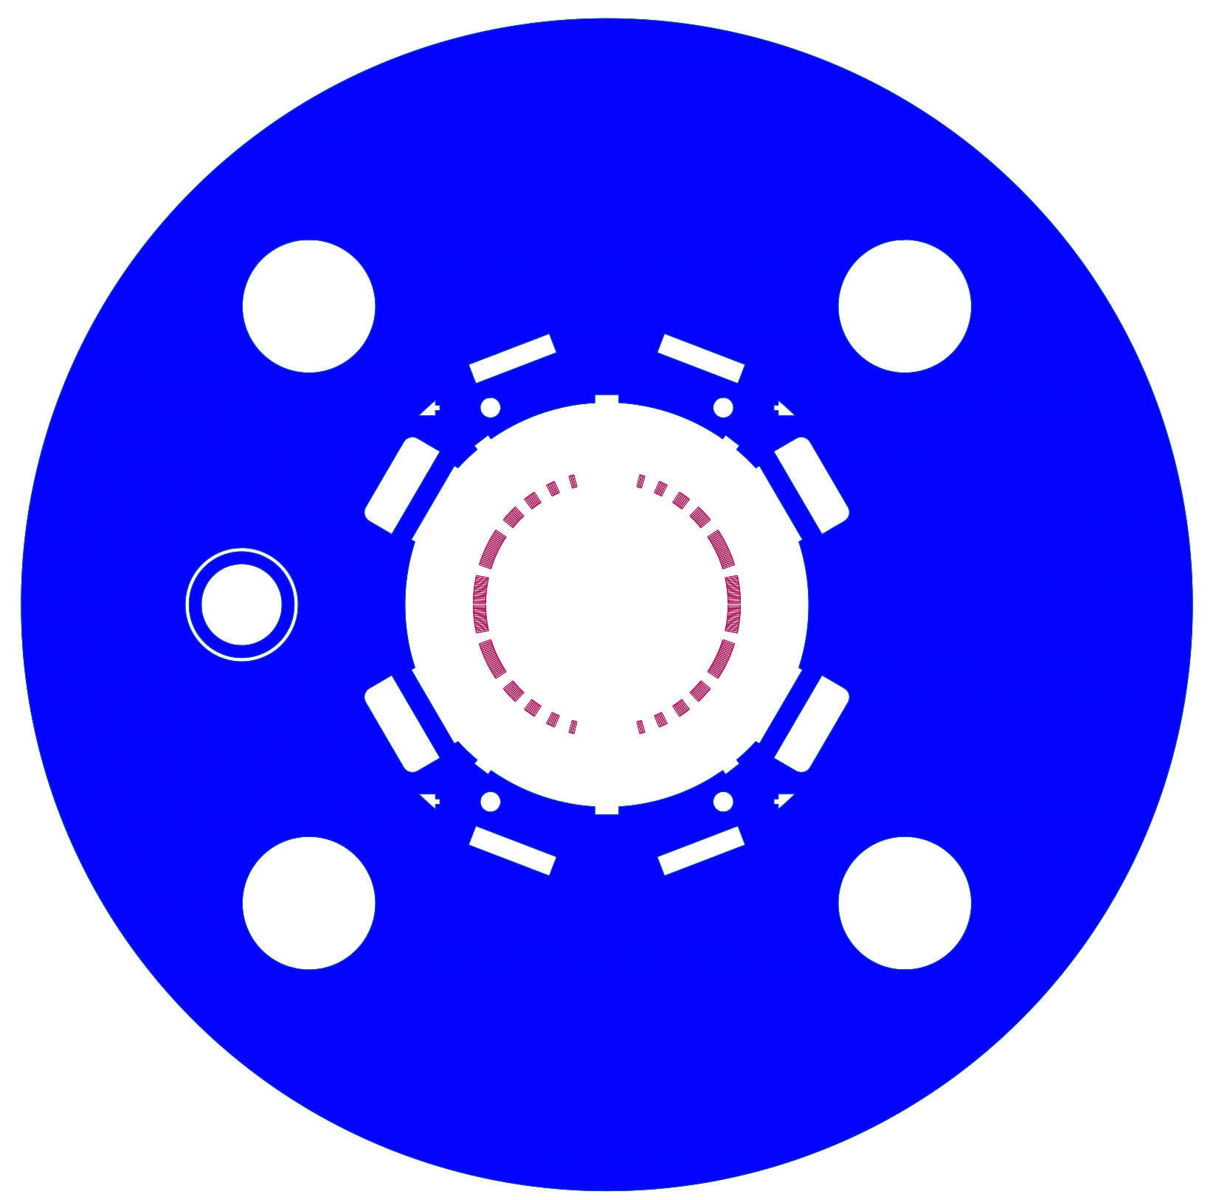




EIC IR Superconducting Magnets
View from the IP
Q2pR-eDrift
B0ApF-eDrift
Q1ApF-eDrift
Q1BpF-Q1eF
Q2pF-eDrift
B0pF-Q0eF
Q1BpR-Q2eR
B2pF
Q1ApR-Q1eR
1 m
Spin rotator
B1pF-eDrif
B1ApF-eDrift
All magnets to the same scale

Slide 18



The 41-GeV ‘bypass’
This bypass provides access to the lowest EIC CoM energy, 29 GeV
Sector 1 without and with the 41-GeV bypass line

Slide 19

Low-energy Cooler Concept
24 GeV protons
12.5 MeV electrons
RF diagnostics line with Deflecting cavity
180°Dipole
(U-turn)
LEReC
Cooling Solenoids
180° Dipole
Spectrometer
Not to scale
Mu-metal shielding
Quad
150 m cooling section
cooling
RF diagnostic
hadron
hadron
hadron
e⁻
HSR
e⁻
HSR
e⁻
extraction
transport
IR2 layout
(all within the
existing RHIC
Tunnel)
Injector test
injection
SC Quad
PM
Cathode transport
PM
PM
Solenoids
Laser
197 MHz
130 kW Beam Dump
Extraction line
900 kW Beam Dump
4x 591 MHz
NCRF correction Cavities
DC Gun
400kV
Injector/linac
Test line
24MHz
RF cavity
16x 197 MHz
NCRF LINAC

Slide 20



The EIC facility is international in characters.
It will be built at BNL in Partnership with JLab, and collaborators around the world.
20

Slide 21

Wolfram Fischer has been named co-chair of the Electron-Ion Collider Accelerator Collaboration
21

