Slide 1





Using gem5 For Open Source Computer Architecture Research
Matthew D. Sinclair
University of Wisconsin-Madison, Computer Sciences Department
sinclair@cs.wisc.edu
Collaborators: John Alsop (AMDR), Brad Beckmann (AMDR), Bobby Bruce (UCD), Alexandru Dutu (AMDR), Anthony Gutierrez (AMDR), Michael LeBeane (AMDR/Qualcomm), Jason Lowe-Power (UCD), Matthew Poremba (AMDR), Mike Swift (UW), and others Students: Divyanshu Agarwal, Kai Batley, Aatman Borda, James Braun, Anuska Chandrashekar, Akanksha Chaudhari, Gaurav Jain, Charles d’Andrea Jamieson, Jarvis Jia, Daniel Kouchekinia, Subhadip Kundu, Marco Kurzynski, Siddhu Mohan, Shreya Mukherjee, Ndubuisi Osuji, Andres Quintanal Escandon, Vishnu Ramadas, Kyle Roarty, Alex Smith, Yu Xia, Bobbi Yogatama, and others

Slide 2
Why Is This Important?
Faster hardware
Improved algorithms (e.g., deeper DNNs)
Larger Datasets
Moore’s Law has enabled a virtuous cycle of progress in many fields
… slowing of Moore’s Law also threatens progress
Modern apps have ravenous (exponential) compute, power needs
Must co-optimize for performance and power
2

Slide 3
What Is Needed?
Need disruptive, cross-layer changes to meet future sys. reqs.
Co-design arch, runtime, OS, compiler, network, batch sched.
For both power and performance (and maybe other factors)
Increasingly important as transistor sizes shrink
Typically sim. & modeling tools enable early-stage design exploration
Recent work: scalably enable accurate co-design for performance
But what about power? Or sustainability?
Need credible, open-source modeling infrastructure for all of these
I co-lead, maintain, and develop for gem5’s open-source HW
3

Slide 4
What is gem5?
Computer Architecture simulator
Used for exploring new computer hardware/system designs
Simulation infrastructure and models for computer components
Most popular tool
Over 6000 citations since 2010
1000s of active users
~20% of top-tier computer architecture papers each year use gem5
Used across industry by leaders (AMD, Arm, Google, & many more)
Open-source software (which models hardware)
Developed since ~2000
Hundreds of contributors from academia, industry, government labs, …
High-velocity: over 1000 commits and 200K LoC in past year
4

Slide 5
Why gem5?
Uniquely suited to model systems with CPUs, GPUs, & accelerators
Highly configurable, models both homogeneous and heterogeneous systems
Huge impact: Wide use in academia, industry, & national labs (6000+ citations)
Can research µarch, caches, main memory, I/Cs, interfaces, coherence & consistency, …
Models entire system, including OS and runtime – not reliant on external tools, traces
Full system effects increasingly important: app diversity, heterogeneous archs., co-design
Recent additions:
We are adding support to scale gem5 to large-scale (e.g., HPC) systems
Able to run modern applications in high-level frameworks like PyTorch/TensorFlow
Significant software engineering effort
Validated, cycle-level fidelity for some components
Rigorous functional regression testing improves stability
gem5 has pieces needed for modeling future systems
5

Slide 6
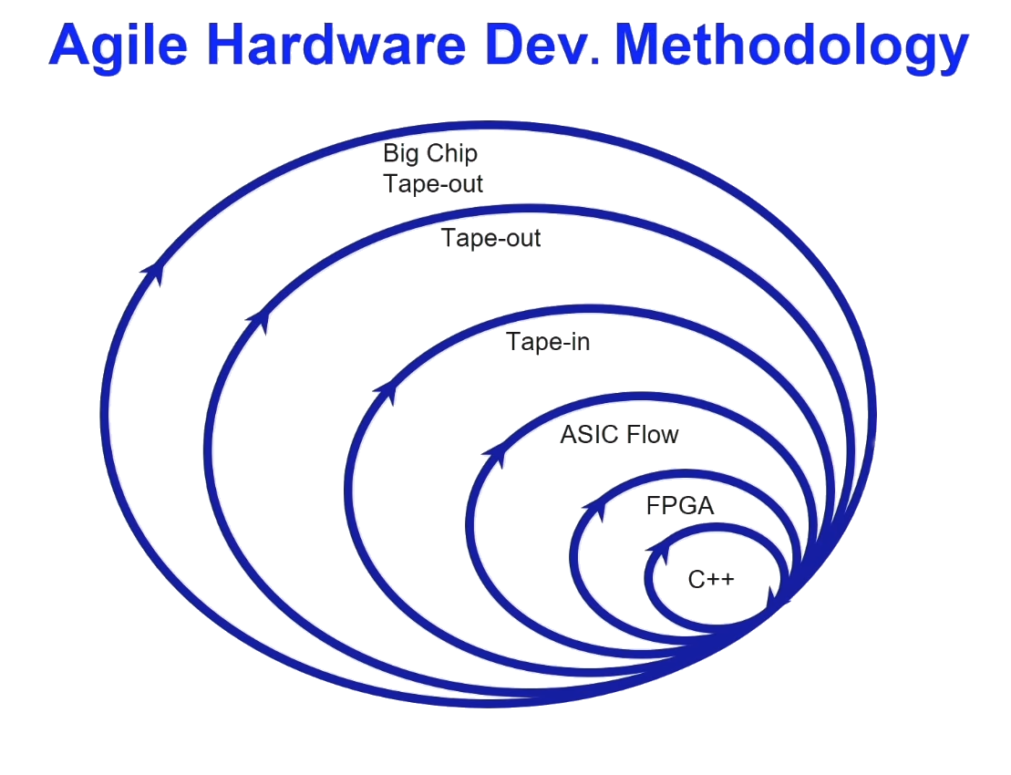
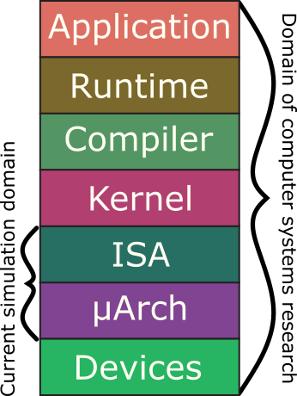
gem5’s Goals
From Hennessey and Patterson
Turing Lecture
6

Slide 7
gem5’s Goals (Cont.)
Anyone (including non-architects) can download and use
Widely used in academia, industry, and national labs
Used for cross-stack research
Change kernel, runtime, HW, etc. all in concert
Run full ML stacks, as well as other emerging apps
Living SW – constantly evolving
Lots of rough edges, but you can help!
7

Slide 8
Our Contributions
GAP: Improve Fidelity of gem5’s GPU Models
Scalably Supporting Large-Scale Workloads in gem5
Additional Ongoing Efforts, Including:
Better power modeling [Smith et al. OSCAR ‘24]
Accelerator integration [Chaudhari & Sinclair gem5’25]
Modeling multi-chiplet systems [Yogatama gem5’21, Dalmia MICRO’24]
Better thermal modeling
…
Today’s Focus: first one (especially for GPGPU)
8

Slide 9
Outline
Motivation
Background
Improvements
Ongoing Work & Conclusions
9

Slide 10

CPU-GPU SE Mode Support in gem5
Execution-drive, cycle-level
Accurately models complex CPUs & GPUs
Rapid prototyping of new features
Validate simulation with execute-in-execute
Our prior work [Gutierrez et al. HPCA’18]
Runs unmodified ROCm user stack
ROCm 4 SE mode, ROCm 6 FS mode
Simulates end-to-end HIP applications
Able to study inter-kernel effects
Able to study interface design
Recently added support for MI200/300 GPUs
Not always highly accurate relative to equivalent real GPUs
[Gutierrez et al., HPCA ‘18]
10
Notes:
The existing gem5 GPU support was introduced by AMD Research at HPCA 2018. They introduced a new cycle-level, execution-driven GPU model that uses AMD’s ROCm stack to run HIP applications.
Our group has been enhancing this to run CPU-GPU experiments in gem5. Prior work our group has done includes creating, validating, and releasing a docker image to run GPU models that include updated versions of ROCm. Additionally, we’ve updated gem5 to make it easier to reproduce results, released support for a number of GPU workloads in gem5-resources, as well as enabled continuous-integration testing for many of these.
One major area for improvement in gem5s GPU support is the accuracy of its models when compared to real GPUs (at least in the public models). This mismatch in accuracy has the potential to be hazardous, with gem5 users prototyping new optimizations being at risk of drawing incorrect conclusions as to the efficacy of their optimizations.

Slide 11
Outline
Motivation
Background
Improvements
GAP: Improve Fidelity of gem5’s GPU Models
Scalably Supporting Large-Scale Workloads in gem5
Ongoing Work & Conclusions
11

Slide 12
How to Systematically Improve Bottlenecks?
Issue: need standard approach for evaluating new configurations
Solution: gem5 GPU Accuracy Profiler (GAP) [Jamieson et al. gem5’22, Ramadas et al. gem5’23, Ramadas et al. YArch’24, Xia gem5’25]
Profiler Metrics
Run each app on real GPU
prof-metrics.csv
App(s) to Run and GAP configuration
Match corresponding metrics
Per App Comparison File
Run benchmarks on gem5
gem5-stats.txt
Using GAP to iteratively refine gem5 GPU models
12

Slide 13
Methodology
Created ~60 hand-tuned assembly kernel microbenchmarks
Enables isolating behavior of different components
Target latency, bandwidth, size, and/or # of levels
Atomic operations (with and without conflicts), L1 I$, L1 D$, L2$, LDS, Main Memory, TLB/Page Table, Max FLOPs, MFMA operations, arithmetic latency, …
Focus on memory: initial tests showed it has biggest gap relative to real HW
Compare uBench gem5 vs. real GPU output with GAP
Target corresponding statistics in gem5 and ROCm profilers
Use results to iteratively refine – next slides show some of optimizations
Leverage combination of patents, publicly disclosed info, reverse engineering
13

Slide 14
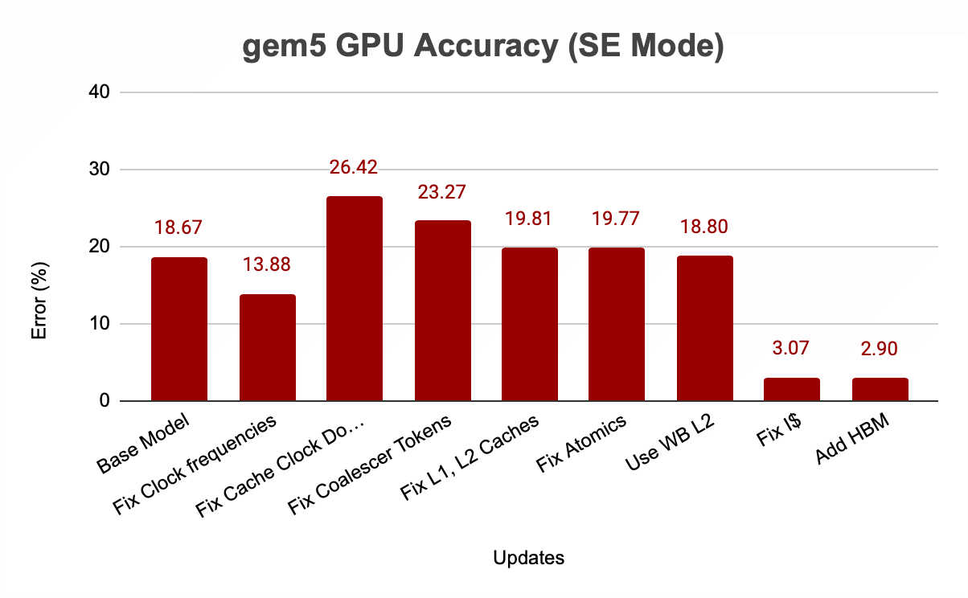
Steadily reducing error relative to real GPU
Backup slides: more granular view of impact on specific tests
GPUFS shows similar behavior
14

Slide 15
More: Improving gem5’s GPU @ UW
Support for ROCm 4.0, 5.1 in SE mode; 6.2 in FS mode
Support for Carrizo-class dGPUs (gfx803)
Support for Vega-class dGPUs & APUs (gfx900, gfx902) and MI200/300 (gfx90a, gfx942) dGPUs
Validated, publicly available, tested benchmarks [Bruce, et al. ISPASS’21 Best Paper Nom.]
More realistic GPU register file model, improved concurrency via dynamic register allocation and VRF schemes
Improved concurrency via better dependency management
CU masking support to run kernels on a subset of GPU resources
Extend BLAS support to use kernels that run on real devices [Roarty, et al. gem5 Wkshp‘20]
Multi-chiplet support – more representative of future GPUs [Yogatama, et al. gem5 Wkshp‘20]
Properly report device properties for (ML) programs that dynamically select kernels
Study various cache replacement policies in GPUs [Jia & Sinclair gem5 Wkshp‘23]
…
Significant effort to model modern systems with high fidelity
15

Slide 16
GAP Conclusion
Having validated gem5 models is important
Existing GPU model does not always behave intuitively
Point solutions insufficient
Solution: More automated framework (GAP)
Results: memory system seems to need the most attention
Potentially can be applied to other, non-GPU models
Goals:
Use microbenchmarks to tune for minimum absolute error in GPU model
Release tool (& continue releasing GPU improvements) publicly
Integrate performance regression testing integrated into gem5
16
Notes:
More automated way to compare real GPU and gem5 GPU

Slide 17
Outline
Motivation
Background
Improvements
Ongoing Work & Conclusions
17

Slide 18
Conclusions & Future Work
Future systems need high fidelity tools for early design-stage exploration
Challenges:
Applications (especially ML) increasingly diverse, scaling voraciously
Detailed (e.g., cycle-level) full stack simulation is very slow
Emerging technologies like chiplets poorly supported in SOTA tools like gem5
Architectures becoming increasingly heterogeneous
Our Approach:
Enhance gem5 to run modern GPU/accel apps with high fidelity on SOTA models
Add multi-fidelity support to reduce simulation time for less important portions
Make gem5 easier to use for these applications and models (open source all of this)
Significant improvements to both usability and accuracy
Reduced barriers to entry for simulation
18
Notes:
Improve gem5's ease-of-use
Reducing setup time
Creating easily reproducible environments
Improve usability of gem5's GPU model
Known working environment
Simulator-specific optimizations
On-going: integrate into develop branch to enable GPU regression testing
Reduce barriers to entry for simulation

Slide 19

19

Slide 20
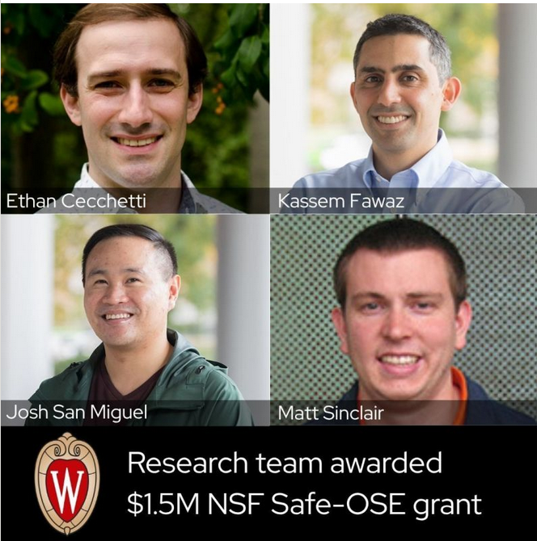
One Next Step for gem5: Better Security
Will be hiring a gem5 “staff engineer” for this – reach out if interested!
(Disclaimer: position has not been posted yet)
20

Slide 21
Backup
21

Slide 22
Nomenclature (Traditional)
Host: the actual hardware you’re using
Running things directly on the HW: Native execution
Guest: Code running on top of “fake” HW
OS in virtual machine is guest OS
Running “on top of” hypervisor
Hypervisor is emulating HW
Your system
App
App
Operating Sys.
Host
Hardware
Virtual machines
App
App
Guest
Operating Sys.
Hypervisor
Host
Hardware

Slide 23
Nomenclature (Simulation)
Host: the actual HW you’re using
Simulator: Runs on the host
Exposes HW to the guest
Guest: Code running on simulated HW
OS running on gem5 is guest OS
gem5 is simulating HW
Simulator’s Code: Runs natively
Executes/emulates the guest code
Guest’s Code: (or benchmark, workload, etc.) Runs on gem5, not on the host
Your system
App
App
Operating Sys.
Host
Hardware
Simulation
Workload
App
App
Guest
Operating Sys.
gem5/Simulator
Host
Hardware

Slide 24
Nomenclature (Simulation, Cont.)
Host: the actual HW you’re using
Simulator: Runs on the host
Exposes HW to the guest
Simulator’s performance:
Time to run simulation on host
Wallclock time as you perceive it
Simulated performance:
Time predicted by the simulator
Time for guest code to run on simulator
Your system
App
App
Operating Sys.
Host
Hardware
Simulation
Workload
App
App
Guest
Operating Sys.
gem5/Simulator
Host
Hardware

Slide 25
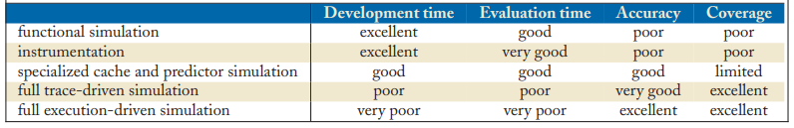
Tradeoffs in Simulation
Development Time: time to develop simulator/models
Evaluation Time: wallclock time to run simulator
Fidelity: How close is the simulator to real HW
Many academic simulators: first-order trends (not cycle-accurate)
Industry simulators often focus on cycle-accurate simulation
Flexibility: how quickly one can modify the simulator to evaluate different algorithms and design choices?
Coverage: How broadly can the simulator be used?
Relative importance of these metrics vary depending on where you are in design process
[Source: Computer Architecture Performance Evaluation Methods]

Slide 26
Tradeoffs in Simulation
Three metrics to evaluate a simulator
Speed
Flexibility
Fidelity
Speed: how fast the simulator runs (xIPs, xCPS)
Flexibility: how quickly one can modify the simulator to evaluate different algorithms and design choices?
Fidelity: how accurate are perf./energy/etc. results simulator generates vs. a real design (simulator error)
Many academic simulators focus on first-order trends (not cycle-accuracy)
Industry simulators often focus on cycle-accurate simulation
Relative importance of these metrics vary depending on where you are in design process

Slide 27
Trading Off Metrics (Inter-Related)
Evaluation time & flexibility affect:
How quickly you can make design tradeoffs
(Sometimes) How accurate the model(s) is/are
Fidelity affects:
How good your design tradeoffs may end up be
How fast you can build your simulator (simulator design time)
Flexibility also affects
How much human effort you need to spend modifying the simulator
Coverage affects what you can model
Tradeoff between these to achieve design exploration and decision goals

Slide 28
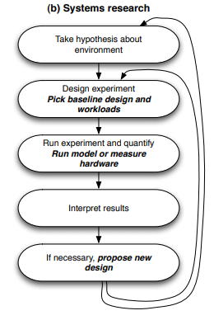
What “Level” Should we Simulate At?
Question: What fidelity is required for this problem?
Example: New register file design
Often, the answer is a mix
gem5 is well suited for this mix
Models with different fidelity
Drop-in replacements for each other
“Cycle level” vs. “Cycle accurate”

Slide 29
(gem5) Cycle-level Simulation
Models system cycle-by-cycle
Often “event-driven” (subsequent slides)
Can be very accurate
Not exact cycle-by-cycle behavior as ASIC
But similar timing (gets first order trends right)
Easily parameterizable
No need for full HW design
Faster than cycle-accurate
Can “cheat” and functionally emulate some things

Slide 30


What is gem5? (History)
Created at Michigan by students of Steve Reinhardt, principally Nate Binkert.
“A tool for simulating systems”

Slide 31
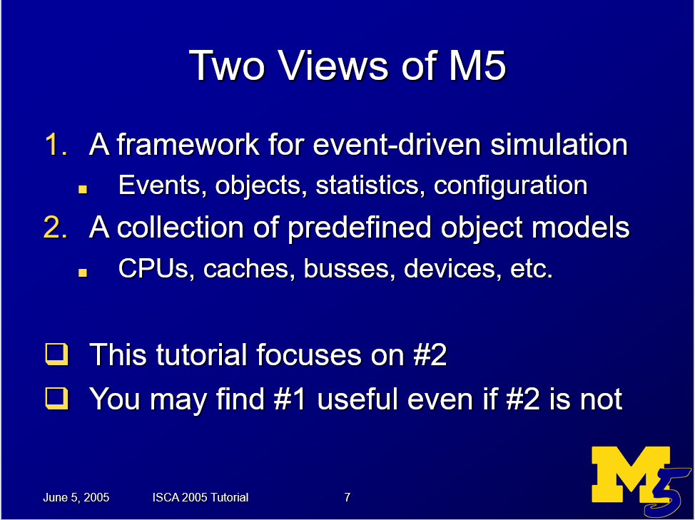

Slide 32

What is gem5? (History, Cont.)
Created at Michigan by students of Steve Reinhardt, principally Nate Binkert.
“A tool for simulating systems”
Created at Wisconsin by students of Mark Hill and David Wood.
Detailed memory system

Slide 33
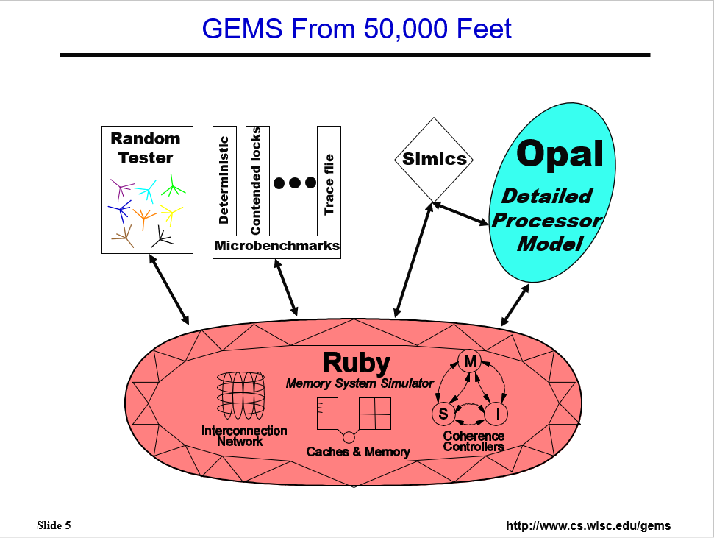

Slide 34
m5 + GEMS = gem5
Created at Michigan by students of Steve Reinhardt, principally Nate Binkert.
“A tool for simulating systems”
Created at Wisconsin by students of Mark Hill and David Wood.
Detailed memory system

Slide 35
What is gem5?
Michigan m5 + Wisconsin GEMS = gem5
“The gem5 simulator is a modular platform for computer-system architecture research, encompassing system-level architecture as well as processor microarchitecture.”
Lowe-Power et al. The gem5 Simulator: Version 20.0+. ArXiv Preprint ArXiv:2007.03152, 2021. https://doi.org/10.48550/arXiv.2007.03152
Nathan Binkert, Bradford Beckmann, Gabriel Black, Steven K. Reinhardt, Ali Saidi, Arkaprava Basu, Joel Hestness, Derek R. Hower, Tushar Krishna, Somayeh Sardashti, Rathijit Sen, Korey Sewell, Muhammad Shoaib, Nilay Vaish, Mark D. Hill, and David A. Wood. 2011. The gem5 simulator. SIGARCH Comput. Archit. News 39, 2 (August 2011), 1-7. DOI=http://dx.doi.org/10.1145/2024716.2024718

Slide 36
gem5-20+: A new era in CA simulation
Version 20.0
Abdul Mutaal Ahmad
Adrian Herrera
Adrien Pesle
Adrià Armejach
Akash Bagdia
Alec Roelke
Alexandru Dutu
Ali Jafri
Ali Saidi
Amin Farmahini
Anders Handler
Andrea Mondelli
Andrea Pellegrini
Andreas Hansson
Andreas Sandberg
Andrew Bardsley
Andrew Lukefahr
Andrew Schultz
Andriani Mappoura
Ani Udipi
Anis Peysieux
Anouk Van Laer
Arthur Perais
Ashkan Tousi
Austin Harris
Avishai Tvila
Ayaz Akram
Bagus Hanindhito
Benjamin Nash
Bertrand Marquis
Binh Pham
Bjoern A. Zeeb
Blake Hechtman
Bobby R. Bruce
Boris Shingarov
Brad Beckmann
Brad Danofsky
Bradley Wang
Brandon Potter
Brian Grayson
Cagdas Dirik
Chander Sudanthi
Chen Zou
Chris Adeniyi-Jones
Chris Emmons
Christian Menard
Christoph Pfister
Christopher Torng
Chuan Zhu
Chun-Chen Hsu
Ciro Santilli
Clint Smullen
Curtis Dunham
Dam Sunwoo
Dan Gibson
Daniel Carvalho
Daniel Johnson
Daniel Sanchez
David Guillen-Fandos
David Hashe
David Oehmke
Derek Hower
Deyaun Guo
Dibakar Gope
Djordje Kovacevic
Dongxue Zhang
Doğukan Korkmaztürk
Dylan Johnson
Earl Ou
Edmund Grimley Evans
Emilio Castillo
Erfan Azarkhish
Eric Van Hensbergen
Erik Hallnor
Erik Tomusk
Faissal Sleiman
Fernando Endo
Gabe Black
Gabe Loh
Gabor Dozsa
Gedare Bloom
Gene WU
Gene Wu
Geoffrey Blake
Georg Kotheimer
Giacomo Gabrielli
Giacomo Travaglini
Glenn Bergmans
Hamid Reza Khaleghzadeh
Hanhwi Jang
Hoa Nguyen
Hongil Yoon
Hsuan Hsu
Hussein Elnawawy
Ian Jiang
IanJiangICT
Ilias Vougioukas
Isaac Richter
Isaac Sánchez Barrera
Ivan Pizarro
Jack Whitham
Jairo Balart
Jakub Jermar
James Clarkson
Jan-Peter Larsson
Jason Lowe-Power
Javier Bueno Hedo
Javier Cano-Cano
Javier Setoain
Jayneel Gandhi
Jennifer Treichler
Jieming Yin
Jing Qu
Jiuyue Ma
Joe Gross
Joel Hestness
John Alsop
John Kalamatianos
Jordi Vaquero
Jose Marinho
Jui-min Lee
Kanishk Sugand
Karthik Sangaiah
Ke Meng
Kevin Brodsky
Kevin Lim
Khalique
Koan-Sin Tan
Korey Sewell
Krishnendra Nathella
Lena Olson
Lisa Hsu
Lluc Alvarez
Lluís Vilanova
Mahyar Samani
Malek Musleh
Marc Mari Barcelo
Marc Orr
Marco Balboni
Marco Elver
Marjan Fariborz
Matt DeVuyst
Matt Evans
Matt Horsnell
Matt Poremba
Matt Sinclair
Matteo Andreozzi
Matteo M. Fusi
Matthew Poremba
Matthias Hille
Matthias Jung
Maurice Becker
Maxime Martinasso
Maximilian Stein
Maximilien Breughe
Michael Adler
Michael LeBeane
Michael Levenhagen
Michiel Van Tol
Miguel Serrano
Mike Upton
Miles Kaufmann
Min Kyu Jeong
Mingyuan
Mitch Hayenga
Mohammad Alian
Monir Mozumder
Moyang Wang
Mrinmoy Ghosh
Nathan Binkert
Nathanael Premillieu
Nayan Deshmukh
Neha Agarwal
Nicholas Lindsay
Nicolas Derumigny
Nicolas Zea
Nikos Nikoleris
Nils Asmussen
Nuwan Jayasena
Ola Jeppsson
Omar Naji
Pablo Prieto
Palle Lyckegaard
Pau Cabre
Paul Rosenfeld
Peter Enns
Pin-Yen Lin
Po-Hao Su
Polina Dudnik
Polydoros Petrakis
Pouya Fotouhi
Prakash Ramrakhyani
Pritha Ghoshal
Radhika Jagtap
Rahul Thakur
Reiley Jeapaul
Rekai Gonzalez-Alberquilla
Rene de Jong
Ricardo Alves
Richard D. Strong
Richard Strong
Rico Amslinger
Riken Gohil
Rizwana Begum
Robert Kovacsics
Robert Scheffel
Rohit Kurup
Ron Dreslinski
Ruben Ayrapetyan
Rune Holm
Ruslan Bukin
Rutuja Oza
Ryan Gambord
Samuel Grayson
Sandipan Das
Santi Galan
Sascha Bischoff
Sean McGoogan
Sean Wilson
Sergei Trofimov
Severin Wischmann
Shawn Rosti
Sherif Elhabbal
Siddhesh Poyarekar
Somayeh Sardashti
Sooraj Puthoor
Sophiane Senni
Soumyaroop Roy
Srikant Bharadwaj
Stan Czerniawski
Stanislaw Czerniawski
Stephan Diestelhorst
Stephen Hines
Steve Raasch
Steve Reinhardt
Stian Hvatum
Sudhanshu Jha
Sujay Phadke
Swapnil Haria
Taeho Kgil
Tao Zhang
Thomas Grass
Tiago Mück
Tim Harris
Timothy Hayes
Timothy M. Jones
Tom Jablin
Tommaso Marinelli
Tony Gutierrez
Trivikram Reddy
Tuan Ta
Tushar Krishna
Umesh Bhaskar
Uri Wiener
Victor Garcia
Vilas Sridharan
Vince Weaver
Vincentius Robby
Wade Walker
Weiping Liao
Wendy Elsasser
William Wang
Willy Wolff
Xiangyu Dong
Xianwei Zhang
Xiaoyu Ma
Xin Ouyang
Yasuko Eckert
Yi Xiang
Yifei Liu
Yu-hsin Wang
Yuan Yao
Yuetsu Kodama
Zhang Zheng
Zicong Wang
jiegec
m5test
seanzw
Éder F. Zulian
Your name here!
36

Slide 37
gem5’s Goals
From Hennessey and Patterson
Turing Lecture

Slide 38
gem5’s Goals (Cont.)
Anyone (including non-architects) can download and use
Widely used in academia, industry, and national labs
Used for cross-stack research
Change kernel, runtime, HW, etc. all in concert
Run full ML stacks, as well as other emerging apps
Living SW – constantly evolving
Lots of rough edges, but you can help!

Slide 39
gem5’s Architecture: SimObjects
Model
C++ code in src/
Parameters
Python code in src/
In SimObject declaration file – all C++ SimObjects exposed to Python
This is the interface with users – scripts define system to model
Instance or configuration
A particular choice for the parameters
In standard library, your extensions, or Python runscript
HW1: Python runscript

Slide 40
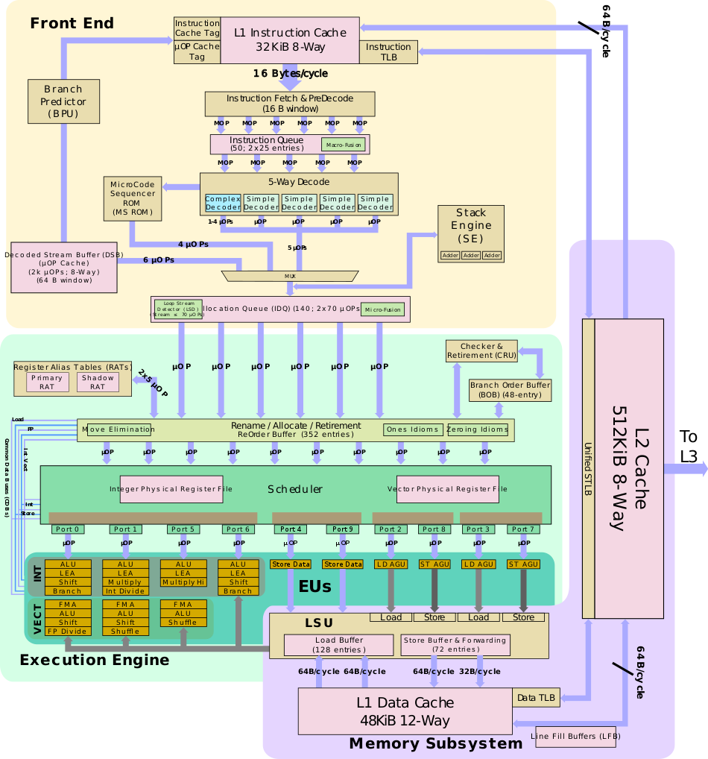
Model vs. Parameters
Generic model and timing in C++
Not vendor or ISA-specific
Expose parameters to Python
Set parameters and connections in Python
[Source: Intel SunnyCove, Wikichip]

Slide 41



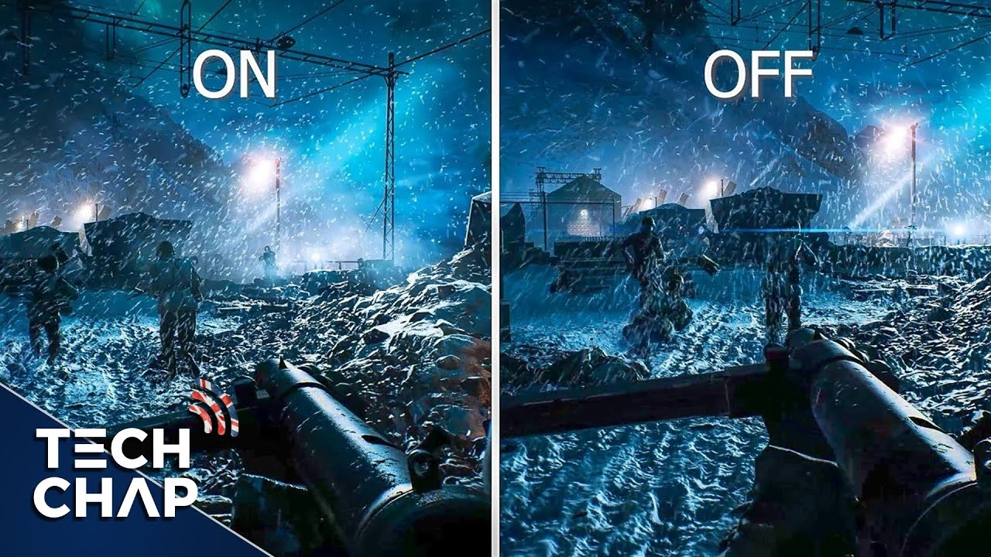
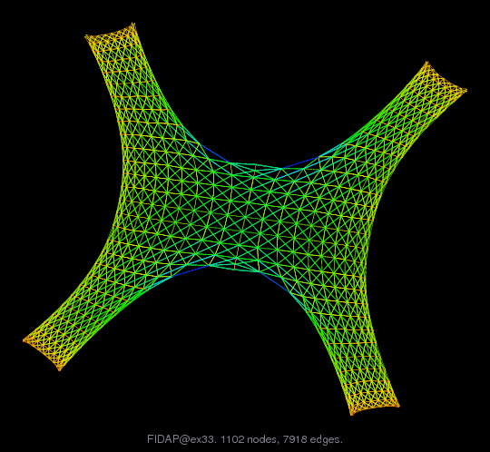
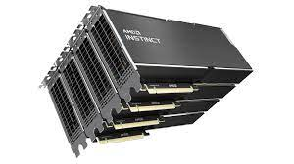


Increasingly Diverse Apps Also Evolving
Scientific Computing
Machine Learning
Graph Analytics
Raytracing
Crypto
Personal Assistants
High fidelity tools crucial for early-stage design exploration
Accelerators require even further evolution (beyond GPGPUs)
41

Slide 42


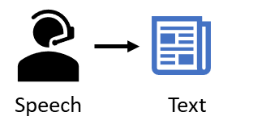
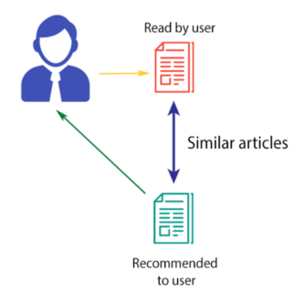
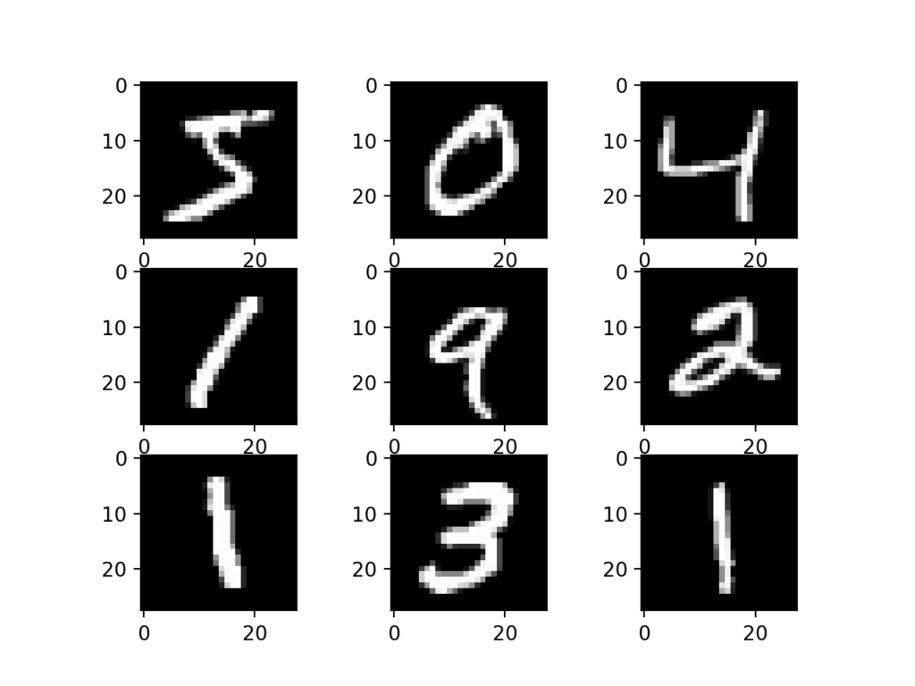
These Applications Drive Systems Reqs.
But they have different characteristics:
…
Machine Learning
Often reuse data, some utilize fine-grained synchronization
Widely varying utilization
Some have tight real-time deadlines
Often utilize high-level frameworks like PyTorch and TensorFlow
High fidelity tools crucial for early-stage design exploration
42
Notes:
High fidelity tools that model the entire system, including the CPU, GPU, memory system, components between the CPU and GPU, etc.

Slide 43
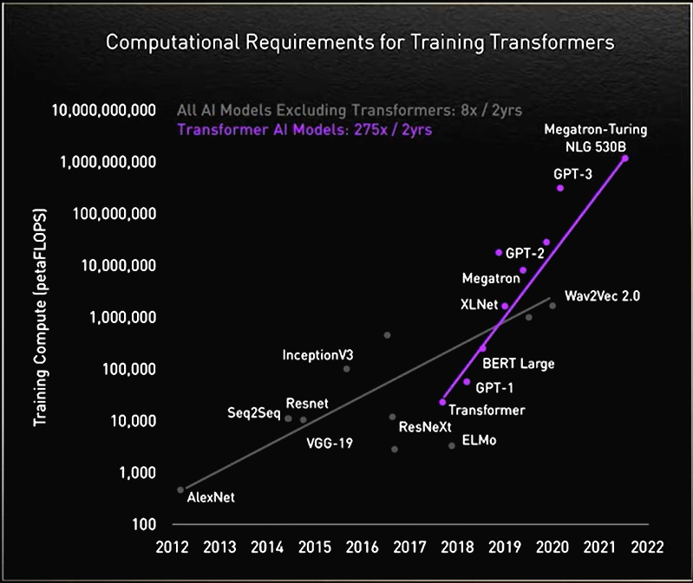
Key Challenge 1: Application Scaling
Simulating entire apps would take months (or years) in many simulators!
Source:
1. https://developer.nvidia.com/blog/using-deepspeed-and-megatron-to-train-megatron-turing-nlg-530b-the-worlds-largest-and-most-powerful-generative-language-model/ 2. https://blogs.nvidia.com/blog/2022/03/25/what-is-a-transformer-model/
43

Slide 44
Simulators to the Rescue?
Future systems will rely on hardware-software co-design
Need a tool to evaluate end-to-end perf, power, energy with full software stack
Need multi-fidelity modeling
Highly detailed models
Low detail models
Fast functional-only models
Need next-gen architects with performance evaluation experience
Systems are too complex to build everything from scratch
44

Slide 45
Key Challenge 2: Simulator Capabilities
Fast
Full System
High Fidel.
Scalable
No RTL
gem5
✗
✓
✓
✗
✓
SST
✓
✗
✗
✓
✓
FireSim
✓
✓
✓
✗
✗
Our Goal
✓
✓
✓
✓
✓
Significant improvements needed
Proposed baseline: gem5+SST
45
Notes:
Future systems will rely on hardware-software co-design
Need a tool to evaluate end-to-end perf, power, energy with full software stack
Need multi-fidelity modeling
Highly detailed models
Low detail models
Fast functional-only models
Need next-gen architects with performance evaluation experience
Systems are too complex to build everything from scratch
Need simulation & modeling that captures full system effects
Issue: modern simulators too slow, inflexible, or high level
gem5 models full system (including OS and runtime) …
… but 200000X slower than bare metal
SST scales to full HPC systems; cost: less design details
FireSim can run full systems, but often require full RTL designs
Some do not extend well to new designs (e.g., accelerators)

Slide 46
gem5’s GPU Simulation Modes
AMD GPUs: ROCm stack to interface with CPU(s)
ROCm stack:
Runtime layer – ROCr
Thunk (user-space driver) – ROCt
Kernel fusion driver (KFD) – ROCk (in Linux)
MIOpen – Machine intelligence (MI/ML) library
rocBLAS – BLAS (e.g., GEMMs) library
HIP (LLVM backend, clang frontend)
Syscall emulation (SE) mode:
Simulate all except ROCk, which gem5 emulates via docker
Full system (FS) model:
Simulated disk image containing entire ROCm stack – great for deep co-design
46

Slide 47
Improving Register Allocation Support
Simple dependence tracking – only 1 wavefront/CU at a time
Even if sufficient registers are available for more WFs
Issue: unrealistic relative to real GPUs
Solution: add dynamic register allocator support
If enough registers available, schedule additional WFs concurrently/CU
Potentially can utilize all WF slots depending on register requirements
More complex, higher performance designs possible
Intuition: Dynamic allocator significantly improves accuracy
47

Slide 48
Dynamic Register Allocator Performance
Reality: dynamic register allocator 6% worse than simple – why?
48

Slide 49
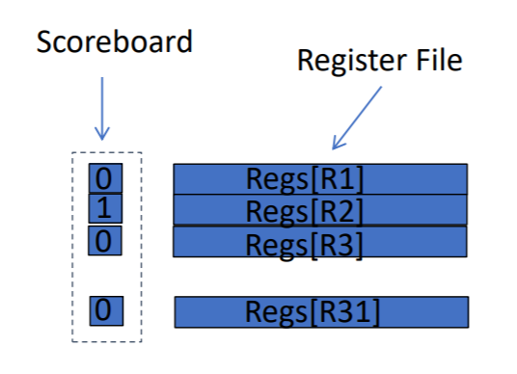
Issue: Dependence Tracking
GPU model did not track dependencies well → many stalls
Result: optimizing register allocation in isolation was insufficient
Issue: Proprietary GPU dependence checking sols unknown
Solution: simple, in-order scoreboard
Bit per register to track use status
Cleared on instruction completion
Checks for RAW/WAW hazards
Result: up to 44% reduction in stalls [gem5-Resources Bruce et al. ISPASS ‘21 Best Paper Nominee]
49
Notes:
Enables design space exploration of GPU scheduling
Scoreboard not often used in practice because cost
Open source alternative to proprietary scheduling
Better models dependencies than existing implementation and increases performance

Slide 50
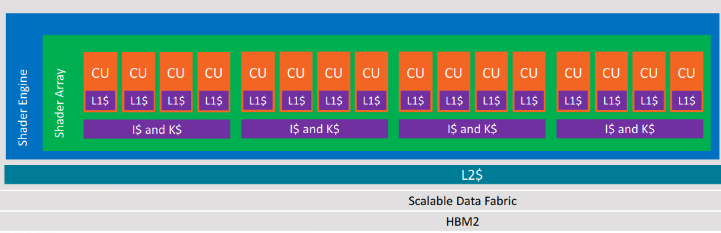
First Target: Vega-class GPUs
Source: AMD
Added new HW support & configurations to model Vega GPUs
Extending to MI200/300
50

Slide 51
GAP Iteration 1: L1/L2 Caches, LDS
Issue: L1 I$/D$, L2 $, LDS clocked 2X as fast as they should be
Should be in same clock domain as CUs
Result: lower latencies than real GPU
Made BWs appear closer to real GPU – baseline even worse
Also tuned cache latency, size parameters
51

Slide 52
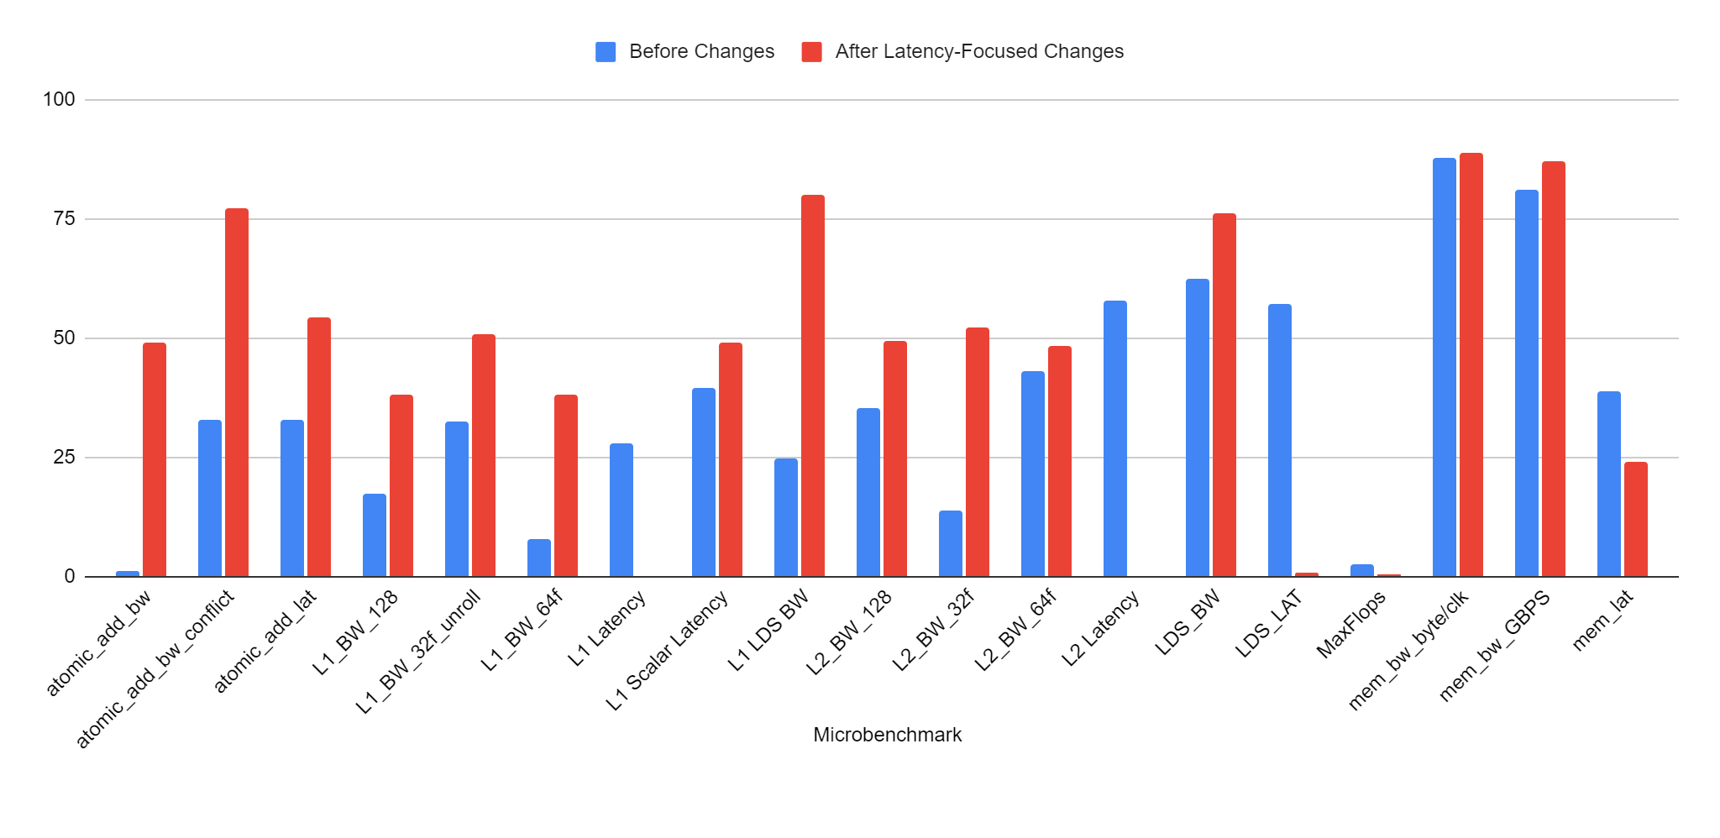

GAP Iteration 1 Results
originally: > 36% error for almost all microbenchmarks, max 86%
L1, L2, LDS latency errors < 0.5% now
But others (especially BWs) increased – 47% average
52
Notes:
Changes not completely independent of one another

Slide 53
GAP Iteration 2: Better BW, Request Bypassing
Step 1: further tune GPU coalescer, cache banks, L1 lat.
Step 2: add cache bypassing support for global mem. reqs.
AMD GPUs: flags indicate when a request should bypass
GLC: Bypass L1 D$, go to shared cache (e.g., L2)
SLC: Bypass all caches, go to main memory
Modified gem5’s Ruby VIPER coherence protocol to support them
53

Slide 54
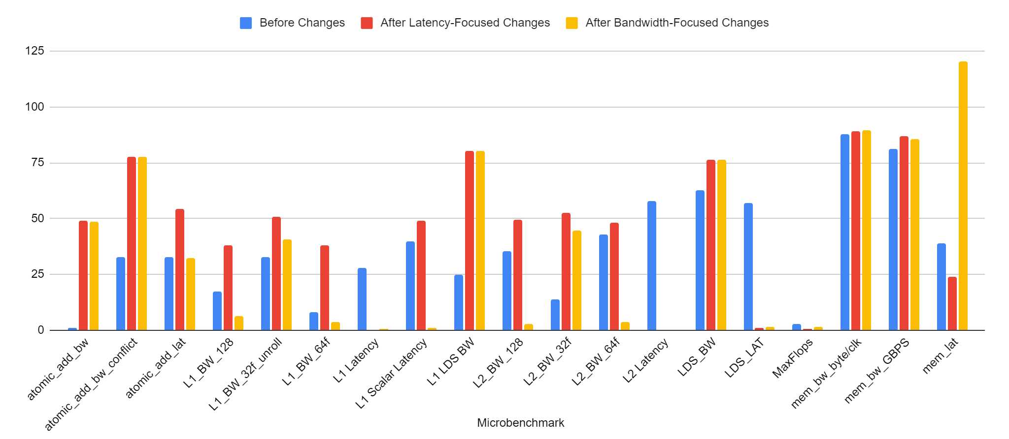
GAP Iteration 2 Results
L1, L2, LDS BWs errors usually within 6% now
Mem latency work (no bypassing → cached) ; Atomic tests unaffected
Overall average error: 26% for latency, 26% for BW
54
Notes:
32 float tests suffer – seems to indicate sectored caches
Tuning L1 helps scalar cache too
Bypassing support makes most tests independent
Hurts mem_lat: prev. L1/L2 caching artificially reduced error
Requests like atomics unaffected – GLC atomics ignore flag

Slide 55
GAP Iteration 3: Proper Atomic Support
Issue 1: gem5 GLC atomics ignore access flags
All atomics treated as system scope (SLC)
Result: much higher latencies than real GPU
Issue 2: gem5’s atomic support ignores conflicts
Results: Artificially increased GLC atomic BW
New: LLC ALUs: configurable latency, respect conflicts
Microbenchmark shows ~64 LLC ALUs in real GPU
Issue 3: gem5 assumed a WT LLC
Real GPUs use WB LLCs
Modified gem5’s Ruby VIPER protocol to support all three
55

Slide 56
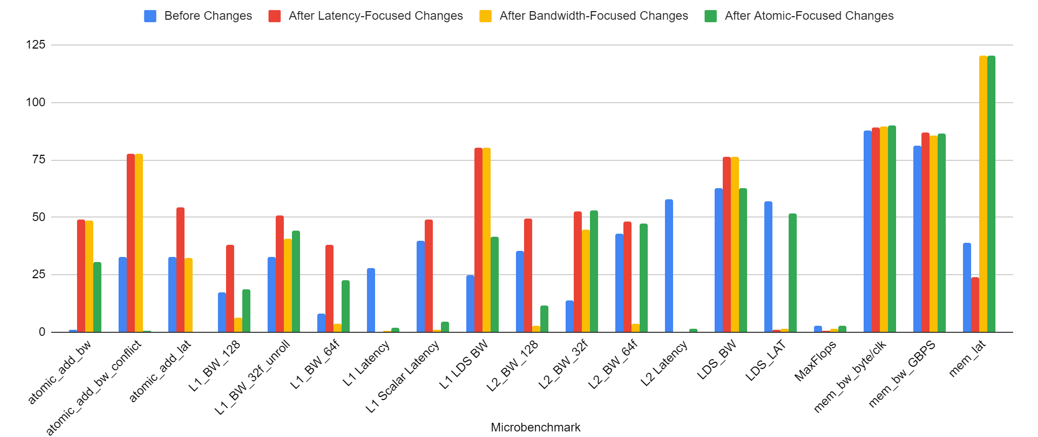
GAP Iteration 3 Results
Atomic errors within 2% now except atomic BW
Overall average error: 21% for latency, 28% for BW
LDS latency impacted by switch to WB L2 ; main memory still unaffected
56
Notes:
Properly modeling conflicts, GLC atomics helps a lot
Latency errors confined to LDS, main memory
LDS latency impacted by WB LLC – need to rebalance
Changes thus far have ignored main memory

Slide 57
GAP Iteration 3 Results
+ WB l2
Currently: 21% average error for latency, 18% error for bandwidth (originally: > 36% error for almost all microbenchmarks, max 86%)
57
Notes:
Again, going back to that high level overview we can compare the previous sets of changes against what we have now in green. In making these changes targeting atomics, we observed increases to some bandwidth inaccuracies (click), which are highlighted here. Some of these can likely be attributed to a now writeback L2, but further targeted investigation is required.

Slide 58
Subsequent Iterations (Not Shown)
Integrated more accurate main memory (HBM2) models [Ayaz gem5 Wkshp’22]
Properly model latency of I$ requests
Update GPU pipeline to support MFMA (TensorCore) ops
Fixed L1 TLB latency/BW
58

Slide 59
What Remains?
Network Model
Biggest remaining bottleneck – minimizes benefits of better HBM2 models
L2/L3 TLB, Page Table
ROCm 6 starts using superpages by default
MSHR Sizing at all cache levels
Integrate cache replacement policy findings
Finish extending to MI200/300 models
Running large-scale tests after all of these fixes
59

Slide 60
Outline
Motivation
Background
Improvements
GAP: Improve Fidelity of gem5’s GPU Models
Scalably Supporting Large-Scale Workloads in gem5
Ongoing Work & Conclusions
60

Slide 61
gem5 CPU-GPU SE Mode: Modern App Support
System calls emulated through docker (SE Mode)
APIs to HIP libraries
SE mode currently doesn’t support frameworks like PyTorch, TensorFlow
We added this support
[Alsop IISWC ‘19], [Roarty gem5 Workshop ‘21]
61

Slide 62
gem5 GPUFS Support
Introduced in gem5 v22.0
Previously only supported SE mode with ROCm 4.0
FS mode supports ROCm 4.2 & 5.4 without significant changes
Can run many kernels of ML workloads like nanoGPT using PyTorch in gem5!
This was not possible in any prior form of gem5
SE mode requires either specific host env containing ROCm stack or a Docker container that encapsulated this environment
GPUFS removes all host requirements
Improves simulation speed by functionally simulating memory copies
Adds KVM CPU-GPU support
62

Slide 63
What is KVM CPU?
Kernel-based Virtual Machine (KVM)
Open-source virtualization technology built into Linux
Turns Linux into a hypervisor that allows host machine to run a VM
KVM CPU allows simulation to fast-forward by running the CPU instructions directly on the VM instead of on other gem5 CPU models
Requires app binary to be compiled for the host machine architecture
CPU-GPU systems can use to fast forward through CPU code
63

Slide 64
gem5 GPUFS Mode Support: High-level Frameworks
Disk image containing ubuntu-22.04 with ROCm 6.1, PyTorch,TensorFlow, and other dependencies
App
PyTorch, TensorFlow
gem5’s CPU model simulates the system calls
ML Frameworks make it easy to build large scale applications, but very slow to simulate completely
How do we make this tractable?
KVM x86 CPU
Can run MNIST, nanoGPT, etc. layers in public gem5!
64

Slide 65
How Can We Scalably Run Large-Scale Apps in gem5?
Holistic solution: scalably runs modern frameworks in gem5:
Key components: [Ramadas et al. OSCAR’24, TECHCON‘24]
PyTorch
Mixed-Fidelity Simulations
Application Checkpointing
Custom Accelerators
TensorFlow
Large-Scale App Support
Scalable Simulations
Universality
Preliminary Results: Only 1.58x - 3x slower than bare metal
65

Slide 66
Our Vision to Run Large-Scale Workloads
Not all application phases require high fidelity
Some functions/code blocks are “more important” to its behavior
Key Insight 1: Some app regions can use lower fidelity models
Can leverage KVM CPU to fast-forward through these regions
Mixed Fidelity Simulation: only simulate ROIs with high fidelity models
Key Insight 2: Some app phases simulate same data/code many times
Can create checkpoint after less important phases (e.g., file reading)
All subsequent simulations restore checkpoint, avoiding repeated simulations
Or: sim more important, but repeated phase once then utilize checkpoint
66

Slide 67
Mixed Fidelity for Less Important App Phases
May not want to fully simulate certain phases of apps
Solution: fast forward through CPU code on host CPU
Simulated system
CPU
GPU
kernel
launch
kernel
completion
kernel
launch
Time
kernel
launch
kernel
comp.
functional only
simulation
kernel
launch
CPU
functional+timing
simulation
GPU
Wall Clock
67

Slide 68
Mixed Fidelity (Cont.)
Observation: GPU model more sim. time intensive than CPU models
Idea: Leverage PyTorch’s/TensorFlow’s CPU offloading feature
Offload phases (GPU kernels) requiring less fidelity to faster/lower fidelity CPU models
Reduces simulation time without significantly compromising fidelity
High Fidelity
TimingSimpleCPU
KVM CPU
Low Fidelity
O3 CPU
Slower
MinorCPU
AtomicSimpleCPU
Faster
68

Slide 69
Mixed Fidelity (Cont.)
Offload GPU Kernels onto CPU and run them at low fidelity
Simulated system
CPU
Region of interest
GPU
kernel
launch
kernel
completion
kernel
launch
Time
kernel
launch
kernel
comp.
functional only
simulation
kernel
launch
CPU
functional+timing
simulation
GPU
Wall Clock
Preliminary Results: Only 1.58x - 3x slower than bare metal
69

Slide 70
How Much Does Mixed Fidelity Help?
Cycle Level GPU Simulation: 10-50 KIPS
Functional KVM Simulation: 100s MIPS
KVM CPU emulating GPU: 10s MIPS
Conservative speedup for a kernel containing 2B SIMD instructions:
11 hours of cycle-level GPU simulation
3 minutes to execute on KVM CPU (single threaded)
Mixed Fidelity makes gem5 speeds much closer to real HW
On-going Work: full set of results for GPU workloads
70

Slide 71
App Checkpointing: Further Speeding Up Sim
Need not re-run parts of app when simulating multiple times
Solution: checkpoint before ROI during first run and restore later
Simulated system
kernel
launch
CPU
Region of interest
GPU
kernel
launch
kernel
completion
Time
Take checkpoint
functional only
simulation
Restore checkpoint
CPU
functional+timing
simulation
GPU
kernel
launch
Wall Clock
Can combine with fast-forwarding to further speed up
71

Slide 72
How Much Does Checkpointing Help?
Ran 100 kernel iterations of square (GPU matrix-vector addition)
End-to-End gem5 runtime: 1076.33 seconds
Created checkpoint after 95 kernel iterations:
Restoration runtime: 122.94 seconds → 8.75x speedup
Fidelity Comparison:
Compare last 5 kernels of original applications with 5 kernels after restoration
Metric | Original Application | Checkpoint Restoration | Difference
Number of GPU Clock Cycles | 126336037500 | 126405051500 Cycles | 0.05%
# ALU Instruction | 284208 | 283800 | 0.14%
# Memory Instructions | 39136 | 39080 | 0.14%
On-going Work: full set of results for GPU workloads
72

Slide 73
Scalable Simulation Conclusion
Simulation tools must evolve to scalably model modern workloads
gem5 Vision: Swiss army knife that efficiently supports modern frameworks
Run CPUs, GPUs, and accels; enables cross-layer, early-stage exploration
Frameworks for Large-Scale Workload Simulation
Mixed Fidelity Simulation
Application Checkpointing
Enables previously not possible research
Reduces barriers to entry for sim. (all publicly available)
73

Slide 74
Implementing Vega ISA in gem5 to enable ISA comparison
Kyle Roarty
74

Slide 75
Motivation
Identify impact ISA changes have on hardware
Identify what is/isn’t being used in a given ISA
Allow more up-to-date simulations
75

Slide 76
Motivation II
Reduce redundant or excess code
Simplify adding new ISAs
Reduce redundant computations
Simplify code where possible
76

Slide 77
Instruction Decoding
Removing redundant code
Every instruction had methods for getting operand info
~39000 lines
Get operand info by encoding, instead
~600 lines
Simplify adding new ISAs
Re-ordered instructions in decoder
Alphabetical → opcode
77

Slide 78
Operands
Reduce redundant computations
Store operand info in vectors
Generate on instruction decoding
Lookup vs function call
Simplify code
Most code needed only src or only dst operands
As well as only vector/scalar registers
Separate vectors for src/dst operands
78

Slide 79
Notable issues
dGPU-specific issues
Both gfx803 and gfx900
APU runs fine
Assert(vma != gpuVmas.end())
Very common
Out-of-bounds memory access
Read/write CPU memory as GPU
Program-specific(?)
ISA validation
Mainly seen in DNNMark
Runtime checks multiple files
First passes
Second fails
79

Slide 80
Vega ISA-specific Implementation
Added support for offsets in FLAT instructions
Added decodings for Vega ISA-specific instructions
Instructions not implemented
Working apps didn’t stress Vega ISA-specific instructions
Implemented instructions as we came across them
80

Slide 81
Comparing ISAs
Ran previously mentioned apps
3 runs of each app, size 0
APU (gfx801)
--gfx-version=gfx801 --singlegcd-64gfx10cu
gem5 build: GCN3_X86
gfx803
--dgpu –gfx-version=gfx803 --singlegcd-64gfx10cu-dgpu
gem5 build: GCN3_X86
gfx900
--dgpu --gfx-version=gfx900 --singlegcd-64gfx10cu-dgpu
gem5 build: VEGA_X86
Main focus: Difference between APU and dGPU
81

Slide 82
Methodology
64 CUs modeled on Radeon Vega 64 architecture
2 SIMD units per CU
1600 MHz
ISAs
gfx801, gfx803: GCN3 ISA
gfx900: VEGA ISA
Compiler
HCC clang version 5.0.0 (based on HCC 1.0.17265-7d030799-fc6e298d87-ebbf2cb19e7)
ROCm 1.6
82

Slide 83
Instruction Mix
83

Slide 84
Operands
84

Slide 85
Operands
85

Slide 86
Operands
86

Slide 87
Virtual Register Use
87

Slide 88
Virtual Register Use II
88

Slide 89
Register Liveness
% of X instructions between writes to same register (tail not shown)
89

Slide 90
Register Liveness
% of X instructions between writes to same register (tail not shown)
90

Slide 91
Register Liveness
% X instructions between reads to same register (tail not shown)
91

Slide 92
Register Liveness
% X instructions between reads to same register (tail not shown)
92

Slide 93
Register Liveness
93

Slide 94
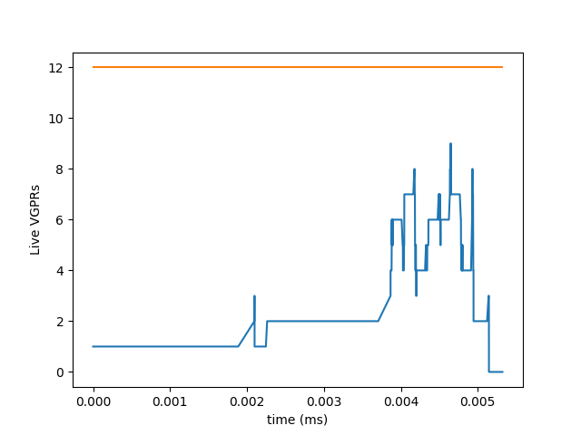
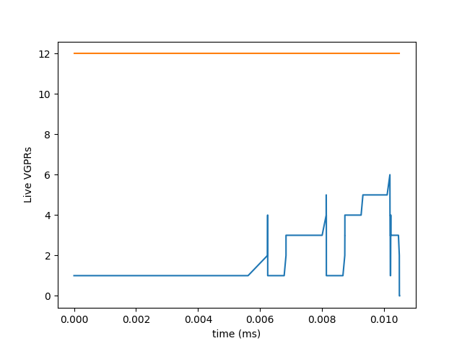
Register Liveness
Square, WF 0
APU (gfx801)
gfx803
94

Slide 95
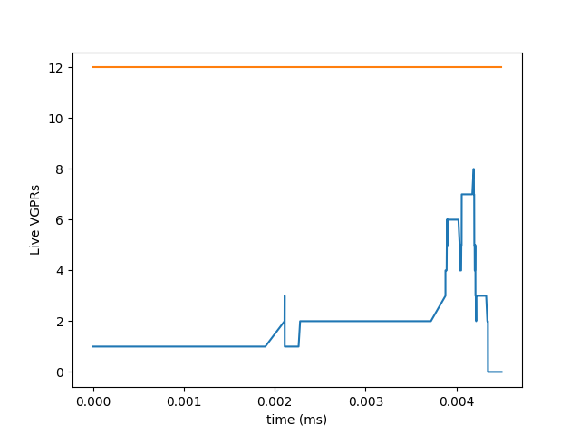
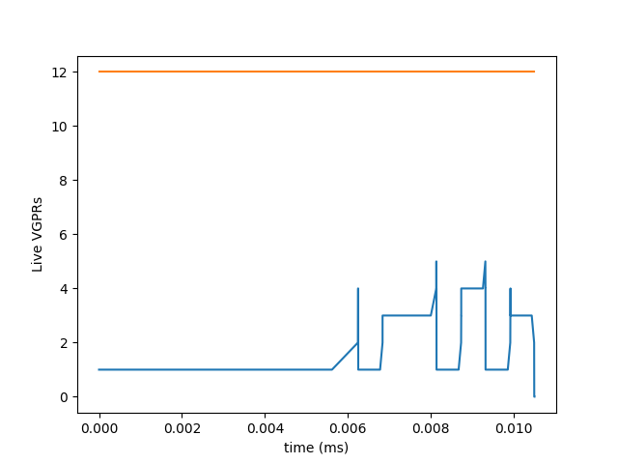
Register Liveness
Square, WF 150
APU (gfx801)
gfx803
95

Slide 96
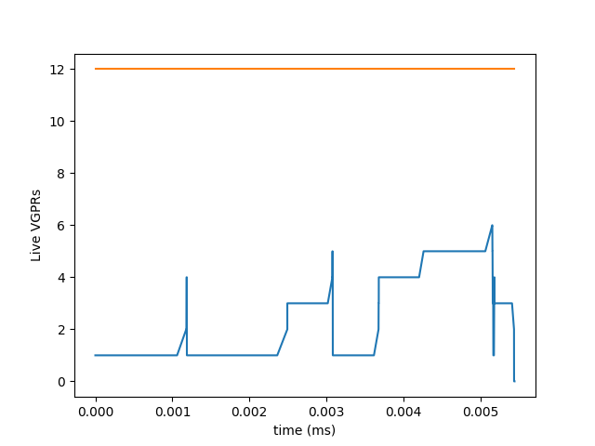
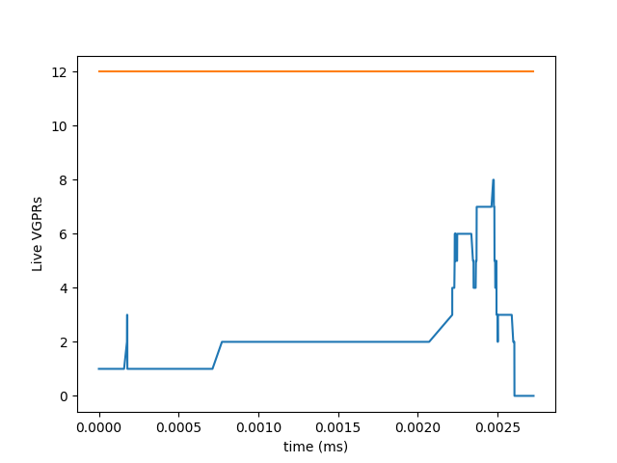
Register Liveness
Square
gfx803, 260
gfx803, 810
96

Slide 97
Future Work
Fix applications to work with dGPU models
Implement new instructions
Find ways to merge redundant code
ISAs tend to build off of each other
instructions.cc/hh, decoder.cc/gpu_decoder.hh
97

Slide 98
Gem5 GPU Scoreboard
E. Barton, A. Jarnutowski, S. Jungerman
98

Slide 99
Purpose
Existing gem5 gpu model does not model dependencies accurately
Users should get accurate results for how their applications perform
The exact dependency checking is proprietary, so we need an approximate solution
Implement a scoreboard in gem5 gpu model to enforce dependencies
99

Slide 100
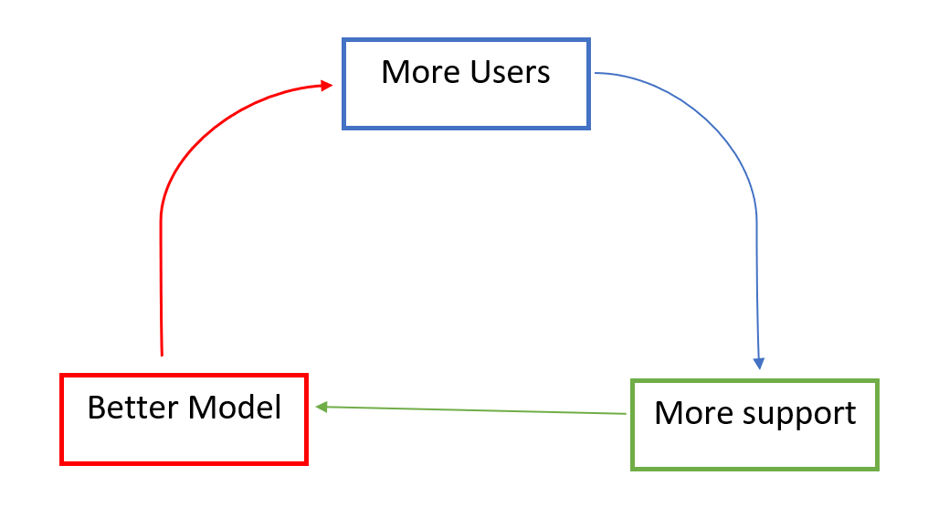
Significance
A more accurate representation of ILP in the gpu model would make gem5 more attractive to users
More users means better community support/maintenance
100

Slide 101
Contributions
Updated gem5 gpu model with correct in-order scoreboard
Investigated removal of non-scoreboard dependencies
Detailed description of how to build and run applications on gem5 apu
101

Slide 102
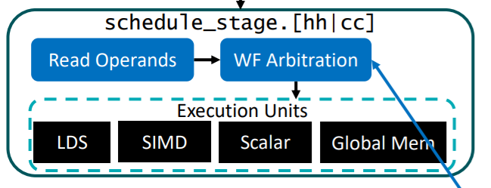
Background - GPU Scheduling
Obtain list of ready wavefronts from a dependency checker
Use a scheduling policy to choose which to issue to each execution unit
Gem5 gpu model uses oldest wavefront first
102

Slide 103
Background - GPU Scoreboard
Keeps a bit for each register to track use status
Instructions are evaluated in-order
Check registers for RAW/WAW
Busy bit cleared on instruction completion
103

Slide 104
Dependencies in scoreboard check
Wait count: memory dependencies
Wavefront Barrier
Wavefront stopped
Empty Instruction Buffer
Operands ready (RAW/WAW)
104

Slide 105
Scoreboard Implementation
Gem5 GPU model already has a scoreboard structure
Busy vector in scalar and vector register files
Existing code enforces RAW, but not WAW
In-order scoreboard should do both
105

Slide 106
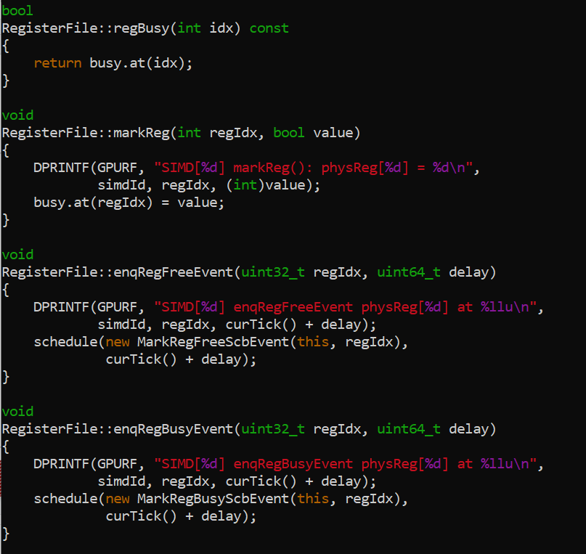
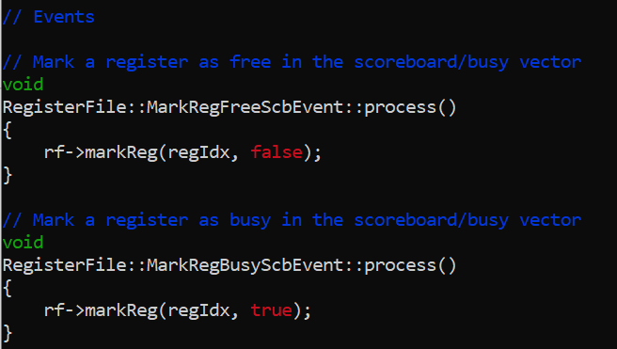
Code Segment
Left: existing scoreboard functions
Bottom: existing scoreboard events
106

Slide 107
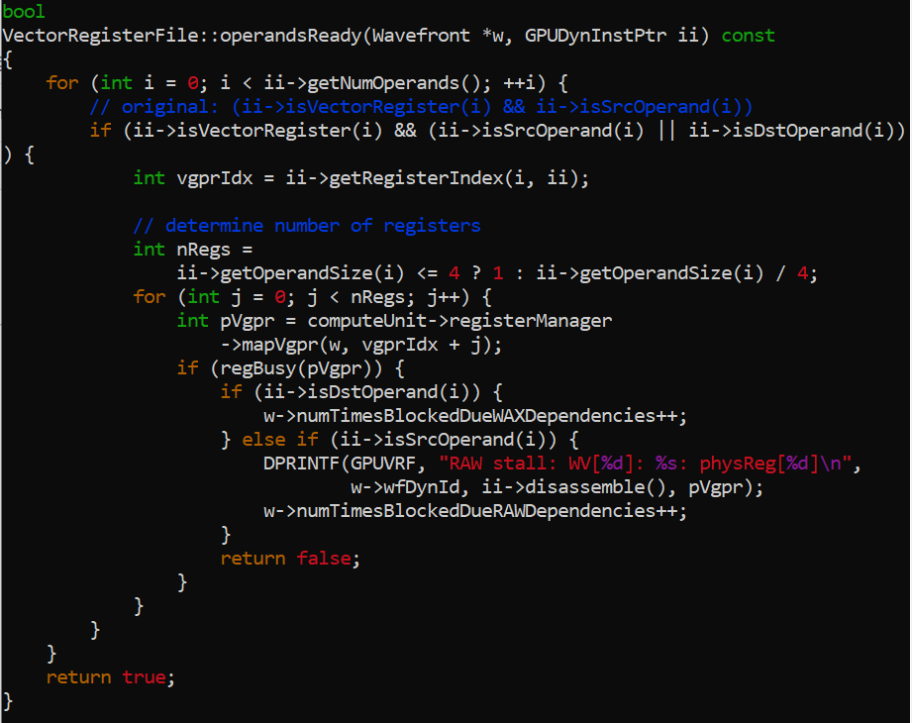
Code Segment - continued
RAW and WAW check in vector register file
Old RAW/WAW check didn’t check destination operands for WAW
Similar method and fix required for scalar register file
107

Slide 108
Benchmarks/Workloads
Avoided ML/DL workloads for sanity, focused mostly on analytical compute
HIP examples for this presentation
Histogram, FastWalshTransform, BitonicSort, DCT, dwtHaar1D, MatrixMultiplication, PrefixSum, SimpleConvolution, FloydWarshall
108
Notes:
We’ve included workloads with applications in signal/image processing, search, and applied math/physics
Takes roughly 10-20 per workload, a neural network out of the question

Slide 109
Evaluation Metrics
Number and types of stall cycles
Times blocked for RAW/WAW dependencies
SIMD interleaving mean
109
Notes:
SIMD interleaving mean: how many instructions able to run at a time per

Slide 110
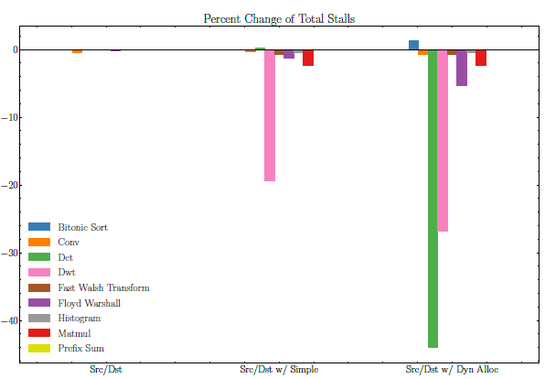
In-Order Scoreboard Results

Slide 111
Why use it?
Enables design space exploration of GPU scheduling
Scoreboard not often used in practice because cost
Open source alternative to proprietary scheduling
Better models dependencies than existing implementation and increases performance
111

Slide 112

Enabling Multi-Chiplet Support in gem5
Kyle Roarty, Bobbi Yogatama, Matthew Sinclair, Michael Swift
University of Wisconsin-Madison
bwyogatama@cs.wisc.edu
Notes:
UW Madison logo

Slide 113
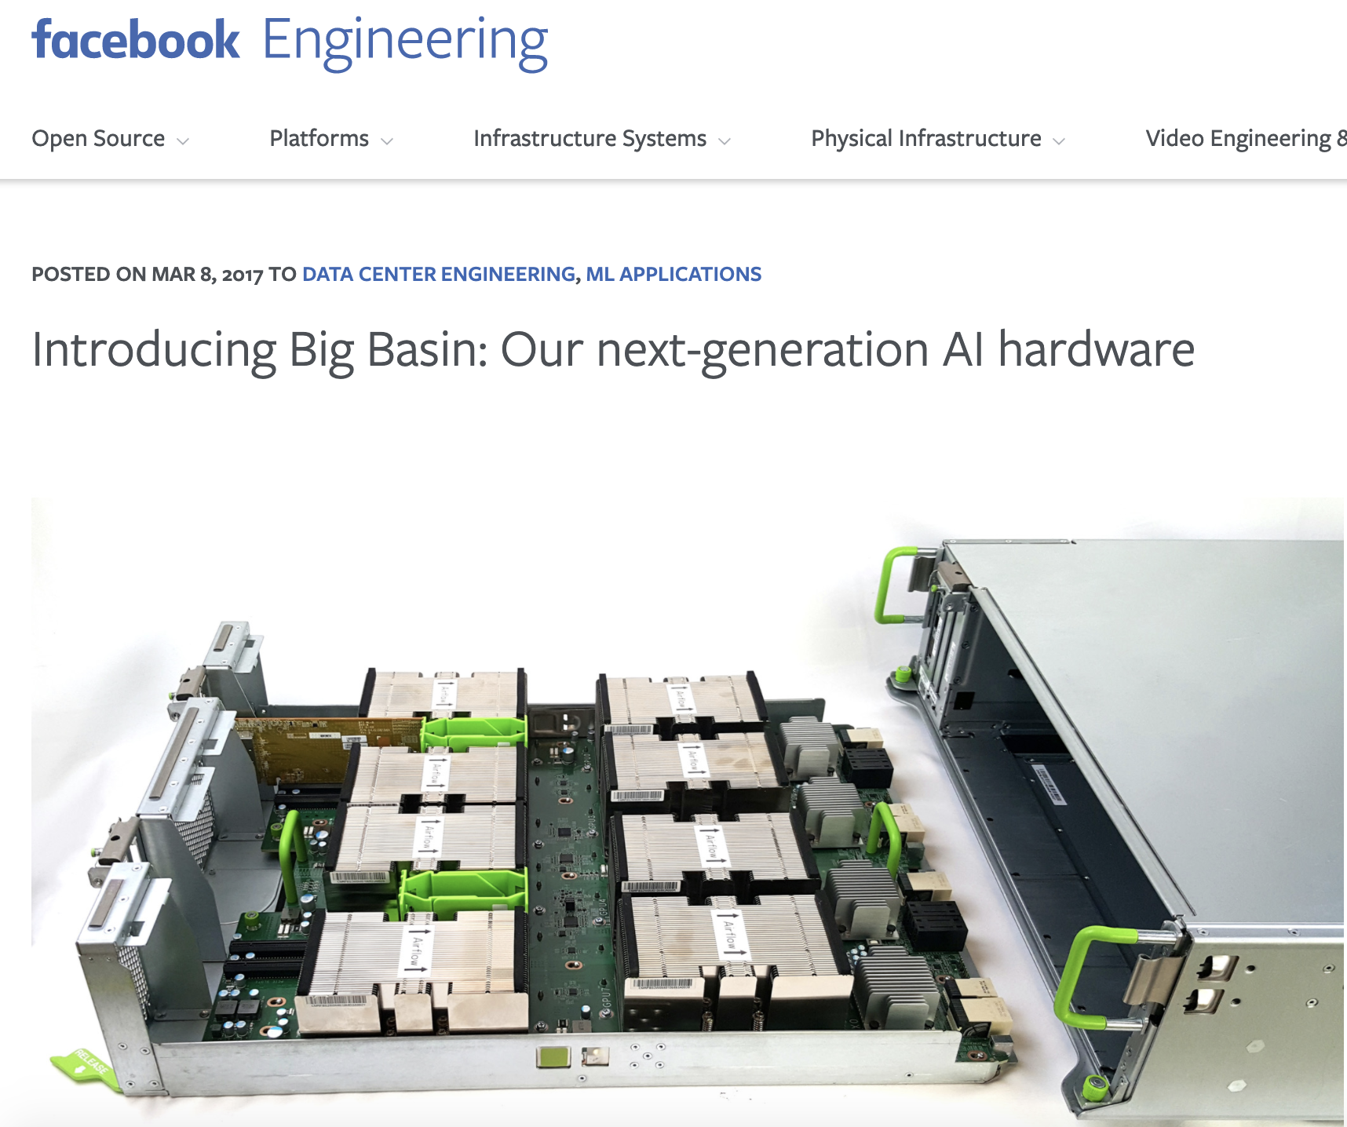
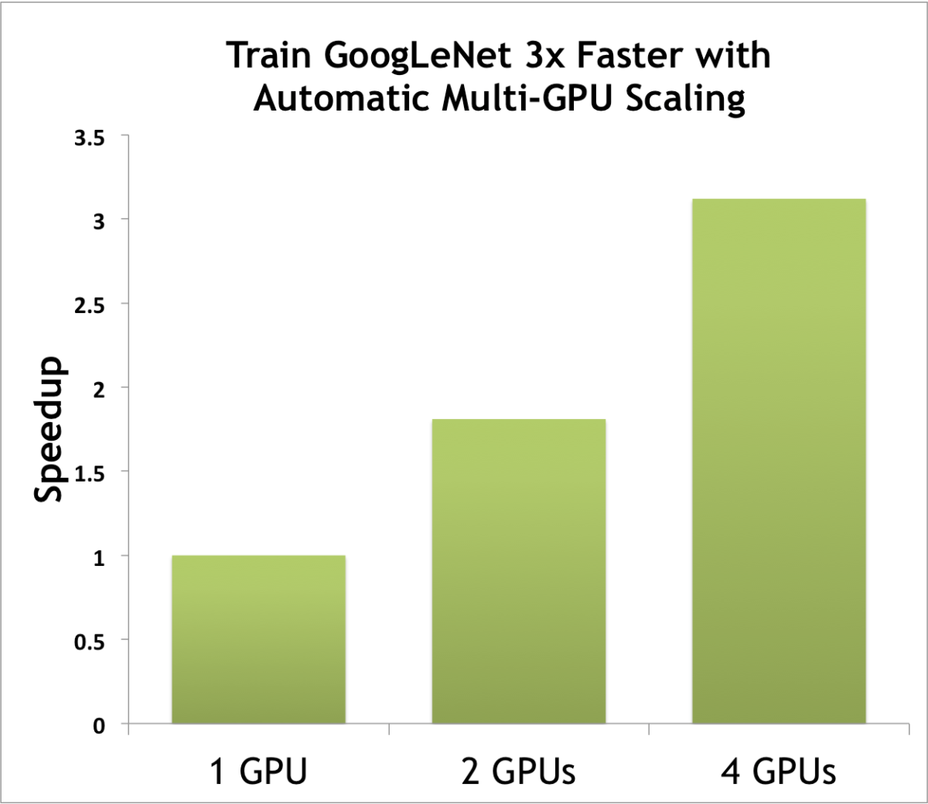
Why Multi-Chiplet?
Workload Partitioning
Data Partitioning
https://devblogs.nvidia.com/easy-multi-gpu-deep-learning-digits-2/
Notes:
Print website facebook, put a slide after this about gem5
“The reason why multi-GPU support is important, in real workload we are using them across a wide variety of workload”
look

Slide 114
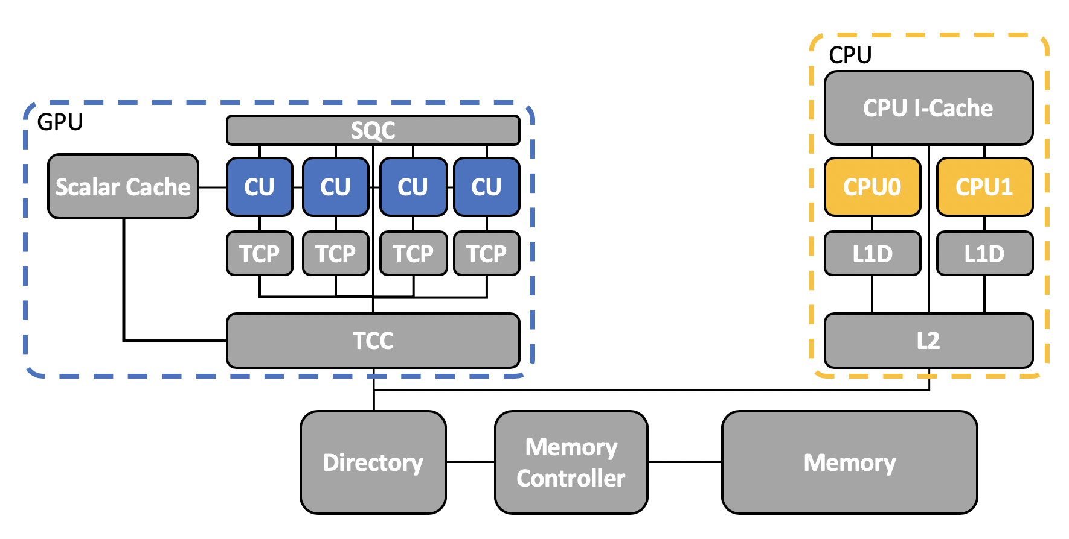

Multi-Chiplet and gem5
Simulate a single GPU
[Gutierrez HPCA '18]
Difficult to study issues arising in multi-GPU/multi-chiplet systems
Scheduling
Resource allocation
Notes:
Print website facebook, put a slide after this about gem5
“The reason why multi-GPU support is important, in real workload we are using them across a wide variety of workload”
look

Slide 115

gem5 AMD APU Overview
Extends gem5 with a GPU timing model
Executes on top of ROCm (Radeon Open Compute Platform)
Models an APU (CPU and GPU on a single die)
User space already supports multiple GPUs. However, gem5 lacks multi-GPU support
Application and compilers
gem5 space
Application source
HIP Compiler
x86 ELF
GCN3 ELF +
Code metadata
Hardware space
MEM
Emulated Linux Kernel
HIP
Libraries
CP
Dispatcher
ROCr
HW Queue Scheduler
work-
groups
CU
User space
ioctl()
HW queue
ROCt
ROCk
HSAPP
GPU
[Gutierrez HPCA '18]
ROCr (Runtime layer) ROCt (user space driver) ROCk (kernel fusion driver)
Notes:
This is an overview
Tony and Matt P will give a separate talk about
Talk a little bit about what is HCC

Slide 116
Enabling Multi-Chiplet Support
User Space SW
ROCk support for multi-GPU
Replicate the GPU Components
ioctl()
ROCk
gem5 space
HW Queue Scheduler
CP
Dispatcher
CP
Dispatcher
work-
groups
HW Queue Scheduler
CU
work-
groups
CU
HW queue
HW queue
HSAPP
HSAPP
GPU 1
GPU N

Slide 117
Enabling Multi-Chiplet Support
CPU
GPU
L1-I
GPU
L1-I
CPU I-Cache
Scalar Cache
CU
CU
CU
CU
Scalar Cache
CU
CU
CU
CU
CPU0
CPU1
L1D
L1D
L1D
L1D
L1D
L1D
L1D
L1D
L1D
L1D
L2
L2
L2
Directory
Memory
Controller
Memory
[Gutierrez HPCA '18]
Enable Writeback Support: Reduces pressure on directory and main memory
Notes:
We realize the coherence protocol in gem5 is writethrough
More representative of what the real GPU is doing
AMD documentations says the protocol is writeback in L2

Slide 118
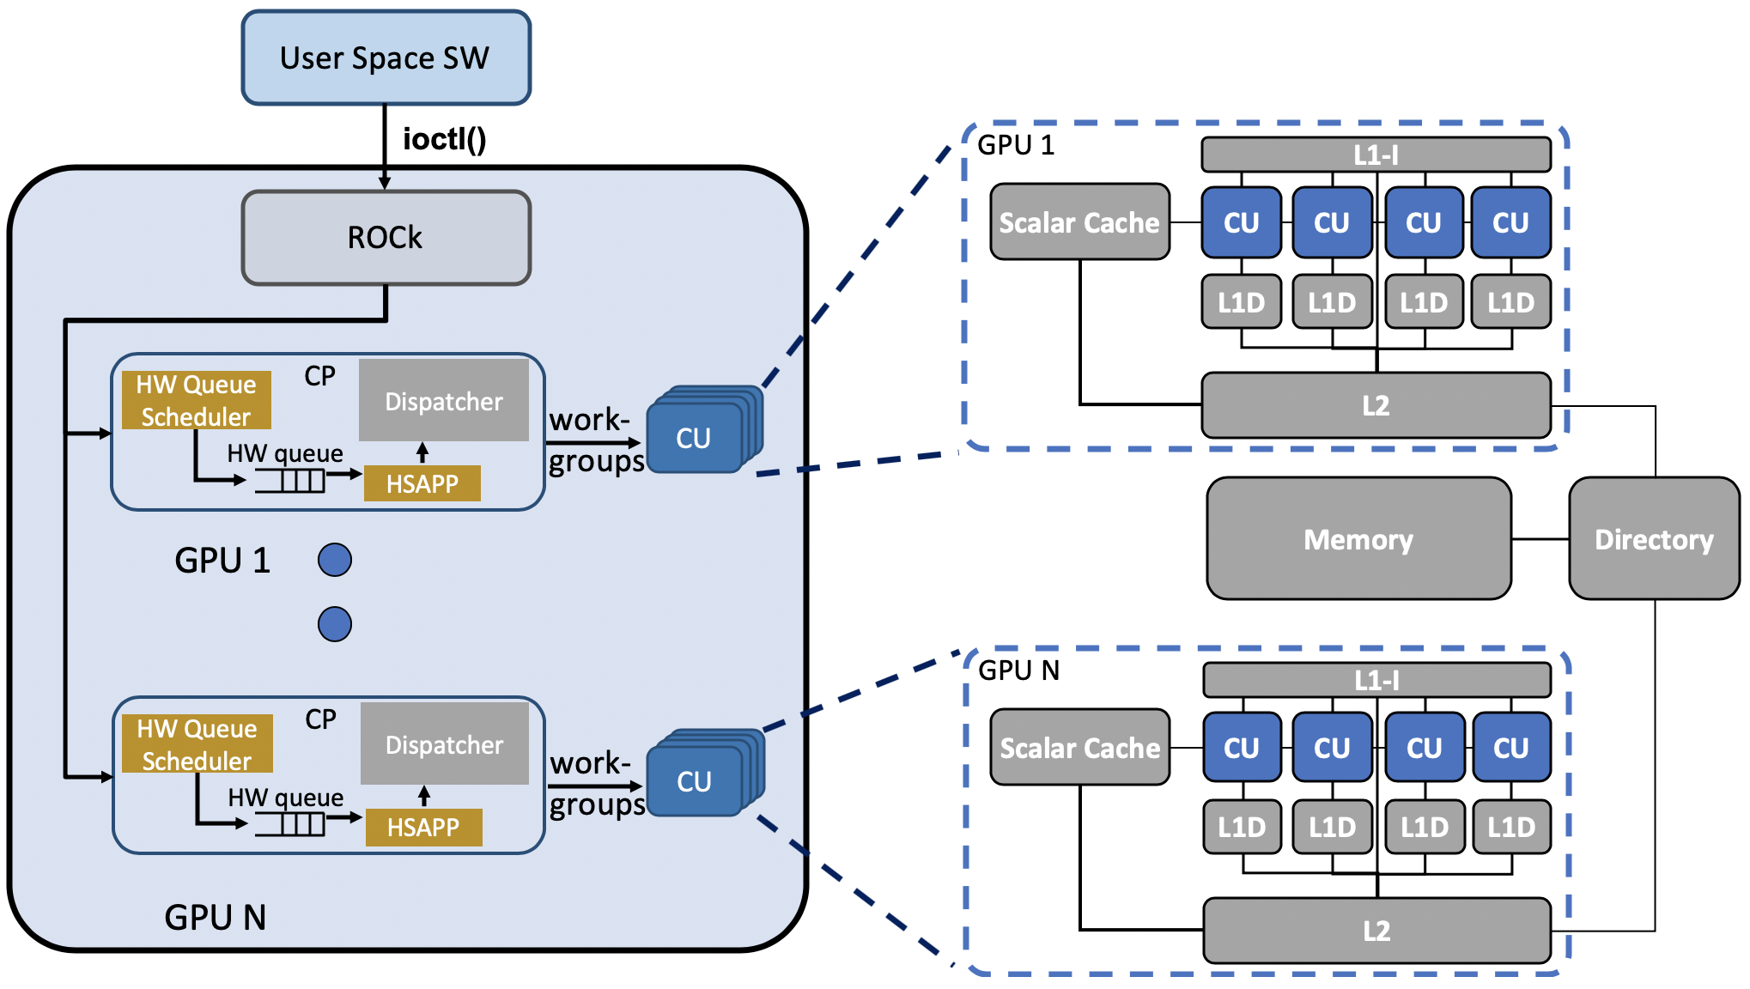
Replicating GPU Components
gpu_driver = GPUComputeDriver(...)
for (i = 0; i < num_gpus; i++) {
shader = Shader(...)
gpu_hsapp = HSAPacketProcessor(...)
dispatcher = GPUDispatcher(...)
gpu_cmd_proc = GPUCommandProcessor(...)
}
Notes:
GPU 1 -> GPU N
Have one sentence explaining the code

Slide 119
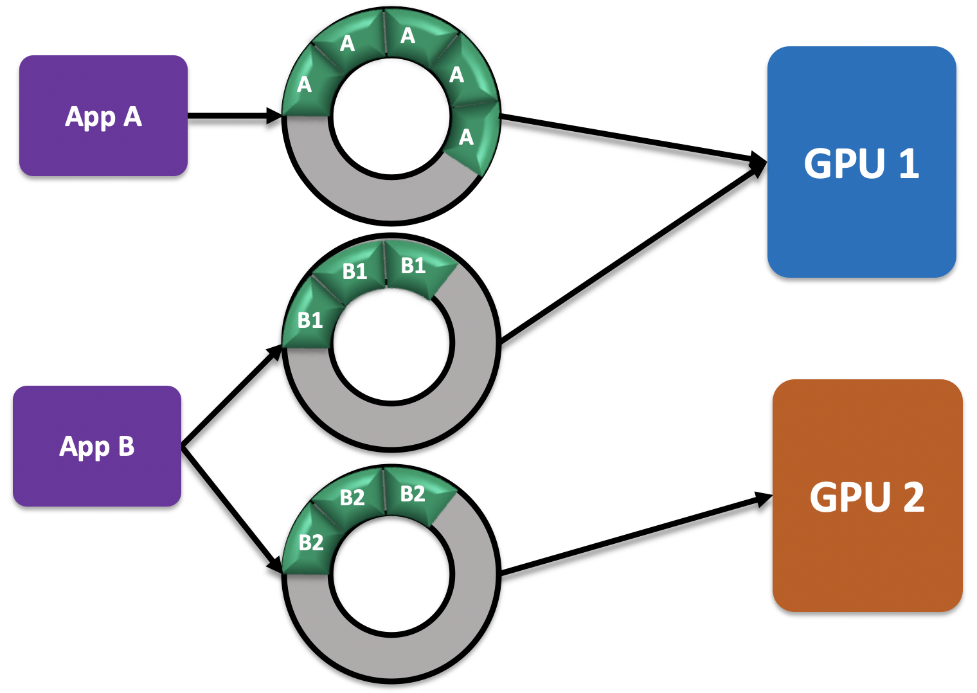
Emulated Driver (ROCk) Support for Multi-Chiplet
Application and GPU communicates through software queues
Use hash table to maintain mapping between software queues and GPUs
ROCk
CREATE QUEUE
GET GPU ID
SEND WORKS TO GPU
User Space SW
ioctl()
HASH TABLE
Queue ID 1
QUEUE ID | GPU ID
Queue ID 2
Queue ID 3
[Gutierrez HPCA '18]

Slide 120
Emulated Driver (ROCk) Support for Multi-Chiplet
mmap(start, length, offset) –> mapping the GPU doorbell to memory
Unmask
Lookup
offset
GPU ID
GPU Base address
Virtual MEMORY
Physical MEMORY
GPU 1 doorbell region
mmap
GPU 2 doorbell region
Base
Address
Start
GPU 3 doorbell region

Slide 121
Supporting Writeback Caches per Chiplet
Propagate flush instructions to L1 and L2
Ensures the data is visible to all CPUs and chiplets at end of kernel
Writethrough
Writeback
1
Write data
Write data
endpgm/
flush insts
1
4
L1
L1
2
Write data
Pass flush event
Write data
5
2
L2
3
L2
Hold data
3
Write data
Flush all written lines
6
Notes:
Being clear on there is a flush instruction at the end of the kernel
Get rid of the states, store/hold the dirty data

Slide 122
Methodology
GPU Components | Configuration
Compute Units/Chiplet | 4
L1-D | 16kB - WT
L1-I | 16kB
L2 | 256kB - WB
Benchmarks | Input Size
Gaussian Mixture Models (GMM) | 1024x32x32 (floats)
Stemmer | 29401 (words)
Histogram | 16384 (integers)
SimpleMultiGPU | 16384 (floats)
Notes:
Test methodology

Slide 123
Multi-Chiplet Execution Time
Execution time decrease as we increase the total number of chiplets
Speedup is not linear and speedups between workload varies
Notes:
Talk about the takeaway longer
Execution time vs speedup
Add 1 GPU 2GPU on the legend

Slide 124
Conclusion
Multi-GPU applications becoming increasingly common
Issue: gem5 only supports single GPU simulations
Solution: add multi-GPU support to gem5:
Replicate the GPU components
Modify the emulated driver
Enable writeback support in the cache protocol to reduce pressure
Result: multi-GPU experiments reduce per-GPU execution time
Multi-GPU support in gem5 is coming!
Notes:
In conclusion blabla

Slide 125
Outline
Motivation
Background
Improvements
Enabling Support for ML Workloads in gem5
Making gem5 GPU models easier to use
Improved, higher fidelity support for gem5 GPU
Future Work & Conclusions
125

Slide 126

Creating Portable Resources
Docker container
Properly installs ROCm software stack
Publicly Available!
Integrated into gem5 repo: https://gem5.googlesource.com/
Added bmks & doc. in gem5-resources [Bruce ISPASS ‘20 Best Paper Nom.]
Used in continuous integration to ensure GPU support is stable
Suggest building applications requiring ROCm with docker

Slide 127
MIOpen Programming Model
HIP
Host Application
MIOpen
Passes GPU mem.
as a (void * ptr)
OpenCL
Chooses a MIOpen backend at compile time
Calls appropriate kernel
127

Slide 128
Running ML Applications in gem5
Codebase and simulator aren't optimized for each other
Example: MIOpen uses OpenCL kernels
Requires online compilation → slow, unsupported in gem5
Solution:
Generate kernel files ahead of time for desired GPU
Link kernel files into Docker container
Avoid re-generating kernels
Reduces simulation time
Mostly automated process eases adoption by new users

Slide 129
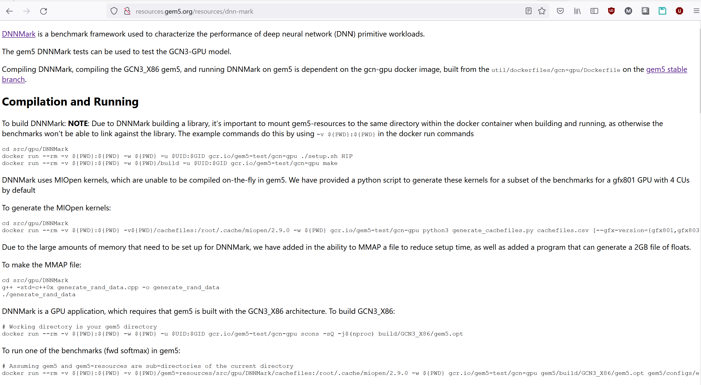
Ex. gem5-resources README (DNNMark)

Slide 130
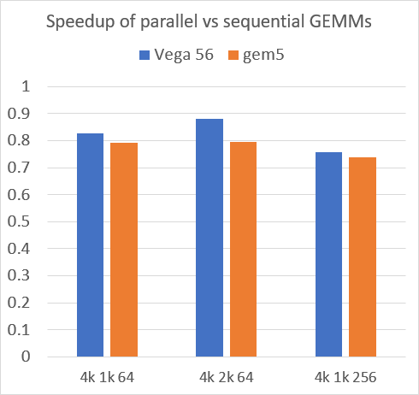
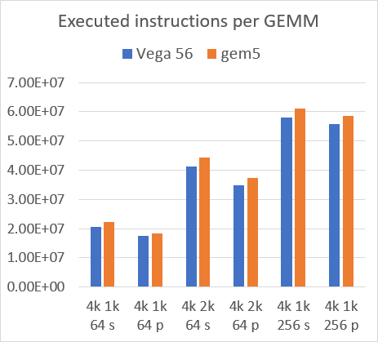
Validating gem5 Vega GPU configuration
Validated Vega GPU configuration against Vega 56 GPU
Ran sets of GEMMs sequentially and concurrently with CU masking & streams
# Dynamic Instructions
Speedup
Average: 6% (Worst case: 10%)
Average: 6% (Worst case: 7%)
130
Notes:
Shows roughly the same trends!

Slide 131
Flow of a ML Application
ML Framework Application
ML Native Application
Support needed
Caffe
TensorFlow
Other Frameworks
MIOpen
ROCm User-level Software (runtime, driver)
Highly-tuned Kernels (e.g., OpenCL, Tensile, rocBLAS, Assembly)
CPUs
GPUs
131

Slide 132
MIOpen Also Requires Additional Libraries
MIOpen
hipBLAS
OpenCL
HIP
rocBLAS (+ Tensile)
ROCm
Build on prior work to add support for ML workloads [Alsop, et al. IISWC ‘19]
132

Slide 133
x86 ELF
GCN3 ELF +
Code metadata
App Source
MIOpen
rocBLAS, …
HIP
HIP
Libraries
User space
ROCr
ROCt
OS kernel space
ROCk
hardware models
MEM
X86 Core
CP
CU
x86 Core
CU
CU
CU
CPU
GPU

Slide 134
Challenges Running (ML in) GPU Model
Specific software is required
Initially ROCm 1.6.x & gcc 5.4 [Gutierrez et al. HPCA ‘18]
We updated to ROCm 4.0 & gcc 7 [Roarty et al. gem5 Wkshp ‘20]
Barriers to entry
Challenging to install the libraries correctly
Lack of support and documentation
Need to support and model newer GPUs, GPU features
Improve accuracy of publicly available GPU models
Our work removes/reduces these barriers to entry

Slide 135
Next Steps
ML Framework Application
ML Native Application
Support still
needed
Caffe
TensorFlow
Other Frameworks
MIOpen
ROCm User-level Software (runtime, driver)
Highly-tuned Kernels (e.g., OpenCL, Tensile, rocBLAS, Assembly)
CPUs
GPUs
Modeling High-Level ML Frameworks in SE Mode is Challenging
135

Slide 136
Power Modeling State-of-the-Art
5 broad types of power models:
Extrapolate first-principal models (e.g., CACTI [Wilton JSSC’96], McPAT [Li MICRO’09])
Were highly accurate, still widely used … but not updated in 8+ years
Empirical measurement-based models (e.g., AccelWattch [Kandiah MICRO’21])
Difficult to generalize beyond specific devices they are measured on
Significant accuracy decrease for even minor perturbations
ML-based models (e.g., [Kumar MLCAD’19], [Wu HPCA’15])
Tremendous potential, but accuracy often lacking for previously unseen devices
Tools based on tape-out values
Time consuming, expensive, can only happen later in design process
Low-level Spice models
Accurate, but often require proprietary information, hard to scale to large systems
Early-stage power model tools divided, arch-specific, out-of-date
How do we support diverse options in gem5?
136

Slide 137
What Can We Do?
Additional Challenges:
Each power modeling approach may be “best”
Often certain power models easier to integrate with certain simulators
Insight: decouple “best” power model from simulator integration
Don’t pick which power model is the right one
Abstract away how simulators integrate → plug-and-play power models
Vision: make power modeling as easy as performance modeling
Today’s Focus: Application to gem5 (with McPAT)
137

Slide 138
Outline
Motivation
Background
Design
Methodology & Results
Conclusion & Future Work
138

Slide 139
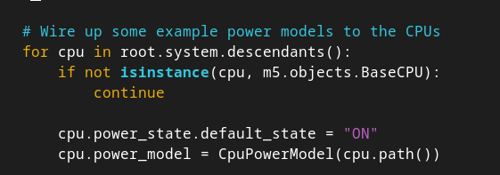
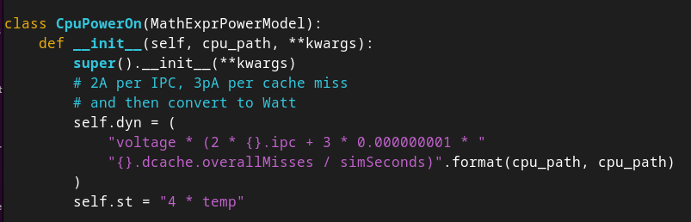
Current Power Modeling in gem5
Power modeling API takes user-defined equations as strings
Simulation statistics passed in as variables (e.g., cache hits)
139

Slide 140
Current Power Modeling in gem5 (Cont.)
Power modeling API takes user-defined equations as strings
Simulation statistics passed in as variables (e.g., cache hits)
Limitation: Difficult for users to express complex functions, novel models
Partial McPAT integration
But not updated in many years …
Partial DVFS & thermal support
Some ISAs have better power support (ARM [Reddy PATMOS‘17])
But also not updated in many years …
Foundation to build off/learn from
140

Slide 141
Outline
Motivation
Background
Design
Methodology & Results
Conclusion & Future Work
141

Slide 142
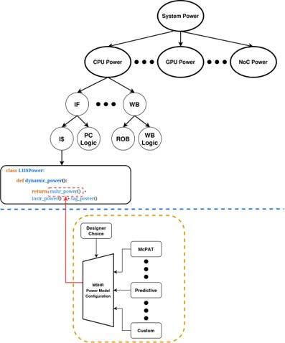
Extending Power Modeling API [OSCAR’24]
How should we extend the power modeling API?
Provides users interface which enables fine-grained customization
142

Slide 143
Extending the Power Modeling API (Cont.)
Hierarchical system of components
Overall power model: sum of components
Separate simulator, power model
Break model into 3 Key Pieces:
Simulator organizes hardware into sub-groups (e.g., known good models)
Power model(s): express static, dynamic power per component
Interface: pick between power models for a given component
143

Slide 144
Putting It All Together
Uses gem5’s Python front-end
Can change power model choice as easily as cache size (no recompile)
Richer way to add support, easy to modify
Could use different power models for different components
Architecture-agnostic
New power model “just” provides static, dynamic power values per component
Simulator handles rest of integration (plug-and-play)
Can integrate and compare/validate different power models
Existing power models (e.g., McPAT)
Pre-built power models
Custom power models (e.g., in-house)
144

Slide 145
Example: McPAT Power Model
Integrate McPAT [Li MICRO’09] into our new interface
Uses first principles for hierarchical modeling
Models 5 stages (Fetch, Execute, LSU, Memory, Renaming)
Basic Flow with new interface:
Grab McPAT activation energies
Activation energies with gem5 stats → power/component (e.g., BP, RF)
Hierarchically sum power/component into per stage, then per core, etc.
145

Slide 146
Example: McPAT Power Model
Integrate McPAT [Li MICRO’09] into our new interface
Models 5 stages (Fetch, Execute, LSU, Memory, Renaming)
Uses first principles for hierarchical modeling
Our interface enables breaking down PM into separate functions!
class O3McPATCPUPowerOn(PowerModelPyFunc):
def __init__(self, cpu: BaseO3CPU, act_energies):
... self._fetch = O3McPATFetchPower(cpu, act_energies, 1.0, 0.9)
self._exec = O3McPATExecutePower(cpu, act_energies, 1.0, 0.76)
self._lsu = O3McPATLsuPower(cpu, act_energies, 1.0, 0.71)
self._mmu = O3McPATMmuPower(cpu, act_energies, 1.0, 0.71)
self._rnu = O3McPATRenamingUnitPower(cpu, act_energies, 1.0)
def dynamic_power(self):
return self._fetch.dynamic_power() + ... + self._rnu.dynamic_power()
146

Slide 147
Example: McPAT Power Model (Cont.)
Deeper Dive Into Fetch stage modeling:
from mcpat_power_model import McPATPowerModel # Base class defining helper fns
class O3McPATFetchPower(McPATPowerModel):
def __init__(self, cpu, act_energies, pipeline_act_factor, ifu_act_factor):
... self._decode = O3McPATDecodePower(cpu, act_energies)
...
def dynamic_power(self):
return (
self._decode.dynamic_power() + ...
)
class O3McPATDecodePower(McPATPowerModel):
def __init__(self, cpu, act_energies):
... def dynamic_power(self):
return self.to_watts(self.inst_buffer_energy() + self.inst_decode_energy())
def inst_buffer_energy(self):
decoded_insts = self.get_stat(decode.decodedInsts)
return (
decoded_insts * self.act_energies[“IB”][“Read”]
+ decoded_insts * self.act_energies[“IB”][“Writes”]
)
147

Slide 148
Outline
Motivation
Background
Design
Methodology & Results
Conclusion & Future Work
148

Slide 149
Methodology
Benchmarks:
gem5-Resources (e.g., Hello World)
a*X + Y (*AX, *AXPY) variants
CPUs: Timing, Minor, O3 (all 1 core/thread)
Goal: validate gem5 McPAT integration vs. standalone McPAT
Use same configuration and statistics as gem5
Turned off m5ops (ROI markers) due to instr. count variations
149

Slide 150
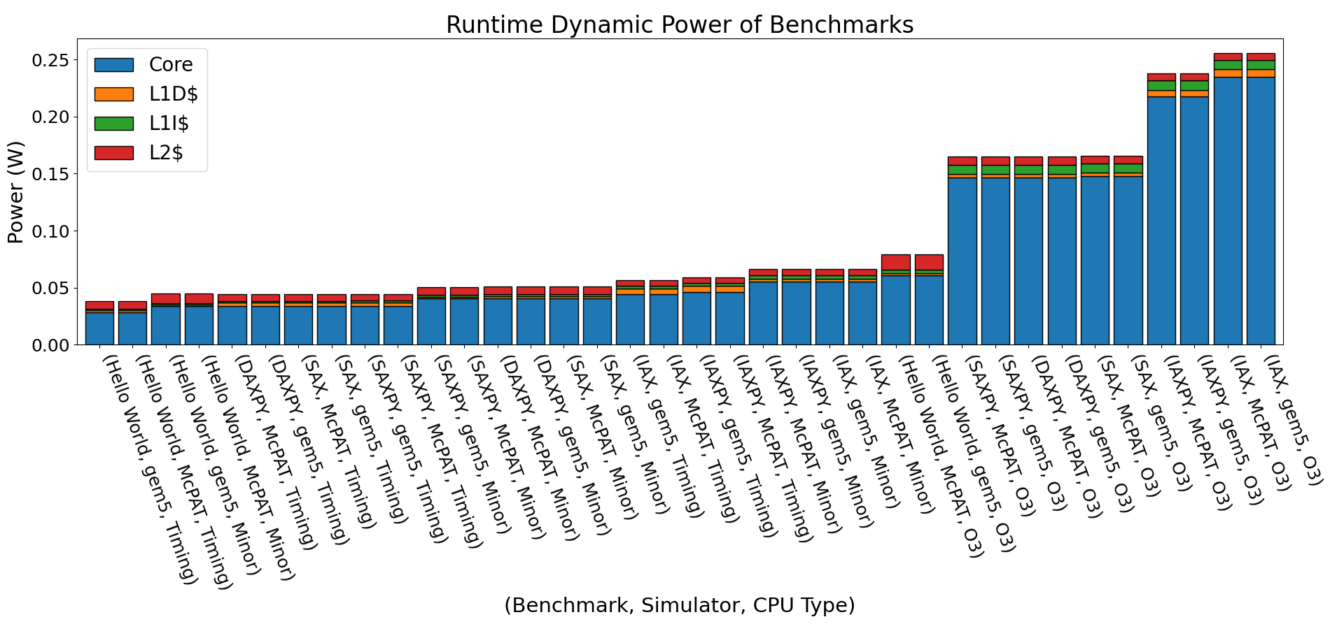
Preliminary Results
a*X > a*X + Y?
Ints > FP > DP?
Mostly follow expectations (e.g., O3 > Minor > Timing), closely match McPAT!
Why Do These Results Occur?
150

Slide 151
Preliminary Results (Cont.)
Several unintuitive results … did we integrate McPAT poorly?
No! Results properly reflect McPAT’s behavior
Unintuitive results highlight McPAT several flaws:
Does not model vector instructions
Does not distinguish between single and double precision
Takeaways:
New interface faithfully models McPAT
Enables rapid prototyping of power models via Python
Interface allows quality evaluation of known/new power models
151

Slide 152
Outline
Motivation
Background
Design
Conclusion & Future Work
152

Slide 153
Conclusion
Future systems need to balance power, performance even more
But power models are out-of-date, brittle, or proprietary
Insight: decouple simulator power model integration, power model
Simulator devs: focus on how power should be integrated …
… without worrying about specifics of underlying power model
Potential Benefits:
Easily support & simple to change between many different power models
Better maintainability – separate power model and simulator design
Easier to integrate new power models (e.g., for novel accelerators)
Integration with mainline gem5 ongoing
Make power modeling as easy as performance modeling
153

Slide 154
BACKUP
154

Slide 155
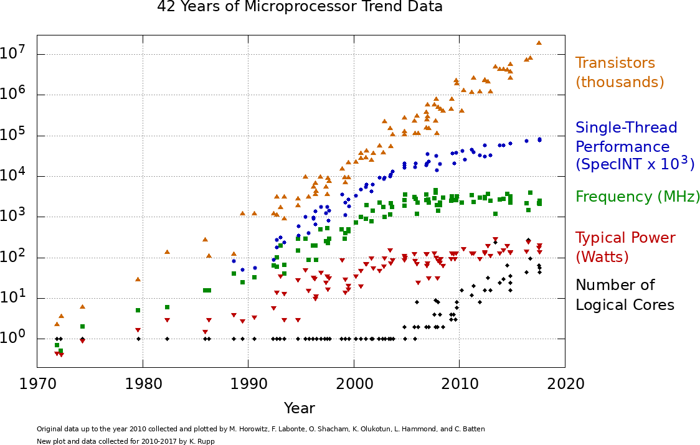
What are Future System Reqs?
One example – recent DOE CFP Requirements:
100+ exaFLOPs, up to 20 GHz frequency, < 20 MW power
But Moore’s Law continues to fade …
155

Slide 156

Why gem5?
Widely used, popular, open-source simulator
Models CPUs, GPUs, and accelerators in a single ecosystem
Supports many layers of the computing stack – enables deep co-design
Extensible through C++/Python modules
Significant software engineering effort
Validated, cycle-level fidelity across a range of components
Rigorous functional regression testing ensures stability
On-going work: performance regression testing
Stable interfaces reduces churn
156

Slide 157
Power Modeling Flow
Current flow:
Grab McPAT activation energies
Use activation energies with gem5 stats to calculate power per component (BP, RF, etc)
Hierarchically sum the power per component into per stage, then per stage to core.
class MinorFetchEnergy(BasePowerModel):
self.dynamic_power():
energy = (
reads * self.act_energies[‘Read’] + writes * self.act_energies[‘Write’’]
)
return to_watts(energy)
class MinorCPUPower(PowerModelPyFunc):
self._fetch = MinorFetchPower()
self.dynamic_power():
return self._fetch.dynamic_power()
McPAT Activation Energies
157

Slide 158
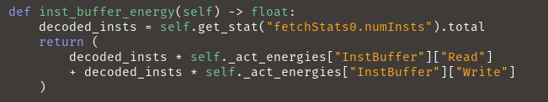
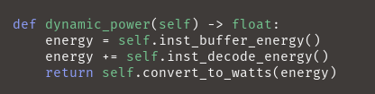
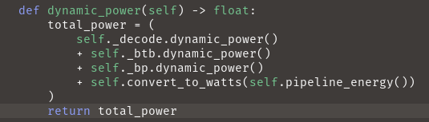
Implementation
InorderMcPATDecodePower()
InorderMcPATDecodePower()
InorderMcPATFetchPower()
158

Slide 159
Toward Full-System Heterogeneous Simulation: Merging gem5-SALAM with Mainline gem5
Akanksha Chaudhari and Matthew D. Sinclair
University of Wisconsin-Madison
sinclair@cs.wisc.edu
Notes:
ADD OUTLINE SLIDES

Slide 160
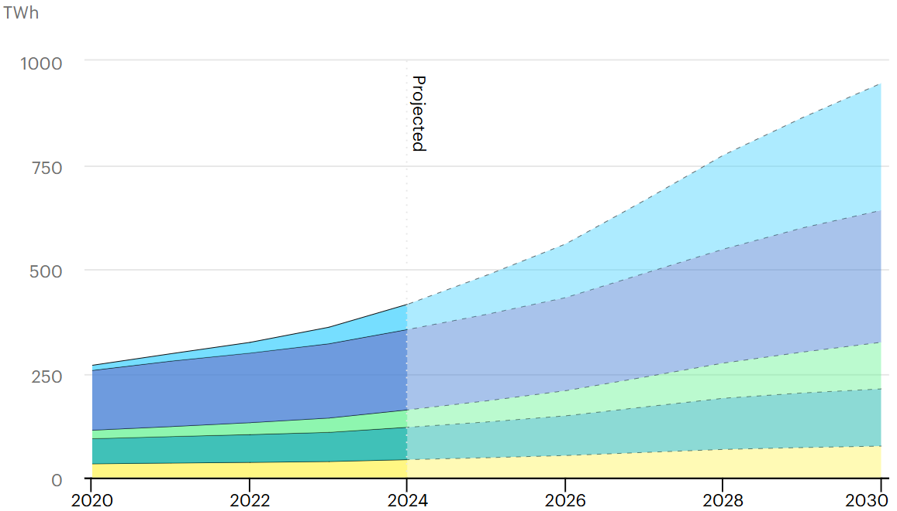

Global Datacenter Electricity Consumption
Escalating Power Demands: Datacenter electricity consumption expected to triple by 2030, with accel-rich servers driving majority of the growth.
Shift toward heterogeneity: By 2030, accelerated servers are projected to deliver ~50% of total compute while comprising <10% of server stock
160
Source: IEA (2025), Energy and AI, IEA, Paris https://www.iea.org/reports/energy-and-ai, License: CC BY 4.0

Slide 161




Heterogeneity is the New Norm
AWS Trainium2 NeuronCore-v3
Servers
Intel Meteor Lake
Laptops
Apple A15 Bionic
Phones/Tablets
161
Sources: AWS Docs Neuron, Intel Tech Tour, Chipwise
Notes:
Die Shot for Visuals?? Venn diagram / triangular flow??
Next-generation computing systems are increasingly heterogeneous
CPUs, GPUs, and domain-specific accelerators integrated at scale
https://awsdocs-neuron.readthedocs-hosted.com/en/latest/general/arch/neuron-hardware/trainium2.html
https://cdrdv2-public.intel.com/

Slide 162
Heterogeneity is the New Norm
Increasingly complex designs!
Non-trivial power/perf characteristics
Memory-compute co-optimization
AWS Trainium2 NeuronCore-v3
Servers
Intel Meteor Lake
Laptops
Apple A15 Bionic
Phones/Tablets
162
Sources: AWS Docs Neuron, Intel Tech Tour, Chipwise

Slide 163
Designing for Heterogeneity: What is Needed?
Cross-layer observability to guide early-stage co-optimization
Full-system context including memory hierarchy and software stack
Validated, cycle-level simulation of all components
163

Slide 164
The Simulation Gap
Simulator | CPU | GPU | Accelerators | FS Support
gem5 (v25) - SOTA | ✔ | ✔ | ✗ | ✔
SALAM | ✗ | ✗ | ✔ | ✗
164
Notes:
Add the table from poster

Slide 165
The Simulation Gap
Simulator | CPU | GPU | Accelerators | FS Support
gem5 (v25) - SOTA | ✔ | ✔ | ✗ | ✔
SALAM | ✗ | ✗ | ✔ | ✗
No unified framework for simulating heterogeneous SoCs within the full-system context
165
Notes:
Add the table from poster

Slide 166
The Simulation Gap
Simulator | CPU | GPU | Accelerators | FS Support
gem5 (v25) - SOTA | ✔ | ✔ | ✗ | ✔
SALAM | ✗ | ✗ | ✔ | ✗
gem5-SALAM | ✔ | ✔ | ✔ | ✔
This work: unify head of gem5, gem5-SALAM
Enables unified simulation of CPUs, GPUs, and accelerators
166
Notes:
We integrate SALAM’s accelerator modeling capabilities into the gem5 mainline (v24)Unify simulation of CPUs, GPUs, and accelerators under a single framework
gem5 provides detailed CPU modeling and now supports full-system GPU simulation; however, accelerator modeling remains fragmented.
gem5-SALAM enables LLVM-based accelerator simulation atop gem5 v21.1:
Operates outside the gem5 mainline.
Restricts modeling to standalone accelerators.
Cannot utilize recent gem5 features
(e.g., GPU integration, memory system improvements).
To bridge this gap, we integrate gem5-SALAM into mainline gem5, enabling tightly coupled, full-system simulation of heterogeneous systems consisting of CPUs, GPUs, and accelerators within a unified framework.

Slide 167
Outline
Introduction
Background
Integration Methodology
Frequency Scaling Study
Results and Analysis
Conclusions and Future Work
167

Slide 168
Integration Overview
gem5 develop-v25
SALAM Accelerator Simulation Models
168
Notes:
Integration effort focused on three key dimensions:
Incorporating SALAM’s simulation components and memory abstractions
Aligning interfaces with gem5’s current software architecture
Validating correctness through regression testing and comparing functional equivalence

Slide 169
Integration Overview
gem5 develop-v25
SALAM Accelerator Simulation Models
Incorporating key Accelerator Modeling and Communication Components
169

Slide 170
Integration Overview
gem5 develop-v25
SALAM Accelerator Simulation Models
Incorporating key Accelerator Modeling and Communication Components
Refactoring and Aligning Interfaces
170

Slide 171
Integration Overview
gem5 develop-v25
SALAM Accelerator Simulation Models
Incorporating key Accelerator Modeling and Communication Components
Refactoring and Aligning Interfaces
Validating Functional Equivalence
171

Slide 172
Methodology: Incorporating SALAM Components
LLVMInterface: Enables cycle-level datapath simulation via runtime IR parsing.
CommInterface: Exposes accelerators via memory-mapped registers and programmable interrupts.
Memory Models (SPMs, DMAs, etc): For low-latency access, data movement, and streaming.
AccCluster: Groups accelerators, local memories, and DMAs into modular subsystems.
Hardware Profile Generator: Extended the toolchain to fully automate the generation of functional units and instruction timing models from user-defined profiles.
Cacti-SALAM Power Models: Modernized the framework to support energy and timing estimation via config files for SPMs
172

Slide 173
Methodology: Refactoring and Aligning Interfaces
SimObject Alignment: Refactored accelerator classes to conform with gem5’s latest SimObject conventions, ensuring proper initialization and parameter declaration structures.
Type-safety Fixes: Replaced unsafe pointer casts in LLVM instruction simulation with intermediate 32-bit variables. This resolved array bounds and strict aliasing warnings during bitcasting.
Latency Generation Standardization: Migrated custom random latency utilities to gem5’s standardized random number generation framework for reproducibility and consistency.
Address Range Corrections: Fixed off-by-one errors in address range definitions for scratchpad and register bank modules to follow gem5’s inclusive-exclusive address semantics.
Environment and ISA Configuration Updates: Updated build environment handling to align with gem5’s latest ISA-specific configuration mechanism, resolving prior compatibility issues.
Build System Integration for LLVM: Added dynamic LLVM configuration via llvm-config to gem5’s SCons build system, enabling seamless compilation and linking for datapath simulation
173

Slide 174
Methodology: Validating Functional Equivalence
Validated outputs and confirmed functional equivalence
Ensured compliance with gem5’s pre-commit and full regression test suite
Adapted SALAM’s system validation tests; cross-validated outputs against baseline to confirm functional equivalence
174
Notes:
More specifics for first two bullet points.

Slide 175

The Integrated Framework: What it Enables
Broader heterogeneity studies
Co-simulate CPUs, GPUs, and custom accelerators.
Realistic modeling of heterogeneous systems with diverse compute elements and interactions.
System-level exploration
Compare static vs dynamic accelerator scheduling, shared vs private local memories.
Evaluate placement, offloading, and sync strategies.
Domain-specific workload support
Use built-in benchmark suite for architectural studies.
Model and study new workloads of interest.
175

Slide 176
Modeling and Simulating an Accelerator
C/C++ Functional Description of Acc. System
LLVM Intermediate Representation
176

Slide 177
Modeling and Simulating an Accelerator
System-level Description (AccCluster, DMA, SPM)
C/C++ Functional Description of Acc. System
LLVM Intermediate Representation
Hardware Profile Generated at Design Time
177

Slide 178
Modeling and Simulating an Accelerator
System-level Description (AccCluster, DMA, SPM)
Host-side Program that launches and monitors the Acc.
C/C++ Functional Description of Acc. System
LLVM Intermediate Representation
Hardware Profile Generated at Design Time
178

Slide 179
Modeling and Simulating an Accelerator
System-level Description (AccCluster, DMA, SPM)
Host-side Program that launches and monitors the Acc.
C/C++ Functional Description of Acc. System
LLVM Intermediate Representation
Host-Accelerator System Model
Hardware Profile Generated at Design Time
179

Slide 180
Modeling and Simulating an Accelerator
System-level Description (AccCluster, DMA, SPM)
Host-side Program that launches and monitors the Acc.
C/C++ Functional Description of Acc. System
LLVM Intermediate Representation
Host-Accelerator System Model
Simulate using run_system.sh
m5out/stats.txt Cycle counts, cache stats, DMA traffic etc.
Hardware Profile Generated at Design Time
m5out/SALAM_power.csv Energy area breakdown if Cacti-SALAM is run
m5out/system.terminal Console prints from the host software
180

Slide 181
Outline
Introduction
Background
Integration Methodology
Frequency Scaling Study
Results and Analysis
Conclusions and Future Work
181

Slide 182
Case Study: Extreme Frequency Scaling
Prior studies suggest accelerators are viable candidates for many GHz-scale execution
Advanced cooling enables transient high-frequency operation (“computational sprinting”).
182
Source: Raghavan et al, HPCA 2012

Slide 183

Case Study: Extreme Frequency Scaling
Prior studies suggest accelerators are viable candidates for multi GHz-scale execution
Advanced cooling enables transient high-frequency operation (“computational sprinting”).
Exceeds TDP; cannot be sustained for too long. No meaningful work completed
Normal Mode Operation
High-Frequency Operation
183
Source: Raghavan et al, HPCA 2012

Slide 184
Case Study: Extreme Frequency Scaling
Prior studies suggest accelerators are viable candidates for multi GHz-scale execution
Advanced cooling enables transient high-frequency operation (“computational sprinting”).
Normal Mode Operation
High-Frequency Operation
Cooled High-Frequency Operation
Cooling allows for longer “sprints” – making them actually beneficial
184
Source: Raghavan et al, HPCA 2012

Slide 185
Case Study: Extreme Frequency Scaling
Prior studies suggest accelerators are viable candidates for multi GHz-scale execution
Advanced cooling enables transient high-frequency operation (“computational sprinting”).
Use the integrated framework to evaluate accelerator performance up to 20 GHz
Normal Mode Operation
High-Frequency Operation
Cooled High-Frequency Operation
185
Source: Raghavan et al, HPCA 2012

Slide 186
Methodology
Limit study to examine upper bound on performance and energy efficiency gains
Use small test inputs, configured to fit in accelerator scratchpad.
Isolates compute, eliminating any memory and interconnect bottlenecks
Simulator Changes: Refined timing logic in LLVM Runtime, DMA, and interfaces to enable sub-cycle event resolution.
Single accelerator instantiated with ARM DerivO3 CPU as host system.
Sweep accelerator frequency from 0.1 to 20 GHz.
Simulate MachSuite kernels to measure:
Runtime for Performance
Dynamic Power for Energy Efficiency
186

Slide 187
Outline
Introduction
Background
Integration Methodology
Frequency Scaling Study
Results and Analysis
Conclusions and Future Work
187
Notes:
Die Shot for Visuals?? Venn diagram / triangular flow??

Slide 188

Preliminary Results: Performance
0.1 – 2 GHz: Perf. is compute-bound, frequency helps.
Small input sizes limit utilization for some benchmarks, reducing observable gains
2 – 20 GHz: Performance plateaus
Bottlenecks shift to CPU and DMA latency.
Takeaway: Benefits of frequency scaling can be limited by both underutilization and system-level bottlenecks.
188
Notes:
Small input sizes limit utilization for some benchmarks, reducing observable gains

Slide 189

Preliminary Results: Dynamic Power
0.1 – 2 GHz: Power shaped by active time reduction
Compute-bound kernels: Power decreases as faster execution shortens active duration; idle time dominates the average.
Others: Power stable/slightly rising; active time is non-negligible.
2 – 20 GHz: Power converges across all benchmarks
Active time becomes negligible, idle state dominates.
Takeaway: Time-averaged power scaling is limited by shorter active phases and increasing idle time at higher frequencies.
189

Slide 190
Outline
Introduction
Background
Integration Methodology
Frequency Scaling Study
Results and Analysis
Conclusions and Future Work
190
Notes:
Die Shot for Visuals?? Venn diagram / triangular flow??

Slide 191
Conclusions and Future Work
Modern and future systems increasingly embracing heterogeneity
But tools are struggling to keep pace with the needs of these heterogeneous systems
Solution: create unified full-system simulation framework for heterogeneous SoCs
Case Study: high-frequency simulation for accelerators → shows promise
Integrating support into gem5 mainline (on-going)
Benchmark suite expansion
Add domain-specific workloads of interest to the SALAM resource set
Multi-ISA enablement
Extend full-system support beyond ARM:
Route accelerator interrupts through ISA-specific interrupt controllers
Core-Local Interrupt Controller (CLIC) for RISC-V (working with NKAU)
Validate boot flow and benchmark functionality for new ISA
191

Slide 192
Backup

Slide 193
High-Frequency Acceleration Studies
Advanced cooling enhances efficiency by enabling higher operating frequencies.
Cooling technology | Viable core-clock domain | Indicative perf/W gain
Air (direct-evaporative) | ≤ 3 – 4 GHz | 1 × (baseline)
Single-phase immersion | ≈ 6 – 8 GHz | ≈ 1.3 – 1.6 ×
Two-phase immersion | ≥ 8 GHz | ≈ 1.6 – 1.7 ×
Cryogenic (≤ 77K LN₂ / ≤ 4K LHe) | > 10 GHz | > 100 × (device energy)
* Datacenter-level data from Microsoft/OCP, IEEE Micro, Upsite, LiquidStack; device-level data for cryogenic from Imec.
193

Slide 194
Narrowing the GAP: Enhancing gem5’s GPU
Memory Bandwidth Accuracy
Yu Xia*, Vishnu Ramadas*, Matthew Poremba**, Matthew D. Sinclair*
*University of Wisconsin-Madison, **AMD Research
xia73@wisc.edu
Notes:
Good day everyone. My name is Yu, a student from the University of Wisconsin-Madison. Today, I will present our continued work on improving the accuracy of gem5’s GPU model. The work is a collaboration with Vishnu Ramadas, Matthew Poremba and Professor Matthew Sinclair

Slide 195
CPU-GPU SE Mode Support in gem5
Architects rely on simulators to rapidly prototype ideas
gem5 widely used (execution-drive, cycle level), supports CPU-GPU systems
AMD updated GPU support [Gutierrez, et al. HPCA ‘18]
Simulates end-to-end HIP application (AMD’s GPGPU programming language) binaries
Recent updates (by us and AMD)
Runs unmodified ROCm user stack
ROCm 4.0 SE mode, ROCm 6.4 FS mode
Full-system mode with GPUs connected via PCIe now supported (+ PyTorch) [Ramadas, et al. OSCAR’24]
Supports ML apps [Roarty & Sinclair gem5 Wkshop’20]
Recently added support for MI200/300 GPUs
HIP
VEGA ELF + Code metadata
HIP Libraries
Runtime loader loads VEGA ELF into memory
[Gutierrez et al., HPCA ‘18]
Validated simulator configurations are crucial
195
Notes:
Let’s start with some background. Researchers usually rely on simulators to rapidly implement and verify ideas. For GPUs, gem5 has its cycle-level, execution-driven model. In 2018, AMD Research updated the GPU support in gem5, which is capable to run real HIP applications. AMD and our group have been providing support to this model. Now it can run modern, unmodified ROCm stack, with support of dedicated GPU connected via PCIe in Full-system mode. It can also run various GPU applications. Recently, we made models for newer GPUs available, such as Mi200 and 300.
(click) But we need to make sure that this model and the configurations are as accurate as possible. Because the researchers might draw misleading or even wrong conclusions, if the inaccuracy is too much.

Slide 196
Initial gem5 GPU Fidelity (vs. Vega-class GPUs)
Most have significant error relative to real GPU (37% geomean error)
196
Notes:
Naturally, we wanted to know how good the initial GPU model performed. So, we measured some performance metrics and compared it against a real Vega 20 GPU.
It turned out a lot of parts were very inaccurate, including
(click) The memory system.
(click)
Overall, there is a 37% mean error.
More work needs to be done to fix this.

Slide 197
How to Address These Shortcomings?
Our prior work: start addressing these inefficiencies [Jamieson, et al. gem5 Wkshp’22], [Ramadas, et al. gem5 Wkshp’23], [Ramadas, et al. YArch’24]
Issue: need standard, systematic approach for validating configurations
Solution: gem5 GPU Accuracy Profiler (GAP)
Profiler Metrics
Run application on real GPU
prof-metrics.csv
App(s) to Run and GAP configuration
Match corresponding metrics
Per App Comparison File
Run application on gem5
gem5-stats.txt
Use GAP to iteratively refine gem5 GPU models
197
Notes:
Our group have been working on addressing the inaccuracies in our prior works. We found it is necessary to have a standard, systematic approach for validating the GPU models.
So, we created gem5 GPU Accuracy Profiler, or GAP, to help us, iteratively refine GPU models. It takes the gpu application, gem5 configuration, and metrics interested. Then, it automatically runs the application on both gem5 and the real GPU, collecting gem5 stats and Roc profiler metrics from real GPU. Finally, it matches the corresponding metrics and generates a per application comparison. But running generic benchmarks with GAP can’t give us the stats of isolated components, such as memory systems. This prevents us from doing targeted improvements.

Slide 198
GAP Methodology
Created ~60 hand-tuned assembly-kernel microbenchmarks
Enables isolating behavior of different components
Target latency, bandwidth, size, and/or # of levels
Atomic operations (with/without conflicts), L1 I$, L1 D$, L2$, LDS, Main Memory, TLBs/Page Table, Max FLOPs, MFMA operations, arithmetic latency, …
Compare microbenchmark gem5 vs. real GPU output with GAP
Target corresponding stats in gem5 and ROC profiler from real GPU
Use results to iteratively refine
Leverage patents, publicly disclosed info, and reverse engineering
198
Notes:
Therefore, we created a set of microbenchmarks to excises specific components. These microbenchmarks have kernels with hand-tuned assembly, allowing us to accurately measure metrics such as bandwidth of different levels of cache,,, and the memory.
Considering both the microbenchmark output and the GAP result, we were able to make targeted, iterative refinements for the GPU models, which is much more feasible. By leveraging patents, publicly disclosed information and some reverse engineering, we discovered some hardware features that gem5 lacked. Then we added those missing features in.

Slide 199
First Target: Vega-class GPU
Source: AMD
Added new HW support & configurations to model Vega GPUs
Extending to MI200/300
199
Notes:
Applying this methodology, we aimed to improve the accuracy of Vega 20 model. We added new hardware features and improved configurations to gem5 model. These changes can also be easily extended to the new MI200 and 300 GPUs.

Slide 200
Prior GAP Improvements
Overall, much better fidelity (from 37% to 6% geomean)!
But … main memory still has huge error (e.g., 88% for memory BW)
This Work: reduce main memory error (for GPUFS)
200
Notes:
After 4 iterative fixes, we drastically decreased error, from 37% to 6% geomean. However, if you look at individual metrics, memory system is still way off.
(Click)
The memory bandwidth has about 88% error.
(Click)
In this work, we are going to further close this memory bandwidth gap for Full system simulation.

Slide 201
Outline
Motivation
Design
Conclusion
201
Notes:
Here are the designs we introduced to improve it.

Slide 202
Issue #1: Insufficient HBM2 Support
Initial main memory BW error: 88% (gem5: 153 GB/s, real GPU: 1223 GB/s)
Observation #1: GPU model supported HBM(2), but not at high fidelity.
Solution #1:
Modify GPU model to support more accurate HBM2 [Akram, et al. gem5 Wkshp’22]
Validation: achieve target BW when directly connecting HBM2 to traffic generators
New HBM model supports 1 TB/s like real GPUs!
Unfortunately, less effective sending traffic through the gem5 GPU to HBM2 model
202
Notes:
We have already known that the default GPU configuration uses a memory controller that doesn’t fully support HBM2
As previously reported by Akram et al., the old controller didn’t support correct timing parameters or pseudo-channel mode, which is critical feature for HBM2. Thanks to their work, we now have a much more accurate memory controller. We can just use this controller. To test it, we set up a standalone experiment using the new controller, where we instantiated memory with the same capacity as a real GPU, and then directly connected it to traffic generators. The results were promising, 1TB/s bandwidth achieved. The old controller couldn’t come close to this. So, we updated the GPU model, expecting big gains.

Slide 203
After HBM2 Support
Result #1: 153 GB/s → 166GB/s (86% error), although mem. latency error is better
Something between CUs & memory controller must be the bottleneck
203
Notes:
But, after integrating the new controller into the GPU model, we only see slight improvement from the baseline 153GB/s to 166GB/s. Far from the real GPU.
Obviously, something else before the memory controller is causing the bottleneck. It is time to dig deeper into stats and traces to find out.

Slide 204
Issue #2: Larger Pages
Observation #2: ROCm 5 switched default to 2 MB GPU pages (from 4KB)
Current gem5 GPU TLB model only fully supports 4 KB pages
Consequence: many redundant translation requests when larger page used
Reality: Majority of GPU memory accesses are to 2 MB pages
99.85% L3 GPU TLB misses were to 2 MB pages (511 redundant translations each)
These redundant translations hurt memory system performance
Solution #2: add multi-page size support to gem5 GPU
Larger page support reduces TLB misses
Should also increase address translation performance
204
Notes:
One thing we discover from it is that the GPU frequently utilizes 2MB pages. This is because since ROCm5, the default GPU page size is 2MB. Unfortunately, the current GPU TLB model in gem5 doesn’t properly handle huge pages.
Why does it matter? Huge pages have many advantages, including more efficient address translation. Imagine scanning a continuous 2MB memory region. With 4k pages, you would go through more than 500 pages, potentially more than 500 TLB misses. But with 2M page, you would only have 1 or 2 pages, which is much fewer misses.
This was noticeable in our benchmark program, where over 99% of L3 TLB misses come from accesses to these 2M pages, not the standard 4K pages. The memory system performance was tanked by those redundant translations.
So, we need to add the multi-page size support to reduce TLB misses for better address translation performance

Slide 205
Issue #2: Larger Pages (Cont.)
Implementation:
Coalescer does not know the request’s page size until request is returned
Solution #2A: Coalescer buffers all req(s) potentially belonging to same larger page
Trades off: increasing critical path if not a match vs. avoiding redundant requests
Solution #2B: TLB properly maps the VA translation according to its page size
Both need upgrades
[Address translation queries] → TLB Coalescer → TLB → [next level]
GPU TLB Structure (per level)
205
Notes:
Before making any changes, lets first take a close look at the current GPU TLB model in gem5.
A level of GPU TLB has two major components, TLB coalescer and the TLB itself.
The TLB coalescer acts like request filter. In a given time window, it only lets one translation request per 4k page pass through to the TLB, while the other requests to the same page are buffered.
Once it receives the response from the TLB, the coalescer reuses the result to translate the buffered queries. It works, because you just need to know one translation per page. The Coalescer reduces redundant TLB lookups.
The TLB itself works much like a set-associative cache. It maps the virtual address to a TLB entry using the hard-coded 4k page size.
click
So, both Coalescer and TLB need large page support.
For the Coalescer, it doesn’t know the request's page size until it’s returned. We chose to make it speculatively buffer and stall all the requests potentially belongs to the same 2M page. If it turns out thats not a 2M page, the Coalescer re-coalesce the requests, falling back to 4k page size. This solution might increase the critical path if the speculation were wrong. But since there are a lot of 2M pages accesses, this drawback is minimal.
Finally, we make the TLB insert the translation according to the page size. At translation lookup, TLB searches for all possible page size.

Slide 206
After Multi-page Size Support
Result #2: 166GB/s → 302 GB/s (75% error)
Significant improvement, but something else still causing issues
206
Notes:
Did it work? Yes, it improves the bandwidth to 302GB/s. We can finally see some good improvements. but this is not enough.

Slide 207
Issue #3: Page Walk Overhead
Observation #3: Page walks expensive in multi-level page tables
Each translation has multiple memory accesses
Tuning page table latency helps, but does not resolve root problem
Solution #3: Add small page walk cache (PWC) to GPU page table walker
PWC caches frequently accessed intermediate nodes in multi-level page table
Reduces number of main memory accesses for each L3 GPU TLB miss
Experimentally tuned size of PWC – 64-entries enough
207
Notes:
With our improved TLB model, TLB misses are still inevitable and costly. Every last-level TLB miss triggers a page walk, requiring multiple memory requests to traverse the page directory. It get worse if there is a data cache miss and requests go to the actual memory. We can tune this page walk latency, but it still relies on the memory system.
Our solution is page walk cache or PWC, which stores frequently accessed page directory entries. So, on TLB misses, there will be fewer memory requests. We tried several sizes. Small size, such as 64 entry is already enough to boost the memory bandwidth.
Eviction/invalidate?

Slide 208
After PWC
Result #3: 302 GB/s → 341 GB/s (72% error)
There is one more adjustment we can do to Network
208
Notes:
This further increases it to 341 GB/s. There is one more adjustment we can do to the network.

Slide 209
After Network Adjustments
Result #4: 341 GB/s → 583 GB/s (52% error)
Iteratively getting closer to target!
209
Notes:
The adjustments make the network to resemble the real GPU, which brings the memory bandwidth to 583 GB/s
As you can see, each improvement we added is making the memory bandwidth in gem5 GPU model one step closer to the real GPU.

Slide 210
Outline
Motivation
Design
Conclusion
210

Slide 211
Conclusion
Having validated “known good” gem5 models is important
Existing GPU models do not always behave intuitively
Point solutions insufficient
Solution: more automated framework (GAP)
Prior GAP work: improve caches, specialized memories, FLOPs
But significant bottlenecks remain, especially for main memory → fixes:
Higher fidelity main memory (HBM) model support
Multi-size page support to reduce redundant, unnecessary translations
Page walk cache to reduce overhead of page table walk
Adjust network bandwidth to better reflect GPUFS system
Optimizations significantly improve gem5 GPU’s main memory BW
Ongoing: identify further bottlenecks with main memory BW
Ongoing: Continue to push support from this work → “known good” GPU models
211
Notes:
We have reiterated that it is important to have an accurate model. And we need a scalable method to validate those models. Thus, we created GAP framework. With it, we have made several improvements. However, main memory bandwidth is still inaccurate.
In this work, we have made additional improvements that noticeably increase the memory bandwidth.
However, the gap hasn’t been completely closed. We are currently actively investigating other potential bottlenecks with the memory. Our group will keep working on validating GPU models for the community.
Thank you.

Slide 213

Baseline GPU Main Memory Status
Memory Bandwidth AMD Vega 20 —1223 GB/s
Memory Bandwidth in gem5 model —153 GB/s
87.49% error!
213
Notes:
All of these improvements have made the GPU model more accurate for caches and atomic operations. As you can see from the chart. Orange colored bars are the absolute errors after integrating our improvements. We can see drastically reduced errors.
But one challenge remains,,, that is the memory bandwidth, which hasn't been shown in the chart. We ran our benchmark on the actual Vega 20 GPU, and measured 1223 GB/s, which is very close to its rated 1TB/s bandwidth. However, in the gem5 model with similar configurations, it only has 153 GB/s, error of more than 87%. This gap is significant, and I will show how we improved it.

Slide 214
What Did We Fix Previously With GAP?
Introduced Dynamic Register Allocator for better parallelization
Introduced scoreboard for better tracking of register dependencies
Added support for Global-Level Coherence (GLC) and System-Level Coherence (SLC) operations
Tuned latency, sizes, and other parameters
214
Notes:
With the results of the microbenchmarks, we have already made several improvements, that aimed to enhance the simulation fidelity.
These include a dynamic register allocator and register dependency tracking scoreboard. They decrease the number of unnecessary stalls.
Next, we added loads and stores support for GLC and SLC (which are Global-Level and System-Level Coherence respectively).
Finally, after a great many of benchmark runs, we got a set of tuned parameters that reflects the real hardware.

Slide 215
What Did We Fix Previously With GAP? (Cont.)
Support for ROCm 4.0, 5.1 in SE mode; 6.2 in FS mode
Support for Carrizo-class dGPUs (gfx803)
Support for Vega-class dGPUs & APUs (gfx900, gfx902) and MI200/300 (gfx90a, gfx942) dGPUs
Validated, publicly available, tested benchmarks [Bruce, et al. ISPASS’21 Best Paper Nom.]
More realistic GPU register file model, improved concurrency via dynamic register allocation and VRF schemes
Improved concurrency via better dependency management
CU masking support to run kernels on a subset of GPU resources
Extend BLAS support to use kernels that run on real devices [Roarty, et al. gem5 Wkshp‘20]
Multi-chiplet support – more representative of future GPUs [Yogatama, et al. gem5 Wkshp‘20]
Properly report device properties for (ML) programs that dynamically select kernels
Study various cache replacement policies in GPUs [Jia & Sinclair gem5 Wkshp‘23]
…
Significant effort to model modern systems with high fidelity
215
Notes:
With the results of the microbenchmarks, we have already made several improvements, that aimed to enhance the simulation fidelity.
These include a dynamic register allocator and register dependency tracking scoreboard. They decrease the number of unnecessary stalls.
Next, we added loads and stores support for GLC and SLC (which are Global-Level and System-Level Coherence respectively).
Finally, after a great many of benchmark runs, we got a set of tuned parameters that reflects the real hardware.

Slide 216
import matplotlib.pyplot as plt
import numpy as np
x = np.array(["Base", "+HBMCtrl", "+TLB", "+PWC", "Target"])
y = np.array([153, 166, 302, 341, 1223])
plt.ylabel("Mem Bandwidth(GB/s)")
plt.bar(x,y)
plt.show()
216

Slide 217
gem5’s GPU Simulation Modes
AMD GPUs: ROCm stack to interface with CPU(s)
ROCm stack:
Runtime layer – ROCr
Thunk (user-space driver) – ROCt
Kernel fusion driver (KFD) – ROCk (in Linux)
MIOpen – Machine intelligence (MI/ML) library
rocBLAS – BLAS (e.g., GEMMs) library
HIP (LLVM backend, clang frontend)
Syscall emulation (SE) mode:
Simulate all except ROCk, which gem5 emulates via docker
Full system (FS) model:
Simulated disk image containing entire ROCm stack – great for deep co-design
217

Slide 218
gem5 CPU-GPU SE Mode: Modern App Support
System calls emulated through docker (SE Mode)
APIs to HIP libraries
SE mode currently doesn’t support frameworks like PyTorch, TensorFlow
We added this support
[Alsop IISWC ‘19], [Roarty gem5 Workshop ‘21]
218

Slide 219
gem5 GPUFS Support
Introduced in gem5 v22.0
Previously only supported SE mode with ROCm 4.0
FS mode supports ROCm 4.2 & 6.4 without significant changes
Can run many kernels of ML workloads like nanoGPT using PyTorch in gem5!
This was not possible in any prior form of gem5
SE mode requires either specific host env containing ROCm stack or a Docker container that encapsulated this environment
GPUFS removes all host requirements
Improves simulation speed by functionally simulating memory copies
Adds KVM CPU-GPU support
219

Slide 220
What is KVM CPU?
Kernel-based Virtual Machine (KVM)
Open-source virtualization technology built into Linux
Turns Linux into a hypervisor that allows host machine to run a VM
KVM CPU allows simulation to fast-forward by running the CPU instructions directly on the VM instead of on other gem5 CPU models
Requires app binary to be compiled for the host machine architecture
CPU-GPU systems can use to fast forward through CPU code
220

Slide 221
gem5 GPUFS Mode Support: High-Level Frameworks
Disk image containing ubuntu-24.04 with ROCm 6.4, PyTorch, and other dependencies
App
PyTorch
gem5’s CPU model simulates the system calls
ML Frameworks make it easy to build large scale applications, but very slow to simulate completely
KVM x86 CPU
Can run MNIST, nanoGPT, etc. layers in public gem5!
221

Slide 222
About adjusted network bw
SimpleNetwork is unrealistic and inaccurate.
Bandwidth is scaled up to meet what a real GPU sees
We did this in SE mode to match the cache performance
Now do the same in FS mode.

Slide 223

223

