Slide 1
Commercializing
Innovations
Spring 2026

Slide 2


WHO WE ARE
Our Vision
Enable University of Wisconsin–Madison research to solve the world’s problems.
Our Mission
To support scientific research within the UW–Madison community by providing financial support, actively managing assets, and moving innovations to the marketplace for a financial return and global impact.
Independent
Nonprofit (501(c)(3)) supporting organization

Slide 3

THE WISCONSIN IDEA
The Wisconsin Idea is a philosophy (embraced by the University of Wisconsin System) that holds that university research should be applied to solve problems and improve health, quality of life, the environment, and agriculture for all citizens of the state.
“…the boundaries of the University are the boundaries of the State.”
Notes:
WARF’s charter is focused on support to UW-Madison. We embrace The Wisconsin Idea.

Slide 4
Cycle of Innovation
IP Protection
Funding to Support Research & Discovery
UW Research & Discovery
Licensing & Startups
4th Overall in research funding
350-400 invention disclosures each year
2000 Issued U.S. Patents
700 Pending U.S. Patents
50+ licenses annually
Over $1 billion of products sold each year
125 faculty start-ups
Annual Support: $200 million FY26
Over $3 billion cumulative to UW
> $200M in inventor Royalties

Slide 5

Intellectual Property Rights
Most every country has such a system of granting and administering IP rights.
Article I, Section 8, clause 8 of the US Constitution states that Congress possesses the power to:
Promote the Progress of Science and useful Arts by securing for limited Times to Authors and Inventors the exclusive Right to their respective Writings and Discoveries

Slide 6
Forms of IP Protection
Patents
Machines and devices
Compounds
Processes and methods
Improvements on any of the above
Trade Secrets
Copyrights
Literary works
Webpages
Software programs
Trademarks
Words and phrases
Colors
Pictures or logos
Sound

Slide 7
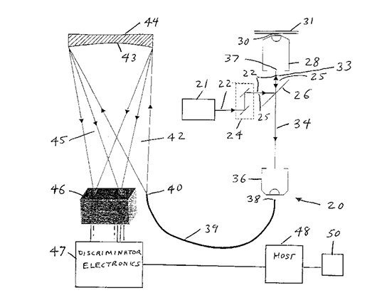

Intellectual Property
Patent
Protects a variety of inventions such as devices, methods, processes, and substances
Must meet criteria:
Useful
Non-Obvious
Enabled and Described
Copyright
Protects “original works of authorship”
Protects Expression of an idea “fixed in a tangible form”
Notes:
US6687000B1 Photon-sorting spectroscopic microscope system

Slide 8
Intellectual Property Rights
Patents
Provide the owner the nationwide
right to exclude others from:
Making
Using
Selling
Offering to Sell
Importing
… the patented invention.
Copyrights
Provide the owner the nationwide
right to exclude others from:
Copying & Making Derivative Works
Copyright protects the EXPRESSION of an idea
Copyright encourages creative efforts by securing the exclusive right to reproduce works and derive income from them
Notes:
A patent is a kind of property right.
The right conferred by the patent grant is, in the language of the statute and of the grant itself, “the right to exclude others from making, using, offering for sale, or selling” the invention in the United States or “importing” the invention into the United States.
Patent holder is not granted the right to make, use, offer for sale, sell or import, but the right to exclude others from making, using, offering for sale, selling or importing the invention.
Copyright is created automatically once an original effort has begun and it has been fixed in a tangible medium
Registration is not required (but highly recommended)
Additional protection and notice to potential infringers.
Simple and inexpensive
Symbol, year, author
Term: Life of the Author plus 70 years

Slide 9
Rights of Others
Important considerations
Federal Funding Obligations with regard to inventions: May not be yours to give away however you’d like
You cannot grant rights to use someone else’s patent
Software may be precluded from specific types of licensing if it was created using other’s code obtained under a license (such as some open source licenses)

Slide 10
Patent Licensing
What is a license?
A contract between owner and third party
Rights to: make, use, sell, or import
License is a promise not to sue, if licensee complies with the terms
Requirements of WARF Licensees
Capability to develop
Commitment to commercialize
Reasonable licensing fees
Fulfill obligations under Bayh-Dole
Reservation of rights for academic use

Slide 11
“Despite superficial similarities to software licenses, most hardware licenses are fundamentally different: by nature, they typically rely more heavily on patent law than on copyright law, as many hardware designs are not copyrightable. Whereas a copyright license may control the distribution of the source code or design documents, a patent license may control the use and manufacturing of the physical device built from the design documents.
https://en.wikipedia.org/wiki/Open-source_hardware
Notes:
This distinction is explicitly mentioned in the preamble of the TAPR Open Hardware License:
"... those who benefit from an OHL design may not bring lawsuits claiming that design infringes their patents or other intellectual property."
— TAPR Open Hardware License

Slide 12

THANK YOU
stephanie@warf.org
or
Visit warf.org

