Slide 1
The IEEE NPSS International Schools
Martin Grossmann
Chair, NPSS Educational Committee

Slide 2
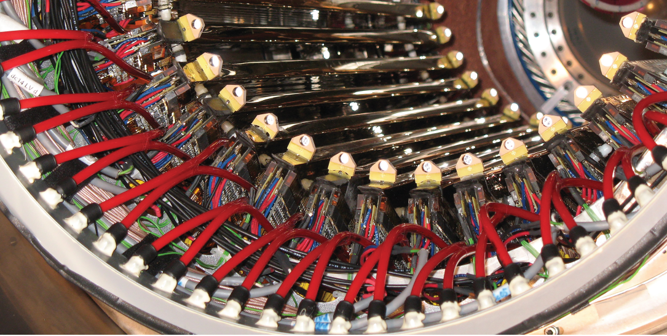

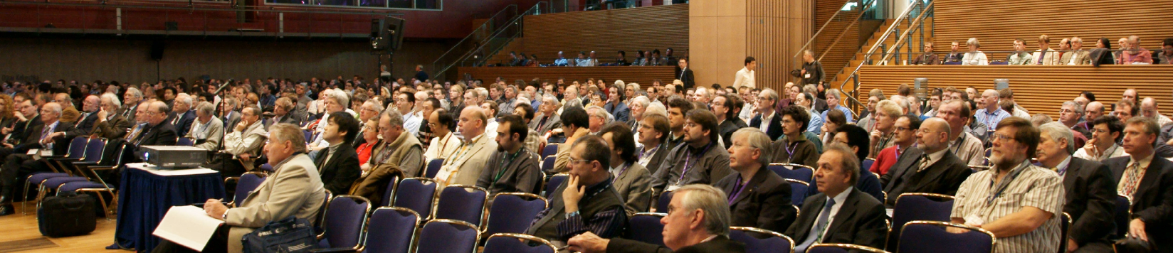
Nuclear and Plasma Sciences Society NPSS
Particle Accelerator Science and Technology
Radiation Instrumentation
Nuclear Medical and Imaging Sciences
Plasma Sciences and Applications
Fusion
Pulsed Power Systems
Radiation Effects
Computer Applications in Nuclear and Plasma Sciences

Slide 3
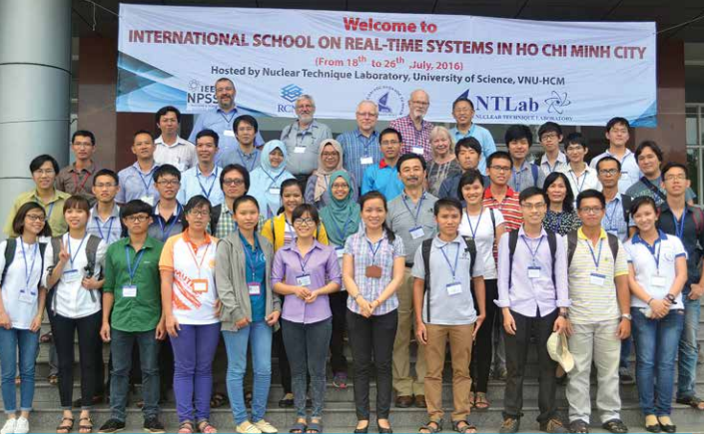
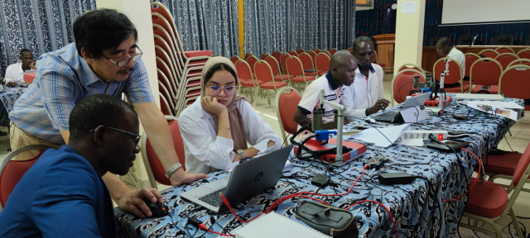
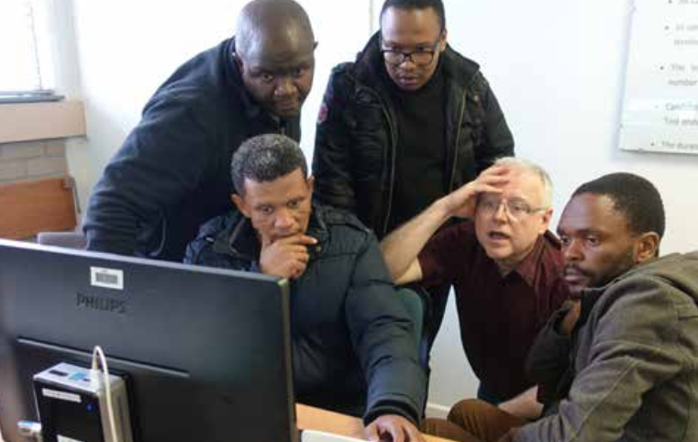
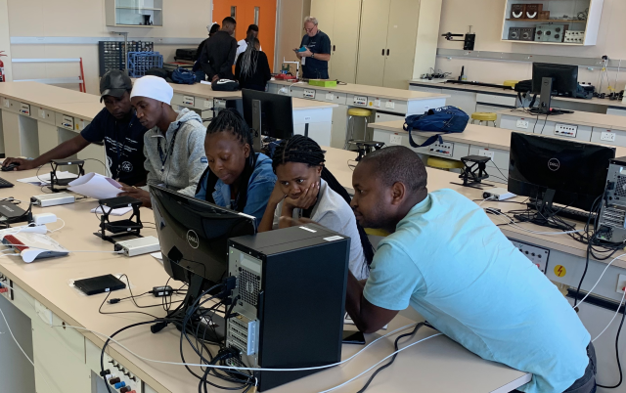
NPSS International Schools since 2014
Nuclear Instrumentation & Data Acquisition
  Osaka, Japan, 2014
  Ho Chi Minh City, Vietnam, 2016
  Capetown, South Africa, 2018
  Kuala Lumpur, Malaysia, 2019
  São Paulo, Brazil, 2020
  Dakar, Senegal, 2022
  Port Elizabeth, South Africa, 2022
  Lucca, Italy, 2023
  Rajkot, India, 2024
  Rabat, Morocco, 2024
  Fukushima, Japan, 2024 & 2025
  Prague, Czechia, 2025
  Mexico City, Mexico, 2025
  Bogotá, Colombia, 2026

Slide 4
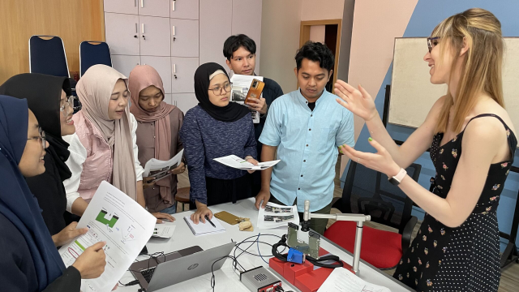
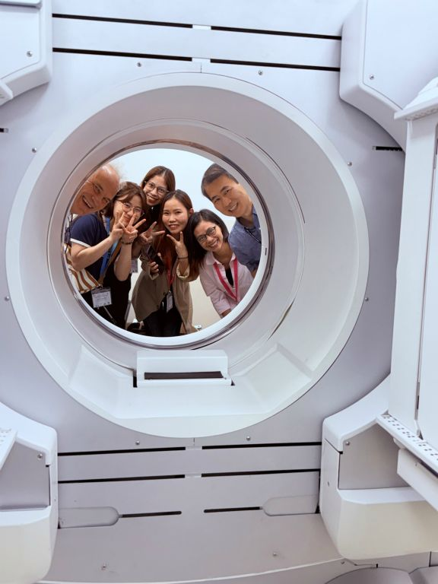
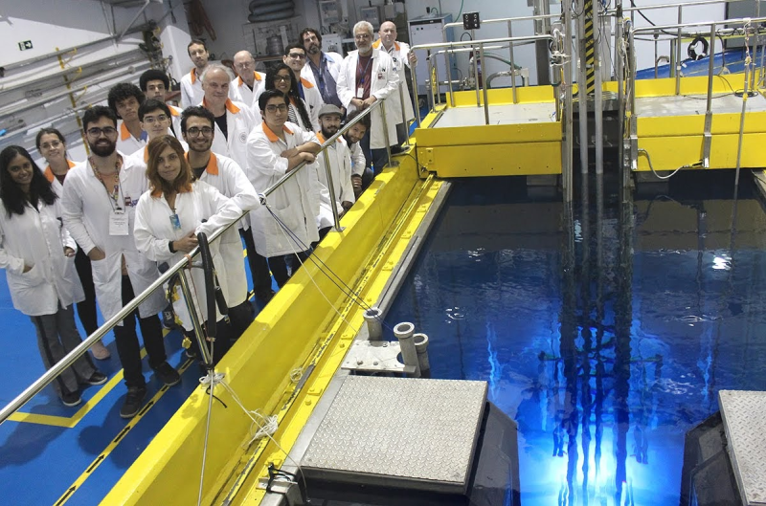
NPSS International Schools since 2014
Medical Imaging
  Nan, Thailand, 2023
  Jakarta, Indonesia, 2024
  Ho Chi Minh City, Vietnam, 2025
  Manila, Philippines, 2026
Radiation Effects & Space Qualification
  Mooloolaba, Australia, 2023
  Sydney, Australia, 2025
  San José, Puerto Rico, 2026
Nuclear Power
  Ho Chi Minh City, Vietnam, 2026

Slide 5
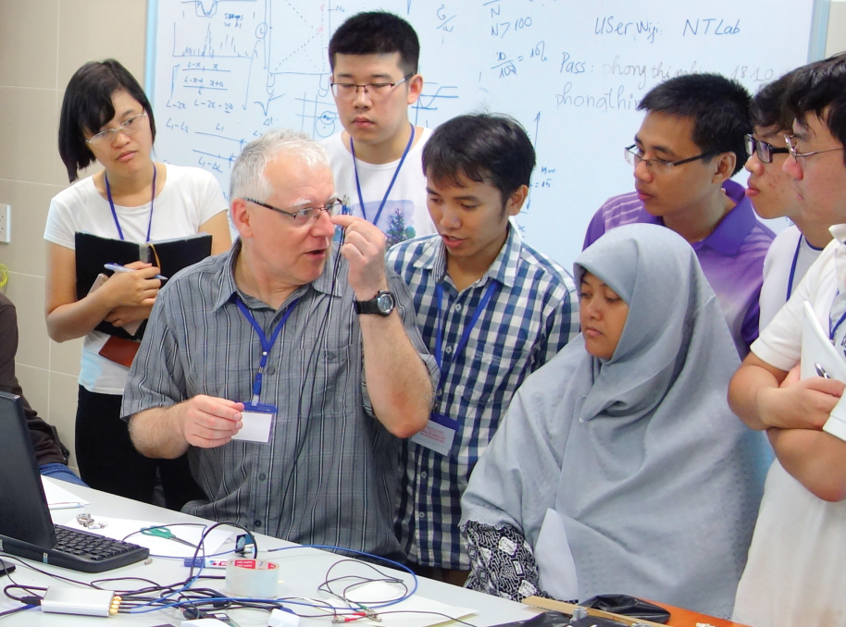
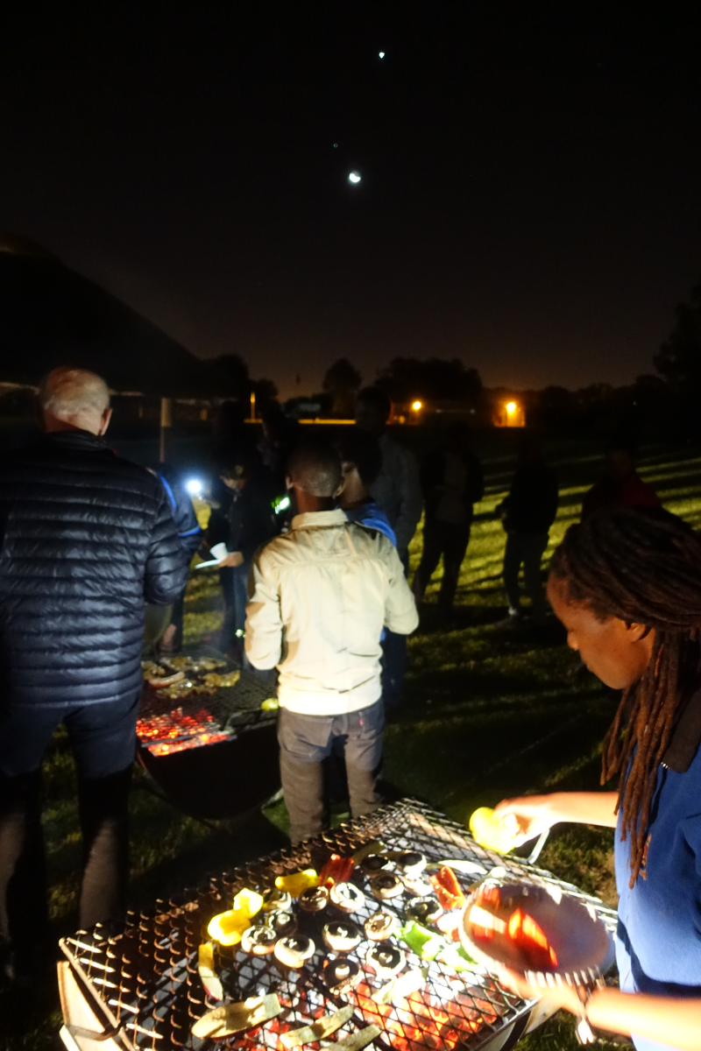
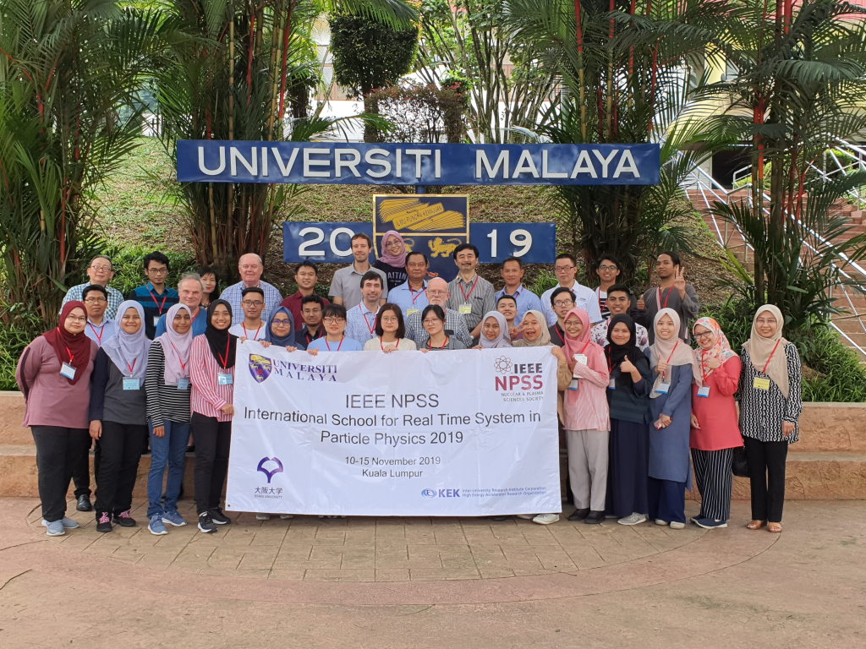
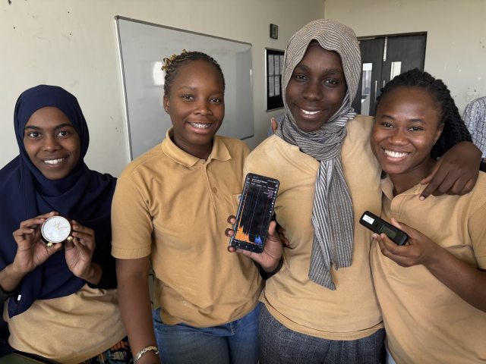
NPSS International Schools
One … two weeks
20 … 40 students
  Master & PhD
Lectures and hands-on exercises
Teachers and students stay in the same place
  Interaction outside of the classroom

Slide 6
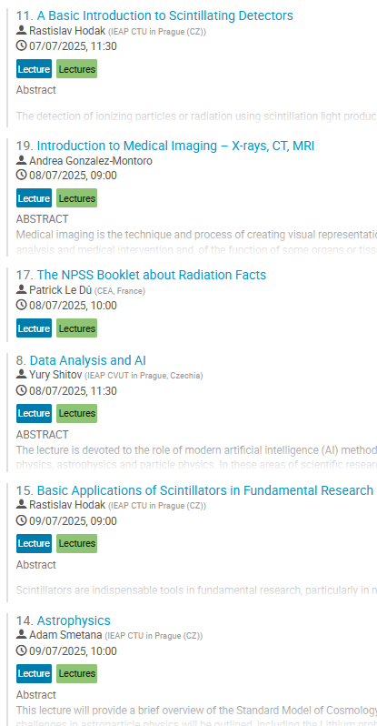
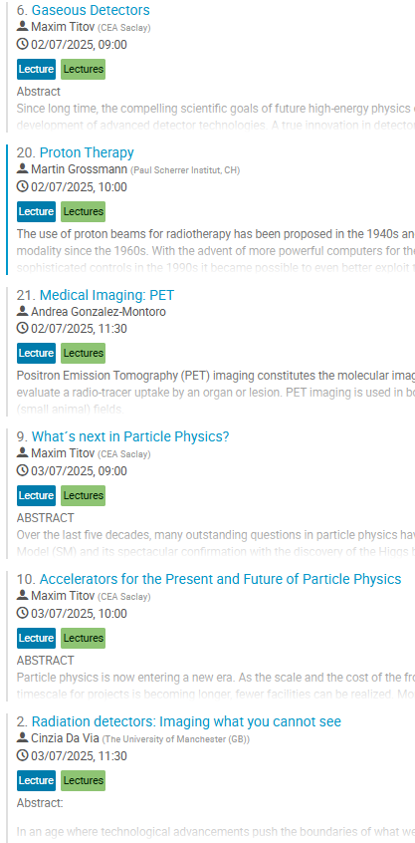
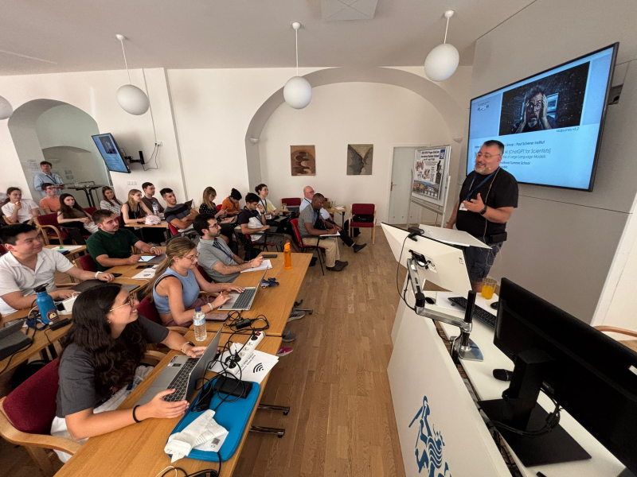
Lectures

Slide 7
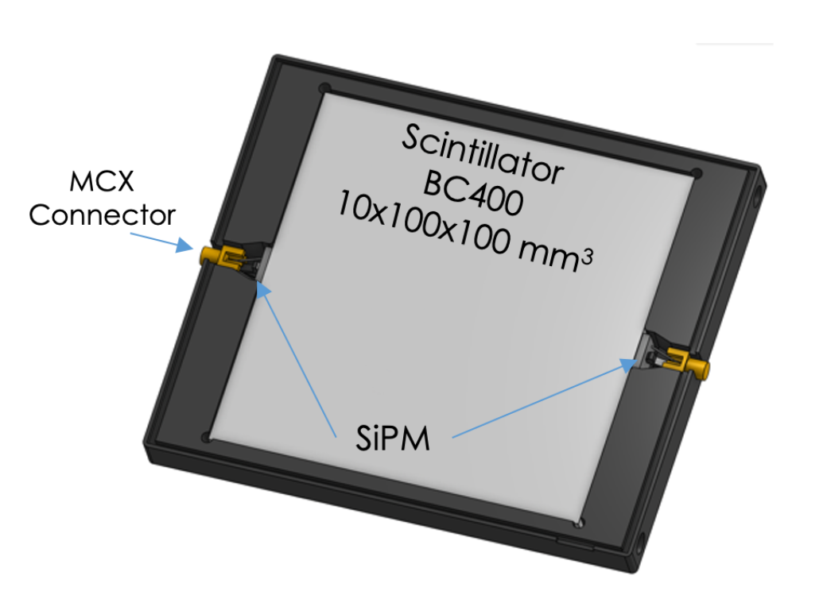
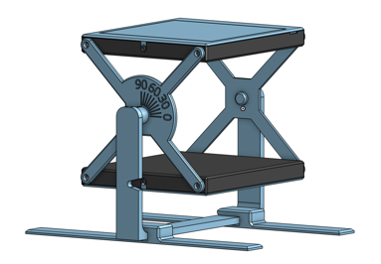
Exercises: Time of Flight with cosmic muons
Stefan Ritt, PSI
d = 10 cm
t = d / v = 0.1 m / (0.9 * 3*10⁸ m/s) =
0.0000000004 s = 0.4 ns
t = ?

Slide 8
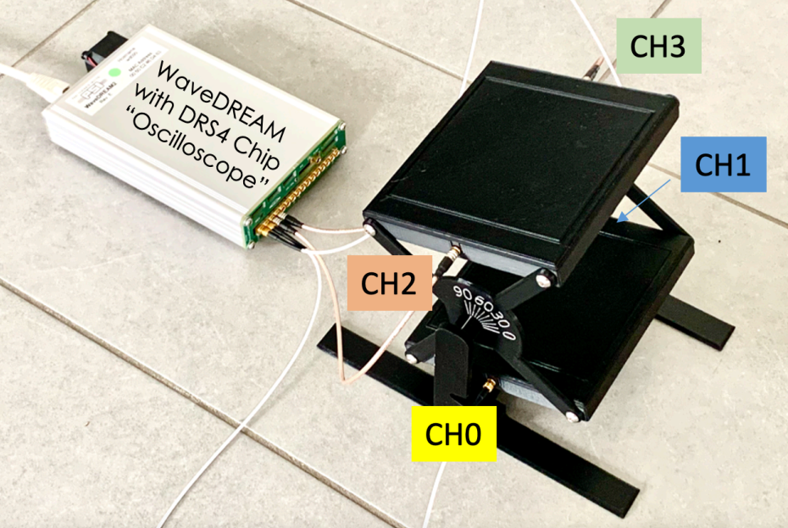
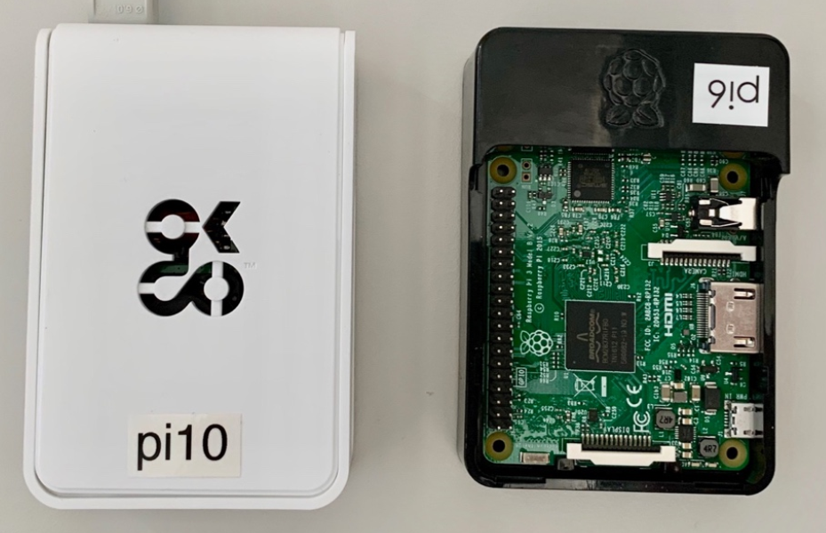
Exercises: Time of Flight with cosmic muons
WaveDREAM board
RaspberryPi computer

Slide 9
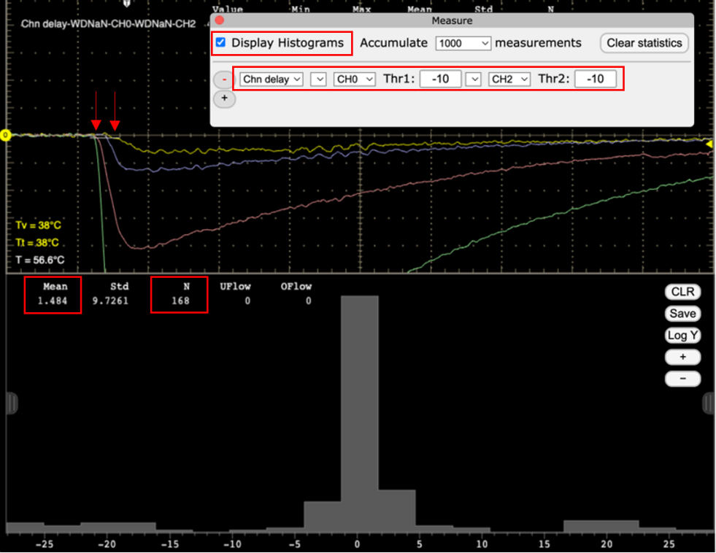
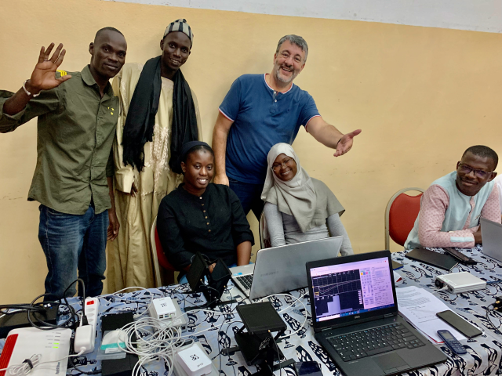
Exercises: Time of Flight with cosmic muons
Oscilloscope application on RaspberryPi
access through webserver

Slide 10
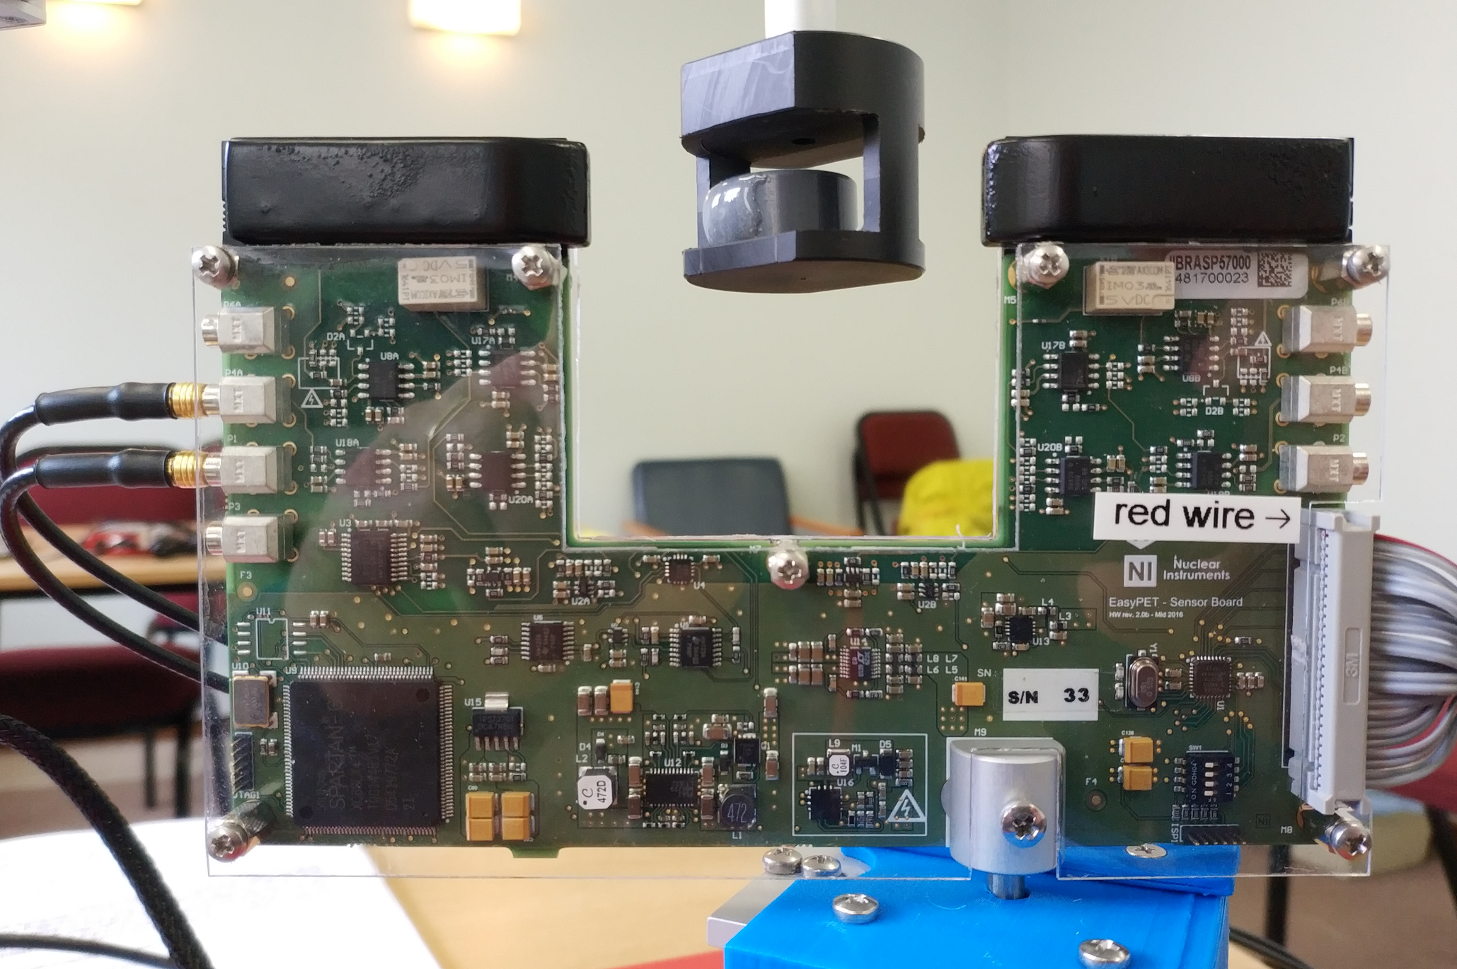
Exercises: Demonstration of PET imaging
EasyPET (University Aveiro, Portugal)
Channel 1
Channel 2

Slide 11
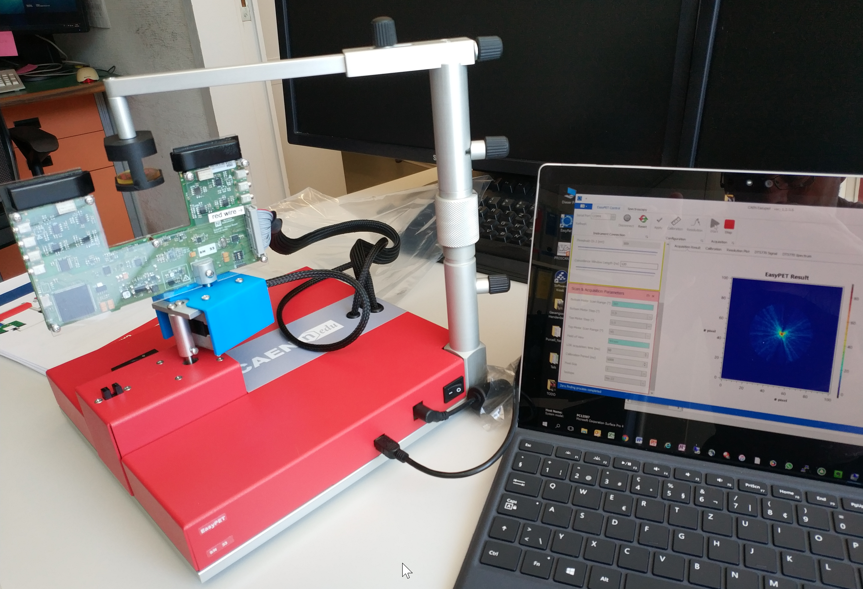
Exercises: Demonstration of PET imaging
Commercial kit (CAEN, Italy)

Slide 12
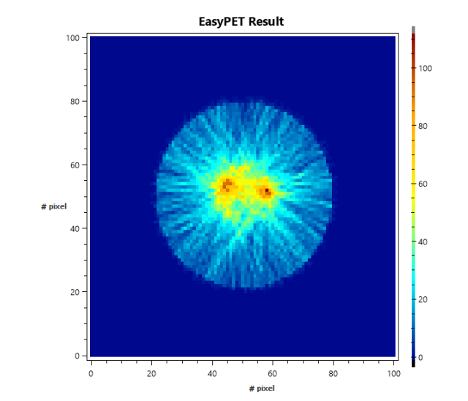
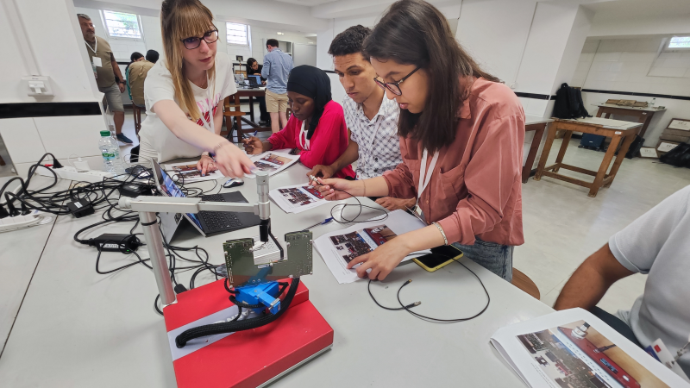
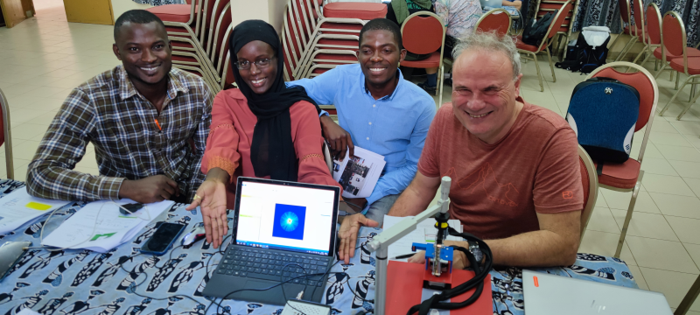
Exercises: Demonstration of PET imaging

Slide 13
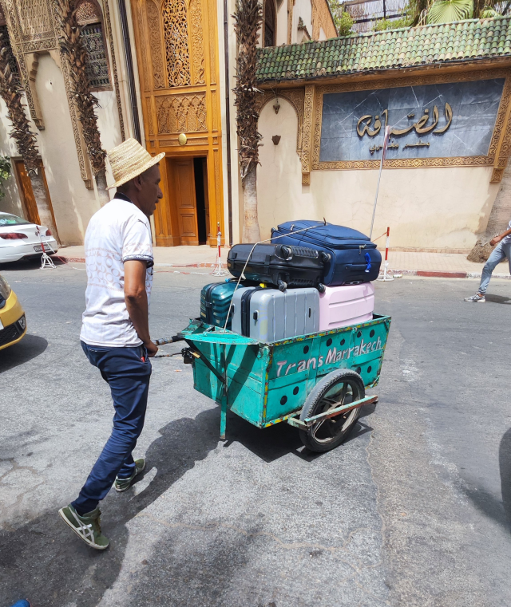
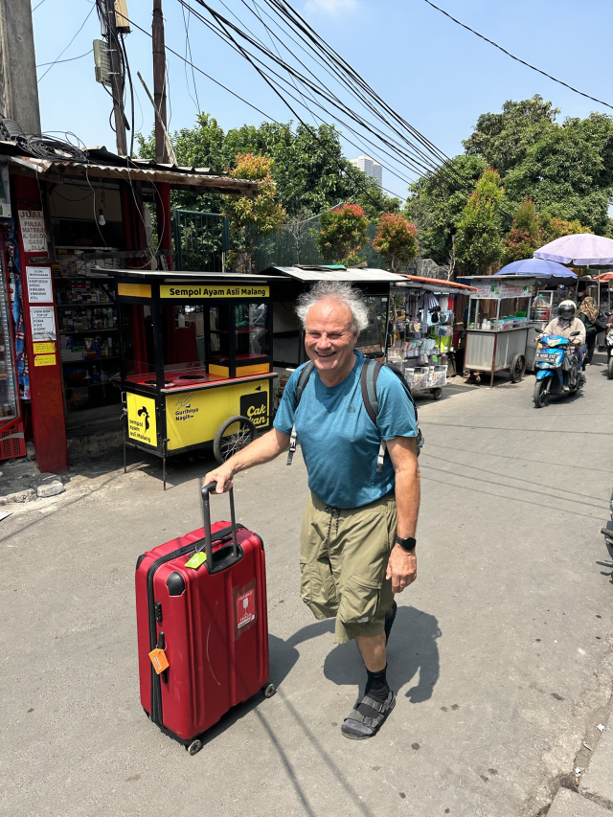
The Travelling EasyPET

Slide 14
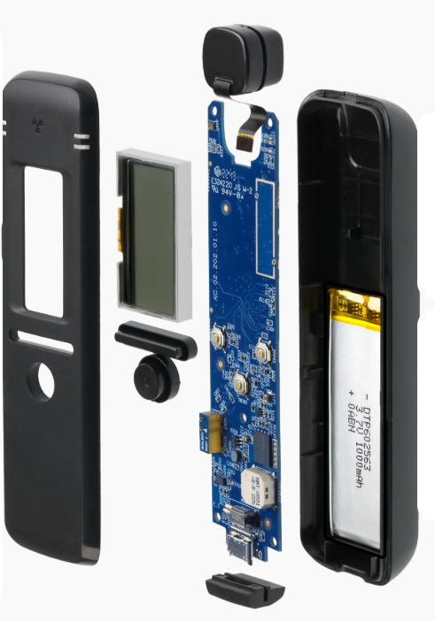
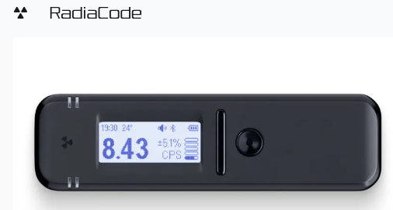
Radiacode – dosimeter and gamma spectrometer
Commercial device, www.radiacode.com, approx. 200 €

Slide 15
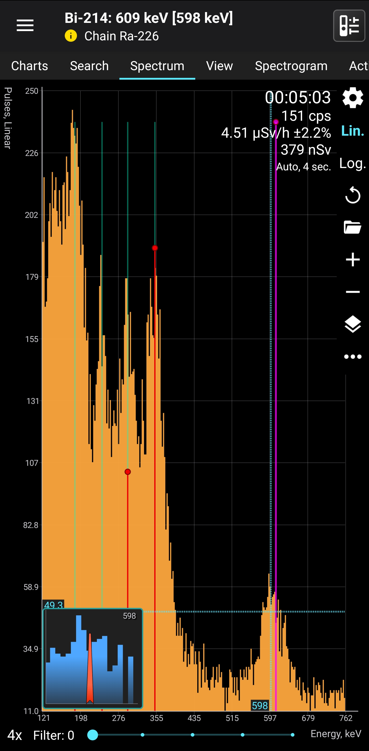
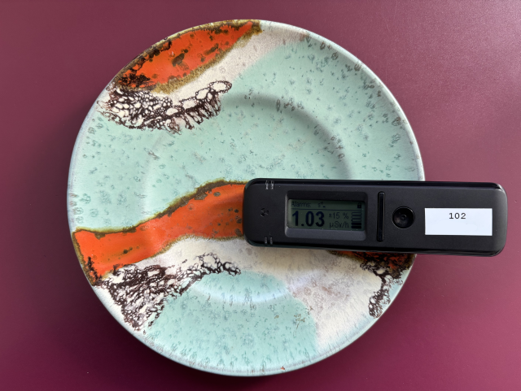
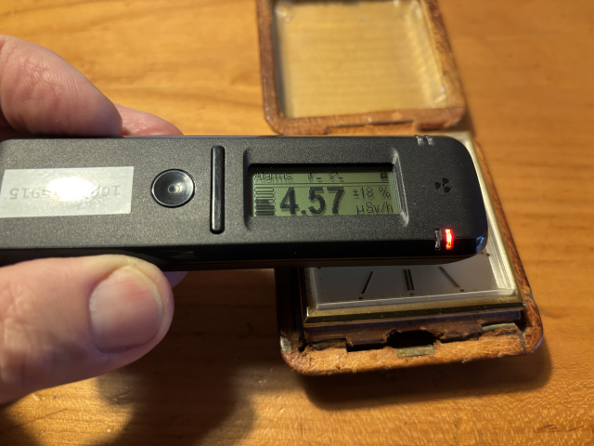
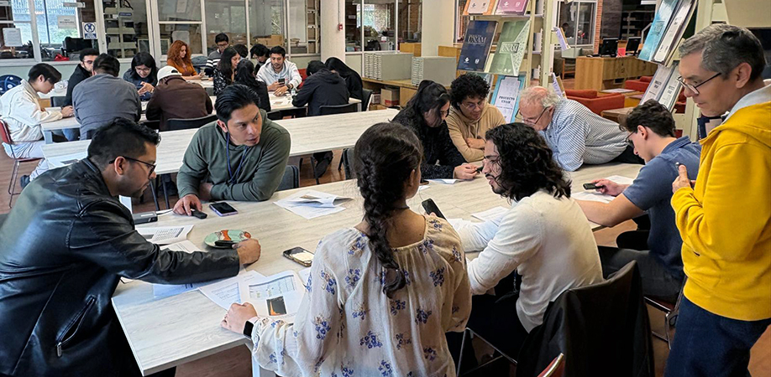
Radiacode
Use with Smartphone app

Slide 16
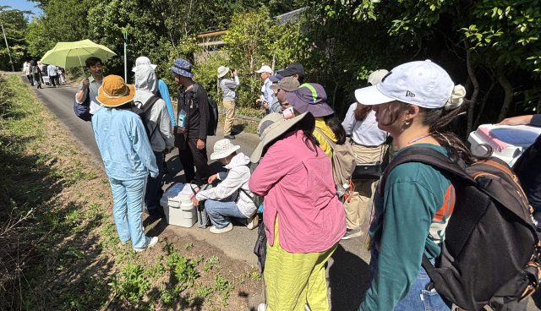
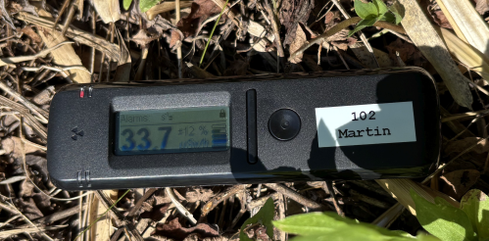
Radiacode
School at Fukushima Center (Osaka University)

Slide 17
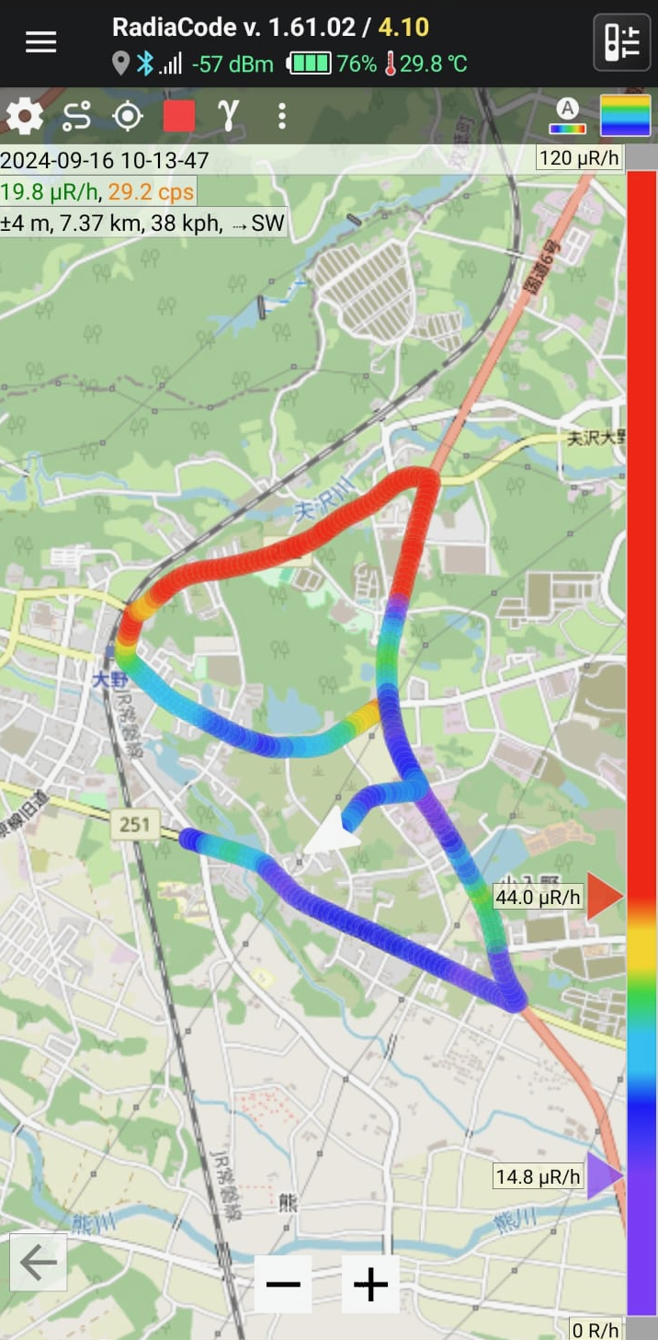
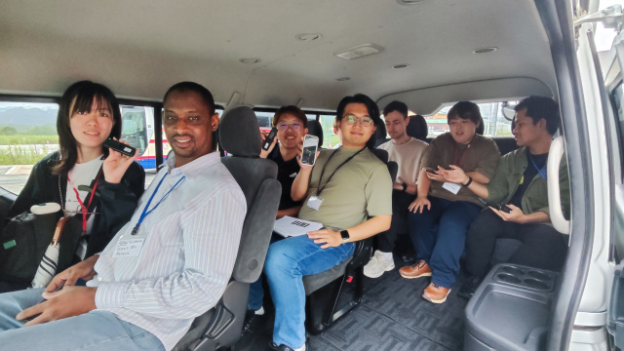
Radiacode
School at Fukushima Center (Osaka University)

Slide 18
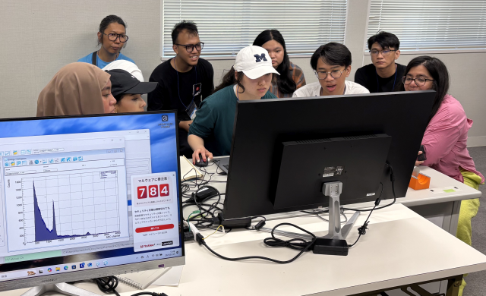
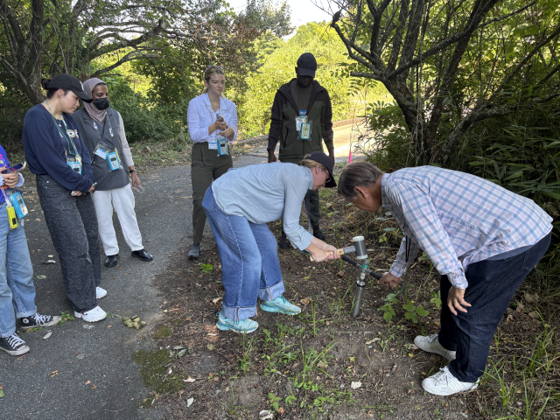
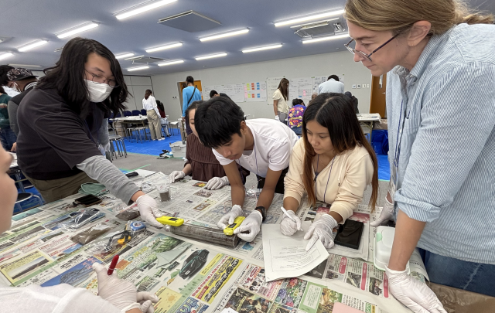
Radiacode
School at Fukushima Center (Osaka University)

Slide 19
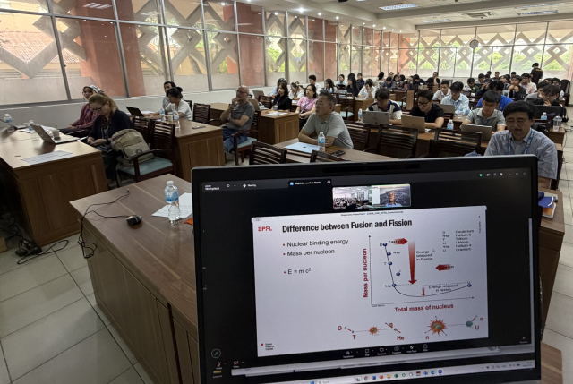
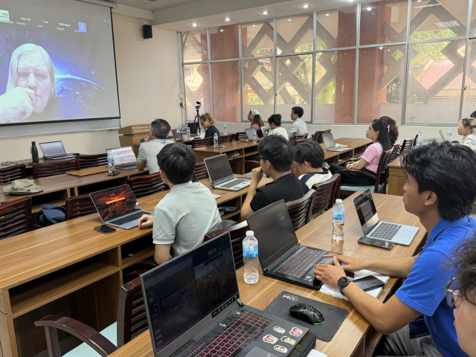
School on Nuclear Power
Ho Chi Minh City, September 2026

Slide 20
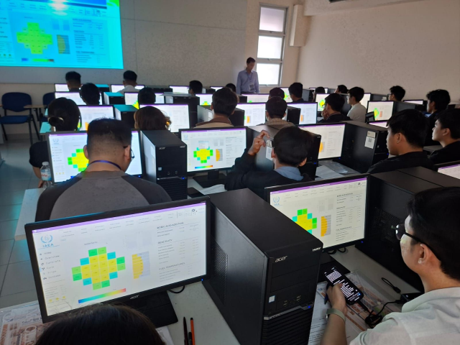
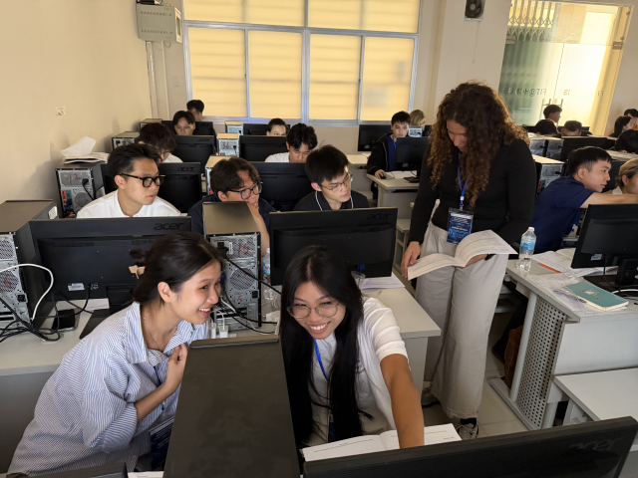
School on Nuclear Power
IAEA PWR Simulator

Slide 21
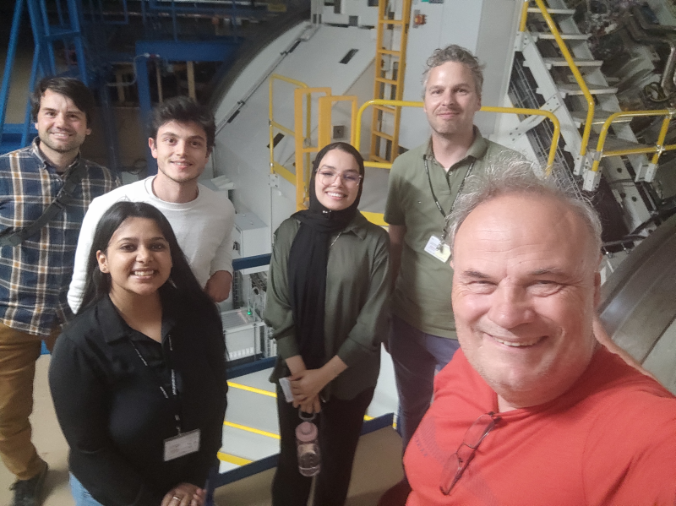
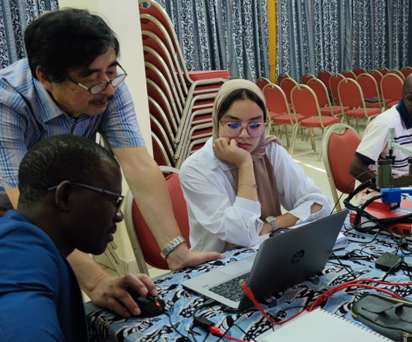
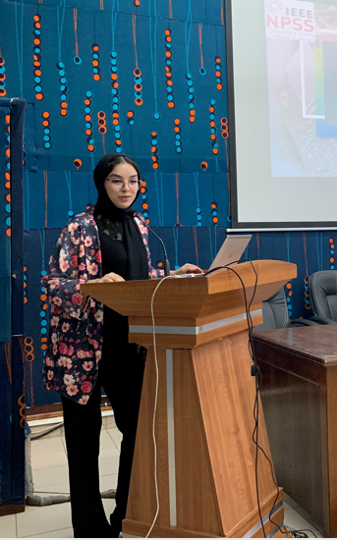
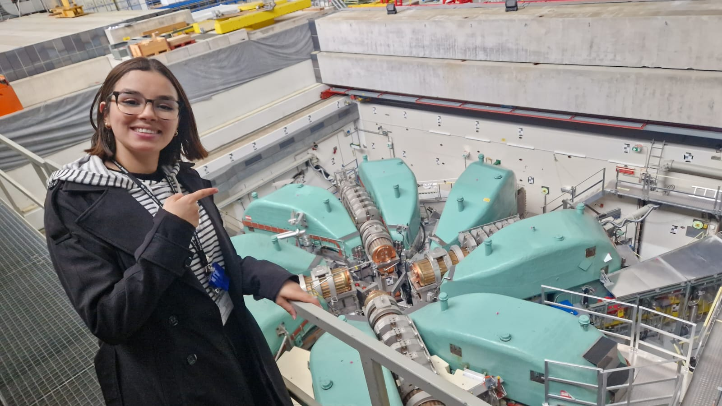
Next Generation
2022
2023
2024

Slide 22

Participants and Teachers from 4 NPSS schools
NSS-MIC-RTSD conference, Yokohama, November 2025

Slide 23


Lessons learned
Combination of lectures and exercises is great!
Schools have big impact for (some) participants!
  Systematic follow-up of participants needed – work in progress
Excellent publicity for NPSS and IEEE
  Students post on social media
Find new volunteers
  Both junior and senior
Need reliable local partner
  «pilot events»

