Slide 1
Patents: what they are, how to get them, and careers
Dr Ed Carter (they/them)
QTFP Winter School guest talk
11 Jan 2023
Trainee Patent Attorney, Marks & Clerk LLP

Slide 2
Who am I?
My name is Ed, and I joined Marks & Clerk LLP as a trainee patent attorney two years ago
Previously: PhD here in Cambridge in experimental atomic physics
Absolutely no law background before starting this job
General area of patent work includes electronics, software, computer networks, optics; but also others!

Slide 3
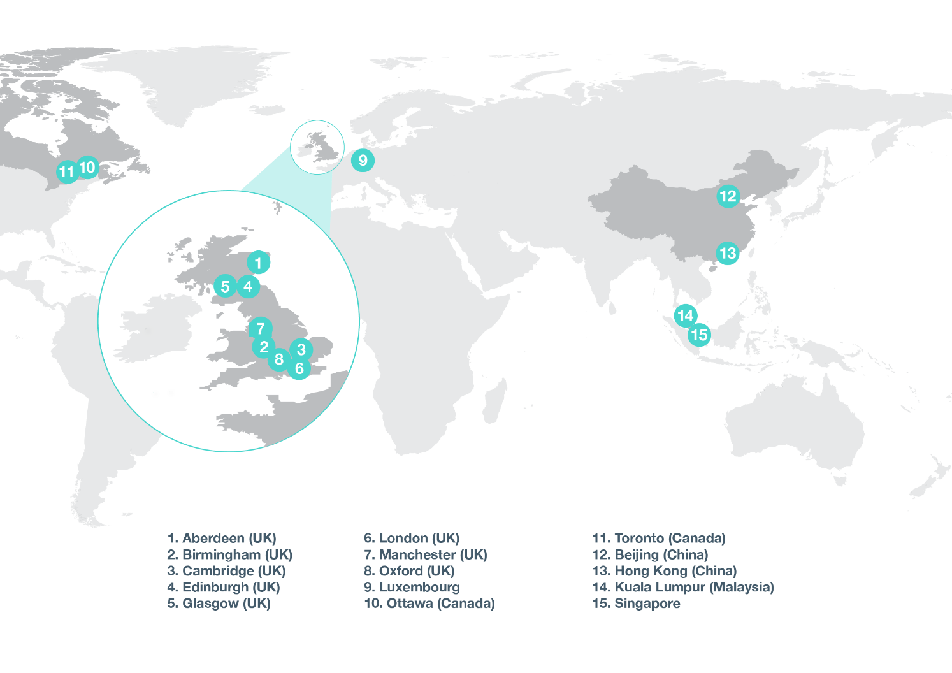
Who do I work for?
Marks & Clerk is the UK’s biggest PA firm (founded 1887), with over 800 people in 15 offices around the world
Cover all areas of technology
Unique relationship with M&C Law (intellectual property lawyers)

Slide 4
Why am I here?
It’s likely that some of you will invent things! In particular, some of you may join tech companies or be involved in Knowledge Transfer Programmes as academics.
It’s also likely that some of you will become patent attorneys.
Either way, hopefully this talk will come in helpful (and hopefully you’ll remember M&C).

Slide 5
What are patents, and what are their benefits?

Slide 6
What is a patent?
A patent is a form of intellectual property that protects an invention for 20 years
You publish an enabling disclosure of your invention, and in return you get the first go at benefiting from it
Supposed to incentivise people and businesses to invent things, and encourage public sharing of ideas (can’t keep things secret)
Also has value in itself – patents can be sold, licensed etc.
For tech start-ups, patents are usually a critical way of growing in value (since you might not have any physical assets yet)

Slide 7
What is an “invention”?
Product or process that’s new, inventive, and technical
New – so don’t tell anyone except in confidence
Inventive – the test for this is different everywhere in the world; most patents are for incremental advances that narrowly clear this bar
Technical – solves a practical problem; some things are considered intrinsically non-technical
Notably: software in itself generally isn’t patentable (but this is quite nuanced and lots of software-related things can still be patented)
Also: methods of treatment or diagnosis carried out on the body generally can’t be patented (but technology for them can)

Slide 8
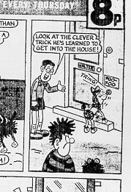
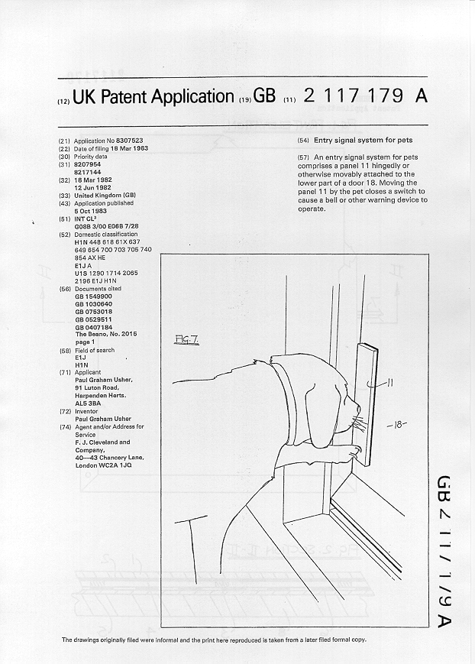
How clever does your idea need to be?
Novelty:
Priority Date
18th March 1982
The BEANO
No. 2015 page 1
28 February 1981
  Inventive step: non-obvious to a person skilled in the art.
  Inventive step is often arguable; the hurdle is different in different jurisdictions

Slide 9
The rights conveyed by a patent
Owning a patent gives you the right to stop someone else from using (or manufacturing etc.) your invention
Referred to as a “negative right” or “monopoly right”
Does not give you the right to use the invention – you might infringe someone else’s patent
But patents can be licensed – offering someone else the chance to use your invention in exchange for money (or access to their invention)
So if someone’s patent blocks your idea, might be able to seek a licence

Slide 10
Aside: other forms of IP
Designs: protect the appearance of products, not function
Trade marks: protect the terms, logos etc. used by businesses to identify themselves
Copyright: automatic right that protects creative works (including computer programs)
(M&C do designs and TMs as well as patents!)

Slide 11
How do you get a patent?

Slide 12
Making a patent application
Patents are awarded by patent offices, which are government bodies
Generally speaking, you write to the patent office with a complete description of your invention and ask for a patent
Each country has its own patent office. In the first instance you’ll generally write to the patent office of the country you live and work in
Don’t try to do this yourself! Applications made without a patent attorney’s help have a very low success rate
Note: this is an expensive process! Generally need to be sure that invention will have commercial benefit (e.g. lead to a product with a clear market).
Once the application has been filed, you’re free to publically disclose the invention (e.g. launch a product)

Slide 13
What goes into a patent application?
Similar to a scientific paper (e.g. includes an abstract)
Must also include a complete (“enabling”) description and figures
Most important part is the claims: this is where you describe, with legal precision, exactly what you’re claiming an exclusive right to
Can’t add anything later without losing filing date

Slide 14
Patent jurisdictions
Generally speaking, patents are handled separately by every country in the world
E.g. a UK patent from the UK patent office holds no weight at all in the US, China etc.
Rules are different in every jurisdiction (though similar in spirit)
We generally handle this by hiring local patent attorneys to correspond with their own patent office

Slide 15
Are there international patents?
Short answer: no
But, you can make an international application (called a PCT application) that can lead to patents in several different countries
Europe also has a single patent office (the EPO), and getting a patent there can cover all of Europe (including the UK)
There are exceptions, e.g. the PCT doesn’t cover Taiwan (but Taiwan has its own provisions)

Slide 16
How are patents examined?
The patent office will check that you fulfil all the formal requirements for an application
Then they’ll look for earlier documents (“prior art”) allegedly showing that your claims aren’t new or aren’t inventive – could be anything that’s public
Everything is deadline driven – missing a deadline often means losing your application
May need to amend your claims and/or argue to persuade the Examiner that your invention is new/inventive despite prior art
Don’t try to navigate this process yourself! This is what patent attorneys are for.

Slide 17
The role of patent attorneys
Patent attorneys talk to inventors to understand their invention and write the corresponding patent application
Once the application is filed, patent attorneys receive patent office correspondence, discuss with inventors, and prepare responses
Note: patent attorneys are not lawyers (in the UK), e.g. rarely appear in court

Slide 18
Should I become a patent attorney?
(Yes!)

Slide 19
What’s the job like?
Broadly: working 9-5, split between office work and going out to meet clients (inventors)
Large part of the job is writing letters, many of them to patent offices
Study on the job (at M&C at least) to pass legal exams and work towards becoming qualified
Work is quite individual, but have a small team to fall back on
As you advance, there’s more and more of a business aspect
Many larger tech firms also have in-house patent attorneys (though that naturally entails less support, and less variety of technology)

Slide 20
Typical daily tasks (as a trainee)
Could be any of:
Drafting a patent application – typically over at least a couple of weeks between other tasks
Drafting a response to an Examiner’s objections – might take a few hours to a day
Meeting with clients to discuss a new invention
Answering client queries and explaining aspects of patent practice
Studying and revising for professional exams
Attending networking events and conferences (like I’m doing right now)
Liaising with overseas patent attorneys to handle cases in other jurisdictions
To begin with, tasks will likely be assigned by a partner of the firm

Slide 21
Patent attorney backgrounds
Patent attorneys generally have technical, not legal, backgrounds
Usually a technical degree (physics, engineering, chemistry, biology, computer science), PhD not required
But postdocs and people with industry experience welcome too!
Legal training is carried out on the job (M&C has an in-house training academy) and you sit legal exams

Slide 22
Why become a patent attorney?
Learn about new technology every day, lots of it cutting edge
Intellectual engagement – always creatively solving problems
Balance between detail focus and long-term big-picture strategy
Work-life balance (9 to 5)
Lots of exposure to the world of business
Great if you like writing and arguing
Qualified patent attorneys are generally pretty desirable – can e.g. leave career and return, or switch firms
International travel

Slide 23
Reasons not to become a patent attorney
Deadlines – need to learn time management
Lots of exams over 4-5 years (but at least you’re being paid for it) – need to balance job and study
Don’t do it if you hate writing!

Slide 24
Questions?

Slide 25
Dr Ed Carter (they/them)
ecarter@marks-clerk.com
T +44 1223 345533
Marks & Clerk LLP
62 – 68 Hills Rd.
Cambridge
CB2 1LA
UK

