Slide 1

Theory motivation for Future Colliders:
Germany BND PhD school, 8th September 2026
Tevong You
tevong.you@kcl.ac.uk

Slide 2
Beyond the Standard Model
Germany BND PhD school, 8th September 2026
Tevong You
tevong.you@kcl.ac.uk

Slide 3
Lecture 1

Slide 4
My World Line
Industry: Merrill Lynch
Postdoc 1:
Cambridge
Postdoc 2:
CERN
Undergraduate: Imperial College London
PhD:
King’s College London
Advisor:
John Ellis
Masters:
ETH Zurich
Faculty:
King’s College London

Slide 5
Why BSM?
The ultimate goal of fundamental physics is to go Beyond the Standard Model (BSM).
Astro / Cosmo
BSM
Particle
Theory
BSM combines our experimental, observational, and theoretical knowledge of the Universe.
We are getting closer to the ultimate truth, empirically, though many unanswered problems remain.

Slide 6
Why BSM?
Astrophysics and Cosmology probe indirectly some of the highest energies or weakest interactions.
Astro / Cosmo
BSM
Particle
Theory

Slide 7
Why BSM?
Theoretical consistency can be a fruitful guide for making progress.
Astro / Cosmo
BSM
Particle
Theory

Slide 8
Why BSM?
Colliders play a unique role in enabling experimental access to small scales.
Astro / Cosmo
BSM
Particle
Theory

Slide 9
Outline
Part I
Lessons in how we got here
Naturalness — what’s the big deal?
Problems of the SM: arbitrary / unnatural / incomplete / inconsistent
Part 2
The SM EFT gateway to BSM (and the “totalitarian principle”)
Supersymmetry, WIMPs, GUTs
BSM at FCC-ee

Slide 10
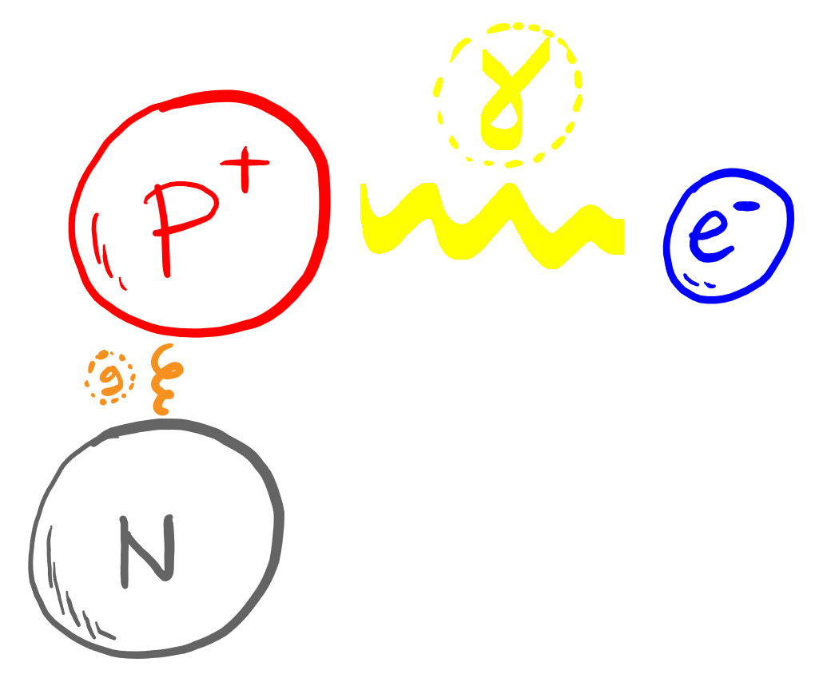
How we got here
1930s: everything is made of protons, neutrons, and electrons
Held together by electromagnetism and the strong force
Minimal, economical theory?

Slide 11
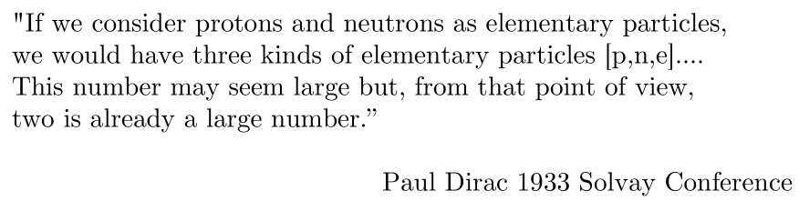
How we got here
1930s: everything is made of protons, neutrons, and electrons
Held together by electromagnetism and the strong force
(From D. Tong slide)
Lesson 1: Beauty in fundamental physics is not an economy of particle multiplicities, it’s an economy of theoretical principles

Slide 12
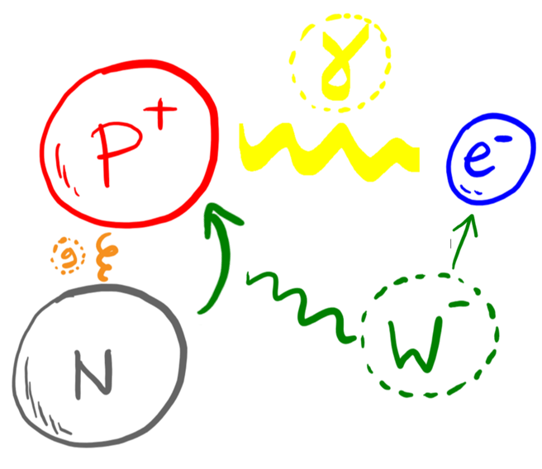
How we got here
Weak force explains radioactivity
Neutron can change into proton, emitting electron

Slide 13
How we got here
Weak force explains radioactivity
Neutron can change into proton, emitting electron
Missing energy? Pauli postulates “a desperate remedy”

Slide 14
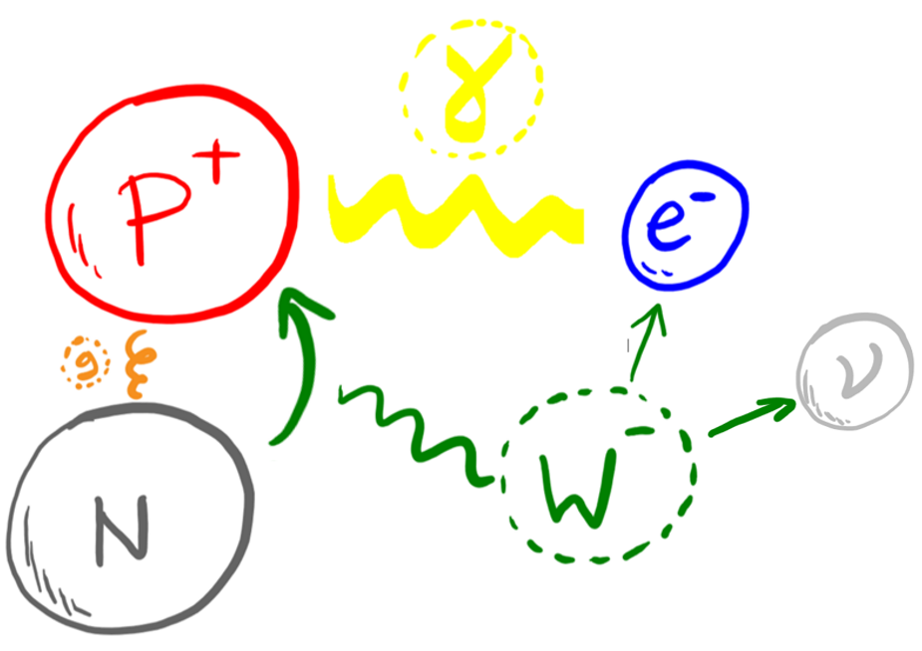
How we got here
Weak force explains radioactivity
Neutron can change into proton, emitting electron and elusive neutrino
Missing energy? Pauli postulates “a desperate remedy”

Slide 15
How we got here
Weak force explains radioactivity
Neutron can change into proton, emitting electron and elusive neutrino
Missing energy? Pauli postulates “a desperate remedy”
Lesson 2: perceived prospect of experimental confirmation is not a useful scientific criteria for establishing what nature actually does

Slide 16
How we got here
Weak force explains radioactivity
Neutron can change into proton, emitting electron and elusive neutrino
Missing energy? Pauli postulates “a desperate remedy”
(Bohr postulates fundamental violation of energy conservation)
Lesson 2.5: Sometimes nature chooses the least radical option

Slide 17
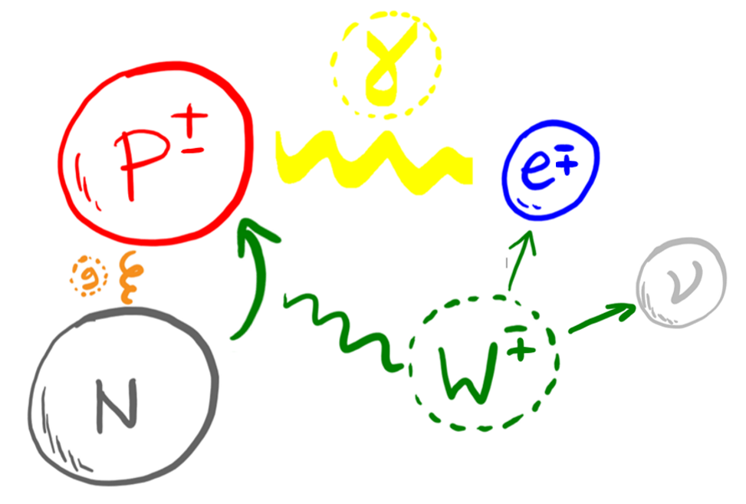
How we got here
Dirac: relativity + quantum mechanics = antiparticles
Every particle has an oppositely charged antiparticle partner

Slide 18
How we got here
Dirac: relativity + quantum mechanics = antiparticles
Every particle has an oppositely charged antiparticle partner
c.f. Lesson 1: antiparticles double the particle spectrum. Nevertheless, the theory is much tighter, less arbitrary, and more elegant

Slide 19
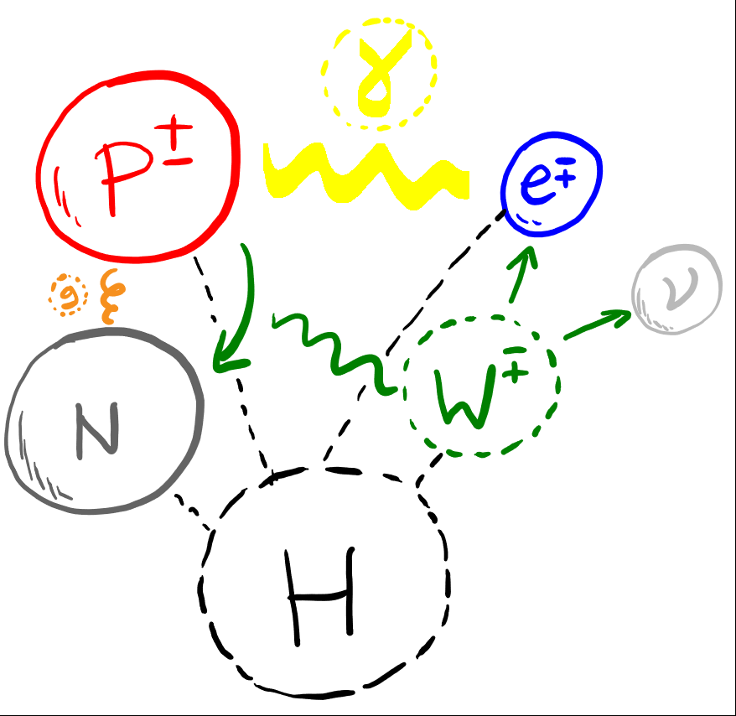
How we got here
Higgs(+Brout+Englert): particle masses require a new scalar boson H

Slide 20
How we got here
Higgs(+Brout+Englert): particle masses require a new scalar boson H
Lesson 3: Keep an open mind.
Ideas initially dismissed as unrealistic (e.g. non-abelian gauge theories that predicted unobserved massless bosons) can turn out to be correct eventually

Slide 21
How we got here
1940
1960
1970
1980
1930-40s:
Success of QED. QFT emerges as the new fundamental description of Nature.
1960s:
QFT is unfashionable, non-Abelian theory dismissed as an unrealistic generalisation of local symmetry-based forces. Widely believed a radically new framework will be required e.g. to understand the strong force.

Slide 22
How we got here
1940
1960
1970
1980
1930-40s:
Success of QED. QFT emerges as the new fundamental description of Nature.
1960s:
QFT is unfashionable, non-Abelian theory dismissed as an unrealistic generalisation of local symmetry-based forces. Widely believed a radically new framework will be required e.g. to understand the strong force.

Slide 23
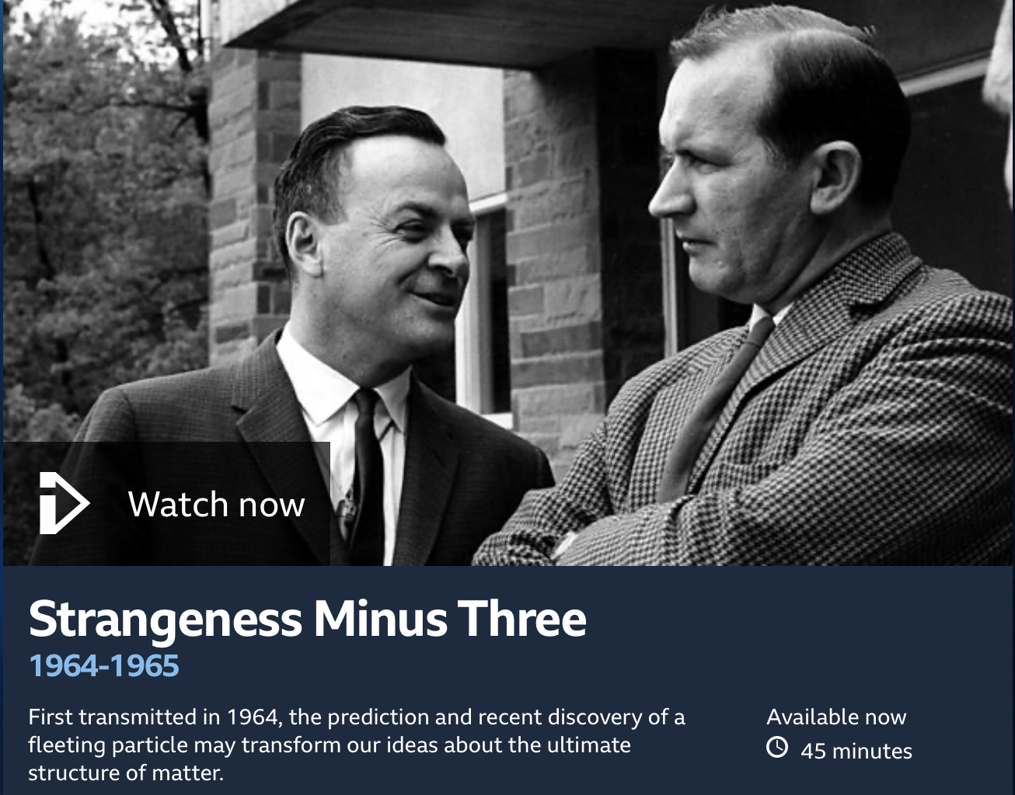
How we got here
1940
1960
1970
1980
1930-40s:
Success of QED. QFT emerges as the new fundamental description of Nature.
1960s:
QFT is unfashionable, non-Abelian theory dismissed as an unrealistic generalisation of local symmetry-based forces. Widely believed a radically new framework will be required e.g. to understand the strong force.
See BBC Horizon 1964 documentary “Strangeness minus three”: https://www.bbc.co.uk/programmes/p01z4p1j

Slide 24
How we got here
1940
1960
1970
1980
1970s:
QFT triumphs following Yang-Mills+Higgs+asymptotic freedom+renormalisation. Nature is radically conservative, but more unified than ever.
1980s:
Success of SM. QFT understood as most general Effective Field Theory (EFT) consistent with symmetry. Higgs and cosmological constant violates symmetry expectation.
Tremendous progress since, despite lack of BSM.

Slide 25
How we got here
1940
1960
1970
1980
1970s:
QFT triumphs following Yang-Mills+Higgs+asymptotic freedom+renormalisation. Nature is radically conservative, but more unified than ever.
1980s:
Success of SM. QFT understood as most general Effective Field Theory (EFT) consistent with symmetry. Higgs and cosmological constant violates symmetry expectation.
Tremendous progress since, despite lack of BSM.

Slide 26
How we got here
1940
1960
1970
1980
2012
2012:
Higgs boson discovery completes SM particle content.

Slide 27
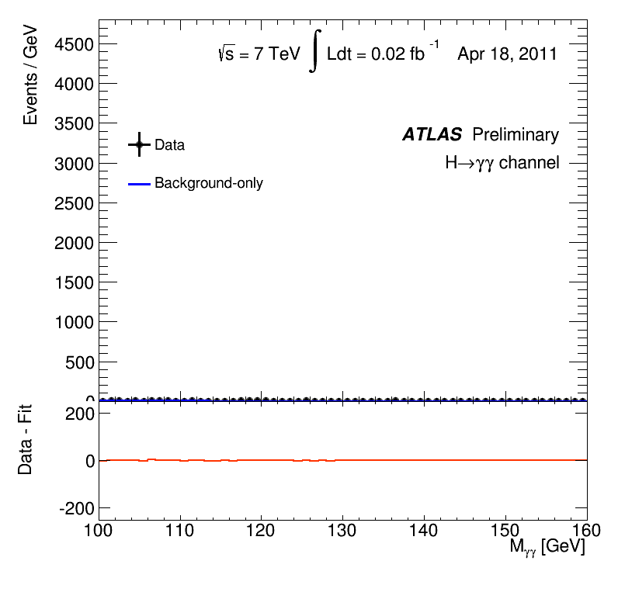
How we got here
1940
1960
1970
1980
2012
2012:
Higgs boson discovery completes SM particle content.

Slide 28
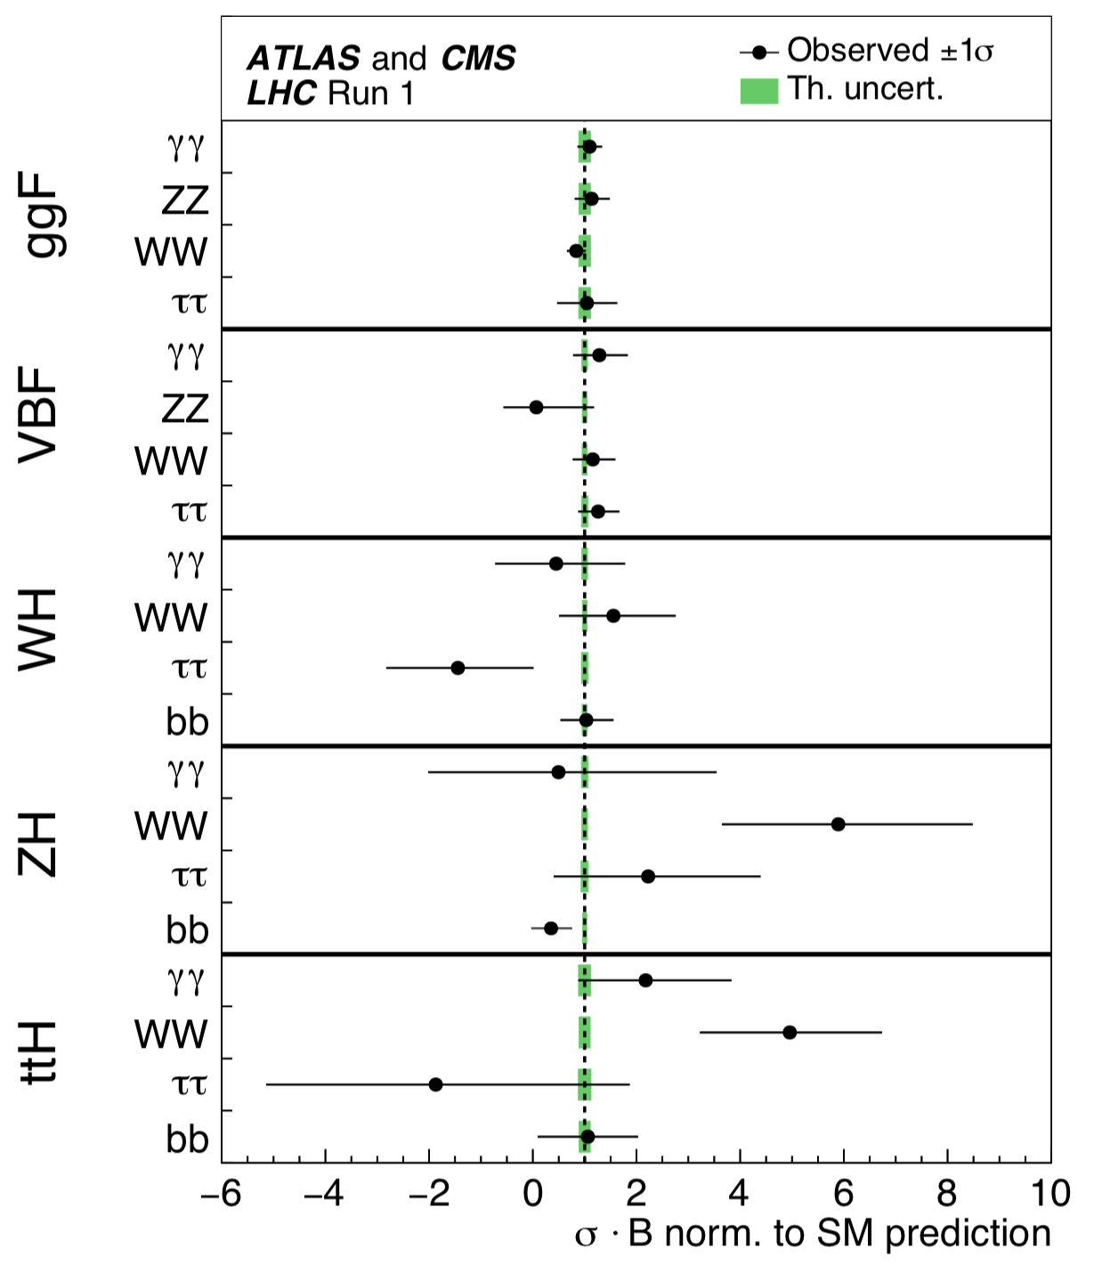
How we got here
1940
1960
1970
1980
2012
2012:
Higgs boson discovery completes SM particle content.

Slide 29
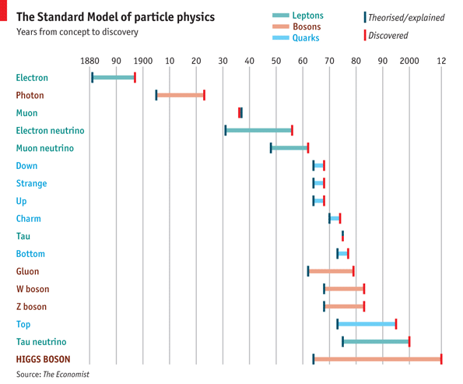
How we got here
1940
1960
1970
1980
2012
2012:
Higgs boson discovery completes SM particle content.

Slide 30
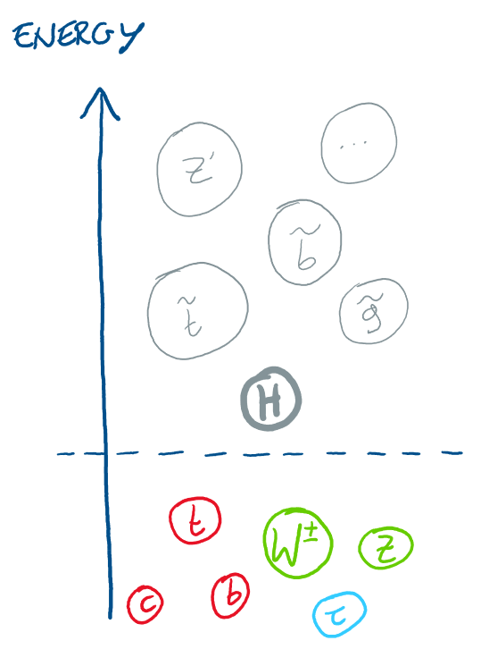
A crisis in particle physics?
Until now, there had been a clear roadmap
Lack of discovery at the LHC: rethink our approach
No-lose theorem: Higgs (or something) guaranteed to appear.
High anticipation of accompanying BSM particles expected to appear.

Slide 31
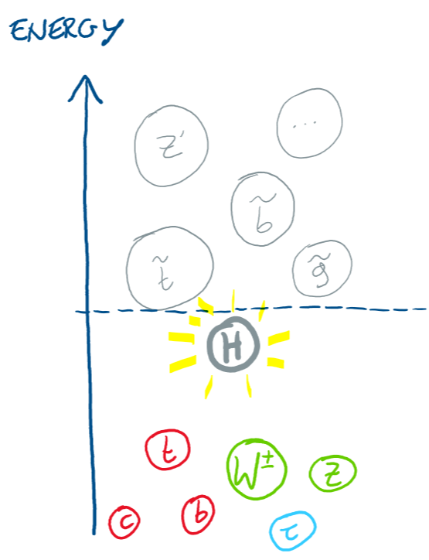
A crisis in particle physics?
Until now, there had been a clear roadmap
Lack of discovery at the LHC: rethink our approach

Slide 32
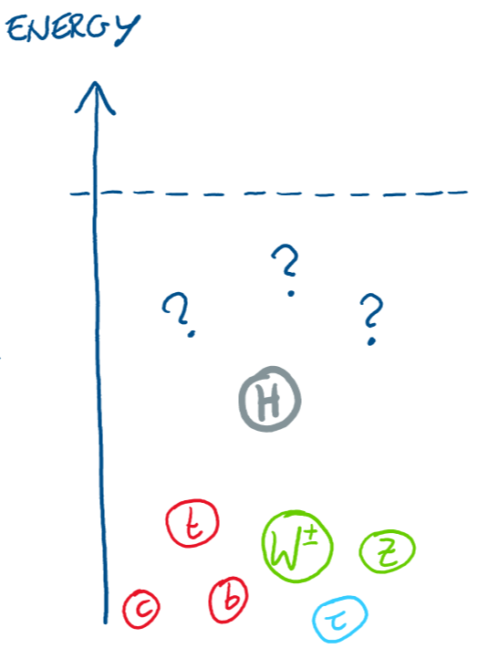
A crisis in particle physics?
Until now, there had been a clear roadmap
Lack of discovery at the LHC: rethink our approach

Slide 33
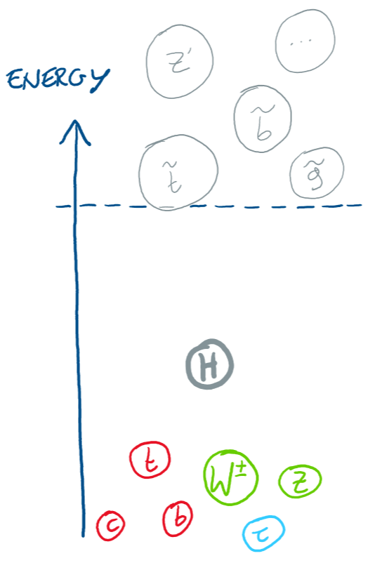
A crisis in particle physics?
Until now, there had been a clear roadmap
Lack of discovery at the LHC: rethink our approach

Slide 34
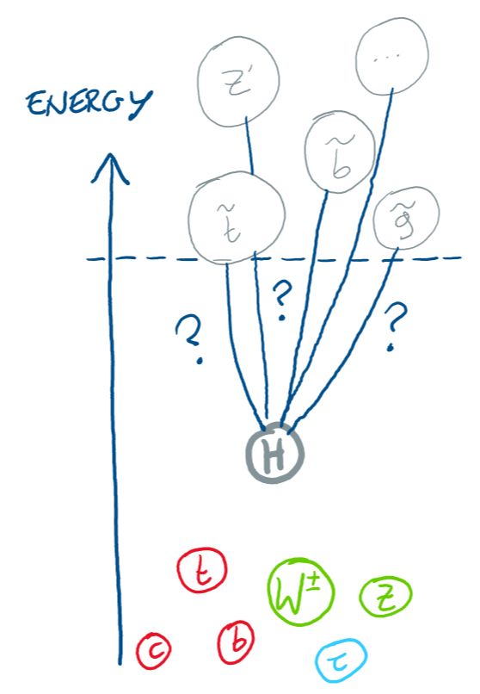
A crisis in particle physics?
Until now, there had been a clear roadmap
Lack of discovery at the LHC: rethink our approach
The hierarchy / naturalness problem of the Higgs is more puzzling than ever

Slide 35
A crisis in particle physics?
Until now, there had been a clear roadmap
Lack of discovery at the LHC: rethink our approach
The cosmological constant problem of a tiny vacuum energy is far worse!

Slide 36


A crisis in particle physics?
Until now, there had been a clear roadmap
Lack of discovery at the LHC: rethink our approach
The cosmological constant problem of a tiny vacuum energy is far worse!

Slide 37
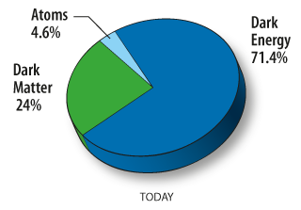
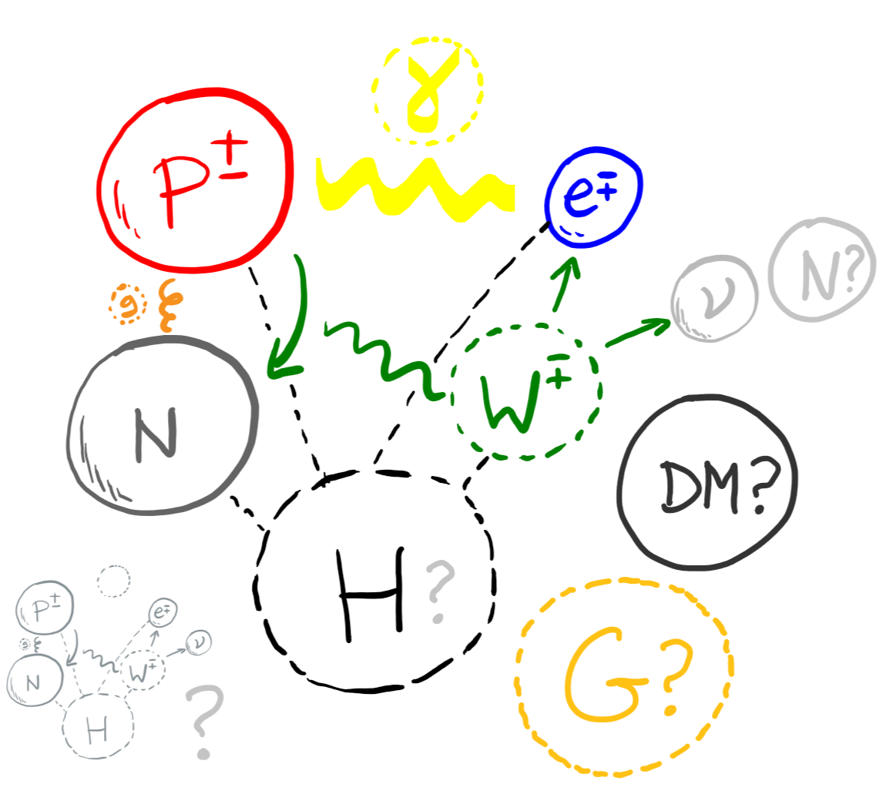
Many more open questions
What is the origin of the Higgs?
What is the origin of matter?
What is the origin of flavour?
What is the origin of dark matter and dark energy?
What is the origin of neutrino mass?
What is the origin of the Standard Model?
…

Slide 38
Problems of the SM
Arbitrary:
  Higgs potential, yukawa couplings, flavour structure, quantized hypercharges – arbitrary parameters put in by hand.
Unnatural:
  Higgs mass, cosmological constant, strong-CP problem – fine-tuned cancellations between independent contributions.

Slide 39
Problems of the SM
Incomplete:
  Experimental & observational evidence: dark matter, neutrino mass, matter-antimatter asymmetry .
Inconsistent:
  Theoretical evidence: quantum gravity, black hole information paradox.

Slide 40



Problems of the SM
Take problems of arbitrariness seriously.
Example 0
$$F=m_{inertia}a$$
$$F∝ \frac{q_{1}q_{2}}{r^{2}}$$
Inertial mass and charge have nothing to do with each other, and yet for gravity we arbitrarily set by hand
q $=m_{inertia}$
Solution to this equivalence problem took centuries: Newtonian gravity $→$ GR

Slide 41
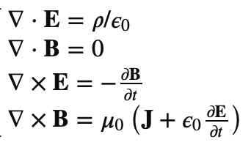
Problems of the SM
Take structural theoretical problems seriously.
Example 1
Maxwell’s equations of electromagnetism did not satisfy the principle of Galilean relativity.
No inconsistencies – one could calculate perfectly well EM phenomena.
Aether medium expected to reconcile Maxwell with Galileo.
Resolution to this structural problem: Galilean relativity $→$ Special relativity

Slide 42

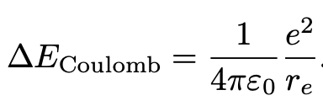
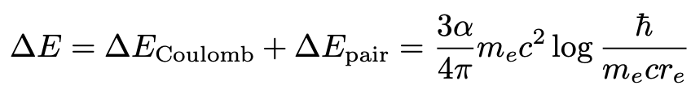
Problems of the SM
Take fine-tuning problems seriously.
e.g. 2205.05708 N. Craig - Snowmass review,
1307.7879 G. Giudice - Naturalness after LHC
Example 2
Avoiding cancellation between “bare” mass and divergent self-energy in classical electrodynamics requires new physics around
Indeed, the positron and quantum-mechanics appears just before!

Slide 43
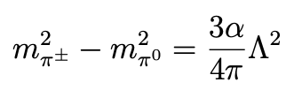

Problems of the SM
Take fine-tuning problems seriously.
e.g. 2205.05708 N. Craig - Snowmass review,
1307.7879 G. Giudice - Naturalness after LHC
Example 3
Divergence in pion mass:
Experimental value is
Expect new physics at $Λ\sim 850$ MeV to avoid fine-tuned cancellation.
$ρ$ meson appears at 775 MeV!

Slide 44
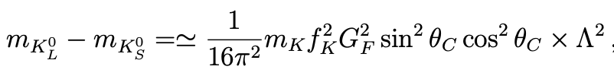
Problems of the SM
Take fine-tuning problems seriously.
e.g. 2205.05708 N. Craig - Snowmass review,
1307.7879 G. Giudice - Naturalness after LHC
Example 4
Divergence in Kaons mass difference in a theory with only up, down, strange:
Avoiding fine-tuned cancellation requires $Λ<3$ GeV.
Gaillard & Lee in 1974 predicted the charm quark mass!

Slide 45
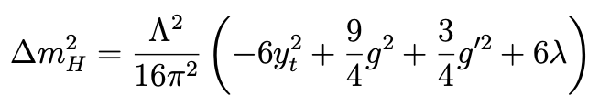
Problems of the SM
Take fine-tuning problems seriously.
e.g. 2205.05708 N. Craig - Snowmass review,
1307.7879 G. Giudice - Naturalness after LHC
Higgs?
Higgs also has a quadratically divergent contribution to its mass
Avoiding fine-tuned cancellation requires $Λ<O(100)$ GeV??
As $Λ$ is pushed to the TeV scale by null results, tuning is around 10% - 1%.
Note for the experts: in the SM the Higgs mass is a parameter to be measured, not calculated. What the quadratic divergence represents (independently of the choice of renormalisation scheme) is the fine-tuning in an underlying theory in which we expect the Higgs mass to be calculable.

Slide 46

Naturalness is still a fundamental problem
Tevong You
Why is unnatural fine-tuning such a big deal? An intuitive picture:
Larger distances
Physical theories govern a huge range of phenomena across vast scales
Smaller distances

Slide 47
Naturalness is still a fundamental problem
Tevong You
Why is unnatural fine-tuning such a big deal? An intuitive picture:
Everything does not depend on everything else equally.
(Otherwise, we would need a Theory of Everything to calculate anything)
Larger distances
Smaller distances

Slide 48
Naturalness is still a fundamental problem
Tevong You
Why is unnatural fine-tuning such a big deal? An intuitive picture:
Effective theory at each energy scale E is predictive as a self-contained theory at that scale

Slide 49
Naturalness is still a fundamental problem
Tevong You
Why is unnatural fine-tuning such a big deal? An intuitive picture:
Effective theory at each energy scale E is predictive as a self-contained theory at that scale
Planetary dynamics, thermodynamics, fluid dynamics, …
In all theories so far, no contributions from smaller scales compete with similar magnitude to effects on larger scales
Strong / weak interactions, …
Chemistry, atomic physics, nuclear physics, …

Slide 50
Naturalness is still a fundamental problem
Tevong You
Why is unnatural fine-tuning such a big deal? An intuitive picture:
Are we missing a fundamentally new “post-naturalness” principle?
Effective theory at each energy scale E is predictive as a self-contained theory at that scale
Unnatural Higgs means the next layer is no longer predictive without including contributions from much smaller scales

Slide 51
Naturalness is still a fundamental problem
Tevong You
Why is unnatural fine-tuning such a big deal? An intuitive picture:
Indicates an unprecedented breakdown of the effective theory structure of nature
Are we missing a fundamentally new “post-naturalness” principle?
Effective theory at each energy scale E is predictive as a self-contained theory at that scale
Unnatural Higgs means the next layer is no longer predictive without including contributions from much smaller scales

Slide 52
Naturalness is still a fundamental problem
Why is unnatural fine-tuning such a big deal? An intuitive picture:
Indicates an unprecedented breakdown of the effective theory structure of nature
Are we missing a fundamentally new “post-naturalness” principle? (c.f. null results in search for aether)
Effective theory at each energy scale E is predictive as a self-contained theory at that scale
Unnatural Higgs means the next layer is no longer predictive without including contributions from much smaller scales

Slide 53
Naturalness is still a fundamental problem
Tevong You
Why is unnatural fine-tuning such a big deal? An intuitive picture:
Indicates an unprecedented breakdown of the effective theory structure of nature
Future colliders are essential for finding out experimentally what nature actually does at higher energies
Effective theory at each energy scale E is predictive as a self-contained theory at that scale
Unnatural Higgs means the next layer is no longer predictive without including contributions from much smaller scales

Slide 54
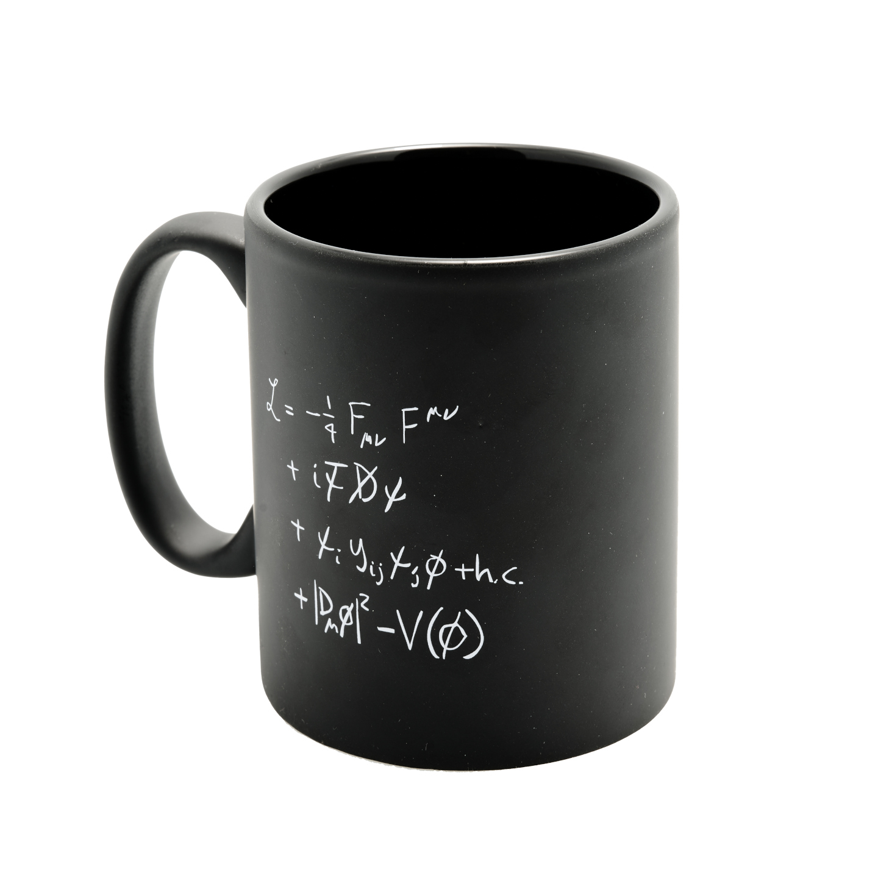
Conclusion
What are we looking for in a satisfying explanation?
Gauge theory of spin-1 vector bosons have the quality we seek in a satisfying theory.
Not just a phenomenological parametrization of independent vector boson interactions a la Fermi.

Slide 55
Conclusion
In contrast, everything to do with the Higgs in the SM is arbitrary; more like a parametrisation than an explanation of electroweak symmetry breaking.
We seek to better understand the origin of the Higgs in an underlying theory from which it emerges, where we can calculate its potential in terms of more fundamental principles.
(c.f. condensed matter Higgs)
Avoiding fine-tuning in underlying theory = expect new physics around weak scale!

Slide 56
Conclusion
The SM still has many arbitrary features put in by hand which hint at underlying structure.
Maybe it just is what it is ¯\_(ツ)_/¯
But we would like a deeper understanding, an explanation for why things are the way they are.
Science is about removing arbitrariness from explanations.

Slide 57
Lecture 2

Slide 58
Outline
Previously
The Standard Model is beautiful
The Standard Model is ugly: arbitrary, unnatural, incomplete, inconsistent
Naturalness of the Higgs is a fundamental problem

Slide 59
Outline
Next
The Totalitarian Principle
The Standard Model as an Effective Field Theory
The Higgs no-lose theorem

Slide 60
The Totalitarian Principle
“Everything not forbidden is compulsory”
Gell-Mann stated this maxim in relation to quantum mechanics summing over all allowed possibilities.
I will use this principle more generally as a theoretical rule of thumb.
When there is a finite set of possibilities, this can be a compelling argument for motivating BSM.

Slide 61
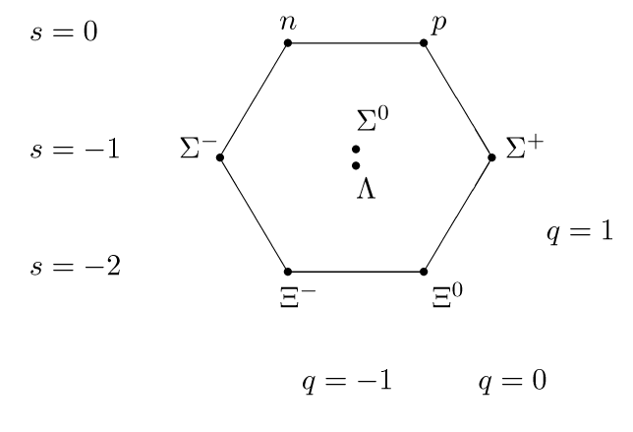
Example: the Eightfold way
In 1961, Gell-Mann and Ne’eman noticed that hadrons could be organized in a pattern according to their “strangeness” number, s, and electromagnetic charge, q.
Spin ½ baryon octet

Slide 62
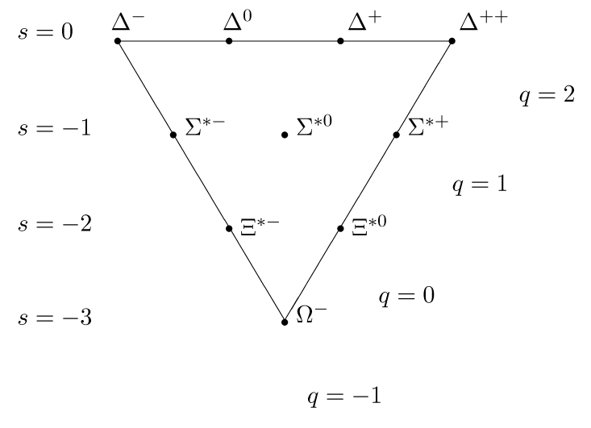
Example: the Eightfold way
Only one baryon was missing. It would be extremely strange (pun not intended) if it weren’t there.
Spin 3/2 baryon decuplet

Slide 63
Example: the Eightfold way
Only one baryon was missing. It would be extremely strange (pun not intended) if it weren’t there.
“Everything not forbidden is compulsory”
Spin 3/2 baryon decuplet

Slide 64
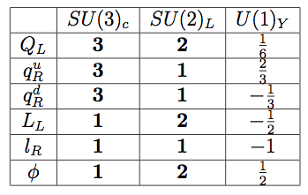
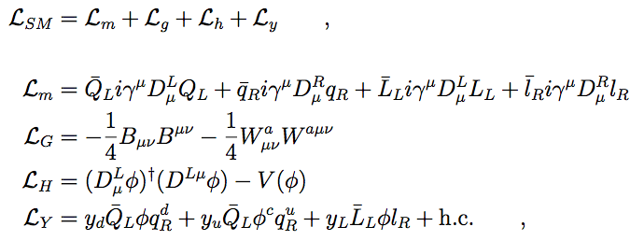
The Standard Model as an Effective Field Theory
Tevong You
Given particle content, write down all terms allowed by symmetries.
Up to mass dimension 4, this is what we typically call “The Standard Model”.

Slide 65
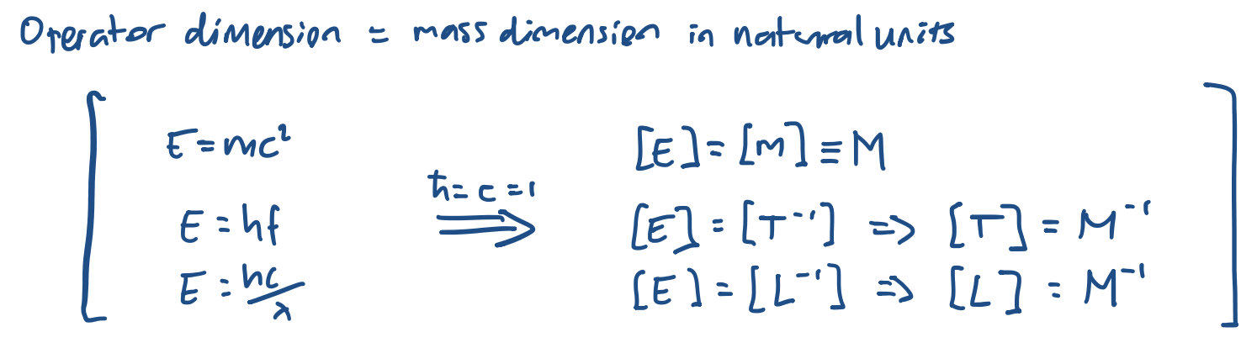
The Standard Model as an Effective Field Theory
Tevong You
Given particle content, write down all terms allowed by symmetries.
Up to mass dimension 4, this is what we typically call “The Standard Model”.

Slide 66
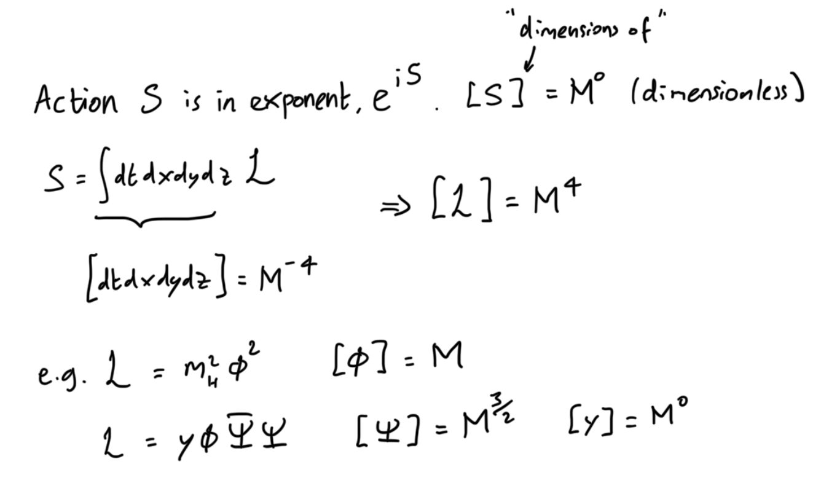
The Standard Model as an Effective Field Theory
Tevong You
Given particle content, write down all terms allowed by symmetries.
Up to mass dimension 4, this is what we typically call “The Standard Model”.

Slide 67
The Standard Model as an Effective Field Theory
Tevong You
Given particle content, write down all terms allowed by symmetries.
Up to mass dimension 4, this is what we typically call “The Standard Model”.

Slide 68

The Standard Model as an Effective Field Theory
Tevong You
Given particle content, write down all terms allowed by symmetries.
“Everything not forbidden is compulsory”
Up to mass dimension 4, this is what we typically call “The Standard Model”.

Slide 69
The Standard Model as an Effective Field Theory
Tevong You
Given particle content, write down all terms allowed by symmetries.
?
Strong-CP problem
“Everything not forbidden is compulsory”
Up to mass dimension 4, this is what we typically call “The Standard Model”.

Slide 70

The Standard Model as an Effective Field Theory
Tevong You
Given particle content, write down all terms allowed by symmetries.
EFT
Including operators of mass dimension $>$ 4! This is the “Standard Model Effective Field Theory”.

Slide 71
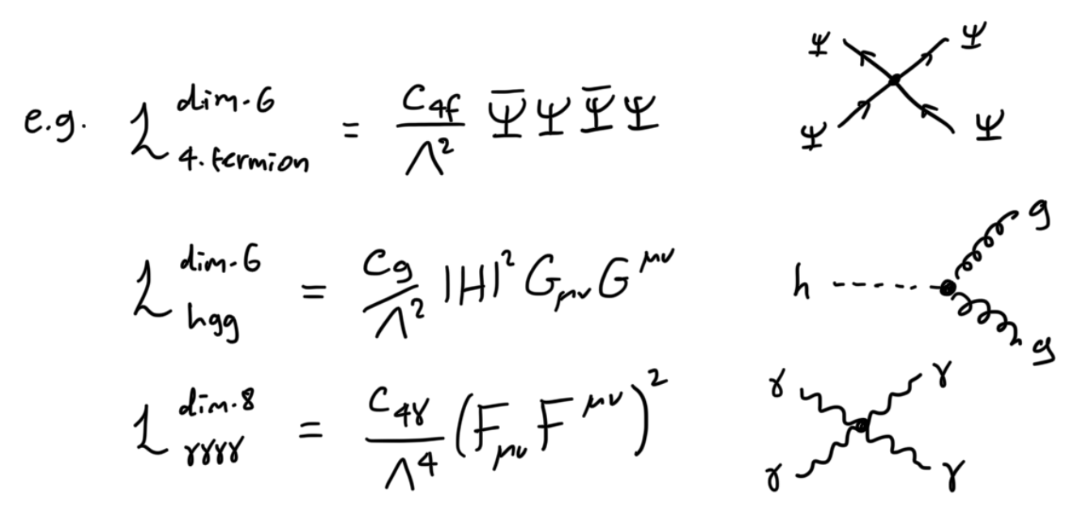
The Standard Model as an Effective Field Theory
Tevong You
Given particle content, write down all terms allowed by symmetries.
EFT
Including operators of mass dimension $>$ 4! This is the “Standard Model Effective Field Theory”.

Slide 72
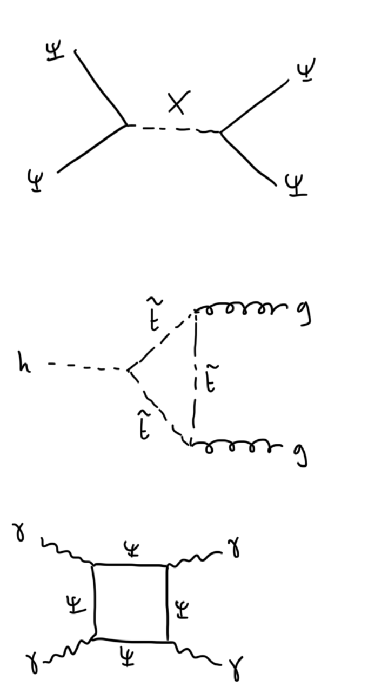
The Standard Model as an Effective Field Theory
Tevong You
Given particle content, write down all terms allowed by symmetries.
EFT
Including operators of mass dimension $>$ 4! This is the “Standard Model Effective Field Theory”.

Slide 73
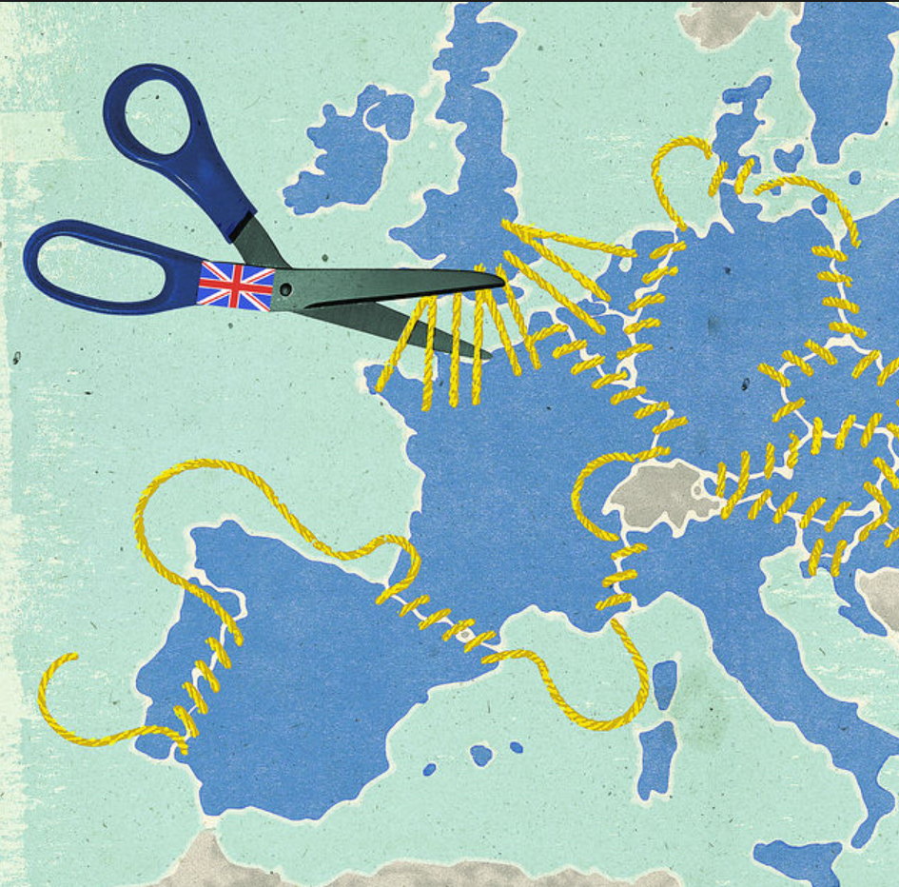
The Standard Model as an Effective Field Theory
Tevong You
SM EFT is the framework for a separation of scales decoupling heavy new physics and the SM:
SMEXIT
SM
NEW PHYSICS

Slide 74

The Standard Model as an Effective Field Theory
Tevong You
SM EFT is the framework for a separation of scales between heavy new physics and the SM.
Symmetries control sizes of parameters – naturalness expectations.

Slide 75
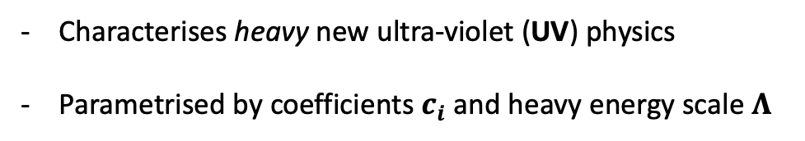
The Standard Model as an Effective Field Theory
Tevong You
SM EFT is the framework for a separation of scales between heavy new physics and the SM.
Symmetries control sizes of parameters – naturalness expectations.
Characterises heavy new ultra-violet (UV) physics
Parametrised by coefficients $c_{i}$ and heavy energy scale $Λ$

Slide 76
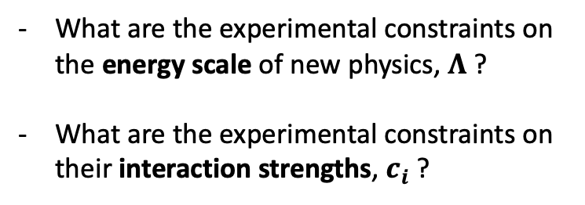
The Standard Model as an Effective Field Theory
Tevong You
SM EFT is the framework for a separation of scales between heavy new physics and the SM.
Symmetries control sizes of parameters – naturalness expectations.
What are the experimental constraints on the energy scale of new physics, $Λ$ ?
What are the experimental constraints on their interaction strengths, $c_{i}$ ?

Slide 77
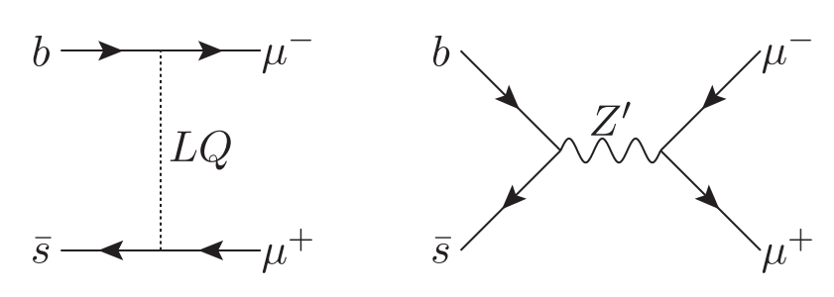

The Standard Model as an Effective Field Theory
Tevong You
SM EFT is the framework for a separation of scales between heavy new physics and the SM.
Symmetries control sizes of parameters – naturalness expectations.
What are the experimental constraints on the energy scale of new physics, $Λ$ ?
What are the experimental constraints on their interaction strengths, $c_{i}$ ?
e.g. leptoquarks or Z’

Slide 78
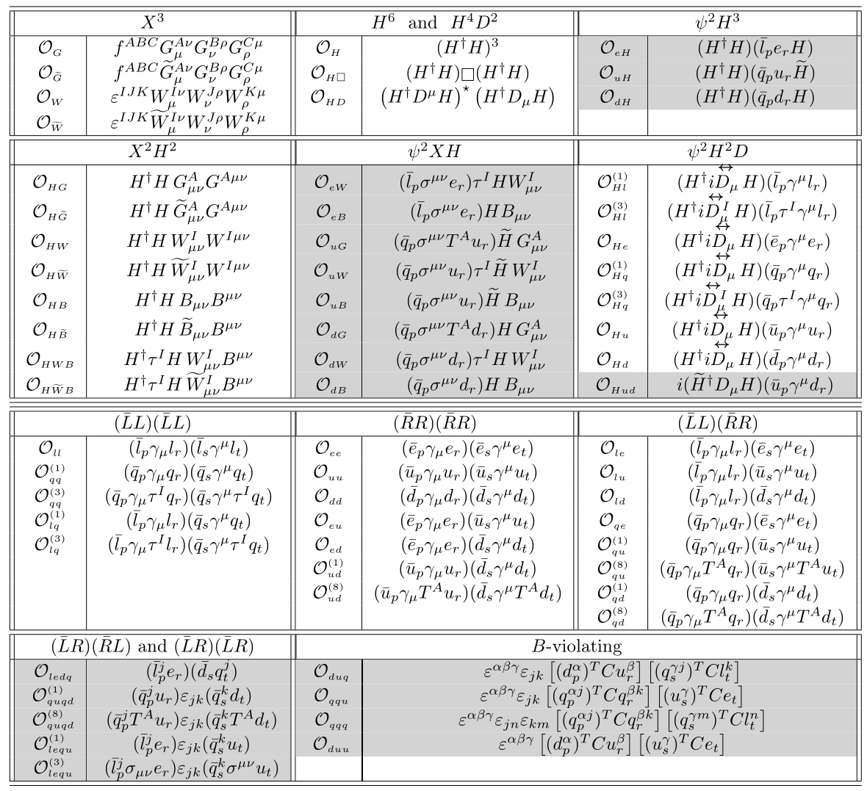
The Standard Model as an Effective Field Theory
Tevong You
Operators of mass dimension 6:
SM EFT coefficients are a map of the uncharted BSM territory to explore!

Slide 79
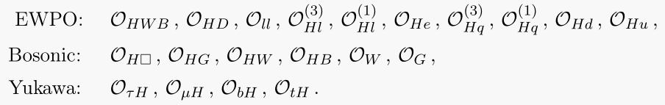
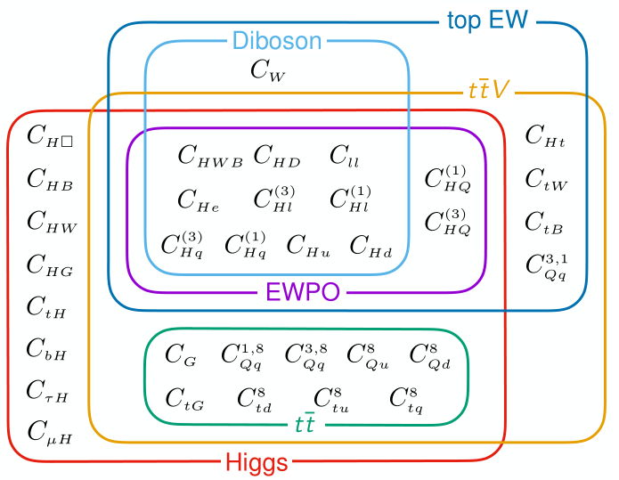
The Standard Model as an Effective Field Theory
Tevong You
Constrained by global fit to experimental data.

Slide 80
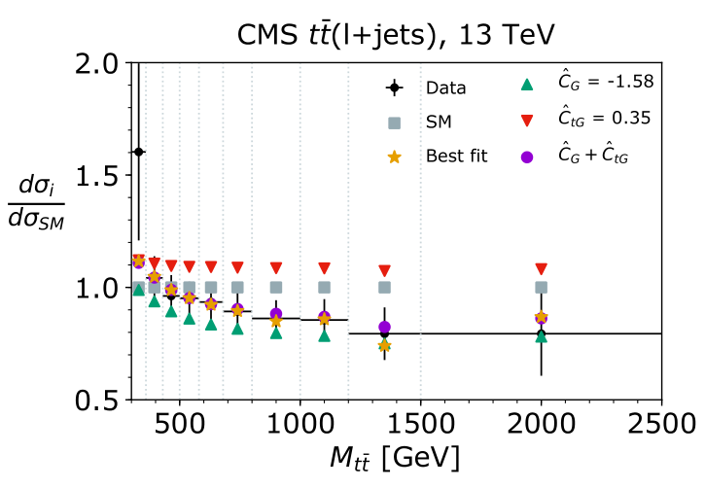
The Standard Model as an Effective Field Theory
Tevong You
Constrained by global fit to experimental data. e.g. top data

Slide 81
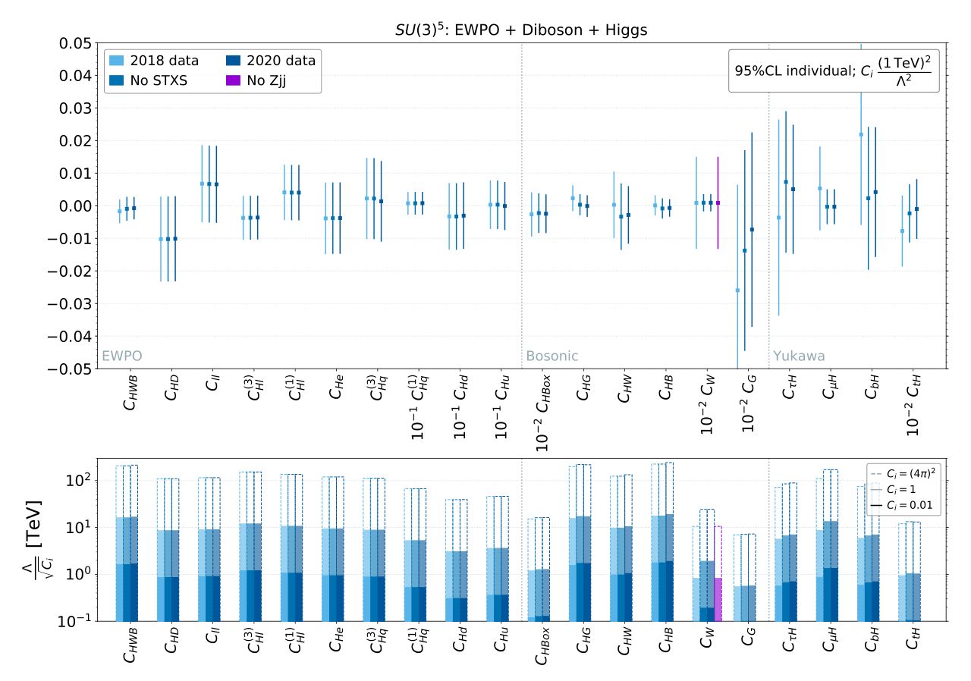
The Standard Model as an Effective Field Theory
Tevong You
Experimental constraints on SMEFT from LEP electroweak observables and LHC measurements:
2012.02779 Ellis, Madigan, Mimasu, Sanz, TY
See also other recent global fits, e.g.
2311.00020 Allwicher, Cornella, Isidori, Stefanek
2311.04963 Bartocci, Biekotter, Hurth
2404.12809 SMEFiT collaboration
Indirect evidence preceded direct discovery for nearly all SM particles. May be true of BSM!

Slide 82
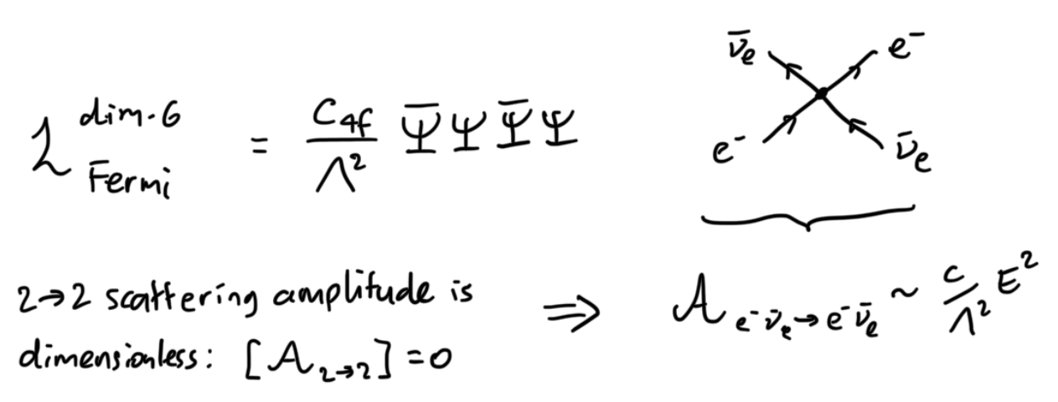
The Higgs no-lose theorem
In the 1940s, Fermi theory was the Effective Field Theory (EFT) of the weak interactions at ~10 GeV.
EFT breaks down at higher energies by predicting nonsense when calculating scattering processes.

Slide 83
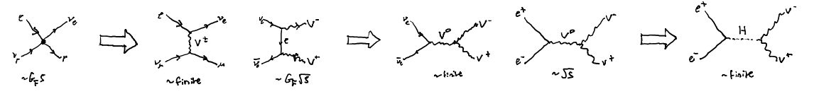
The Higgs no-lose theorem
In the 1940s, Fermi theory was the Effective Field Theory (EFT) of the weak interactions at ~10 GeV.
EFT breaks down at higher energies by predicting nonsense when calculating scattering processes.
By analogy with photon of QED, add spin 1 intermediate vector boson (with mass and charge).

Slide 84
The Higgs no-lose theorem
In the 1940s, Fermi theory was the Effective Field Theory (EFT) of the weak interactions at ~10 GeV.
EFT breaks down at higher energies by predicting nonsense when calculating scattering processes.
Makes scattering process finite, but introduces another process with divergent energy growth.

Slide 85
The Higgs no-lose theorem
In the 1940s, Fermi theory was the Effective Field Theory (EFT) of the weak interactions at ~10 GeV.
EFT breaks down at higher energies by predicting nonsense when calculating scattering processes.
Add neutral spin 1 vector boson with appropriate couplings to make this scattering process finite.

Slide 86
The Higgs no-lose theorem
In the 1940s, Fermi theory was the Effective Field Theory (EFT) of the weak interactions at ~10 GeV.
EFT breaks down at higher energies by predicting nonsense when calculating scattering processes.
But another amplitude now grows unbounded with energy.

Slide 87
The Higgs no-lose theorem
In the 1940s, Fermi theory was the Effective Field Theory (EFT) of the weak interactions at ~10 GeV.
EFT breaks down at higher energies by predicting nonsense when calculating scattering processes.
Add a scalar spin 0 boson.

Slide 88
The Higgs no-lose theorem
In the 1940s, Fermi theory was the Effective Field Theory (EFT) of the weak interactions at ~10 GeV.
EFT breaks down at higher energies by predicting nonsense when calculating scattering processes.
Adding spin 1 and spin 0 particles with couplings fixed to cancel divergent energy contributions recovers the Standard Model theory of non-Abelian gauge bosons and Higgs mechanism!
See e.g. Chris Quigg gauge theories textbook
Without the Higgs, the theory breaks down around 1 TeV: LHC guaranteed to discover something new.

Slide 89
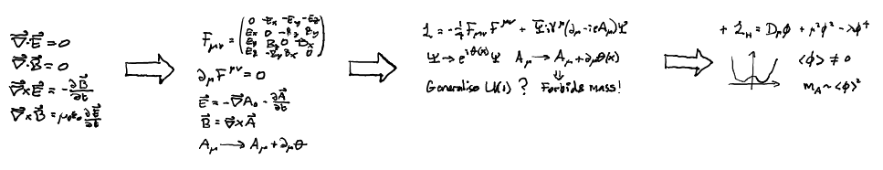
The Higgs no-lose theorem
Historically:
Inevitably:
Theoretical self-consistency can be a powerful guide to extending our fundamental frameworks.

Slide 90
Conclusion
The totalitarian principle is not to be taken too seriously, but gives a sense of pleasing theoretical reasoning.
The Standard Model, like Fermi theory before it, is an Effective Field Theory.
Theoretical reasoning is powerful, but only experiment can tell us what the underlying theory will be.

Slide 91
Lecture 3

Slide 92
Outline
Previously
The Totalitarian Principle
The Standard Model as an Effective Field Theory
The Higgs no-lose theorem

Slide 93
Outline
Next
Grand Unified Theories, WIMP dark matter, and Supersymmetry
BSM at FCC-ee
Conclusion and personal remarks

Slide 94
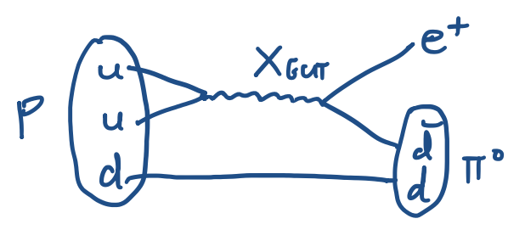
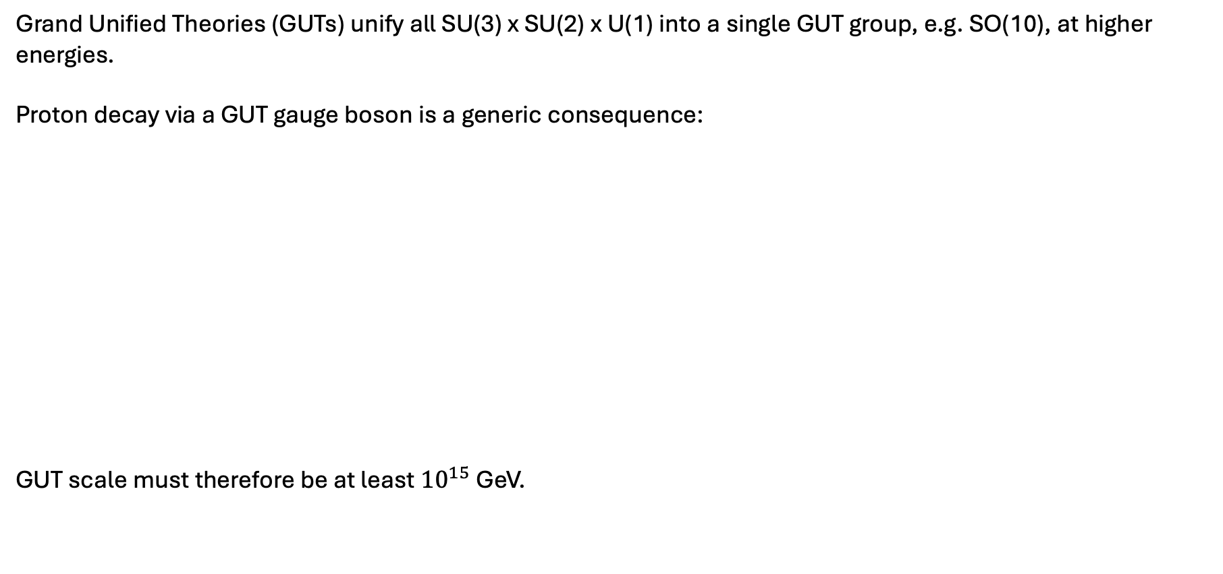
Grand Unified Theories
Grand Unified Theories (GUTs) unify all SU(3) x SU(2) x U(1) into a single GUT group, e.g. SO(10), at higher energies.
Proton decay via a GUT gauge boson is a generic consequence:
GUT scale must therefore be at least ${10}^{15}$ GeV.

Slide 95
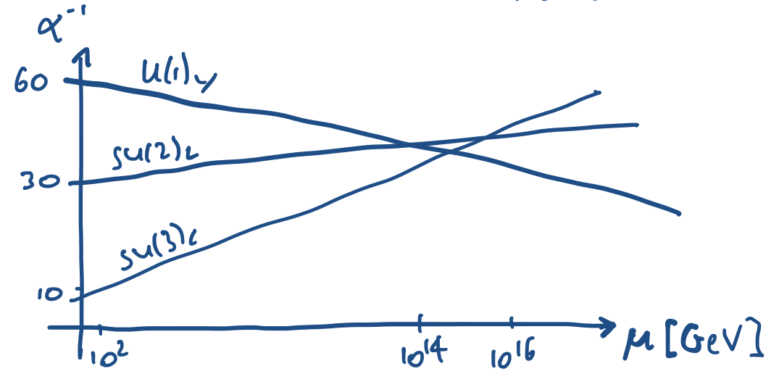
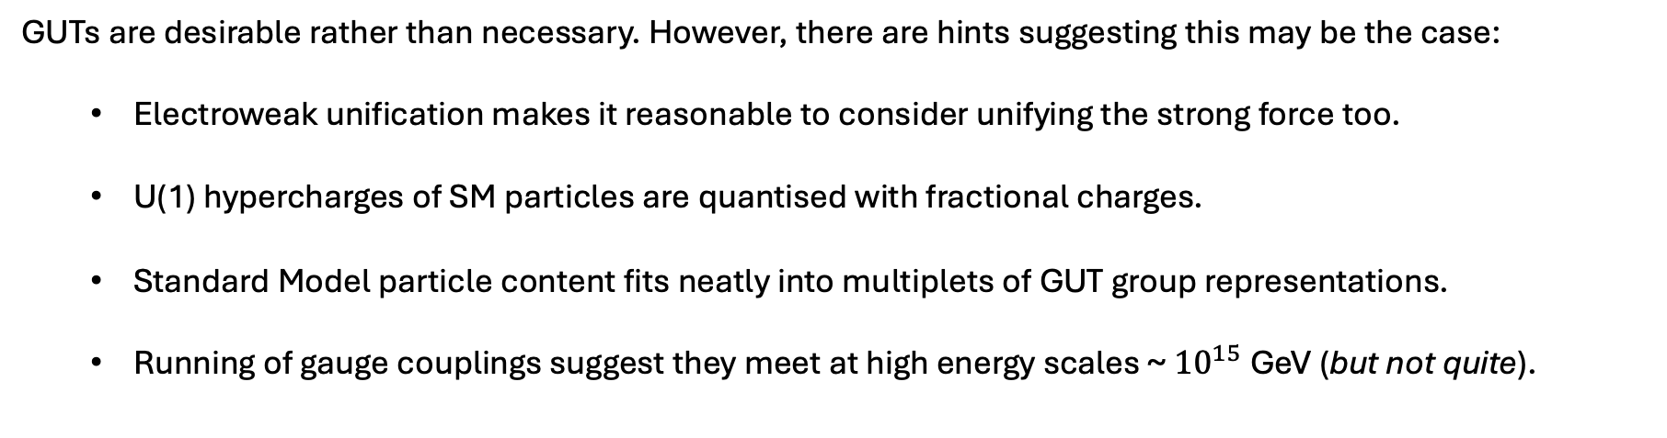
Grand Unified Theories
GUTs are desirable rather than necessary. However, there are hints suggesting this may be the case:
  Electroweak unification makes it reasonable to consider unifying the strong force too.
  U(1) hypercharges of SM particles are quantised with fractional charges.
  Standard Model particle content fits neatly into multiplets of GUT group representations.
  Running of gauge couplings suggest they meet at high energy scales ~ ${10}^{15}$ GeV (but not quite).

Slide 96
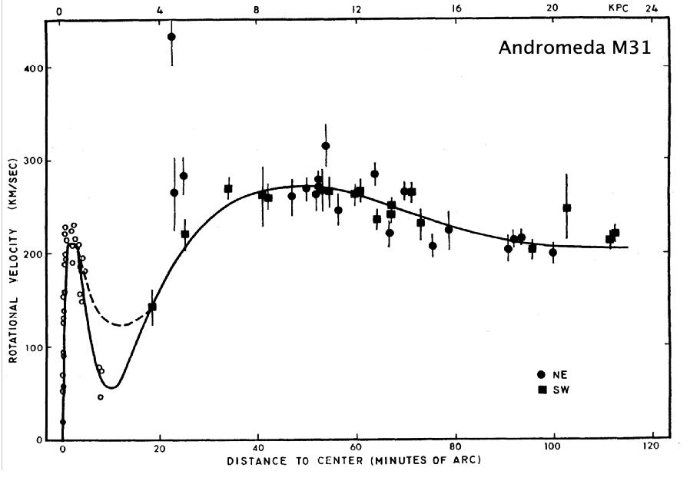
Dark Matter
Multiple independent observational evidence for dark matter on all scales:
Rubin and Ford 1970
See e.g. 2406.01705 Cirelli, Strumia, Zupan for a comprehensive review.

Slide 97
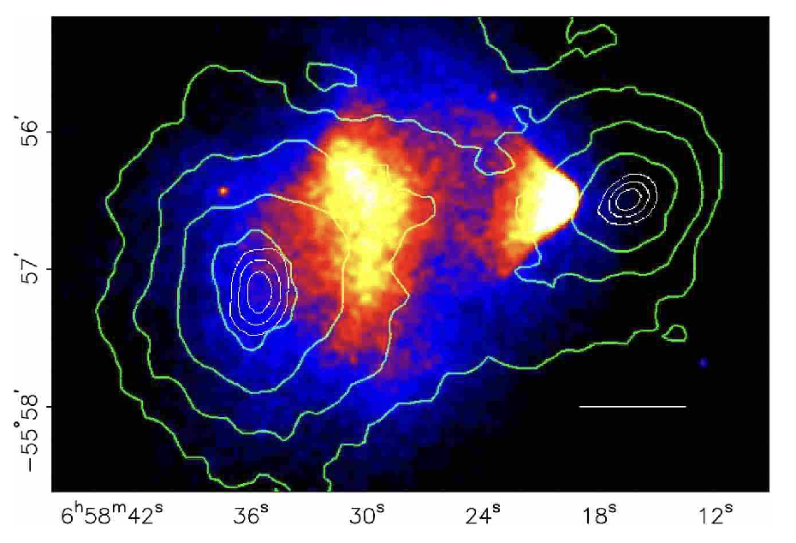
Dark Matter
Multiple independent observational evidence for dark matter on all scales:
Clowe et al 2006
See e.g. 2406.01705 Cirelli, Strumia, Zupan for a comprehensive review.

Slide 98


Dark Matter
Multiple independent observational evidence for dark matter on all scales:
Planck
See e.g. 2406.01705 Cirelli, Strumia, Zupan for a comprehensive review.

Slide 99


WIMP Dark Matter
Weakly Interacting Massive Particles (WIMP) are a simple candidate for dark matter.
Add to the Standard Model a DM particle $χ$ with mass $m$ and coupling $α$through which it annihilates.
Its averaged annihilation cross-section is $<σv>\sim \frac{α^{2}}{m^{2}}.$
Relic abundance of DM is set by thermal freeze-out as the Universe expands and temperature falls.

Slide 100


WIMP Dark Matter
Weakly Interacting Massive Particles (WIMP) are a simple candidate for dark matter.
Add to the Standard Model a DM particle $χ$ with mass $m$ and coupling $α$through which it annihilates.
Its averaged annihilation cross-section is $<σv>\sim \frac{α^{2}}{m^{2}}.$
Relic abundance of DM is set by thermal freeze-out as the Universe expands and temperature falls.
This gives the observed relic abundance for a typical weak coupling with weak-scale mass!

Slide 101
Supersymmetry
Historically, the success of classifying particles into representations of symmetry groups led to a search for a symmetry that included not just matter particles but also the force particles.
Coleman-Mandula theorem: impossible.
- Internal (non-spacetime) symmetry generators must be Lorentz scalars.
- Fermions and bosons behave differently under Lorentz transformations.
- A symmetry that interchanges them therefore does not commute with Lorentz generators
i.e. can’t be a Lorentz scalar!
Haag-Lopuzanski-Sohnius: possible, only if the supersymmetry generators are fermionic.
Supersymmetry is the unique extension allowed of spacetime symmetries.

Slide 102

Supersymmetry
Supersymmetrising the Standard Model introduces a superpartner for every SM particle – the Minimal Supersymmetric Standard Model (MSSM).
Immediate benefits
Fermion superpartners of the Higgs and weak gauge bosons can be WIMP dark matter!
Controls quantum corrections to the Higgs mass to solve the unnatural fine-tuning problem:

Slide 103

Supersymmetry
Supersymmetrising the Standard Model introduces a superpartner for every SM particle – the Minimal Supersymmetric Standard Model (MSSM).
Immediate benefits
Gauge couplings unify at a single GUT scale!

Slide 104
Supersymmetry
Supersymmetrising the Standard Model introduces a superpartner for every SM particle – the Minimal Supersymmetric Standard Model (MSSM).
But also downsides
A degree of arbitrariness is reintroduced by supersymmetry breaking.
Many more free parameters due to ignorance of supersymmetry breaking mechanism.
Extra structure must be imposed to control violation of symmetries that were automatically small in the Standard Model Effective Field Theory.
No WIMPs discovered yet?
No superpartners discovered yet?

Slide 105





Supersymmetry
Perhaps supersymmetry does not solve the Higgs fine-tuning problem but still exists at some energy scale in nature. Is this just wishful thinking?
The historical line of reasoning by generalising may make it seem that way:
Generalising Abelian gauge theories to non-Abelian gauge theories,
Generalising the Poincare algebra to a supersymmetry algebra,

Slide 106

Supersymmetry
Perhaps supersymmetry does not solve the Higgs fine-tuning problem but still exists at some energy scale in nature. Is this just wishful thinking?
Alternatively, consider the theoretical self-consistency of all allowed interactions of massless particles:
Relativity + quantum mechanics forbids all but the following possibilities:
  spin 0
  spin ½
  spin 1
  spin 3/2
  spin 2
Spin $>2$ is not allowed.

Slide 107

Supersymmetry
Perhaps supersymmetry does not solve the Higgs fine-tuning problem but still exists at some energy scale in nature. Is this just wishful thinking?
Alternatively, consider the theoretical self-consistency of all allowed interactions of massless particles:
Relativity + quantum mechanics forbids all but the following possibilities:
  spin 0
  spin ½
  spin 1 – can only self-interact consistently as a Yang-Mills non-Abelian gauge theory.
  spin 3/2
  spin 2 – can only interact universally as in General Relativity.
Spin $>2$ is not allowed.

Slide 108

Supersymmetry
Perhaps supersymmetry does not solve the Higgs fine-tuning problem but still exists at some energy scale in nature. Is this just wishful thinking?
Alternatively, consider the theoretical self-consistency of all allowed interactions of massless particles:
Relativity + quantum mechanics forbids all but the following possibilities:
  spin 0 – scalars.
  spin ½ – matter.
  spin 1 – can only self-interact consistently as a Yang-Mills non-Abelian gauge theory.
  spin 3/2
  spin 2 – can only interact universally as in General Relativity.
Spin $>2$ is not allowed.

Slide 109

Supersymmetry
Perhaps supersymmetry does not solve the Higgs fine-tuning problem but still exists at some energy scale in nature. Is this just wishful thinking?
Alternatively, consider the theoretical self-consistency of all allowed interactions of massless particles:
Relativity + quantum mechanics forbids all but the following possibilities:
  spin 0 – scalars.
  spin ½ – matter.
  spin 1 – can only self-interact consistently as a Yang-Mills non-Abelian gauge theory.
  spin 3/2 – ?
  spin 2 – can only interact universally as in General Relativity.
Spin $>2$ is not allowed.

Slide 110

Supersymmetry
Perhaps supersymmetry does not solve the Higgs fine-tuning problem but still exists at some energy scale in nature. Is this just wishful thinking?
Alternatively, consider the theoretical self-consistency of all allowed interactions of massless particles:
Relativity + quantum mechanics forbids all but the following possibilities:
  spin 0 – scalars.
  spin ½ – matter.
  spin 1 – can only self-interact consistently as a Yang-Mills non-Abelian gauge theory.
  spin 3/2 – can only interact supersymmetrically!
  spin 2 – can only interact universally as in General Relativity.
Spin $>2$ is not allowed.

Slide 111
Supersymmetry
Perhaps supersymmetry does not solve the Higgs fine-tuning problem but still exists at some energy scale in nature. Is this just wishful thinking?
Alternatively, consider the theoretical self-consistency of all allowed interactions of massless particles:
Relativity + quantum mechanics forbids all but the following possibilities:
  spin 0 – scalars.
  spin ½ – matter.
  spin 1 – can only self-interact consistently as a Yang-Mills non-Abelian gauge theory.
  spin 3/2 – can only interact supersymmetrically!
  spin 2 – can only interact universally as in General Relativity.
Spin $>2$ is not allowed.
“Everything not forbidden is compulsory”

Slide 112
Summary
WIMPs are well-motivated candidates for DM.
GUTs are desirable and appealing extensions of the Standard Model, but not necessary.
Supersymmetry arises uniquely out of strong theoretical consistency constraints and solves several phenomenological problems automatically.
However, there is no experimental evidence for it yet.

Slide 113

FCC

Slide 114
BSM at FCC-ee
Tevong You
There is a misconception that FCC-hh is the really exciting frontier of high energy exploration while FCC-ee is relatively boring.
Nothing could be further from the truth — even if indirect, FCC-ee is exquisitely sensitive to an extremely wide variety of generic new physics at high energy scales far beyond the LHC.
Tera-Z statistics on the Z pole is a vital part of this programme of quantum exploration.

Slide 115


Why Tera-Z?
Tevong You
2311.00020 Allwicher, Cornella, Isidori, Stefanek
Indirect exploration of the O(10) TeV scale.
Even for TeV-scale new physics coupling only to third generation!
Naturalness a major motivation for fully exploring 3rd gen @ TeV.
See also 2407.09593 Stefanek

Slide 116


Why Tera-Z?
Tevong You
Indirect sensitivity to all possible BSM extensions coupling linearly to SM
2608.xxxxx Gargalionis, Maura, Mimasu, TY
See also:
2408.03992 Allwicher, McCullough, Renner
2412.01759 Gargalionis, Vuong, Quevillon, TY
2604.16596 Armadillo et al

Slide 117


Why Tera-Z?
Tevong You
Indirect sensitivity to all possible BSM extensions coupling linearly to SM
2608.xxxxx Gargalionis, Maura, Mimasu, TY
See also:
2408.03992 Allwicher, McCullough, Renner
2412.01759 Gargalionis, Vuong, Quevillon, TY
2604.16596 Armadillo et al

Slide 118



Why Tera-Z?
1312.3322 McCullough
Tevong You
Indirect sensitivity to the Higgs self-coupling at NLO benefits from Tera-Z, marginalised over all other effects:
2503.13719 Maura, Stefanek, TY
See also:
2504.05974 Hoeve et al
2512.06916 Allwicher, Grojean, Tabatt
Note self-coupling modification correlated with coupling modification: natural upper bound on their ratio
2209.00666 Durieux, McCullough, Salvioni

Slide 119

Why Tera-Z?
1312.3322 McCullough
Tevong You
Indirect sensitivity to the Higgs self-coupling at NLO benefits from Tera-Z, marginalised over all other effects:
2503.13719 Maura, Stefanek, TY
See also:
2504.05974 Hoeve et al
2512.06916 Allwicher, Grojean, Tabatt
FCC CDR Vol. 1
Note self-coupling modification correlated with coupling modification: natural upper bound on their ratio
2209.00666 Durieux, McCullough, Salvioni

Slide 120
Many more open questions
Nature of the electroweak phase transition: first-order?
Potential gravitational wave signal in range accessible by LISA
FCC CDR Vol. 1

Slide 121

Many more open questions
Coverage of entire upper mass range of doublet and triplet thermal WIMP dark matter
FCC CDR Vol. 1

Slide 122


Many more open questions
e.g. Z’ and leptoquarks may relate to origin of flavour, Higgs compositeness, or other BSM
B meson anomalies may be going away, but flavour still a highly sensitive indirect probe
FCC-hh can probe directly the multi-TeV scale in a complementary way
Azatov et al [2205.13552]
Allanach, Corbett, Dolan, You [1810.02166]

Slide 123


Origin of the Higgs
Note: naturalness aside, still motivation in exploring origin of Higgs in models from which it emerges, where its mass is calculable
FCC CDR Vol. 1
Supersymmetry
  Massless spins 0, ½, 1, 3/2, 2 only
  Spin 3/2 must be supersymmetric
  (Ir)relevant for solving naturalness?
Composite Higgs / extra dimensions
  Is the Higgs elementary or composite?
  Are there accessible extra dimensions?

Slide 124
Potential BSM outcomes for naturalness
Radically conservative
  Naturalness restored just around the corner by the usual symmetry-based solutions, e.g. supersymmetry or composite Higgs / extra-dimensions.
Creatively conservative
  Symmetry-based solution at the weak scale exists, but neutral or hidden at the LHC, e.g. twin Higgs, stealth supersymmetry.
Post-naturalness BSM
  Cosmological dynamics, self-organized criticality, accept tuning, e.g. relaxion, inflationary multiverse, split supersymmetry.
Radically new
  Hard to imagine what form this might take, by definition. How might this show up?

Slide 125
Potential BSM outcomes for naturalness
Radically conservative
  Naturalness restored just around the corner by the usual symmetry-based solutions, e.g. supersymmetry or composite Higgs / extra-dimensions.
Creatively conservative
  Symmetry-based solution at the weak scale exists, but neutral or hidden at the LHC, e.g. twin Higgs, stealth supersymmetry.
Post-naturalness BSM
  Cosmological dynamics, self-organized criticality, accept tuning, e.g. relaxion, inflationary multiverse, split supersymmetry.
Radically new
  Hard to imagine what form this might take, by definition. How might this show up?

Slide 126
How we got here
1940
1960
1970
1980
1930-40s:
Success of QED. QFT emerges as the new fundamental description of Nature.
1960s:
QFT is unfashionable, non-Abelian theory dismissed as an unrealistic generalisation of local symmetry-based forces. Widely believed a radically new framework will be required e.g. to understand the strong force.
1970s:
QFT triumphs following Yang-Mills+Higgs+asymptotic freedom+renormalisation. Nature is radically conservative, but more unified than ever.

Slide 127
How we got here
1980
2020
2040
2070
1980-2020s:
Success of SM - established as the fundamental description of nature up to TeV scale.
2030s:
QFT is unfashionable, supersymmetry theory dismissed as an unrealistic generalisation of symmetry principles. Widely believed a radically new framework will be required e.g. to understand the hierarchy problem.
2050s:
QFT triumphs following Yang-Mills+Higgs+asymptotic freedom+renormalisation+supersymmetry. Nature is radically conservative, but more unified than ever.

Slide 128
Potential BSM outcomes for naturalness
Radically conservative
  Naturalness restored just around the corner by the usual symmetry-based solutions, e.g. supersymmetry or composite Higgs / extra-dimensions.
Creatively conservative
  Symmetry-based solution at the weak scale exists, but neutral or hidden at the LHC, e.g. twin Higgs, stealth supersymmetry.
Post-naturalness BSM
  Cosmological dynamics, self-organized criticality, accept tuning, e.g. relaxion, inflationary multiverse, split supersymmetry.
Radically new
  Hard to imagine what form this might take, by definition. How might this show up?

Slide 129


Radically new BSM?
Energy
Direct exploration by FCC-hh
$$Λ$$
$$E<Λ$$
Indirect exploration by FCC-ee

Slide 130

Radically new BSM?
Energy
Direct exploration by FCC-hh
$$Λ$$
e.g. Consider indirect sensitivity to UV theory
$$E<Λ$$
Indirect exploration by FCC-ee

Slide 131

Radically new BSM?
Energy
Direct exploration by FCC-hh
$$Λ$$
Matching explicit UV models populates a subspace of SMEFT coefficient space
$$E<Λ$$
Indirect exploration by FCC-ee

Slide 132






Radically new BSM?
Energy
Direct exploration by FCC-hh
$$Λ$$
Unitarity
Locality
Causality
…
Positivity bounds forbid negative signs of dim-8 SMEFT coefficients assuming only general fundamental principles in the UV
$$E<Λ$$
Measuring the “wrong” sign experimentally would have truly revolutionary consequences for the underlying theory!
Indirect exploration by FCC-ee

Slide 133
Radically new BSM?
Energy
May not even have a Lagrangian/QFT description
Direct exploration by FCC-hh
$$Λ$$
Unitarity
Locality
Causality
…
Positivity bounds forbid negative signs of dim-8 SMEFT coefficients assuming only general fundamental principles in the UV
$$E<Λ$$
Measuring the “wrong” sign experimentally would have truly revolutionary consequences for the underlying theory!
Indirect exploration by FCC-ee

Slide 134




Tevong You
Radically new BSM?
Sometimes an anomaly in indirect precision measurement = something missing:
Anomaly in orbit of Uranus
Discovery of Neptune
Other times its implications are far more radical:
Anomaly in orbit of Mercury
Explained by General Relativity
(Could have been anticipated by Effective Theory and naturalness!)
1106.1568 J.D. Wells

Slide 135
Radically new BSM?
Keep an open mind.
1900s:
Almost all data agree spectacularly with the fundamental framework of the time, no reason to doubt its universal applicability or completeness.
1920s:
A combination of precision measurements (Mercury), aesthetic arguments (relativity) supported by null experimental results (Michelson-Morley), and theoretical inconsistencies (Rayleigh-Jeans UV catastrophe) lead to an overhaul of the fundamental picture at smaller scales and higher energies after pushing the frontiers of technology and theory into new regimes.

Slide 136
Radically new BSM?
Keep an open mind.
2020s:
Almost all data agree spectacularly with the fundamental framework of the time, no reason to doubt its universal applicability or completeness.
2050s?
A combination of precision measurements (flavour, Hubble), aesthetic arguments (naturalness) supported by null experimental results (LHC), and theoretical inconsistencies (black hole information paradox) lead to an overhaul of the fundamental picture at smaller scales and higher energies after pushing the frontiers of technology and theory into new regimes.

Slide 137
Concluding Remarks
It is a non-trivial empirical fact that our universe is comprehensible and a unified whole.
(It didn’t have to be that way! Universe could have been much simpler, or hopelessly complex / random)
To keep making progress in probing the fundamental foundations will require more data.

Slide 138









Concluding Remarks
Telescopes are observatories for exploring outer space
Colliders are experimental observatories for exploring inner space
We need all eyes open on all scales in our universe

Slide 139

Concluding Remarks
Sharpen our picture of the Universe, e.g. before and after Planck.

Slide 140


Concluding Remarks
Sharpen our picture of the Universe, e.g. before and after LEP.
Guy Wilkinson slide

Slide 141

Concluding Remarks
Sharpen our picture of the Universe, e.g. before and after FCC-ee.

Slide 142
Concluding Remarks
There are no guarantees of BSM discovery at future colliders. There are no guarantees of BSM discovery anywhere else either.
What we can guarantee is a rich and wide-ranging programme of fundamental physics at the smallest scales experimentally accessible.
https://cerncourier.com/a/future-colliders-are-particle-observatories/

Slide 143
Concluding Remarks
Tevong You
Future colliders are not just a wild punt for BSM, any more than JWST or LISA is only about breaking ⋀CDM.
They are scientific laboratories for doing all kinds of fundamental experiments on small scales – a general-purpose “particle observatory” for the zeptoscopic world.
The wealth of information they provide about the most fundamental quantum processes we can directly access experimentally make colliders a unique, irreplaceable, and crucial instrument for the job of fundamental physics: to better understand our universe.
Particle physics must be reframed in same way as astro/cosmo: about doing good science.
https://cerncourier.com/a/future-colliders-are-particle-observatories/

Slide 144
Concluding Remarks
There is value in pushing frontiers – definite questions are answered, and we learn something regardless of the outcome.
A new generation of improved measurements, analysis techniques, theoretical calculational tools, data management, hardware development, cutting-edge engineering, large international collaboration, popular culture inspiration, and spirit of fundamental exploration, can only benefit humanity. Doing good science is its own reward.
Progress in science is about continuously refining existing knowledge and exploring the unknown.
https://cerncourier.com/a/future-colliders-are-particle-observatories/

Slide 145
Concluding Remarks
  “What would be the use of such extreme refinement in the science of measurement? […] The more important fundamental laws and facts of physical science have all been discovered, and these are so firmly established that the possibility of their ever being supplanted in consequence of new discoveries is exceedingly remote. […]”
  –A. Michelson 1903

Slide 146
Concluding Remarks
  “What would be the use of such extreme refinement in the science of measurement? Very briefly and in general terms the answer would be that in this direction the greater part of all future discovery must lie. The more important fundamental laws and facts of physical science have all been discovered, and these are so firmly established that the possibility of their ever being supplanted in consequence of new discoveries is exceedingly remote. Nevertheless, it has been found that there are apparent exceptions to most of these laws, and this is particularly true when the observations are pushed to a limit, i.e., whenever the circumstances of experiment are such that extreme cases can be examined.”
  –A. Michelson 1903
Keep pushing to examine extreme cases across all frontiers of fundamental physics

Slide 147
Questions?
tevong.you@kcl.ac.uk

Slide 149
  “What would be the use of such extreme refinement in the science of measurement? […] The more important fundamental laws and facts of physical science have all been discovered, and these are so firmly established that the possibility of their ever being supplanted in consequence of new discoveries is exceedingly remote. […]”
  –A. Michelson 1903

Slide 150
  “What would be the use of such extreme refinement in the science of measurement? Very briefly and in general terms the answer would be that in this direction the greater part of all future discovery must lie. The more important fundamental laws and facts of physical science have all been discovered, and these are so firmly established that the possibility of their ever being supplanted in consequence of new discoveries is exceedingly remote. Nevertheless, it has been found that there are apparent exceptions to most of these laws, and this is particularly true when the observations are pushed to a limit, i.e., whenever the circumstances of experiment are such that extreme cases can be examined.”
  –A. Michelson 1903

Slide 151
Literature
Textbooks:
  Weinberg - QFT
  Schwartz - QFT
  Quigg - Gauge theories
Lecture notes and reviews:
  McCullough - BSM lectures: https://inspirehep.net/literature/1684708
  Wulzer – BSM lectures: https://arxiv.org/abs/1901.01017
  Murayama – Supersymmetry lectures: https://arxiv.org/abs/hep-ph/0002232
  Craig – Naturalness: https://arxiv.org/abs/2205.05708
  Giudice – Naturalness: https://arxiv.org/abs/1307.7879
  Arkani-Hamed, Huang, Huang – little group constraints https://arxiv.org/abs/1709.04891

Slide 152
Q: Isn’t it too expensive?
  Not really on the scale of governmental spending. It’s about the same as what a single nation spends hosting the Olympics for a couple of weeks of entertainment. The cost of FCC on the other hand is split between dozens of countries over decades for fundamental results that stand for all time.
  The UK government alone wasted £10bn on PPE (protective clothing for medical personnel) that were not fit for purpose and went unused straight into a landfill. £10bn in a couple of years literally all gone, for nothing. https://www.theguardian.com/politics/2024/jan/25/uk-government-wasted-nearly-10bn-on-unused-covid-ppe-figures-show
  Studies have also demonstrated positive return on investment to economies of investing in CERN so it pays for itself in the long run.

Slide 153
NHS National Programme for IT. The classic example. Launched in 2002 to create a national electronic patient record system, abandoned in 2011, with the final bill to taxpayers put at £10.1bn. Original contracts were worth around £6bn, and although total costs approached £12.7bn, the government conceded it produced only about £2.6bn in actual benefits. A follow-up PAC report found that a decade in, not a single trust had a fully working Lorenzo records system, the main deliverable.
PPE. DHSC's 2020/21 accounts wrote off £8.7bn: £673m of equipment was completely unusable, £750m expired before use, £2.6bn was unsuitable for the NHS, and the remaining stock's value was cut by £4.7bn as prices fell. A further £6bn reduction the following year took total write-downs to nearly £15bn over two years.
Test and Trace. The PAC concluded it failed its main objective of breaking transmission chains despite receiving around £37bn over two years, roughly 20% of the NHS's entire annual budget.
HS2's northern leg. Around £2.2bn of sunk costs on the cancelled stages, plus £592m spent buying land and roughly 1,000 properties that are no longer needed, and up to £100m to remediate sites where work had begun. The PAC judged that delivering Phase 1 alone would be very poor value for money.

Slide 154
Q: Should we be doing FCC in the face of climate change?
  Big fundamental science projects help directly and indirectly with solving practical problems of humanity.
  Climate change is as much a political as a technological challenge. Large international scientific collaborations are a driver for positive change.
  All human economic activity contributes in some way, so the question is really about whether an activity is worth doing (do we really need music, the arts, sports?)
  I truly believe a world in which FCC exists will be a world more likely and better equipped to face the climate change than one without.

Slide 155

Backup

Slide 156

Backup

Slide 157

Backup

Slide 158
Neutrino masses
Neutrino oscillations imply neutrinos have mass.
The Standard Model does not allow a mass term for neutrinos to be written down.

Slide 159
Neutrino masses
Neutrino oscillations imply neutrinos have mass.
The Standard Model does not allow a mass term for neutrinos to be written down.
The Standard Model Effective Field Theory, on the other hand, enables more operator combinations at higher mass dimensions.
When the Higgs gets a vacuum expectation value, these could generate a dimension 3 neutrino mass term.
EFT

Slide 160



Neutrino masses
The Standard Model EFT has a unique dimension 5 operator – the Weinberg operator.
After electroweak symmetry breaking, when the Higgs gains a non-zero vacuum expectation value, the Weinberg operator gives neutrinos a small mass suppressed by $v/Λ$.
For $m_{ν}\sim 0.1$ eV, if $c_{5}\sim O\left(1\right)$ then expect new physics that generates this operator to be at $Λ \sim {10}^{14}$ GeV.

Slide 161

Neutrino masses
What kind of new physics could generate the Weinberg operator?

Slide 162

Neutrino masses
Add a new completely neutral fermion $υ_{R}$ to the SM particle content.

Slide 163

Neutrino masses
Add a new completely neutral fermion $υ_{R}$ to the SM particle content.
Note that it already has a mass $M$ that we fix to be $\sim {10}^{14}$ GeV.

Slide 164

Neutrino masses
Add a new completely neutral fermion $υ_{R}$ to the SM particle content.
After electroweak symmetry breaking, the Higgs yukawa coupling generates another neutrino mass term.

Slide 165
Neutrino masses
Add a new completely neutral fermion $υ_{R}$ to the SM particle content.
We diagonalise the 2 x 2 mass matrix in the Lagrangian to obtain the physical mass eigenstates.

Slide 166

Neutrino masses
Add a new completely neutral fermion $υ_{R}$ to the SM particle content.
We diagonalise the 2 x 2 mass matrix in the Lagrangian to obtain the physical mass eigenstates.

Slide 167
Neutrino masses
Add a new completely neutral fermion $υ_{R}$ to the SM particle content.
We diagonalise the 2 x 2 mass matrix in the Lagrangian to obtain the physical mass eigenstates.

Slide 168

Neutrino masses
Add a new completely neutral fermion $υ_{R}$ to the SM particle content.
This UV theory generates the Weinberg operator with $c_{5}\sim y_{ν} , Λ \sim M$ in the SM EFT.

Slide 169

Neutrino masses
Why didn’t we just add the neutral fermion $υ_{R}$ with only one mass term through the Yukawa coupling?
With $y_{ν} \sim {10}^{−12}$this gives a neutrino mass $m \sim 0.1$ eV as required.

Slide 170

Neutrino masses
Why didn’t we just add the neutral fermion $υ_{R}$ with only one mass term through the Yukawa coupling?
But the other mass term is necessarily there!
“Everything not forbidden is compulsory”

Slide 171
Lepton number
The Weinberg operator violates a Lepton number symmetry that is accidentally conserved by operators of mass dimension $≤4$.
The Standard Model Effective Field Theory provides an explanation for small Lepton number violation.

Slide 172

Baryon number
There exist operators at dimension 6 that violate a Baryon number symmetry that is accidentally conserved by operators of mass dimension $≤4$.
Just like Lepton number violation at dimension 5, Baryon number violation at dimension 6 is expected.
Lack of proton decay in experiments such as Super-Kamiokande implies $Λ > {10}^{15}$ GeV.

Slide 173

The QCD axion
Recall the strong CP problem:
Experiments probing the neutron electric dipole moment do not see any CP violation from this term: $θ<{10}^{−10}$
Not only is there no reason for it to be small, but it is also a contribution of two independent terms – the intrinsic theta parameter and a quark mass phase – that must cancel out to 1 part in 10 billion!
?
“Everything not forbidden is compulsory”

Slide 174





The QCD axion
Add a naturally light axion scalar field, $a$, that originates from some UV theory at a heavy scale $f_{a}$:

Slide 175


The QCD axion
Add a naturally light axion scalar field, $a$, that originates from some UV theory at a heavy scale $f_{a}$:
Potential energy is minimized for vanishing effective theta angle $θ_{eff}≡θ+\frac{a}{f_{a}}=0$.

Slide 176
The QCD axion
Add a naturally light axion scalar field, $a$, that originates from some UV theory at a heavy scale $f_{a}$:
Potential energy is minimized for vanishing effective theta angle $θ_{eff}≡θ+\frac{a}{f_{a}}=0$.

Slide 177

The QCD axion
Many experimental searches and observational constraints on a light QCD axion, e.g. through photon coupling.
QCD axion could also be dark matter.
Many more Axion-Like Particle (ALP) possibilities that have nothing to do with QCD or strong CP.
cajohare.github.io

Slide 178


The Relaxion
Add an axion coupled to a heavy Higgs boson.
The Higgs mass term is initially large and positive, with electroweak symmetry unbroken, i.e. $<h> =0.$

Slide 179

The Relaxion
Add an axion coupled to a heavy Higgs boson.
The Higgs mass term is initially large and positive, with electroweak symmetry unbroken, i.e. $<h> =0.$
Note that the cosine potential then vanishes, since the pion mass $m_{π}∝m_{q}∝ <h> =0.$

Slide 180

The Relaxion
Add an axion coupled to a heavy Higgs boson.
In the early universe (during inflation) it rolls down its linear potential.

Slide 181

The Relaxion
Add an axion coupled to a heavy Higgs boson.
As axion rolls past critical point, the effective Higgs mass turns negative.

Slide 182


The Relaxion
Add an axion coupled to a heavy Higgs boson.
As axion rolls past critical point, the effective Higgs mass turns negative.
Electroweak symmetry is broken, $<h> ≠0.$
The cosine potential proportional to $<h>$ grows as the axion evolves.
Stops when bumps are too large, at small Higgs mass.

Slide 183


Self-Organised Criticality
Cosmological dynamics may self-tune our universe to live near criticality.
The Standard Model itself, with no BSM, has a Higgs potential coincidentally on the critical boundary of two phases.
A small Higgs mass may also be the result of dynamical self-organized criticality on a cosmological scale.
1205.6497 Degrassi et al
e.g. 1907.07693 Khoury et al, 2105.08617 Giudice, McCullough, TY

