Slide 1
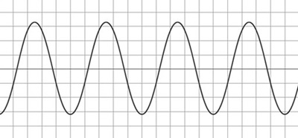



The Noble Element Simulation Technique (NEST) at the
University at Albany
SUNY Department of Physics
University of Rochester physics colloquium
(NOT covering the snowball chamber – it was co-invented w/ Prof. Cecilia Levy; it’s like the cloud & bubble chambers)
Matthew Szydagis Oct. 23, 2026 CPAD in Seattle

Slide 2
Thank You!
(sorry I was not here all week! Travel for LZ...)
I’m honored to receive this award. This recognition unexpected
  I could not have done it without the work of a GREAT MANY individuals (listed at the end here)
  My postdoc mentor Mani Tripathi of UCD (here this week) requires a specific shout-out
I also thought I had too many gray hairs to be considered “early” career still
(warning: I am a very non-linear presenter, but I think unrelated to age!)
As the founder/creator of the software, and leader/spokesperson, of a real, separate collaboration (from LZ, LUX, etc.) like the GEANT4 (software-only) collaboration, I acknowledge that nothing would have been possible without community support
  Especially in the face of severely limited funding, even for sims (~cheap!)

Slide 3
What is NEST? Motivated by Discovery Science in HENP
(I pushed for @Snowmass)
Software: the Noble Element Simulation Technique, created at UC Davis
  Available on GitHub: https://github.com/NESTCollaboration/nest Don’t re-invent the wheel!
Monte Carlo simulation package for dark matter (direct WIMP detection) as well as neutrino experiments (but not limited to them: PET too)
  Xenon and Argon (some approximations for other elements in place too), liquid and gas (sometimes other phases too like solid and super-critical fluid!)
  Single and dual-phase TPCs / non-TPC detectors: both non-zero and zero drift electric fields
Particle types: not just ER (electron recoil) and NR (nuclear recoil)
  ER is split into beta and gamma as well as EC and DEC and other types
  Alpha and ion yields, some hypothetical but others experimentally verified
  Custom energy spectra possible, like uniform, exponential, and Gaussian
Light and charge yields as functions of field, energy, and interaction type
  But also pulse shapes, for primary (S1) and secondary (S2) scintillation: time profiles

Slide 4
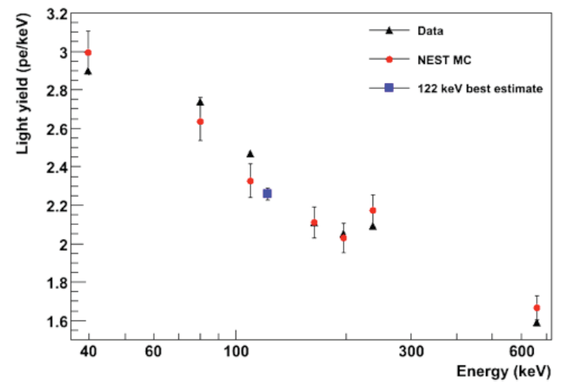
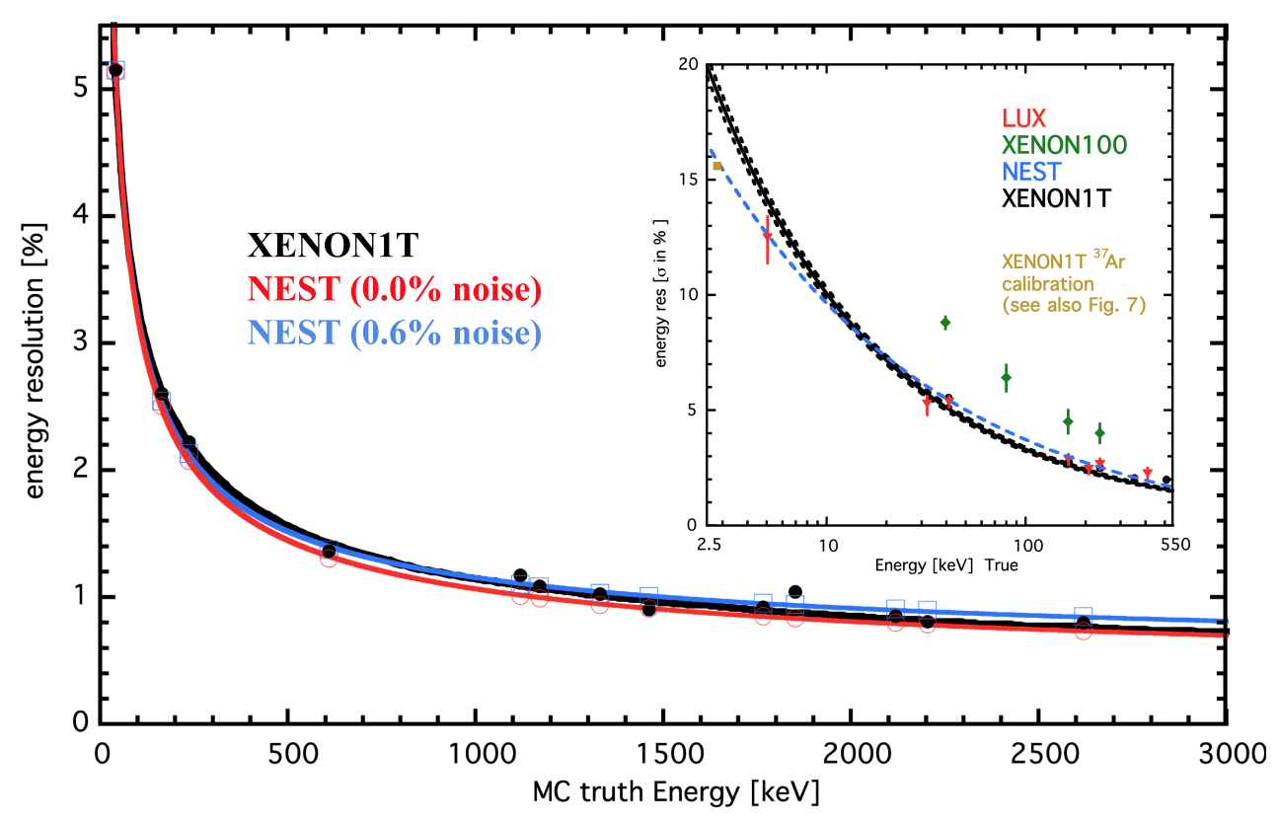
More Factoids
https://zenodo.org/records/17851406
Not entirely empirical: it has made successful predictions
  Not just post-dictions or ad-hoc fits
  Not perfect, but treat as your first pass
NEST helped lead to a breakaway from relative yields for ER and NR and empirical-only calibrations
Not tied to only LZ / its predecessors: used by all, informed by all
It doesn’t just do mean yields
  It does energy resolution
  Width models for both S1 and S2
Mentioned in the PDG Review
  For instance: in 2022-23
  https://pdg.lbl.gov/2023/reviews/rpp2022-rev-particle-detectors-non-accel.pdf
Aprile, Dark Attack 2012 and Melgarejo, IDM 2012
(Version 0.98)
XENON100: 530 V/cm
No ⁵⁷Co calibration, so MC was key part of final WIMP limit, as with PandaX
https://arxiv.org/pdf/2007.00528
Notes:
Relative yield to absolute on next page, and ER to NR. Means (top) AND widths (bottom) on this page.

Slide 5
Stability Over Time >> Ambulance Chasing
SEMI-empirical. Emphasis on the SEMI
A traditional WIMP signal is exponential-like, so even for medium to high masses, the region below 10 keV is the MOST important to model for potential signal events
(neutrons)
To be conservative on low-mass WIMPs: 2013, 2015
these PRE-date the LUX DD (deuterium-deuterium) n generator analysis
Now, we have Boron-8 down here
<==
The charge yield is a similar great story except for the sub-keV regime: was pressured
Sorensen
Dahl
Notes:
aaa

Slide 6

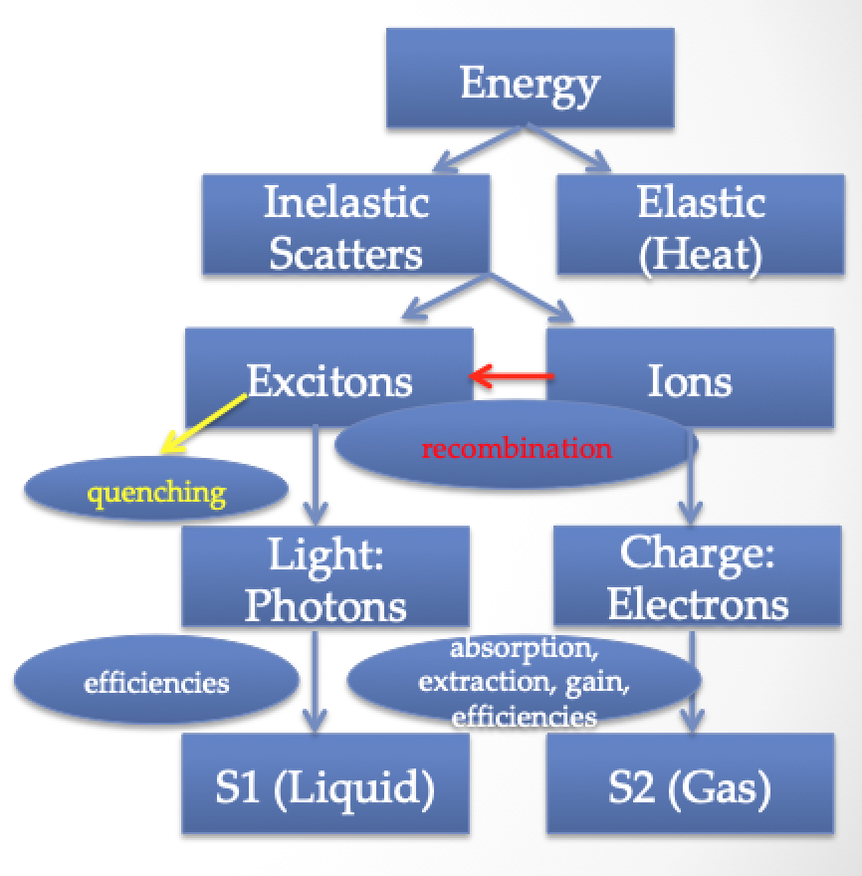
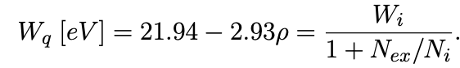


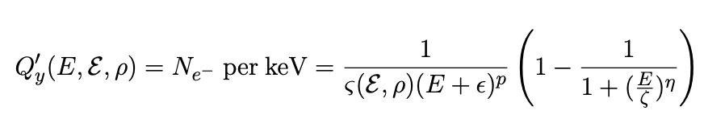
NEST’s Very Precise Modeling
https://arxiv.org/pdf/2211.10726.pdf
(Electron Recoils, ER)
(Nuclear Recoils, NR: primed variables here)

Slide 7
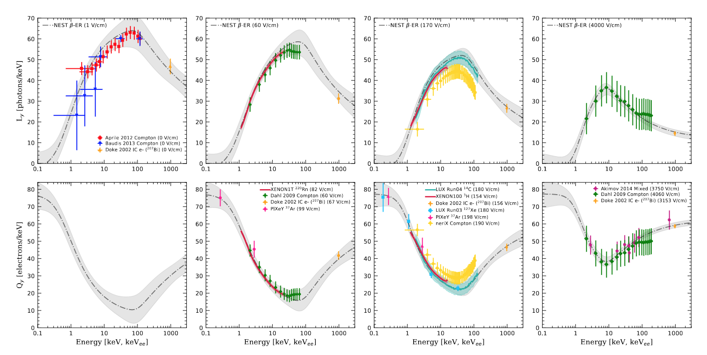
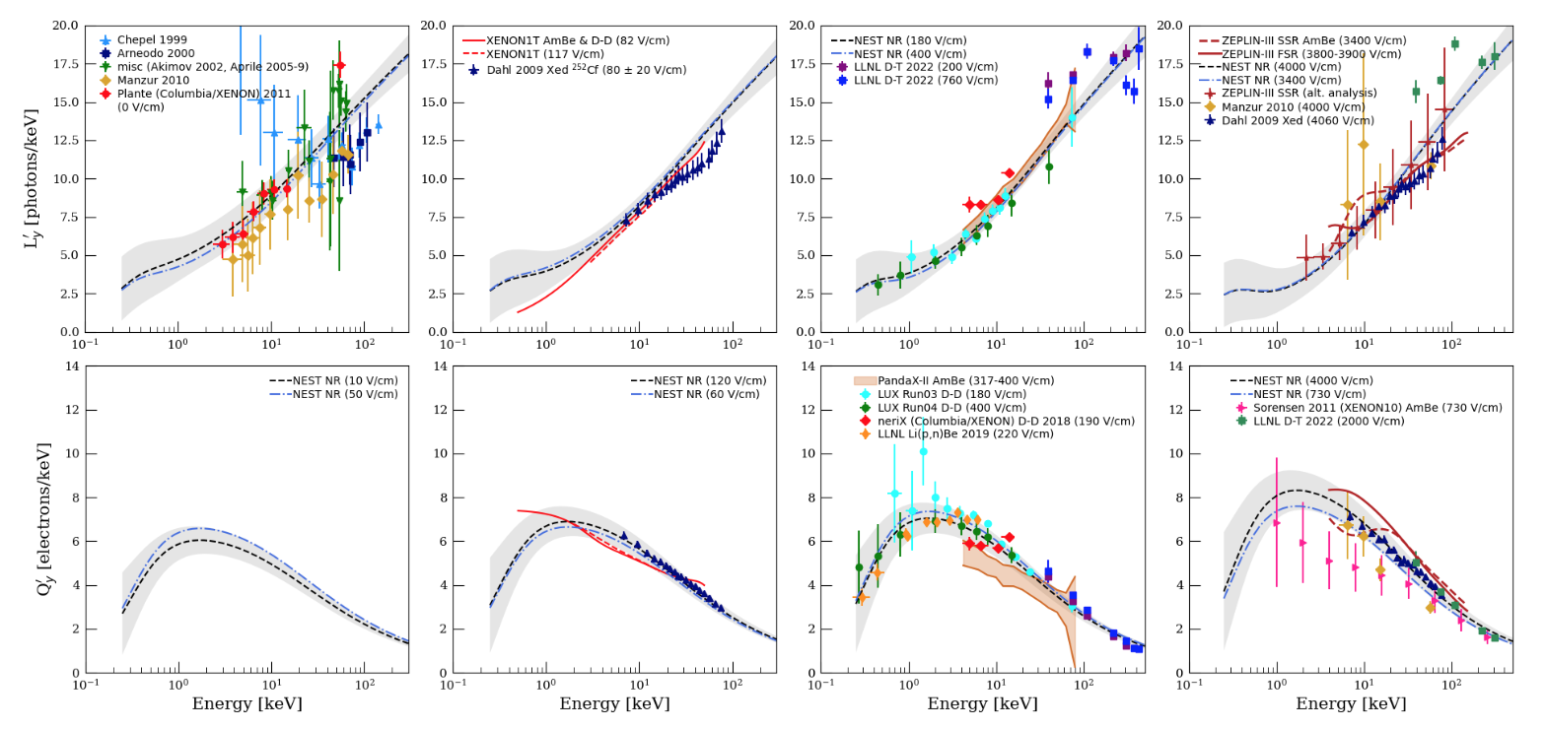
https://doi.org/10.3389/fdest.2024.1480975
Betas and Compton scatters shown as examples for ERs
  Yields for gamma or x ray photoabsorption a bit different
The two sigmoids model two distinct regimes in energy
  The Thomas-Imel (low) and Doke/Birks (high-E) regions
The field dependence is very obvious reading horizontally
  Anti-correlation exists in energy as well, when reading vertically
Light yield for NRs roughly monotonic with increasing E
Charge yield has a maximum
  Competition between quenching factor and recombination prob.
ER
NR
Lindhard applies to charge too!

Slide 8
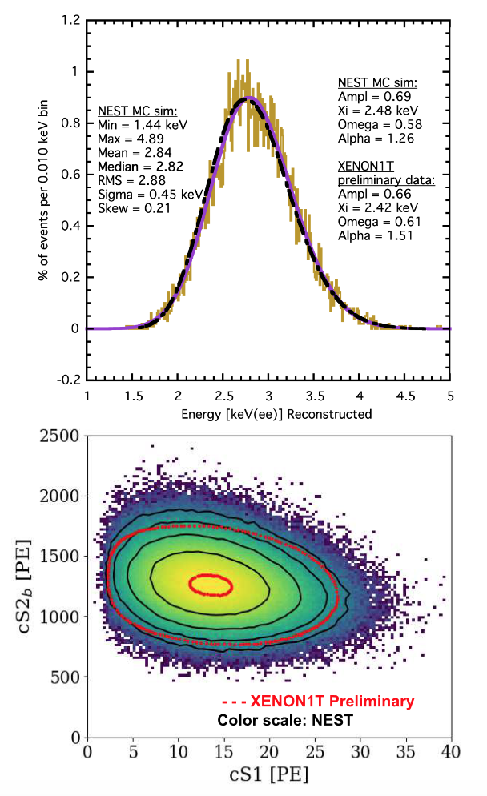
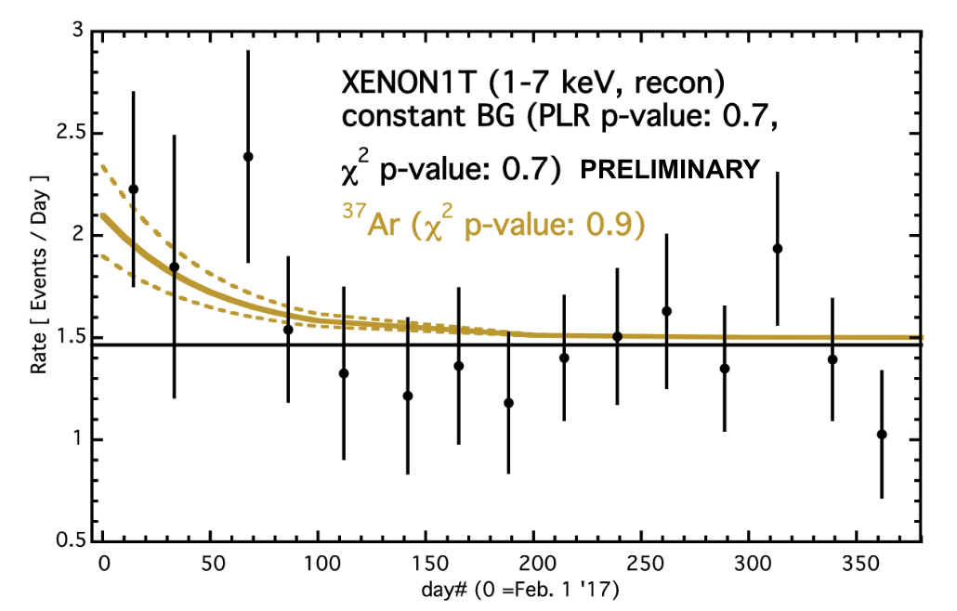
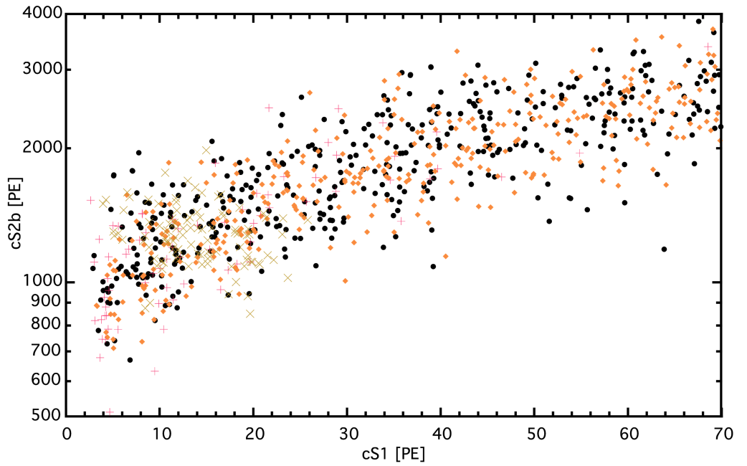
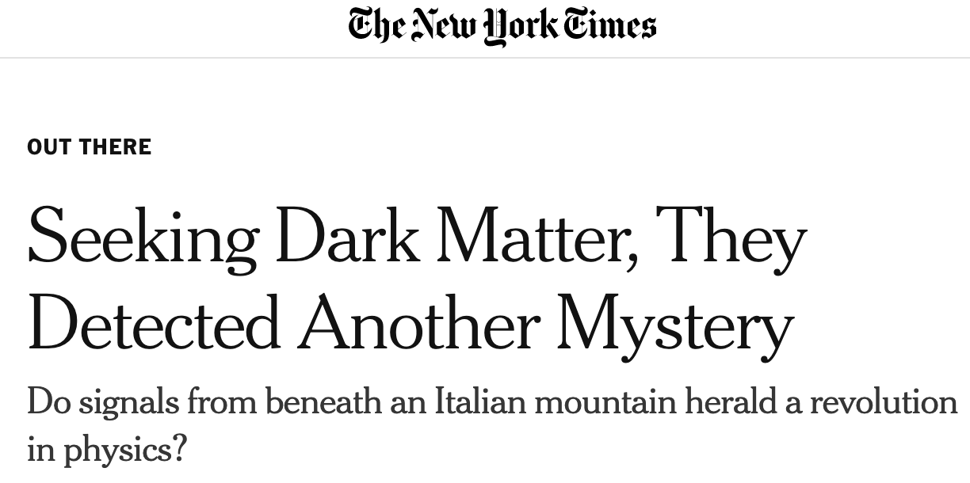
Mimicry of Real Data w/ NEST
It was useful for testing a potential signal!
NEST matched 1T’s data very well even cf. to XENON1T sims
It models non-LZ work quickly, down to energy resolution
https://arxiv.org/abs/2007.00528
-> Phys. Rev. D
ER “band”
(XENON1T story)
Important: XENON says this is impossible, they ruled out Ar-37
(where the Argon-37 would be living in plot)
They said all along it was tritium
Notes:
from basic yields to data-like sims

Slide 9
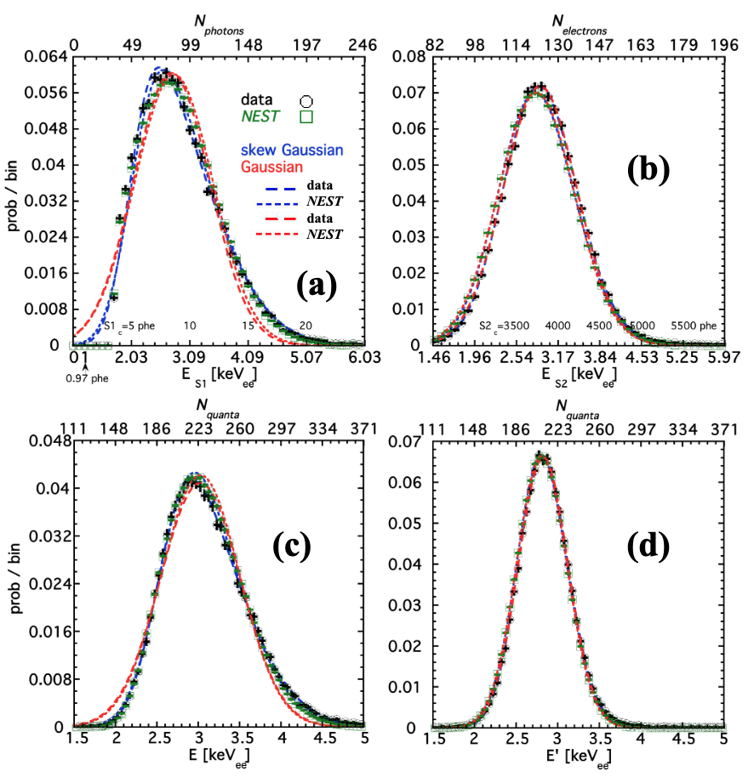
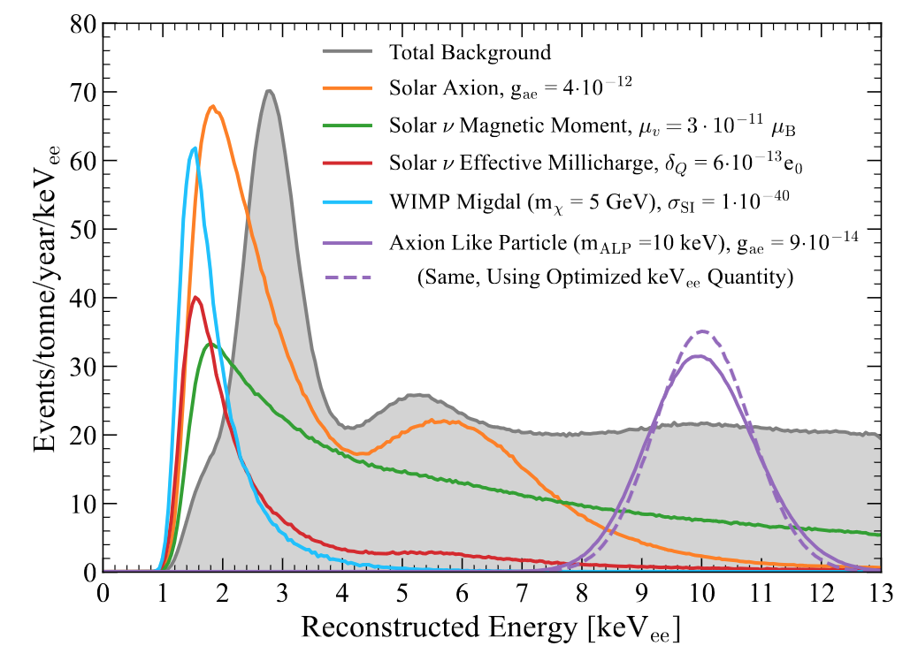
A Newer E Recon. Technique
(cite score 2.6)
NEST Instruments paper (36 mos.)
  #4 most cited (from 314 papers, all fields)
  #5 most viewed (4,817 views).
  #6 most downloaded (1,109 downloads, competing with DUNE's CDR!!!!!! 1,474)
Part of special collection. NEST paper on E resolution and reconstruction, in LAr too (including in DUNE) + for 0νββ decay
https://arxiv.org/pdf/2307.15753.pdf
First usage by a major experiment
(LZ)
https://arxiv.org/pdf/2102.10209.pdf
Notes:
Bump or hump energy resolution, on different scales

Slide 10
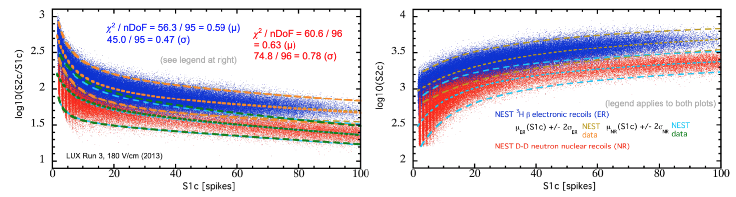
Continuous Data: Beta Spectrum and Neutron Recoil ‘BANDS’
* S1 pulses come from the L_{y}: namely, S1 = g₁*N_{ph}, where N_{ph} = L_{y} times energy, and g₁ is photon det. eff.
* S2 pulses come from the Q_{y}: namely S2 = g₂*N_{e-,} where N_{e-} = Q_{y} times energy, and g₂ is a gain factor (>1)
digital “spike” counting (making a comeback)
NEST loads a fully customizable detector parameter file for your detector. A huge number of parameters, but most important are g₁, g₂, N-fold coincidence level (photo-sensors), and field
- g₂ must be broken down into its stages (https://iopscience.iop.org/article/10.1088/1748-0221/15/02/T02007/pdf)

Slide 11

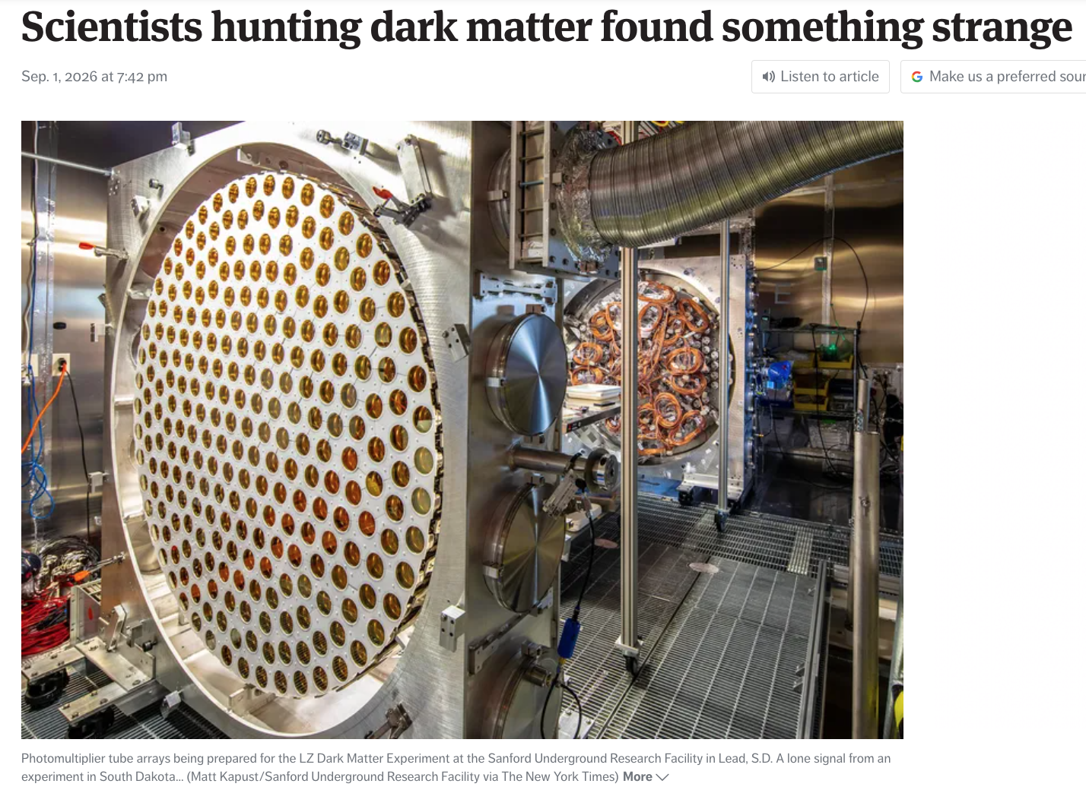
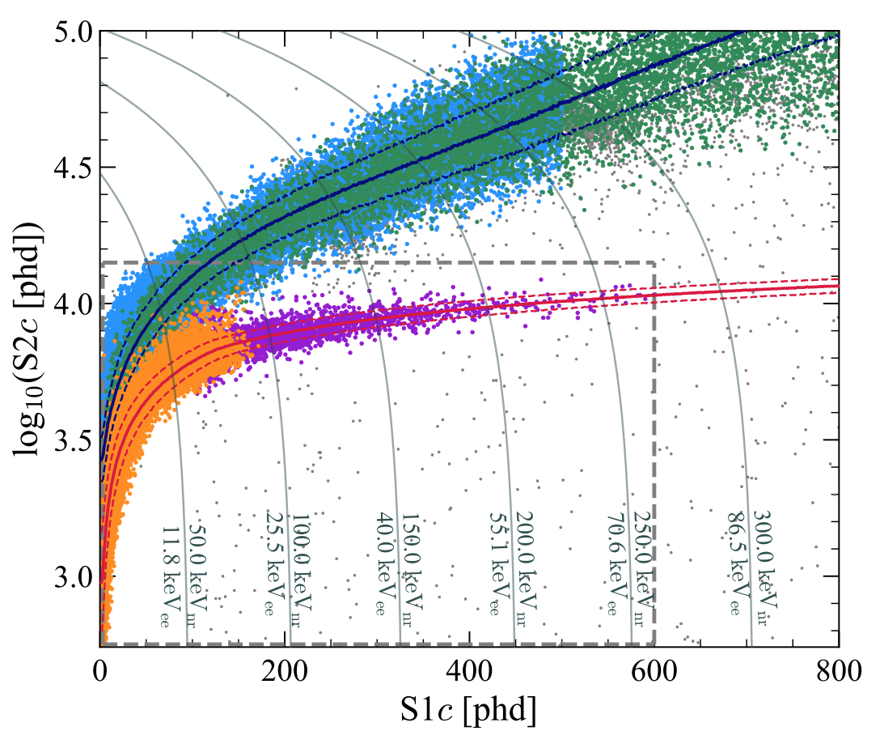
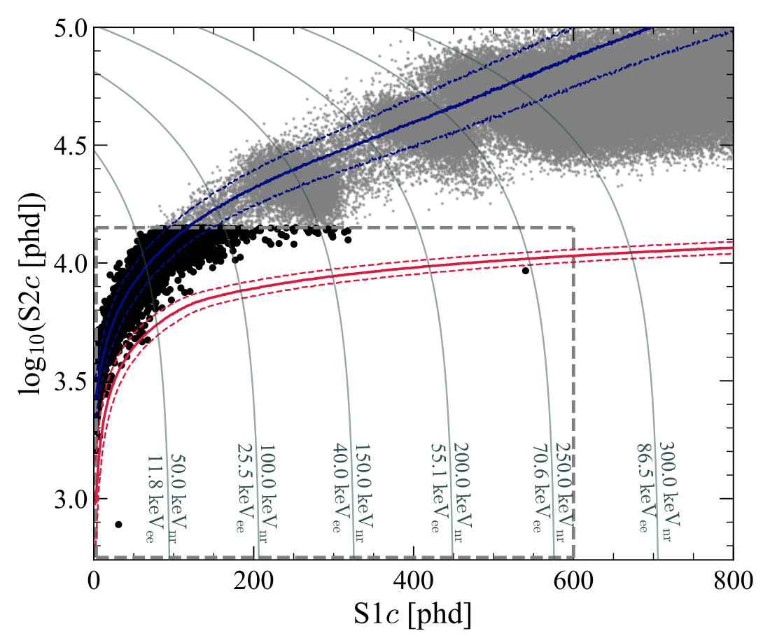
Recent LZ Result: Big https://arxiv.org/pdf/2609.02823
NEST was critical in nailing the ER and NR band means and widths
MC sims & calibration working together in a symbiotic relationship
NEST did need tweaking for EC, DEC
The Seattle Times
Tritium and C-14 (blue)
Also
in
the
NYT!
Pb-212 (green)
What are these points below the beta band?
NEST predicted long ago less Q_{y} from gammas
AmBe (purple)
D-D again
(orange)
Going back in time to
https://arxiv.org/abs/1307.6601
https://link.aps.org/doi/10.1103/447w-94h3 (LZ PRD)
GdLS is CRITICAL to LZ!

Slide 12
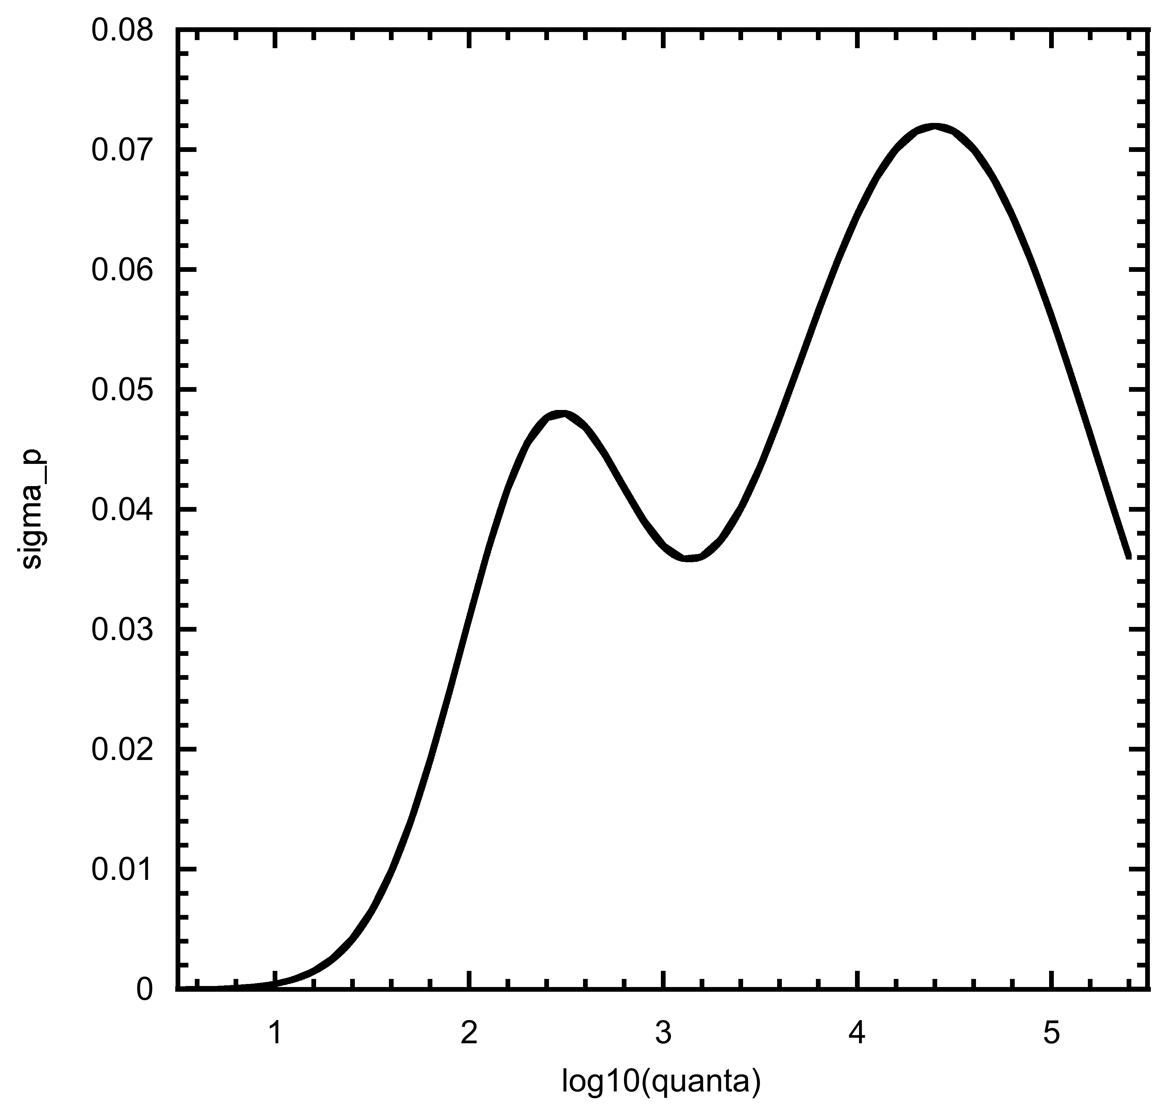
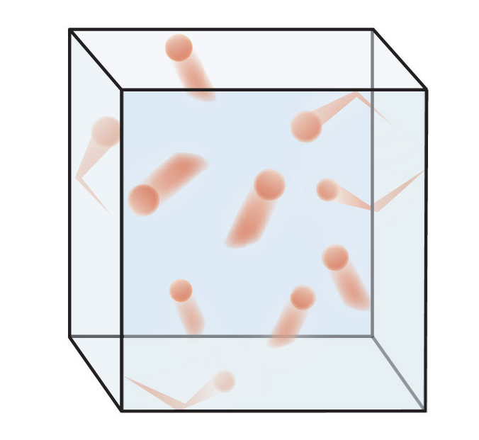
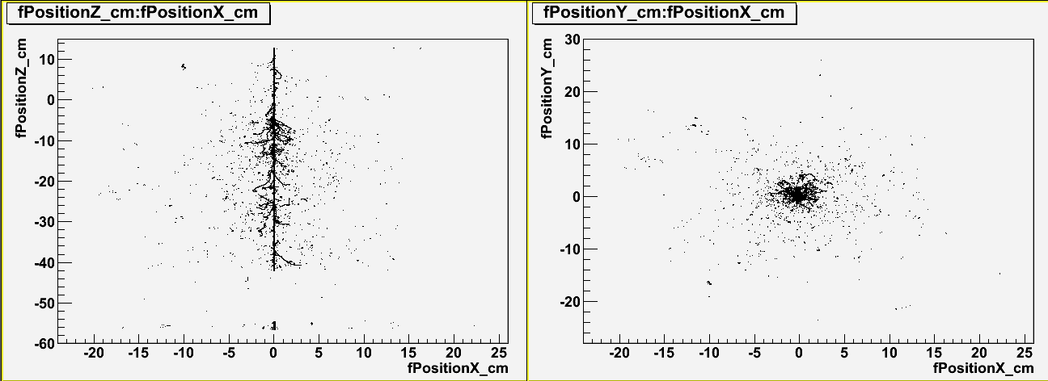
NEW Dual Skew Gaussian for Recombination Fluctuations
The width of the ER band for a dark-matter search region driven primarily by that first peak
  Famously non-binomial in LXe
But.. we care about higher energies now! (EFT, HENR)
NEST did ignore a known problem for years, on S1 and S2 resolutions
  Because, for mono-E bumps, the combined-E scale hides problem
Empirical-only patch for now but we’ll circle back to first principles eventually
  Likely explanation: boxy and cylindrical tracks (T-I and Doke)
ampl = 0.05-0.10
mean = 4-5
width = 0.5-1.0
(driven primarily by gamma calibration humps)
100s of keV to MeV
sometimes called omega or Fr
ampl = 0.02-0.05
mean = 1-3
width = 0.2-0.5
Sub-keV to
10s of keV
Notes:
ER band width driven by these

Slide 13
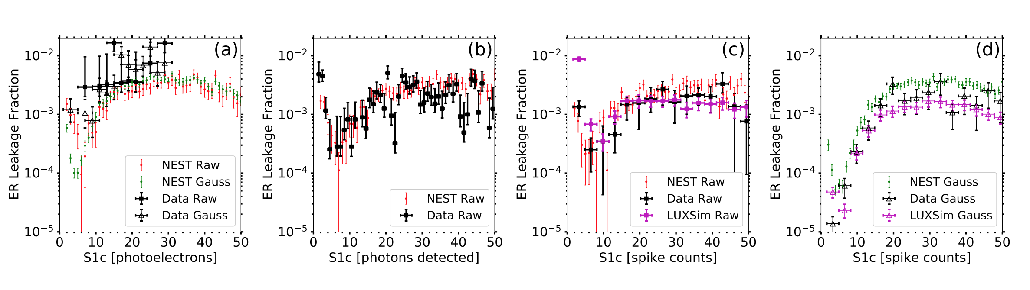
Leakage Dependence at Low-Energy Pulses
arXiv:2211.10726 (v3)
Based only on last model’s lower-energy peak. Signal (NR) vs. BG (ER)
As a function of S1 or energy, the NR and ER bands start in a fuzzy overlap, then separate, then “kiss” at medium energies, and then separate hugely
The checkmark shape was a prediction (pre-LUX)
Naïve extrapolation was wrong
Notes:
Signal background discrimination driven by ER width (and NR versus ER separation, of course). Extrapolate this to higher S1 and leakage goes to ~Zero!

Slide 14
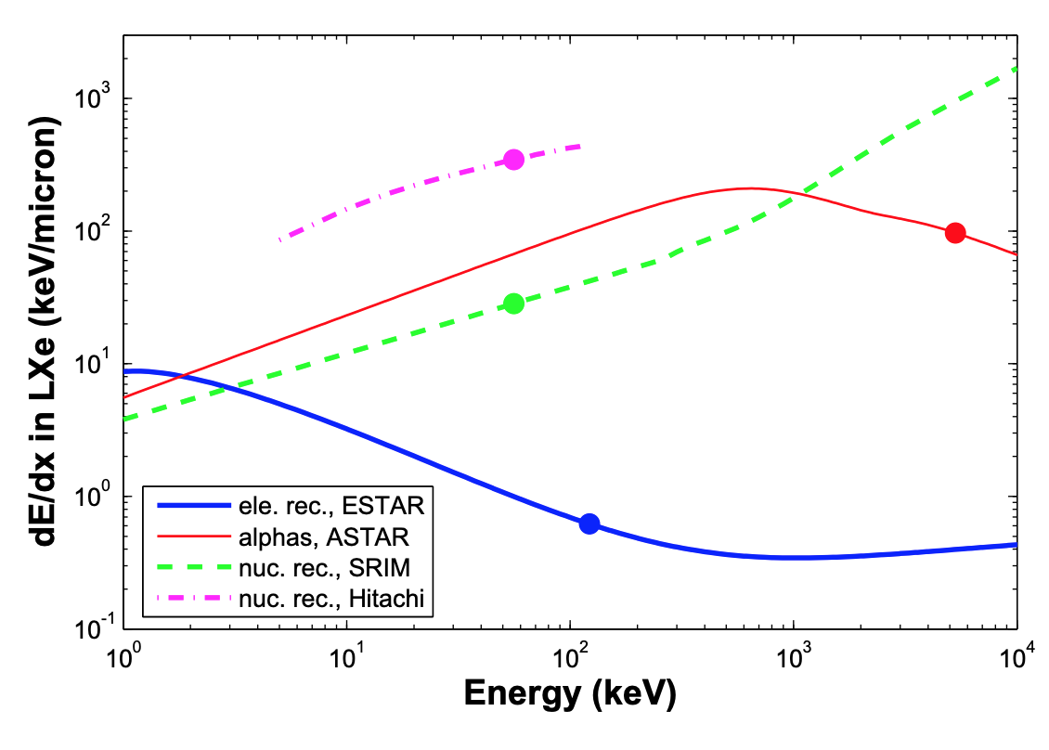
Another Tweak: But an Old Paper NEST Based on Helped!
https://inspirehep.net/literature/709143
Aprile et al. landmark study in PRL proving NRs observable
Forgotten plot at end of an important paper with much more significant plots, based on real data
Until EFT operator-based searches, no one cared about O(100 keV_{nr}) in Xe
  So, this was a low priority for NEST as well
But, no need to add fudge factors or kludges: existing NEST functions and parameters workable
this kink here is critical to understanding the mean of the high-energy NR band from AmBe in LZ!
In a ER BG-free regime
Notes:
NR band median or centroid also part of the discrimination equation

Slide 15
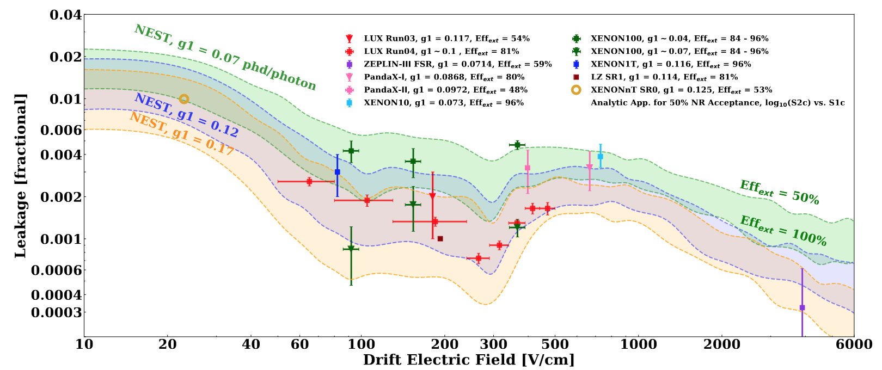
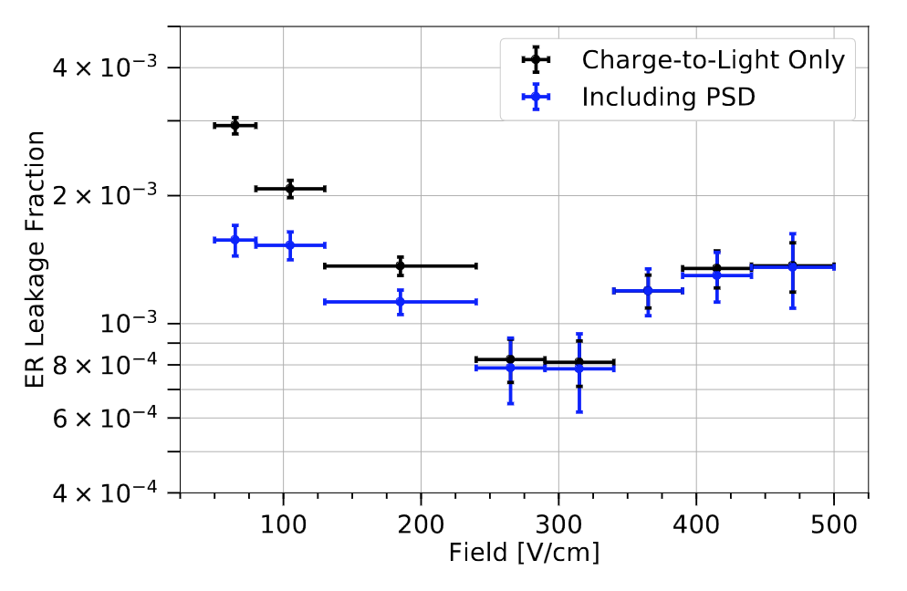
The Future of LXe: Key Plot From the Latest NEST Paper
Each point in it is an average over an S1 range (see Slide 13)
below work extended now in https://arxiv.org/abs/2603.26877, which made cover of EJPC!
UAlbany worked closely w/ Rochester on LZ to add S1 PSD, as it enhances discrimination if field is low (at right)
These are not error bands but differences in other dimensions
https://arxiv.org/pdf/2004.06304.pdf (PRD)
PSD = Pulse Shape Discrimination (S1)
Work carried forward from LUX -> LZ
Notes:
the discrimination is a function of field not just energy

Slide 16
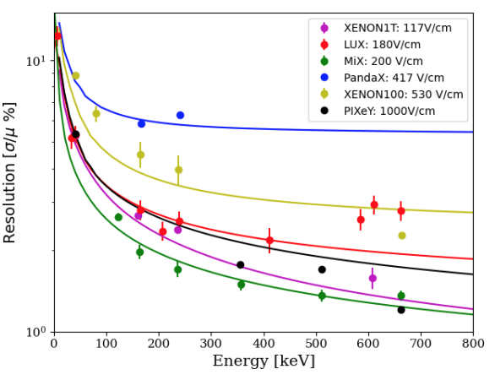
Back to Monoenergetic Peaks
Band widths for continuous spectra, mono-E peak resolutions from γ photo-absorption contain the same contributions
  from the LXe “microphysical” details
Correlated “noise”
  Energy and density-dependent Fano factor F_{q} applied to the total quanta
Anti-correlated fluctuations
  Excitations and recombination
Uncorrelated noise
  Known: g1 and the g2 “family”
  Unknown: linear Gaussian terms
Over-reliance on the unknown terms has been going down and down over the years to ~0%
  but E-dep. Fano still seems real and necessary to include
https://scholarsarchive.library.albany.edu/cgi/viewcontent.cgi?article=4005&context=legacy-etd
Greg R. PhD thesis
LZ seems to have hit the bottom: lowest energy res. at Q_{ββ}

Slide 17
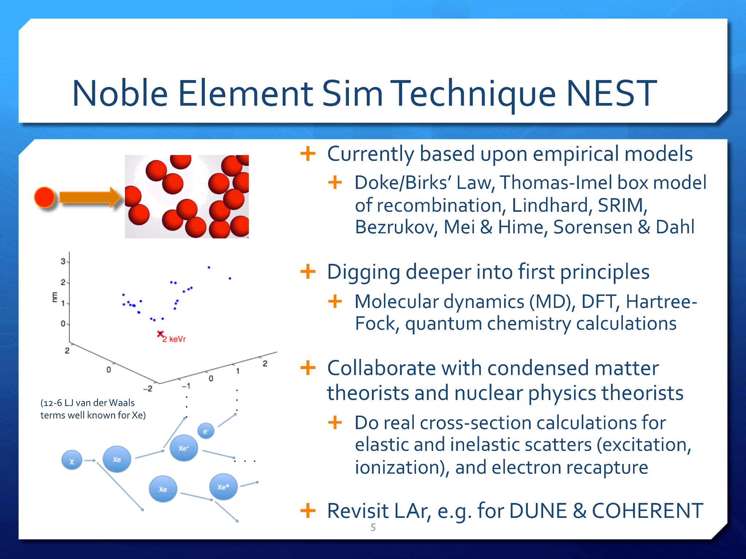
The Future of the
DFT = Density Functional Theory
I unfortunately never have time to get to this!

Slide 18

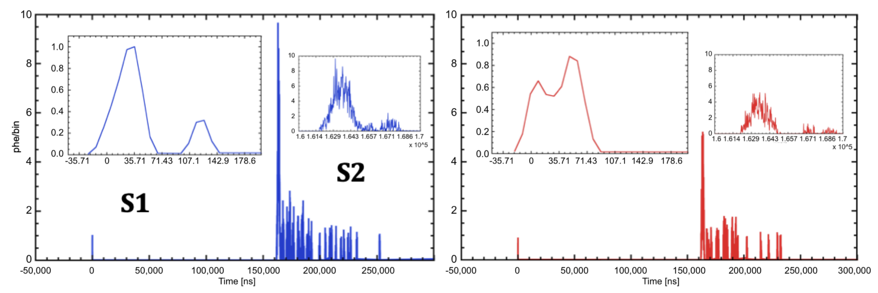
Pulse Shapes in the Here and Now: The Forgotten Feature
https://arxiv.org/pdf/2211.10726v3 (Version 3 specifically)
ER
e- trains!
NR
Credit: Maria Elena Monzani, SLAC
This is built upon earlier work: https://iopscience.iop.org/article/10.1088/1748-0221/9/04/T04002 (newer not published, like leakage plots. Why?)

Slide 19
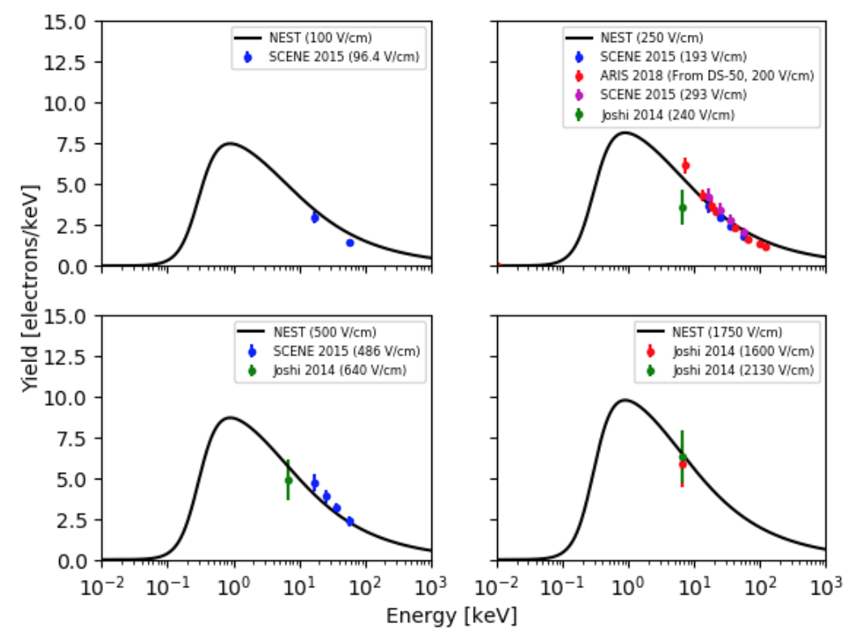
I Never Have The Time to Cover Liquid Argon (+GXe, etc.)
Dave Nygren
On the total opposite end of energy from this: we absolutely do have models useful for DUNE. Data from ICARUS reproduced in Instruments paper
Choosing only these plots to show: Qy at low energies
  Relevant to S2-only searches for low-mass WIMPs
Call to action: still waiting on DarkSide to try out NEST
In addition to informal note on site (https://docs.google.com/document/d/1vLg8vvY5bcdl4Ah4fzyE182DGWt0Wr7_FJ12_B10ujU/edit?tab=t.0) we have paper
https://doi.org/10.3390/instruments5010013

Slide 20
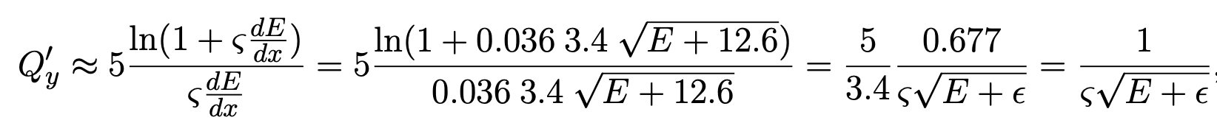
Charge Yield Equations: Retroactively Justified / Validated
in NEST Frontiers paper
Perfect example of cross-pollination: This came from grabbing ideas from LAr modeling for ER in DUNE, seriously! Being used for WIMP quest in LXe NRs!
(’ is NR, not ER)
modified Thomas-Imel box model of recombination from LArIAT
see the 2005 dE/dx plot from earlier!
At the end: this is where NEST empirical charge model for NR started
THIS SHOWS THAT EVEN EQUATIONS ORIGINALLY CONSIDERED 100% EMPIRICAL WERE PHYSICAL
This has happened many times (like power-law L-factor for total quanta in NR: consistent with a power of 1.0)
Notes:
Exponent of 1.0: Lindhard k-factor also recovered

Slide 21
Past and/or Present Contributors to NEST
no particular order!
Jon Balajthy
Grant Block
Jason Brodsky
Ethan Brown
Jacob Cutter
Sophia Farrell
Junying Huang
Alvine Kamaha
Yung Nok Lau
Ekaterina Kozlova
Chloe Liebenthal
Daniel McKinsey
Kirsten McMichael
Ryan McMonigle
Michael Mooney
Justin Mueller
Kaixuan Ni
Greg Rischbieter
Kian Trengove
Mani Tripathi
Chris Tunnell
Vetri Velan
Shawn Westerdale
Madison Wyman
Min Zhong
Zehong Zhao
Cecilia Levy
Greg Blockinger
Nishat Parveen
Collin Farquhar
Alex Flesher
Emily Mangus
Andrew Schwartz
Brian Lenardo
Kareem Kazkaz
Aaron Manalaysay
Jeremy Mock
Nichole Barry
Sergey Uvarov
Michael Woods
Nicholas Walsh
Adalyn Fyhrie
Daniel Thorngren
Richard Ott
James Morad
Jamison Blanchard
Augustine Zhao
Robert Svoboda
Melinda Sweany
Evan Angelico
Dustin Stolp
Jacob Pasner

Slide 22
Past and/or Present Contributors to NEST (Many on LZ!)
Attila Dobi
Maria Elena Monzani
Quentin Riffard
Luke Kreczko
Paola Ferrario
Albert Baker
Sky Shi
Scott Kravitz
Ryan Linehan
Vladislav Soshnikov
Robert James
Yanina Biondi
Lukas Gerritzen
Noah Everett
Dacheng Xu
Lanqing Yuan
Pierce Comerford
Chami Amarasinghe
Alberto Uson
Olga Razuvaev
Sam Eriksen
Nicholas Carrara
Michael Mulhearn
Sebastian Vetter
Joran Angevaare
...people I missed!

Slide 23
Publications
https://arxiv.org/abs/1106.1613
  https://doi.org/10.1088/1748-0221/6/10/P10002 (peer-reviewed version of record: JINST)
https://arxiv.org/abs/1307.6601
  https://doi.org/10.1088/1748-0221/8/10/C10003 (JINST conference proceedings)
https://arxiv.org/abs/1310.1117
  https://doi.org/10.1088/1748-0221/9/04/T04002 (JINST “technical paper”)
https://arxiv.org/abs/1412.4417
  https://doi.org/10.1109/TNS.2015.2481322 (Transactions in Nuclear Science)
https://arxiv.org/abs/2007.00528
  https://doi.org/10.1103/PhysRevD.103.012002 (Physical Review D)
https://arxiv.org/abs/2102.10209
  https://doi.org/10.3390/instruments5010013 (MDPI Instruments)
https://arxiv.org/abs/2211.10726
  https://doi.org/10.3389/fdest.2024.1480975 (Frontiers in Detector Science)

Slide 24
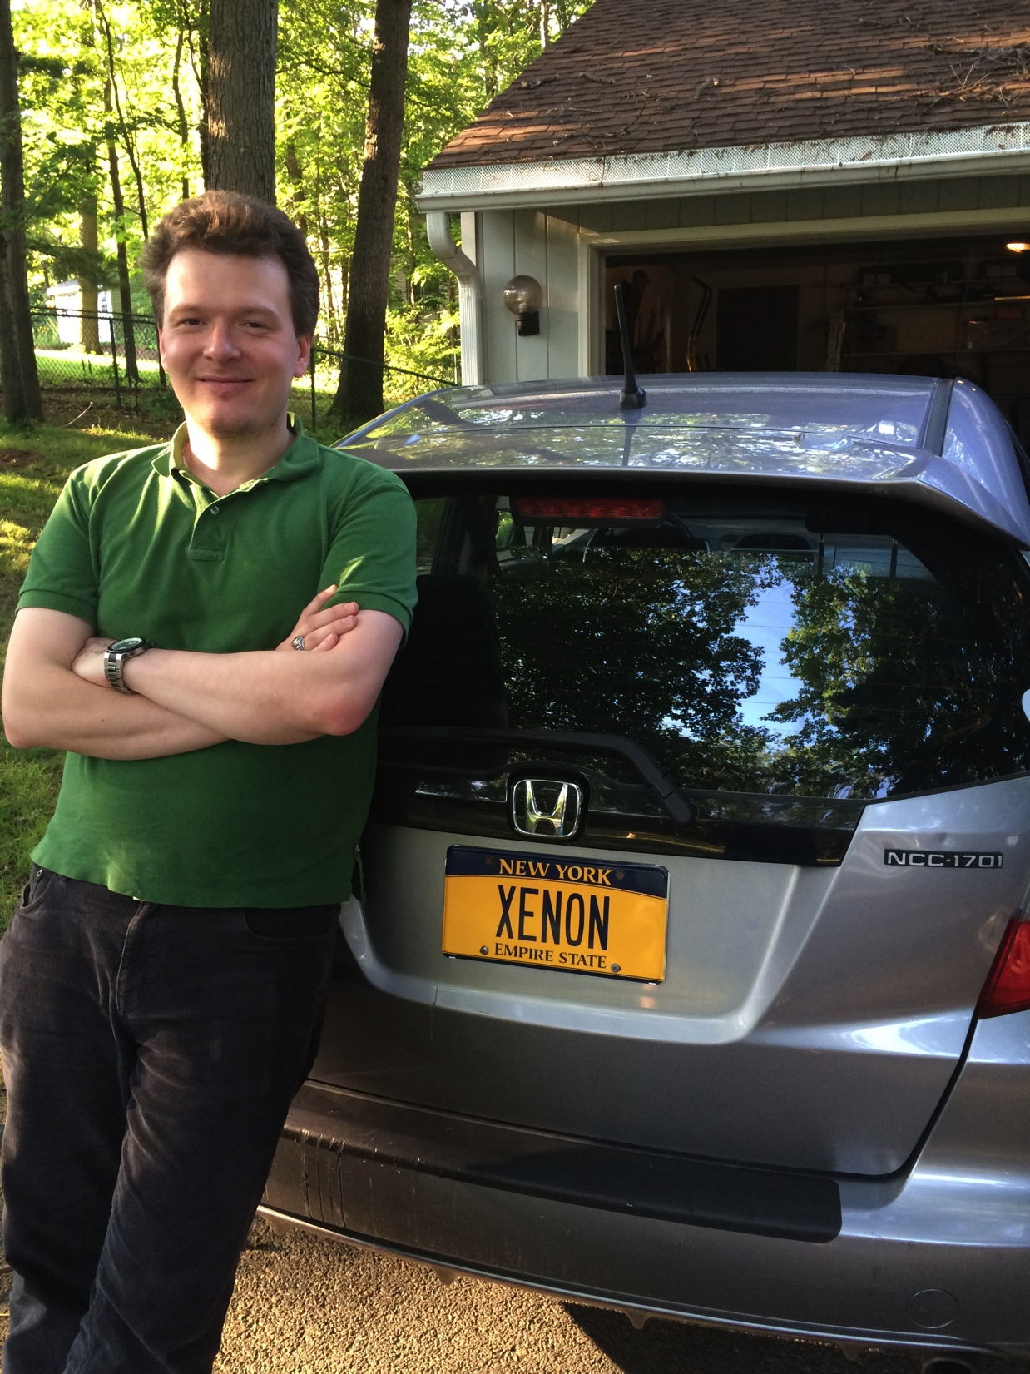

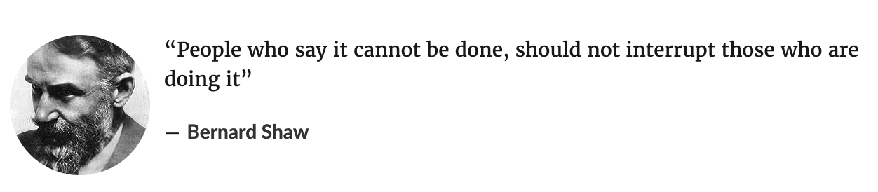
Conclusion
(sadly, I don’t have that car nor license plate any longer!!)
(this quote is a huge inspiration of mine)

