Slide 1
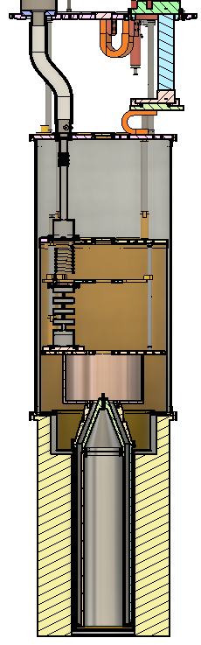
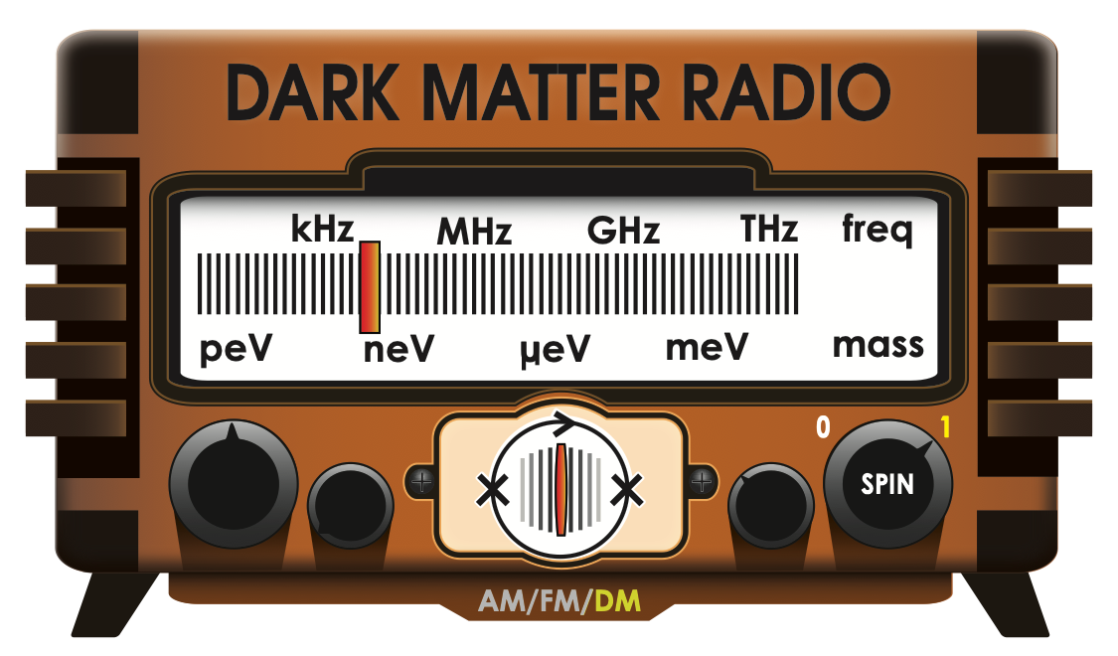
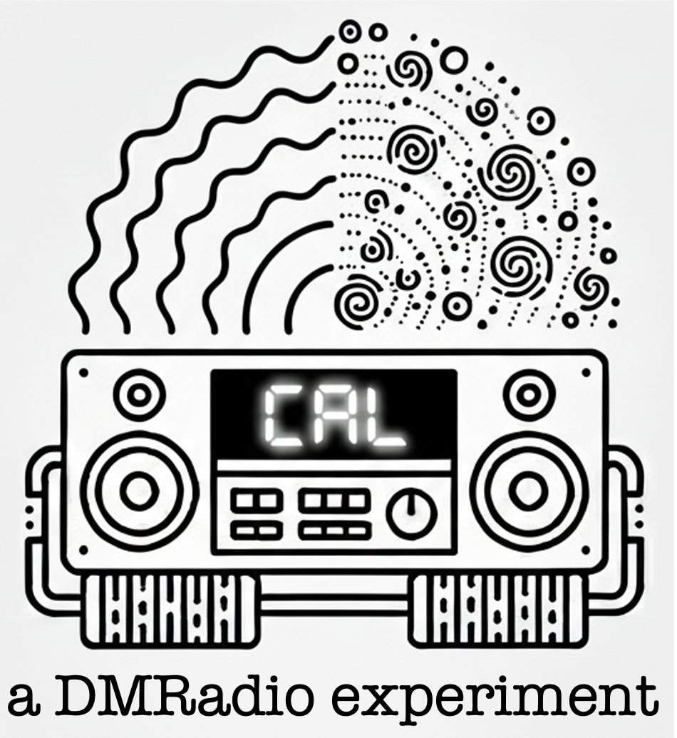


CAL-Pathfinder
Shreya Puranam
CPAD October ‘26
S. Puranam
spuranam0305@berkeley.edu
Notes:
Change color of text
Make image not white background

Slide 2
Axions
Axions are a highly motivated dark matter candidate, first proposed to solve the strong CP problem in QCD!

Slide 3
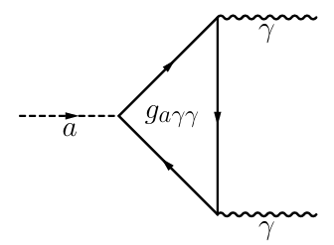
Axions
Axions are a highly motivated dark matter candidate, first proposed to solve the strong CP problem in QCD!
Search for the axion using its coupling to photons

Slide 4
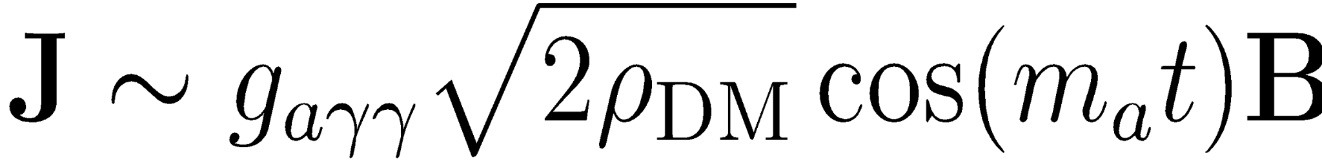
Axions
Axions are a highly motivated dark matter candidate, first proposed to solve the strong CP problem in QCD!
Search for the axion using its coupling to photons
Low mass = wave-like → searching for an effective current
→ g_{a𝛾𝛾} = coupling strength to photons
→ ⍴_{DM}= dark matter density
→ m_{a} = axion mass
Notes:
- State specifically frequency stuff

Slide 5
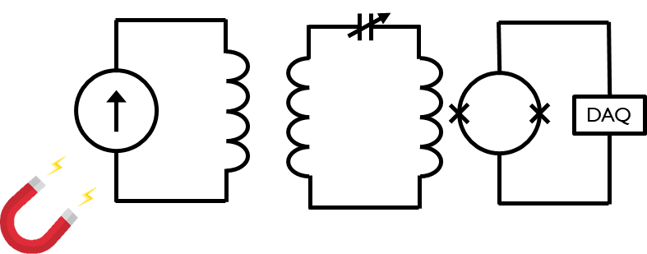
Lumped Element Detection
Lumped element: 𝜆_{axion} > detector size
Resonant modes are given by inductive and capacitive elements
Use an LC resonator with the axion effective current acting as a current source
flux to voltage amplifier
Notes:
Note aloud CAL-Pathfinder starts to leave the >> limit
Resonant modes are not intuitive

Slide 6
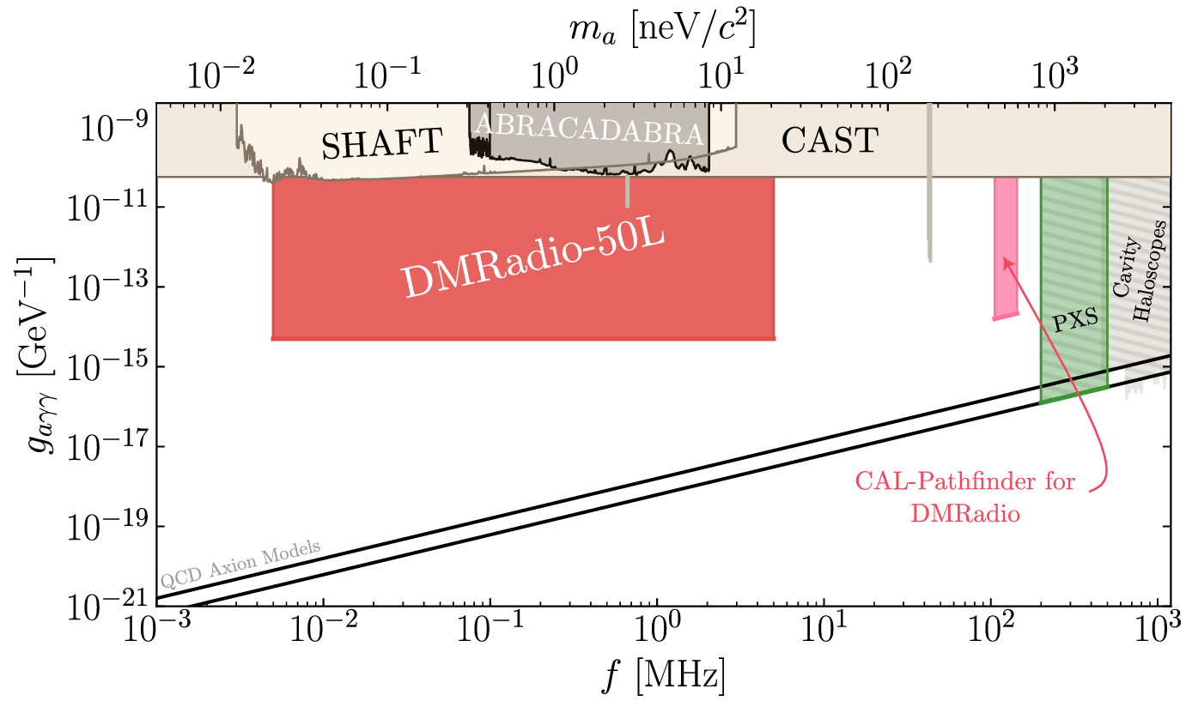
DMRadio Program

Slide 7
DMRadio Program
DMRadio-50L
20 peV – 20 neV (5 kHz – 5 MHz)
1T Toroidal magnet
Commissioning is in progress at Stanford!

Slide 8
DMRadio Program
CAL-Pathfinder
108-133 MHz
9T Solenoidal magnet
Located in Berkeley

Slide 9
CAL: Cal Axion LC
Demonstrate solenoid geometry for axion searches while holding discovery potential for axions and high frequency gravitational waves
Building on existing DMRadio expertise and infrastructure
Initial phase (CAL-Pathfinder) is funded by Templeton
Hosted in a BlueFors LD400 dilution refrigerator at Berkeley

Slide 10
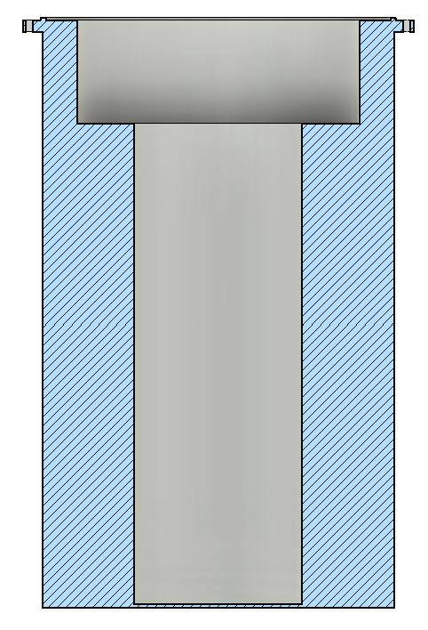
How CAL Couples to Axions
Solenoidal B-Field

Slide 11
Solenoidal B-Field
Axion Effective Current

Slide 12
Solenoidal B-Field
Axion Effective Current
Axion Induced B-Field

Slide 13
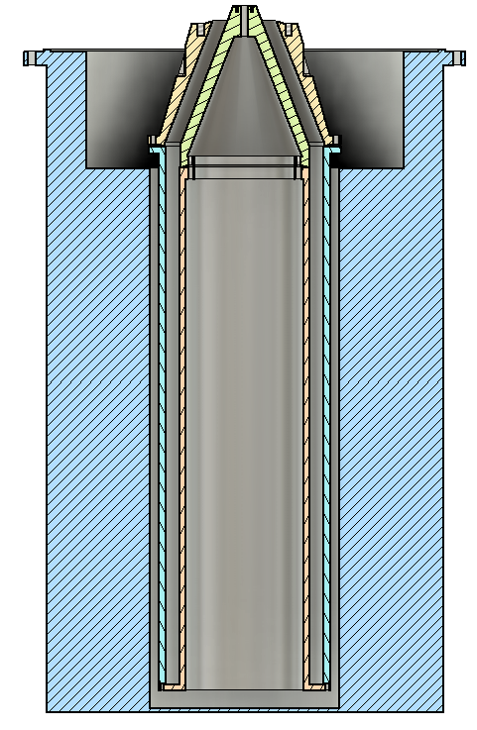
Pickup
Axion Induced B-Field

Slide 14




Pickup
Axion Induced B-Field
Induced Current

Slide 15
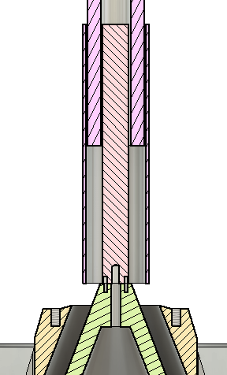
Tuner
Pickup
Axion Induced B-Field
Induced Current

Slide 16
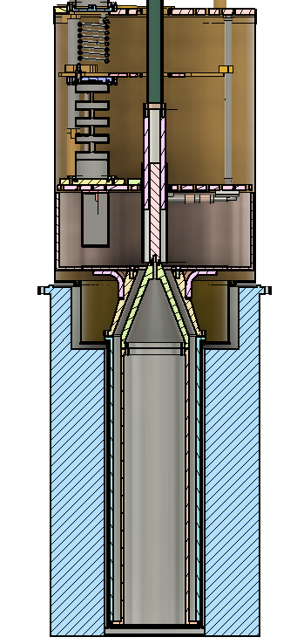
The CAL-Pathfinder Detector
SQUIDs
Low Field Box
Coaxial Tuner
Coaxial Pick-up
Magnet
Notes:
Say between here and next slide that these are all things we have been working on but focus of talk will be the tuner and pickup. Happy to chat about the other components after.

Slide 17
The CAL-Pathfinder Detector
SQUIDs
Low Field Box
Coaxial Tuner
Coaxial Pick-up
Magnet
Notes:
Say between here and next slide that these are all things we have been working on but focus of talk will be the tuner and pickup. Happy to chat about the other components after.

Slide 18
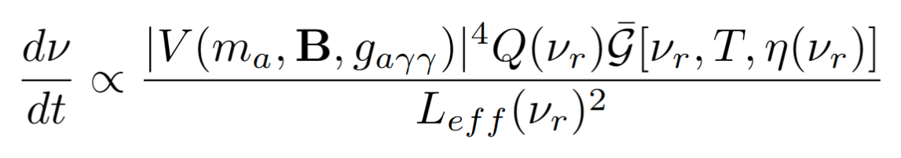
What is Scan Rate for CAL-Pathfinder
Magnitude of the induced voltage
from arXiv:2302.14084v2
Notes:
Cite EM modeling paper

Slide 19
What is Scan Rate for CAL-Pathfinder
Total effective inductance
from arXiv:2302.14084v2
Notes:
Cite EM modeling paper

Slide 20
What is Scan Rate for CAL-Pathfinder
Quality factor of the resonator
from arXiv:2302.14084v2
Notes:
Cite EM modeling paper

Slide 21
What is Scan Rate for CAL-Pathfinder
Parameterizes the noise physics.
from arXiv:2302.14084v2
Notes:
Cite EM modeling paper

Slide 22
Designing the Coaxial Pick-Up and Tuner
Design coaxial pickup
Does it fit in our fridge and magnet?
Unrealistic Designs

Slide 23
Designing the Coaxial Pick-Up and Tuner
Design coaxial pickup
COMSOL
Does it fit in our fridge and magnet?
Unrealistic Designs
Extract impedance and voltage in presence of axion effective current

Slide 24
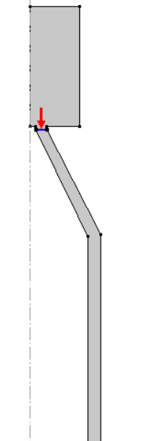
Designing the Coaxial Pick-Up and Tuner
Design coaxial pickup
COMSOL
Does it fit in our fridge and magnet?
Unrealistic Designs
Extract impedance and voltage in presence of axion effective current
Extracting the impedance: Solve for the impedance across a lumped port (red arrow on the right).

Slide 25

Designing the Coaxial Pick-Up and Tuner
Design coaxial pickup
COMSOL
Does it fit in our fridge and magnet?
Unrealistic Designs
Extract impedance and voltage in presence of axion effective current
Extracting the voltage response:
1. Define an external current density that is the axion effective current.

Slide 26
Designing the Coaxial Pick-Up and Tuner
Design coaxial pickup
COMSOL
Does it fit in our fridge and magnet?
Unrealistic Designs
Extract impedance and voltage in presence of axion effective current
Extracting the voltage response:
2. Solve for voltage across the lumped port.

Slide 27
Designing the Coaxial Pick-Up and Tuner
Design coaxial pickup
COMSOL
Does it fit in our fridge and magnet?
Unrealistic Designs
Extract impedance and voltage in presence of axion effective current
Design tuner to cancel highest range of coaxial impedances
Using Pozar, D. M. (2012). Microwave engineering (4th ed.). John Wiley & Sons.
Notes:
Cite pozar

Slide 28
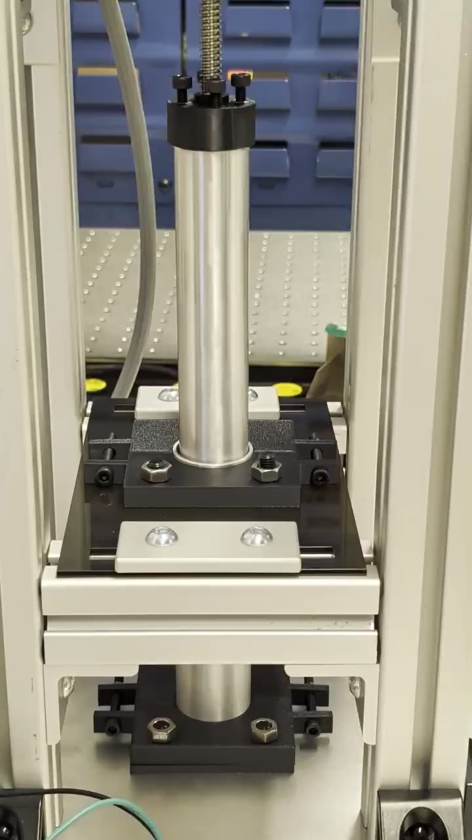
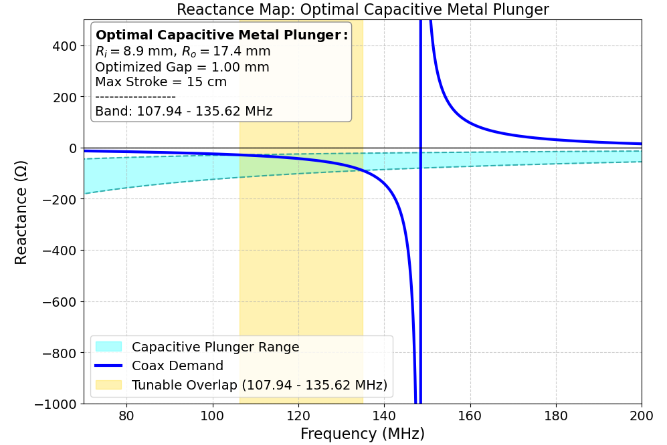
Designing the Coaxial Pick-Up and Tuner
Design coaxial pickup
COMSOL
Does it fit in our fridge and magnet?
Unrealistic Geometries
Extract impedance and voltage in presence of axion effective current
Design tuner to cancel highest range of coaxial impedances
Using Pozar, D. M. (2012). Microwave engineering (4th ed.). John Wiley & Sons.
Notes:
Cite pozar

Slide 29
Designing the Coaxial Pick-Up and Tuner
Design coaxial pickup
COMSOL
Does it fit in our fridge and magnet?
Unrealistic Designs
Extract impedance and voltage in presence of axion effective current
Design tuner to cancel highest range of coax impedances
Can we build this tuner?

Slide 30
Designing the Coaxial Pick-Up and Tuner
Design coaxial pickup
COMSOL
Does it fit in our fridge and magnet?
Unrealistic Designs
Extract impedance and voltage in presence of axion effective current
Design tuner to cancel highest range of coax impedances
Can we build this tuner?
Calculate scan rate
Final geometry chosen is the one that gives us the best scan rate

Slide 31
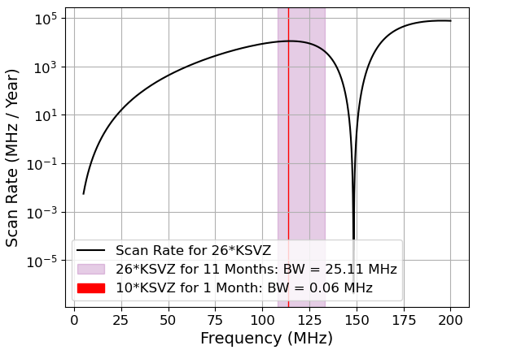
Expected CAL-Pathfinder Scan Rate
Current Run Plan
Axion sensitivity of 26*KSVZ for 11 months spanning 108-133 MHz
Axion sensitivity of 10*KSVZ for 1 month at 114 MHz
Note: this assumes a sensitivity bandwidth of 10 kHz
Notes:
Get rid of inductive tuner
Main message is we have options on what run plan will be
100*KSVZ black line
Make labels larger
Spend more time here!!

Slide 32
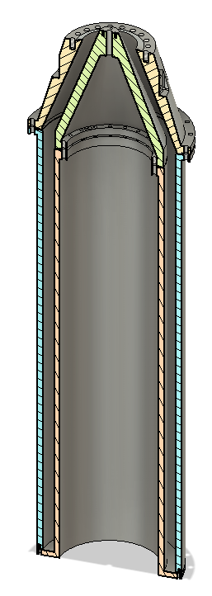
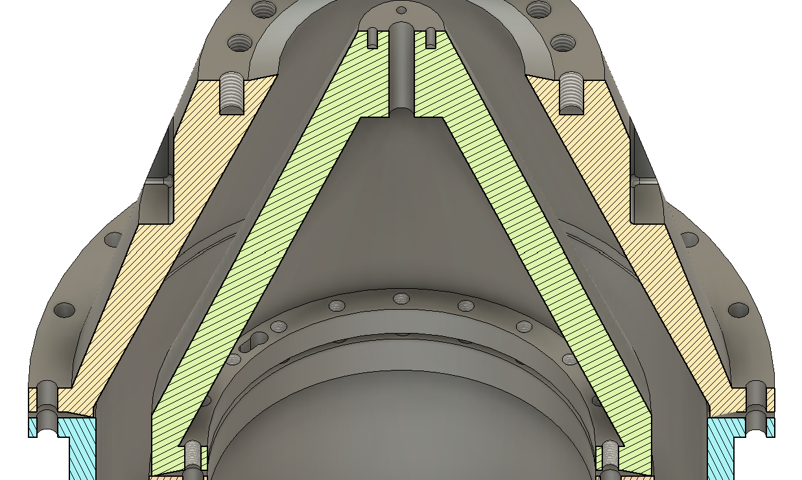







Building the Coaxial Pick-Up
Material: Copper coated stainless steel
Copper coating for high Q
Stainless steel bulk for quench protection
Notes:
Explain quenching
Explain Q
Zoom into cavity to be more clear that only interior surfaces get coated

Slide 33
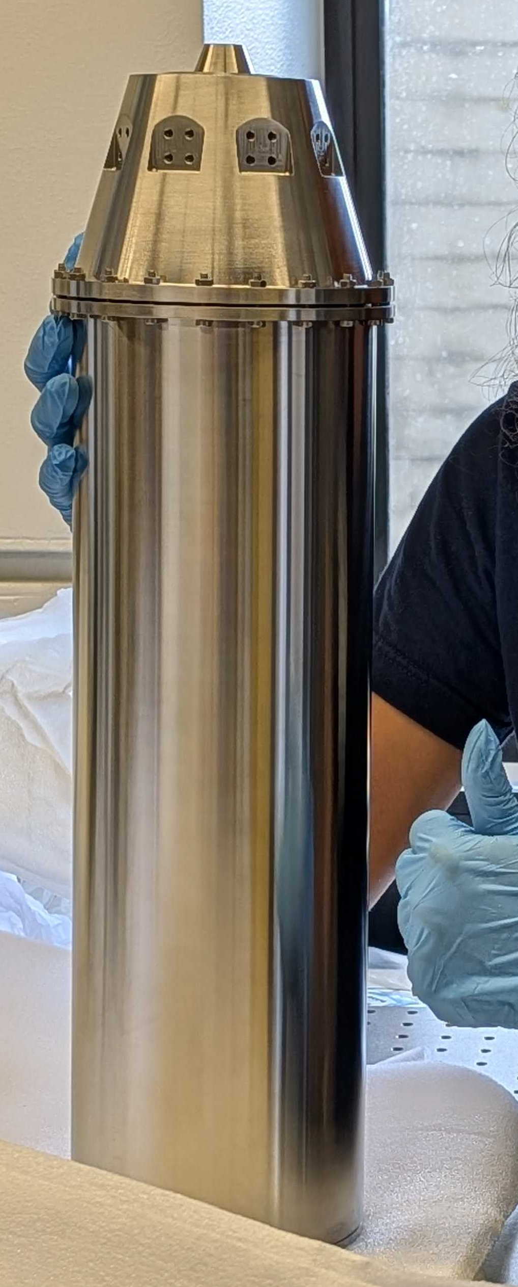
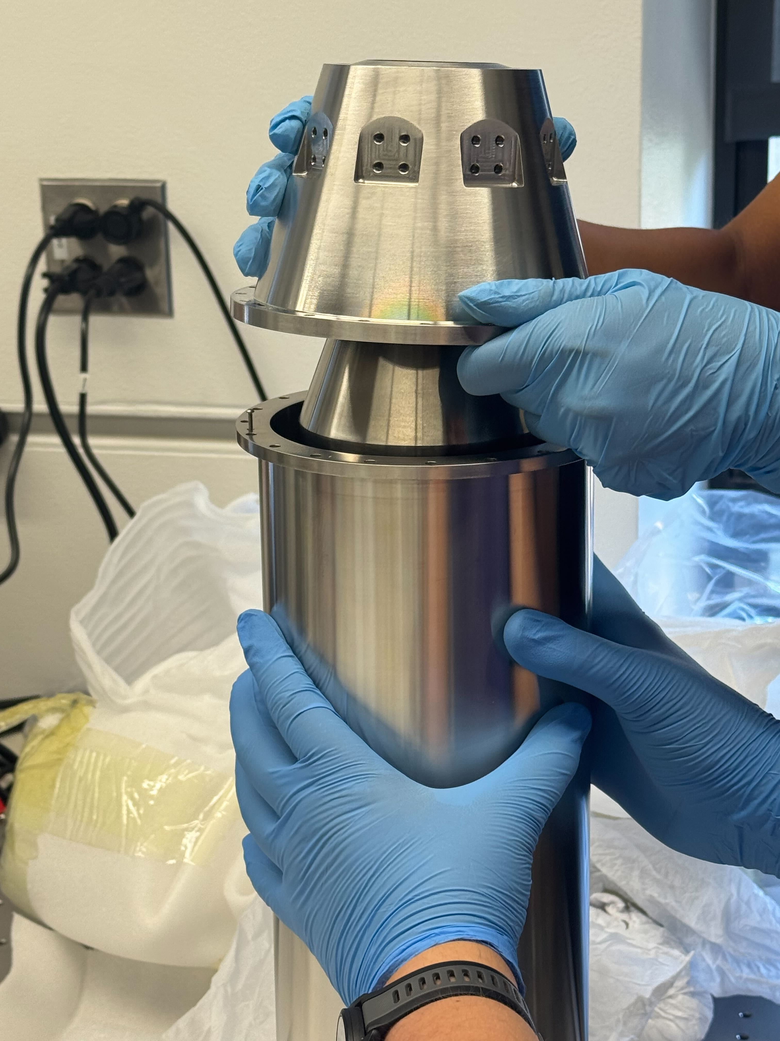
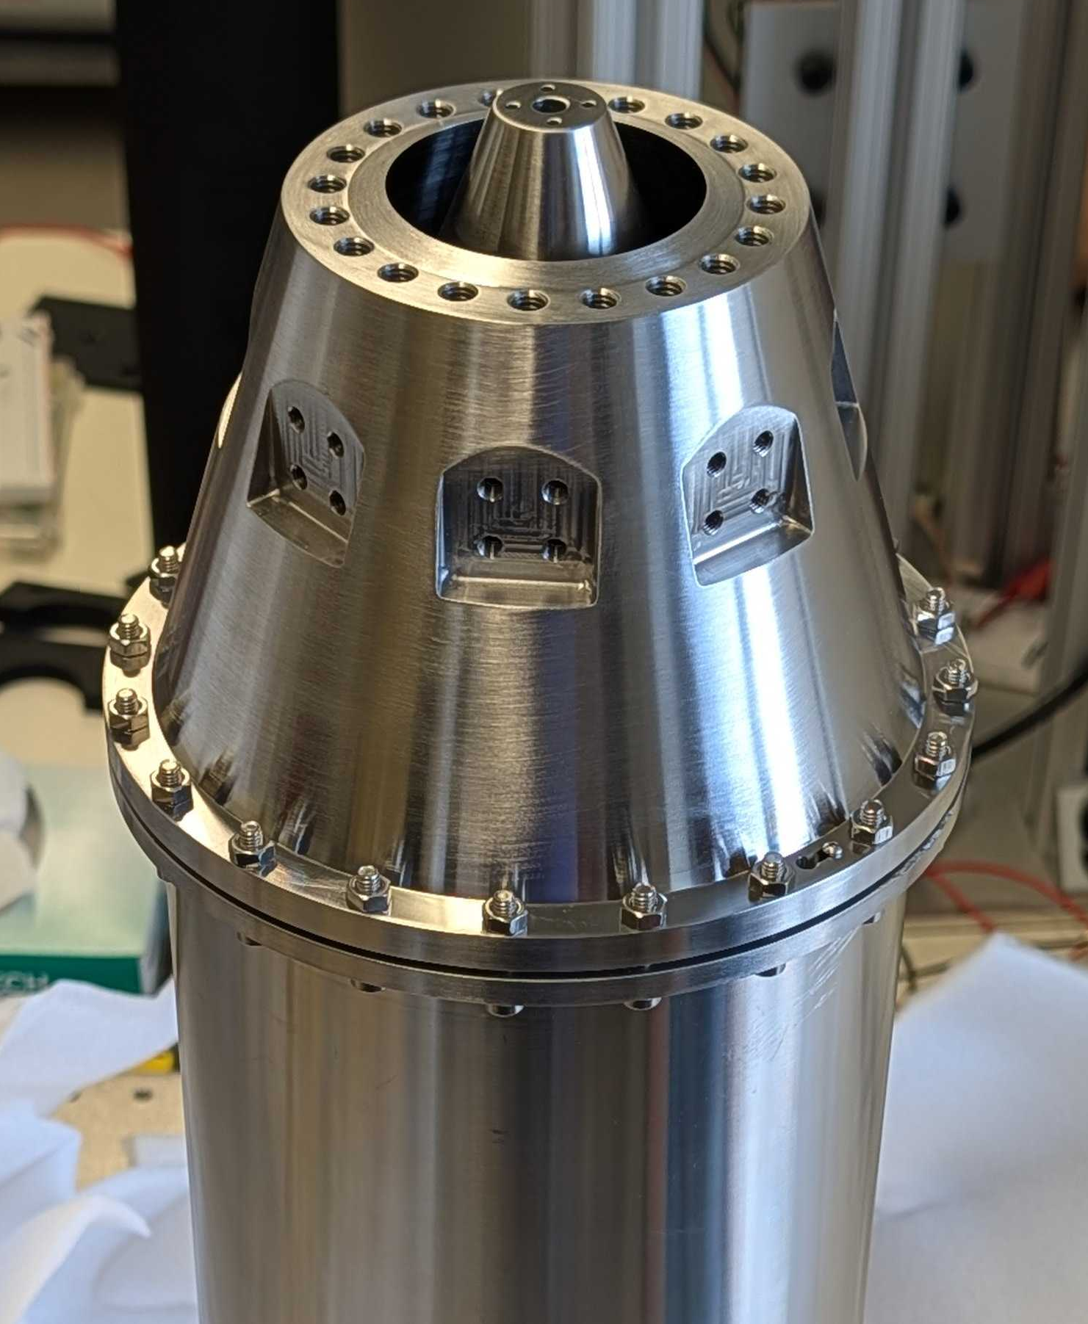
Building the Coaxial Pick-Up
Notes:
Explain quenching
Explain Q
Zoom into cavity to be more clear that only interior surfaces get coated

Slide 34
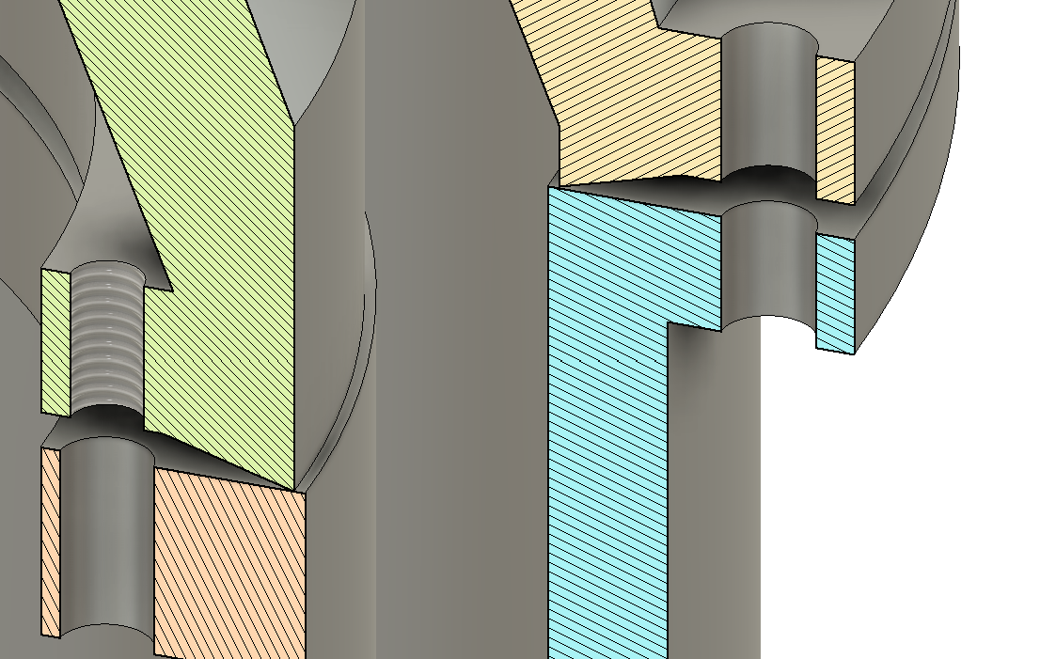
Building the Coaxial Pick-Up
Knife-edge Joints
Knife-edge Joints:
Pressure of screwing in compresses contact down to eliminate interface loss
    Testing the quality of these is one of the goals for room temperature testing of the pickup.
Notes:
- backup!

Slide 35
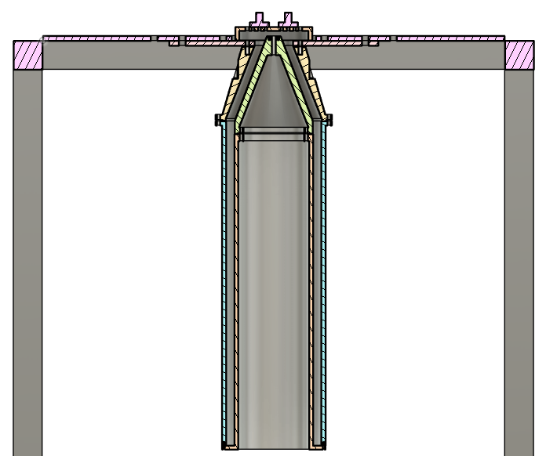
Testing the Coaxial Pickup
VNA
Goal: Measure the cavity properties of the coax and compare to COMSOL simulations.
1. Cavity Quality Factor Measurements
  Transmission measurements (S21)
  Weakly coupled antenna regime
Notes:
Beadpull and S21 are jargony!
Add wire in top image

Slide 36
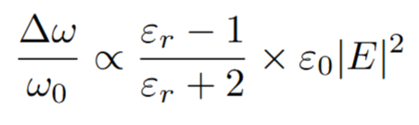
Testing the Coaxial Pickup
VNA
Goal: Measure the cavity properties of the coax and compare to COMSOL simulations.
2. Mode Mapping: Bead Pull
  Introduce a small bead (PTFE) to perturb the field inside of a cavity
  Measuring a change in resonance frequency maps to field strength in that location
Using Pozar, D. M. (2012). Microwave engineering (4th ed.). John Wiley & Sons.
Notes:
Cite Pozar

Slide 37
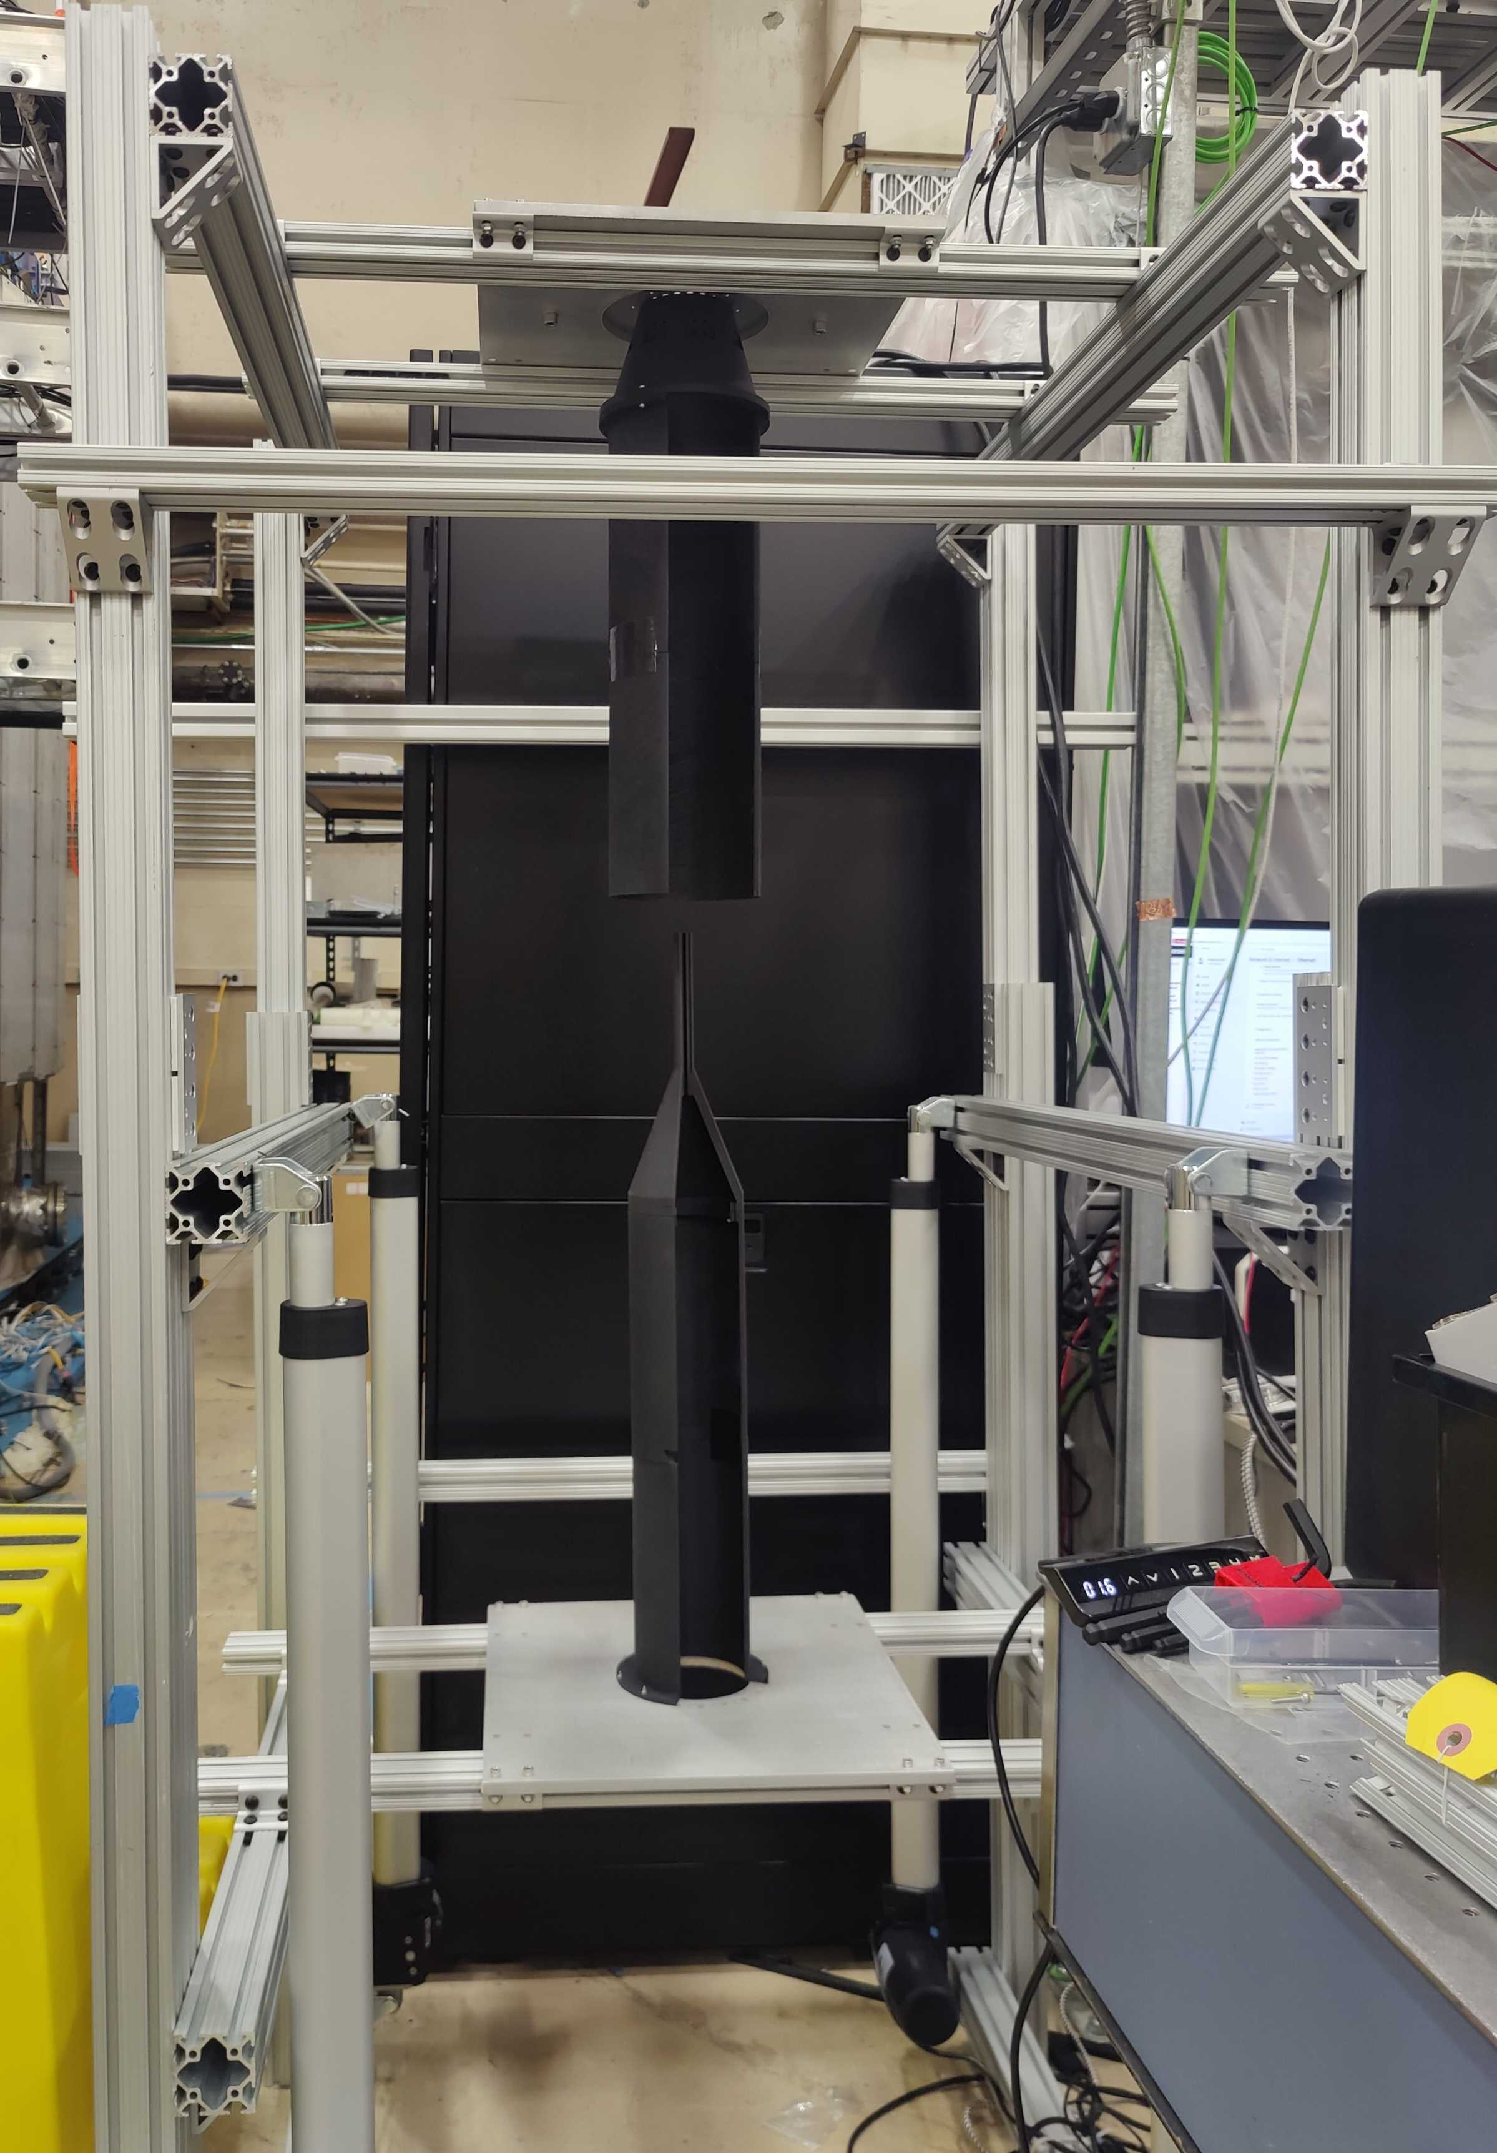
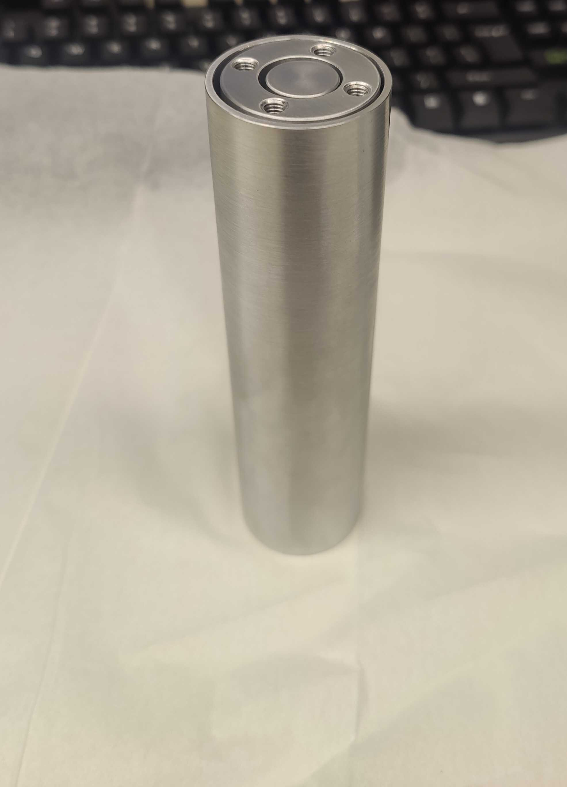
Current Status of Coaxial Pickup and Tuner
Tuner
Prototype has been manufactured
First room temperature capacitance measurements are underway!
Pickup
Assembly procedure tested with 3D print
Coated and arriving back today!
Room temperature tests starting next week.

Slide 38












Slide 39


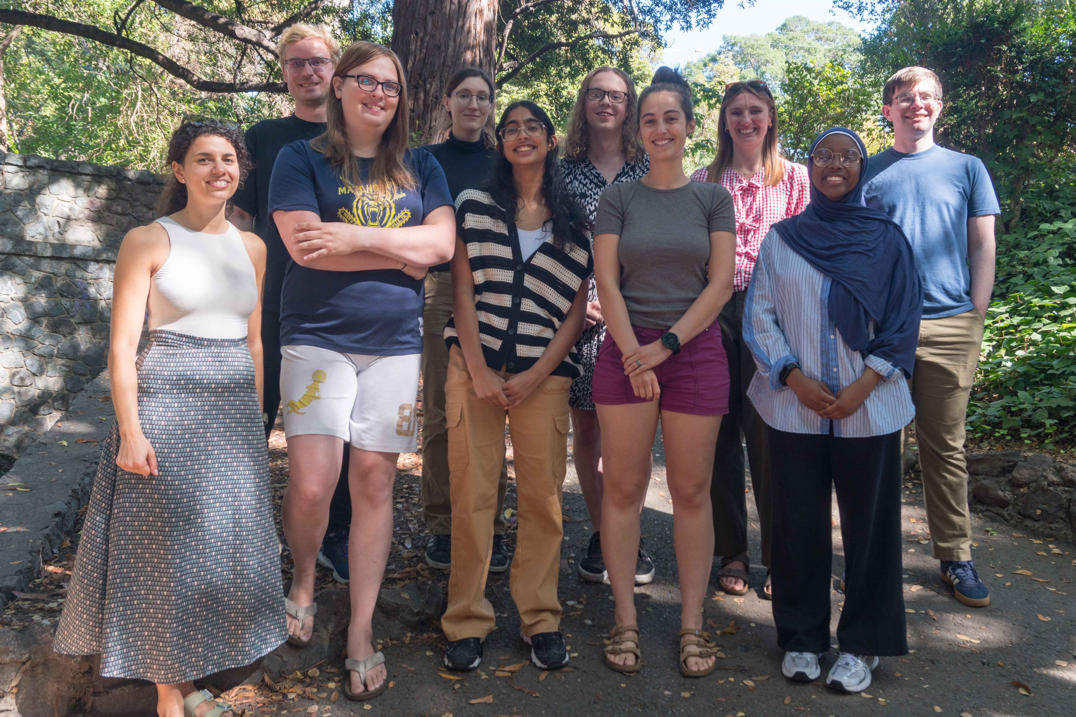
Notes:
- Play around more with images

Slide 40
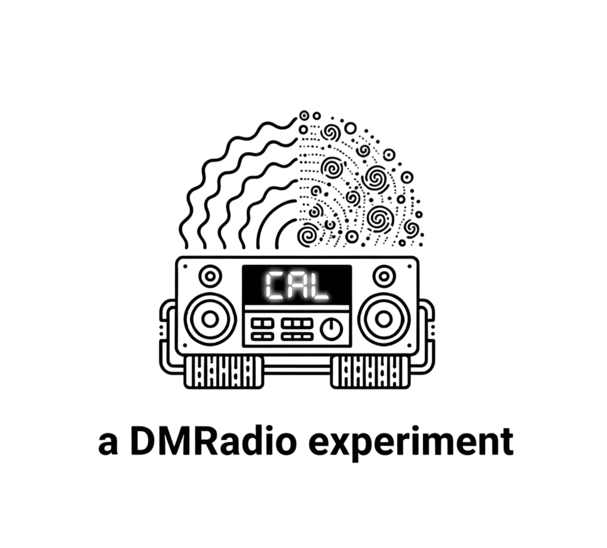
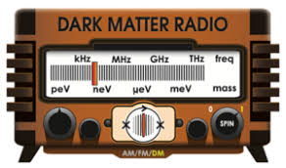

Summary
CAL-Pathfinder is a solenoidal lumped element experiment
  Novel coaxial pick-up
  Targeting axions in the 108-133 MHz range
Many critical parts of CAL-Pathfinder are being designed and tested
  Coaxial pick-up is being tested
  Tuner prototype is being tested
  SQUIDs are being designed and tested
  Shielding box is under design
  Cryo-actuation methods are under design
Goal is to have first science data in 2027!

Slide 41
Backup Slides

Slide 42
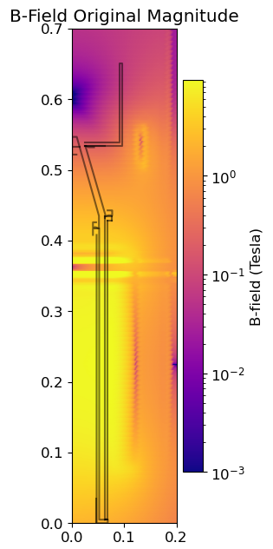
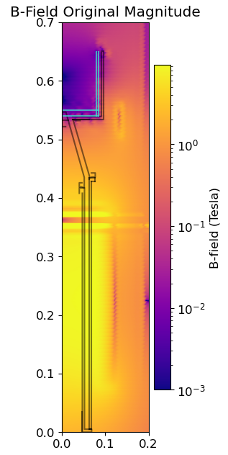
Shielded Box Design
Need to reduce fields from 0.3T to below HC1 of Nb (~0.1T) such that the tuner can be superconducting and the SQUIDs can be places in a Nb box to sit in a field free region.
Methods being explored:
Passive/Active cancellation coils
Cryoperm shields
Medium permeability nickel alloy shields
Problems: Need to be able to design a structural support that will tolerate the forces felt on any shielding in the presence of our magnet.

Slide 43
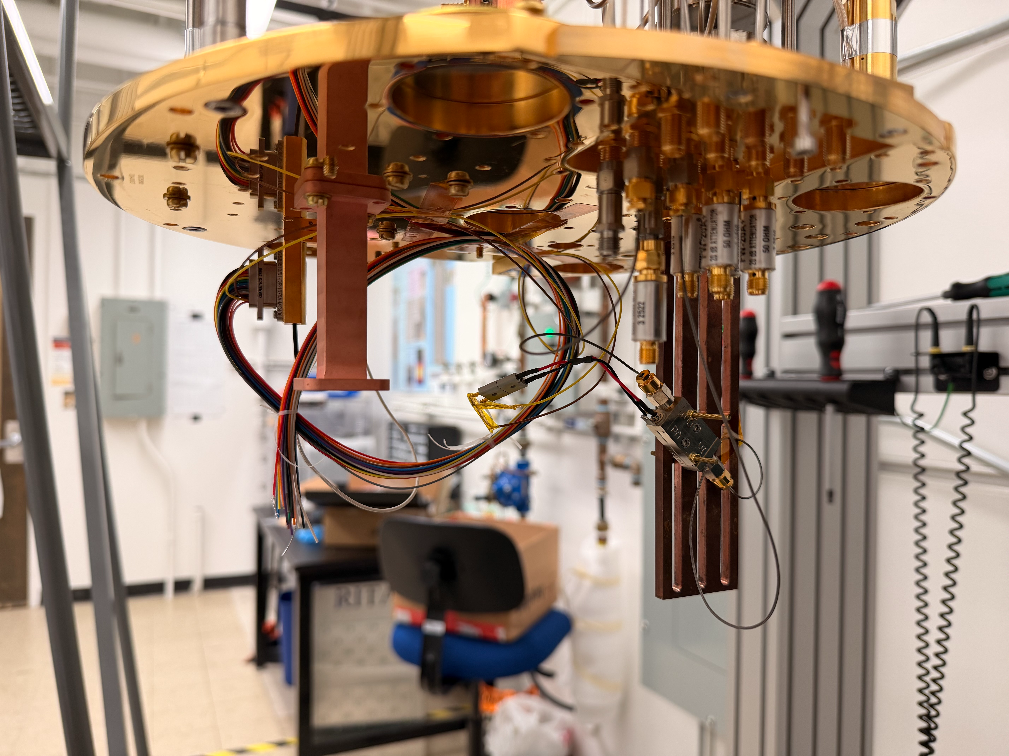
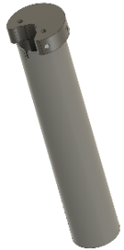
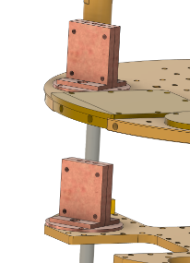
SQUID Readout Chain
Design custom DC SQUIDs being manufactured at NIST → Initial design chosen
Set up biasing and readout infrastructure → Ongoing
  Magnicon, SQUID wiring and shielding, cryoamp, thermal clamps, etc.
Test system with CMB SQUID Arrays
Incorporate custom SQUIDs into the system

Slide 44
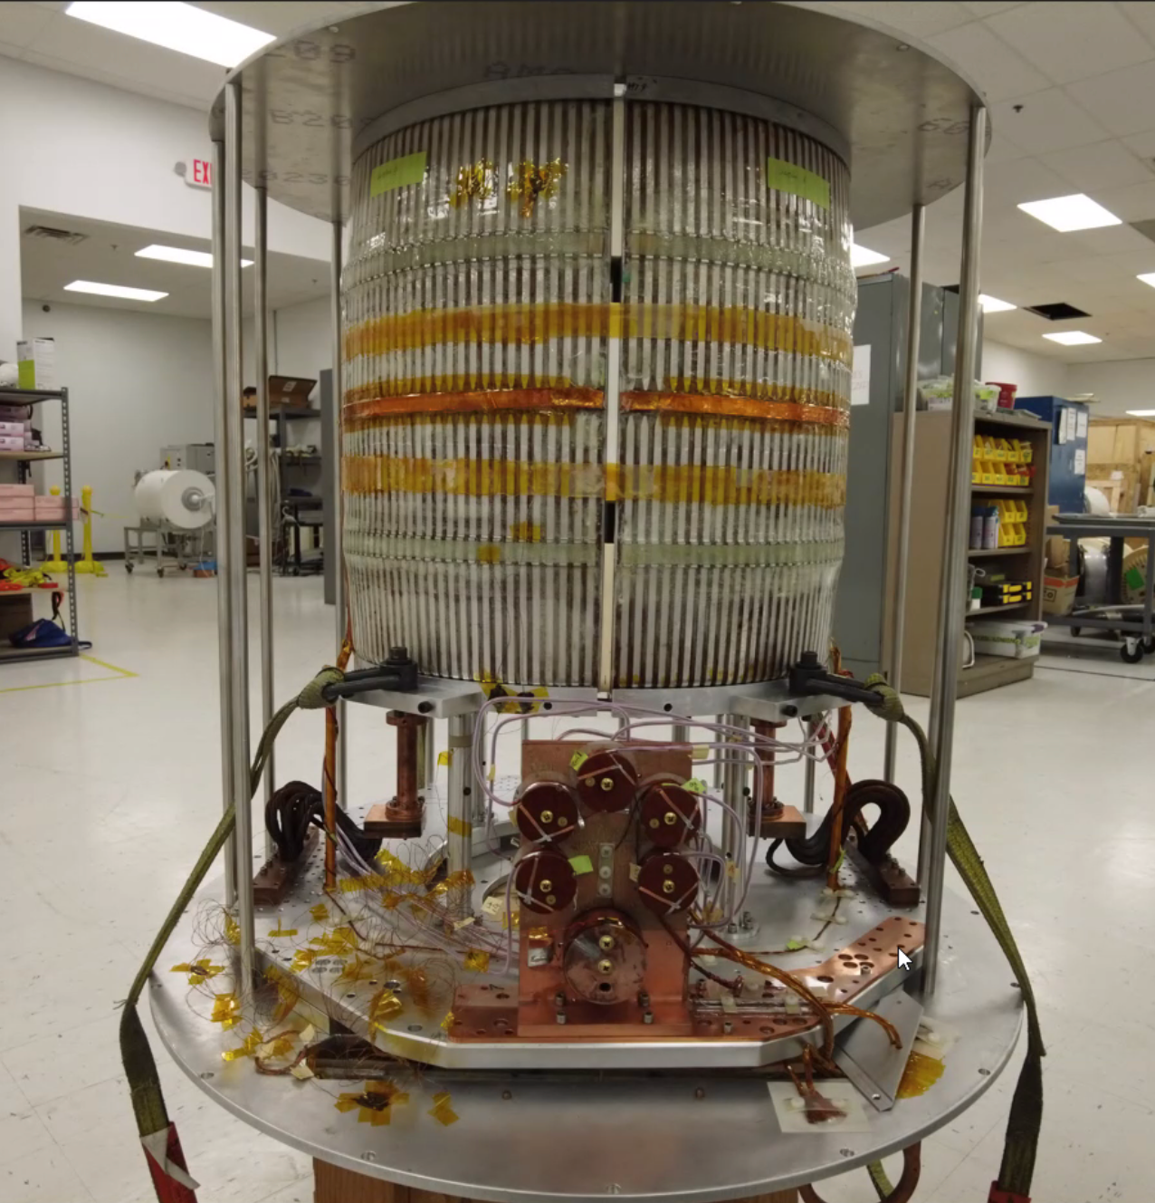
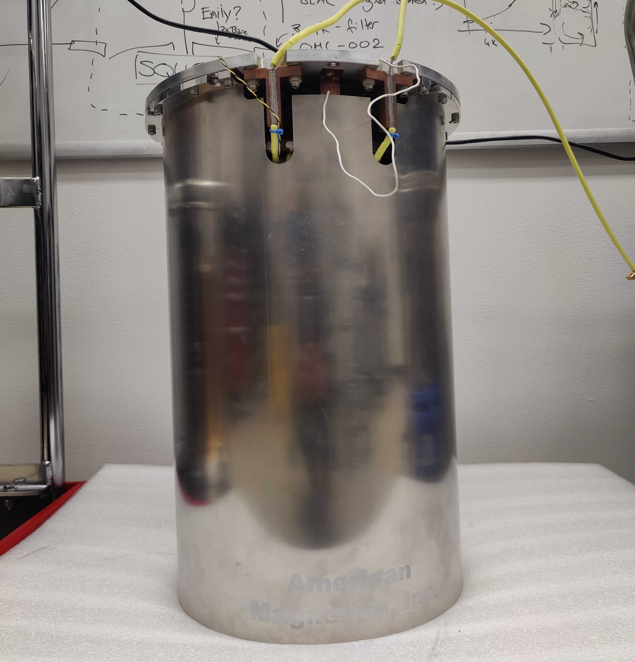
Magnets: Solenoid versus Toroid
 | Toroid (used in 50L and ABRA) | Solenoid (used in CAL)
Pros | Magnet Bore fully contains field. | Available commercially so typically cheaper!
Cons | Needs to be custom built, expensive :( | Large fringe fields
Building towards a GUT scale experiment, we need to scale up magnetic fields. One option to do this is solenoids!
Notes:
What are fringe fields? Why are they bad (orally)
Larger solenoids are still easily manufacturable even when they aren’t off the shelf
More experience!

Slide 45
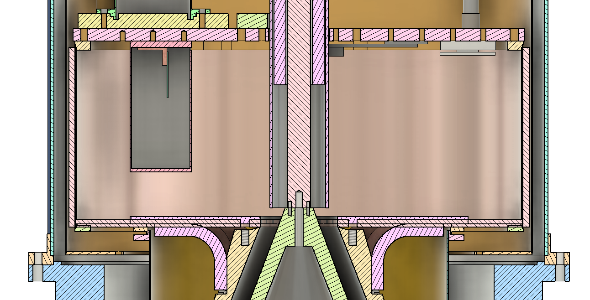
Readout Design
Building off DMRadio-50L infrastructure for DAQ software and calibration plan
Shielded box:
Houses sensitive electronics
SQUID readout chain

Slide 46
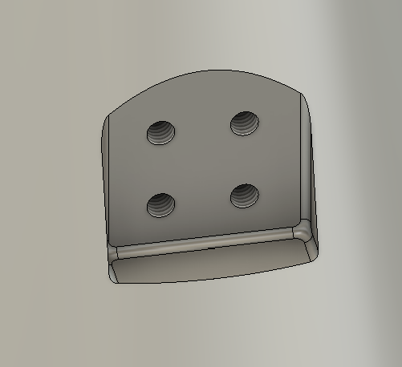
Building the Coaxial Pick-Up
Estimating the cooldown time of the coated pickup alone is over a day, not including cooldown time of magnet and fridge itself. Goal is to speed this up using copper braids between the MXC and the pickup.
Thermal Clamps
Notes:
- backup!

Slide 47
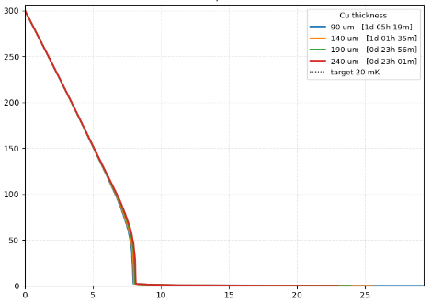
Building the Coaxial Pick-Up
Temperature (K)
Thermal Clamps
Time (hours)
Notes:
- backup!

