Slide 1
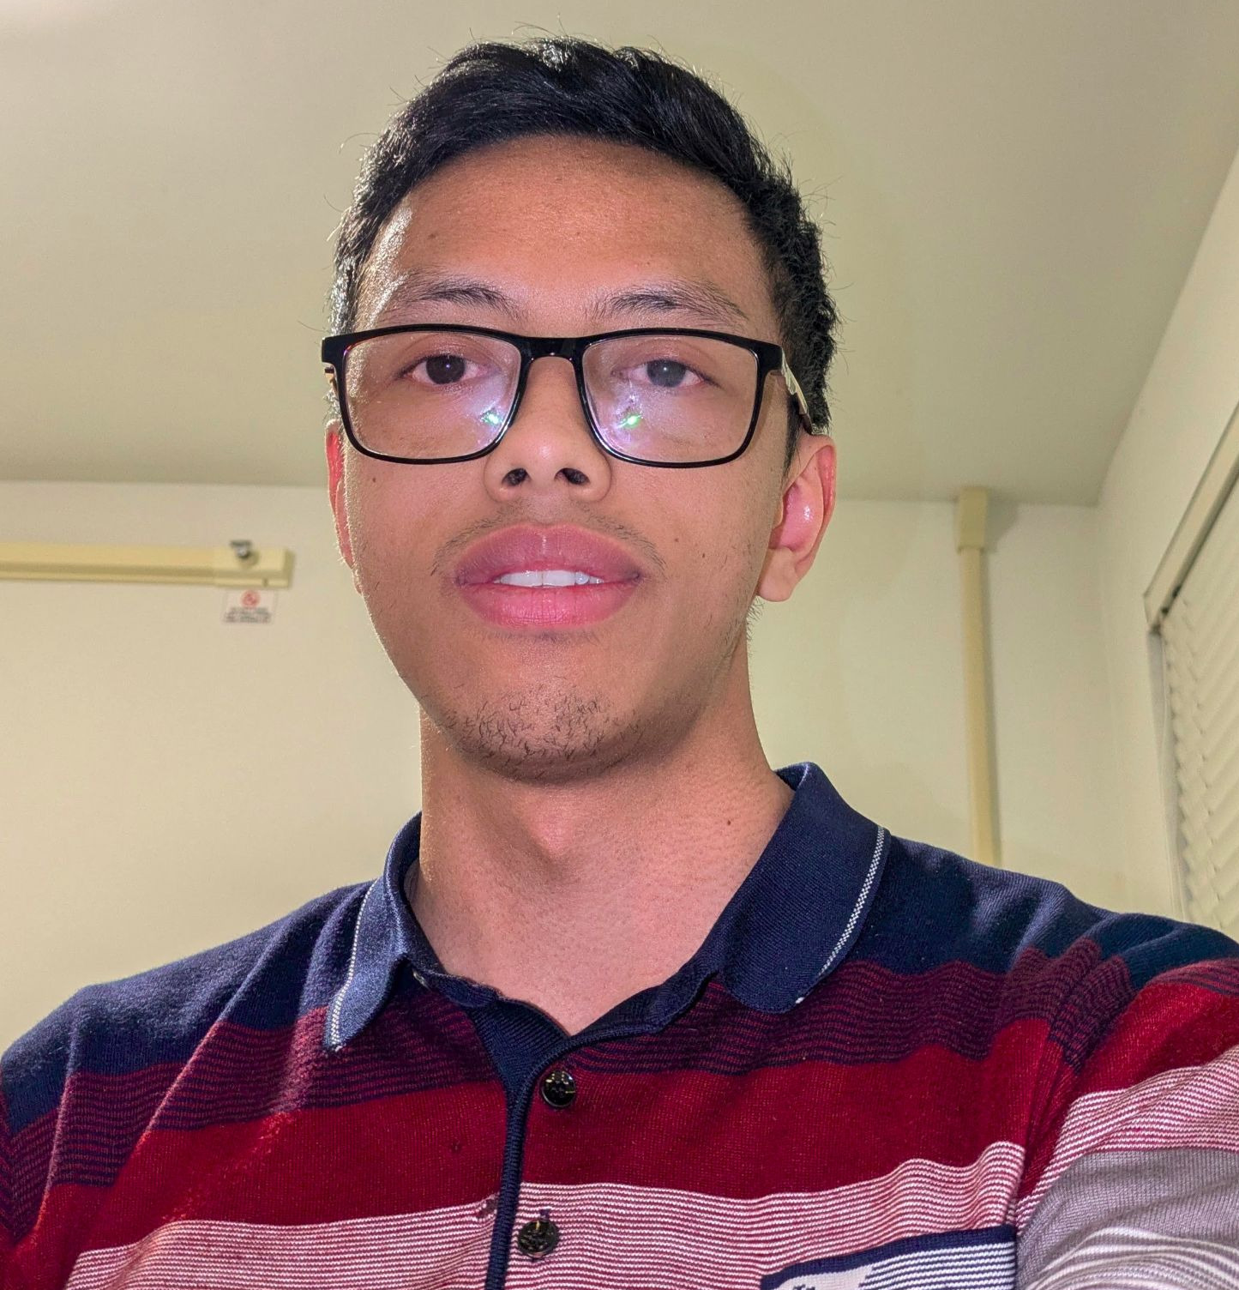

Solvent coating of wavelength shifting materials for next-generation photodetector systems
Rado Razakamiandra
October 21st, 2026
CPAD 2026 at Seattle

Slide 2
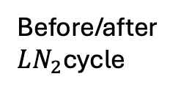
Workflow
Solvent: solution to dissolve the wavelength-shifting powder
Substrate: the material on which the WLS is to be deposited
Spectroscopy:
  Measurement of the WLS-shifted and transmitted light.
  Measurement of light attenuation to check coating uniformity.
WLS powder
Solvent
Spraying using an airbrush
substrate
Before/after $LN_{2}$cycle
Spectroscopy
Coating thickness measurement
Transmittance measurement at VUV range

Slide 3
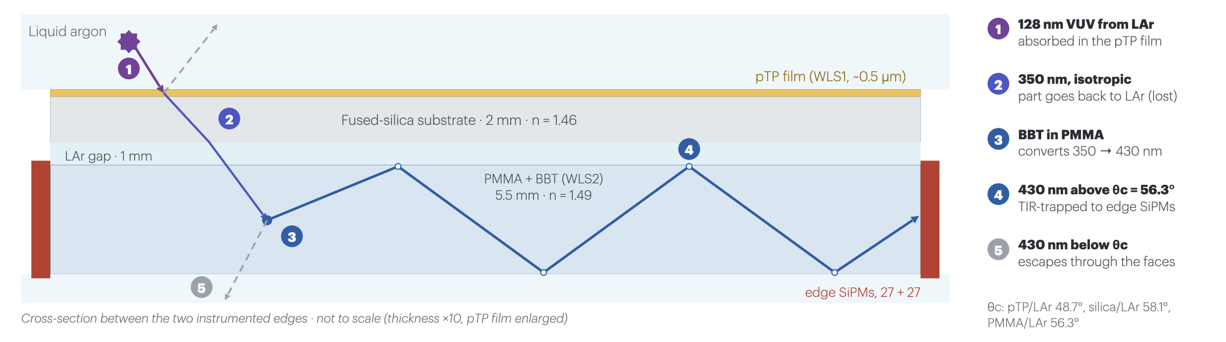
Motivation of solvent coating
Noble liquid detectors (dark matter, neutrino experiments, nuclear and particle physics):
  Detecting scintillation light (128 nm for LAr) requires wavelength shifting to the wavelength range the PMTs or SiPMs can detect.
Investigation of solvent coating of p-terphenyl (pTP) onto an acrylic substrate:
  Low cost
  Can accelerate coating a large-area photodetector once automated.
Advantages of using an acrylic:
  Low weight
  More radiopure than a typical glass substrate.
DELTA PhotoCollector (F. Cavanna, W. Shi’s talk)
PMMA

Slide 4
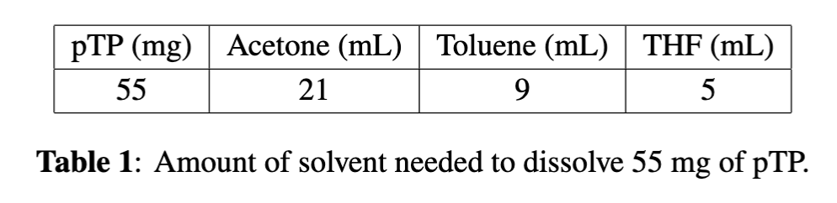
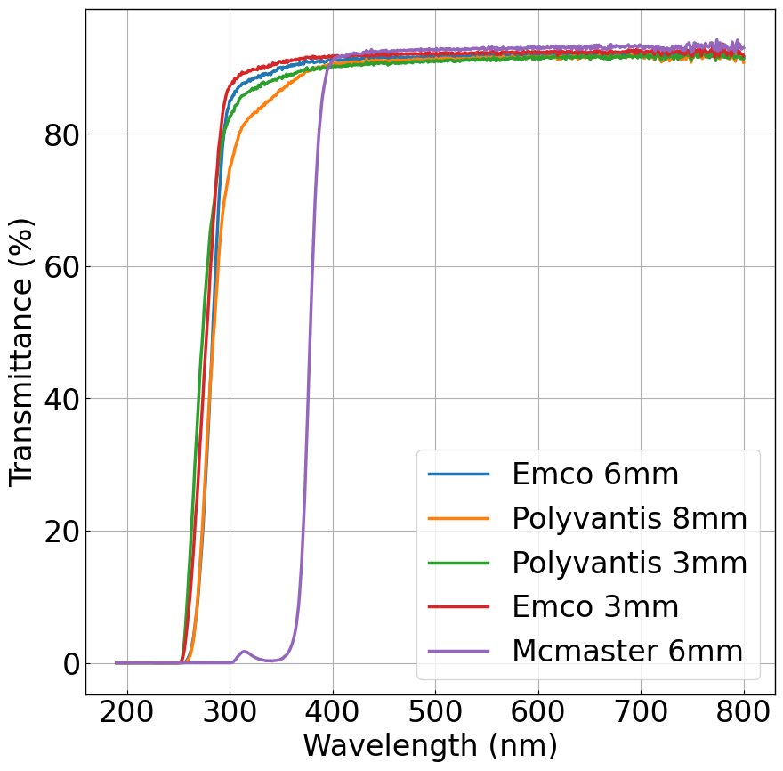
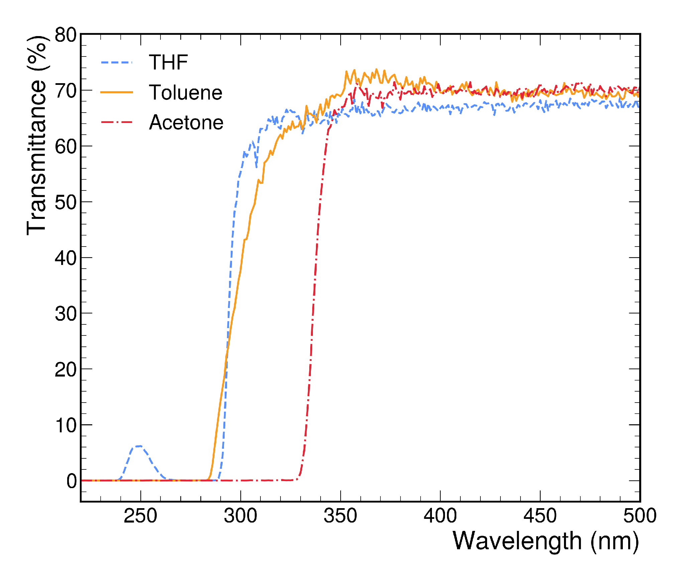
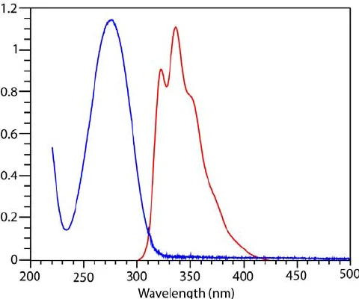
Selection of materials
Need: material transparent to the emission spectrum of pTP
UV-transparent acrylic cutoff: ~260 nm
Acetone, Toluene, and THF can all dissolve pTP
Cutoff of acetone: ~330 nm → not selected
Toluene is used for consistency across samples.
pTP absorption (blue) and emission (red) spectra
Transmittance of the acrylics
Transmittance of the solvents

Slide 5
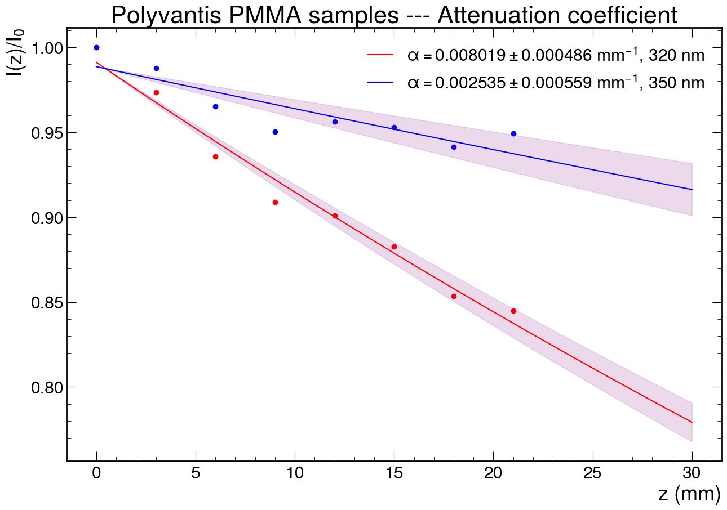
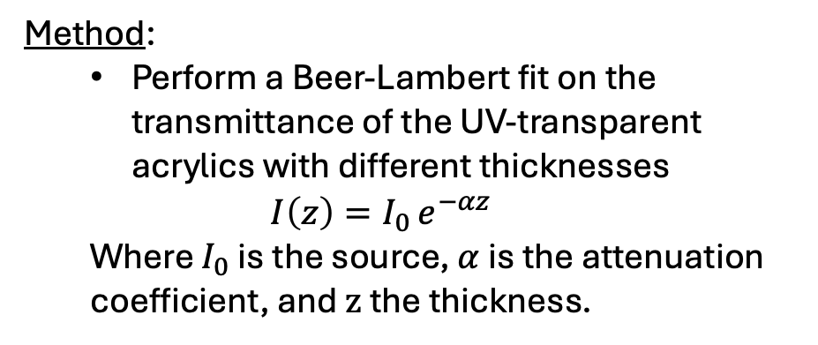
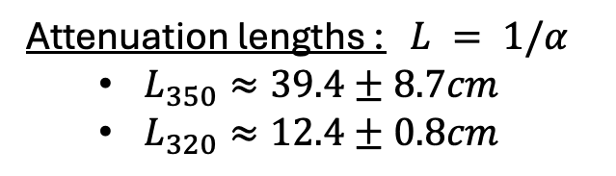
Attenuation length of the 320 nm and 350 nm light in the UV-transparent acrylic
Method:
  Perform a Beer-Lambert fit on the transmittance of the UV-transparent acrylics with different thicknesses
  $$I\left(z\right)=I_{0 }e^{−αz}$$
  Where $I_{0}$ is the source, $α$ is the attenuation coefficient, and $z$ the thickness.
Measurement using a UV-vis spectrophotometer:
  Stacks of multiple acrylic sheets were made to achieve the desired thickness (no bulk acrylic available).
  We accounted for losses due to Fresnel reflections at the air/acrylic and acrylic/air interfaces.
Attenuation lengths : $L = 1/α$
  $L_{350}≈39.4±8.7cm$
  $L_{320}≈12.4±0.8cm$

Slide 6
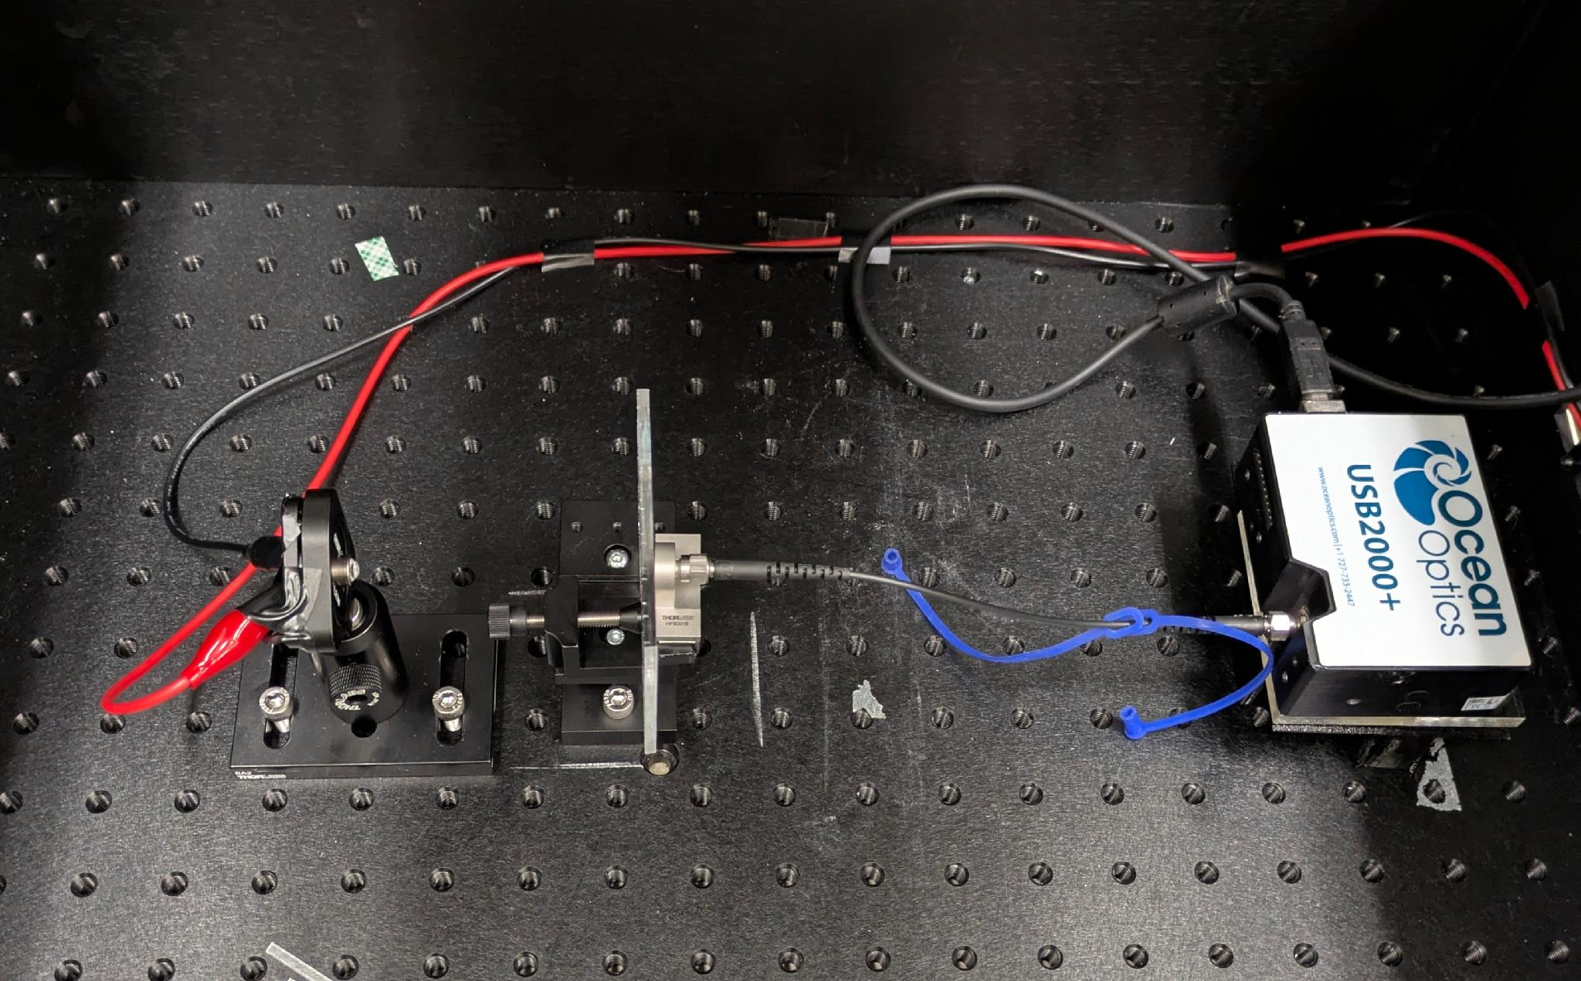
Setup of the spectroscopy
UV LED:
  285 nm for the pTP emission measurement.
  340 nm for the uniformity scan of the samples
Spectrometer: OceanOptics USB2000+ with a wavelength range of 200 nm to 1000 nm
Acrylic sample
air
UV source
Spectrometer
UV LED
Fiber optics
Spectrometer

Slide 7
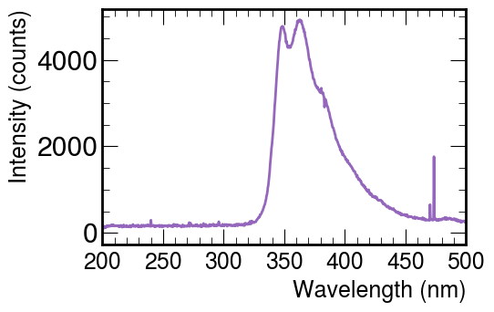
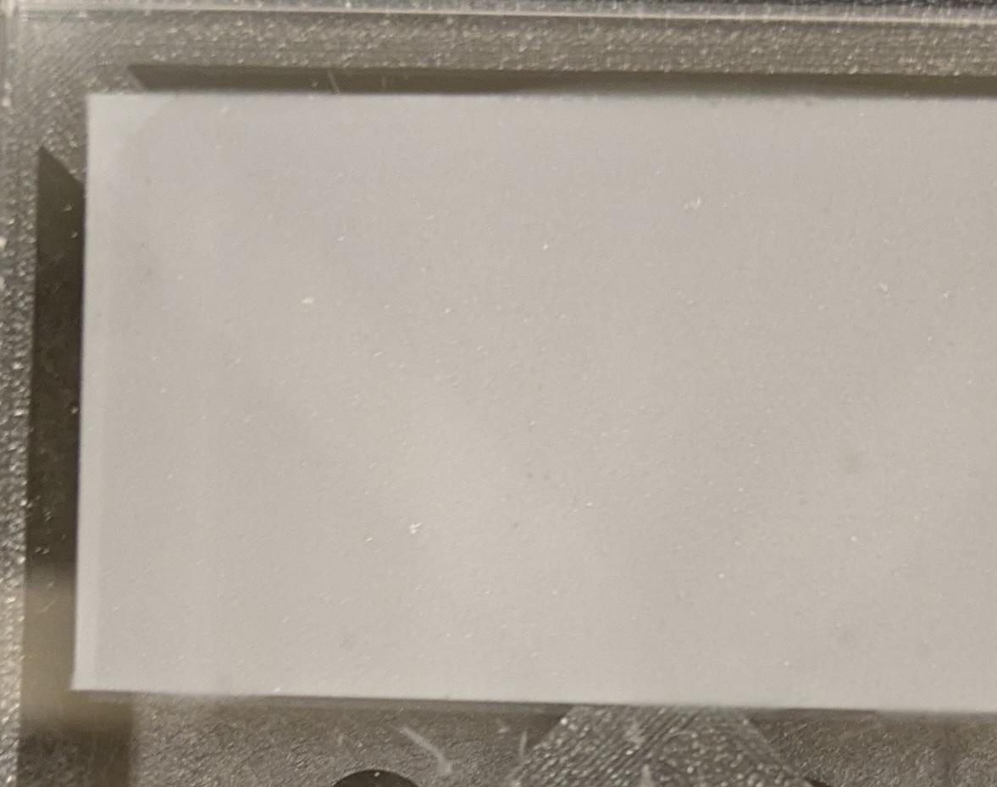
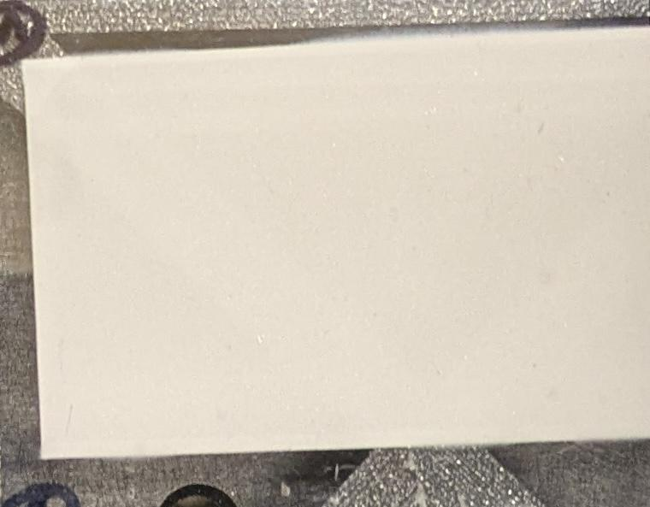
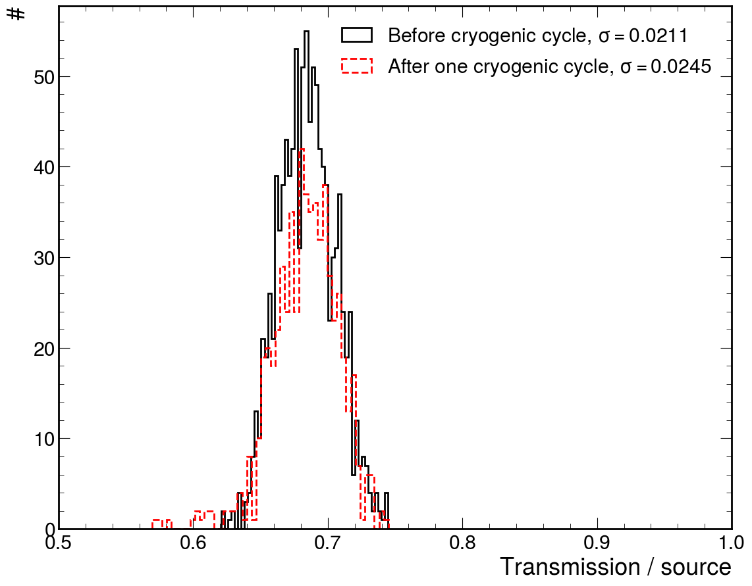
pTP deposited samples and uniformity
Transmission of the pTP-deposited sample. Source wavelength: 285 nm
pTP samples were prepared by hand spraying
  No 285 nm light gets through
  Reemission at ~320 – 450 nm
  Spike at 470 nm: noise
A 340 nm wavelength was used to scan the sample’s uniformity before and after the cryogenic cycle
  Mean transmission unchanged
  Spread increased slightly; no visible detachment
Before cryogenic cycle
After cryogenic cycle
Number of spectra
Integral of the spectra normalized by the source.

Slide 8
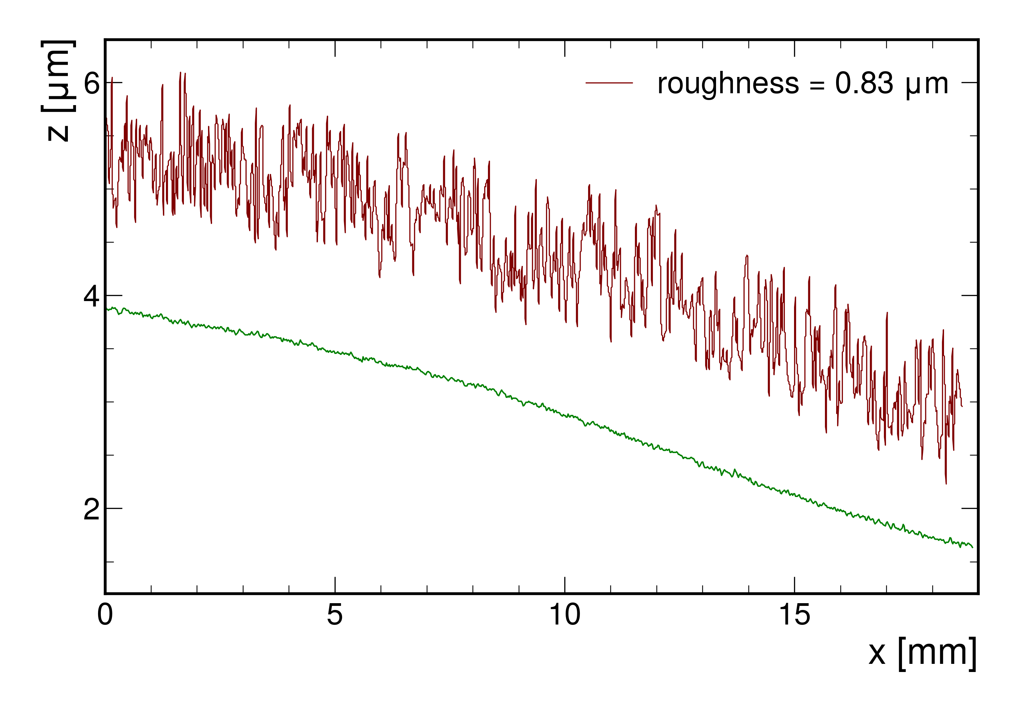
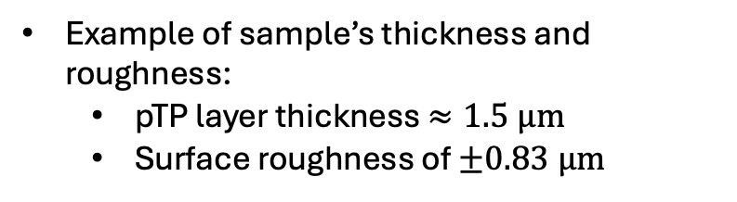
Thickness and roughness of the pTP layer
Variation of the pTP deposited layer
substrate’s surface
The measurement was done with white-light interferometry
Profile lines on the surface of the pTP-deposited layer and the acrylic substrate.
Example of sample’s thickness and roughness:
  pTP layer thickness $≈1.5 μm$
  Surface roughness of $±0.83 μm$

Slide 9
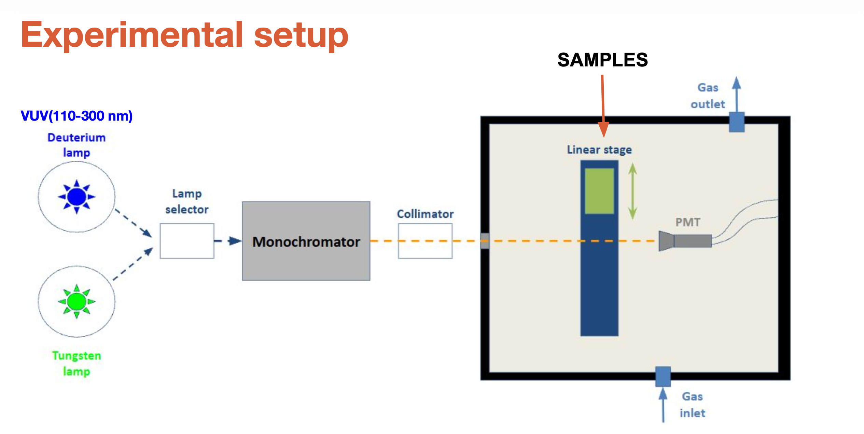
Setup of wavelength shifting efficiency measurement
Measurement done at IFIC
The deuterium lamp is used for this measurement
Monochromator: scans the wavelength
Atmosphere of the sample and PMT: argon gas
Instituto de Física Corpuscular (IFIC), CSIC and Universitat de València, Valencia, Spain

Slide 10
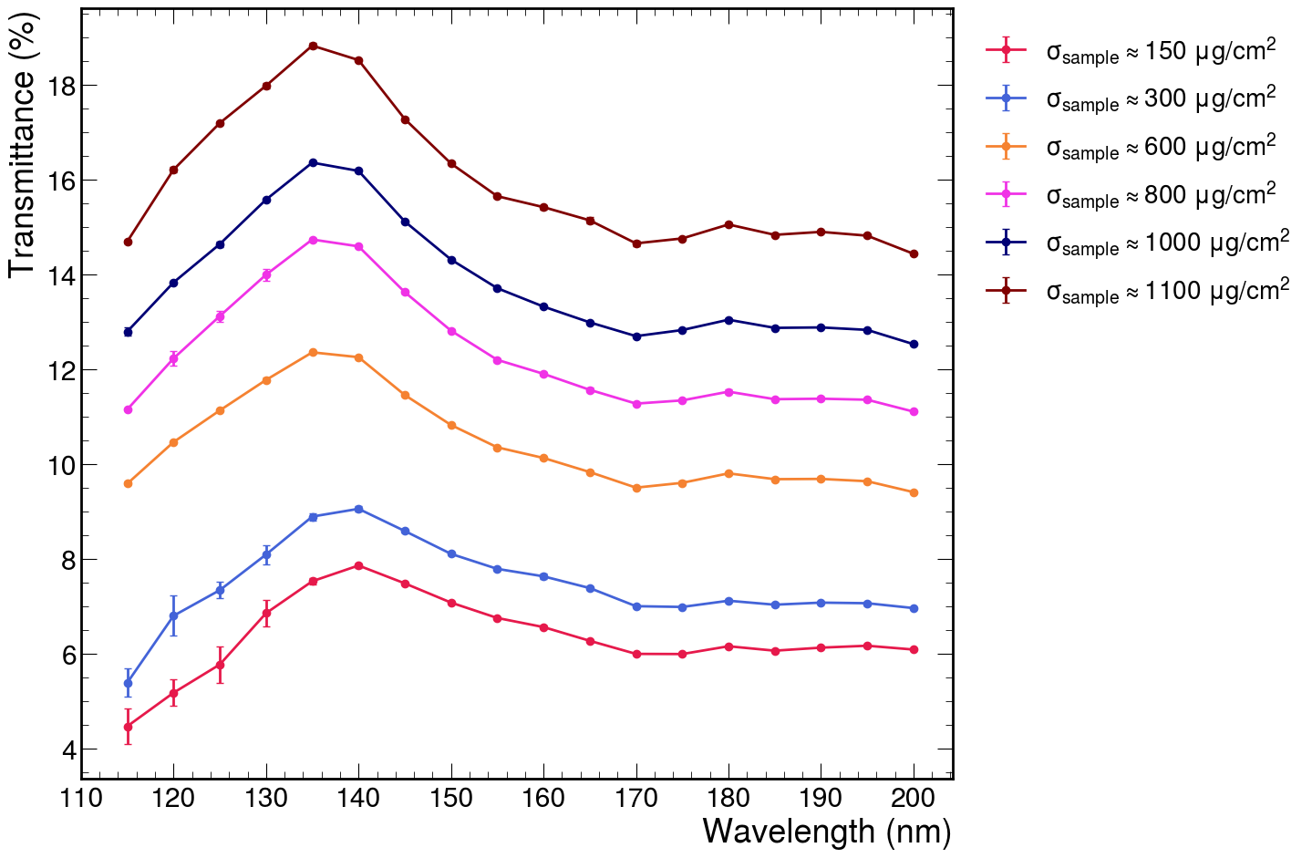
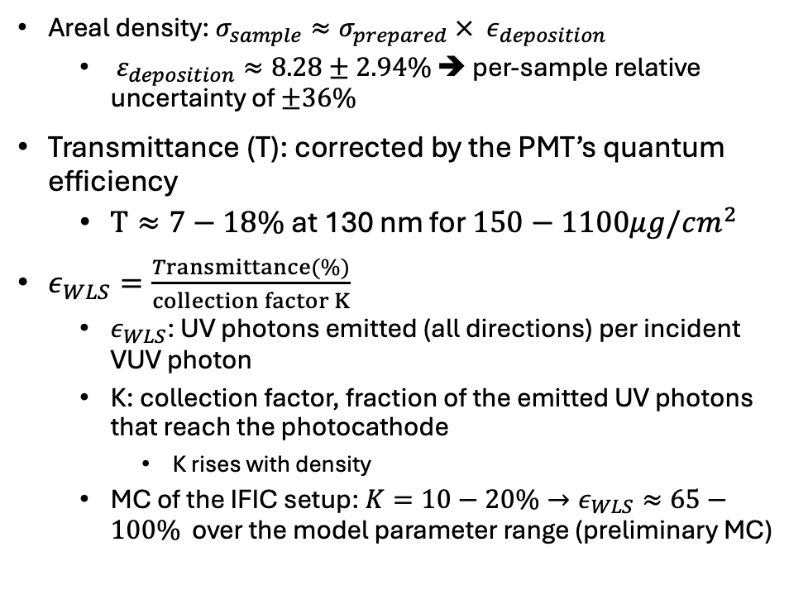
Wavelength shifting efficiency measurement at IFIC
Areal density: $σ_{sample}≈σ_{prepared} ×{ ε}_{deposition}$
  $ε_{deposition}≈8.28±2.94\%$ ➔ per-sample relative uncertainty of $±36\%$
Transmittance (T): corrected by the PMT’s quantum efficiency
  $T≈7−18\%$ at 130 nm for $150−1100μg/cm^{2}$
$ε_{WLS}=\frac{Transmittance(\%)}{collection factor K}$
  $ε_{WLS}$: UV photons emitted (all directions) per incident VUV photon
  K: collection factor, fraction of the emitted UV photons that reach the photocathode
    K rises with density
  MC of the IFIC setup: $K=10−20\%→ε_{WLS}≈65−100\%$ over the model parameter range (preliminary MC)

Slide 11
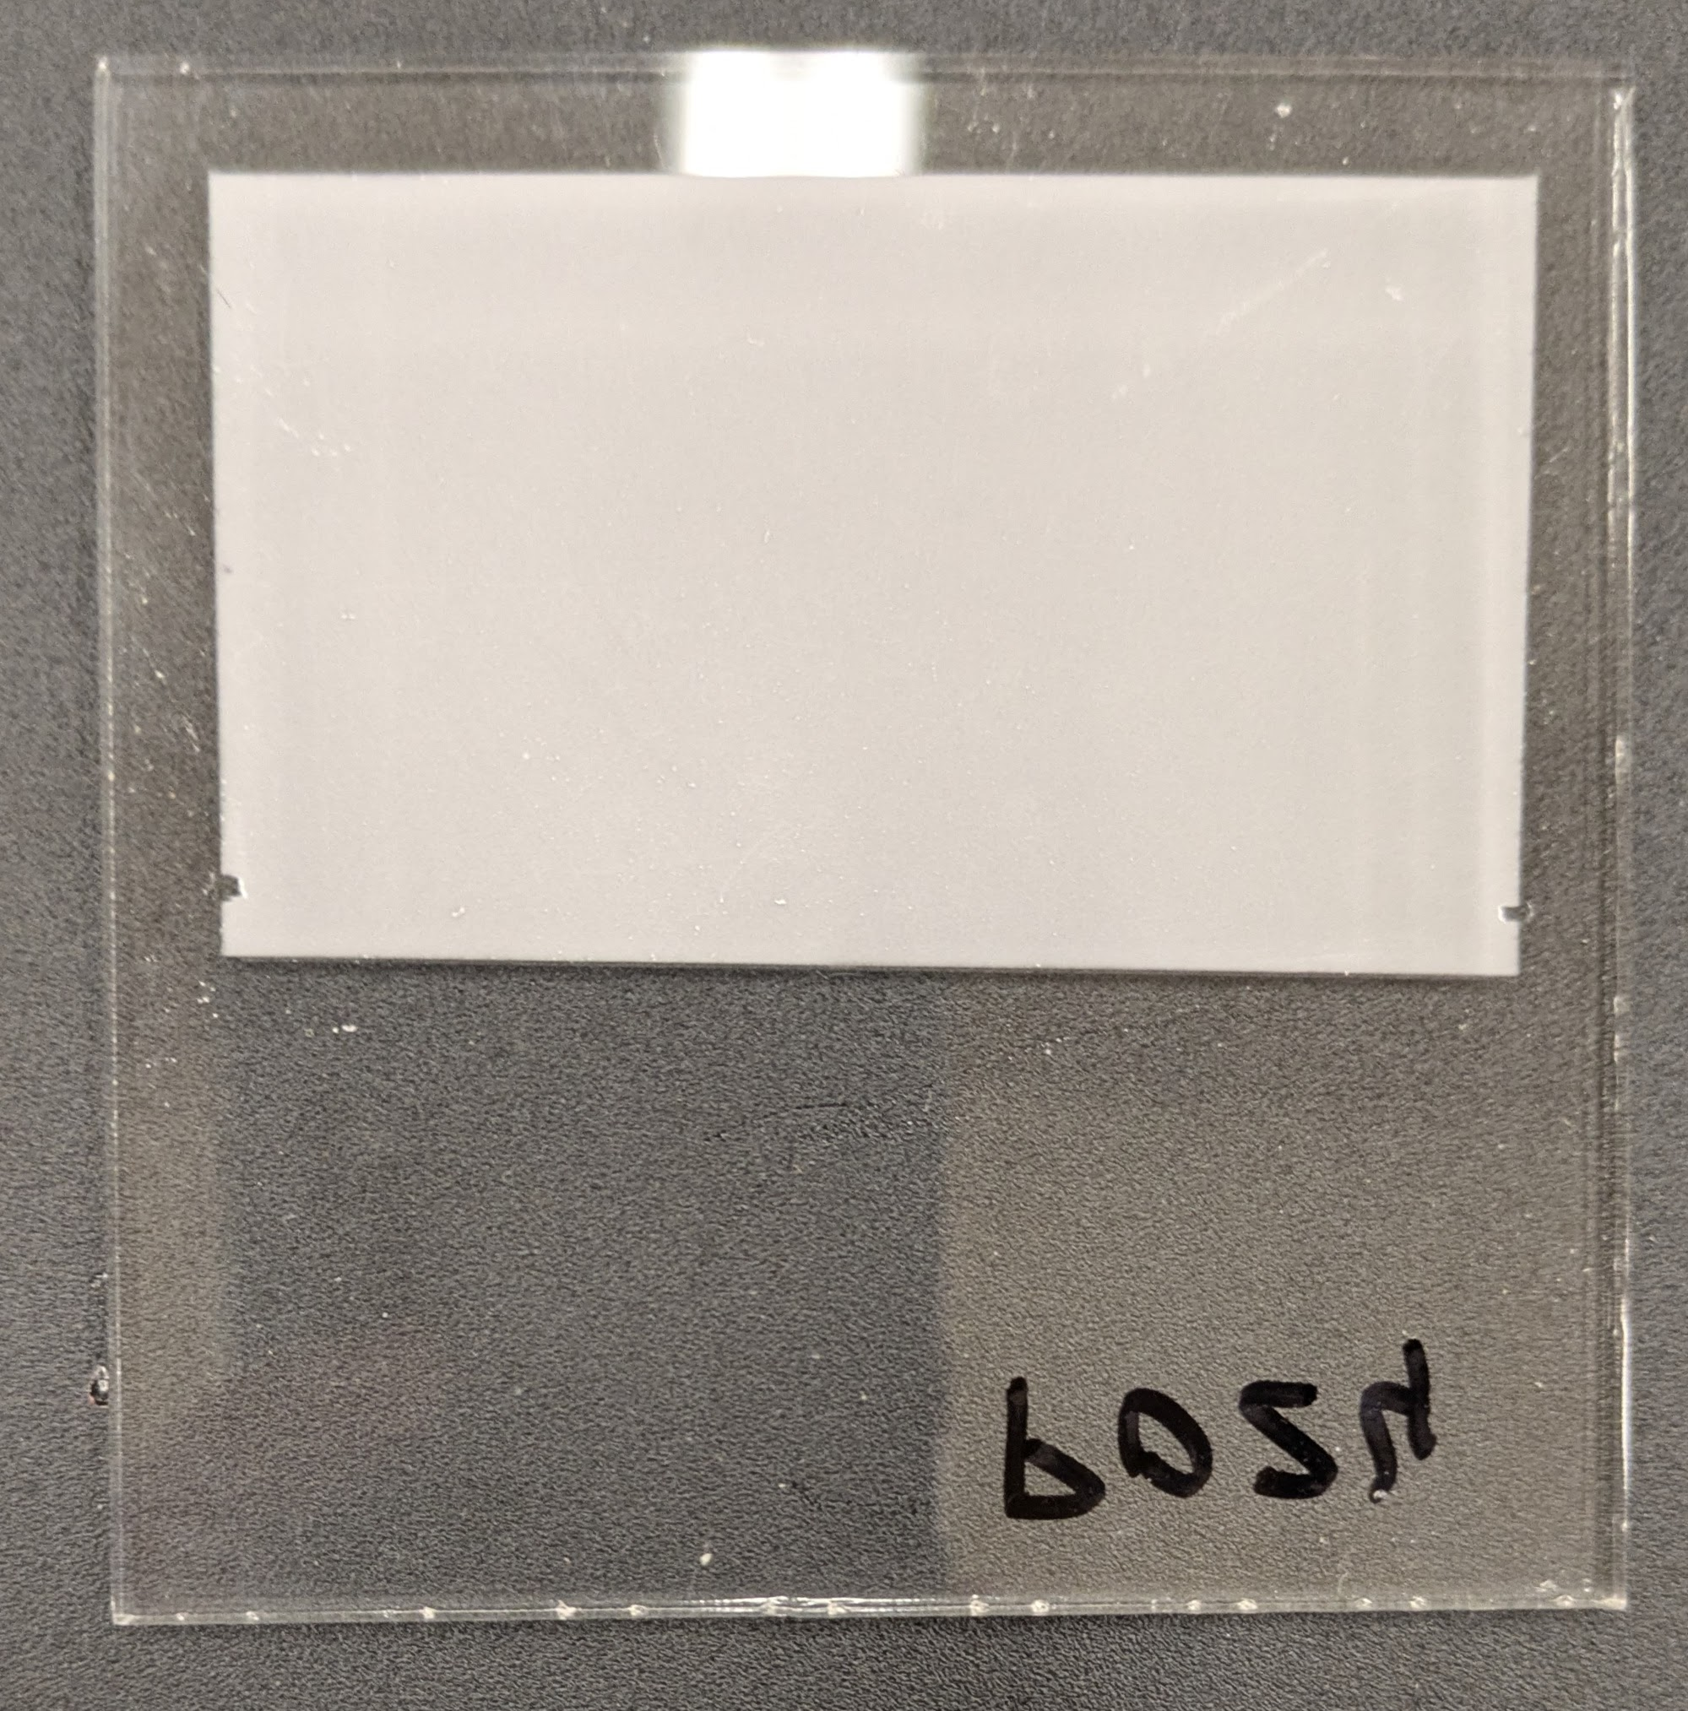
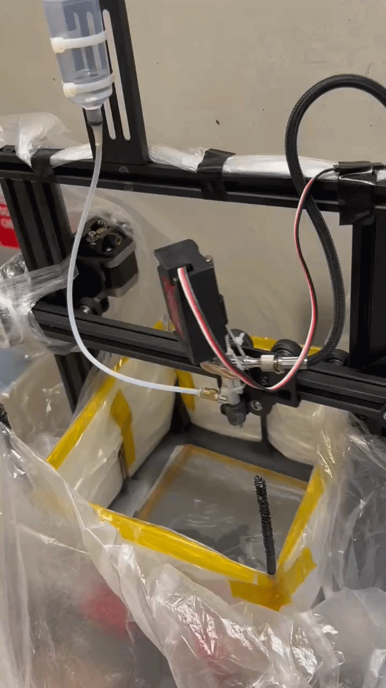
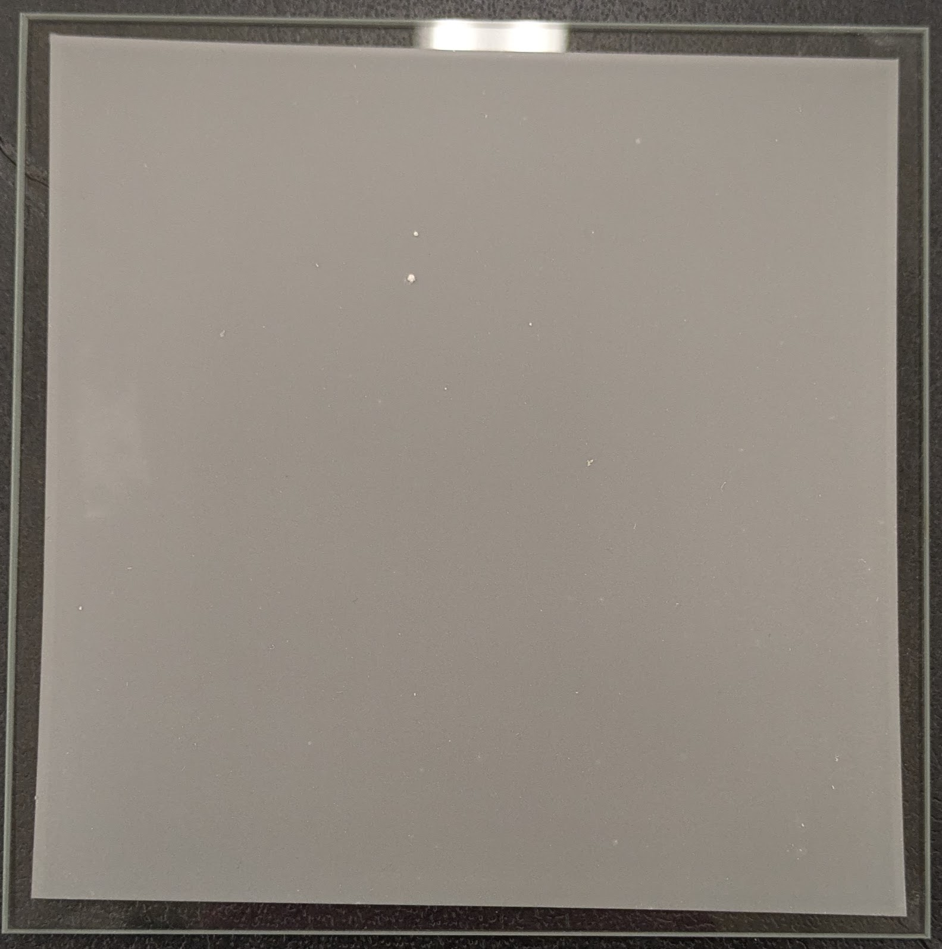
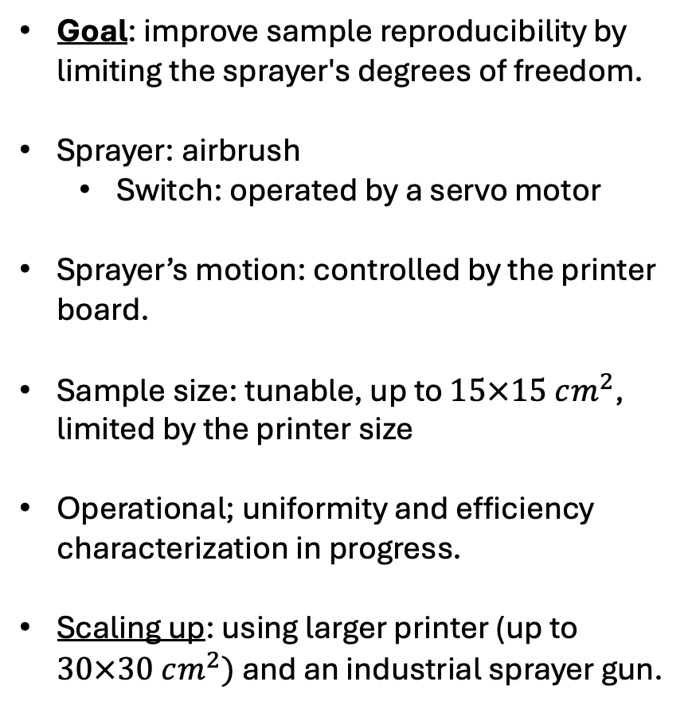
Solvent coating automation using a repurposed 3D printer
Hand-sprayed
Goal: improve sample reproducibility by limiting the sprayer's degrees of freedom.
Sprayer: airbrush
  Switch: operated by a servo motor
Sprayer’s motion: controlled by the printer board.
Sample size: tunable, up to $15×15 cm^{2}$, limited by the printer size
Operational; uniformity and efficiency characterization in progress.
Scaling up: using larger printer (up to $30×30 cm^{2})$ and an industrial sprayer gun.
3d printer sprayed

Slide 12
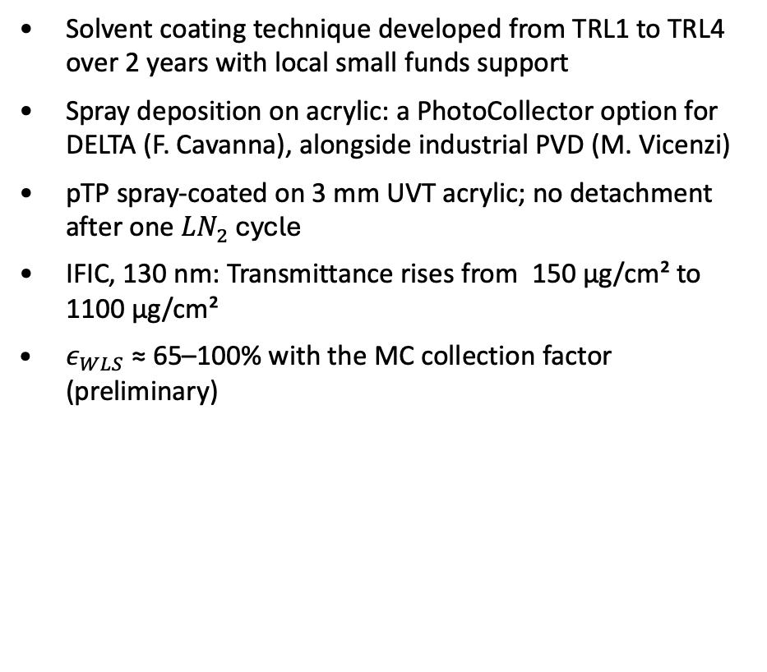
Summary and Future works
Solvent coating technique developed from TRL1 to TRL4 over 2 years with local small funds support
Spray deposition on acrylic: a PhotoCollector option for DELTA (F. Cavanna), alongside industrial PVD (M. Vicenzi)
pTP spray-coated on 3 mm UVT acrylic; no detachment after one $LN_{2}$ cycle
IFIC, 130 nm: Transmittance rises from 150 µg/cm² to 1100 µg/cm²
$ε_{WLS}$ ≈ 65–100% with the MC collection factor (preliminary)
Characterization of the automated sprayer:
  Measuring the pTP layer’s uniformity and deposition efficiency
Diffuse reflectance and transmittance at 350 nm vs density:
  film scattering; fixes K in the MC
Integrating-sphere quantum yield of spray-deposited films (with BNL)
Building a 15 × 15 cm² prototype: coated plate + WLS-doped plate + SiPMs
A technical paper is in preparation, coming out soon.

Slide 13
Backup

Slide 14
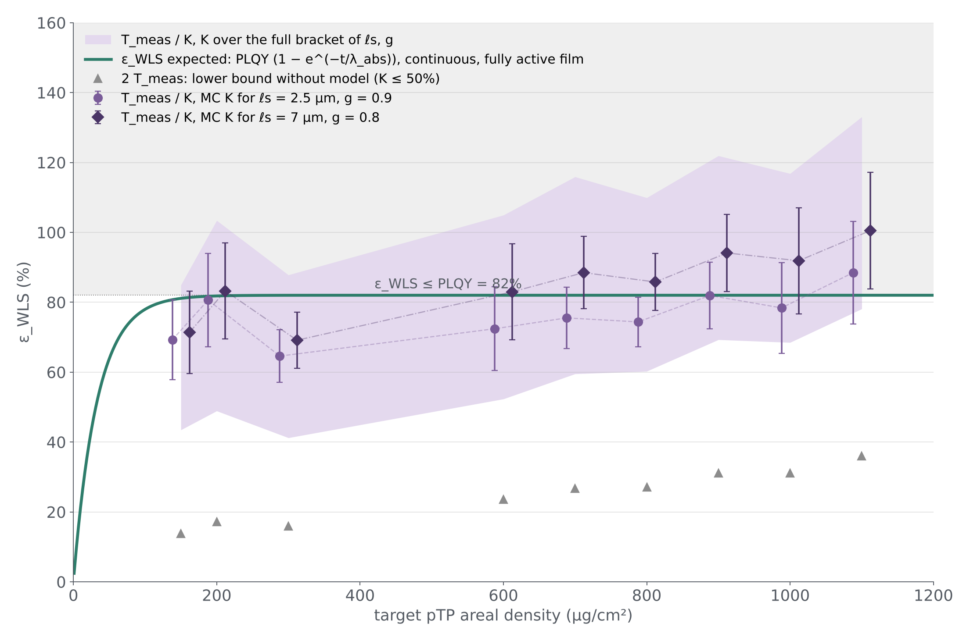
Backup: ε_WLS with the MC collection factor (preliminary)
K from pTP-SD-sim (F. Cavanna): MC of the IFIC setup
  gap 7 mm, MgF₂ window, Ø 23 mm photocathode, measured beam profile
  continuous pTP film; re-emitted light scattered in the film
  scattering parameters bracketed a priori, not fitted
ε_WLS = T / K: band over the bracket; points for two example parameter sets
  Flat within errors
Lower bound 2T (K ≤ 50%) is 2.5–5× below

