Slide 1
HEP in Genesis Mission
October 20, 2026
Nhan Tran
CPAD 2026

Slide 2

Prologue
This talk is about HEP in the Genesis Mission
  This talk is partially informational, interspersed with a examples and editorial comments
    Several borrowed slides as a result
  Outline:
    Genesis Mission, Spotlights, Outlook
With the rise of AI:
  We have an opportunity to do things fundamentally differently
  We need (?) to do things fundamentally differently
  We should (?) do things fundamentally differently
This talk does not address societal or ethical aspects of AI (mostly for time purposes - but that does not mean it shouldn’t be a part of the discourse

Slide 3
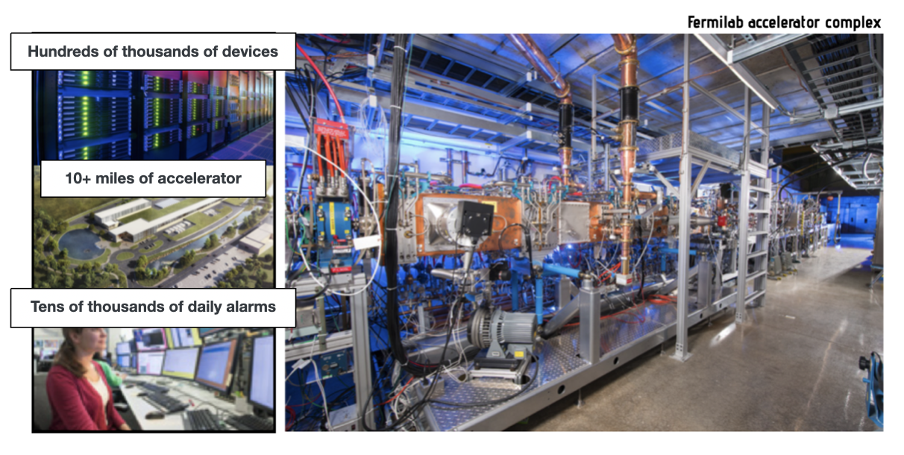
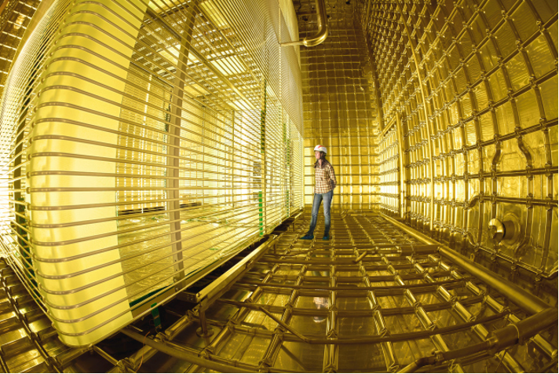
HENP value proposition for AI
Facilities and experiments: complex operation in extreme scenarios
Deep domain knowledge: surrogate and physics-inspired models
Trustworthy AI for Science: foundation models, robustness, generalizability
Data: uniquely massive, rich, high-fidelity data and simulation
Notes:
This is where we have identified our AI strengths in 3 main categories
1 - from our analysis and operations, making sure the ML tools are robust for making scientific insights
2 – because we have such complex facilities and experiments, it’s a big part of what we do
3 – and with extreme data rates and environments, edge AI and codesign is a big part of our core AI program

Slide 4
Genesis Mission

Slide 5
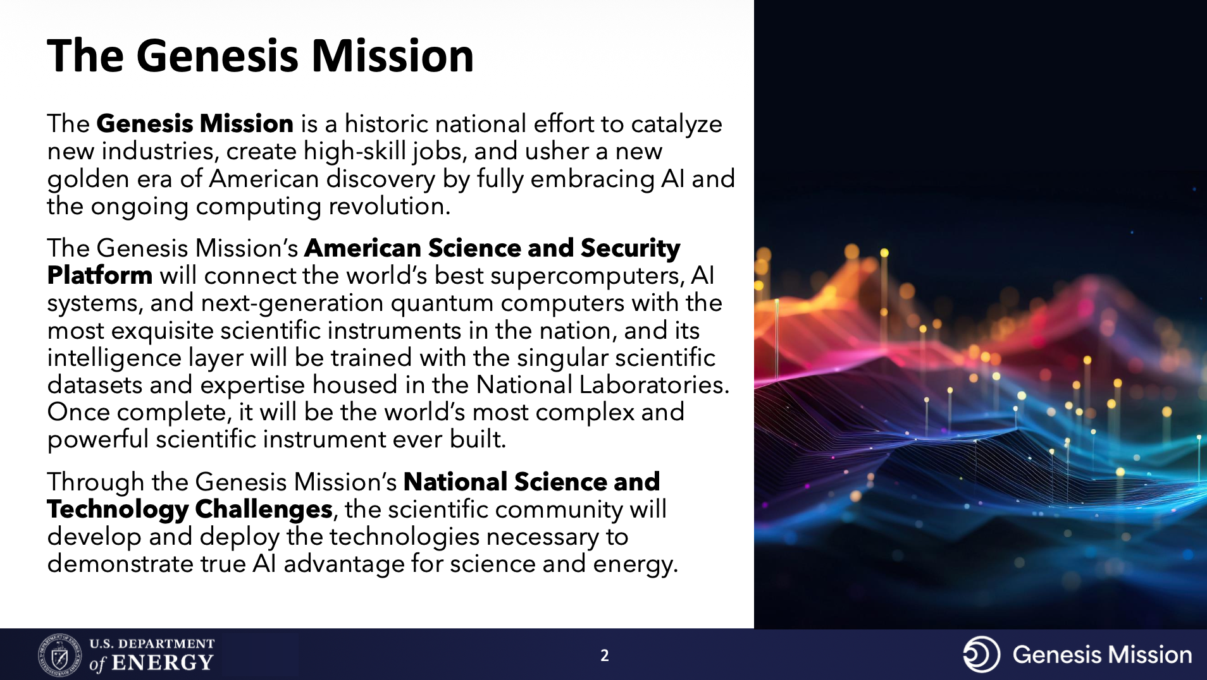
Jeremy Love, DPF 2026
Notes:
This is where we have identified our AI strengths in 3 main categories
1 - from our analysis and operations, making sure the ML tools are robust for making scientific insights
2 – because we have such complex facilities and experiments, it’s a big part of what we do
3 – and with extreme data rates and environments, edge AI and codesign is a big part of our core AI program

Slide 6
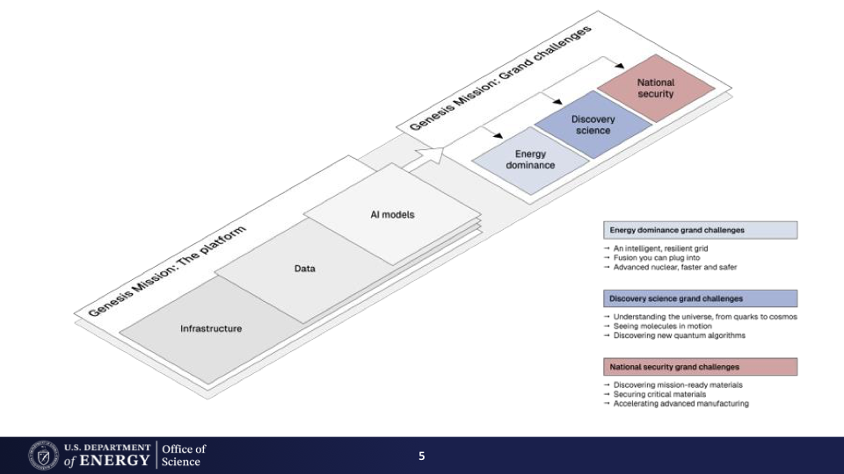
Notes:
This is where we have identified our AI strengths in 3 main categories
1 - from our analysis and operations, making sure the ML tools are robust for making scientific insights
2 – because we have such complex facilities and experiments, it’s a big part of what we do
3 – and with extreme data rates and environments, edge AI and codesign is a big part of our core AI program

Slide 7

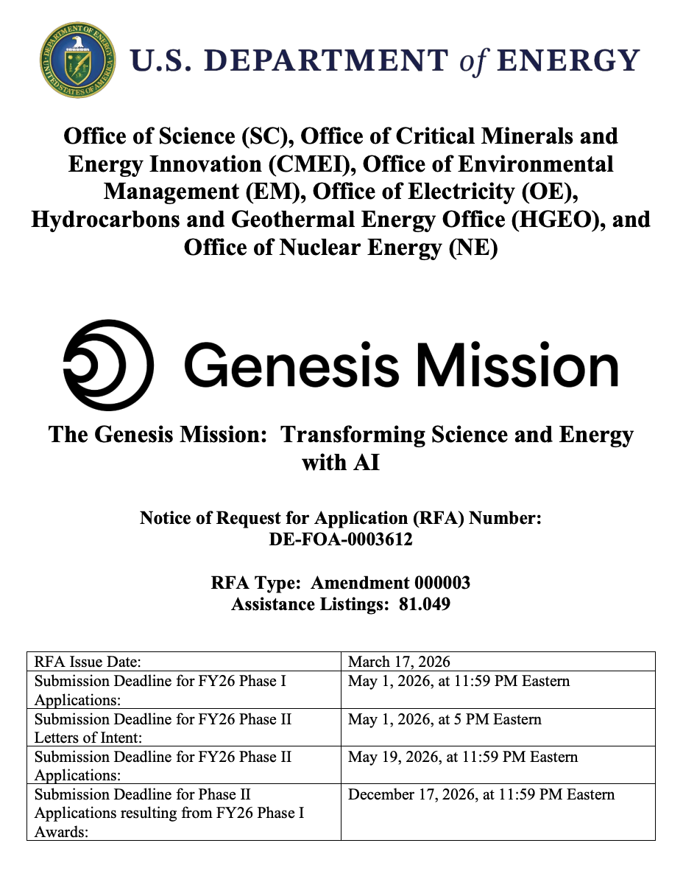
The Genesis Mission timeline
Data
Compute/Storage
Models
Applications
HEP Data Pilots
American Science Cloud
Model Consortium
AI for Science and Energy
Fall 2025
(DOE labs only)
TREASURE: tokenization for colliders
AI Universe: data for cosmology foundation models
Knowledge Extraction: agentic exploration and tools
Fall 2025
(DOE labs only)
ASCR-led:
Compute and data platform
Infrastructure Partners connect compute with domain facilities, experiments, and capabilities
e.g.
Scientific User Facilities (IaaS, networking, etc.)
Fermi Data Platform
FemtoMind (LQCD)
Fall 2025
(DOE labs only)
ASCR-led:
Model capabilities, e.g. Agents, multi-modal, evaluation, safety
Seed model teams were early application teams
e.g.
MOAT – Multi-Office Accelerator Team
AXESS – Accelerating eXtreme Environment Specs-to-Silicon
Q2C - Quarks to Cosmos
Spring 2026
(Lab, university, industry)

Slide 8
SC HEP Portfolio Summary: 20 awards from 381 applications
DPF talk by Gina Rameika
HEP’s selected portfolio spans the HEP program utilizing existing and forging new collaborations for AI-driven scientific discoveries
  Enabling science at HEP’s flagship experiments ATLAS, CMS, DUNE, Rubin/DESC
    Developing new AI methods for deeper insight from Exabyte-scale datasets
  Accelerate the R&D cycle of technologies needed for the next generation of experiments
    AI and agentic systems that can design, control, and realize more advanced technical solutions in QIS, Microelectronics, and particle accelerators
  Partner with ARDAP, ASCR and NP to pursue discoveries in areas of mutual interest beyond traditional stovepipes
    International researchers from CERN and French, Japanese, and British institutions
    Three Genesis Mission aligned awards through US-Japan Program further broadens international partnership
  HEP maintains some Phase-I alternate applications for future consideration.

Slide 9
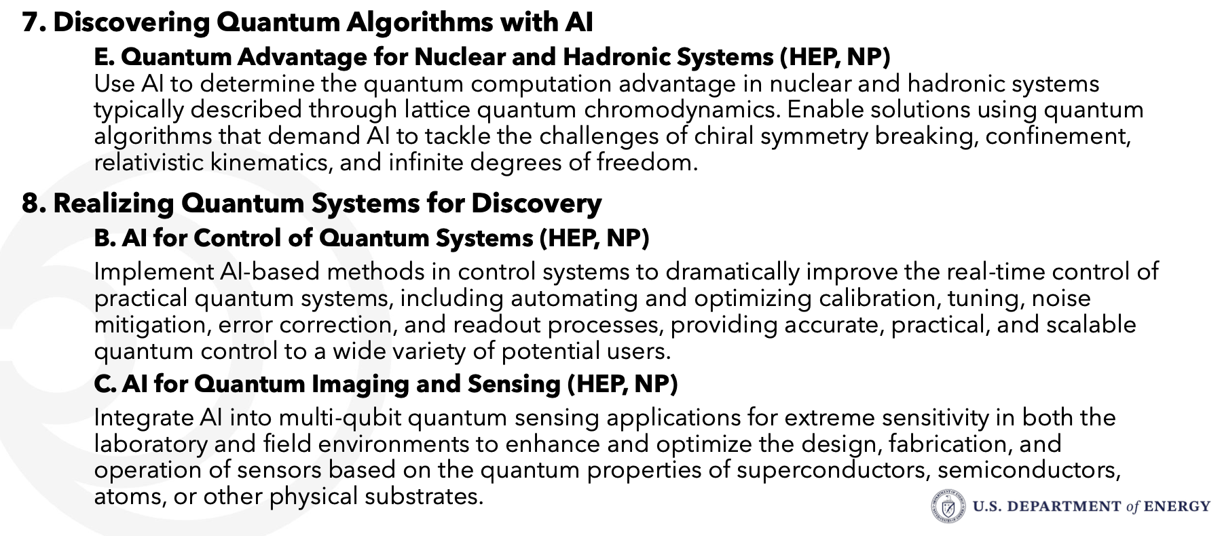
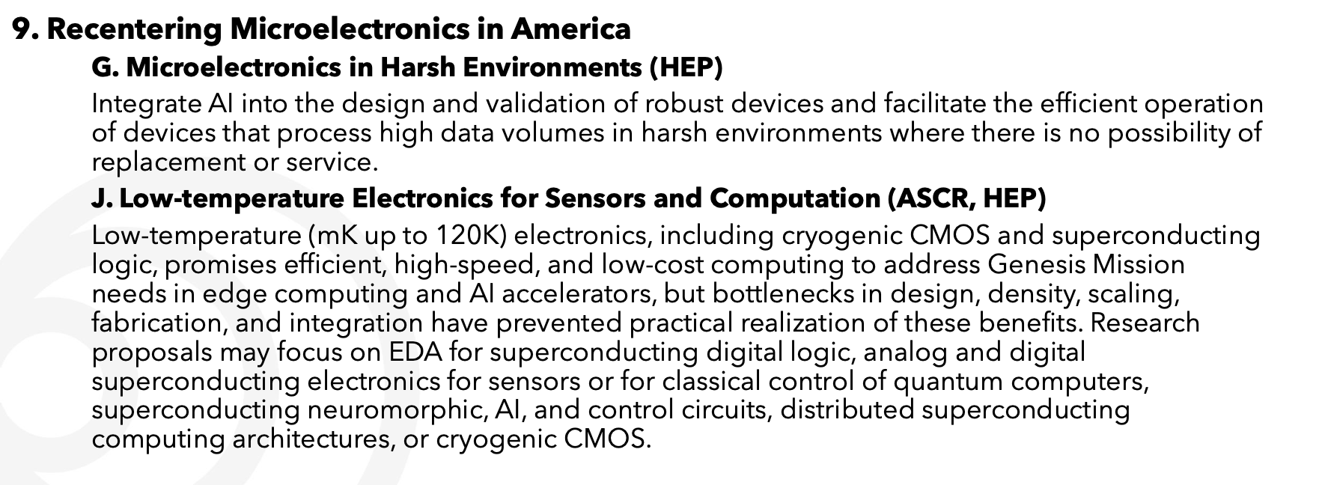
HENP National Challenges and FY26 focus areas

Slide 10
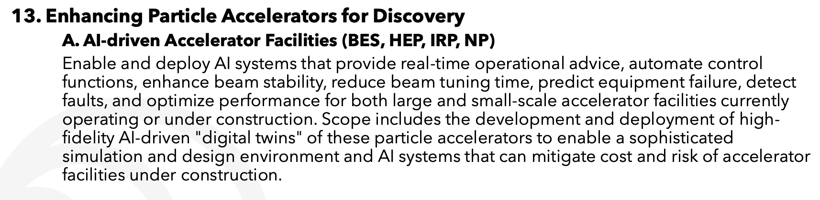
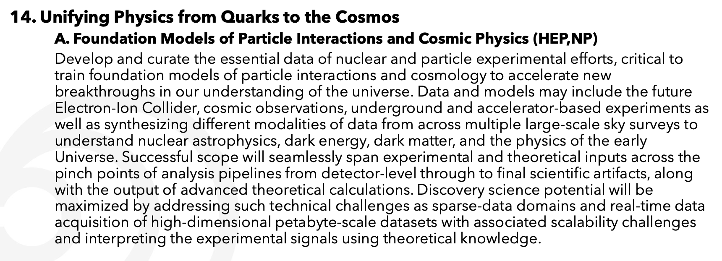
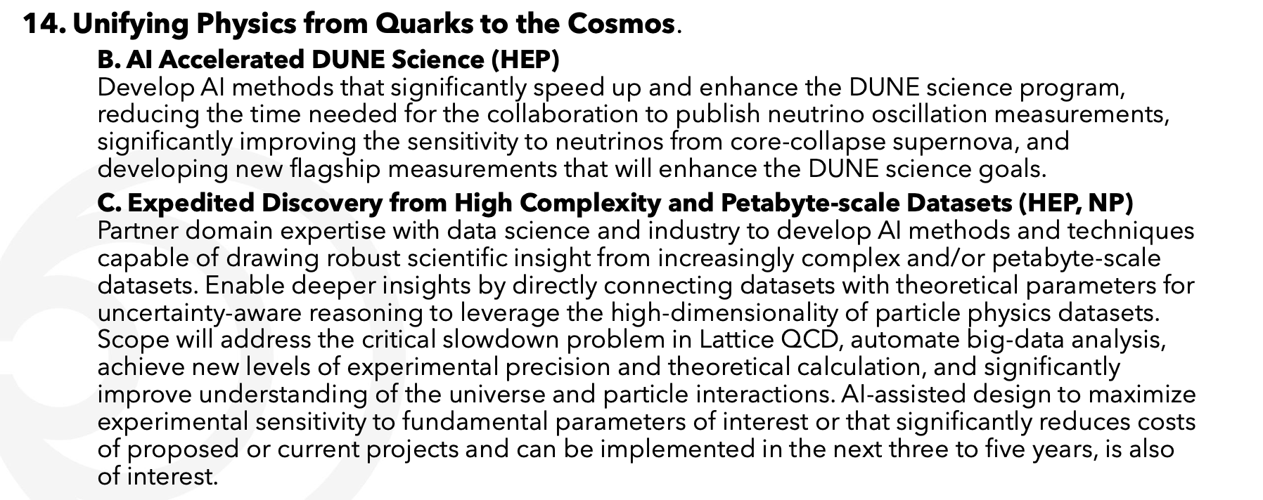
HENP National Challenges and FY26 focus areas

Slide 11
More from DPF 2026
Gina Rameika:
  DOE HEP has always expected researchers to use the best tools possible
    …
    To take advantage of this rapidly developing frontier AI requires collaboration and partnerships requiring a shift in the structure and support of HENP research
Jeremy Love:
  Advance the HEP mission by using the best tools available, the frontier AI and computing of the Genesis Mission Platform
    Requires a change in approach and a move toward larger multi-institution and multi-disciplinary collaborative effort

Slide 12
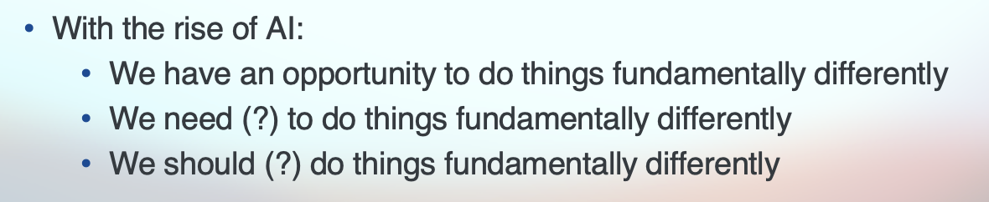
More from DPF 2026
Gina Rameika:
  DOE HEP has always expected researchers to use the best tools possible
    …
    To take advantage of this rapidly developing frontier AI requires collaboration and partnerships requiring a shift in the structure and support of HENP research
Jeremy Love:
  Advance the HEP mission by using the best tools available, the frontier AI and computing of the Genesis Mission Platform
    Requires a change in approach and a move toward larger multi-institution and multi-disciplinary collaborative effort
Me, slide 3

Slide 13
Spotlights

Slide 14
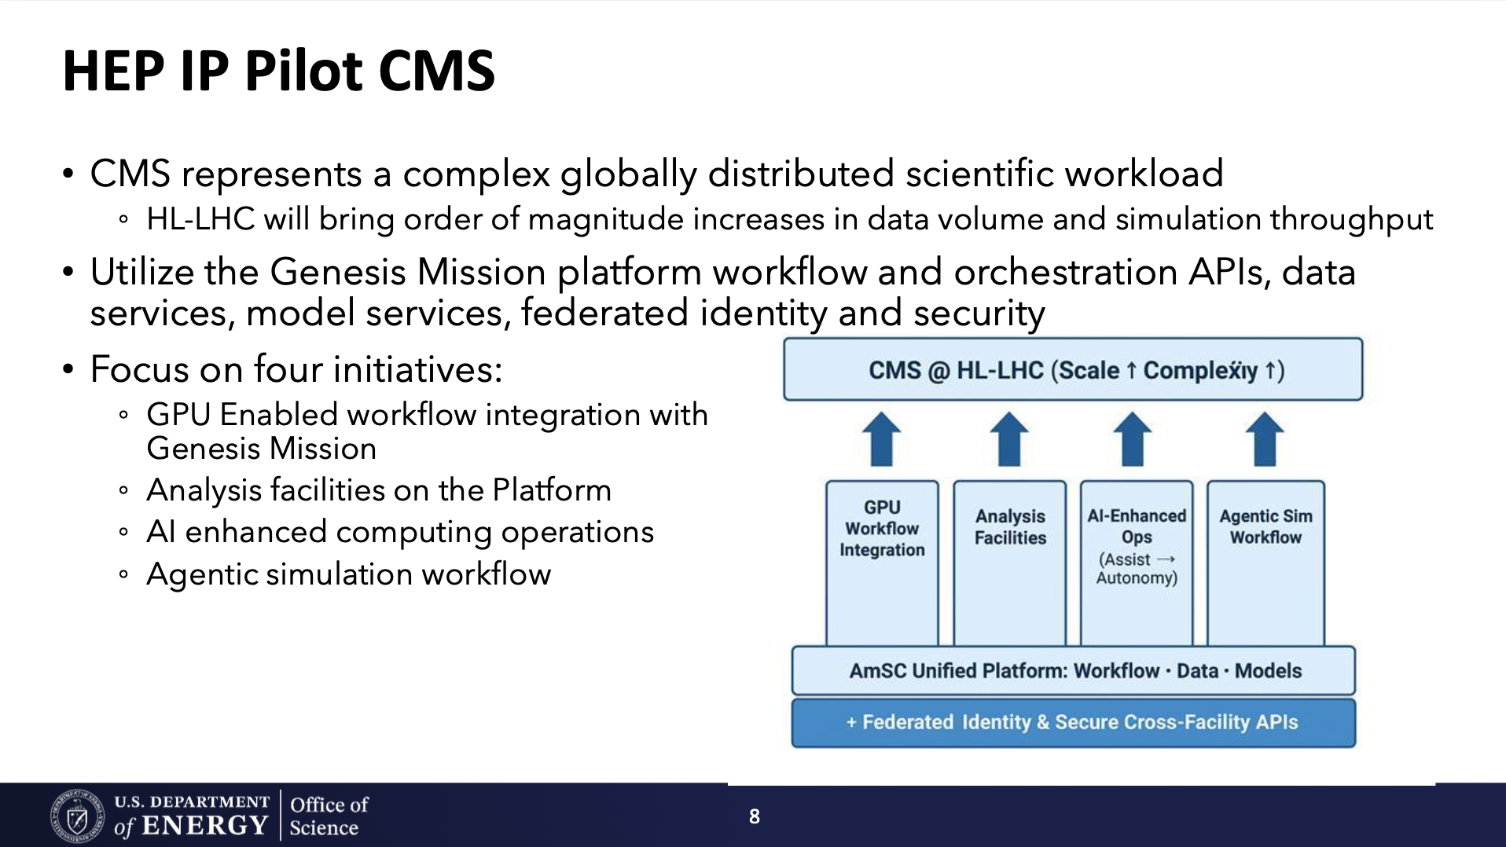
Jeremy Love, DPF 2026
Notes:
This is where we have identified our AI strengths in 3 main categories
1 - from our analysis and operations, making sure the ML tools are robust for making scientific insights
2 – because we have such complex facilities and experiments, it’s a big part of what we do
3 – and with extreme data rates and environments, edge AI and codesign is a big part of our core AI program

Slide 15
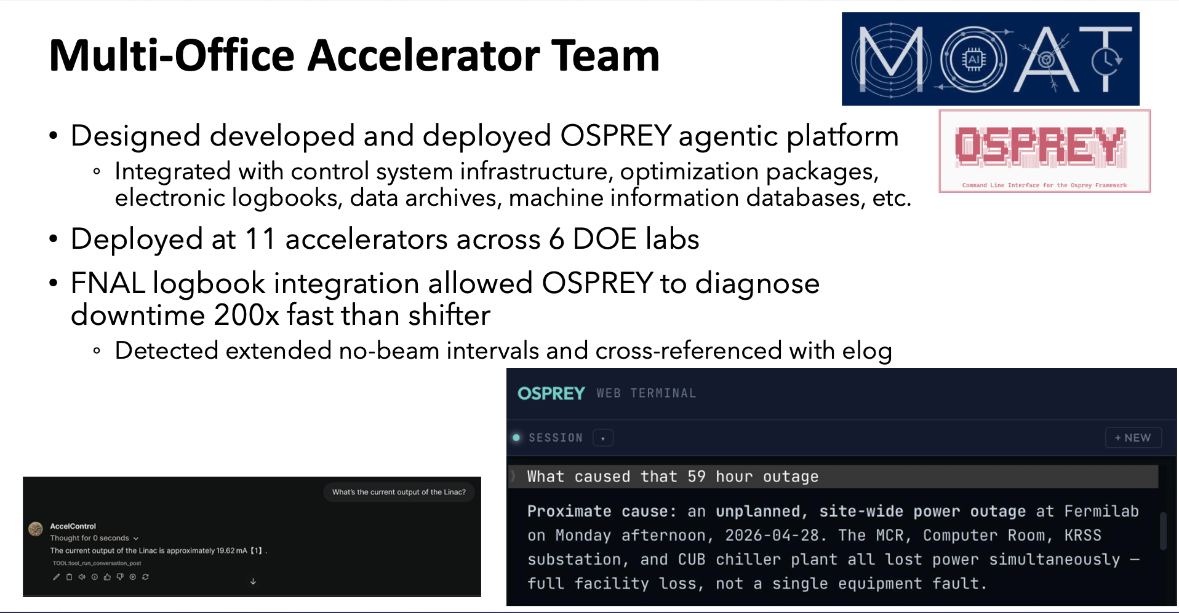
Jeremy Love, DPF 2026
Notes:
This is where we have identified our AI strengths in 3 main categories
1 - from our analysis and operations, making sure the ML tools are robust for making scientific insights
2 – because we have such complex facilities and experiments, it’s a big part of what we do
3 – and with extreme data rates and environments, edge AI and codesign is a big part of our core AI program

Slide 16
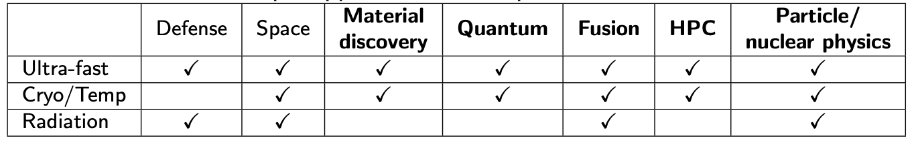
AXESS:
Accelerating eXtreme Environment Specs-to-Silicon
(Genesis Mission seed team, now ramping up for Phase 2)
Develop DOE-specific Microelectronics design tools to speed-up research and development in extreme environments where commercial tools fall short
Use decades of ASIC circuit designs from applications in extreme environments with characterization and testing data – initial focus on cryogenic environments
Vision: Significantly accelerate and enable extreme environment design with unprecedented reliability and precision based on DOE measurement and simulation capabilities

Slide 17
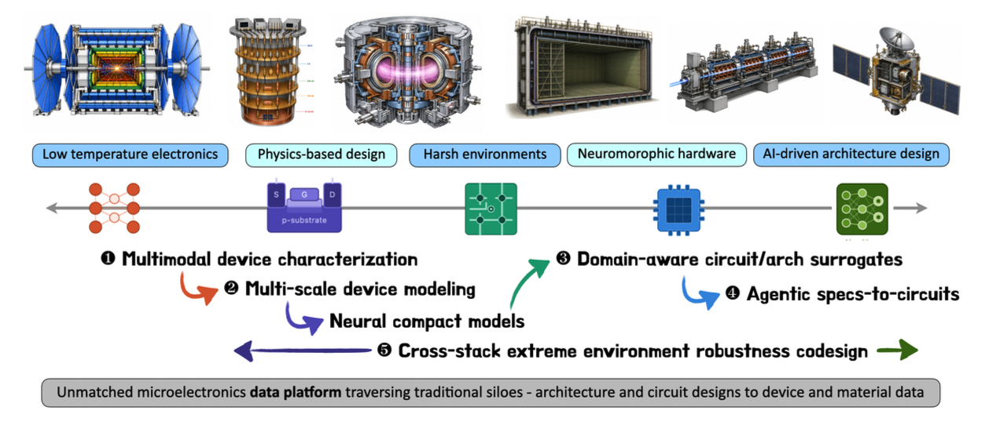
United data and modsim ecosystem with AI-ready data
Foundational Surrogate Models across different levels of the microelectronics stack
Agentic tools to automate design optimization and data generation/discovery

Slide 18
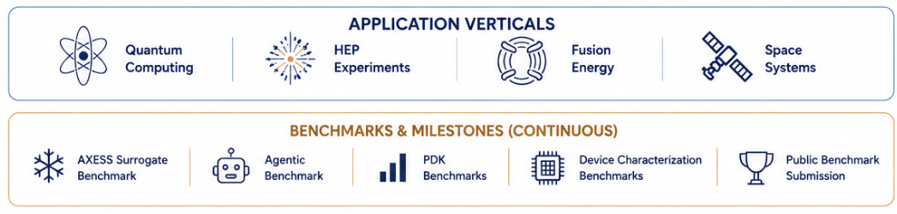
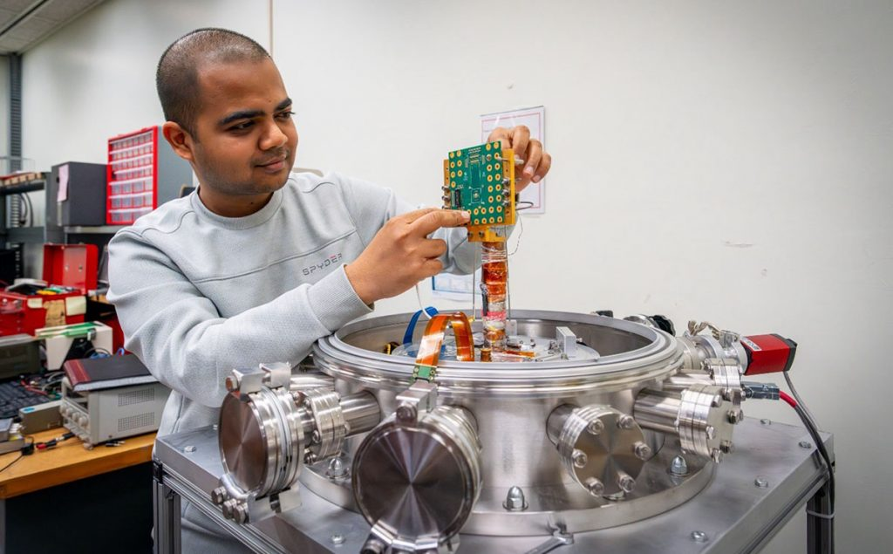
United data and modsim ecosystem with AI-ready data
Foundational Surrogate Models across different levels of the microelectronics stack
Agentic tools to automate design optimization and data generation/discovery

Slide 19
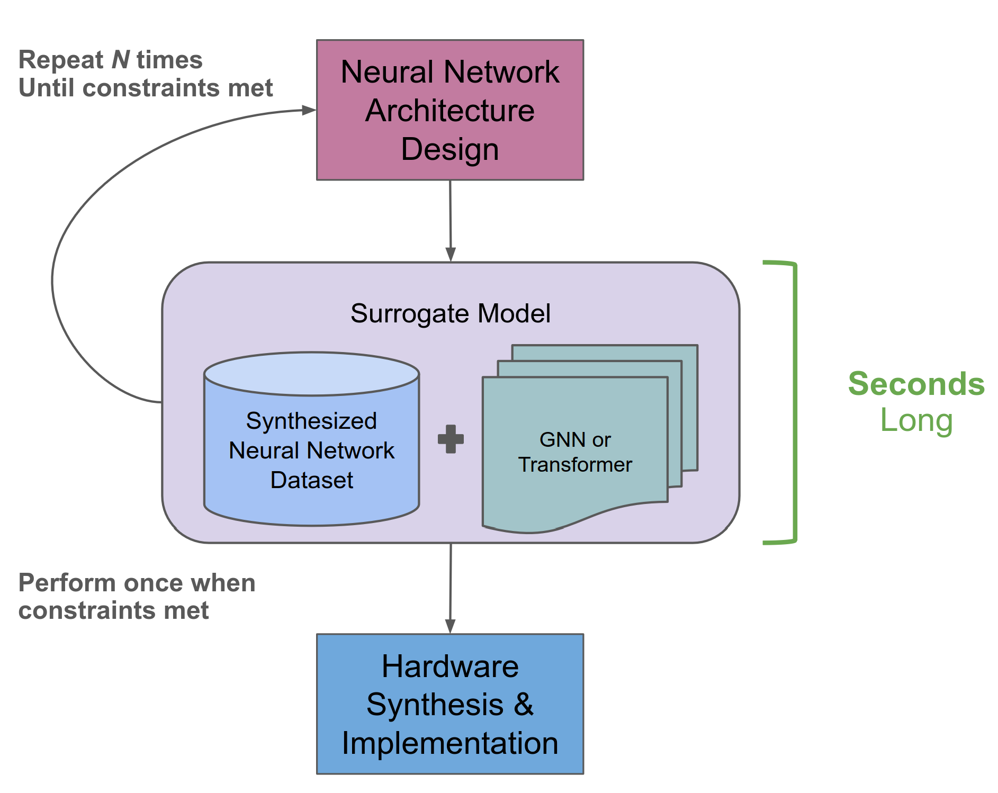
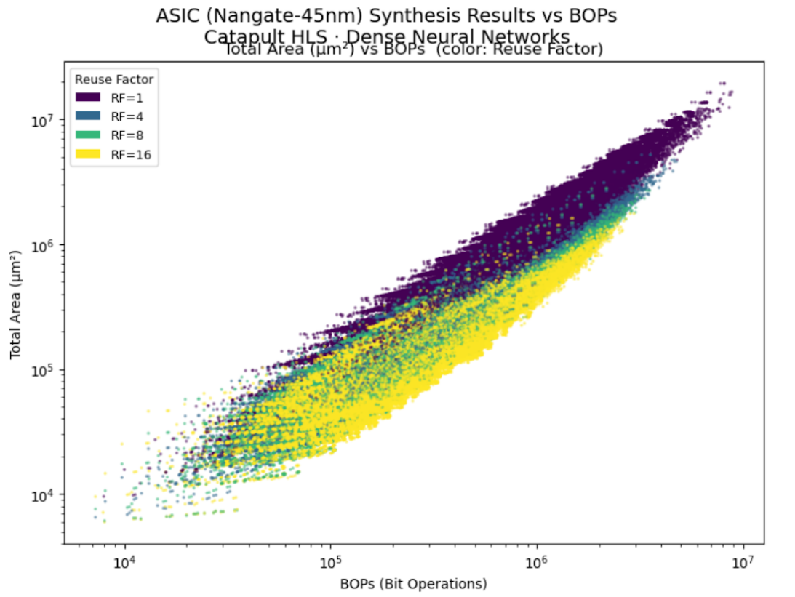


Architecture Cost and Performance Surrogates
Challenge: ASIC synthesis takes hours per NN accelerator design, repeated N times in architecture search
Surrogates (GATv2 / Transformer) predict area, latency, throughput in milliseconds
  Enables accelerated agentic-codesign
  Send only winners to full EDA/CAD flow
Achievement:
  Trained on ~500K designs across Nangate 45nm and GF22FDX
  Accuracy: R² ≈ 0.999 for latency and area
  Cross-node transfer: 45 nm → GF22FDX with ~10% target-node data
References
A. R. Das et al., “Scaling Out hls4ml for ASICs: A Surrogate Model for Neural Network Accelerator Synthesis Metrics”, Fast Machine Learning for Science, 2026

Slide 20
Outlook – a shared mission

Slide 21
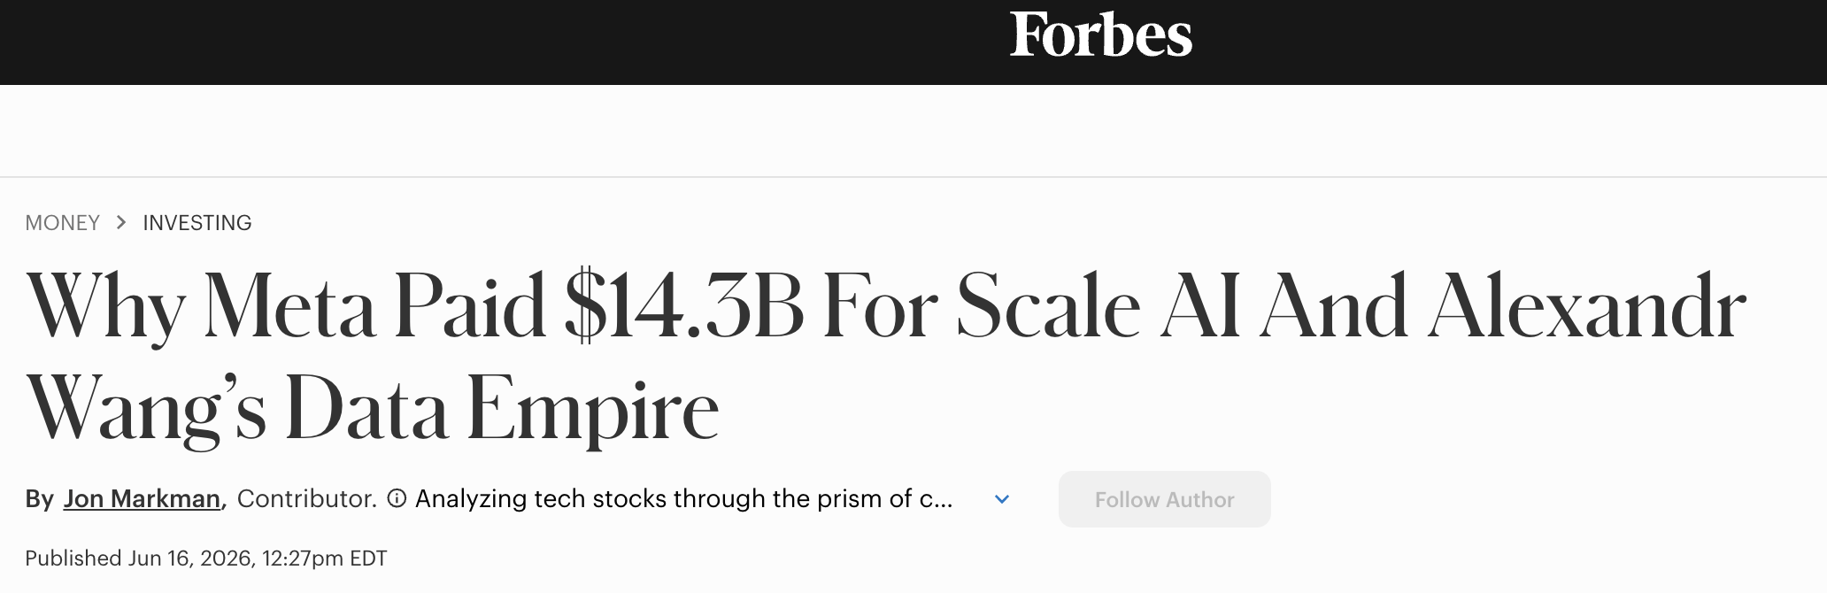
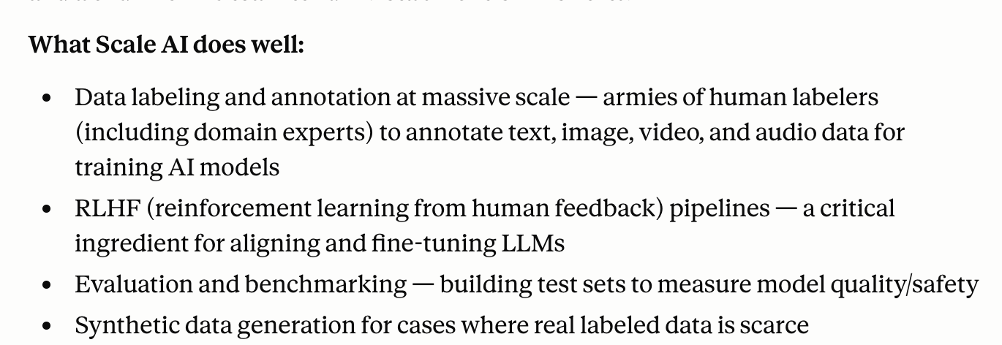


Claude

Slide 22

Data
HEP has long had historical strength in data
But, this needs to be revisited:
Multiple modalities - research, operational, construction, project data
Big and small - smaller R&D efforts, test stands
Dedicated efforts for data curation and system redesign
Could Genesis be the catalyst to do this?
Notes:
Data is a big component of who we are, driven by those big data rate experiments
Say features
But also in addition to the storage, we are also stewards of the software frameworks for CMS and DUNE.
The leads to capabilities for Genesis

Slide 23
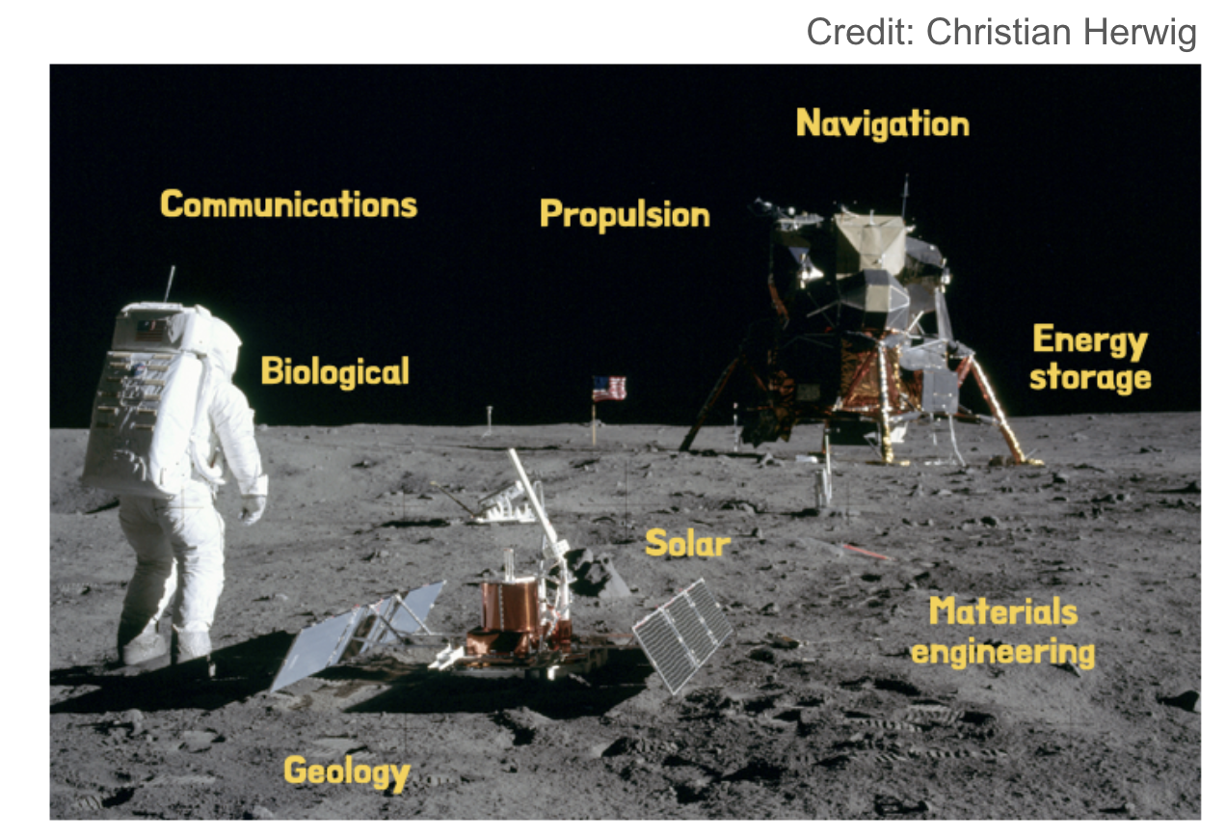
Moonshots and benchmarks
“What get measured, gets improved.”
Defines meaningful scientific challenges
Specifies common metrics for comparison
Unites multidisciplinary experts and scientific workloads

Slide 24
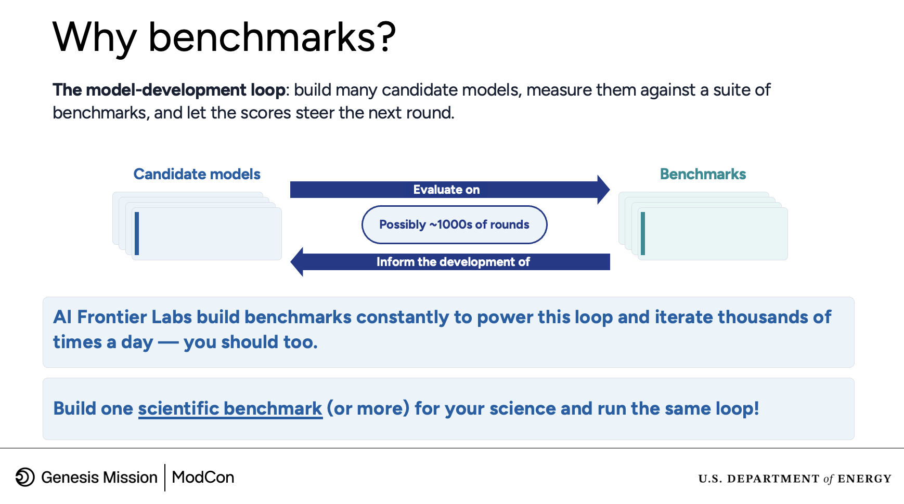
Benchmarks
Fernando Llorente, ModCon Hackathon, Oct 2026

Slide 25
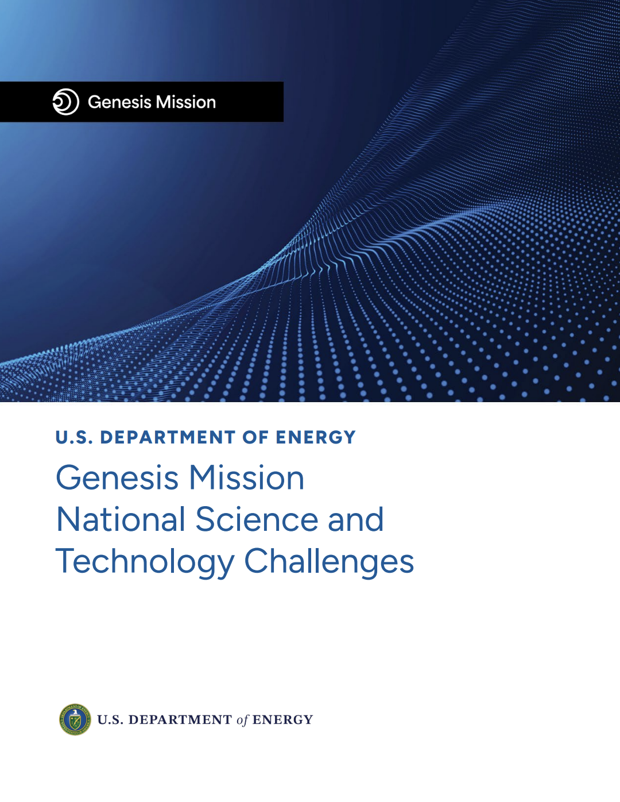
Benchmarks
Genesis is a good opportunity to define the benchmark problems needed to meet the national challenges
Admirable benchmarking efforts exist in the community but need to be:
  Holistic - to capture all aspects of scientific life cycle
  Dynamic - continually adapted as progress is made
  Championed

Slide 26
Parting thoughts
Image: ChatGPT
AI is the big technological leap of this generation
  Understand what it can (and can’t do) (vs. time)
With the rise of AI and Genesis Mission:
  We have an opportunity to do things fundamentally differently
  We need (!) to do things fundamentally differently
You are the resource, understand what the frontier labs are doing
  Data is (still) the foundation
  Knowledge is encoded in our simulations, models, and domain expertise
  Benchmarks define priority tasks and meaningful progress
Notes:
Like the internet?

Slide 27
Extra

Slide 28
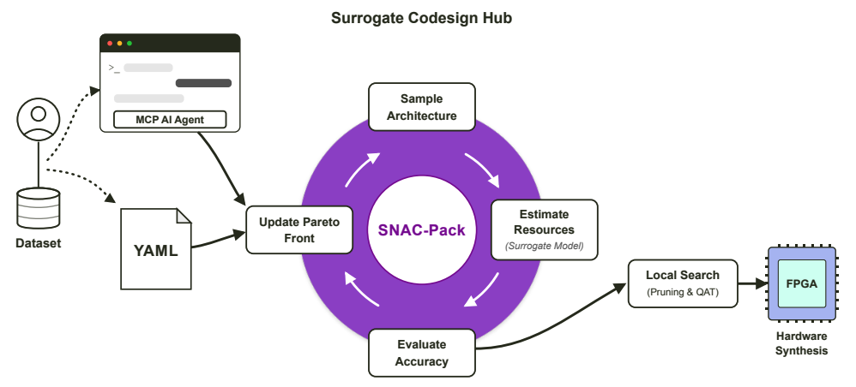
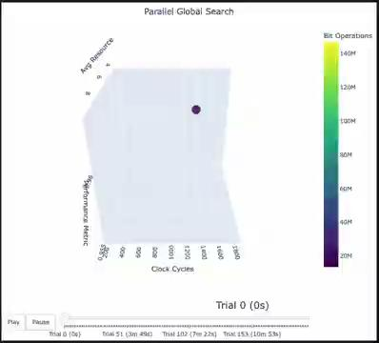

Agentic Codesign Workflow
SNAC-Pack embeds surrogate models in an agentic co-design loop
Queries the surrogate instead of synthesizing every candidate
Refines promising candidates with pruning and quantization-aware training
Achievement:
  ~500× faster design phase for qubit readout hardware accelerator
  Faster, smaller FPGA implementation: ~33% lower latency, ~54% fewer LUTs
References
J. Weitz et al., “Surrogate Neural Architecture Codesign Package (SNAC-Pack)”, arXiv:2605.16138, 2026

