Slide 1




Simulating Microwave SQUID Multiplexers Using
Coupled-Mode Theory
Luke Wanner^{1,*}, Morgan Kasch¹, Ben Mates²,
Wouter Van De Pontseele¹, Doug Bennett²
¹ Colorado School of Mines
² National Institute of Standards and Technology
Notes:
One-sentence message: we built a time-domain simulation of µMux channels, tested it against measured transients, and it shows what limits the flux-ramp rate in our system.

Slide 2
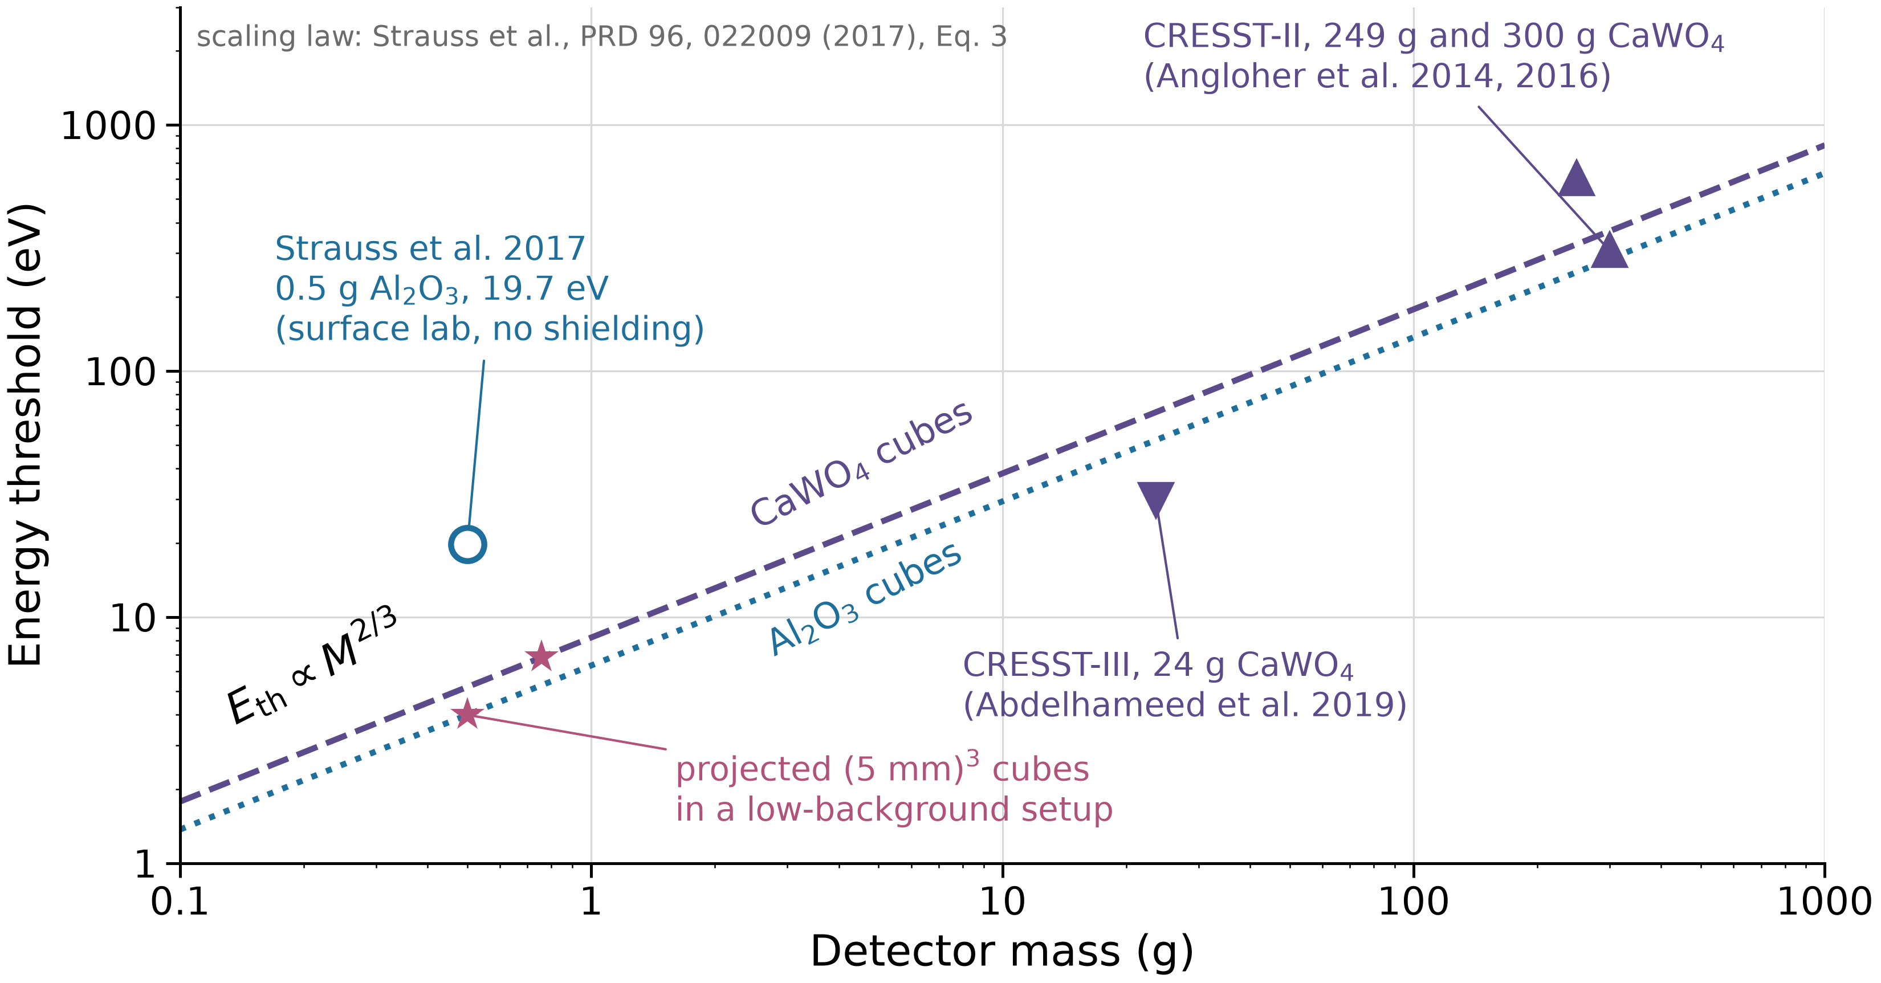
Many cryogenic detector experiments need thousands of readout channels
Target mass: thresholds rise with mass, so large targets split into many small detectors
e.g. dark matter, CEvNS, 0νββ
Imaging: cameras need one pixel per point in the image
e.g. CMB, mm/sub-mm astronomy
Count rate: pile-up limits the events each pixel can handle, so high statistics need many pixels
e.g. neutrino mass, X-ray spectroscopy
All three lead to 1000+ channels, too many to wire out individually
Energy threshold vs. detector mass; scaling law after Strauss et al. (2017), with CRESST data points
Notes:
CEvNS, dark matter, and 0νββ searches all gain sensitivity with total target mass.
A detector's threshold usually gets worse as each detector gets bigger. For CRESST-type detectors it scales as M^(2/3); this plot follows Strauss et al.
So the mass is split into many small detectors, N = M_total / M_max: hundreds to thousands of channels.
Wiring every channel separately doesn't scale, which is why we multiplex.
Examples: HOLMES (TES) and ECHo (MMCs) read out arrays with microwave SQUID multiplexers. NUCLEUS and CRESST show gram-scale detectors for CEvNS and dark matter.

Slide 3
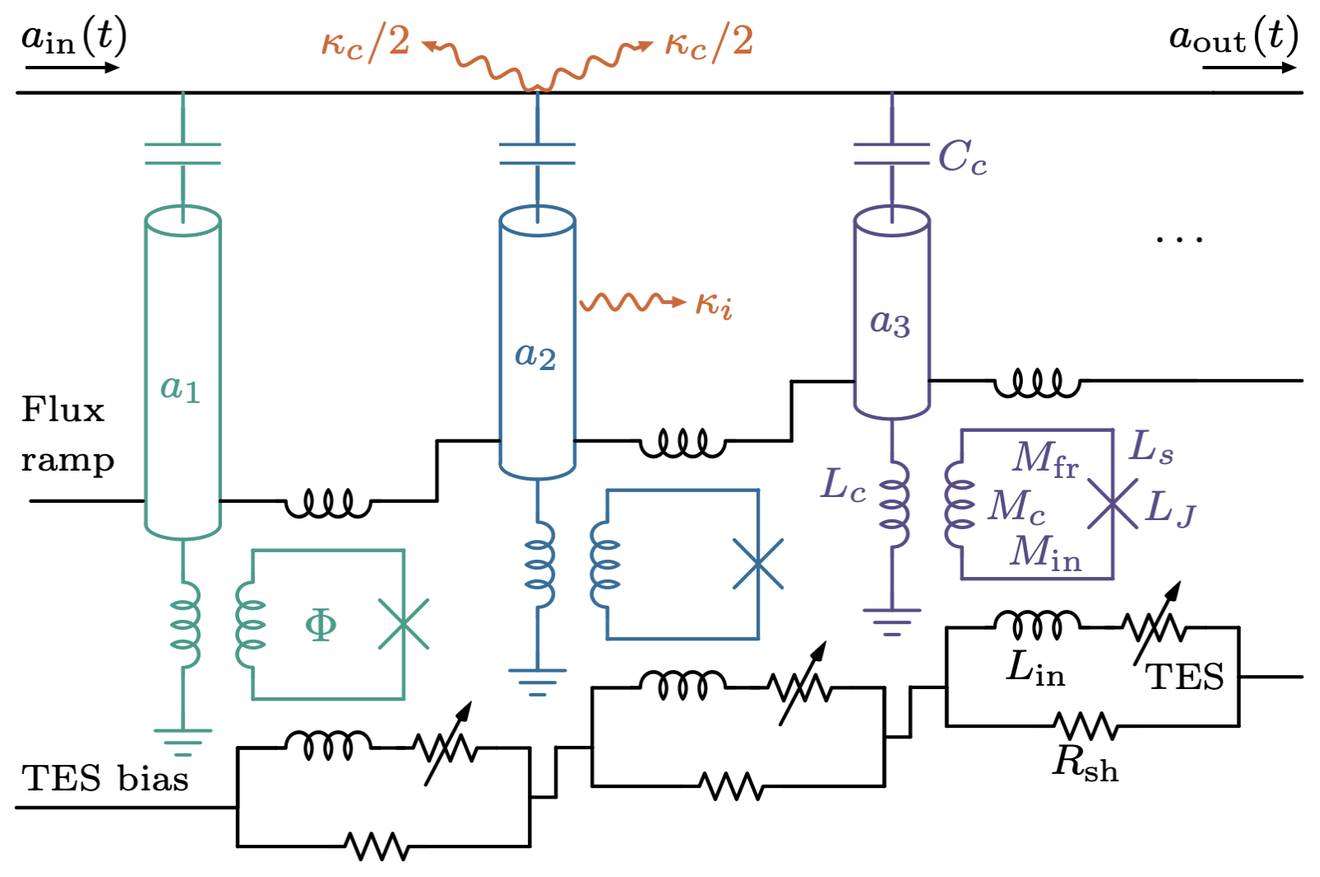
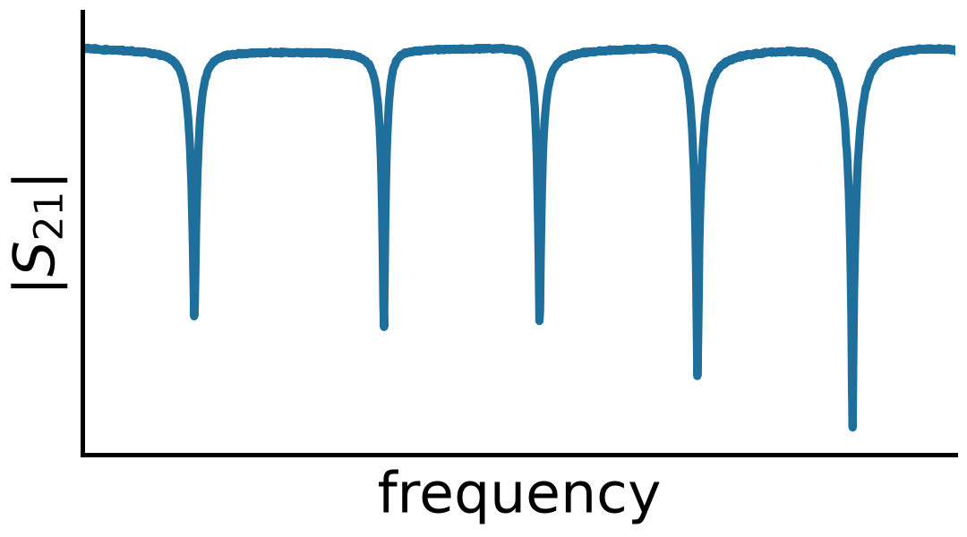
Each detector gets its own resonance, tuned by SQUID flux
Each detector has its own resonant frequency
Detector current shifts that resonance through SQUID flux
Notes:
Each channel is a quarter-wave resonator on a shared feedline, terminated by an inductor coupled to an RF-SQUID.
Detector current → flux in the SQUID → effective inductance → resonance shift.
The response is periodic in Φ0. Each resonator sits at its own frequency, so many share one feedline (frequency-division multiplexing).
Our device: 32 resonators between about 5.51 and 5.72 GHz.

Slide 4
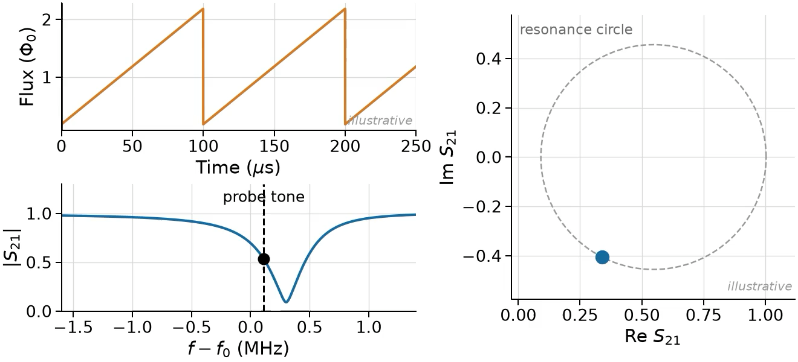
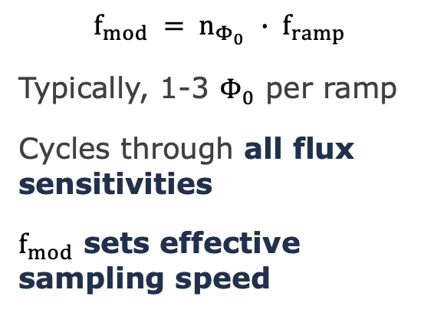
The flux ramp modulates every channel
$$f_{mod} = n_{Φ_{0} }∙ f_{ramp}$$
Typically, 1-3 $Φ_{0}$ per ramp
Cycles through all flux sensitivities
$f_{mod}$ sets effective sampling speed
Notes:
Every channel is modulated this way, even with no detector signal.
This linearizes the response and moves the signal away from low-frequency (1/f) noise.

Slide 5
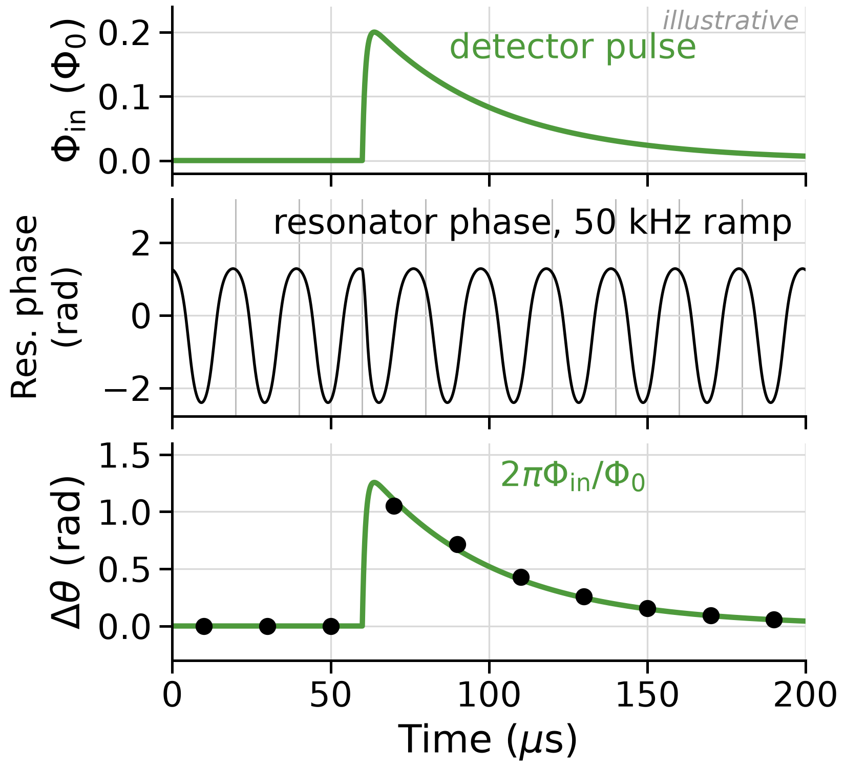
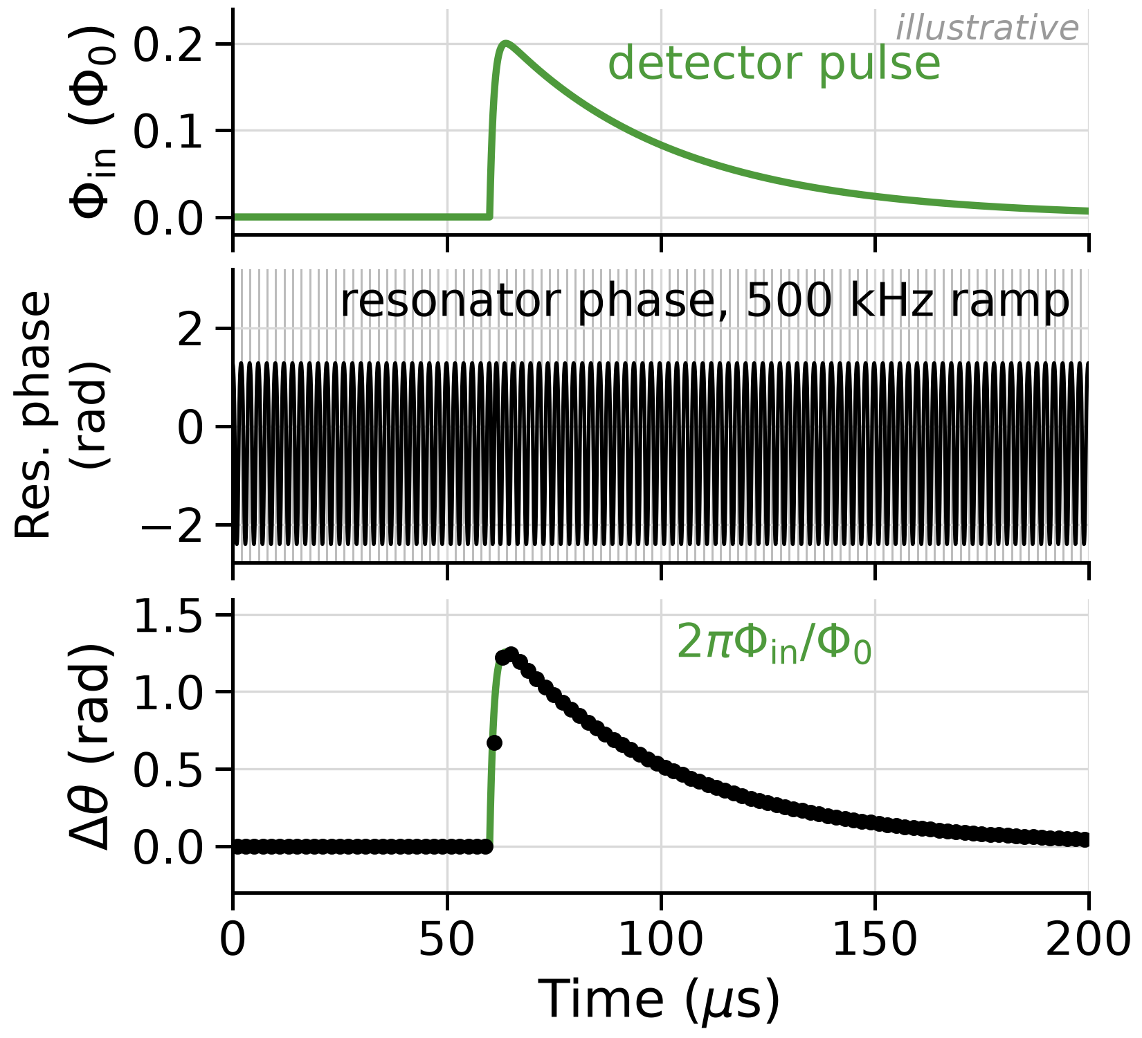
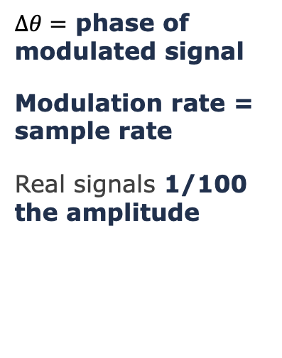
Detector signals shift the phase of that modulation
$∆θ=$ phase of modulated signal
Modulation rate = sample rate
Real signals 1/100 the amplitude
Notes:
A slowly varying input flux shifts the phase of this periodic pattern by 2πΦ_in/Φ0. Call this Δθ; it is not the probe phase θ.
We demodulate once per ramp, so we get one sample per ramp: the ramp rate is the sampling rate.
To resolve a fast pulse we need many ramps across its rise, so we want to ramp fast.

Slide 6
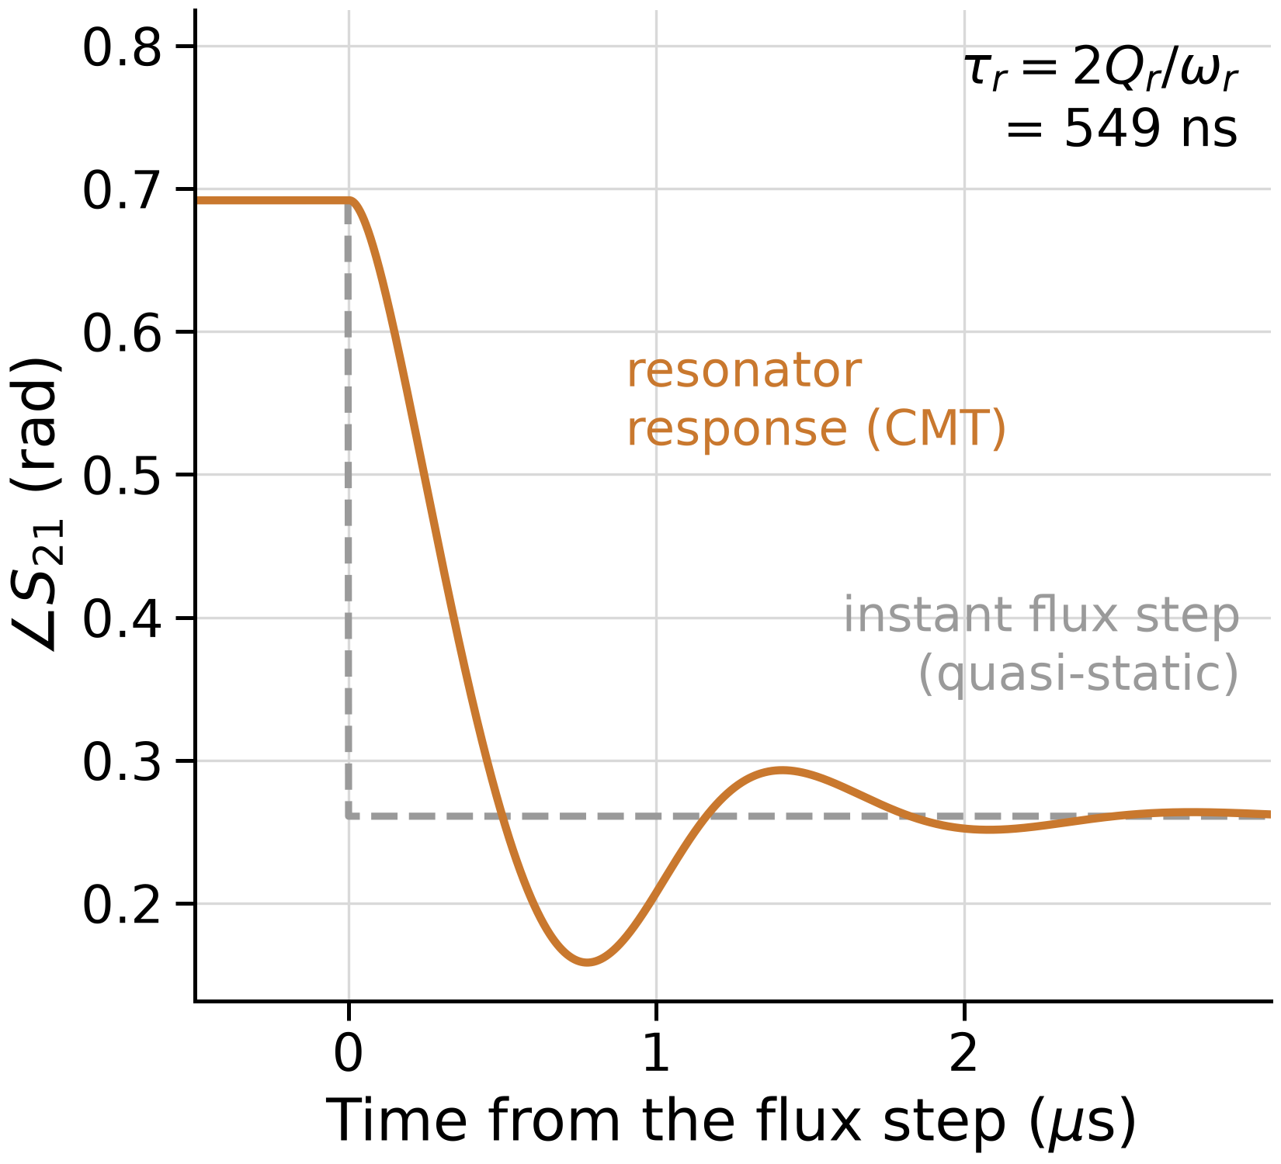
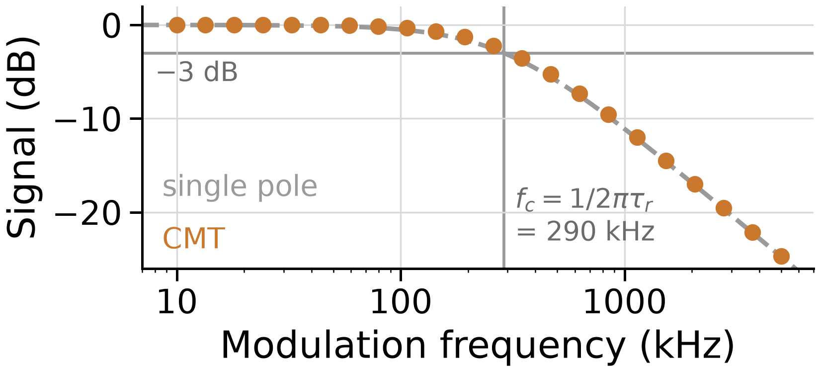
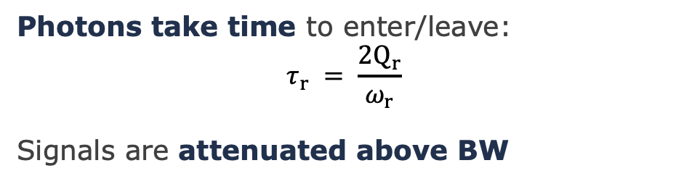
Limit 1: Resonator ring-up
Photons take time to enter/leave:
$$τ_{r} = \frac{2Q_{r}}{ω_{r}}$$
Signals are attenuated above BW
Notes:
Two effects limit how fast we can ramp. The first is ring-up.
The transmitted wave settles on τ_r = 2Q_r/ω_r ≈ 550 ns. Here the resonator bandwidth f_r/Q_r is about 580 kHz.
As the modulation frequency approaches that bandwidth, the signal is attenuated and distorted.
Tone tracking keeps the probe on the steep slope of the resonance and recovers [TBD: amount from Yu et al. 2022] of the loss, but it doesn't remove the cavity's response time.

Slide 7
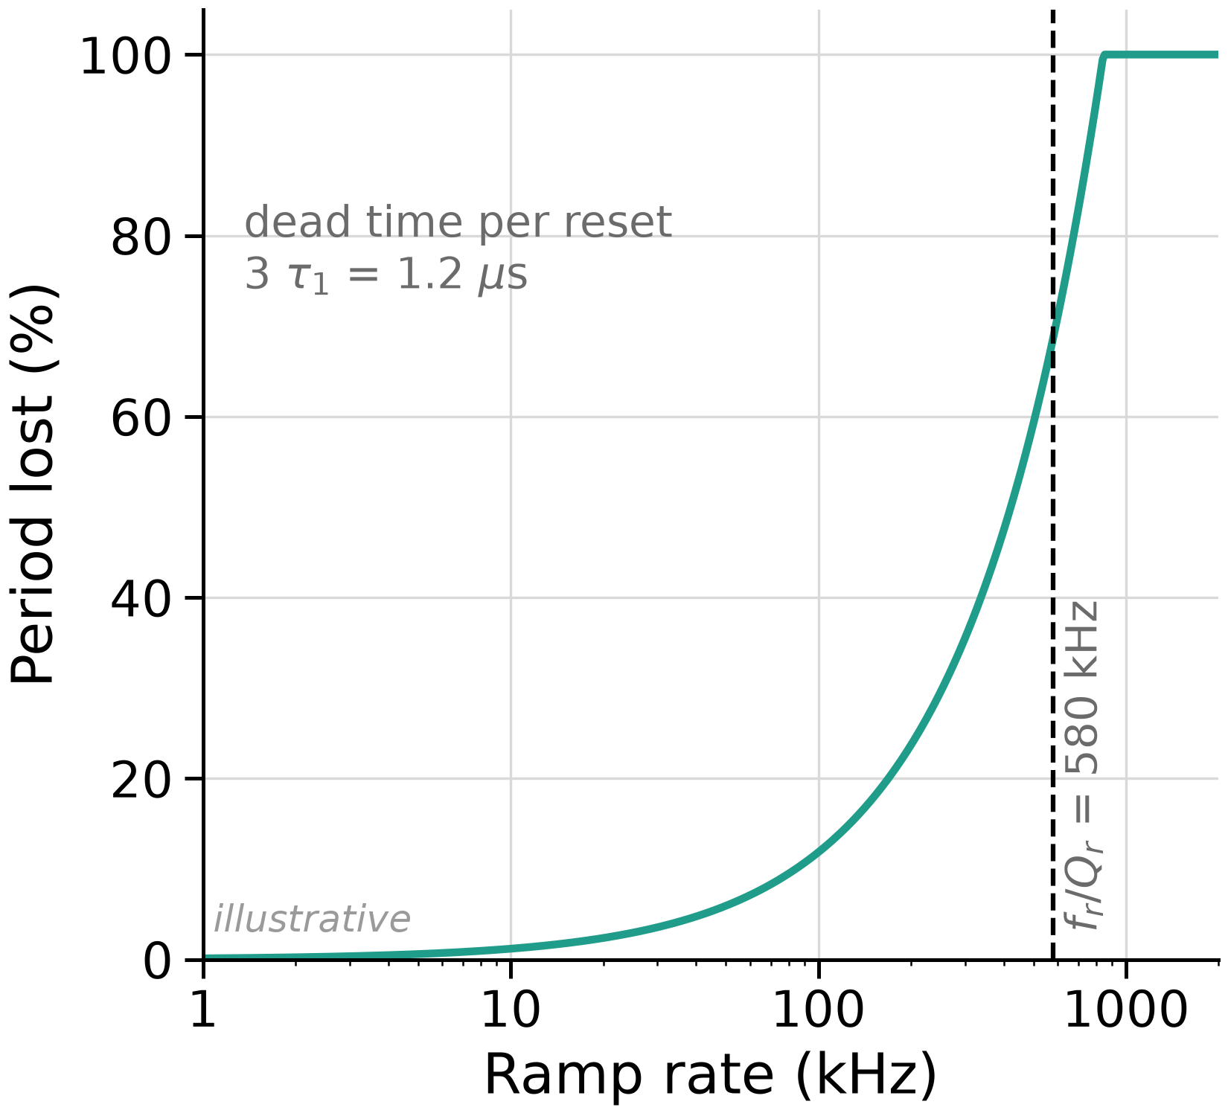
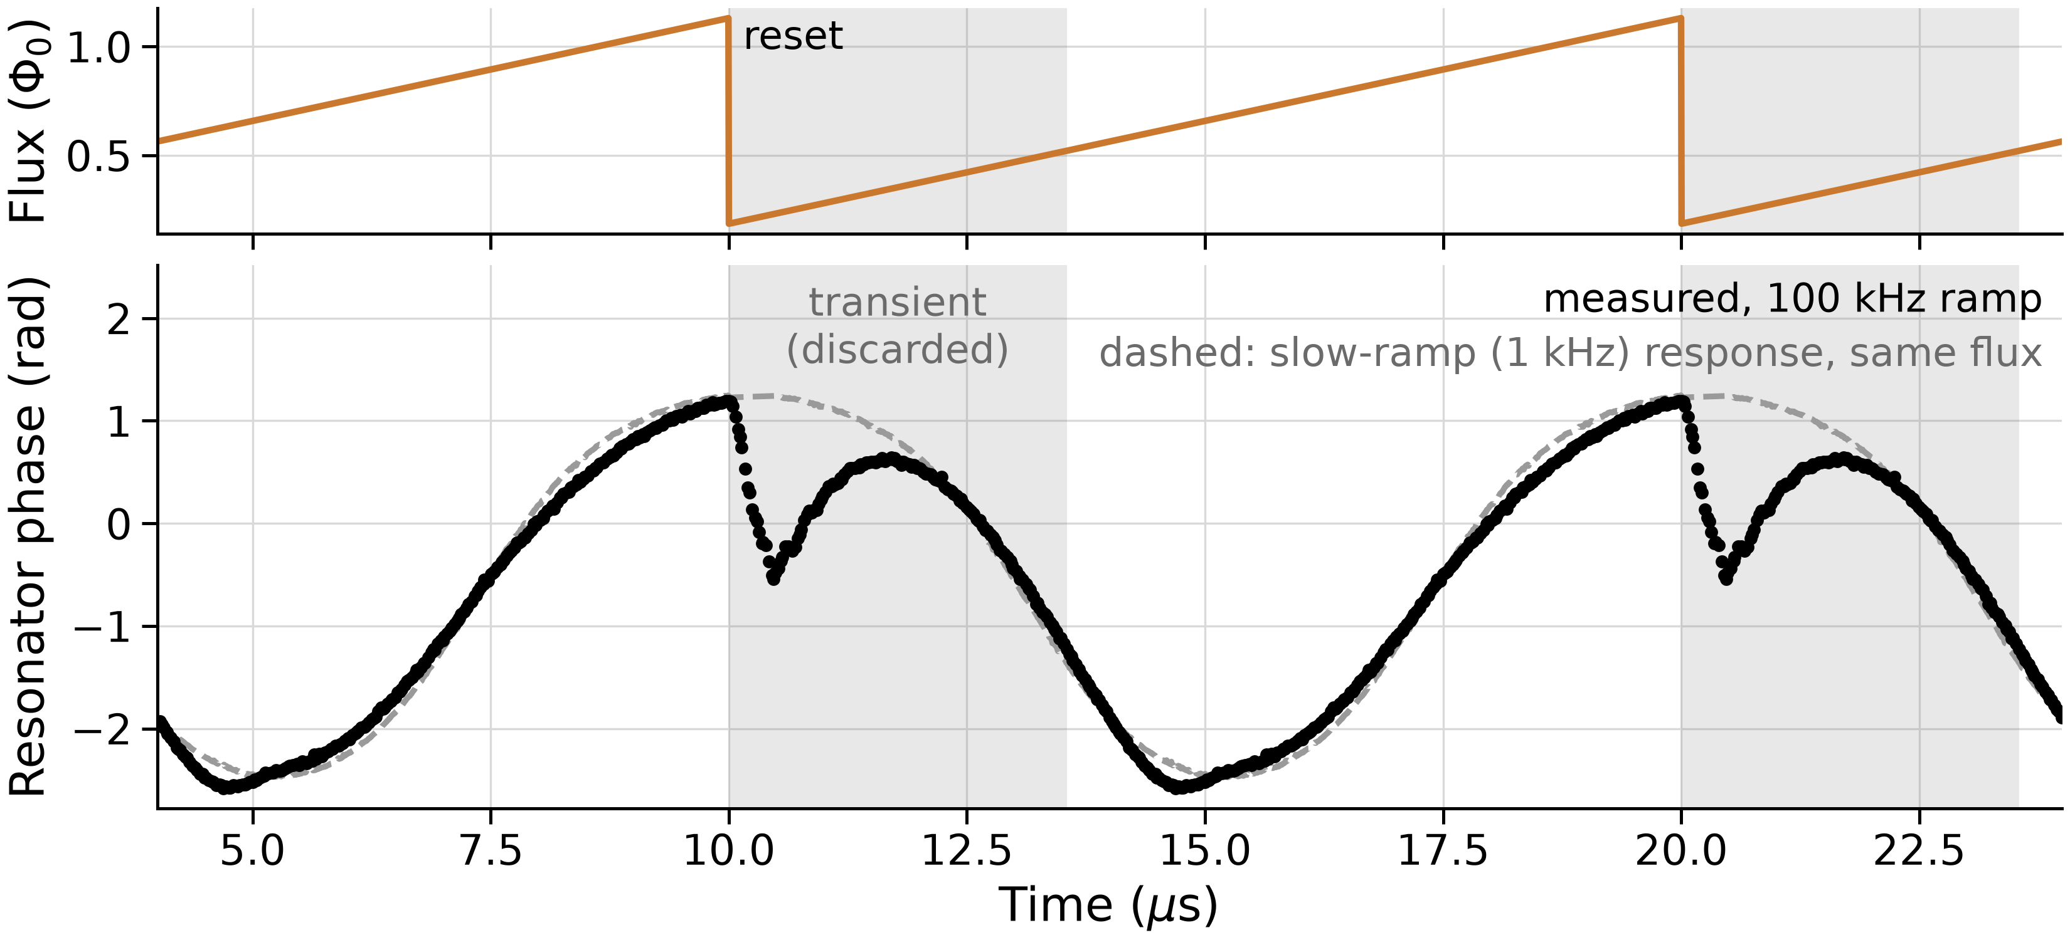
Limit 2: Ramp reset transients
Non-ideal ramp causes transients at reset
Typically discarded, so ramp rate is limited
Notes:
The second effect is the reset transient: each ramp reset excites a transient.
That data is discarded, which costs signal-to-noise and limits the ramp rate.
Ben Mates showed at ASC 2026 that the transient originates in the flux-ramp bias line [TBD: talk title/ID]. Our contribution is to model it quantitatively and validate the model against data.

Slide 8
Simulation can guide design and readout choices, but no data-tested transient simulator
Approach | Time-domain? | Resonator dynamics? | Flux line? | Compared to measured transients? | Open source?
Full-wave / multiphysics (Elkin, Roth) | No | No | No | No | No
Steady-state (Wegner, Neidig) | No | No | No | No | No
Quasi-static time-domain (e.g., SMuRF, Yu et al.) | Yes | No | No | No | Readout only
First-order dynamic (Schuster) | Yes | Yes | Ideal Butterworth | No | No
This work | Yes | Yes | Yes | Yes | Yes
Notes:
We simulate to optimize device design and readout choices, for example for integrated designs like Sidecar.
Full-wave and multiphysics solvers are accurate but too slow for many ramp periods.
Steady-state models give the flux and power dependence of the resonance.
Time-domain models are mostly quasi-static. Schuster et al. add a first-order resonator relaxation and an ideal Butterworth filter for the flux line.
To our knowledge, none of the dynamic models has yet been compared quantitatively with measured transients.
Our framework uses coupled-mode theory (CMT). It will be released open source on GitHub together with the publication.

Slide 9
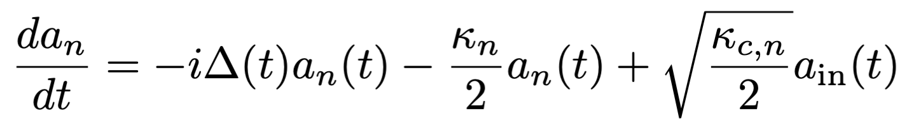
Equation of Motion from Coupled Mode Theory (CMT)
Detuning
Drive tone offset from resonance
Δ(t) = ω_{d}(t) − ω_{r}(t)
Loss
Feedline coupling plus internal loss
κ_{c} = ω₀ / Q_{c} κ_{i} = ω₀ / Q_{i}
Drive
Feedline input via the coupler
a_{in}(t): incident field
Measured transmission S₂₁(t) = a_{out}(t) / a_{in}(t)
Notes:
This is the equation of motion for the resonator field a(t), written in the frame of the probe tone.
Drive: the probe tone couples in through the feedline.
Loss: κ = κ_c + κ_i, coupling plus internal loss.
Detuning: ω_d − ω_r(t). This is the only place the SQUID enters, through its flux- and power-dependent inductance.
It's the semiclassical limit of input–output theory, equivalent to temporal coupled-mode theory (CMT). Q_r, Q_c, and α from a standard S21 circle fit enter unchanged.
The RF flux follows the energy stored in the resonator, |a|², so readout-power effects stay consistent through transients. We integrate it with SciPy's BDF solver.

Slide 10
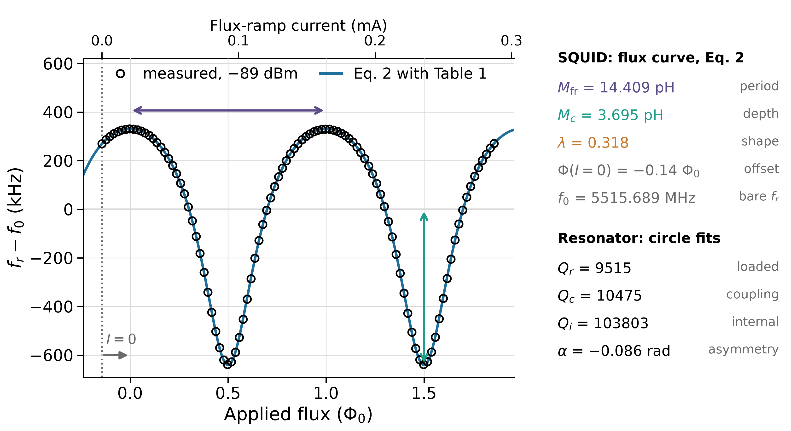
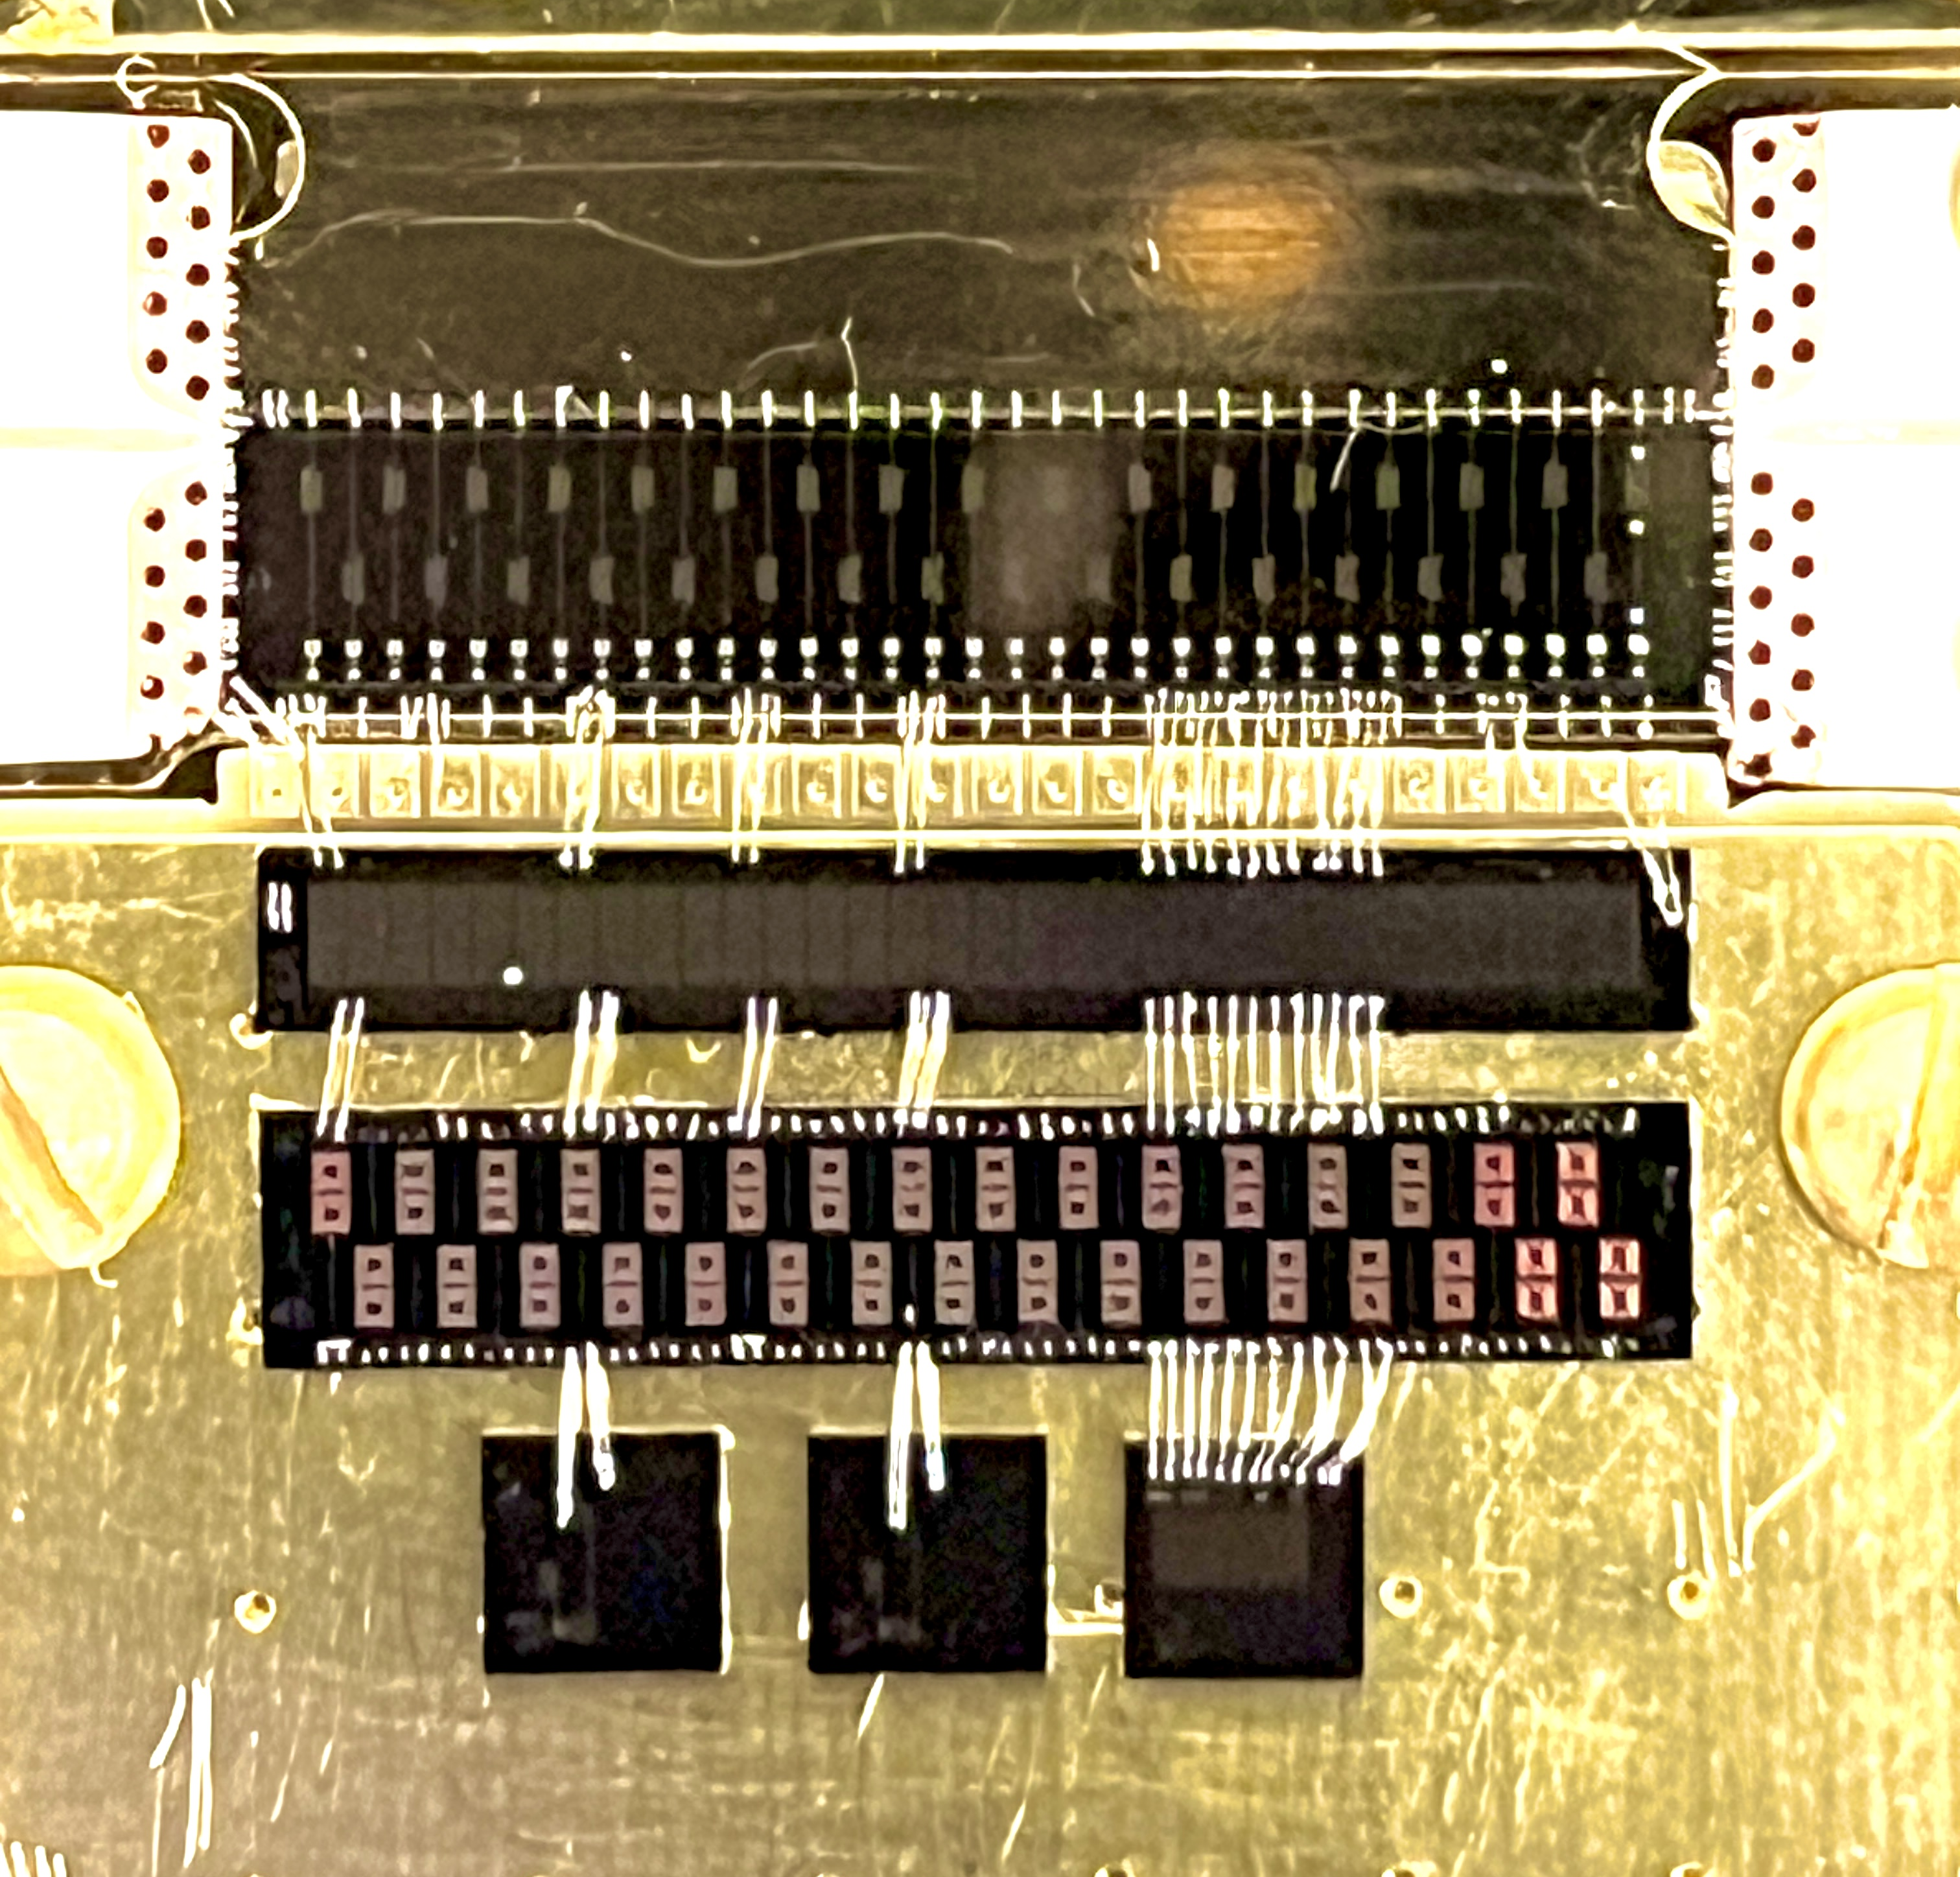
A VNA sweep and a slow flux scan characterize each channel
32-channel multiplexer fabricated by NIST
Notes:
The device is a 32-channel µMux fabricated by NIST, with Nb resonators, operated at about 10 mK in a Maybell dilution refrigerator.
A VNA S21 sweep gives Q_r, Q_c, and α.
A slow flux-bias scan gives f0, λ, M_c, M_fr, and the trapped flux.
On the curve: M_fr sets the period, M_c and λ set the swing, λ sets the sharpness of the cusp, and the trapped flux sets the horizontal offset.
These are the only device inputs. The characterization can be automated in [TBD: confirm < 10 s] per resonator.

Slide 11
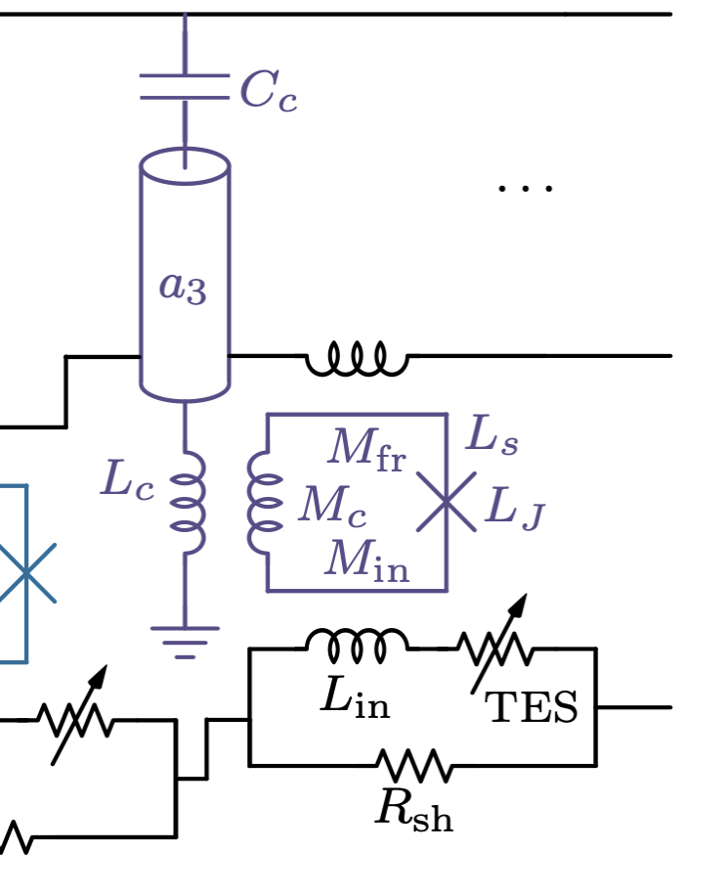
A VNA sweep and a slow flux scan characterize each channel
Notes:
The device is a 32-channel µMux fabricated by NIST, with Nb resonators, operated at about 10 mK in a Maybell dilution refrigerator.
A VNA S21 sweep gives Q_r, Q_c, and α.
A slow flux-bias scan gives f0, λ, M_c, M_fr, and the trapped flux.
On the curve: M_fr sets the period, M_c and λ set the swing, λ sets the sharpness of the cusp, and the trapped flux sets the horizontal offset.
These are the only device inputs. The characterization can be automated in [TBD: confirm < 10 s] per resonator.

Slide 12
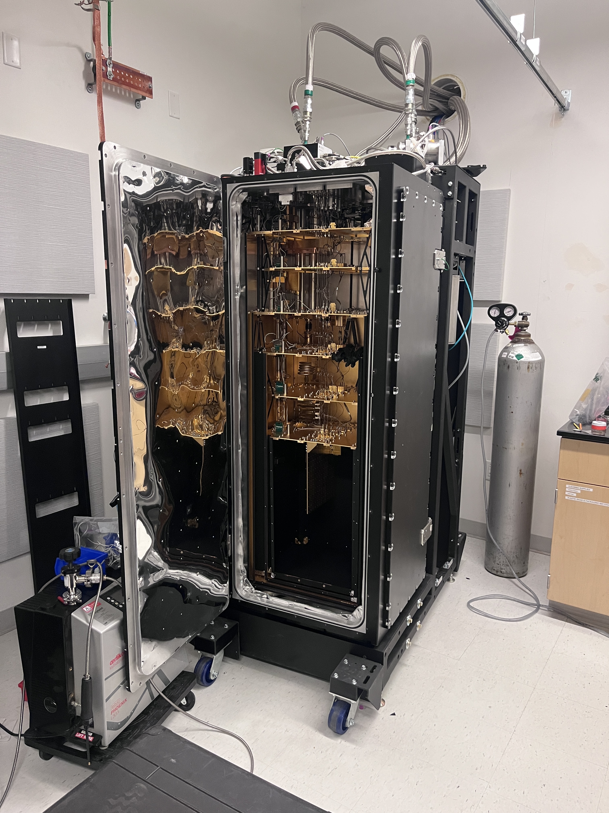
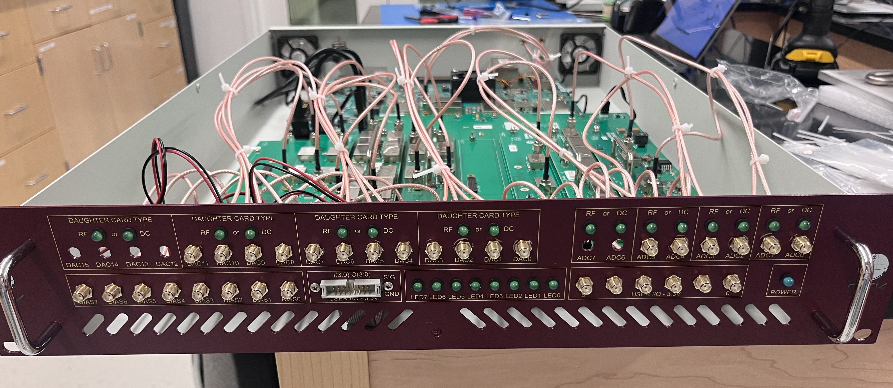
QICK-enabled ZCU216 used for probe tone and flux ramp
QICK on a ZCU216 RFSoC drives all inputs
Probe tones: RF balun daughter board
Flux ramps: DC board
One low-pass filter (225 MHz) on the flux-ramp line
QICK box: ZCU216 RFSoC with balun and DC boards
Maybell DR used for these measurements

Slide 13
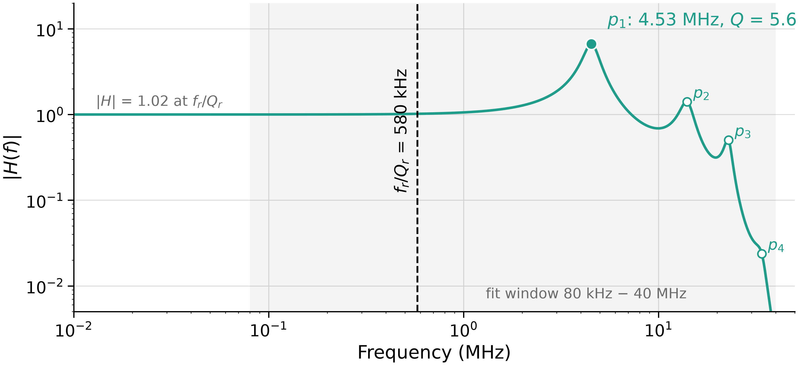
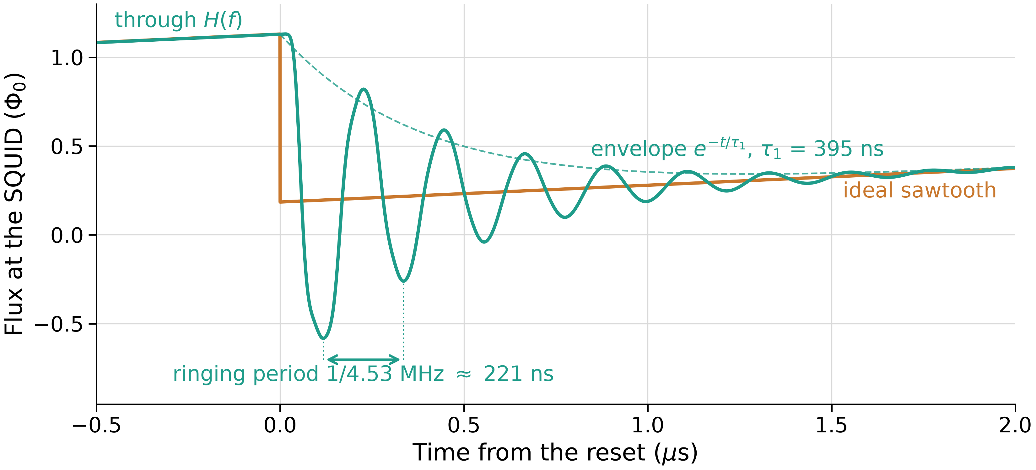
Flux lines often have MHz resonances and roll-off
Measured once with VNA, not fitted to any IQ data
Poles fitted to build transfer function H(f)
Dominant Resonance: 4.53 MHz
Ringing seen at ramp reset sets transient response
Top: measured |H(f)|. Bottom: predicted flux at the SQUID (not measured)
Notes:
The flux line doesn't deliver the ideal sawtooth to the SQUID.
We measured the differential impedance of the flux-ramp input once with a VNA, and built an all-pole transfer function H(f) from it.
Dominant resonance: 4.53 MHz with Q = 5.6, giving about 400 ns of ringing after every sharp edge.
All poles lie well above the 580 kHz resonator bandwidth. They don't change the ring-up, but sharp edges excite them.
H(f) is not fitted to IQ data, so the comparisons that follow test it independently.
The time-domain plot shows predicted flux at the SQUID; we don't measure the coil current directly.

Slide 14
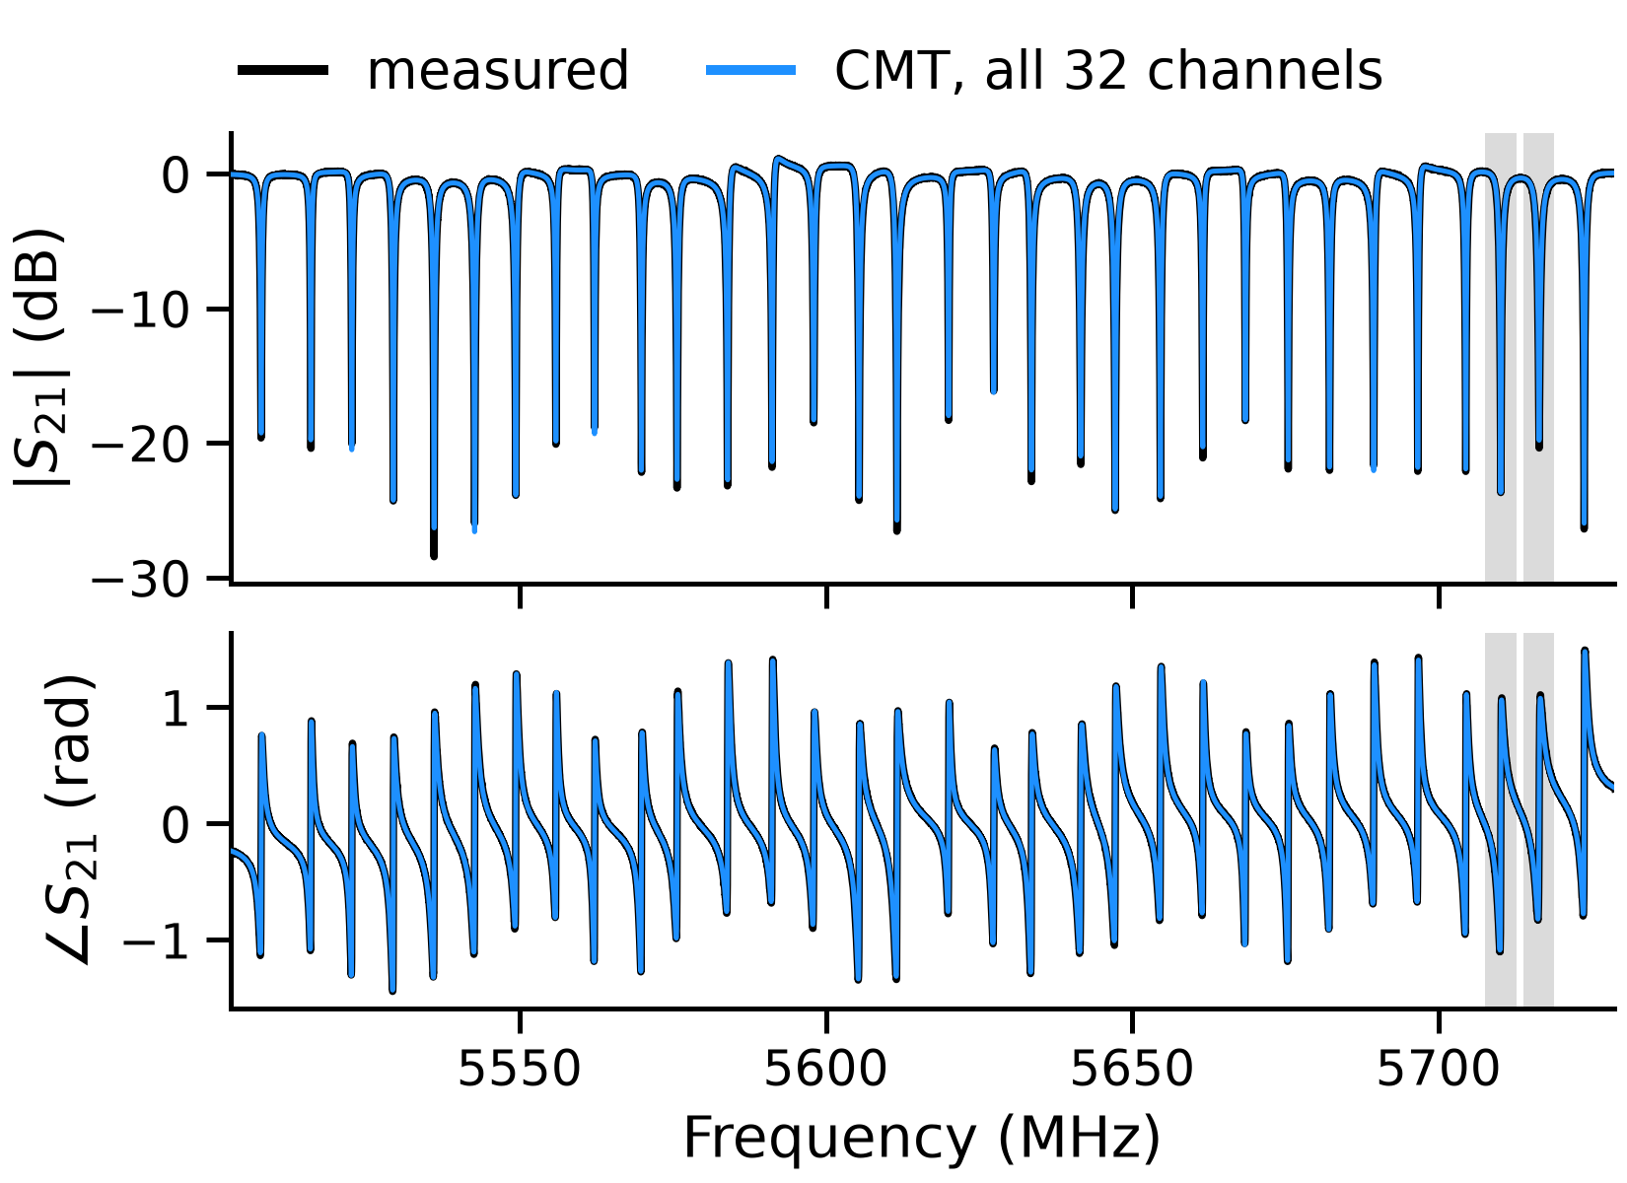
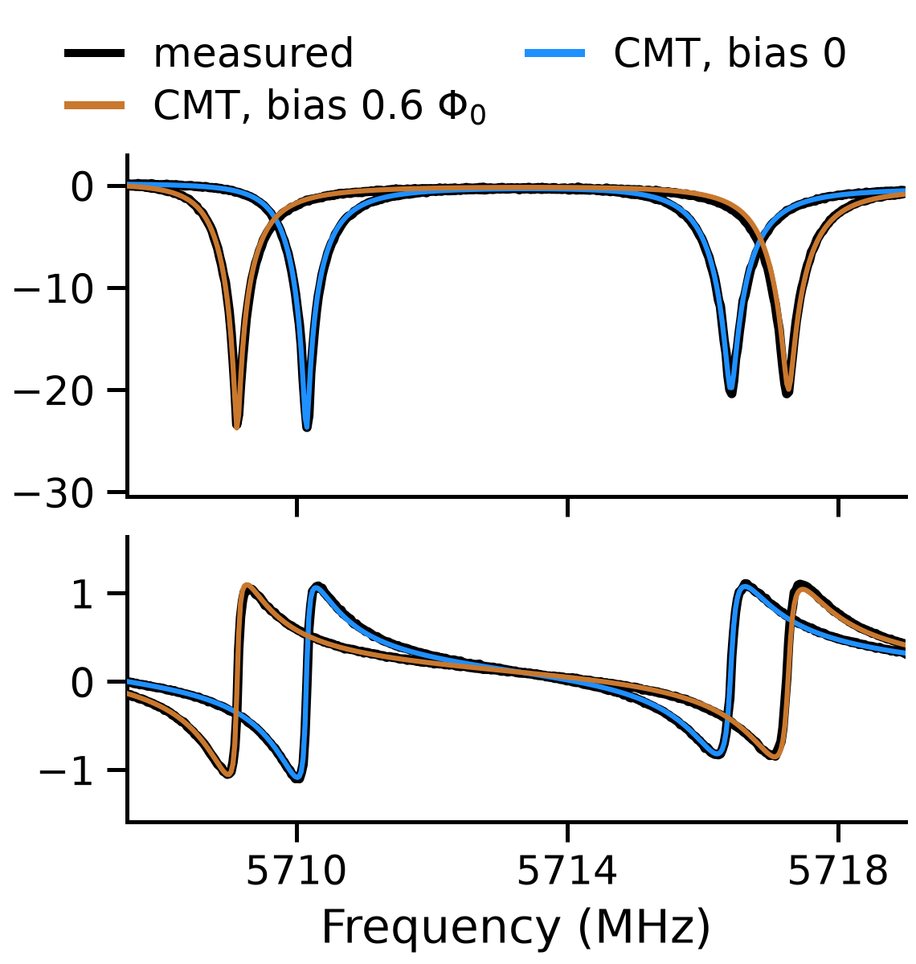
CMT model matches measured S21 on all 32 channels
Full spectrum (32 channels × 10,000 frequencies): ~1.5 min
Single resonator (1 channel x 351 frequencies): 0.2 s

Slide 15
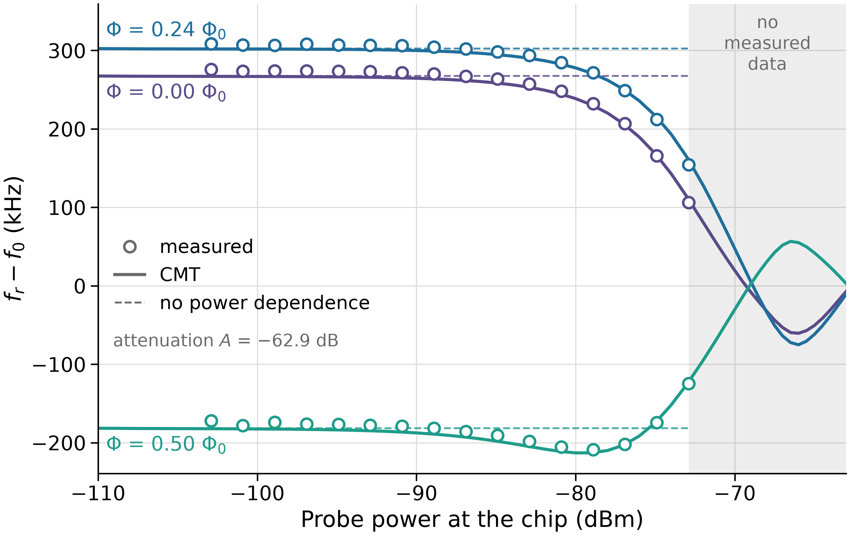
Low-power characterization predicts behavior at operating power
Probe power adds RF flux into SQUID, shifting the resonance.
The computes this from energy stored in the resonator
One fitted parameter: A
Power sweep (171 points, 60,021 solves): ~45 s
Resonance shift vs. probe power at three flux biases; model uses parameters from one low-power sweep
Notes:
Probe power adds RF flux in the SQUID, which shifts the resonance by an amount that depends on the flux bias.
The model computes this from the energy stored in the resonator, using parameters extracted at a single power.
The one fitted parameter is the attenuation A from source to chip: −62.9 dB.
Result: 5.7 kHz rms residual, compared with 41 kHz for a model with no power dependence. Fitting two biases and predicting the third gives 5.8 kHz, so A isn't absorbing other errors.
Why it matters: we characterize at low power and operate at higher power, and the model bridges the two.

Slide 16
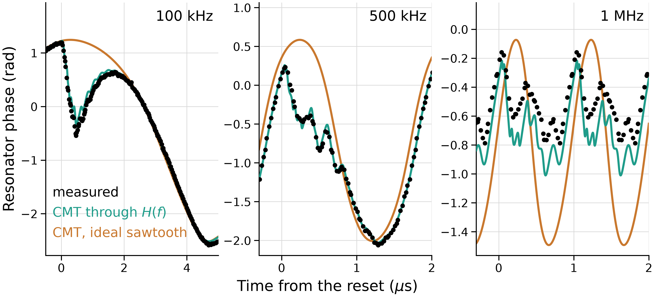
With quasi-static calibration, model predicts resonator dynamics above resonator BW
Measured resonator phase after each ramp reset; calibration held fixed from the 1 kHz record
Simulating 5 µs per trace: ~0.5 s
Notes:
We calibrate once on the 1 kHz record: complex gain, DC offset, and flux at reset. These are then held fixed for every other rate.
The ringing after each reset appears in the simulation only when it is driven through the measured H(f).
From 10 to 500 kHz: median residual 6.5%, compared with 13–54% for an ideal sawtooth and about 47% for a static model. The measurement noise is 1.6%.

Slide 17
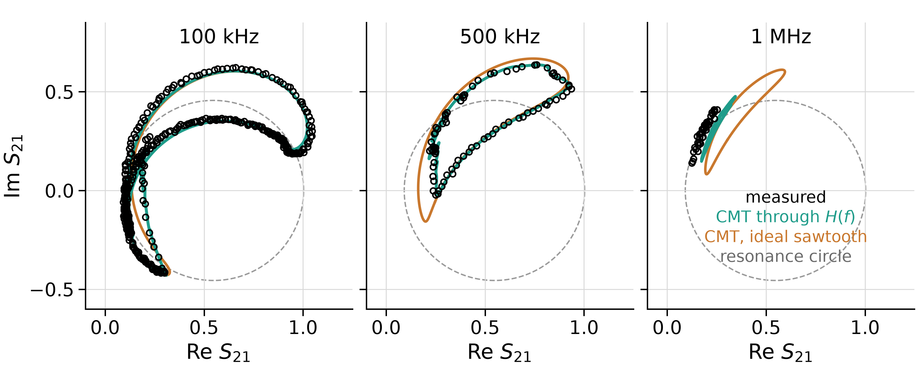
With quasi-static calibration, model predicts resonator dynamics above resonator BW
The same records in the complex plane (Re/Im S21); gray: resonance circle from the VNA fit
Simulating 5 µs per trace: ~0.5 s
Notes:
Same calibration, now at faster ramps: the teal curve is the model driven through the measured H(f), the orange one assumes an ideal sawtooth.
Up to 500 kHz the model follows the measured loops.
Above 500 kHz the shape is still reproduced, but there is a constant offset we haven't explained yet. At 2 MHz the digitizer's anti-aliasing filter also matters.

Slide 18
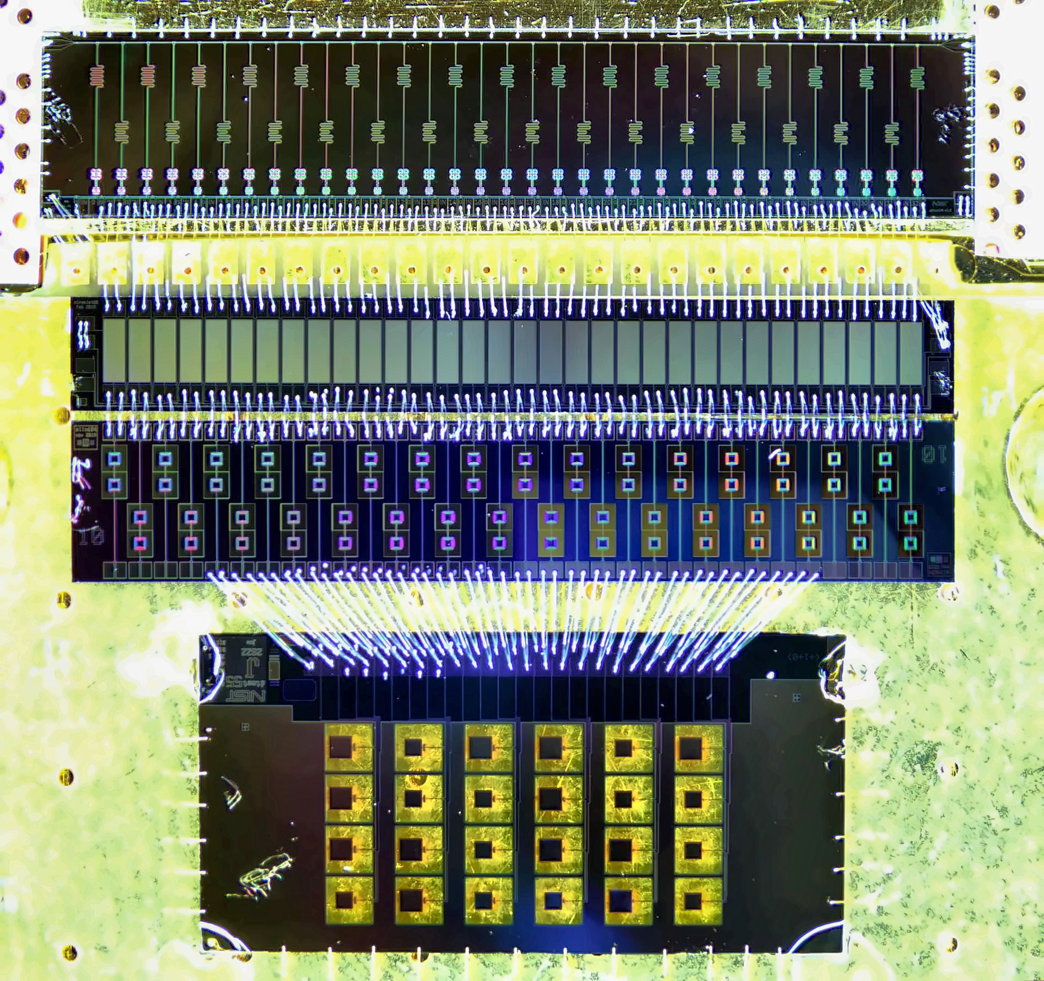
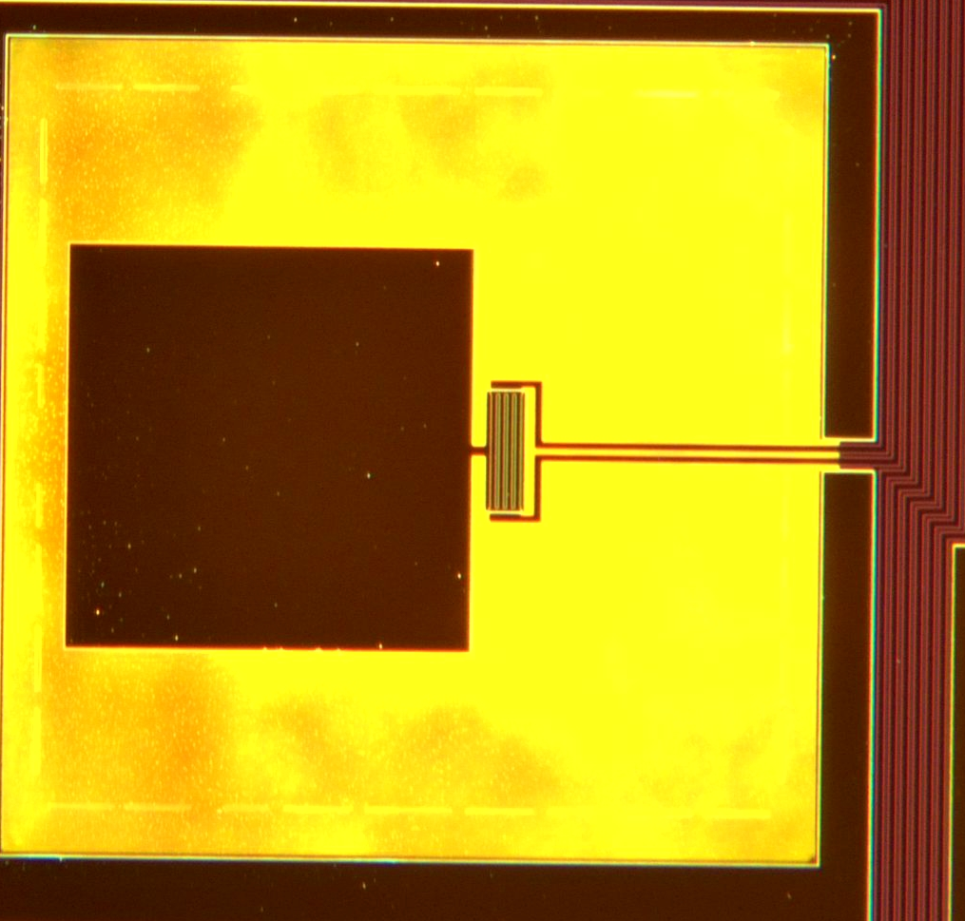
Future work
TES readout with NIST uMux: sidecar TES chip from NIST, Argonne TES modular readout
Flux-ramp correction by pre-inverting H(f) to minimize transients
Incorporating noise models into the simulation
Notes:
Pre-distort the ramp with the inverse of H(f).
Recover the data during the transient instead of discarding it.
Add noise and multi-channel effects.
Test other devices.
Release the code open source on GitHub together with the publication.

Slide 19
Conclusion
1
Validated against data
The CMT model reproduces steady-state and flux ramp ramp responses using only VNA characterization.
2
Flux line sets the transient
In this system, the post-reset transient is dominated by the flux line (4.53 MHz), not the resonator bandwidth (580 kHz).
3
Predictable, so designable
Because the transient is predictable, it can be accounted for in design.
arXiv paper to be released in the next week, along with open-source code
Notes:
The model reproduces steady-state, ramp, and step data, using only VNA characterization as input.
In this system, the post-reset transient is dominated by the flux line (4.53 MHz), not the resonator bandwidth (580 kHz).
Because the transient is predictable, we can design around it.

Slide 20
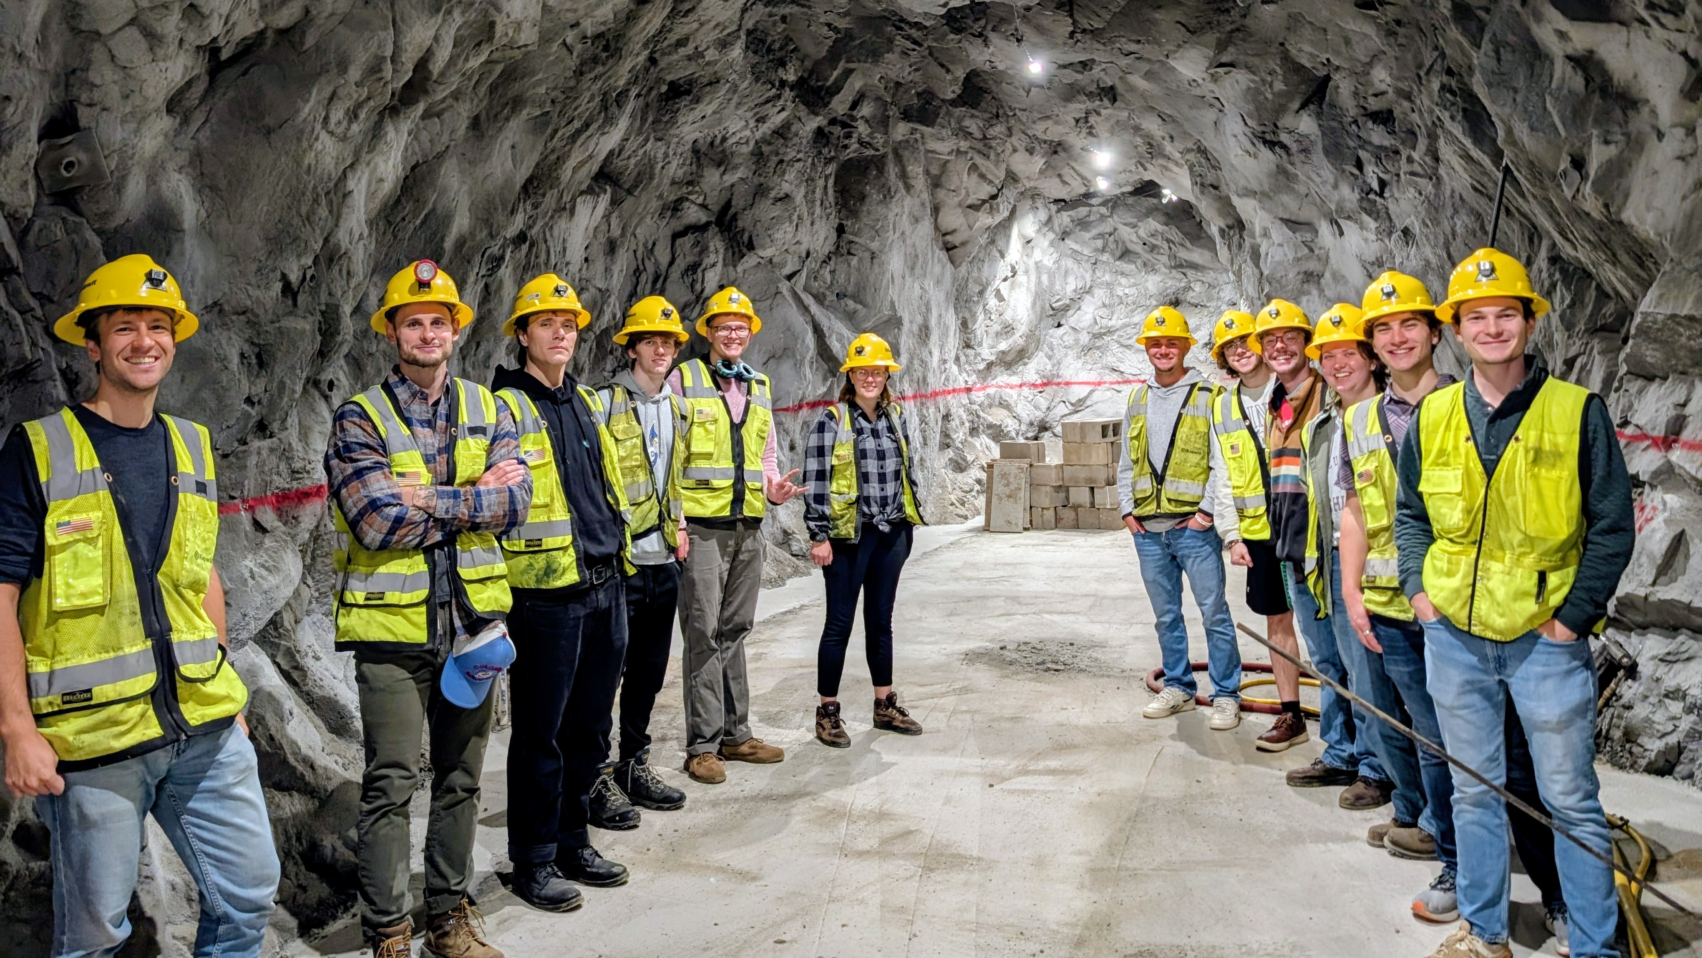
Questions?
Paper and simulation code to be released in the next week!
https://qtsf.mines.edu

Slide 21
Supplemental Slides

Slide 22
References
R. Strauss et al., “Gram-scale cryogenic calorimeters for rare-event searches,” Phys. Rev. D 96, 022009 (2017).
A. H. Abdelhameed et al. (CRESST), “First results from the CRESST-III low-mass dark matter program,” Phys. Rev. D 100, 102002 (2019).
G. Angloher et al. (NUCLEUS), “Exploring CEνNS with NUCLEUS at the Chooz nuclear power plant,” Eur. Phys. J. C 79, 1018 (2019).
L. Gastaldo et al., “The electron capture in 163Ho experiment – ECHo,” Eur. Phys. J. Spec. Top. 226, 1623 (2017).
J. A. B. Mates, “The Microwave SQUID Multiplexer,” PhD thesis, University of Colorado Boulder (2011).
J. A. B. Mates et al., “Flux-Ramp Modulation for SQUID Multiplexing,” J. Low Temp. Phys. 167, 707 (2012).
J. D. Gard et al., “A Scalable Readout for Microwave SQUID Multiplexing of Transition-Edge Sensors,” J. Low Temp. Phys. 193, 485 (2018).
C. Yu et al., “Bandwidth and Aliasing in the Microwave SQUID Multiplexer,” J. Low Temp. Phys. 209, 589 (2022).
K. M. Morgan et al., “Expanding the capability of microwave multiplexed readout for fast signals in microcalorimeters,” J. Low Temp. Phys. 199, 164 (2020).
S. T. Elkin, M. Haider, T. E. Roth, “Multiphysics Numerical Methods for Designing Multiplexed Superconducting Qubit Readout Chains,” ACES (2025).
T. E. Roth, S. T. Elkin, “Maxwell-Schrödinger Modeling of Superconducting Qubits Coupled to Transmission Line Networks” (2023).
M. Wegner, C. Enss, S. Kempf, “Analytical model of the readout power and SQUID hysteresis parameter dependence of the resonator characteristics of microwave SQUID multiplexers,” Supercond. Sci. Technol. 35, 075011 (2022).
M. Neidig, M. Wegner, S. Kempf, “Advanced microwave SQUID multiplexer model incorporating readout power effects and Josephson junction inhomogeneities,” Supercond. Sci. Technol. 39, 045003 (2026).
C. Yu et al., “A simulation suite for readout with SMuRF tone-tracking electronics,” Proc. SPIE 12190, 121900V (2022).
M. E. García Redondo et al., “Optimal demodulation domain for microwave SQUID multiplexers in presence of readout system noise,” J. Appl. Phys. 136, 114401 (2024).
J. C. Groh et al., “Crosstalk effects in microwave SQUID multiplexed TES bolometer readout,” J. Low Temp. Phys. 216, 225 (2024).
C. Schuster, M. Wegner, S. Kempf, “Simulation framework for microwave SQUID multiplexer optimization,” J. Appl. Phys. 133, 044503 (2023).
C. W. Gardiner, M. J. Collett, “Input and output in damped quantum systems,” Phys. Rev. A 31, 3761 (1985).
H. A. Haus, W. Huang, “Coupled-mode theory,” Proc. IEEE 79, 1505 (1991).
M. S. Khalil et al., “An analysis method for asymmetric resonator transmission applied to superconducting devices,” J. Appl. Phys. 111, 054510 (2012).
S. Probst et al., “Efficient and robust analysis of complex scattering data under noise in microwave resonators,” Rev. Sci. Instrum. 86, 024706 (2015).
D. E. Bockelman, W. R. Eisenstadt, “Combined differential and common-mode scattering parameters: Theory and simulation,” IEEE Trans. Microw. Theory Tech. 43, 1530 (1995).

Slide 23
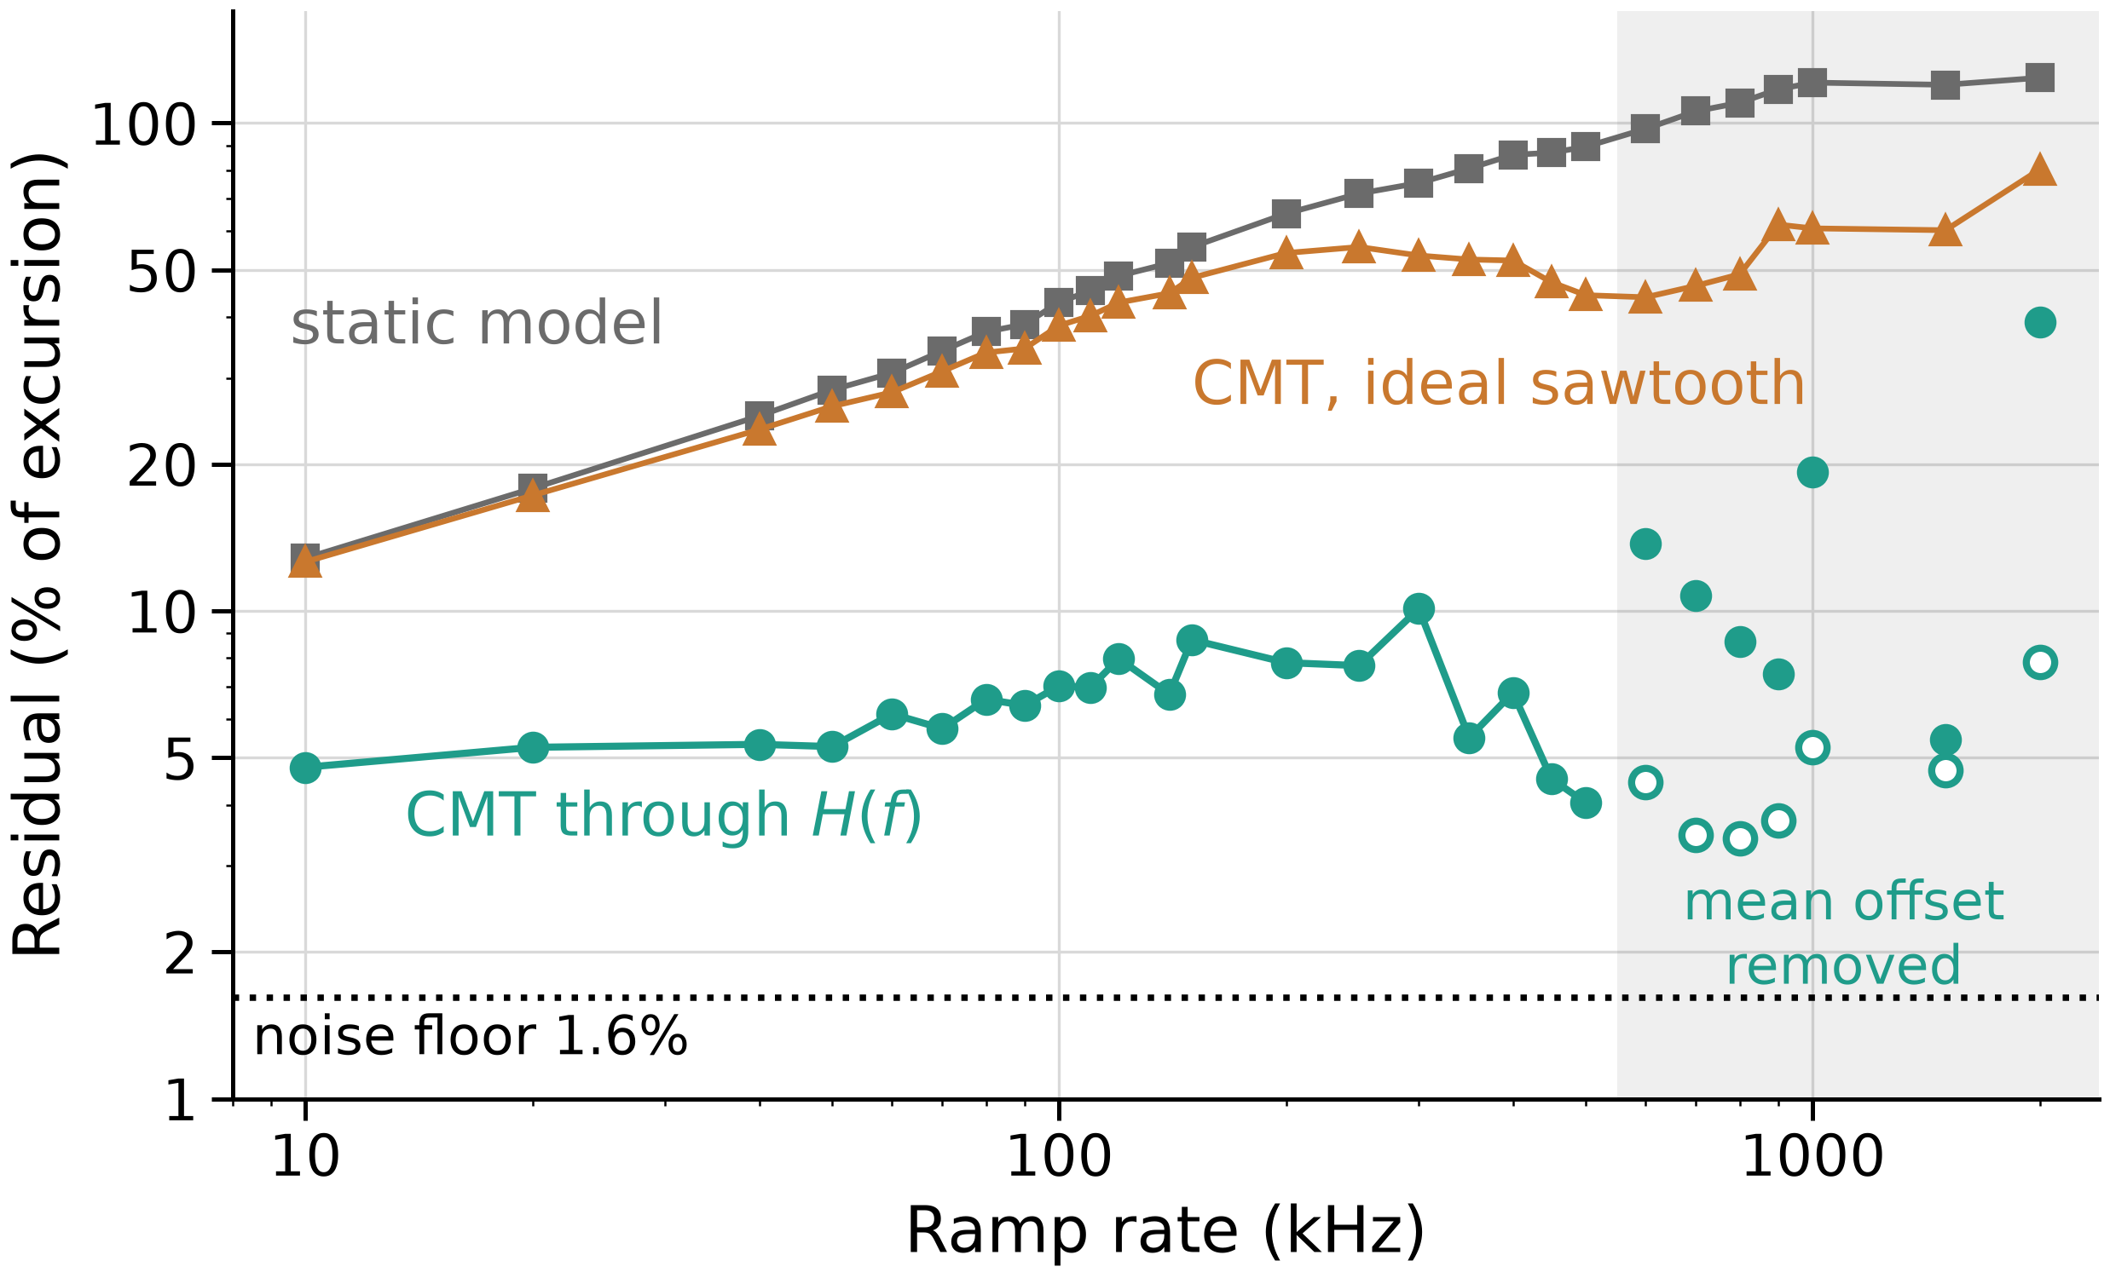
Error over different ramp rates

Slide 24
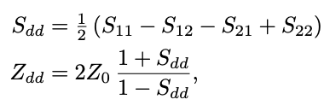
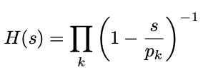
Transfer function VNA measurement
Two-port full S-matrix measurement on FR input ports
Extract differential impedance using S-parameters
Fit rational function, assuming a pole-only function
Build transfer function from fitted poles

Slide 25
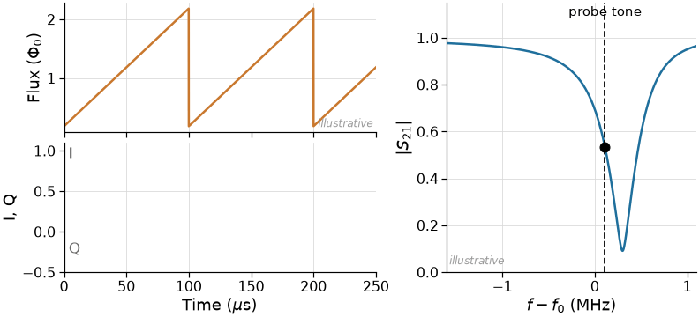
The flux ramp modulates every channel
$$f_{mod} = n_{Φ_{0} }∙ f_{ramp}$$
Typically, 1-3 $Φ_{0}$ per ramp
Cycles through all flux sensitivities
$f_{mod}$ sets effective sampling speed
Notes:
The probe tone is fixed. A sawtooth flux ramp sweeps the resonance past it.
I and Q become periodic at f_m = n_Φ0 · f_fr, typically with 1–3 Φ0 per ramp.

