Slide 1

LGAD Gain saturation characterization with highly ionizing particles
Jessie Yang
University of Washington
October 22, 2026

Slide 2

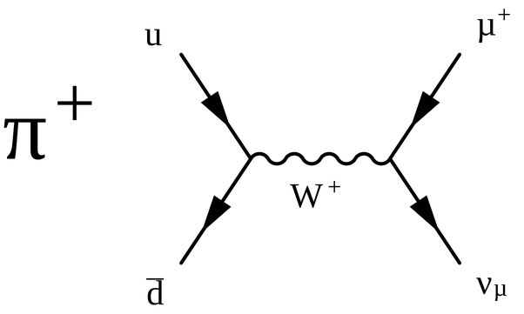
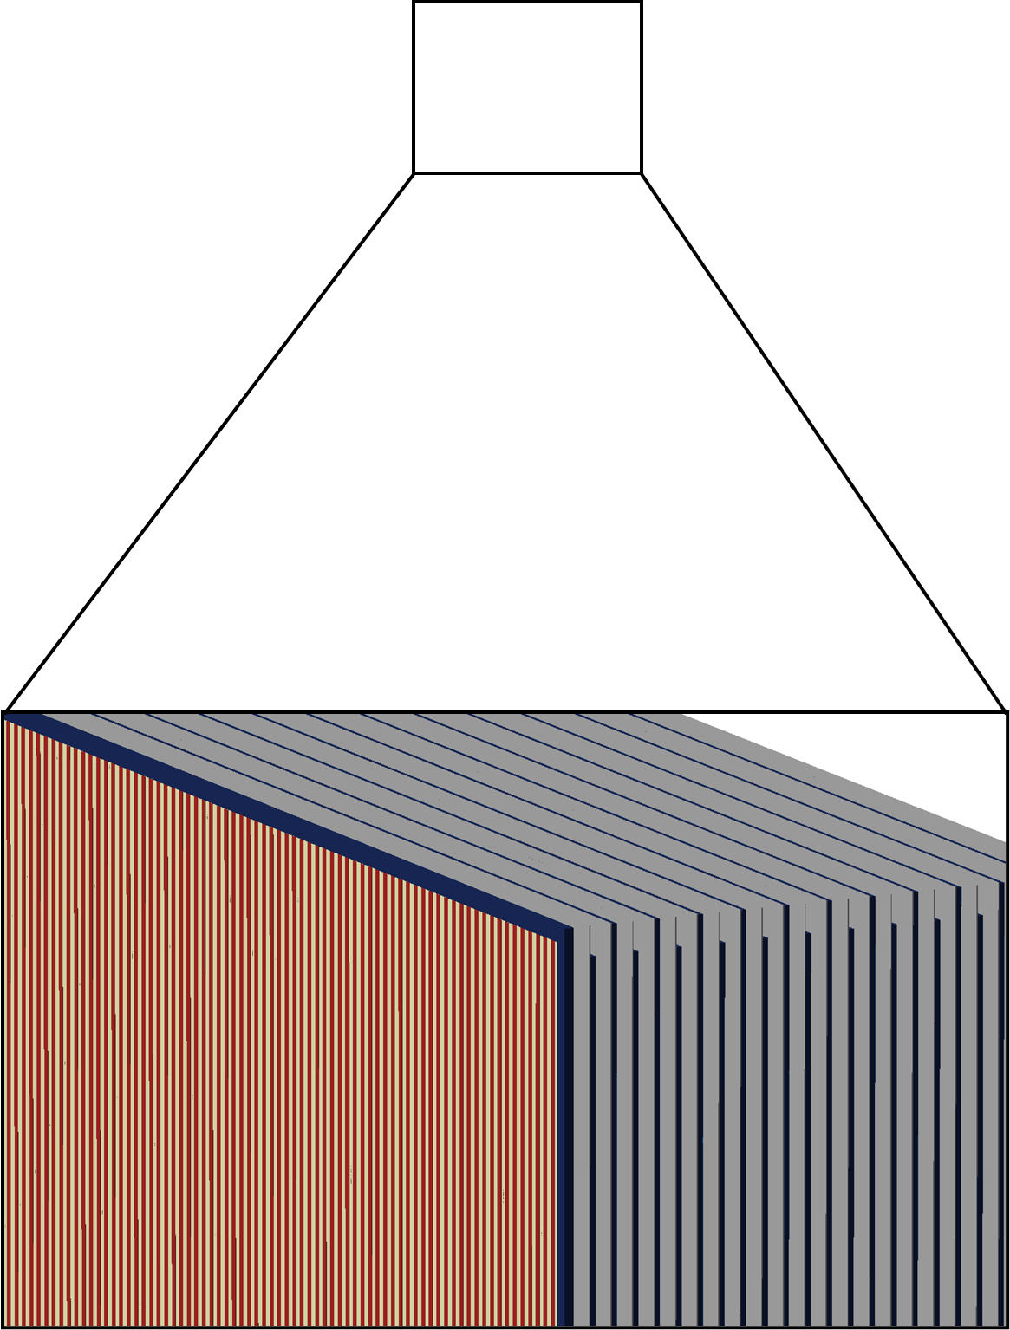
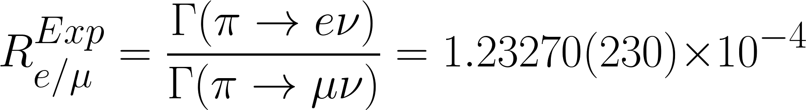
LGAD Based Active Target for PIONEER
Will measure pion branching ratio to 0.01% precision
15x improvement of world’s best experimental measurements
The most sensitive probe of Lepton Flavor Universality Violation (LFUV)
Charged lepton
l ⁺
e⁺
Pion
𝜋⁺ at 65 MeV
Neutrino
𝜈_{l}
𝜇⁺?
∼ 65 cm
(not to scale)
LGADs provide 5D tracking (x,y,z,t,E) in the target region.
We need to understand LGAD response for a large range of energy deposits
Bragg peak from pion and muon stops equals O(100) MIPs
100 Strips
48 Layers

Slide 3
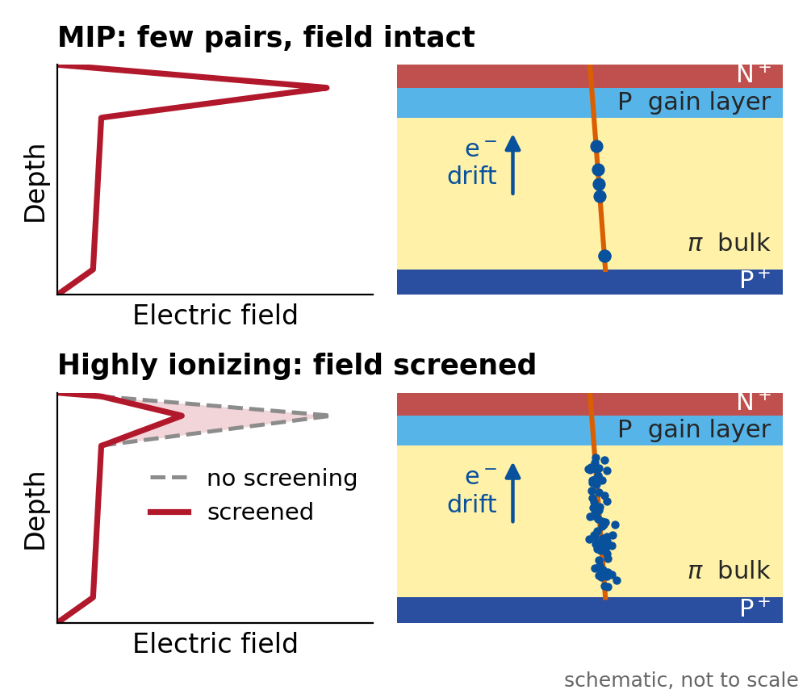
Physics of Gain Suppression
LGADs are designed for detecting minimum ionizing particles (MIPs)
  Extension of PIN diode design with an additional p-doped layer
Signals are amplified by an increased E-field in the avalanche region
A highly localized energy deposit can cause screening in the gain layer
  Reduced E-field suppresses the observed gain
We aim to characterize and model dependencies of gain saturation in LGADs for highly ionizing particles.

Slide 4
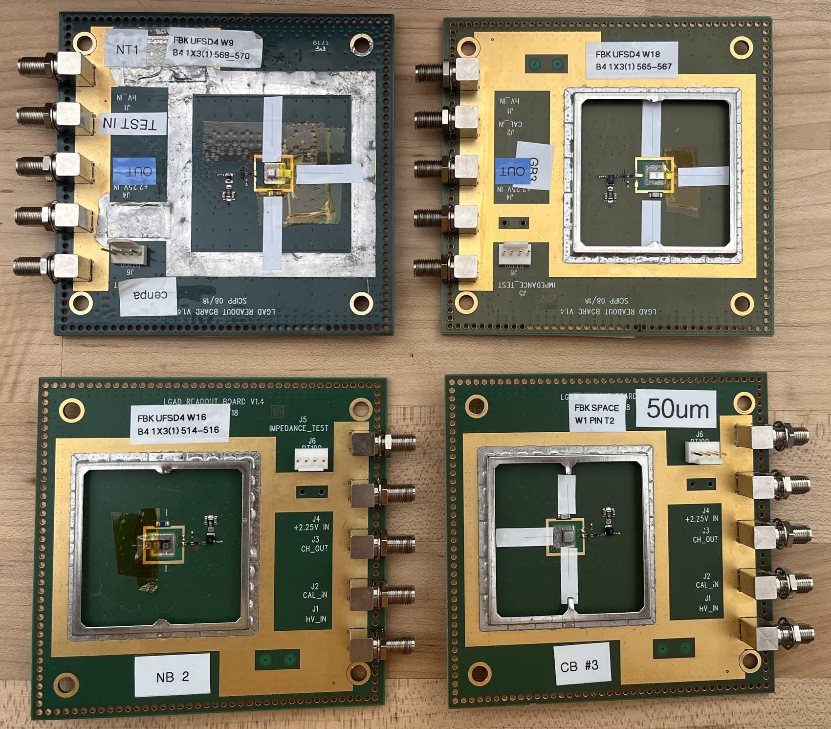
Devices Under Test (DUTs)
All DUTs are single-pad LGADs
Two vendors: FBK and HPK
  Focus on FBK due to ability to reliably produce Ti-LGADs for minimal cross-talk in PIONEER
Wafer | Vendor | Thickness | Gain layer
2023 · HPK
3.1 | HPK | 50 µm | Deep
3.2 | HPK | 50 µm | Deep
2024 · FBK Space
W1 | FBK | 50 µm | Shallow
W8 | FBK | 100 µm | Shallow
W11 | FBK | 150 µm | Shallow
2025 · FBK UFSD4, this paper
W9 | FBK | 50 µm | Shallow
W16 | FBK | 50 µm | Deep
W18 | FBK | 50 µm | Deep
Readout chain
W9 · shallow
W18 · deep
Amplifier board
2 GHz bandwidth
single-channel board, UCSC SCIPP
1.3 × 1.3 mm LGAD pad
Second stage
gain 10
GALI-52+, Mini-Circuits
W16 · deep
W1PIN · no gain
Space-production PIN
Waveform digitizer
6.4 GS/s, 11 bit, self-triggering
SAMPIC, CEA-IRFU and IJCLab
Two papers published, third one in preparation
S. Braun et al NIM A 1064 (2024) 169395
J. Yang et al 2025 JINST 20 C08028
SAMPIC: D. Breton et al., Nuovo Cim. C 43 (2020) 7

Slide 5
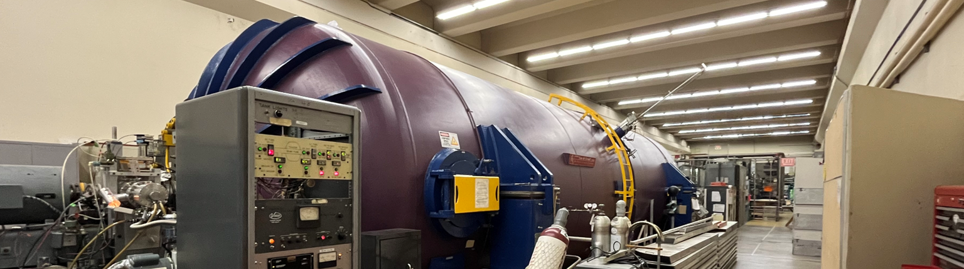
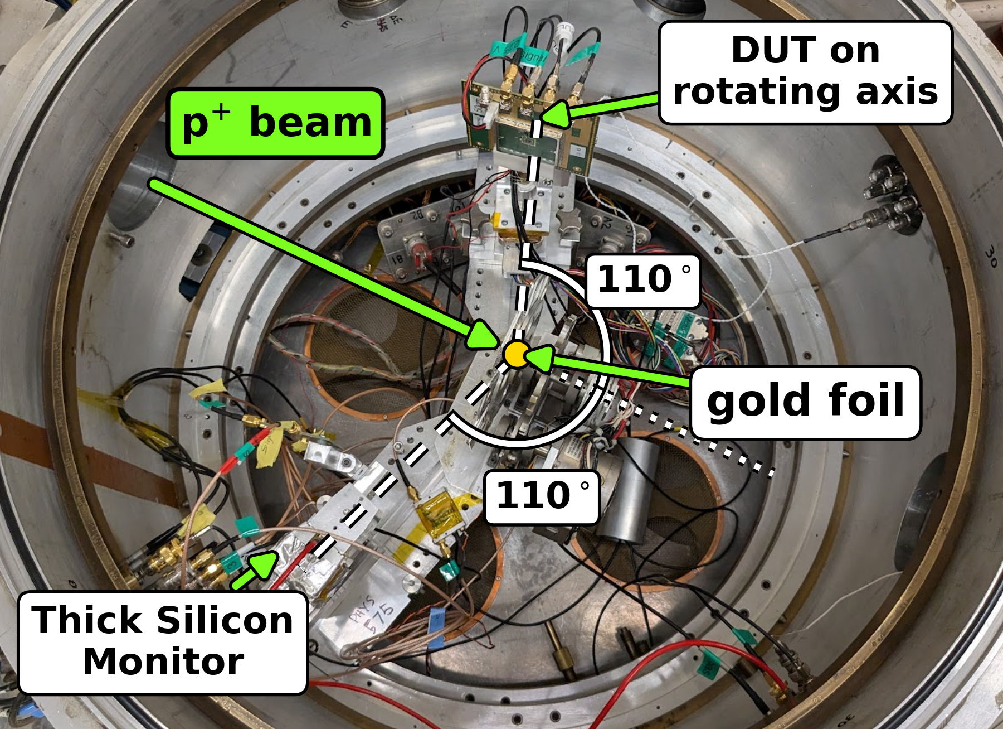
Experimental Setup
DUTs placed in a Rutherford Backscattering (RBS) chamber to reduce intensity to O(kHz) rate
Silicon monitor (SiMon) positioned opposite DUT to measure post-RBS spectrum
Scan parameters per sensor:
  Operating bias voltage
  Incident angle (1° to 71°)
  Incident proton energy
Control measurements performed with PIN diodes and with Sr-90 and Am-241 sources

Slide 6
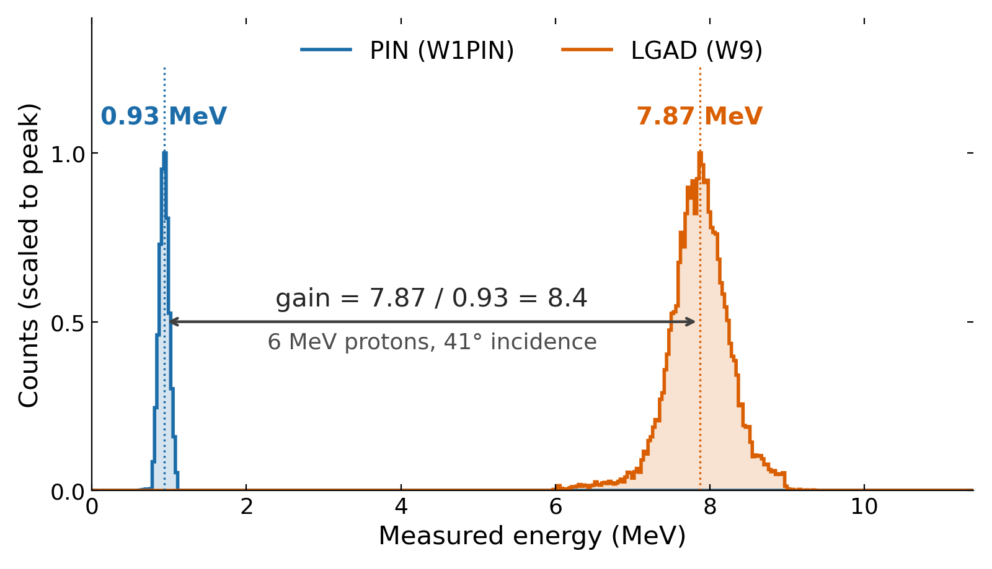
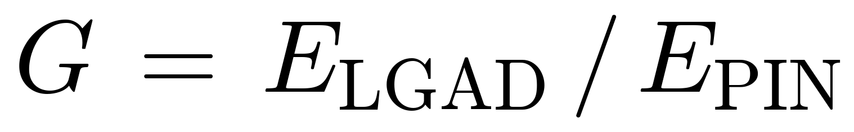
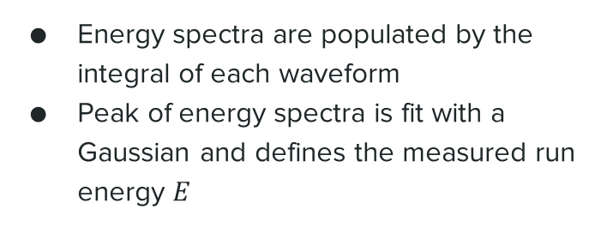
Measuring Proton Gain
Energy spectra are populated by the integral of each waveform
Peak of energy spectra is fit with a Gaussian and defines the measured run energy $E$
Reference: the W1PIN peak, checked against Geant4
PIN reference uncertainty: 3.3% to 6.6%, the same for every sensor
LGAD: W9 at 180 V. PIN: W1PIN at 100 V.
To study suppression, we need to compare the measured proton gain with the unsaturated MIP gain.

Slide 7
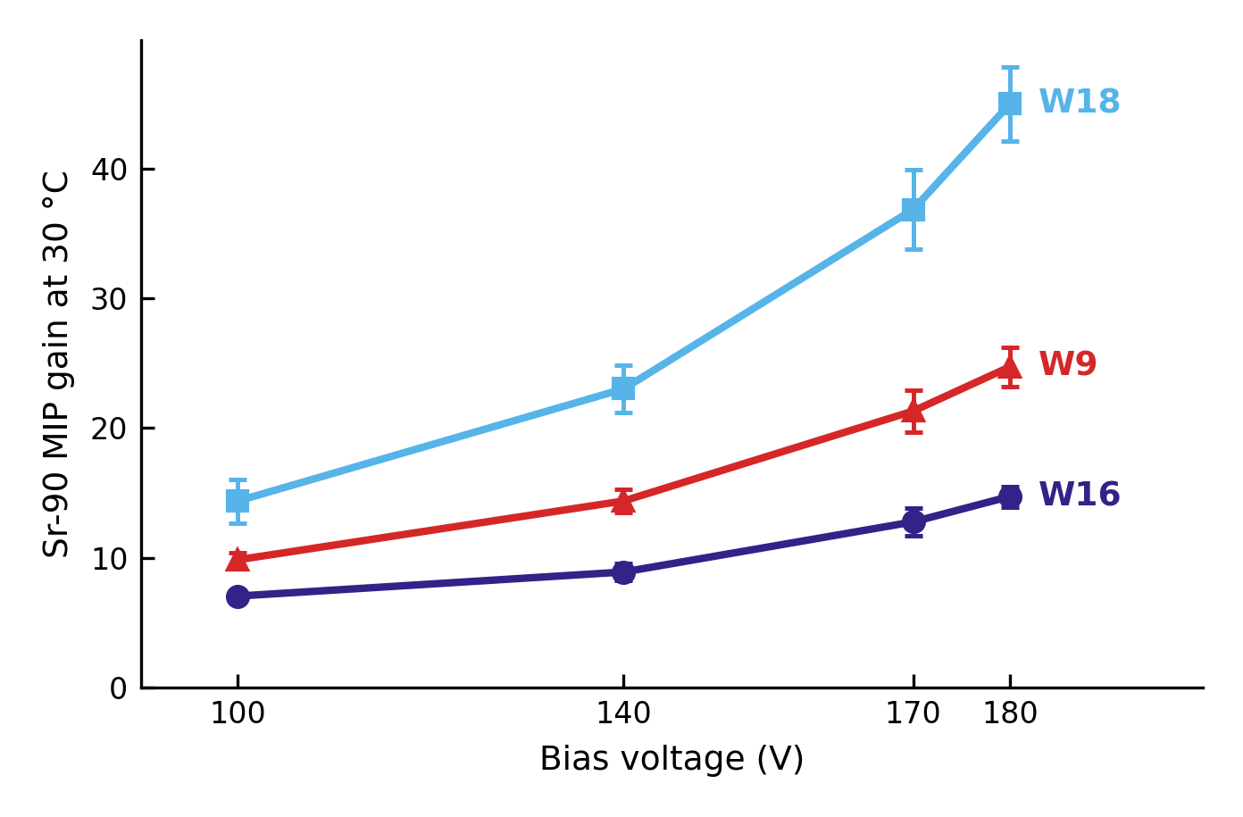
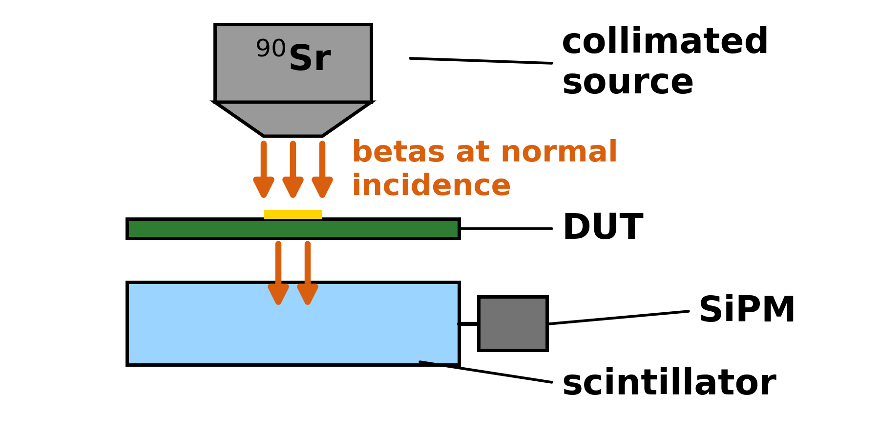
Measuring MIP Gain
Sr-90 betas serve as the MIP reference (gain at low charge density, before saturation sets in)
A coincident hit in a scintillator behind the LGAD selects the high-energy betas that pass through it, so each deposits close to a MIP.
Absolute deposit simulated with Geant4.
Sensor | Thickness | Doping depth | Relative doping
FBK W9 | 50 um | Shallow | 1.06
FBK W16 | 50 um | Deep | 0.83
FBK W18 | 50 um | Deep | 0.81
Sensors obtained from an old ATLAS production

Slide 8
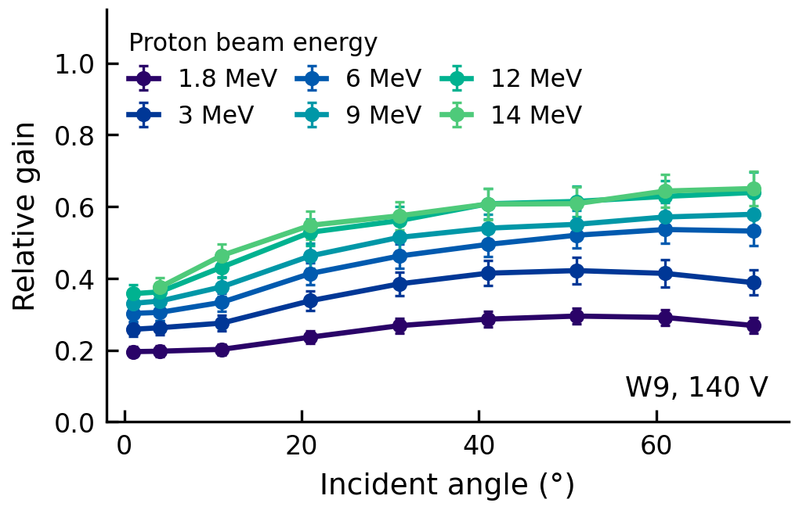

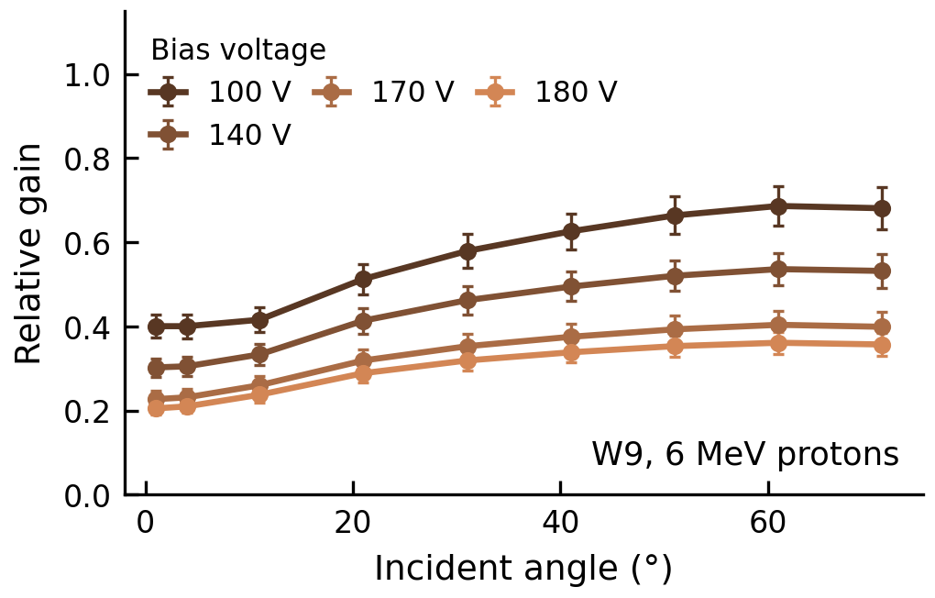
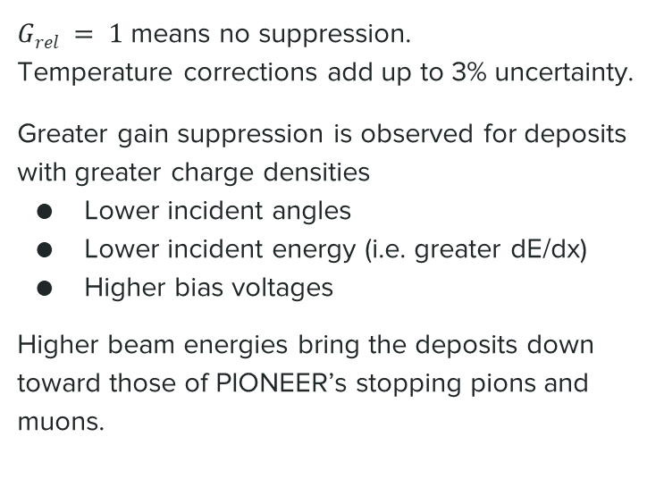
Measured Relative Gain Depends Strongly on the Density of Charges Deposited
$Grel = 1$ means no suppression.
Temperature corrections add up to 3% uncertainty.
Greater gain suppression is observed for deposits with greater charge densities
Lower incident angles
Lower incident energy (i.e. greater dE/dx)
Higher bias voltages
Higher beam energies bring the deposits down toward those of PIONEER’s stopping pions and muons.

Slide 9
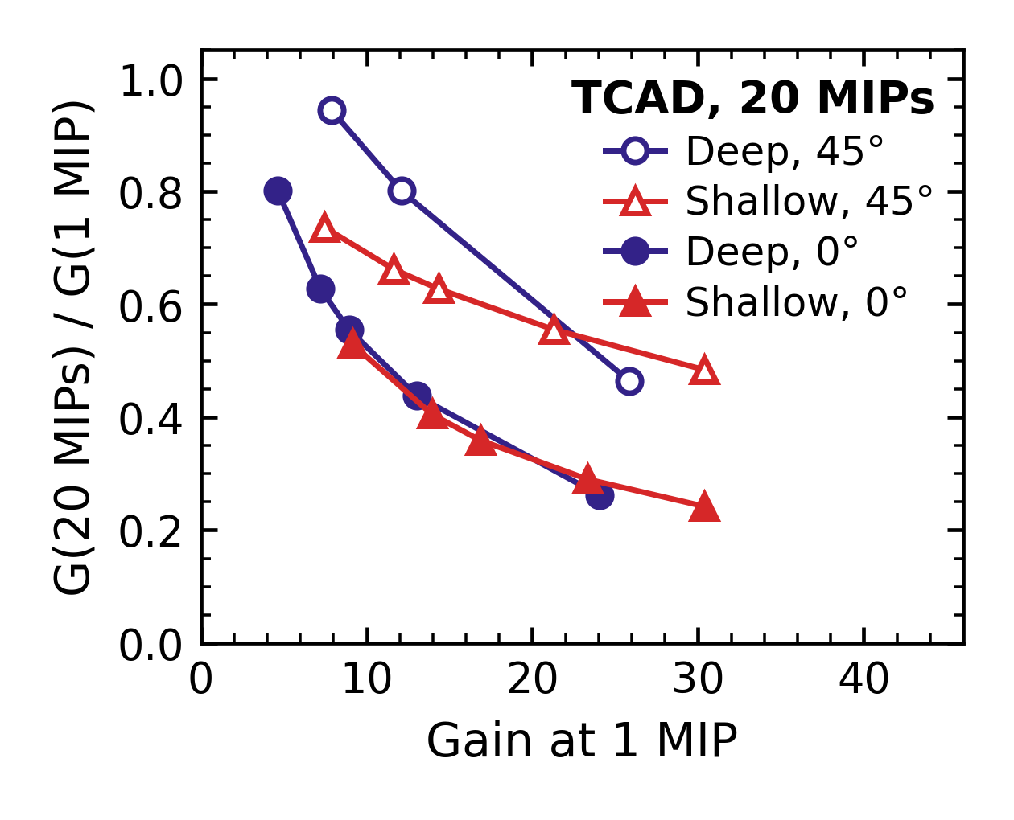
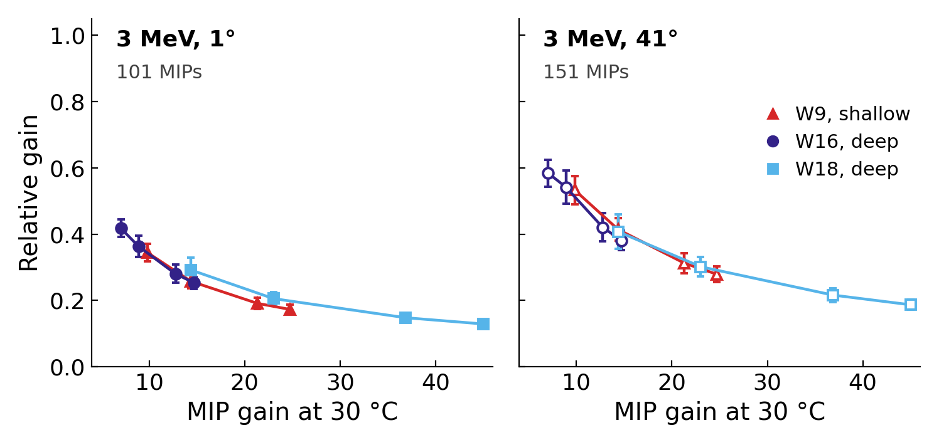
Gain-Layer Depth Makes Little Difference
In 2023–24, the deep HPK 3.1 was suppressed less than the shallow FBK W1, but the vendors differ
TCAD at 20 MIPs predicts no difference at normal incidence and less suppression for a deep layer at 45°
In 2025, the shallow W9 and the deep W16 and W18, all FBK, show no significant difference at 1° or 41°
These protons deposit 100 MIPs or more, so a difference may only appear at lower charge densities

Slide 10
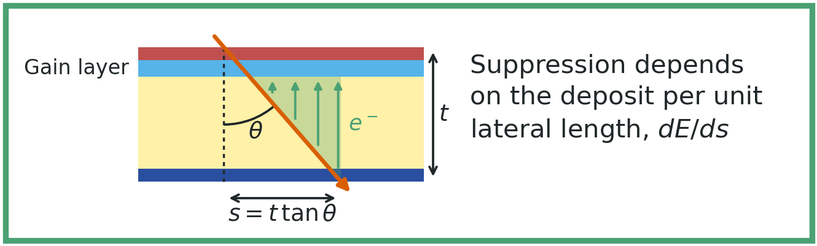
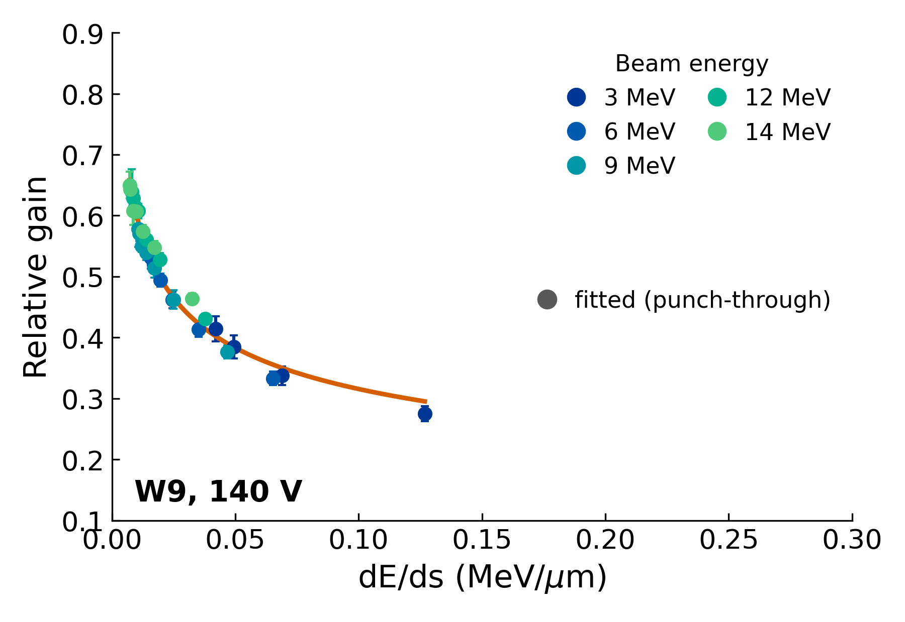
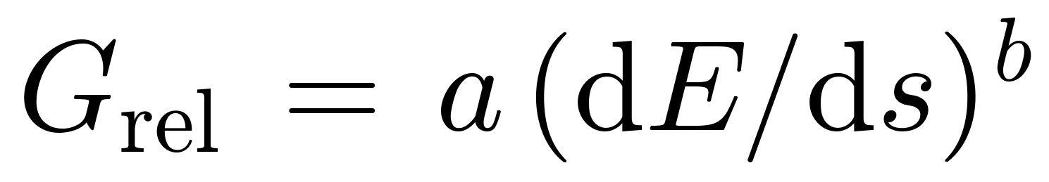
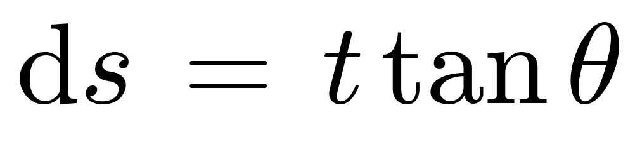
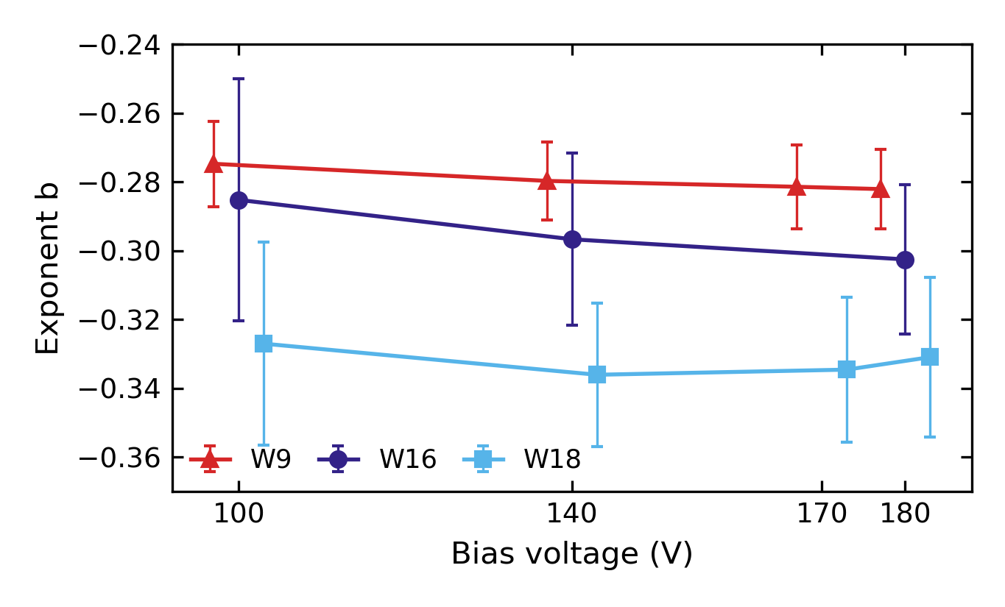
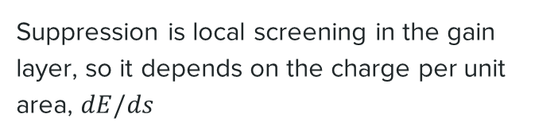
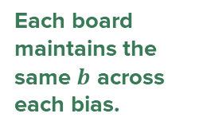
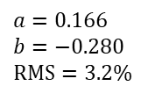
Modeling Gain Suppression
Suppression is local screening in the gain layer, so it depends on the charge per unit area, $dE/ds$
Fit to punch-through protons, W9 at 140 V:
$a=0.166$
$b=−0.280$
$RMS=3.2\%$
t = 55 µm; ds is the track's projection on the gain layer
Each board maintains the same $b$ across each bias.

Slide 11
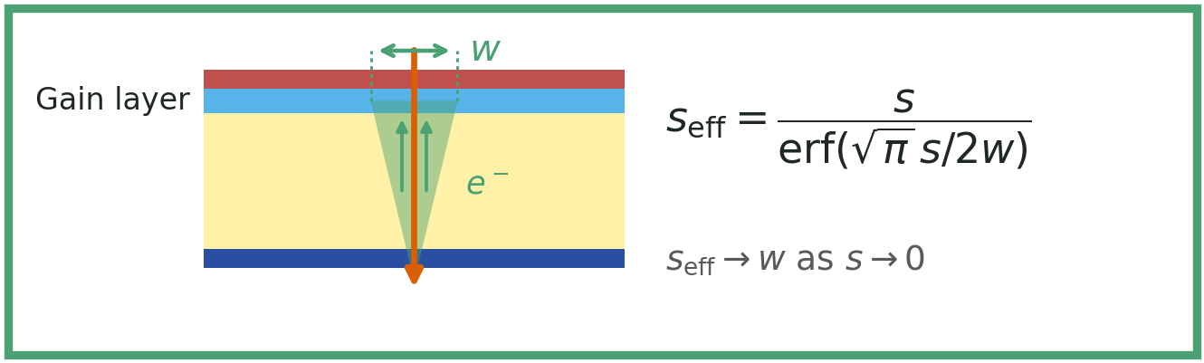
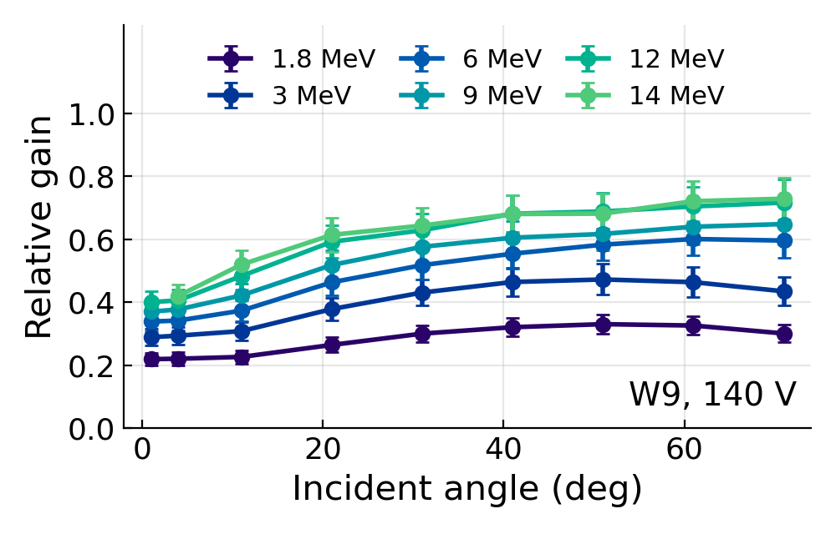
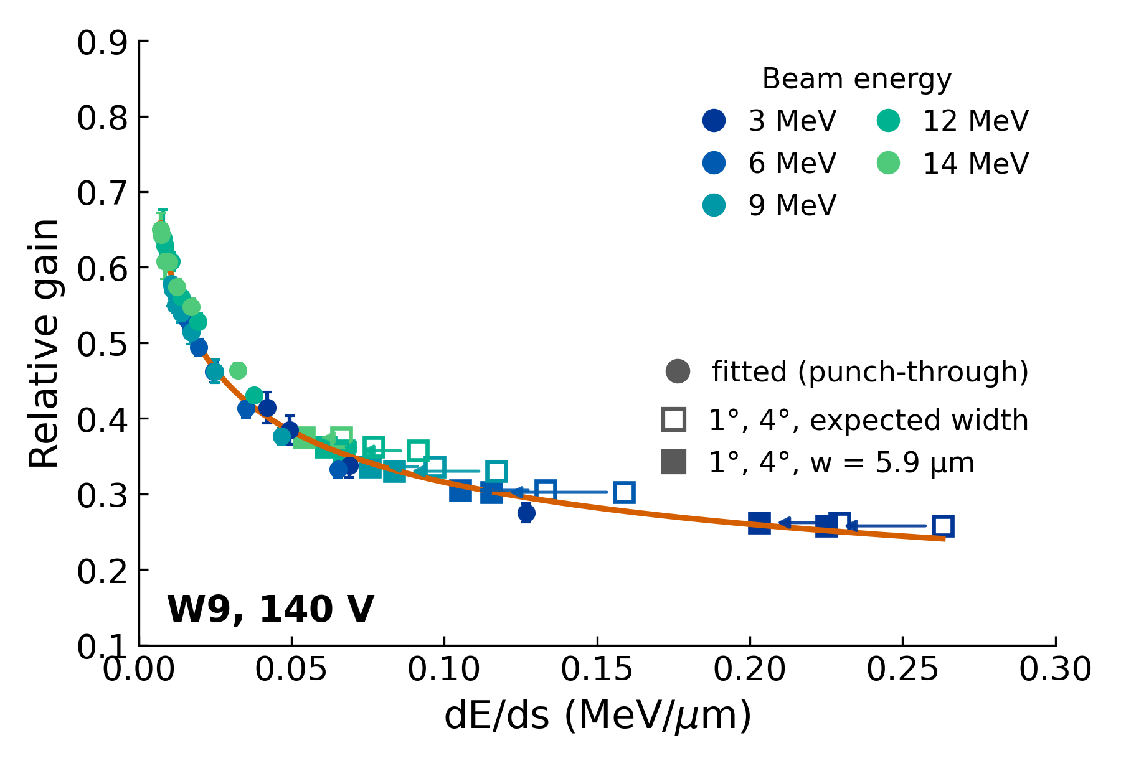

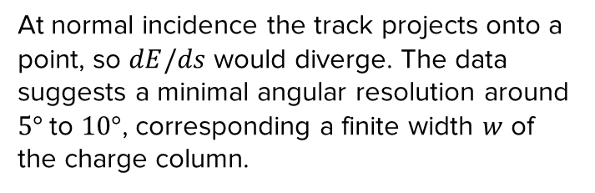
Lateral Width w
$w$ is fitted to the 1° and 4° runs for each board/bias, with the power law held fixed
$a=0.166$
$b=−0.280$
$RMS=3.2\%$
At normal incidence the track projects onto a point, so $dE/ds$ would diverge. The data suggests a minimal angular resolution around $5°$ to $10°$, corresponding a finite width $w$ of the charge column.

Slide 12
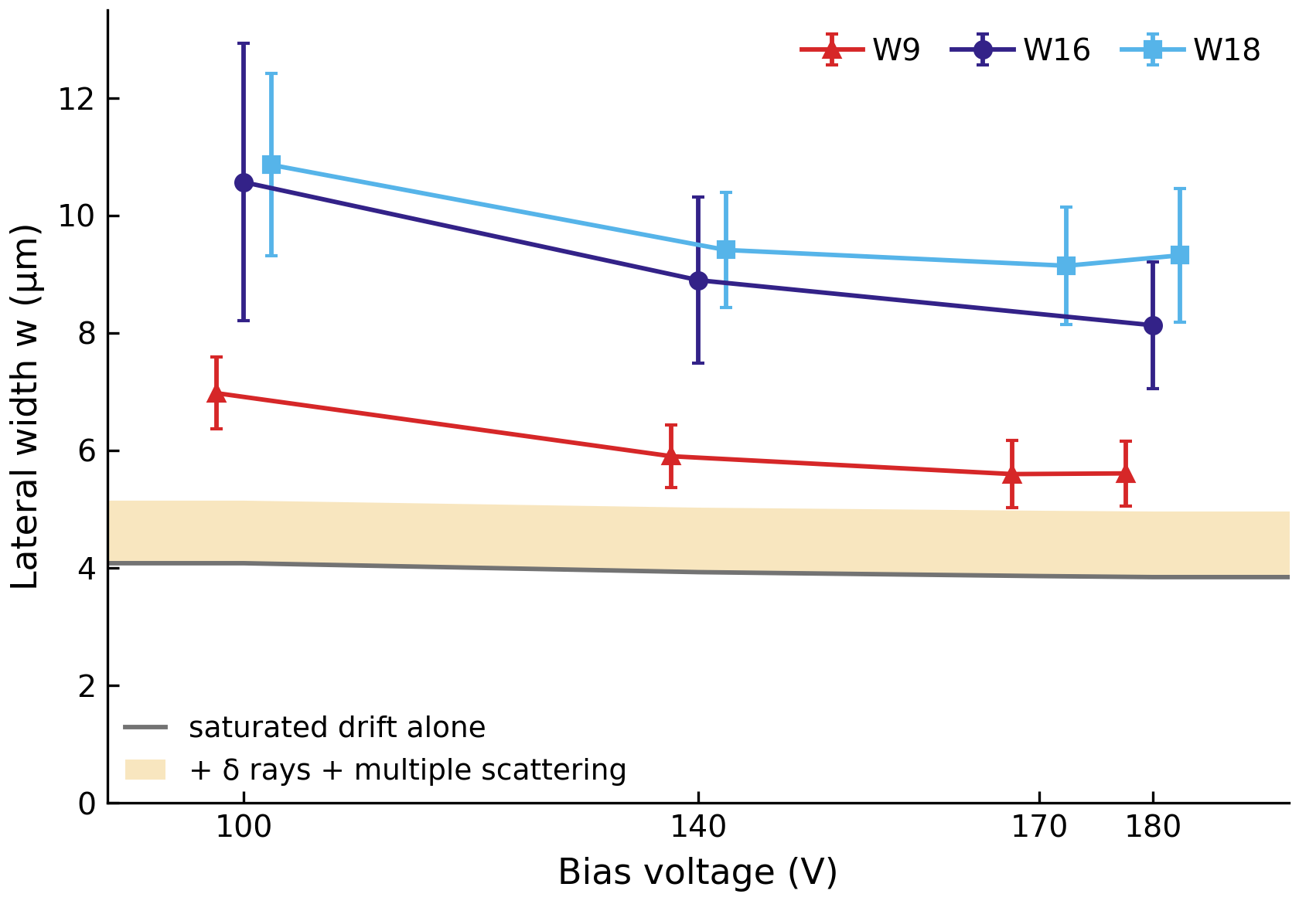
Lateral Width by Sensor
Option D
All three sensors are wider than expected
The estimate is at most 5.2 µm, from drift, δ rays and scattering
W16 and W18, deep gain layers
8.1 to 10.9 µm, which is 1.6 to 2.1 times the estimate
W9, shallow gain layer
5.6 to 7.0 µm, which is 1.1 to 1.4 times the estimate
Other models are being considered.

Slide 13
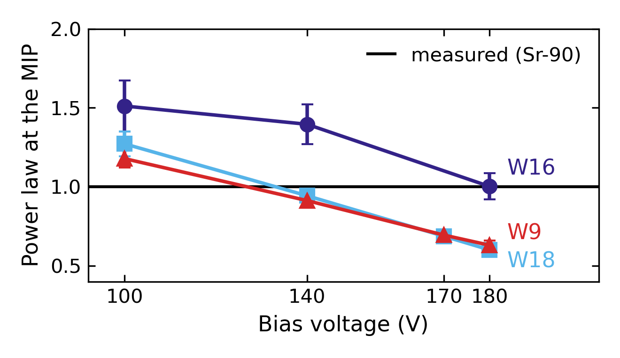
Systematics and Open Questions
Primary systematics
Open questions
The law misses the MIP gain, 1.2–1.5 at 100 V and 0.6–1.0 at 180 V
Fitted widths are 1.5–2.7 times the saturated-drift width
MIP gain
4–12%
W1PIN reference
3.3–6.6%
Added in quadrature:
Simulation vs. data
1.8–5.8%
Board transimpedance
2.8%
Beam energy offset
up to 2.9%
Proton-run temperature
0.9–2.9%

Slide 14
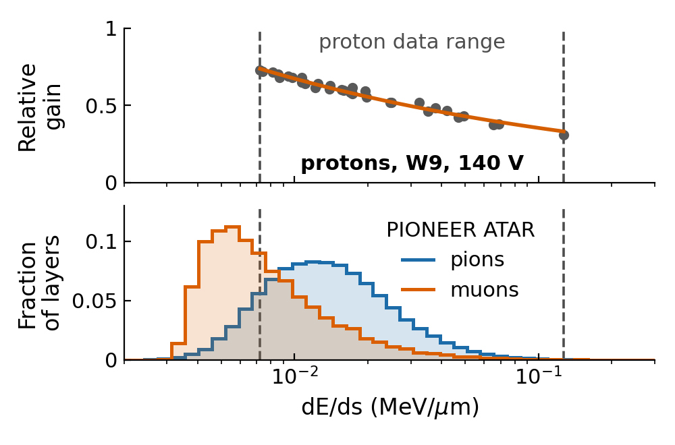
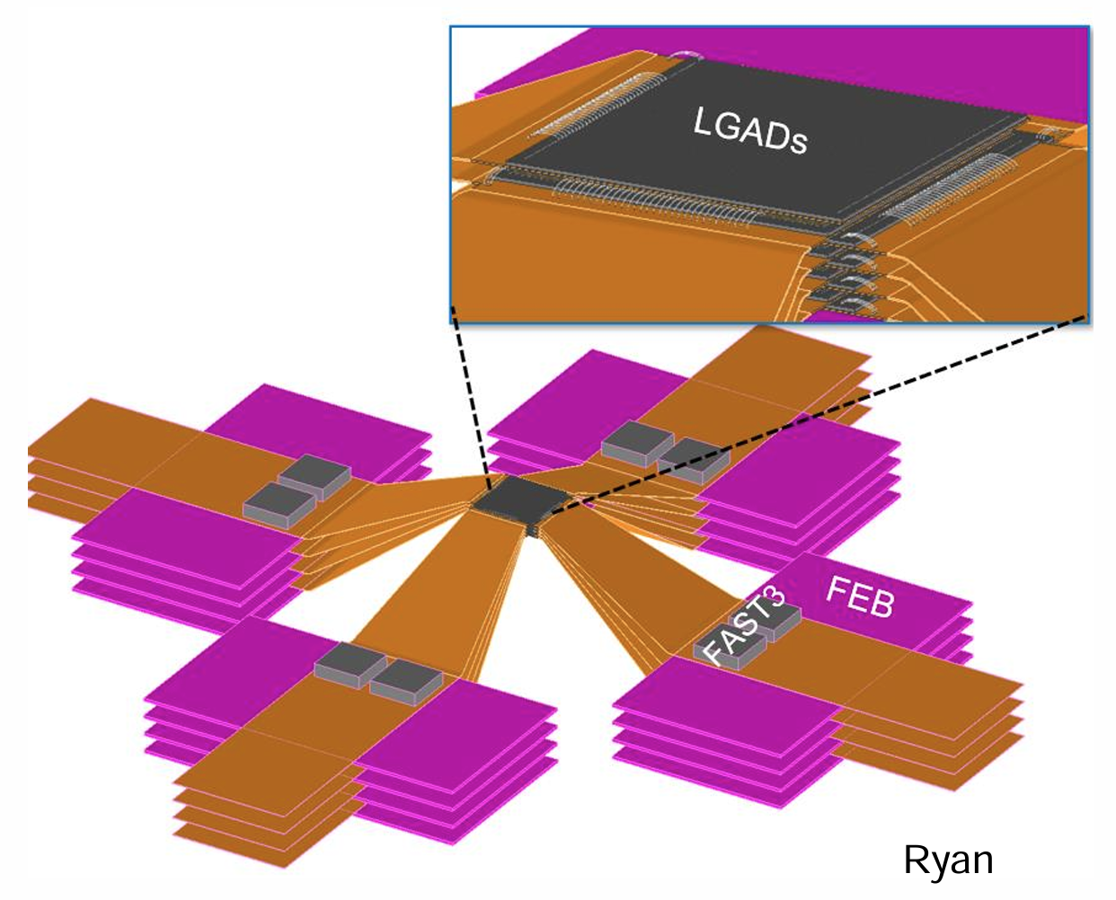
Summary and Outlook
Measured the gain suppression of LGADs with protons:
FBK W9, W16 and W18 at 1.8–14 MeV and up to 71°
Stronger at higher bias and for lower-energy protons; the gain-layer depth matters little
Punch-through data follow a power law in dE/ds
Beamtime for the PIONEER demonstrator at the end of 2026!
Validate species independence
with muons (and pions)
Test below our data range,
where 55% of muon layers lie
Run incident angle scan with a
MIP-like positron beam

Slide 15
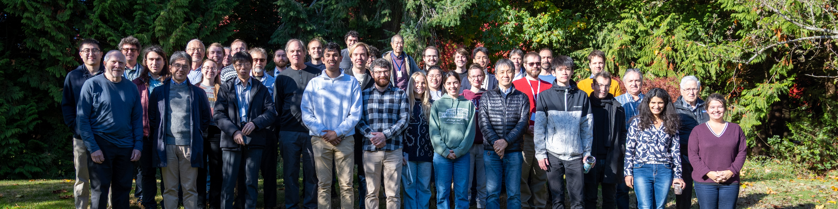
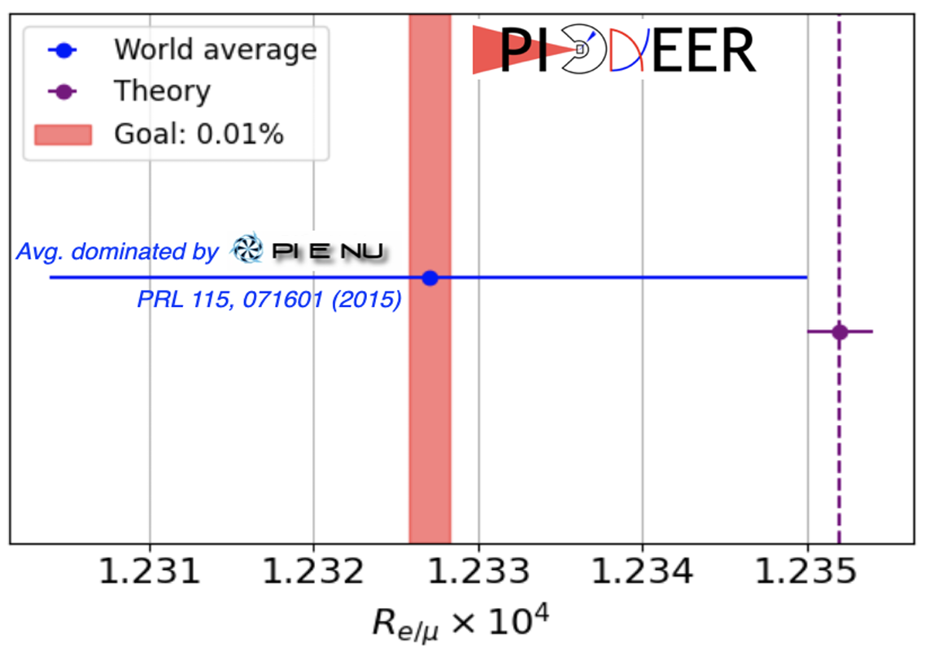
Thank You!

Slide 16
Backup Slides

Slide 17
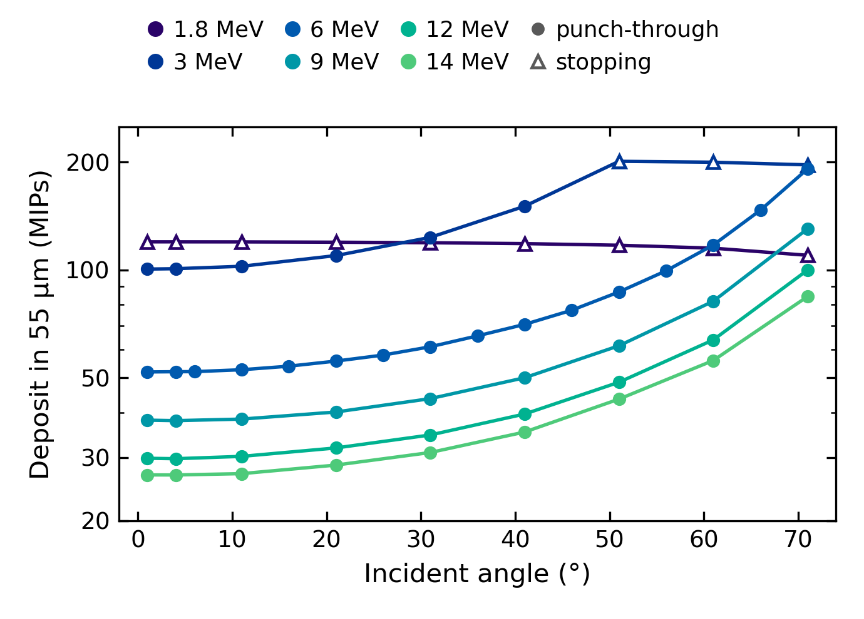
Proton Deposit in MIPs
One MIP: 13.25 keV, the most probable Sr-90 deposit in the 55 µm layer; the W1PIN peak over it
Punch-through: rises with angle, the longer path; 27 MIPs at 14 MeV near normal incidence
Stopping: all the energy is left in the sensor; up to 200 MIPs at 3 MeV
Far above a MIP: ≥ 27 MIPs everywhere, ≥ 100 MIPs at 1.8 and 3 MeV
Notes:
The deposit is the measured peak of the W1PIN spectrum at 100 V, the same 55 um sensor without a gain layer, so it is the energy left in the active layer after the scattering foil and the inactive electrode on the entrance face. No stopping-power table enters. Each peak is divided by one MIP, 13.25 keV, the simulated most probable deposit of the Sr-90 electrons in the 55 um layer with the hardest momentum cut scanned standing in for the scintillator coincidence; with no cut the MIP would be 15.3 keV, so a deposit in MIPs can only be overestimated, by up to 13%. For punch-through protons the path through the active layer grows with angle and outweighs the extra energy lost in the electrode, so the deposit rises with angle; at 14 MeV near normal incidence it is about 27 MIPs. Stopping protons (all of 1.8 MeV, 3 MeV from 51 degrees) leave all their remaining energy in the sensor, and the longer path through the electrode lowers it slightly at large angles; at 3 MeV they deposit about 200 MIPs. Every proton deposit is far above a MIP: at least 27 MIPs, and 100 or more at 1.8 and 3 MeV. Charge follows from energy at 3.6 eV per pair, so charge in MIPs and energy in MIPs are the same number.

Slide 18
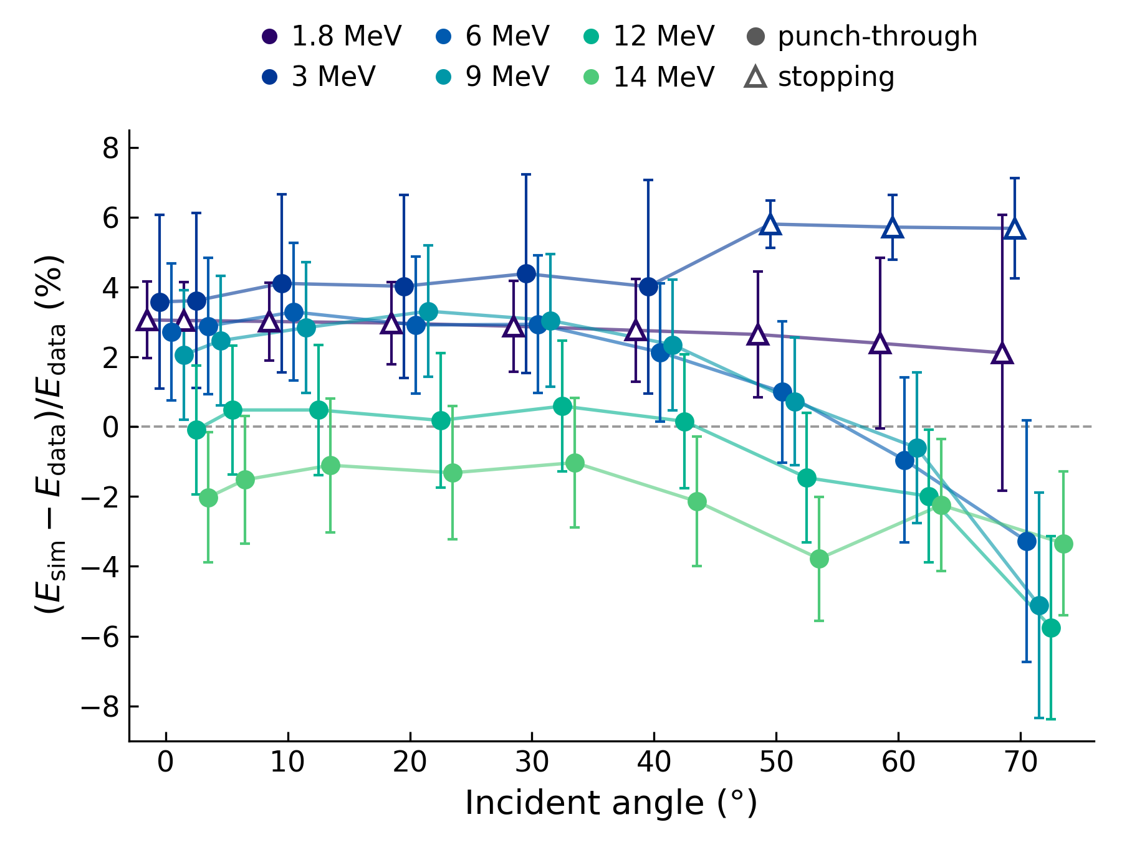
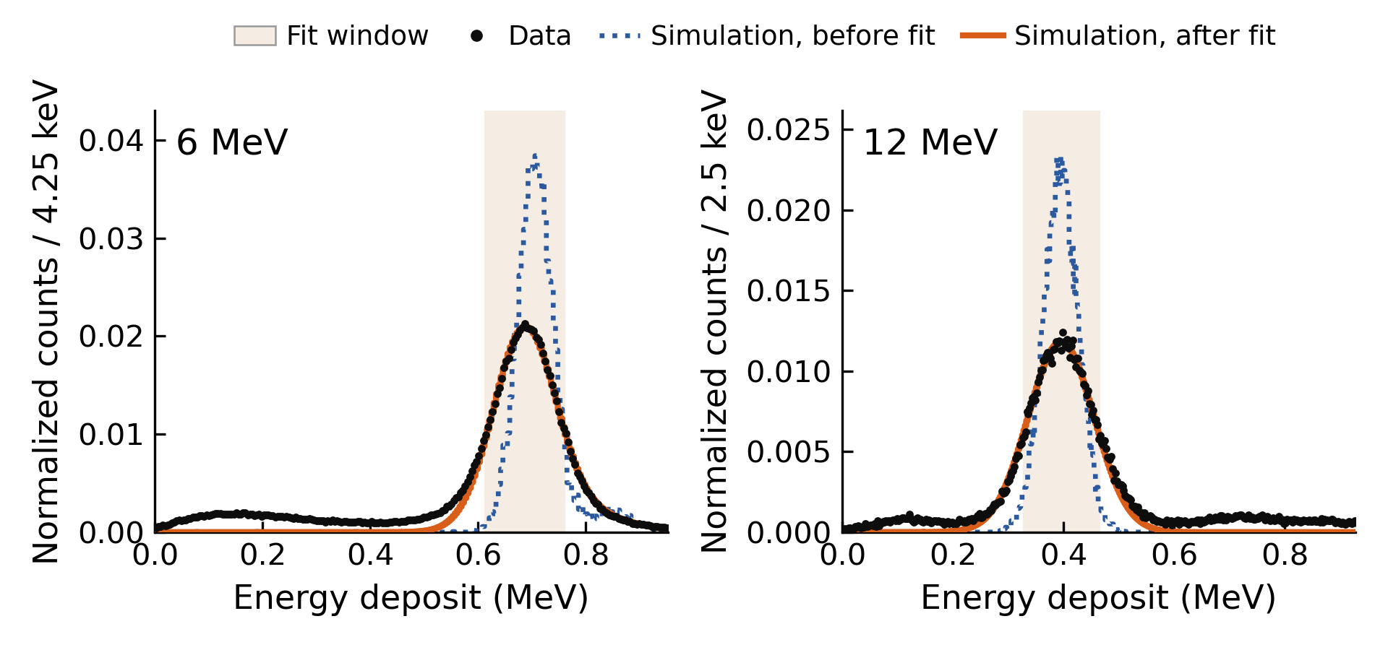
W1PIN Reference, Measured vs. Geant4
Geant4 reproduces the W1PIN peak within its uncertainty, except 3 MeV stopping protons
Fit: normalization, energy shift, Gaussian smearing. 3 MeV stopping runs (open triangles from 51°): simulation +6% (150 keV), not understood. The reference error is the larger of the shift and its uncertainty, 1.8–5.8%.
Notes:
The W1PIN has no gain, so its spectrum can be simulated and compared with the data. Geant4 models it as a 3 mm x 3 mm x 55 um block of active silicon behind a 2.0 um aluminium electrode; the protons scatter off a gold foil about 1 cm across, 16.2 cm away, so the simulated incident angles are spread uniformly over +-2 degrees around nominal. Each simulation takes as its input beam the SiMon spectrum recorded alongside that W1PIN run (at 1.8 MeV the one recorded with W18); at 12 and 14 MeV, which the SiMon cannot measure, a monoenergetic source at the energy of a proton elastically scattered off gold. The simulation is fitted to the data with a normalization, a rigid energy shift and a Gaussian smearing, over the region where the measured spectrum exceeds half its maximum; chi2/ndf is 0.7 to 3.8. Left: examples at 6 MeV (SiMon input) and 12 MeV (monoenergetic, so the smearing also absorbs the beam spread). Right: the fitted shift as a fraction of the measured peak, every energy and angle at 100 V; errors combine the fit's statistical error with +-1 um of active layer, +-0.5 um of electrode and +-1 degree of angular spread, plus the unmodelled beam spread at 12 and 14 MeV. The simulation agrees within these uncertainties everywhere except the 3 MeV protons at about 50 degrees and above, which stop in the sensor: there it is 6% (150 keV) above the data, and this is not understood. The W1PIN sees a similar 2.5 MeV deposit from 6 MeV protons at 71 degrees, where the simulation agrees, so the diode's response to a deposit of that size is unlikely to be the cause. The gain uses the measured peak, so the discrepancy does not change the gain, but the reference uncertainty at each energy and angle is the larger of the shift and its uncertainty (1.8 to 5.8%, median 2.9%). At 8 MeV, with no W1PIN data, the simulated peak is the reference, with the 9 MeV fractional uncertainty at the same angle.

Slide 19
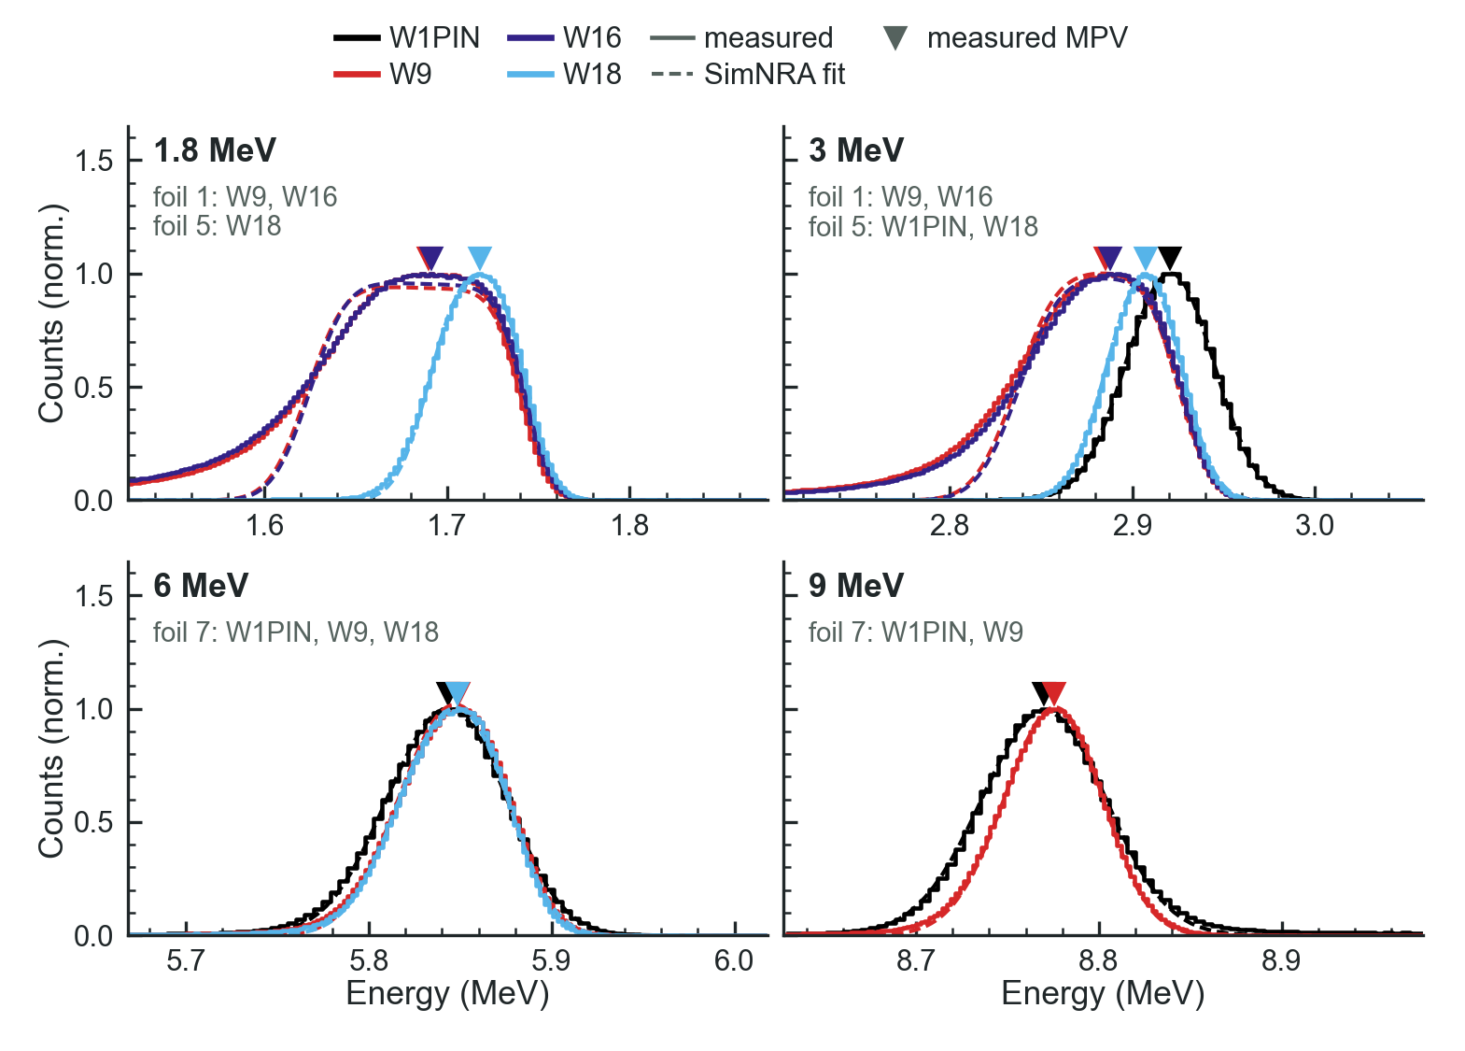
SimNRA Fit of the SiMon Spectra
Gain error: beam-energy differences add at most 2.9% (W9, 3 MeV, 41°), below 0.6% at 6 MeV and above
Fit: one thickness per foil, one beam offset per run, one resolution per energy
Agrees: peak positions and run-to-run differences within 2 keV
Misses: shapes behind foil 1: one uniform gold layer, no C/O or plural scattering
Foil shift: foil 1 (0.60 µm): peak 27–35 keV below foil 5 (0.27 µm)
Notes:
The SiMon spectra recorded with every gain set were fitted jointly with SIMNRA, with one gold thickness per foil, one beam-energy offset per run to absorb drift, and one detector resolution per beam energy and preamplifier. Solid lines are the measured gold peaks, dashed the fit, triangles the measured most probable values (MPV, the vertex of a parabola fitted to the top 20% of the peak). The fit reproduces the peak centroids and the differences between runs within 2 keV, but it models each foil as a single uniform gold layer, so it misses the sloped top and soft low-energy edge behind the thick foil 1 at 1.8 and 3 MeV; there its MPVs depart from the measured ones by up to 7 keV, which is why the beam energies use the measured MPVs and the fit is only a cross-check. Foil shift: the fitted thicknesses are 0.60 um of gold for foil 1 and 0.27 um for foil 5 (computed by the paper's code, not quoted in its text). Behind foil 1 the gold peak sits 27 to 35 keV below the W1PIN's behind foil 5 at 1.8 and 3 MeV (W9 and W16); that includes the day-to-day change, since W18 behind the same foil as the W1PIN still differs by 13 keV at 3 MeV, and at 6 and 9 MeV, all behind foil 7, the offsets are 5 to 6 keV. The W1PIN has no SiMon spectrum at 1.8 MeV, so W18's, behind the same foil, stands in for it. Each offset is turned into a change of the deposit at the run's angle with PSTAR and added in quadrature to the gain's error: largest, 2.9%, for W9 at 3 MeV and 41 degrees, where the protons leave the sensor with little energy, and below 0.6% at 6 MeV and above. At 12 and 14 MeV the scattered protons punch through the SiMon, so the carbon peaks are compared instead; they agree within 0.4%. Foil 1's thickness still includes W9's 6 MeV spectrum, which the frozen fit treated as foil 1 before that run was corrected to foil 7.

Slide 20
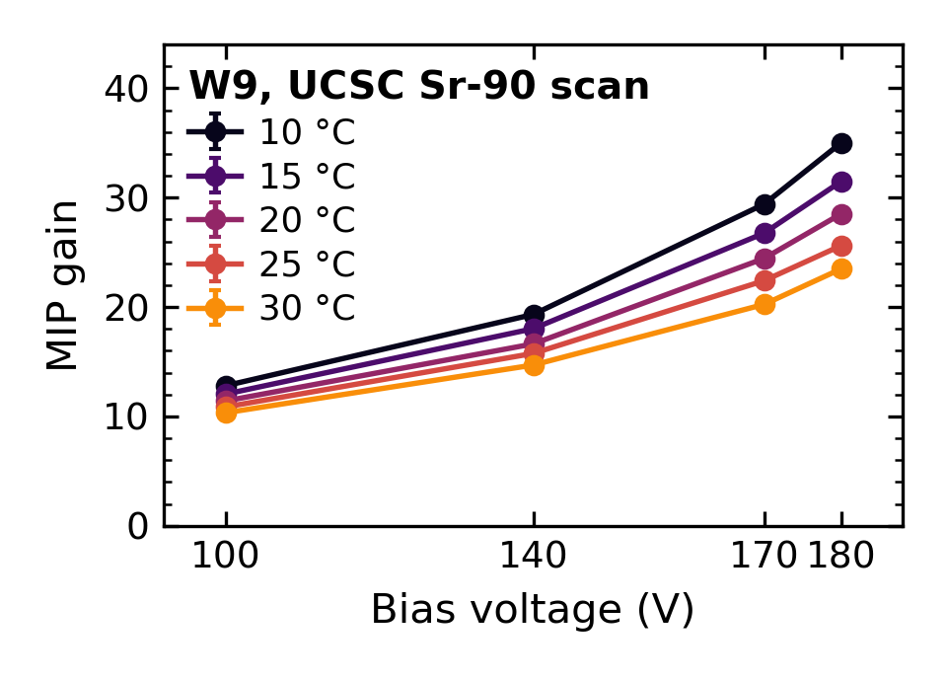
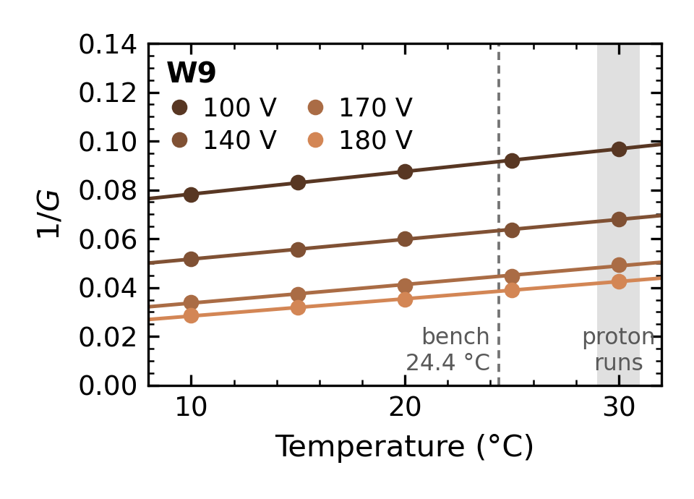
Temperature Correction of the MIP Gain
Warmer → shorter mean free path → fewer ionizations (lower I) → lower gain
lowers the MIP gain by 3–11%
Notes:
I is the average number of secondary carriers one carrier produces crossing the gain layer. The total per initial carrier is the geometric sum, which diverges as I approaches 1 at breakdown. The paper does not test for curvature in 1/G; a uniform-field exponential model predicts some, and a straight line is adequate over 10 to 30 °C.

Slide 21
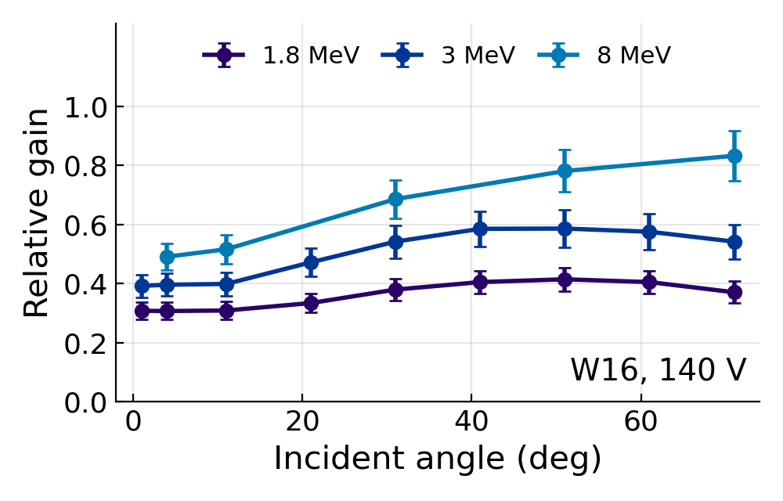
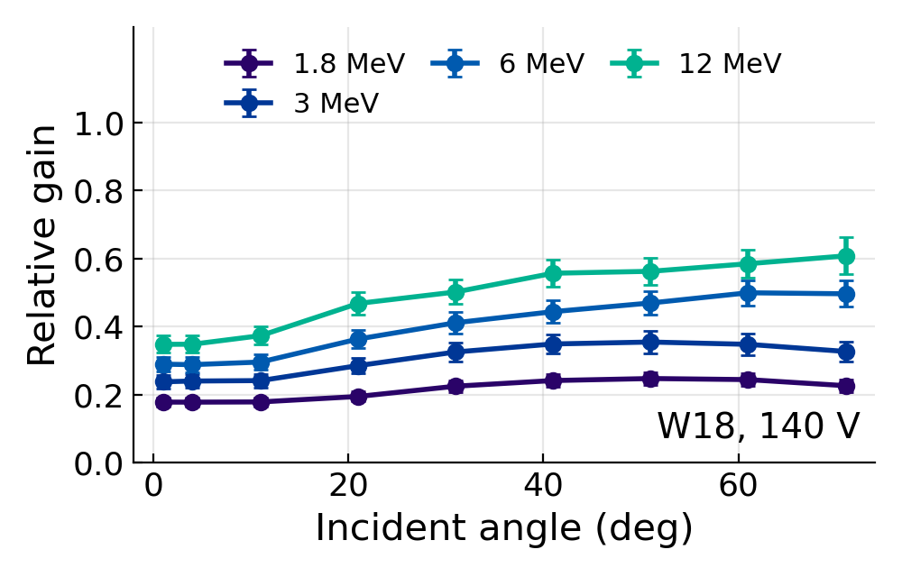
Relative Gain of W16 and W18
The same trends as W9: relative gain rises with incident angle and with beam energy, and is lower for higher gain sensors.
Notes:
Relative gain against incident angle at 140 V, referred to the 30 °C MIP gain, for the two deep-doped sensors. W16 has 1.8, 3 and 8 MeV data; W18 has 1.8, 3, 6 and 12 MeV. Error bars are the paper's full uncertainty on each run. At the same energy W18, which has the higher MIP gain, is suppressed more than W16.

Slide 22
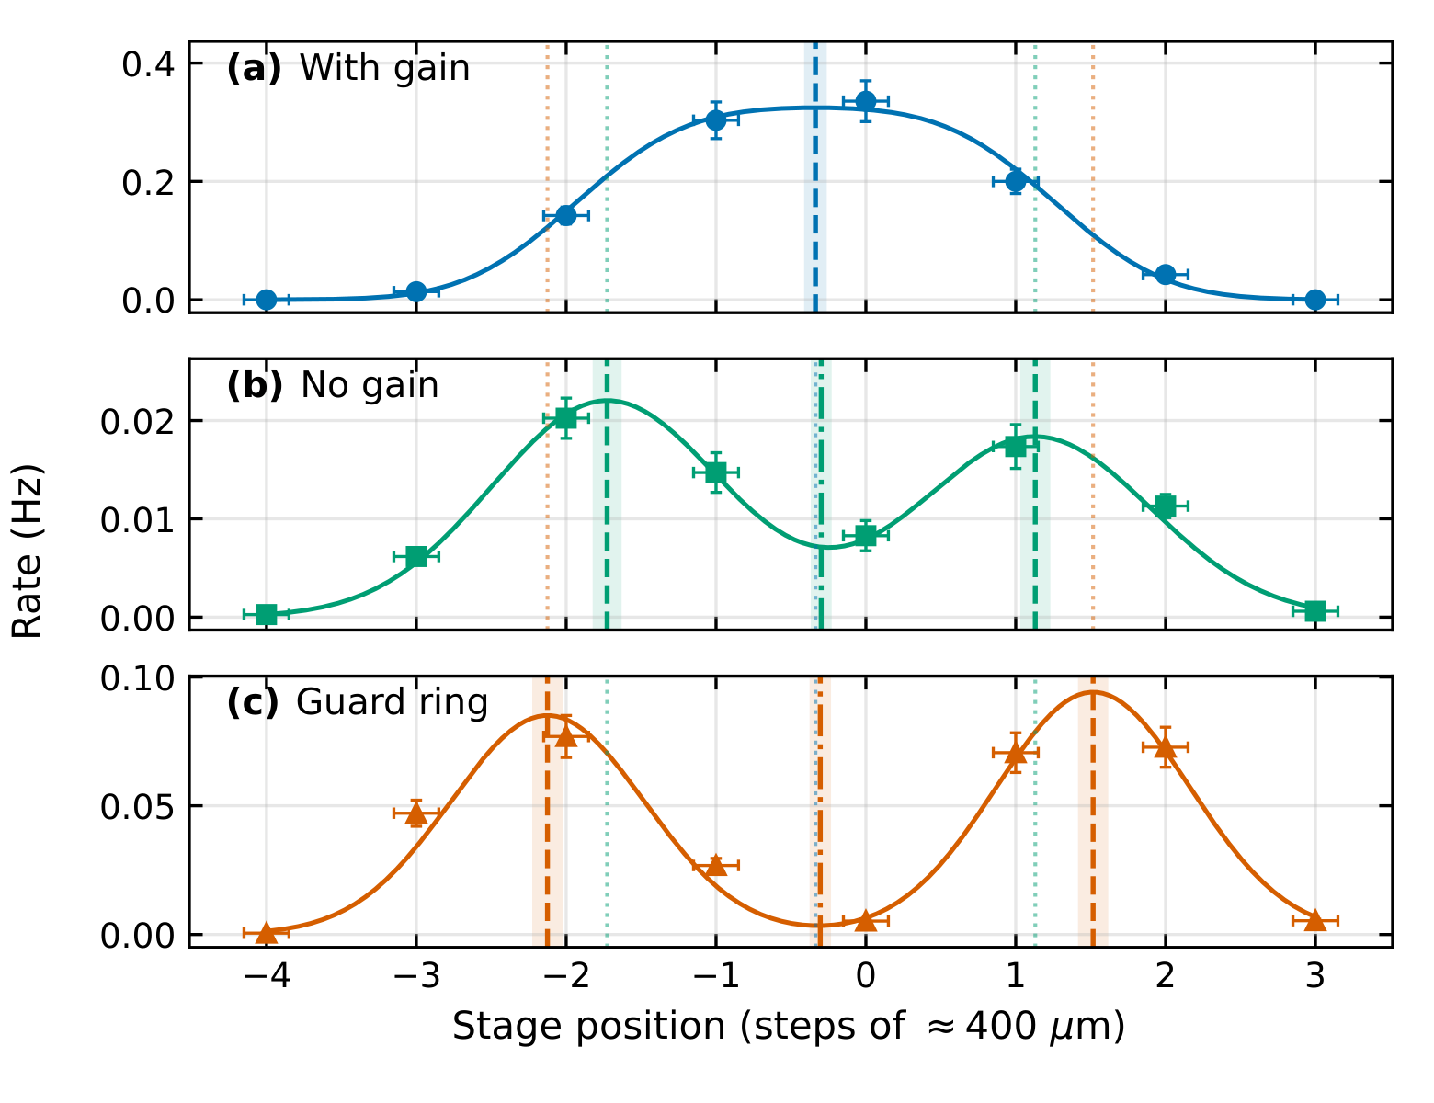
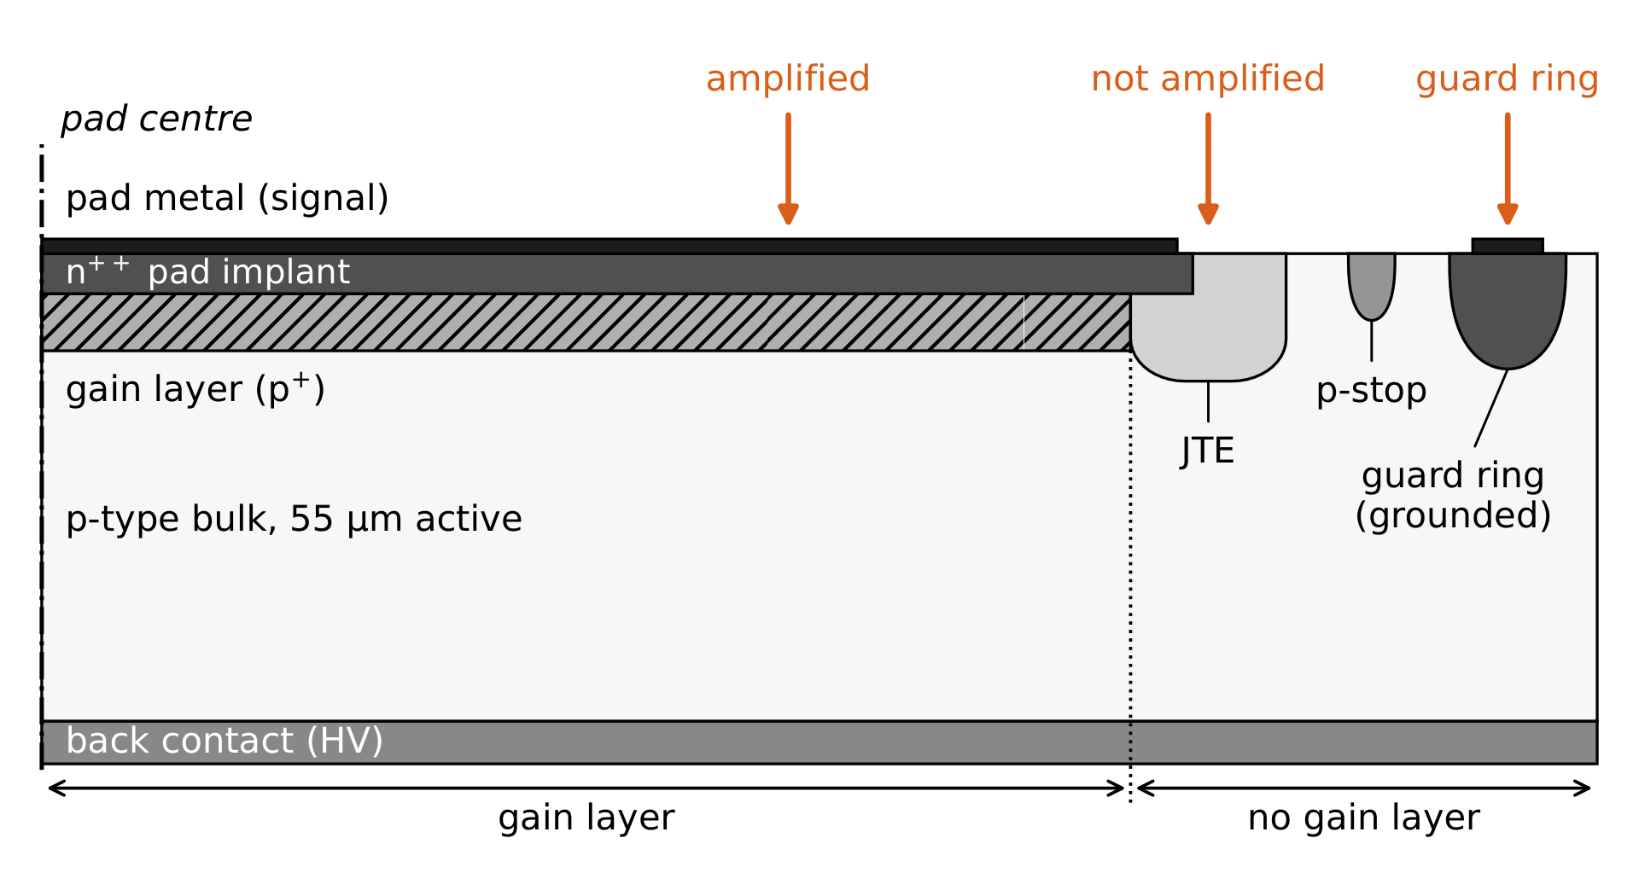
Pinhole Scan and Edge Effects
Every energy spectrum has two small peaks besides the main one; a ²⁴⁴Cm pinhole scan finds where on the pad each comes from
Scan: ²⁴⁴Cm alphas, 500 µm pinhole, steps of about 400 µm, W18 at 140 V
With gain: a plateau 1.28 mm wide, against the 1.3 mm pad
No gain: just inside the end of the gain layer; follows the W1PIN peak in the proton spectra
Guard ring: further out; induces a positive pulse on the pad
So: the gain fit uses only the main peak; PIONEER’s TI-LGADs narrow the no-gain region
Notes:
Every proton spectrum shows three peaks, and the pinhole scan was done to find where on the sensor the two smaller ones come from. A 244Cm alpha source sat about 2 cm behind a 500 um hole in a 25 um gold foil, and a linear stage moved the hole across the pad in steps of about 400 um. All three populations were seen on every LGAD, but the full scan was done only on W18 at 140 V, read out with a WaveDREAM digitizer instead of the SAMPIC, with one run triggering on negative and one on positive pulses at each position. The main population is the amplified negative pulse; its rate, fitted with a plateau with soft edges, is 1.28 mm wide, close to the 1.3 mm pad. A second population of smaller negative pulses peaks at -1.73 and +1.13 steps: deposits just inside the edge, where the gain layer has ended. In the W9 proton spectra this peak follows the W1PIN peak with incident angle, which confirms it is unamplified. The positive pulses peak further out, at -2.12 and +1.52 steps: those particles deposit under the grounded guard ring, which collects the charge, and its motion induces a signal of opposite sign on the pad. The midpoints of both pairs agree with the plateau center, about 0.3 steps (120 um) from the stage zero. The gain analysis fits only the main peak, so neither edge population enters it, and the edge regions without gain will be narrower in PIONEER's trench-isolated LGADs. (Paper section 6.)

Slide 23
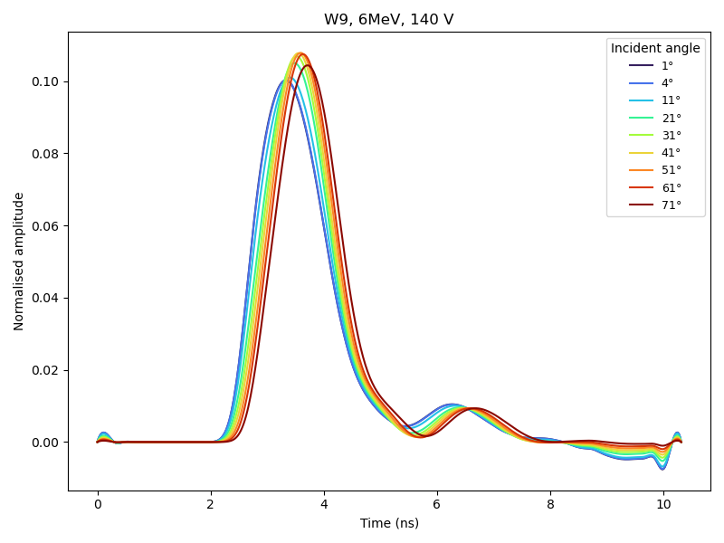
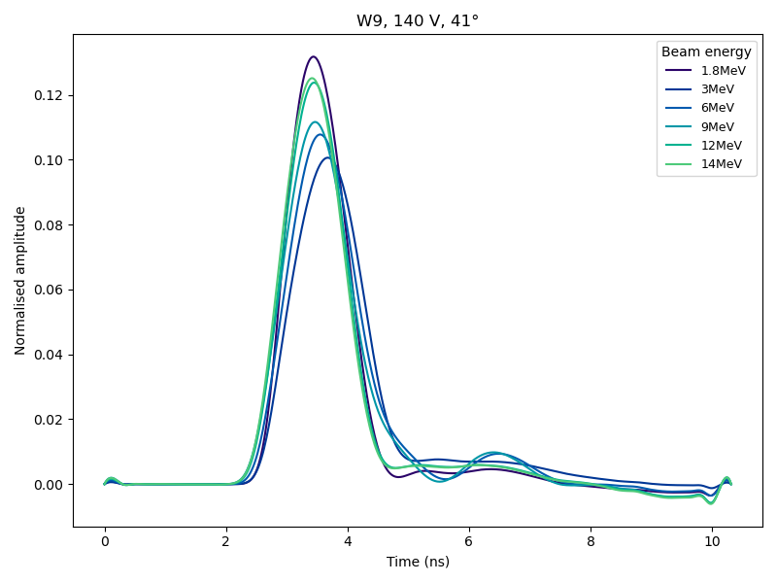
Average Waveforms
Normalized average pulses of W9: the pulse delays and broadens with incident angle and changes height with beam energy.
W9, 6 MeV, 140 V, by incident angle
W9, 140 V, 41°, by beam energy
Notes:
Average waveforms of the accepted-proton events, normalized. Left: W9 at 6 MeV and 140 V by incident angle; right: W9 at 140 V and 41 degrees by beam energy. The pulse peaks later at larger angles because the charge is deposited over a longer path through the sensor.

Slide 24
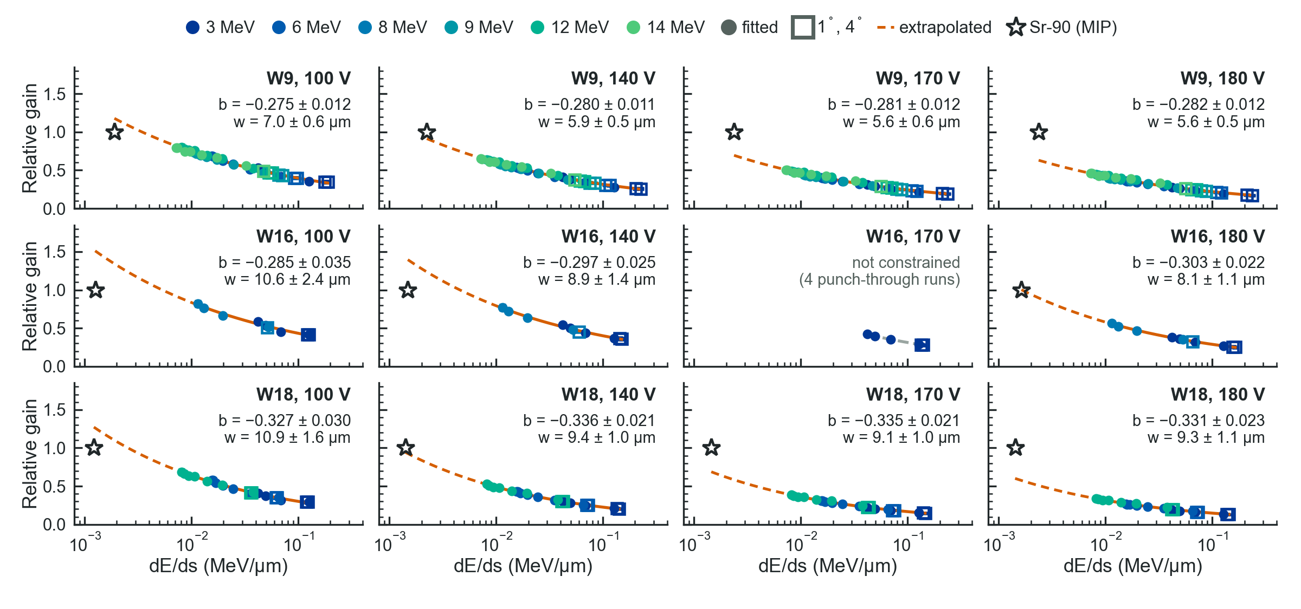
Power-Law Fits
Notes:
W9, the one board measured at every beam energy (1.8 to 14 MeV), 32 punch-through runs per bias. b is −0.275 to −0.282 and the prefactor a falls with bias (0.235 to 0.128), so the curves move down as the MIP gain rises. w is 5.6 to 7.0 um, smallest of the three boards. At the MIP the law gives 1.31 at 100 V and 0.70 at 180 V, against 1 by construction. Over the setups with a bench Am-241 measurement, the law and the measured peak differ by at most 21%. Errors combine the bootstrap scatter, the dE and angle uncertainties, and the 11 degree width effect.

Slide 25
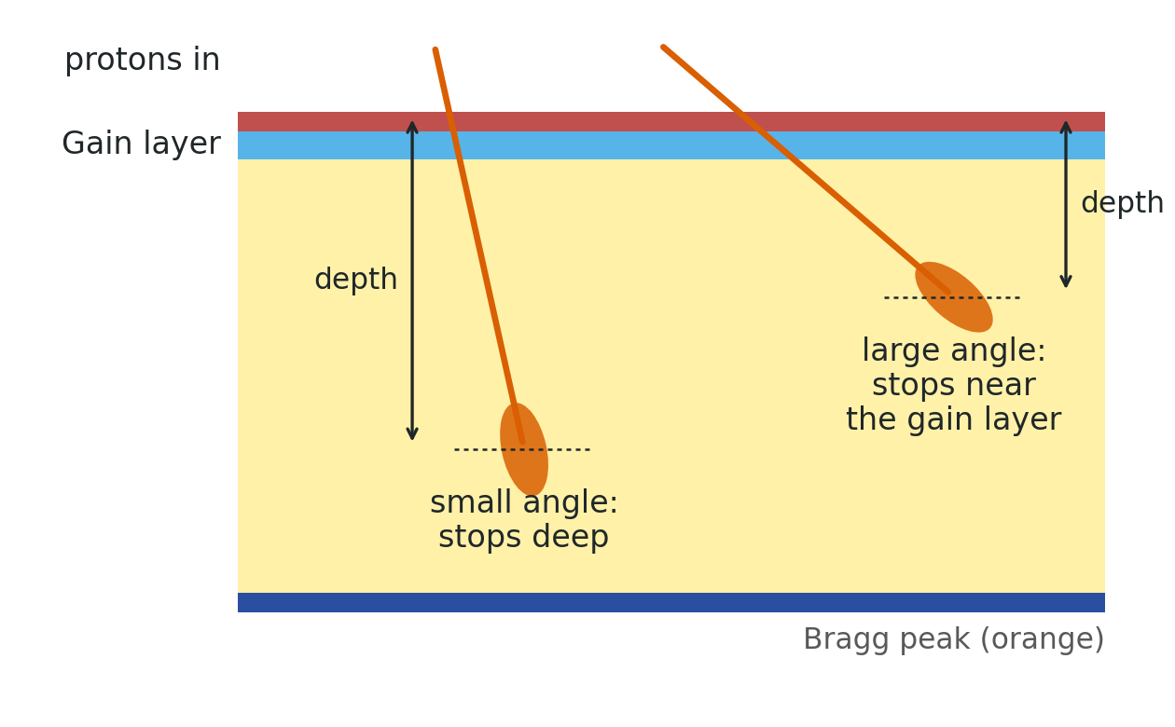
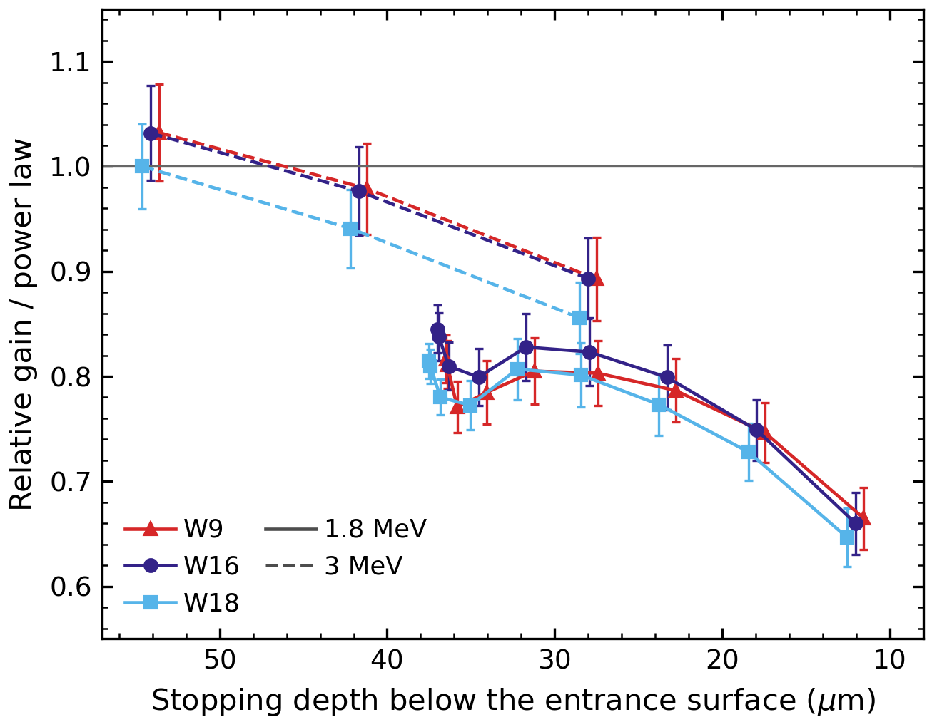
Stopping Protons
Relative gain over the power law at 140 V, against the depth where the proton stops; the gain layer is to the right
Not fitted: the charge sits in a Bragg peak, which the mean dE/ds over the path does not describe
3 MeV: 1.02 of the law stopping at 54 µm, 0.88 at 28 µm
1.8 MeV: 0.79–0.83 from 37 to 23 µm (angles ≤ 51°), 0.66 at 12 µm
dE/ds sets the angle dependence at small angles, the depth at large ones. Not modeled; stopping pions and muons in PIONEER need the depth profile too
Notes:
Every stopping run at 140 V for all three boards: all the 1.8 MeV runs and the 3 MeV runs past the crossover angle (51, 61, 71 degrees). Each relative gain is divided by the power law at the run's dE/ds, so one is a run on the law. The x axis is the depth at which the proton stops, the range (37 um at 1.8 MeV, 86 um at 3 MeV) times the cosine of the incident angle, measured from the entrance surface; the gain layer is on the entrance side, to the right. The 1.8 MeV points run from 1 degree (deepest) to 71 degrees (shallowest). The stopping protons are not fitted because their charge is deposited in a Bragg peak, which the mean dE/ds over the path does not describe. The 3 MeV runs sit at 1.02 of the law at 54 um and 0.88 at 28 um. The 1.8 MeV runs stay between 0.79 and 0.83 of the law from 37 to 23 um, the angles up to 51 degrees, and fall to 0.66 at 12 um. So the angle dependence follows dE/ds at small angles and the depth takes over at large angles, consistent with the earlier campaigns, where the relative gain of stopping protons rose with angle up to about 50 degrees and then fell; we attributed that to the Bragg peak coming closer to the gain layer, where the charge has less distance to spread by diffusion. This is not modeled. Bars combine the W1PIN reference, the beam difference and the range uncertainty; the boards are offset by 0.5 um for clarity.

Slide 26

Why Muons Fall Below the Proton Data
dE/ds of whole ATAR layers against incident angle: muons at large angles fall below the proton data range.
Notes:
From the PIONEER ATAR simulation (baseline beam, 48 layers of 120 um silicon, lateral width 8.67 um). Lines are medians and bands the 16 to 84% range of whole-layer dE/ds. Muons cross the layers at large angles to the normal, where dE/ds approaches dE/dx divided by sin(theta), about 3 to 7 keV/um. 86% of pion layers and 45% of muon layers are inside the proton range. The width scaling for the thicker 120 um ATAR sensors is untested.

