Slide 1
The Visibility of Error Bursts in Superconducting Qubits from Electron Impacts
We coupled an electron linac with a dilution refrigerator: The CLIQUE Facility
Alan W. Hunt, T. McJunkin, Y. S. Jones-Alberty, T. M Haard, M. K Spear and K. M Schultz
Alan.Hunt@jhuapl.edu
(240) 228-3169

Slide 2
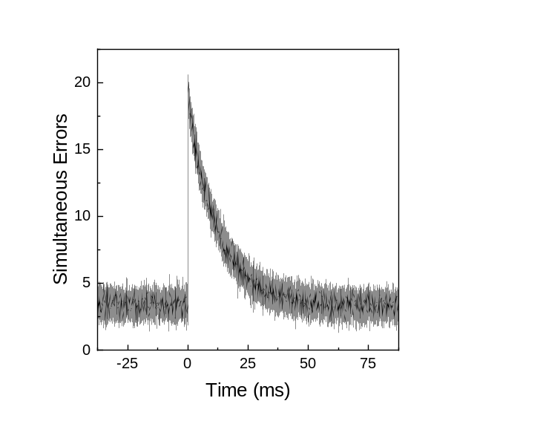
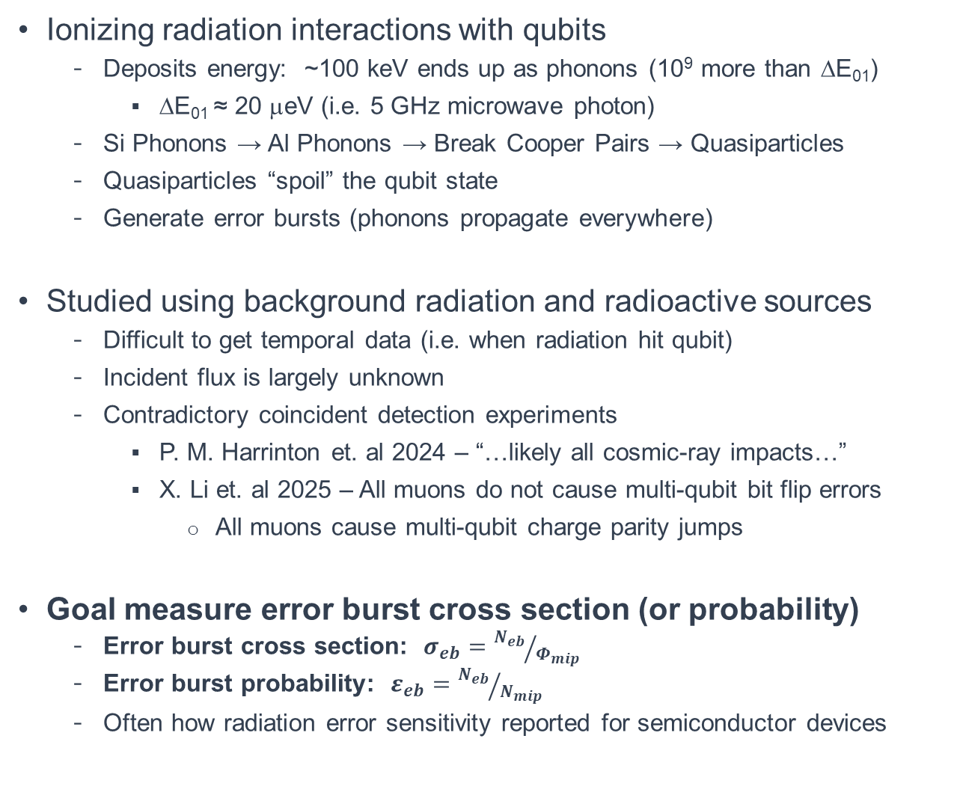
What is the Probability a MIP Causes an Error Burst?
Ionizing radiation interactions with qubits
  Deposits energy: ~100 keV ends up as phonons (10⁹ more than ΔE₀₁)
    ΔE₀₁ ≈ 20 μeV (i.e. 5 GHz microwave photon)
  Si Phonons → Al Phonons → Break Cooper Pairs → Quasiparticles
  Quasiparticles “spoil” the qubit state
  Generate error bursts (phonons propagate everywhere)
Studied using background radiation and radioactive sources
  Difficult to get temporal data (i.e. when radiation hit qubit)
  Incident flux is largely unknown
  Contradictory coincident detection experiments
    P. M. Harrinton et. al 2024 – “…likely all cosmic-ray impacts…”
    X. Li et. al 2025 – All muons do not cause multi-qubit bit flip errors
      All muons cause multi-qubit charge parity jumps
Goal measure error burst cross section (or probability)
  Error burst cross section: $σ_{eb}={N_{eb}}/{Φ_{mip}}$
  Error burst probability: $ε_{eb}={N_{eb}}/{N_{mip}}$
  Often how radiation error sensitivity reported for semiconductor devices
Josephson Junction
(critical component of a superconducting qubit)
β ⁻
μ
Al
e⁻ e⁻
AlO₃
e⁻ e⁻
250 nm
e⁻ e⁻
e⁻
e⁻
e⁻ e⁻
e⁻
e⁻
e⁻ e⁻
k
k
k
k
Si
350 μm
k
h⁺ e⁻
k
k
h⁺ e⁻
k
Electron/Hole:
e⁻ h⁺
Cooper pair:
e⁻ e⁻
Phonon:
k
Quasiparticle:
e⁻

Slide 3
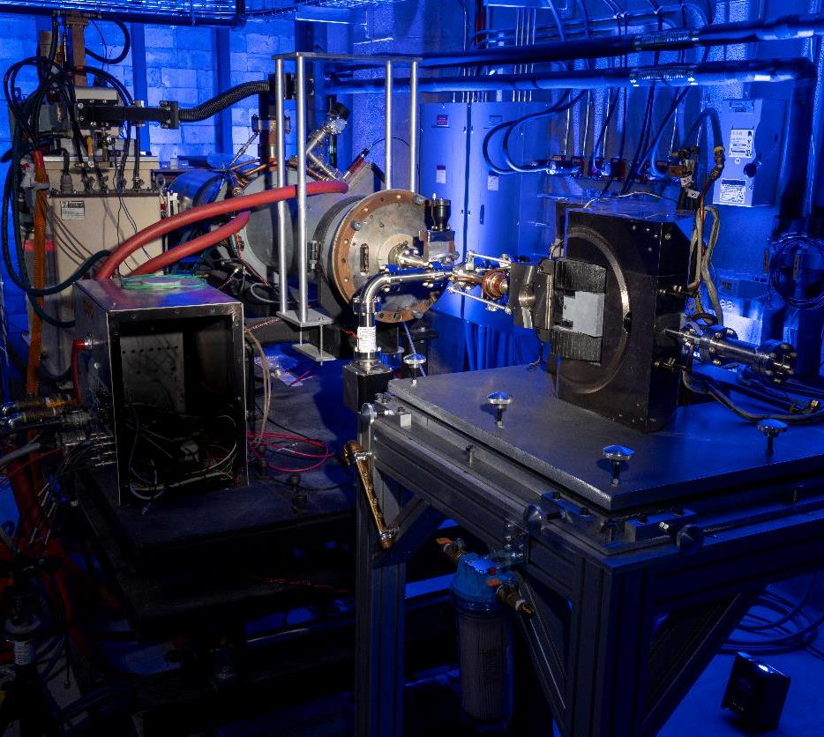
High-Energy Electron Accelerator for Qubit Irradiation
Accelerator Parameters
Advantages of accelerator driven qubit irradiation
  Intrinsic temporal data (i.e. accelerator trigger)
  Quickly induce upsets
Challenge: Requires very low currents
  Accelerator designed to maximize dose (medical/industrial)
    Charge per pulse 360 nC
  For qubits operate at 22 fC per accelerator pulse
    Current stability is not the best
Accelerator Waveguide Model | Varian 2500
Fundamental RF Frequency | ~2.856 GHz
Electron Energy | 5 to 25 MeV
Pulse Width | 200 ns to 4 μs
Repetition Rate | 0 to 100 Hz
Maximum Charge per Pulse | 360 nC
Maximum Time Averaged Current | 36 μA
Maximum Time Averaged Power | 750 W

Slide 4
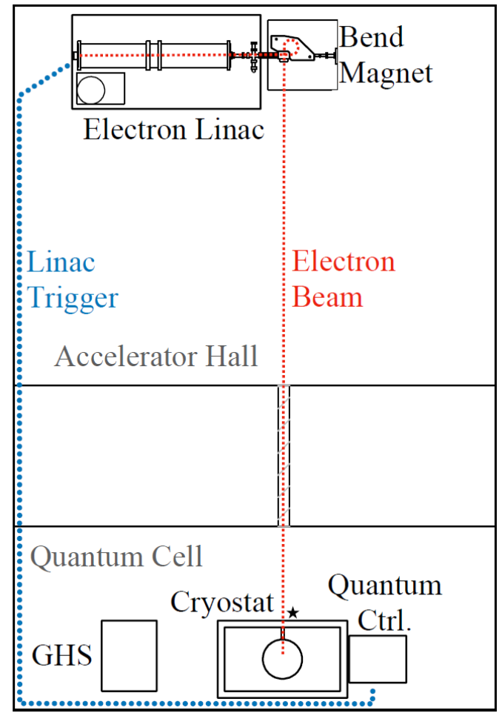
Electron Transport to the Qubits
Accelerator transport
  Inject 18 keV electrons into accelerating structure
  Accelerate to 18.5 MeV through 36 cavities over ~1.9 m
  270º bending magnet redirects electrons towards refrigerator
  Electrons exit through 250 μm Be window into atmosphere
    Beam diameter ~3 mm
Beam expands during transport through atmosphere
  40 cm diameter at penetration in concrete wall
    Beneficial: Decreases electron flux
  Penetration spatially collimates beam to 15.2 cm
  Final 3 cm aluminum collimator before refrigerator
  Electron lose ~1.6 MeV over ~7.6 m
Modified Bluefors LD400 to facilitate electron penetration
  Outer vacuum chamber with 25 μm Ti window, 3.8 cm diameter
  Four thermal shields with 25 μm Al window, 3 cm diameter
  Magnetic shield 1 mm mumetal (electrons lose ~1.7 MeV)
  Electron energy at qubit ~14.5 MeV
15.2 cm
Penetration
8 m
Concrete Wall
1.8 m
First and only facility to couple
accelerator and qubits?

Slide 5
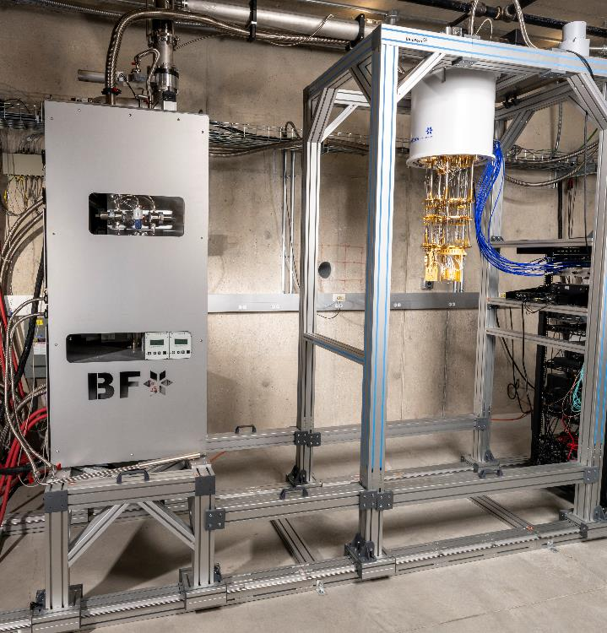
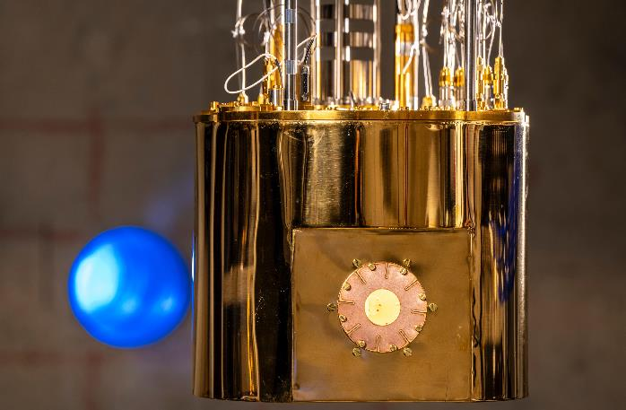
Dilution Refrigerator in Pictures
6” OD penetration to
Accelerator Hall
6” OD penetration to
Accelerator Hall
Inner thermal shield
~1 mm Cu
Window
~25 μm Al (removed)
Gas handling system
Circulates ³He/⁴He
Qubits

Slide 6
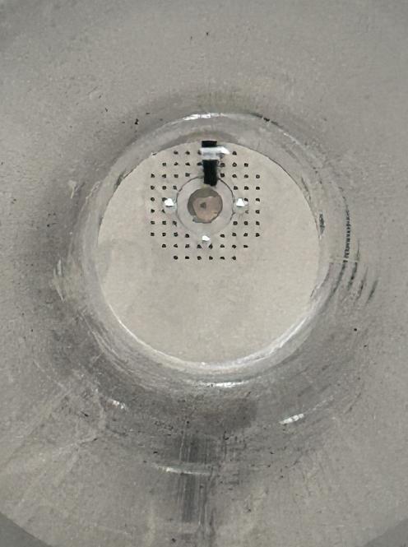
Electron Flux Monitored with Plastic Scintillators
Electron
Detector
Electron detector
  1 cm², 4 mm thick plastic scintillator on PMT
  Energy deposition through 4 mm scintillator
    634 keV × number of electrons in pulse
  Detector #1: outside fridge, always present as flux monitor
  Detector #2: inside warm fridge, measure flux at qubit
  Inside/outside detectors linearly correlated
Data acquisition
  Standard pulse height analysis
  Accelerator trigger injected into data stream
Energy calibration
  Originally used Compton edges
  Currently use electrons
Currently switching to Si PIN diodes
  Easier to measure larger or smaller fluxes
Collimator
Aluminum
3 cm ID
5.1 cm thick
Aluminum
Tube
25 μm Thick
Titanium Window

Slide 7
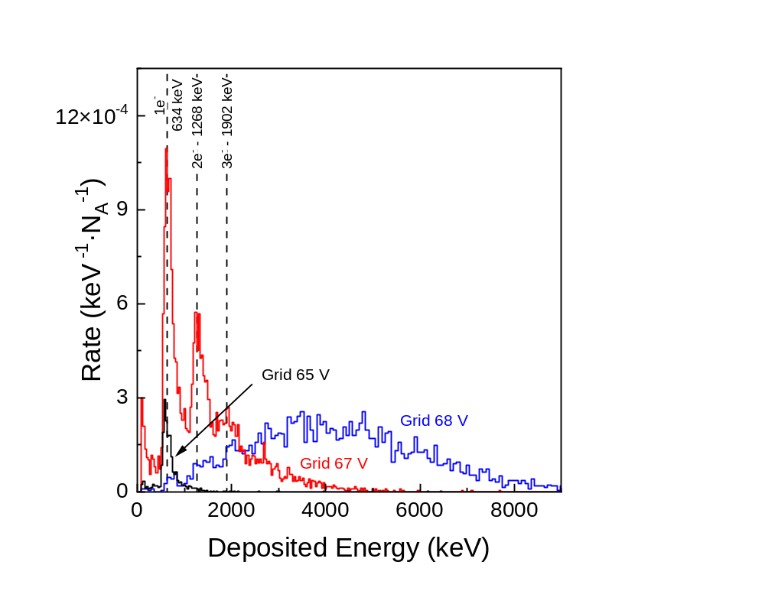
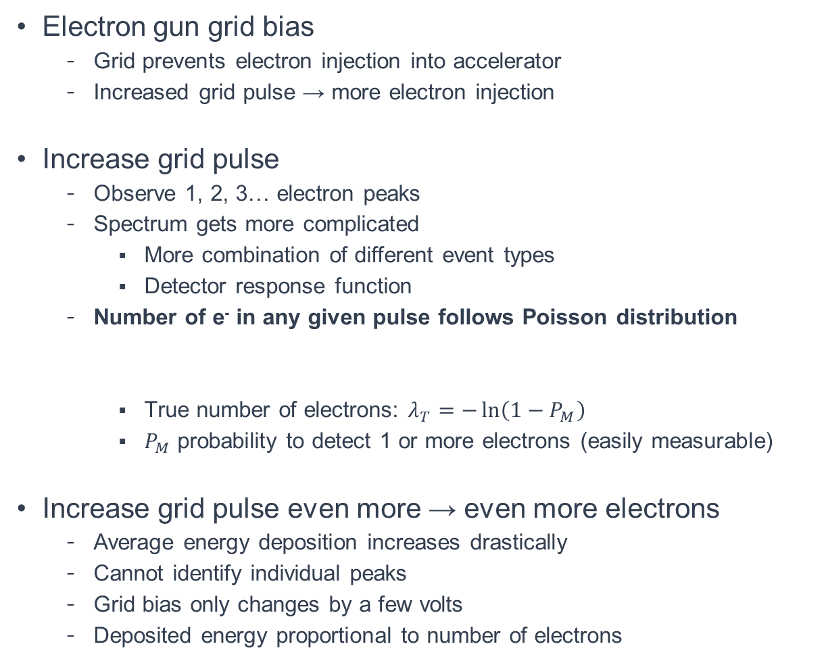
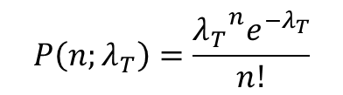
Increase Electron Fluence by Increasing Grid Pulse
Electron gun grid bias
  Grid prevents electron injection into accelerator
  Increased grid pulse → more electron injection
Increase grid pulse
  Observe 1, 2, 3… electron peaks
  Spectrum gets more complicated
    More combination of different event types
    Detector response function
  Number of e⁻ in any given pulse follows Poisson distribution
    True number of electrons: $λ_{T}=−\ln\left(1−P_{M}\right)$
    $P_{M}$ probability to detect 1 or more electrons (easily measurable)
Increase grid pulse even more → even more electrons
  Average energy deposition increases drastically
  Cannot identify individual peaks
  Grid bias only changes by a few volts
  Deposited energy proportional to number of electrons
$$P\left(n;λ_{T}\right)=\frac{{λ_{T}}^{n}e^{−λ_{T}}}{n!}$$

Slide 8
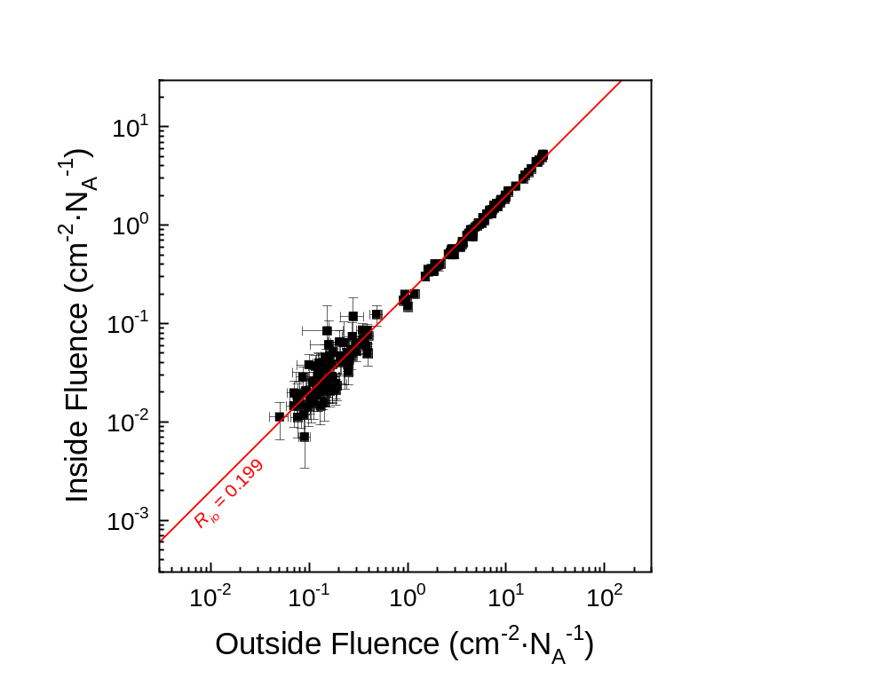
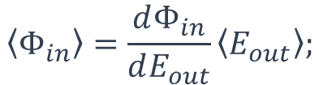

Correlate Electron Fluence Inside to Outside
Install electron detector #2 inside refrigerator
  Identical detector as #1
  Calibration technique is the same
  Add material in front of detector to mimic device package
  Fridge is at room temperature
Linear correlation between inside and outside fluences
  Cannot be anything else
  Simple equation for inside electron fluence
  Constant depends on setup (e.g. mumetal vs. no mumetal)
Qubit fluence ranges that can be monitored
  Low: ~3×10⁻² cm⁻²
  High: ~300 cm⁻²
  Energy deposition ~100 keV to 10 MeV (25 mm²; 350 μm thick Si)
$$\left\langle Φ_{in}\right\rangle =\frac{dΦ_{in}}{dE_{out}}\left\langle E_{out}\right\rangle \text{;}$$
$$\frac{dΦ_{in}}{dE_{out}}=0.31\frac{1}{\text{MeV}∙{\text{cm}}^{−2}}$$

Slide 9
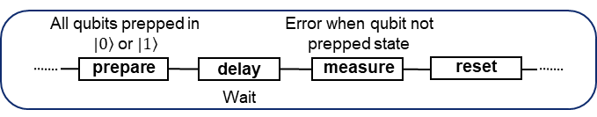
Multi-Qubit Device Has Incidental Gap Engineering
Quantum device
  8 fixed-frequency uncoupled transmon qubits
  SQUILL fabricated, Al on a 25 mm² Si
  T1 across chip is ~30 - 90 μs
  Incidental gap engineering
    4 Low-Gap → Slower recovery
    4 High-Gap → Faster recovery
Quantum control
  Fast active readout for few-μs shot time
  Linac trigger integrated into data stream
  Qubit measurement scheme
    Detection delay varied between 200 ns to 12 μs
    Sequence time range between 4.96 to 16.76 μs
Low-Gap Qubit
To Ground Plane
Low-Gap 160 nm Al
To Capacitor Island
AlO₃
High-Gap 30 nm Al
Si
350 μm
High-Gap Qubit
To Capacitor Island
Low-Gap 160 nm Al
To Ground Plane
AlO₃
High-Gap 30 nm Al
Si
350 μm

Slide 10
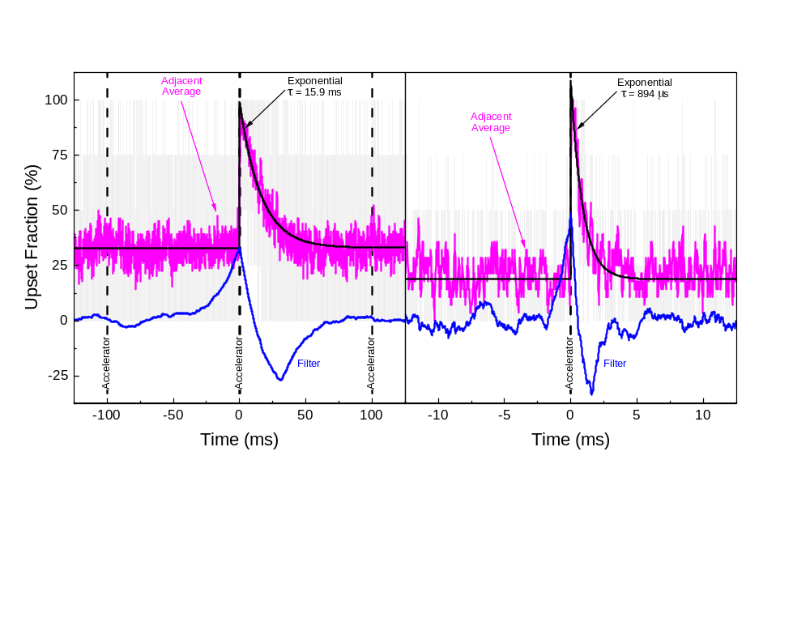
Linac Based Qubit Error Burst Experiment
Low-gap
High-gap
Detection delay: 12 μs
Linac experimental protocol
  ~18.5 MeV, 10 Hz repetition rate
  Electron flux at qubit: ~0.8 cm⁻² per accelerator trigger
    ~0.2 e – strikes qubit silicon per pulse
  Keeping electron flux steady was challenging
Low-gap qubits recover more slowly
  Error bursts appear exponential
  Only ~18% of accelerator pulses contained 1 or more e⁻
  Low-gap recovery time 15.9 ms
  High-gap recovery time 894 μs

Slide 11
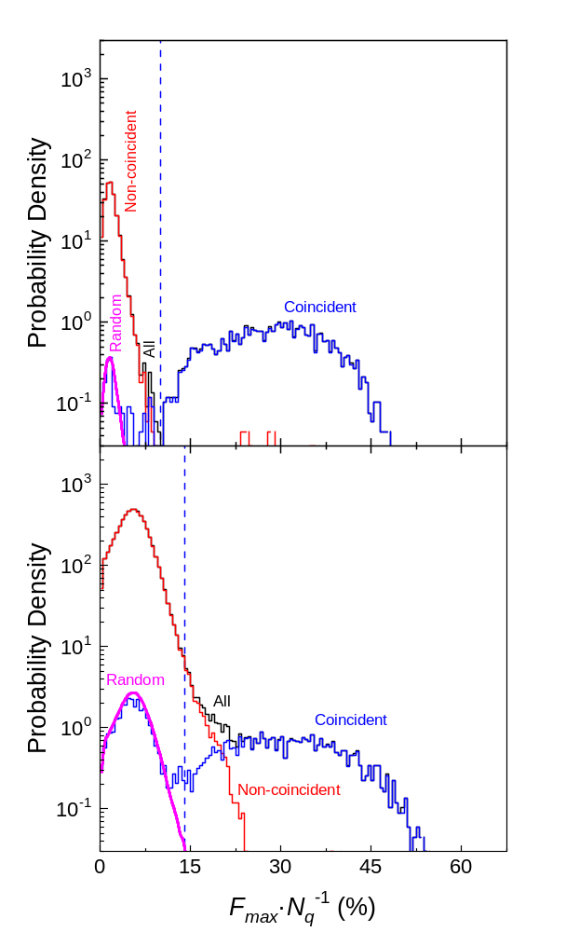
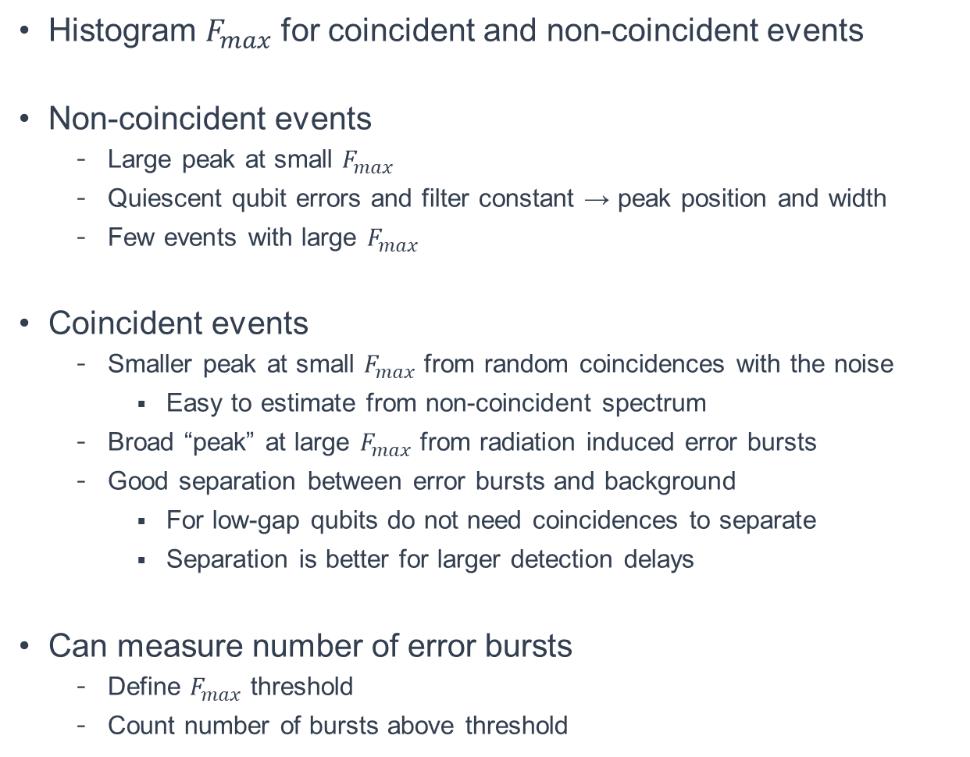
Peak Height Spectra Identifies Error Bursts
Histogram $F_{max}$ for coincident and non-coincident events
Non-coincident events
  Large peak at small $F_{max}$
  Quiescent qubit errors and filter constant → peak position and width
  Few events with large $F_{max}$
Coincident events
  Smaller peak at small $F_{max}$ from random coincidences with the noise
    Easy to estimate from non-coincident spectrum
  Broad “peak” at large $F_{max}$ from radiation induced error bursts
  Good separation between error bursts and background
    For low-gap qubits do not need coincidences to separate
    Separation is better for larger detection delays
Can measure number of error bursts
  Define $F_{max}$ threshold
  Count number of bursts above threshold
Low-gap
High-gap
Detection delay: 12 μs

Slide 12
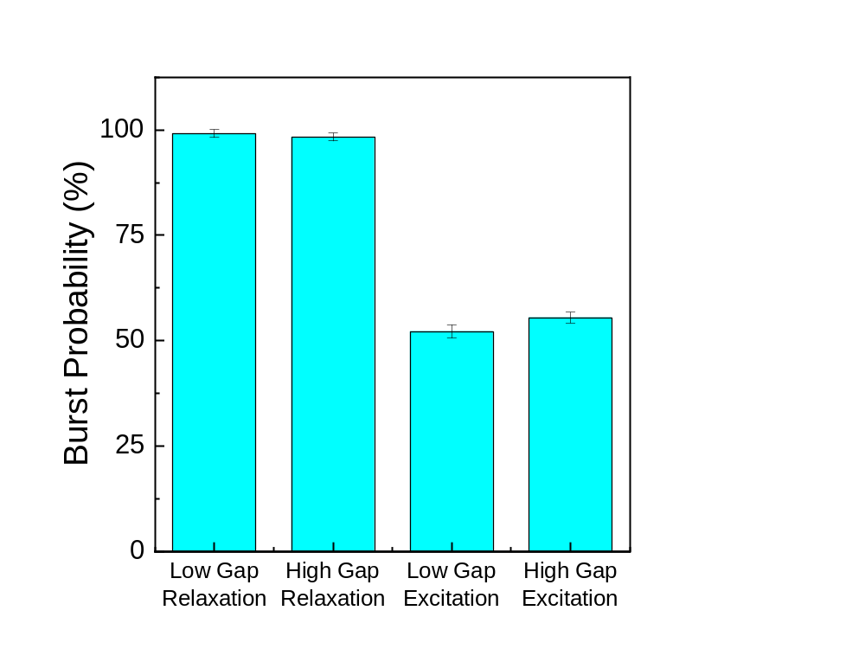
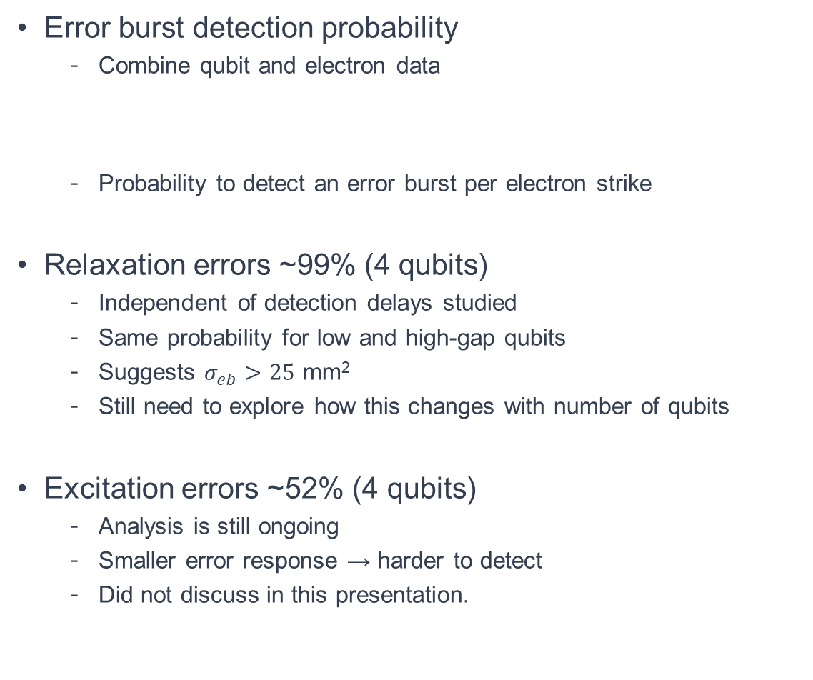
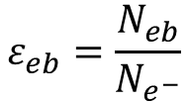
Every Electron Impact → Qubit Relaxation Error
Error burst detection probability
  Combine qubit and electron data
  Probability to detect an error burst per electron strike
Relaxation errors ~99% (4 qubits)
  Independent of detection delays studied
  Same probability for low and high-gap qubits
  Suggests $σ_{eb}>25$ mm²
  Still need to explore how this changes with number of qubits
Excitation errors ~52% (4 qubits)
  Analysis is still ongoing
  Smaller error response → harder to detect
  Did not discuss in this presentation.
$$ε_{eb}=\frac{N_{eb}}{N_{e^{−}}}$$

Slide 13
Conclusions
Coupled a high-energy electron linac with dilution refrigerator
  Standard pulsed S-band electron linac
  Dilution refrigerator modified with thin windows on vacuum can and thermal shields to facilitate electron penetration
Developed “single” electron operation technique
  Low currents achieved by decreasing electron gun grid pulse
  Electron fluence from 0.03 to 300 cm⁻² per accelerator pulse at qubit
  Accelerator can go higher but need to change electron detector, also will start to heat up the dilution refrigerator
  Electron fluence at qubit monitored by plastic scintillator outside dilution refrigerator
    Linear relationship with electron fluence inside dilution refrigerator
Time resolution: A couple of qubit measurement sequences
  Enables investigation of many qubit/radiation phenomenon
Measured probability to detect error burst per electron impact
  Relaxation errors: ~99%
  Excitation errors: ~52%

Slide 14


The CLIQUE Facility supports external research.
We invite the quantumｘradiation community to leverage the experimental advantages of this facility for their research.
We can support a wide range of quantum devices, measurement schemes, and collaboration styles.
We have already hosted a gap-engineering study with MIT, quantum dot measurements with Wisconsin, and an MKID study with LLNL.
Reach out to CLIQUE.Facility@jhuapl.edu to learn more!
CLIQUE.Facility@jhuapl.edu

Slide 15
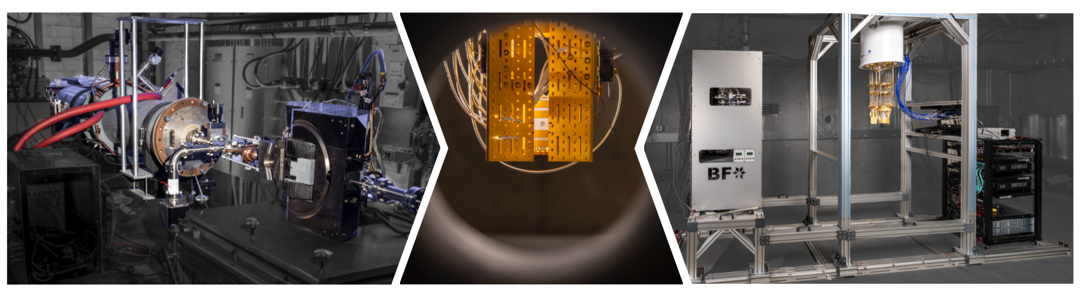

Review: The CLIQUE Facility is a powerful tool to study the effects of ionizing radiation on quantum systems.
The electron linear accelerator provides a on-demand irradiation similar to muons.
Thousands of events with high timing precision and known energy can be collected in minutes.
Subtle error mechanisms like excitation and detuning are easily extracted.
The CLIQUE facility is open to external collaborations.
Future directions include TLS studies, parity switching, mitigation techniques, other quantum systems.
arXiv:2603.13124

Slide 16


Slide 17
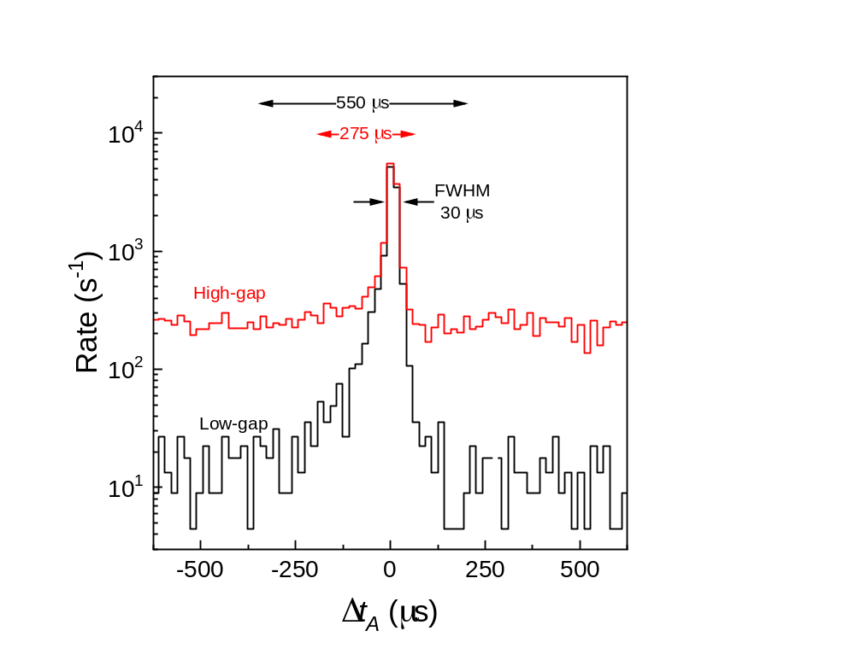
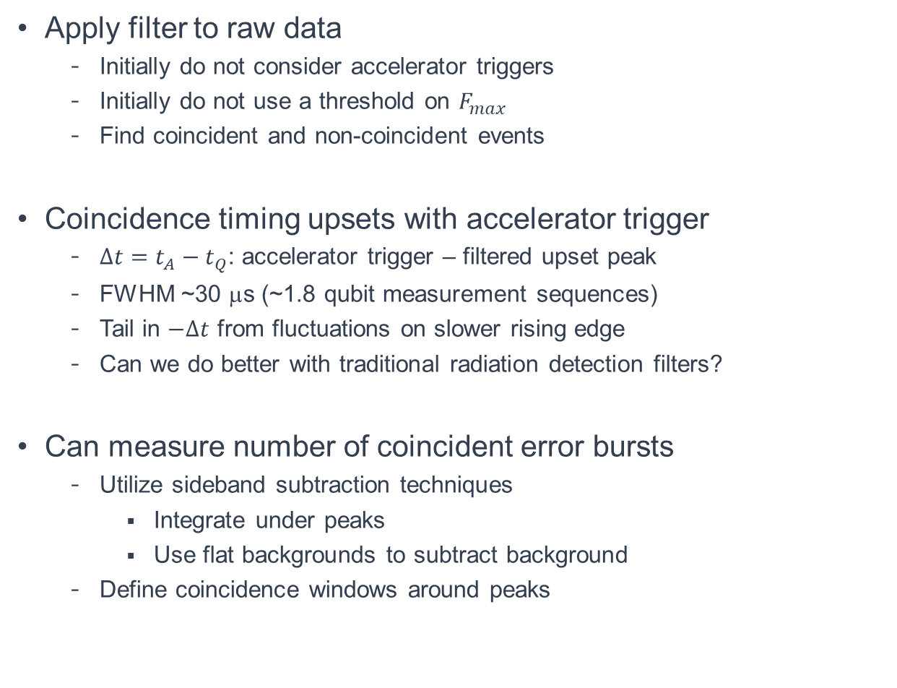
Time Resolution: Few Qubit Measurement Rounds
Apply filter to raw data
  Initially do not consider accelerator triggers
  Initially do not use a threshold on $F_{max}$
  Find coincident and non-coincident events
Coincidence timing upsets with accelerator trigger
  $∆t=t_{A}−t_{Q}$: accelerator trigger – filtered upset peak
  FWHM ~30 μs (~1.8 qubit measurement sequences)
  Tail in $−∆t$ from fluctuations on slower rising edge
  Can we do better with traditional radiation detection filters?
Can measure number of coincident error bursts
  Utilize sideband subtraction techniques
    Integrate under peaks
    Use flat backgrounds to subtract background
  Define coincidence windows around peaks
Detection delay: 12 μs

Slide 18
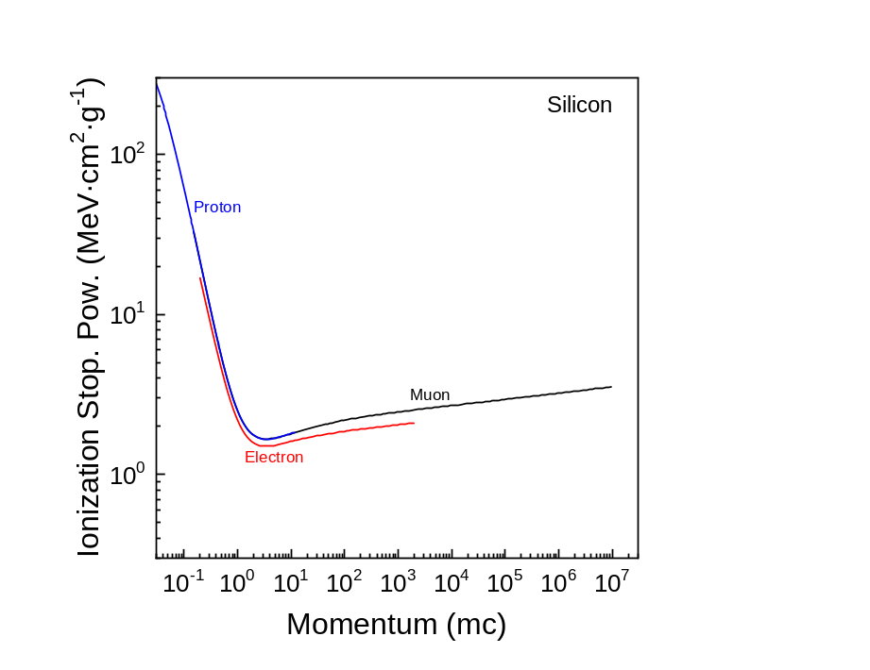
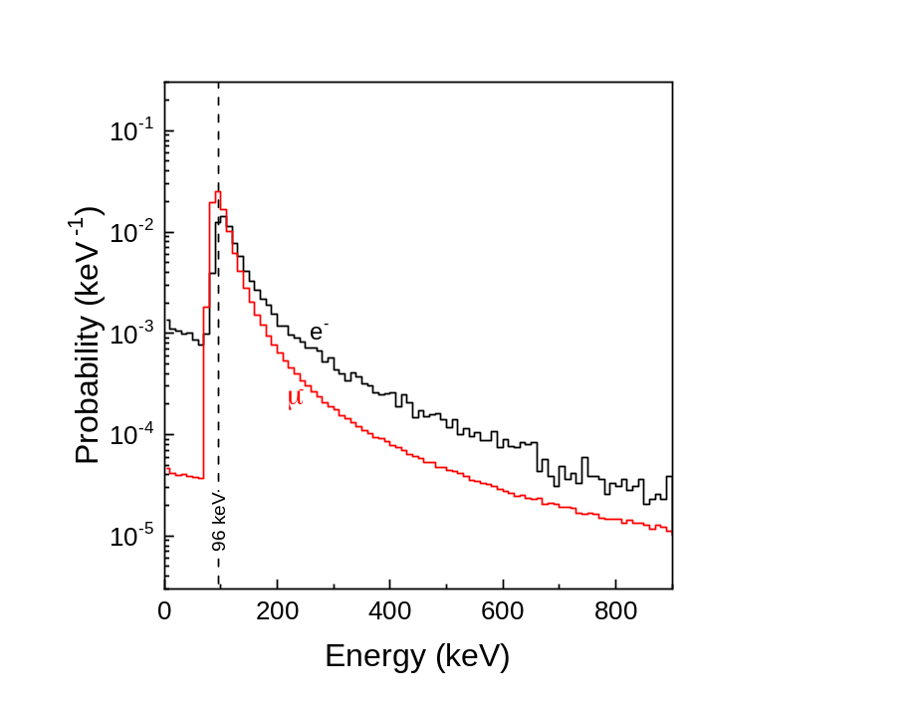
High-Energy Electrons are Minimum Ionizing Particles
Charged particles at minimum energy deposition
  Proton 2.5 GeV
  Muon 270 MeV
  Electron 1.2 MeV
  Minimum Ionizing Particles (MIPs)
Energy deposition increases slowly after minimum
  Increase energy by 1,000 → 55% increase in energy deposition
What is a typical cosmogenic muon
  Average energy: ~4.5 GeV
  Most probable energy: ~350 MeV
Average energy deposition in 350 μm of Si
  Average muon: 168 keV
  Most probable muon: 136 keV
  14.5 MeV electron: 141 keV
  Electron energy deposition within 20% of a muon
Much more to the radiation environment: γ-rays, neutrons, alphas, protons etc…

Slide 19
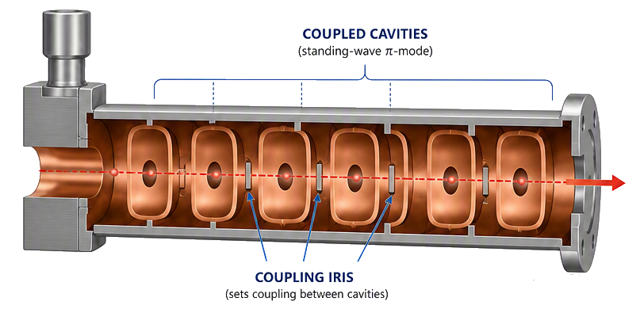
Pulsed Radiofrequency Electron Linac – Primer
Resonant cavities
  Metallic structure supports accelerating electric fields
  Normal metal or superconducting
  Standing or traveling wave
  Resonant frequency for S-band 2.856 GHz
RF Power
  Pulsed klystron amplifies input RF power by ~10⁶
  Typical output power ~5 MW over 10 μs
  Frequency matches resonant cavities e.g. 2.856 GHz
    Potential interference with qubits?
Electron source
  Thermionic triode source – hot filament with control grid
  Photosource – photocathode with laser/diode
Many supporting systems
  Beam optics, pulsed power, cooling etc…
RF – In
Electron
Source
E_{z}
a_{z}
E_{z}
E_{z}
a_{z}
E_{z}
E_{z}
a_{z}
E_{z}
e⁻
Drawing mostly AI generated

Slide 20
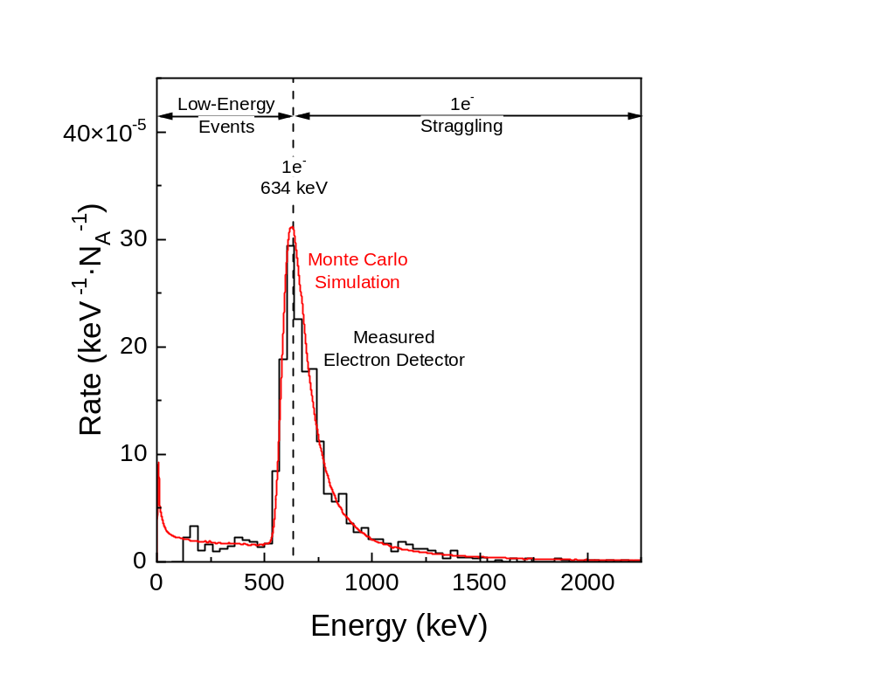
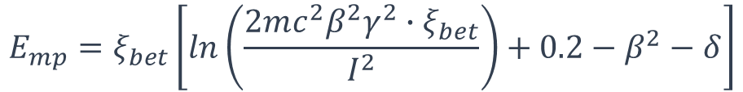
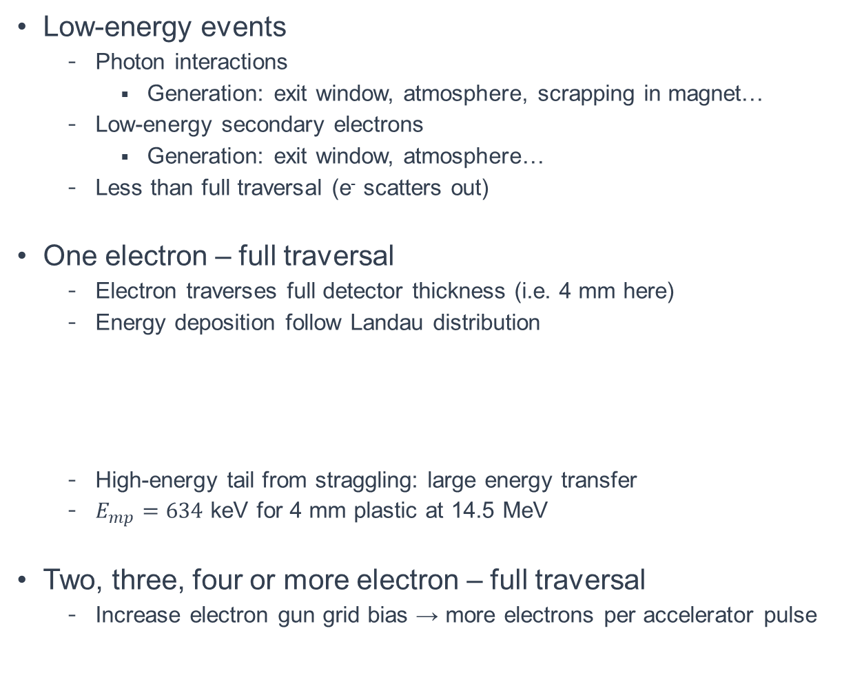
Anatomy of Electron Detector Spectrum
Low-energy events
  Photon interactions
    Generation: exit window, atmosphere, scrapping in magnet…
  Low-energy secondary electrons
    Generation: exit window, atmosphere…
  Less than full traversal (e⁻ scatters out)
One electron – full traversal
  Electron traverses full detector thickness (i.e. 4 mm here)
  Energy deposition follow Landau distribution
  High-energy tail from straggling: large energy transfer
  $E_{mp}=634$ keV for 4 mm plastic at 14.5 MeV
Two, three, four or more electron – full traversal
  Increase electron gun grid bias → more electrons per accelerator pulse
$$E_{mp}=ξ_{bet}\left[ln\left(\frac{2mc^{2}β^{2}γ^{2}∙ξ_{bet}}{I^{2}}\right)+0.2−β^{2}−δ\right]$$

Slide 21
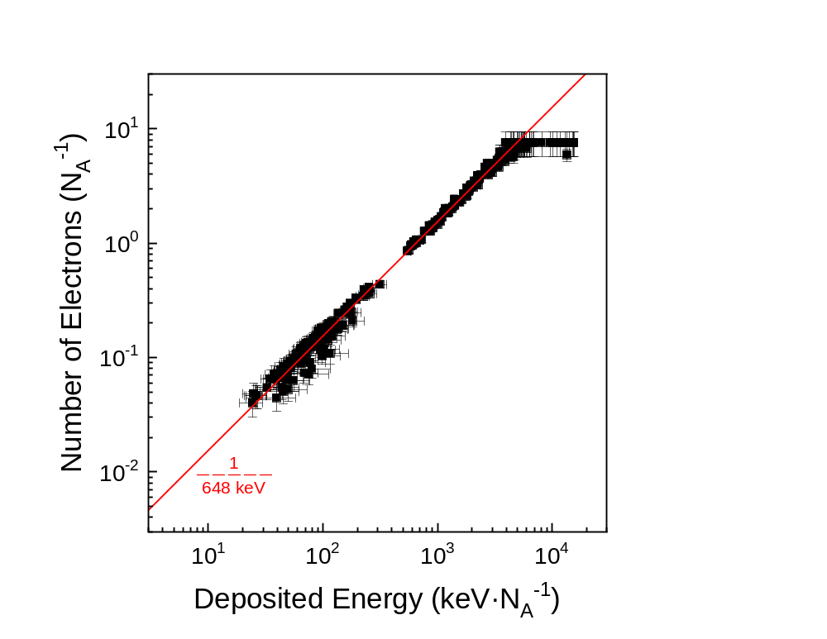
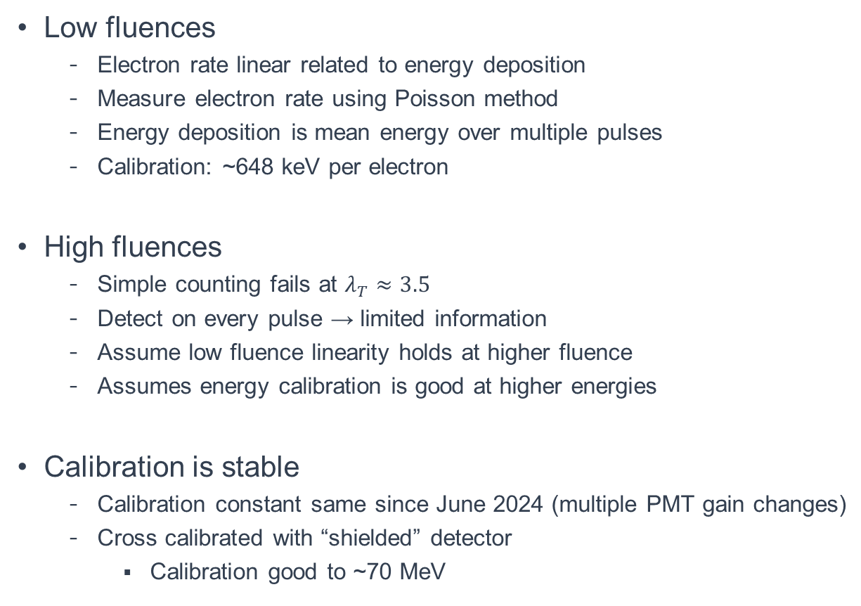
Higher Electron Fluences Use Energy Deposition
Low fluences
  Electron rate linear related to energy deposition
  Measure electron rate using Poisson method
  Energy deposition is mean energy over multiple pulses
  Calibration: ~648 keV per electron
High fluences
  Simple counting fails at $λ_{T}≈3.5$
  Detect on every pulse → limited information
  Assume low fluence linearity holds at higher fluence
  Assumes energy calibration is good at higher energies
Calibration is stable
  Calibration constant same since June 2024 (multiple PMT gain changes)
  Cross calibrated with “shielded” detector
    Calibration good to ~70 MeV

Slide 22
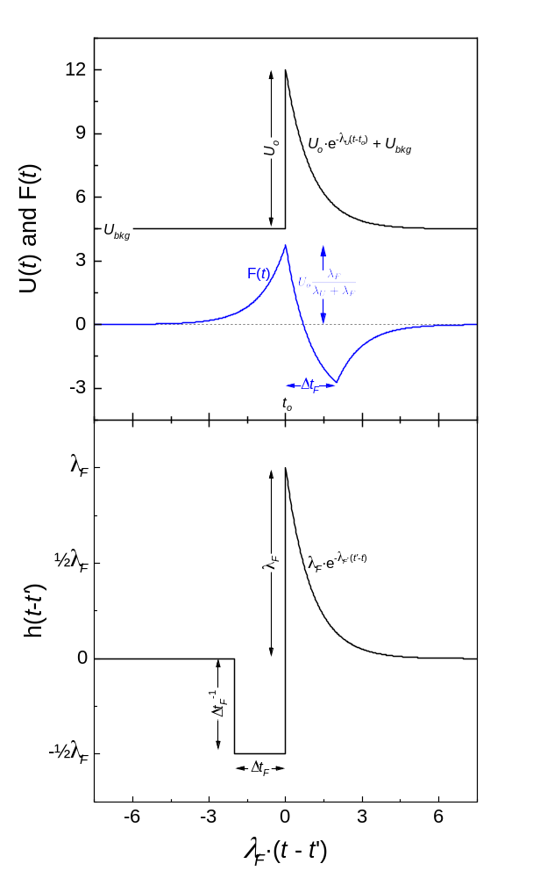

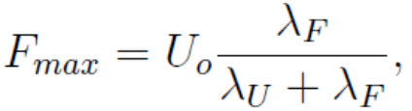
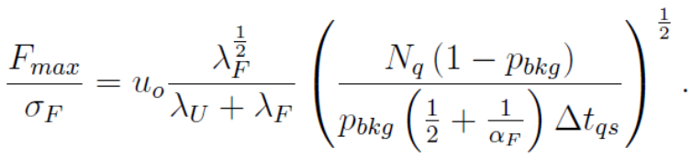
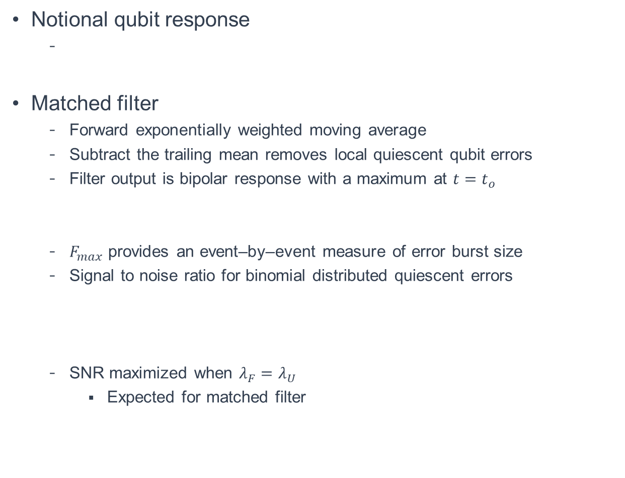
Identify Error Bursts with Matched Filter
Notional qubit response
Matched filter
  Forward exponentially weighted moving average
  Subtract the trailing mean removes local quiescent qubit errors
  Filter output is bipolar response with a maximum at $t=t_{o}$
  $F_{max}$ provides an event–by–event measure of error burst size
  Signal to noise ratio for binomial distributed quiescent errors
  SNR maximized when $λ_{F}=λ_{U}$
    Expected for matched filter

Slide 23
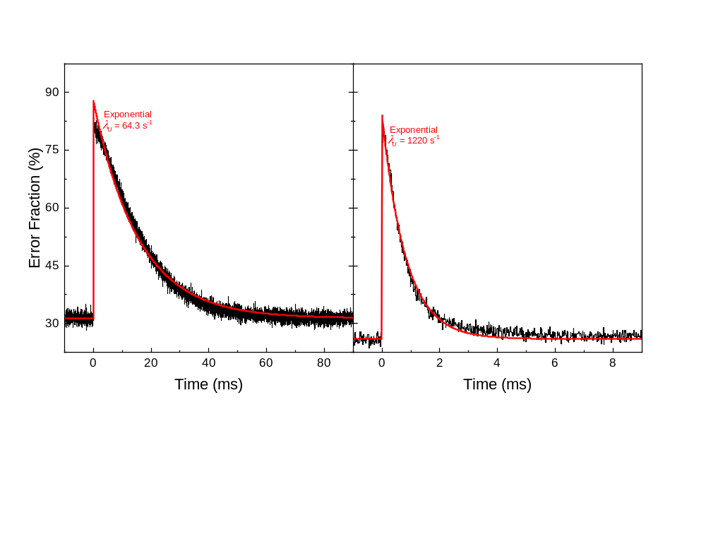
Easy to Measure Effective Recovery Constant
Low-gap
High-gap
Detection delay: 12 μs
Average responses to measure recovery
  Easy with time tagged radiation source
  Non-exponential behavior observable
  Shorter detection delays appear exponential
  Average recovery constants: 64.3 and 1220 s⁻¹
Normalized to per pulse with an electron
  Represents the average response to a MIP
  Quiescent errors ~30%
  Particle impact error fraction jumps to 80%
  Recovery

