Slide 1





Performance Degradation of
Neutron Irradiated 4H-SiC LGADs
Yashas Satapathy^{1,2}, Tao Yang³, Ben J. Sekely^{1,2}, Chengxi Yang⁵, Dylan Ponman⁶, Abraham Tishelman-Charny⁴, Gil Atar¹, Greg Allion¹, Philip Barletta¹, Steve Holland³, Carl Haber³, John F. Muth¹, Spyridon Pavlidis¹, Jennifer Roloff⁶, Stefania Stucci⁴, Haichen Wang⁵
¹Department of Electrical and Computer Engineering, NC State University
²Department of Materials Science and Engineering, NC State University
³Physics Division, Lawrence Berkeley National Laboratory
⁴Nuclear and Particle Physics Division, Brookhaven National Laboratory
⁵Department of Physics, University of California Berkeley
⁶Department of Physics, Brown University
Acknowledgement: DOE Grant #DE-SC0024252 (PM: Helmut Marsiske), NSF (ECCS-1542015)

Slide 2
Outline
Introducing the Team
Background
Fabrication Process of 4H-SiC LGADs
Electrical Characteristics of Irradiated 4H-SiC LGADs
Charge Collection Characteristics of Irradiated 4H-SiC LGADs
Conclusion
Notes:
Colliders not all over the world. Make text bigger in figures . Make an outline slide. Make font arial

Slide 3
NCSU-L(BNL)² Collaboration
NC State University
  Expertise
    Fabrication, characterization, and simulation of (ultra-) wide bandgap semiconductor devices
    Members: Dr. John Muth, Dr. Spyridon Pavlidis, Dr. Gil Atar, Dr. Philip Barletta, Dr. Ben Sekely, Greg Allion, Yashas Satapathy
Lawrence Berkeley National Laboratory
  Expertise
    Detector and electronics development and characterization for high energy physics
    Members: Dr. Carl Haber, Dr. Steve Holland, Dr. Tao Yang, Dr. Haichen Wang (UC Berkeley), Chenxi Yang (UC Berkeley)
Brookhaven National Laboratory
  Expertise
    Fabrication, characterization, and simulation of Si LGADs
    Detector and electronics development and characterization for high energy physics
    Members: Dr. Stefania Stucci, Dr. Abraham Tishelman-Charny
Supporting Institutions and Organizations
  Brown University
  UC Berkeley
  Rice University
  NASA Space Radiation Laboratory (NSRL)
  Rhode Island Nuclear Science Center (RINSC)
  NCSU Nanofabrication Facility (NNF)
  NCSU PULSTAR Reactor

Slide 4
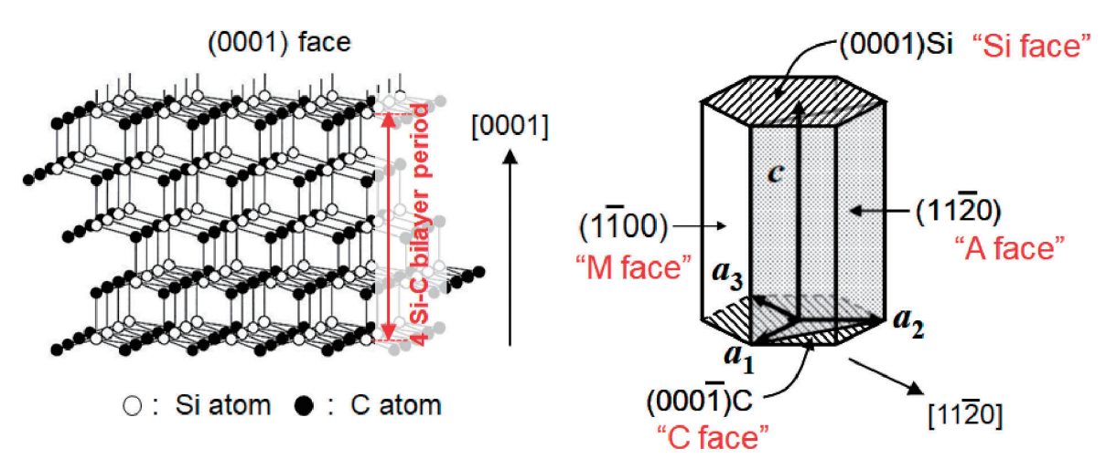
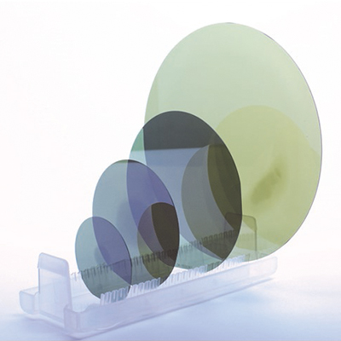
Incorporating 4H-SiC into LGAD Technology
Properties
  Hexagonal crystal structure w/ an ABAC stacking sequence
  Indirect bandgap of 3.26 eV
Current status
  Large substrates (up to 200 mm)
  Mature processing technologies
Advantages over Si-based devices
  Potentially higher radiation hardness
  Reduces need for extensive cooling systems
Objective
  Fabricate a functional 4H-SiC LGAD and determine its radiation hardness
Kimoto, T. and Cooper, J. A. (2014). Fundamentals of Silicon Carbide Technology: Growth, Characterization, Devices and Applications. John Wiley & Sons. Google- Books-ID: 586iBAAAQBAJ.
Kimoto T. High-voltage SiC power devices for improved energy efficiency. Proc Jpn Acad Ser B Phys Biol Sci. 2022;98(4):161-189. doi: 10.2183/pjab.98.011. PMID: 35400694; PMCID: PMC9071924.
https://www.plutosemi.net/show-105-426-1.html
Notes:
Don’t like “orphan” words. Add slide discussing proton irradiation of SiC, this will explain slide 4

Slide 5
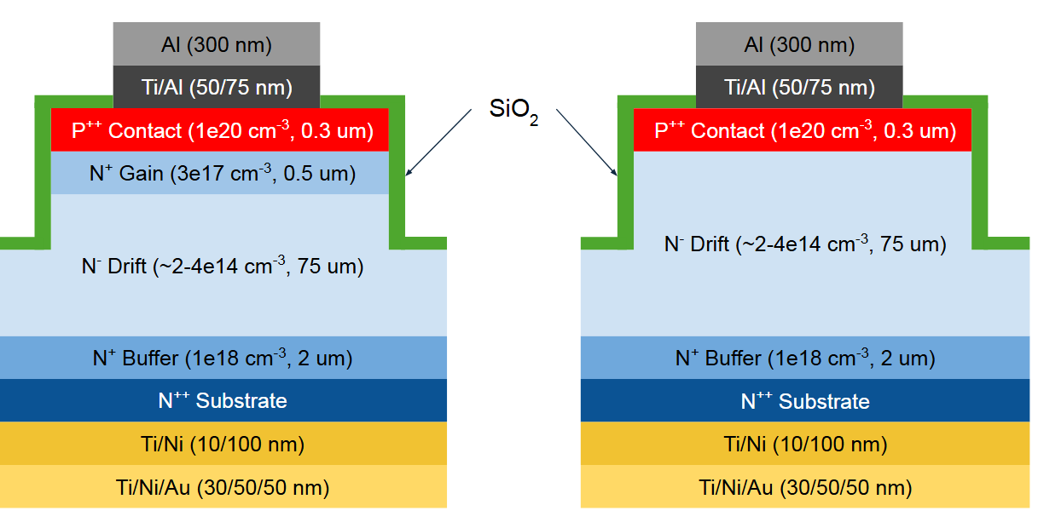
Neutron Irradiation Campaign
LGADs and complementary PiN diodes were irradiated at the Rhode Island Nuclear Science Center (RINSC)
Fluences: Non-irradiated (pristine), 1e13, 1e14, 1e15 n_{eq}/cm²
Gamma ray exposure: 0.0097 kGy, 0.097 kGy, and 0.97 kGy
Goals:
  Investigate the electrical and charge collection characteristics of an irradiated LGAD
  Begin developing a model to explain the performance of an irradiated LGAD
LGAD
PiN Diode
Credit: Jennifer Roloff
Dylan Ponman
Notes:
Describe what possibly could happen (i.e. what defects could be generated from proton irradiation), review literature and describe what you effect? Compensation can be different depending on irradiation type. Reduce word count, maybe make a table out of hypotheses (symptoms vs. outcomes)

Slide 6
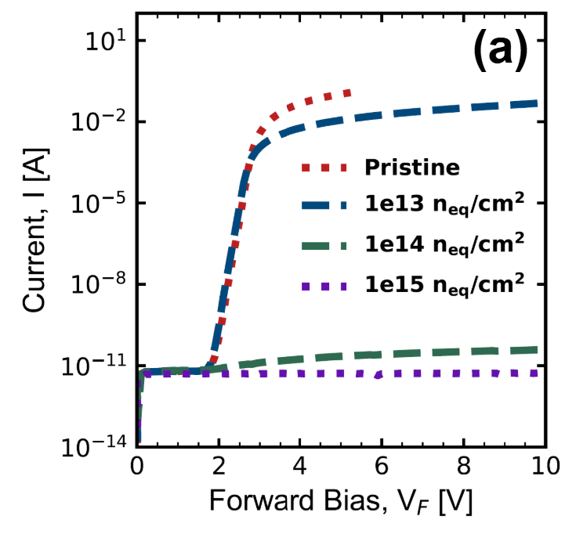
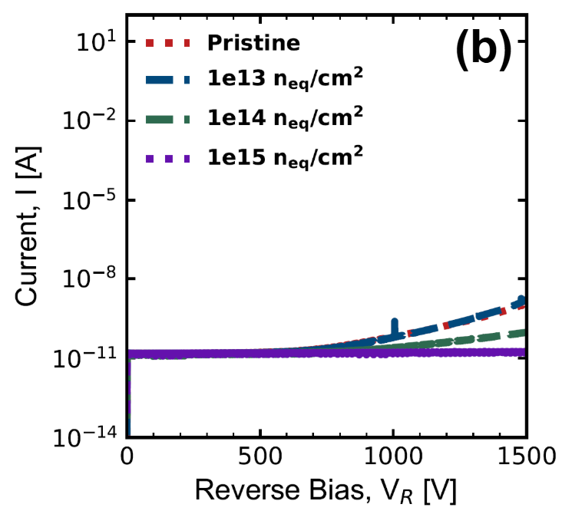
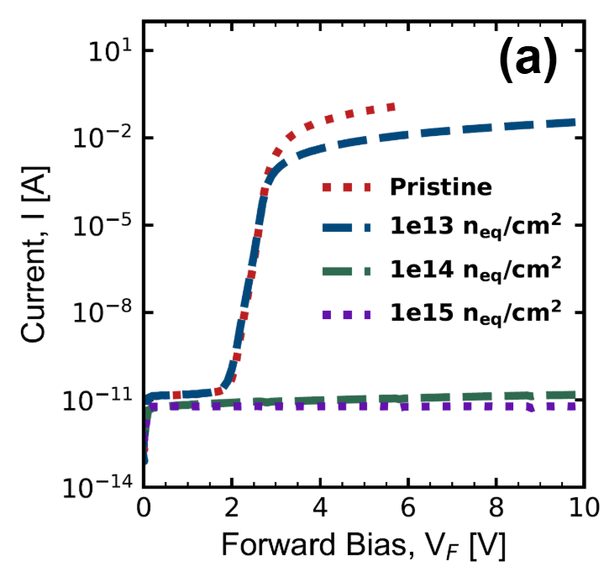
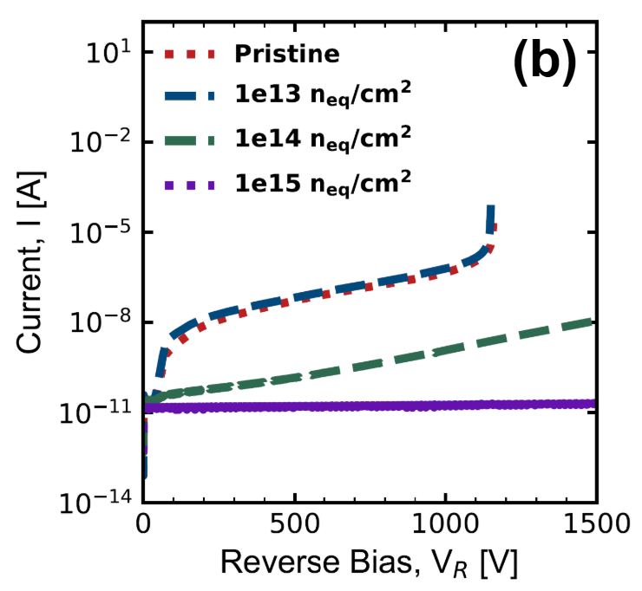
I-V Characteristics of Irradiated Devices
PiN
PiN
LGAD
LGAD
Device specs.: 300 um diameter
Increasing neutron fluence leads to…
  Higher ON-state resistance
  Lower leakage currents
  Higher breakdown voltages
  Loss in rectification (RR → 1)
  Removal of characteristic “step” feature (in the LGAD)
Key Takeaways: Radiation-induced defects are compensating epi- layers which result in degrading I-V performance.
Notes:
Describe what possibly could happen (i.e. what defects could be generated from proton irradiation), review literature and describe what you effect? Compensation can be different depending on irradiation type. Reduce word count, maybe make a table out of hypotheses (symptoms vs. outcomes)

Slide 7
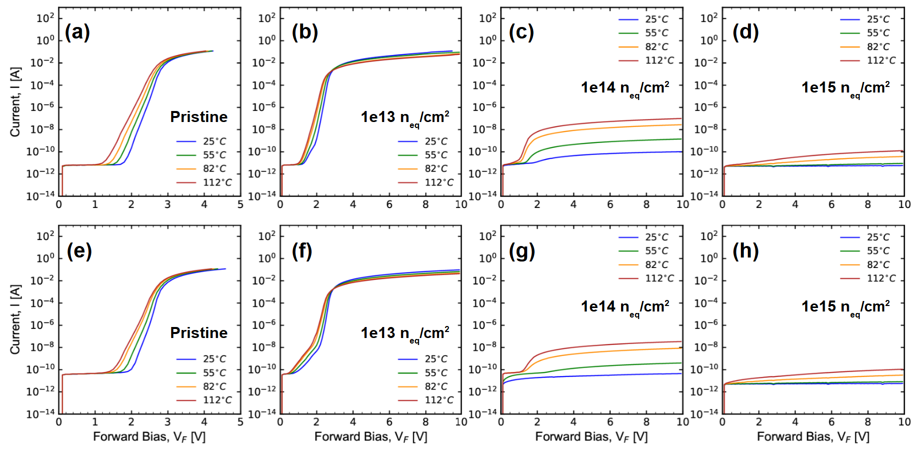
I-V-T Characteristics of Irradiated Devices
Device specs.: 600 um diameter
At low fluences…
  Increasing temp. leads to decreasing ON-state current
  ON-state current is limited by phonon scattering
At high fluences…
  Increasing temp. leads to increasing ON-state current
  ON-state current is limited by radiation-induced defects
PiN
PiN
PiN
PiN
LGAD
LGAD
LGAD
LGAD
Key Takeaways: Interactions between mobile carriers and the lattice change with increasing incorporation of radiation-induced defects.
Notes:
Describe what possibly could happen (i.e. what defects could be generated from proton irradiation), review literature and describe what you effect? Compensation can be different depending on irradiation type. Reduce word count, maybe make a table out of hypotheses (symptoms vs. outcomes)

Slide 8
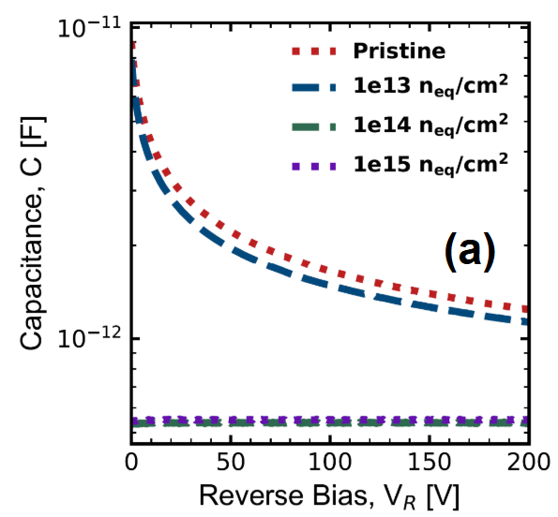
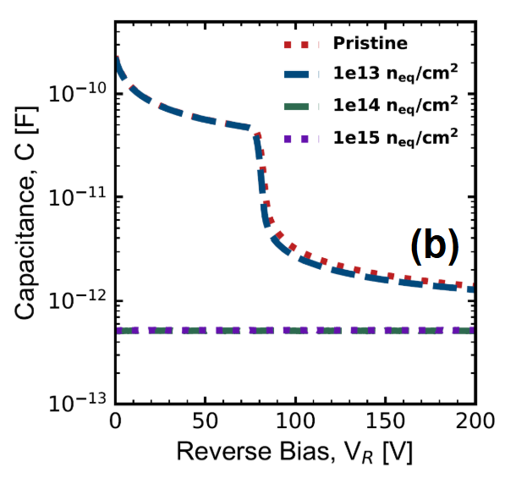
C-V Characteristics of Irradiated Devices
Device specs.: 600 um diameter
At low fluences…
  Capacitance decreases slightly in the voltage regime where the drift layer is being depleted
At high fluences…
  Capacitance loses its voltage-dependence
Observations:
  Gain and drift layer become “electrically indistinguishable” at high fluences
PiN
LGAD
Question: Is the gain layer completely compensated?
.

Slide 9
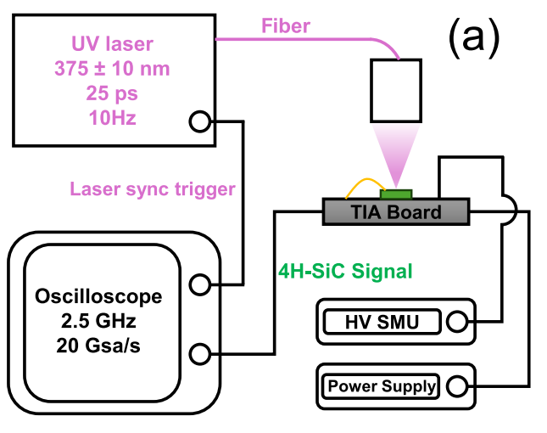
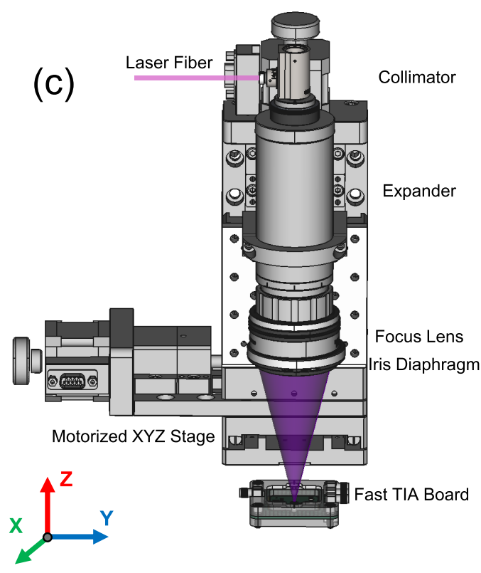
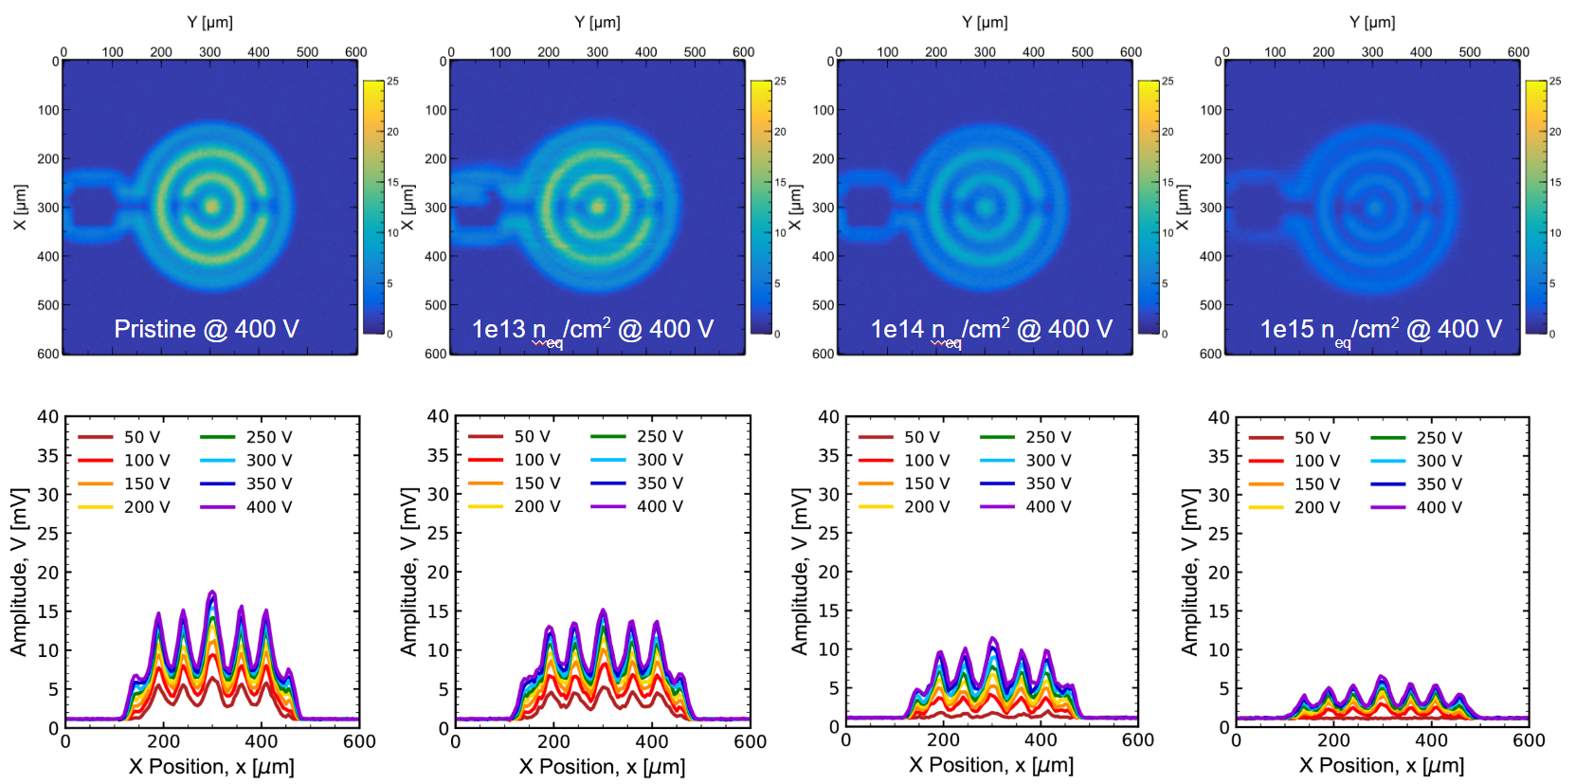
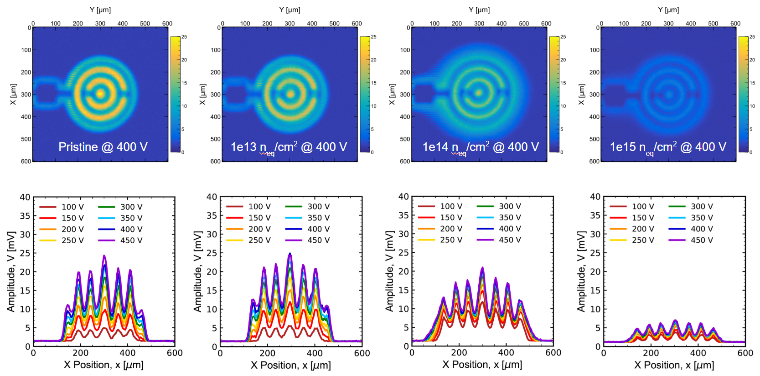
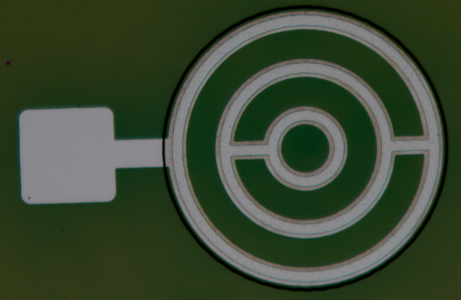
UV-TCT Characterization
              Laser specs.
                λ = 375 ± 10 nm
                Spot size ~ 24 um
                Pulse width: 25 ps
                Rep rate: 10 Hz
              Oscilloscope specs.
                2.5 GHz
                20 Gsa/s
Credit: Tao Yang
Tao Yang et al.. "Ultra-Fast 4H-SiC LGAD with Etched Termination and Field Plate," in IEEE Electron Device Letters, doi: 10.1109/LED.2025.3548509.

Slide 10
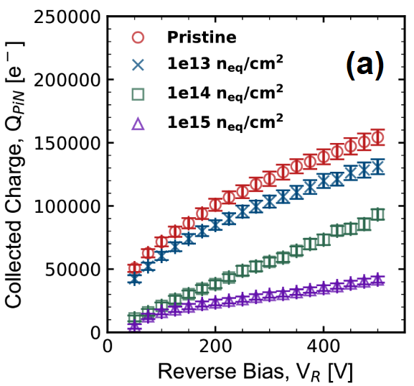
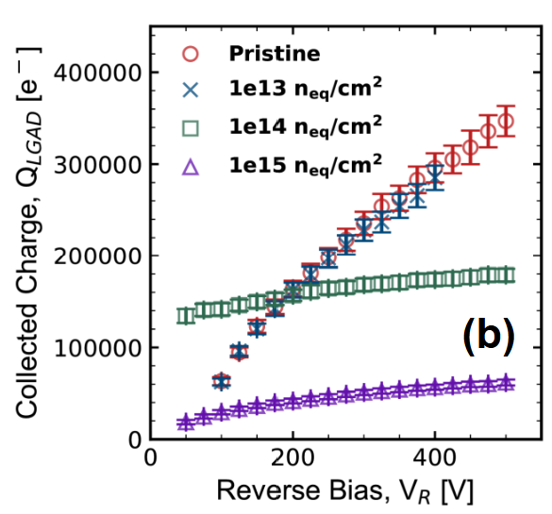
Charge Collection Characteristics
Increasing neutron fluence leads to decreasing charge collection in both the LGAD and PiN diode
Charge collection is enhanced in low voltage regime for 1e14 n_{eq}/cm² LGAD
Gain degradation is clear, however quantifying it is tricky due to changing depletion region volumes
PiN Diode
LGAD
Key Takeaways: Gain degradation appears to be severe.
Question: Can we predict the degradation of the irradiated 4H-SiC LGAD’s performance?
Notes:
Add a horizontal line at the Gain = 1, to show where Gain>1. Think what you want the audience to takeaway. Replace figure with updated one

Slide 11
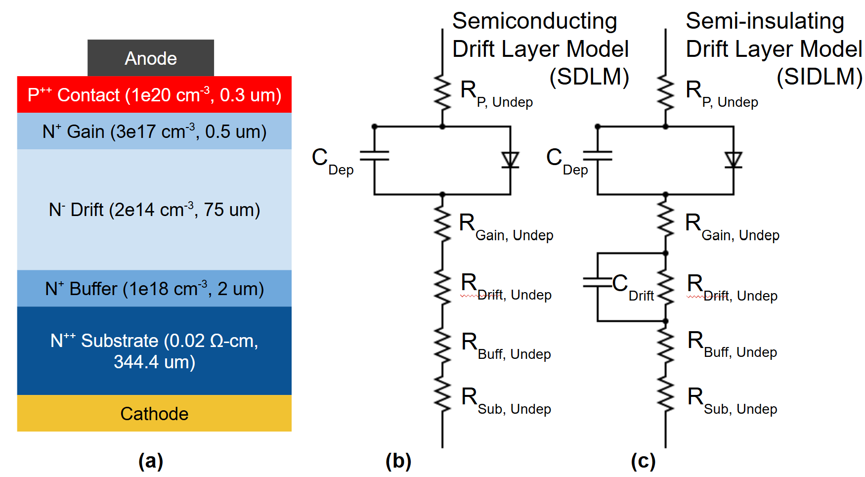
Equivalent Circuit Model of LGAD
Hypothesis
  For pristine and “lightly” irradiated LGADs…
    Every layer is lightly compensated
    Drift layer acts as a semiconductor w/ a finite resistance
  For “highly” irradiated LGADs…
    Drift layer is heavily compensated, other layers are comparatively not as affected
    Drift layer acts as a semi-insulating layer with a non-negligible capacitance

Slide 12
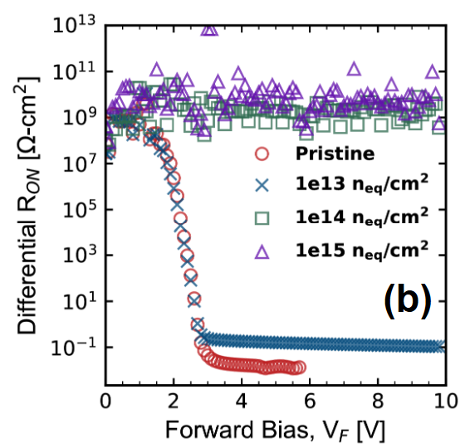
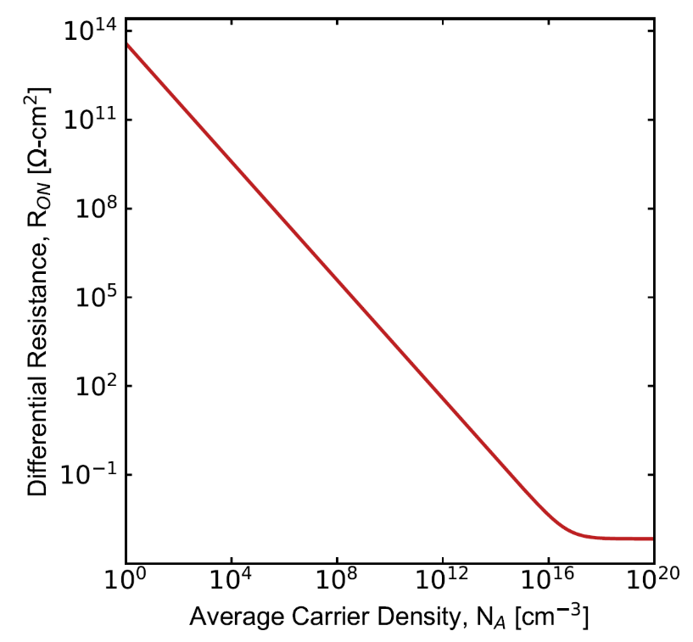
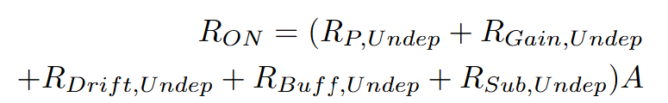
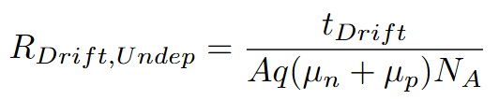
Equivalent Circuit Model (I-V Comparison)
Experimental
Experimental
Calculated
High differential ON-state resistance values results from average carrier density reduction in the drift layer.
This is due to radiation-induced defects causing compensation and a reduction in carrier lifetime.

Slide 13
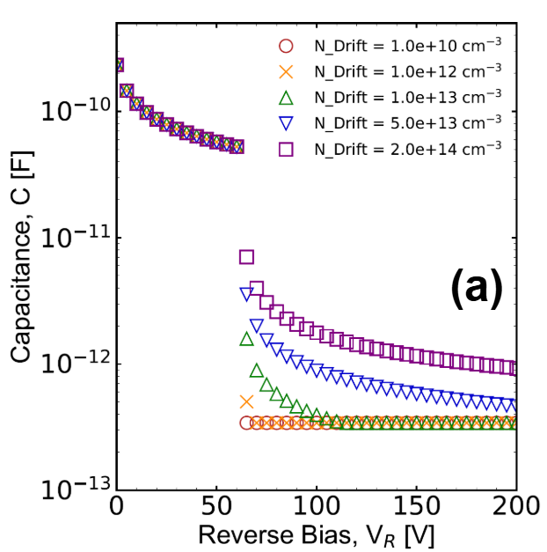
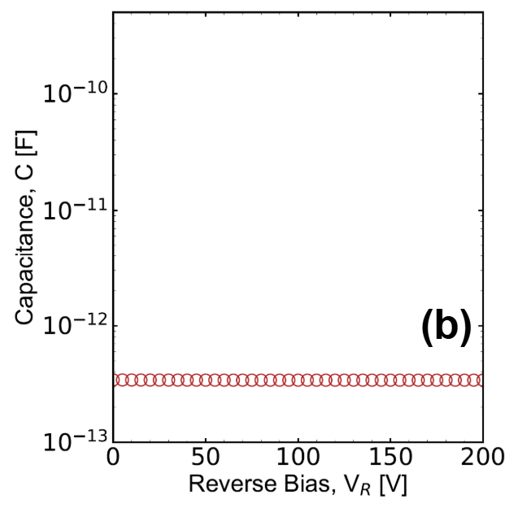
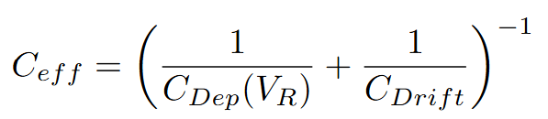
Equivalent Circuit Model (C-V Comparison)
Calculated
Calculated
Experimental
SDLM model is more accurate in describing C-V characteristics of pristine and “lightly” irradiated LGADs
SIDLM model is more accurate in describing C-V characteristics of “heavily” irradiated LGADs

Slide 14
Conclusion
Electrical (I-V, I-V-T, and C-V) characteristics show degradation due to introduction of radiation-induced defects which lead to compensation.
Charge collection characteristics show significant gain reduction
Equivalent circuit models can be used to describe the device physics of an irradiated 4H-SiC LGAD
Important Question: Is the 4H-SiC LGAD more radiation-hard than its Si counterpart?
Areas of research:
  Use TCAD to predict 4H-SiC LGAD degradation due to radiation-induced defect incorporation.
  Determine compensation of n-type and p-type SiC w/ varying doping levels at varying radiation fluences.
  Determine methods to make 4H-SiC LGAD more radiation-hard. Defect engineering?
  Establish a figure-of-merit to compare Si LGAD and 4H-SiC LGAD performance (need to consider timing resolution, operating temperature, radiation hardness, etc.)

Slide 15
Questions?

Slide 16
Backup Slides

Slide 17
Si vs. 4H-SiC
Property | Si | 4H-SiC | Consequences
Bandgap (eV) | 1.12 | 3.26 | Larger operating voltage range and lower leakage/higher temp. operation
Thermal Conductivity (W m⁻¹ K⁻¹) | 130 | 370 | Lower thermal impedance
Threshold Displacement Energy (eV) | 13-20 | 22-35 | Higher radiation hardness
Saturation Velocity (10⁷ cm s⁻¹) | 1 | 2 | Faster collection time and timing resolution
EHPs per μm | 75 | 55 | Less ionization in SiC LGAD
Impact Ionization Coefficient | α_{e} > α_{h} | α_{e} < α_{h} | Device polarity is changed (NPiP→PNiN)
P. Barletta, M. Cerullo, C. Haber, S.E. Holland, J. F. Muth, B. Sekely, “Fast Timing With Silicon Carbide Low Gain Avalanche Detectors’, (2022) Proceedings of the US Community Study on the Future of Particle Physics (Snowmass 2021)

Slide 18
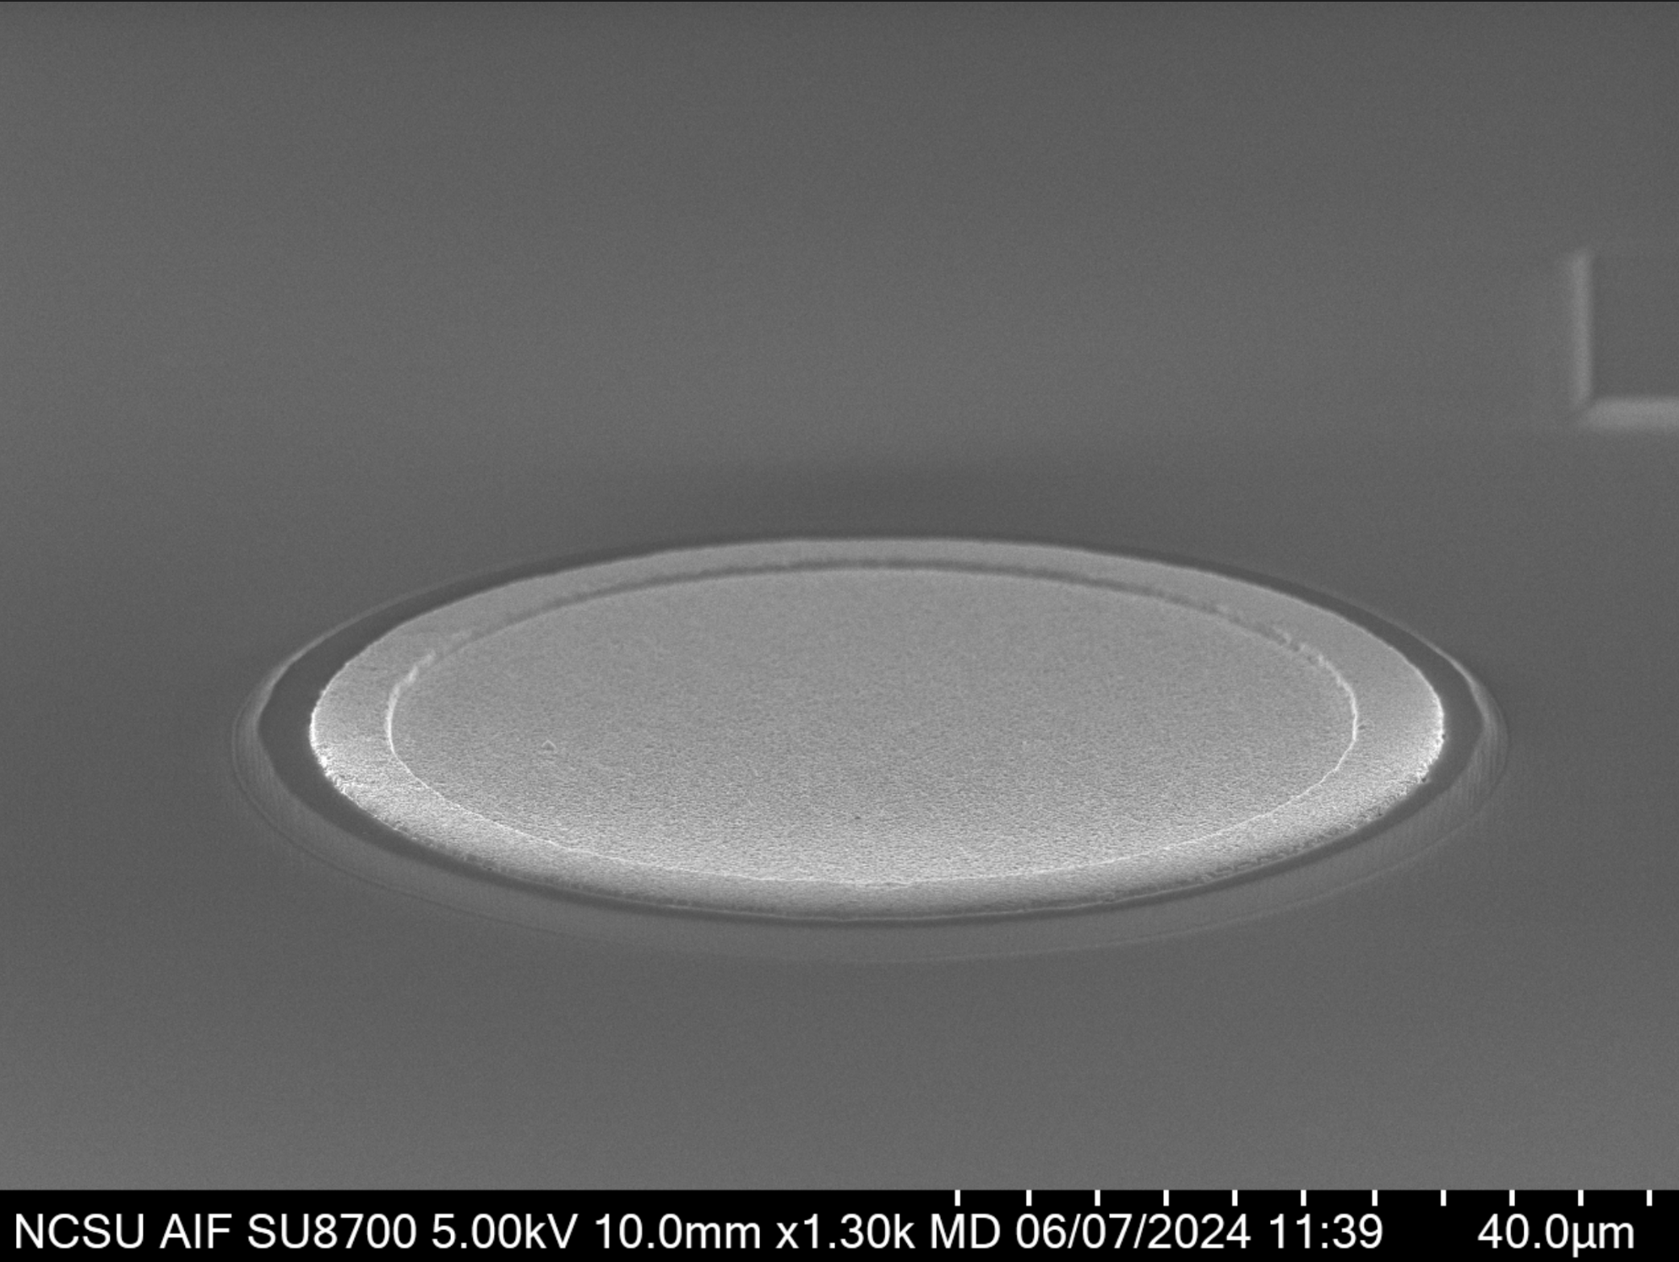
4H-SiC LGAD Fabrication Process
SiO₂ (500 nm)
P⁺⁺
P⁺⁺
Thermal Ox
+ PECVD
P⁺⁺
Passivation
Open
P⁺⁺
N⁺
Mesa Etch
N⁺
N⁺
N⁺
N⁻
N⁻
N⁻
N⁻
N⁺
N⁺
N⁺
N⁺
N⁺⁺
N⁺⁺
N⁺⁺
N⁺⁺
Metal Dep.
Ti/Al (50/75 nm)
Ti_{x}Si_{y}C_{z}
Al (300 nm)
P⁺⁺
Thermal
Anneal
P⁺⁺
Metal
Dep.
P⁺⁺
Mesa
Anode
N⁺
N⁺
N⁺
N⁻
N⁻
N⁻
N⁺
N⁺
N⁺
N⁺⁺
N⁺⁺
40 um
N⁺⁺
Ti/Ni (50/75 nm)
Ti_{x}Ni_{y}Si_{z}
Ti/Ni/Au (30/50/50 nm)

Slide 19
Effects of Irradiating 4H-SiC
Defects generated
  Point/cluster defect generation
  Neutron transmutation doping
  Nuclear spallation
Consequences of radiation induced defects
  Compensation in p-type and n-type SiC
    V_{C}, V_{Si}⁺, V_{C}+V_{Si} are acceptor-like and have been seen compensate n-SiC
    Al_{Si} -V_{C} complex has been seen to compensate p-SiC
  Reduced carrier lifetime
    Z_{1/2} (carbon vacancy) is a well-known lifetime killer
Expected effects to proton irradiating 4H-SiC LGADs
  N-type gain and drift layers will experience compensation
  Carrier lifetime will decrease due to increasing Z_{1/2} concentration
Anode
P⁺⁺ Contact
N⁺ Gain
N⁻ Drift
N⁺ Buffer
N⁺⁺ Substrate
Cathode
4H-SiC LGAD
V.V. Kozlovski, A.A. Lebedev, E.V. Bogdanova and N.V. Seredova, Effect of irradiation with MeV protons and electrons on the conductivity compensation and photoluminescence of moderately doped p-4H-SiC (CVD), Semiconductors 49 (2015) 1163
H. Matsuura, S. Kagamihara, Y. Itoh, T. Ohshima and H. Itoh, Mechanisms of reduction in hole concentration in Al-doped 4H-SiC by electron irradiation, Microelectronic Engineering 83258(2006) 17.
T. Kimoto, K. Danno and J. Suda, Lifetime-killing defects in 4H-SiC epilayers and lifetime control by low-energy electron irradiation, physica status solidi (b) 245 (2008) 1327.
V. Kažukauskas, R. Jasiulionis, V. Kalendra and J.V. Vaitkus, The effect of irradiation with high-energy protons on 4H-SiC detectors, Semiconductors 41 (2007) 345.
Notes:
Don’t like “orphan” words. Add slide discussing proton irradiation of SiC, this will explain slide 4

