Slide 1
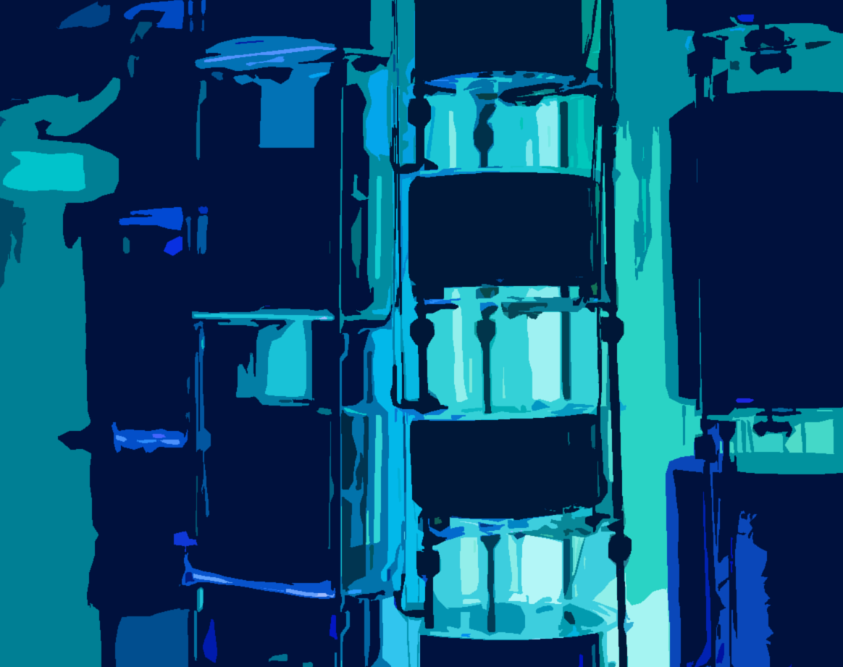



High-Purity Germanium Detectors for the LEGEND experiment
Aparajita Mazumdar
On behalf of the LEGEND Collaboration
Postdoctoral Research Associate
University of North Carolina at Chapel Hill
jita@unc.edu
Coordinating Panel for Advanced Detectors 2026,
Seattle, October 20, 2026

Slide 2
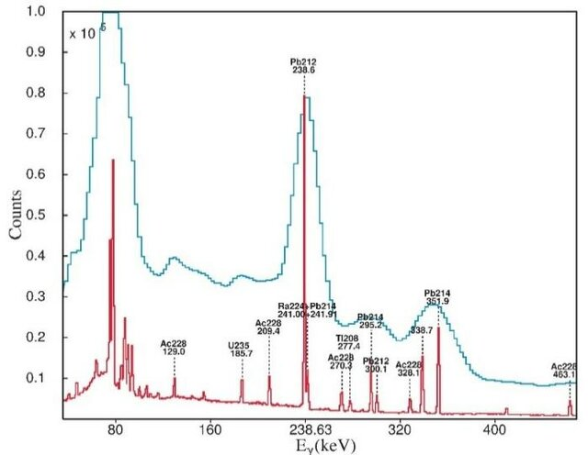

High-purity Germanium detectors (HPGe)
Semiconductor diode detector operated in reverse bias
Excellent energy resolution
Ref
γ peaks resolved using HPGe detectors but not in NaI
Signal read-out
$$γ$$
passivated surface
p+
NaI
holes
electrons
n+
High-purity Ge
(Impurities < 10¹⁰/cm³)
HPGe
Applied high voltage
Core detector technology used in γ-ray spectroscopy, studying nuclear structure and nuclear reactions
Schematic (Planar Geometry)

Slide 3
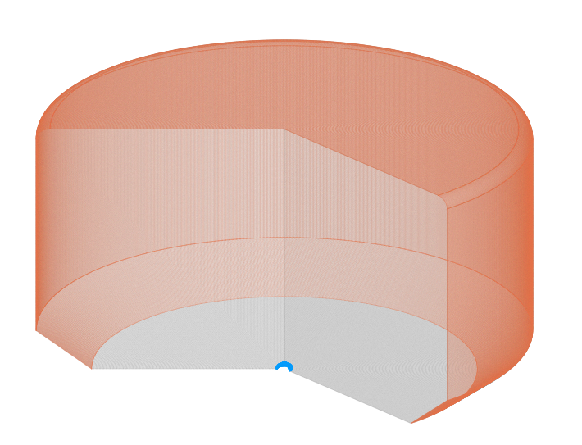
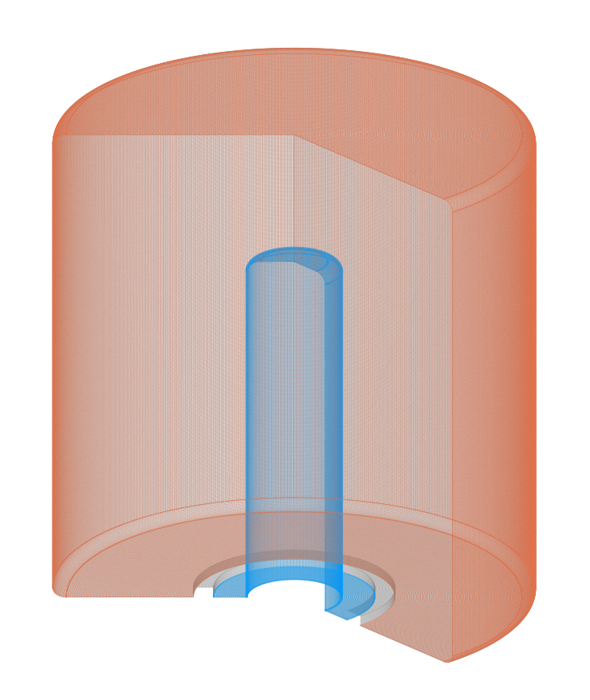

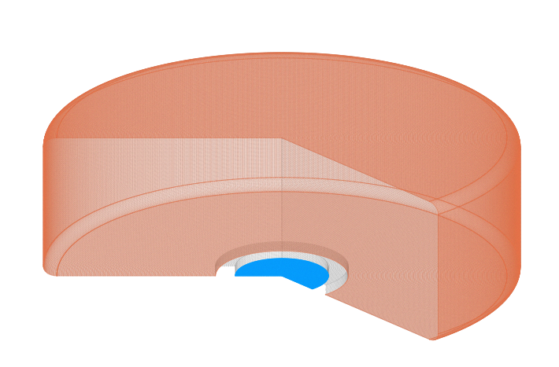
Evolution of the detector geometry
Variants of the technology exist from the 1960s, yet the designs continue to improve today!
passivated surface
p+
n+
Planar
Semi-Coaxial (“Coax”)
Point Contact
Simple geometry
Difficult to scale to large masses
Large Mass
Uniform Electric Fields
Capable of discriminating based on the event topology
Latest designs have a large mass

Slide 4
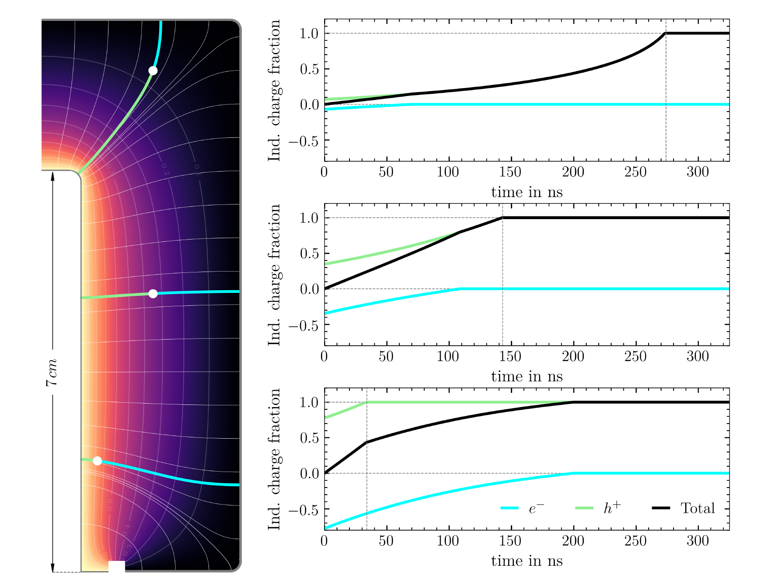



Signal formation in Germanium detectors
D. Hervas, Ph.D. thesis
Shockley-Ramo theorem (for a single charge q)
$$Q_{ind}^{q}=qφ_{0}(\vec{r}(t))$$
Instantaneous induced charge
Weighting Potential
Weighting Potential
$$∇^{2}φ_{0}=0$$
Laplace’s equation with artificial boundary conditions: Signal electrode at 1V, others set to 0V
Our signal: Integrated induced charge due to drift of electrons and holes
Coax detector
$$Q_{ind}^{}={Q_{0} (φ}_{0}({\vec{r}}_{h} (t) −{ φ}_{0}({\vec{r}}_{e} (t)))$$

Slide 5
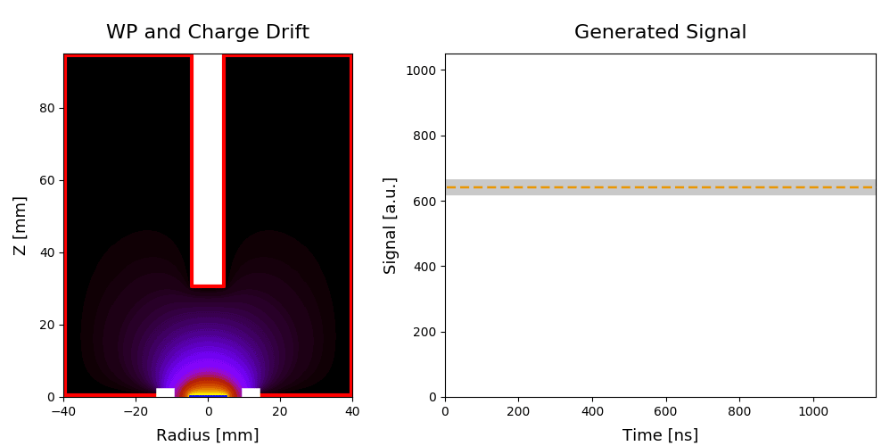
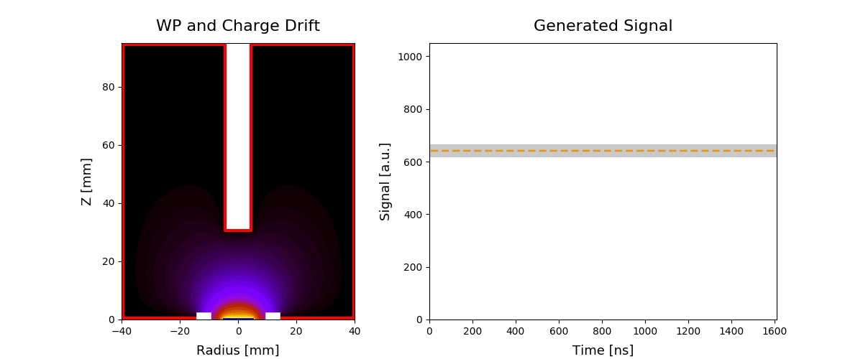
Pulse Shape Discrimination
Point contact detectors are sensitive to the event topology
Acceptance window
Acceptance window
Charge waveform
Current (Smoothed derivative of charge waveform)
Same energy but different values for the maximum amplitude of the current pulse!

Slide 6
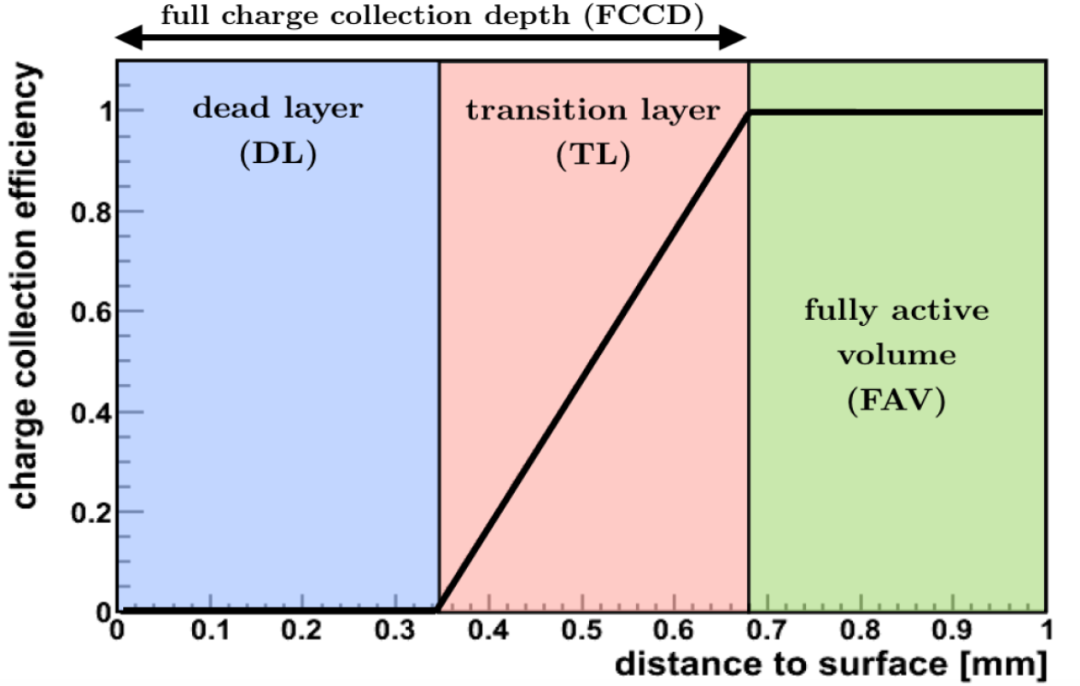
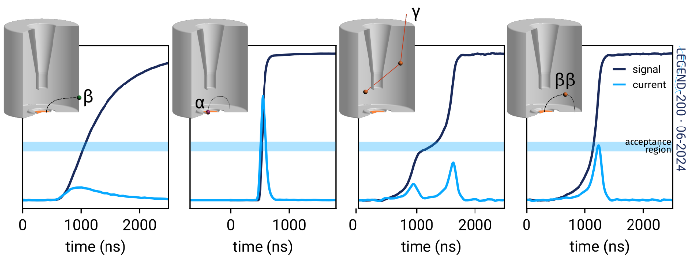








Charge collection near the surface
p+ : O(100 nm) thick, Boron implantation
n+ : O(1mm) thick, Lithium diffusion.
Events in the FCCD are energy-degraded “slow” pulses.
“slow”
“normal”
$$α$$
$$β$$
$$γ$$
Not typically used for charged α/β spectroscopy, yet excellent for studying internal ββ decays
$$γ$$
$$β$$
$$ββ$$
$$α$$

Slide 7
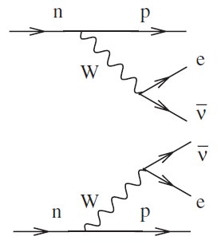
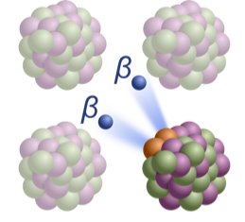
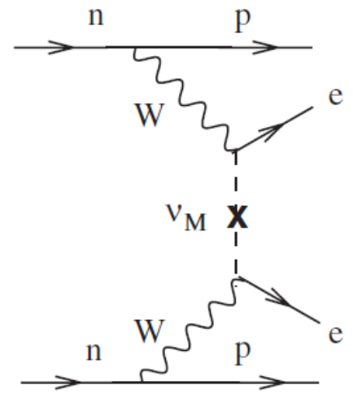

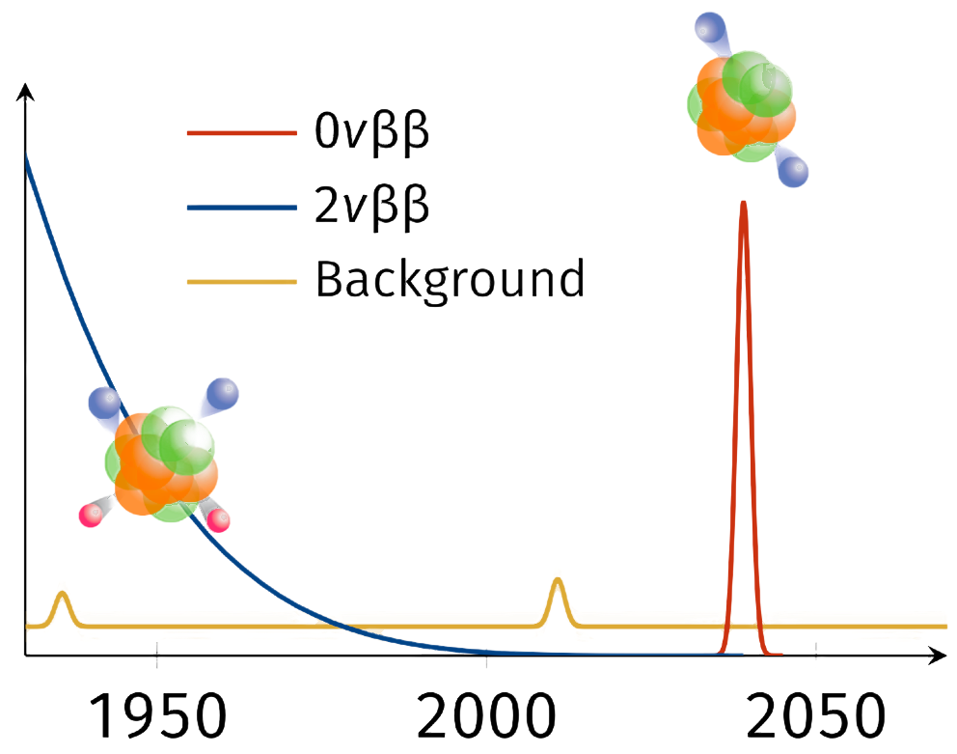
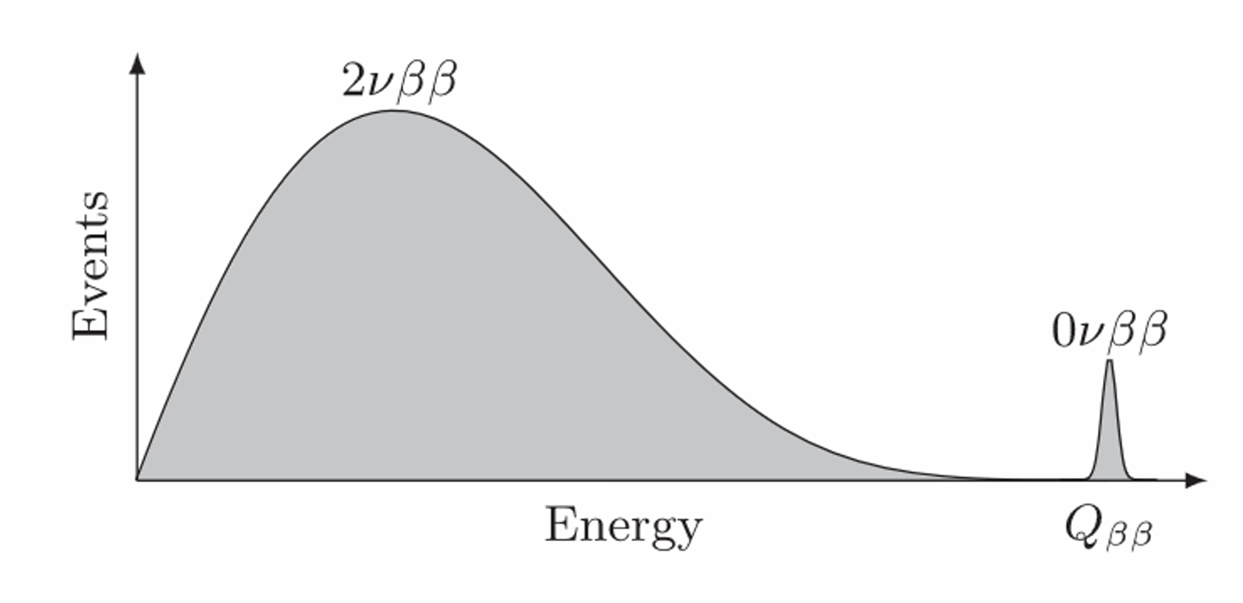

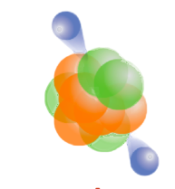


The search for Neutrinoless Double Beta Decay
2νββ
${}_{}^{76}{Ge→} {}_{}^{76}{Se}+{2e}^{−}$
𝑄_{𝛽𝛽} = 2039 keV
0νββ
$$ββ$$
Detector = Source, high detection efficiency for electrons
⁷⁶Ge enrichment of >90% possible
Yet to be observed!
Smoking gun evidence of the Majorana nature of ν
Highly radiopure
Excellent energy resolution
(𝐅𝐖𝐇𝐌 ~ 𝟎.𝟏% @ 𝑄_{𝛽𝛽} )
Summed energy of electrons
HPGe excellently suitable

Slide 8

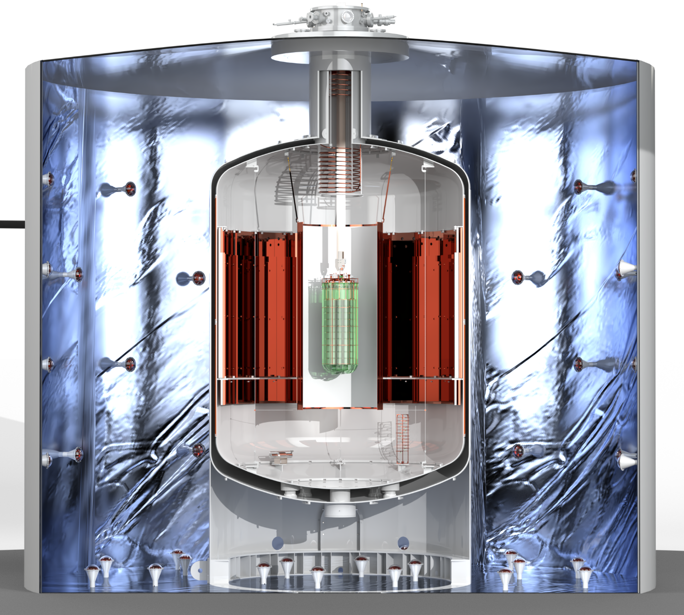
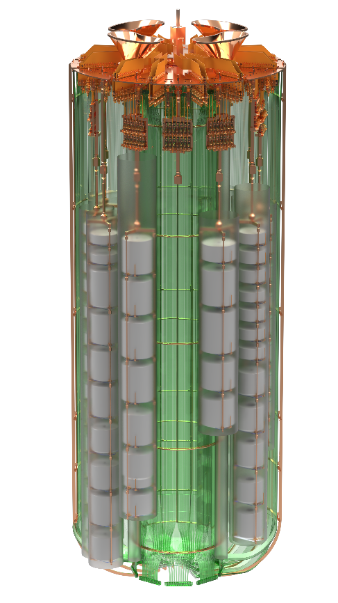
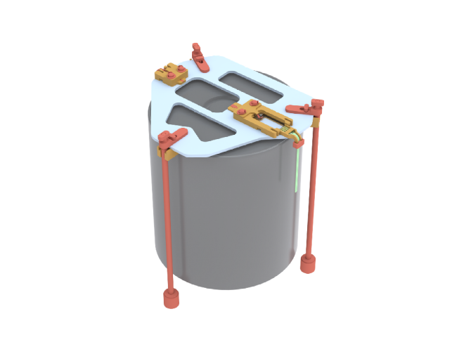
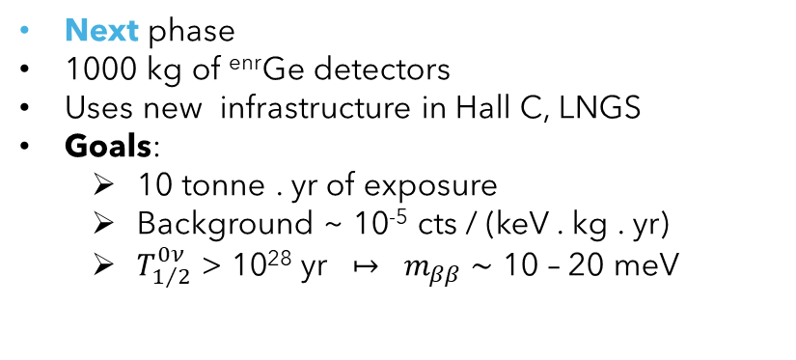
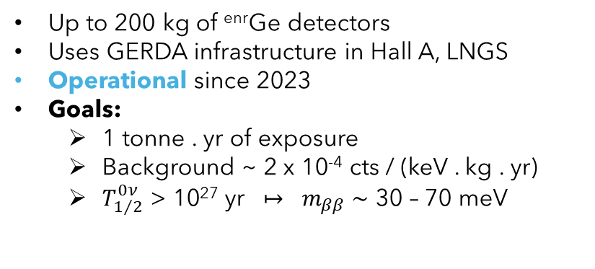
Designed to be quasi-background free at every phase
LEGEND-200
Readout electronics
Up to 200 kg of ^{enr}Ge detectors
Uses GERDA infrastructure in Hall A, LNGS
Operational since 2023
Goals:
  1 tonne . yr of exposure
  Background ~ 2 x 10⁻⁴ cts / (keV . kg . yr)
  $T_{1/2}^{0ν}$ > 10²⁷ yr $↦$ $m_{ββ} \sim$ 30 – 70 meV
HPGe
LEGEND-200
LEGEND-1000
Next phase
1000 kg of ^{enr}Ge detectors
Uses new infrastructure in Hall C, LNGS
Goals:
  10 tonne . yr of exposure
  Background ~ 10⁻⁵ cts / (keV . kg . yr)
  $T_{1/2}^{0ν}$ > 10²⁸ yr $↦$ $m_{ββ} \sim$ 10 – 20 meV
Bare HPGe operated in LAr
with strong Compton Suppression

Slide 9
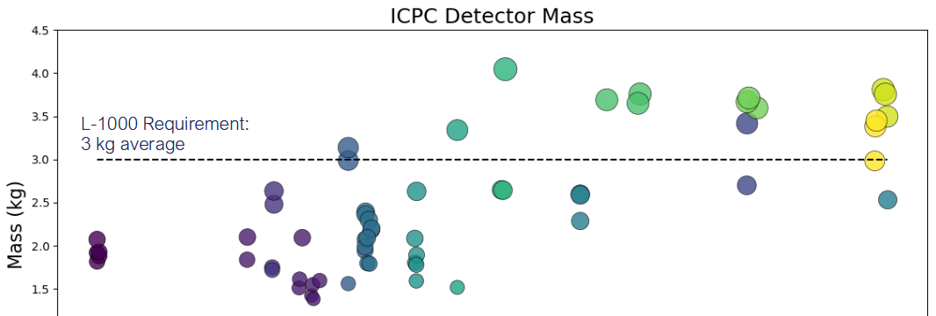
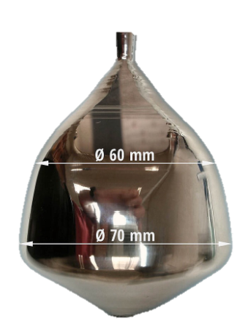
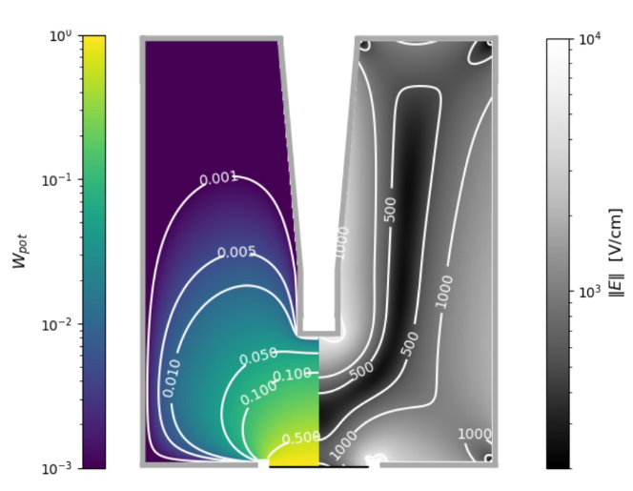
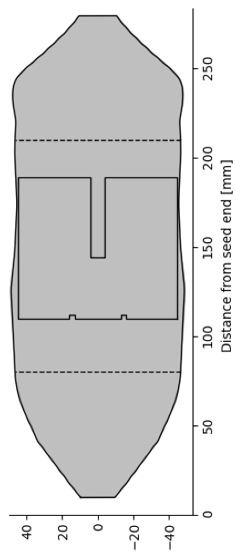
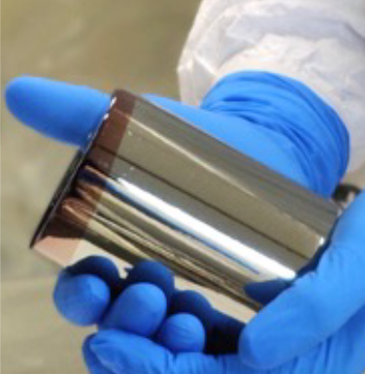
HPGe detector Production
LEGEND IC Detector Mass
Collaborative process between LEGEND and vendor
Average detector mass improved over time
After production, detector characterized by LEGEND.
Time
Electric Field and Pulse
Shape Simulations
Crystal growth
Geometry optimization
Detector produced

Slide 10

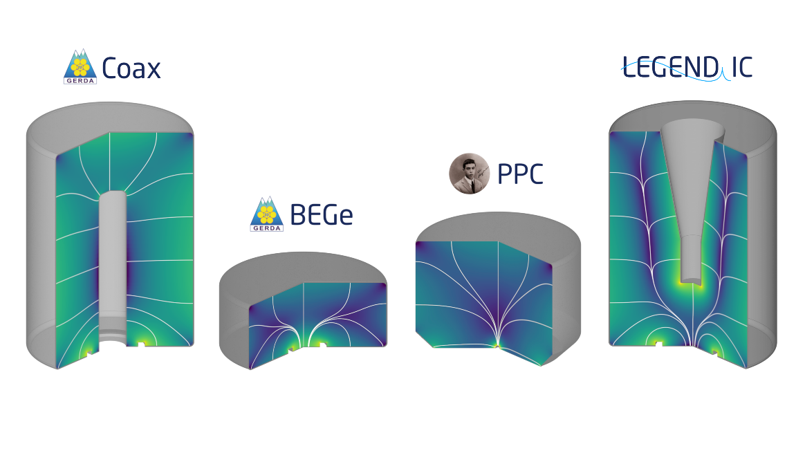
LEGEND-200 HPGe
Property | Coax | BEGe | PPC | IC
Point contact | NO | YES | YES | YES
Small passivated surface | YES | YES | NO | YES
Typical detector mass | 2.5 kg | 0.7 kg | 1 kg | 2-4 kg
Point contact detectors are
  Capable of event topology-based discrimination
  Have low noise
Small passivated surface detectors
  Operate stably in the LAr
Increased detector mass
  Reduced background by means of reducing non-active components (cabling, copper rods, etc)
Detector characterization
Stability monitoring
Systematics Studies
14.7 kg
Inputs to the final result
86.7 kg
Configuration for Mar ’23 – Feb ’24 Physics Data taking
19.0 kg
(combined fit from
GERDA, Majorana
and LEGEND-200)
T_{1/2} (0𝜈ββ) >1.9 x 10²⁶ yr (90% CL)
m_{ββ} < 70 -200 meV
22.1 kg
Leading limit for ⁷⁶Ge, Published in PRL
Phys. Rev. Lett. 136, 022701

Slide 11
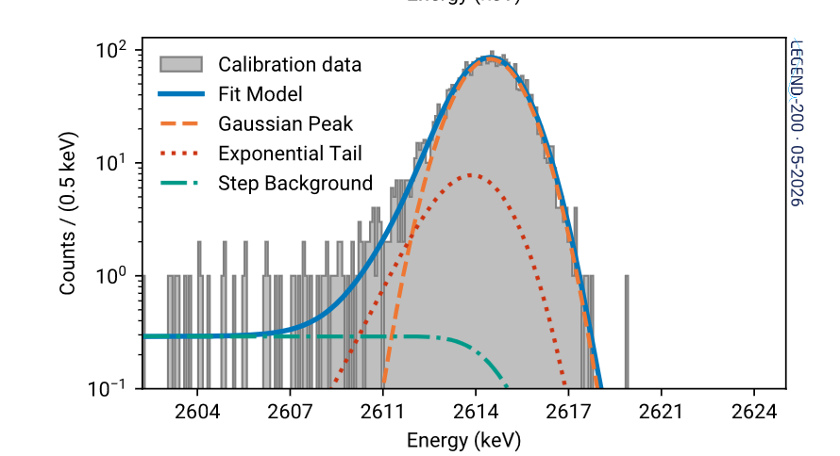
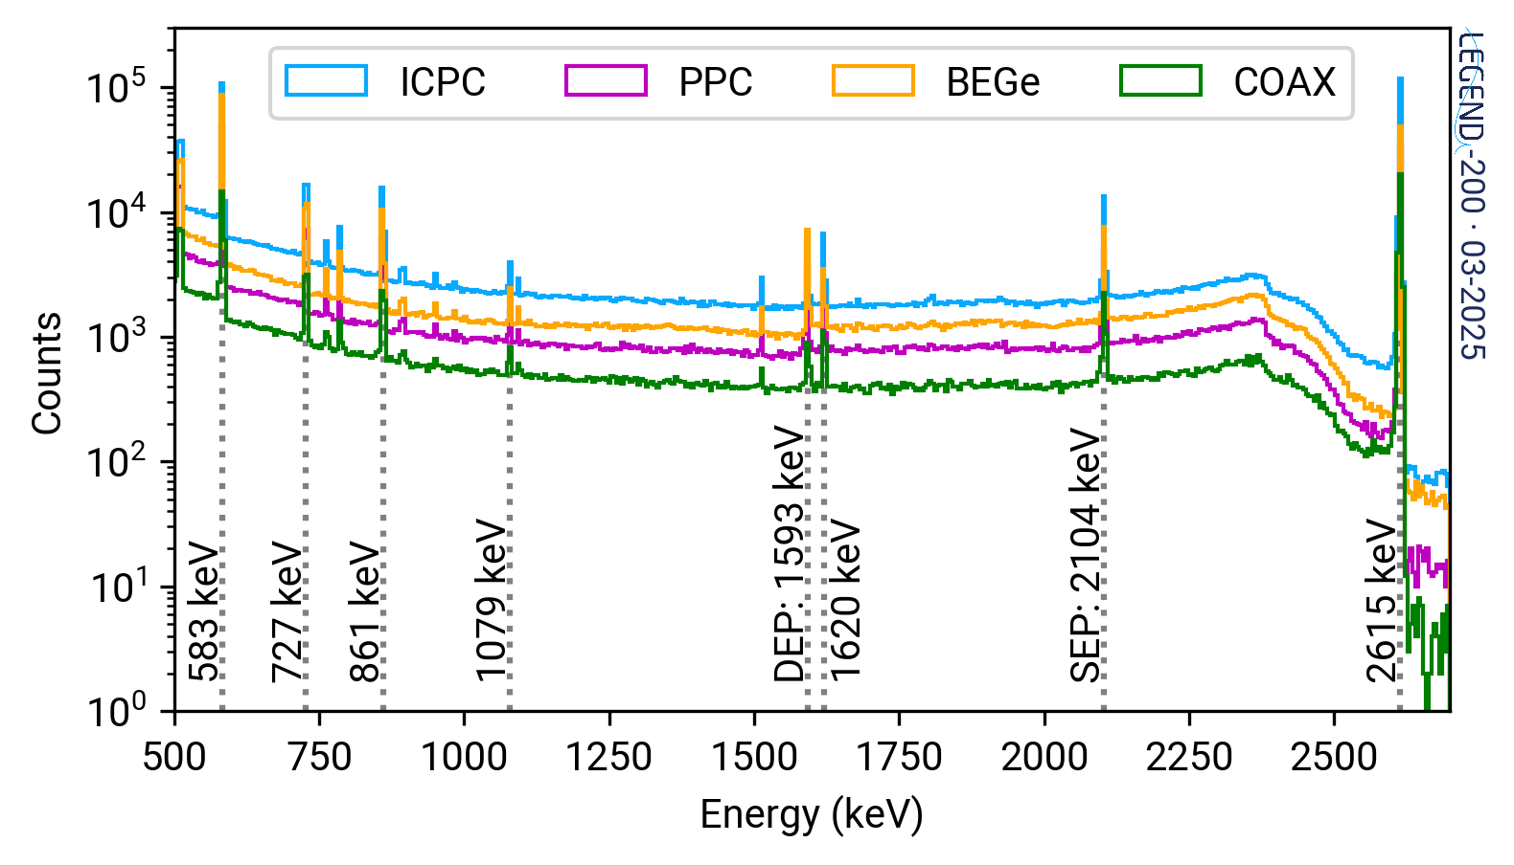
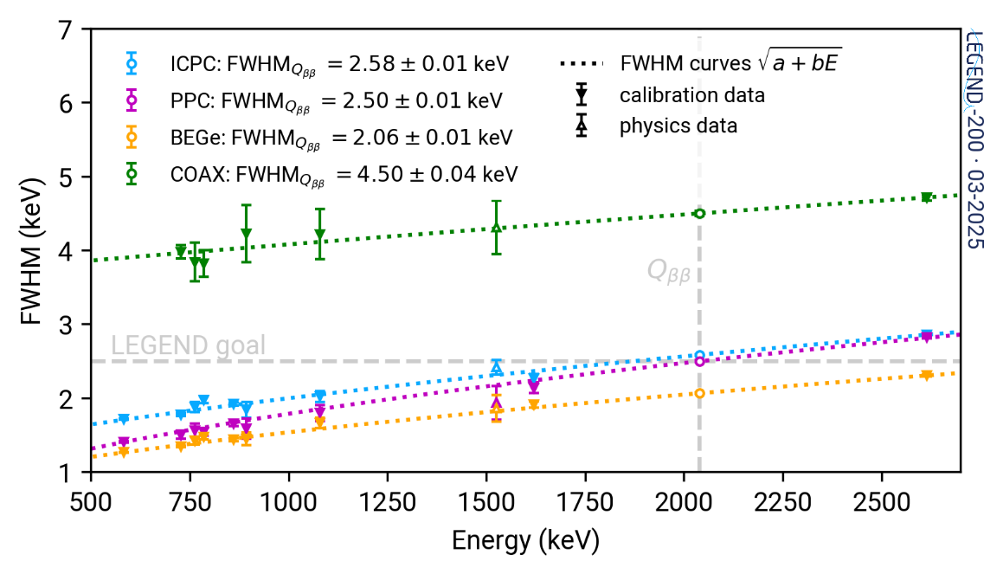
Energy resolution
Calibration
Excellent energy resolution
~0.1% FWHM at Q_{ββ}
Stable energy observables
Monitored Weekly calibrations performed using ²²⁸Th
Second order variations tracked in time
Data set partitioned according to stability
https://arxiv.org/abs/2605.22479; Accepted in EPJ C

Slide 12
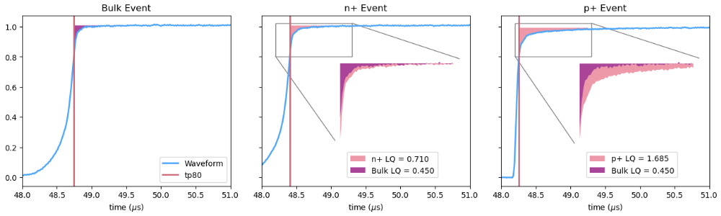
PSD in LEGEND-200
A/E = max(current)/energy
Low A/E: multi-site rejection, n+ surface event rejection
High A/E: p+ surface event rejection
LQ replaces high A/E as surface cut for detectors with large passivated surfaces.
Special PSD Cuts developed for Coax detectors.
n+ surface event
(⁴²K/⁴²Ar)
REJECTED
Low A/E
p+ surface event
(α)
REJECTED
High A/E
Multi site event
(γ)
REJECTED
Low A/E
Single site event
(0νββ/2νββ)
ACCEPTED
Late Charge (LQ) : slow component above the rising edge after 80% of charge is collected, i.e., the area above the waveform
Single site (0νββ/2νββ)
ACCEPTED
n+ surface
(⁴²K/⁴²Ar)
REJECTED
p+ surface
(α)
REJECTED

Slide 13
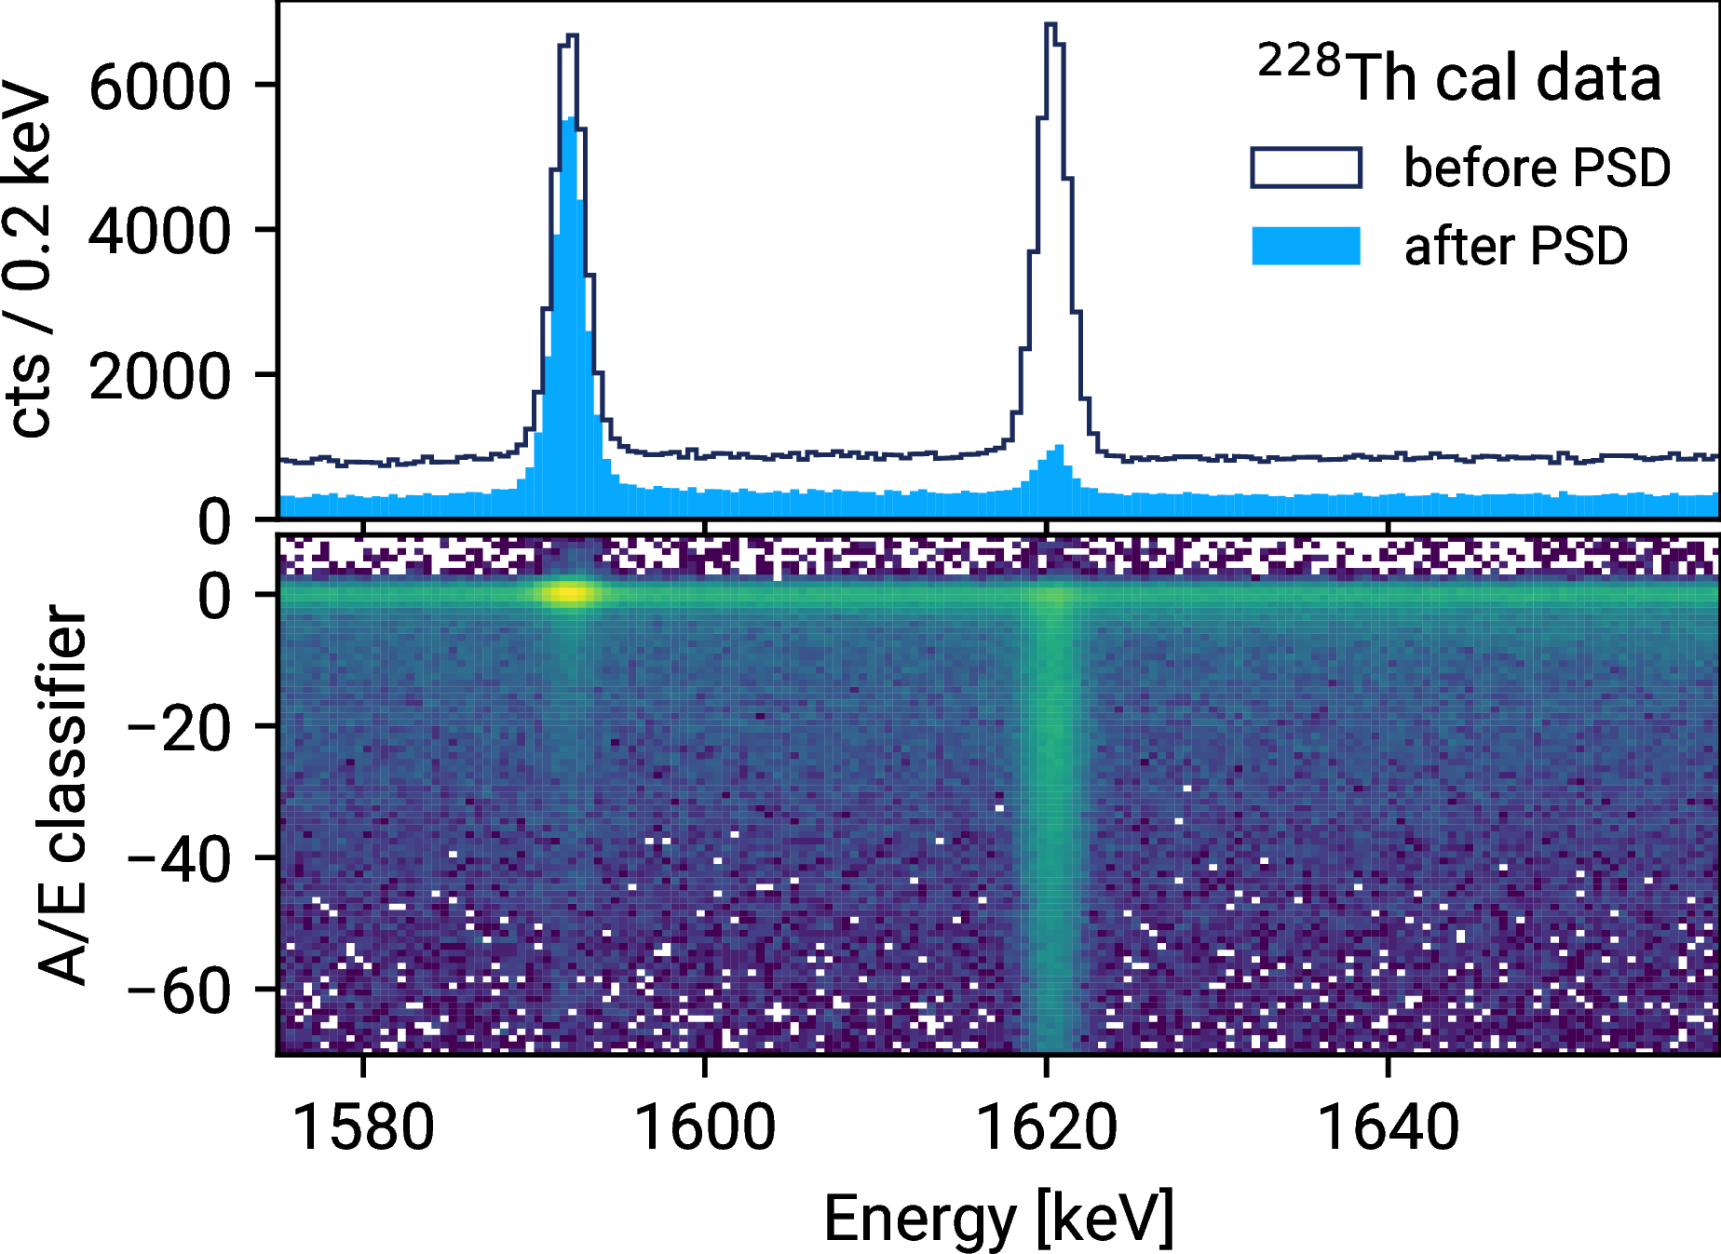


Single-site proxies
u
0νββ signal
Single-site proxies
v
2νββ
w
Singly Compton Scattered
$$\overline{ν}$$
Compton scattered γ
x
Double escape peak (DEP)
$$\overline{ν}$$
v
u
e⁻
e⁻
e⁻
e⁻
‘Detector’
w
e⁻
e⁻
Escaping 511 keV
e⁺
Incoming γ
x
Single site
Multi site
Incoming γ
Escaping 511 keV
Stable PSD observables:
Monitored with weekly ²²⁸Th calibrations.
Data set partitioned according to stability.

Slide 14
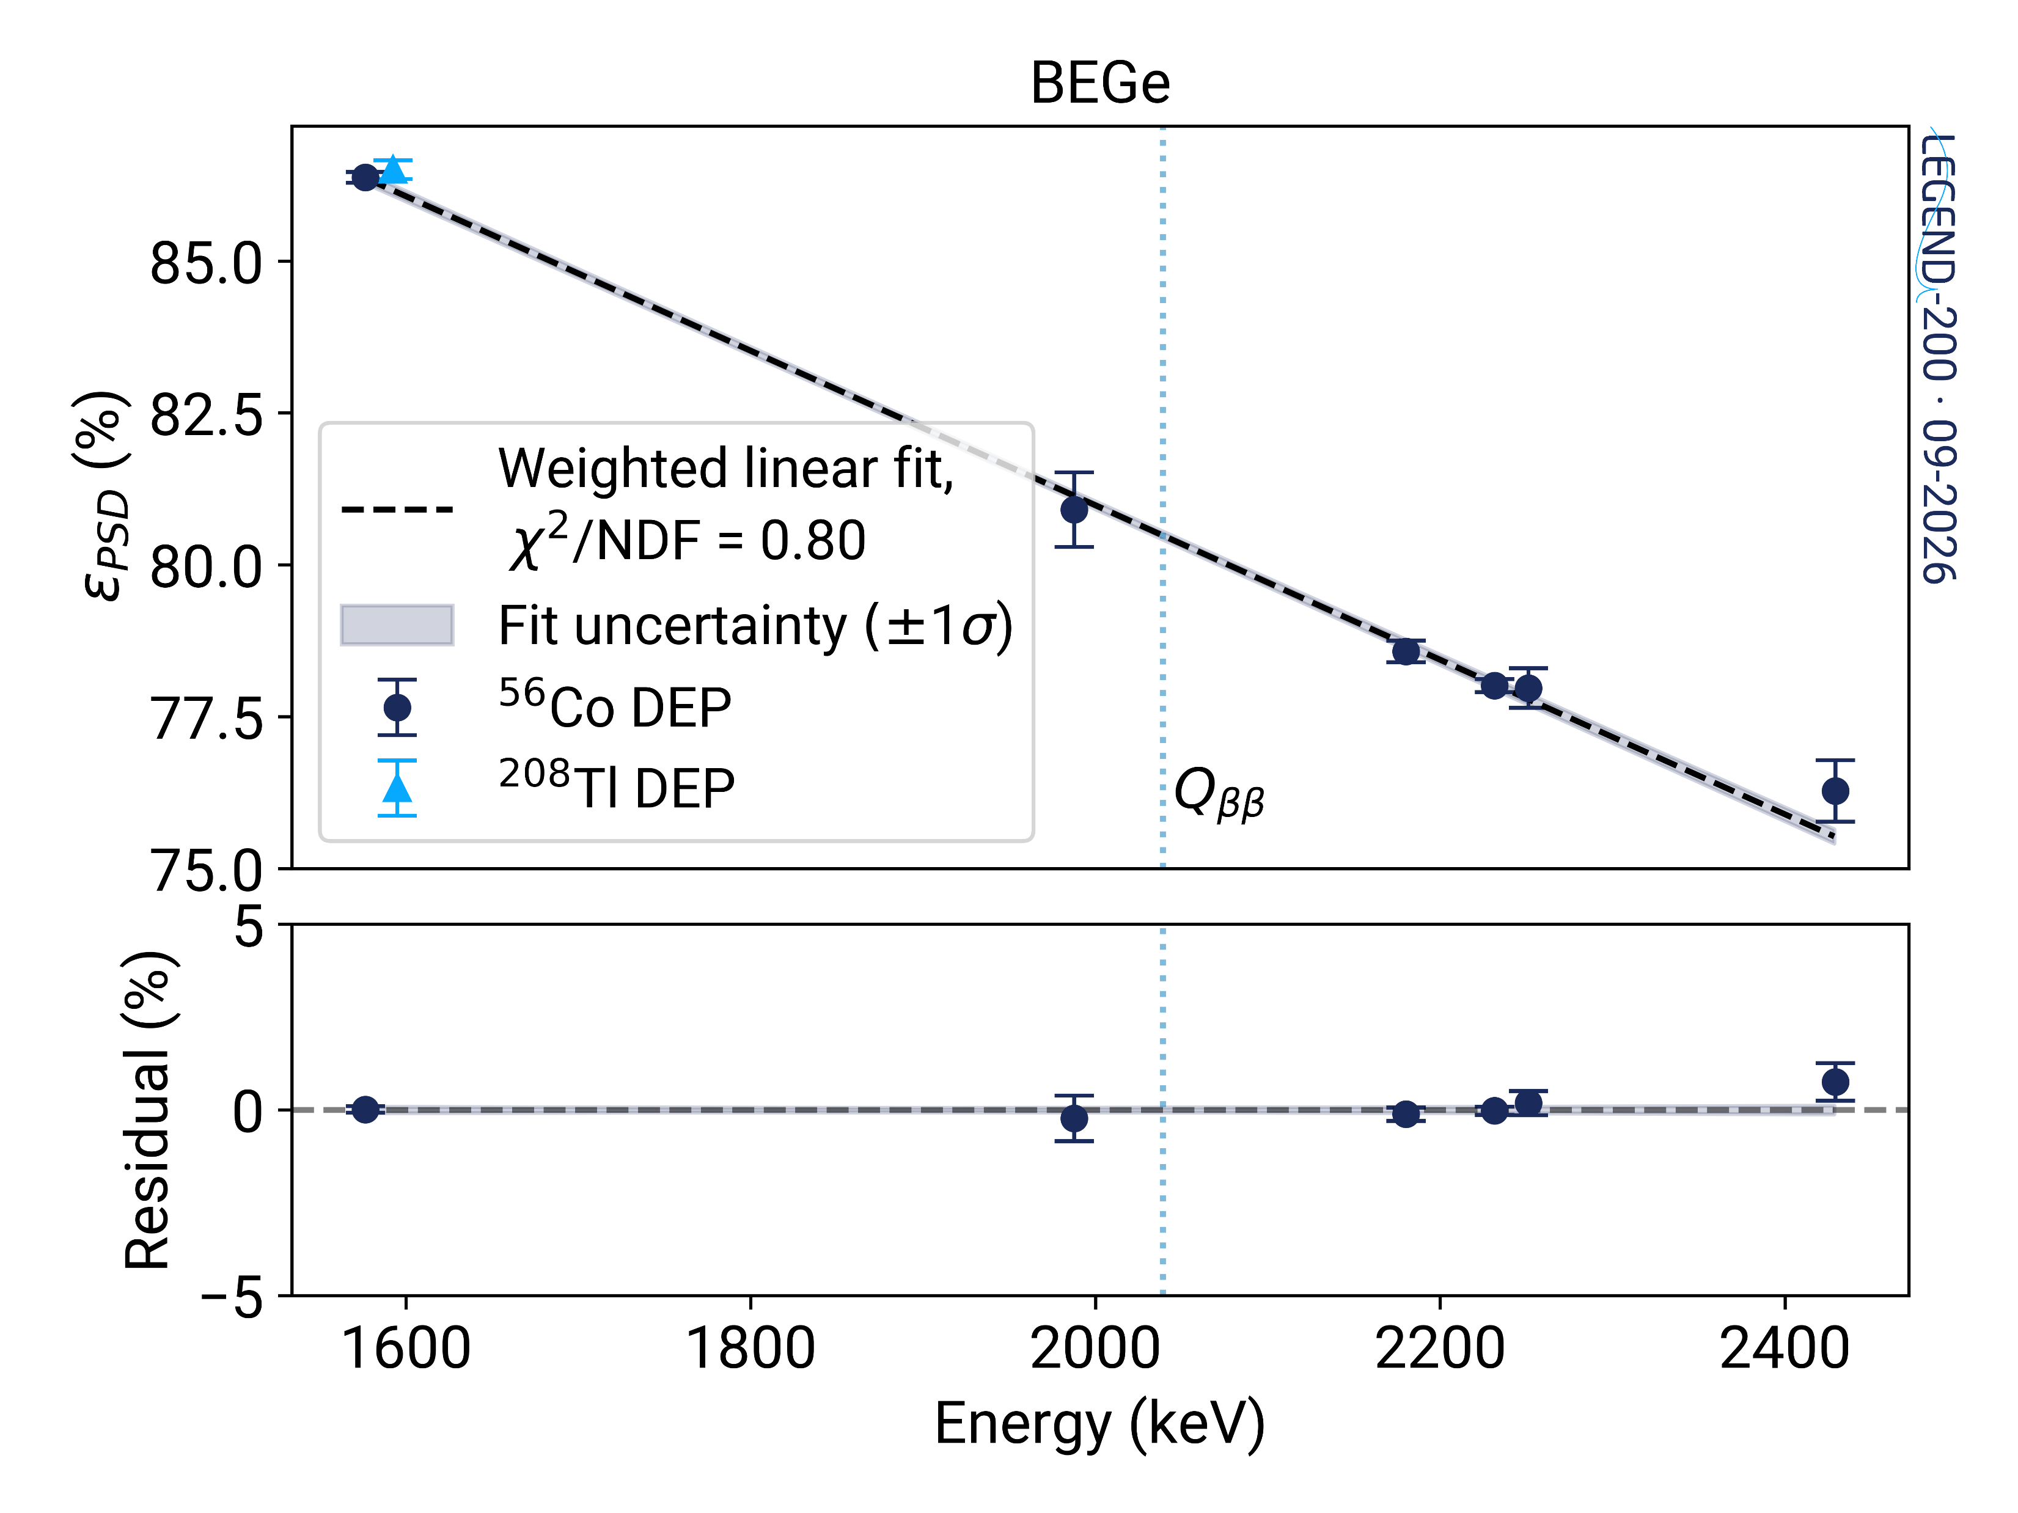
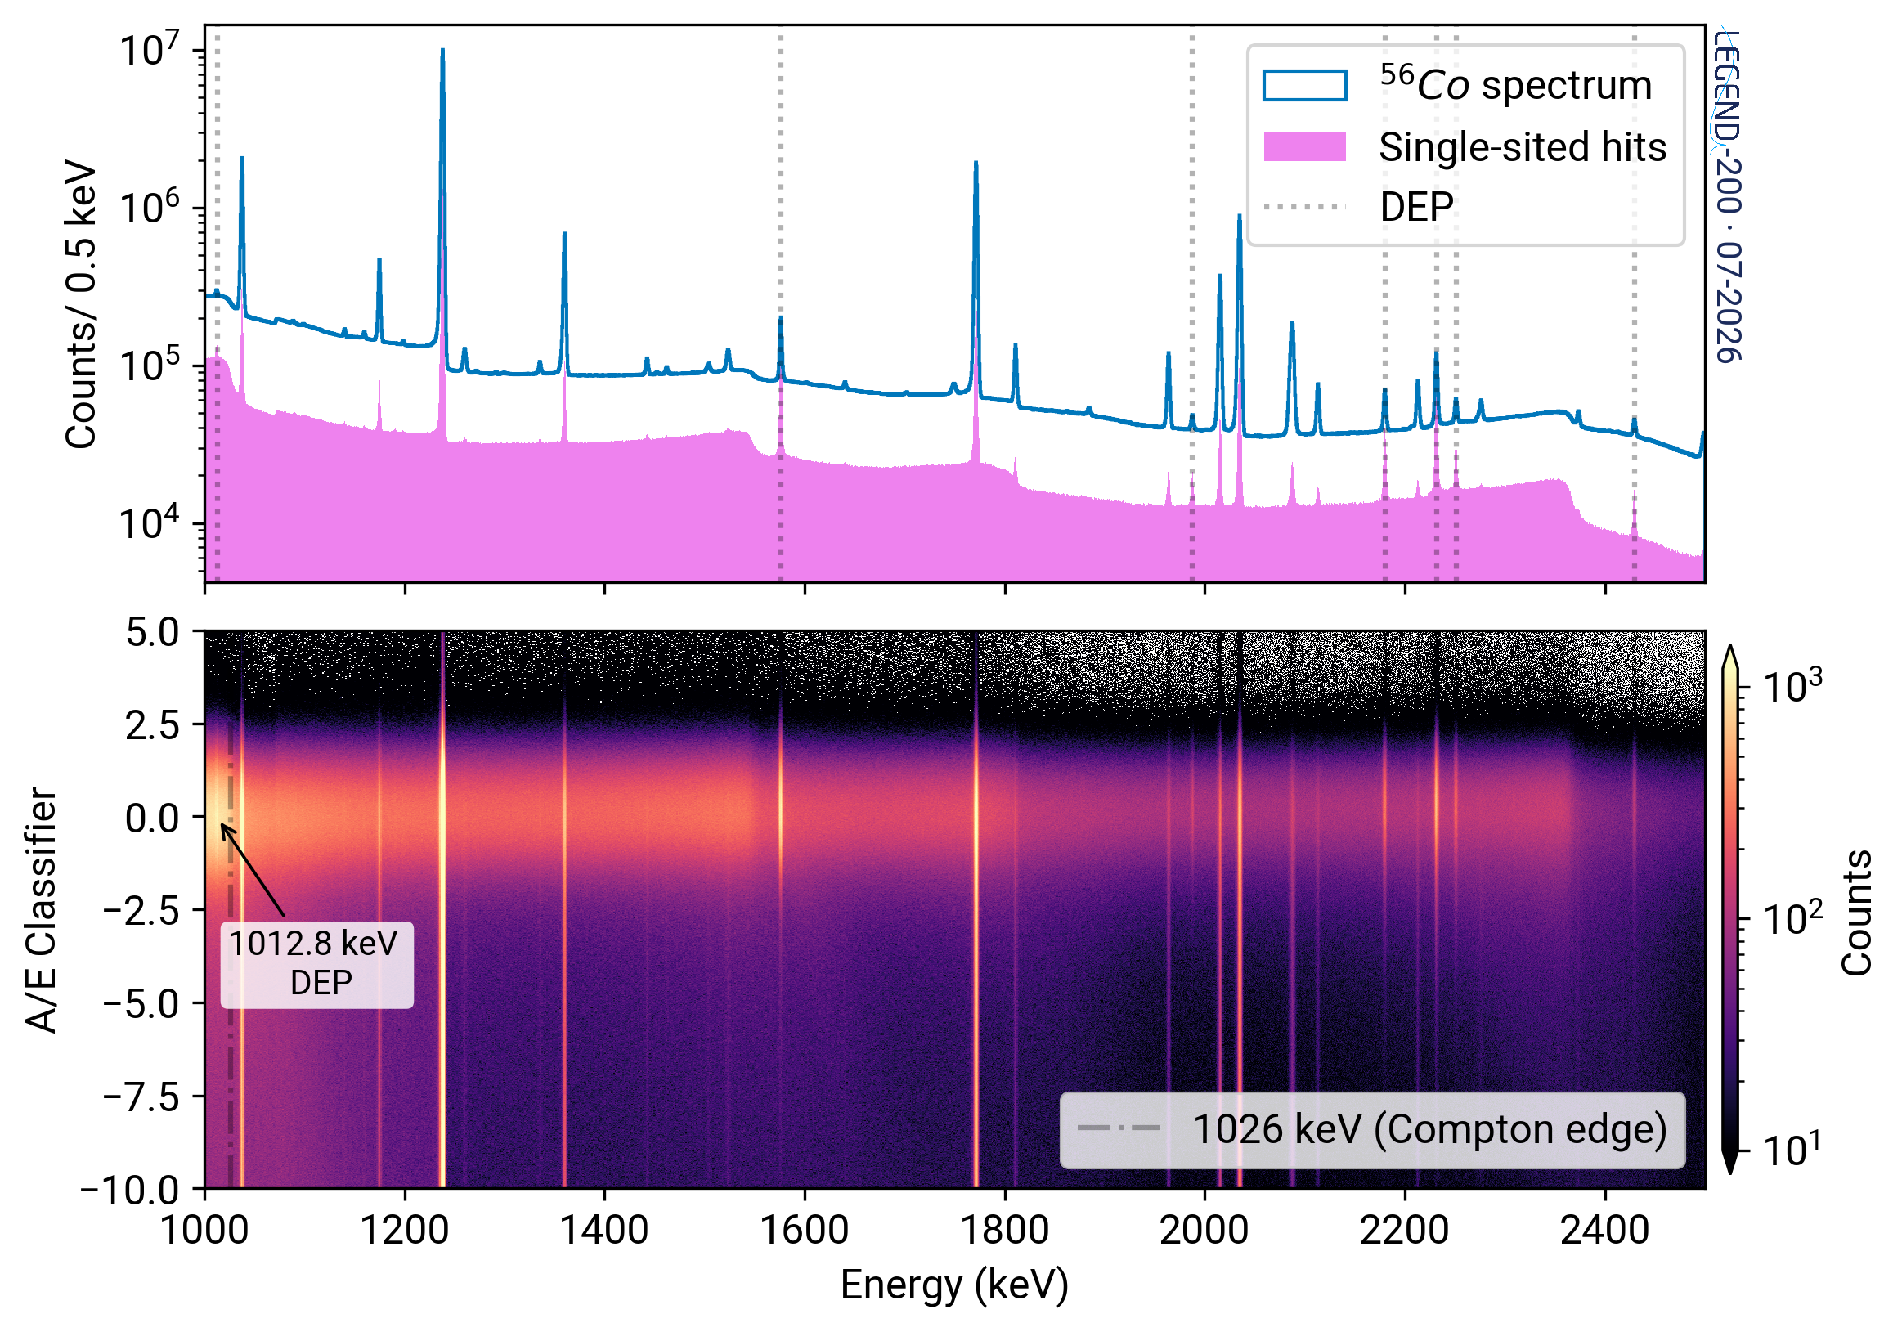
PSD Systematics
$$ε_{PSD } = ε_{MSE}⋅ ε_{surf} + {Δε}_{stab} +{ Δε}_{noise} + { Δε}_{Co} + {Δε}_{2v}$$
Eff of PSD cuts at 0νββ
Eff of MSE and surface cuts at ²⁰⁸Tl DEP
Time stability
Uncertainty due to noise
Energy-dependent
effects
Geometric difference between DEP and 0νββ
Detector type | Efficiency at Q_{ββ}
IC | 84.3 ± 3.0 %
BEGe | 81.1 ± 3.9 %
PPC | 85.0 ± 4.5 %
Coax | 76.0 ± 5.7 %
Special calibration sources such as ⁵⁶Co are useful to characterize the systematics arising from calibration procedure biases.
IC detectors have a high signal efficiency.
Papers in preparation

Slide 15
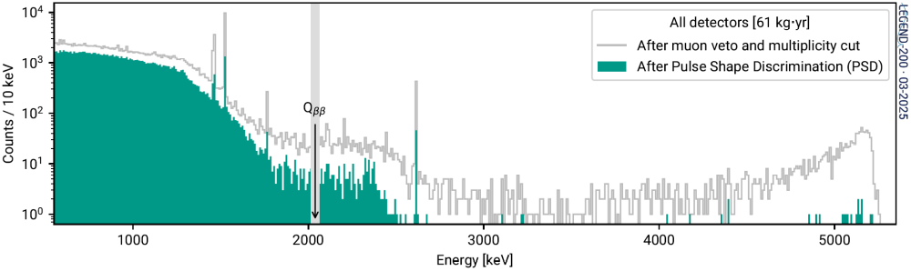
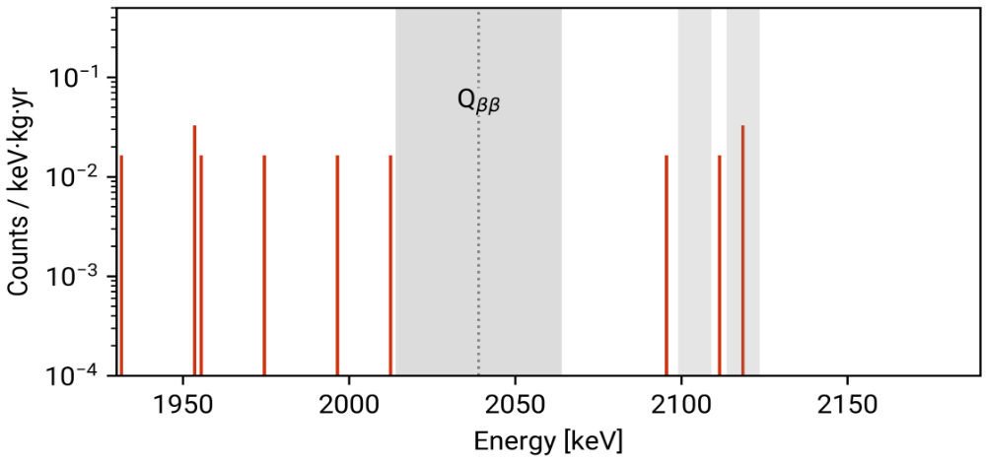
Background rejection performance of the PSD cut
⁴²K
⁴⁰K
Surviving Compton background
²¹²Bi
²⁰⁸Tl
α background suppressed
Background estimation window
After ALL cuts
Cuts applied on spectrum:
  data cleaning + muon veto + multiplicity cut
  Pulse Shape Discrimination:
    Surface α and β backgrounds highly suppressed
    ~60% suppression of Compton background at Q_{ββ}
  Complementarity with the LAr cut
²¹⁴Bi
²⁰⁸Tl
BLINDED
Powerful background mitigation!

Slide 16
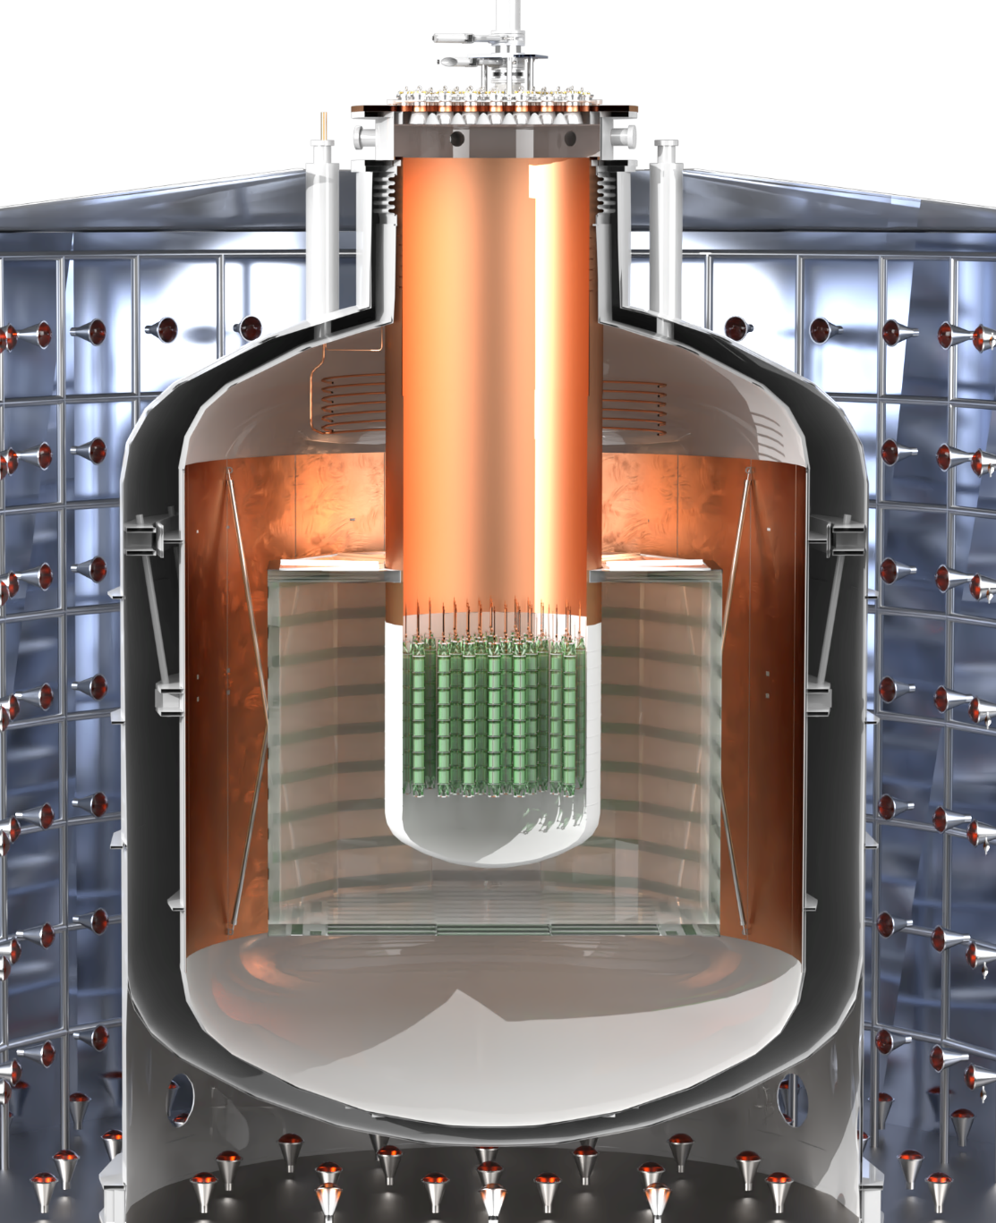
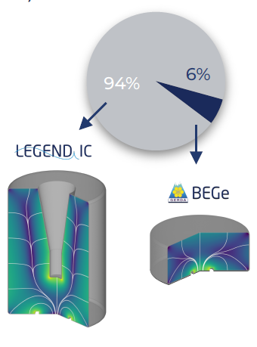
Current Status
Future Plans
142 kg of LEGEND-200 HPGe acquired physics data Mar’23 – Feb’24 and showed excellent performance.
Across the entire detector array, a combined average resolution of (2.47 ± 0.08) keV at Q_{ββ} is achieved.
Energy calibration and systematics publication accepted in EPJ C (https://arxiv.org/abs/2605.22479)
PSD papers in preparation
First LEGEND-200 background index and 0νββ result published in Phys. Rev. Lett. 136, 022701
After maintenance period, redeployment of 138 kg detectors in July 2025
Potential improvements to PSD to further reject the ⁴²K surface events.
Improved FCCD measurements and n+ layer modelling in simulations
Better understanding of the low energy backgrounds, to pursue other novel physics beyond the Standard Model.
Conversion of PPC, Coax and underperforming detectors to IC
LEGEND-1000 will employ IC detectors with an average mass of 3 kg!

Slide 17
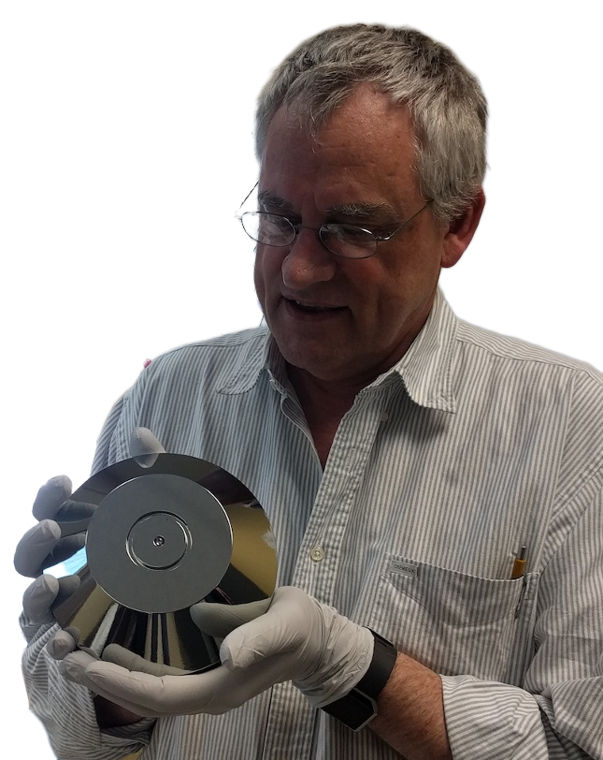













Thank you for your attention
LEGEND Collaborator Dr. David C. Radford
with a large Germanium detector

Slide 18
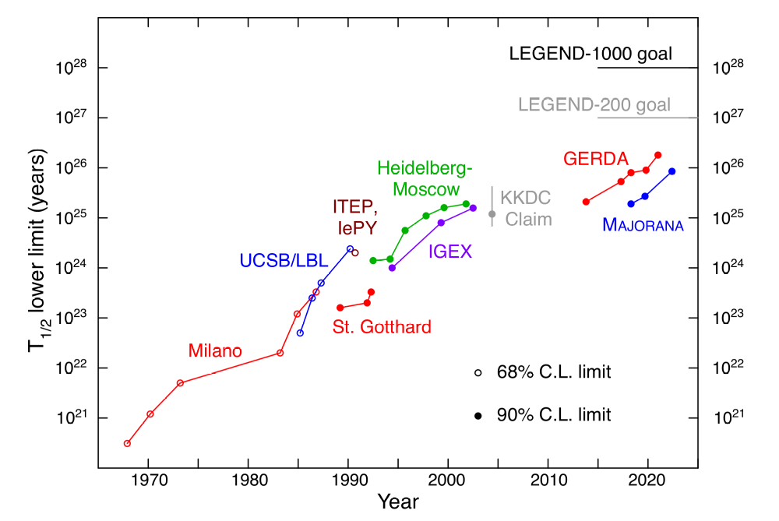

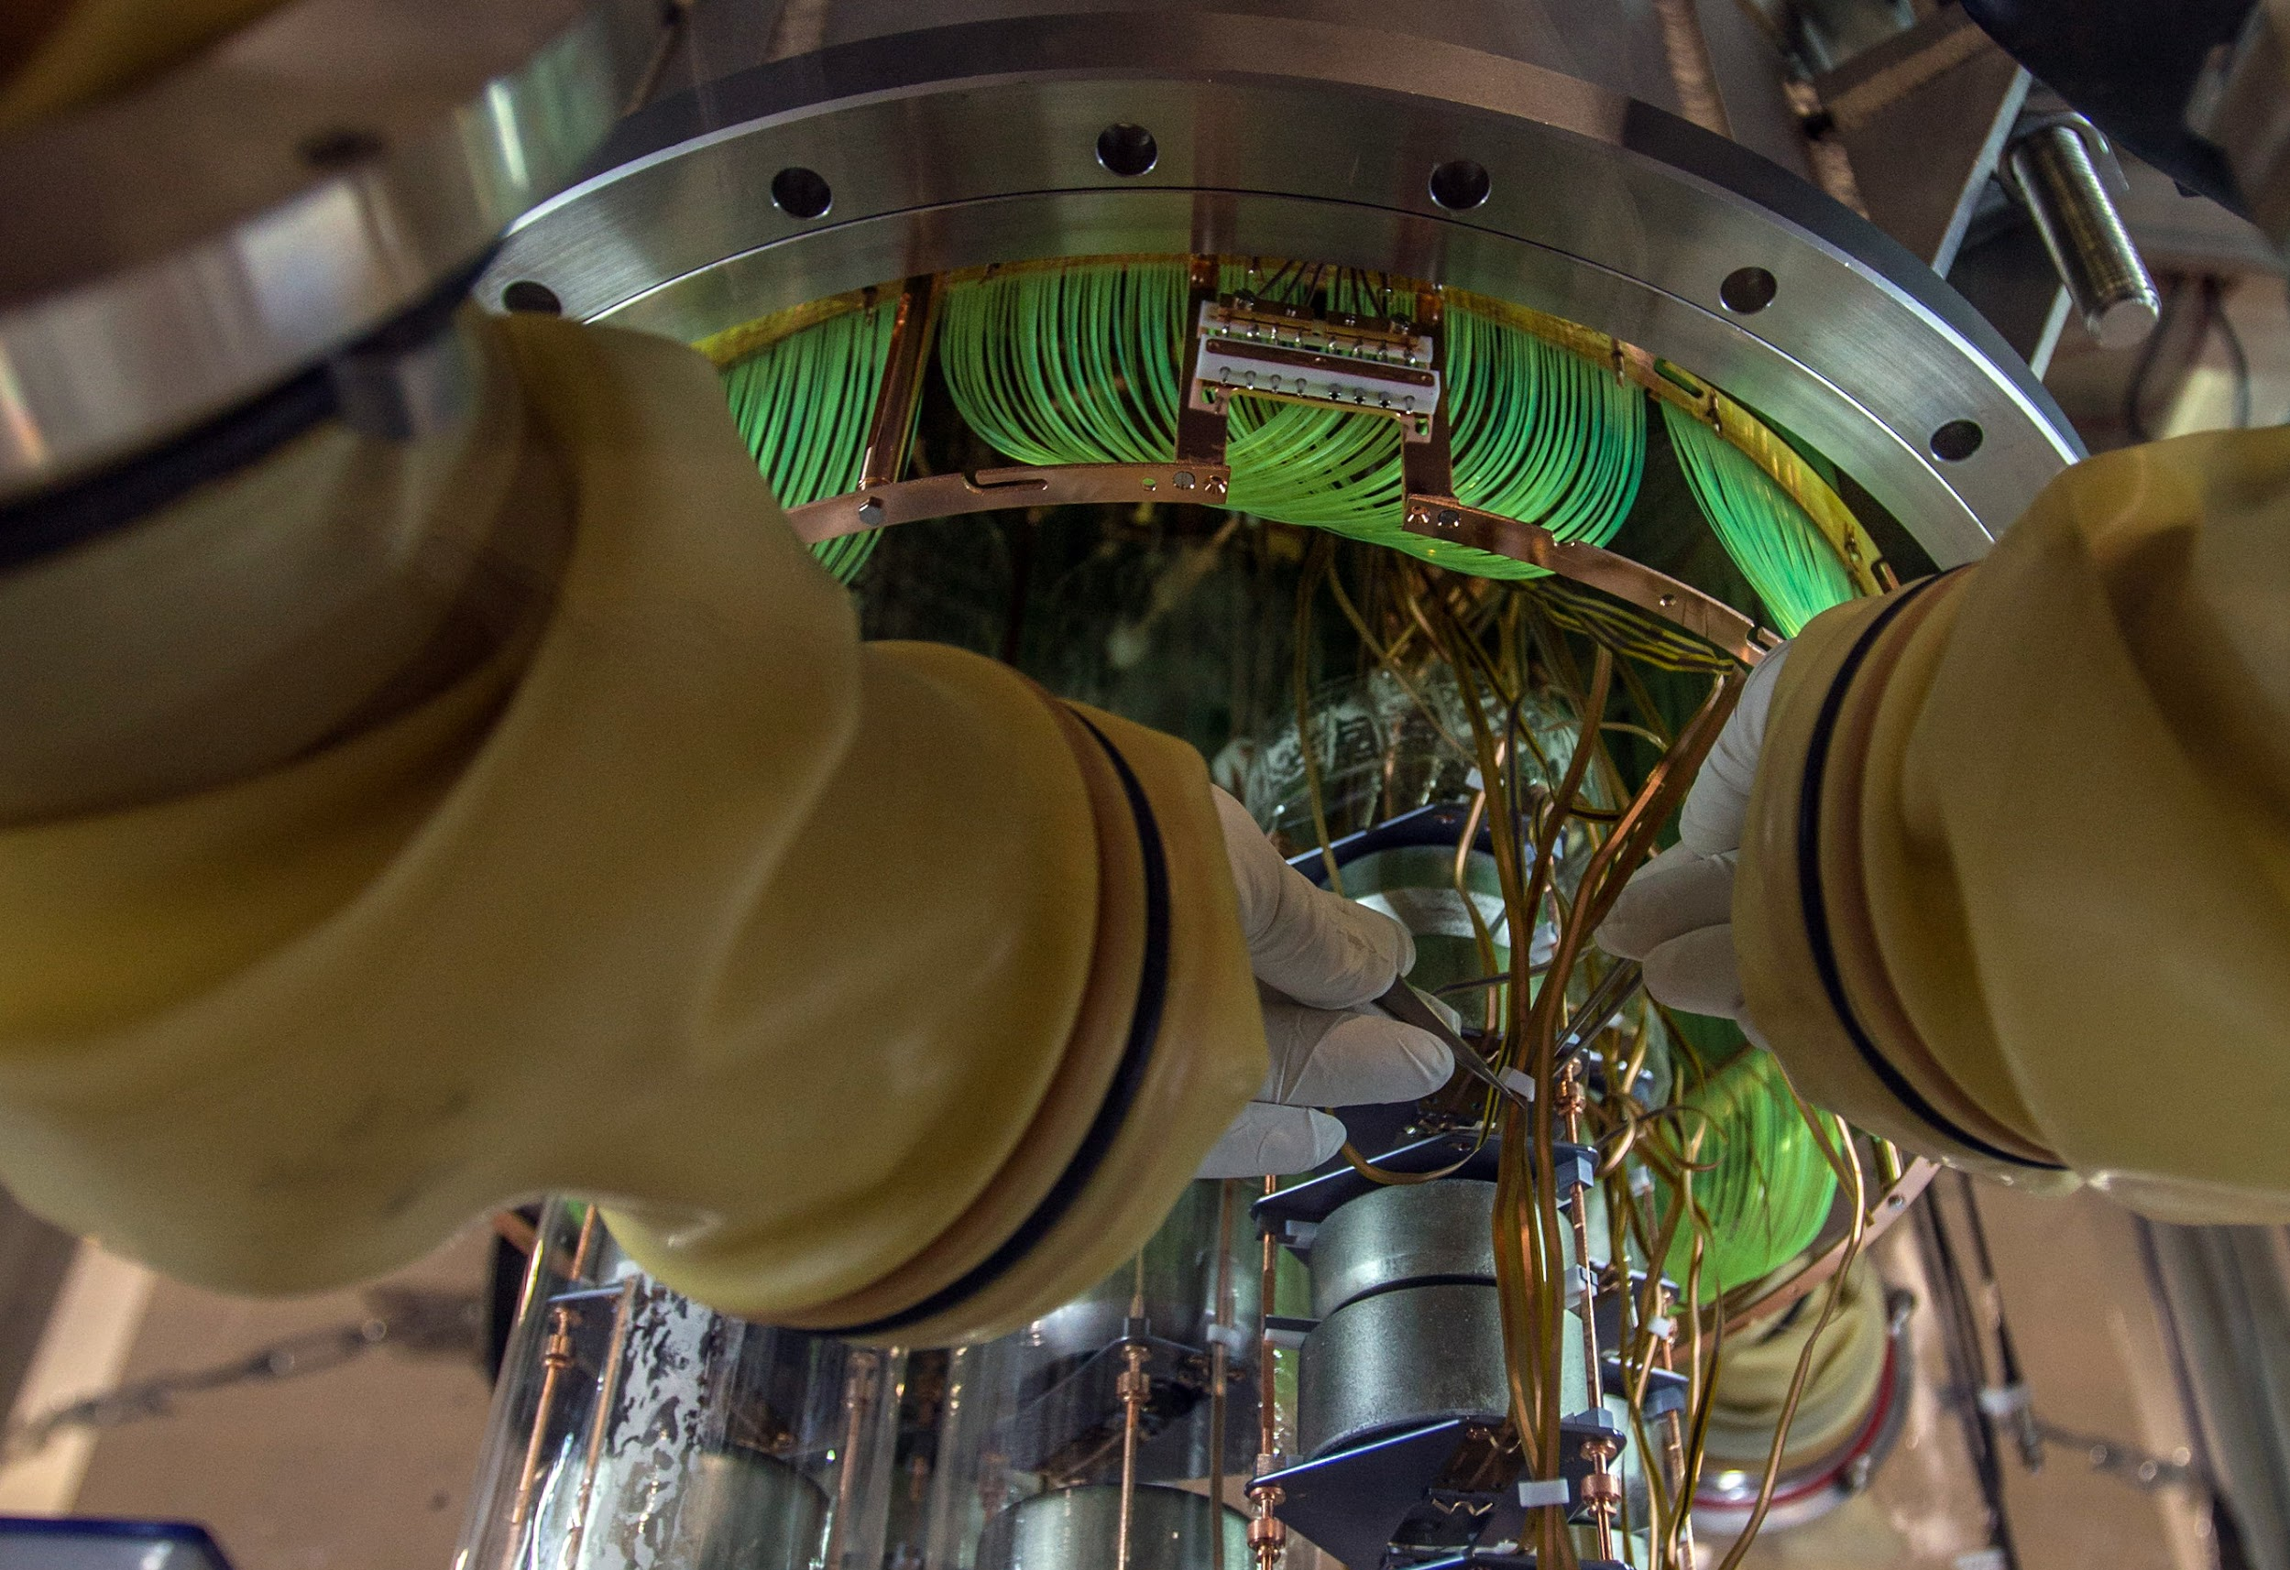
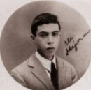
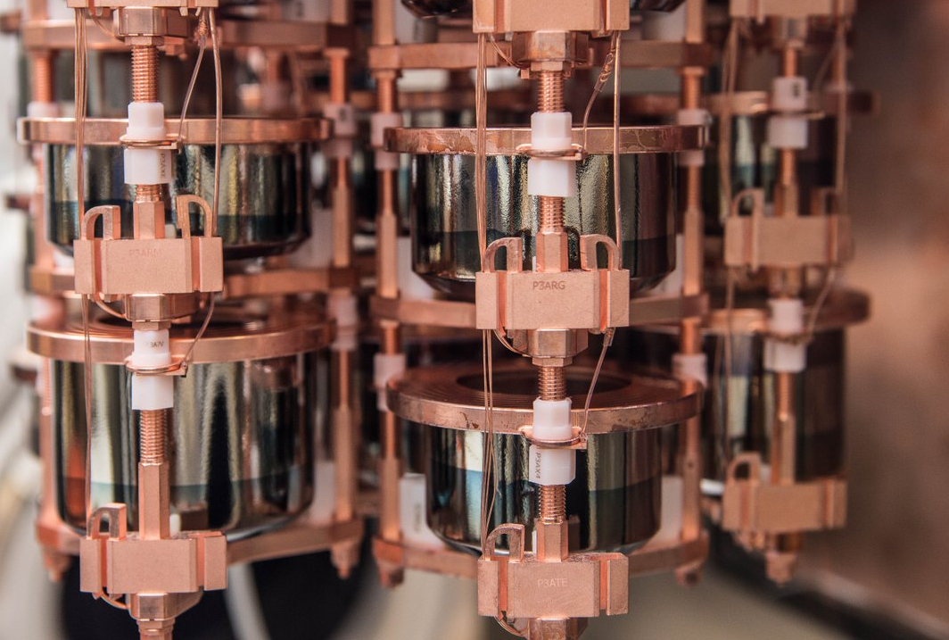
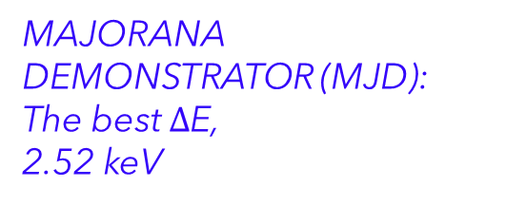
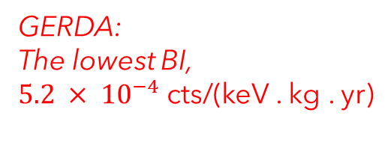
Suitability of HPGe detector technology
> Half a century of research
GERDA:
The lowest BI,
$5.2 × {10}^{−4}$ cts/(keV . kg . yr)
Improved exposure and technology!
MAJORANA DEMONSTRATOR (MJD): The best $∆$E,
2.52 keV
LEGEND combines the best technologies from MJD and GERDA + new innovations!
Phys. Rev. Lett. 136, 022701 (LEGEND-200 + MJD + GERDA result)

Slide 19
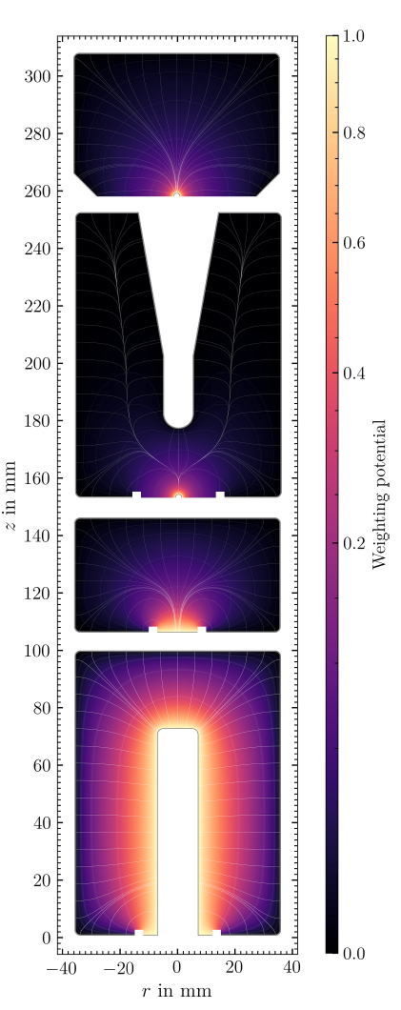
Signal formation
in point contact detectors
Point
Contact
Geometry
Largest contribution to the signal as charge drifts near the p+ contact (typically hole dominated)

Slide 20
Other PSD
Late Charge (LQ)
Is quantified by the slow component above the rising edge after 80% of charge is collected, i.e., the
area above the waveform.
Targets slow charge re-release events, which originate from the passivated and n+ surfaces.
These events are energy degraded and can add to the background in the region of interest.
Replaces the high A/E cut as a surface event cut in detectors with a large passivated surface (PPCs)
Single site (0νββ/2νββ)
ACCEPTED
n+ surface
(⁴²K/⁴²Ar)
REJECTED
p+ surface
(α)
REJECTED
Artificial Neural Network
Method developed for Coax detectors, which do not have a point contact style geometry.
Rise time cut
p+ contact events in Coax detectors are rejected using a cut based on the pulse risetime. Similar method to GERDA Phys. J. C 82, 284 (2022)
PSD cuts developed for Coax detectors

Slide 21
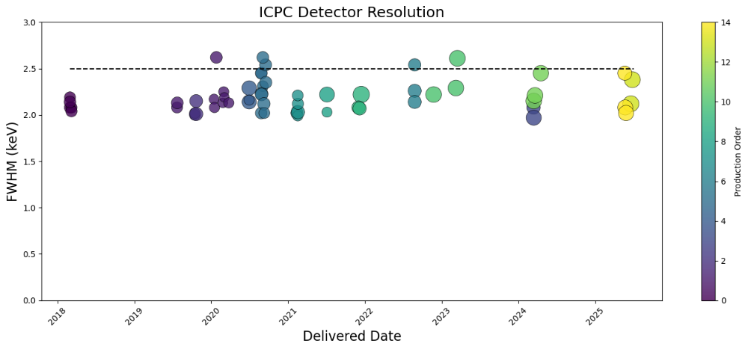
Energy resolution of ICPC is overall constant even when the mass increases.
Time

Slide 22
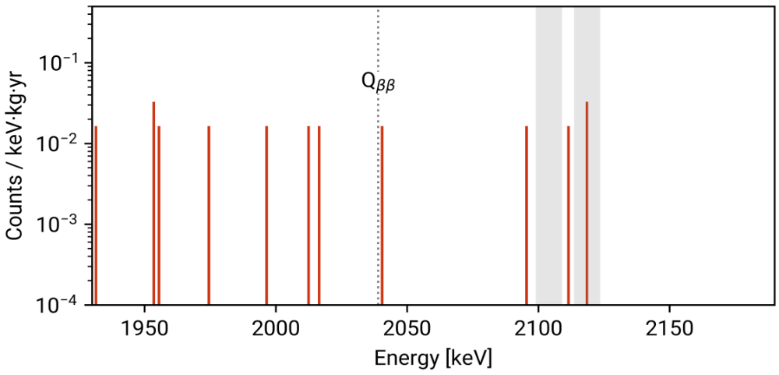
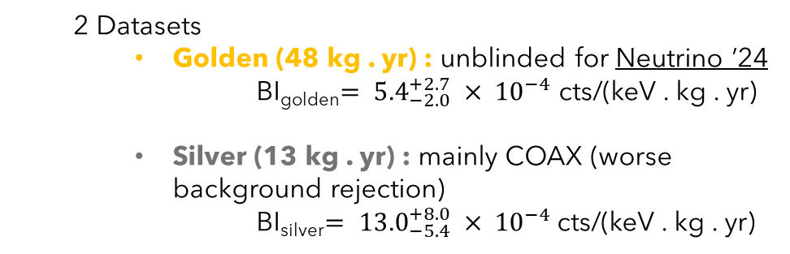
Data in the region of interest
²¹⁴Bi
Background estimation window: 1930 – 2190 keV
  Excluded γ lines at 2104 (²⁰⁸Tl) and 2119 keV (²¹⁴Bi)
  9 events
²⁰⁸Tl
Blinded
    + 2 events AFTER unblinding = 11 surviving events
unblinded
²¹⁴Bi
  2 Datasets
    Golden (48 kg . yr) : unblinded for Neutrino ’24
    BI_{golden}$= {5.4}_{−2.0}^{+2.7} × {10}^{−4}$ cts/(keV . kg . yr)
    Silver (13 kg . yr) : mainly COAX (worse background rejection)
    BI_{silver}$= {13.0}_{−5.4}^{+8.0} × {10}^{−4}$ cts/(keV . kg . yr)
²⁰⁸Tl
Comparable to GERDA

