Slide 1
Novel Characterization of Materials for use in Liquid Xenon Chromatographic Radon Reduction System
Liam Sherman – Physics PhD Candidate – SLAC + KIPAC
On behalf of the ReLIC team
Notes:
Hi all, my name is Liam Sherman and I’m a PhD candidate at Stanford University/SLAC
I’m here today to present novel measurements performed at SLAC on the characterization of materials for potential use in a liquid xenon chromatography system for radon removal

Slide 2
Liquid Phase Chromatography
Notes:
First I want to spend a minute on what the motivations are behind exploring liquid phase chromatography as a purification strategy

Slide 3
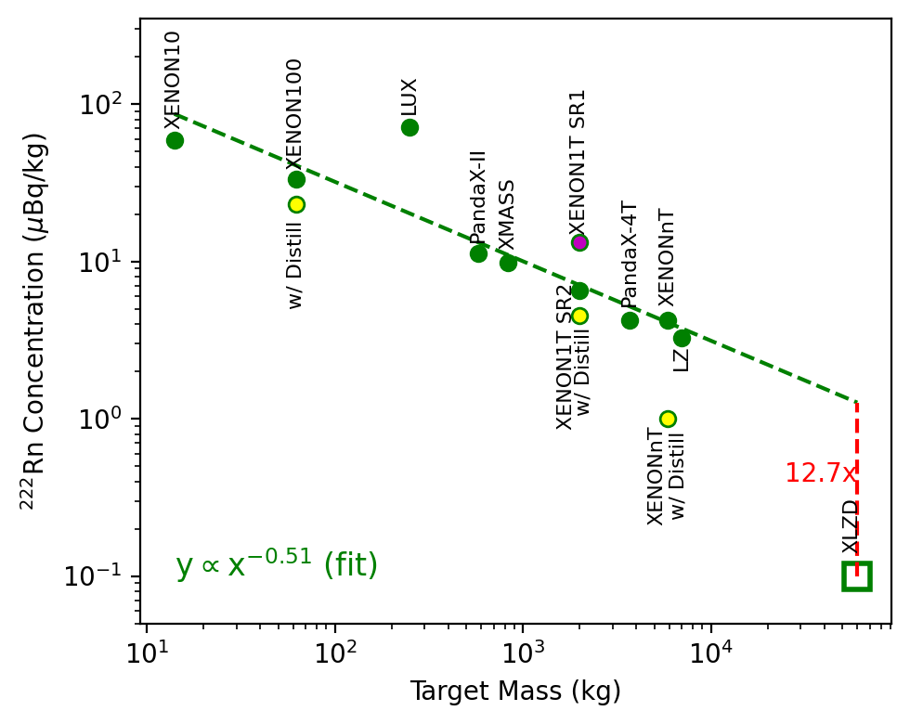

Radon as a background in Liquid Noble TPCs
Rn 222 decay chain is a persistent background in low background liquid noble experiments
Rn 222 is continuously emitted by materials
Next Gen detectors (ex. XLZD) have stringent radon requirements–may require new methods to reach
The work I am presenting today is on our exploration of the viability of liquid phase chromatography to reach these requirements
credit–B. Mong
Notes:
So first to set the stage on why we want to remove radon.
Rn222 and its daughters are a difficult to remove background in many liquid noble low background experiments
While some impurities like krypton can be purified out of the material before the experiment, as radon is continuously emitted from detector materials, it requires a continuous purification strategy to push down levels
Next generation experiments like XLZD have stringent Rn 222 requirements, which necessitate innovative strategies to achieve
On this plot we can see the Rn 222 levels of several previous generations of TPCs plotted against fiducial mass, and the rough trend line they follow. Then we can see the requirements for XLZD, significantly exceeding the current trend
New technologies or methods need to be developed in order to reach this reduction level
Liquid phase chromatography is the method that we explored the viability of in this work

Slide 4
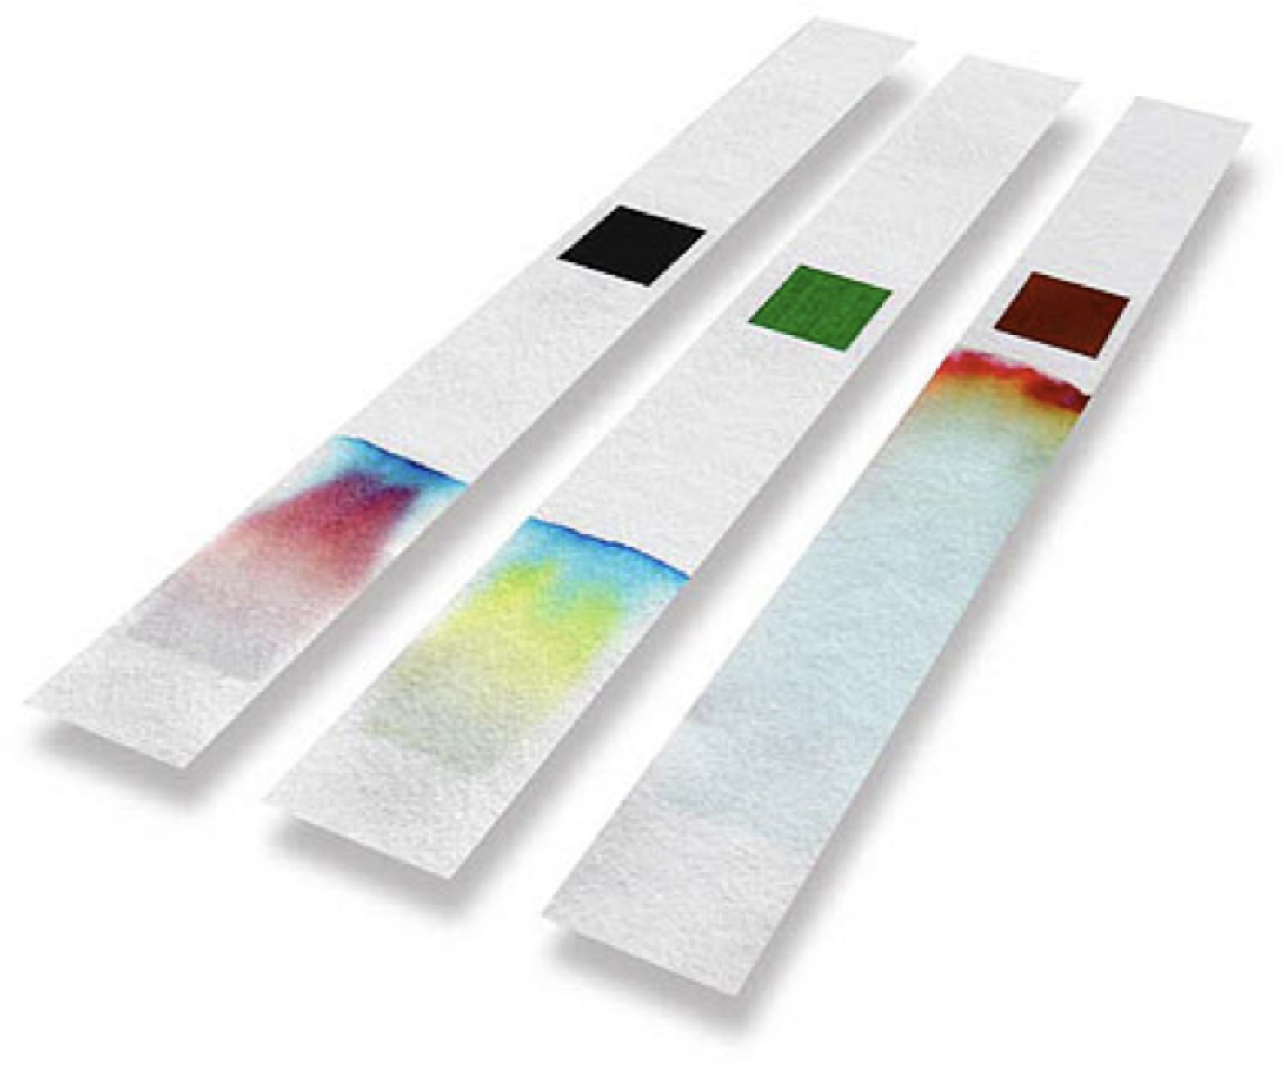
Brief Refresher on Chromatography
Chromatography is a method to separate chemicals in a mixture
Different dilute species in the carrier separate as they pass through the media, and emerge at different times from the column
‘Radon’
flow
‘Xenon’
Notes:
So quickly a very brief review of chromatography
Chromatography is the process of separating out a chemical mixture into its various components by passing them through an adsorbent media
The different components of the mixture are delayed by different amounts, separating in tim when they exit the media
The performance of these systems depends on the media used, and the relative absorbance strengths of the components of the mixture

Slide 5
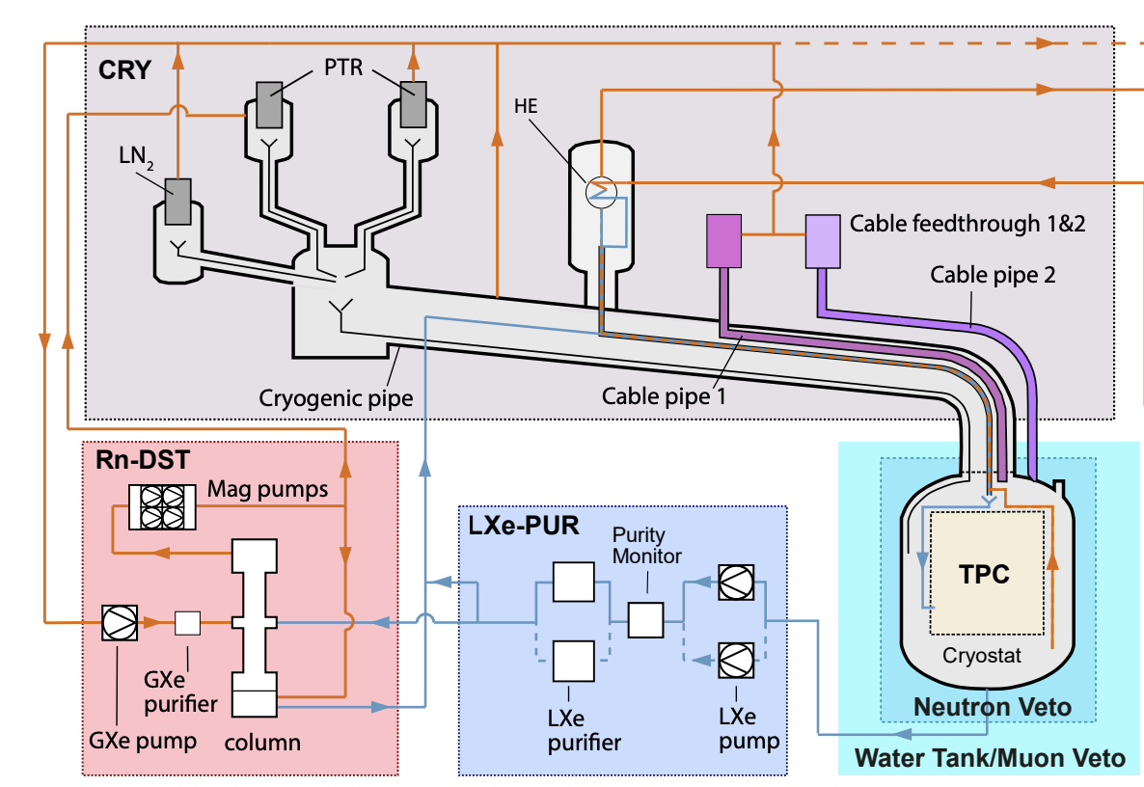
Why Liquid Chromatography
Cleaning xenon in the liquid phase addresses two different obstacles
Adsorbents emit Rn, liquid chromatography allows for smaller columns
Liquid phase purification allows for liquid circulation, more energy efficient, don’t need very high gas flow rates
arXiv:2402.10446
Notes:
Cleaning xenon in the liquid phase addresses a few obstacles to xenon purification
Many adsorbent materials used in chromatography setups themselves emit radon. This limits the radon floor you can reach in your experiment, eventually your adsorbent media can become the main emitter. Liquid phase chromatography allows us to use less adsorbant media, so less radon is emitted
Liquid phase purification is also coming into vogue. On the right here we can see Xenon N-tons liquid phase purification system for electronegatives removal. If other purification technologies are trending toward all liquid running, it makes sense to pursue radon purification in that phase as well

Slide 6

Current Chromatography Methods->Decay in Place Systems
These have a breakthrough time which is several times the dilute specie half life (Rn 222 -> 3.82 days).
Increasing flow rate requires increasing material–poses an issue as media emit radon
Such a system is infeasible for current O(5) ton LXe TPCs, and even more so for planned O(60) ton experiments
Decay in Place Column
Radon Concentration
Xenon Flow
Rn contaminated Xe
Purified Xe
Notes:
One existing method of removing radon from xenon with chromatography is a decay in place column
If you design a column with a breakthrough time, the time it takes radon to make it all the way through your column, be several radon half lives, most of the radon will decay in your column and you will have a purer product emerge
This technology faces issues scaling up to what would be required for a current generation or next generation scale liquid noble TPC
If you want to increase the rate at which you clean Xenon, you have to increase the amount of adsorbent material. As most of these materials are radon emitters themselves, this poses a significant challenge as the column begins to be a dominant radon source

Slide 7
Current Chromatography Methods->Swing System
An alternative to decay in place
Two columns in parallel are utilized
One column is always cleaning fluid
The other column is being flushed to remove the contaminants (Rn)
Less material can be used than decay in place, but in gas phase swing system the emanate Rn is still prohibitive
Radon
Column A
Xenon Flow
Column B
Notes:
Another model of a chromatography system is a swing system.
Swing systems are generally used for both research and commercial purposes to provide continuous purification without the need for massive chromatographic columns
The principle is simple, you run the bulk of your fluid through one column. Right before the breakthrough time of your contaminate, you switch to flowing through a second column. To clean the contaminate out of your first column, you divert a small fraction of your cleaned fluid to flow backwards through the dirty column, to flush out the contaminates.
By repeating this process, you can continuously clean fluid while only wasting a small amount to backflow the dirty columns. Importantly, for this to work, you need to be able to flush the dirty column with only a small amount of fluid in less than the breakthrough time of your contaminate

Slide 8
Current Chromatography Methods->Swing System
An alternative to decay in place
Two columns in parallel are utilized
One column is always cleaning fluid
The other column is being flushed to remove the contaminants (Rn)
Less material can be used than decay in place, but in gas phase swing system the emanate Rn is still prohibitive
Radon
Column A
Xenon Flow
Column B
Notes:
Swing systems are generally used for both research and commercial purposes to provide continuous purification without the need for massive chromatographic columns
The principle is simple, you run the bulk of your fluid through one column. Right before the breakthrough time of your contaminate, you switch to flowing through a second column. To clean the contaminate out of your first column, you divert a small fraction of your cleaned fluid to flow backwards through the dirty column, to flush out the contaminates.
By repeating this process, you can continuously clean fluid while only wasting a small amount to backflow the dirty columns. Importantly, for this to work, you need to be able to flush the dirty column with only a small amount of fluid in less than the breakthrough time of your contaminate

Slide 9
Current Chromatography Methods->Swing System
An alternative to decay in place
Two columns in parallel are utilized
One column is always cleaning fluid
The other column is being flushed to remove the contaminants (Rn)
Less material can be used than decay in place, but in gas phase swing system the emanate Rn is still prohibitive
Radon
Column A
Xenon Flow
Column B
Notes:
Swing systems are generally used for both research and commercial purposes to provide continuous purification without the need for massive chromatographic columns
The principle is simple, you run the bulk of your fluid through one column. Right before the breakthrough time of your contaminate, you switch to flowing through a second column. To clean the contaminate out of your first column, you divert a small fraction of your cleaned fluid to flow backwards through the dirty column, to flush out the contaminates.
By repeating this process, you can continuously clean fluid while only wasting a small amount to backflow the dirty columns. Importantly, for this to work, you need to be able to flush the dirty column with only a small amount of fluid in less than the breakthrough time of your contaminate

Slide 10
Current Chromatography Methods->Swing System
An alternative to decay in place
Two columns in parallel are utilized
One column is always cleaning fluid
The other column is being flushed to remove the contaminants (Rn)
Less material can be used than decay in place, but in gas phase swing system the emanate Rn is still prohibitive
Clean output
Radon
Column A
Xenon Flow
Column B
Notes:
Swing systems are generally used for both research and commercial purposes to provide continuous purification without the need for massive chromatographic columns
The principle is simple, you run the bulk of your fluid through one column. Right before the breakthrough time of your contaminate, you switch to flowing through a second column. To clean the contaminate out of your first column, you divert a small fraction of your cleaned fluid to flow backwards through the dirty column, to flush out the contaminates.
By repeating this process, you can continuously clean fluid while only wasting a small amount to backflow the dirty columns. Importantly, for this to work, you need to be able to flush the dirty column with only a small amount of fluid in less than the breakthrough time of your contaminate

Slide 11
Current Chromatography Methods->Swing System
An alternative to decay in place
Two columns in parallel are utilized
One column is always cleaning fluid
The other column is being flushed to remove the contaminants (Rn)
Less material can be used than decay in place, but in gas phase swing system the emanate Rn is still prohibitive
Clean output
Radon
Column A
Xenon Flow
Column B
Notes:
Swing systems are generally used for both research and commercial purposes to provide continuous purification without the need for massive chromatographic columns
The principle is simple, you run the bulk of your fluid through one column. Right before the breakthrough time of your contaminate, you switch to flowing through a second column. To clean the contaminate out of your first column, you divert a small fraction of your cleaned fluid to flow backwards through the dirty column, to flush out the contaminates.
By repeating this process, you can continuously clean fluid while only wasting a small amount to backflow the dirty columns. Importantly, for this to work, you need to be able to flush the dirty column with only a small amount of fluid in less than the breakthrough time of your contaminate

Slide 12
Current Chromatography Methods->Swing System
An alternative to decay in place
Two columns in parallel are utilized
One column is always cleaning fluid
The other column is being flushed to remove the contaminants (Rn)
Less material can be used than decay in place, but in gas phase swing system the emanate Rn is still prohibitive
Clean output
Radon
Column A
Xenon Flow
Column B
Notes:
Swing systems are generally used for both research and commercial purposes to provide continuous purification without the need for massive chromatographic columns
The principle is simple, you run the bulk of your fluid through one column. Right before the breakthrough time of your contaminate, you switch to flowing through a second column. To clean the contaminate out of your first column, you divert a small fraction of your cleaned fluid to flow backwards through the dirty column, to flush out the contaminates.
By repeating this process, you can continuously clean fluid while only wasting a small amount to backflow the dirty columns. Importantly, for this to work, you need to be able to flush the dirty column with only a small amount of fluid in less than the breakthrough time of your contaminate

Slide 13
Current Chromatography Methods->Swing System
An alternative to decay in place
Two columns in parallel are utilized
One column is always cleaning fluid
The other column is being flushed to remove the contaminants (Rn)
Less material can be used than decay in place, but in gas phase swing system the emanate Rn is still prohibitive
Clean output
Radon
Column A
Xenon Flow
Column B
Notes:
Swing systems are generally used for both research and commercial purposes to provide continuous purification without the need for massive chromatographic columns
The principle is simple, you run the bulk of your fluid through one column. Right before the breakthrough time of your contaminate, you switch to flowing through a second column. To clean the contaminate out of your first column, you divert a small fraction of your cleaned fluid to flow backwards through the dirty column, to flush out the contaminates.
By repeating this process, you can continuously clean fluid while only wasting a small amount to backflow the dirty columns. Importantly, for this to work, you need to be able to flush the dirty column with only a small amount of fluid in less than the breakthrough time of your contaminate

Slide 14
Current Chromatography Methods->Swing System
An alternative to decay in place
Two columns in parallel are utilized
One column is always cleaning fluid
The other column is being flushed to remove the contaminants (Rn)
Less material can be used than decay in place, but in gas phase swing system the emanate Rn is still prohibitive
Clean output
Radon
Column A
Xenon Flow
Column B
Notes:
Swing systems are generally used for both research and commercial purposes to provide continuous purification without the need for massive chromatographic columns
The principle is simple, you run the bulk of your fluid through one column. Right before the breakthrough time of your contaminate, you switch to flowing through a second column. To clean the contaminate out of your first column, you divert a small fraction of your cleaned fluid to flow backwards through the dirty column, to flush out the contaminates.
By repeating this process, you can continuously clean fluid while only wasting a small amount to backflow the dirty columns. Importantly, for this to work, you need to be able to flush the dirty column with only a small amount of fluid in less than the breakthrough time of your contaminate

Slide 15
Novel Method->The Phase Swing System
Our novel idea to remove radon from LXe would be the phase swing adsorption system
One column is cleaning liquid while the other is purged with gas
In this way, liquid can be continuously cleaned without the need for a large decay in place column
Clean output
Radon
Column A
Gas Xenon Purge
Liquid Xenon Flow
Column B
Notes:
Many existing systems achieve this by changing the pressure or temperature between the two columns. We hope to achieve this by changing phase, leveraging the large density difference between liquid and gaseous xenon to clean liquid continuously, and boil a small amount of the liquid to clean the dirty column
Thus liquid will be continuously cleaned while a small amount of gas is used to clean the dirty column

Slide 16

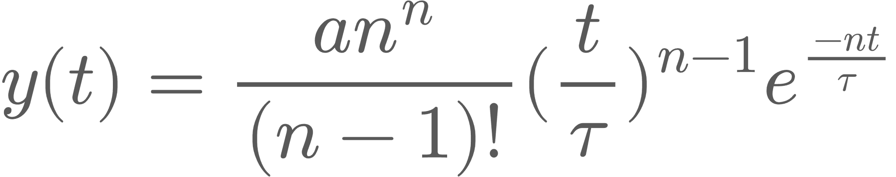
Engineering the System – Elution Curves
The elution curve describes the concentration profile of a dilute species exiting the column for a spike (delta function) concentration input
The elution curve is characterized by
: the ‘breakthrough time’ - The average amount of time it takes for the dilute species on average to reach the end of the column
n: the number of theoretical plates in the column - larger n produces a sharper, more gaussian elution profile
Time (of Dilute species exiting the column)
Amplitude of Inlet Concentration Pulse
Number of Theoretical Plates
Breakthrough Time
Notes:
The framework we use to model the chromatographic performance of each media is the parallel plate model of chromatography
This model imagines the column divided into n plates, based on how distillation columns are modeled. It’s a pretty empirically motivated model, and makes several assumptions which do not hold in all cases as well see later
Under this framework, for a solute whose initial concentration is a delta function in time, the concentration profile of a dilute species exiting the column is given by an elution curve
These curves depend on two numbers, the breakthrough time Tau which is the average time delay, and the number of theoretical plates n, which corresponds roughly to how well packed the column is
A higher T delays the dilute species in the column for longer, a higher n makes the output distribution of concentrations tighter
In the limit of high n the elution curve converges to a gaussian
It is desirable to have a larger T because it means your media adsorbs your dilute species more strongly and makes it easier to separate
It is desirable to have a higher n because it increases the sharpness of the elution profile. If you have a strict radon requirement, this is very helpful

Slide 17
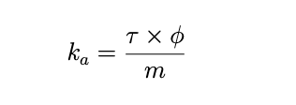
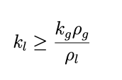
Minimum Material Requirements of a Phase Swing system
The breakthrough time depends on flow rate and adsorbent mass, the adsorption coefficient is the material property we want to measure
In a lossless idealized phase swing system, the ratio of the liquid and gas phase adsorption coefficients must equal the inverse ratio of the liquid and gas densities in order to break even
Breakthrough time
Volumetric flow rate
Adsorption coefficient
Adsorbent mass
Gas Adsorption coefficient
Gas density
Liquid Adsorption coefficient
Liquid density
Notes:
Such a phase swing system also provides us with a minimum material requirement
Time delays depend on flow rate and adsorbant mass, the more fundamental material property is the adsorption coefficient, defined here
With some simple assumptions of an ideal chromatography system, with no losses, we can caculate that the liquid adsorption coefficient needs to be larger than the gas adsorption coefficient times the ratio of gas to liquid densities
For a physical system, we would need to have a higher liquid adsorption coefficient than this to account for inefficiencies, but this gives us a good lower bound for viability

Slide 18
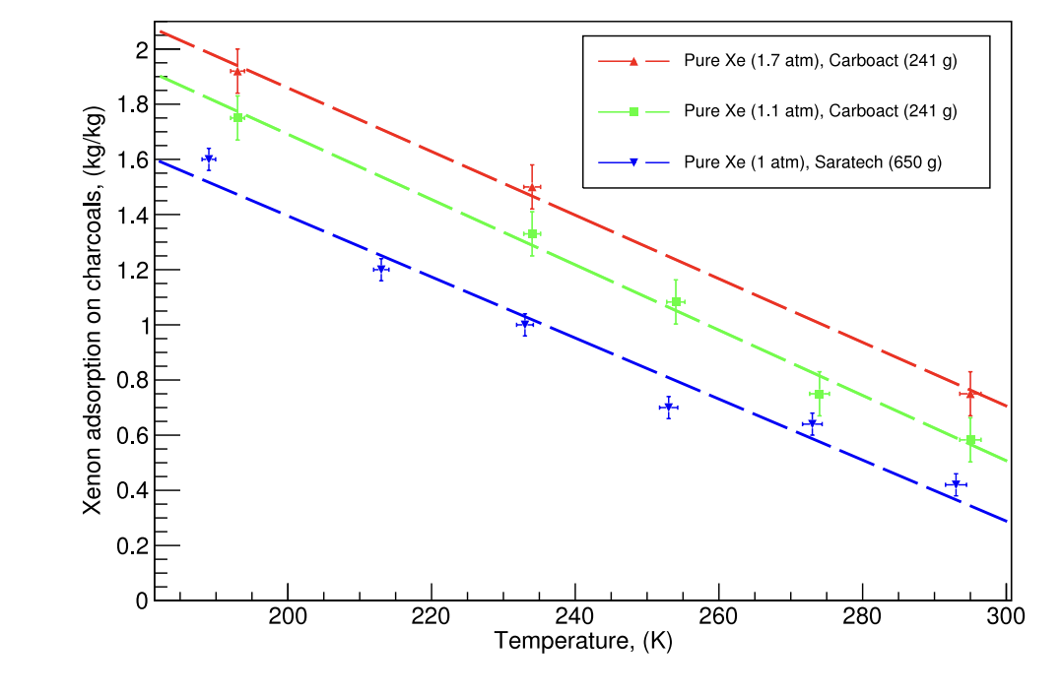
Hints at Liquid Chromatography Viability
Previous studies* showed Saratech charcoal works well for Rn removal in cold (190K) gas
Measurements indicated that at 190K the density of xenon in the column was ~¼ liquid density
This indicated to us that liquid phase charcoal chromatography may have viability
*From Study of radon reduction in gases for rare event search experiments
10.1016/j.nima.2018.06.076
Notes:
So the last piece of mkotivation I want to go over is what encouraged us to explore liquid phase chromatography in xenon in the first place
Gas phase chromatography to remove radon from xenon is actively in use in some low background experiments
Researchers in the University of Michigans LUX ZEPLIN group performed measurements of the gas phase cghromatographic performance of several charcoals, for use in the LZ inline radon reduction system.
While performing these measurements, they observed the density of xenon in their column was nearly ¼ that of liquid xenon, and the column was still performant
This indicated to us that liquid phase chromatography may be viable, despite fears about saturating the adsorbant with xenon. We also performed a replication of this measurement, and confirmed the xenon density numbers Michigan produced

Slide 19
The ReLIC Experiment
Notes:
Okay so now with the background out of the way, I’ll go over the ReLIC experiment and what we measured

Slide 20
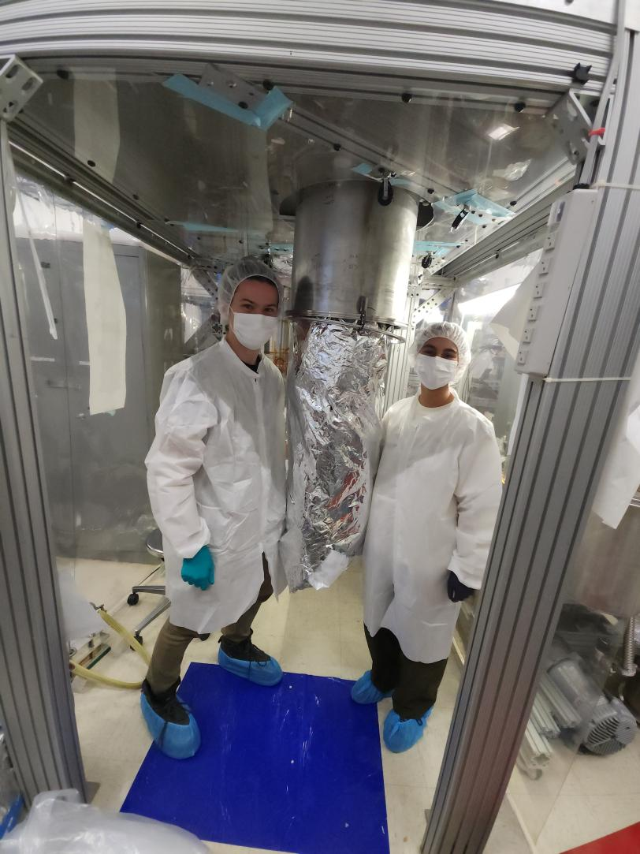
The System
The Removal of Liquid Impurities via Chromatography (ReLIC) system was constructed at SLAC to measure the material properties of proposed adsorbents
It allows Xenon to be liquified and passed through a chromatographic column
Radon can be injected for measurements
MFC
Getter
Heat Exchanger
Rn 222 Source
Sub-Cooler
Circulation Pump
Ch 1
PMT
Ch 0
PMT
Mainly liquid Xe in line
Mainly gaseous Xe in line
Chromatography Column
Vacuum Vessel
Notes:
The Removal of Liquid Impurities via chromatography (ReLIC) system was constructed at SLAC national accelerator laboratory to test proposed adsorbants for use in a phase swing radon removal system
It consists of a gas phase circulation and purification system, utilizing a compressor, a hot getter, and a mass flow controller to control flow rate on the room temperature side
Inside the vacuum vessel it was a subcooler powered by a liquid nitrogen thermosyphon to condense the xenon, which then flows through a cell containing a Photomultiplier tube, a chromatographic column, and then another cell containing a photomultiplier tube
It also has a radon injection system, so Rn222 gas can be injected into the gas phase xenon to be circulated through the system

Slide 21
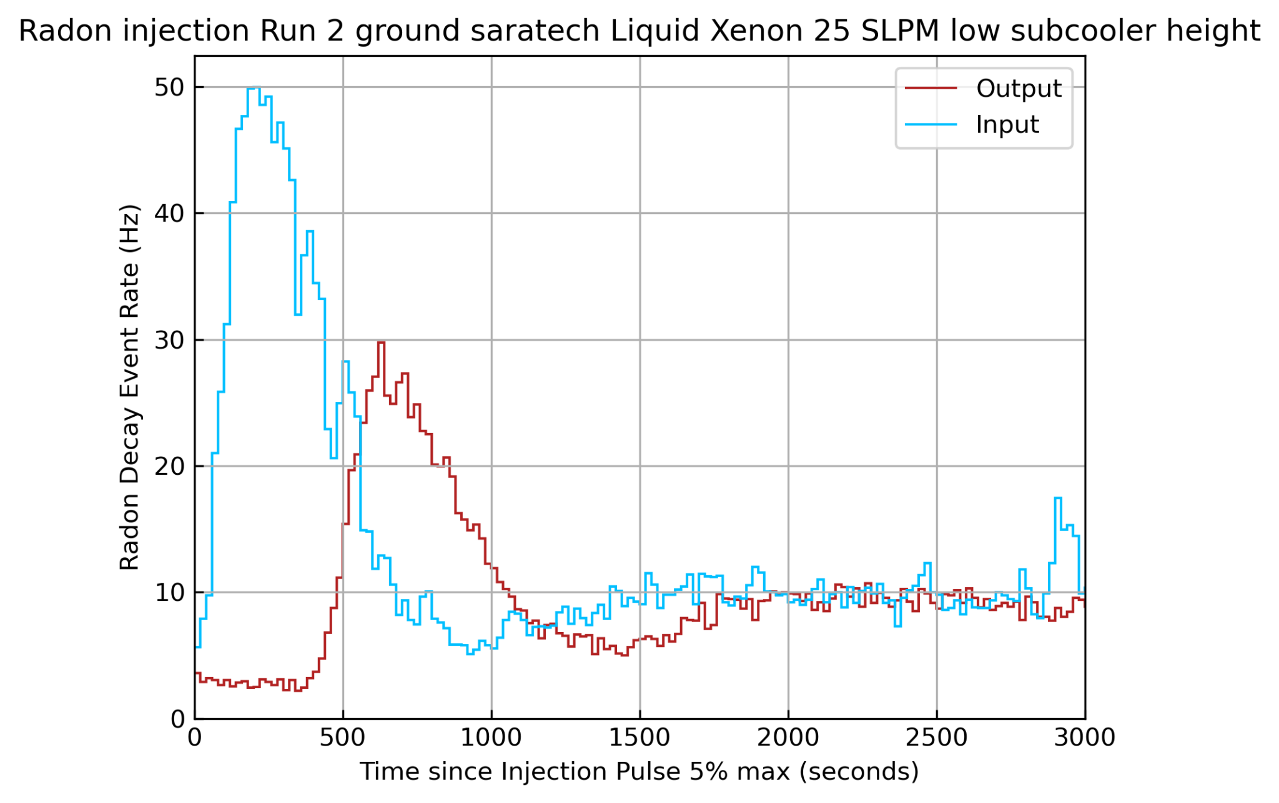
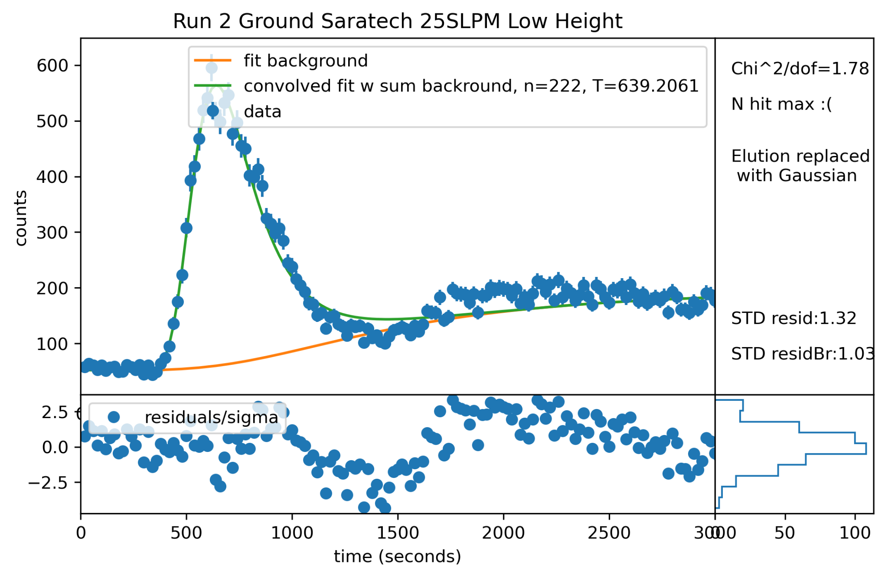
The Data
Using the PMTs we measure radon alpha decays via scintillation light. We then select radon events with a waveform area cut
We then look at the time dependent radon rate in the PMT before and the PMT after the columns
We fit these curves to extract the time delay of the radon
Notes:
We measure radon decay alpha events using Photomultiplier tubes to track radon in our system
We then select radon events from background by looking at PMT areas
We primarily fit and analyze the Radon decay event rate vs time. Above is an example dataset for an injection. The light blue pulse is the radon distribution passing the first PMT, and the red is the radon passing the second PMT after being delayed by the chromatographic column
We fit this second curve as can be seen on the right, to extract the breakthrough time of the radon

Slide 22
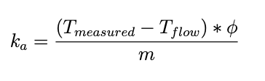
Extracting the adsorption coefficient (k)
In Gas
Inlet PMT
Outlet PMT
In Liquid
Liquid Xenon Flow
Notes:
The breakthrough time we directly measure depends on the rate of fluid flow and the amount of adsorbent mass. To understand our fundamental material properties, we convert this to the flow and mass independent asdorbtion coefficient. In gas we can use the equation on the left, where phi is the mass flow rate and m is the adsorbent mass. In the liquid measurements, we also have to account for the time delay not caused by chromatography but due to the slow travel time of fluid across the column. So we modify the equation to subtract off this travel time

Slide 23
Extracting the adsorption coefficient (k)
In Gas
Radon enters First PMT→ T=0
Inlet PMT
Outlet PMT
In Liquid
Radon
Liquid Xenon Flow
Notes:
The breakthrough time we directly measure depends on the rate of fluid flow and the amount of adsorbent mass. To understand our fundamental material properties, we convert this to the flow and mass independent asdorbtion coefficient. In gas we can use the equation on the left, where phi is the mass flow rate and m is the adsorbent mass. In the liquid measurements, we also have to account for the time delay not caused by chromatography but due to the slow travel time of fluid across the column. So we modify the equation to subtract off this travel time

Slide 24
Extracting the adsorption coefficient (k)
In Gas
Inlet PMT
Outlet PMT
In Liquid
Radon
Liquid Xenon Flow
Notes:
The breakthrough time we directly measure depends on the rate of fluid flow and the amount of adsorbent mass. To understand our fundamental material properties, we convert this to the flow and mass independent asdorbtion coefficient. In gas we can use the equation on the left, where phi is the mass flow rate and m is the adsorbent mass. In the liquid measurements, we also have to account for the time delay not caused by chromatography but due to the slow travel time of fluid across the column. So we modify the equation to subtract off this travel time

Slide 25
Extracting the adsorption coefficient (k)
In Gas
Inlet PMT
Outlet PMT
In Liquid
Radon
Liquid Xenon Flow
Notes:
The breakthrough time we directly measure depends on the rate of fluid flow and the amount of adsorbent mass. To understand our fundamental material properties, we convert this to the flow and mass independent asdorbtion coefficient. In gas we can use the equation on the left, where phi is the mass flow rate and m is the adsorbent mass. In the liquid measurements, we also have to account for the time delay not caused by chromatography but due to the slow travel time of fluid across the column. So we modify the equation to subtract off this travel time

Slide 26
Extracting the adsorption coefficient (k)
In Gas
Inlet PMT
Outlet PMT
In Liquid
Radon
Liquid Xenon Flow
Notes:
The breakthrough time we directly measure depends on the rate of fluid flow and the amount of adsorbent mass. To understand our fundamental material properties, we convert this to the flow and mass independent asdorbtion coefficient. In gas we can use the equation on the left, where phi is the mass flow rate and m is the adsorbent mass. In the liquid measurements, we also have to account for the time delay not caused by chromatography but due to the slow travel time of fluid across the column. So we modify the equation to subtract off this travel time

Slide 27
Extracting the adsorption coefficient (k)
In Gas
Inlet PMT
Outlet PMT
In Liquid
Radon
Liquid Xenon Flow
Notes:
The breakthrough time we directly measure depends on the rate of fluid flow and the amount of adsorbent mass. To understand our fundamental material properties, we convert this to the flow and mass independent asdorbtion coefficient. In gas we can use the equation on the left, where phi is the mass flow rate and m is the adsorbent mass. In the liquid measurements, we also have to account for the time delay not caused by chromatography but due to the slow travel time of fluid across the column. So we modify the equation to subtract off this travel time

Slide 28
Extracting the adsorption coefficient (k)
In Gas
Radon enters Second PMT→ T=T_{measured}
Inlet PMT
Outlet PMT
In Liquid
Radon
Liquid Xenon Flow
Notes:
The breakthrough time we directly measure depends on the rate of fluid flow and the amount of adsorbent mass. To understand our fundamental material properties, we convert this to the flow and mass independent asdorbtion coefficient. In gas we can use the equation on the left, where phi is the mass flow rate and m is the adsorbent mass. In the liquid measurements, we also have to account for the time delay not caused by chromatography but due to the slow travel time of fluid across the column. So we modify the equation to subtract off this travel time, which is the time delay that would be seen in the absence of chromatography

Slide 29
The Results
Notes:
So when what did our results look like?

Slide 30
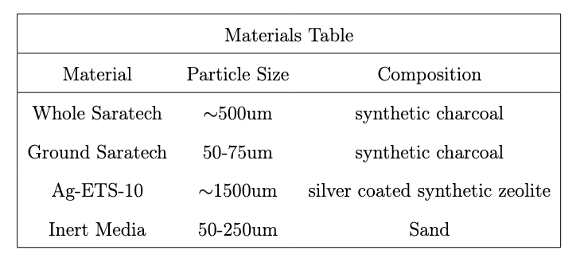
Materials Tested
We tested 3 different materials for this study
We also tested an inert material composed of sand, used to calibrate our system
Notes:
We tested the performance of 3 different materials
Whole Saratech Charcoal – this was the charcoal that was determined to be the most performant by the Michigan LZ group, and is currently used in the LZ Inline Radon reduction system for gas phase chromatography
Ground Saratech Charoal – the same Saratech but with reduced particle size
Ag-ETS-10 – A silver exchange zeolite which other studes have shown was 3 orders of magnitude more performant in argon and nitrogen at radon removal
We also ran the column with a inert sand material to calibrate our system

Slide 31
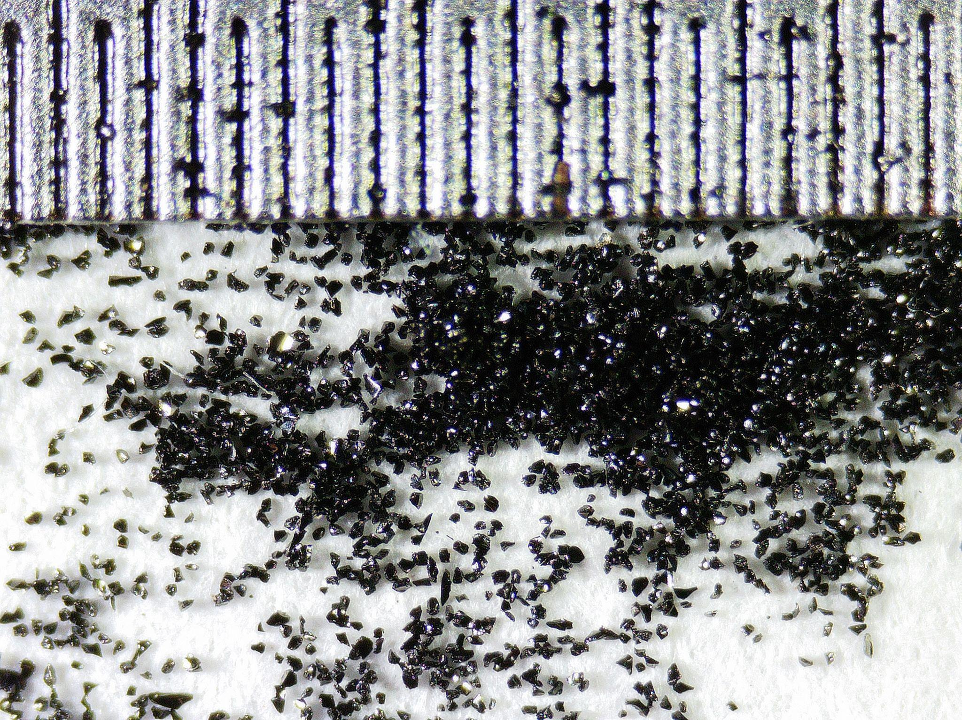
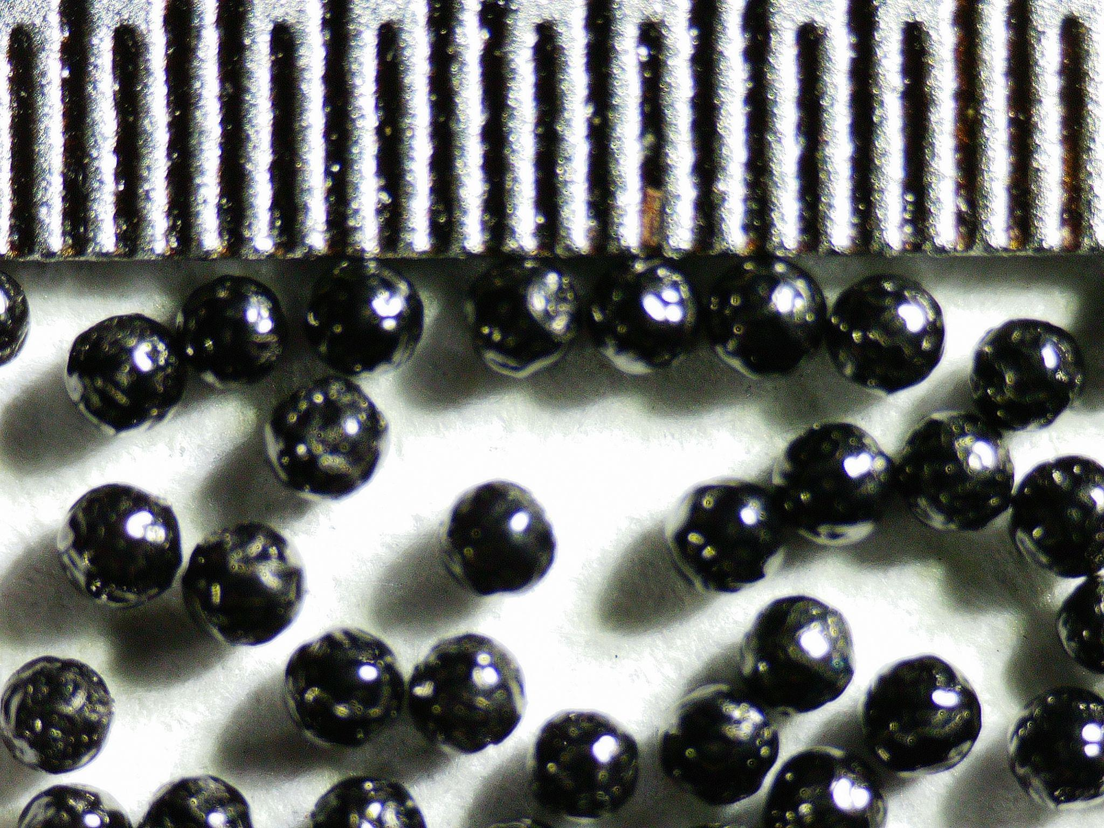
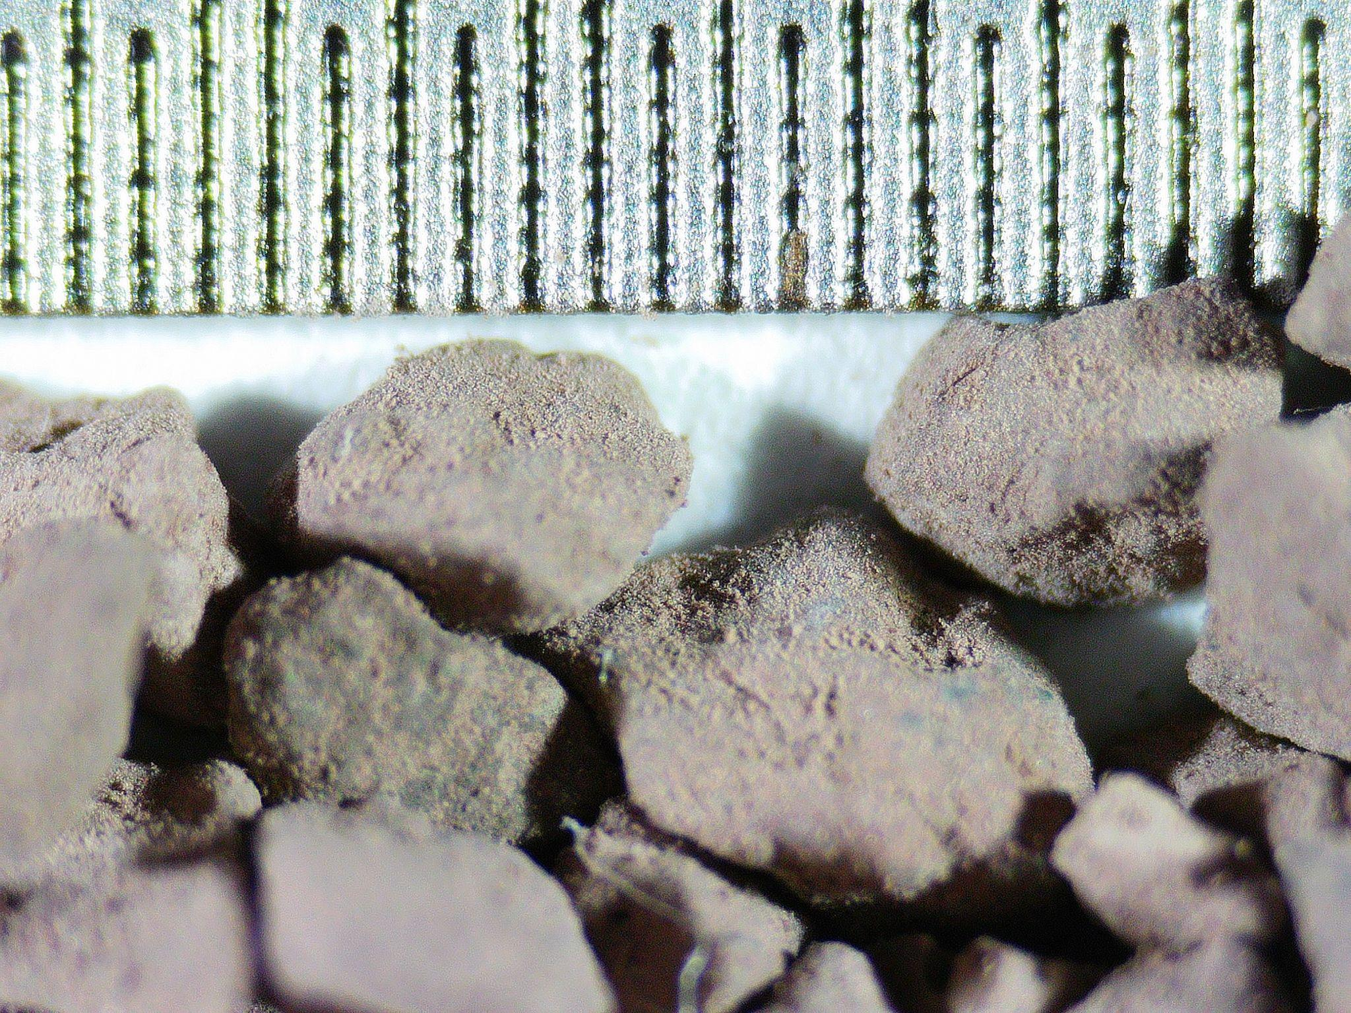
Materials Tested
We tested 3 different materials for this study
We also tested an inert material composed of sand, used to calibrate our system
Ground Saratech
Whole Saratech
Ag-ETS-10
Tic marks are 1/100’’
Notes:
We tested the performance of 3 different materials
Whole Saratech Charcoal – this was the charcoal that was determined to be the most performant by the Michigan LZ group, and is currently used in the LZ Inline Radon reduction system for gas phase chromatography
This charcoal was specifically selected by the Michigan LZ group for its low emissivity. Natural charcoals have high radon levels, this synthetic charcoal has much lower levels which is why we tested it
Ground Saratech Charoal – the same Saratech but with reduced particle size
Ag-ETS-10 – A silver exchange zeolite which other studes have shown was 3 orders of magnitude more performant in argon and nitrogen at radon removal
We also ran the column with a inert sand material to calibrate our system

Slide 32
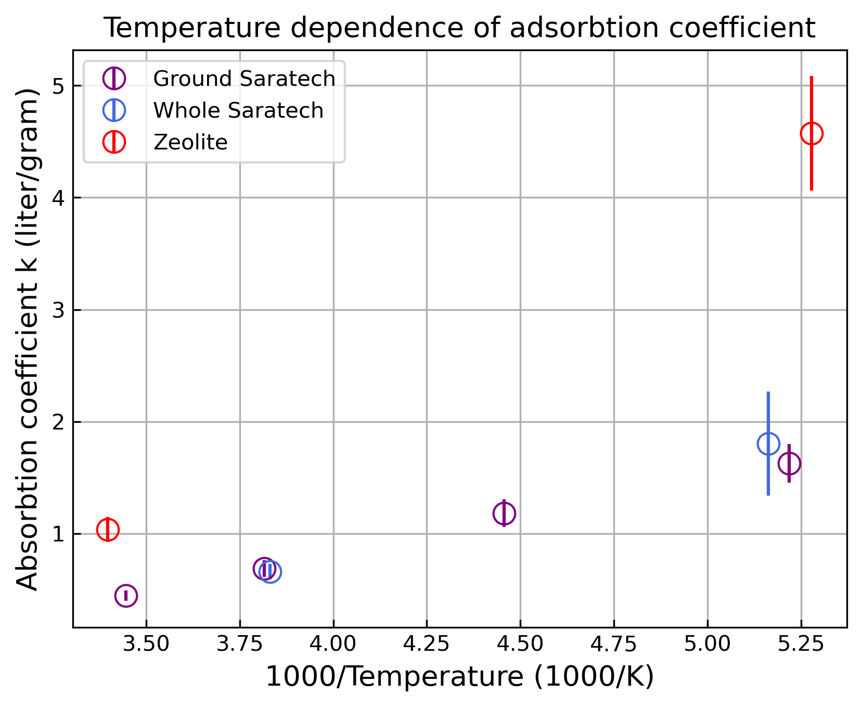
Gas Phase Results: System Validation and Comparison
Before the liquid measurements we performed gas phase chromatography measurements of the media
For the charcoal, these let us compare to prior measurements to confirm system performance
For the Ag-ETS-10 this was a novel measurement
Material | k_{a} at ~190K (l/g)
Whole Saratech | 1.8±0.5
Ground Saratech | 1.6±0.2
Ag-ETS-10 | 4.5±0.5
Notes:
Before we performed liquid measurements, we performed gas chromatography measurements to validate our system as these could be compared to others measurements as these had been measured before while the liquid coefficients have not
The whole and ground saratech adsorption coefficients were consistent with eachother, and with prior measurements
The Ag-ETS-10 performed better thant he charcoal, but not nearly as much better as it had in argon or nitrogen. We attribute this to the much greater similarity in the atomic size and attraction to the zeolite of xenon and radon vs xenon and argon

Slide 33
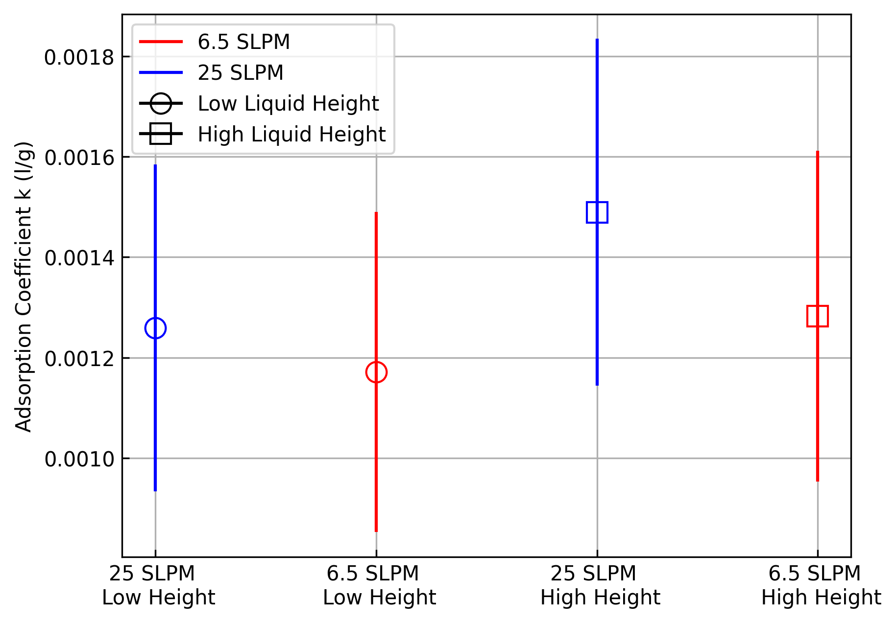
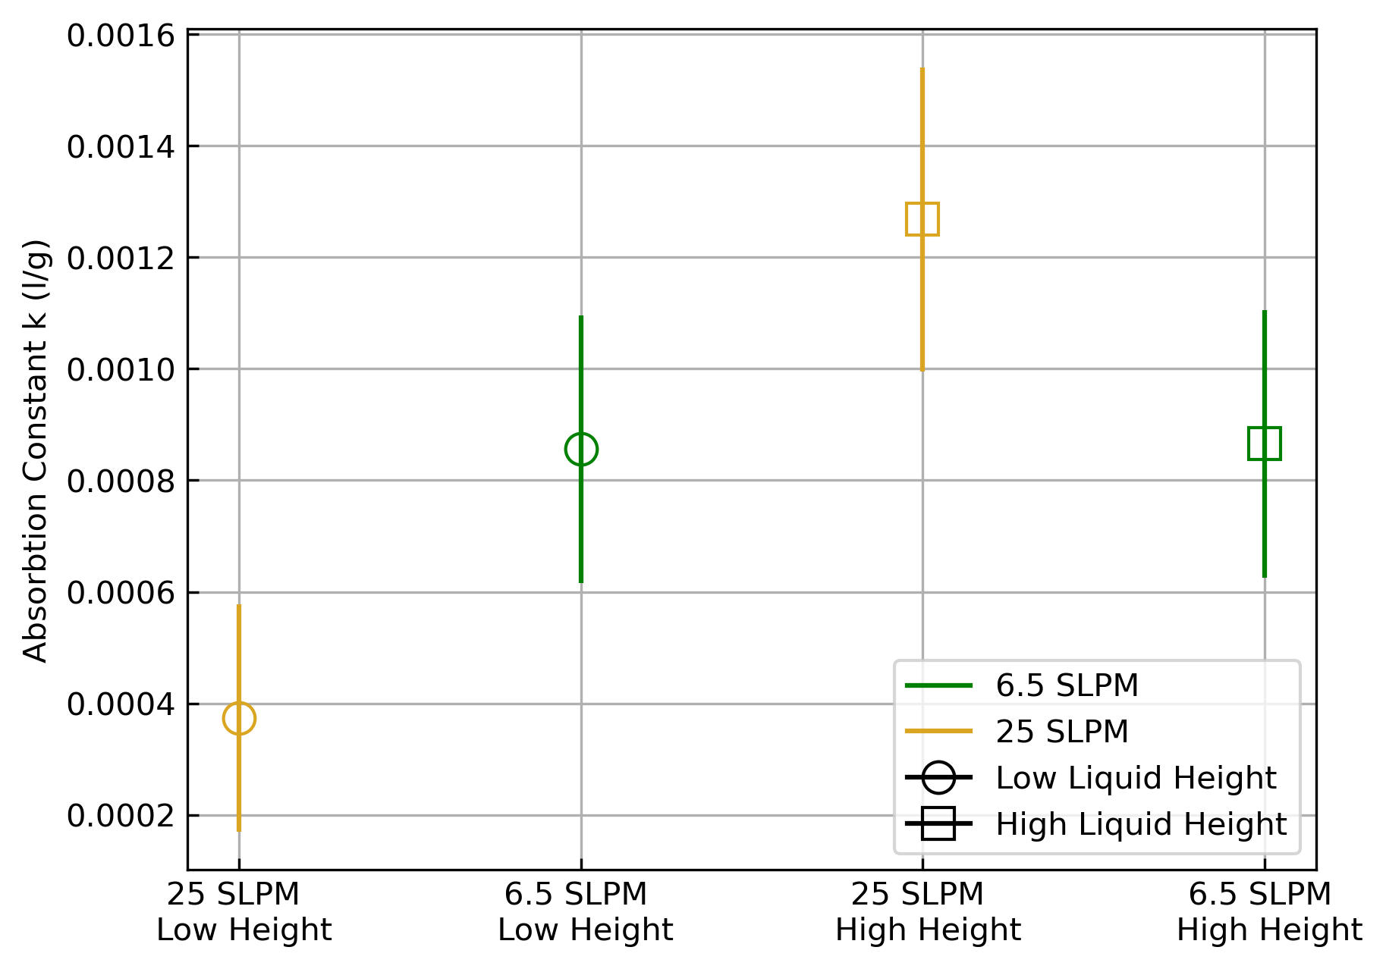
Liquid Phase Results – Charcoal
Both Saratech performance drops 3 orders of magnitude from liquid to gas!
We performed measurements of each charcoal in several detector states to check systematics
Material | Liquid k_{a} (l/g) | Gas k_{a} (l/g)
Ground Saratech | (1.3±0.2*10⁻³ | 1.6±0.2
Whole Saratech | (0.8±0.1)*10⁻³ | 1.8±0.5
Notes:
After validating our performance in the gas, we moved on to liquid measurements
We measured the adsorption coefficients of the whole and ground saratech charcoals, at two flow rates and in two different system thermodynamic conditions
Overall, we saw that the ground saratech performed better on average than the whole, but both saratechs suffered a drop in the adsorption coefficient of more than 3 orders of magnitude
This is puzzling, and not what we expected from the previous measurements. The density only changes by a factor of about 4 from the cold gas measurements, so it does not make sense for this to just be a story about density. Some process in the phase transition must impact the adsorption coefficient

Slide 34
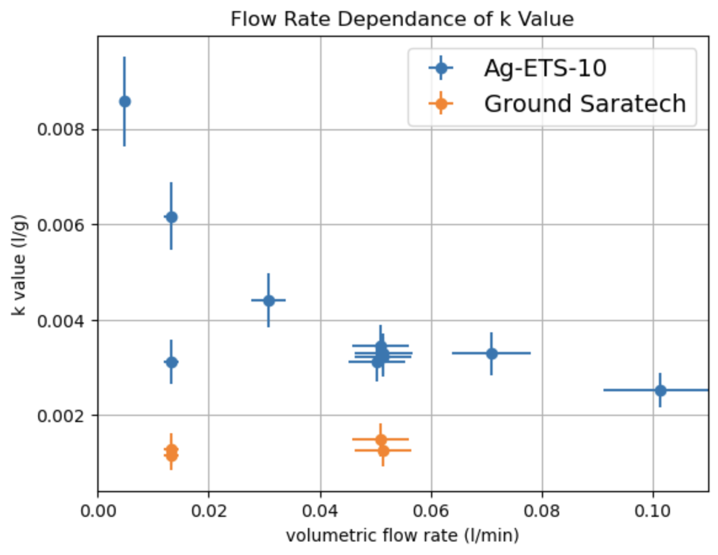
Liquid Phase Results – Zeolite
Zeolite performance decreased similarly from liquid to gas
Adsorption coefficient showed a marked flow rate dependance
Material | Liquid max k_{a} (l/g) | Gas k_{a} (l/g)
Ag-ETS-10 | (8.6±0.9)*10⁻³ | 4.6±0.5
Notes:
After the charcoal, we performed liquid measurements of the zeolite
The zeolite similarly showed a similar performance drop from gas to liquid as the charcoal
Interestingly though, the zeolite showed a marked flow rate dependence in its adsorption coefficient
The slower the volumetric flow rate of the liquid, the better the adsorption coefficient
This behavior is not predicted by parallel plate chromatography theory, so we are reaching the end of the regime this model describes well. We think this may be due to the radon taking significant time to penetrate the zeolite crystal structure, and thus at slower flow rates it is able to access more binding sites, but further study would be needed to confirm this

Slide 35
Conclusion
We performed the first and only measurements of the liquid phase adsorption coefficients of Saratech Charcoal and Ag-ETS-10 Zeolite for Rn removal from LXe
Neither Saratech Charcoal or Ag-ETS-10 are viable candidates for a LXe Rn removal swing system
They both have insufficient liquid phase adsorption coefficients to reach the breakeven threshold
Further development of a phase swing system would require a new material, and a better understanding of the decrease effectiveness of these tested materials in the liquid phase
Material | ~190K Gas k_{a} (l/g) | Liquid k_{a} (l/g) | Required liquid k_{a} (l/g)
Whole Saratech | 1.8±0.5 | (1.3±0.2)*10⁻³ | 5.17*10⁻³
Ground Saratech | 1.6±0.2 | (0.8±0.1)*10⁻³ | 4.68*10⁻³
Ag-ETS-10 | 4.6±0.5 | (8.6±0.9)*10⁻³ | 13.1*10⁻³
Notes:
In conclusion, we conudced the first and only measurements of the adsorbtiuon coefficients of Saratech Charcoal and Ag-ETS-10 zeolite in liquid xenon for radon removal
Unfortunately neither material has a liquid adsotbtion coefficient that meets the minimum requirements for a phase swing system
Further development of a phase swing system would require a new material, and a better understanding fo the cause of the sharp performance drop from the gas to liquid phase

Slide 36
Backup

Slide 37
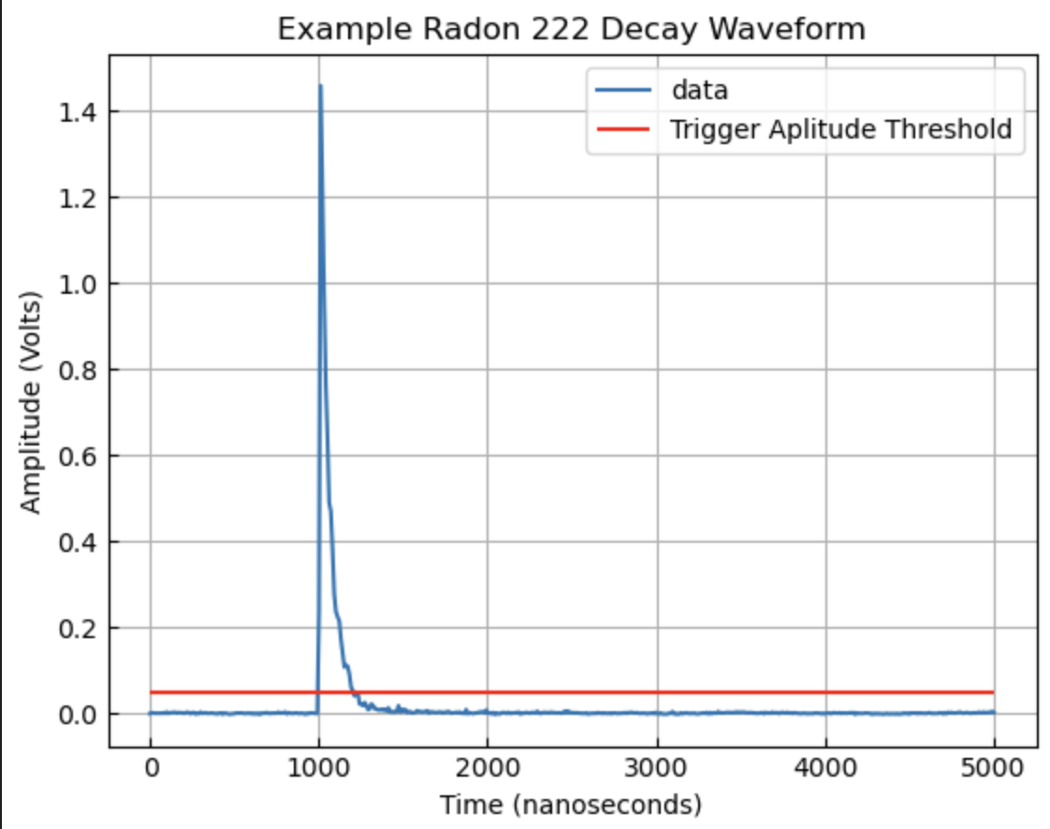
The Data: Making radon visible through alpha decay (edit me)
Using the PMTs we measure radon alpha decays via scintillation light
We then select radon events with a waveform area cut
Xe*
Xe
𝛄
Xe₂*
Xe
𝜶
𝜶
Xe
Notes:
We measure the rate of radon decays as a proxy for radon concentration using the two PMTs
When a radon undergoes an alpha decay, the alpha particle scatters off of the liquid or gaseous xenon producing scintillation light which out PMTs detect. We trigger on an amplitude threshold, which can be set high to cut out noise due to the large radon alpha scintilaltion pulses

Slide 38
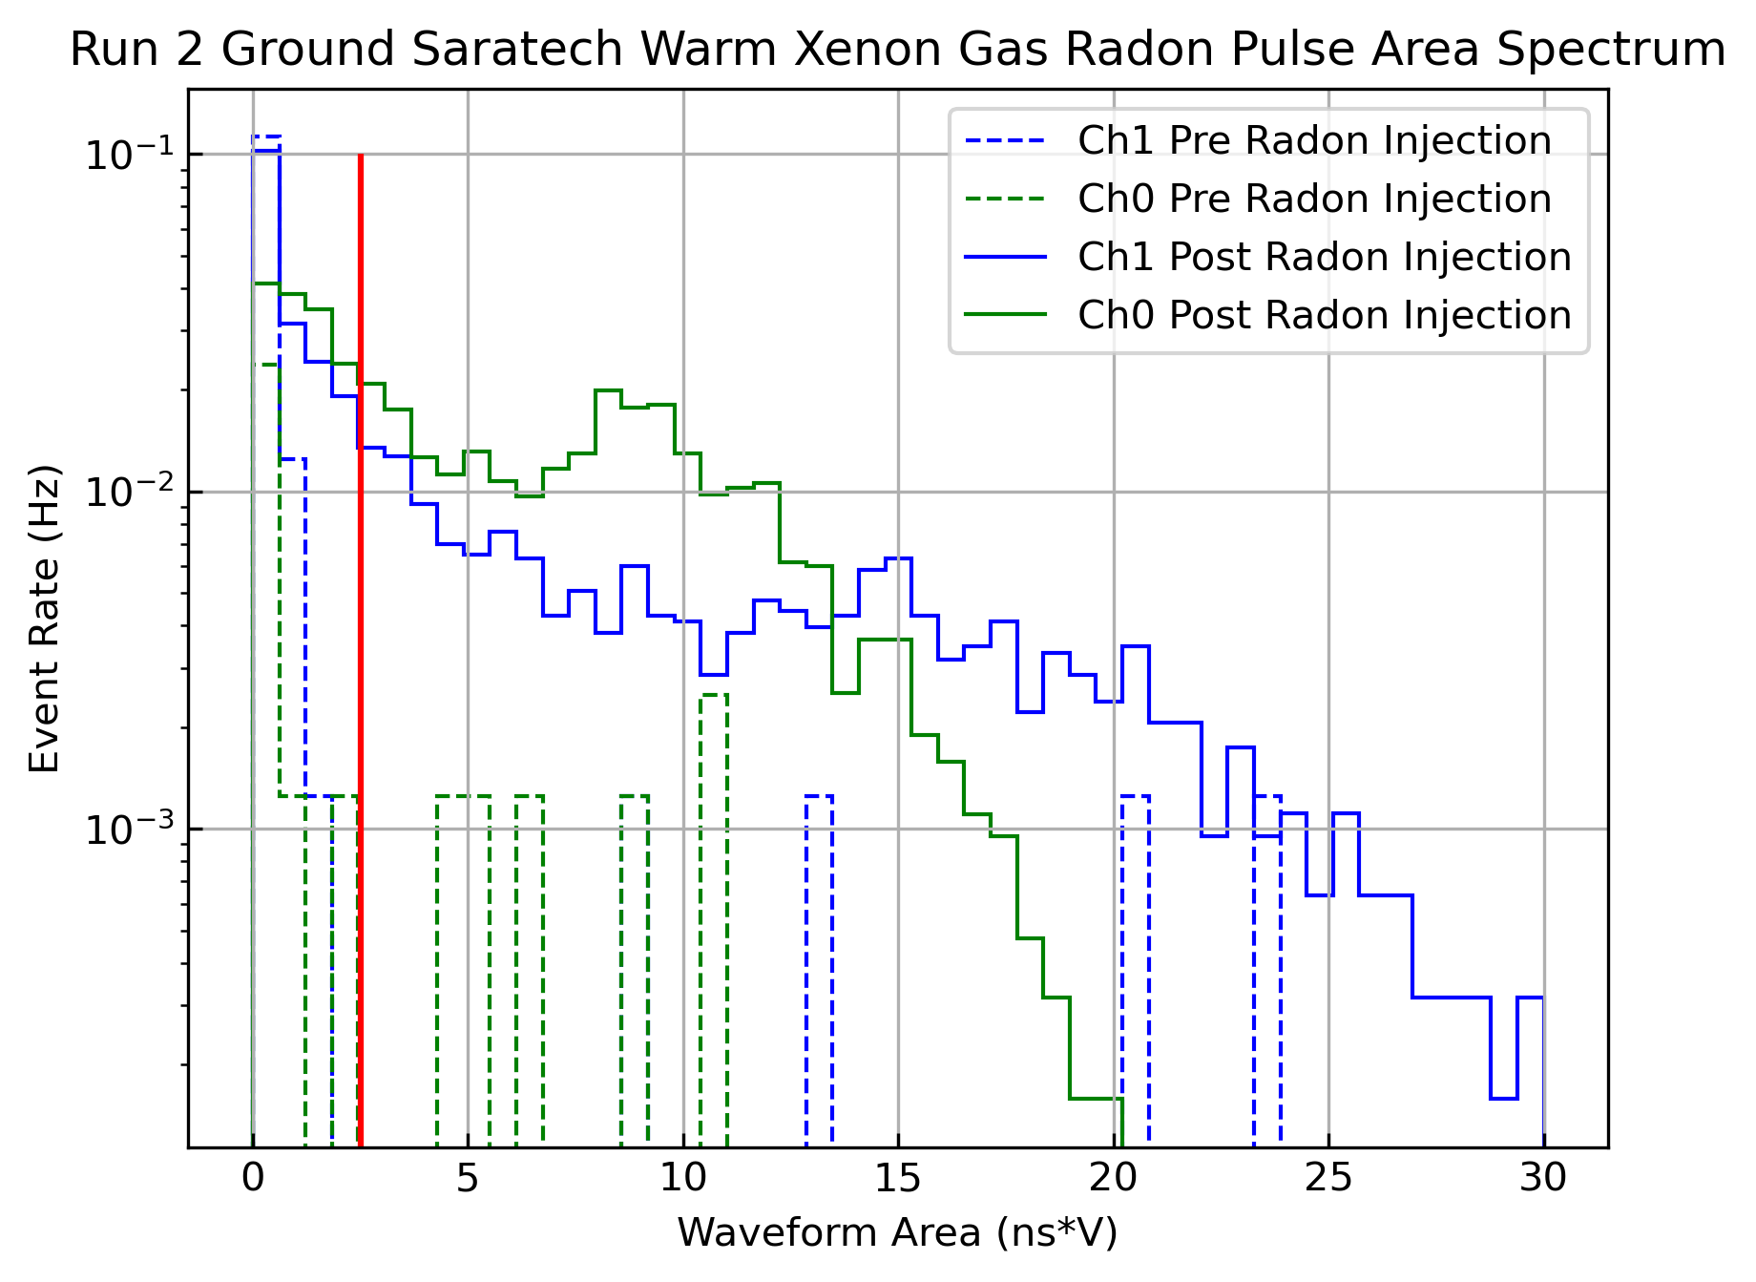
The Data
We then perform a cut on waveform area to select Radon events and remove low energy backgrounds and dark events
We calibrate this cut by observing event area spectrum pre-radon injection and post radon injection
Notes:
We then select radon events from backgrounds or noise events by an area cut
This cut is determined by looking at the area spectrum in each channel before and after a radon injection. The cut is placed to preserve as many radon events as possible while cutting out the low energy noise events

Slide 39
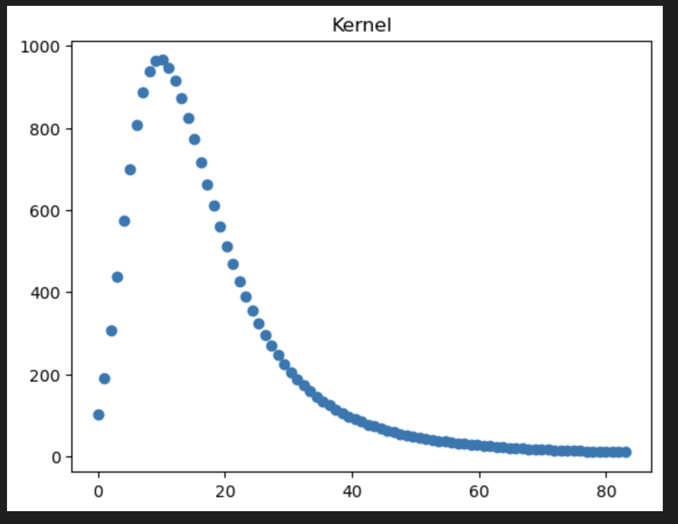
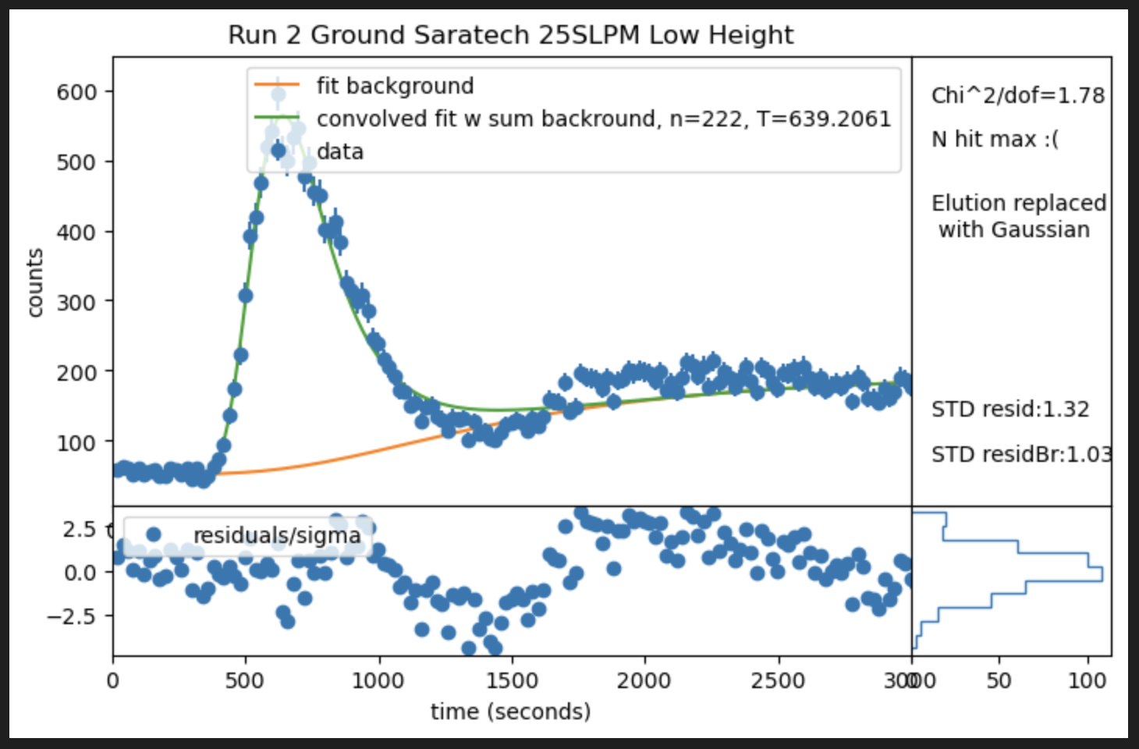
Fitting Procedure
We first fit the input pulse to a skewed gaussian
We then convolve it with an elution curve
We also add a rising background to account for the echo
SECTION TITLE AND/OR DEPARTMENT

Slide 40
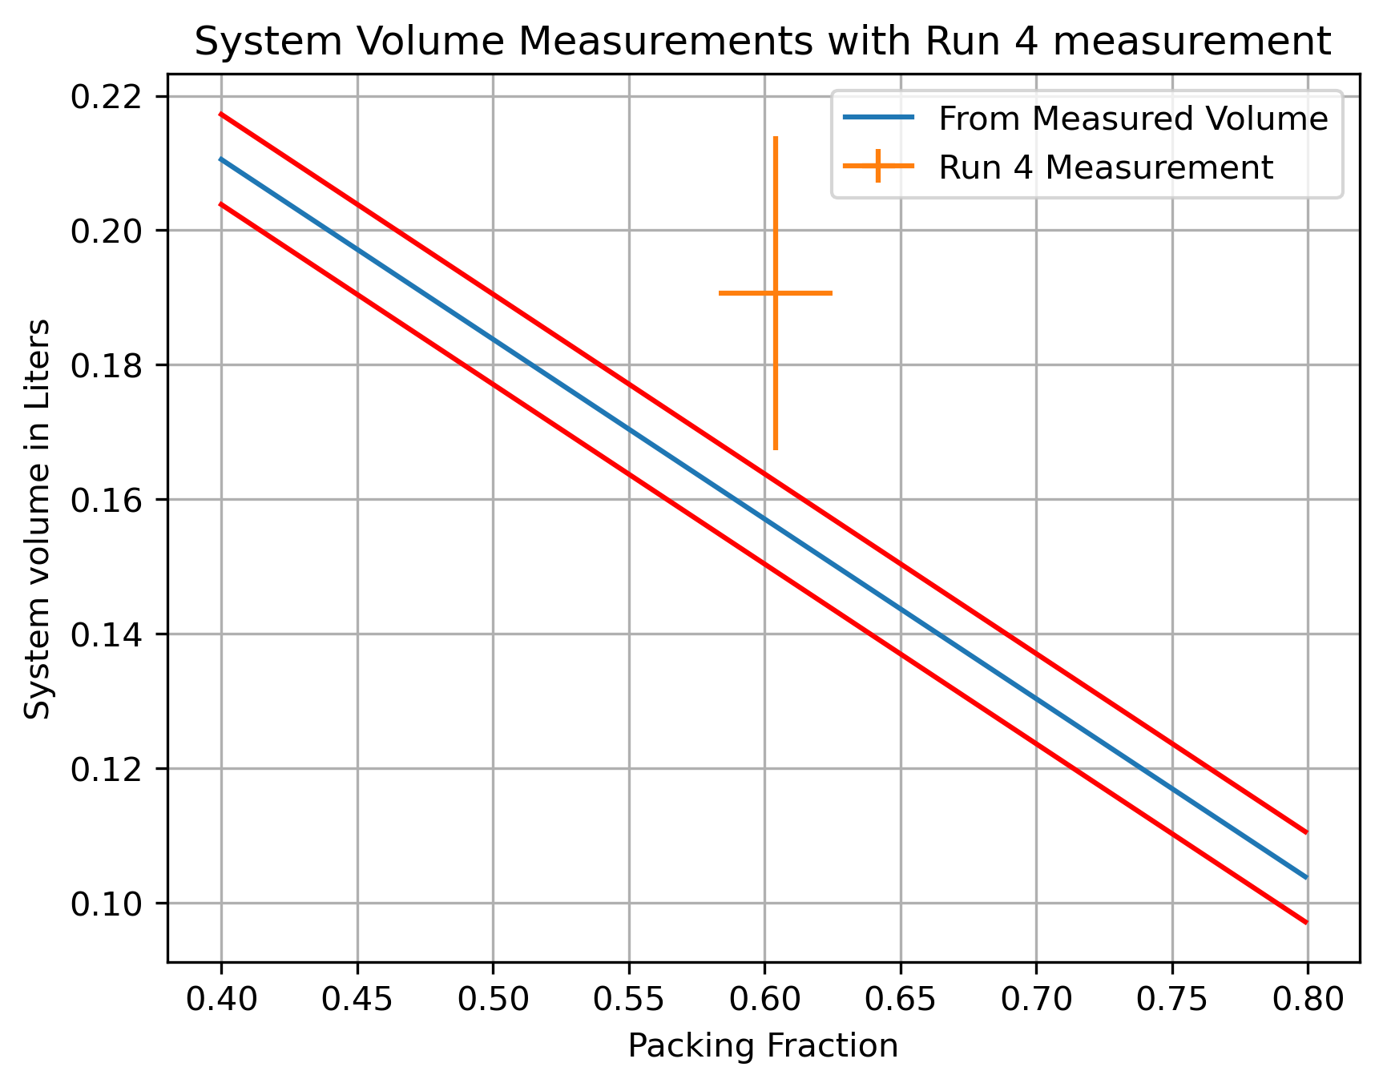
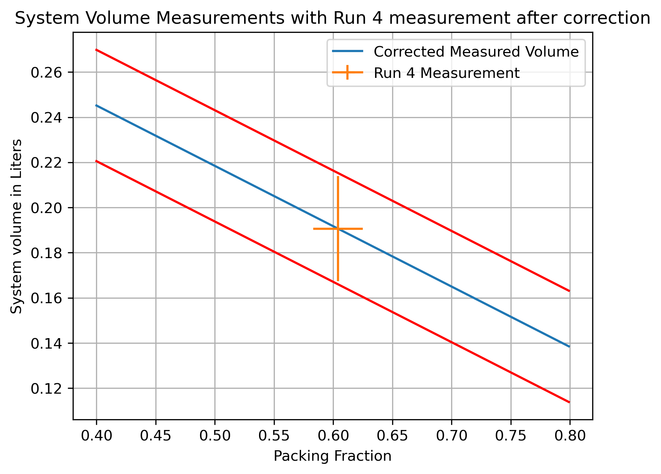
Volume Measurements
We estimated the system volume by measuring the internal volumes of components
We then corrected the measured volume with a measurement with a material with no chromatographic properties, an inert sand media
SECTION TITLE AND/OR DEPARTMENT

Slide 41
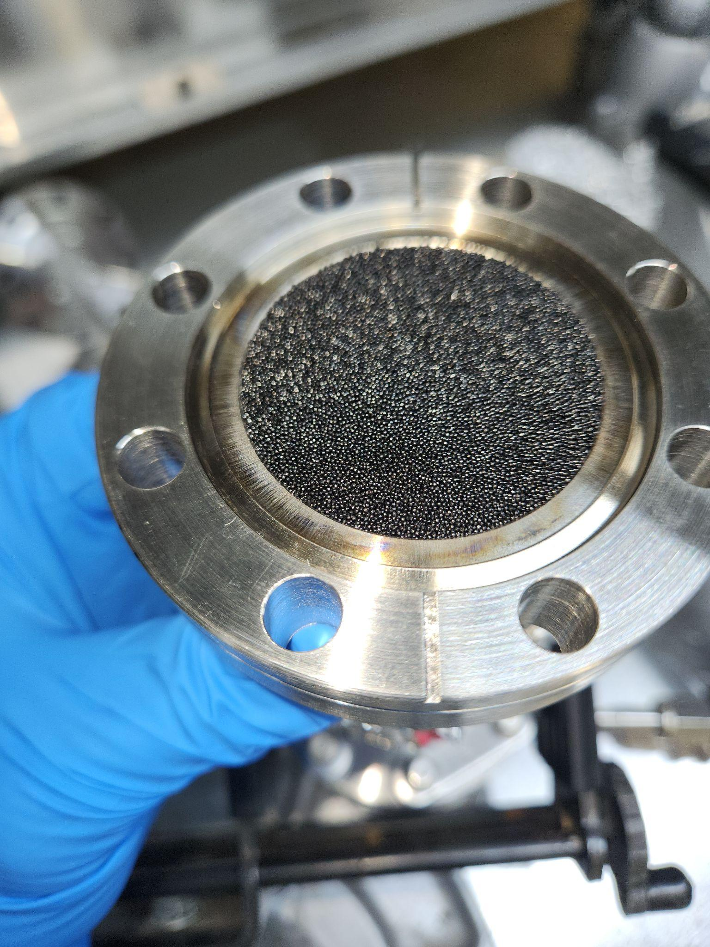
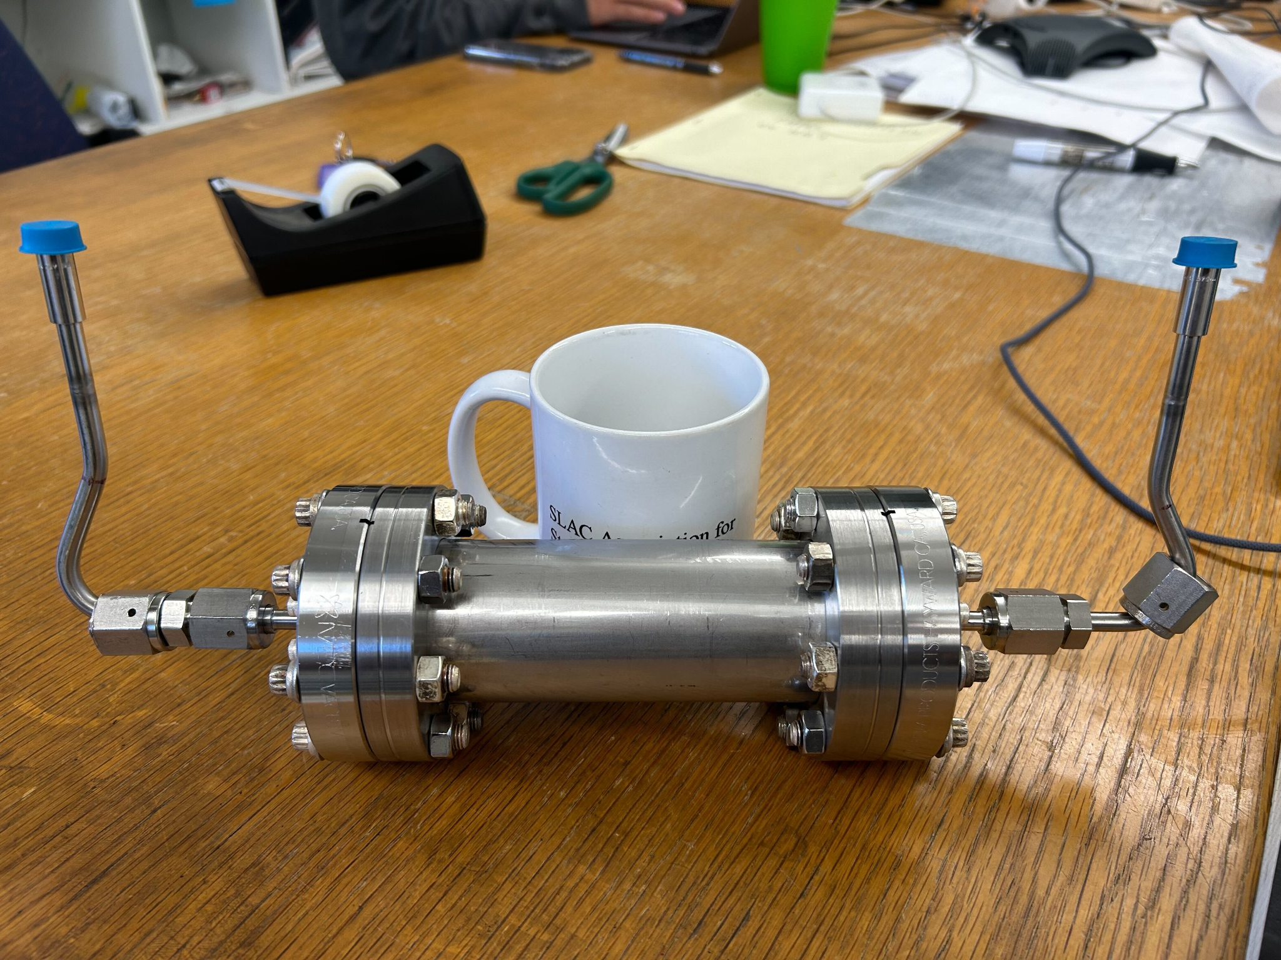
The Trap
SECTION TITLE AND/OR DEPARTMENT

Slide 42
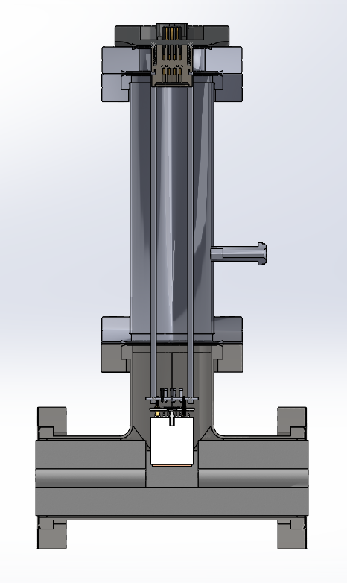
The PMT cells
SECTION TITLE AND/OR DEPARTMENT

Slide 43
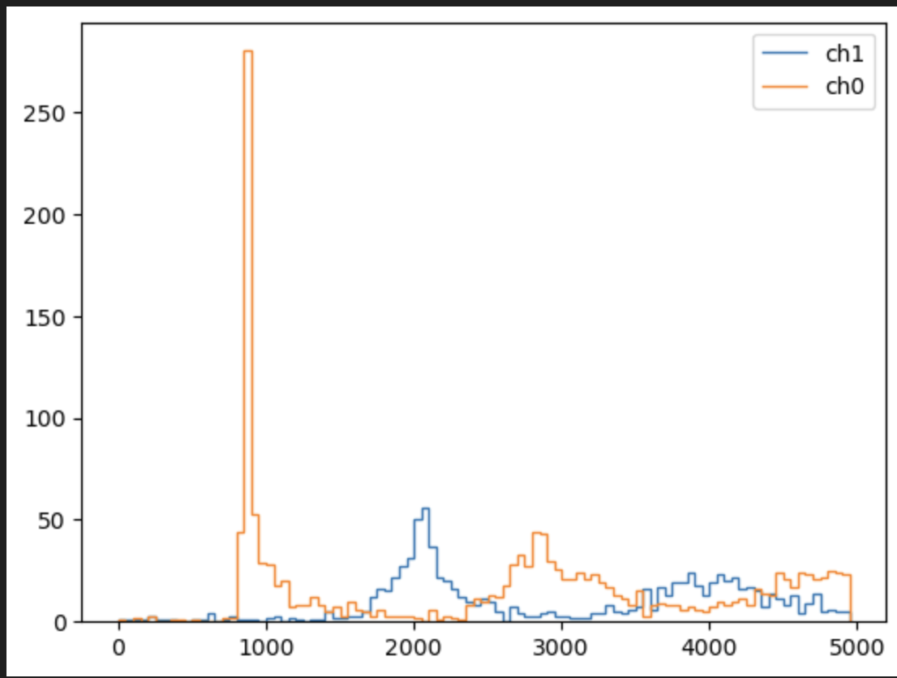
System Echos
As our system is a closed loop, radon will continue to circulate until it decays
In the liquid results this radon recirculation diffuses into a flat background
In gas we see clear ‘echo’ peaks
SECTION TITLE AND/OR DEPARTMENT

