Slide 1

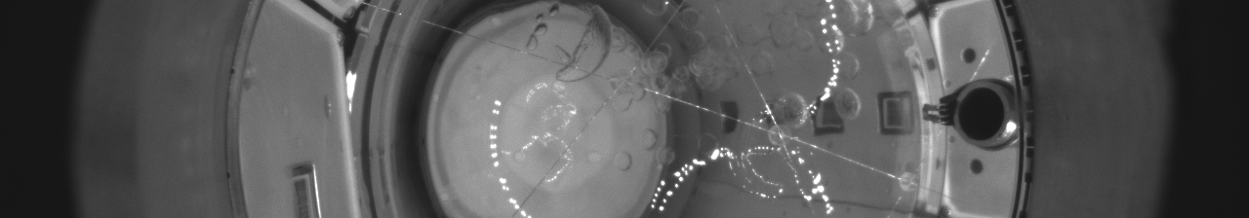
First Results from the Scintillating Bubble Chamber Liquid Argon 10 kg (SBC-LAr10) Detector
Ryan Zhang
representing SBC collaboration
CPAD
October 20, 2026

Slide 2
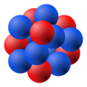
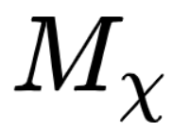
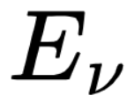
Introduction
Scintillating Bubble Chamber
  Scintillation: high energy background discrimination
  Bubble: O(100) eV nuclear recoil (NR) detection
    Dark matter via elastic scattering: ~ GeV
    Neutrino via Coherent elastic neutrino-nucleus scattering (CE𝑣NS): ~ MeV
Notes:
we are detecting rare scattering event such as dark matter and CEVSN. They scattering from nucleus. and cause NR.
GeV dark matter detection
MeV energy neutrino

Slide 3
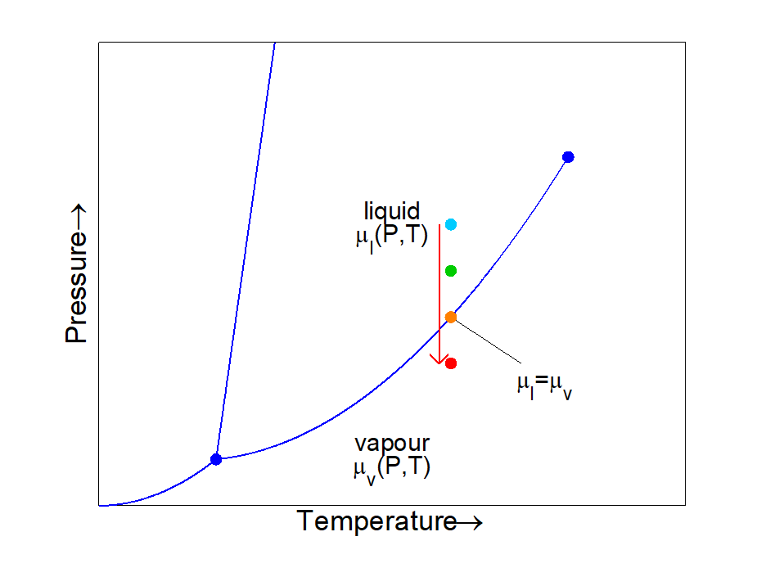

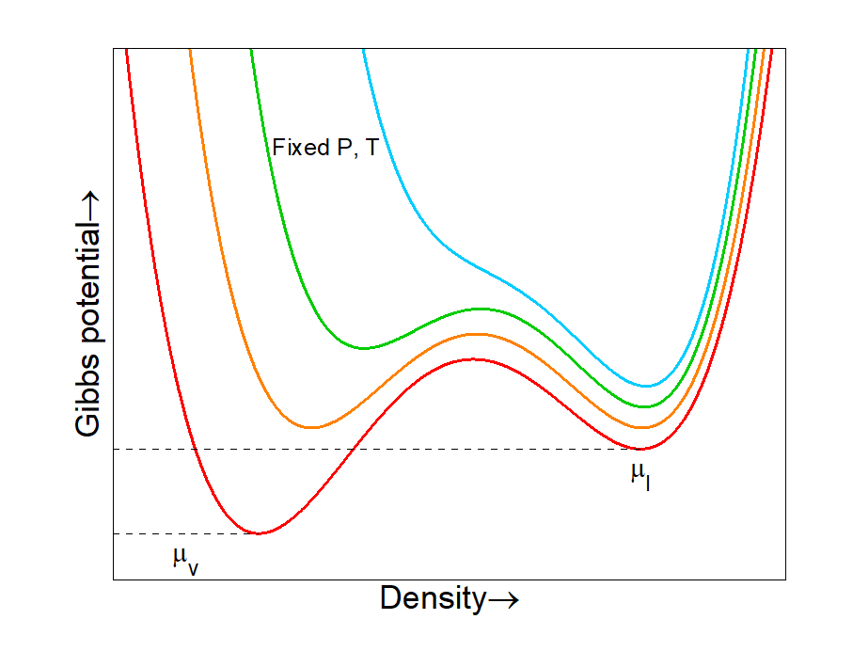
Signals in Bubble Chamber
Superheated fluid
  NR > energy threshold ( )
  Bubble nucleates
Advantage
  Electron Recoil (ER):
    Dominant background
    Low nucleation efficiency
  Strong gamma rejection

Slide 4
Signals in Bubble Chamber
Superheated fluid
  NR > energy threshold ( )
  Bubble nucleates
Advantage
  Electron Recoil (ER):
    Dominant background
    Low nucleation efficiency
  Strong gamma rejection
Particle Interaction

Slide 5
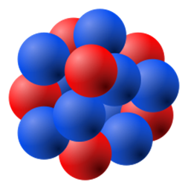
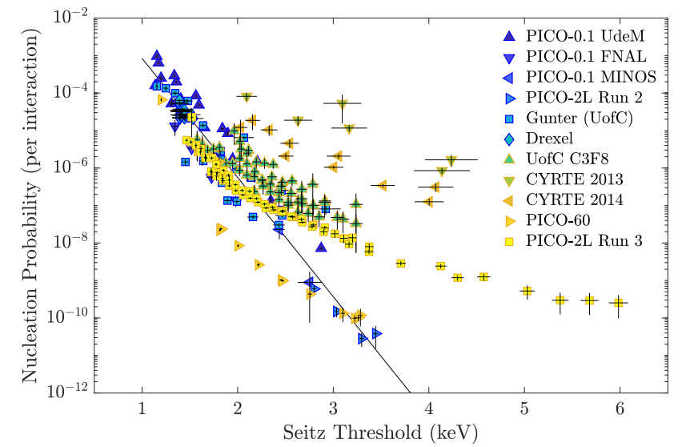
Signals in Bubble Chamber
Superheated fluid
  NR > energy threshold ( )
  Bubble nucleates
Advantage
  Electron Recoil (ER):
    Dominant background
    Low nucleation efficiency
  Strong gamma rejection
PICO: https://arxiv.org/pdf/1905.12522

Slide 6
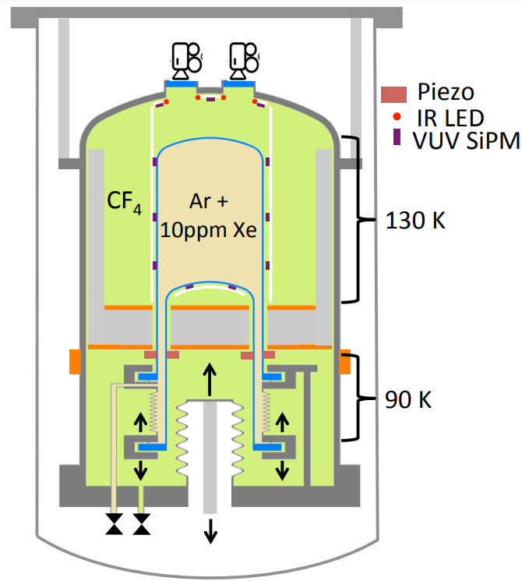
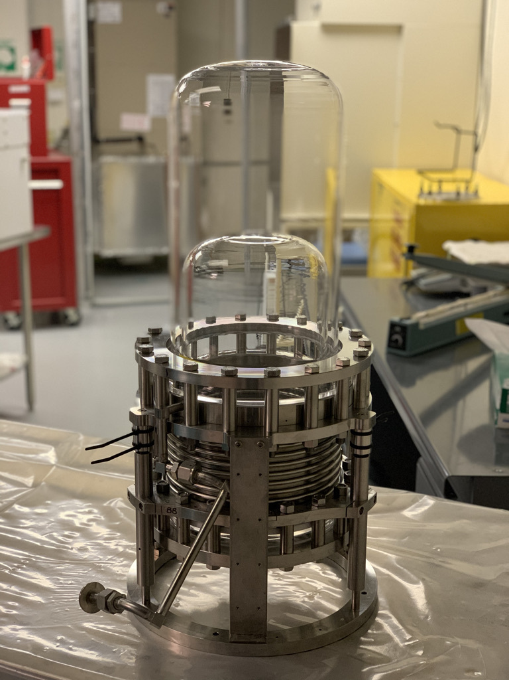
SBC Structure
Sensitive volume - liquid argon
  Heat -> bubble
  Scintillation light

Slide 7
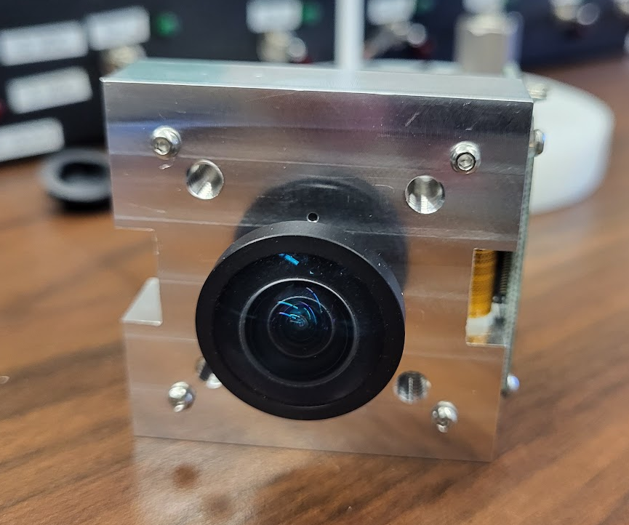
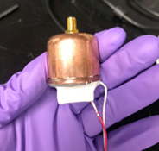
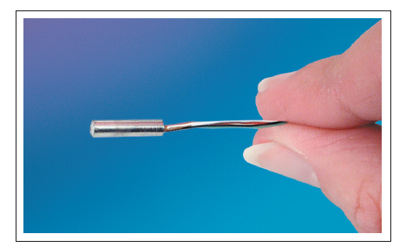
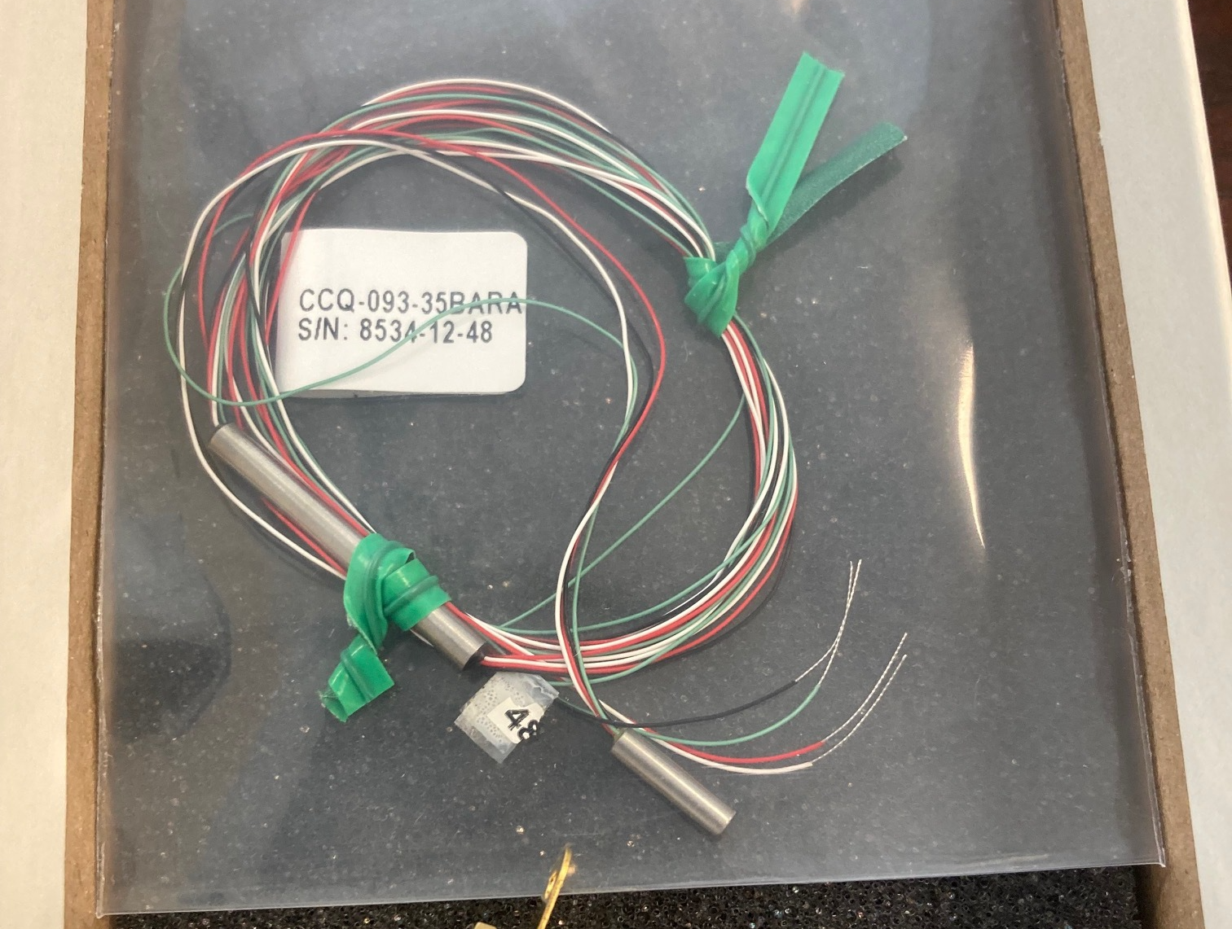
SBC Structure
Sensitive volume - liquid argon
  Heat -> bubble
  Scintillation light
Bubble detection
  Camera
  Acoustic sensor
  Pressure transducer

Slide 8
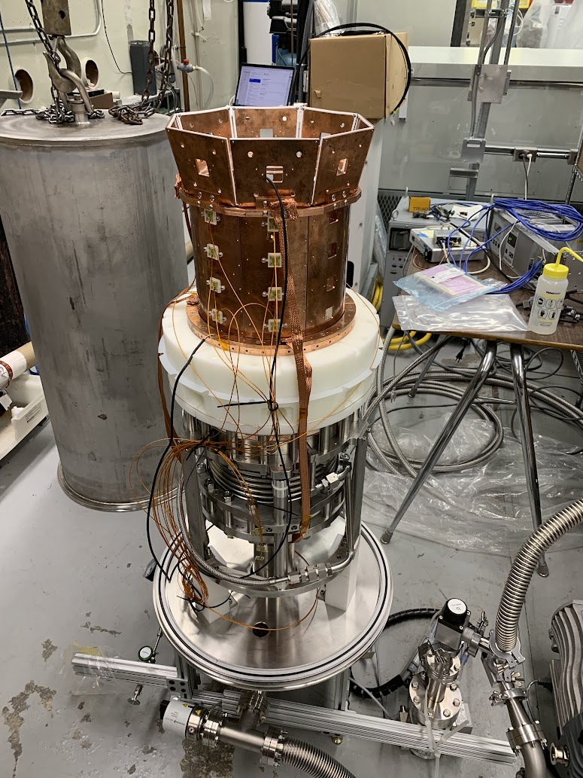
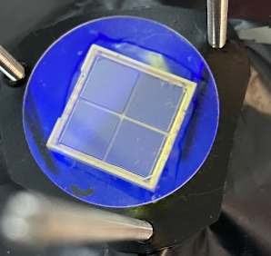
SBC Structure
Sensitive volume - liquid argon
  Heat -> bubble
  Scintillation light
Bubble detection
  Camera
  Acoustic sensor
  Pressure transducer
Scintillation detection
  Silicon PhotoMultiplier (SiPM)
  Xenon doping

Slide 9

SBC Structure
SBC-LAr10
  10kg calibration chamber
  MINOS, Fermilab
SBC-SNOLAB
  Identical detector
  SNOLAB
  Dark matter search
Sensitive volume - liquid argon
  Heat -> bubble
  Scintillation light
SBC Projects
Bubble detection
  Camera
  Acoustic sensor
  Pressure transducer
Scintillation detection
  Silicon PhotoMultiplier (SiPM)
  Xenon doping

Slide 10
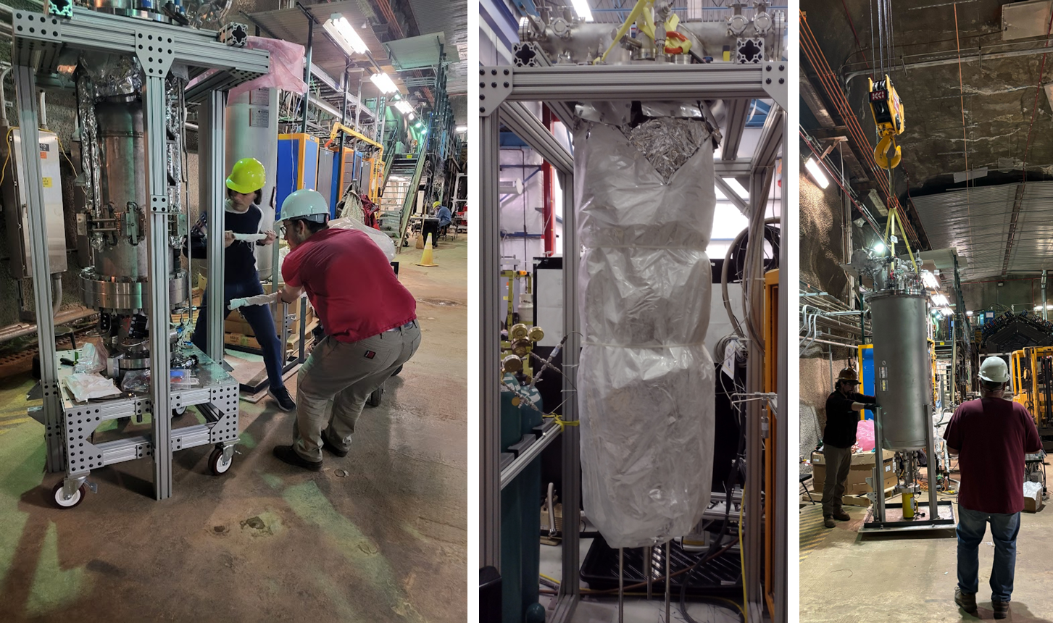
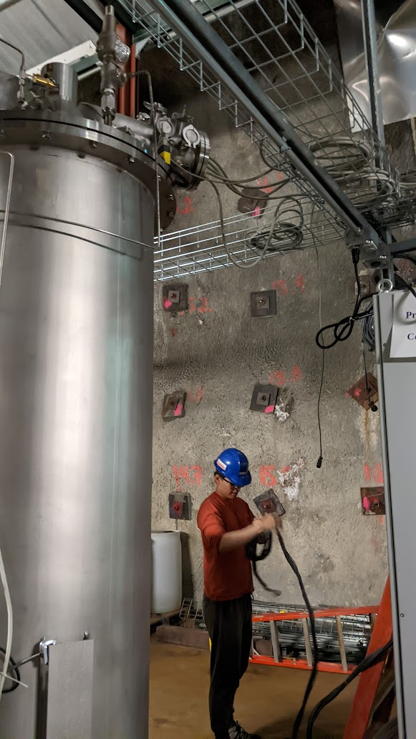
SBC-LAr10 First Operation
Notes:
should I use my pictures or no?

Slide 11
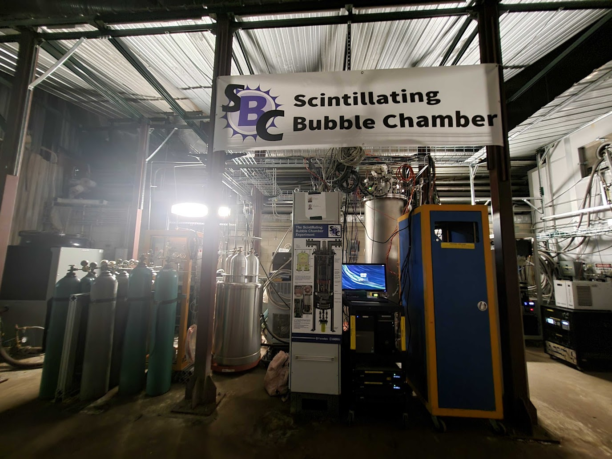
SBC-LAr10 First Operation
Programmable Logic Controller (PLC)
Slow Control (SC)
Data Acquisition (DAQ)
The first run began in the fall of 2025
PLC
SC
Detector
DAQ

Slide 12
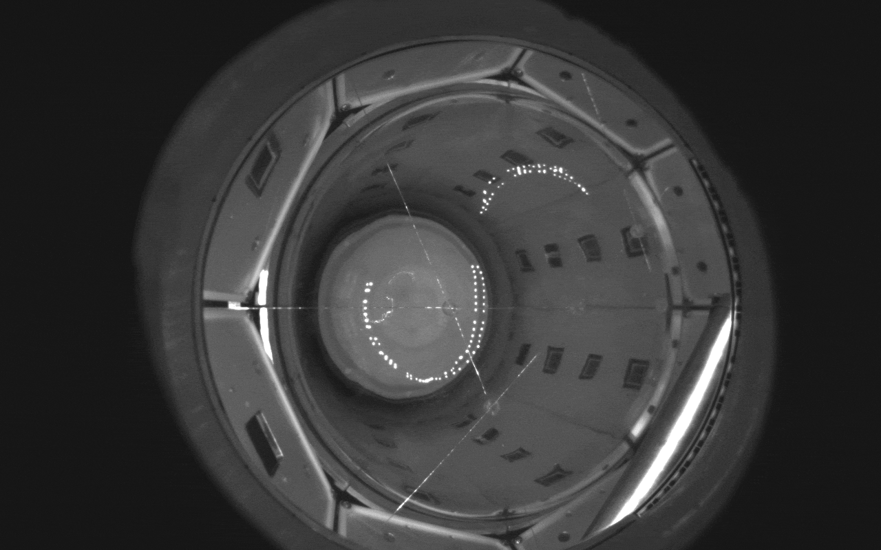
We See Bubbles!

Slide 13
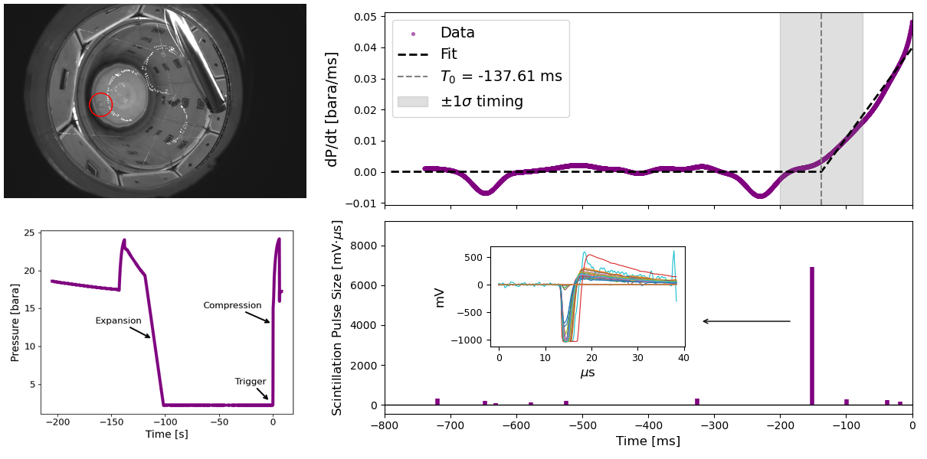

Multi-channel Signals
Camera
Pressure
Scintillation
Notes:
how pressure control system operates in a bubble event

Slide 14
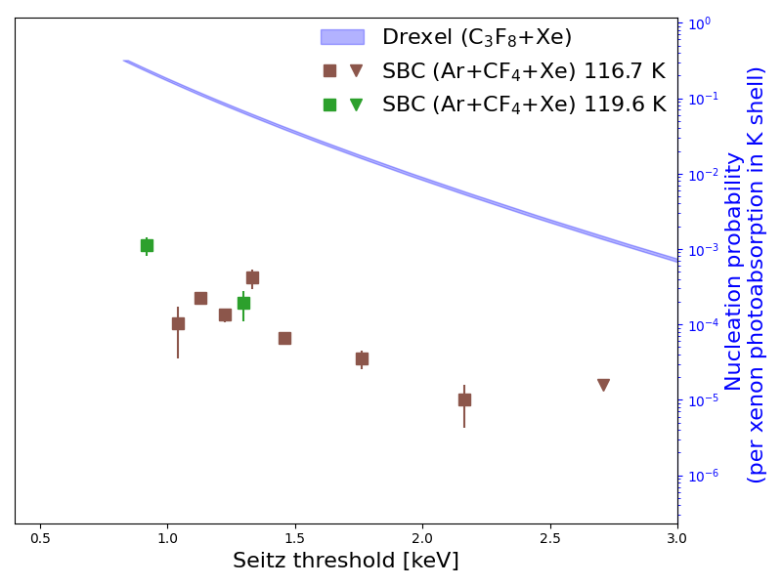
Gamma Rejection Analysis
Bubble chamber
  Strong ER background rejection
  Depends on the liquid thermodynamic properties
SBC ER nucleation
  Driving mechanism
    Xe photoabsorption induced
  Performance evaluation
    Good at 1 keV: 10⁻⁷ per keV
  Future improvement
    Remove CF₄ hydraulic fluid contamination
    Estimated to reach 10⁻⁶ per xenon photoabsorption
SBC
Preliminary

Slide 15
Gamma Rejection Analysis
Bubble chamber
  Strong ER background rejection
  Depends on the liquid thermodynamic properties
SBC ER nucleation
  Driving mechanism
    Xe photoabsorption induced
  Performance evaluation
    Good at 1 keV: 10⁻⁷ per keV
  Future improvement
    Remove CF₄ hydraulic fluid contamination
    Estimated to reach 10⁻⁶ per xenon photoabsorption
SBC
Preliminary
~10³ 𝛾-rejection
improvement

Slide 16
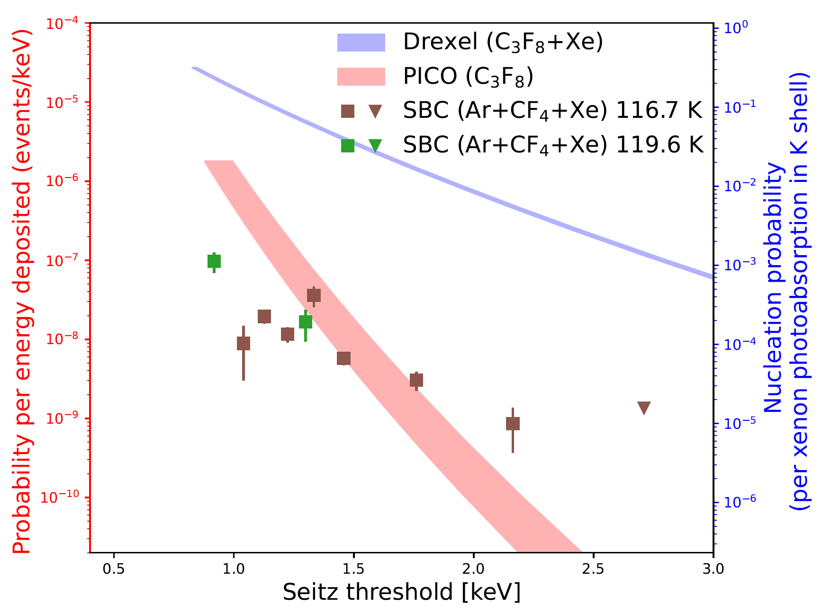
Gamma Rejection Analysis
Bubble chamber
  Strong ER background rejection
  Depends on the liquid thermodynamic properties
SBC ER nucleation
  Driving mechanism
    Xe photoabsorption induced
  Performance evaluation
    Good at 1 keV: 10⁻⁷ per keV
  Future improvement
    Remove CF₄ hydraulic fluid contamination
    Estimated to reach 10⁻⁶ per xenon photoabsorption
SBC
Preliminary
Notes:
we can also scale our gamma rejection to PICO model and compare result

Slide 17
Gamma Rejection Analysis
Bubble chamber
  Strong ER background rejection
  Depends on the liquid thermodynamic properties
SBC ER nucleation
  Driving mechanism
    Xe photoabsorption induced
  Performance evaluation
    Good at 1 keV: 10⁻⁷ per keV
  Future improvement
    Remove CF₄ hydraulic fluid contamination
    Estimated to reach 10⁻⁶ per xenon photoabsorption
SBC
Preliminary
~10² 𝛾-rejection improvement
Notes:
clear picture

Slide 18
Gamma Rejection Analysis
Bubble chamber
  Strong ER background rejection
  Depends on the liquid thermodynamic properties
SBC ER nucleation
  Driving mechanism
    Xe photoabsorption induced
  Performance evaluation
    Good at 1 keV: 10⁻⁷ per keV
  Future improvement
    Remove CF₄ hydraulic fluid contamination
    Estimated to reach 10⁻⁶ per xenon photoabsorption
SBC
Preliminary
~10² 𝛾-rejection improvement
Notes:
clear picture

Slide 19
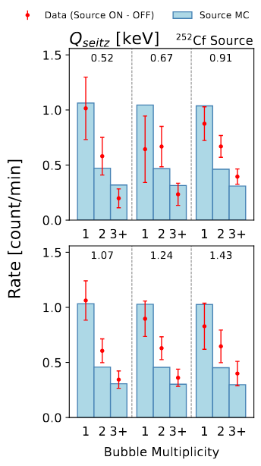
Sensitivity to ²⁵²Cf Neutrons
Produce bubbles via ²⁵²Cf NR
Multiplicity rates gives threshold information
  Consistent with Monte Carlo simulation
Notes:
replace the graph
1st peak reason: maybe the HDPE
Hard to distinguish the different threshold
Why the MC’s shape doesn’t change? 0th order

Slide 20
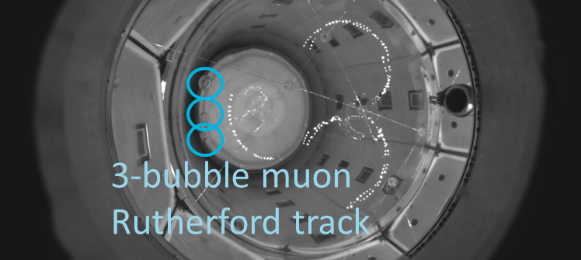
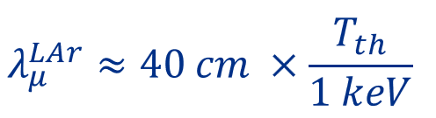
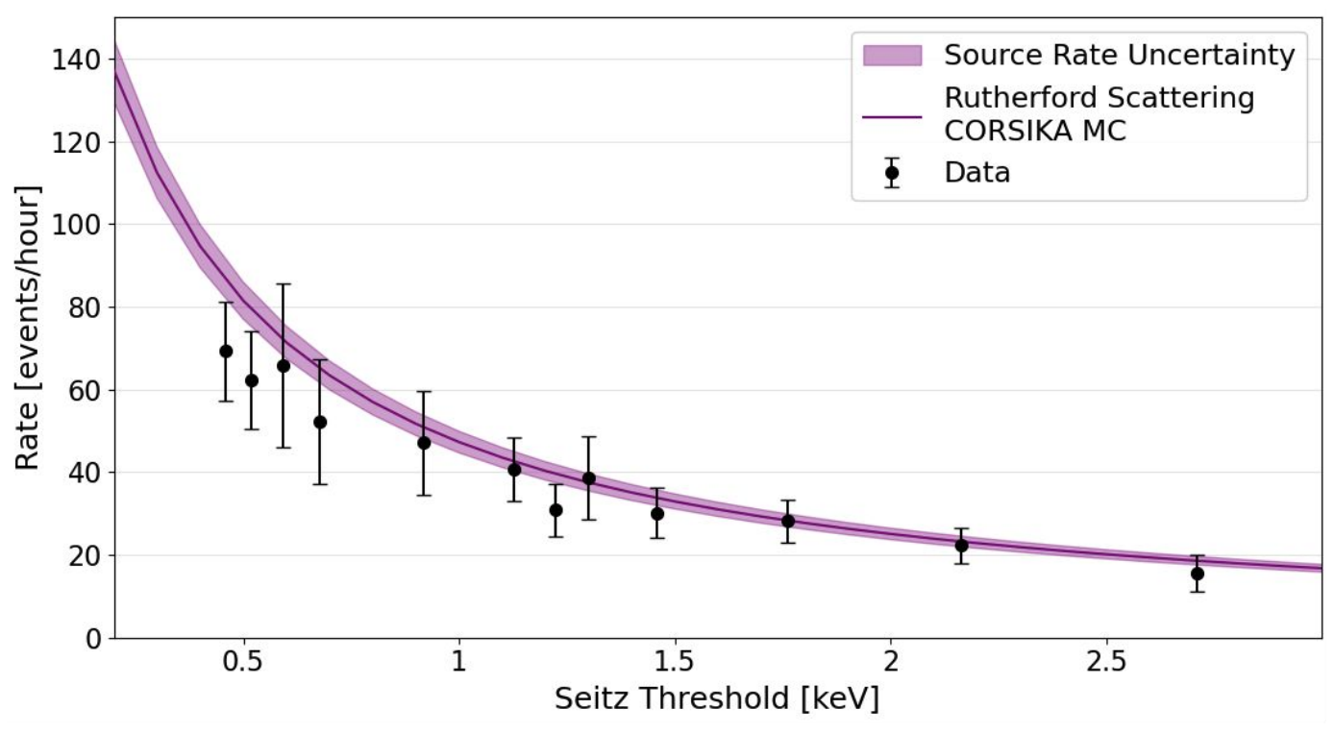
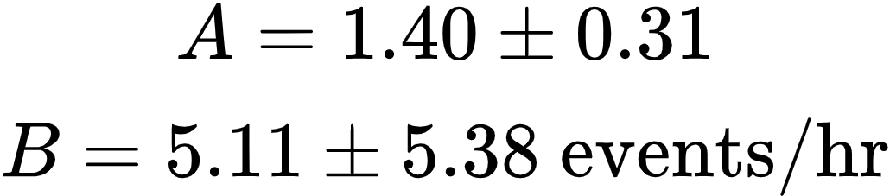
Sensitivity to Cosmic Muon Rutherford Scattering
Cosmic muons
  Bright events observed by SiPMs
  Bubble rate
    Rutherford scattering
    Calibrate data:
Notes:
Tth B is y axis unit
Shift between experimental data and MC indicates the difference between true threshold and theoretical threshold.
Ask Gray permissions
Geometry?
Why rutherford? – Charge force
difference between rutherford and muon spllation? Particle traces shape?
What Geant4 elastic scattering on muons?

Slide 21
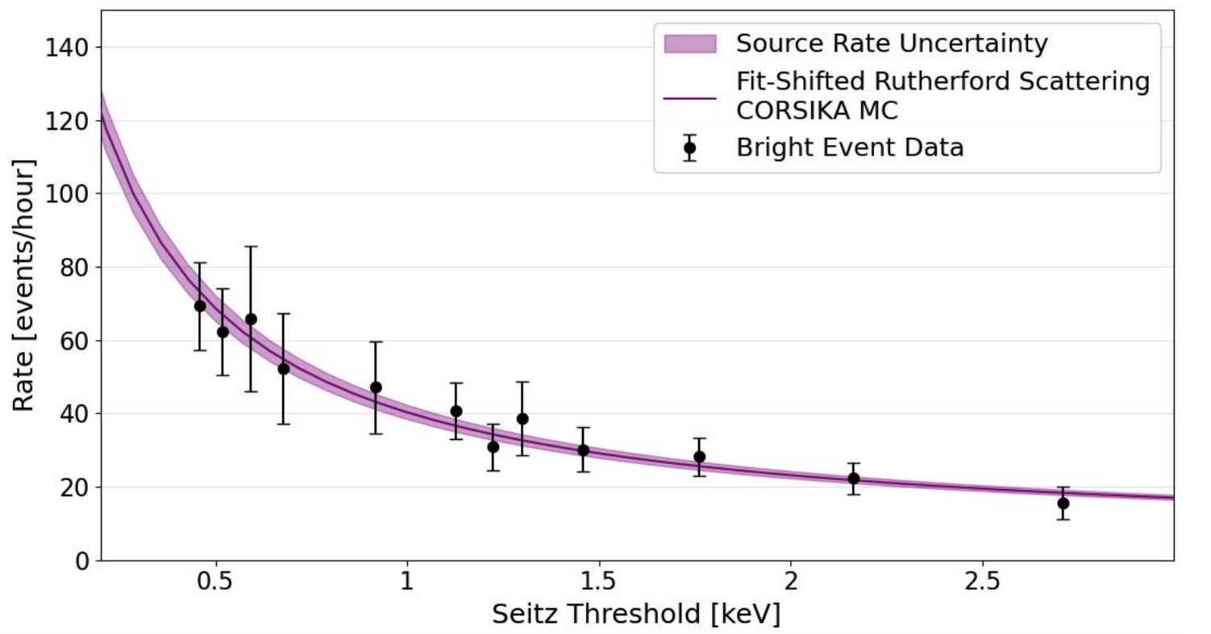
Sensitivity to Cosmic Muon Rutherford Scattering
Cosmic muons
  Bright events observed by SiPMs
  Bubble rate
    Rutherford scattering
    Calibrate data:
Notes:
Tth
Ask Gray permissions
Geometry?
Why rutherford? – Charge force
difference between rutherford and muon spllation? Particle traces shape?
What Geant4 elastic scattering on muons?

Slide 22
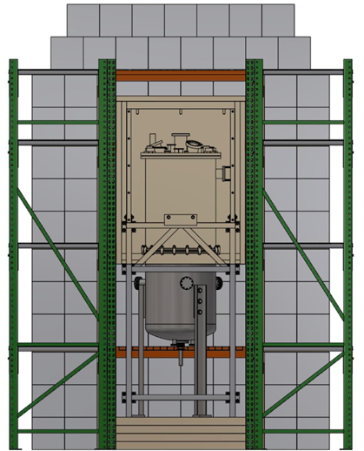
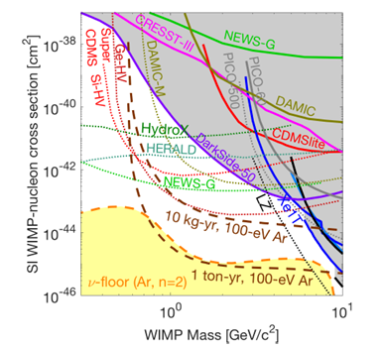
SBC-SNOLAB
SBC-LAr10: calibration
SBC-SNOLAB:
  SNOLAB, 2 km / 6,800 ft underground, Canada
  Improved design and better shielding
  Formal run searching for WIMPs
    100 eV energy threshold

Slide 23
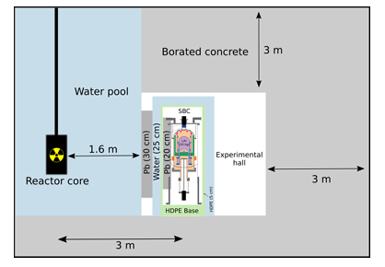
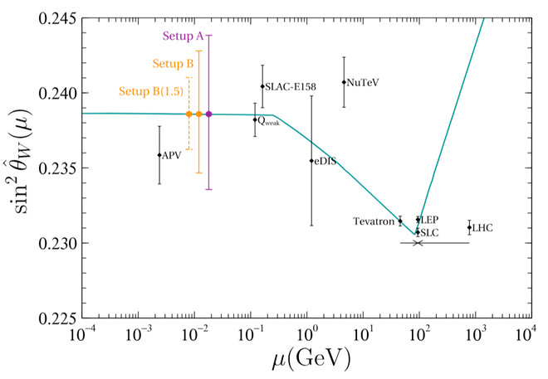
CE𝑣NS Detection via SBC
100 eV energy threshold allows CE𝑣NS detection
  Reactor at National Institute for Nuclear Research (ININ) near Mexico City
  Weak mixing angle
Phys. Rev. D 103, L091301

Slide 24
Conclusion
SBC can reach O(100) eV energy threshold NR detection
  Dark matter via elastic scattering: ~ GeV
  Neutrino via CE𝑣NS: ~ MeV
SBC-LAr10 at Fermilab has completed the first calibration run
  Gamma rejection: 10⁻⁷ per keV energy deposited at 1 keV threshold
  Bubble multiplicity calibration
  Threshold calibration based on cosmic muon Rutherford scattering
Paper on the first results is in preparation!
SBC prospects:
  Dark matter search in SNOLAB
  CE𝑣NS measurement from reactor

Slide 25




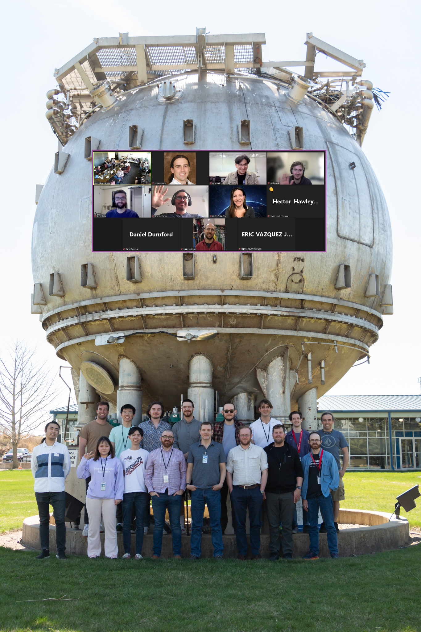


















Ken Clark
Ben Broerman
Alex Wright
Ben Broerman
Austin De St Croix
Carter Garrah
Gary Sweeney
Jonathan Corbett
Ezri Wyman
Jack Walker
Lydia Magurn
Sean Hughson
Koby Dering
Nicholas Moss
Carsten Krauss
Hugh Lippincott
Ryan Zhang
Shawn Westerdale
Eric Dahl
Baishaki Mitra
Zhiheng Sheng
Otto Nicholson
Al Kucich
Pedro Rodriguez
Catarina Matador
David Velasco
Gray Putnam
Daniel Baxter
Orin Harris
Jeter Hall
Reg Castilloux
Mathieu Laurin
Eric Vázquez-Jáuregui
Pietro Giampa
Christopher Jackson
Ilan Levine
Ed Behnke
Cody Cripe
Russell Neilson
Daniel Pyda
Jake Curran
Olivia Chiarini
Shashank Priya
Carsten Krauss

Slide 27
Backup Slides

Slide 28
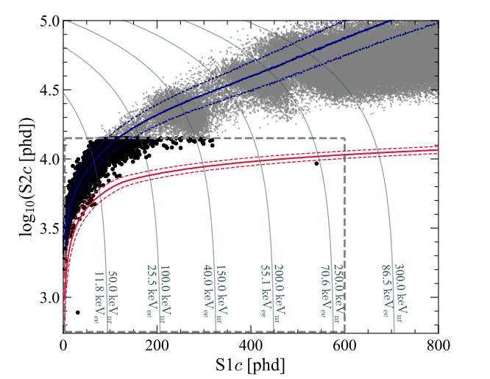
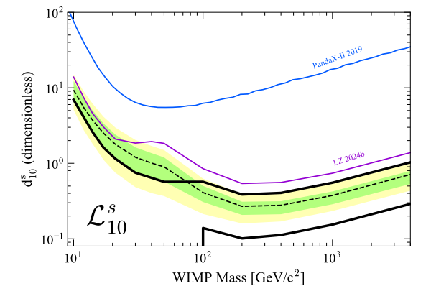
100 GeV/c*2 DM elastic scattering:
~ 200 keV NR SBC able to detect it

Slide 29
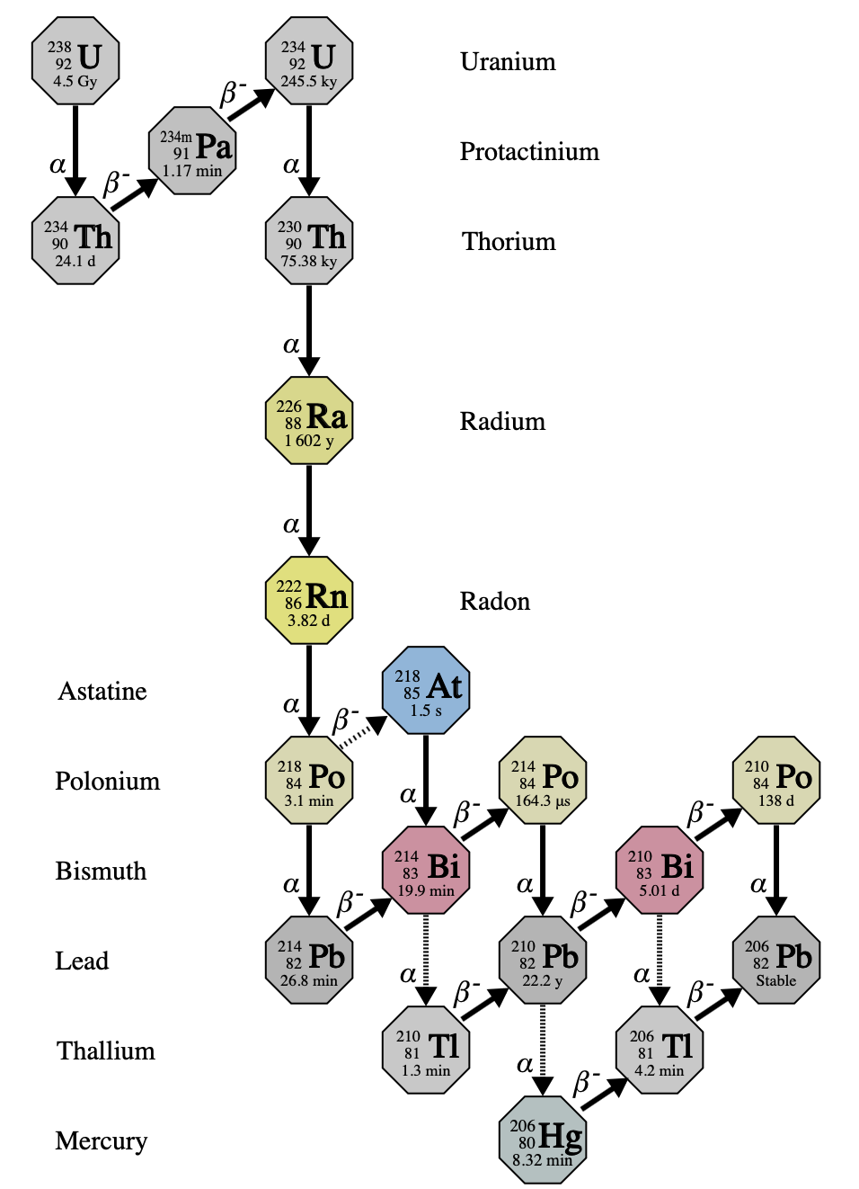
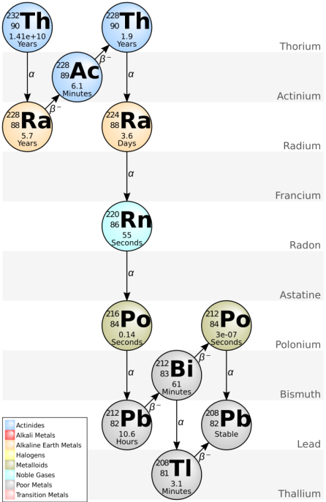

Slide 30
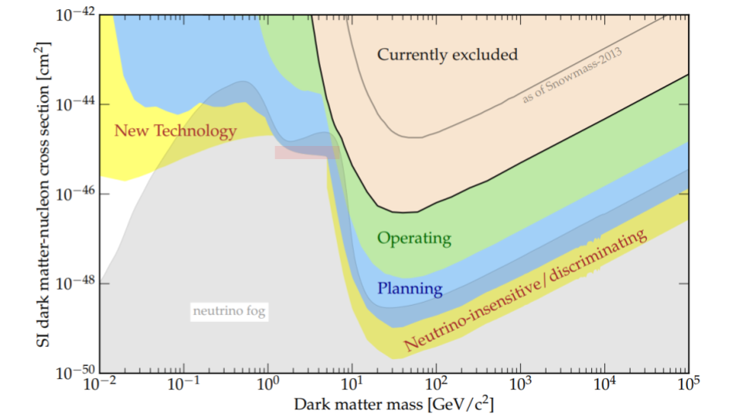



Slide 31
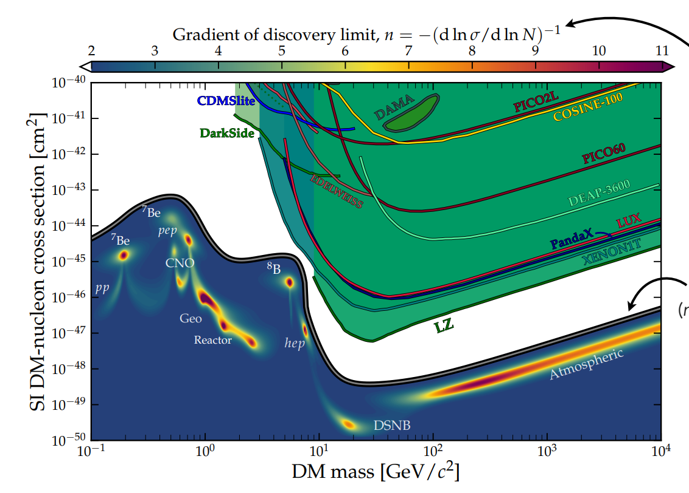
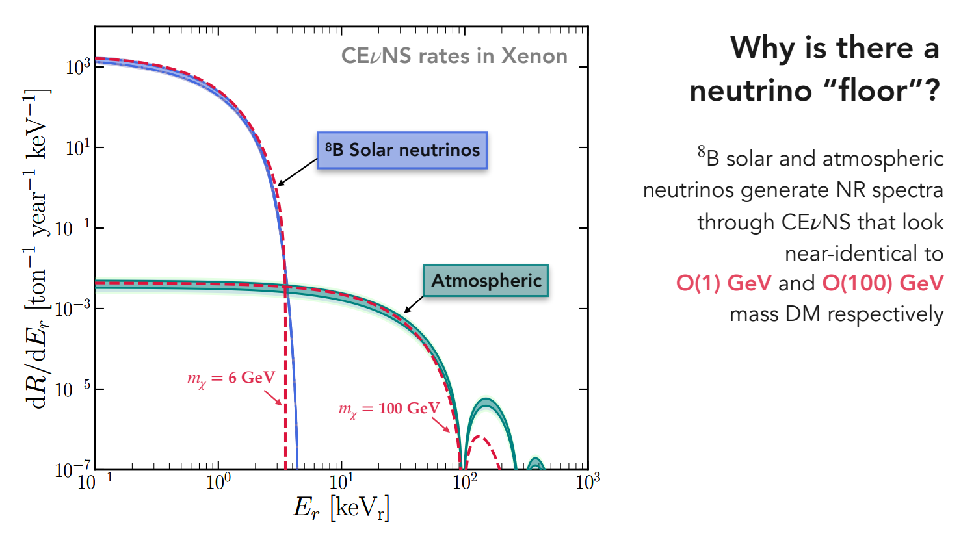
https://indico.global/event/6083/contributions/50030/attachments/24952/42709/nufog.pdf

Slide 32
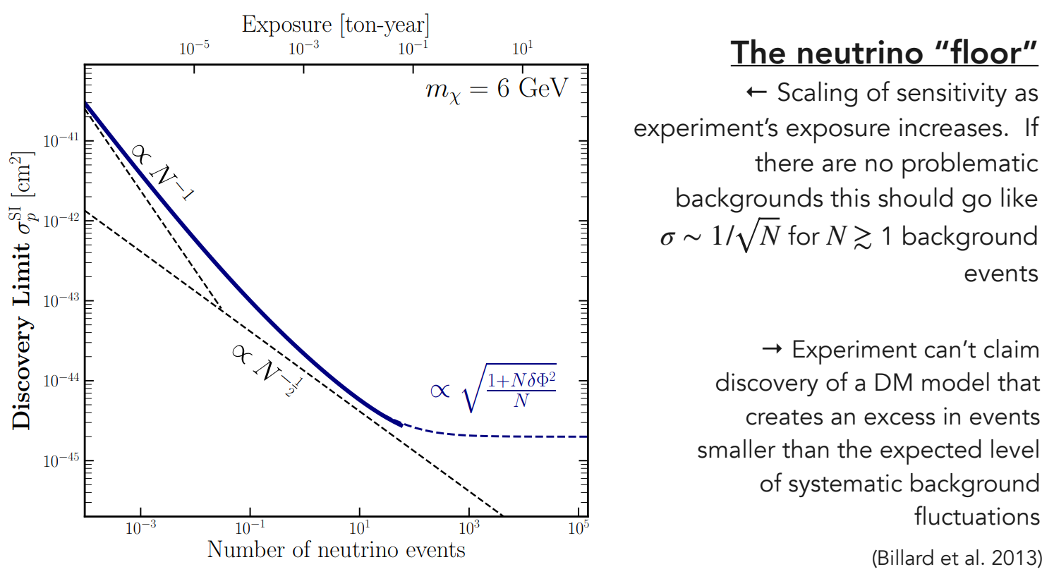
https://indico.global/event/6083/contributions/50030/attachments/24952/42709/nufog.pdf

Slide 33
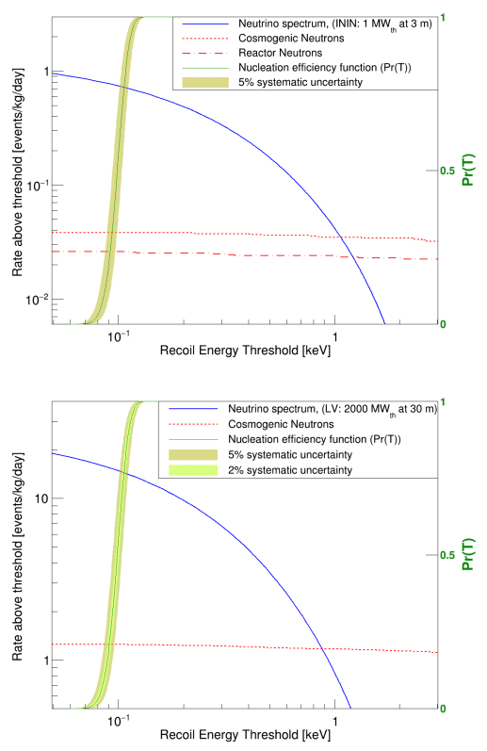
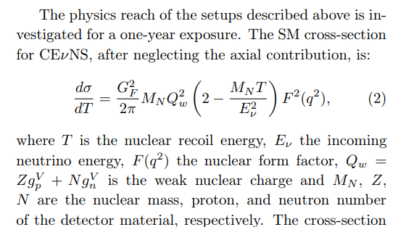



Slide 34
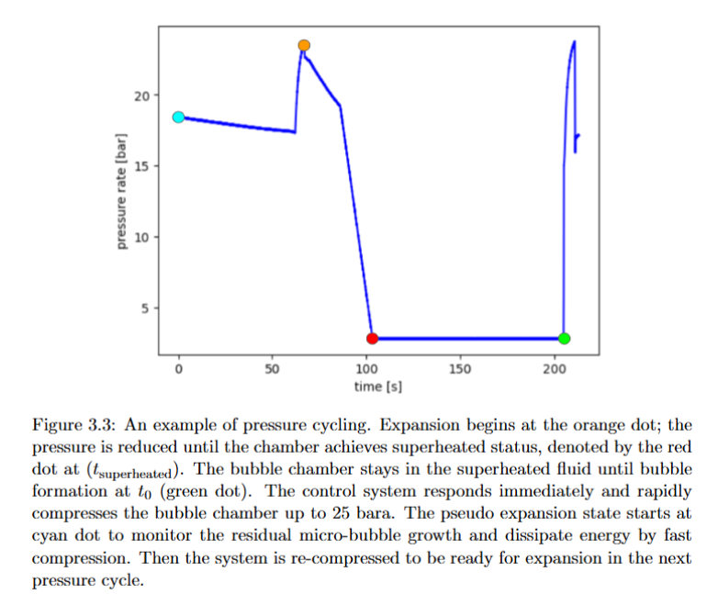
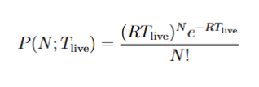
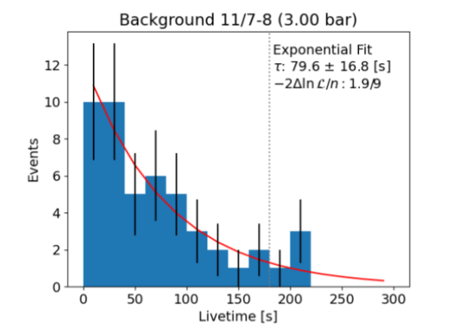

Slide 35
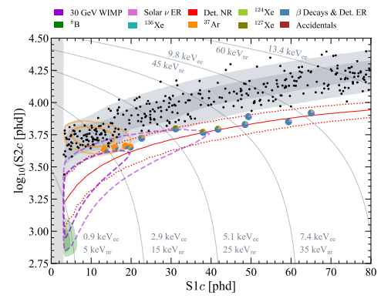
Electron recoil (ER) is a huge background for dark matter search
Bubble chamber has inherent advantages for the ER rejection
  ER cannot deposit enough energy locally -no bubbles
Important to evaluate the gamma rejection rate
ER
NR
LZ: arxiv.org/abs/2211.17120

Slide 36
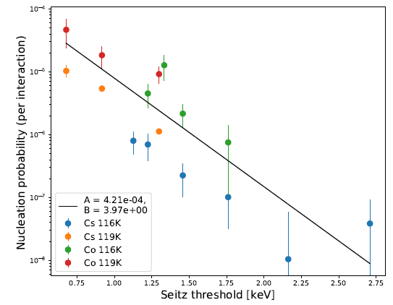
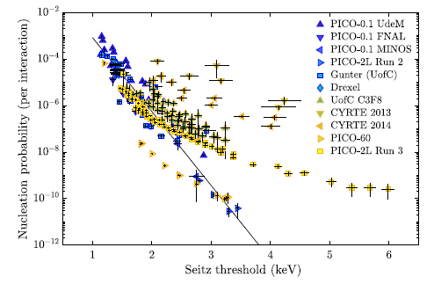


Gamma Rejection Analysis
Still world leading rejection under keV than any other other experiments so far
  Current SBC 10⁻⁵
  PICO 10⁻³
  LZ ~ 10⁻³ at ~ 5 keV
  DarkSide 10⁻⁶ at 72 keV_{nr} ^{[12]} (18 keV_{ee}).
Cannot proceed to neutron calibrations without solving it
  Requires 10⁻⁸ gamma rejection rates
SBC ER rejection (top left); PICO ER rejection (top right); LZ ER leakage (bottom left); DarkSide ER leakage (bottom right)
[9] arxiv.org/abs/1905.12522
[10] https://arxiv.org/pdf/2211.10726v3
[11] https://arxiv.org/pdf/2103.12202

Slide 37



Slide 38



Slide 39

XeBC gamma rejection:

Slide 40

Thermalization: CF₄ has shorter thermalization range ; recombine quickly -> higher local energy deposition -> higher bubble production
TRANSLATE simulation by Gray Putnam
Y thermal radius

Slide 41




Backgrounds in Scintillation Channel
Bright muon events
Wall events by alpha decay
Rutherford Scattering
summed Pulse Area [mV · µs]

Slide 42


Before Fitting:
Threshold shift:
can be caused by the heat dissipation
After Fitting:

Slide 43

XeBC Calibration
Prototype - XeBC
  20 g of superheated LXe
  Calibrated using ²⁵²Cf, ⁸⁸Y-Bi, ²⁰⁷Bi-Be
achieved results to ~1 keV level as displayed at right: arXiv:2410.07241v1

Slide 44

XeBC Calibration
Prototype - XeBC
  20 g of superheated LXe
  Calibrated using ²⁵²Cf, ⁸⁸Y-Bi, ²⁰⁷Bi-Be
achieved results to ~1 keV level as displayed at right: arXiv:2410.07241v1

Slide 45



NR Calibration Sources
4.8 MeV
5.6 MeV
8.8 MeV
6.3 MeV
Simulated liquid argon recoiled energy Spectrum S

Slide 46

Calibration Robustness
Validation
5% uncertainty source strength
External backgrounds: 500 bubble events in 100 hours
Uncertainty on the predicted dark matter rate
  Am-Li: 3.7 %
  Bi-Be: -2 %
Published on JINST:
  DOI: 10.1088/1748-0221/21/03/P03020

Slide 47

Calibration Robustness
Validation
5% uncertainty source strength
External backgrounds: 500 bubble events in 100 hours
Uncertainty on the predicted dark matter rate
  Am-Li: 3.7 %
  Bi-Be: -2 %
Published on JINST:
  DOI: 10.1088/1748-0221/21/03/P03020

Slide 48

Neutron Backgrounds from Geant4
Background for Thomson and photo-neutron sources
Neutron Backgrounds Source:
  Rock Neutron
    ²³²Th
    ²³⁸U
  Muon-Induced Neutrons
1.368- 1.618 single bubble events/hour for MINOS (no shield)

Slide 49


Slide 50


