Slide 1


Quantum Amplifiers for Axion Dark Matter Detection
Kieran Enzian

Slide 2
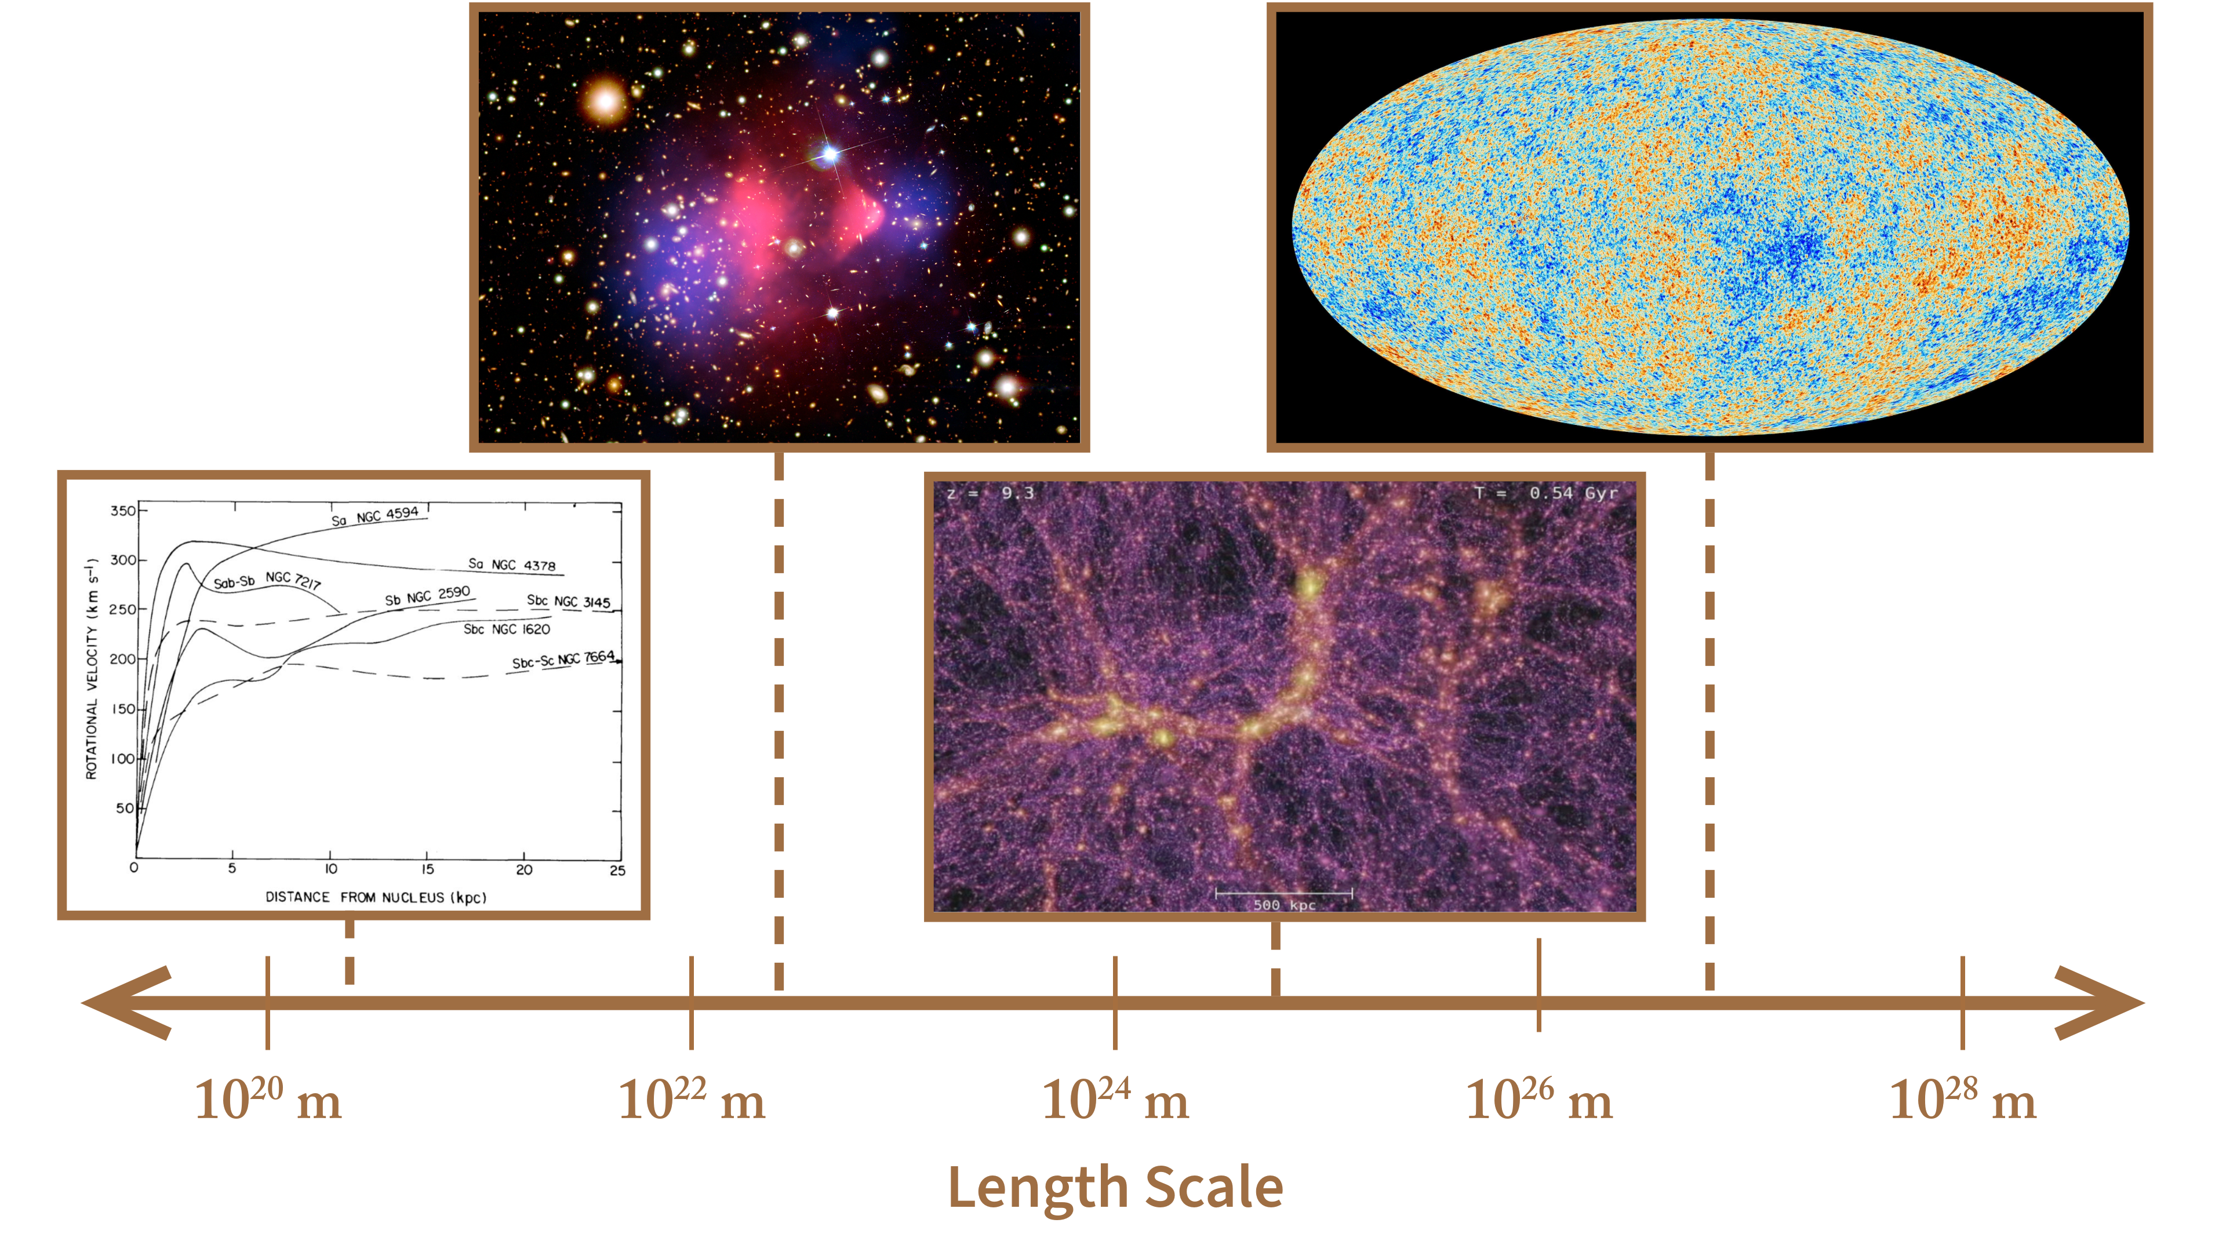
Dark Matter Evidence

Slide 3
The Axion
QCD contains CP violations that are not observed in experiments
Introducing a new axial U(1) symmetry cancels CP violation
The axion appears as a pseudo-Goldstone boson when the U(1) symmetry is broken at low energy
Axions acquire small mass below QCD phase transition
Axions can be produced in large enough quantity to be dark matter
Axions have small couplings to standard model particles

Slide 4
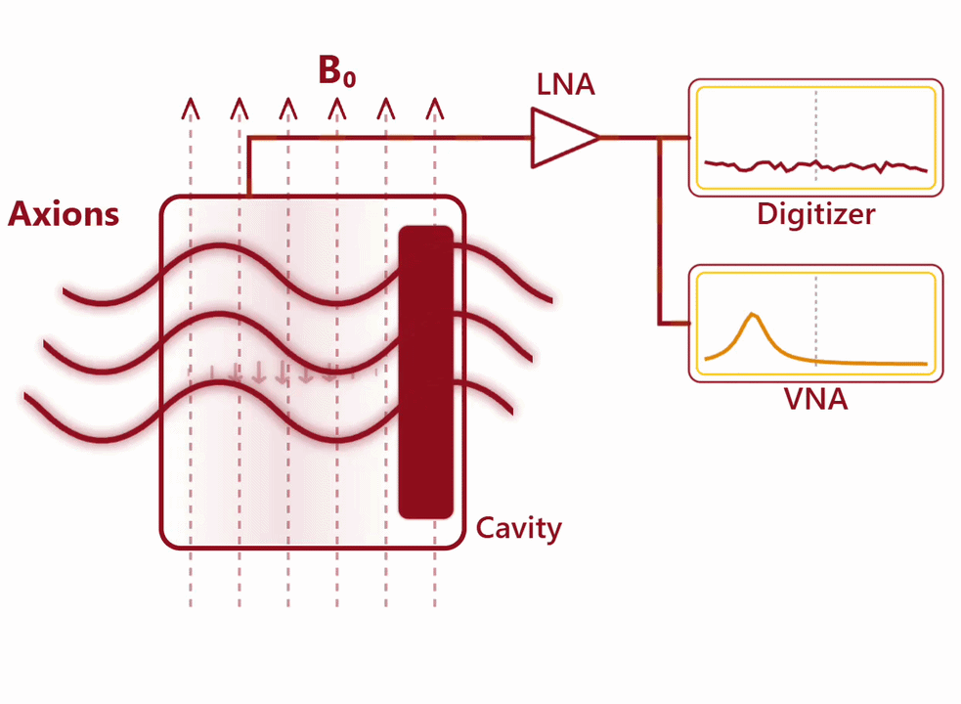
The Axion Haloscope
Probe axion-photon coupling
Resonant cavity and strong magnetic field enhance axion to photon conversion
Tune cavity to search parameter space
Notes:
Remobe last point

Slide 5
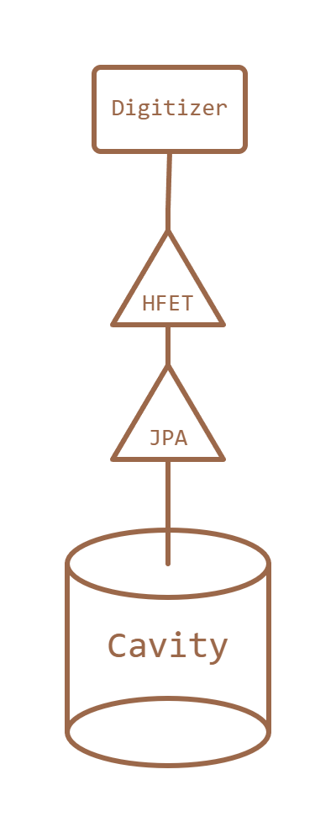
ADMX Receiver
Axion haloscope background comes from thermal and electronic noise
Low noise, high gain amplifiers suppress noise contributions from downstream electronics
  Josephson parametric amplifier (JPA) produces large gain with near-quantum limited performance
Digitizer records power output

Slide 6
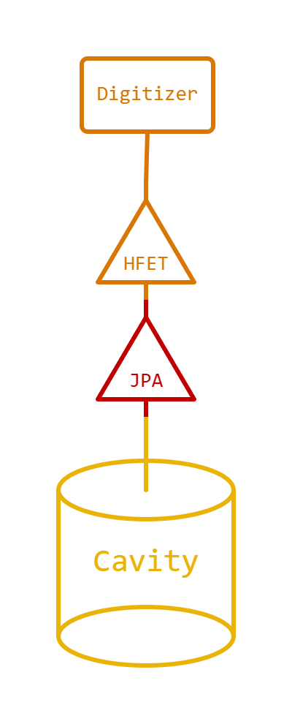
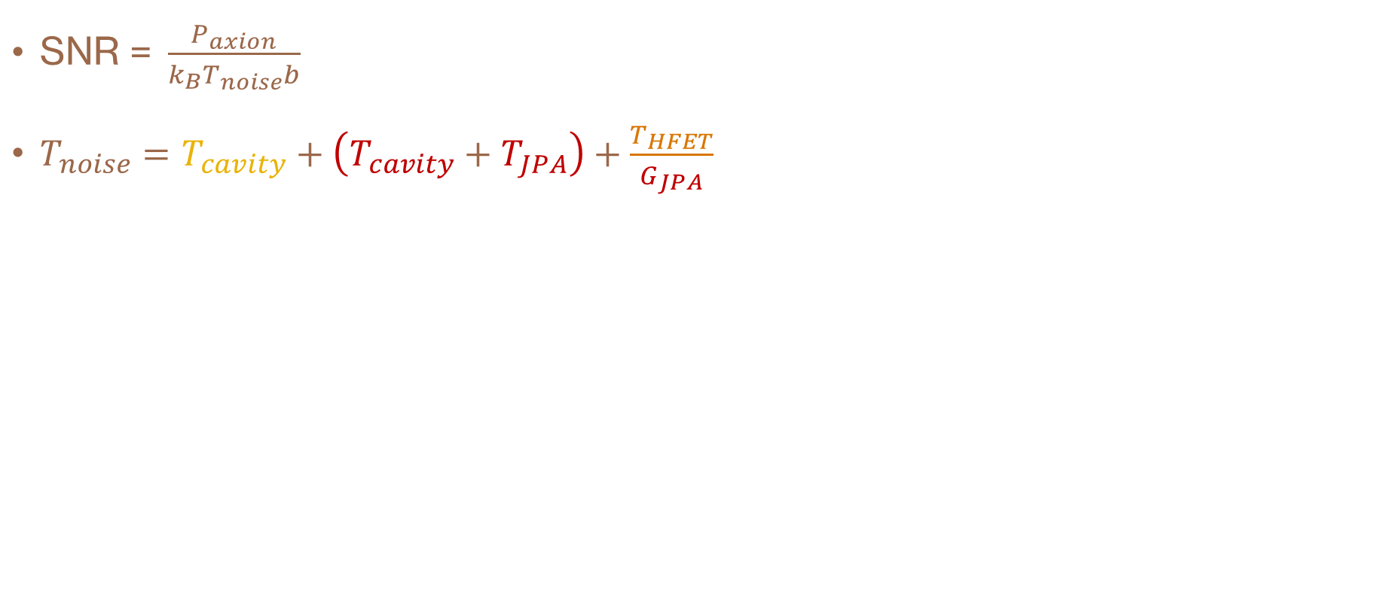
ADMX Noise Background
$\text{SNR = }\frac{P_{axion}}{k_{B}T_{noise}b}$
$T_{noise}=T_{cavity}+\left(T_{cavity}+T_{JPA}\right)+\frac{T_{HFET}}{G_{JPA}}$

Slide 7
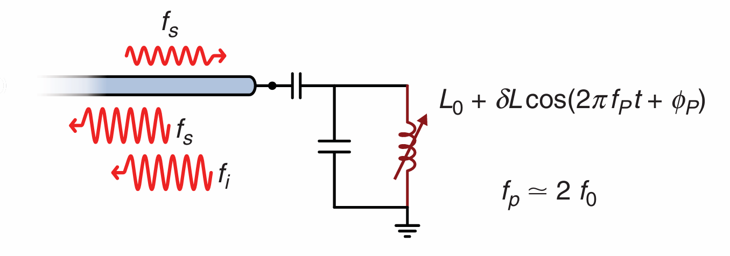
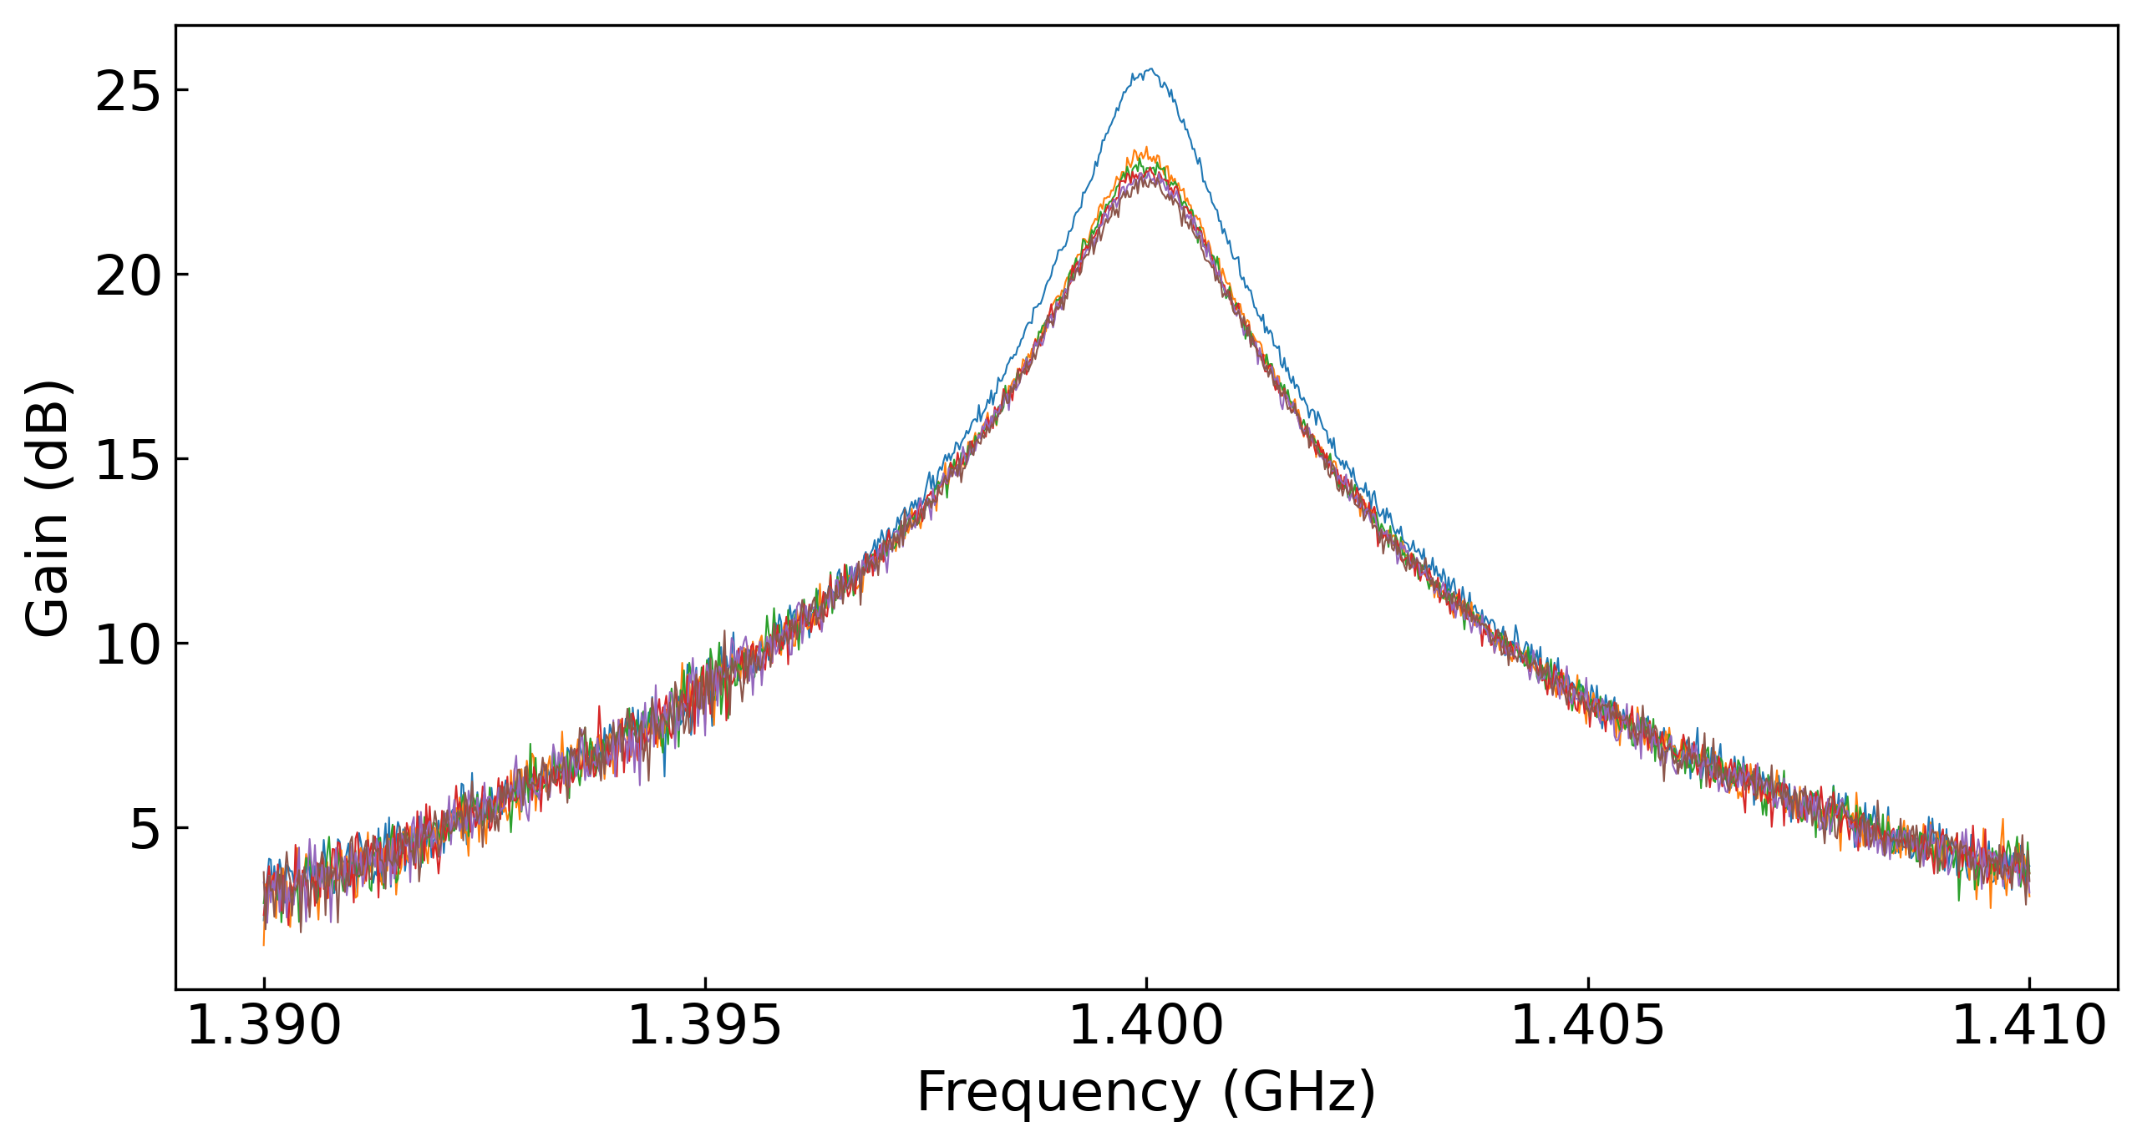

Josephson Parametric Amplifier
$$f_{s}+f_{i}=f_{p}$$
Superconducting LC circuit
High, quantum limited gain over narrow bandwidth
Parametric pumping of Josephson inductance
Mixing generates photons at two different frequencies
Noise mixed in from idler channel satisfies standard quantum limit (SQL) for noise added during amplification

Slide 8
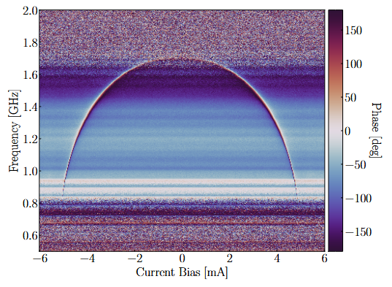
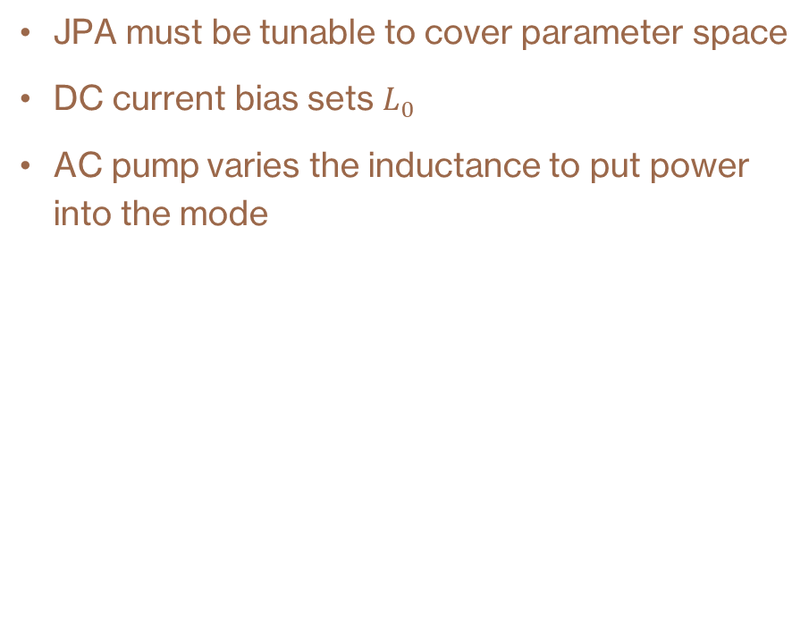
JPA Tuning
JPA must be tunable to cover parameter space
DC current bias sets $L_{0}$
AC pump varies the inductance to put power into the mode

Slide 9
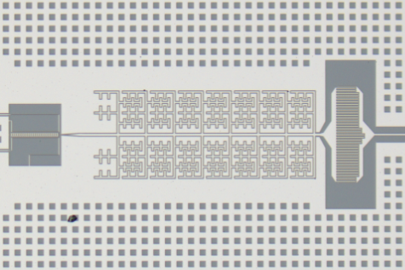
JPA Operation
Up to 35 dB of gain
Continuous biasing and noise monitoring
  JPA performance may change with frequency, temperature, etc.
    Automated biasing keeps the JPA resonance near the cavity resonance
    Regular noise measurements monitor changes in noise performance and trigger re-biasing when noise gets too high
Improvements to receiver chain and controls have improved stability of JPA performance and reduced time spent on JPA biasing and monitoring

Slide 10
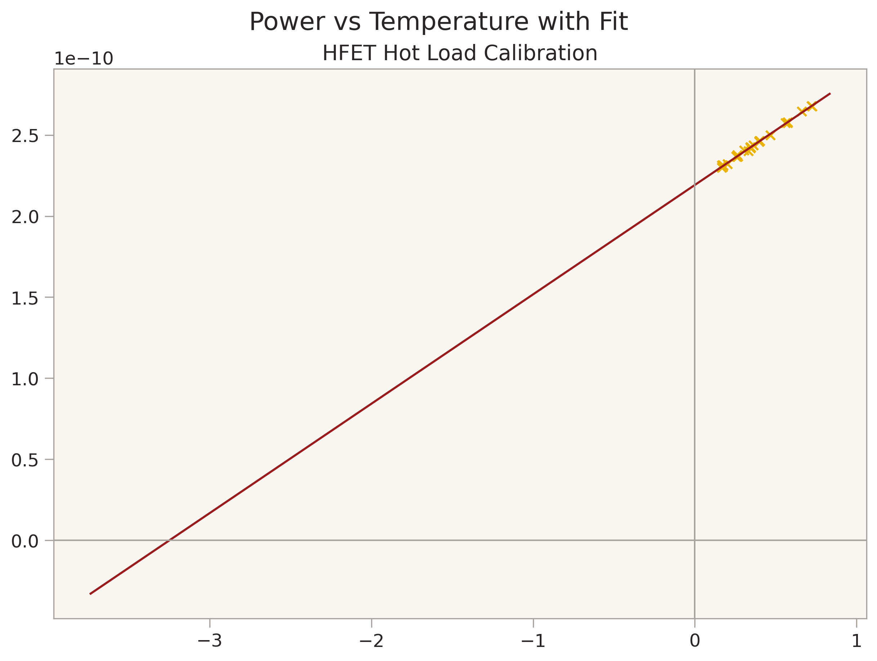
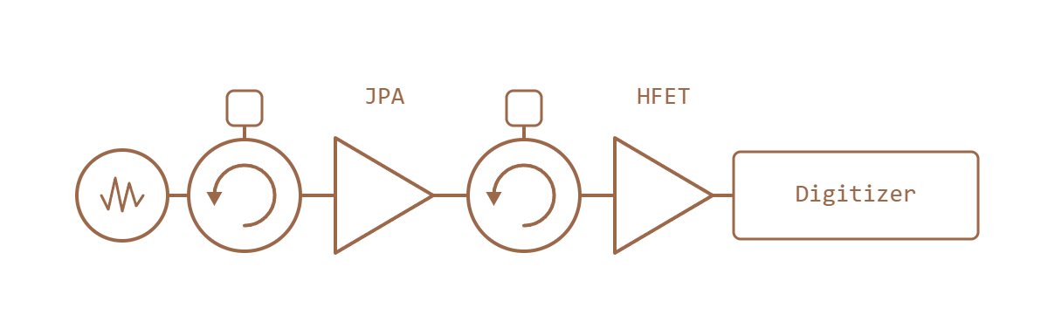
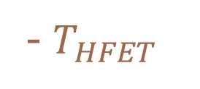
Noise Temperature Calibration
Variable temperature stage (VTS) inputs known noise into receiver chain
Fitting scatter of VTS temperature and power output constrains noise added by receiver
Can isolate noise added by JPA and HFET
- $T_{HFET}$
Digitized Power (W)
VTS
VTS Temperature (K)

Slide 11
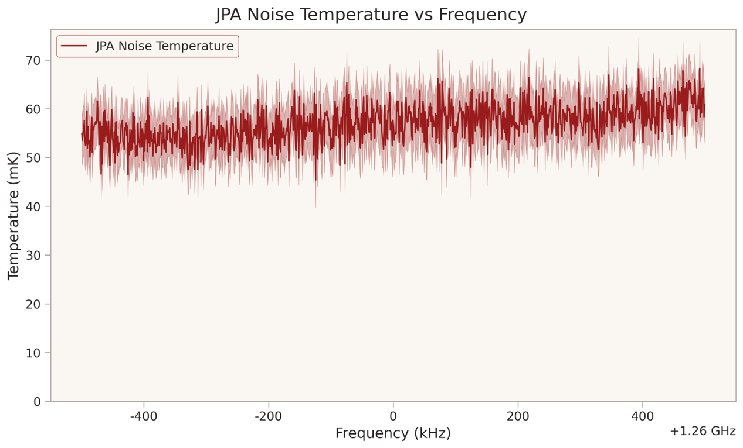
JPA Noise Calibration

Slide 12
Total System Noise Temperature
3 methods of determining total system noise temperature
  SNR Improvement (SNRI)
  Gain based noise model
  Idler correlation noise model

Slide 13
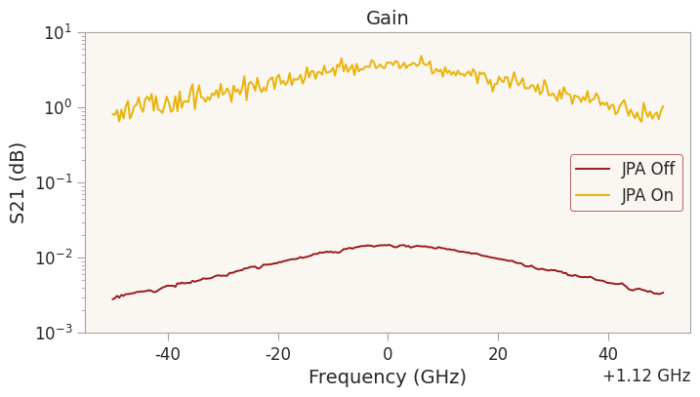
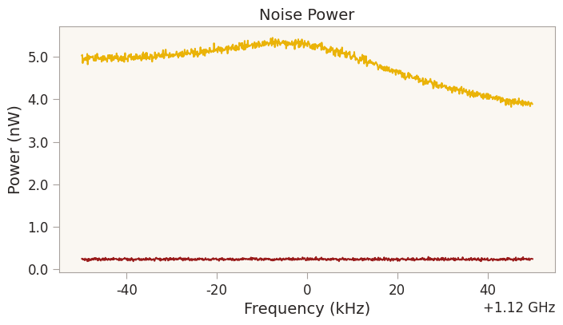
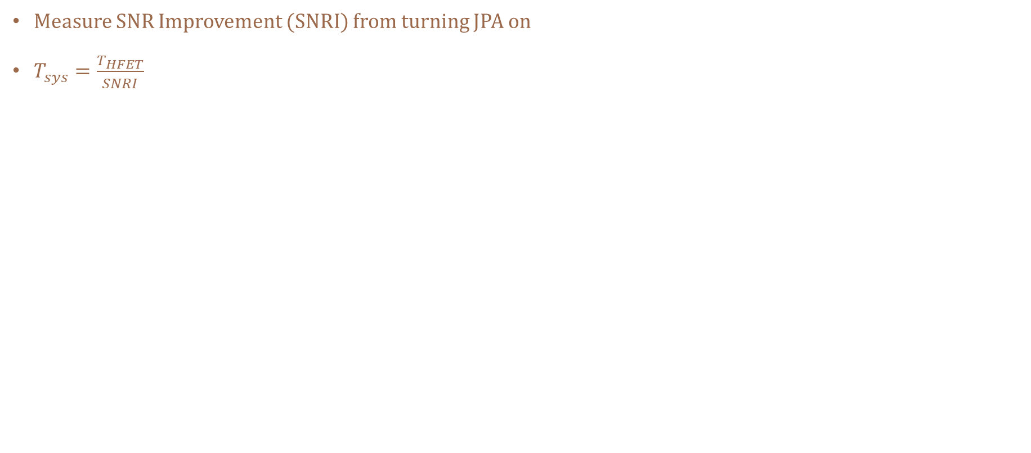
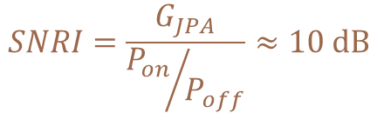
SNRI Noise Measurement
Measure SNR Improvement (SNRI) from turning JPA on
$T_{sys}=\frac{T_{HFET}}{SNRI}$
$$SNRI=\frac{G_{JPA}}{{P_{on}}/{P_{off}}}≈10 dB$$
~ 25 dB
~ 15 dB

Slide 14
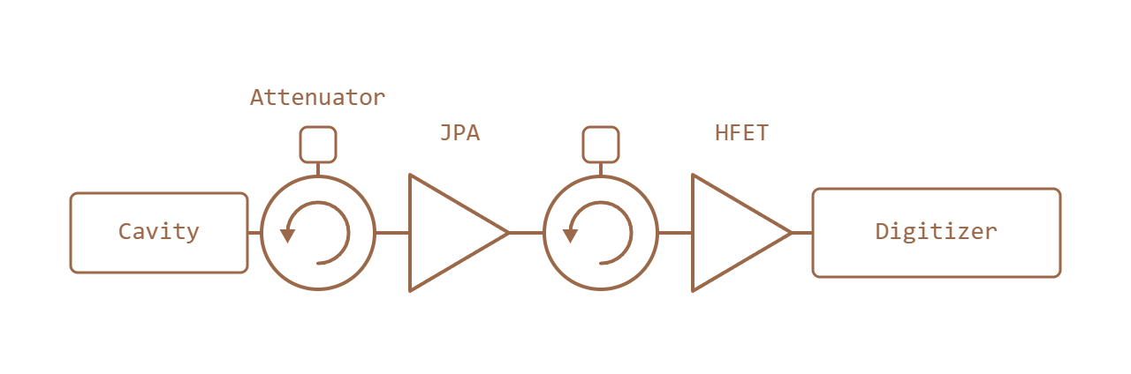
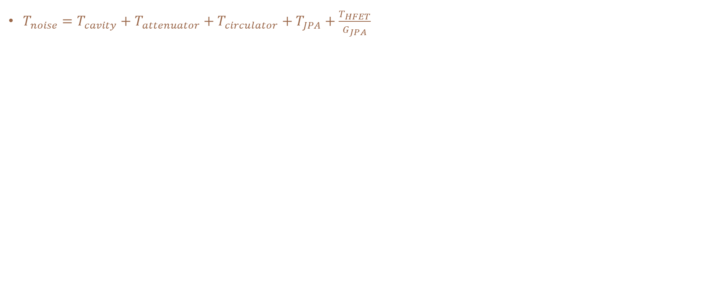
System Noise Model
$T_{noise}=T_{cavity}+T_{attenuator}+T_{circulator}+T_{JPA}+\frac{T_{HFET}}{G_{JPA}}$
Notes:
T_sys

Slide 15
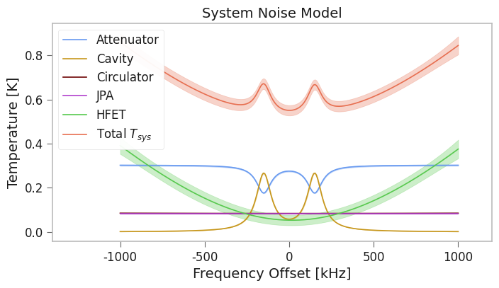
System Noise Model
$T_{noise}=T_{cavity}+T_{attenuator}+T_{circulator}+T_{JPA}+\frac{T_{HFET}}{G_{JPA}}$

Slide 16
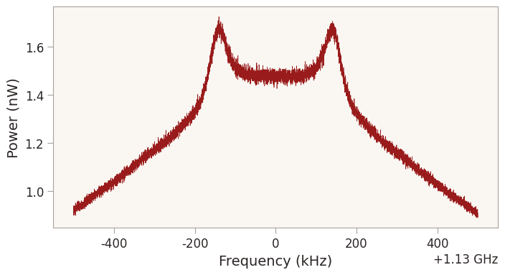
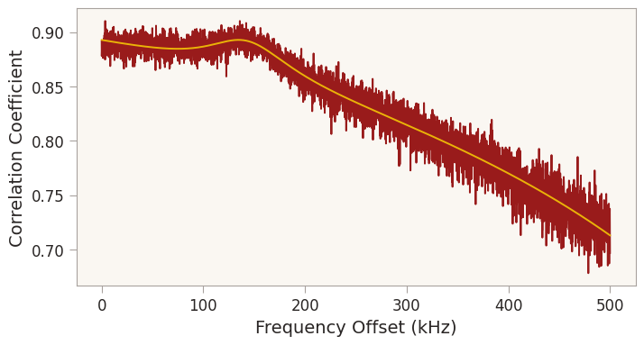
Idler Combination
JPA entangles signal and idler channels
Noise added after the JPA is uncorrelated
Averaging signal and idler bands reduces uncorrelated noise
  3-5% increase in SNR
Signal and idler correlation provides independent measurement of noise temperature

Slide 17
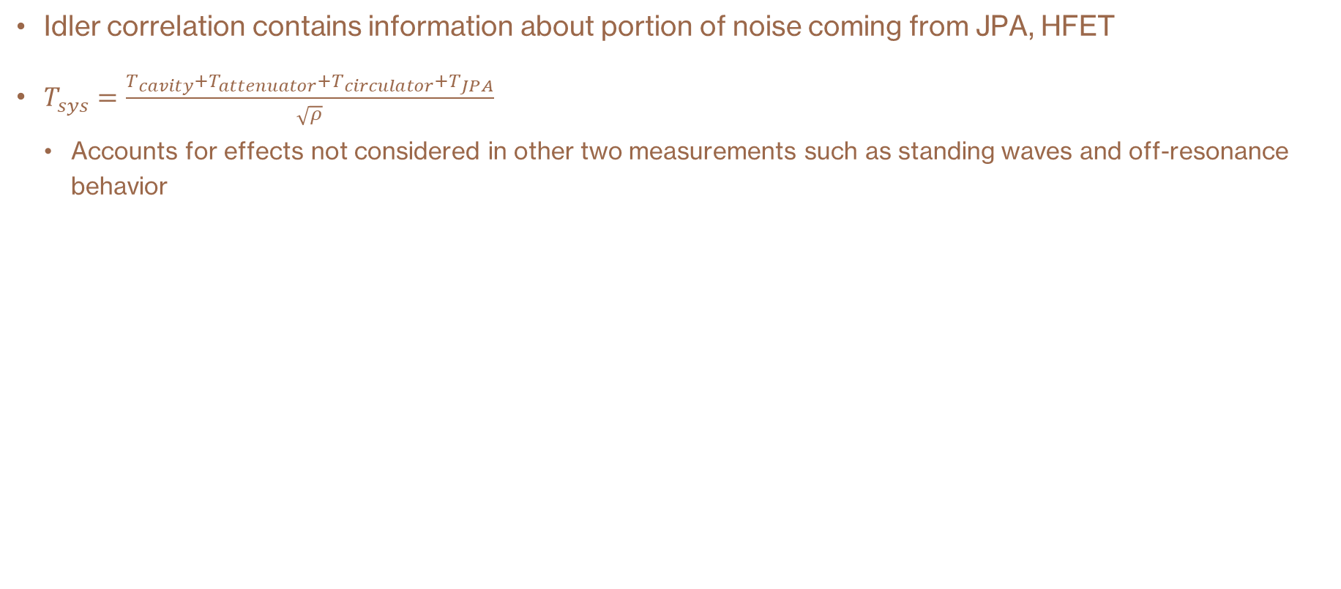
Idler Correlation Noise Model
Idler correlation contains information about portion of noise coming from JPA, HFET
$T_{sys}=\frac{T_{cavity}+T_{attenuator}+T_{circulator}+T_{JPA}}{\sqrt{ρ}}$
  Accounts for effects not considered in other two measurements such as standing waves and off-resonance behavior
Noise Correlated by JPA
Noise Not Correlated by JPA

Slide 18
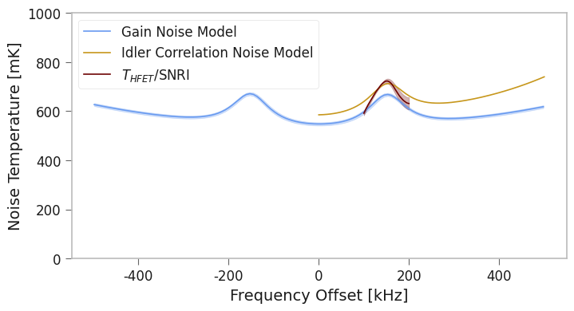
Noise Temperature Comparison

Slide 19
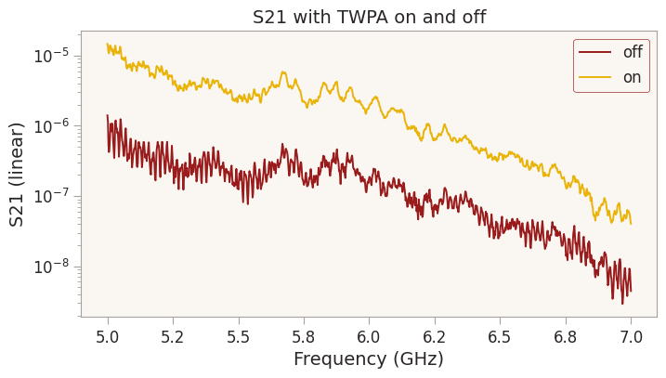
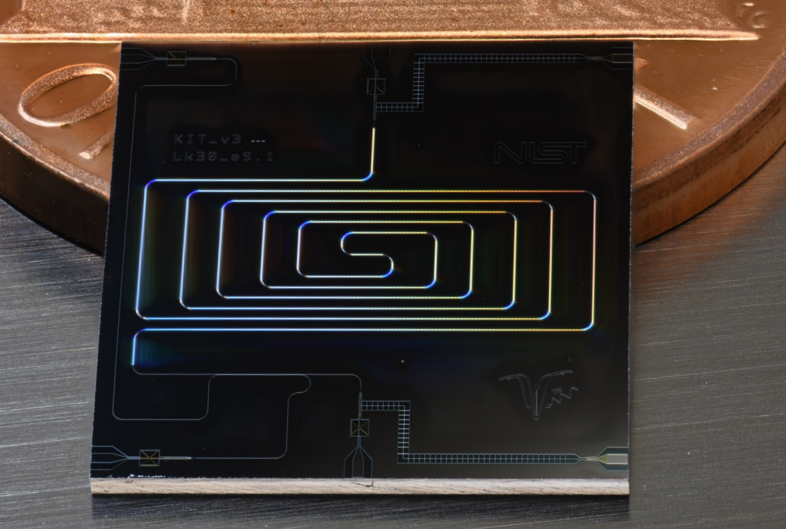
Kinetic Inductance Traveling Wave Parametric Amplifier (KI-TWPA)
Parametric amplification as signal propagates along transmission line
  No resonant structure so gain is more broadband
Kinetic inductance used instead of Josephson inductance
  Less sensitive to magnetic fields
Testing in ADMX-Sidecar
  Operates without magnetic shielding
  Achieved 13 dB of gain
  Observed large attenuation in receiver chain
Notes:
Spell out KITWPA

Slide 20
Summary
Acknowledgements
Quantum sensors enable haloscopes to be sensitive to QCD axion dark matter
ADMX uses a JPA to approach quantum limited performance
Several complimentary noise calibration methods determine noise sensitivity
This work is supported by U.S. Department of Energy through Awards No DE-SC0009800, No. DE-SC0009723, No. DE-SC0010296, No. DE-SC0010280, No. DE-SC0011665, No. DEFG02-97ER41029, No. DE-FG02-96ER40956, No. DE-AC52-07NA27344, No. DE-C03-76SF00098, No. DE-SC-0022148 and No. DE-SC0017987. Fermilab is a U.S. Department of Energy, Office of Science, HEP User Facility managed by Fermi Research Alliance, LLC (FRA), under Contract No. DE-AC02-07CH11359. Additional support was provided by the Heising-Simons Foundation and by the Lawrence Livermore National Laboratory LDRD office. PNNL is a multi-program national laboratory operated for the U.S. DOE by Battelle Memorial Institute under Contract No. DE-AC05-76RL01830. UWA and Swinburne participation is funded by the ARC Centre of Excellence for Engineered Quantum Systems and CE170100009, Dark Matter Particle Physics, CE200100008. The Sheffield group acknowledges support from the UK Science and Technology Facilities Council (STFC) under grants ST/ T006811/1 and ST/X005879/1. CRB is supported by DOE Office of Science, High Energy Physics, Early Career Award (FWP 77794 at PNNL). Chelsea Bartram acknowledges support from the Panofsky Fellowship at SLAC. John Clarke acknowledges support from the U.S. Department of Energy, Office of Science, National Quantum Information Science Research Centers.
Collaborating Institutions:
University of Washington
Washington University St. Louis
University of Western Australia
University of Florida
University of Sheffield
Illinois Institute of Technology
Swinburne University of Technology
Stanford University / SLAC
UC Berkeley
Harvard University
Fermilab
Pacific Northwest National Laboratory
Lawrence Livermore National Laboratory
Los Alamos National Laboratory
University of Maryland

Slide 21
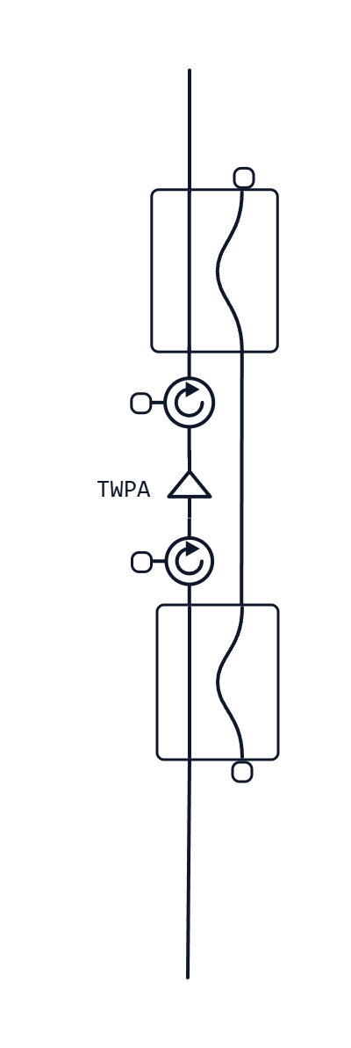
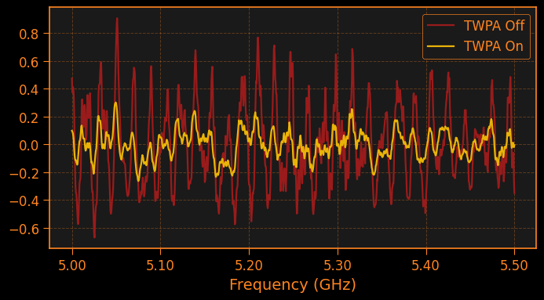
Two Path Interference Model
Two path interference between TWPA path and directional coupler path
  Interference is large when power transmission through the two paths is similar in magnitude
  Interference is small when the TWPA is on because much more power goes through the TWPA path
  Requires large attenuation on the TWPA path
-50 dB

Slide 22
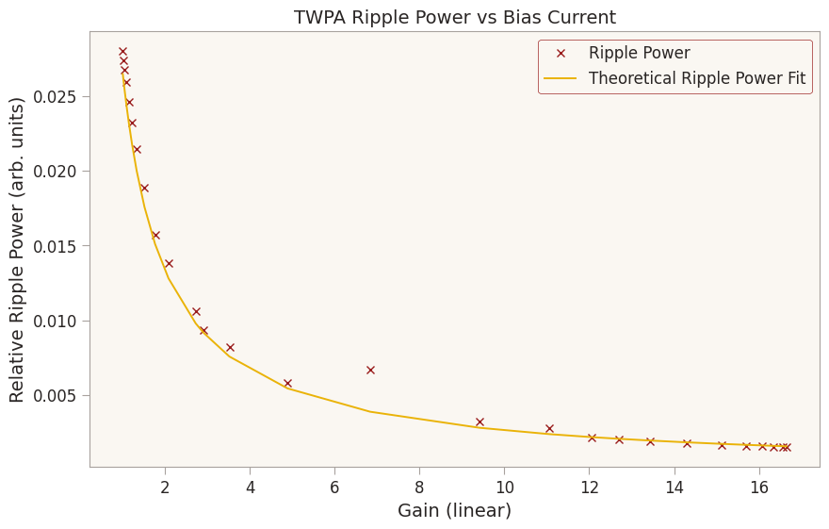
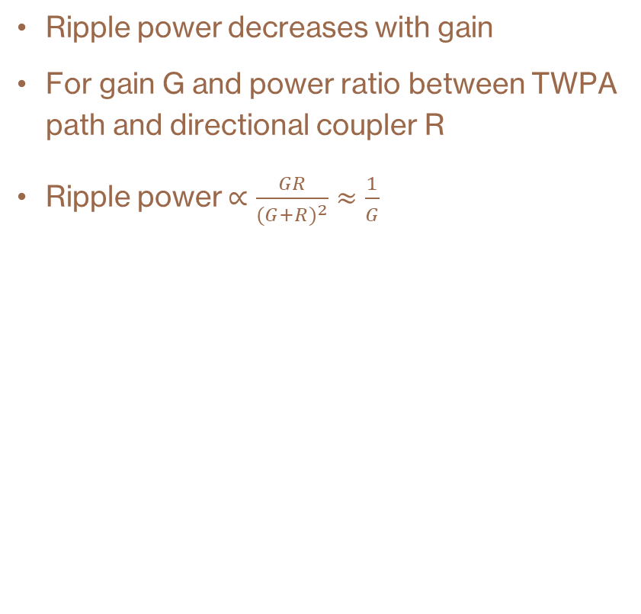
Gain Test
Ripple power decreases with gain
For gain G and power ratio between TWPA path and directional coupler R
Ripple power $∝\frac{GR}{{(G+R)}^{2}}≈\frac{1}{G}$

Slide 23
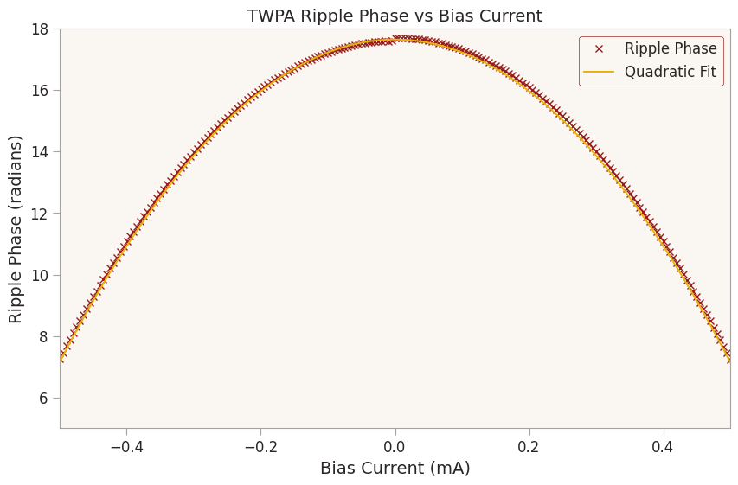
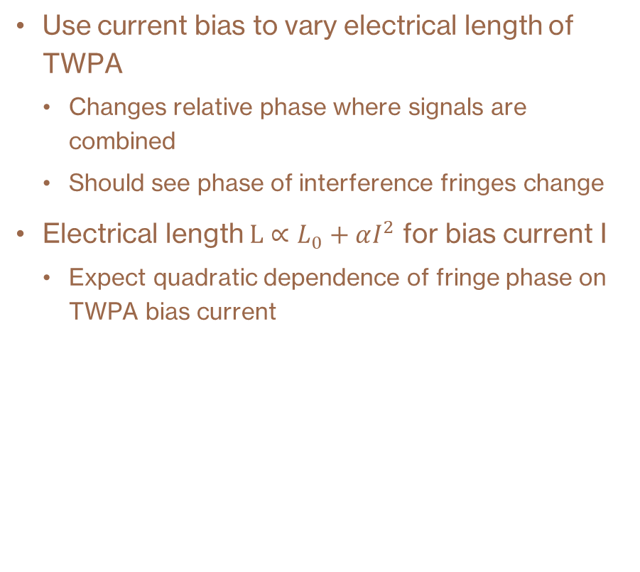
Current Bias test
Use current bias to vary electrical length of TWPA
  Changes relative phase where signals are combined
  Should see phase of interference fringes change
Electrical length $L∝L_{0}+αI^{2}$ for bias current I
  Expect quadratic dependence of fringe phase on TWPA bias current

