Slide 1
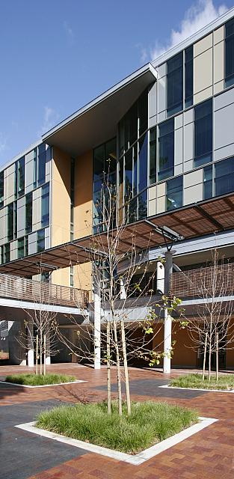
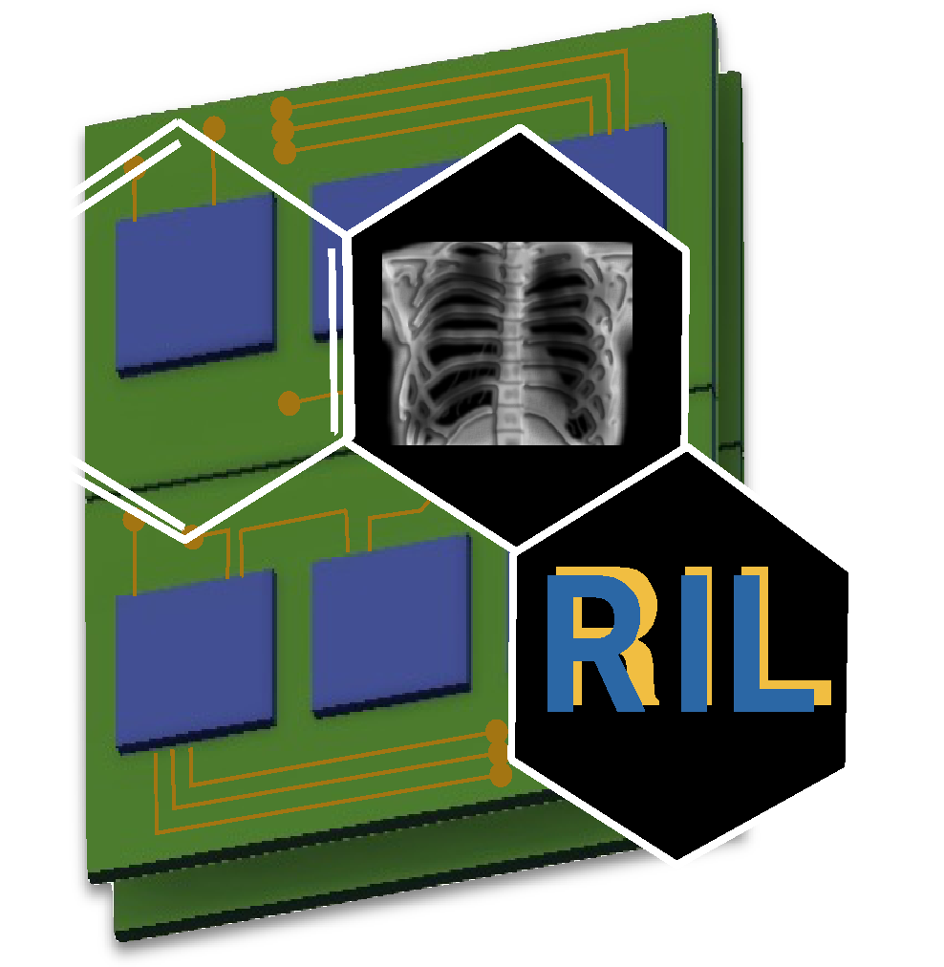

Optical and Electrical Characterization of Multilayer Amorphous Selenium-Tellurium Photodetectors
Teo Schnell¹
Kaitlin Hellier² and Shiva Abbaszadeh²
¹ San José State University, Department of Aerospace Engineering
² University of California Santa Cruz, Department of Electrical and Computer Engineering

Slide 2
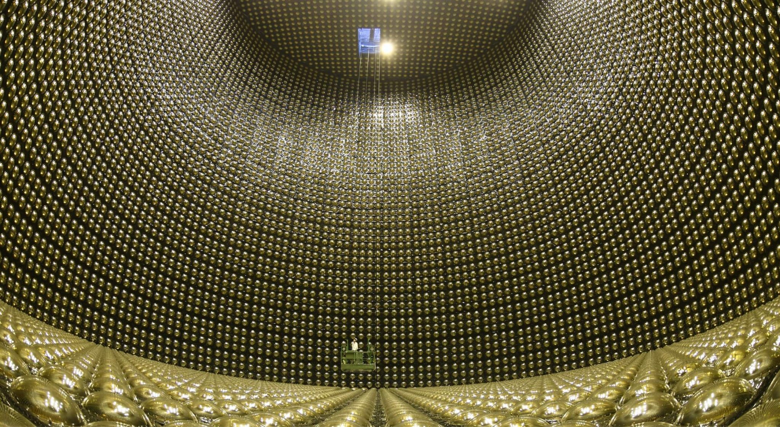
Photodetection for High-Energy Physics
Applications in High-Energy Physics
Liquid noble detectors: Scintillation and direct VUV-light detection
Particle and charge detection
Cherenkov-light detection
The Detector Challenge
Most existing detectors (PMTs, SiPMs, APDs) meet only one or two of these criteria:
Low cost
High sensitivity - high internal gain and low noise
Large-area fabrication
Notes:
Applications in High-Energy Physics
Many HEP experiments require detection of small amounts of light or charge produced by particle interactions.
Liquid noble detectors: Liquid argon and xenon emit scintillation light when particles deposit energy.
This light is in the vacuum ultraviolet (VUV) range.
Detecting these photons helps reconstruct particle interactions.
Particle/charge detection: Particles ionize detector materials, producing electrical charges that can be collected.
Cherenkov detection: Charged particles traveling faster than light's phase velocity in a medium produce light, which can be used for particle identification.
The Detector Challenge
Existing technologies include photomultiplier tubes (PMTs), silicon photomultipliers (SiPMs), and avalanche photodiodes (APDs).
Most meet only one or two of our desired criteria
Low cost: Affordable fabrication and deployment
High sensitivity: Internal multiplication of weak signals while maintaining low noise.
Large-area fabrication: Ability to manufacture large, uniform detector surfaces.
Covering large detector areas while maintaining sensitivity and low cost remains challenging.
Transition to a-Se

Slide 3
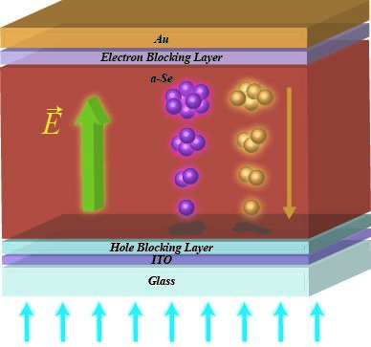
Amorphous Selenium for high sensitivity photodetectors
Why a-Se?
High resistivity enables low dark current
Capable of avalanche charge multiplication
Tunable bandgap by alloying (with Te, Ge)
Easily fabricated over a large area
The Challenge
Conventional avalanche multiplication requires high electric fields (~70–100 V/µm)
Alternative structures may enable greater control over multiplication
Notes:
- Amorphous selenium (a-Se) is an established material for direct-conversion X-ray detectors.
- High resistivity helps maintain low dark current.
- Can be deposited over large areas, making it useful for imaging applications.
- a-Se exhibits **avalanche multiplication**, amplifying charge through impact ionization.
- Conventional avalanche multiplication requires very high electric fields, around **70-100 V/um**.
- This motivates engineering the electronic structure to achieve controlled multiplication.

Slide 4

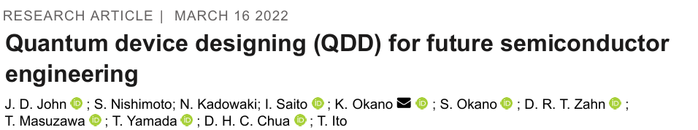
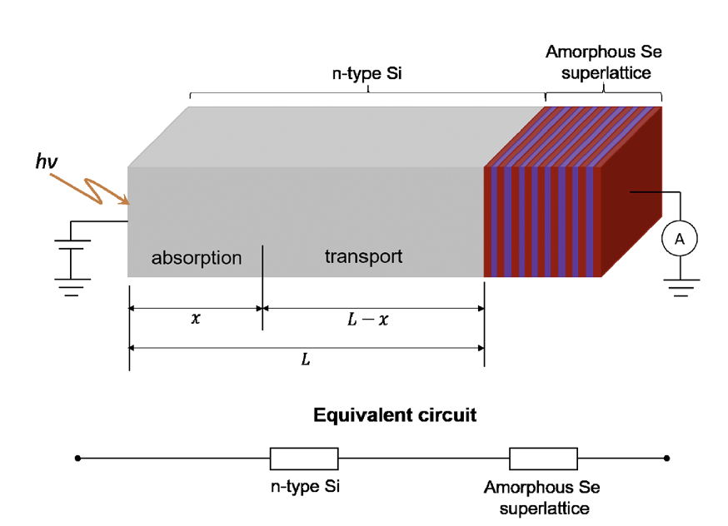
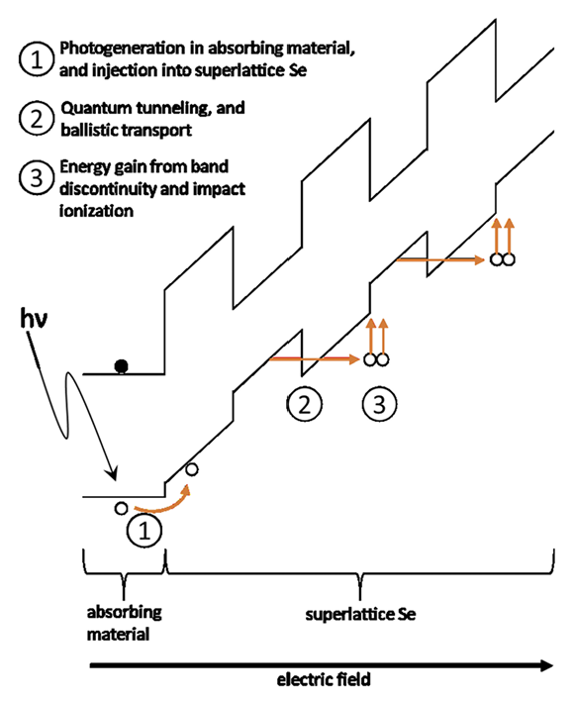
Charge Multiplication in Amorphous Superlattices
Superlattice Concept:
Alternating nanolayers form periodic potential wells and barriers
Multiplication Mechanism:
Carrier Injection: Photogenerated holes enter the superlattice while electrons are largely blocked
Sequential Tunneling: An applied field allows holes to tunnel through thin Se barriers between As₂Se₃ quantum wells
Impact Ionization: Holes gain energy at band discontinuities, generating additional electron-hole pairs that can continue the multiplication process
Theoretical Multiplication:
M = k · N
M: Multiplication factor, N: Number of barriers, k: Effective multiplication per barrier
Ideal Case (k = 1): M = N
Notes:
Staircase APDs use engineered band discontinuities to promote carrier multiplication.
A superlattice consists of periodically alternating nanometer-scale layers, creating repeating potential wells and barriers.
John's work investigated this concept using amorphous Se and As₂Se₃.
Incident photons generate carriers in an absorbing material, which are then injected into the superlattice.
Holes move through the structure, crossing barriers through tunneling or field-assisted transport.
At band discontinuities, carriers can gain energy and produce additional electron-hole pairs through impact ionization.
John's proposed model relates multiplication to the number of barriers: (M=kN).
Under idealized conditions, (k=1), giving one additional unit of gain per barrier in this simplified model.

Slide 5
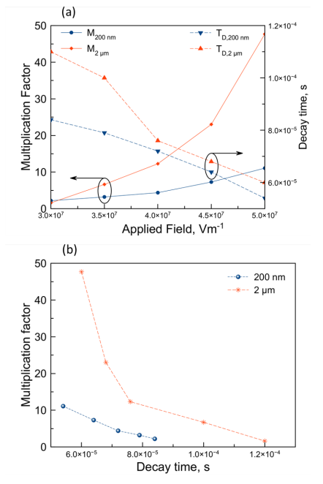
Previously Demonstrated: Charge Multiplication
Experimental Results - (John et al., 2022)
11× gain measured for 200 nm films (12 blocking layers)
→ 12× gain predicted
48× gain measured for 2 µm films (125× blocking layers)
→ 125x gain predicted
→ Thicker films exhibit substantially lower gain than predicted
Possible limitations:
Nonuniform electric fields may reduce multiplication at some barriers
Structural imperfections and interface irregularities may contribute to these field variations
More layers also increase carrier transit time
Can we reproduce superlattice charge multiplication using alternative amorphous materials and our existing thermal evaporation equipment?
John et al., Rev. Sci. Instrum. 93, 034703 (2022).

Slide 6
Developing a-Se superlattices in RIL
Research Objectives
Develop a versatile fabrication process using conventional thermal evaporation
Fabricate alternating a-Se/Se-Te nanolayers
  Individual layer thickness: 6–10 nm
  Te concentration: 20–30 at.% to tune the bandgap and band offsets
  Total thickness: Initial ~150 nm films; scaling toward 2–3 µm
  Vary layer thickness, composition, and number of layers to optimize performance
Investigate optical properties and charge multiplication
  Characterize optical response and bandgap
  Investigate potential quantum confinement and impact ionization
  Evaluate charge multiplication at reduced electric fields
Proposed Structure:
a-Se
a-Se
Se₇Te₃
Se₇Te₃
E_{g} ~ 2 eV
E_{g} ~ 1.4 eV
Alternating semiconductor layers
Notes:
- Joshua John’s fabricated two different thicknesses of Se/As₂Se₃ superlattices: 200 nm and 2 µm.
- Based on the number of barriers, the idealized model predicted multiplication gains of 12 and 125.
- Experimentally, he measured 11× and 48× gain at 50 V/µm.
- The thinner film was relatively close to predictions, but the thicker film achieved substantially less multiplication than expected.
- John proposed that nonuniform electric fields, potentially caused by structural imperfections, prevented effective multiplication at every barrier.
- Holes can also be confined within quantum wells and require tunneling to continue transporting, particularly at lower fields.
- Increasing the number of layers can increase gain, but also increases transit time.
- Controlling multilayer structure and maintaining effective carrier transport are important for realizing the expected gain.
Can we reproduce these structures using different materials and a more flexible fabrication system?
And if so, can we build on Joshua John’s work and improve realized gain

Slide 7
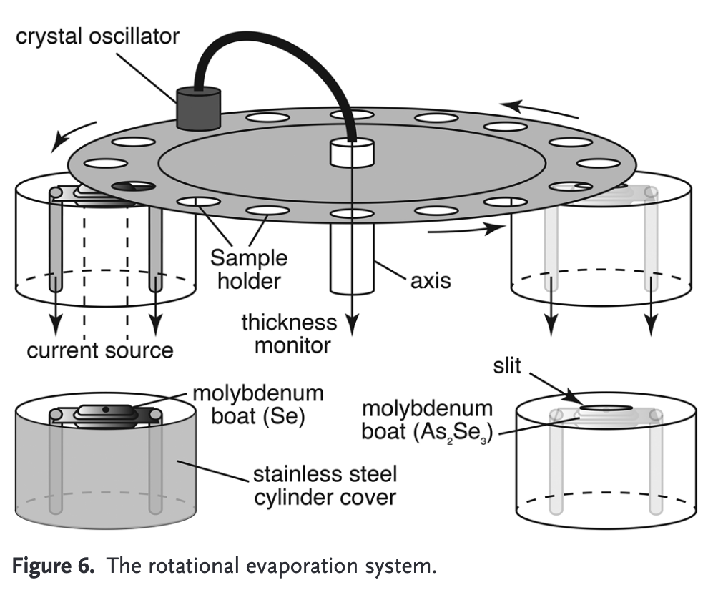
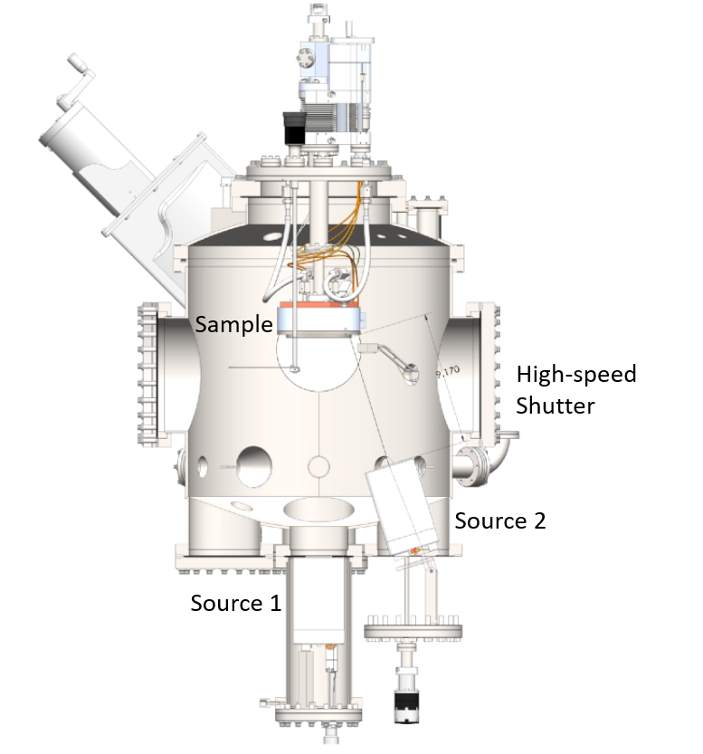
Developing a-Se superlattices in RIL
Okano Lab
Abbaszadeh Lab
Sample rotation:
40 RPM
As, Te, Ge
Se
J. D. John, Ph.D. dissertation, International Christian University, 2021, Fig. 2.1.

Slide 8
Sequential fabrication of Se/Se–Te multilayers
Sample
Procedure:
Main shutter
Heat the a-Se and Te sources
Open the main shutter and deposit a-Se
Close the main shutter and open the Te shutter
Reopen the main shutter and deposit Se-Te
Close both shutters to end the alloy layer
Reopen the main shutter for the next a-Se layer
Repeat the procedure for each desired layer
Te shutter
…
N Se/Se-Te layers
a-Se Source: 2-4 Å/s
Te Source: 0.6-2 Å/s
Glass/ITO

Slide 9
Challenges of Nanolayer fabrication
Deposition Rate & Composition Control
Maintaining stable Se and Te deposition rates
Controlling alloy composition and individual layer thickness
QCM calibration:
Existing QCM calibration was established for thicker films (µm scale)
Small calibration errors become significant for individual 6–10 nm layers
Crystal lifetime and deposition conditions can affect measurement accuracy, requiring periodic recalibration
Scalability & Reproducibility
Scaling from ~150 nm films to µm-scale multilayers requires roughly 10× more deposition cycles
Deposition-rate drift and accumulated errors become increasingly problematic over longer runs
Maintaining consistent layers throughout the entire film
Notes:
QCM calibration: crystal calibration can change with use of the crystal and thicknesses calibrated for
Measuring very thin samples is difficult and can have high error
calibrating QCM tricky, and can drift with crystal use
Since evaporator is used for thick films and thin films, hard to calibrate for both

Slide 10
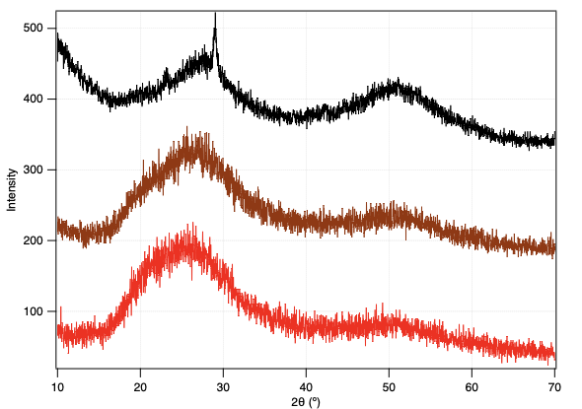
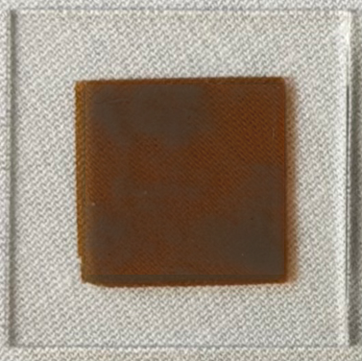
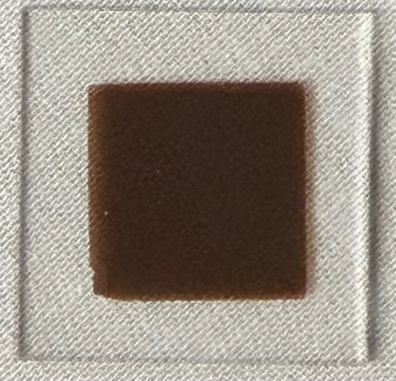
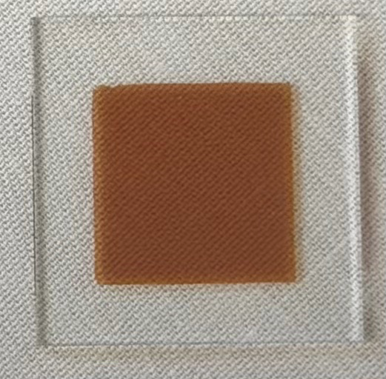
Fabrication Results: Verifying Amorphous Structure
XRD - reason important is because slow deposition rates can lead to crystallization during fabrication
broad, shallow peaks in XRD show that it is fully amorphous, similar to the a-Se
pictures of samples will show glassy, smooth look on amorphous samples; old Se-Te will be foggy, indicating oxidation and crystallization
Low deposition rates can cause crystallization during fabrication
→ XRD shows amorphous structure in multilayer and Se-Te thin films
Se-Te has been shown to oxidize with exposure to air, resulting in TeO_{x} and Se crystallization
Adding a 10 nm Se “cap” prevents air exposure of Te and crystallization
Multilayer sample does not exhibit signs of crystallization 3+ months after fabrication and storage in air
Aged Se-Te
Se-Te w/ cap
Multilayer
Hellier et al., J. Mater. Sci.: Mater. Electron., 37, 1204 (2026).
Notes:
see crystlysation in Se-Te sample
glossy samples in the Se-Te and Multilayer
Multilayer shows nice smooth peaks
aged Se-Te is showing some peaks due to chryslization

Slide 11
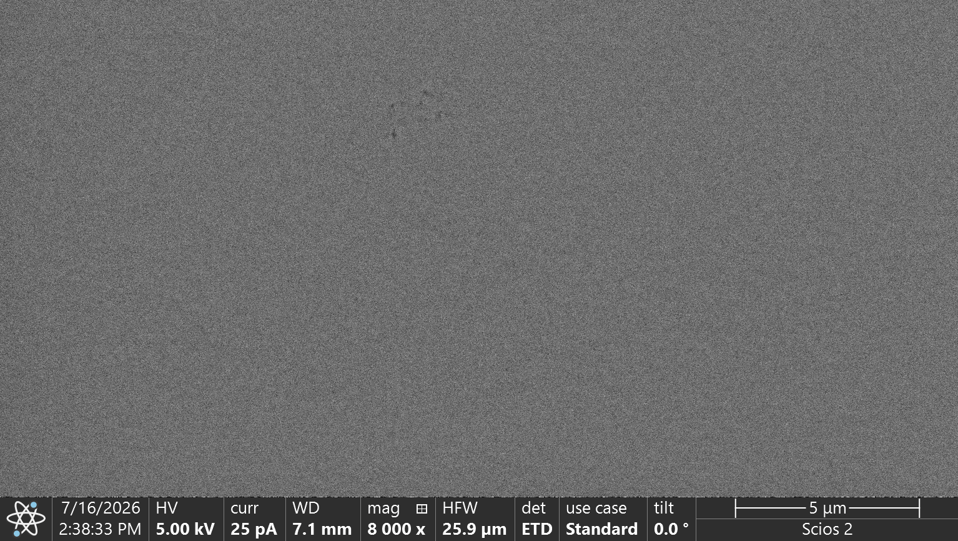
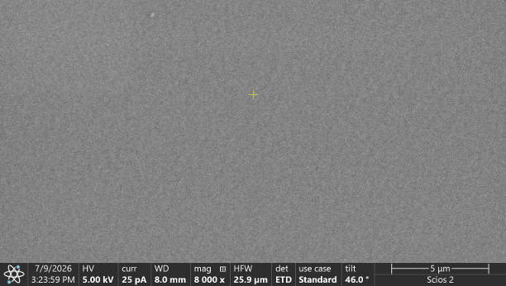
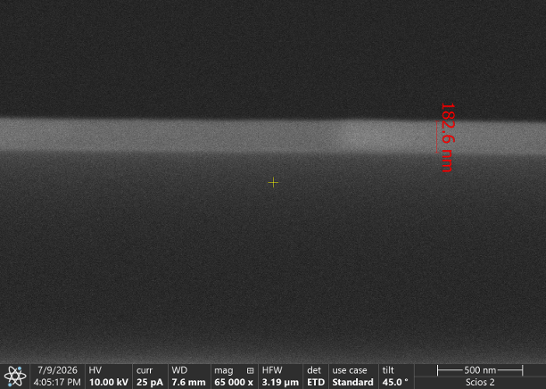
Fabrication Results: Morphology
Se-Te
19.2 at.% Te
Established Se-Te Deposition
Previous thicker Se-Te films demonstrated smooth morphology and controlled composition
Extending the process to nanometer-scale layers requires more precise calibration
Initial Multilayer Results
72 nm a-Se base layer + 19 alternating ~8 nm layers
Thickness: 182 nm measured (SEM) vs. 224 nm expected
Te composition: 3.6 at.% measured (EDS) vs. 6.1 at.% expected
Smooth morphology, but reduced thickness and Te content suggest deposition calibration errors
Ongoing Improvements
Refining QCM (crystal) calibration for ultrathin layers
Newer films show encouraging surface morphology
Next: TOF-SIMS depth profiling to investigate layer periodicity and composition
Multilayer
3.6 at. at% Te
Notes:
QCM calibration: crystal calibration can change with use of the crystal and thicknesses calibrated for
Measuring very thin samples is difficult and can have high error
calibrating QCM tricky, and can drift with crystal use
Since evaporator is used for thick films and thin films, hard to calibrate for both

Slide 12
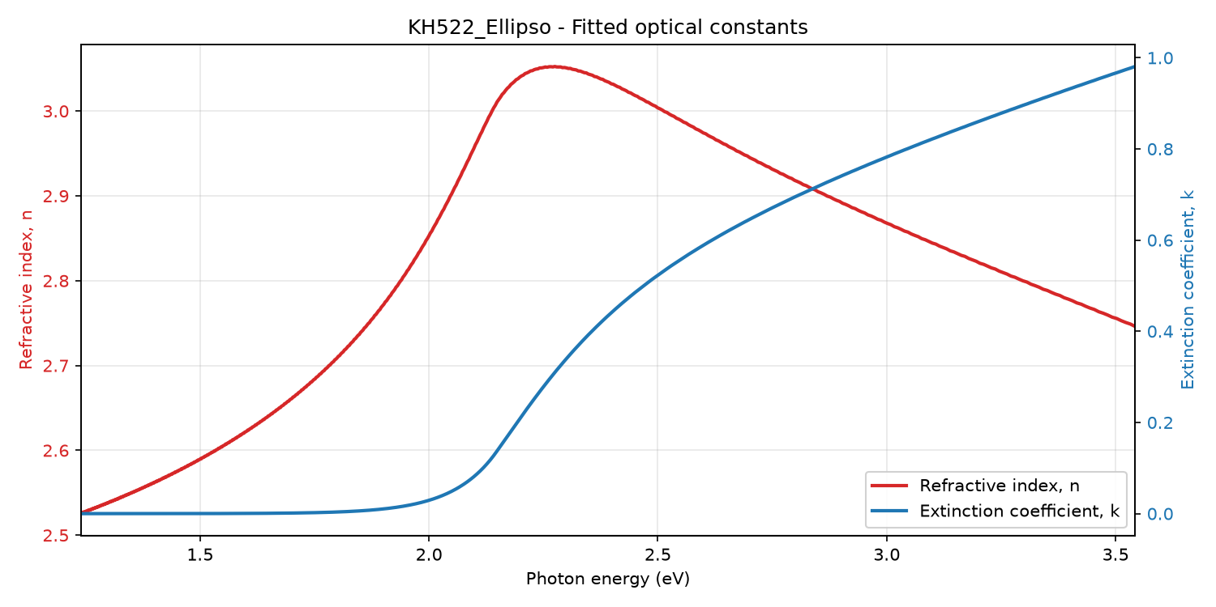
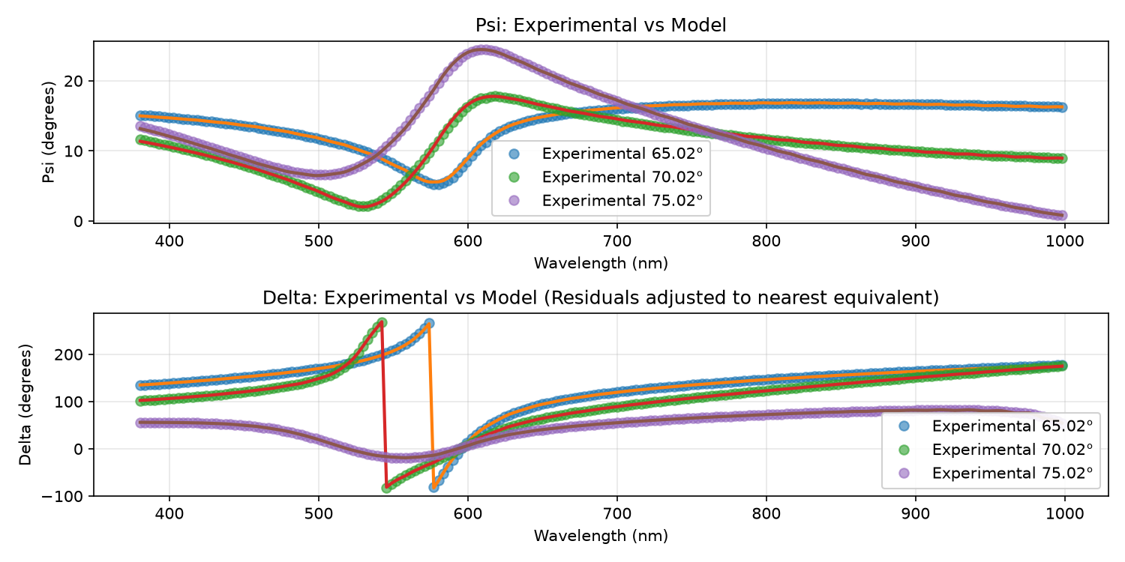
Ellipsometry Modeling: a-Se
Cody–Lorentz Dispersion Model
Single Cody–Lorentz oscillator
Accounts for band-edge absorption and Urbach tail
Optical constants consistent with published a-Se measurements
Model Fit Results:
E_{g} = 1.998 eV
E_{u} = 88.8 meV
Film Thickness: 106 nm
Joshua D John et al 2021 J.Phys.D: Appl.Phys. 54 255106

Slide 13
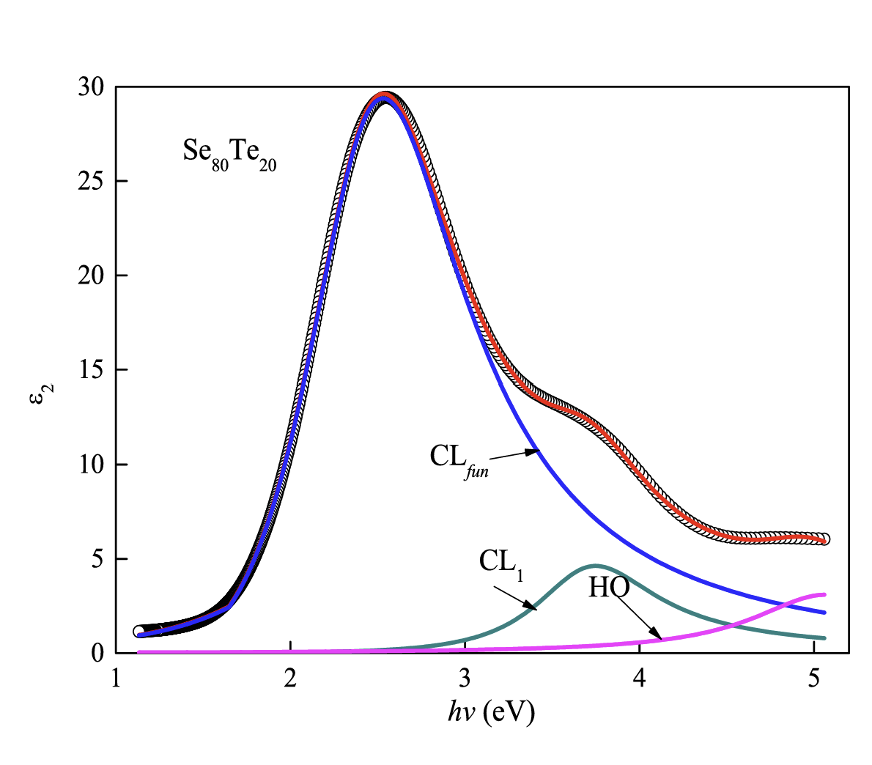
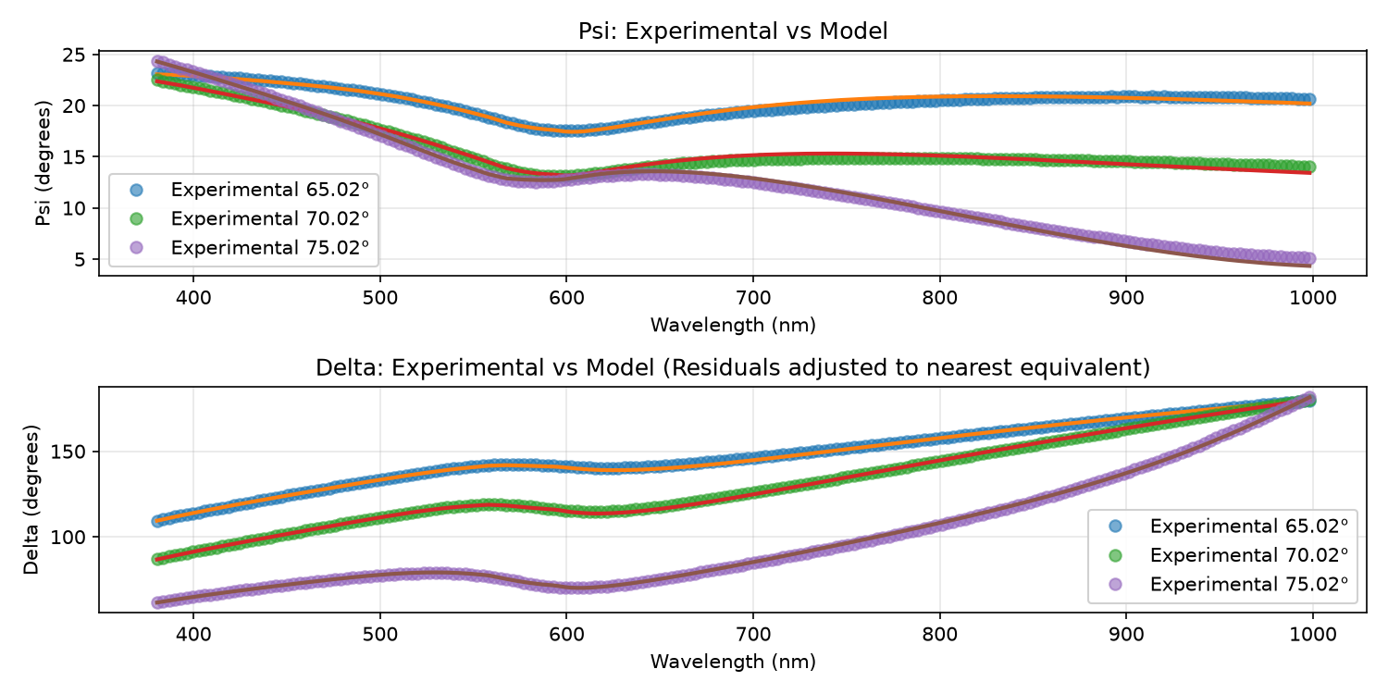
Ellipsometry Modeling: Se-Te
a-Se
a-Se: A single Cody–Lorentz (CL) oscillator can describe the dominant absorption edge over the measured spectral range
Se-Te: Adding Te modifies the electronic structure, shifts the optical band gap, and changes the strengths of higher-energy features
Multiple overlapping absorption contributions cannot always be reproduced by a single CL oscillator
Two CL oscillators and one harmonic oscillator represent the fundamental absorption edge, higher-energy transitions, and UV response
Single Cody–Lorentz model
Se-Te
Two Cody–Lorentz + harmonic oscillator contributions
F. Abdel-Wahab et al., Applied Physics A, 127, 531 (2021).

Slide 14
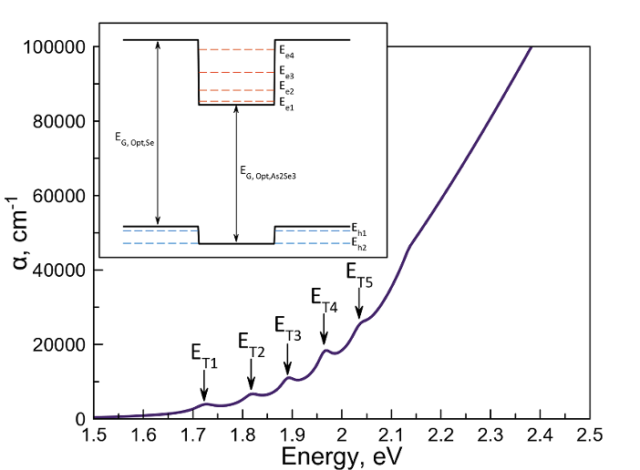
Ellipsometry Modeling: Superlattice
John (2021) - Se/As₂Se₃ Superlattices
Modeled the multilayer as a single effective optical layer
Used Cody–Lorentz dispersion with additional Lorentz oscillators to capture quantum-confinement-related absorption features
Se/Se₇Te₃ Superlattices
Overlapping optical contributions: Se-Te already exhibits multiple absorption features, potentially obscuring superlattice-specific transitions
Model validation: Additional oscillators may improve a fit without representing genuine quantum transitions
Model combination: Due to the more complex dielectric function of Se-Te, integrating the individual material models into a physically accurate superlattice model requires further development and validation
Joshua D John et al 2021 J.Phys.D: Appl.Phys. 54 255106
a-Se
Se-Te
+
= ?
Single Cody–Lorentz model
Two Cody–Lorentz + harmonic oscillator contributions

Slide 15
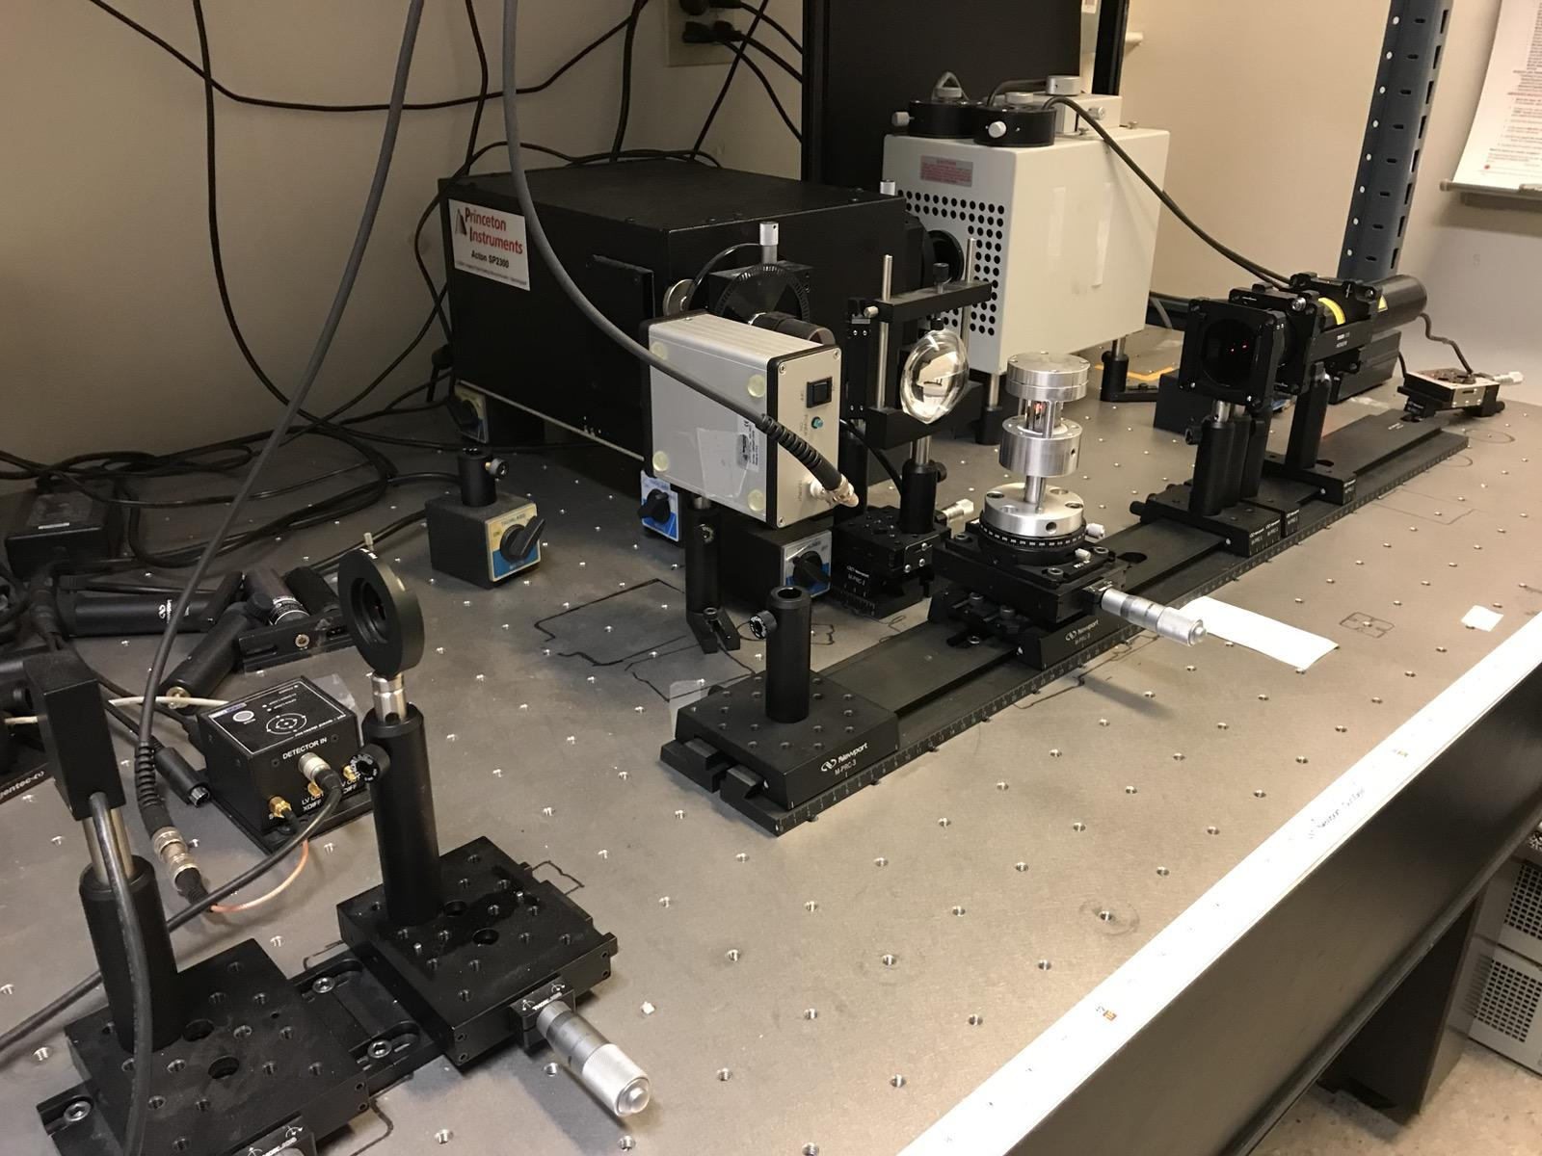
Next Steps in Developing a-Se Superlattice Devices
Refinement of Multilayer Structure:
Revise calibrations for layer thicknesses
Verify concentrations and layers by TOF-SIMS, EDS
Observation of Optical and Electronic Properties
Continue to develop models for ellipsometry, characterize thicker samples
Employ photothermal deflection spectroscopy (PDS) for additional transition states and trapping
Deep level transient spectroscopy (DLTS) for trap state evaluation
Fabrication and Testing of First Devices:
Device shadow masks and testing apparatus designed
Fabricate first devices on silicon
Simulate electric fields across device in COMSOL
Measure photocurrent/gain vs. electric field
Light
ITO
n-type Si
Superlattice
Pogo Pins
PCB
SMA Connections
A
Notes:
Refinement of Multilayer Structure
Revise calibrations for layer thicknesses
Verify concentrations and layers by TOF-SIMS, EDS
Observation of Optical and Electronic Properties
Continue to develop models for ellipsometry, characterize thicker samples
Employ photothermal deflection spectroscopy (PDS) for additional transition states and trapping
Deep level transient spectroscopy (DLTS) for trap state evaluation
Fabrication and Testing of First Devices
Device shadow masks and testing apparatus designed
Fabricate first devices on silicon
Simulate electric fields across device in COMSOL
Measure photocurrent/gain vs. electric field
Image for each ‘category’

Slide 16

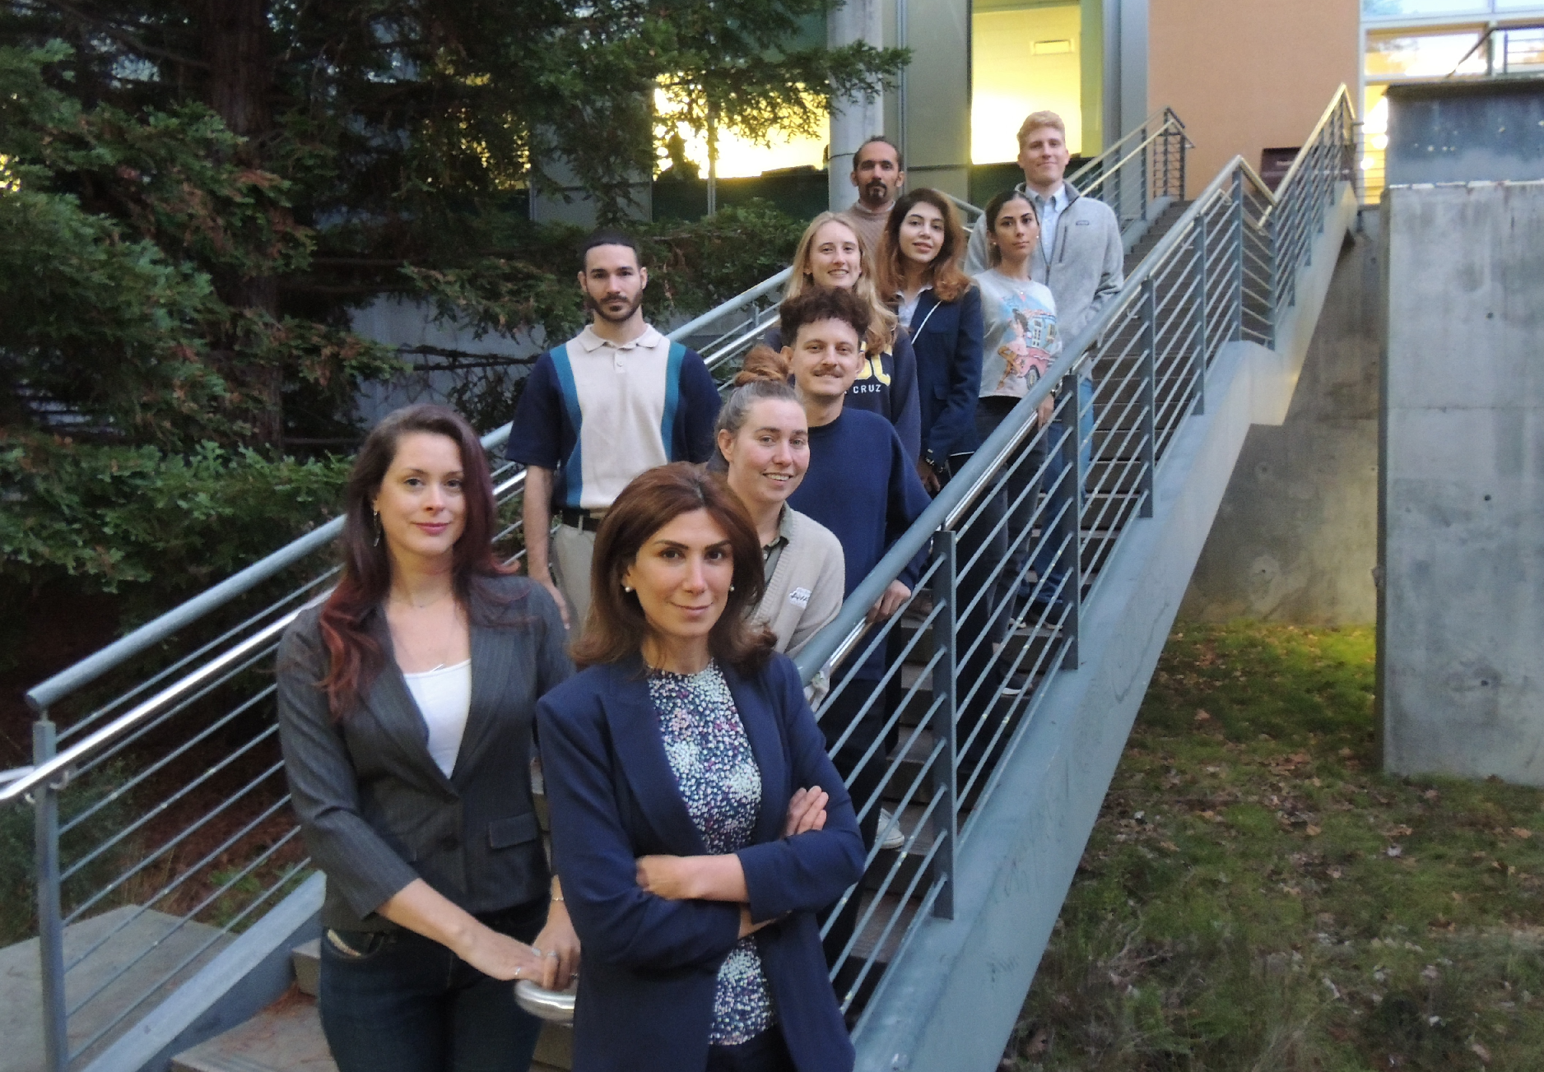




Radiological Instrumentation Laboratory (RIL)
Prof. Shiva Abbaszadeh
Electrical & Computer Engineering
sabbasza@ucsc.edu
Funding Provided by:
Research Scientists
Dr. Praveen Gurunath Bharathi
Postdoctoral Scholars
  Dr. Kaitlin Hellier
  Dr. Chris Lamb
Graduate Students
  Gregory Romancheck (UIUC)
  Greyson Shoop
  Max Teichiera
  Evan Walls
Undergraduate Students
  Minahill Shafi
  Teo Schnell
  Austin Brown
  Gabriel Graves
  Teddy Li
  Noah Botelho
  Ananya Goyal
Department of Energy - High Energy Physics
DE-SC0026034
UCSC REU program through the National Science Foundation
Grant # 2349305
Notes:
Thank you for joining me today, I am happy to answer your questions if I'm able!

