Slide 1










In-pixel machine learning in the presence of silicon detector noise
By: Ben Weiss on behalf of the Smartpixels group
Cornell University – bw539@cornell.edu
CPAD – 21 October 2026
Notes:
Funding Acknowledgement?

Slide 2
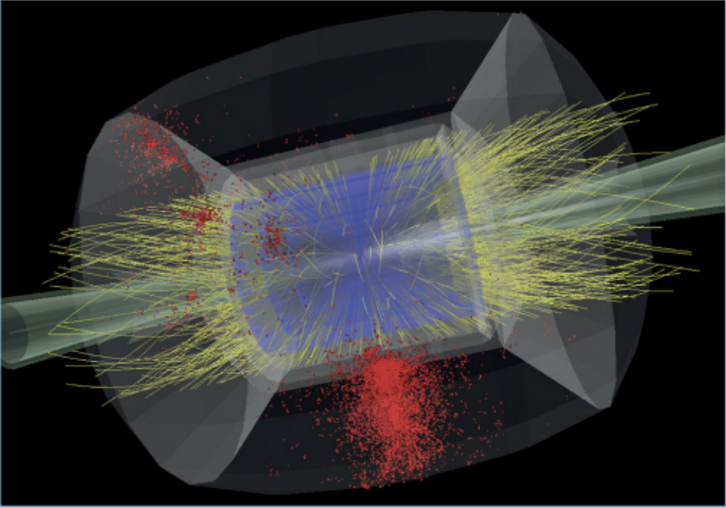
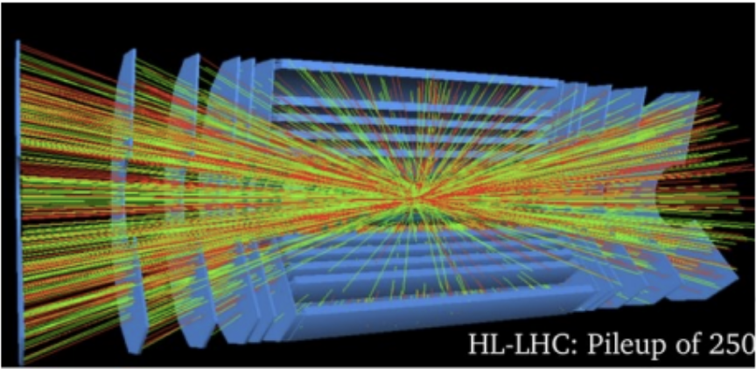

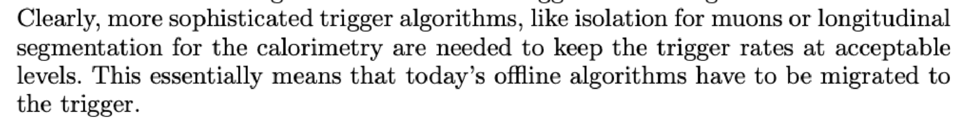
Pixel Granularity VS Data-rate
Muon Collider:
Si-pixel tracking in high–luminosity colliders requires
ultra-high resolution that strains bandwidth
Intelligent front-ends relieve the burden
on triggers downstream by beginning
reconstruction at the source
FCC-hh:
Notes:
Event display pic HL LHC Muon collider ED, include lindsey slide 2 in backup at least

Slide 3
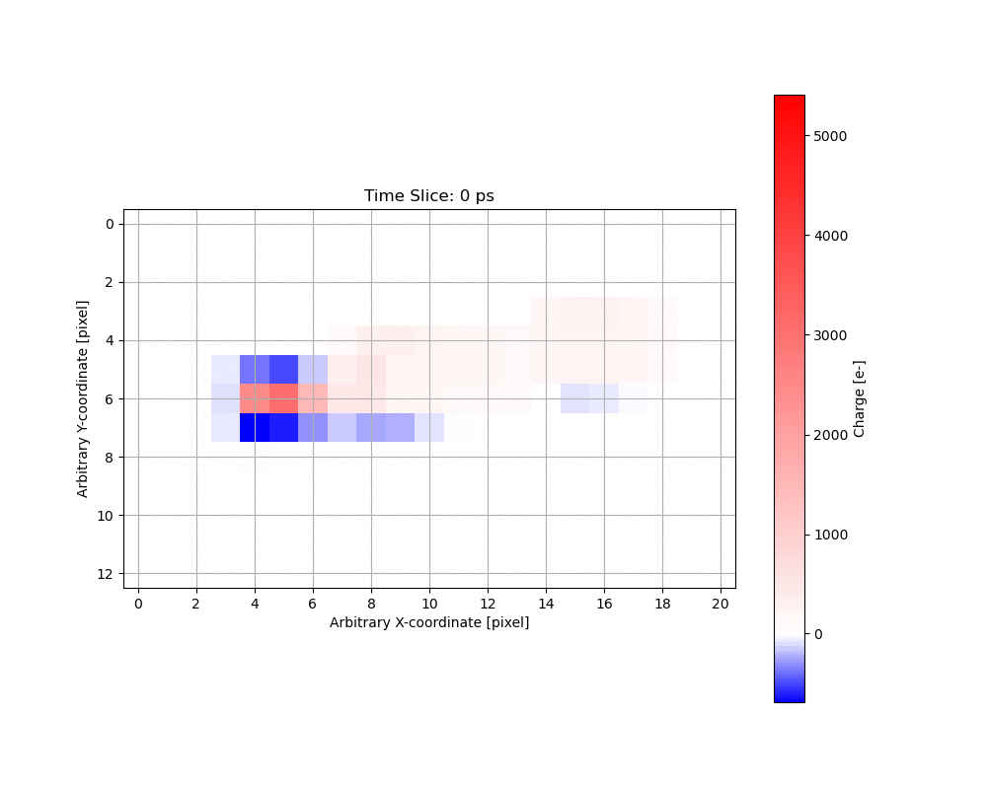
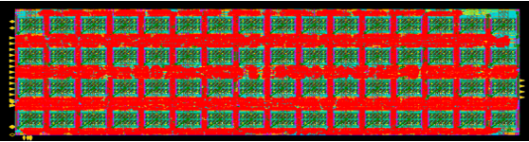
Enter Smartpixels!
Smartpixels goal: embed small NNs on Si-pixel ASIC readout chips that perform pre-trigger data refinement at the collision rate.
p_{T} filtering and regression of track geometry from a single Si-layer
  Advantage: track parameter readout does not scale with granularity!
Extreme-edge implementation targeting CMS Phase 3 conditions
Pixelated charge
SmartPix ROC bonded to pixel
Predictions:
- High vs. low pt?
- Hit position
- Track angle
L1 Trigger
@ 40 MHz
Digital NN
Analog readout

Slide 4
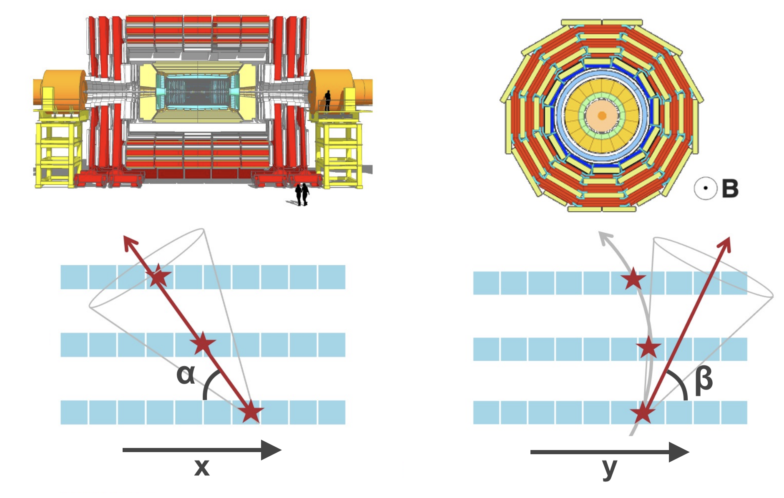
Smartpixels Datasets
π
Pixels
Si
Incident pion kinematics taken from real CMS data.
Sensor charge collection simulated with PixelAV.
16x16 pixel array
50µm x 12.5µm pixel pitch
20 timesteps (200ps appart)
Subset available on Zenodo
500k-4M events/dataset
Dataset production work by Danush Shekar, Morris Swartz

Slide 5
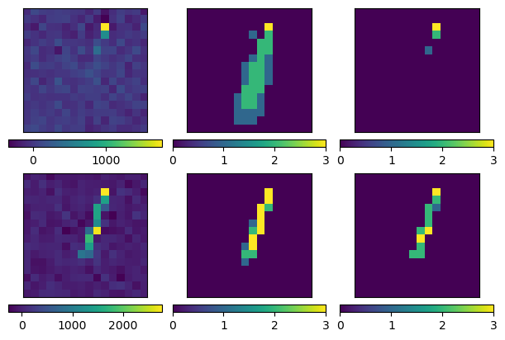
Noise in a Si-pixel frontend
Estimated noise contributions
σ_{Th} | ENC | ENC w/ 0.5 GRad | Total σ_{N}
45e | 40e | 55e | ~78e
Si-pixel noise sources include thermal excitations, leakage current, irradiation…
This study assumes noise sampled from gaussian with µ=0, σ=σ_{N}
Detailed simulation of FE response presented in Harshul Gupta’s talk
Simulated irradiation studied in SmartPixels filter.
Standard denoising approach:
impose a 3-5σ_{N} threshold
Raw charge + σ_{N} = 80e Noise
T_{No Noise} =
[0, 30, 845]
T_{80e Noise} =
[248, 668, 1663]
Last TS First TS
Noise estimated in https://arxiv.org/pdf/2510.07485
Notes:
Enc is 55 without radiation at -40c (Sec. 4.4)

Slide 6
3 regression algorithms considered
Encoder Network
Dencoder Network
2D images
x Proj.
Dense
MLP
SlimMLP
Params: 2,179
HLS: 0.34 mm²
Latent Space
<16>
Small MLP
Output: {x,y,β}
y Proj.
Dense
Increasing # of operations
2D images
Seperable Conv2D
Conv2D
SlimConv2D
Params: 1,682
HLS: 0.28 mm²
Latent Space
<4x4x5>
Small MLP
Output: {x,y,β}
2D images
Patch Encoder
Multi-head Attention
Latent Space
<20x64>
Output: {x,y,ɑ,β}+10 Covariances
Transformer Params: 705K
Large MLP
X 4
Notes:
Switch graphic to include transformer

Slide 7
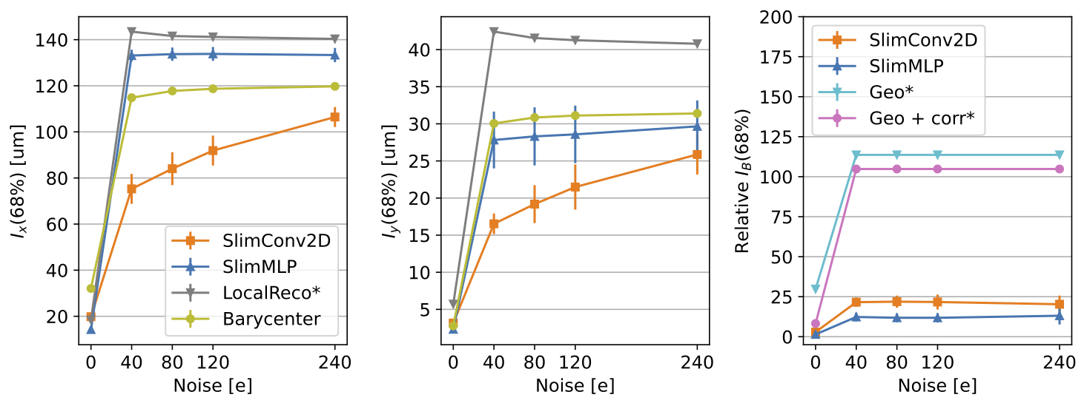
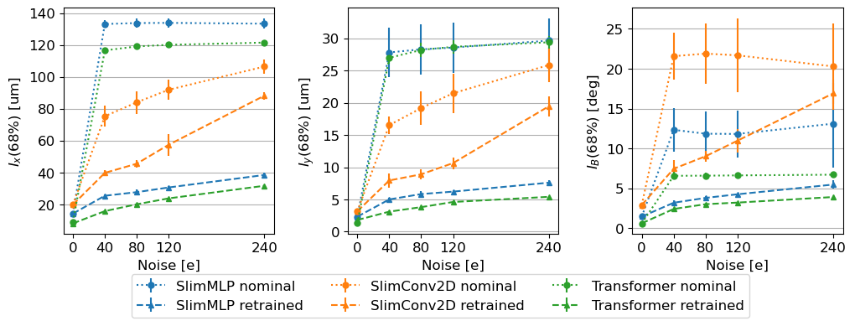
Regression in the presence of noise
Base performance
Base deployable network performance competes with non-ML techniques but both fail with a small amount of injected noise
Retraining with noise recovers performance but barely reaching sub-pixel accuracy
Networks here use ADC thresholds assuming no noise… Can we optimize these?
Retraining with noise
x pitch
y pitch

Slide 8
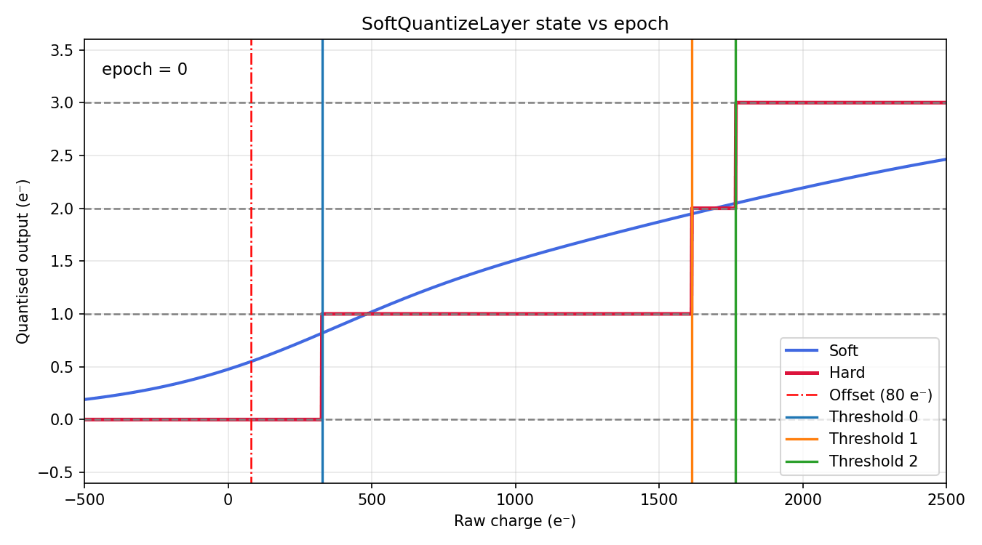
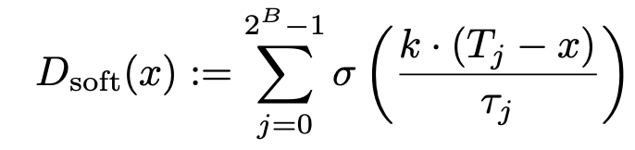
Soft Quantization: Optimize FE in training
Choice of 2-bit ADC thresholds matters! Treat these as trainable parameters.
First network layer: Smooth step function with trainable step location.
Annealed slowly for optimization stability
SQ Technique and animation by Arghya Das https://arxiv.org/abs/2602.15946v3

Slide 9
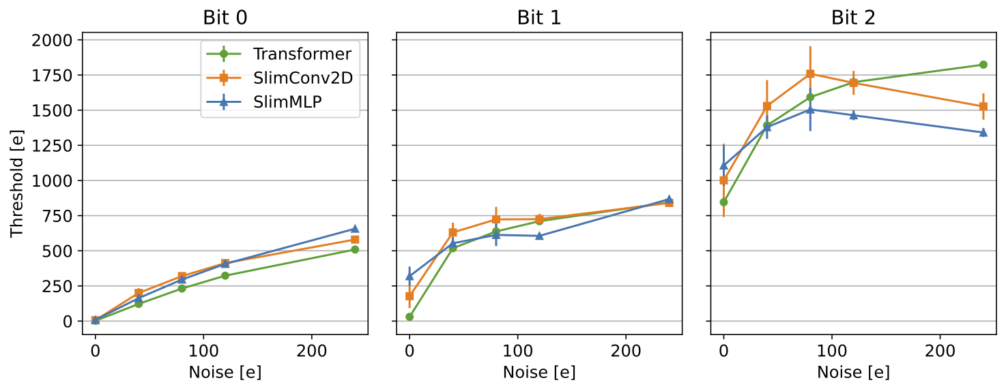
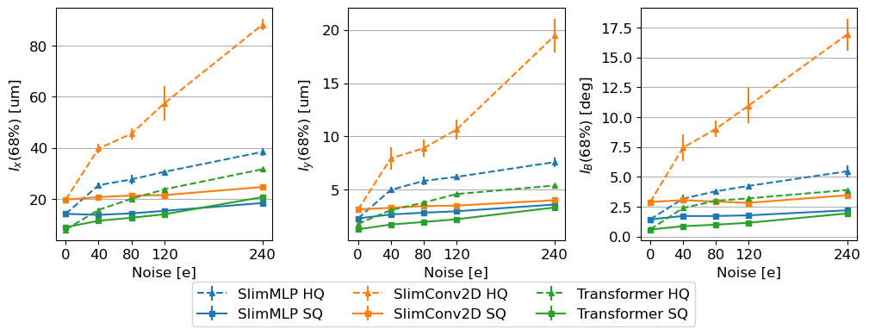
SQ thresholds and regression results
Threshold 0
Threshold 1
Threshold 2
Soft Quantization naturally sets the lowest threshold to roughly 3xσ_{N}
SQ drastically improves regression performance
Can we go further?
  Can charge information
bellow σ_{N} be reintroduced by denoising?
SQ improves regression
x pitch
y pitch

Slide 10
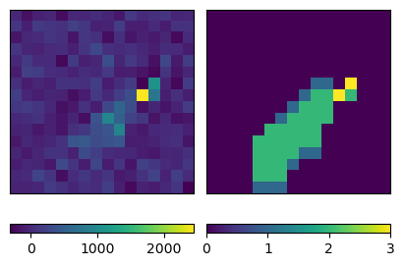
In pixel denoising
Denoising Goal: recover the cluster shape according to σ_{N} = 0 thresholds.
Denoised 2-bit image
w/ Th(σ_{N} =0e):
[0e, 30e, 845e]
Raw charge collected +noise
Denoise & digitize

Slide 11
In pixel denoising – SQAutoEncoder
1. Train each encoder to denoise using an AutoEncoder architecture
Denoised 2-bit image
w/ Th(σ_{N} =0e):
[0e, 30e, 845e]
Raw charge collected + σ_{N} noise
Soft Quant.
Encoder
LS
Large Decoder
Classification

Slide 12
In pixel denoising – SQAutoEncoder
1. Train each encoder to denoise using an AutoEncoder architecture
Denoised 2-bit image
w/ Th(σ_{N} =0e):
[0e, 30e, 845e]
Raw charge collected +noise
Soft Quant.
Encoder
LS
Large Decoder
Classification
2. Freeze the encoder
and retrain the
regression MLP
The MLP now operates on a LS rich with charge shape information below σ_{N}!
MLP
x, y, β
Soft Quant.
Encoder
LS

Slide 13
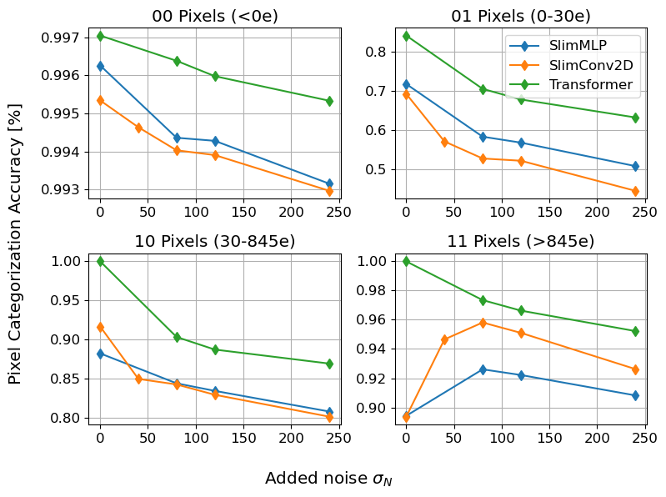
SQAutoEncoder Pixel Categorization accuracy
All SQ AutoEncoder architectures achieve high denoised pixel categorization accuracy, even well bellow σ_{N}
Note: 90% of denoised pixels are 00
Comparison to accuracy with standard digitization scheme in backup!

Slide 14
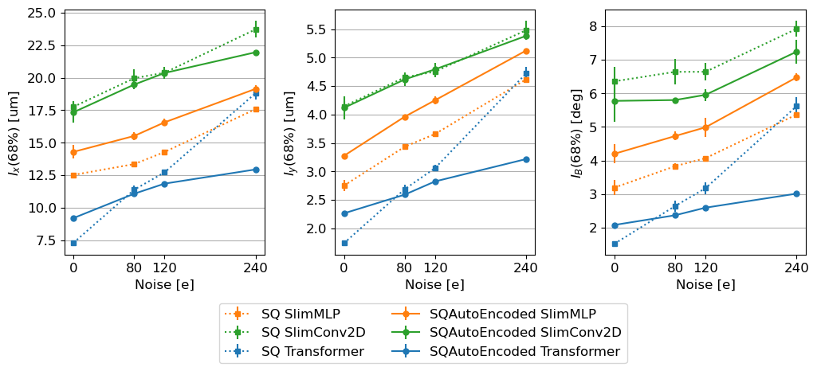
SQAutoEncoder: Denoising and regression
So, can we go further?
A little bit, but only with a more complex on-chip algorithm
SlimMLP performance degrades with SQAutoEncoder
  Denoising may shift the learning objective too far from the regression task
  Future work: multi-objective training

Slide 15
Conclusions
Si-Pixel detector noise degrades on-ASIC ML track parameter regression, but performance is recoverable with ML tricks.
Intelligent front-ends offers a route towards tracking in HL environments.
Even a simple noise model on a Si-AFE destroys track geometry predictions.
Retraining the on-chip network improves performance. Optimizing ADC thresholds in the training loop helps even more.
It is possible to further improve regression using a denoising autoencoder to enrich some network layers with information below the noise floor.
  Currently this technique only works with a more sophisticated network on-chip.

Slide 16

The Smartpixels group!
Fermi National Accelerator Laboratory: Abhijith Gandrakota, Benjamin Parpillon, Chinar Syal, Douglas Berry, Farah Fahim, Gauri Pradhan, Giuseppe Di Guglielmo, James Hirschauer, Jennet Dickinson, Lindsey Gray, Nhan Tran, Ron Lipton
Cornell University: Jennet Dickinson, Ben Weiss
Johns Hopkins University: Dahai Wen, Morris Swartz, Petra Maksimovic
Northeastern University: Nick Manganelli
Northwestern University: Manuel Blanco Valentin
Oak Ridge National Laboratory: Aaron Young, Shruti R. Kulkarni
Purdue University: Mia Liu, Arghya Das
University of Chicago: Karri DiPetrillo, Carissa Kumar, Emily Pan, Rachel Kovach-Fuentes, Aidan Nicholas, Eliza Howard, Eric You
University of Colorado Boulder: Jannicke Pearkes, Ricardo Silvestre
University of Illinois Chicago: Corrinne Mills, Danush Shekar, Jieun Yoo, Mohammad Abrar Wadud
University of Illinois Urbana-Champaign: Mark S. Neubauer, David Jiang
University of Kansas: Alice Bean

Slide 17
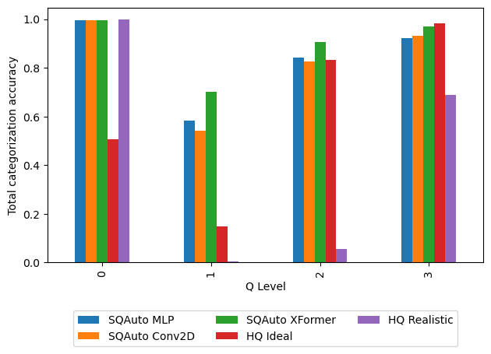
SQAutoEncoders (MLP, Conv2D, XFormer)
Given a cluster with 80e gauss. noise added, how well can each model predict denosied pixel values
Average pixel categorization accuracy
Denoised pixel values defined by Xformer optimized SQ thresholds with no added noise:
  T_{Ideal} = [0e, 30e, 845e]
  T_{Real} = [231e, 637e, 1592e]\

Slide 18
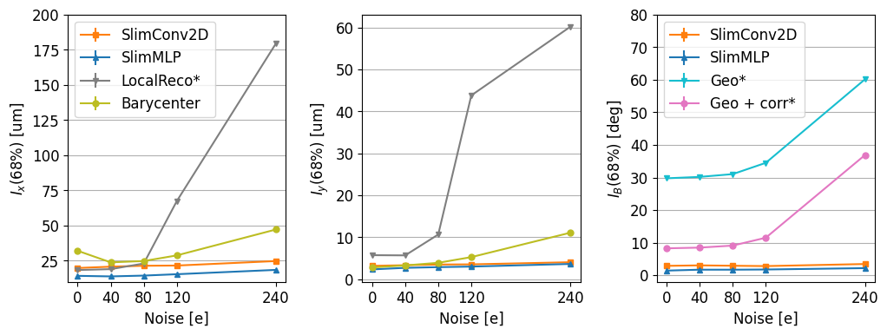
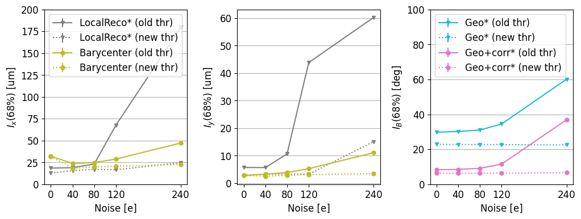
Non-ML
performance
Using 80e thresholds ->
(but SQ ML models)
Optimized thresholds -> by noise

Slide 19
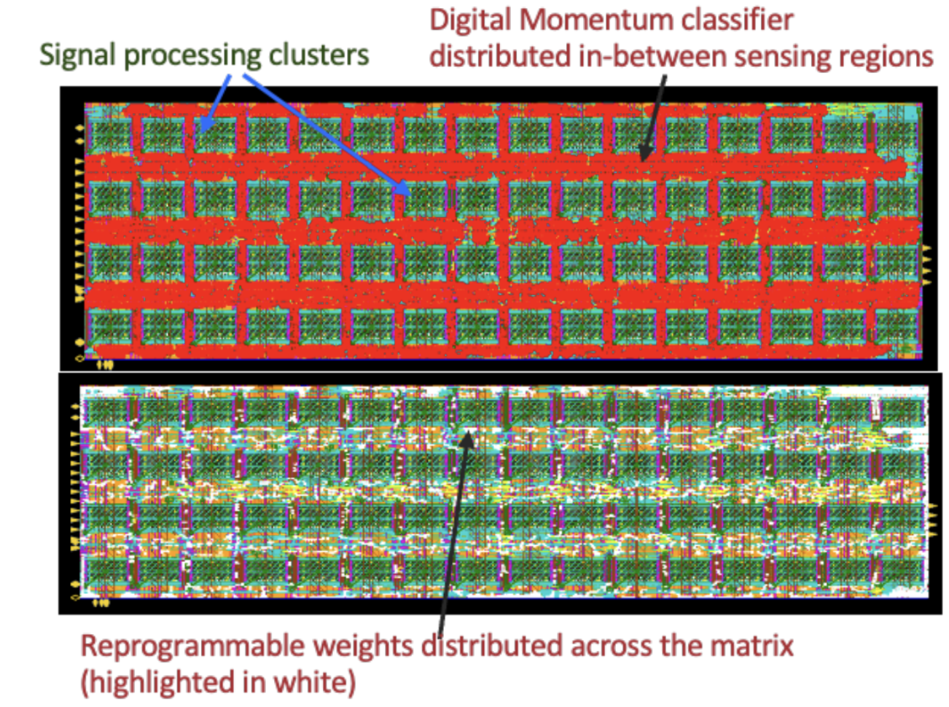
ASIC synthesis
Established pipeline to translate quantized python level model to RTL design
hls4ml converts QKeras model to C++
Catapult HLS converts C++ to RTL
Estimates model footprint (mm²), power consumption
Feedback for python optmization
Full precision Python model
QKeras: quantized model
hls4ml:
C++
CatapultHLS:
RTL design
Tapeout!
Credit: Giuseppe Di Guglielmo

Slide 20
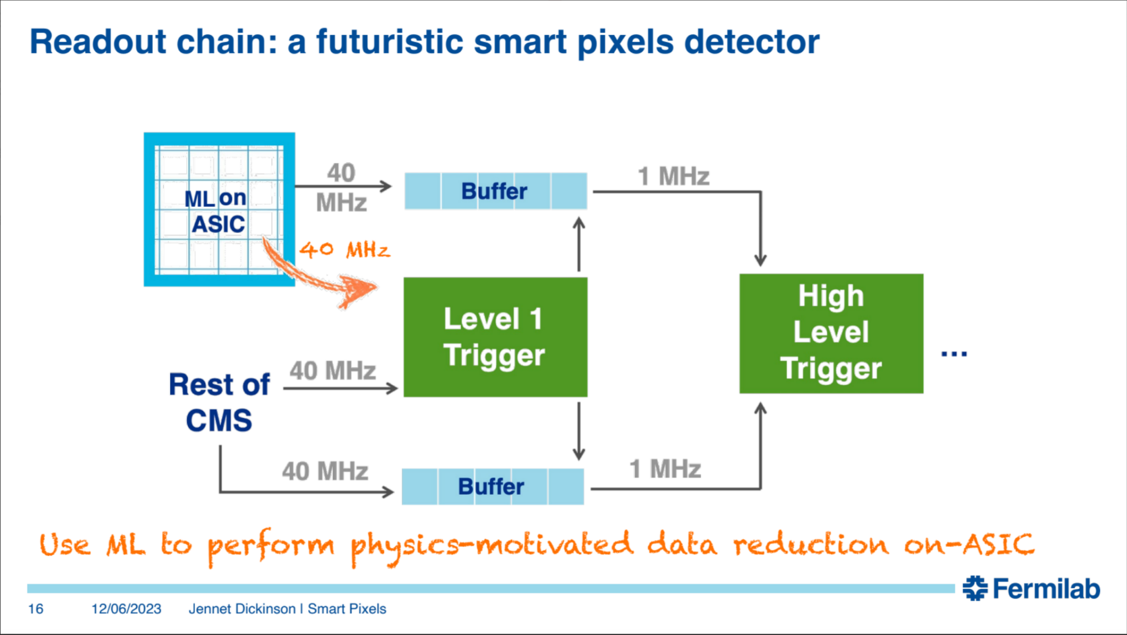

Slide 21
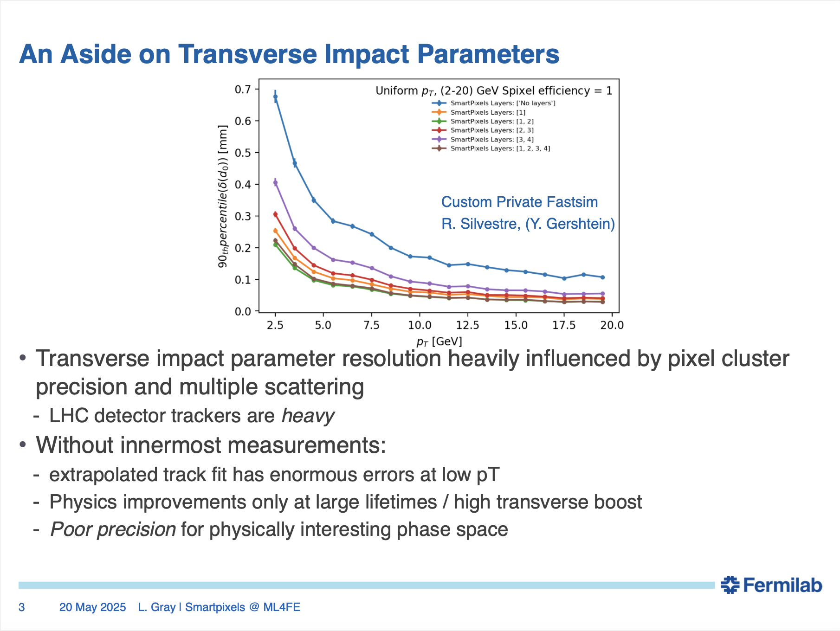

Slide 22
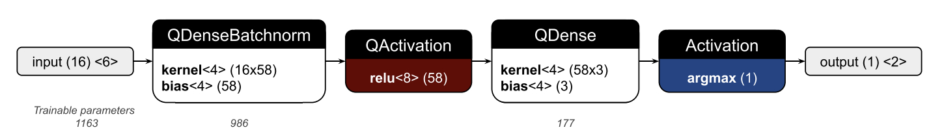
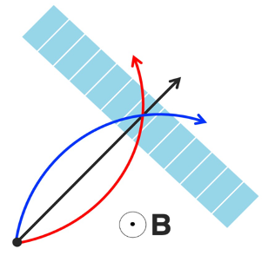
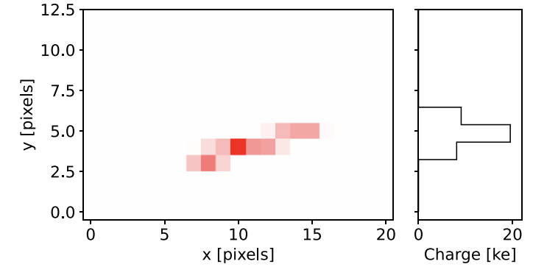
Filtering algorithm
input (14) <2>
Classifies high vs low momentum particles with ~0.2 GeV threshold
13x21 pixel array with 2-bit quantization on front end charge
Dense network trained on y-projection of charge cluster images
4 Bit quantization of weights & biases
Credit: Jieun Yoo et al 2024. https://doi.org/10.1088/2632-2153/ad6a00
Notes:
Geometry and irradiation comparisons from danush?

Slide 23
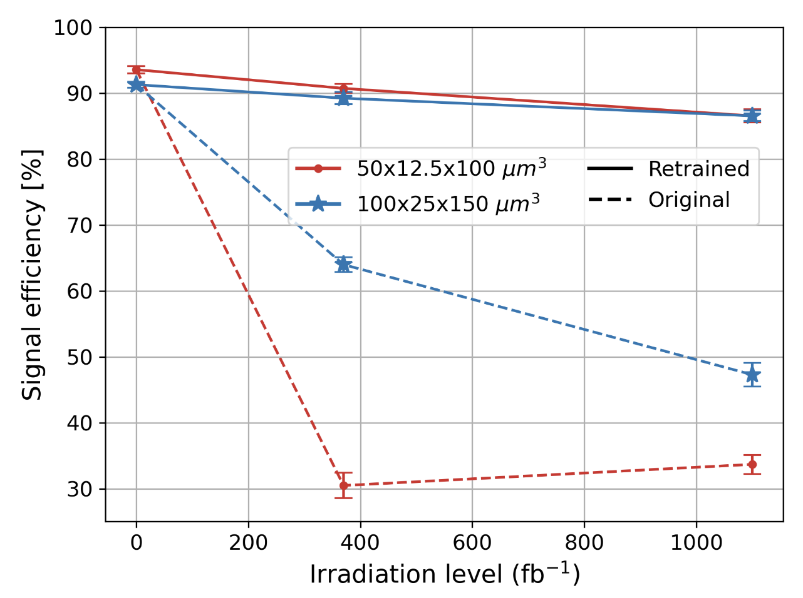
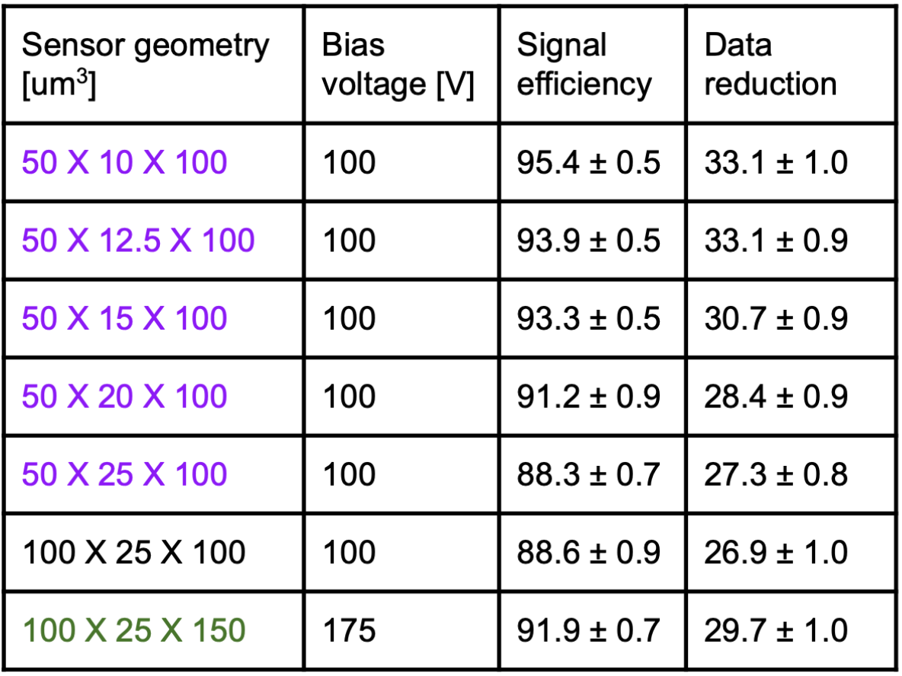
Filtering algorithm performance
Multiple geometries (0.2 GeV thresh.):
Retrainable to endure irradiation:
%
%
Credit: Danush Shekar, Jennet Dickinson
Notes:
Highlight reprogramability

Slide 24
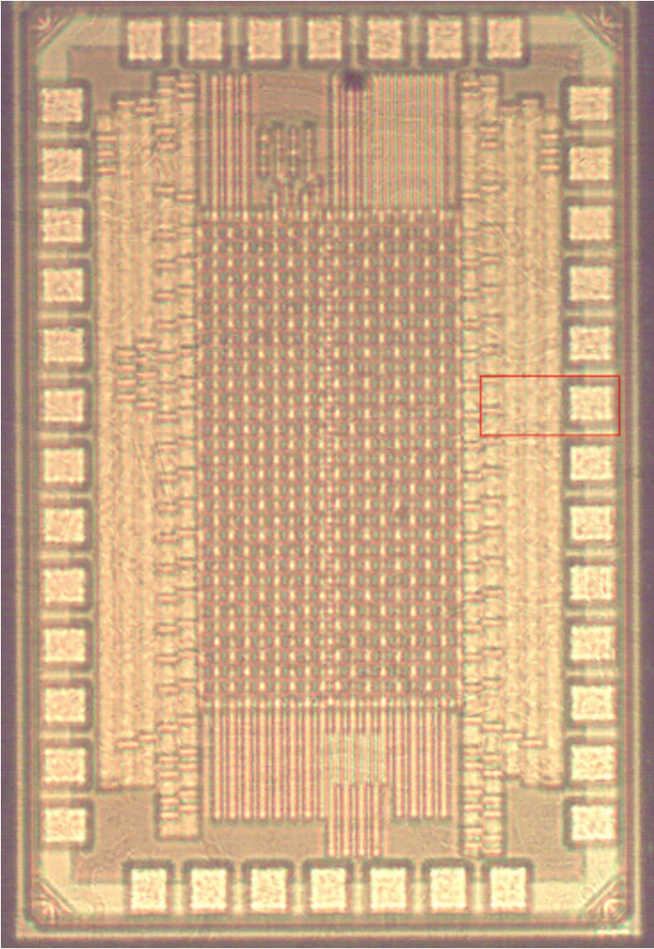
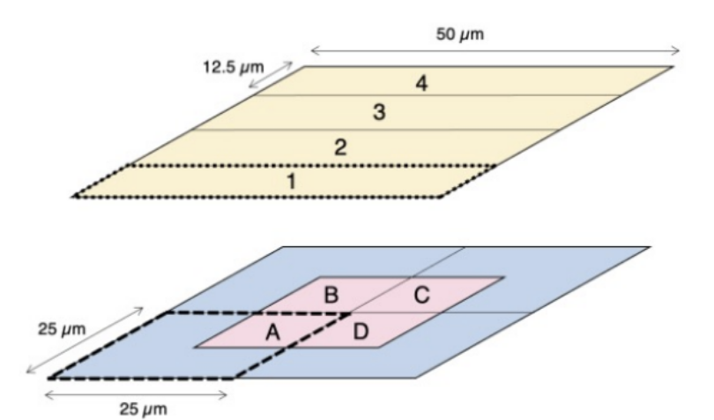
New Prototype SmartPixels ROIC
Spec. | Value | Units
Parameters | 4652 | w+b
DNN+ADC area | ~0.2 | mm²
Total area | ~1.6 | mm²
Clock frequency | 40 | MHz
Latency | 50 | ns
Newest Smartpixels TSMC 28 nm chip hosts per-pixel charge injection and programmable network for classifier.
2 sets of 8x32 pixel arrays (2 ADC vers.)
ADC+DNN consumes ~6 µW/pixel @ 40 MS/s
ADC v1
ADC v2
1mm
Credit: Benjamin Parpillon, Anthony Badea
Notes:
Power consumption assumes 1hit/mm^2, within 1mW/cm^2 budget
1.6 mm2 ASIC chip. A TSMC CMOS 28

Slide 25
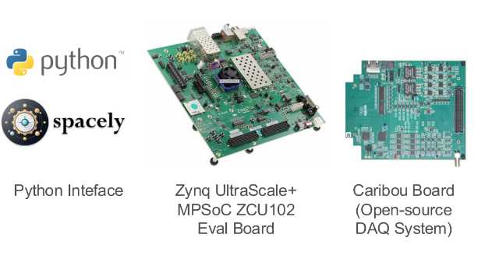
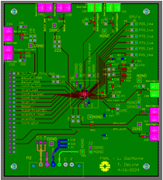
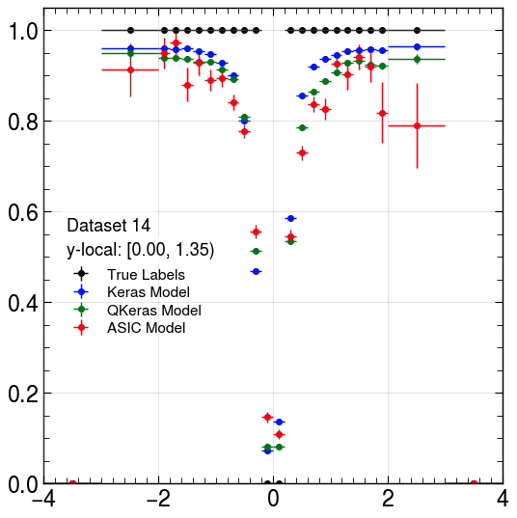
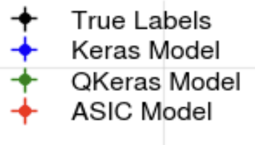
Chip testing efforts
FPGA based setup to communicate with the smartpixels ROIC
Spacely+Caribou+Peary
ASIC on eval. board
Test routines developed to measure:
Power consumption
Pixel S-curves
DNN programing/
predictions on chip
Fraction predicted high p_{T} (>0.2GeV)
Credit: Benjamin Parpillon, Anthony Badea
True p_{T} [GeV]
Notes:
Ask anthony about turn on curve!!!

Slide 26
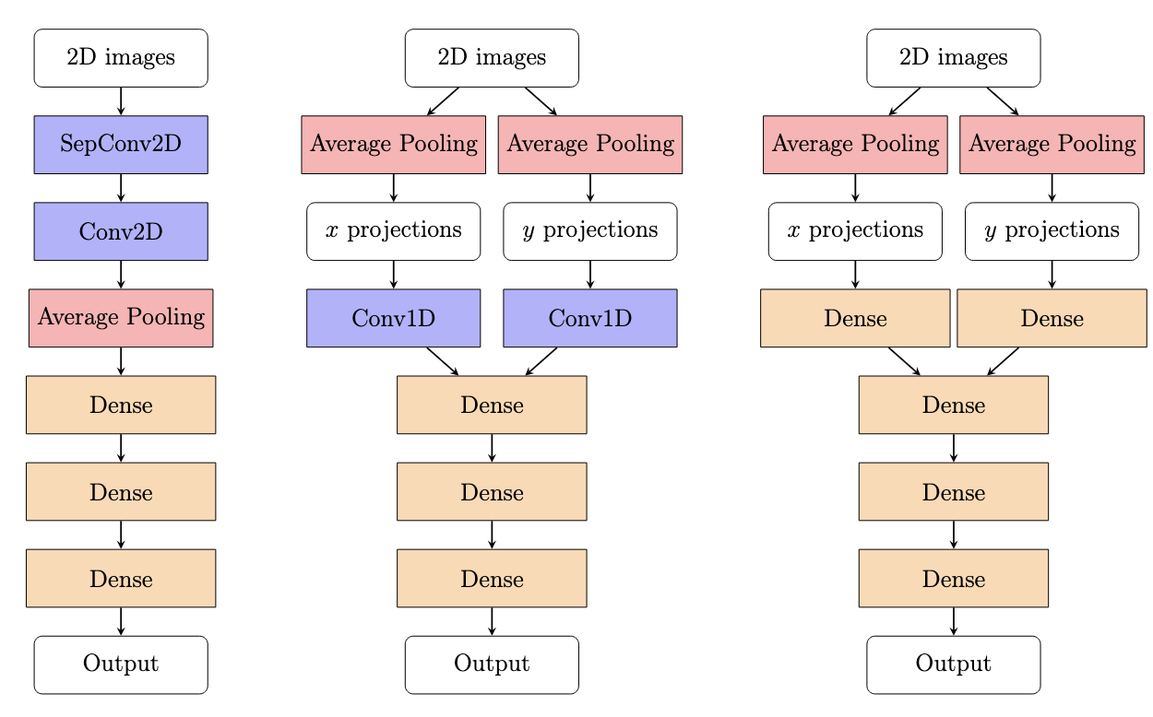
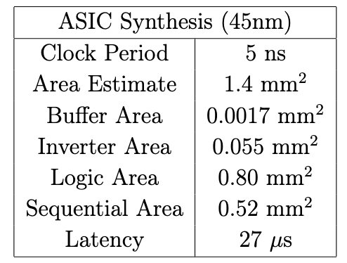
Regression Alg. design space exploration
Reducing # of operations
Current development to reduce model size for hardware implementation
On ASIC, generally:
Conv2D>Conv1D>Dense

Slide 27
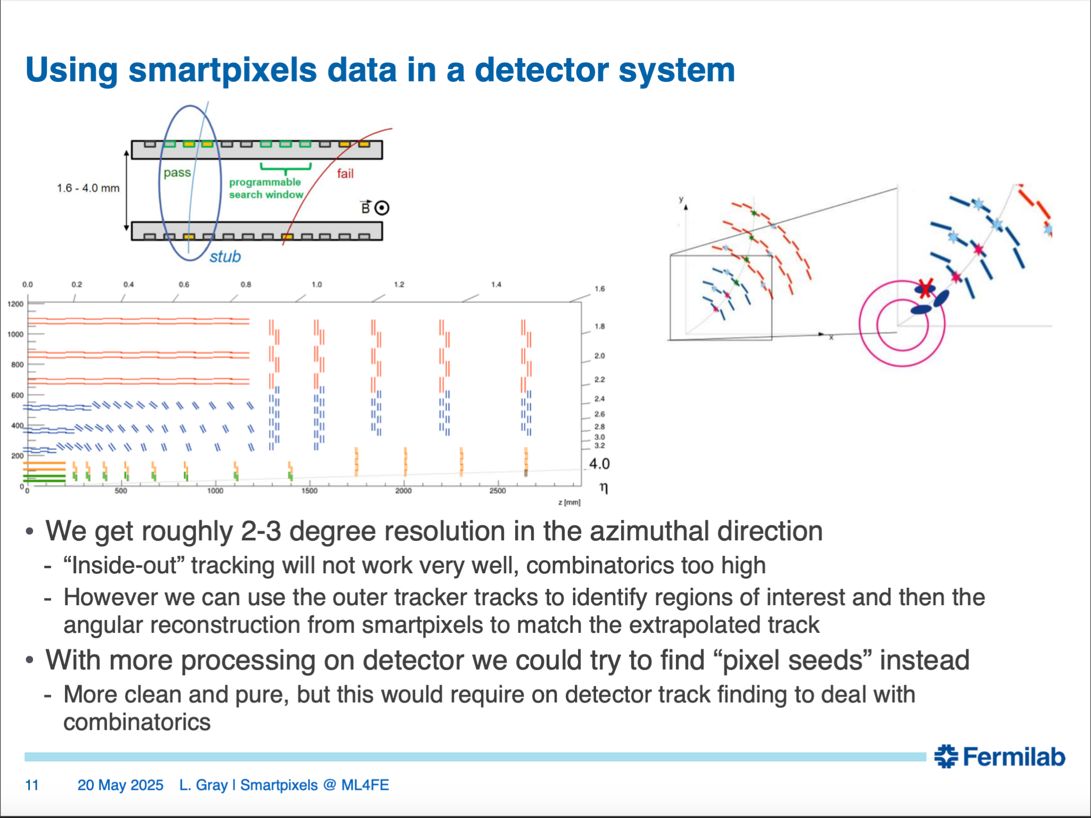

Slide 28
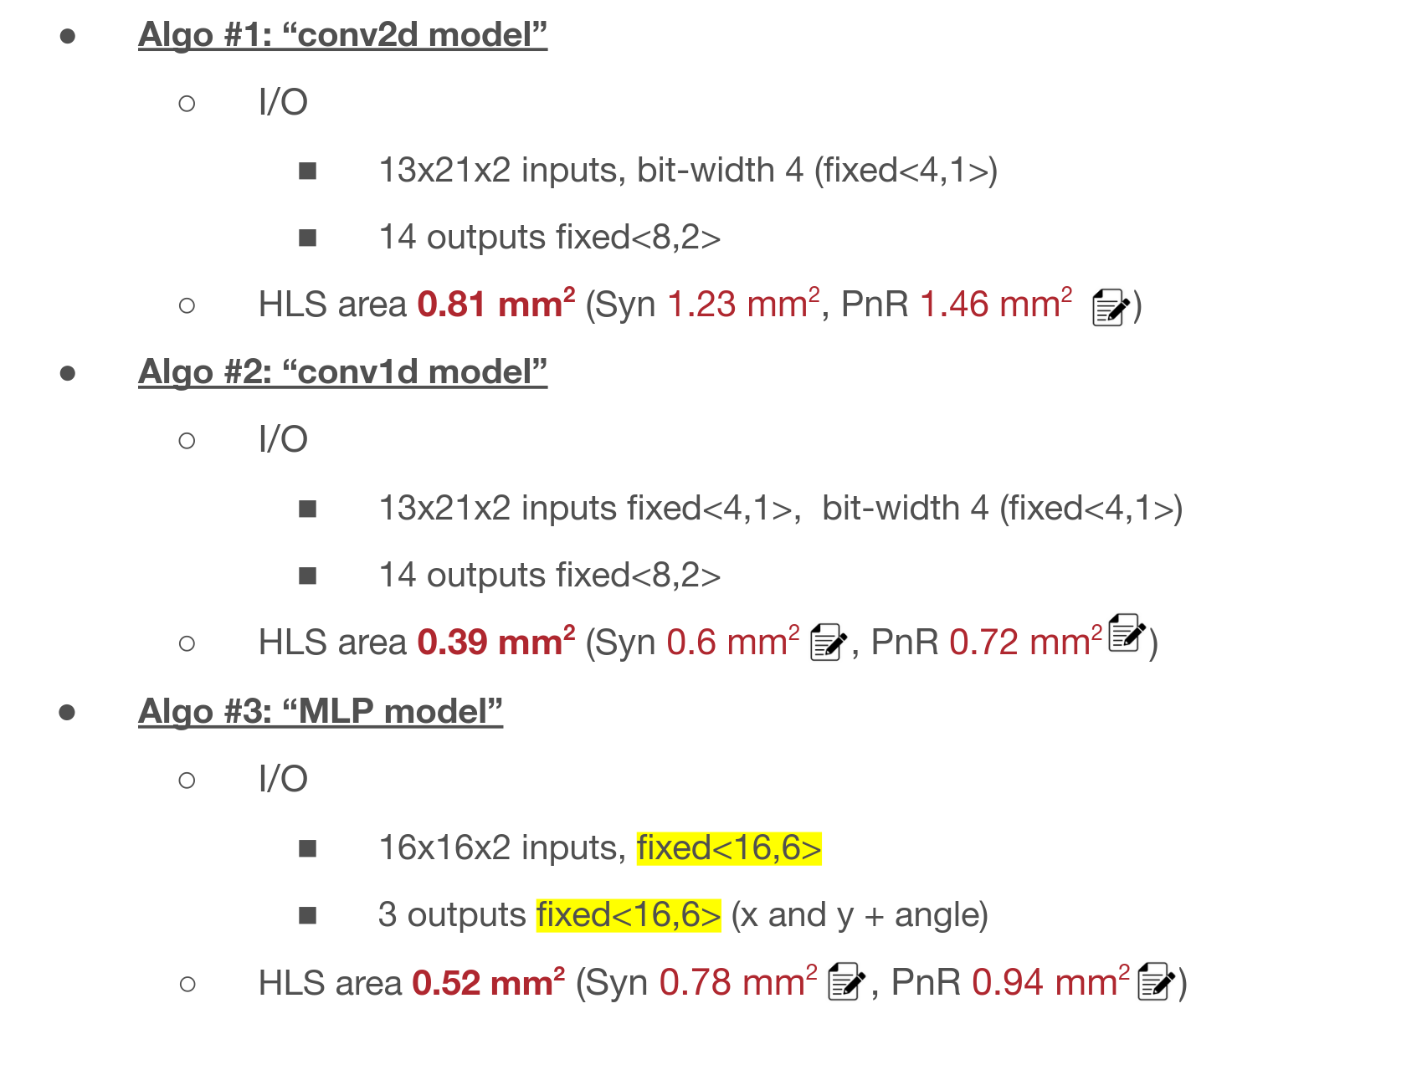
Regression ROIC synthesis estimates

Slide 29
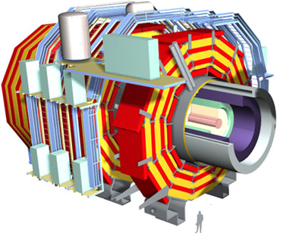

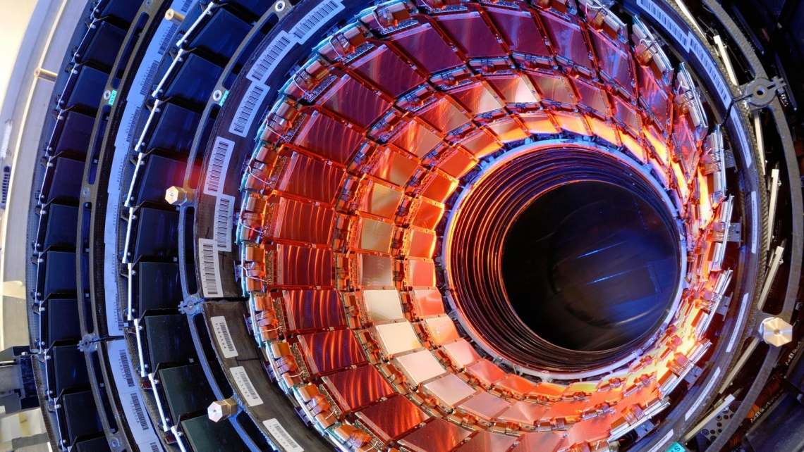
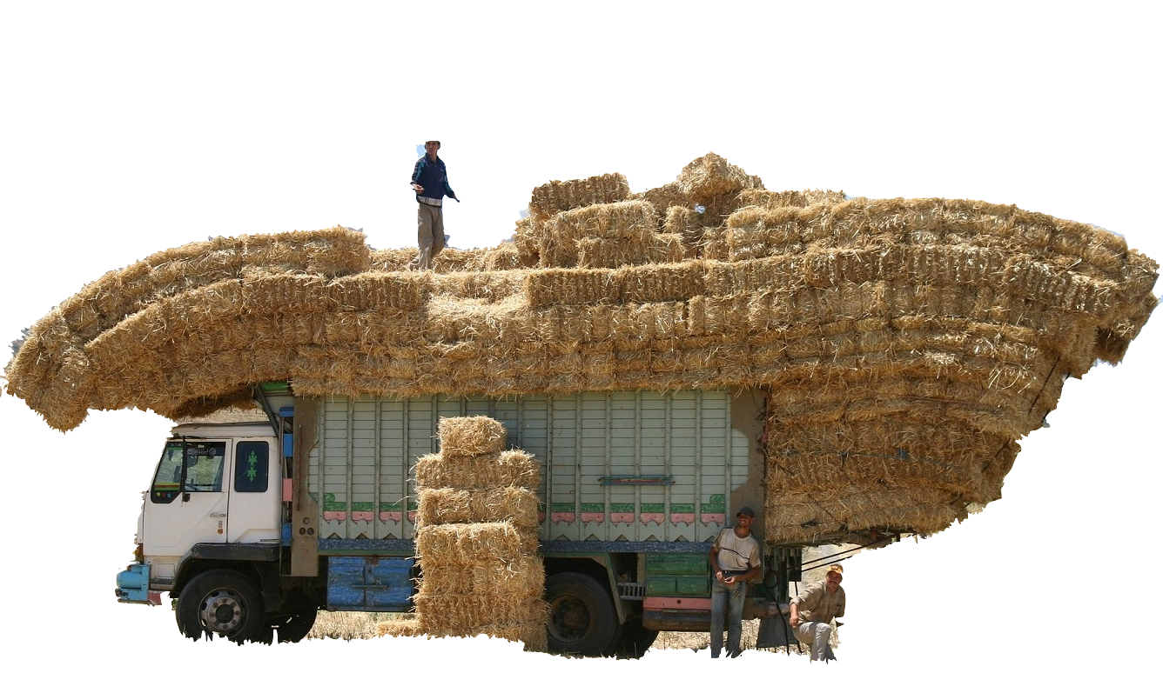
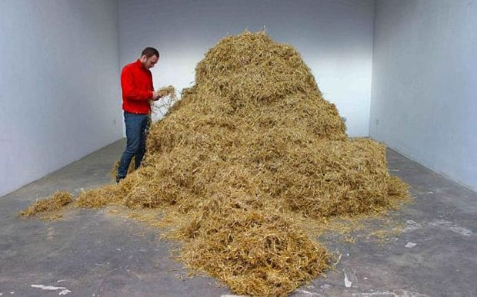
Data rates at the LHC
*Very rough estimate, YouTube streams ~60B hrs/year
≈
YouTube’s total average streaming data rate*
~O(TB/s)
Compact Muon Solenoid (CMS) Pixel detector
~Raw O(TB/s)
Triggers
!!!
HL LHC: 5x data rate

