Slide 1


Toward Sub-10 ps Time Resolution in InAs/GaAs Quantum Dot Scintillation Detector
M. Yakimov¹, T. Mahajan¹, G. Biswal,¹ V. Tokranov¹,
L. Casias,² S. Addamane,²
M. Hedges³, P. Murat³ , and S. Oktyabrsky¹
¹ University at Albany - SUNY, Albany NY 12203
²Sandia National Laboratory, Albuquerque, NM 87123
³Fermilab, Batavia, IL 60510

Slide 2
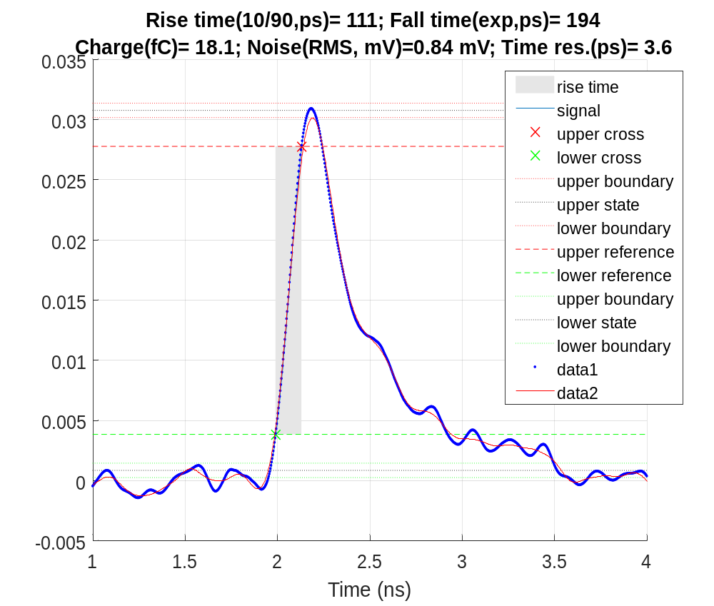
Existing device
and projections
We demonstrated novel device with InAs quantum dot base scintillator
We believe device has a
lot more potential
Fast scintillation process in semiconductor
~0.1 ns risetime (for apha)
~ 10 ps jitter
Possible to achieve those parameters for MIP
Problems exit

Slide 3
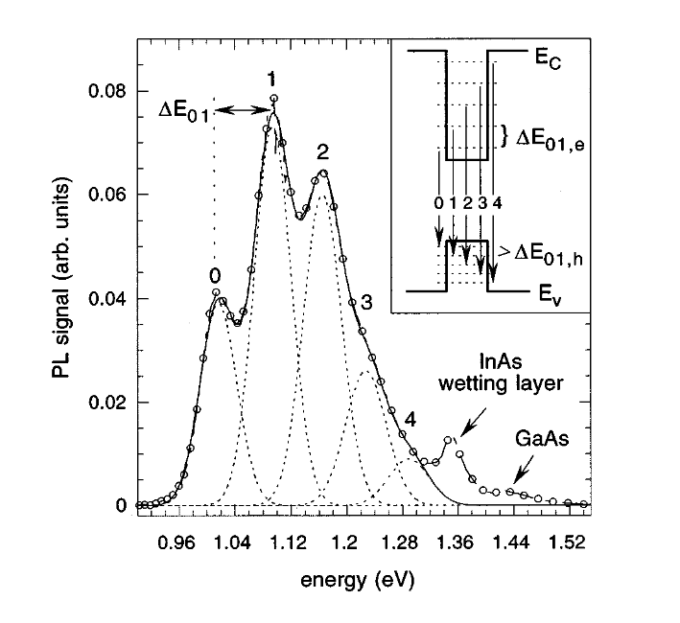
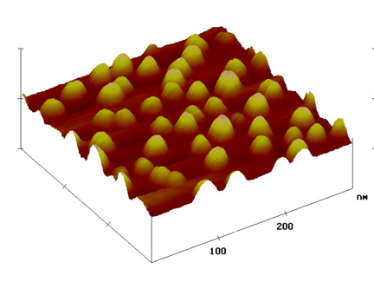
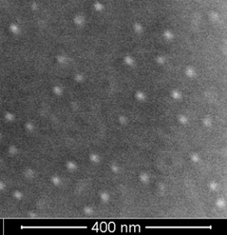
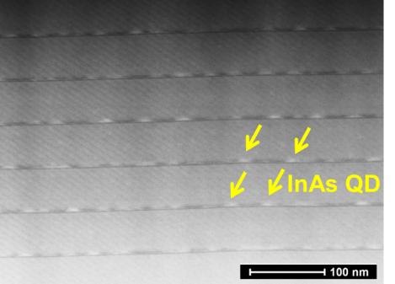
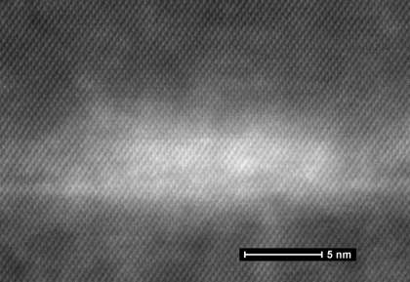
InAs Quantum Dots
InAs Quantum dots:
Islands of InAs formed on GaAs surface during growth due to lattice mismatch
Capped and embedded into GaAs / AlGaAs matrix
Each dot is a potential well
  electrons and holes 3D confined
  Discrete energy levels are formed
  Broadening in ensemble due to inhomogeneity in size
  Electron-hole transitions produce light, ~1 eV or 1200 nm wavelength
Photoluminesce spectra:
Transitions between levels vs spectral lines
Figure from: Schmidt, Klaus H., et al. "Carrier relaxation and electronic structure in InAs self-assembled quantum dots." Physical review B 54.16 (1996): 11346.
Other applications of InAs QDs:
QD semiconductor lasers
  low threshold current, defect tolerance
  considered for Si integration
QD infrared photodetectors (QDIP) for mid-IR
Imaging of QDs: TEM, SEM, AFM..
TEM cross-section of an individual InAs dot
QD diameter (FWHM)~ 18.7nm
QD density (2.7-4.2) x 10¹⁰ cm⁻²

Slide 4
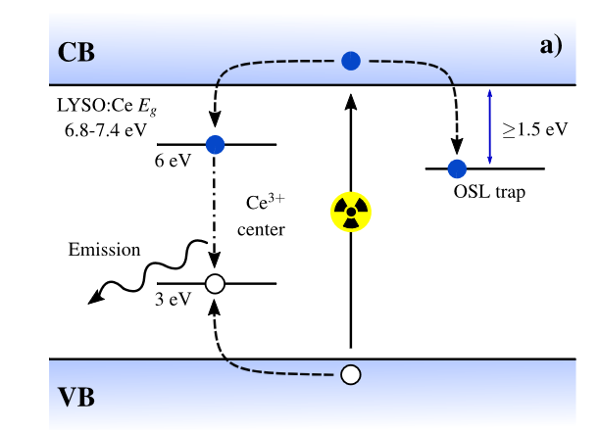
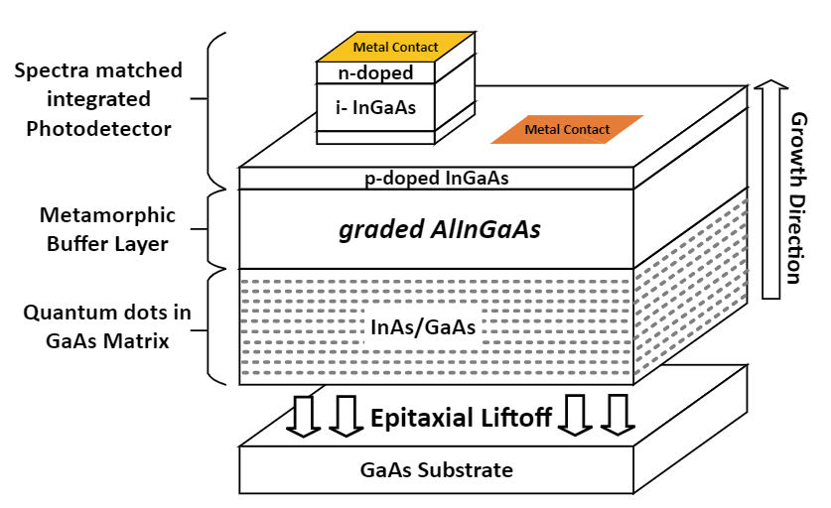
InAs QD scintillator
QD:
Fast scintillation, <0.50 ns
LYSO:
Fast scintillation, <50 ns
Same basic physics as regular scintillator:
  Generated carries captured by recombination center in a wide bangap matrix
    Low matrix absorption of emitted light for both
    different physical nature of recombination center
    High quality semiconductor as a matrix vs oxide crystal
      High electron mobility in GaAs and fast recombination in QDs
  GaAs/InAs structure has more engineering capabilities
Jensen, Mads L., et al. "Optically stimulated luminescence in state-of-the-art LYSO: Ce scintillators enables high spatial resolution 3D dose imaging." Scientific Reports 12.1 (2022): 8301.
Device fabrication:
Epitaxial structure is grown on GaAs, consisting of thick QD layer and integrated photodiode
Photodiode is processed on top of scintillator
Device is separated from the structure by epitaxial lift-off
Result:
GaAs planar waveguide with embedded QD recombination centers and integrated photodetector

Slide 5
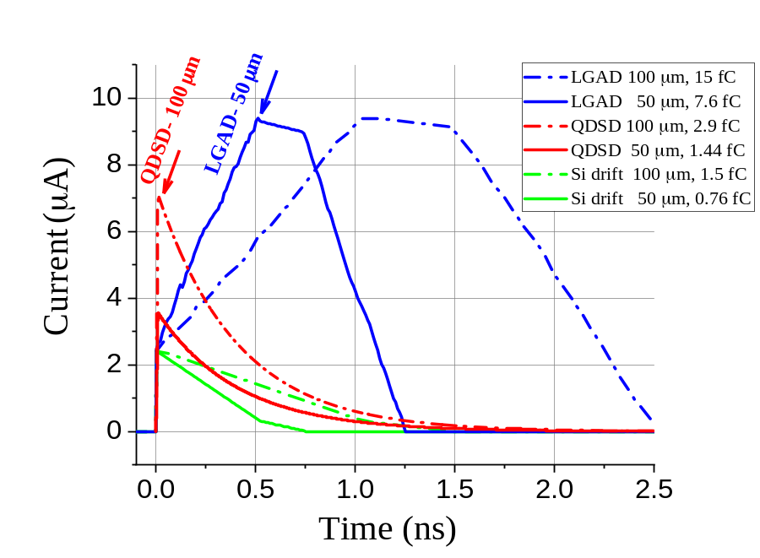
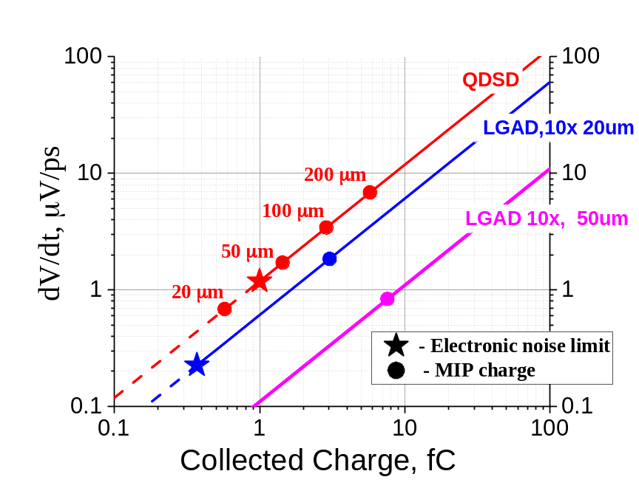
Modeled Response
Comparison
QD scintillator response:
Total number of carriers generated in GaAs is similar to Si of the same thickness
High initial current output, with a short risetime (few ps estimated)
Short pulse – higher fraction of energy is processed per unit time
Pulse width independent of scintillator thickness
Signal in QD scintillator is collected from entire volume simultaneously
  Landau noise is averaged out.
Simulated MIP-induced currents from a QD scintillation detector with an integrated photodiode (this work), a Si LGAD (10× gain), and a non-amplified Si detector (Weightfield2)

Slide 6
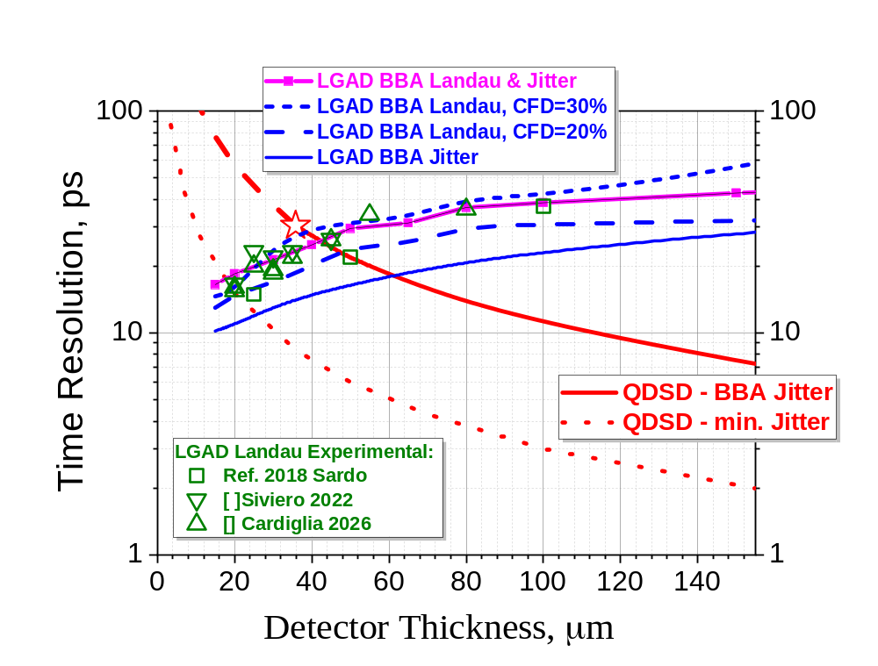
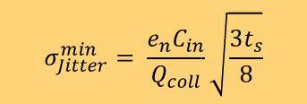
Modeled
Thickness Scaling
comparison of the MIP time resolution of InAs/GaAs QDSD with Si LGAD (10× gain)
Both detectors with 100% conversion efficiency
Solid lines: jitter with BBA front end C_{in}=1 pF, noise bandwidth matched to the signal risetime. The star indicates the QDSD electronic noise-limited collected charge
Dotted line: minimum achievable time jitter for centroid timing
Ramo current times affect timinig
Light propagation in the structure is fast
  InGaAs photodiodeis the same
$$σ_{Jitter}^{min}= \frac{e_{n}C_{in}}{Q_{coll}}\sqrt{\frac{3t_{s}}{8}}$$

Slide 7
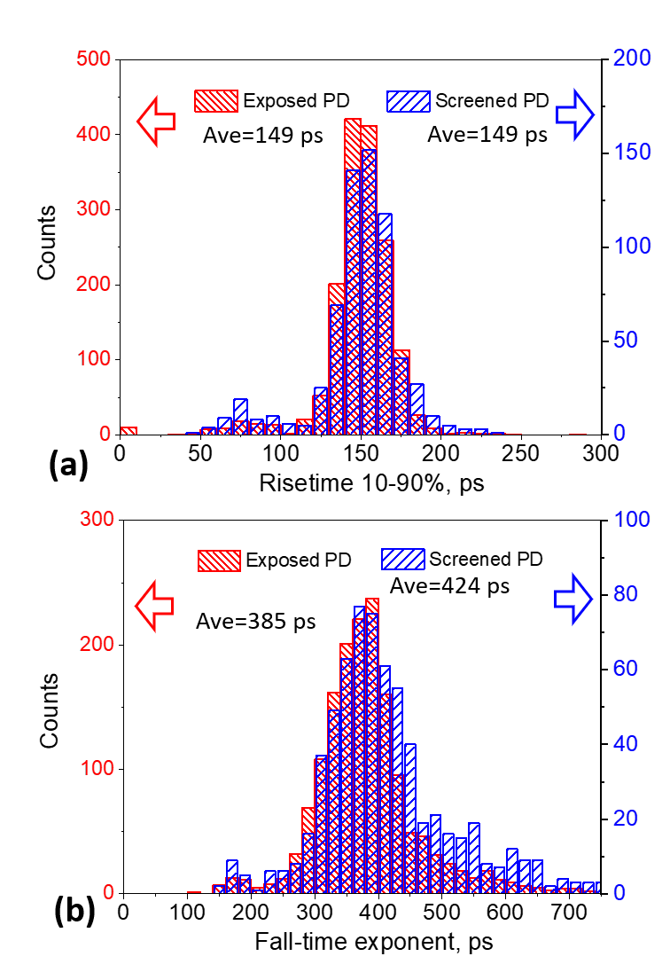
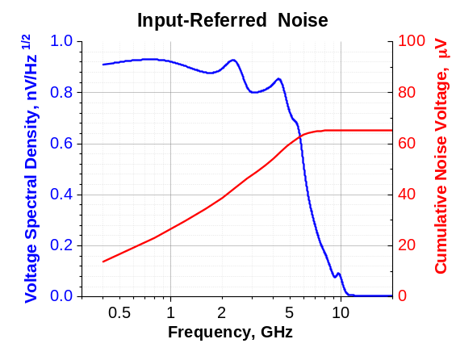
Experimental Timing:
Alpha Particles
  Example of alpha particle detected pulse (BBA, 4 GHz, 22 dB, 5 dB noise figure
  More energy released than with MIP
    can be tested on existing device
~150 ps for 10-90 risetime is observed
Input referred noise 0.9 nV/Hz^{1/2}

Slide 8
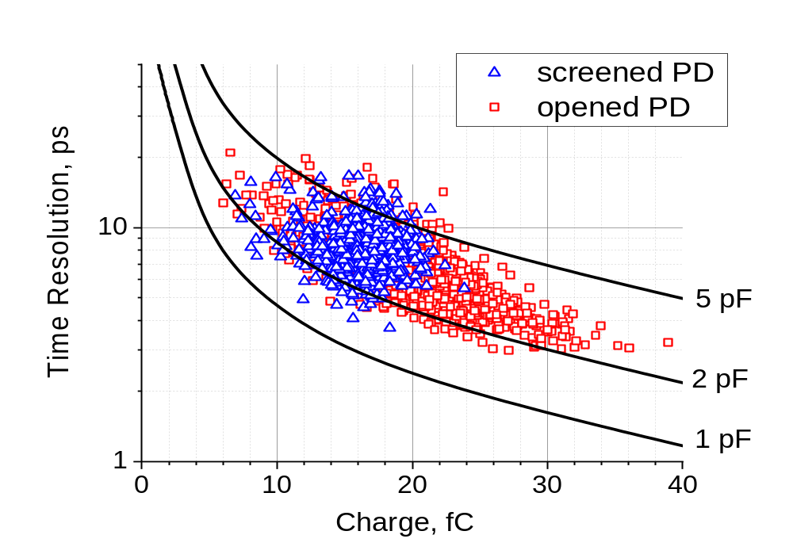
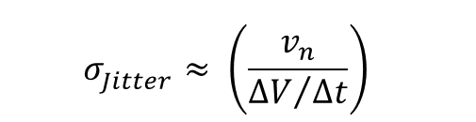
Experimental Timing:
Alpha Particles
$$σ_{Jitter}^{}≈ {\left(\frac{v_{n}}{{∆V}/{∆t}}\right)}^{}$$
Measurements with alpha-particle illumination in area including photodetector (“opened”) and excluding diode area (“screened”) shows <10ps-range timing
Matches expected jitter values for the energy
Input referred RMS noise 66 μV in 4 GHz BW
Time resolution: <10 ps out of the box

Slide 9
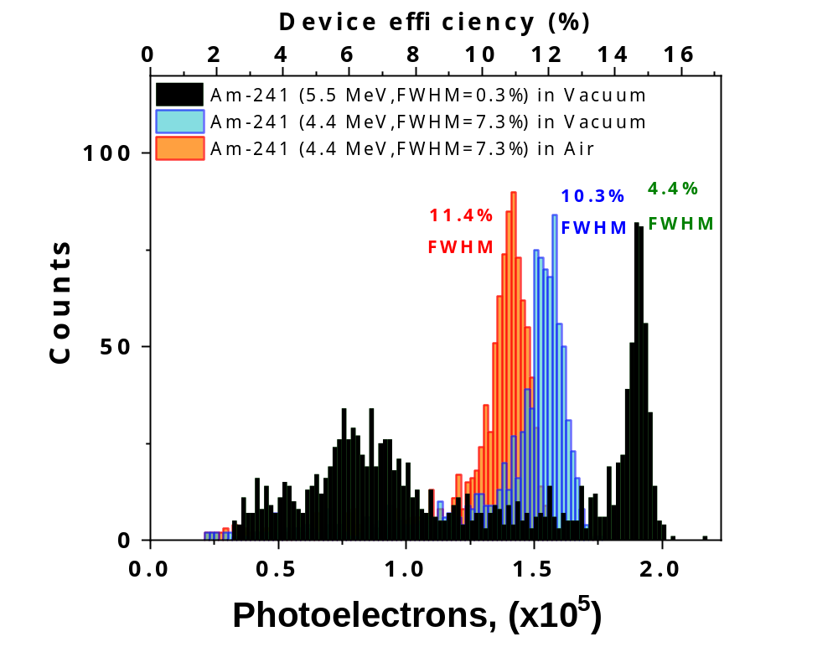
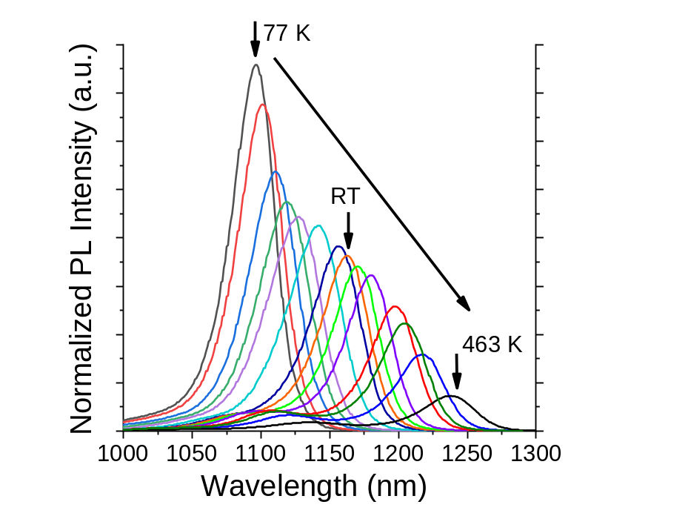
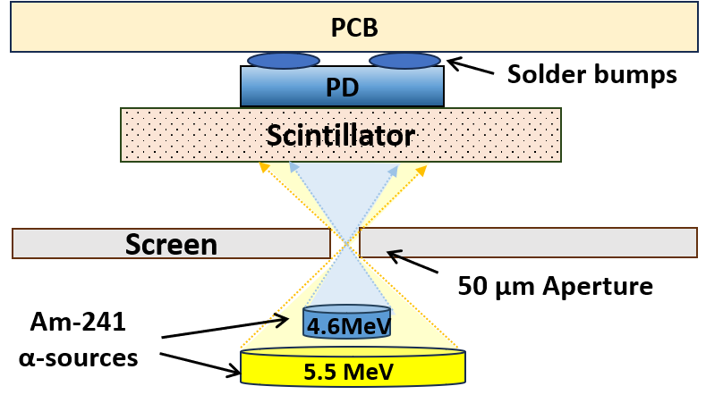
Energy Conversion
Efficiency
Textbook energy per e-h pair value: 2.8Eg = ~4 eV
Expected pairs from 5.5 MeV alpha particle: >1e6
Actually detected photons: <2e5
  Device efficiency ~15% due to:
  optical losses in waveguide and through backside
  Low barrier around quantum dots in current devices
  affects radiation hardness as well
timing estimates use 100% collection efficiency
Current devices have 15% at room temperature

Slide 10
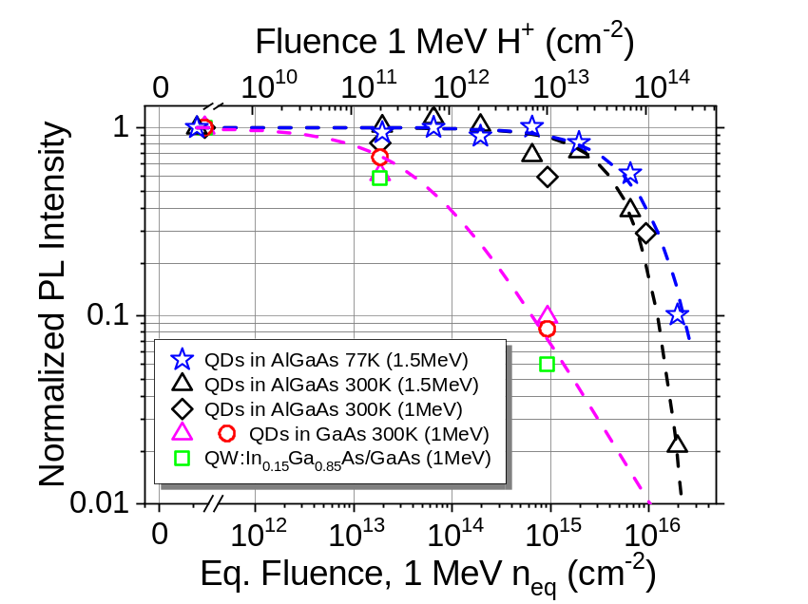
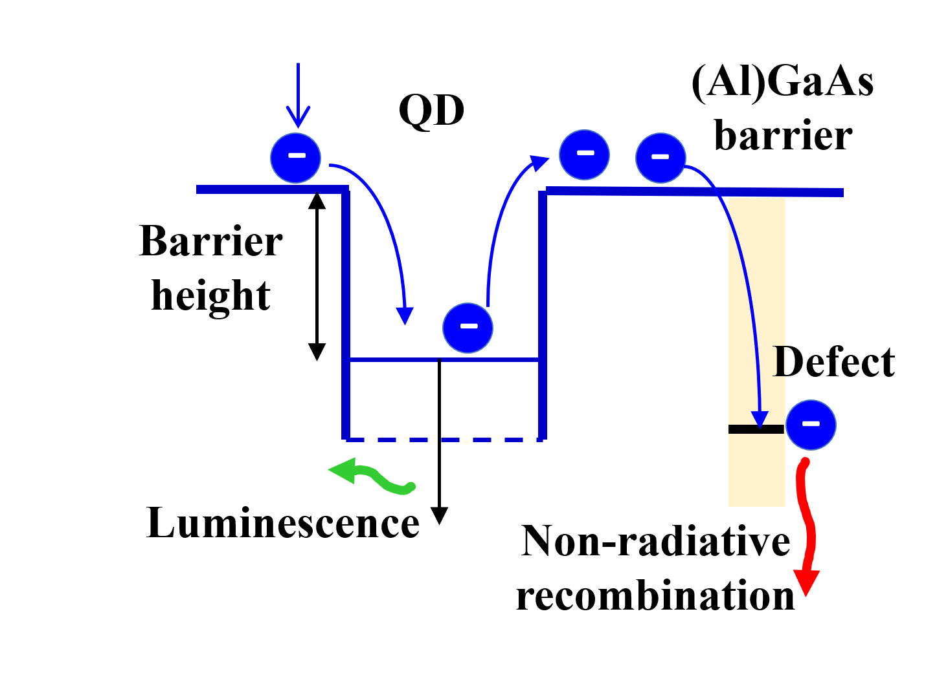
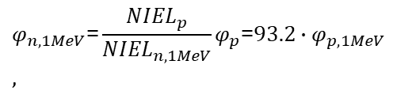
QD media:
Radiation Hardness
Quantum dot structures are more radiation tolerant than bulk semiconductors
Confinement reduces defect recombination chances for captured carriers
Quick capture and low escape probability are desired
Low temperature and higher engineered barrier improve optical efficiency and defect tolerance
Neutron transmutation:
  Not addressed yet
  Some extra n-type doping should be tolerated by p-doped media
$$φ_{n,1MeV}\text{=}\frac{{NIEL}_{p}}{{NIEL}_{n,1MeV}}φ_{p}\text{=}{93.2∙φ}_{p,1MeV} ,$$
Summers, Geoffrey P., et al. "Damage correlations in semiconductors exposed to gamma, electron and proton radiations." IEEE Transactions on Nuclear Science 40.6 (1993): 1372-1379.
C. Baur, M. Gervasi, P. Nieminen, S. Pensotti, P. Rancoita, and M. Tacconi, "NIEL dose dependence for solar cells irradiated with electrons and protons," in Astroparticle, Particle, Space Physics and Detectors for Physics Applications: Proc. 14th ICATPP Conference, 2014, pp. 692-707.
Summers, G. P., et al. "Displacement damage in GaAs structures." IEEE Transactions on Nuclear Science 35.6 (1988): 1221-1226.
Akkerman, A., et al. "Updated NIEL calculations for estimating the damage induced by particles and γ-rays in Si and GaAs." Radiation Physics and Chemistry 62.4 (2001): 301-310.

Slide 11
Summary
Fast scintillator based on InAs QDs in GaAs matrix is demonstrated
Technology of epitaxial growth gives a lot of knobs to tweak for optimizing device properties
Such system can naturally achieve <10 ps timing due to:
      Fast optical collection of signal
      High electron mobility in GaAs and fast recombination in QDs enabling fast scintillation
      High initial output – maximum current is achieved within few ps of particle transit
      Landau noise is averaged out by collecting signal from entire device thickness.
Present devices are a proof-of-concept with insufficient thickness and non-optimal parameters
Proof of timing viability is presented

