Slide 1

ALICE ITS3 MOSAIX sensor measurements and developments for ePIC SVT
Gregor Eberwein (MIT) on behalf of ALICE
CPAD Seattle, 22 Oct. 2026
The work of the MIT HI group and MIT PixElφ Lab was supported by US DOE-NP and by the SVT-EIC project

Slide 2
ALICE – A Large Ion Collider Experiment
Study of strongly interacting matter at extreme densities (QGP) in heavy-ion collisions at the LHC (CERN)
Low momentum (≲ 1 GeV/c) particle reconstruction
  New inner tracker for
  Run 4 (2030)

Slide 3
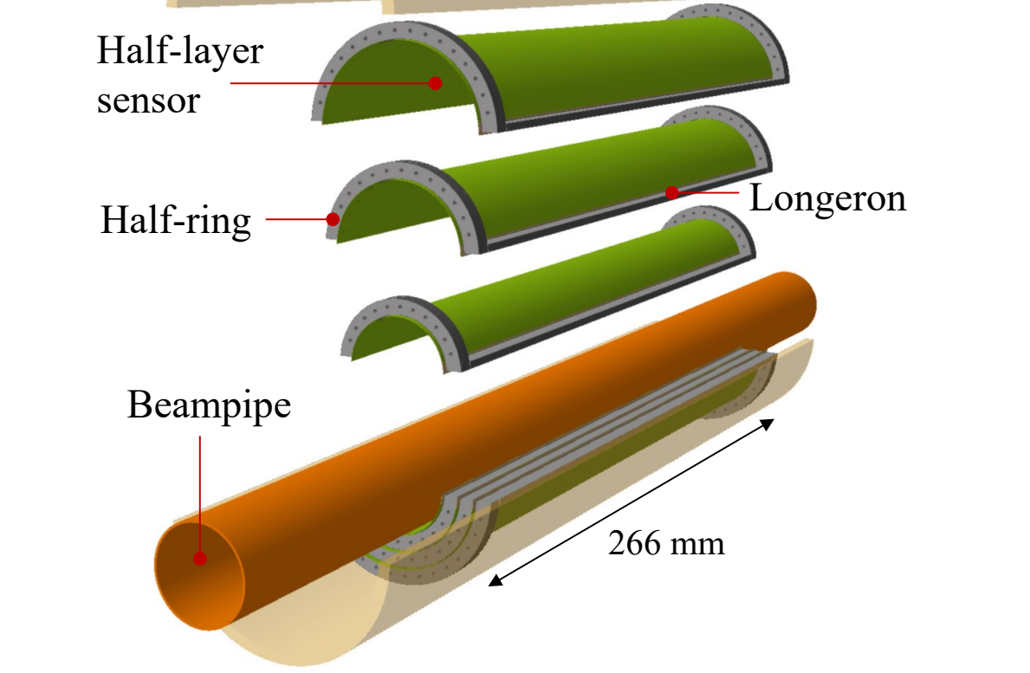
ALICE Inner Tracking System 3 (ITS3)
ITS2 half-barrel – currently installed
ITS3 half-barrel – engineering model
L2
L1
L0
Beampipe
266 mm
r=19 mm
r=24 mm
Improved low p_{T} physics performance – low material budget, air cooling, small inner radius
→ bent, wafer-scale monolithic active pixel sensors (MAPS) – in total just 6 sensors for entire inner barrel

Slide 4
ePIC – electron-Proton and Ion Collider
Study of strongly interacting matter in electron-ion collisions at the future Electron-Ion Collider (EIC) at BNL
Low mass detectors with high spatial resolution tracking essential (e.g. scattered e⁻ measurements)
  Tracker installation in 2032

Slide 5
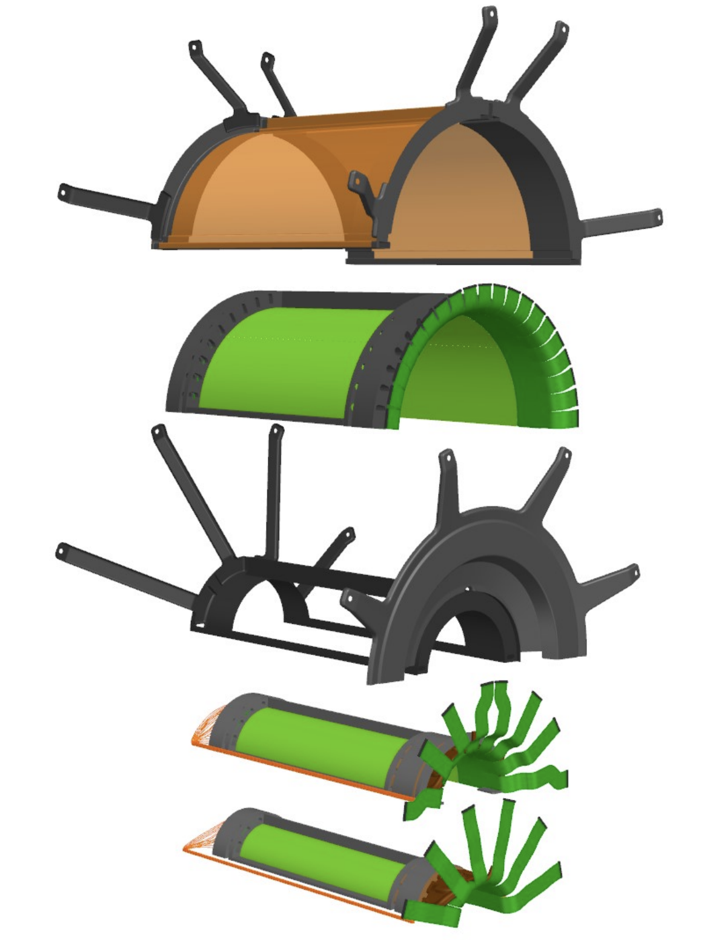
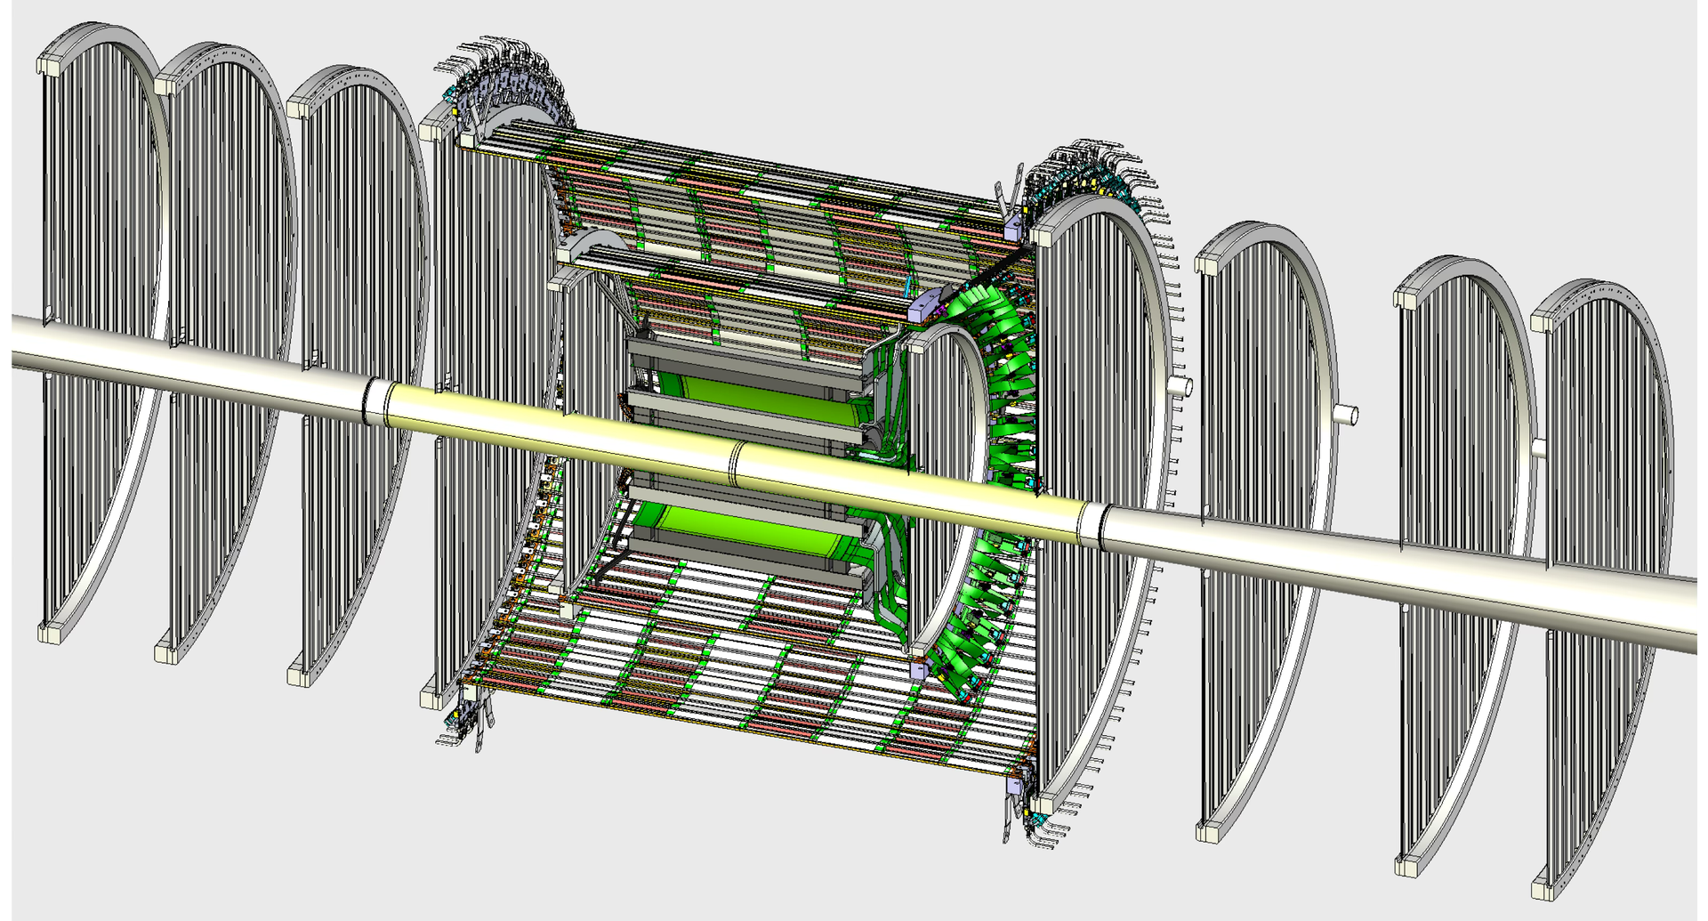
ePIC Silicon Vertex Tracker (SVT)
4x L2
2x L1
84 cm
2x L0
266 mm
Inner barrel - based on
bent, wafer-scale MAPS
Outer tracker - based on large-area MAPS of same type
Total ~8.5 m² of silicon

Slide 6
MOSAIX
300 mm (12 in)
ER2 run: 65nm, stitched, wafer-scale, CMOS, MAPS

Slide 7
MOSAIX
babyMOSAIX
19 mm
SEGMENT (SEG)
266 mm
300 mm (12 in)
ER2 run: 65nm, stitched, wafer-scale, CMOS, MAPS

Slide 8
MOSAIX
L2
L1
L0
Beampipe
266 mm
300 mm (12 in)

Slide 9
MOSAIX
L2
L1
L0
Beampipe
266 mm
300 mm (12 in)

Slide 10
MOSAIX
L2
L1
L0
Beampipe
266 mm
300 mm (12 in)

Slide 11
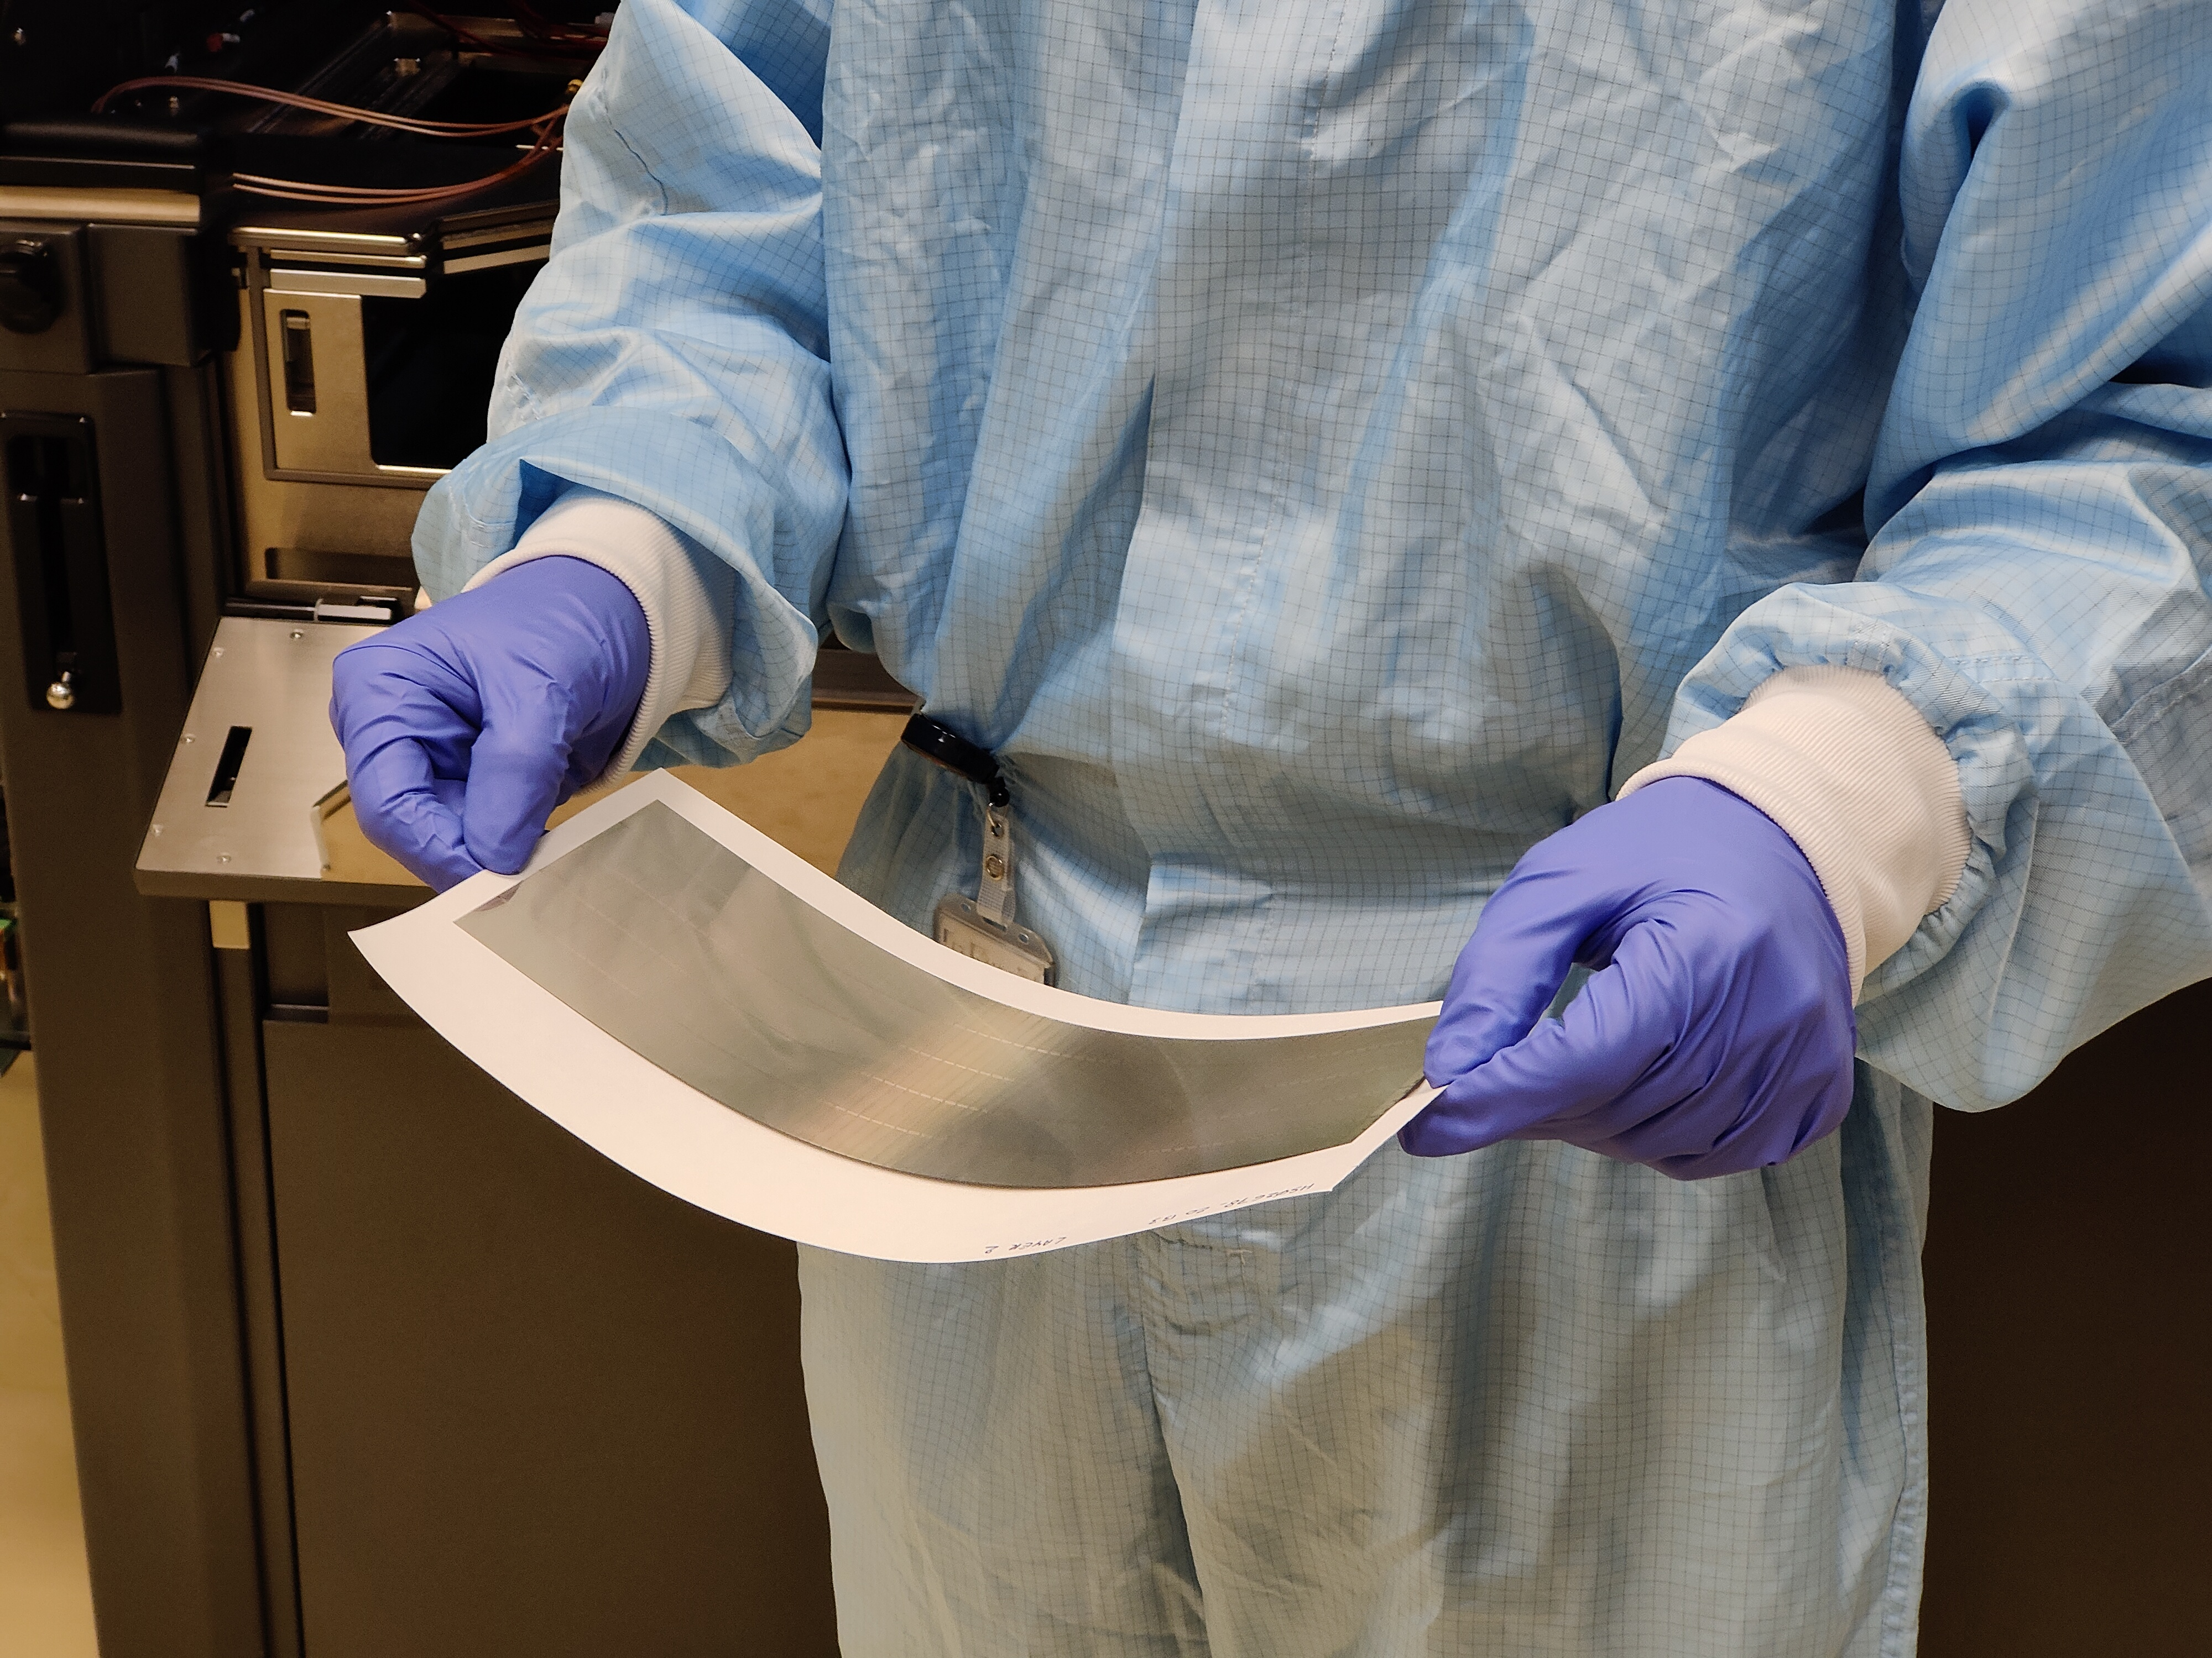
MOSAIX
L2
L1
L0
Beampipe
266 mm
flexible when thinned to <50 µm !
300 mm (12 in)

Slide 12
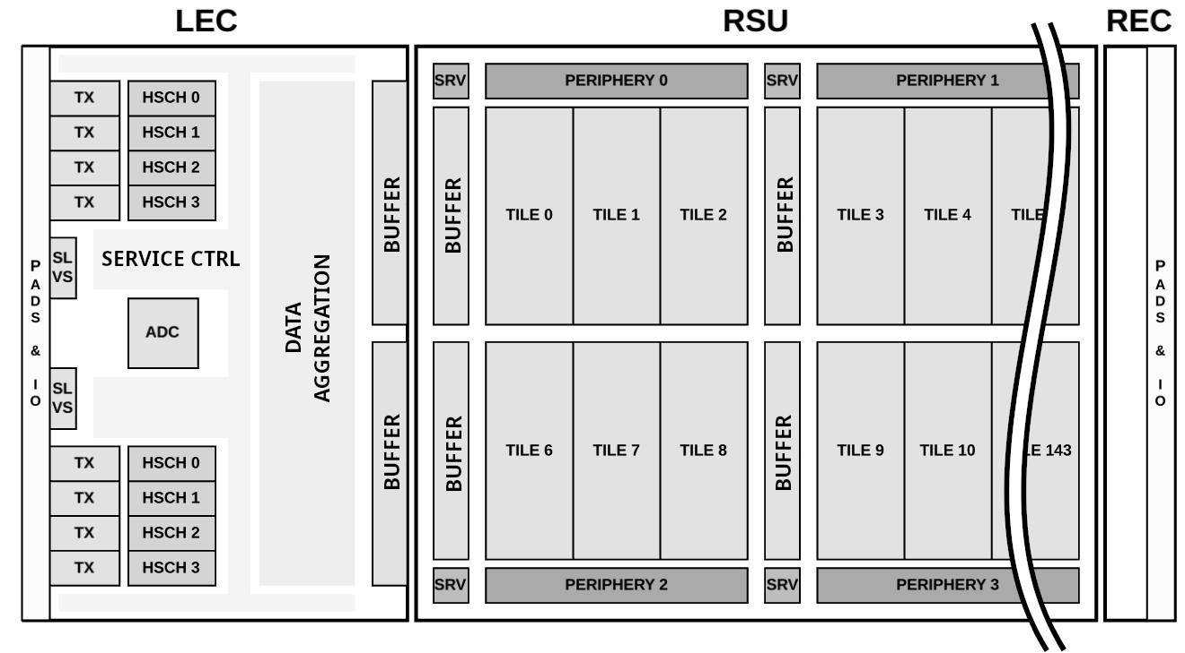
MOSAIX design
3 functional blocks:
  1x Left-Endcap (LEC)
  12x Repeated Sensor Unit (RSU)
  1x Right-Endcap (REC)
1x
12x
144x
1x
…
…
…
…
SEGMENT (SEG)
266 mm

Slide 13
MOSAIX design
12 independent tiles per RSU
Each tile is switched (service node)
Overall: 12 RSUs x 12 tiles = 144 tiles
144 x 160 Mb/s transmission
144 biasing/periphery blocks
288 local power domains
Service Node
Clk & ctrl
Biasing/periphery blocks for each tile
444 × 156 pixels/tile 20.8 x 22.8 µm² pixels
~ 10 Mpx/SEGMENT
12x

Slide 14
MOSAIX design
160 Mb/s data link
per tile
12 independent tiles per RSU
Each tile is switched (service node)
Overall: 12 RSUs x 12 tiles = 144 tiles
144 x 160 Mb/s transmission
144 biasing/periphery blocks
288 local power domains
Service Node
Clk & ctrl
Biasing/periphery blocks for each tile
444 × 156 pixels/tile 20.8 x 22.8 µm² pixels
~ 10 Mpx/SEGMENT
12x

Slide 15
MOSAIX design
160 Mb/s data link
per tile
8 x 10 Gb/s transmitter with lpGBT logic encoded
4 x global power domains
+TX domain
Analog monitoring ADC
2 slow control endpoints
CLK, SYNC, RST
I/O
Power
Power
12 independent tiles per RSU
Each tile is switched (service node)
Overall: 12 RSUs x 12 tiles = 144 tiles
144 x 160 Mb/s transmission
144 biasing/periphery blocks
288 local power domains
Service Node
Clk & ctrl
Biasing/periphery blocks for each tile
444 × 156 pixels/tile 20.8 x 22.8 µm² pixels
~ 10 Mpx/SEGMENT
12x

Slide 16
MOSAIX design
160 Mb/s data link
per tile
8 x 10 Gb/s transmitter with lpGBT logic encoded
4 x global power domains
+TX domain
Analog monitoring ADC
2 slow control endpoints
CLK, SYNC, RST
I/O
Power
Power
12 independent tiles per RSU
Each tile is switched (service node)
Overall: 12 RSUs x 12 tiles = 144 tiles
144 x 160 Mb/s transmission
144 biasing/periphery blocks
288 local power domains
Service Node
Clk & ctrl
Biasing/periphery blocks for each tile
444 × 156 pixels/tile 20.8 x 22.8 µm² pixels
~ 10 Mpx/SEGMENT
Note: powering from LEC only feasible when limiting the number of enabled tiles
12x

Slide 17
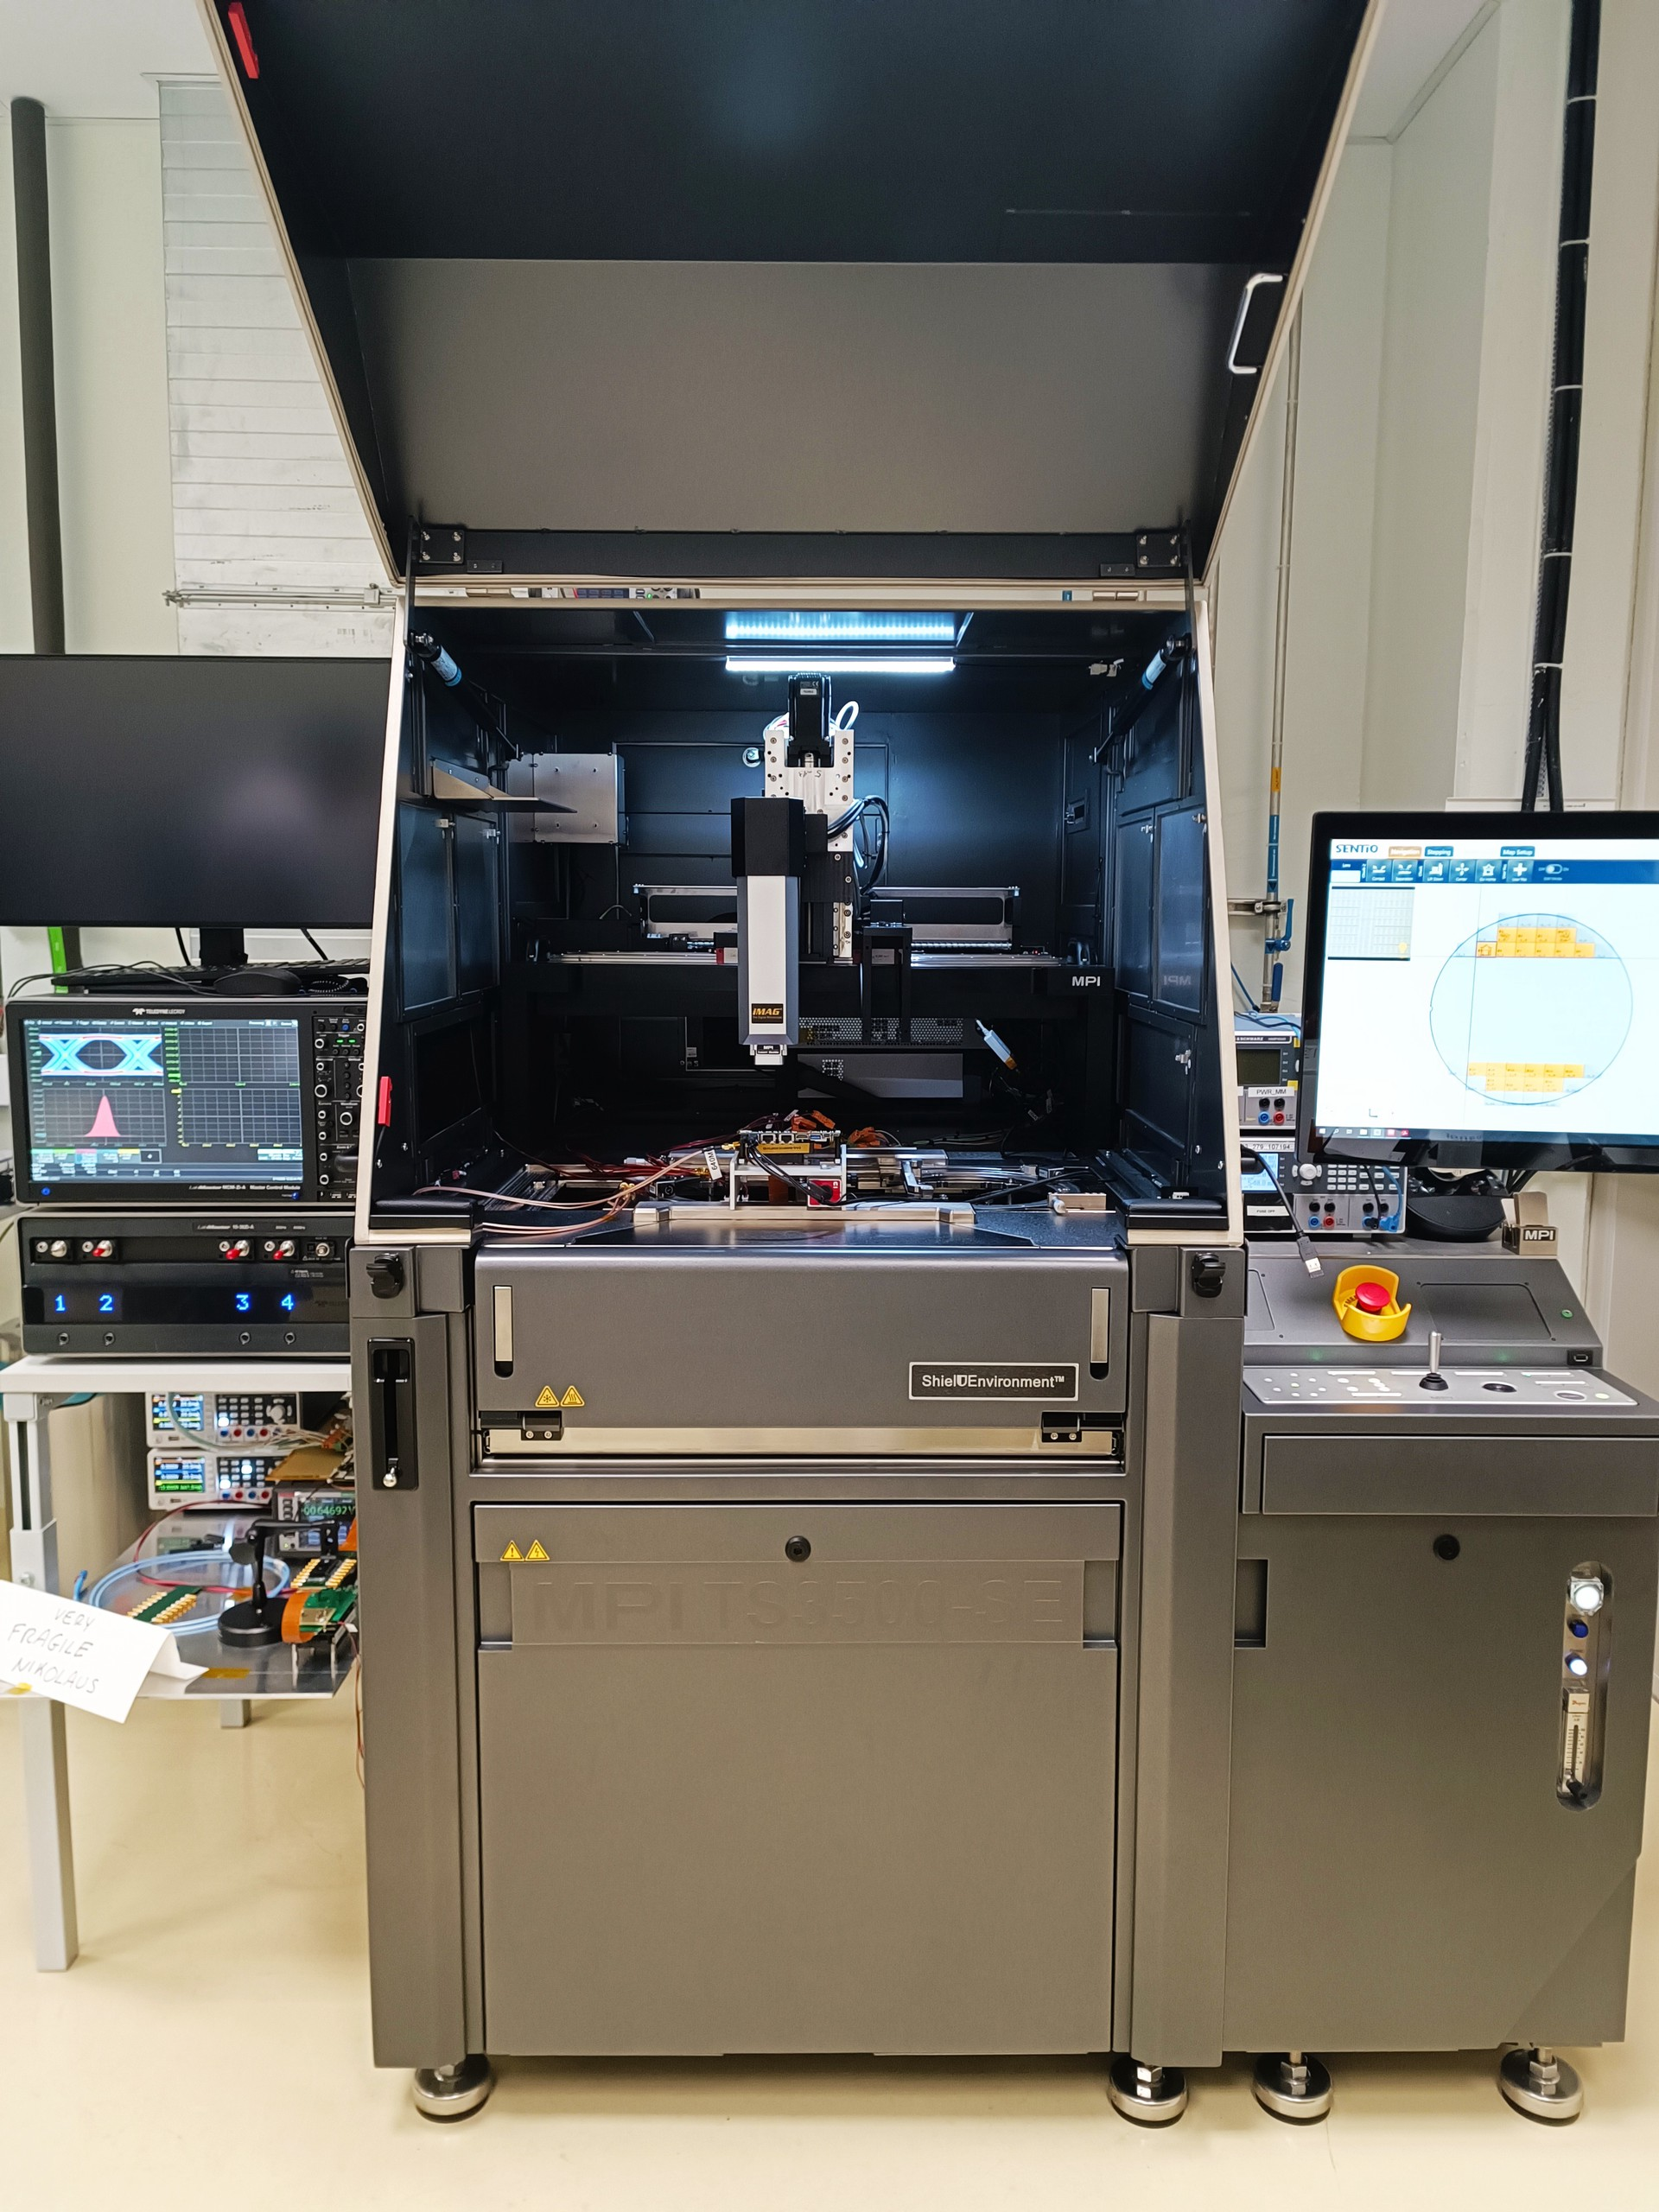
MOSAIX wafer probing
On-wafer testing of full MOSAIX production
(2 x 25 wafers): max. coverage on functionality, including high-speed tests
Note: Test beam measurements and irradiation campaigns performed on carrier PCB’s, not covered here
12x

Slide 18
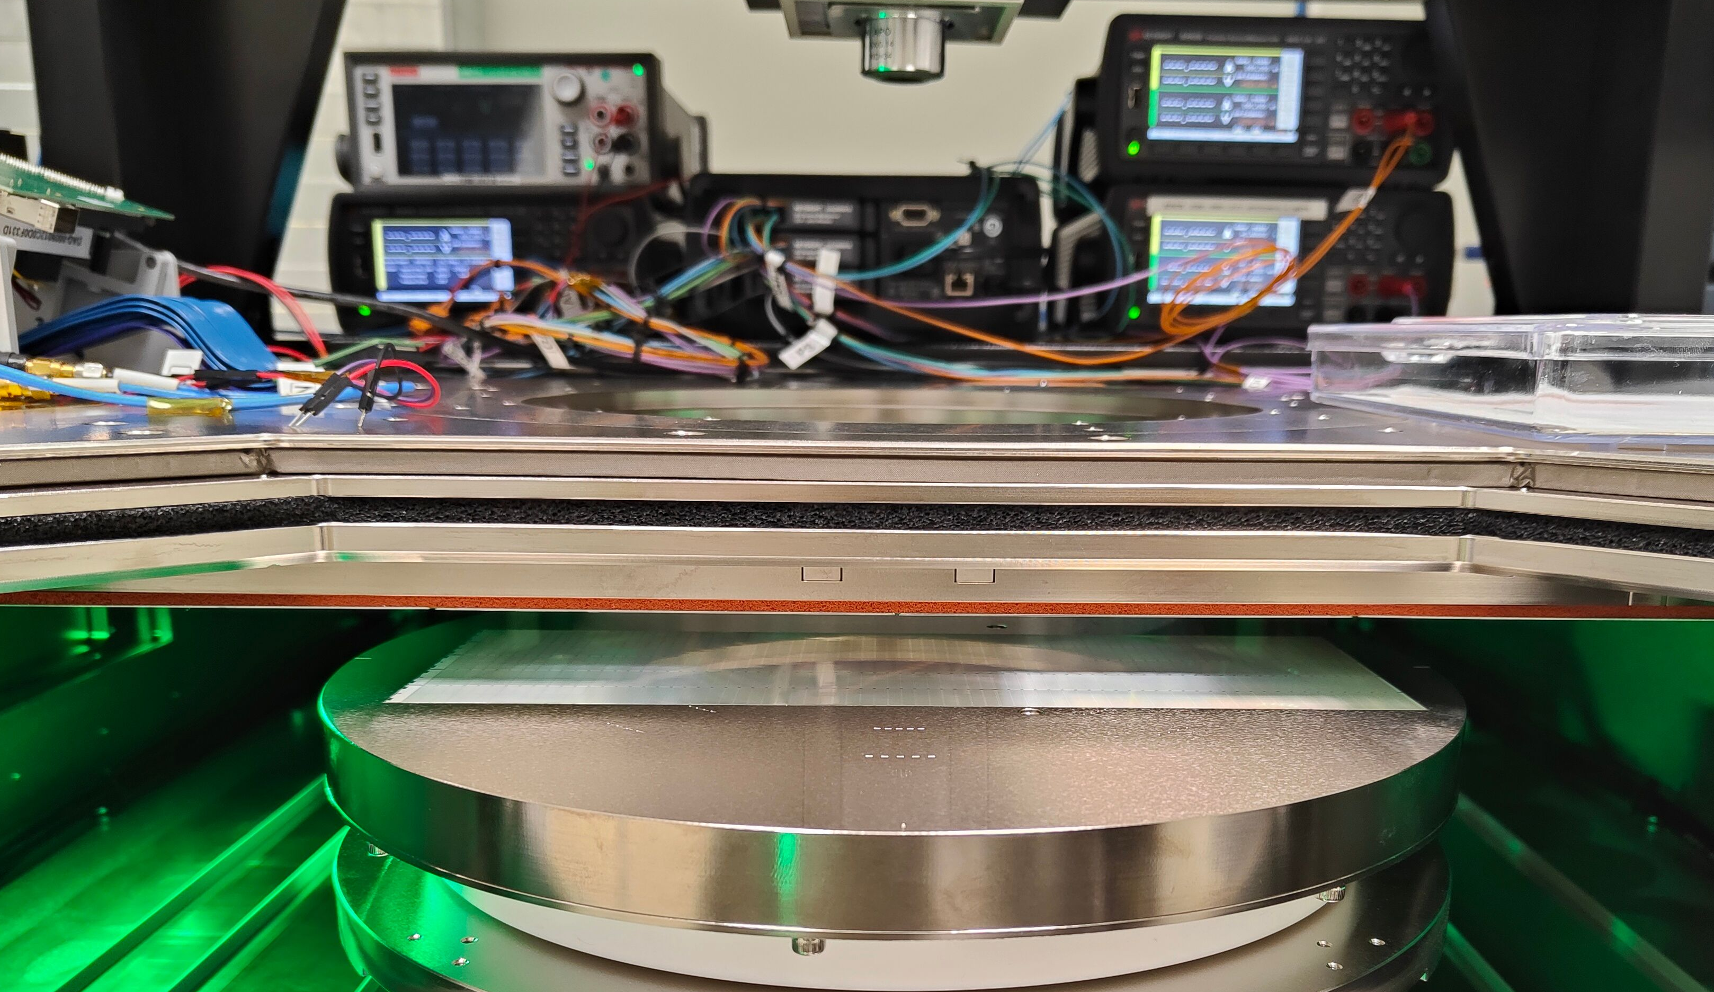
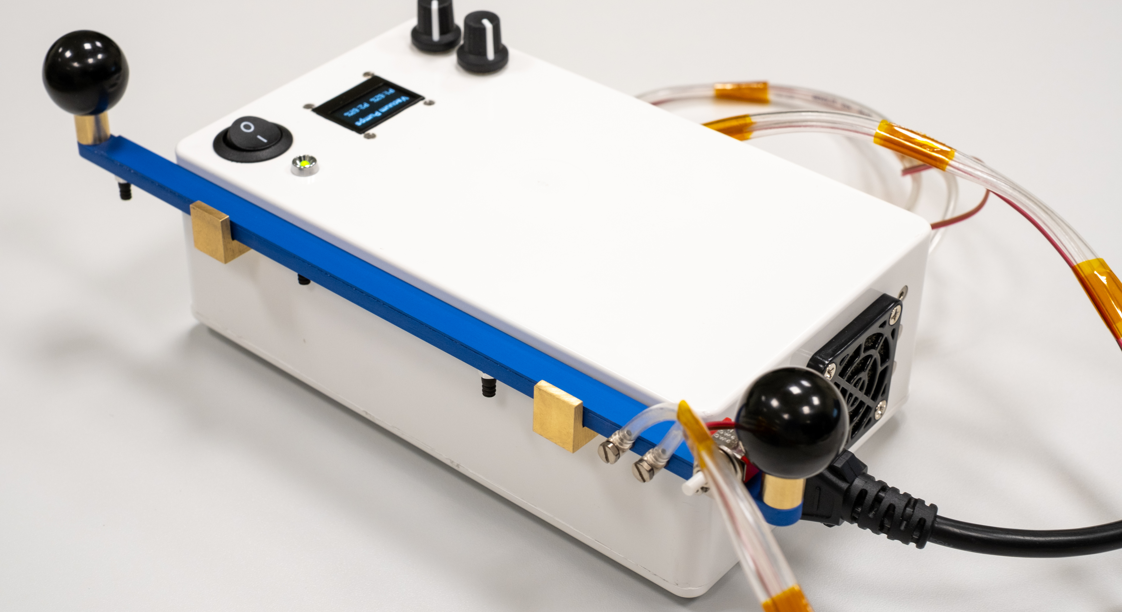
MOSAIX wafer probing – thinned layers
Developed procedure to test 50 µm thinned layers of any size
  Custom handling tool to pick-up and transfer thinned layers
  Custom mylar cover sheet allows to uniformly suck silicon layers flat onto the chuck
wafer chuck
Thinned L2 layer
Handling tool

Slide 19
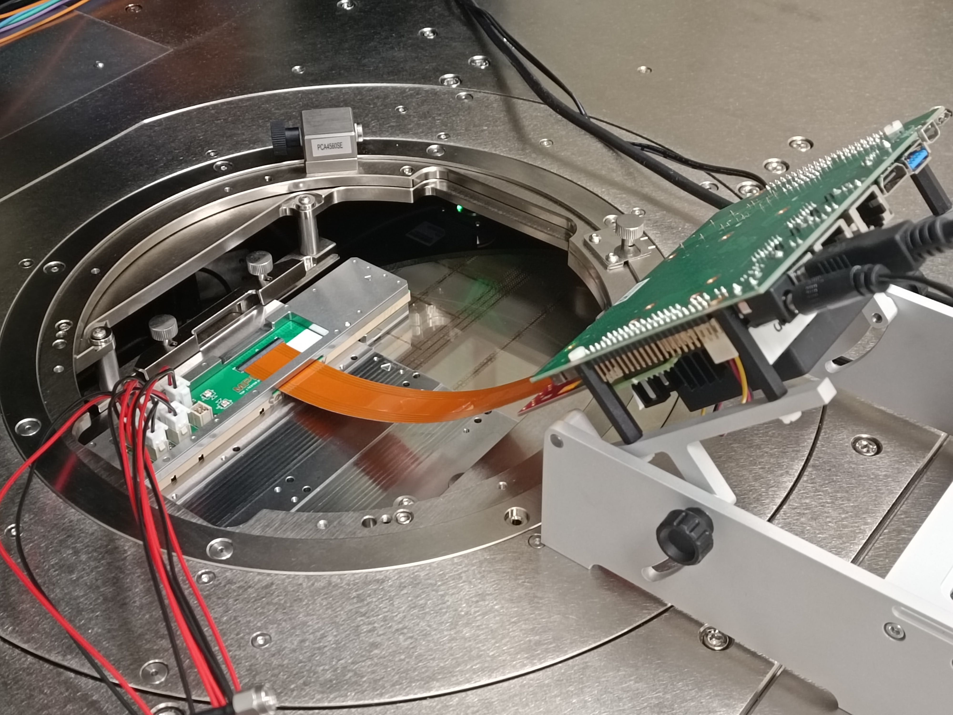
MOSAIX wafer probing – high-speed
Commercial FPGA (Arria10 + Enclustra baseboard) – uniform test infrastructure across carrier PCB’s/test beams/detector models
Custom high-speed FPC (flexible printed circuit) –simulations and material choice, in-house production
Wafer
Probecard
FPGA
Power
High-speed FPC
12x

Slide 20
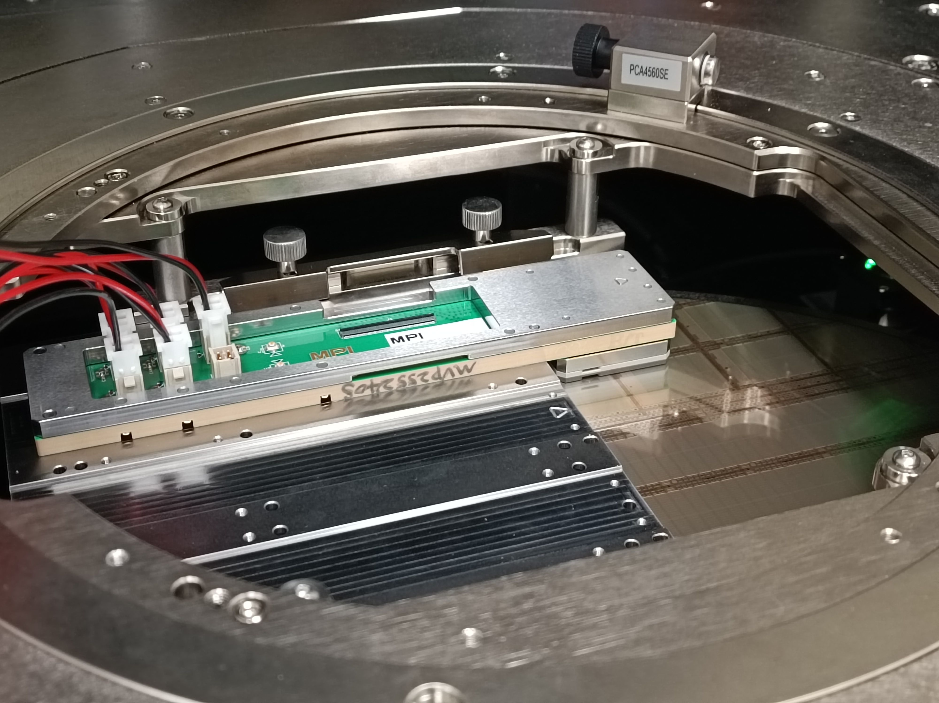
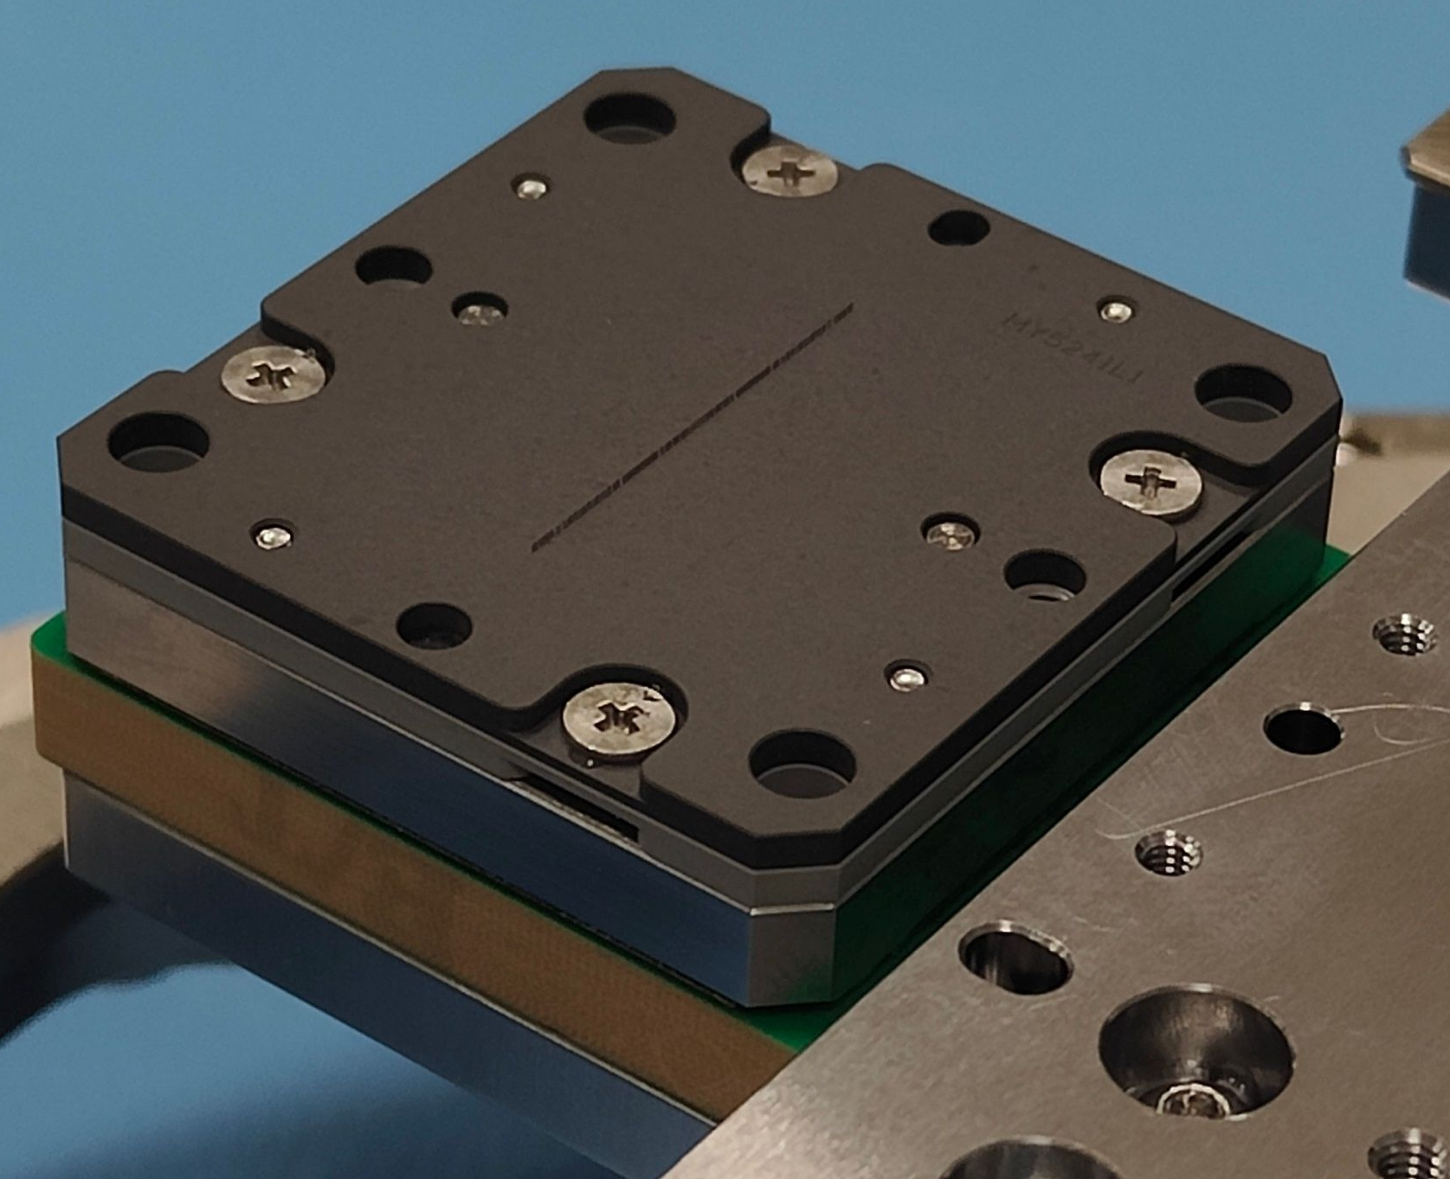
MOSAIX wafer probing – high-speed
Probecard
10.24 Gbps
Wafer
vertical
Needles
Probecard
Probecard
Wafer
10.24 Gbps
12x
Bottom view – needles exposed
cantilever
Vertical probe needles, embedded in MLO (multilayer organic material)
  High-speed vertical probecard co-developed with industry partner – low inductance, and impedance matching for stable 10.24 Gbps transmission
Large advancement over standard cantilever probecards (also produced, baseline,
no high-speed tests possible)

Slide 21
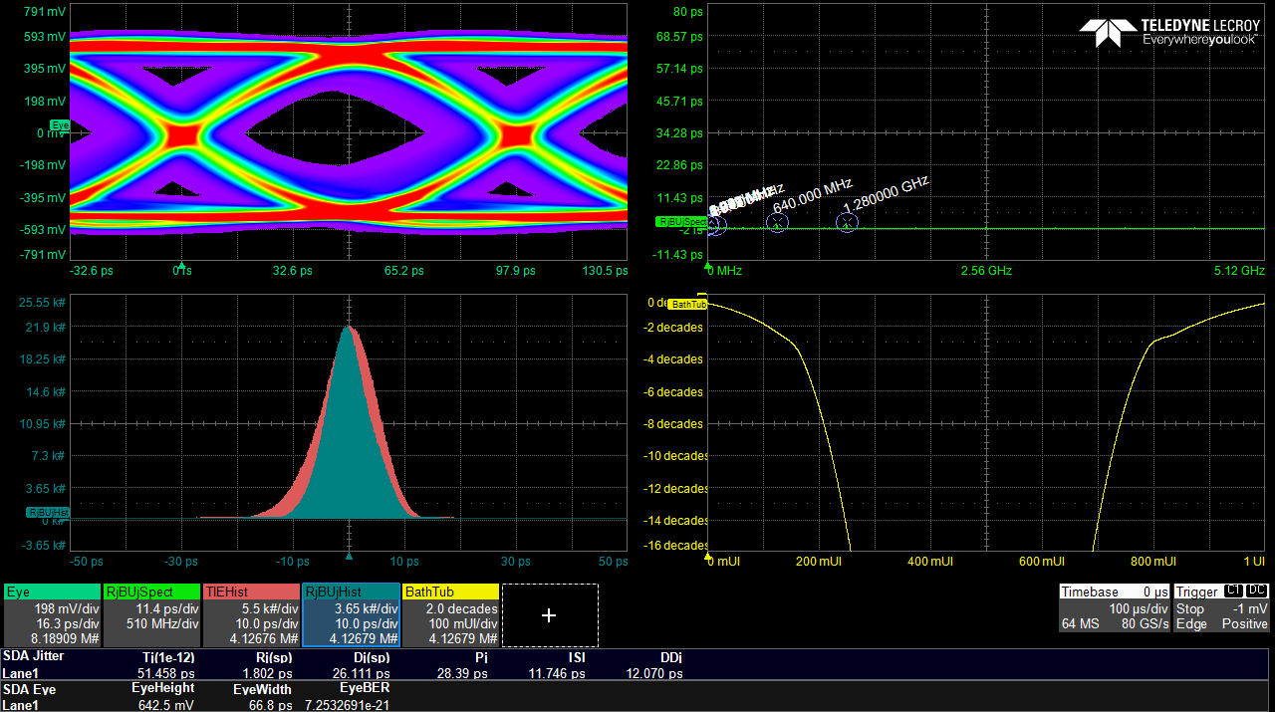
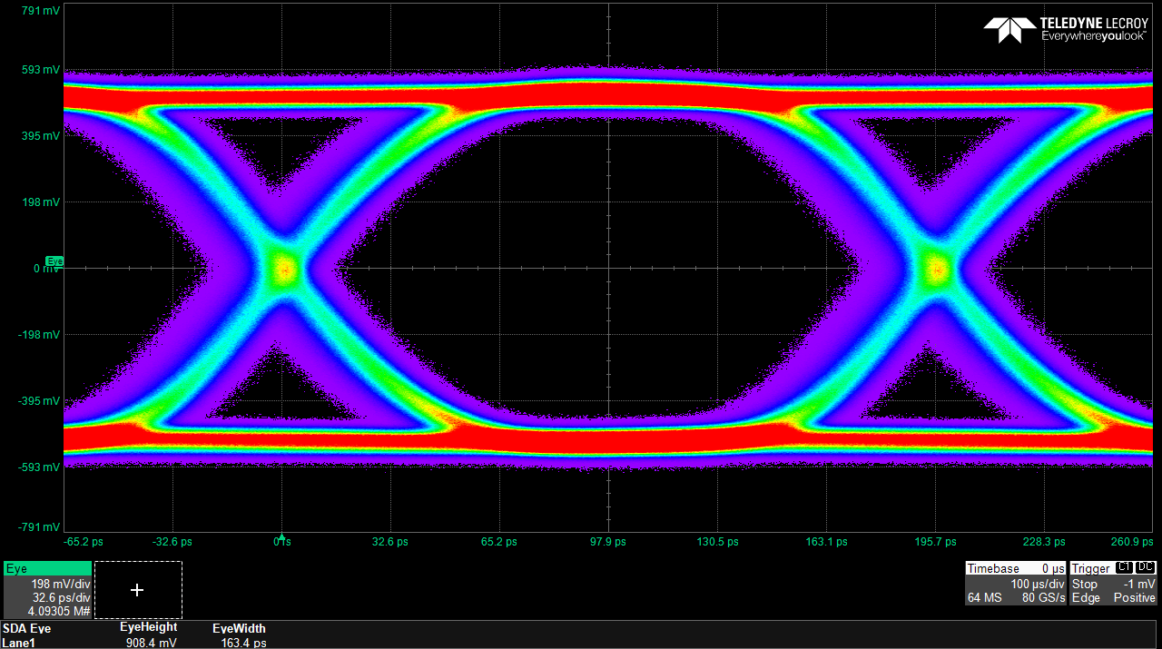
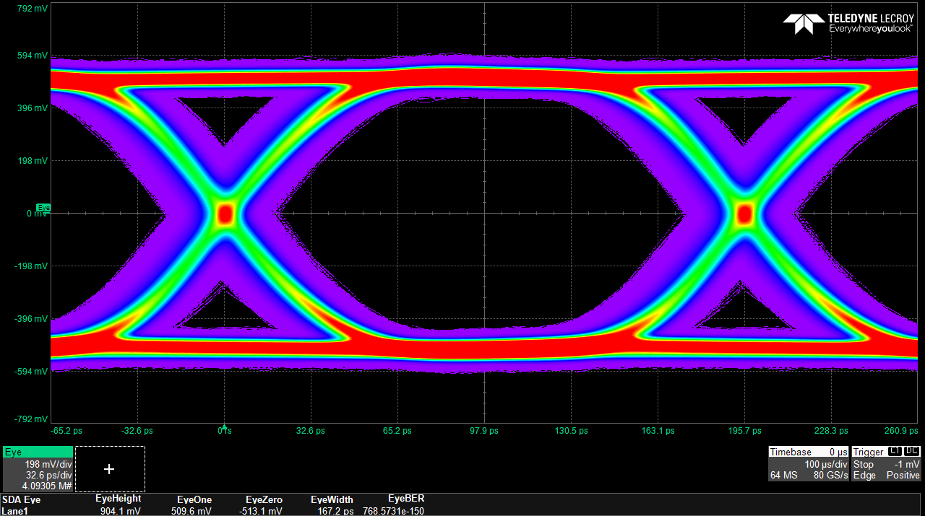
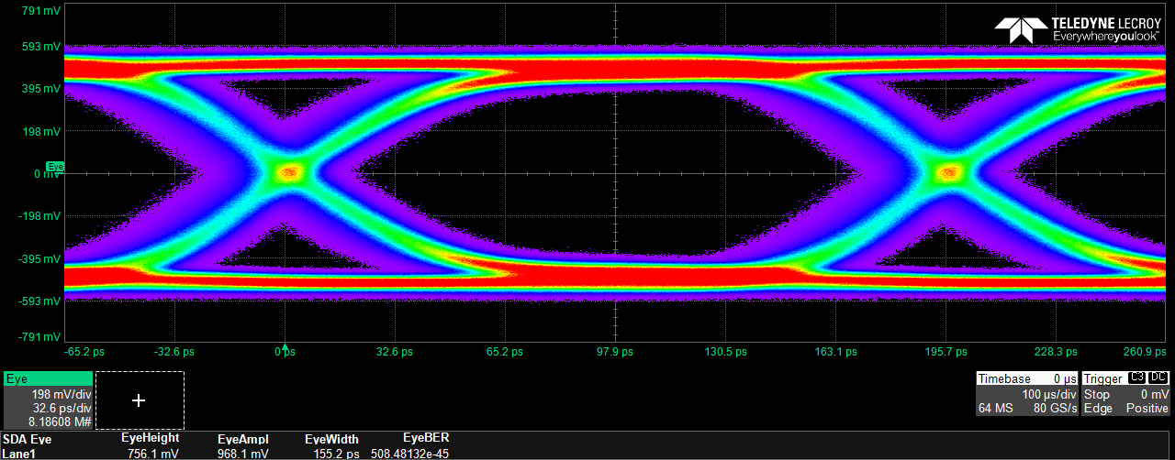
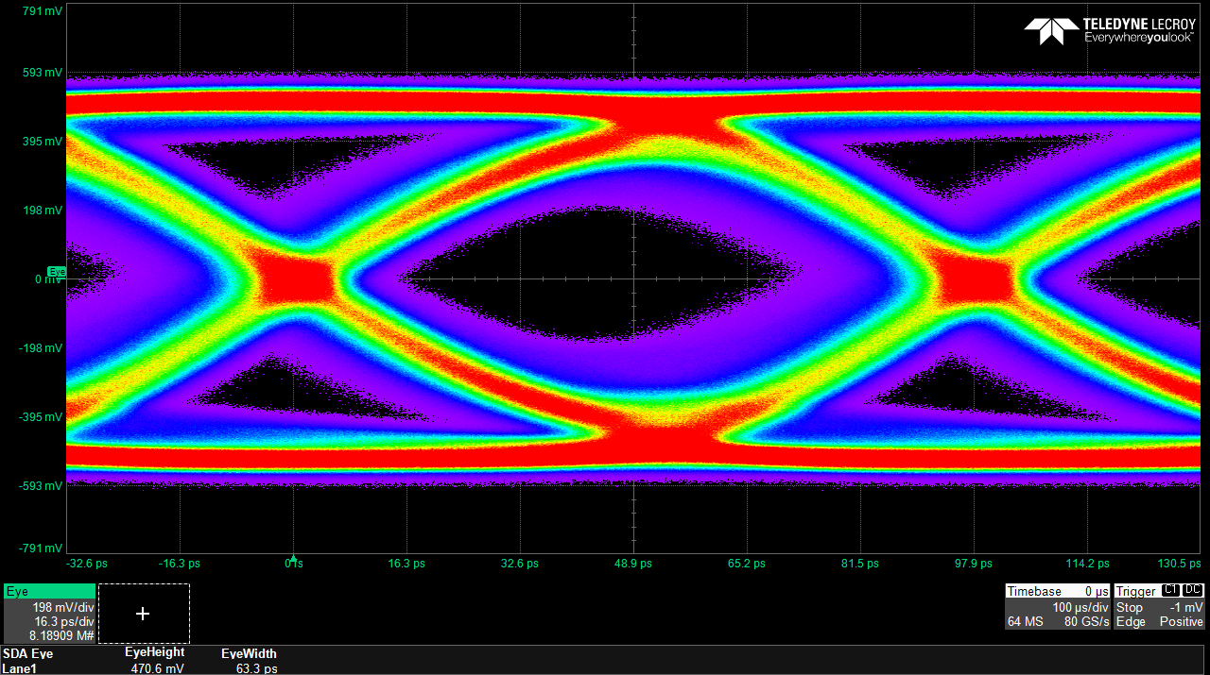
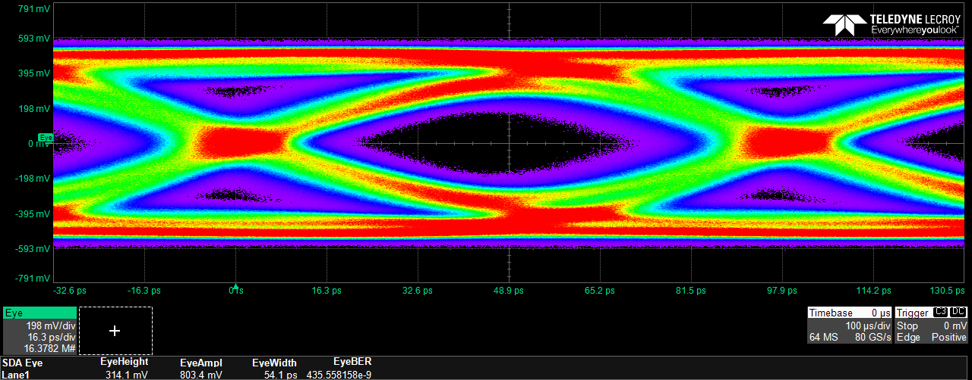
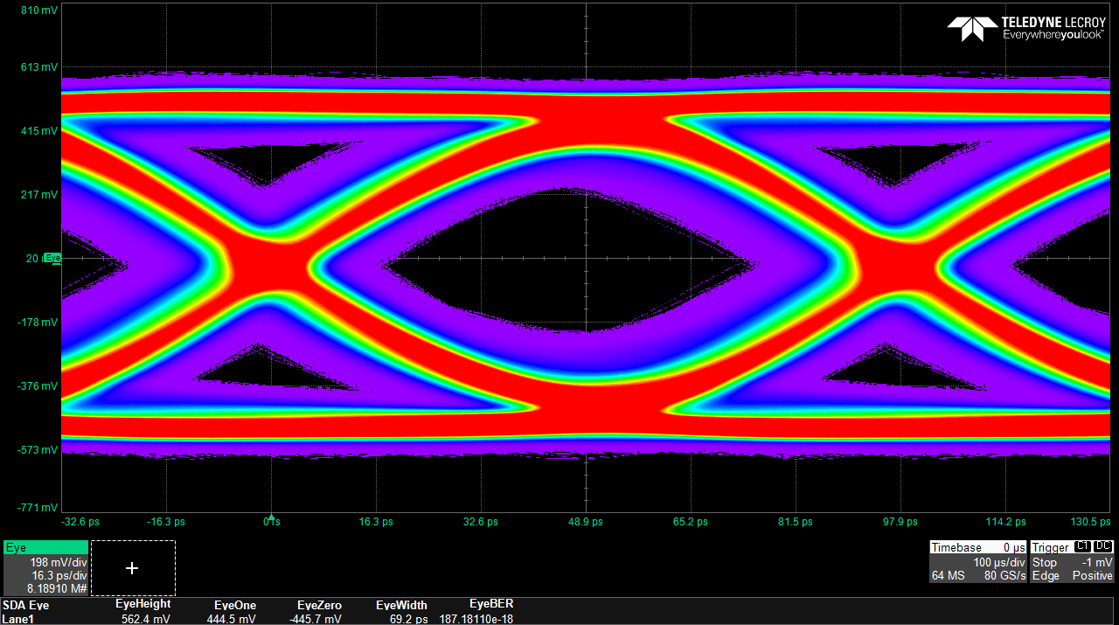
High-speed capability
Wire bonds
FPGA
FPGA
SEGMENT
FPC
Breakout
Breakout
FPC
Probecard
Wafer
Carrier PCB
5.12 Gbps
PRBS
Wafer probing at
10.24 Gbps achieved!
(BER@FPGA <1e-12,
see later)
10.24 Gbps
PRBS
12x

Slide 22
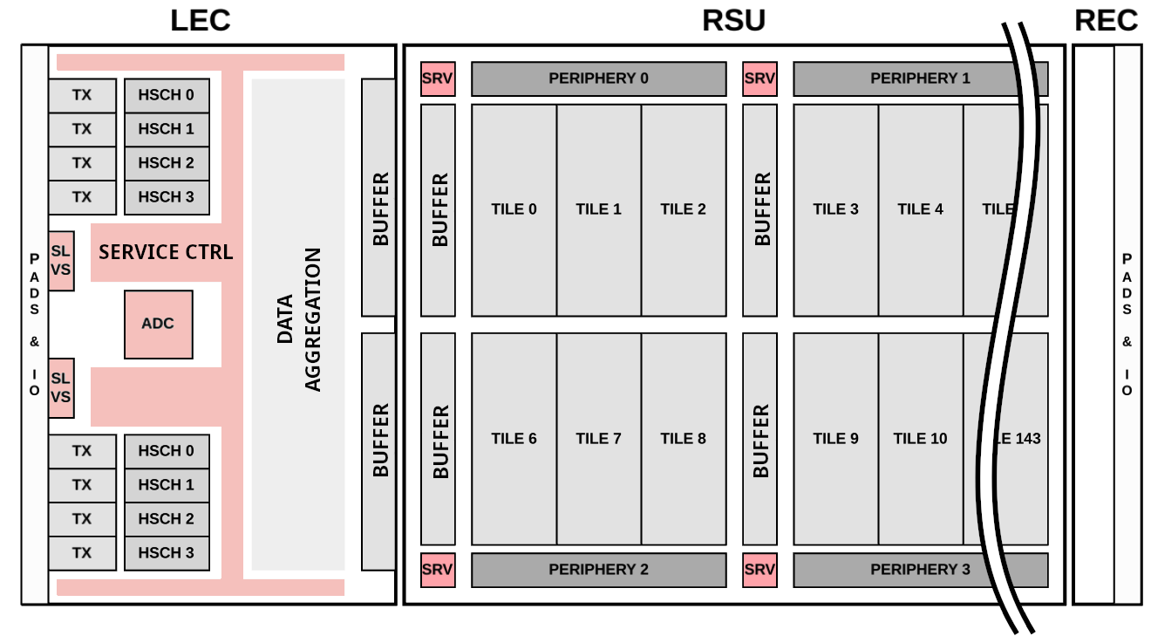
Testing sequence
Primary sequence
PSUB
GSVDD

Slide 23
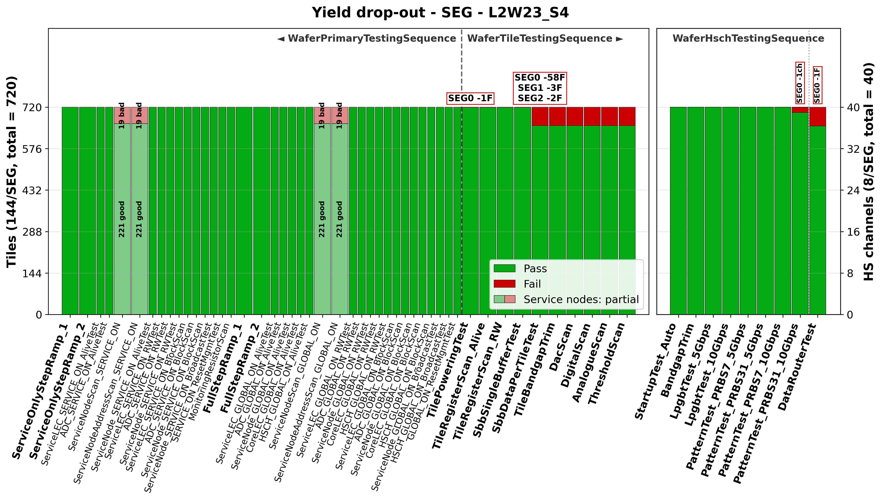
Testing sequence
1 wafer, 5 SEG
Primary sequence
PSUB
GSVDD
Checking
Service registers and Service Nodes

Slide 24
Testing sequence
1 wafer, 5 SEG
Primary sequence
PSUB
GSVDD
GAVDD
GDVDD
Global power up
Core and service registers

Slide 25
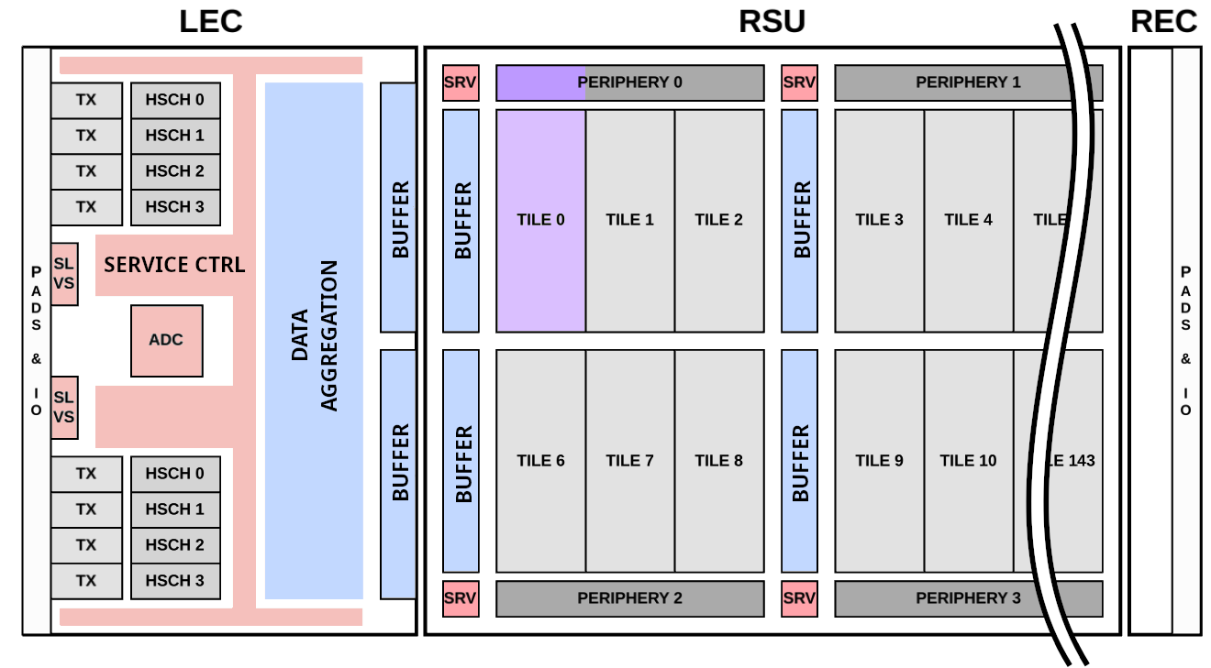
Testing sequence
1 wafer, 5 SEG
Primary sequence
Tile sequence
PSUB
GSVDD
GAVDD
GDVDD
1-by-1 tile testing: power, registers, data, DACs, pixels

Slide 26
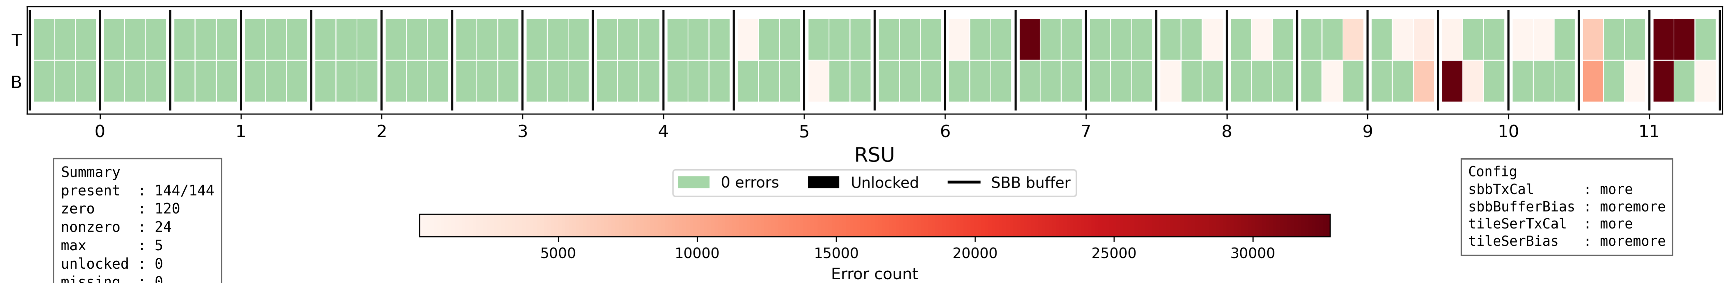
Testing sequence
1 wafer, 5 SEG
Primary sequence
Tile data transmission with other active tiles – Bit Error Count
1 wafer, 5 SEG
Tile sequence
NO PIXEL ACTIVITY
READOUT
PSUB
GSVDD
Weakness solved: unshielded in-metal stack area found and closed (next run)
GAVDD
GDVDD
1-by-1 tile testing: power, registers, data, DACs, pixels

Slide 27
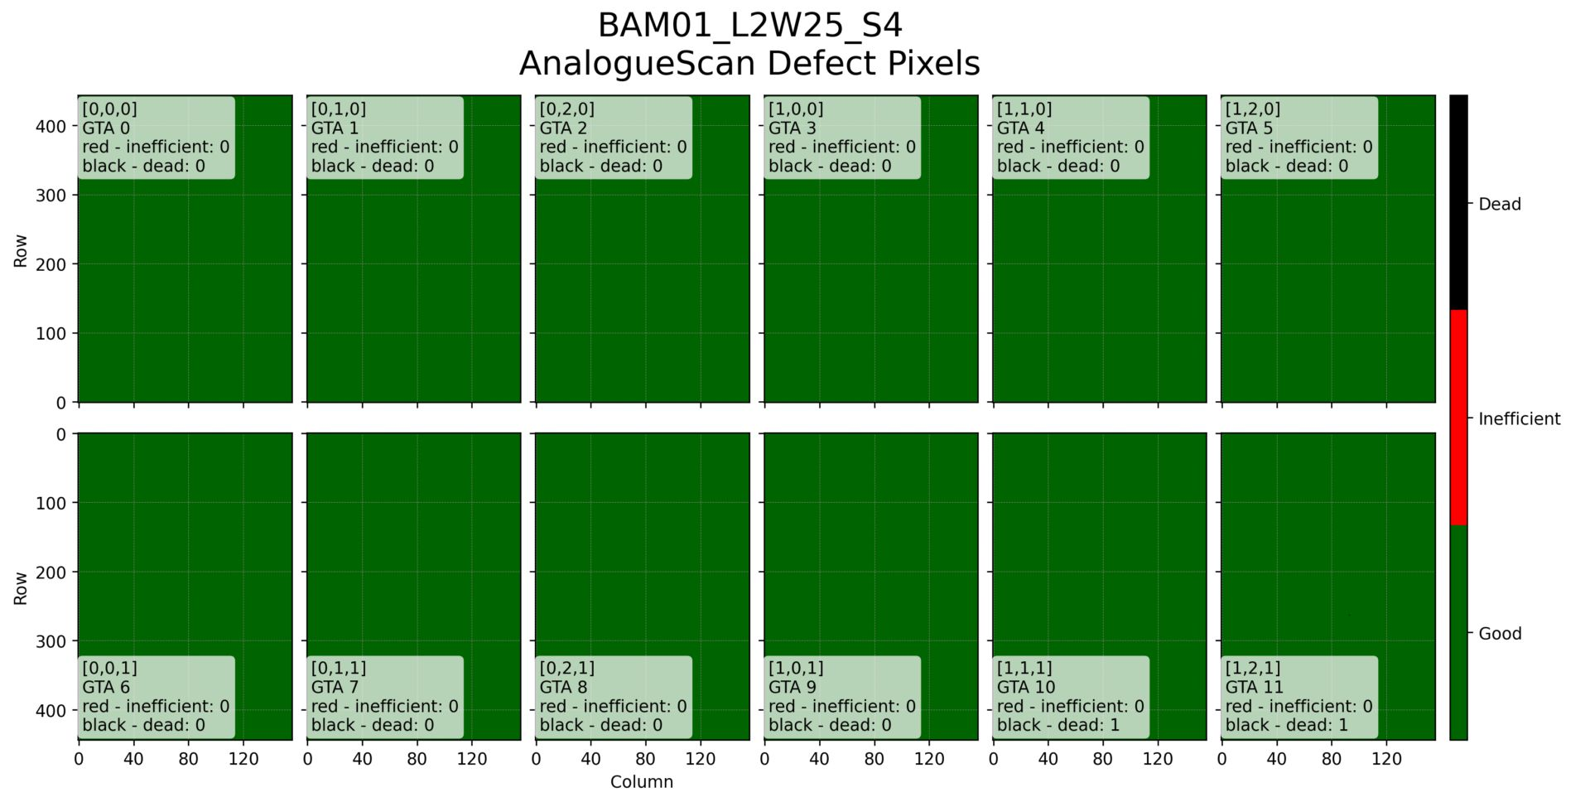
Testing sequence
1 wafer, 5 SEG
Defect pixels – one RSU
Primary sequence
Tile sequence
PSUB
GSVDD
GAVDD
GDVDD
1-by-1 tile testing: power, registers, data, DACs, pixels

Slide 28
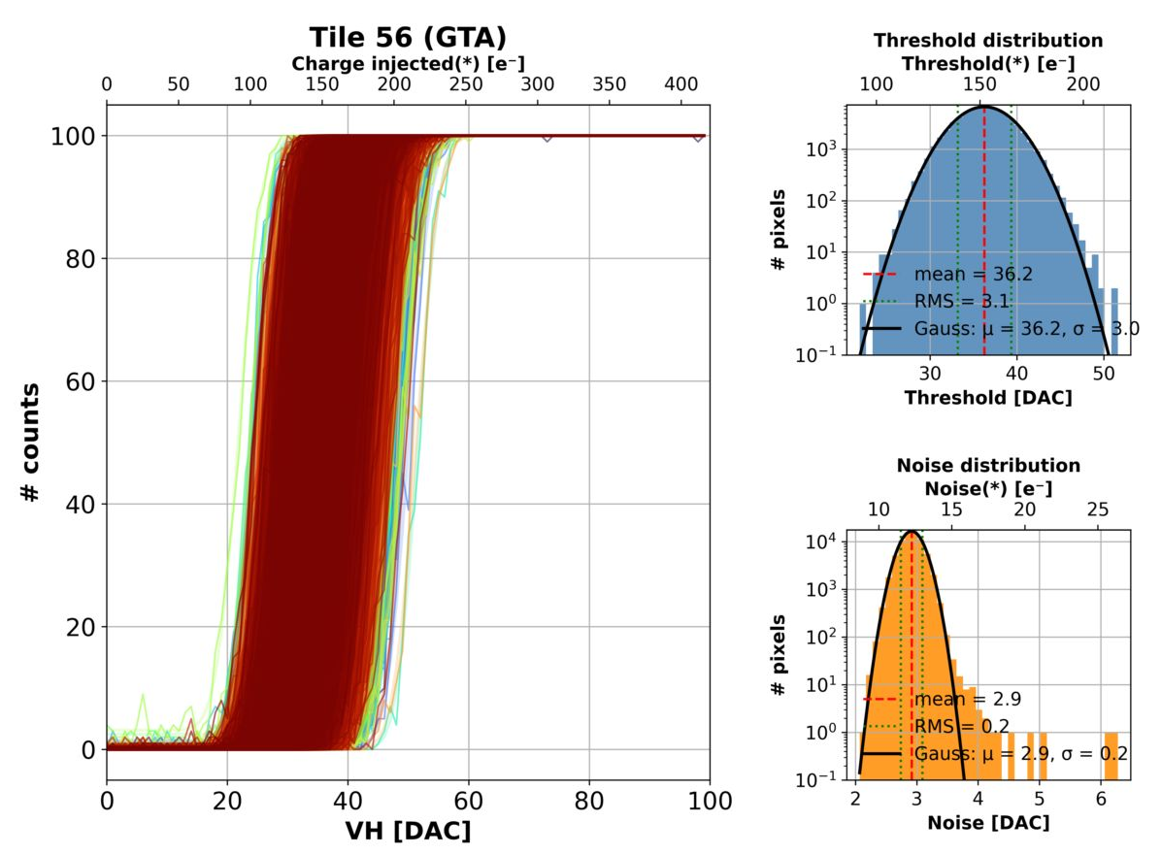
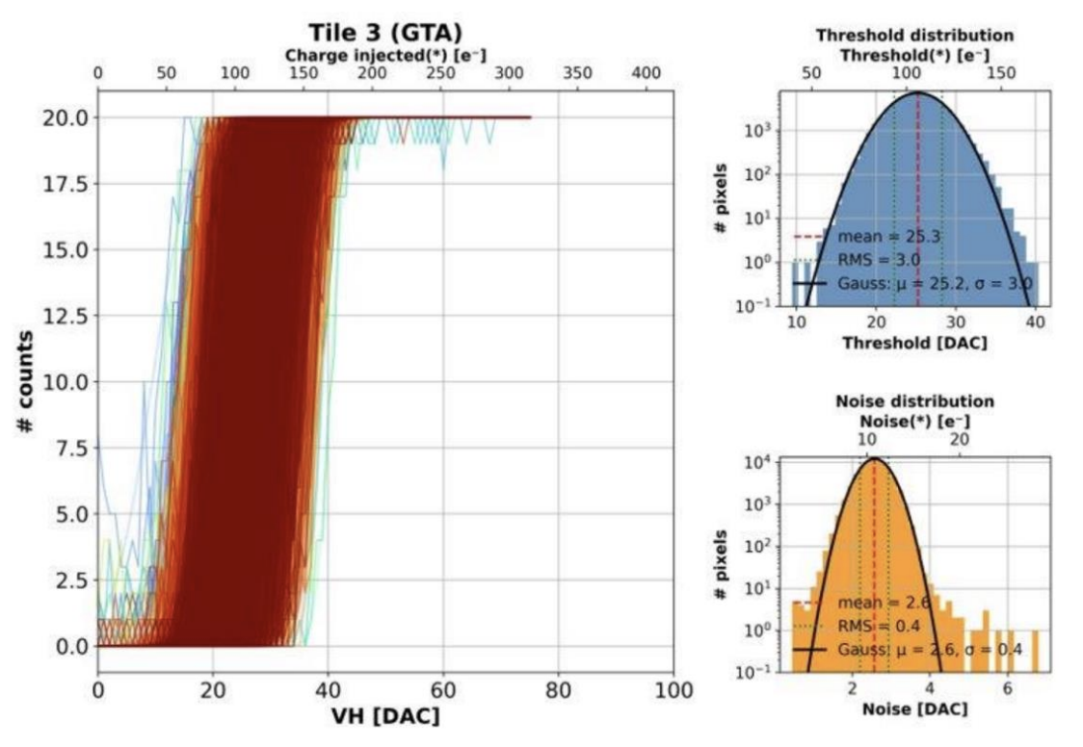
Testing sequence
Threshold scan – one tile
1 wafer, 5 SEG
Primary sequence
Tile sequence
PSUB
GSVDD
GAVDD
GDVDD
1-by-1 tile testing: power, registers, data, DACs, pixels

Slide 29
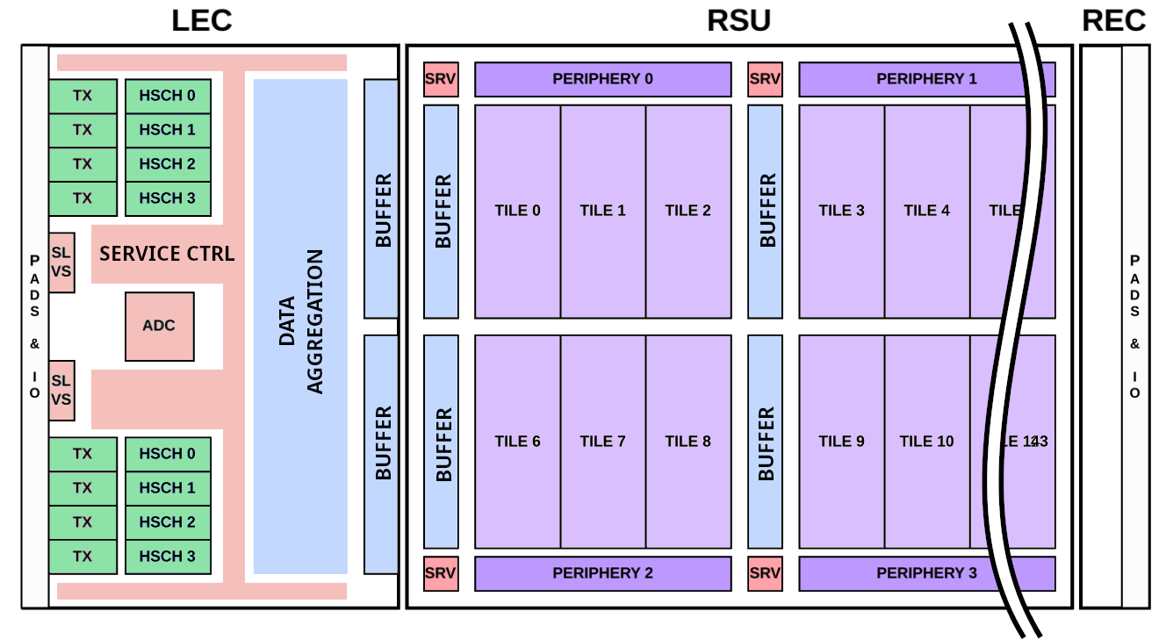
Testing sequence
1 wafer, 5 SEG
Primary sequence
Tile sequence
High-speed sequence
PSUB
GSVDD
GAVDD
GDVDD
TXVDD
High-speed serializer and full data path

Slide 30
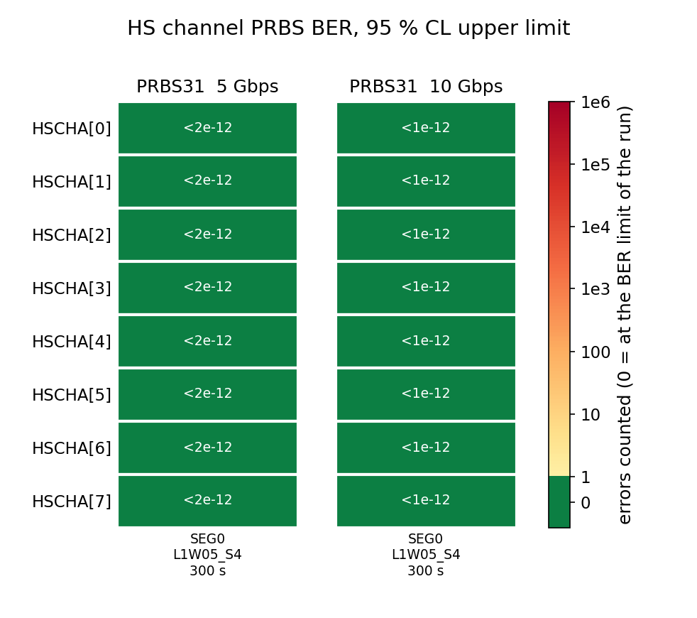
Testing sequence
1 wafer, 5 SEG
High-speed channel Bit Error Rate (BER) PseudoRandomBinarySequence (PRBS)
Primary sequence
Channel 0
Tile sequence
Channel 1
High-speed sequence
Channel 2
Channel 3
Channel 4
PSUB
Channel 5
GSVDD
Channel 6
GAVDD
Channel 7
GDVDD
300s
300s
TXVDD
1 SEGMENT
High-speed serializer and full data path

Slide 31
Testing sequence
Primary sequence
Tile sequence
High-speed sequence
PSUB
GSVDD
GAVDD
GDVDD
TXVDD
MOSAIX chip is (nearly) fully functional – crosstalk on tile links addressed in next submission (ER3)

Slide 32
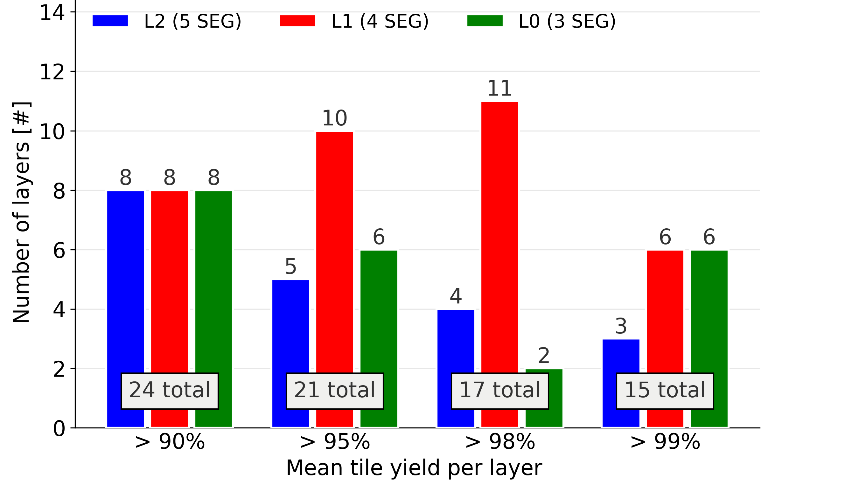
Layer yield – maximum layer size
from 40 wafers

Slide 33
Layer yield – maximum layer size
Effort on yield improvement in collaboration with the foundry ongoing
from 40 wafers
At >98% tile yield, we
can build:
2x ITS3 or
1x SVT half barrel

Slide 34
Wafer probing extensions and SVT QC
SVT foresees a production of:
  75 ER3 wafers (inner barrel)
  330 LAS wafers (outer barrel)
  LAS: Large Area Sensor – MOSAIX derived, with same pad structure
SEGMENT
75x
Probecard
LAS
330x

Slide 35
Wafer probing extensions and SVT QC
SVT foresees a production of:
  75 ER3 wafers (inner barrel)
  330 LAS wafers (outer barrel)
  LAS: Large Area Sensor – MOSAIX derived, with same pad structure
Large volume requires fast QC procedures - paralellization required:
LEC
Probecard
SEGMENT
75x
Probecard
Probecard
LAS
330x

Slide 36
Wafer probing extensions and SVT QC
SVT foresees a production of:
  75 ER3 wafers (inner barrel)
  330 LAS wafers (outer barrel)
  LAS: Large Area Sensor – MOSAIX derived, with same pad structure
Large volume requires fast QC procedures - paralellization required:
  LEC + REC probecards -> allows
  full powering of all tiles in parallel
LEC
REC
Probecard
SEGMENT
Probecard
75x
Probecard
Probecard
LAS
Probecard
330x

Slide 37
Wafer probing extensions and SVT QC
SVT foresees a production of:
  75 ER3 wafers (inner barrel)
  330 LAS wafers (outer barrel)
  LAS: Large Area Sensor – MOSAIX derived, with same pad structure
Large volume requires fast QC procedures - paralellization required:
  LEC + REC probecards -> allows
  full powering of all tiles in parallel
  Multiple dies in parallel
LEC
REC
Probecard
SEGMENT
Probecard
Probecard
SEGMENT
Probecard
75x
Probecard
LAS
Probecard
Probecard
Probecard
LAS
Probecard
330x

Slide 38
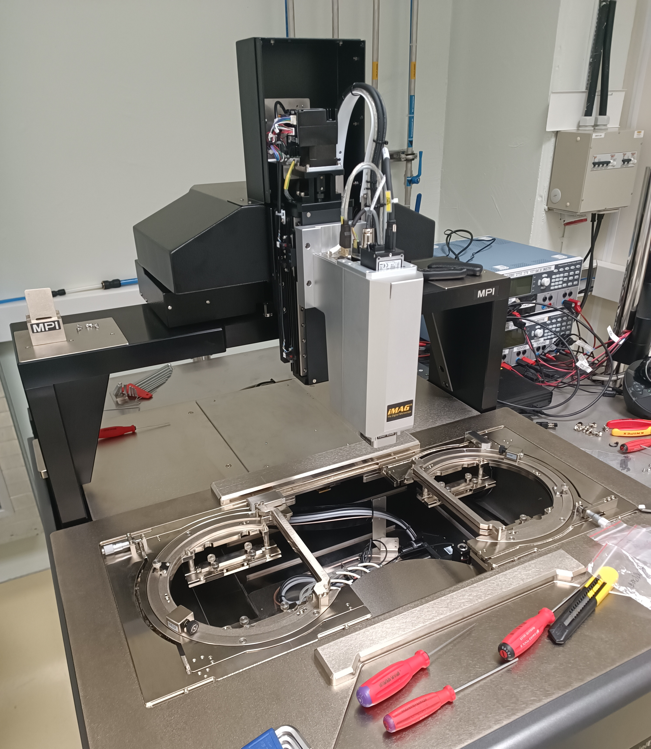
Wafer probing extensions and SVT QC
Vertical probecard for LEC (current)
Additional REC probecard (to be produced)
-> Full chip powering (all tiles in parallel)
REC
LEC

Slide 39
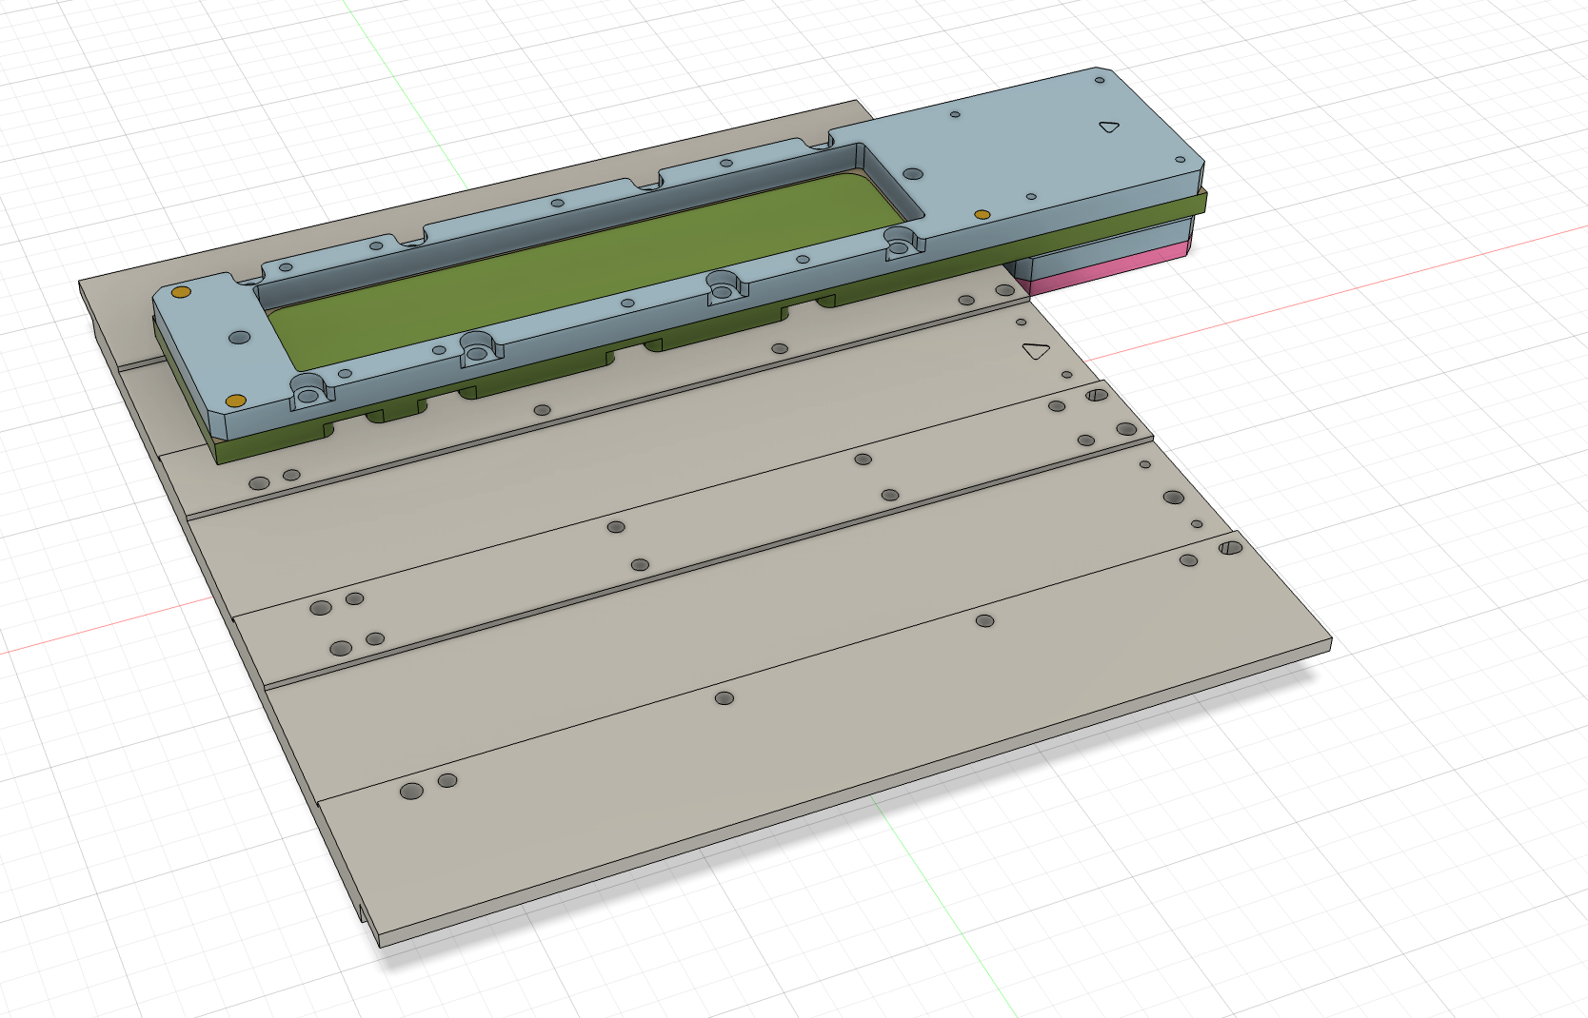
Wafer probing extensions and SVT QC
Probecard
SEGMENT
1x
Parallelization of sensor testing:
Up to 3 SEG in parallel (depending on arrangement)

Slide 40
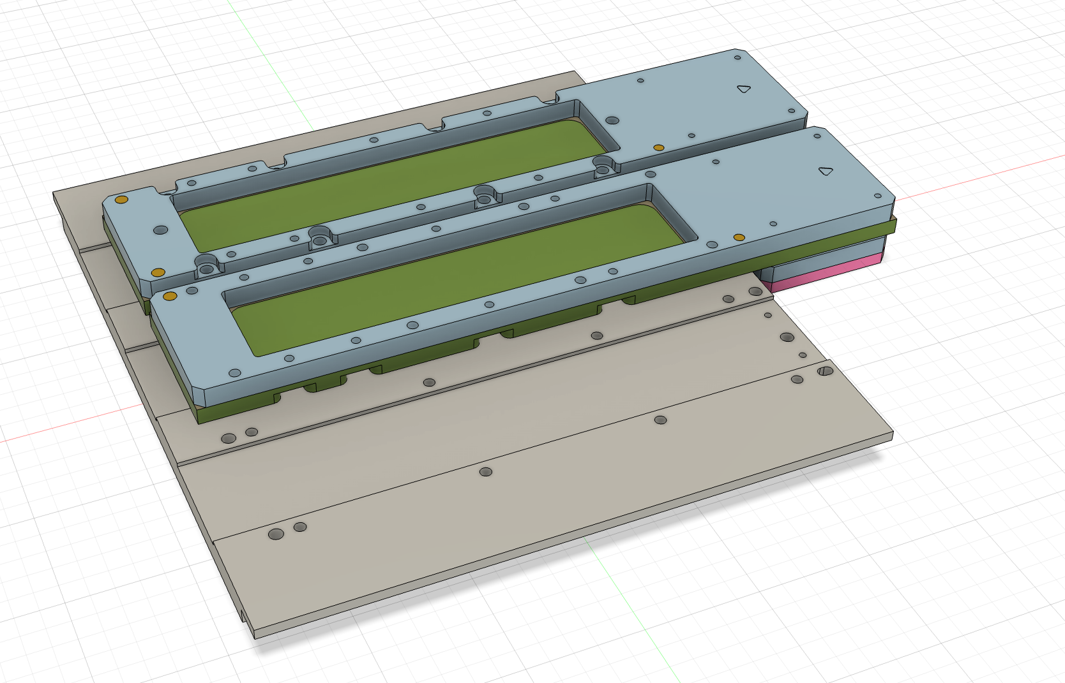
Wafer probing extensions and SVT QC
Probecard
2x
Parallelization of sensor testing:
Up to 3 SEG in parallel (depending on arrangement)
Probecard

Slide 41
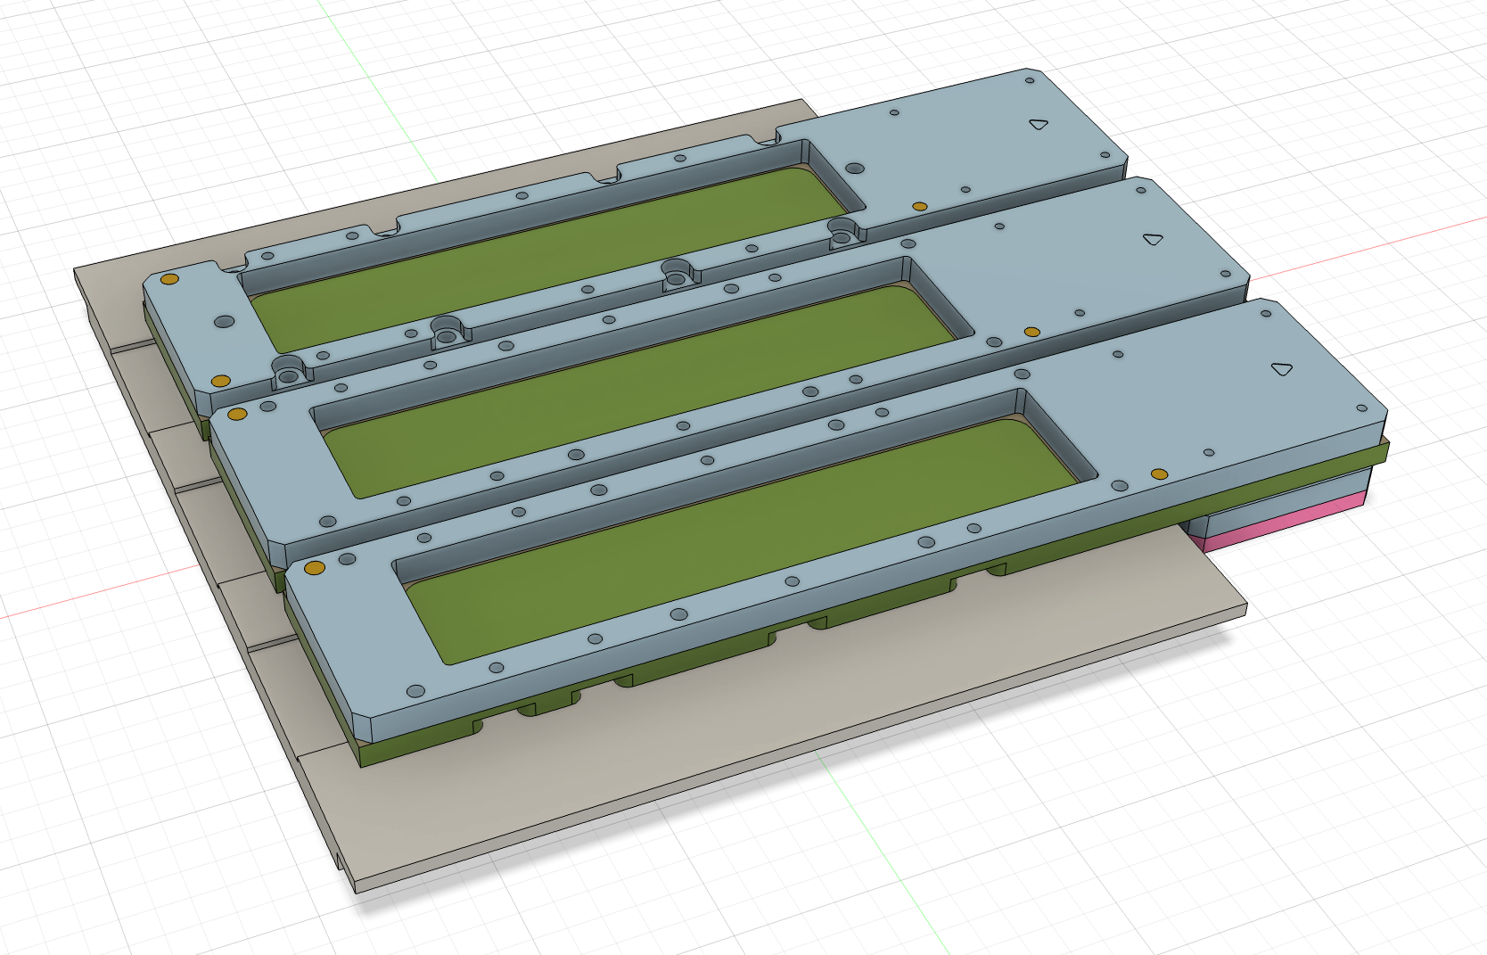
Wafer probing extensions and SVT QC
Probecard
Probecard
3x
Parallelization of sensor testing:
Up to 3 SEG in parallel (depending on arrangement)
Adaptable to LAS
Estimated reduction of total QC testing time for one site from ~560 to ~110 calendar days!
Probecard

Slide 42
Summary
MOSAIX chip (nearly) fully functional
  On track for ER3 submission by end of year
  Transmission weakness found and fix implemented
  Manufacturing yield improvement ongoing
Testing infrastructure for highly complex chip in full operation
Wafer probing at 10.24 Gbps achieved
  Essential to fully exercise all chip blocks on-wafer
  Custom high-speed chain wafer-to-FPGA developed
High-volume SVT production QC readiness
  Dual-sided powering and multi-probecard system

Slide 43
BACKUP

Slide 44
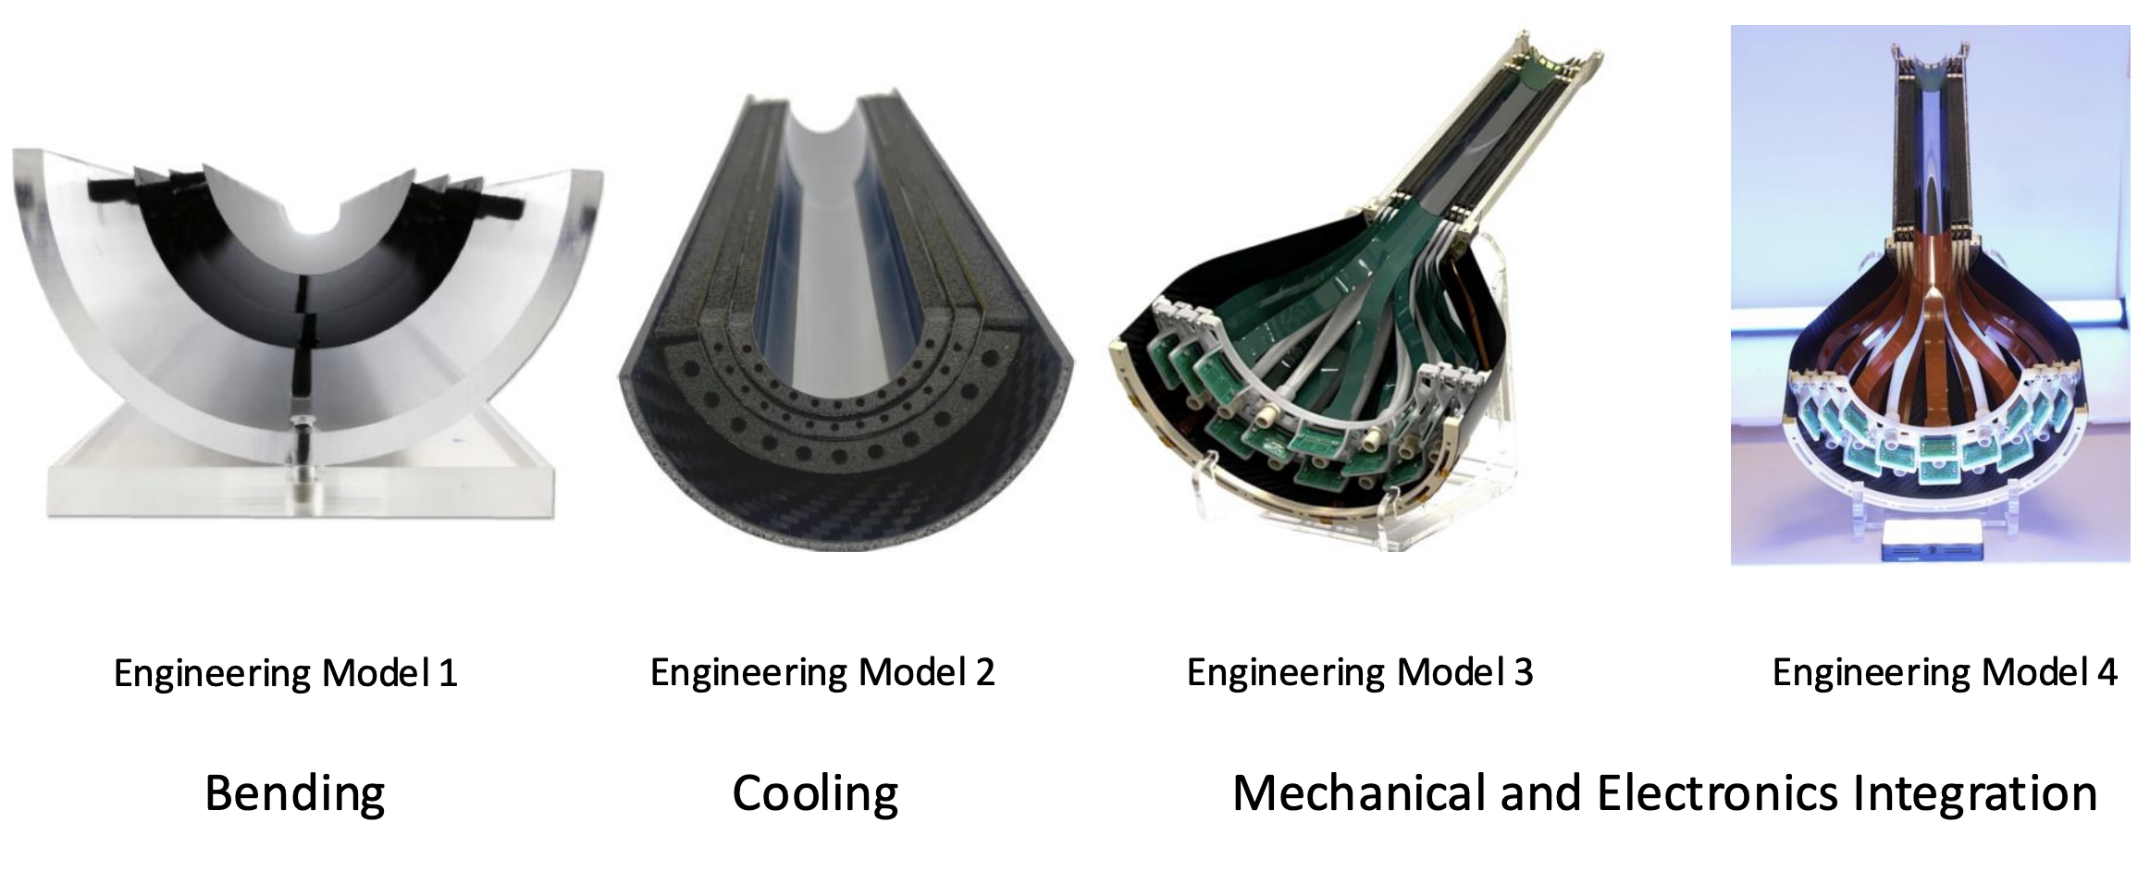
Mechanics integration

Slide 45
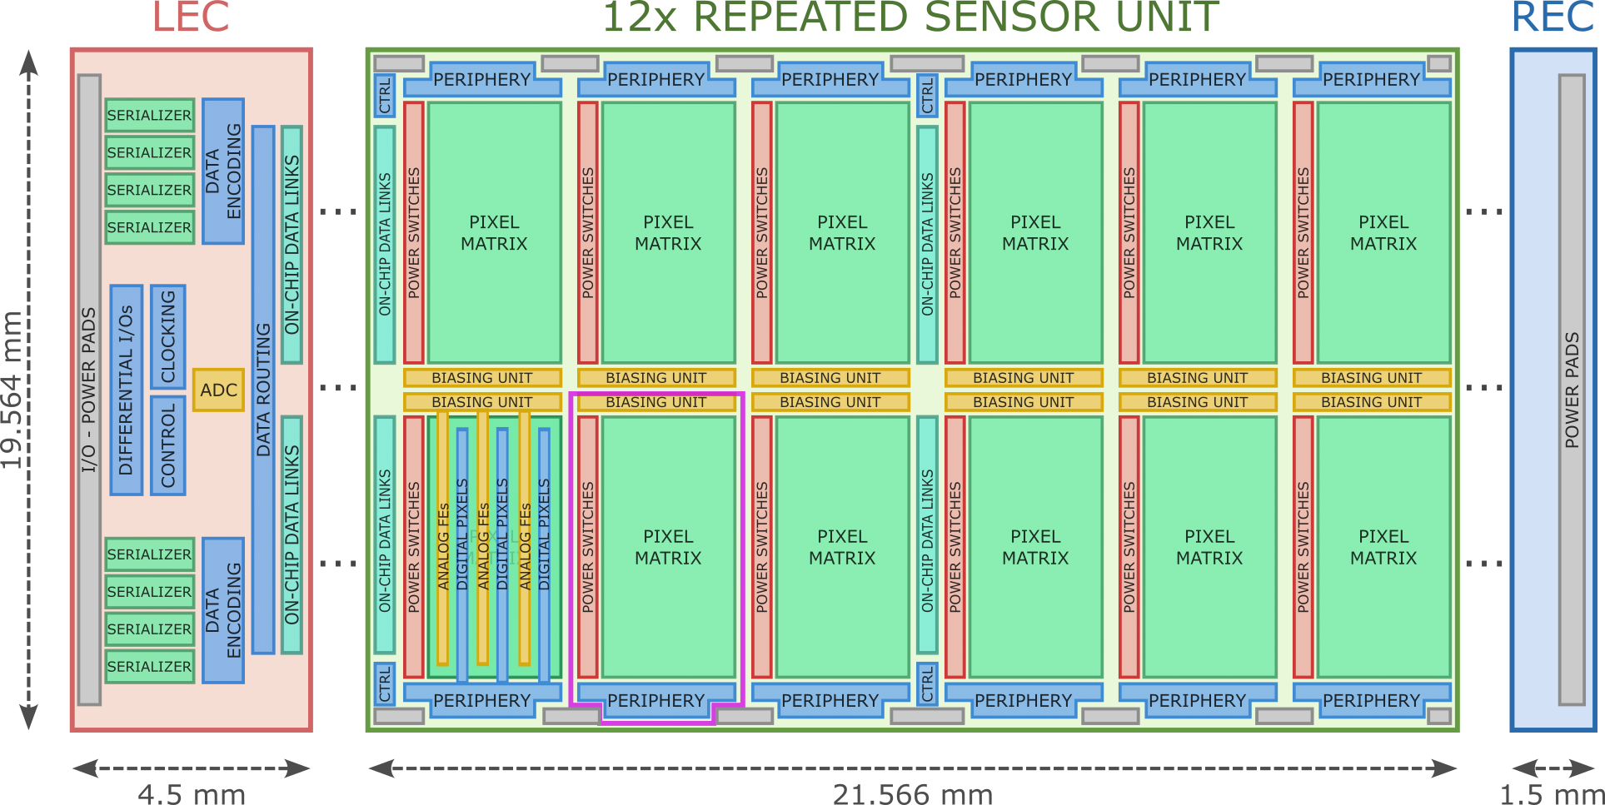
Block digaram detailed

Slide 46
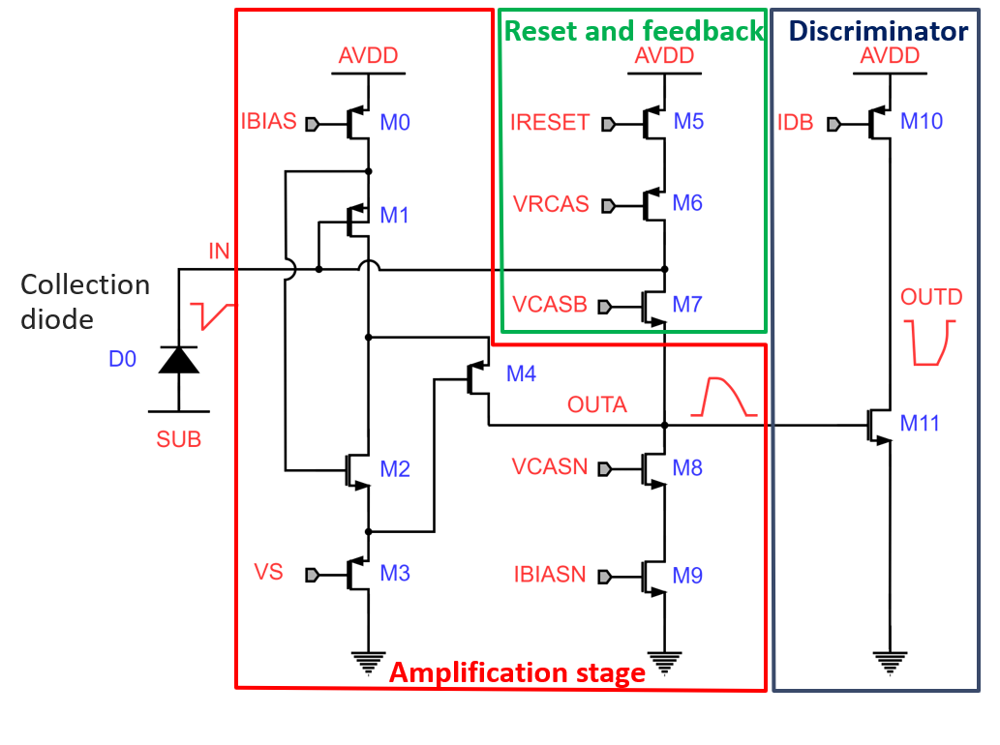
Analog pixel frontend

Slide 47
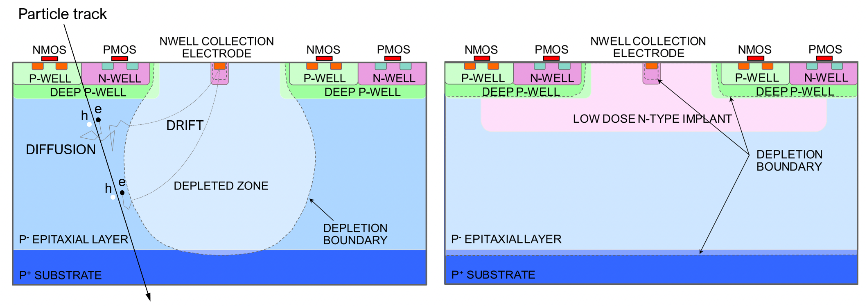
MAPS pixel cross section

Slide 48
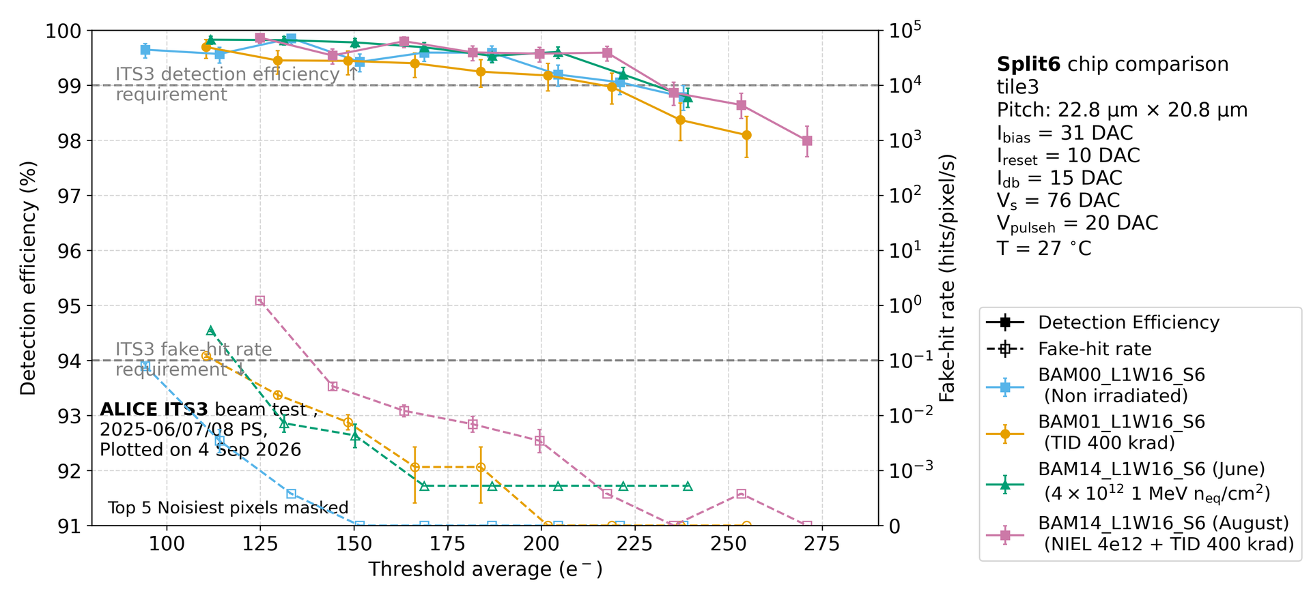
Testbeam - detection efficiency / fhr

Slide 49
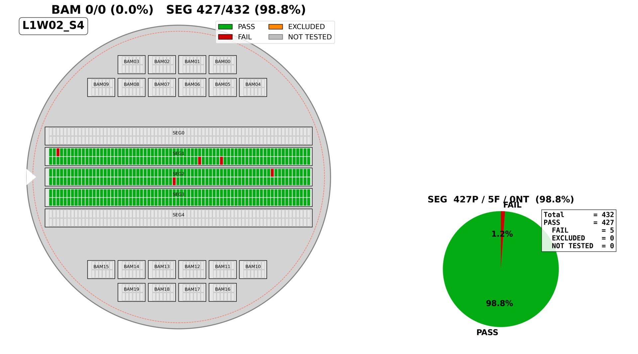
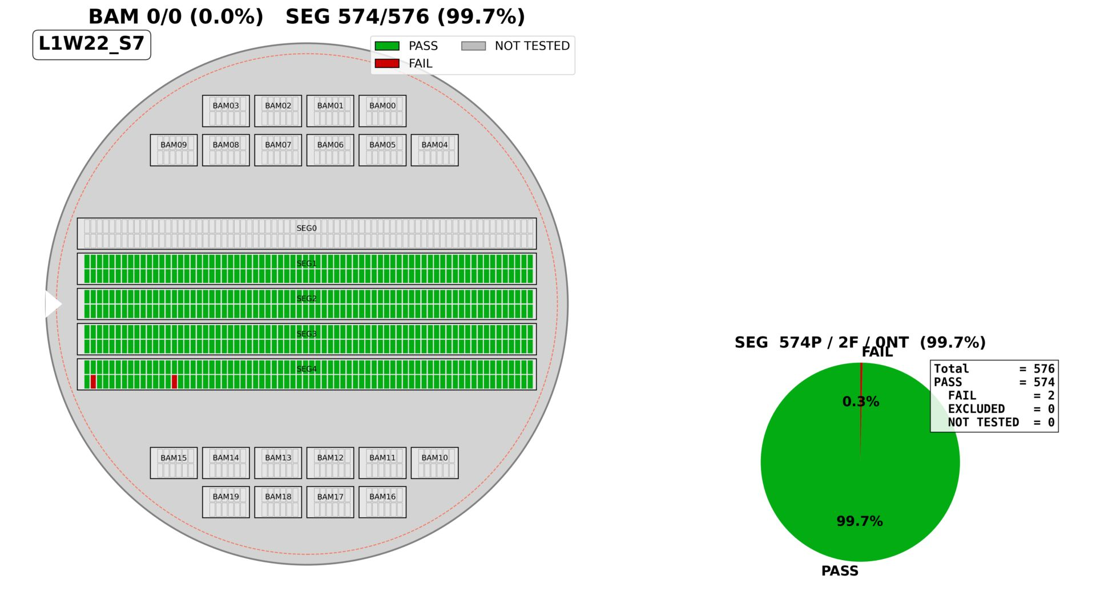
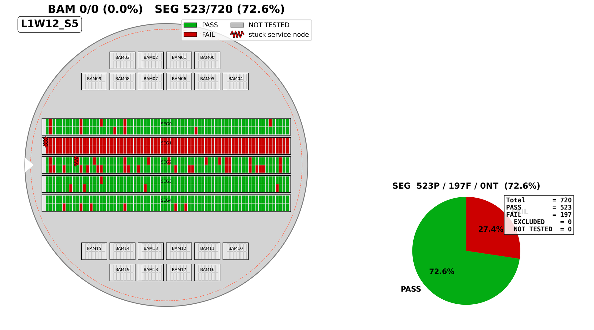
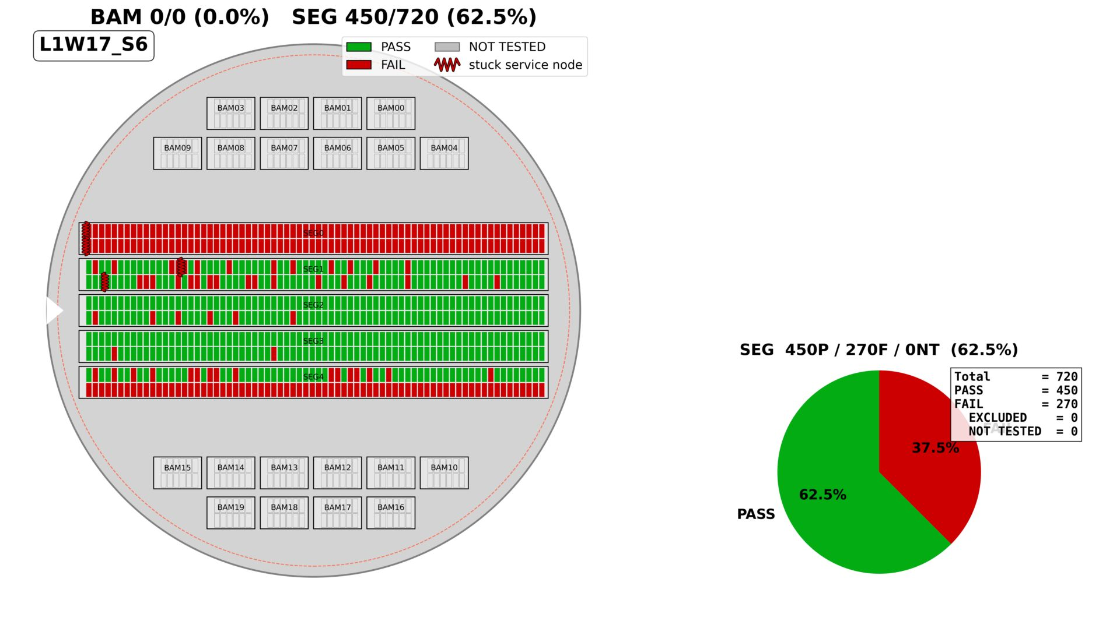
Yield – thinned layers example
Thinned layers tile yield
1x L0: 99%
1x L1: 99%
2x L2: 73% / 63%

Slide 50
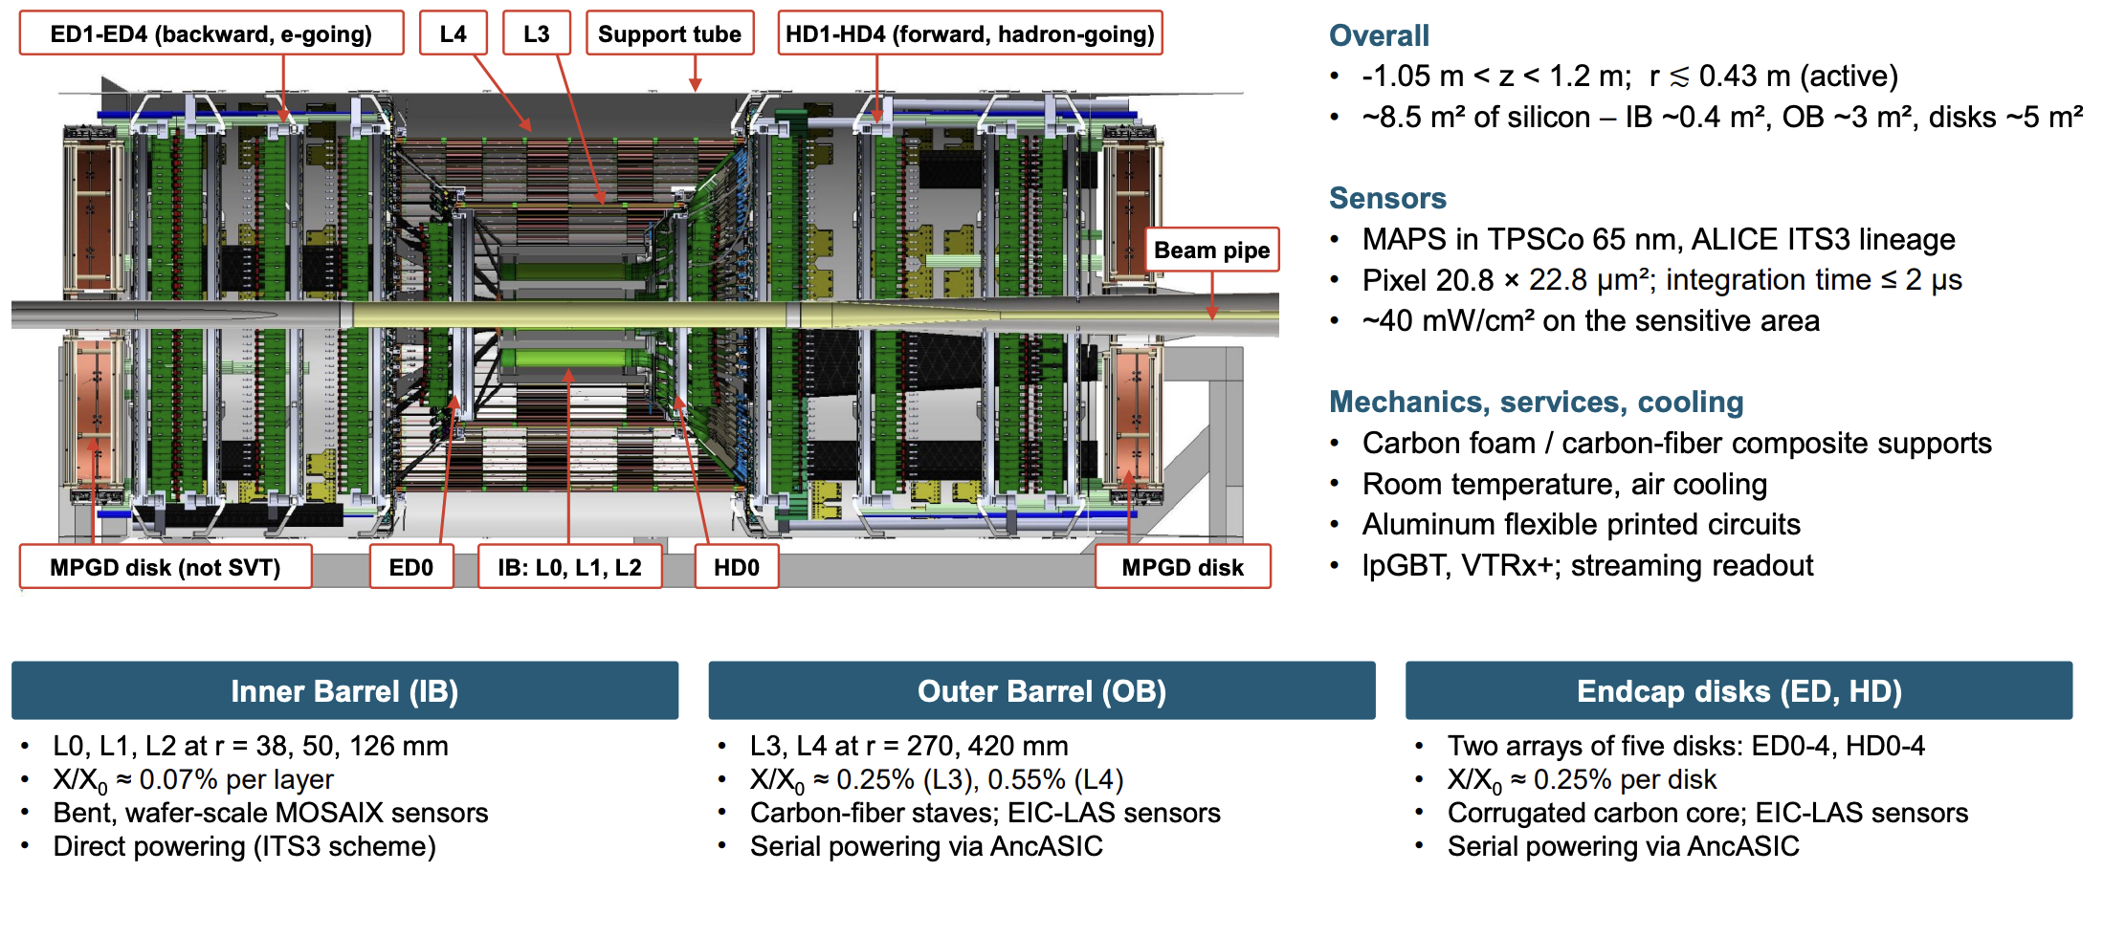
SVT

Slide 51
Mosaix anatomy
LEC
12x RSU
1x Segment
REC
Service nodes
Tile
8x 10 Gb/s transmitter
lpGBT logic/encoded
5x global power domains
Analog monitoring/testout
Slow control/clk/sync/rst
12 tiles,12 pixel variants
Each tile is switched
Overall: 12*12 = 144 tiles
144 * 160 Mb/s transmission
144 biasing/periphery blocks
288 local power domains
One tile ~ one pixel sensor
5x global power domains
Notes:
48 service nodes, 24 low swing buffers, 444x156 ~70k pixels per tile, 20.8 x 22.8 um
On SRV nodes:
A slow control endpoint accessible through the SRV interface • Controls the SBB tile configuration – Data buffers, driver strengths, etc • Controls the analog monitoring – Supply voltages – Bias currents – Bias voltages • Controls the tile power switches • Controls the tile reset • All services nodes must be configured before global supplies are switched on!
Power pads takes up most of real-estate – E-links (all differential CLPS): • Clock - input • Reset - input • Sync - input • 2x slow control – SRV and CORE input/output – Data (all differential): • 8x high-speed channels (4 top, 4 bottom) – 2x analog monitoring • No connection to FPC – 2x testout • No connection to FPC

Slide 52
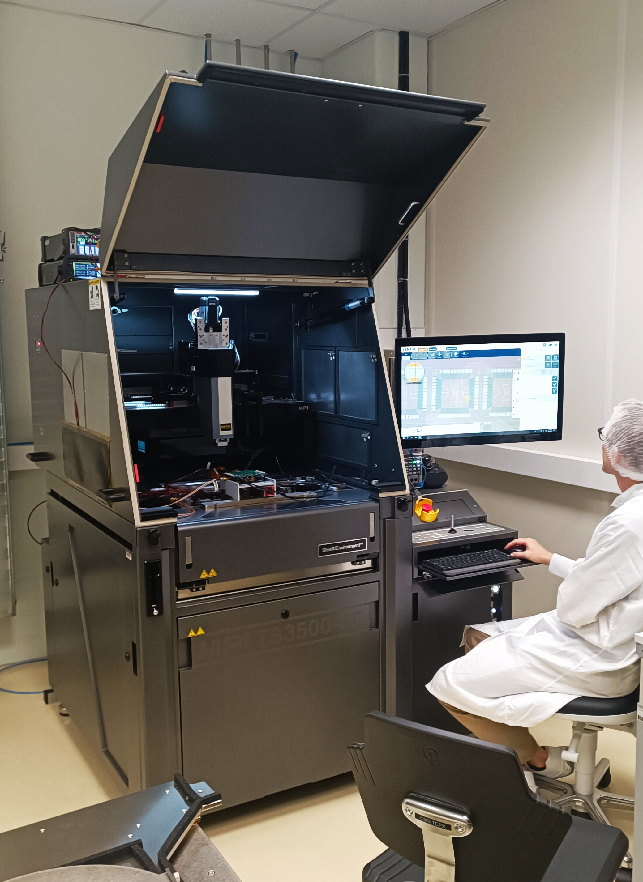
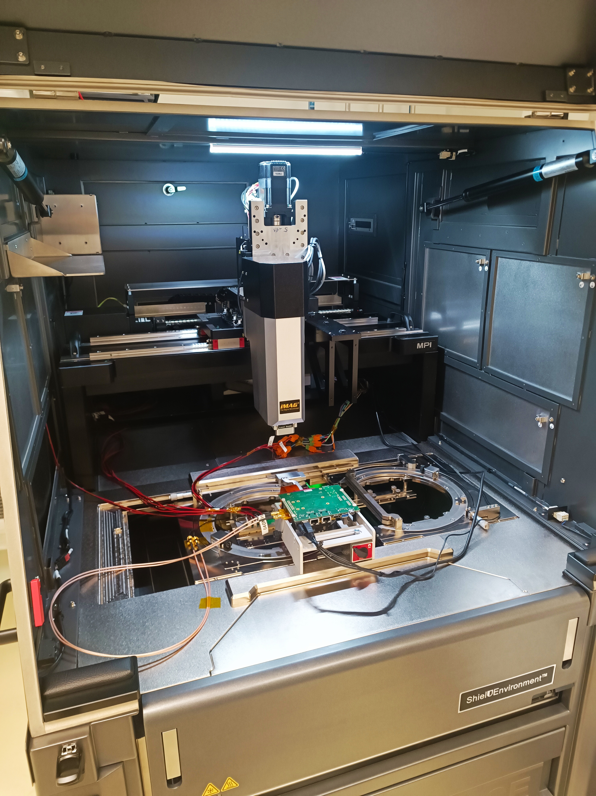
Wafer prober upgrade
New platen, allowing for two probecards at once:
Cantilever for REC powering (to be produced)
Vertical for LEC (as is)
Requires new microscope travel range
Installation complete, incl. dark box (sources, laser)
Taken into operation again

