Slide 1

Packaging Efforts
for the Selena Project
Edwin Solis, CPAD 2026

Slide 2
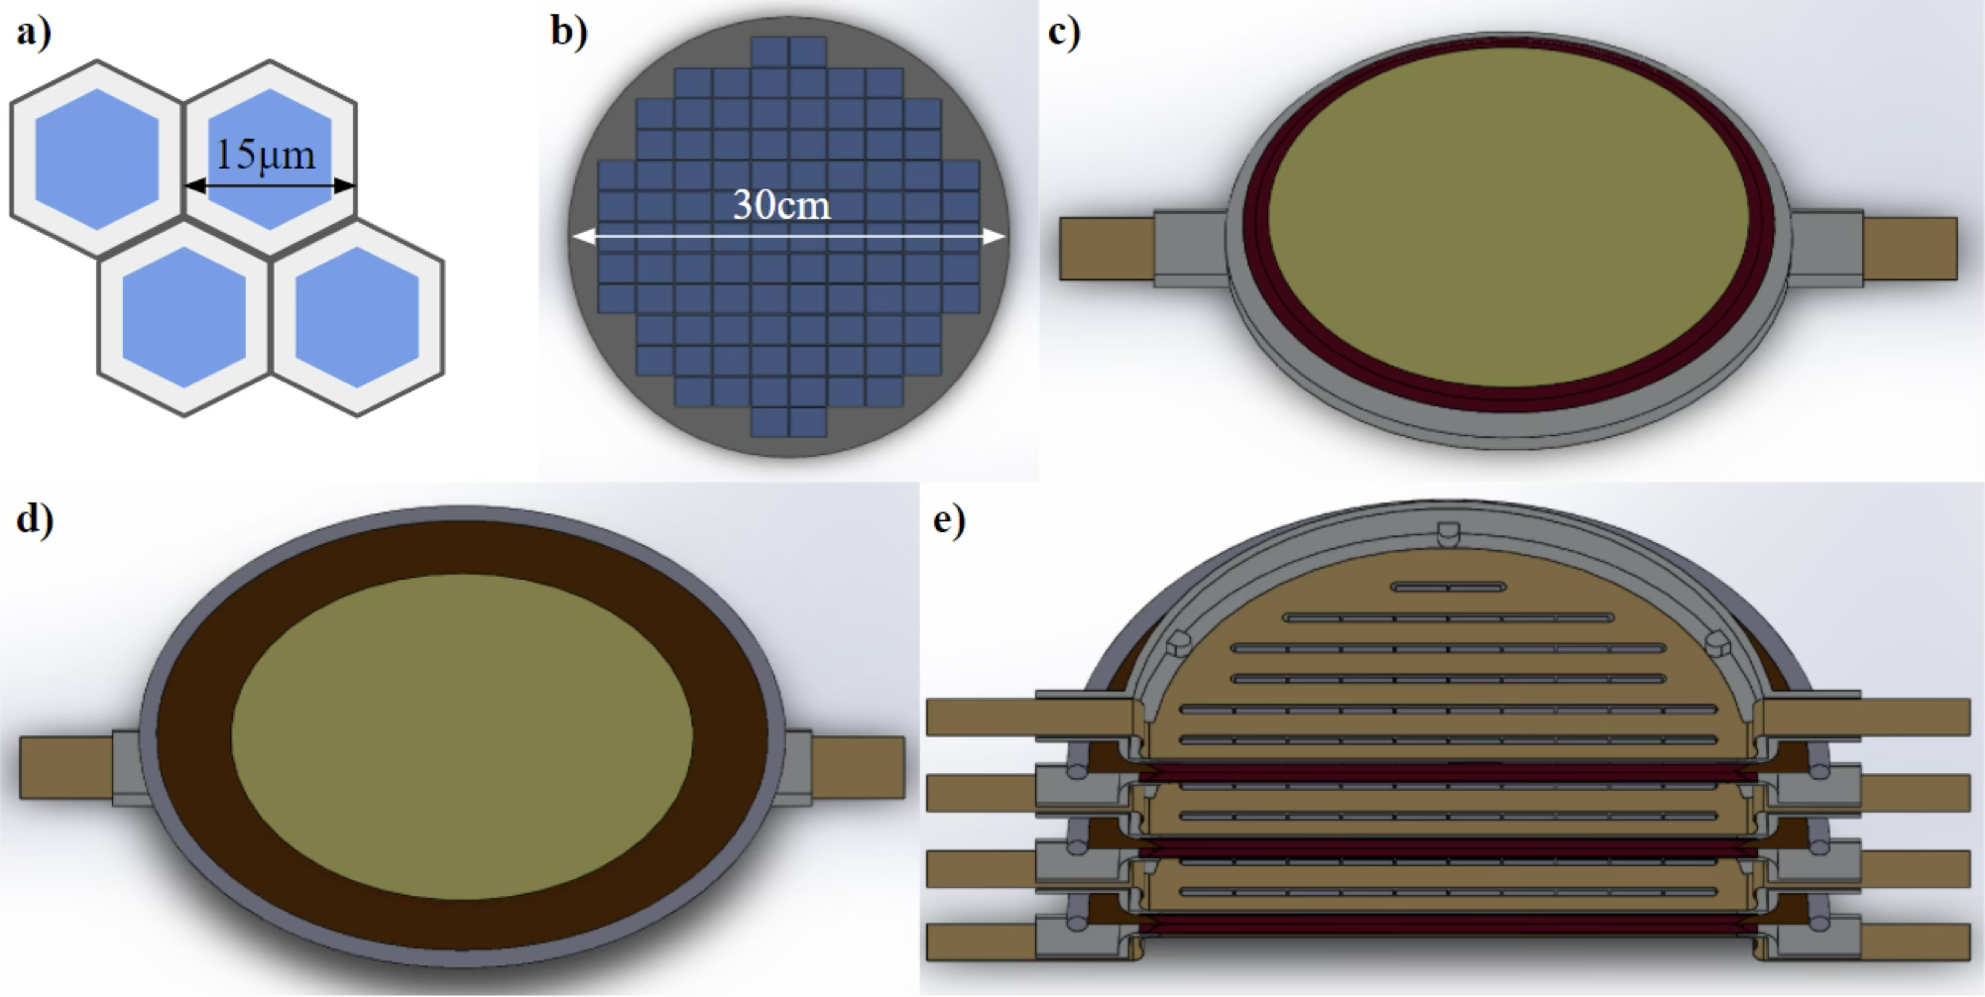
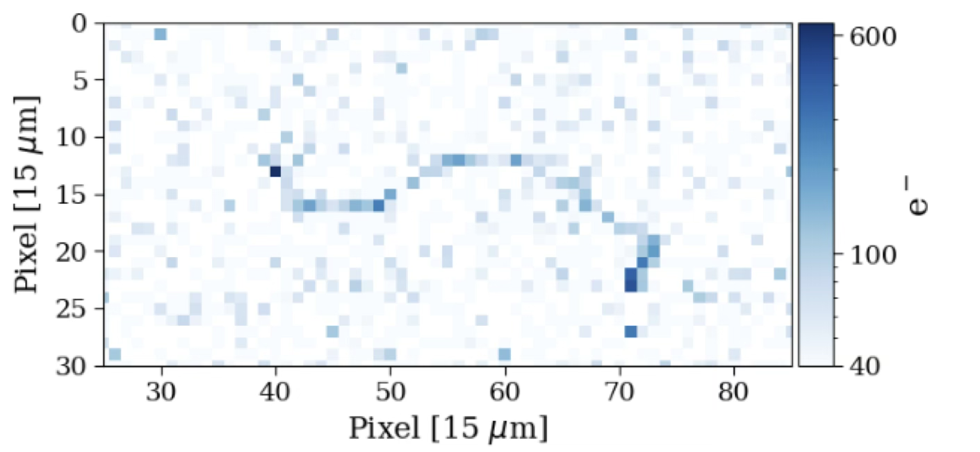
Selena 0𝜈𝛽𝛽 search
A search for Neutrinoless Double Beta Decay in ⁸²Se using amorphous Selenium/CMOS detectors
High Q_{𝛽𝛽} (3MeV) protects from natural backgrounds
CMOS spatiotemporal resolution provides event classification and decay chain tagging
Existing industrial capabilities to fabricate a ton-scale detector
[1] arXiv:1609.03887, [2] arXiv:2012.04079

Slide 3
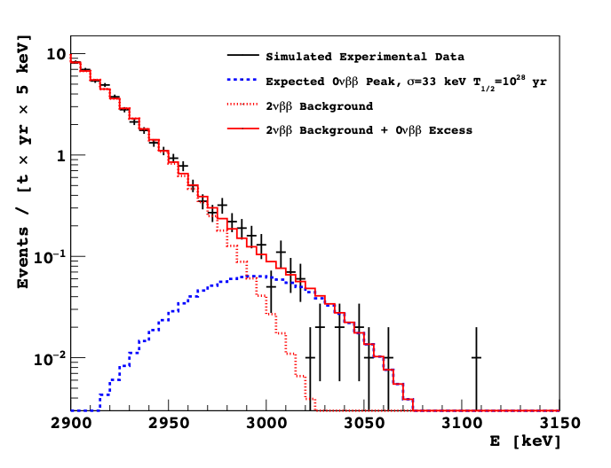
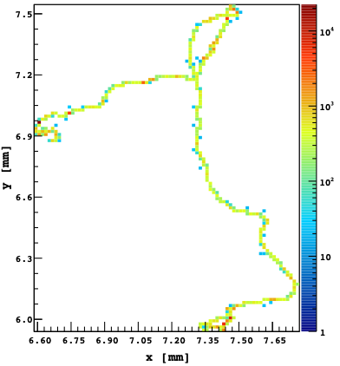
Selena 0𝜈𝛽𝛽 Detection
By reconstructing energy tracks of a 0𝜈𝛽𝛽 decay using spatial charge correlations, we can reject bulk background and achieve close to 1% energy resolution
Simulated data for 100 ton-year data exposure, 1.1% RMS res of Q_{0v𝛽𝛽} T_{1/2} =10²⁸ y in ⁸²Se

Slide 4
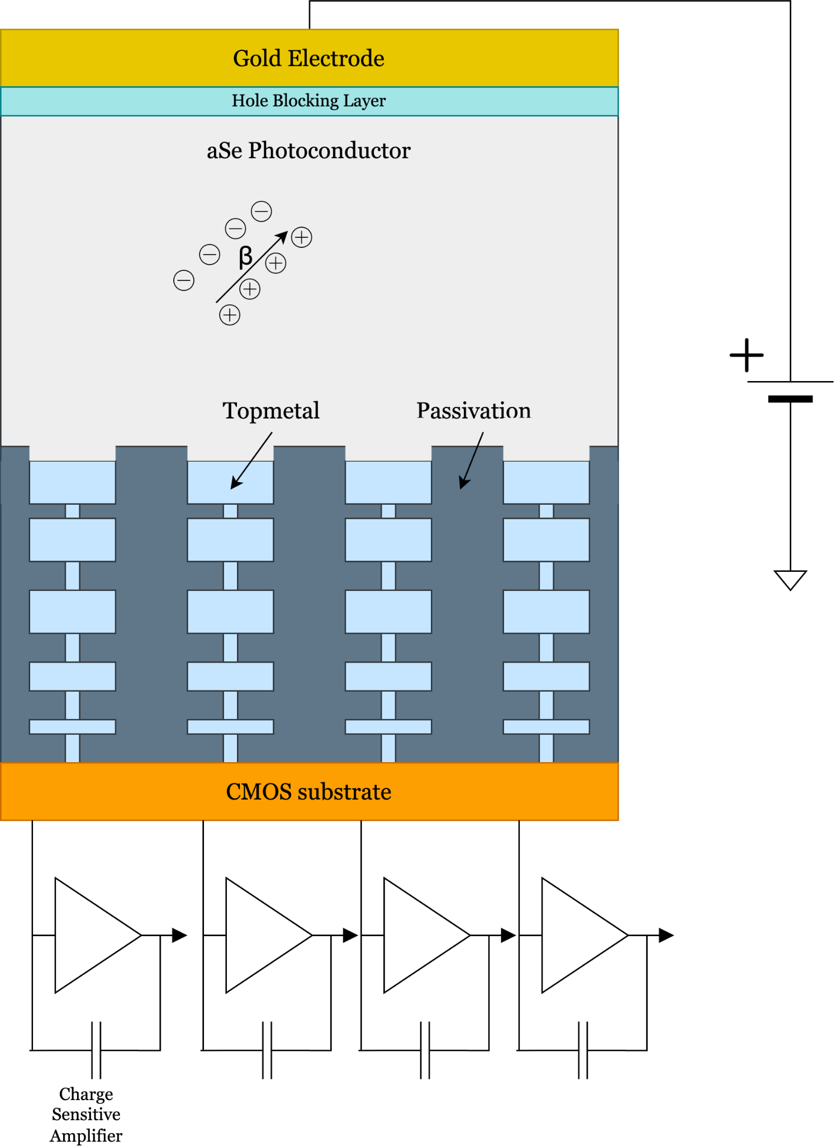
Hybrid aSe/CMOS Sensors
Amorphous Selenium
Easily deposited over large areas
Room temperature operation
Readout of drifted holes
CMOS Pixel Arrays
Low noise, fast readout
Industry standard
Fine pixel pitch achievable (O(10) um)
[4] https://doi.org/10.3390/qubs5040029

Slide 5



Production Pipeline
Chip Design & Simulation
Chip Production
Chip Packaging
Characterization & Electrical Testing
Selenium Deposition

Slide 6
PART 1
Chip Packaging

Slide 7
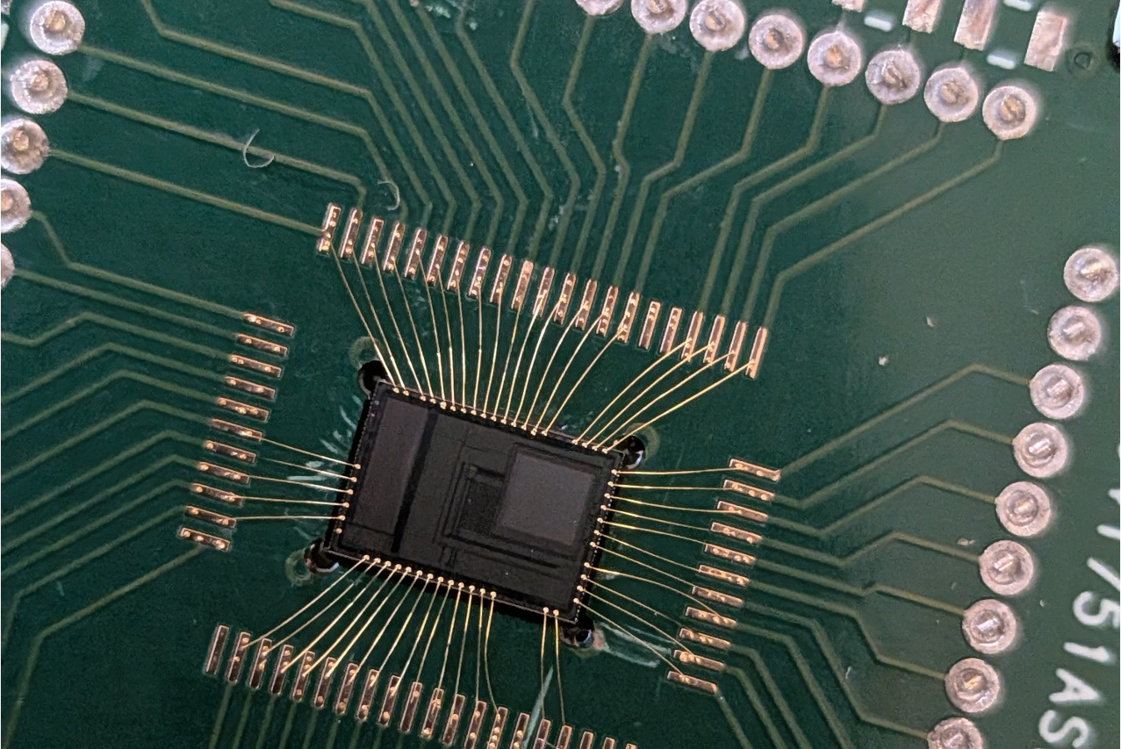
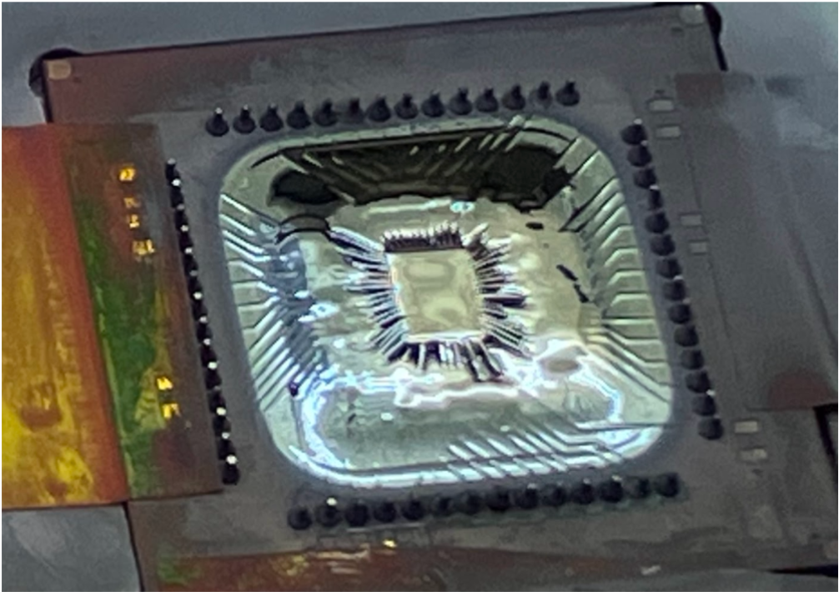
Chip Packaging
Gold wires are connected between the chip and PCB pads (e.g. used in integrated circuits)
Problems
  Unwanted leakage paths
  Irregular deposition near the edges distorting the electric field
Wire Bonding

Slide 8
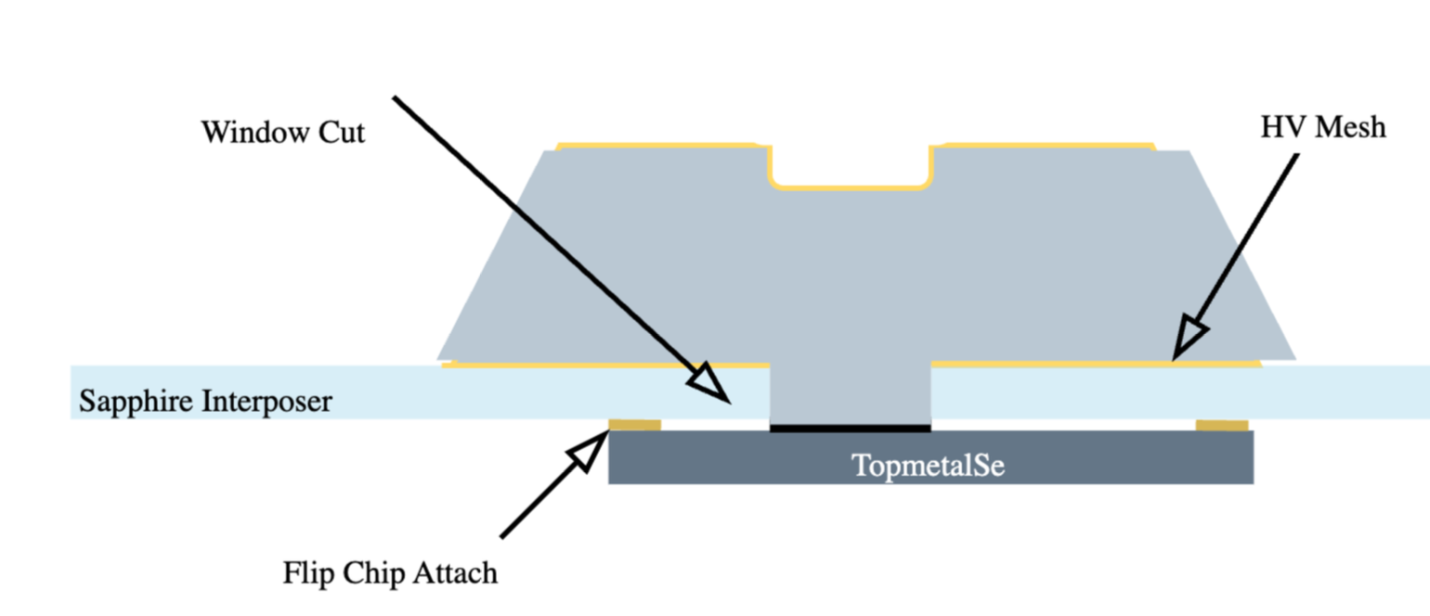
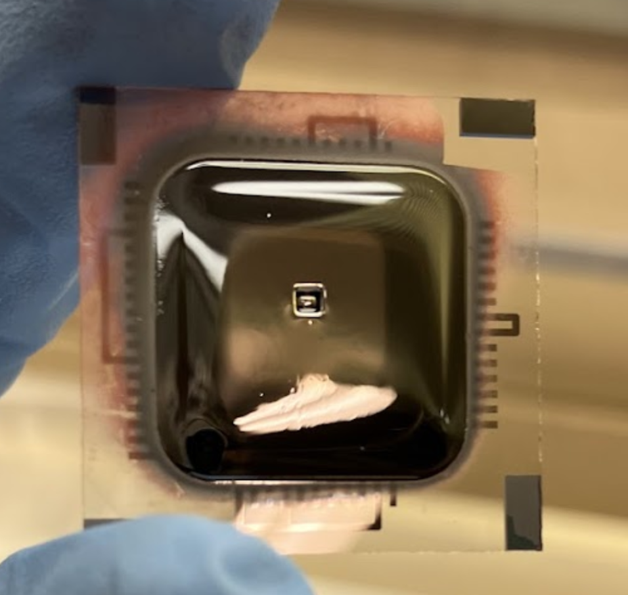
Chip Packaging (cont.)
Flip Chip Packaging
Chip and PCB pads are bonded to each other through a gold bump connection
Problems
  Harder to fabricate reliably
  Unreliable HV and electrode contact
  Pocket also created distortion of the electric field around the corner

Slide 9

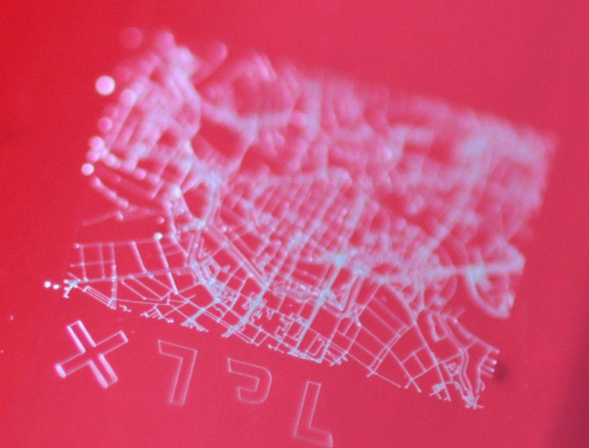
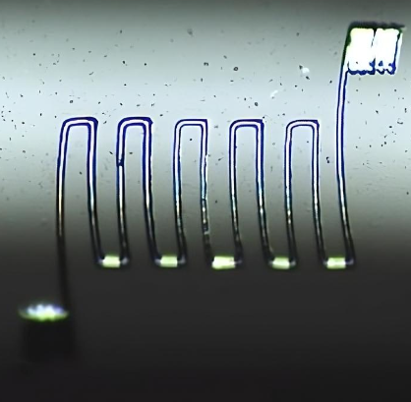
Introducing the XTPL Printer
Viscous silver nanoparticle inks extruded through 1–50 µm nozzles with variable speed control
Family of silver inks: inkjet/aerosol (IJ36, CL34), dense pastes (CL60, CL85), and new CL83 and LP84
Surface mapping, manual and scripted automation

Slide 10
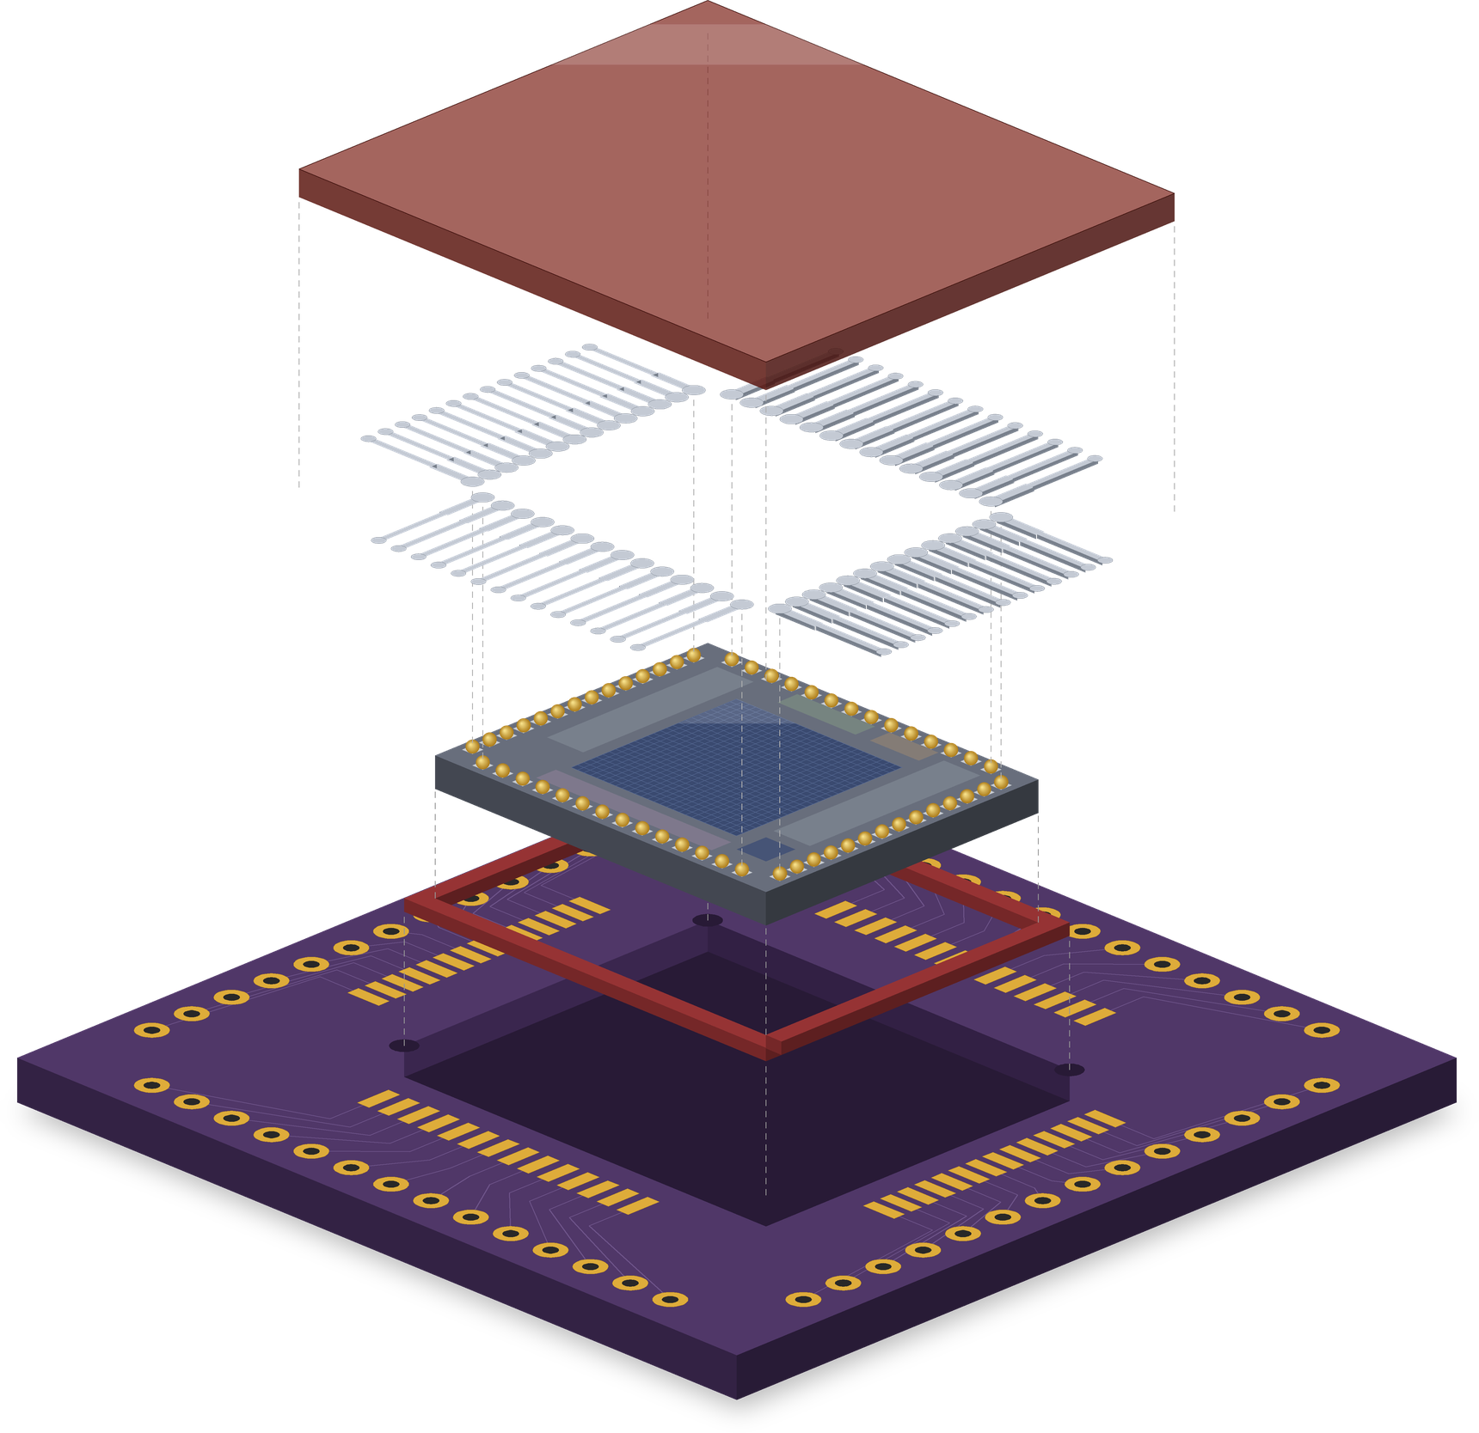
Changes to the chip/PCB setup
Amorphous selenium (aSe)
deposited over chip and traces
Printed silver traces
CL83 ink: studs → ENIG pads
Topmetal-Se RESPIN die
Al pads with gold studs
Resin fill
gap between die and pocket
PCB with ENIG pads
milled pocket: die sits flush
Front view (cross-section)
aSe layer
TopMetalSe
PCB
Printed Silver Trace
Resin gap
Exploded view, not to scale

Slide 11
PART 2
Printing Traces

Slide 12
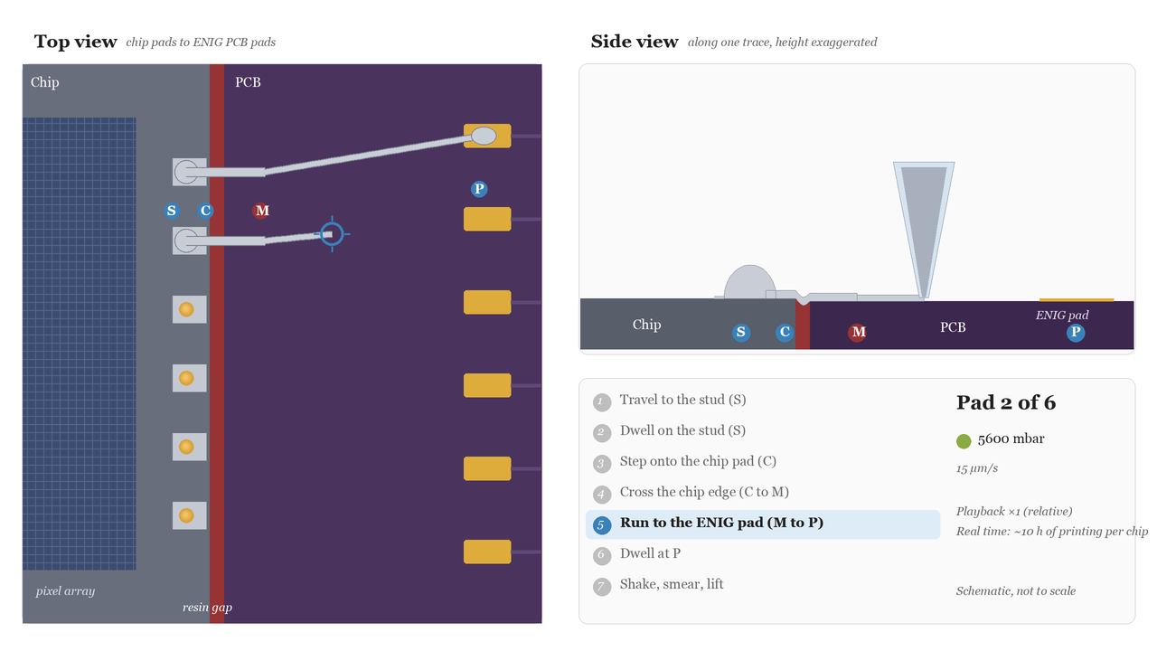
Mapping & Printing
S top of the stud C chip pad, between stud and edge
M C + 600 µm toward the P line P ENIG PCB pad
5 µm/s
Mapping
Manually store S, C, and P points, compute M
Printing
Dwell at S and P points
C → M 5 µm/s, M → P 15 µm/s
Full chip ≈ 12 h:
~2 h mapping & prep + ~10 h printing

Slide 13
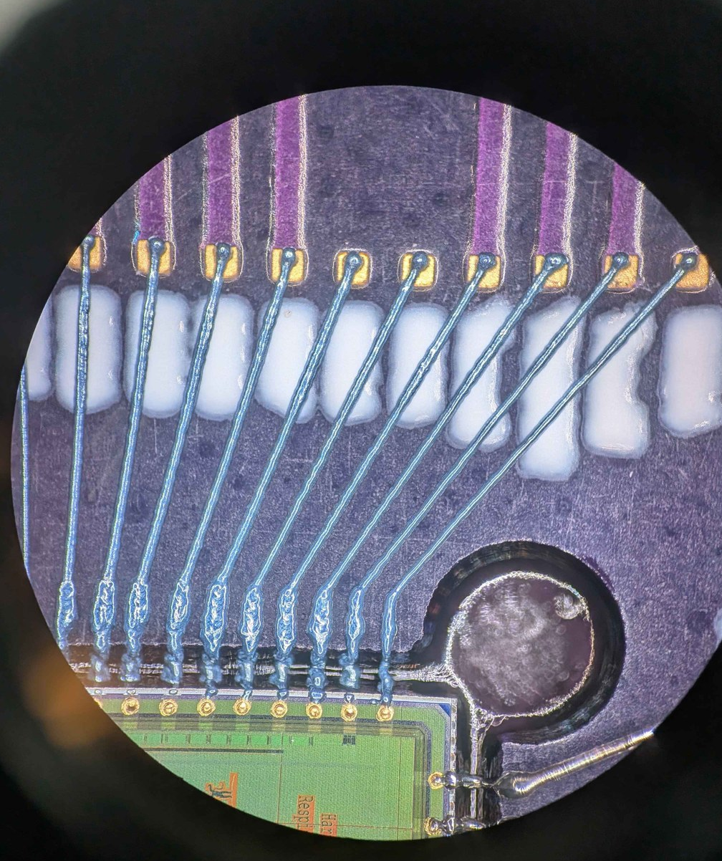
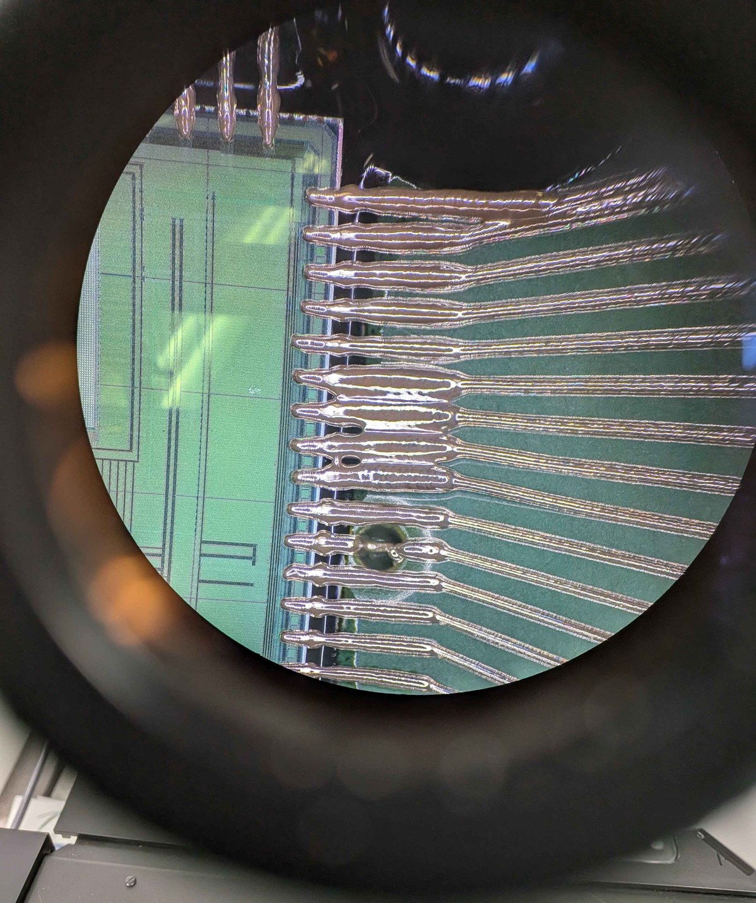
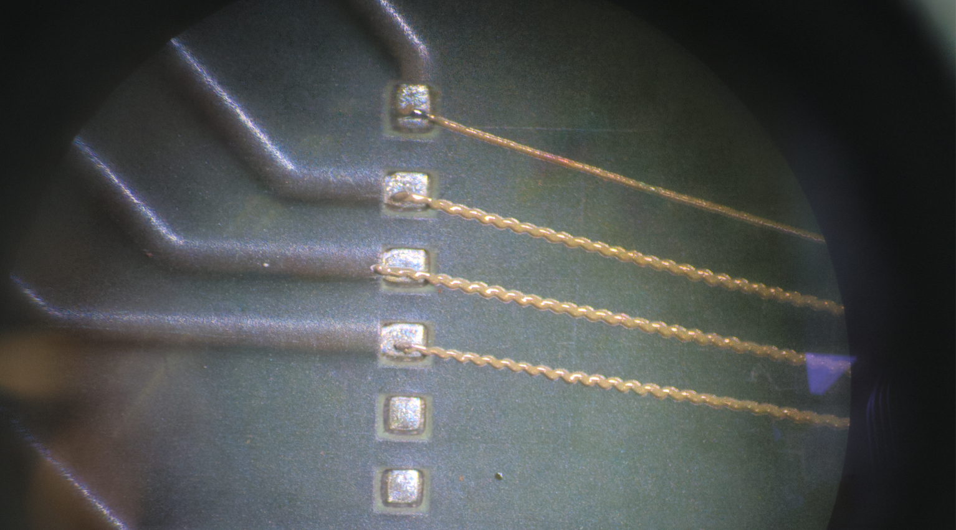
Tuning for Good Traces
 | First tests | Now
Nozzle | 45 µm: brittle, wide lines bridge | 20 µm: sturdy, paste-like flow
Ink | CL85 paste: clogs, brittle | CL83: flows, less cracking
Pressure | 6700–8000 mbar: lines widen, bridge | ~5400 mbar (min + 200)
Speed | one speed for the whole trace | 5 µm/s at the chip, 15 µm/s on PCB
Curing | 250 °C, 10 min: micro-cracks | 150 °C: 10 min ramp, 30 min hold, slow cool
PCB pads | tin, ~5 mm away: 30–50 Ω | ENIG, 2.3 mm
Pressure sweep
Trying 45 um nozzle
Wiggly prints

Slide 14
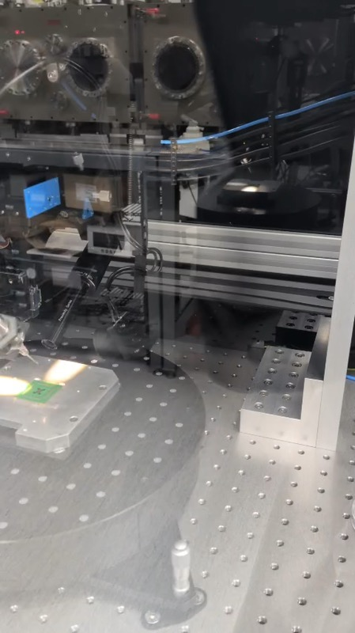
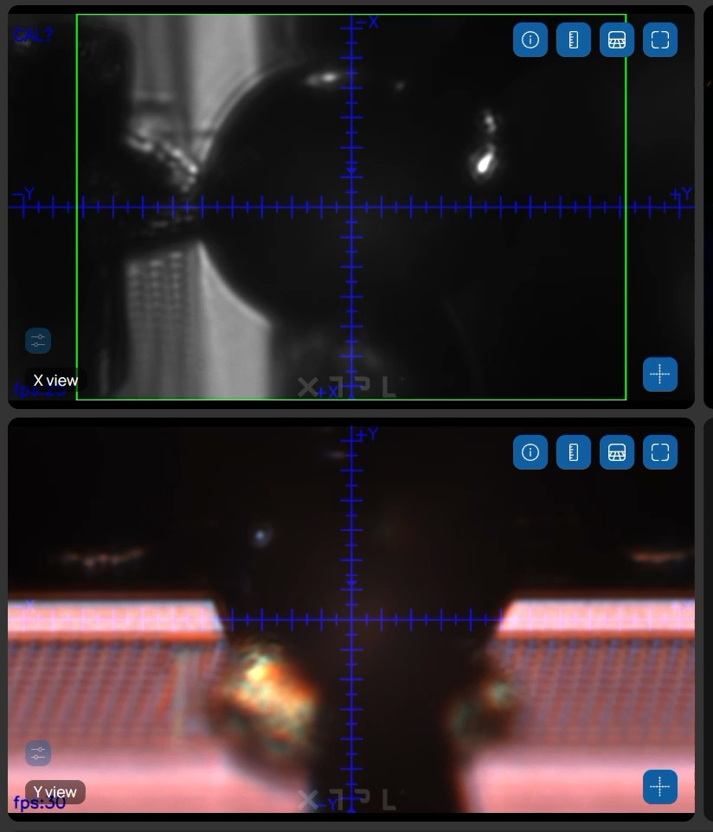
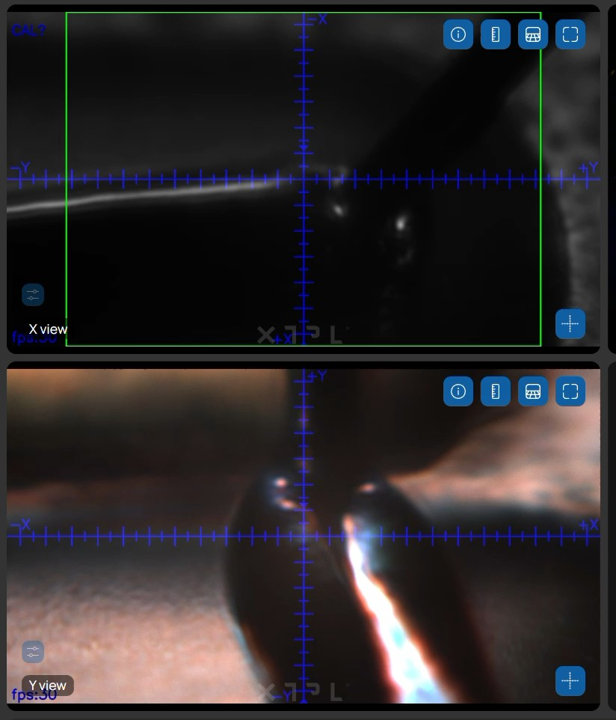
Printing in Action
The printer, zoomed out
Over a gold stud
Arriving on the ENIG pad

Slide 15
PART 4
Results

Slide 16
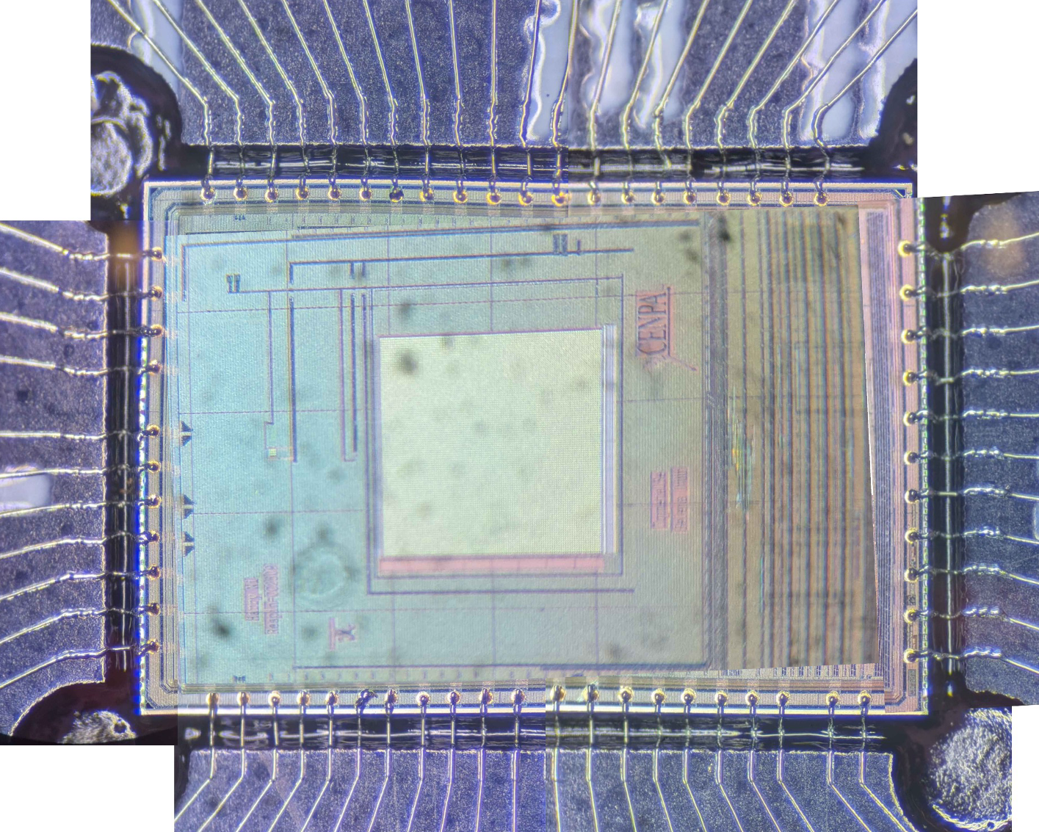
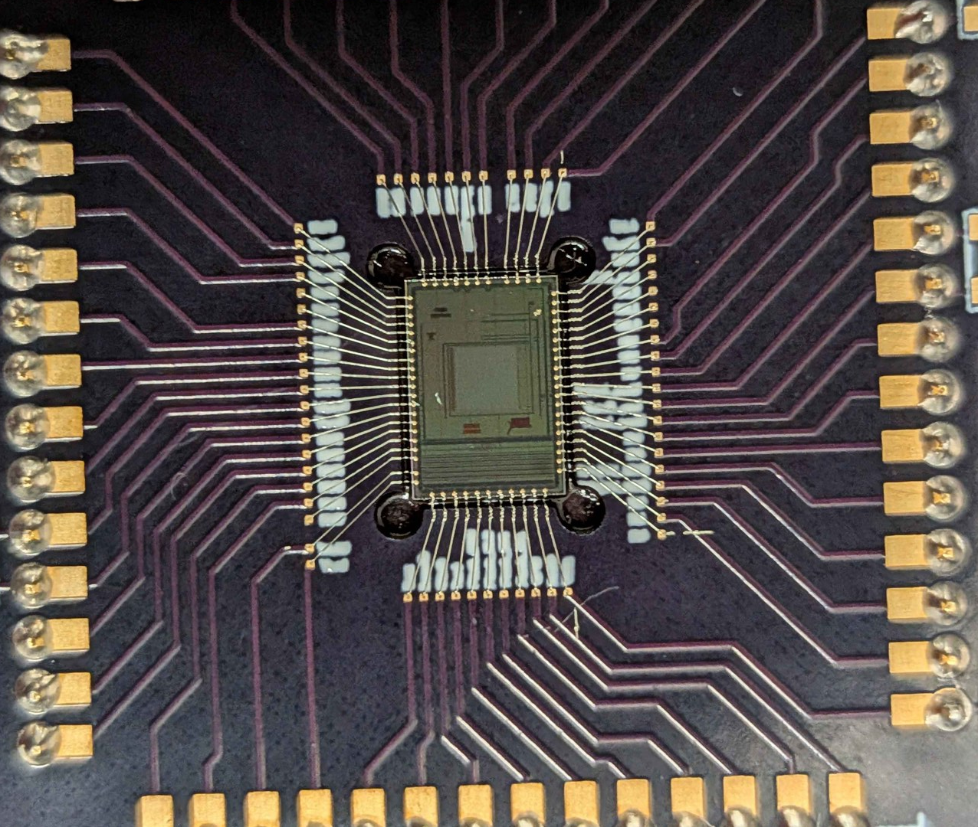
First Fully Printed Chip

Slide 17
Continuity: PCB Pin to Gold Stud
54/54
measured traces conduct
15 Ω
median (range 9–50 Ω)
30 / 20 µm
line width at chip / on PCB

Slide 18
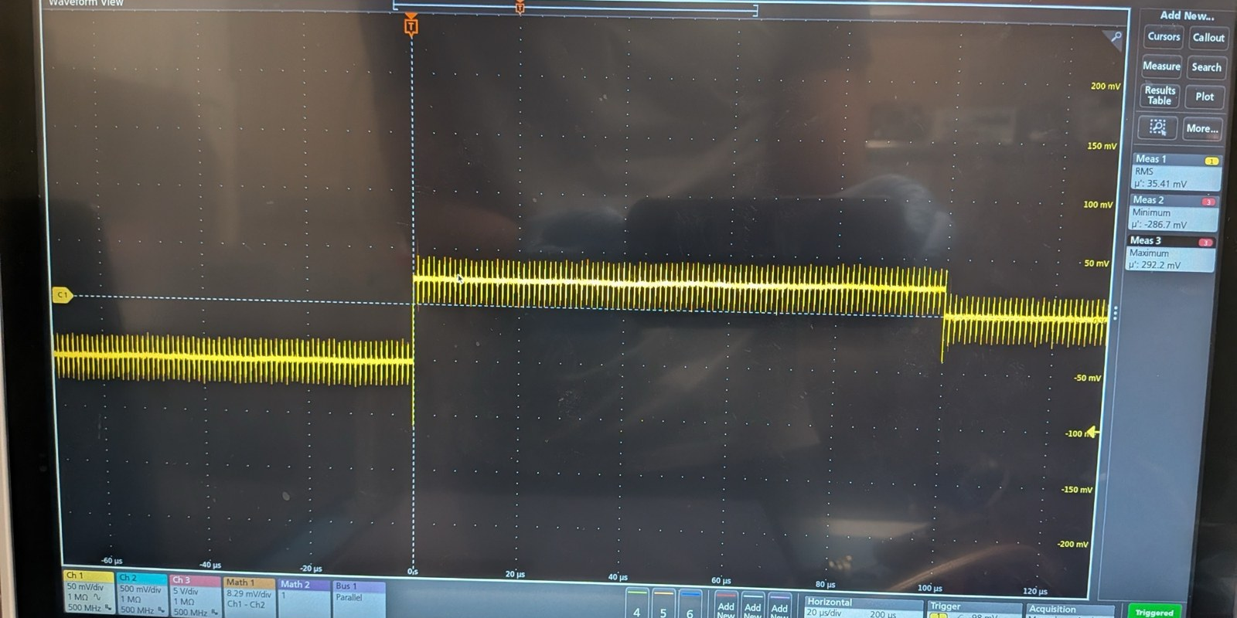
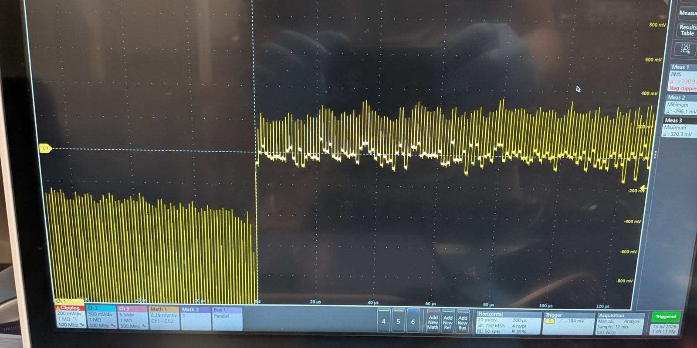
Response of the chip
What works
Chip ID read-back and firmware demo on the Caravel SoC
Analog biases match a known-good chip
3×3 test array responds to light
What does not
Large-array output flat; no guard-ring pulse response
LA_OUT and ROW_SEL1 shorted to VDDIO, found by probing through the studs
Likely Cause
The current stud recipe could cause mechanical stress on pads and cause internal shorts due high ultrasonic power
Responds, but no proper clocking
Wirebonded chip, normal pixel clocking

Slide 19
Summary & Next Steps
Where we are
Next
• Repeatable 20 µm printing with CL83 on studded pads and ENIG PCBs
• Two-script mapping + printing workflow; full chip in ≈ 12 h
• Every measured trace is conductive
• Printed chip boots; internal shorts likely from stud-bonding stress
• Print and test chips with 150 °C studs
• Stud yield → 100% with a gentler 150 °C recipe
• Deposit aSe on a printed assembly
≈ 12 h
54 / 54
30 µm
2.3 mm
2 h mapping + 10 h printing
measured traces conduct
trace width at the chip pads
Trace length (was ~5)

Slide 20
Thanks!
Special Thanks to:
Harry Ni
Alvaro Chavarria
Marcel Conde
Sarice Jones (Washington Nanofabrication Facility)
Joey Law, David Peterson, Nate Miedema, Ryan Roehnelt
Jeff DiCorpo (ChipFoundry), XTPL application team

Slide 21
BACKUP
Backup Slides

Slide 22
Nozzle and Pressure
Extrusion pressure (mbar), 20 µm nozzle, CL83 ink
5400: full chip
no / weak flow
uniform
wider lines
bridging
5000
5500
6000
6500
7000
7500
8000
Sep 16 sweep: 5600 → 6400
 | 45 µm | 20 µm (current)
Top print speed | Faster (15–25 µm/s) | Slower (5–15 µm/s)
Nozzle | Brittle: chipped on touching the PCB | Sturdier: tolerates few-µm surface irregularities
Ink flow | Flows freely, honey-like | Paste-like, holds its shape
Line width | ~40 µm, grew to ~60 µm as the tip chipped | ~20–30 µm, set by speed
Trace resistance | Lower (much thicker traces) | Higher, still conductive (median 15 Ω)
Main risk | Ink bridging neighbouring traces | Slower print; chipped tips lose flow control
20 µm line width
 | 5 µm/s | 15 µm/s
5400 mbar | ~30 µm | ~20 µm
8000 mbar | 30–40 µm | ~30 µm*
* sometimes wiggly
• Flow starts at ~5000–5400 mbar, drifts day to day
• Test traces each session, print at min + ~200 mbar

Slide 23
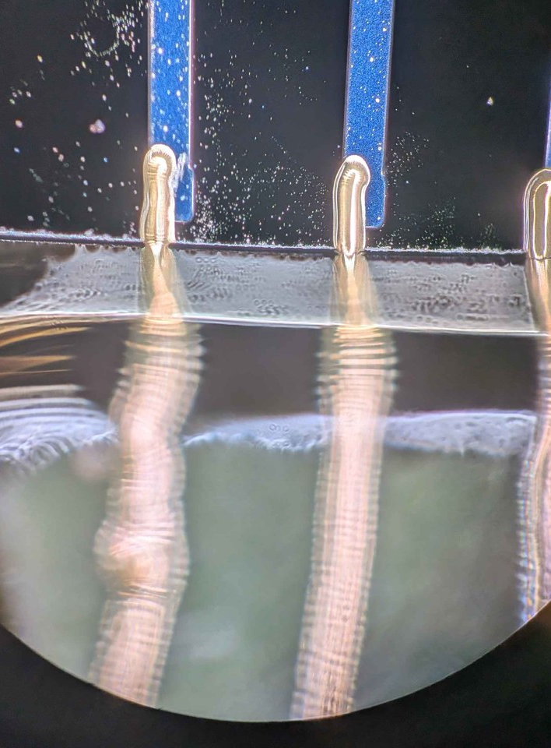
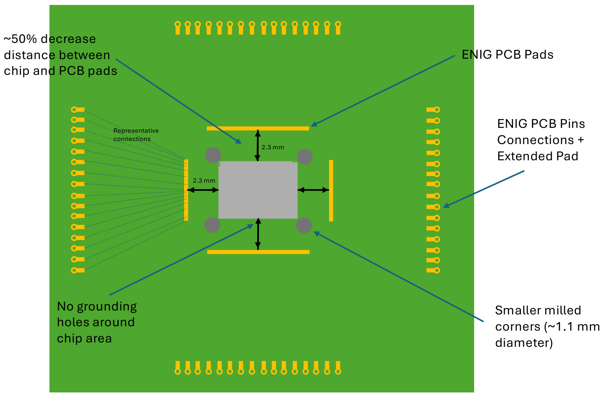
Ink, Curing and PCB
Curing profile
Ink
 | CL85 (before) | CL83 (now)
Type | Paste, 82 wt% Ag | For 3D topography
Viscosity | > 100 000 cP, thickens with age | Lower: less clogging
Cured trace | Brittle | Less cracking over steps
Status | Datasheet available | Pre-production, no datasheet yet
PCB redesign
250 °C: cracks
• ENIG pads: gold for the ink
• Chip-to-pad 2.3 mm (was ~5): print time halved
• No grounding vias near the chip
• Extended pads for wire bonds
• 250 °C, 10 min: micro-cracks break the whole trace
• Now: 10 min ramp to 150 °C, 30 min hold, ~30 min slow cool
• Less thermal-expansion stress and shock
• XTPL: OK; may cure further at high current (not our case)

Slide 24
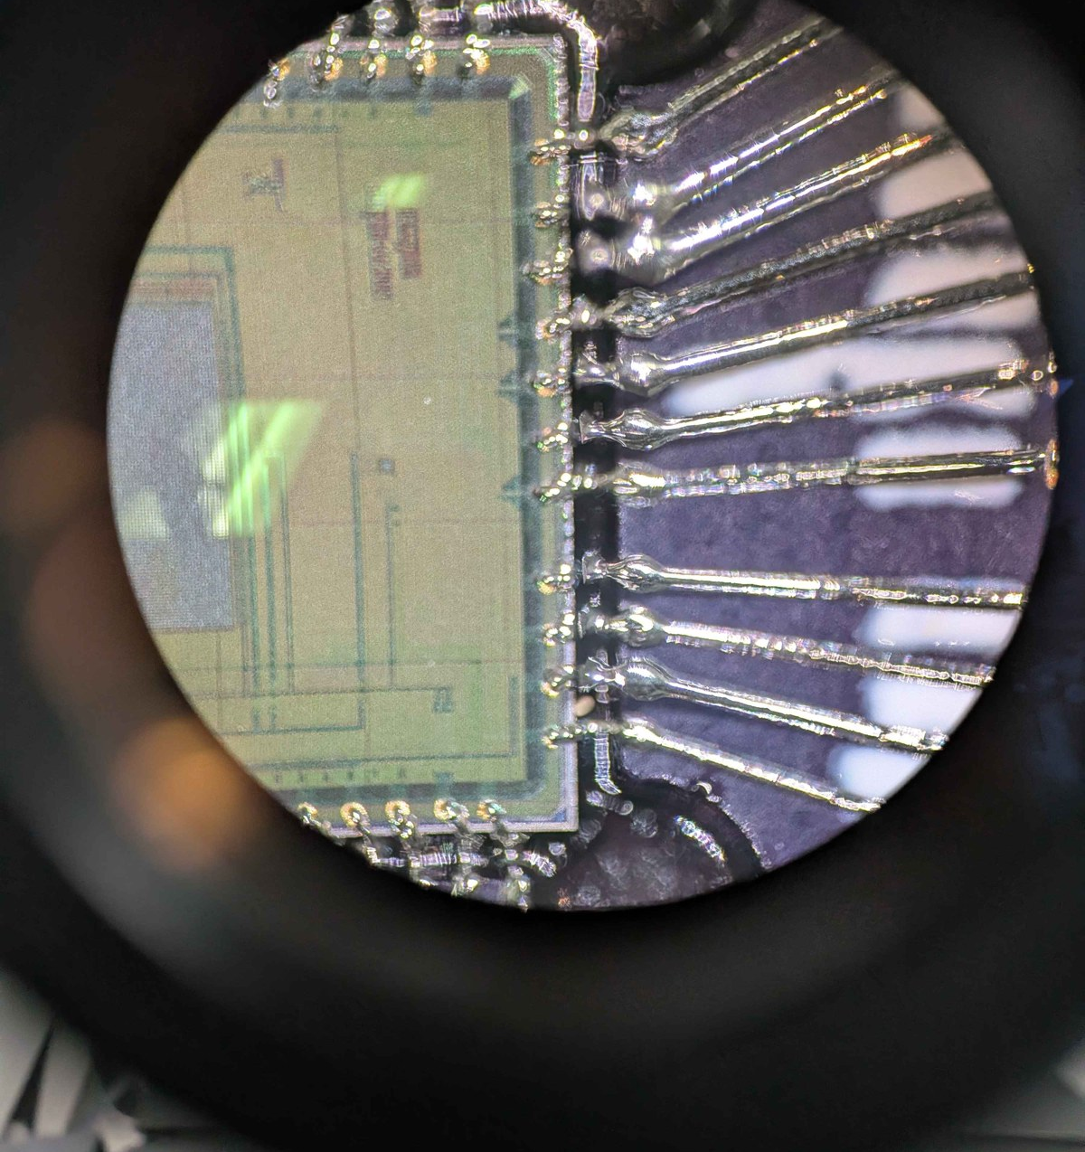
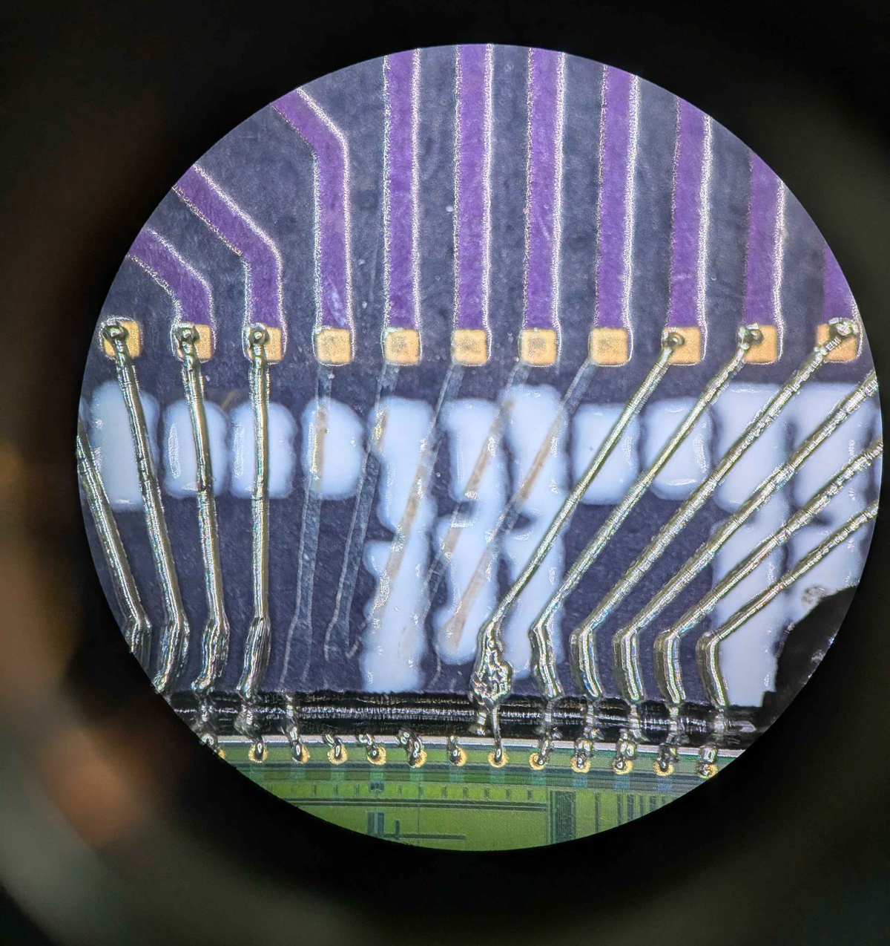
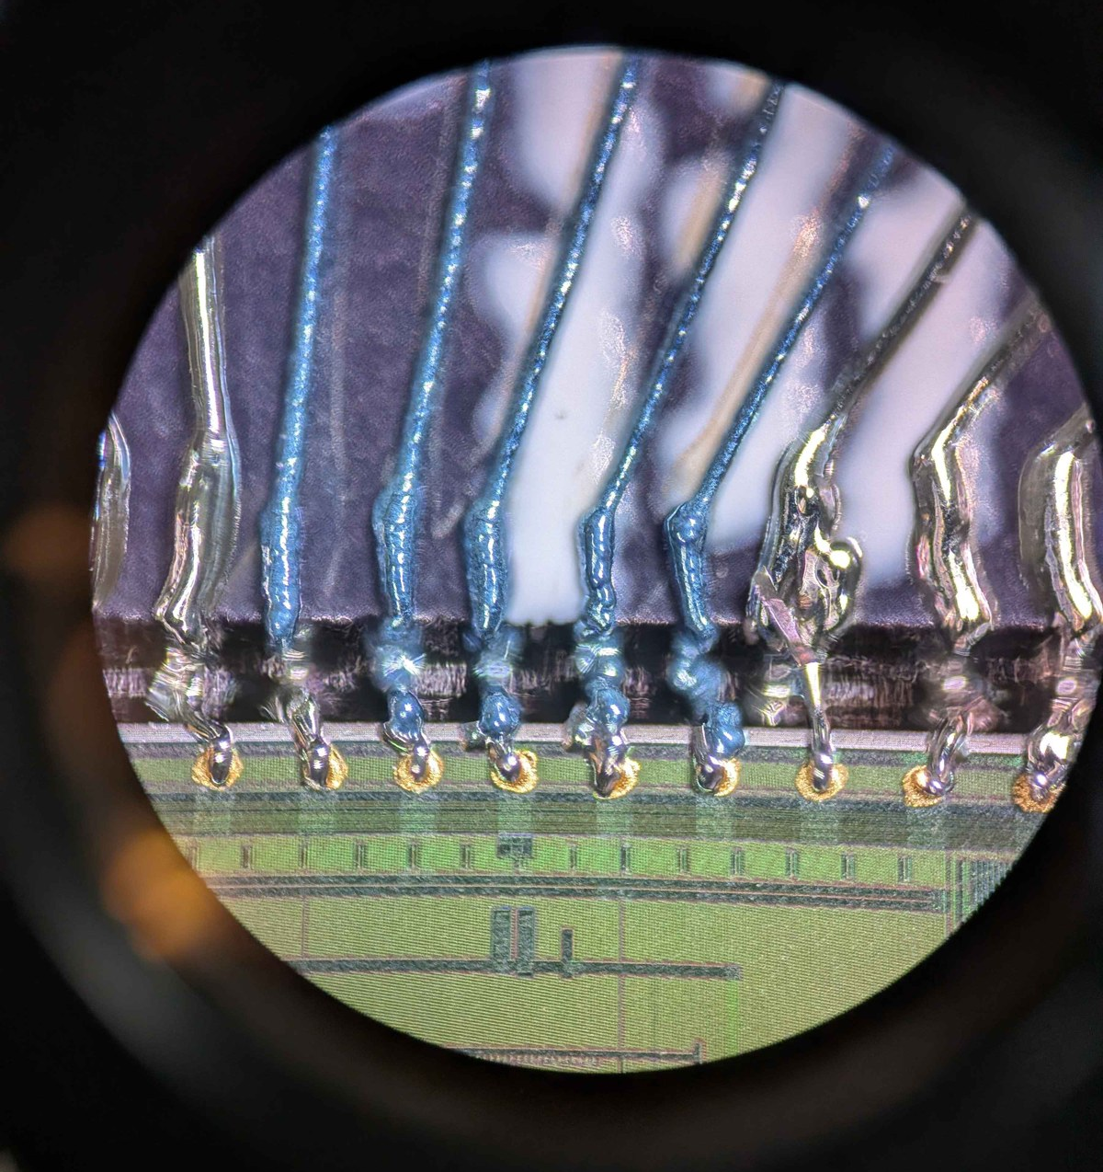
Repairing a Broken Trace
Broken traces
Removed by shear after curing
Reprinted
1 Cure the sample (liquid ink only smears)
2 Shear the trace off: it lifts cleanly with the broken pieces, sometimes in segments
3 Reprint the trace and cure again
Joining instead: add extra ink over the break, print as usual; conduction returns after curing

Slide 25
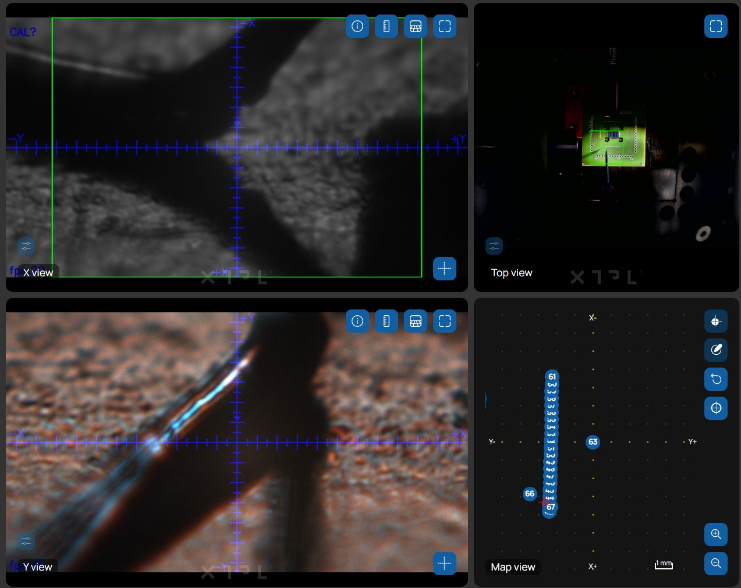
XTPL Printing Software

Slide 26
Evolution of the Printing Scripts
XTPL examples
Starting point
Group printing
Spring 2026 · original chip
Trace + top-up
Sep 9 · ENIG PCB
S–C–M–P
Sep–Oct · current
• A→B line between two saved points
• Map N-point paths, expand into groups, print
• Touch-based surface mapping
• Follow a measured z-profile
• Mapped chip & PCB points per pad
• Fixed speed / pressure per trace
• 45 µm, then 20 µm nozzle
• Automated C→M→P trace
• Ink added on each stud by hand
• 11 pads: 40 min map + 1 h print + 40 min manual
• Stud top (S) mapped; dwell replaces manual step
• M computed, not mapped
• Resume from any pad, time estimate
Manual alignment per trace → mapped once, printed unattended. Current scripts: save_print_points.xtpl + print_print_points.xtpl

