Slide 1



Synthetic Pixel-Detector Data for SNN Training with TCAD, Allpix² and NEUROPix
Sebastian Hortua, Aaron Young, Alice Bean, Amanda Steinhebel, Andrew Nicholson, Jessie Harris, John Sparger, Kailyn Mack, Katie Schuman, Larry Zhang, Mathieu Benoit, Pranay Damuka, Seth Johnson, Shruti Kulkarni, Stefan Spanier, Thomas Evans
10-22-26
University of Kansas
Acknowledgements:
This work was supported by Department of Energy Genesis Mission Grant
“NEUROPIX: A Neuromorphic computing framework for Pixelated detector data processing”
- Oak Ridge National Laboratory, University of Tennessee Knoxville, University of Kansas

Slide 2
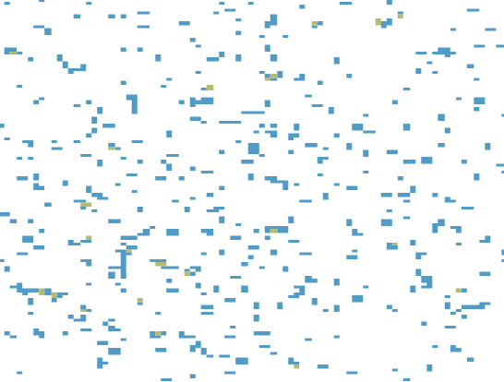
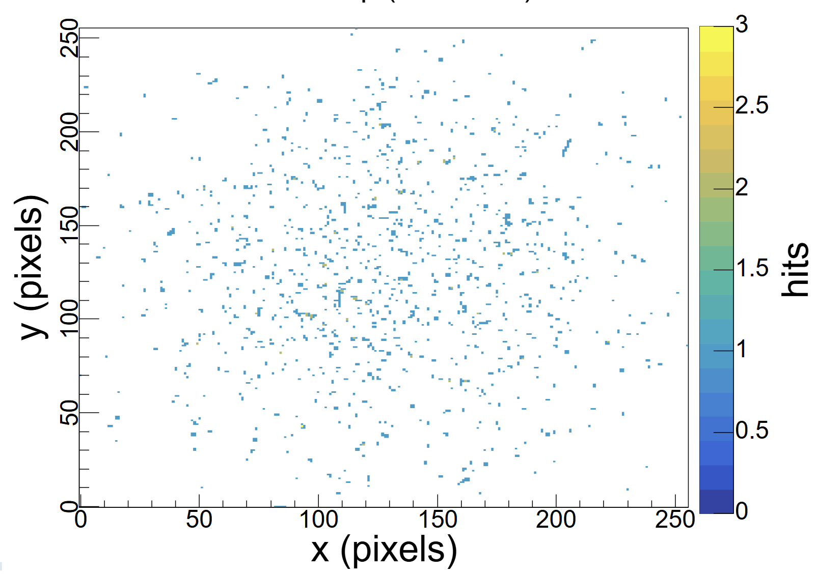
NEUROPix
Framework for pixelated detector data processing
Goals:
  Clustering: Five-Dimensional (5D)
    Use position, charge, and “time” to cluster particle hits
  Classification
    Determine particle ID from cluster information
  Interpolation
    Estimate real-valued cluster properties, e.g. sub-pixel hit position
Pixel hits by position
Notes:
Current goal 5D clustering, further away goals, PID, ….

Slide 3
NEUROPix
Problem: too much data to be moved offline for processing
Our Solution: Use SNNs to move processing closer to detector (edge)
On Detector
Data
Collect charge for pixels only over # threshold
Digitize
Off Detector
Find cluster position (cluster algo), energy, tracking, AI
EDGE
ASIC
FUTURE
NOW
Pixel (x,y)
Charge
011011100
Time
Why Spiking Neural Networks (SNNs)?
    need fewer parameters
    provide better latency
    Results in lower power consumption
    More on this in next talk
Notes:
Current goal 5D clustering, further away goals, PID, ….

Slide 4
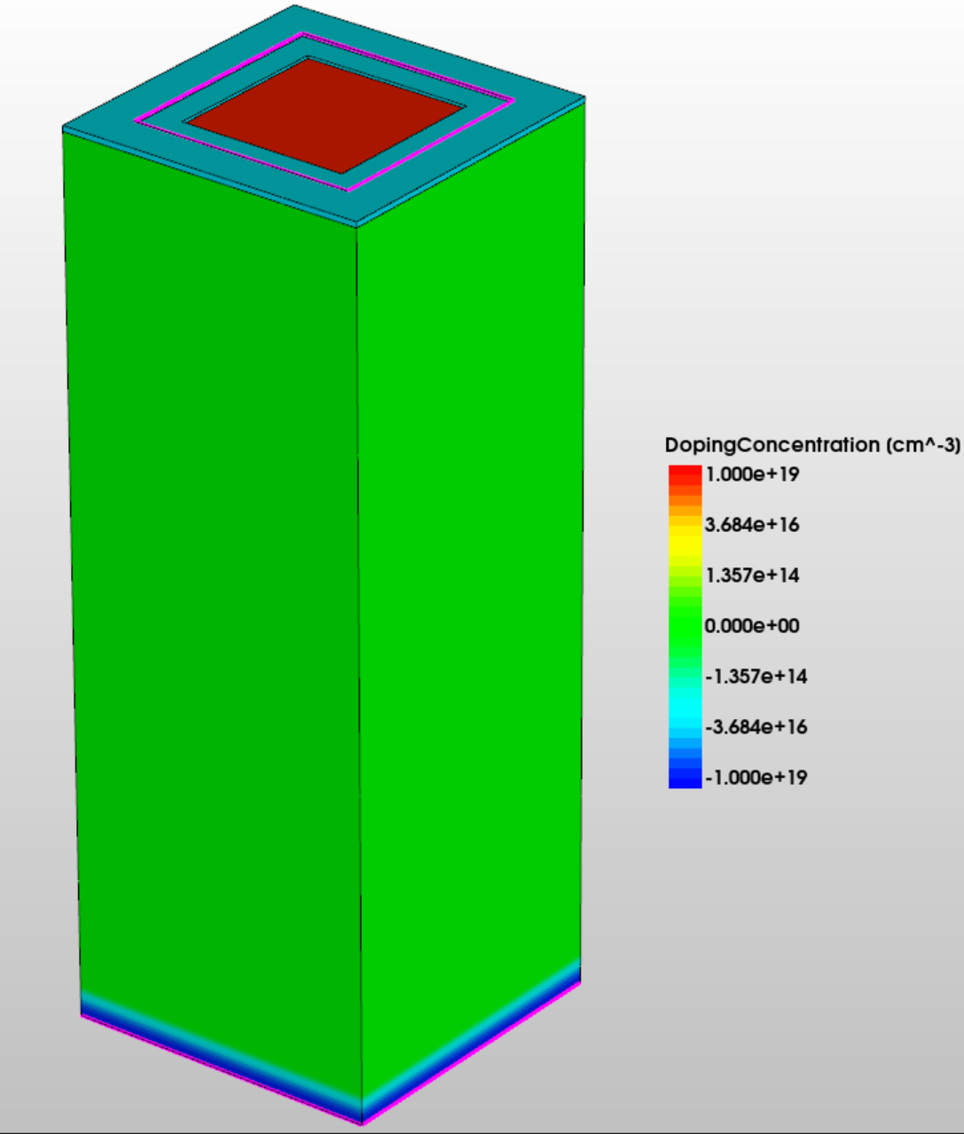
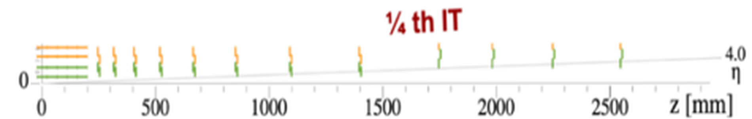
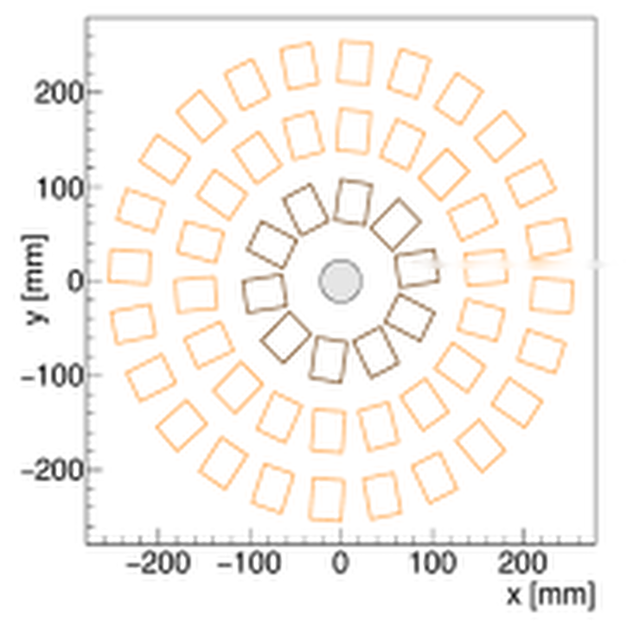
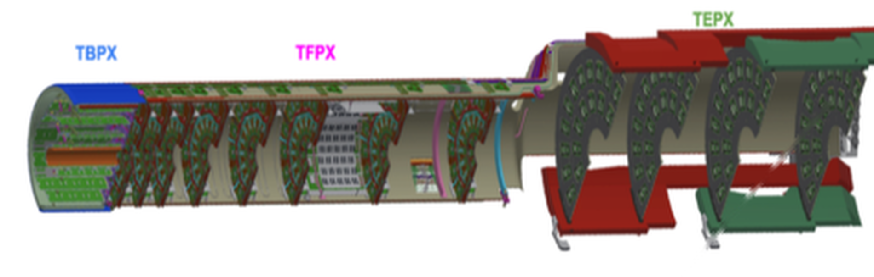
Two Example Applications
Generic pixel sensor used with Timepix4 simulations
Timepix4 chip for beam tests, electron microscopy, …
  Time resolution of ~200ps
  Unlocks 5D clustering
CMS Pixel Detector
  Will count clusters in tracker endcap module for luminosity
https://iopscience.iop.org/article/10.1088/1748-0221/17/01/C01044
TEPX Disk 4

Slide 5
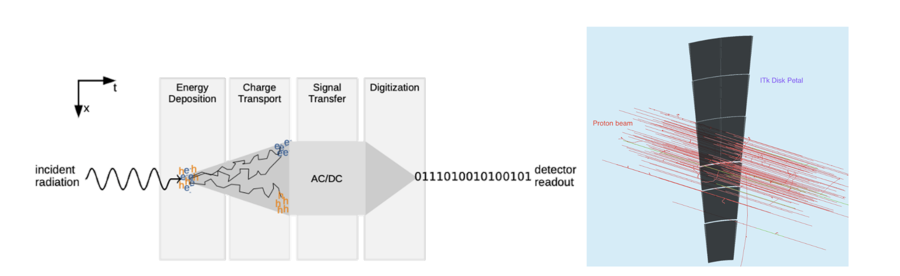
Need Realistic Simulations to Train SNNs
Use Allpix² with technology computer-aided design (TCAD) simulations
Notes:
Notes: Inject TCAD into this pipeline instead of generic Allpix^2 for charge transport
Need more detailed electric field sims to simulate pulse shape

Slide 6
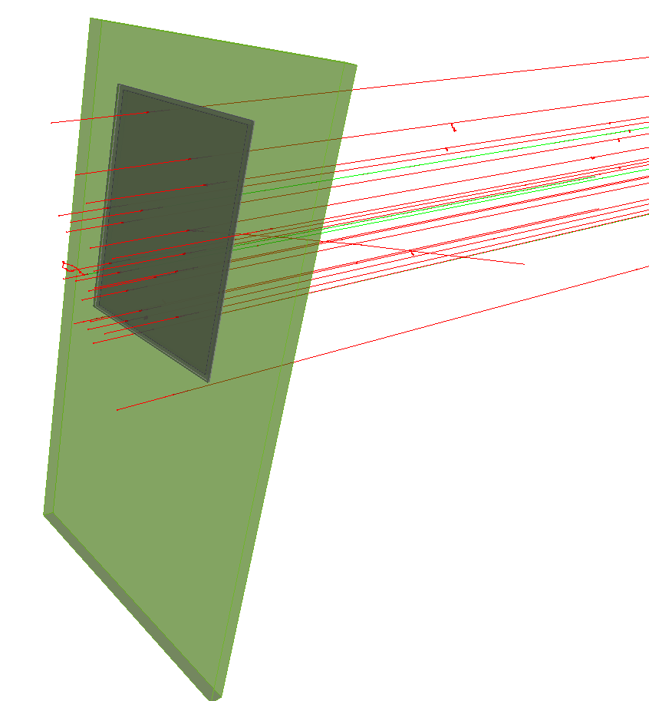
Geant4 inside Allpix²
Geant4 simulates ionization, delta electrons and scattering inside of different materials
Tracks energy loss at each step
Timepix4 event simulation
Limitation: need to understand detailed electron/hole movement through electric field for individual pixels
J. Allison et al., "Geant4 developments and applications," in IEEE Transactions on Nuclear Science, vol. 53, no. 1, pp. 270-278, Feb. 2006, doi: 10.1109/TNS.2006.869826.

Slide 7
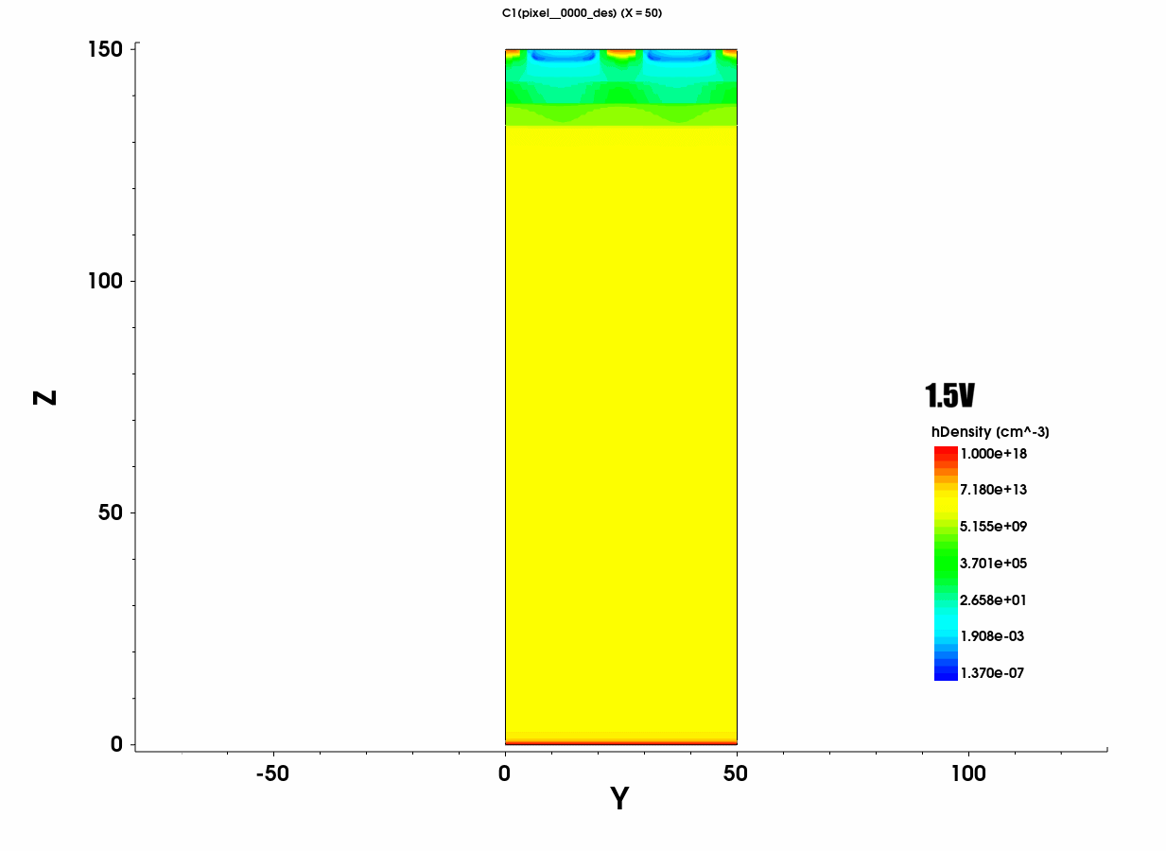
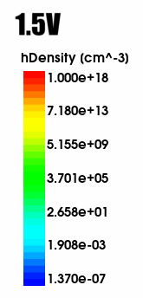
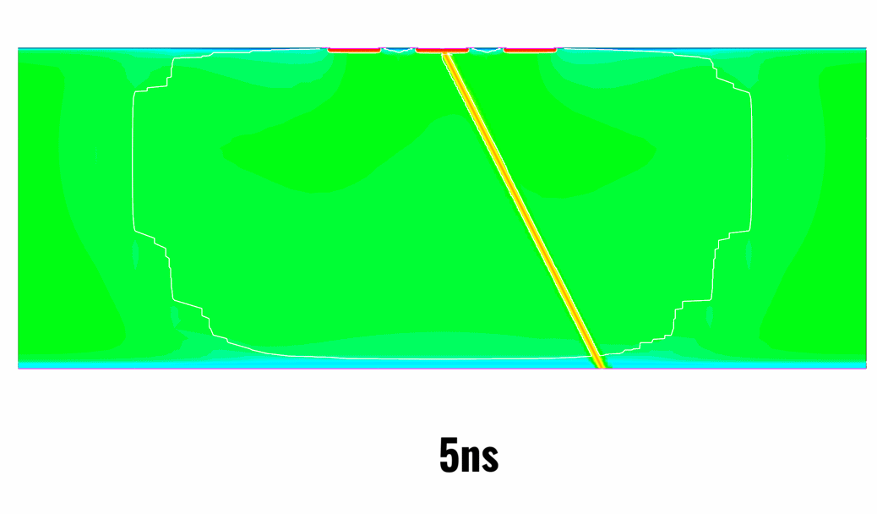

Device Simulations to get Electric Fields: TCAD
Solves Poisson’s equation + electron/hole continuity equations
Inputs: geometry, doping profiles, bias voltage, and physics models (carrier mobility, recombination)
Outputs: electric field, electrostatic potential, and carrier densities
TCAD
TCAD animation of charged particle traversing sensor
TCAD simulation of charge density as function of bias voltage

Slide 8
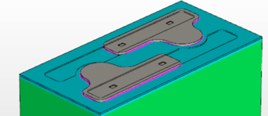
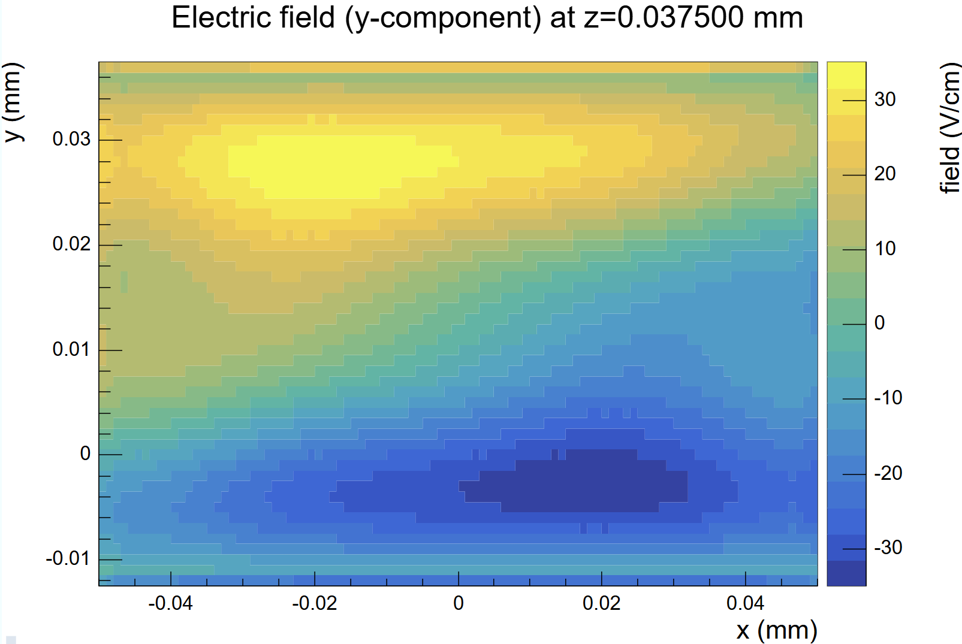
Realistic Model of Electric Fields from TCAD
Two field maps are taken from TCAD:
  Electric field: how charges drift
  Weighting (Ramo) potential: physical model of how charge is induced on a given electrode for given geometry
Allpix² imports both maps, replacing generic fields
Next step: radiation damage
100um
X
Y
50um
50um
Thanks to CMS collaborators, including Joern Schwandt and Bianca Raciti at the University of Hamburg
https://ediss.sub.uni-hamburg.de/handle/ediss/12084
Y
X
100um
Electric field simulation of CMS sensor
Notes:
Write out full names and cms colab for the thank you

Slide 9
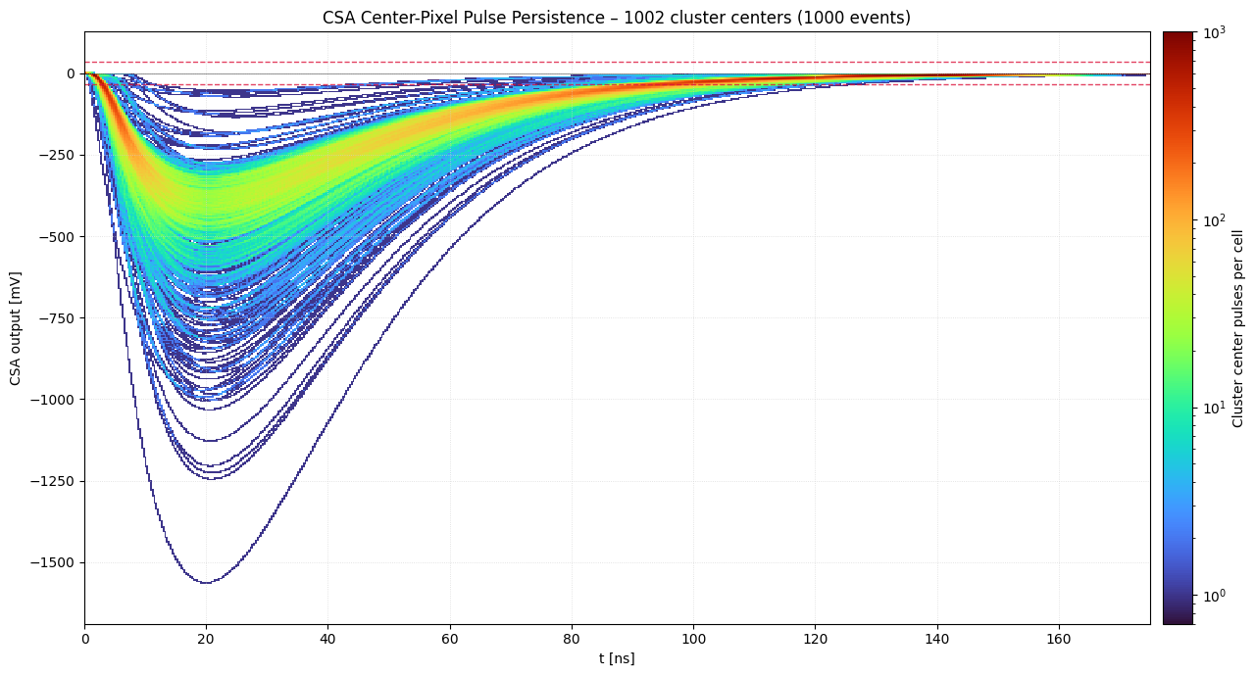
Charge Propagation and Signal Formation
Charge carriers are now tracked through the TCAD field at each step
  Without TCAD, charge is just attributed to the pixel
At each step, induced current is found from moving charge and the TCAD weighting potential (Ramo–Shockley)
Current travels from pixel through bump bond, to the readout chip
Induced current builds up a full pulse shape on each pixel
Threshold
Time over Threshold
Time of Arrival
Persistent plot of voltage vs time for each center pixel on timepix4 chip
Notes:
Add flash slide shoing linegraphs from allpix^2

Slide 10
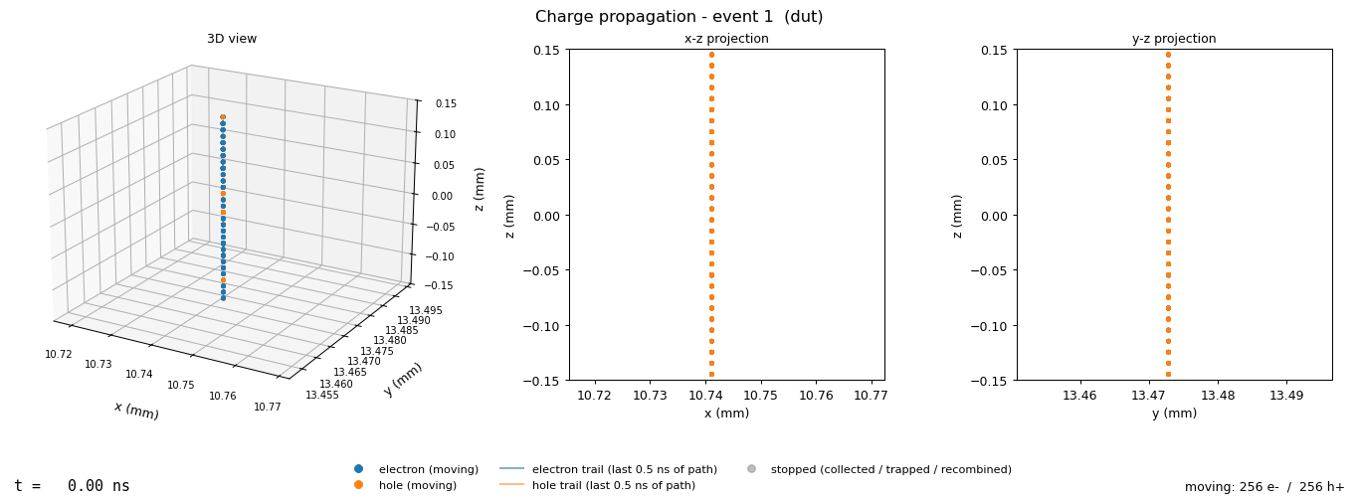
Linegraphs
10/19/2026
Notes:
Add flash slide shoing linegraphs from allpix^2

Slide 11
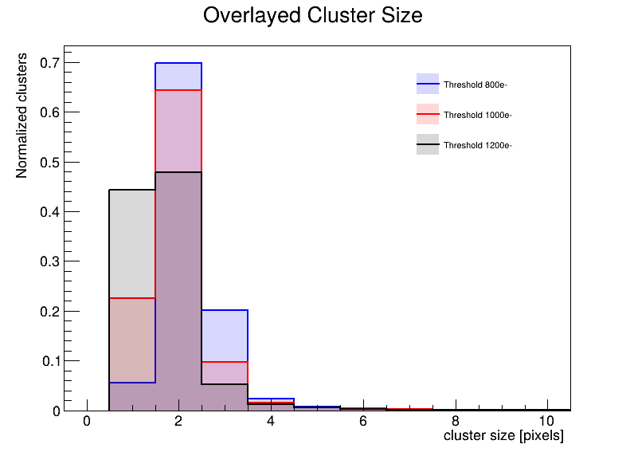
Allpix²: Digitization
Converts accumulated analog pixel charges into digitized discrete hits
Digitizer module adjusts thresholds, time resolution, and electronic noise for the chip being simulated
  E.g., CROCv2 and Timepix4 chips
Custom digitization is a unique feature to Allpix²
Threshold variation study for CMS sensor with CROCv2
Notes:
Highlight how allpix is special bc adjustable digitization variables

Slide 12
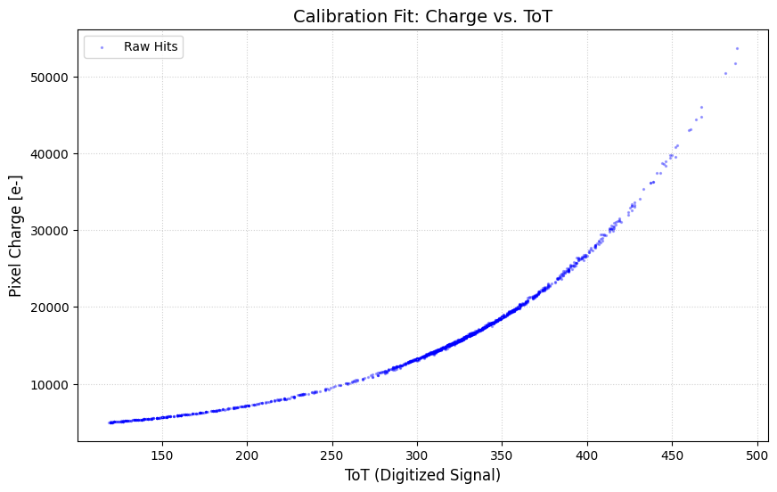
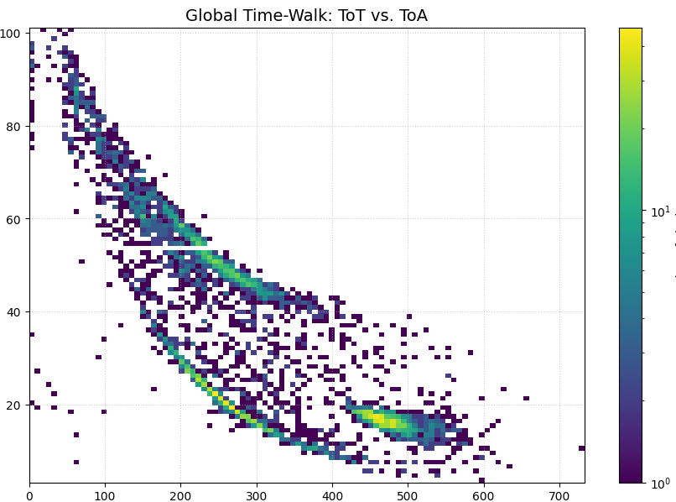
More Precise Timing Enables 5D Clustering
Plot of Charge vs ToT
ToT (time-over-threshold): related to charge collected
ToA (time-of-arrival): helps decide which pixels belong to the same cluster
Timewalk: small pulses cross threshold later than larger ones, so ToA arrives late
The threshold sets how strong timewalk is
  point of focus to study
Variables being used to study cluster algorithms and SNNs
Electrons at 5.2 GeV
Charge
ToT
Timewalk effects
ToA
Number of Pixels
ToT
Plot of ToT vs ToA

Slide 13
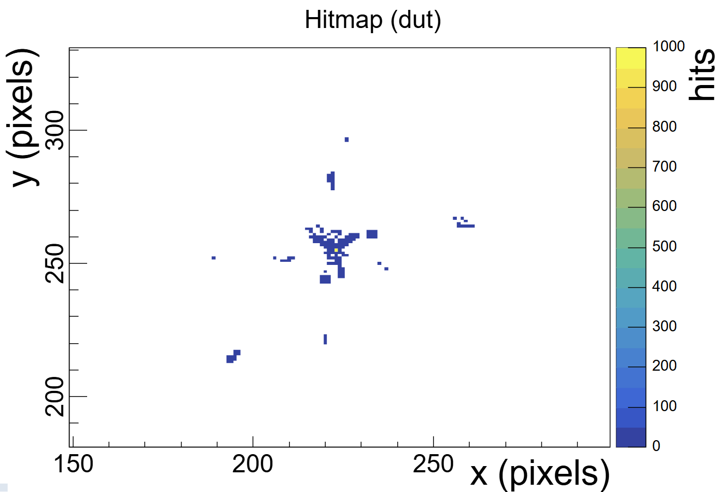
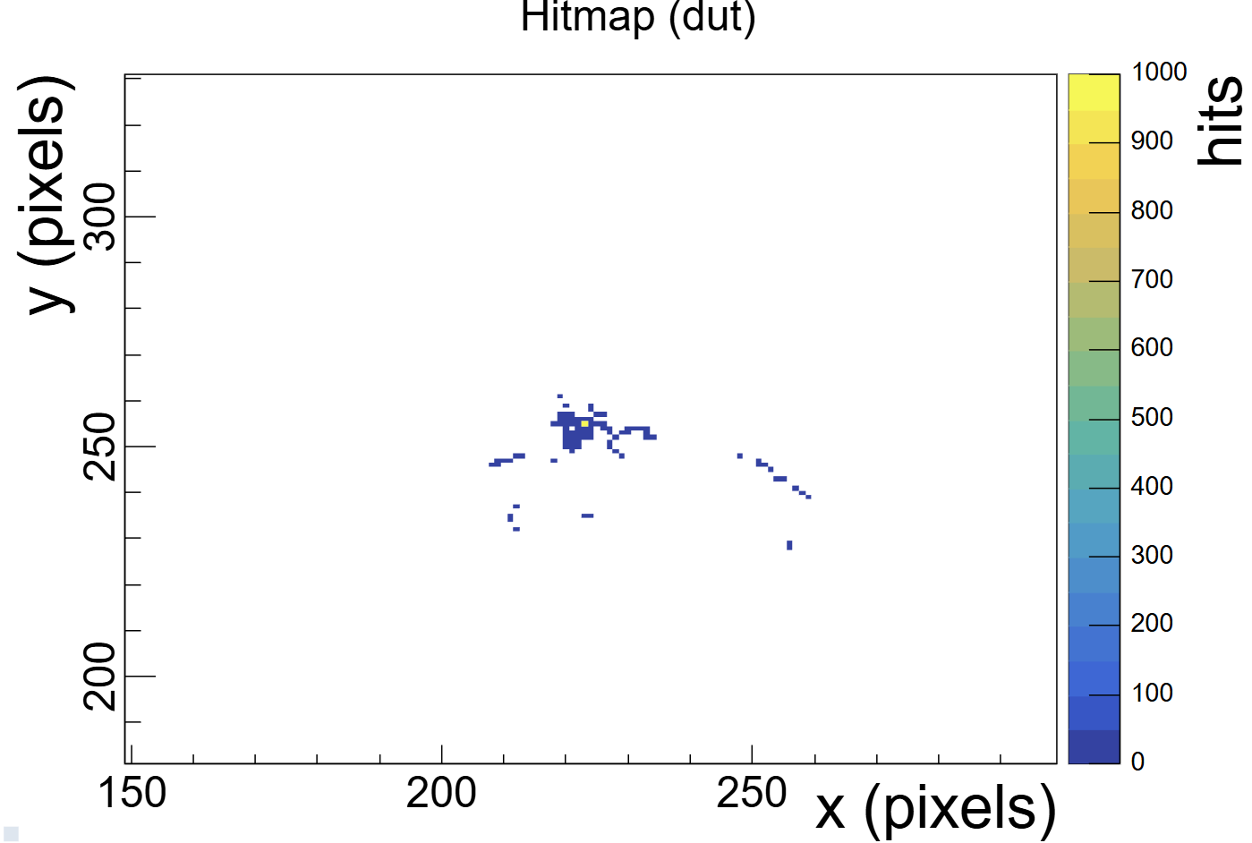
Future Goals
Hit map
Train SNNs on the synthetic TCAD + Allpix² data to reach the our goals:
  5D clustering: group hits into clusters using position, charge (ToT) and time (ToA)
  Classification: identify the particle type from cluster shape, size and charge
  Interpolation: give real-valued outputs from each cluster, such as sub-pixel hit position
Protons at 5.2 GeV
Electrons at 5.2 GeV

Slide 14
Summary
With this whole pipeline, we get our synthetic data to compare with real data
  CMS
    CMS collaborators are comparing test beam data to simulation
    Start using ToT for CROCv2
  Timepix4
    Compare simulations to data taken in test beams and electron microscopes
Working on using simulations to train neural networks

